Slide 1

Simon Klemperer “Crustal Group” Department of Geophysics
Our research:
tectonics, composition and structure
of continental lithosphere
from explosion- & earthquake-source seismology
and integration with geologic and other data

Slide 2
Example seismic experiments in key plate-tectonic settings of diffuse deformation:
• crustal structure of Himalaya and Tibet: how is deformation distributed during continental collision?
•continental rifting in the Basin-&-Range: how are magmatism and faulting related?

Slide 3
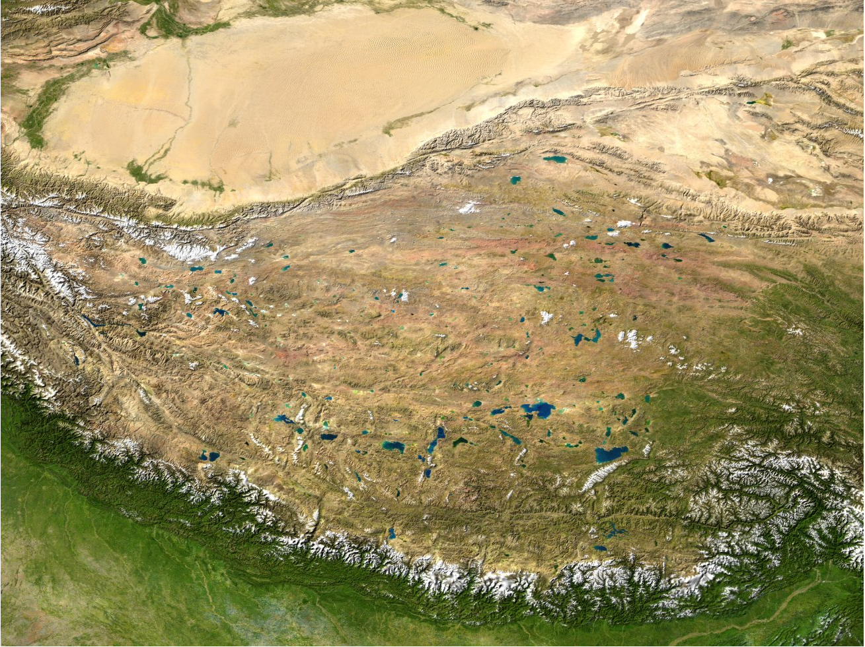
Tibet projects in the Crustal Group:
passive
INDEPTH 4
fieldwork 2007
Marianne
active
SINOPROBE
active & passive
2011-12
Cyndi
INDEPTH 3
HIMPROBE
Indian
passive data
Warren
SINOPROBE
MT & passive
2011-13
INDEPTH 1-2

Slide 4
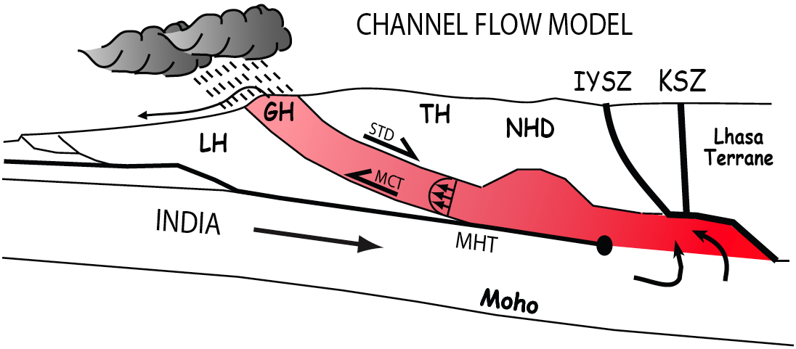
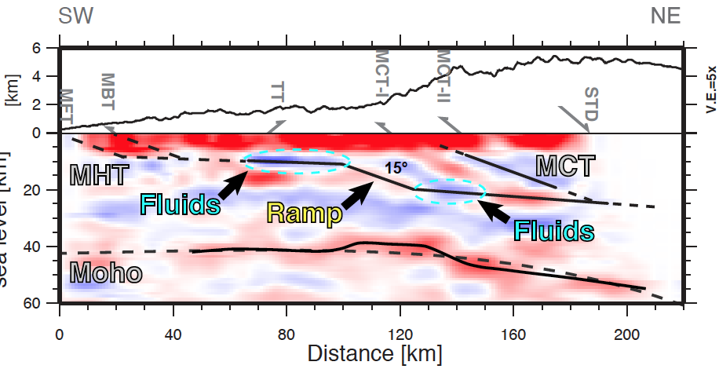
South side of Tibet: great earthquakes on low-angle thrusts
MODELS:
•We want to study thrust geometry and earthquake hazard
SEISMOLOGY:
•CCP imaging suggests
a ramp in MHT –
the nucleation point for great earthquakes – and downdip crustal thinning suggestive of crustal duplexing in the thrust sheets
Caldwell, Klemperer, Lawrence, Rai, EPSL, 2013

Slide 5
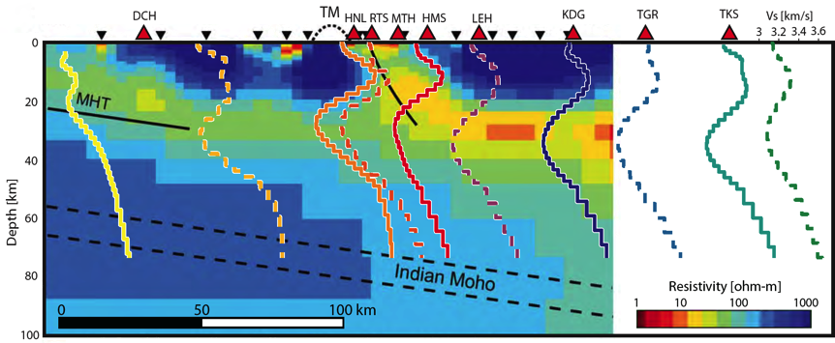
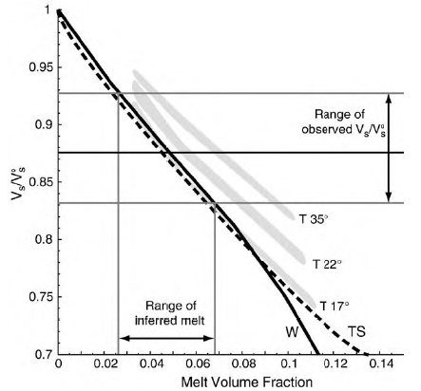
South side of Tibet: ductile extrusion between low-angle faults
MODELS:
•We want to test channel-flow extrusion out of large hot orogens
SEISMOLOGY:
•Rayleigh wave group velocities show LVZ, coincident with high
electrical conductivity
ROCK PHYSICS:
•Low shear velocity + high electrical conductivity imply 3–7 % melt
- maybe enough to allow ductile channel flow!
Caldwell, Klemperer, Rai, Lawrence, Tectonophys., 2009

Slide 6

South side of Tibet: near-surface magmas in the suture zone
MODELS:
•We want to understand melting in and north of suture zone
REFLECTION SEISMOLOGY:
•unusual reflections with extreme amplitude and negative polarity may be ponded magma
KSZ
IYSZ
MOHO
Kelly, Klemperer, AGU 2012
Notes:
This is the unmigrated stack section from Line B (as indicated by diffraction hyperbolas)
Several observable features in the stack:
Moho at ~24 s twt
High amplitude reflection in the Karakoram Fault
Can also observe some reflections from the Gangdese Granite Belt
In this talk I will focus on the brightest visible feature highlighted in the red box – a high amplitude reflector at ~6 s twt with large lateral extent across the stack
Notice hyperbolic nature, however, the large lateral extent on both the stack and gathers indicate this is a reflector would shorten and move up-dip rather than become a point source post-migration

Slide 7
Distributed extension in the Basin-&-Range Province
What is the interplay between rifting and magmatism?
Notes:
Since the time of Bullard and Vening Meinesz, EAR has become the archetypal narrow rift, dominant as such in textbooks, Localized seismicity
ETOPO1 datasets, at same scale on Google-globes - 1 minute topography

Slide 8

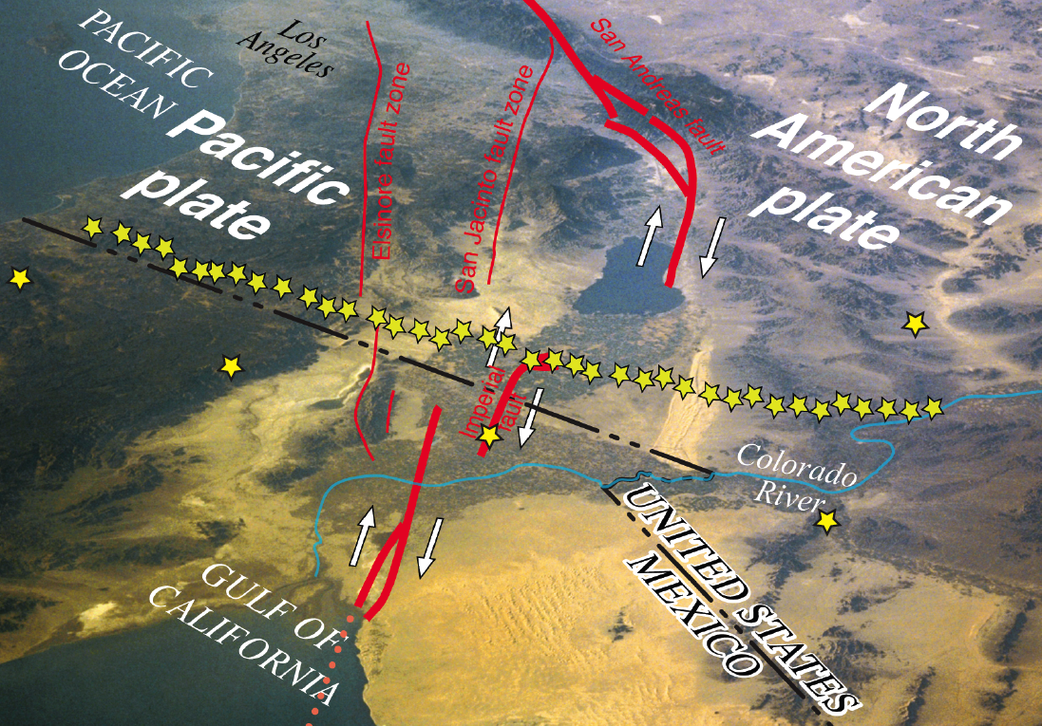
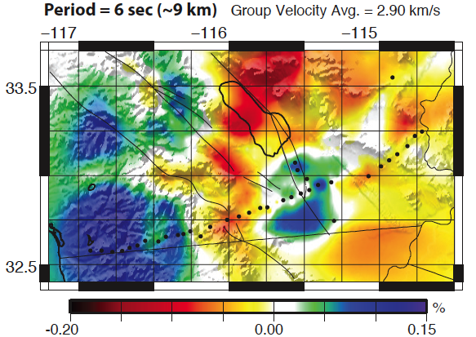
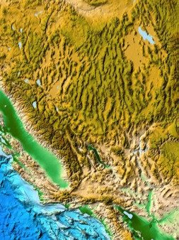
An oceanic spreading center in continental crust: 42 passive recorders imaging beyond the classic rift boundaries (Shahar Barak’s PhD)

Slide 9


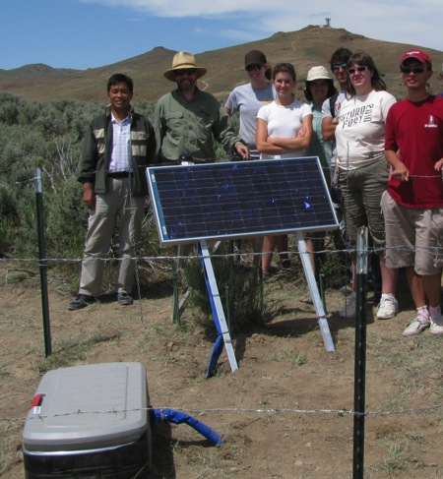
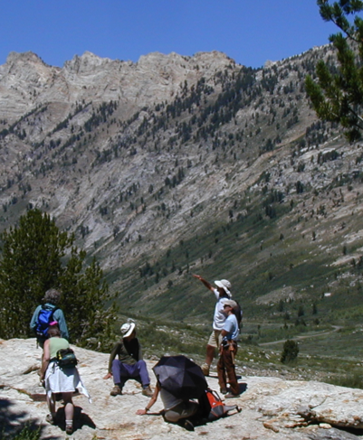
A metamorphic core complex: 50 passive recorders for 2 years in three intersecting profiles
for shear-wave splitting,
common-conversion point & ambient noise tomographic imaging
to constrain magma intrusion and mass re-distribution
(Mairi Litherland’s PhD)
41°N
39.5°

Slide 10

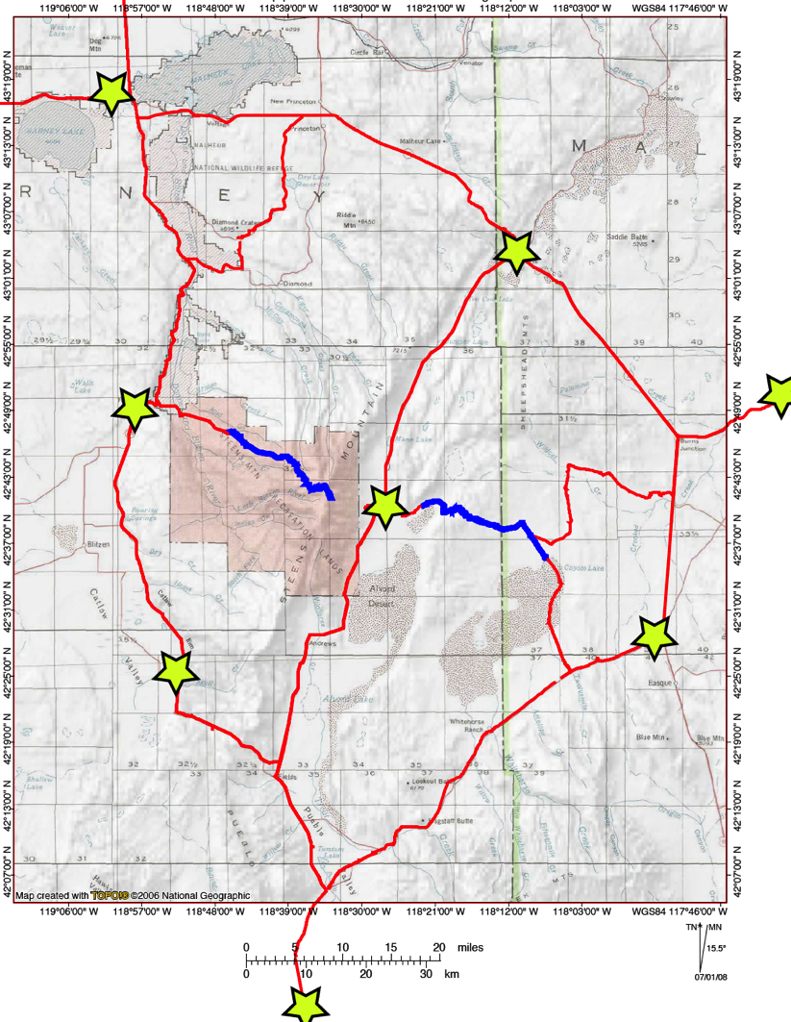

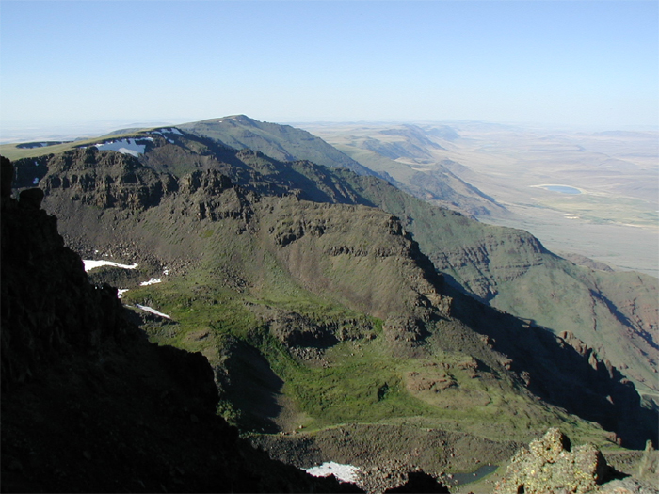
A major flood basalt eruption in an area of low extension: explosion seismology,
8 shots, 500-2000 kg
~ 1000 vertical receivers
(areal array for 3D modeling)
~ 400 3-component
(linear array for 2D, S-wave)
to constrain magma intrusion associated with basalt eruption
(Chris Castillo’s PhD)
Steens basalts: 65,000 km³ at 17 Ma

Slide 11
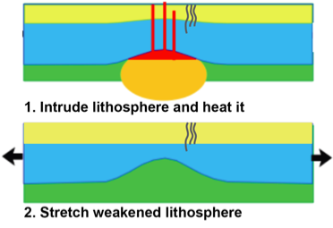
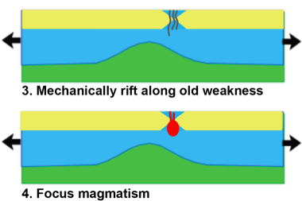
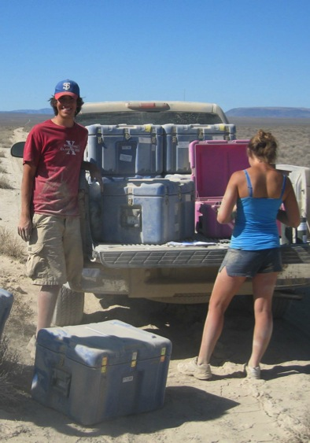
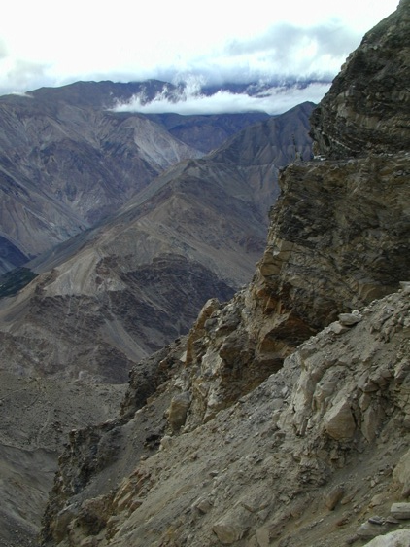
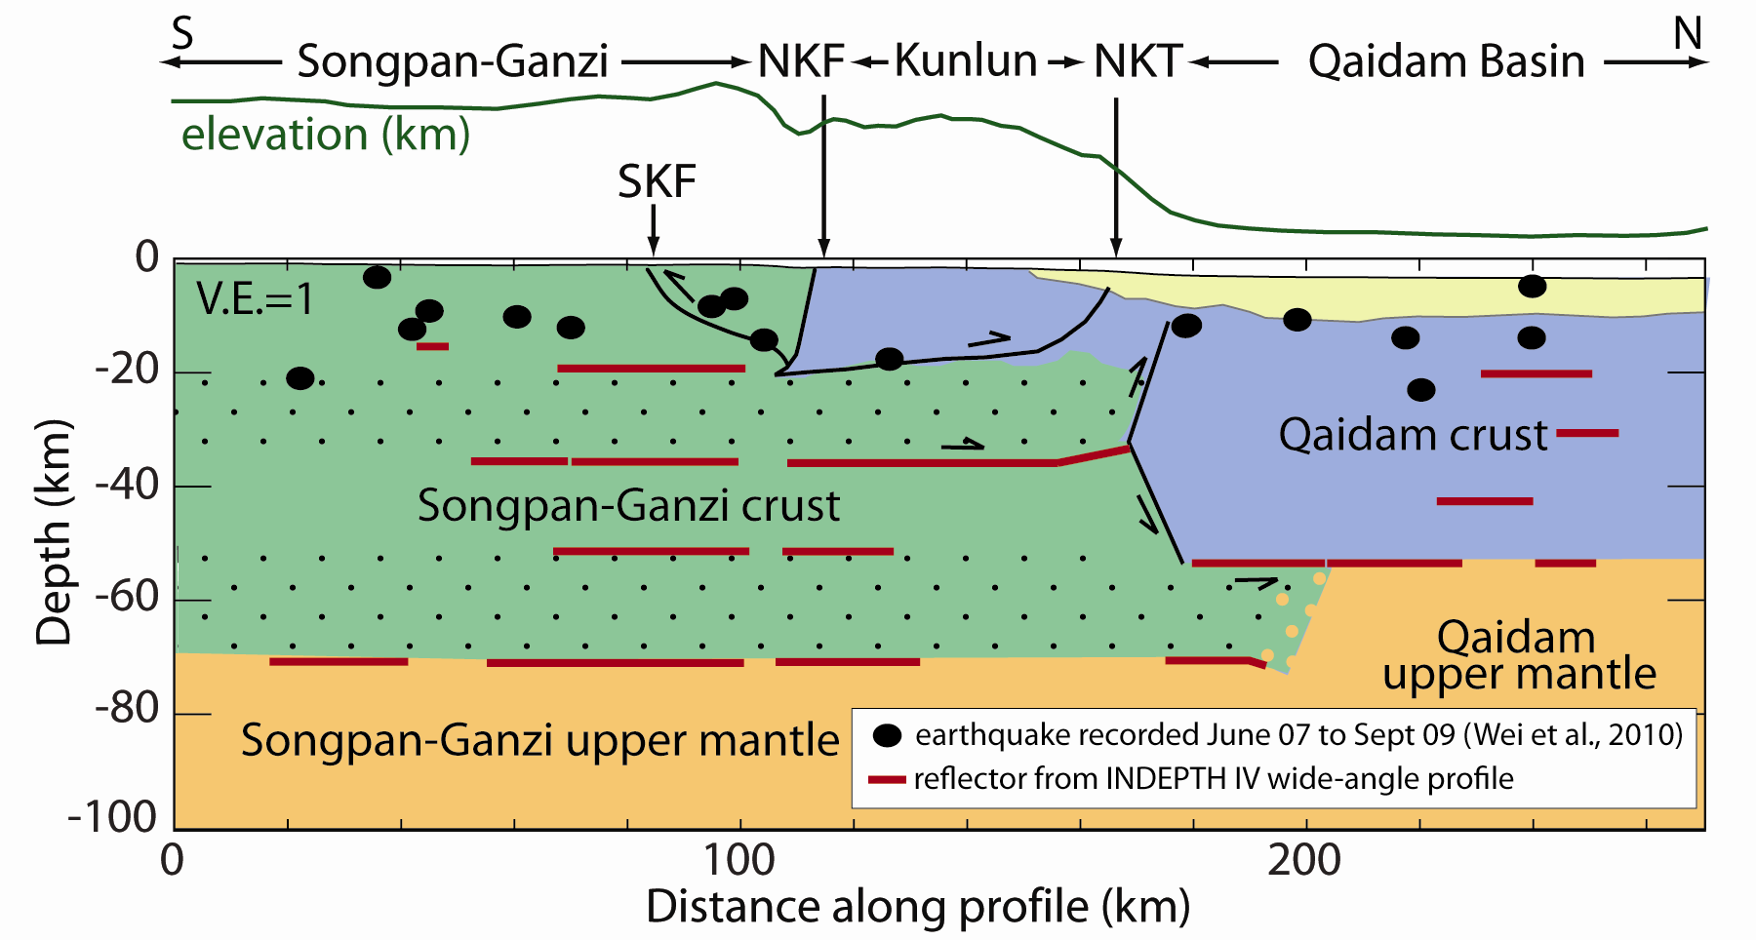
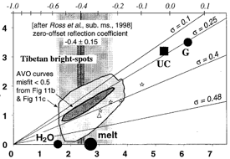
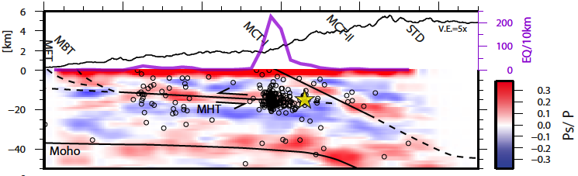
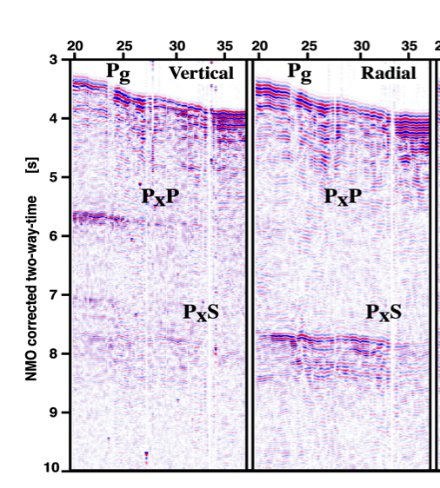
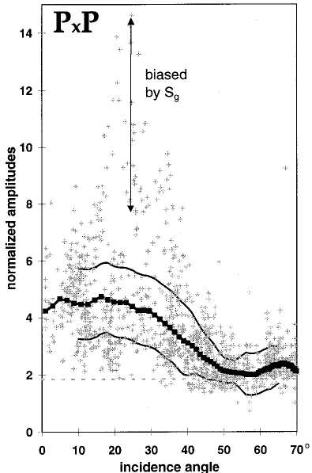
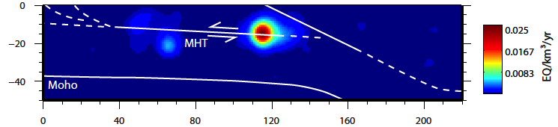
New & testable tectonic models
Field projects
New data
Crustal Group
Analysis & Modeling
Interpretation & Integration

