Slide 1

Opportunities and Challenges of
Shale Gas Development
Day 4
Gdansk Technical University
December 12-15, 2011
Mark D. Zoback
Professor of Geophysics
Stanford University

Slide 2

Opportunities and Challenges of
Shale Gas Development
Day 4
Gdansk Technical University
December 12-15, 2011
Mark D. Zoback
Senior Technical Advisor
Baker Hughes Incorporated

Slide 3

Course Overview
Day 1 Opportunities and Challenges of Shale Gas Development
Characterization and Physical Properties of Organic Rich Shales
Day 2 Geomechanics
Wellbore Stability
Drilling Operations
Day 3 Hydraulic Fracturing and Reservoir Stimulation
Day 4 Shale Permeability, Gas Production and Reservoir Simulation
Water Management and Minimizing Environmental Impacts

Slide 4
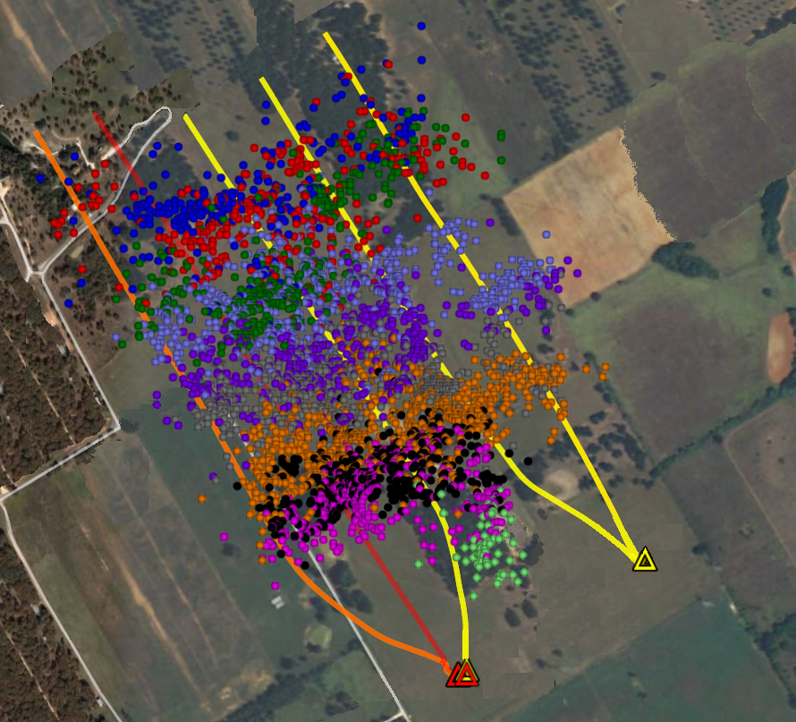
Microearthquakes Can’t Explain Production
Volume Affected by 4000 Microearthquakes Can
Account for Less Than 1% of Gas Production in First 6 Months

Slide 5
Eagleford Shale Pore Structure
Notes:
5

Slide 6
Eagleford Shale Pore Structure
Notes:
6

Slide 7
Eagleford Shale Pore Structure
Notes:
7

Slide 8
Reservoir Drainage and EUR
~100 m
~300 m
How is an interconnected pore and fracture network created from:
Nano-scale pore network?
Pre-existing micro-cracks?
Pre-existing macro-scale fractures?
Induced shear events?
Slick-water frac plane?
~50 m
How does slip on ~100, ~ 1m fault patches change permeability and create an interconnected fracture network in the stimulated volume?
Notes:
8

Slide 9
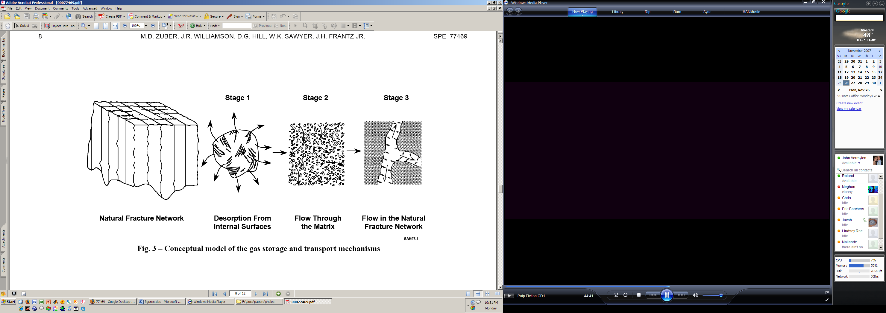
Permeability in Gas Shales
Multiple scales of permeability, all potentially affected by stress changes
Stress-dependence of permeability is an important input to reservoir simulators
Recent work has focused on stress dependence of fracture permeability in the Barnett shale
Desorption From Internal Surfaces
Flow Through Intact Matrix
Flow Through Fracture Network
Our study is the first attempt to measure effective stress coefficients for matrix permeability in a gas shale reservoir
k(P_{eff}); P_{eff} = P_{c} - χ*P_{p}

Slide 10
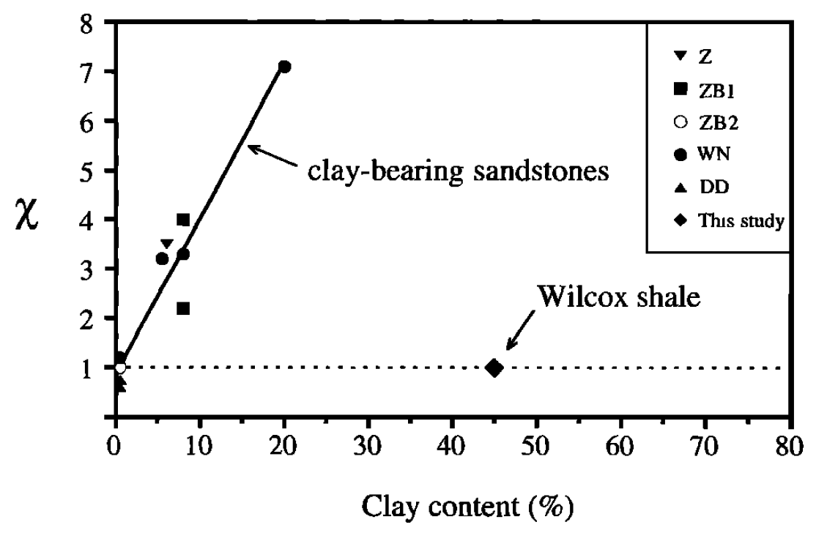
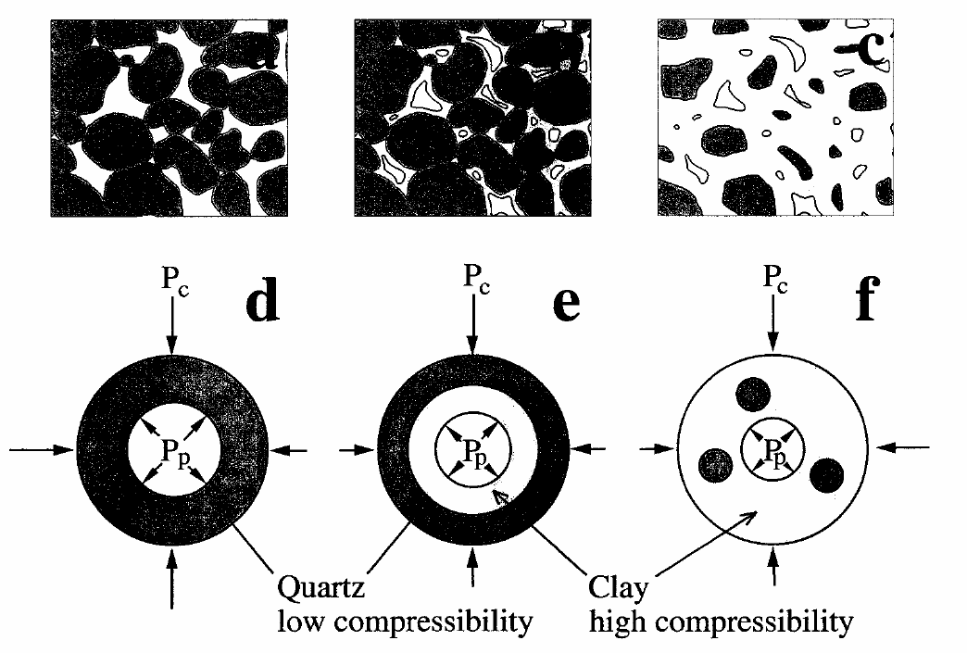
Pore Structure and Composition Controls the Permeability Effective Stress Coefficient
Effective Stress Coefficient vs. Clay Content
Conceptual Pore Network
Kwon et al. (2001)
Kwon et al. (2001)
For certain clay-bearing sandstones, χ found to be greater than 1, often significantly
But above a certain clay fraction, χ found to be ≤ 1, similar to typical measured values for most rocks
Internal P_{P,} external P_{C}
In rocks with no clay-lined pores, stresses are balanced: χ ≤ 1
With clay-lined pores, quartz supports P_{C} while pores expand with P_{P}: χ > 1
If clay fraction gets too high, clays bear all load: χ ≤ 1

Slide 11
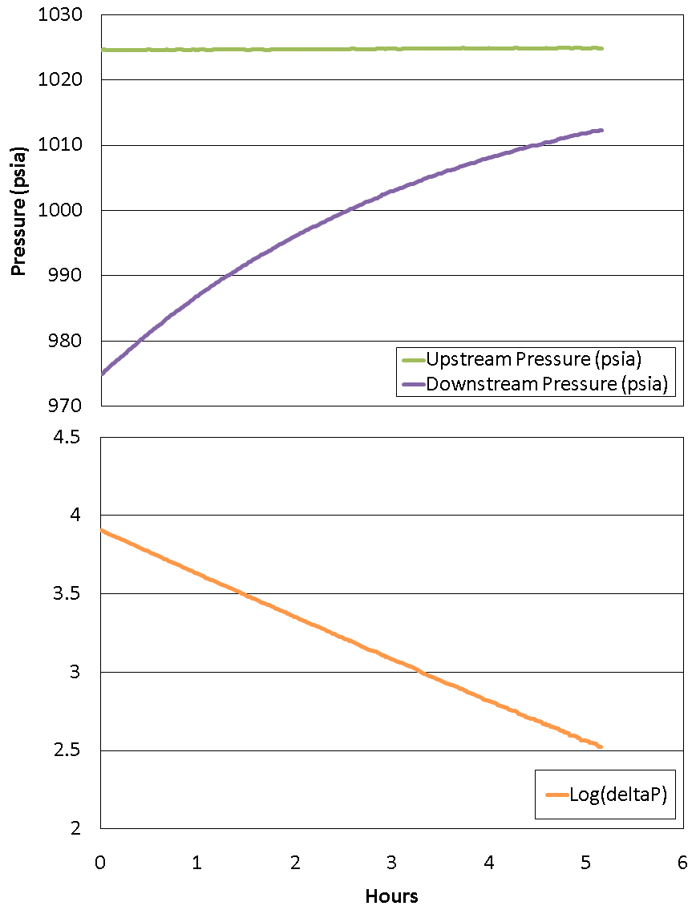
Permeability Test Methodology
Pulse-Decay Example
Sample Preparation
  1” diameter plugs cut parallel to bedding
  Samples dried under vacuum at 105° before testing
Used helium to isolate permeability effects from adsorption effects
Conducted both static darcy-flow tests and pulse-decay tests
For pulse-decay, used simple Brace et al. (1969) logarithmic decay method:

Slide 12

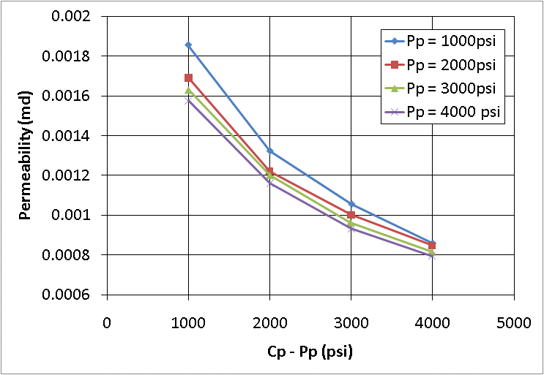
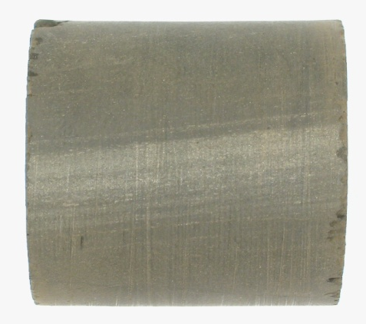
Results: Sample 27Ha
Barnett Shale 27Ha
Sample w/ interbedded carbonate layer
56.7% qtz, 9.1% carbonate, 23.8% clay, 3.8% TOC
Density porosity: 8.6%

Slide 13
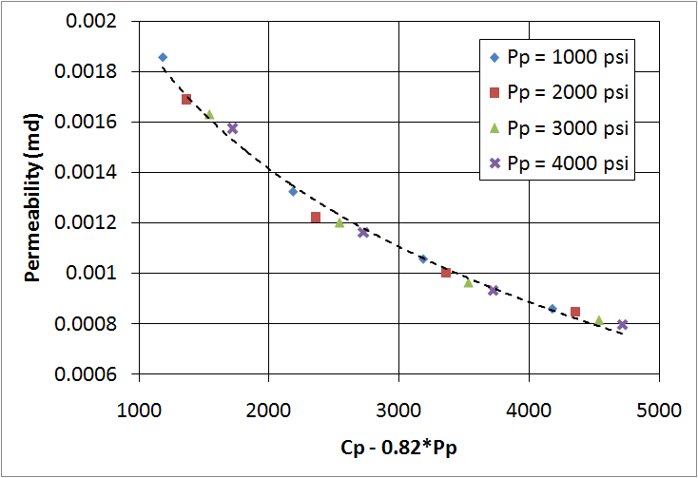
Results: Sample 27Ha
Best Fit Effective Stress Coefficient: χ = 0.82
Barnett Shale 27Ha
Sample w/ interbedded carbonate layer
56.7% qtz, 9.1% carbonate, 23.8% clay, 3.8% TOC
Density porosity: 8.6%

Slide 14
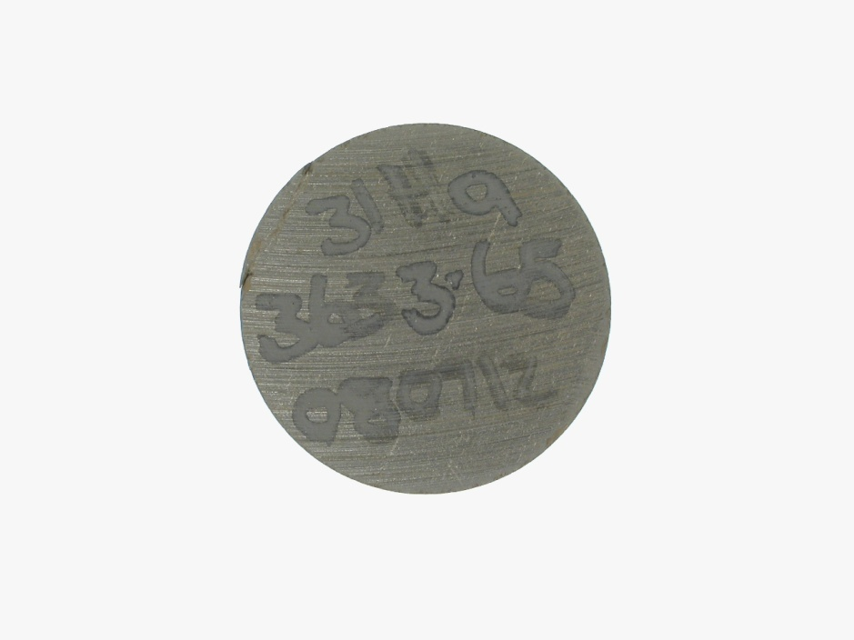
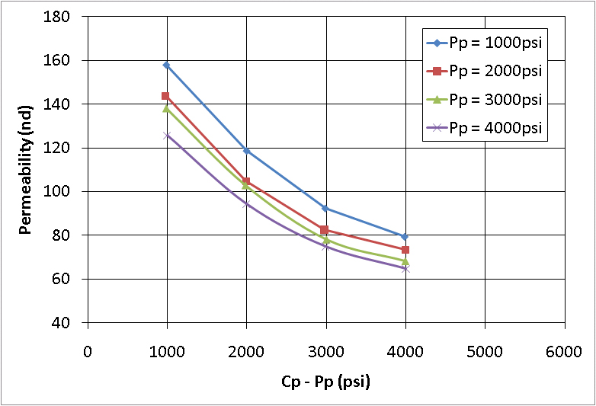
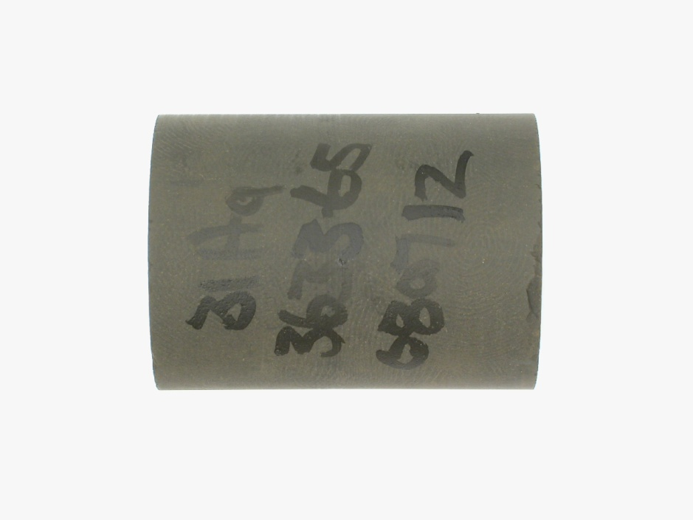
Results: Sample 31Ha
Barnett Shale 31Ha
Typical dark, organic-rich sample
51.3% qtz, 0.4% carbonate, 37.4% clay,
5.3% TOC
Density porosity: 10.7%

Slide 15
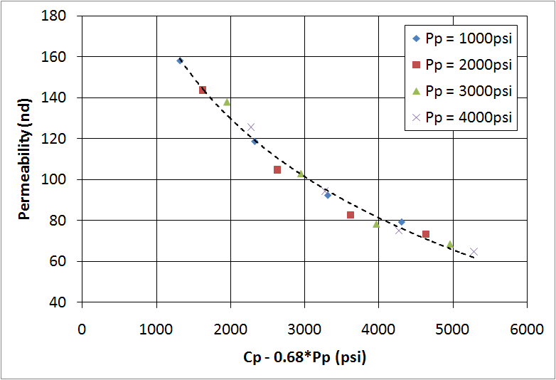
Permeability of Barnett Shale
Effective Stress Coefficient: χ = 0.68
Barnett Shale 31Ha
Typical dark, organic-rich sample
51.3% qtz, 0.4% carbonate, 37.4% clay,
5.3% TOC
Density porosity: 10.7%
Permeability Dominated by Flow Through Microcracks

Slide 16
Stress-Dependent Permeability: Conclusions
Permeability 10x higher in sample with interbedded carbonate layer compared to dark, organic-rich sample
Both samples have χ < 1, indicating that the kerogen is likely not surrounding isolated flow paths
Able to fit data from both samples using simple functions based on Darcy’s law; Darcy-type flow may still be dominant regime in these samples
With χ < 1 and Darcy-type flow still apparent, microcracks most likely form a controlling flow path
Kerogen grains do not form an isolated compressible flow path
χ < 1
χ > 1
χ < 1
Permeability Dominated by Flow
Through Microcracks

Slide 17
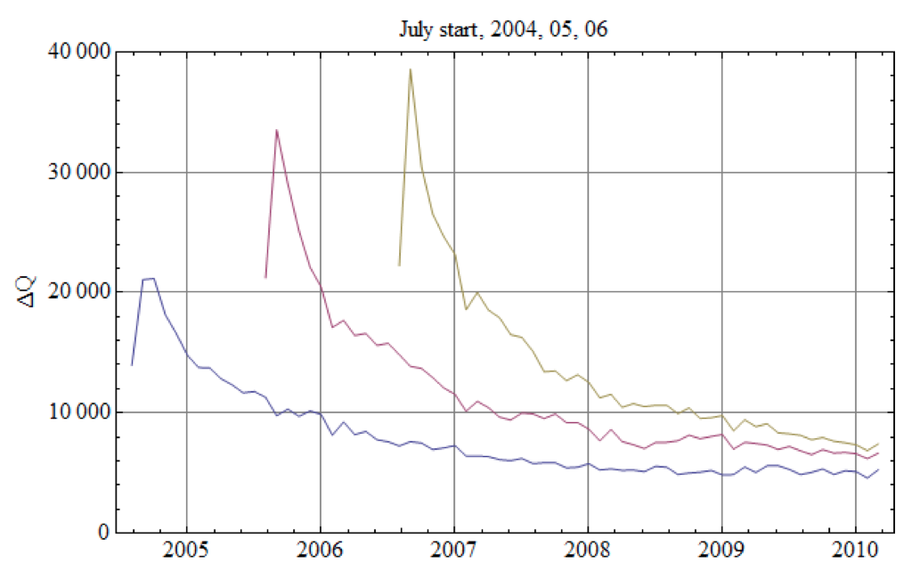
Why Is Production Persistent?
Average Monthly Well Production
Barnett Shale
Valko and Lee (2010)
Extended Exponential Model
SPE 134231
Notes:
17

Slide 18
Scale Dependent Flow Mechanisms
Sondergeld et al., 2010
Notes:
18

Slide 19

Knudsen Diffusion
Knudsen diffusion will be the dominant mechanism whenever the mean free path is large compared with the pore diameter.
Collisions with the pore walls will be more frequent than those between the molecules
Knudsen diffusion prevails:
1) when gas density is low
2) when pore dimensions are very small
Notes:
19

Slide 20
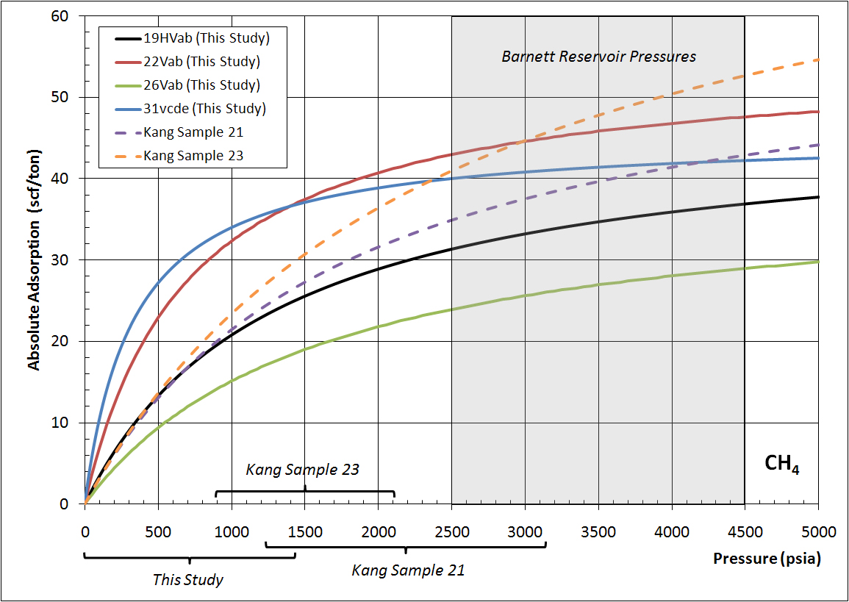
Is Desorption Important?

Slide 21
Why Is Production Persistent?
Average Monthly Well Production
Barnett Shale
Valko and Lee (2010)
Extended Exponential Model
SPE 134231
Are Diffusion and Desorption
Dominant?
How Long Will Production
Persist?
Notes:
21

Slide 22
If Microearthquakes Can’t Explain Production
What is Happening During Stimulation?
Volume Affected by 4000 Microearthquakes Can
Account for Less Than 1% of Gas Production in First 6 Months

Slide 23
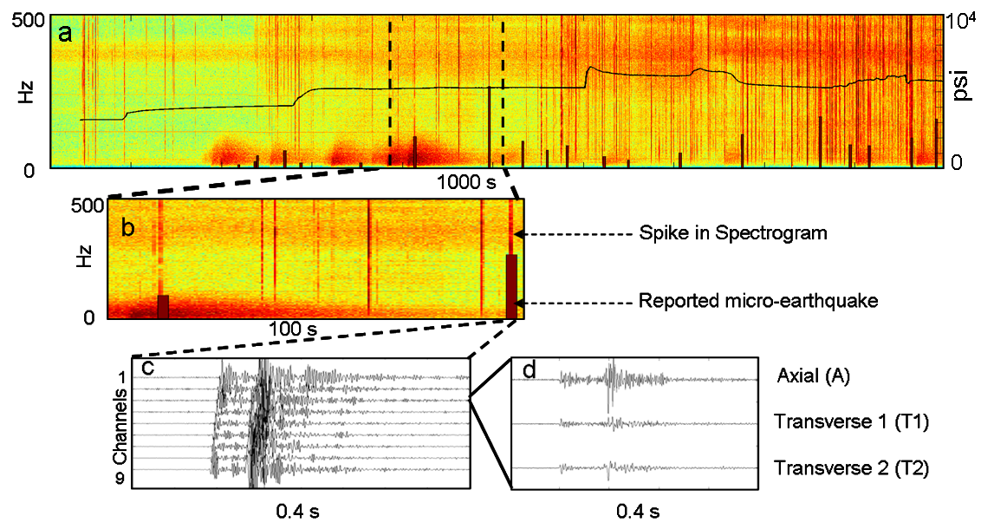
Typical Microearthquakes
Das and Zoback, The Leading Edge (July 2011)

Slide 24
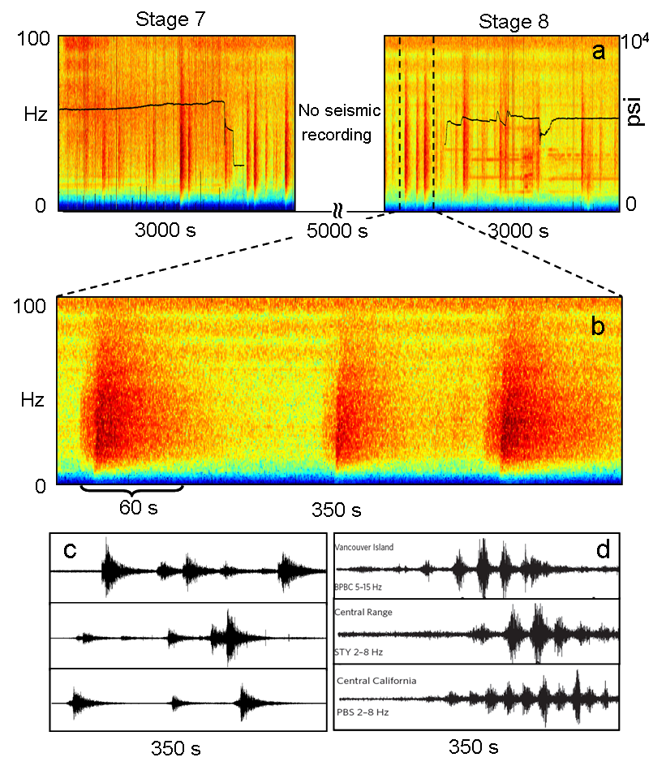
Long Period Long Duration Seismic Events
Das and Zoback,
The Leading Edge (July 2011)

Slide 25
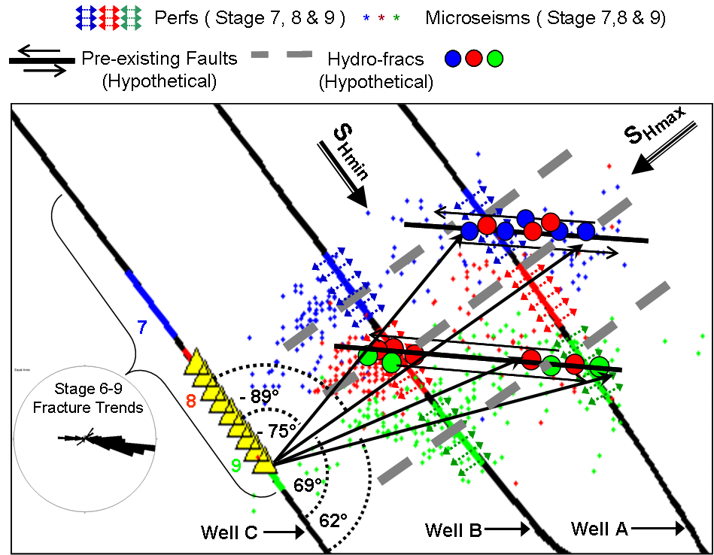
Slow Slip on Cross-Cutting Faults?
Das and Zoback, The Leading Edge (July 2011)

Slide 26
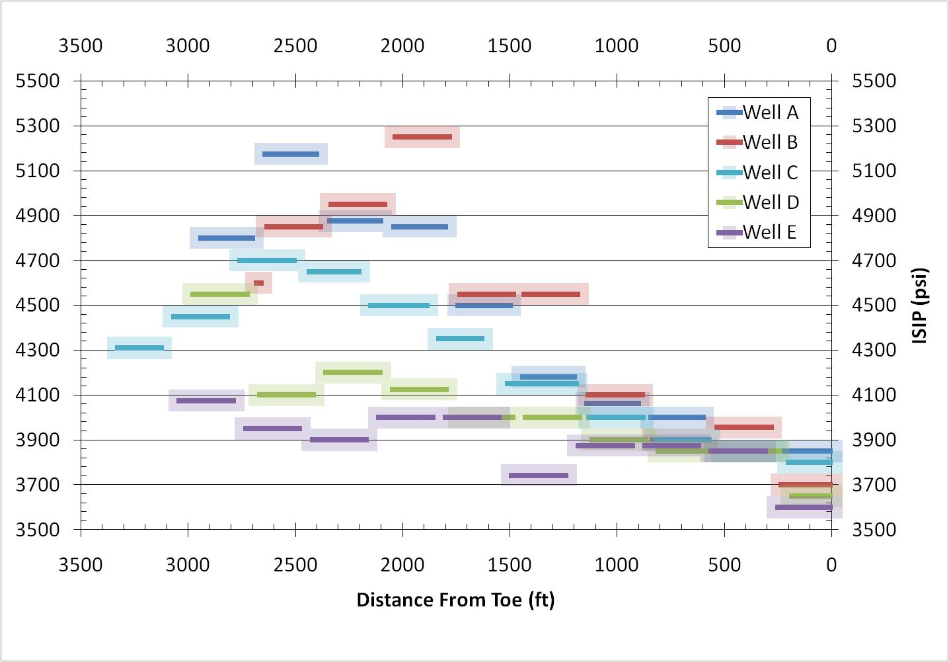
Are the LPLD Events Due to
High Pumping Pressures?
10 MPa

Slide 27
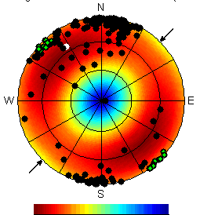
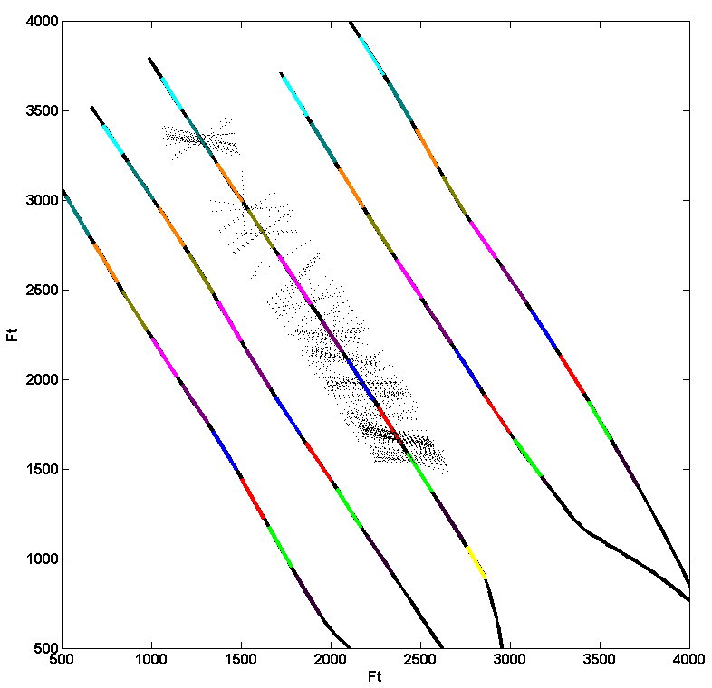
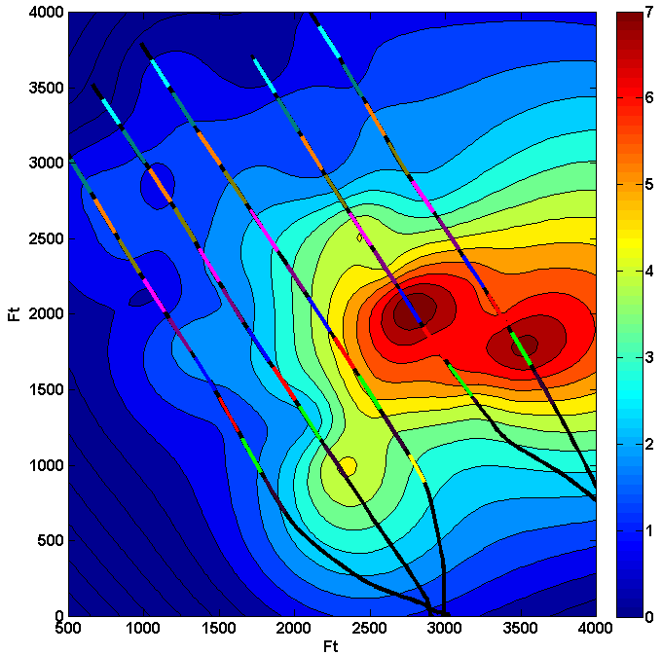
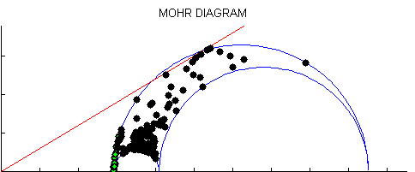
Fractures turned on at ΔP of 0 MPa
Not Critically Stressed
Critically Stressed
20 25 30 35 40
Critical Pore Pressure (MPa)
Shear Stress (MPa)
10
5
0
Δ P ( MPa)
20 25 30 35 40 45
Normal Stress ( MPa )
PP = 17.8 Mpa
ΔP= 0 MPa

Slide 28
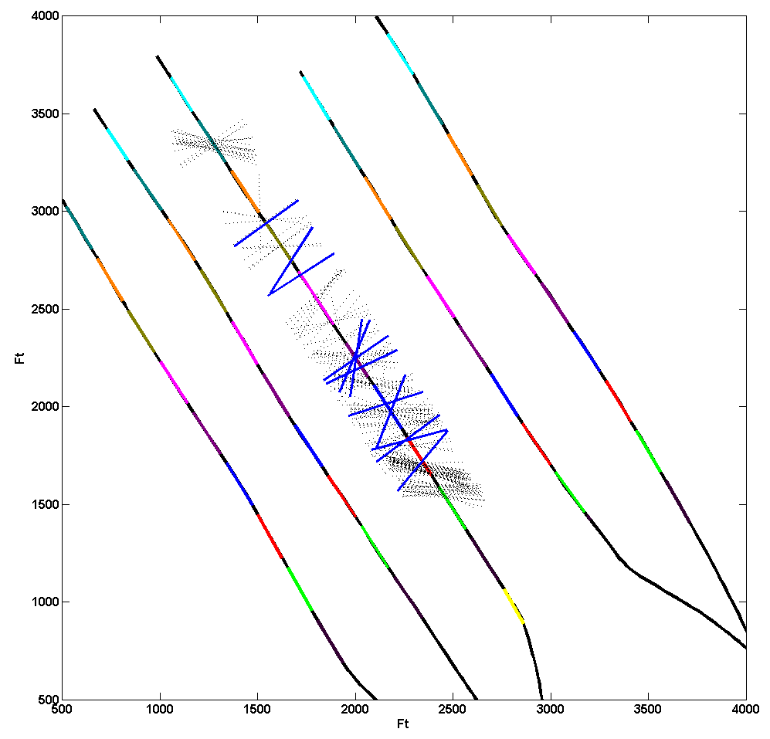

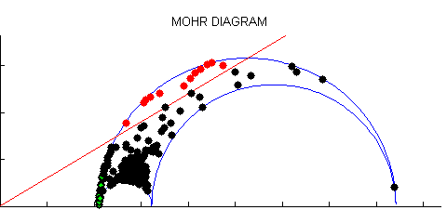
Fractures turned on at ΔP of 2 MPa
Not Critically Stressed
Critically Stressed
20 25 30 35 40
Critical Pore Pressure (MPa)
Shear Stress (MPa)
Δ P ( MPa)
10
5
0
20 25 30 35 40 45
Normal Stress ( MPa )
PP = 19.8 Mpa
ΔP = 2 MPa

Slide 29
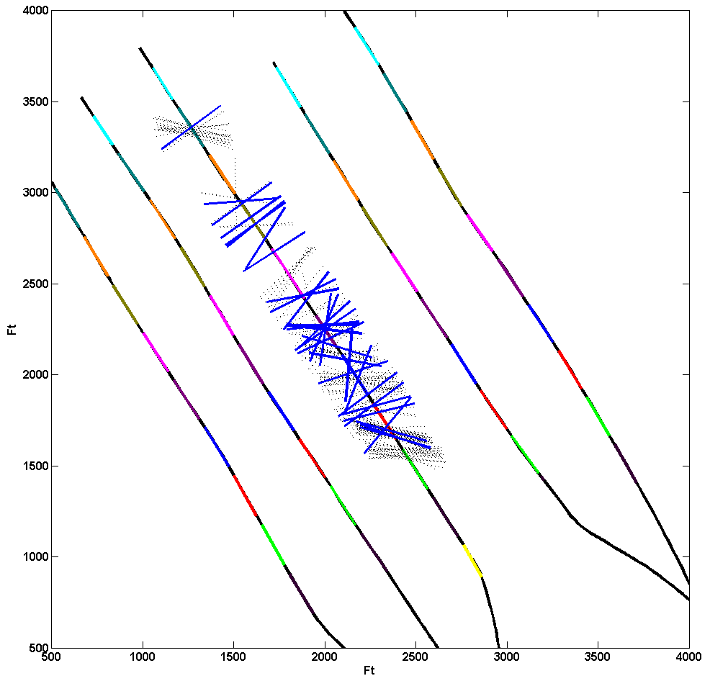

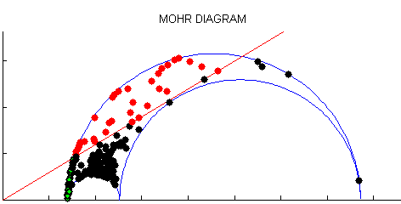
Fractures turned on at Δ P of 4 MPa
Not Critically Stressed
Critically Stressed
20 25 30 35 40
Critical Pore Pressure (MPa)
Shear Stress (MPa)
Δ P ( MPa)
10
5
0
25 30 35 40 45
Normal Stress ( MPa )
PP = 21.7 Mpa
ΔP = 4 MPa

Slide 30
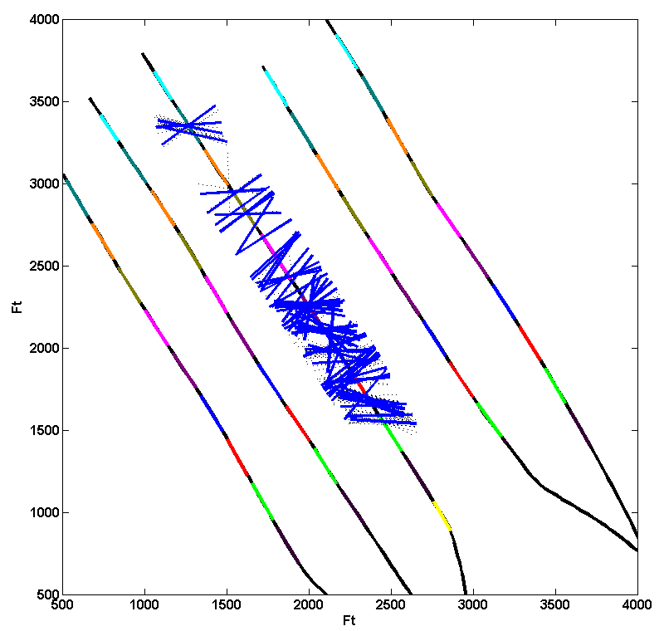

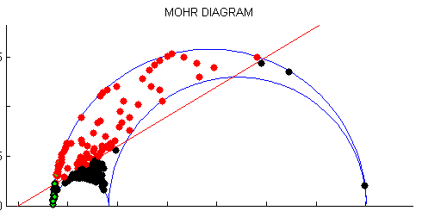
Fractures turned on at ΔP of 6 MPa
Not Critically Stressed
Critically Stressed
20 25 30 35 40
Critical Pore Pressure (MPa)
Shear Stress (MPa)
ΔP ( MPa)
10
5
0
25 30 35 40 45
Normal Stress ( MPa )
PP = 23.7 Mpa
ΔP = 6 MPa

Slide 31
5 Why Are There so Few Microearthquakes
Toward Toe?

Slide 32
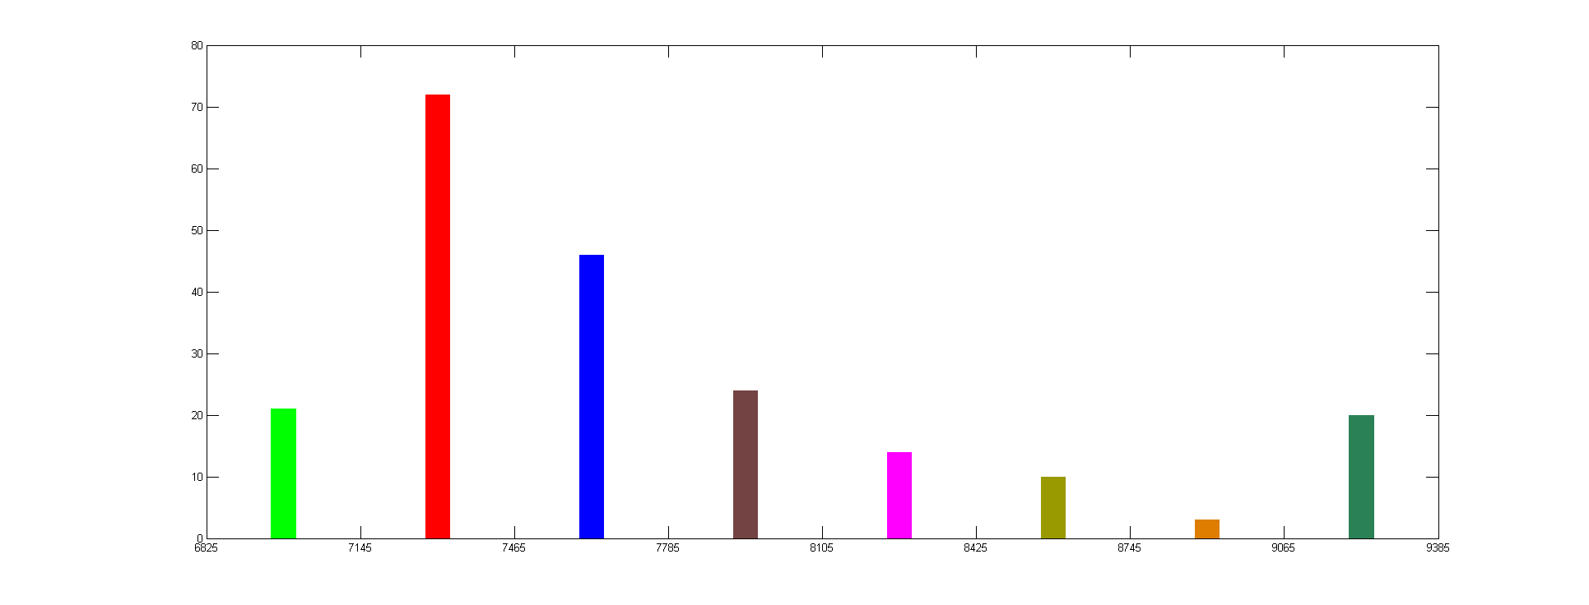
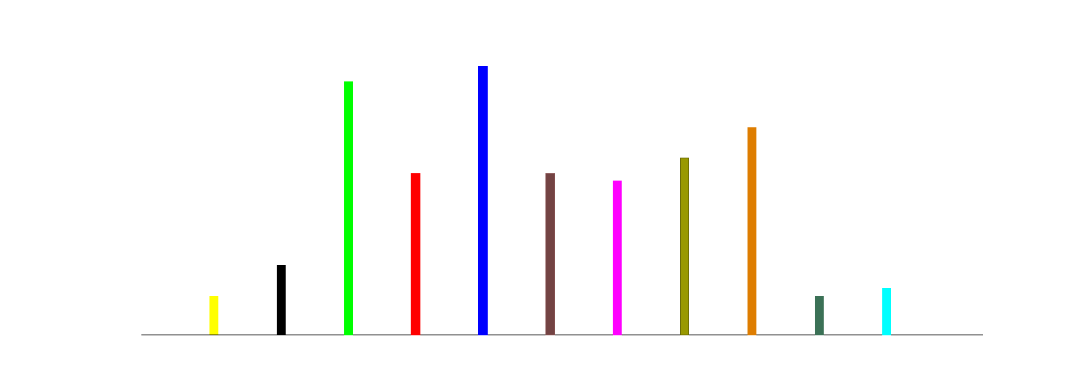
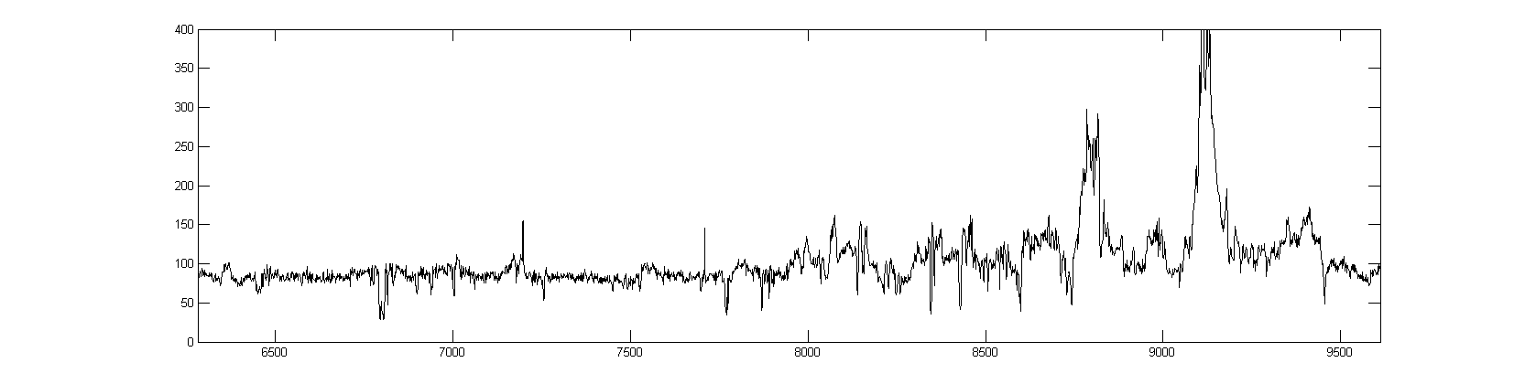
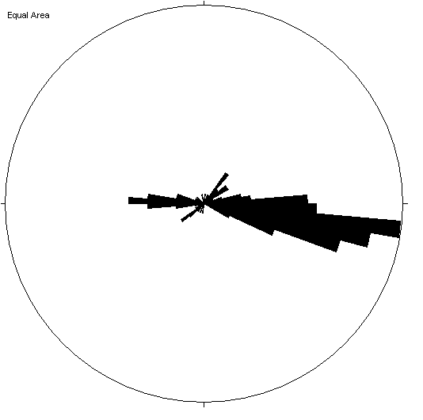
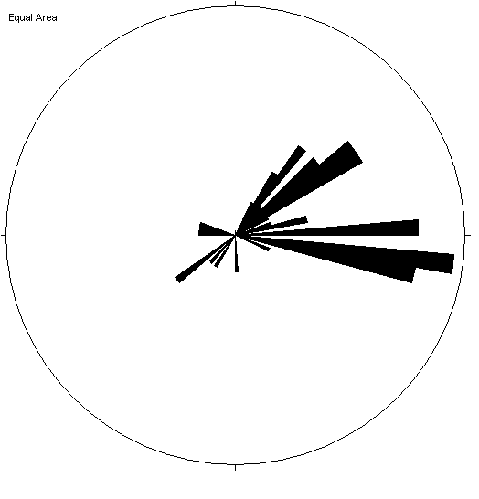
Well C
Recording Arrays in C
while frac-ing A-B
Heel
Toe
11
10
9
8
7
6
5
4
3
2
1
Frac Stages
80
Natural Fractures in Each Frac Stage (from FMI)
0
40
Number of meqs ≥-2.5 per Stage
0
400
API
Gamma Ray
0
Stages 6-9
Stages 1-5
S_{Hmax}
S_{Hmax}
Fracture Strikes

Slide 33
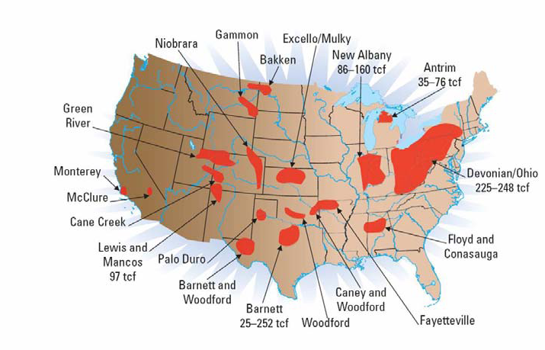
RDS Shale Gas Projects – Continental US
Notes:
A little history of the company…

Slide 34
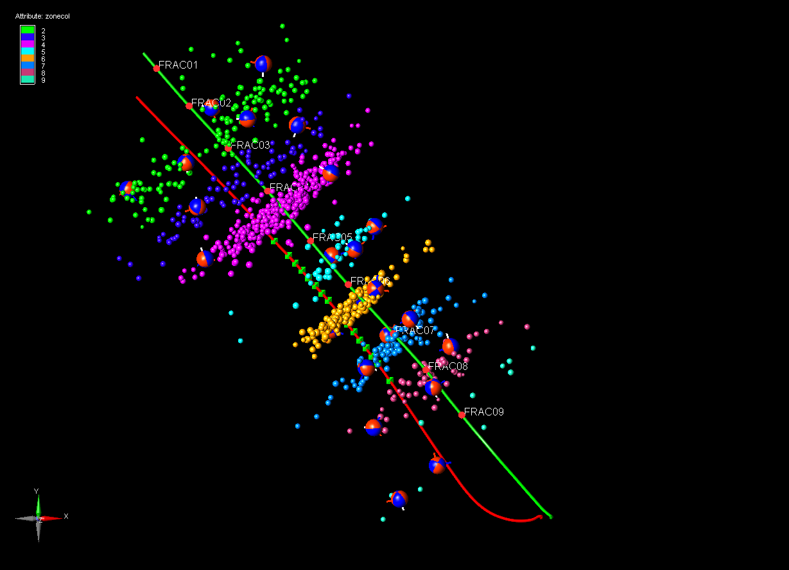
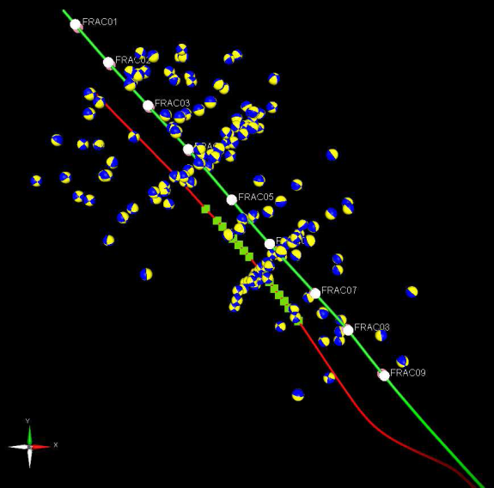
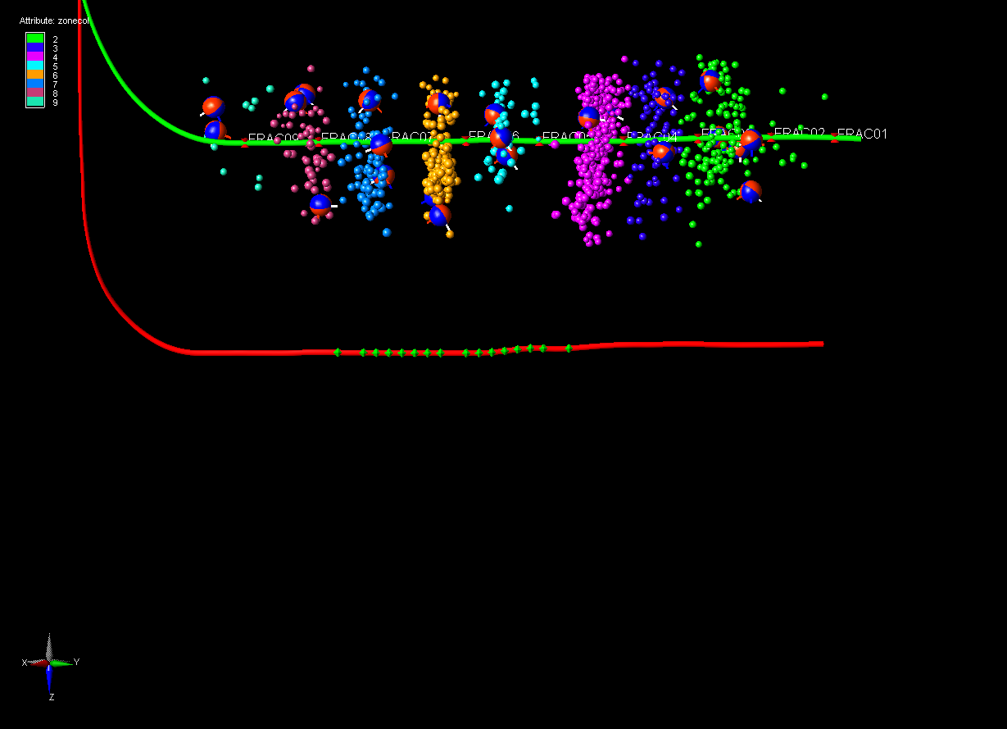
Microseismic observed zone shape
Map
Plan View
Vertical view across well
Color bar / cluster
Color bar / cluster
MAL 563
MAL 564
Receivers
Best coverage
Receivers
Observations:
Narrow microearthquake zones
Zones oriented NE-SW
Wider zones at toe and heel?
Events that can be inverted to determine focal mechanisms form narrower bands except at heel and toe, which is outside the zone best imaged by the receiver array
Events
Notes:
This confirms the prediction, but also illustrates a problem with the array “focus” leading to poor locations outside the ends of the array and larger horizontal uncertainties
Also - note bypassed pay and variations in separation of clusters

Slide 35
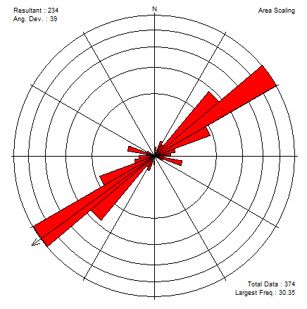
Frac and Completion behavior
Stress Orientation
Fracs initiate away from ports
Production is poorly correlated to the number of events
Zone growth appears to align better with joints than with stress
Joint Orientation
Micro seismicity
Natural Fracture / Joint Density
Ports
Packers
Production from PLT
Notes:
This illustrates that #events is a poor correlate
That packers nucleate events due to the local stress concentration; this leads to leaks…
That stimulated zones initiate and grow along pre-existing sets of joints

Slide 36
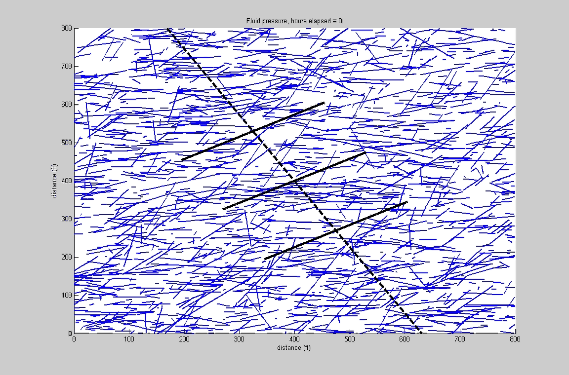
Evolution of Aseismic Slip in Reservoirs

Slide 37
Shear Fracture Activation
Slip occurs along pre-existing weaknesses
Shear activation stress can be lower than σ_{min}
Pre-slip:
Small open aperture (a_{o})
Permeability
Shear slip
Post-slip:
Larger open aperture (a_{o})
Effective normal stress
CSUG/SPE 146912

Slide 38
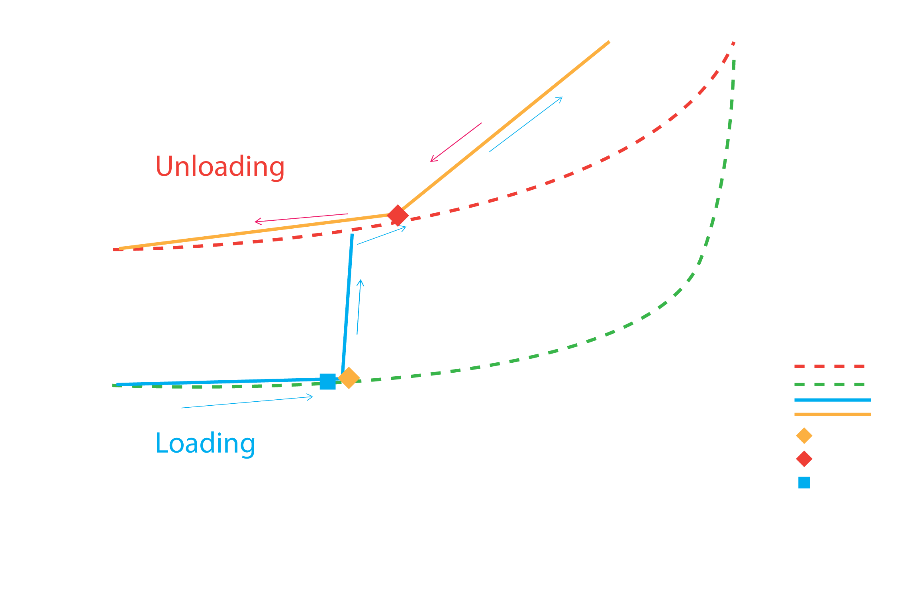
Tuning the Empirical Hysteresis Curves
Theoretical
Laboratory
Stress conditions
Rock properties
Frac Pressure
Slope ~ Bulk Modulus
Permeability
Slope ~ Pore Compressibility
Pressure
Critical Pressure inferred from in-situ stress
Shape based on theoretical model

Slide 39
Frac and Completion behavior
Stress Orientation
Fracs initiate away from ports
Production is poorly correlated to the number of events
Zone growth appears to align better with joints than with stress
Joint Orientation
Micro seismicity
Natural Fracture / Joint Density
Ports
Packers
Production from PLT
Notes:
This illustrates that #events is a poor correlate
That packers nucleate events due to the local stress concentration; this leads to leaks…
That stimulated zones initiate and grow along pre-existing sets of joints

Slide 40
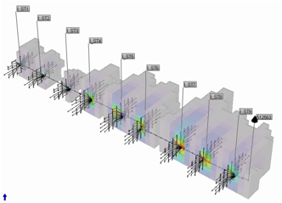
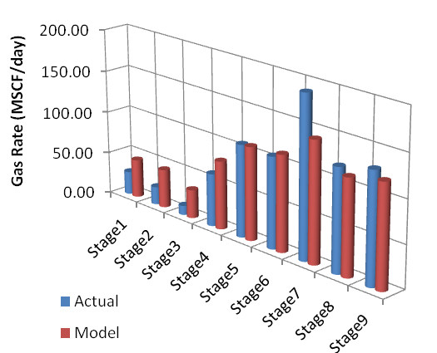
Full Model Results
Predictions of the full well model matched the distribution of production from each stage
Notes:
When we combine different frac stages in a single model we are able to describe performance along the horizontal well. We saw that different frac stages would behave differently and the main reason was the distribution of natural fractures. In this process we are able to match the actual redactions from each frac stage. Also using the proper placement distribution as it came from a specific software by Meyer and Associates and that was used to describe the conductivity of each frac stage as it relates to propane placement. After all this was done it was possible to predict the performance of this well and do our history match. This slide shows the predictions of the model which is a continuous slide verses the historical data which are the individual dots. It is important to note that the model was used in the fully predictive mode. In other words their was no pressure or rate history included as a means to predict the other. The model was set in fully predictive mode with only maximum rate and minimum pressure constraints.

Slide 41
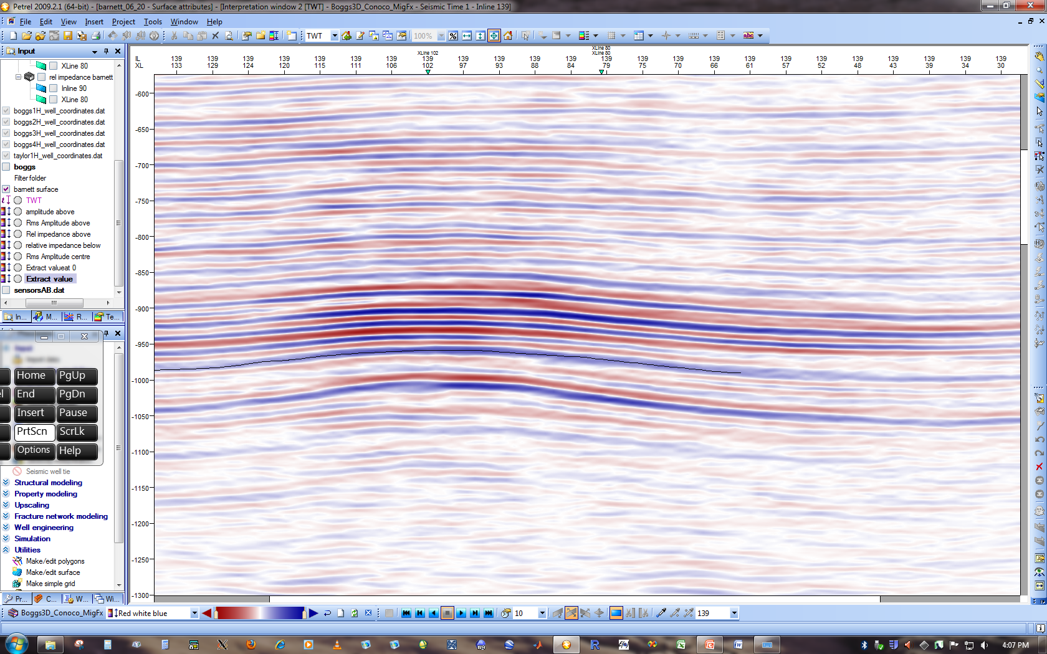
Can we Identify Optimal Areas For Reservoir
Stimulation Before Drilling and Frac’ing?
Formation Top
Formation Bottom

Slide 42
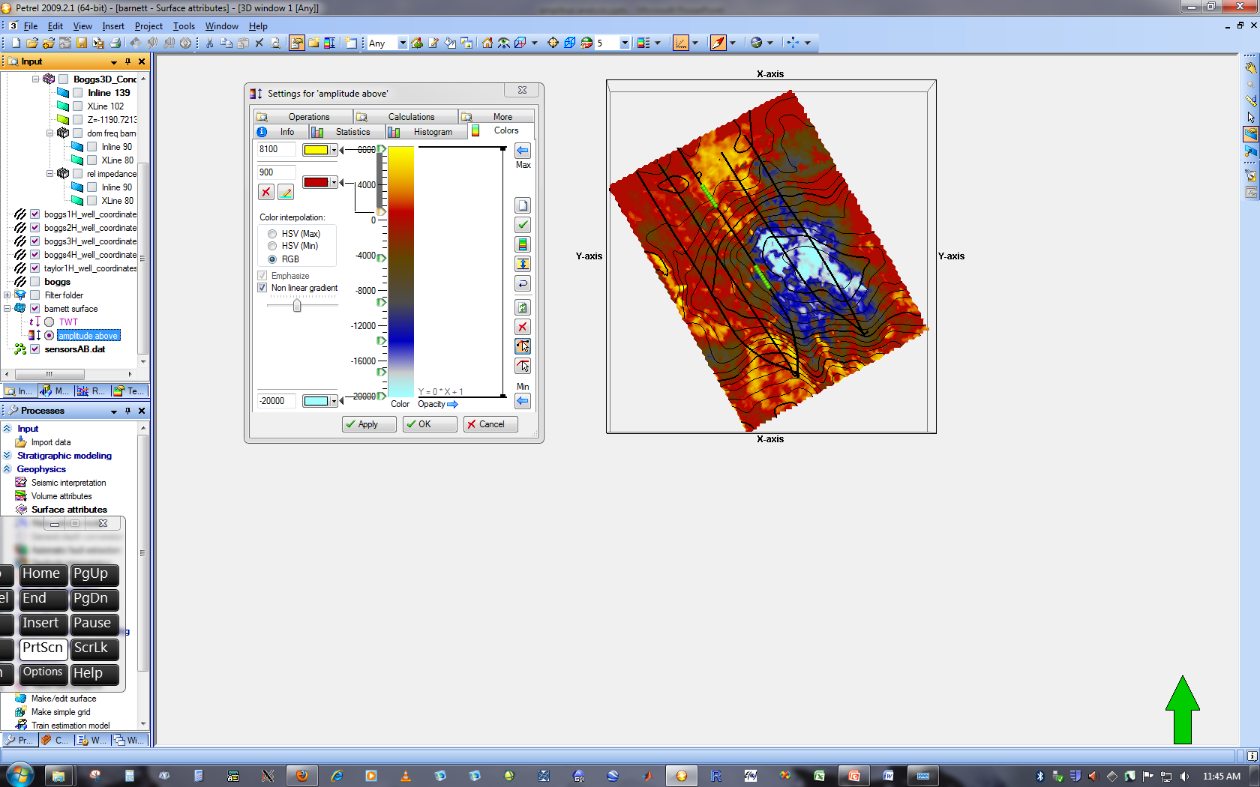
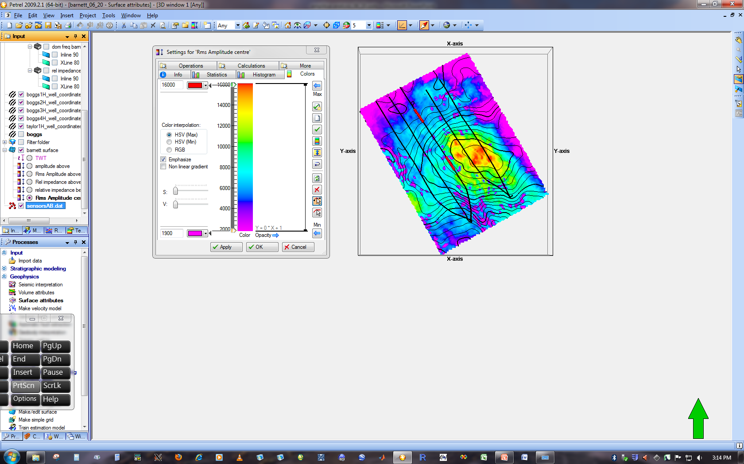
Attribute Analysis
Actual Amplitude Formation Top
RMS Amplitude Formation Top
8000
16000
-20000
2000
Location of LPLD events are correlative with amplitude anomalies

Slide 43
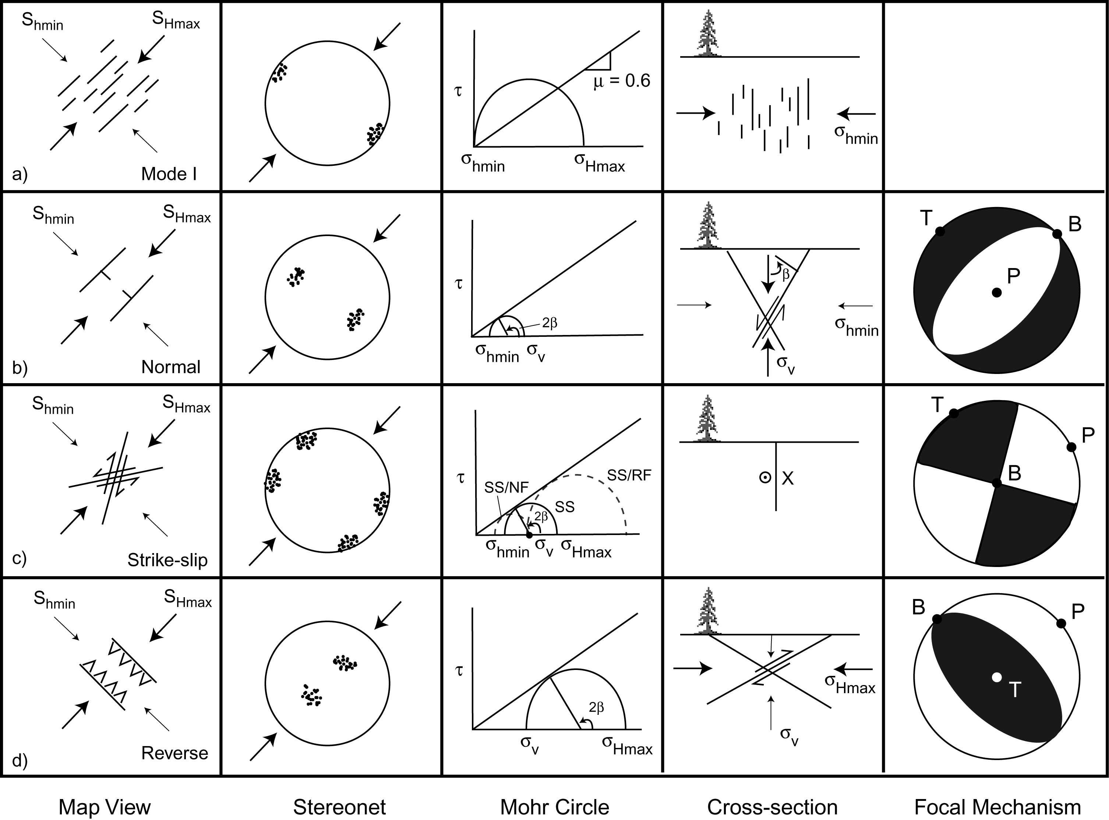
Relationship Between Stress State and Fault Slip
Normal faults trend parallel to S_{Hmax}
Normal
Strike-slip faults trend about
±30° from S_{Hmax}
Strike-Slip
Reverse faults trend perpendicular
to S_{Hmax}
Reverse

Slide 44
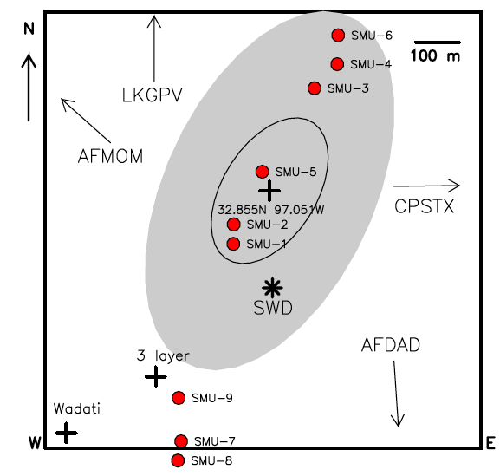
Earthquakes Triggered by Injection of
Flow-Back Water After Hydraulic Fracturing
DFW – 2009 Magnitude 2.2-3.3
Frohlich et al. (2011)

Slide 45
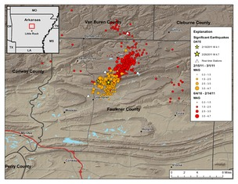
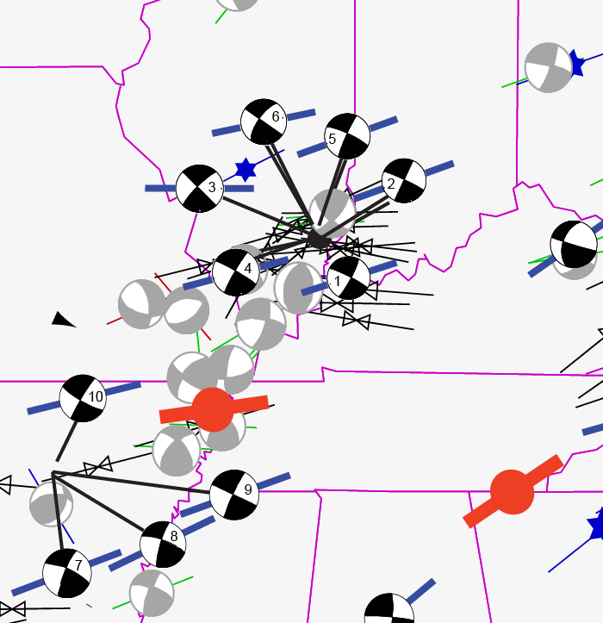
Stress Map
New Madrid Area
Guy Arkansas
Earthquake Swarm
Largest M 4.7
Hurd and Zoback (Submitted)
Right-Lateral SS Fault
30° from S_{Hmax}

Slide 46
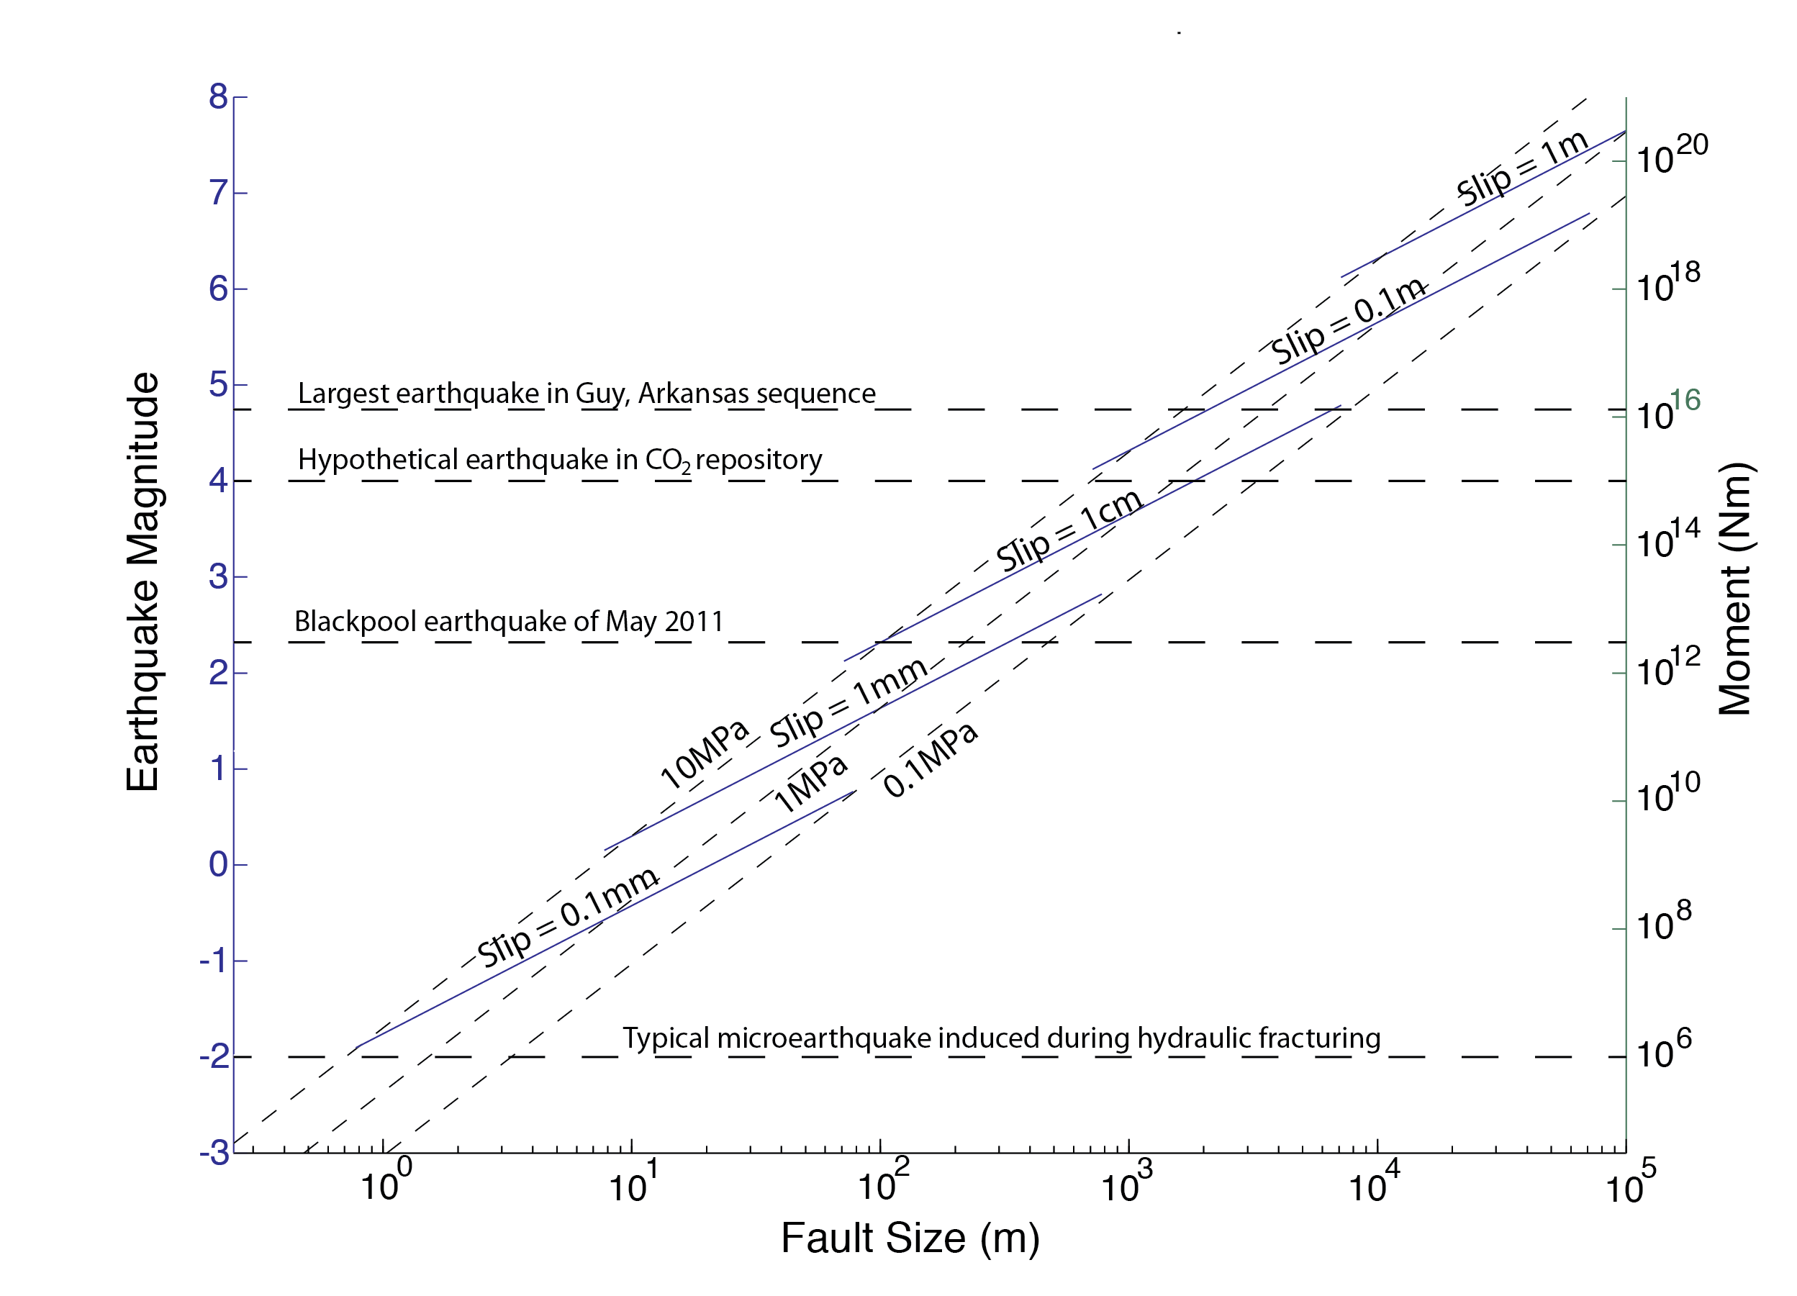
Scaling Fault Slip in Earthquakes
Notes:
46

Slide 47
Managing the Risk Associated with Triggered Earthquakes Associated with Shale Gas Development
Monitor Microseismicity
Avoid Faults, Limit Pressure Increases
Be Prepared to Abandon Some Injection Wells
Guy Arkansas
Earthquake Swarm

Slide 48

Managing the Risk Associated with Triggered Earthquakes Associated with Shale Gas Development
Monitor Microseismicity
Avoid Faults, Limit Pressure Increases
Be Prepared to Abandon Some Injection Wells*
S_{Hmax}
or Injection Intervals*

Slide 49
Comprehensive Protocol for Risk Reduction
Framework understanding of stress state, pore pressure, pre-existing faults
Real-time seismic monitoring
Mechanistic understanding of triggered seismicity (triggering of well-oriented, critically-stressed faults or poorly-oriented faults that are slipping only because of the large pressure perturbation)
“If…then…” rules. For example, if an earthquake of M 2.0 occurs on a well-oriented fault to the stress field, injection should immediately cease…

Slide 50

Strategies for Geologic Sequestration of CO₂
IPCC (2005)
Notes:
50

Slide 51
Most Common Concern About CO₂ Sequestration
HUGE SCALE – Comparable to volumes oil and gas produced annually
HUGE COSTS – Carbon capture, pipelines, injection wells, monitoring systems
Notes:
51

Slide 52



Sleipner Field
1996 to present
1 Mt CO₂ injection/yr
Seismic monitoring
X ~3500 !
1 GT C/y wedges
Pacala and Socolow (2004)
Statoil

Slide 53
Most Common Concern About CO₂ Sequestration
HUGE SCALE – Comparable to volumes oil and gas produced annually
HUGE COSTS – Carbon capture, pipelines, injection wells, monitoring systems
Notes:
53

Slide 54
Saline Aquifers in Well-Cemented
Sedimentary Formations
LIMITED INJECTIVITY – Many saline aquifers will not have sufficient permeability to permit injection at high rates for long periods of time without significant pressure build up
Notes:
54

Slide 55
The Context of Concern: In Most Places, The Brittle Crust is in Frictional Failure Equilibrium
1. Intraplate Earthquakes Occur Nearly Everywhere

Slide 56
2. Seismicity is Often Triggered by the Extremely
Small Pressure Perturbation Associated with
Reservoir Impoundment
Reservoir “Triggered” Seismicity

Slide 57

3. Deep Borehole Stress Measurements
Zoback and Harjes (1997)

Slide 58

Highly Stress in Intraplate Areas
Hydrostatic Pore Pressure
Townend and Zoback (2001)
How Faulting Keeps the Crust Strong

Slide 59
Are Stress Magnitudes Lower in Stable Areas?
Reservoir Triggered Seismicity – No!

Slide 60

Geomechanics and CO₂
How Likely is the Change in Pressure Resulting from CO₂ Injection to:
  Induce Slip on Reservoir Bounding Faults?
  Induce Slip on Faults Within the Reservoir and Cap Rock?
  Hydrofrac the Cap Rock?

Slide 61

Methodologies Used Widely
in the Oil and Gas Industry
Strike-Slip/Reverse
Wiprut and Zoback (2002)

Slide 62
Geomechanics and CO₂
Case Studies
  AEP Mountaineer Site, W. Virginia
  Mt. Simon Sandstone, Illinois Basin
  Teapot Dome, Wyoming

Slide 63

AEP Mountaineer Project: New Haven, WV
NY Times Sept. 21, 2009
Current Plans to Inject 100 ktons/y for 2-5 years

Slide 64

AEP Mountaineer Project
183 Coal burning plants in Ohio River Valley (emitting 700 Megatons of CO₂/year)
AEP Mountaineer CO₂ Emissions
~7 Mton/year
Lucier, Zoback et al. (2006)

Slide 65

Regional Seismicity and CO₂ Point Sources

Slide 66

After CO₂ Injection for 30 Years
Note that the pressure front moves ahead of CO₂ front

Slide 67


Slip on Optimally-Oriented Fault Planes
Injection rate limited to 35,000 tons/year to avoid triggering slip on faults (3.5 Mpa)

Slide 68
AEP Mountaineer Project
183 Coal burning plants in Ohio River Valley (emitting 700 Megatons of CO₂/year)
AEP Mountaineer CO₂ Emissions
~7 Mton/year
~ 35 kton/year per injection zone - 200 injection zones required!

Slide 69

What if a M~4 Earthquake
Occurred in a CO₂ Reservoir?

Slide 70
A Magnitude 4 Earthquake Threatens Seal
Would it be prudent to leave CO₂ in place even after a small earthquake?

Slide 71

A Regional Solution?
Illinois Basin
Mt. Simon Sandstone
Zhou et al. (2009)
Injection of 100 Mtons/y of CO₂

Slide 72
Regional Perturbations Affect Regional Faults
Illinois Basin

Slide 73
Summary
Because of the enormous Scale of Carbon Capture and Storage and Shale Gas Development, Triggered Earthquakes Will be a Common Occurrence
Even small earthquakes at CO₂ storage sites will cause major problems
Sites Can be Found where Long-Term Storage of CO2 Will be Feasible but It’s Not going to be One of the Solutions to Greenhouse Gas Accumulation

Slide 74
Air Pollution and Energy Source*
CH₄
Oil
Coal
CO₂ | 117,000 | 164,000 | 208,000
CO | 40 | 33 | 208
NO_{x} | 92 | 448 | 457
SO₂ | 0.6 | 1,122 | 2,591
Particulates | 7.0 | 84 | 2,744
Formaldehyde | 0.75 | 0.22 | 0.221
Mercury | 0 | 0.007 | 0.016
*Pounds/Billion BTU
EIA, 1998

Slide 75
Coffee Break
Notes:
75

Slide 76


Slide 77
DOE Shale Gas Subcommittee
John Deutch – MIT
Stephen Holditch – Texas A&M
Fred Krupp – Environmental Defense Fund
Katie McGinty – Pennsylvania DEP
Sue Tierney – Massachusetts Energy
Dan Yergin – Cambridge Energy Research
Mark Zoback - Stanford

Slide 78

New DOE Committee
President Obama directed Secretary Chu to convene this group as part of the President’s “Blueprint for a Secure Energy Future”

Slide 79
90 Day Report Summary
Shale gas is extremely important to the energy security of the United States
Shale gas currently accounts for 30% of the total US natural gas production
Shale gas development has a large positive economic impact on local communities and states
Shale gas development creates jobs
Shale gas can be developed in an environmentally responsible manner.

Slide 80
90 Day Report Summary
Improve public information about shale gas operations: Create a portal for access to a wide range of public information on shale gas development…
Improve communication among state and federal regulators: Provide continuing annual support to STRONGER (the State Review of Oil and Natural Gas Environmental Regulation) and to the Ground Water Protection Council…
Improve air quality: Measures should be taken to reduce emissions of air pollutants, ozone precursors, and methane as quickly as practicable...

Slide 81
90 Day Report Summary
Protection of water quality-1: The Subcommittee urges adoption of a systems disclosure of the flow and composition of water at every stage of the shale gas production process.

Slide 82
90 Day Report Summary
Protection of water quality-1: The Subcommittee urges adoption of a systems disclosure of the flow and composition of water at every stage of the shale gas production process.

Slide 83
90 Day Report Summary
Disclosure of fracturing fluid composition: The Subcommittee shares the prevailing view that the risk of fracturing fluid leakage into drinking water sources through fractures made in deep shale reservoirs is remote. Nevertheless the Subcommittee believes there is no economic or technical reason to prevent public disclosure of all chemicals in fracturing fluids...
http://www.shalegas.energy.gov/

Slide 84
90 Day Report Summary
Protection of water quality-2: Hydraulic Fracturing

Slide 85

Will Vertical Hydrofrac Growth Affect
Water Supplies?

Slide 86

Depth of Affected Region Affected
by Hydraulic Fracturing
Fisher (2010)
http://nwis.waterdata.usgs.gov/nwis/inventory

Slide 87

Depth of Affected Region Affected
by Hydraulic Fracturing
Fisher (2010)

Slide 88
Will Vertical Hydrofrac Growth Affect
Water Supplies?
Representation and
Public Opinion

Slide 89

News report following Blackpool Earthquake
BBC, online news

Slide 90
90 Day Report Summary
Protection of water quality-3:
  Adopt best practices in well development and construction, especially casing, cementing, and pressure management. Pressure testing of cemented casing and state-of-the-art cement bond logs should be used to confirm formation isolation.

Slide 91

The Challenges of $4 Gas
Estimated NYMEX Price Required for 10% IRR
$8.00
2007-2008 PRICES
$6.00
NYMEX
$4.00
3/1/11
$2.00
Pinedale
Horn River
Nikanassin
Jonah
Huron Shale
Barnett (Tier 1)
Nora (CBM)
Haynesville
Uinta (Shallow)
Raton (CBM)
Barnett (Tier 2)
Barnett (Tier 3)
Granite Wash (HZ)
Wattenberg (Core)
Alberta Deep Basin
Mannville (CBM)
Fayetteville (3.4 Bcf)
Fayetteville (2.8 Bcf)
Deep Bossier (E. TX)
Woodford(Arkoma)
Alberta Shallow Gas
Powder River (CBM)
Marcellus Wet (Core)
Marcellus Dry (core)
Marcellus Dry (Tier 2)
Piceance (Highlands)
Piceance (Valley-Core)
Eagle Ford (Hawkville)
Montney (10 Stage Frac)
Woodford (Anadarko)
Jean Marie (Tight Gas)
Eagle Ford (Black Hawk)
Montney (4 Stage Frac)
Horseshoe Canyon (CBM)
Warwick (W. TX Overthrust)
Source: Morgan Stanley Research Report
Notes:
All the shale plays APC is involved in will meet 10% IRR at $4.00/mcf
Most of the larger plays such as Marcellus, Hville, EF and Horn River are economic down to lower price levels = very large COMMERCIAL resource
Sensitivities are more on some of the smaller shale resource plays
Shale gas is here to stay and will be predictable

Slide 92


Courtesy George King, Apache Corp.

Slide 93
90 Day Report Summary
Protection of water quality-4:
  Water use and water disposal issues are changing rapidly

Slide 94

Water Issues Changing Rapidly

Slide 95

Water Issues Changing Rapidly
Courtesy George King, Apache Corp.

Slide 96
90 Day Report Summary
Managing short-term and cumulative impacts on communities, land use, wildlife, and ecologies. Each relevant jurisdiction should pay greater attention to the combination of impacts from multiple drilling, production and delivery activities
http://www.shalegas.energy.gov/

Slide 97
90 Day Report Summary
Organizing for best practice: The Subcommittee believes the creation of a shale gas industry production organization dedicated to continuous improvement of best practice, defined as improvements in techniques and methods that rely on measurement and field experience, is needed to improve operational and environmental outcomes.
Final Report: Just Released
http://www.shalegas.energy.gov/

Slide 98
BHI Water Management Solutions
Dilemma of Water Management
Use of water in every aspect of drilling, completing, and producing an oil or gas well is heavily regulated
Each step in this life cycle comes with a Cost
By Reducing or Recycling produced water, Total Cost of sourcing, using, & disposing of water can be reduced

Slide 99
Water Management in Shales
Most Shale Gas wells produce Very little or No water (Exceptions Antrim and New Albany Shales)
  However, water may be produced later in well life or from fracing into a water zone
Water Problems are primarily associated with:
- Frac Flowback Water
- Water Sourcing for Frac and Drilling
- Water Treating, Handling for Re-Use
- Water Handling for Disposal

Slide 100

BHI Water Management Solutions
Water Management
  -- Optimizes Oil Recovery
  -- Reduces OPEX
  -- Protects the Environment & Complies with Regulations
  BHI Downhole Water Shutoff & Solutions
  -- Design and Deploy customized Solutions – Avoidance/ Minimizing Excess Water Production (new installations)
  -- Diagnose, Design, and Deploy customized (Mechanical, Cement, Chemical Shutoff) Solutions for Water Problems (existing wells)
BHI Water Reuse Services
  Recycles produced and flow back water in a controlled process
  Formulates customized frac fluids using recycled water
Recognizes every formation is different with varying challenges
  Design, build, and operate fit-for-purpose treatment solutions to address cost, quality, and regulatory requirements
Notes:
Avoid water contact and costly drilling risk
In-depth reservoir understating helps avoid water contact and identify optimal wellbore trajectories
Geosteering technology and Navigation services precisely place wells on time and on budget.
Cut costs by conserving water - Condition and reuse fluids using a customized water treatment program that ensures compatibility, maintains performance, and minimizes formation damage, while reducing transportation and disposal costs.
Anticipate and inhibit potential water threats – Expert prediction of the water induced threats e.g. scale, and develop a fit-for-purpose solution to inhibit damaging deposits, while ensuring compatibility.
Water inflow control to increase asset economics - With reliable completions technology you can reduce or delay produced water while ensuring wellbore integrity to extend the economic life of your asset.
Maintain environmental efficiency - Comprehensive culture of reducing waste and spills, increasing recycling, conserving resources, and increasing safety measures
Baker Hughes upstream water management optimizes oil recovery, reduces OPEX, and sustains your environmental commitment for increased return on investment. Building on our century-long legacy of water conformance technology, we’re launching two new services: water shutoff and water reuse.
By combining our existing water shutoff tools and pressure pumping/coiled-tubing expertise, we can diagnose, design, and deploy a customized solution to solve your excess water production issues.
On the surface, our water reuse services reduce waste and recycle produced and flow back water in a closed-loop. Because we recognize every shale formation is different with varying contaminants, we’ll determine the adequate treatment solution so produced water can be reused.

Slide 101
BHI Three-Tier Approach to Water Management
Notes:
Baker Hughes approach to water management focuses on the reduction of waste through avoidance while drilling and later water shut-off downhole. Once water reaches the surface we are developing the capability to treat the water for our customers to reuse in hydraulic fracturing. There will be residue from this treatment process as well as water that can not be treated to the necessary standard for reuse as a frac fluid. These two waste streams could be addressed through the acquisition of disposal capacity in those areas where we are targeting our surface treatment efforts. In these instances, it makes sense to pursue this opportunity.

Slide 102

BHI Water Management Solutions
Multi-Tiered Surface Water Solutions
Frac Flowback
Produced Water
Drilling Waste Water
Centralized Processing
Treatment
Disposal
Surface Transport (Hpump)
Reservoir Modeling
& Completion Design
Planning
Avoidance Strategies
Downhole Solutions
Diagnosis Tools
Mechanical & Chemical SO’s
Rel Perm Modifiers
Avoidance Equipment
ESP’s – Water Source Wells

Slide 103
90 Day Report Summary
Shale gas is extremely important to the energy security of the United States
Shale gas currently accounts for 30% of the total US natural gas production
Shale gas development has a large positive economic impact on local communities and states
Shale gas development creates jobs
Shale gas can be developed in an environmentally responsible manner.

Slide 104

POLAND

Slide 105
But we still
have a lot of work to do!
WILL
POLAND

