Slide 1

Opportunities and Challenges of
Shale Gas Development
Day 3
Gdansk Technical University
December 12-15, 2011
Mark D. Zoback
Professor of Geophysics
Stanford University

Slide 2

Opportunities and Challenges of
Shale Gas Development
Day 3
Gdansk Technical University
December 12-15, 2011
Mark D. Zoback
Senior Technical Advisor
Baker Hughes Incorporated

Slide 3

Course Overview
Day 1 Opportunities and Challenges of Shale Gas Development
Characterization and Physical Properties of Organic Rich Shales
Day 2 Geomechanics
Wellbore Stability
Drilling Operations
Day 3 Hydraulic Fracturing and Reservoir Stimulation
Day 4 Shale Permeability, Gas Production and Reservoir Simulation
Water Management and Minimizing Environmental Impacts

Slide 4
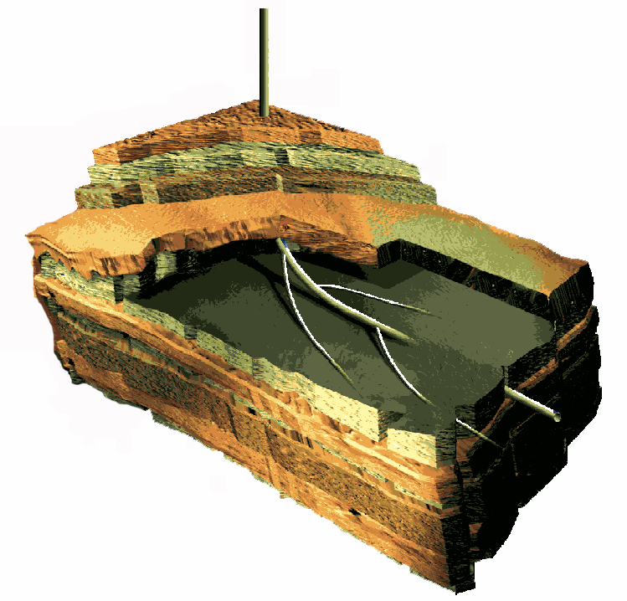
Building a Geomechanical Model
Principal Stresses at Depth
S_{v} – Overburden
S_{Hmax} – Maximum horizontal principal stress
S_{hmin} – Minimum horizontal principal stress
S_{v}
Additional Components of a
Geomechanical Model
UCS
Pp
P_{p} – Pore Pressure
UCS – Rock Strength (from logs)
Fractures and Faults (from Image Logs, Seismic, etc.)
S_{hmin}
S_{Hmax}
4
Notes:
4
The geomechanical model begins by defining the principal stress tensor.
The principal stress tensor resolves the in situ stresses into three mutually perpendicular vectors, S1, S2 and S3.
S1 is greater than or equal to S2, which is greater than or equal to S3.

Slide 5
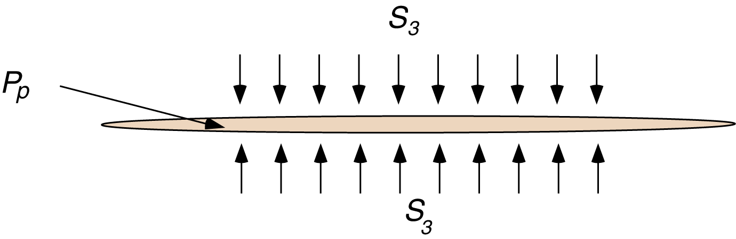
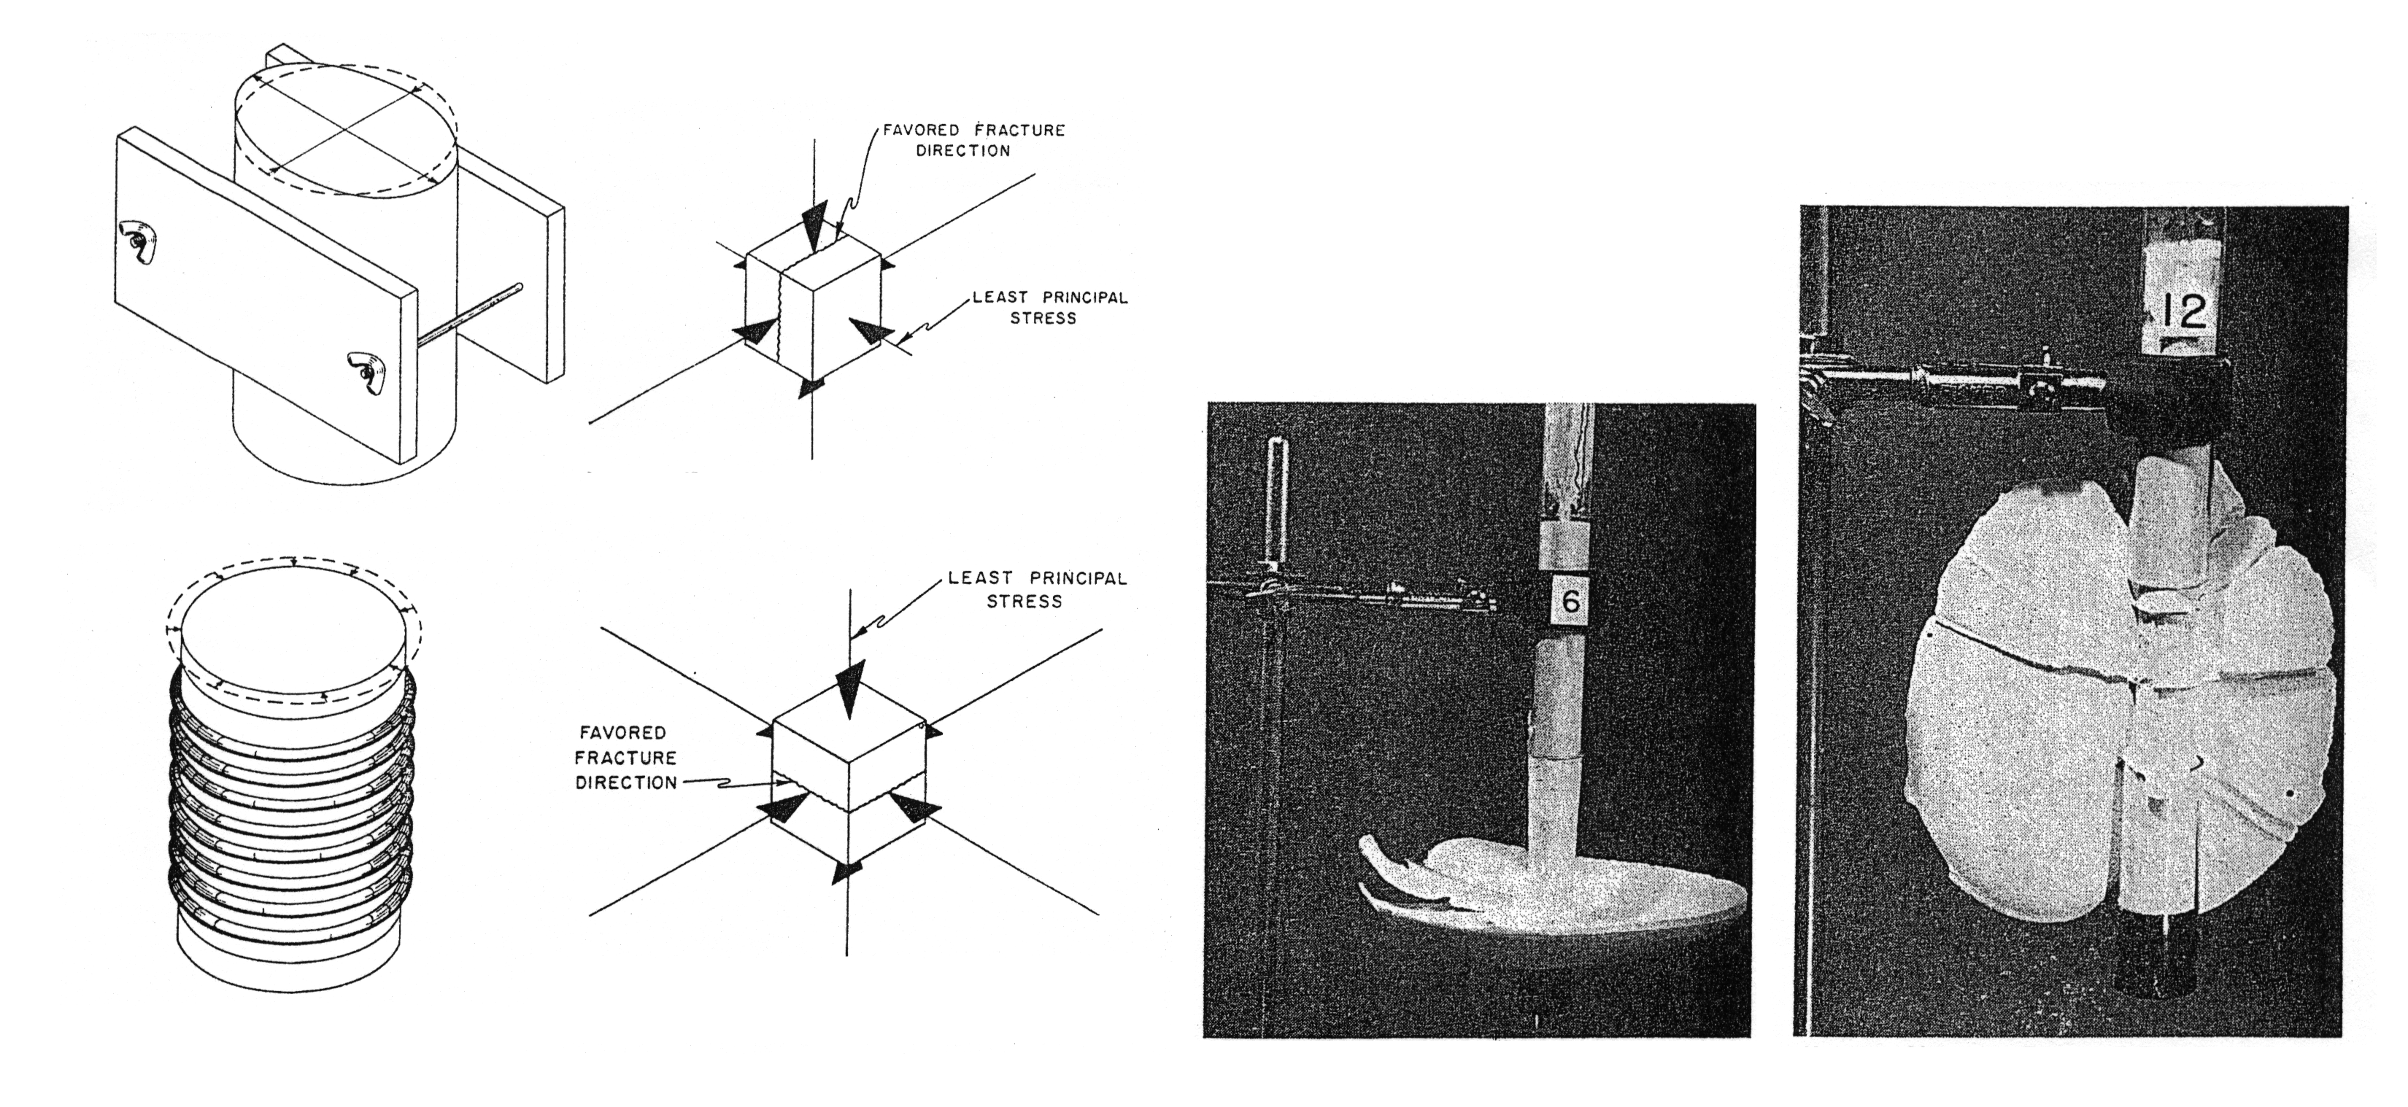
Propagation of Hydraulic Fractures - 1
S_{hmin}
P_{f}
S_{hmin}

Slide 6
Fracture Orientation – Normal Faulting
S₁ = S_{v}
Fracture plane
Fault
S₃ = S_{hmin}
S₂ = S_{Hmax}
β
Hydraulic fracture
Normal faulting regime → s_{v} > s_{Hmax} > s_{hmin}
The hydraulically-induced fracture is vertical & parallel to active normal faults
Notes:
After Hubbert and Rubey.

Slide 7
Fracture Orientation – Strike Slip Regime
S₂ = S_{v}
S₃ = S_{hmin}
Hydraulic fracture
S₁ = S_{Hmax}
Fracture plane
Strike-slip regime → S_{Hmax} > S_{v} > S_{hmin}
The hydraulically-induced fracture is vertical and 20°-35° from the strike of the fault
Notes:
After Hubbert and Rubey.

Slide 8
Fracture orientation – Thrust regime
Hydraulic fracture
Fracture plane
S₃ = S_{v}
β
S₁ = S_{Hmax}
S₂ = S_{hmin}
Thrust regime → s_{Hmax} > s_{hmin} > s_{v}
Hydraulically-induced fractures are horizontal
Notes:
After Hubbert and Rubey.

Slide 9
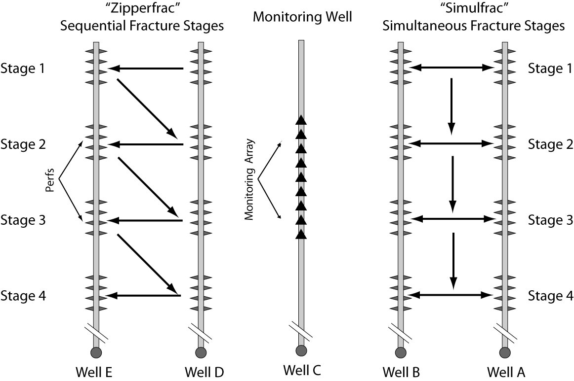
Shale Gas Wells Are Drilled Parallel to S_{hmin}
S_{hmin}
P_{f}
S_{hmin}
Notes:
9

Slide 10
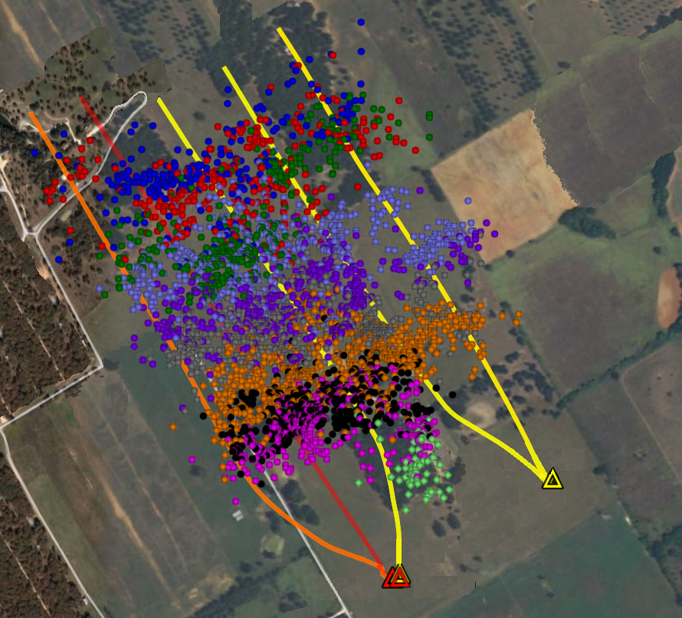
Barnett Shale Example
5 Wells, 40 Stages, ~4000 Microseismic Events

Slide 11
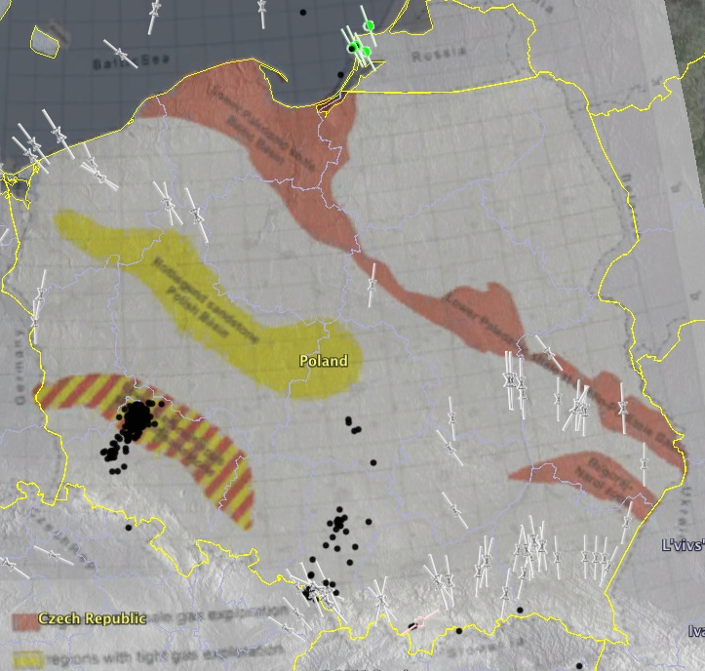

Stress Map of Poland

Slide 12
Propagation of Hydraulic Fractures - 2
S_{hmin}
P_{f}
S_{hmin}
In order to make a hydraulic fracture propagate, it is necessary to increase pressure in the fracture to slightly more than the magnitude of S_{hmin}

Slide 13
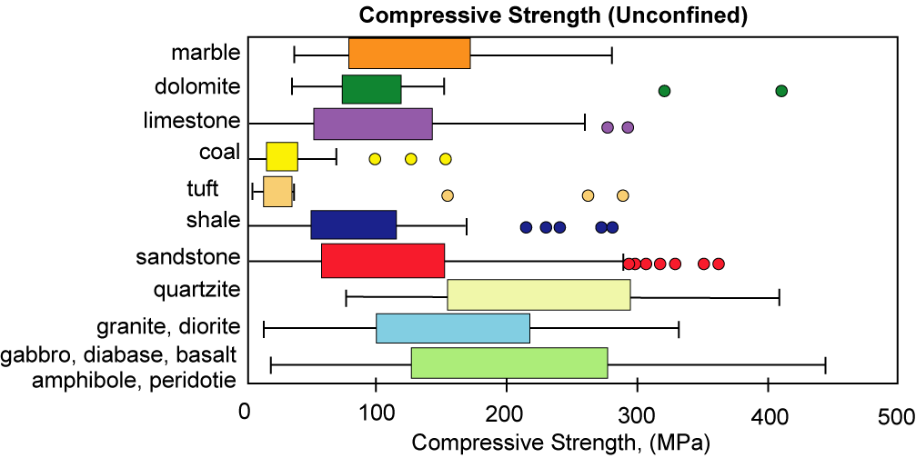
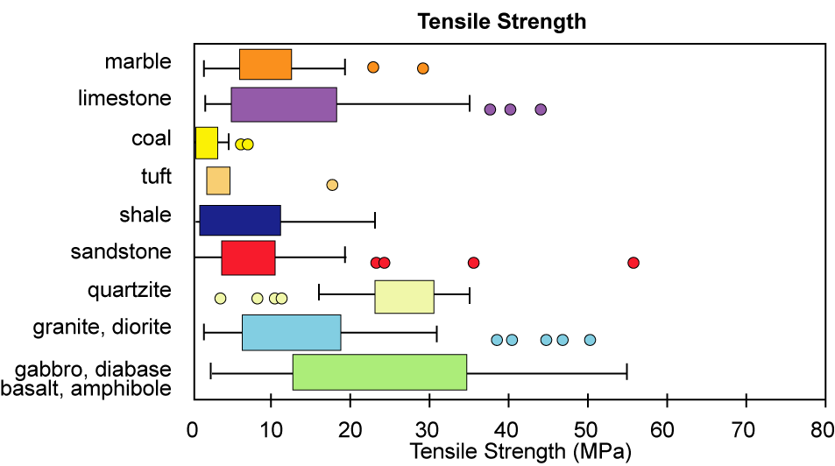
Ranges of Rock Strength

Slide 14
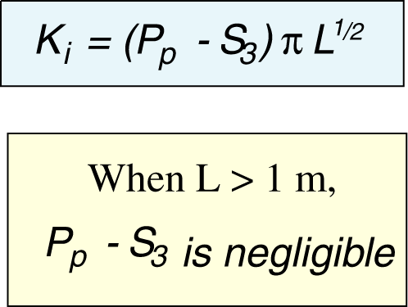
Propagation of a Mode I Fracture
P_{f}
P_{f}
P_{f}

Slide 15
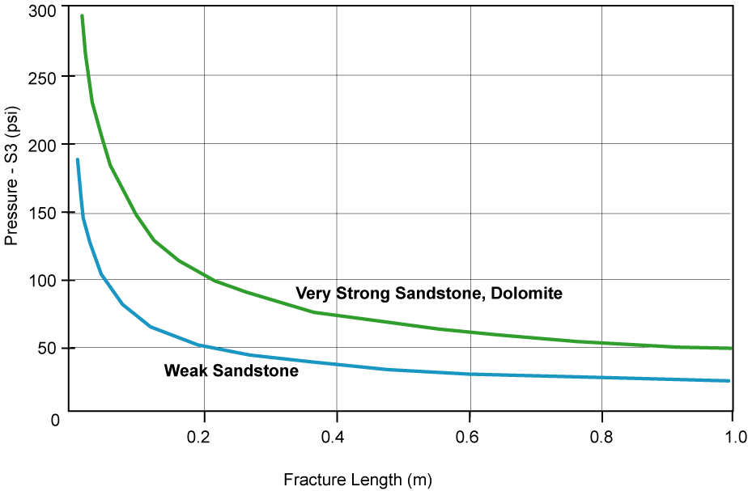
Propagation of Hydraulic Fractures in Sedimentary Rocks

Slide 16
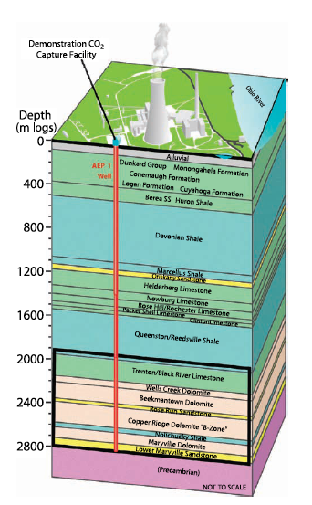
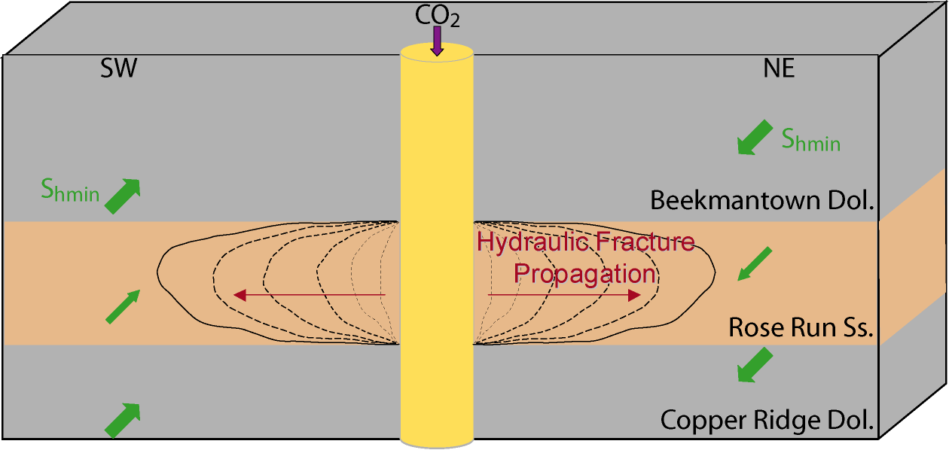
How do we Avoid Propagation of Hydraulic Fractures?

Slide 17
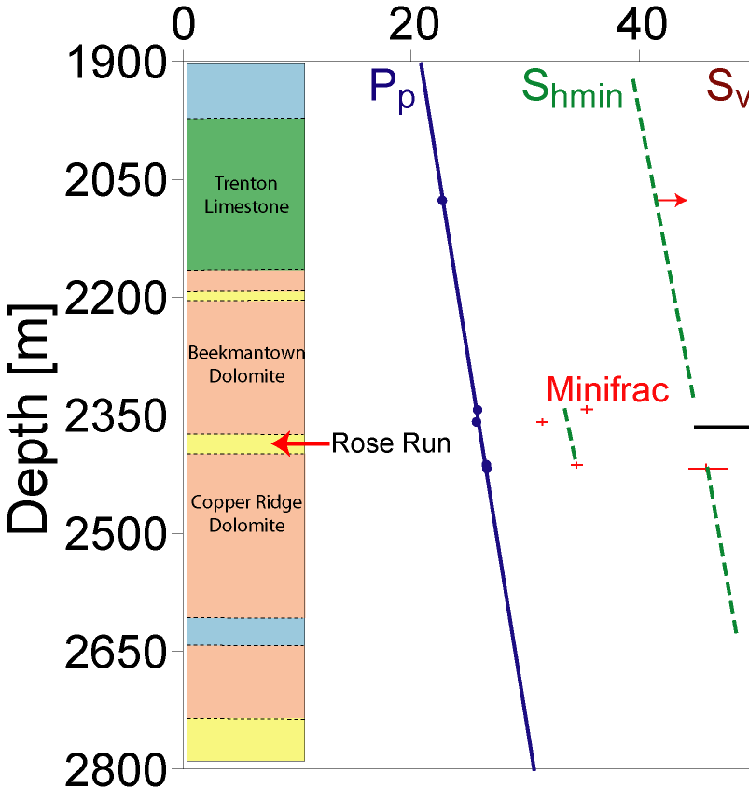
Case 1 – A Strong Contrast Between the Magnitude of S_{hmin} Within the Target Formation
3000
6000 psi

Slide 18
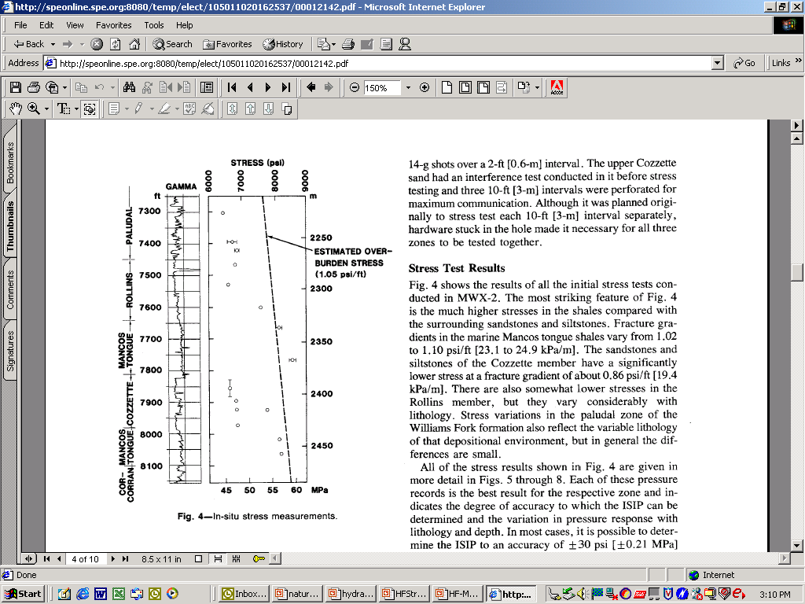
Effect of Stress Contrast on Fracture Containment
Stress profile, Mesaverde Group, Rifle, Colorado (after Warpinski et al., 1985)
Usually, S_{sand} < S_{shale}
Stress measurements in shale
Stress measurements in sand

Slide 19
Effect of Stress Contrast on Fracture Containment
For a symmetric stress profile
→ S₂=S₃, b₂=b₃, K_{IC} _{top} = K_{IC bottom} (Simonson et al., 1978):
σ₂
a
σ₁
h
b₂
b₂
a
σ₂
If the stress contrast is much larger than the fracture toughness → K_{IC} is normally neglected !!!
Notes:
Same stress intensity at both ends of the fracture results in a simpler equation.

Slide 20
Effect of Stress Contrast on Fracture Containment
Symmetric profile:
s_{u}
h_{s2}
s_{s}
h
2a
h_{s2}
s_{l}
Non-symmetric profile:
s_{u}
h_{s3}
2a
s_{s}
h
h_{s2}
s_{l}

Slide 21
Case 2 – What if S_{hmin} Above the Shale is About the Same?
3000
6000 psi

Slide 22
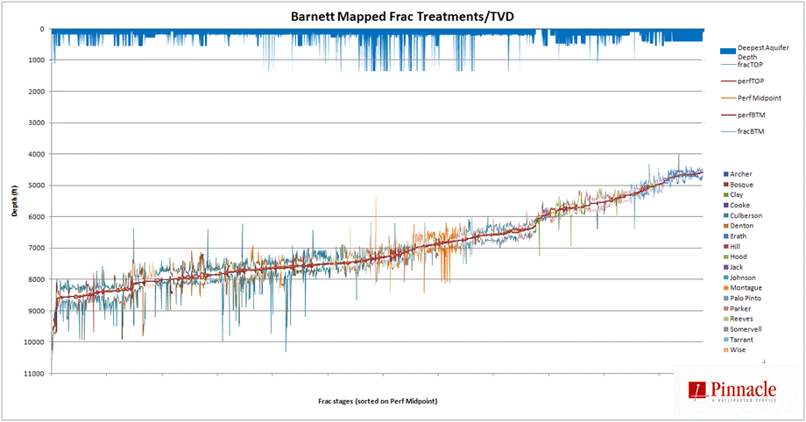
Mostly Downward Growth of Hydraulic Fractures
in the Barnett Shale into the Ellenburger Limestone
Fisher (2010)
http://nwis.waterdata.usgs.gov/nwis/inventory

Slide 23
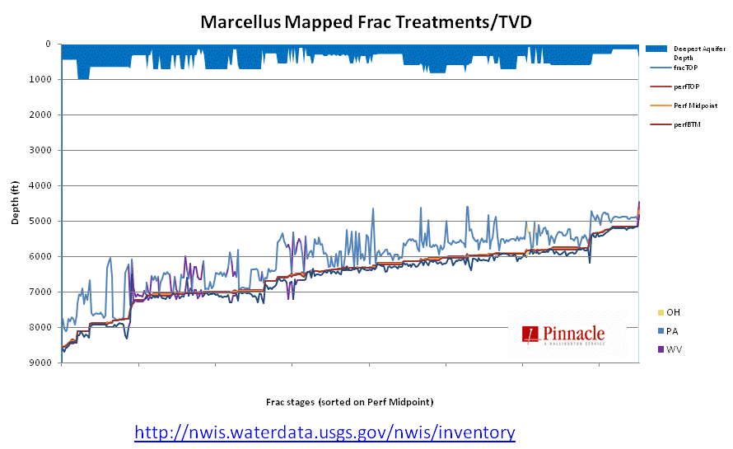
Upward Vertical Hydraulic Fracture Growth
in the Marcellus Shale
Fisher (2010)

Slide 24
Propagation of Hydraulic Fractures - 3
S_{hmin}
P_{f}
S_{hmin}
Propagation of hydraulic fractures to determine the magnitude of S_{hmin}

Slide 25
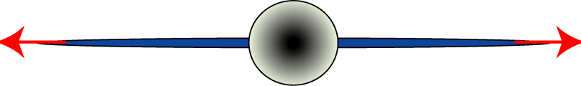
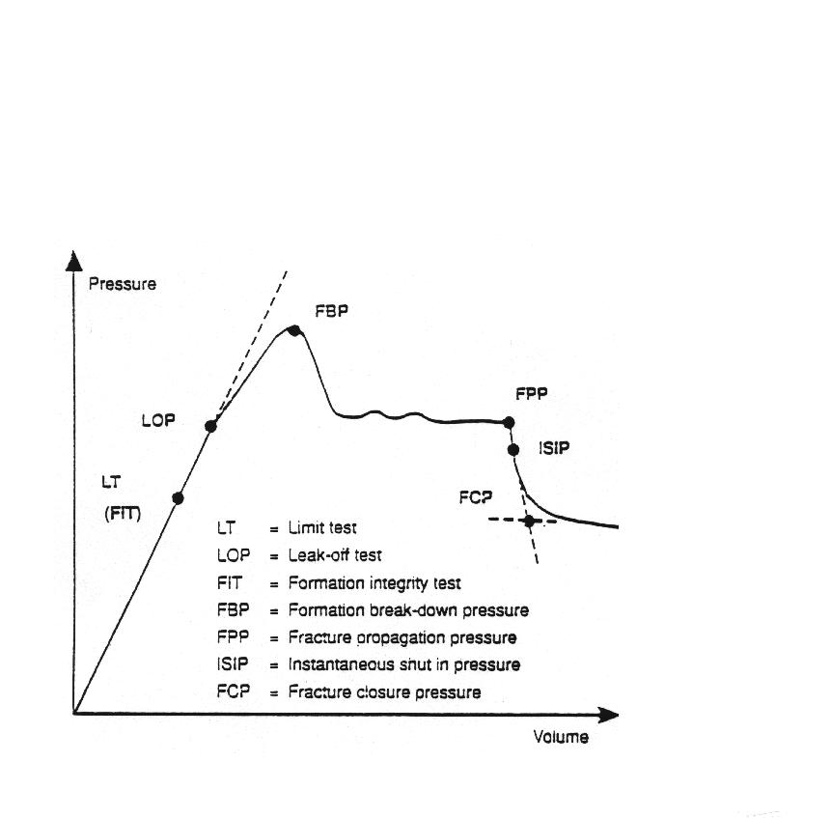
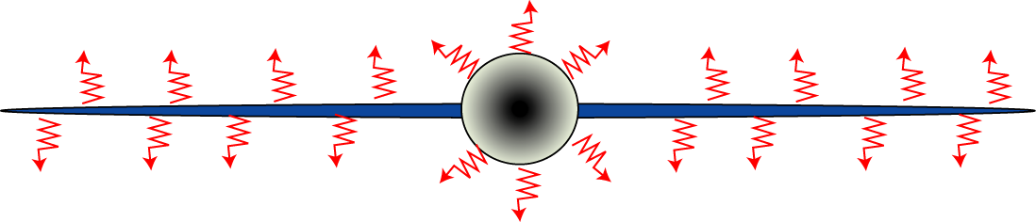
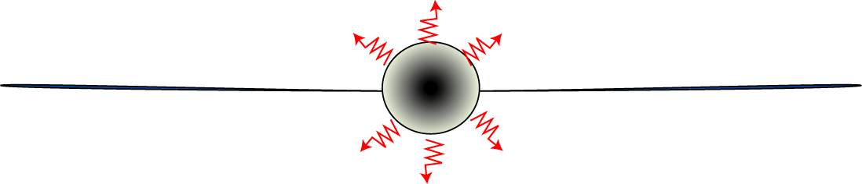
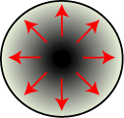
Extended Leak Off Test/Minifrac
Time or volume
Notes:
An idealized extended leak-off test is shown. The pumps are turned on and the pressure down hole increases linearly with increasing volume of fluid pumped. If the test is stopped before there is a deviation in the linear trend it is called a Formation Integrity Test (FIT). An FIT does not provide any information about the least principal stress. The FIT can be either above or below the least principal stress because of the stress concentration around the wellbore. If the test is continued then at some point volume will be created down hole as a result of either a pre-existing fracture opening, or a new fracture being created. At this point there is a deviation from the linear trend and the beginning of the deviation is called the Leak-Off Point (LOP). If the test is stopped at this point, the LOP can be a reasonable estimate of the least principal stress. If the test is continued beyond this point, then the formation will break down at the Formation Breakdown Pressure (FBP) and the fracture will propagate away from the wellbore at the Fracture Propagation Pressure (FPP). The FBP is an unpredictable number that depends on the tensile strength of the rock, the stress concentration around the wellbore, the complexity of the fracture being created, and the frictional losses of the fluids moving from the wellbore into the fracture. The FPP is a combination of the fracture toughness, the fluid invasion to the tip of the fracture, the tensile strength of the fracture, and the frictional losses of the fluid moving through the fracture. If the well is shut in and the pressure decline is monitored, then the two most accurate measures of the least principal stress can be obtained. The Instantaneous Shut-In Pressure (ISIP) is measured immediately after the well is shut in and there is still fluid propping open the fracture. The Fracture Closure Pressure (FCP) is measured after the fracture closes by extrapolating the steady-state pore pressure back to the intersection with the ISIP line. The ISIP is typically taken as the upper bound of the least principal stress and the FCP is the lower bound of the least principal stress.

Slide 26
Avoiding Vertical Fracture Growth
A Few Comments on the Utilization of
Poisson’s Ratio For Determination of
Horizontal Principal Stress Magnitudes
or
Why the Magnitudes of the Horizontal Principal Stresses Should Not be Determined from Geophysical Logs

Slide 27
It Would be Extremely Useful to Calculate Stress Magnitudes from Log-derived Elastic Constants

Slide 28
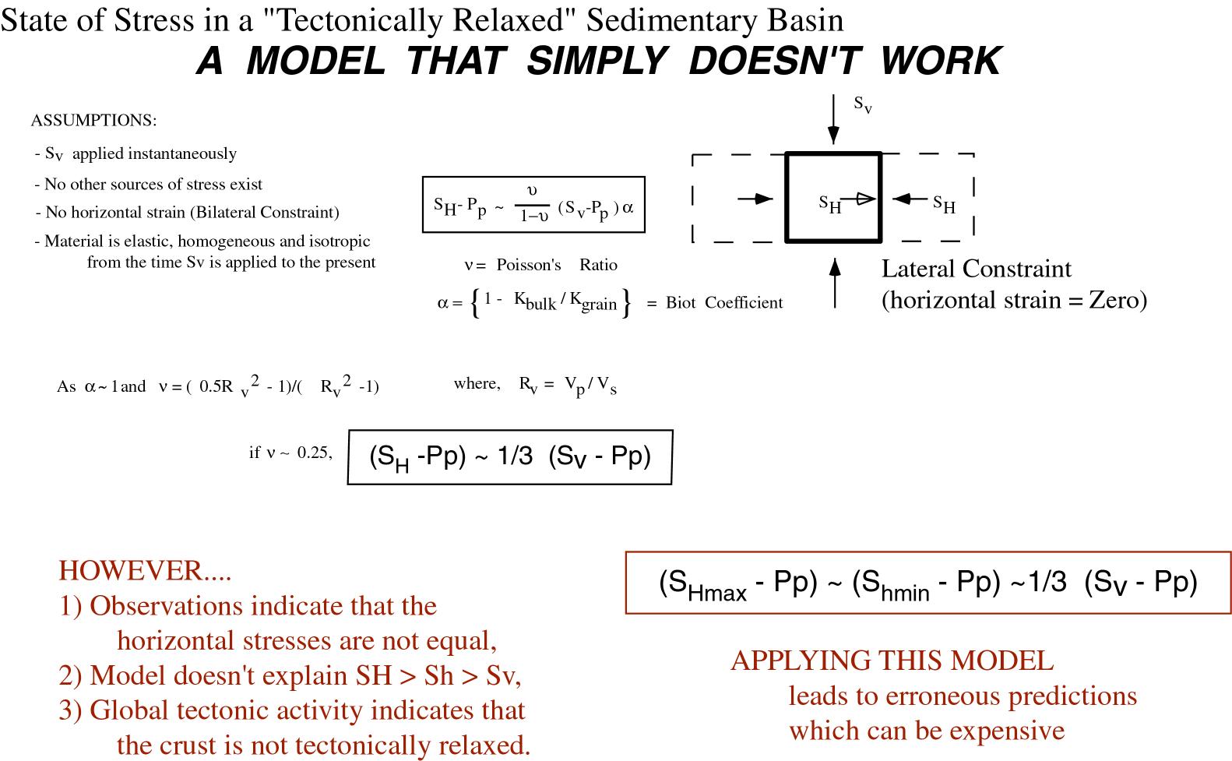
It all started with Eaton (1969)*
Assumptions:
Earth is elastic, homogeneous and isotropic in the absence of gravity
S_{v} is applied instantaneously in the absence of horizontal strain
No other sources of stresses so
S_{Hmax} = S_{hmin}
Lateral Constraint (horizontal strain = zero)
*from the outset, Eaton recognized that this equation did not work, even in the GOM for which it was intended. He used an empirical, depth dependent ν, varying from ν ≈ 0.25 at 1000 ft (σ_{h}/σ_{v}~0.33) to ν ≈ 0.45 (!) at 10,000 ft (σ_{h}/σ_{v}~0.82)

Slide 29
Evolution of the Eaton Equation – 1*
Attempt to Incorporate
Poroelasticity
But the applicable form of the effective stress law varies with application:
Simple (Terzaghi) form
“Exact form”
Applicable to rock strength,
friction, etc.
Applicable to volumetric
strain (Nur and Byerlee, 1971)
-
Permeability
β ≥ 1 sandstone with clay
* Uses empirical, depth dependent α (as well as ν) as needed

Slide 30
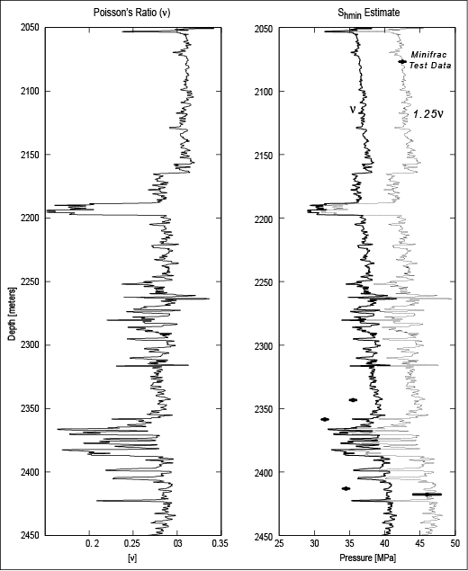
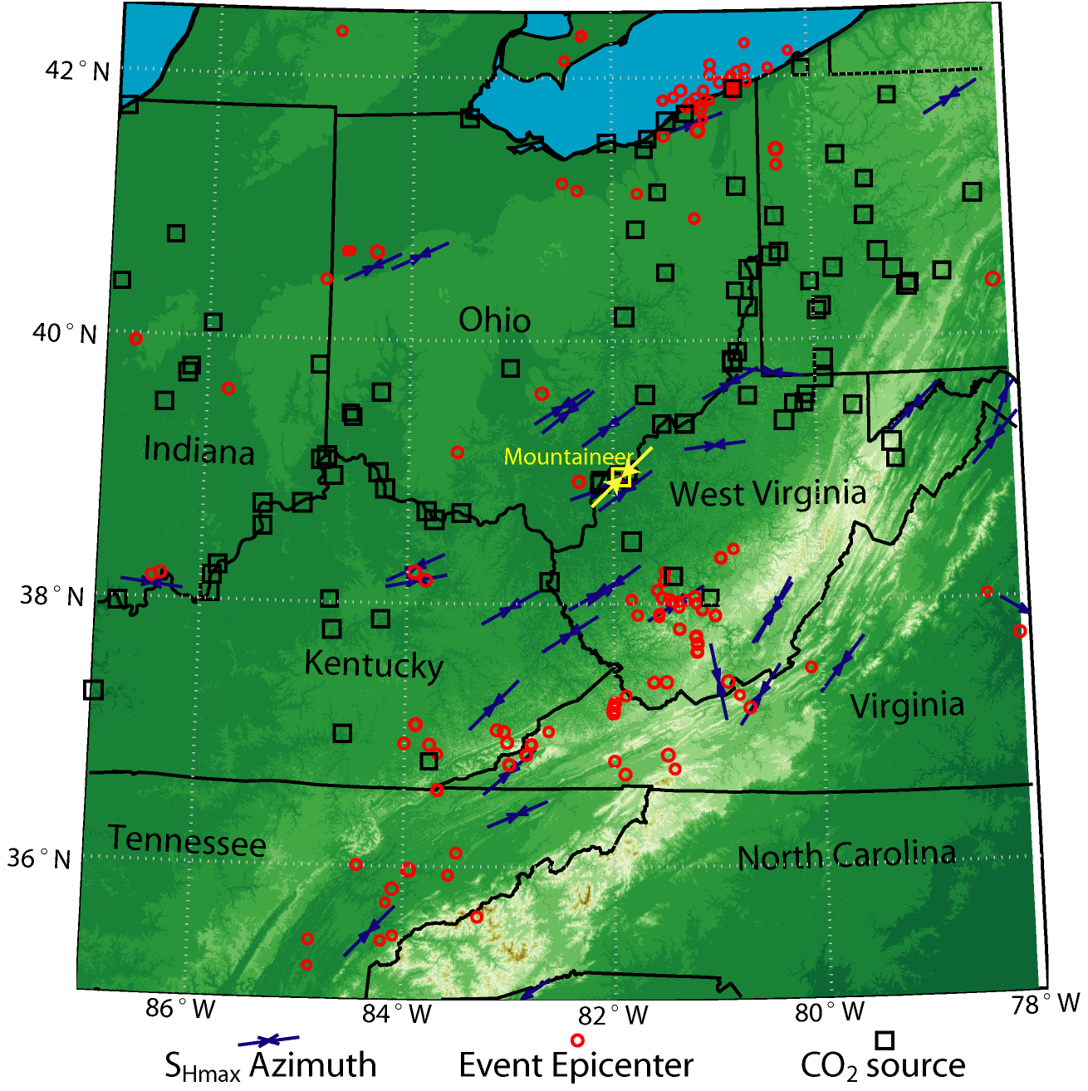
Eaton (with ν^{eff}) fits some observations
But S_{Hmax} ≠ S_{hmin}
Earthquakes (mostly strike-slip
S_{Hmax}>S_{v}>S_{hmin})

Slide 31
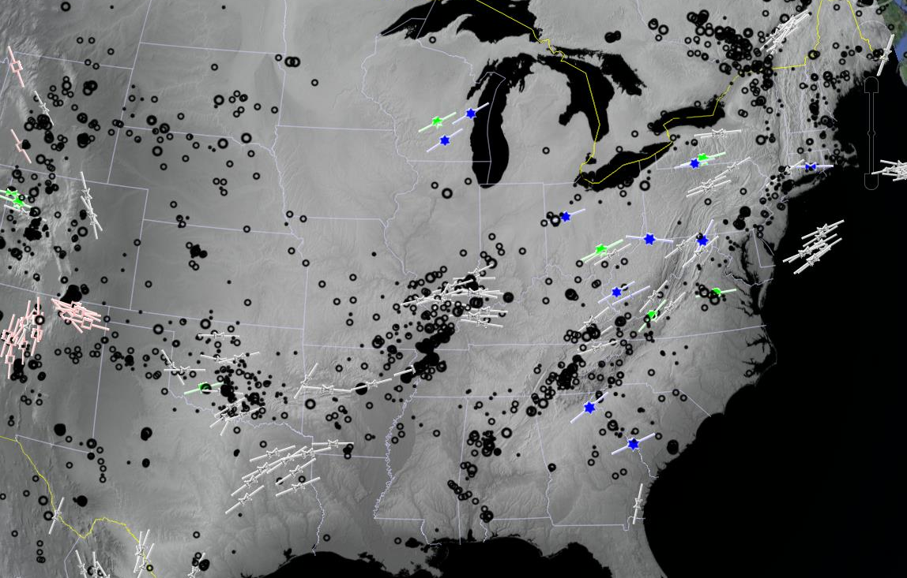
Problems with the Eaton Equation - 1
Problems:
Horizontal principal stresses are almost never equal
There is active tectonics almost everywhere

Slide 32
Evolution of the Eaton Equation - 2
Problems:
Horizontal principal stresses are almost never equal
There is active tectonics almost everywhere
Solution:
Add depth dependent tectonic stress
tect
tect

Slide 33
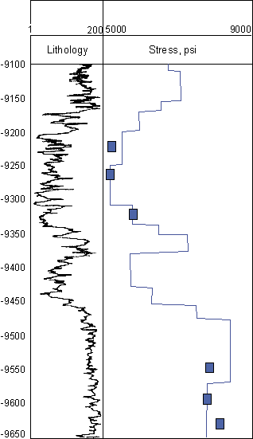
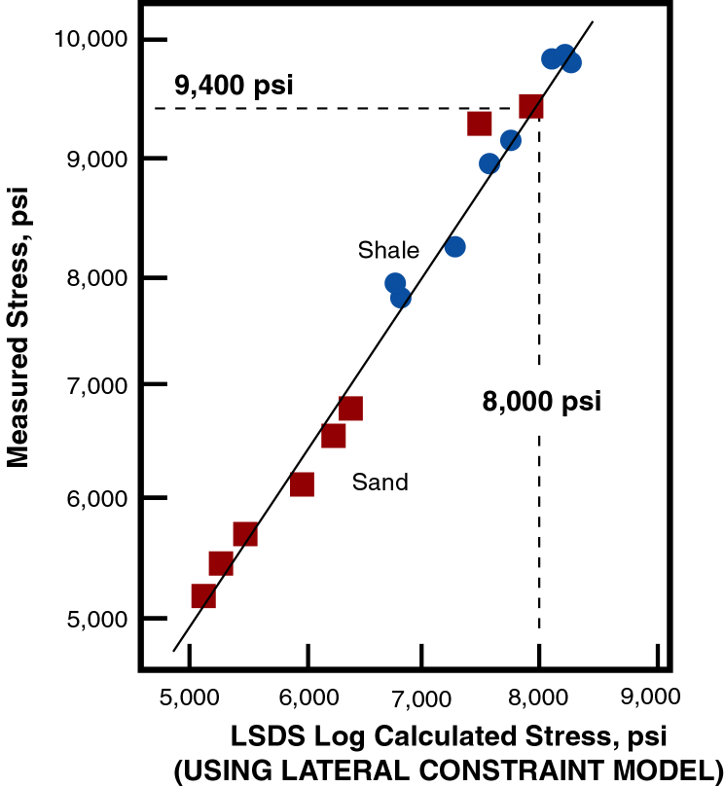
Predicting Travis Peak Stresses Using Eaton’s Eqn. and Tectonic Stress

Slide 34
Predicting Travis Peak Stresses Using Eaton’s Eqn. and Tectonic Stress
To fit the measured data:
Use effective modulii
Add depth dependent
tectonic stress (no longer need empirical α and ν !)

Slide 35
Problems with the Eaton Equation - 2
Historical Note:
With each eqn. having 4 adjustable parameters, I used to refer to these as the equations from hell
tect
tect
“α”
“ν”
x and y (z)

Slide 36
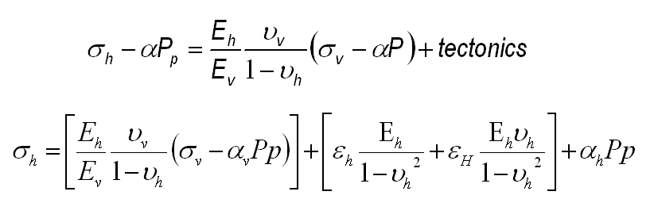
Evolution of the Eaton Equation - 3
But the real equations from hell appear to be:
<Repeat for σ_{H}>
8 parameters
+ pore pressure!
Transverse Isotropic Formation
E_{h}, E_{v} Young’s modulus in horiz and vert. directions
n_{h}, n_{v} Poisson’s ratio in horiz and vert. directions
e_{H}, e_{h} Horizontal principal strains obtained by iterating
strain in each stratigraphic unit to match LOT’s

Slide 37
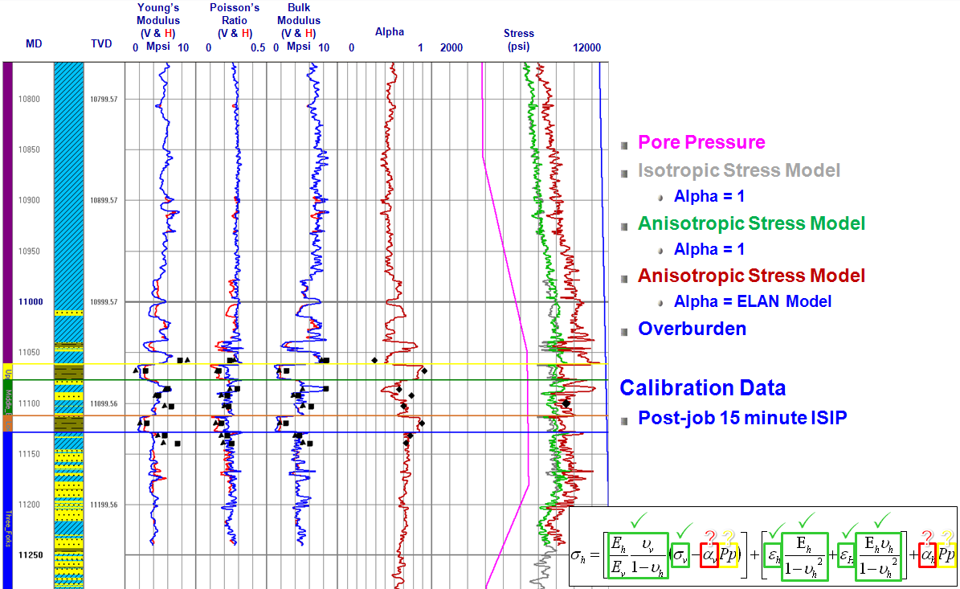
Bakken Shale Example
????

Slide 38
So What is So Wrong with This Overall Approach?
Original Assumptions:
Earth is elastic, homogeneous and isotropic in the absence of gravity
S_{v} is applied instantaneously in the absence of horizontal strain
No other sources of stresses
Added Assumption:
Horizontal strains are applied instantaneously, independently
Fundamental Problems:
Over time, the earth is not elastic
Well-cemented reservoirs are elastic-plastic (stress at frictional limit)
Poorly-cemented reservoirs are visco-plastic (stresses relax with time)
Stress is not instantaneous
Overburden
Tectonic stress (or strain)

Slide 39
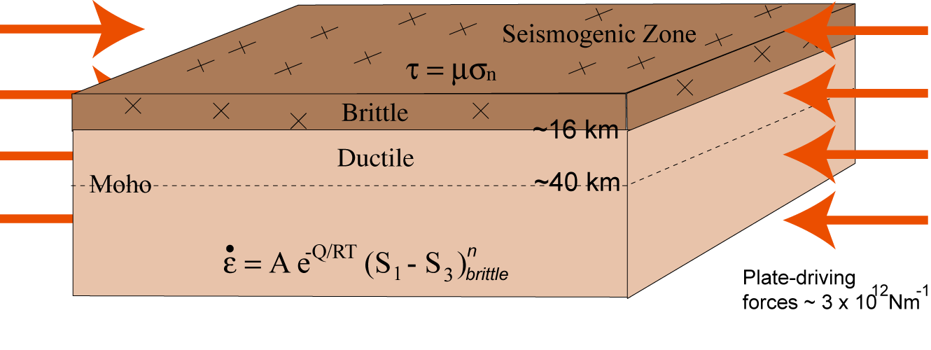
Brittle Crust is in a State of Frictional Equilibrium
(Elastic-plastic)
Normal Faulting

Slide 40
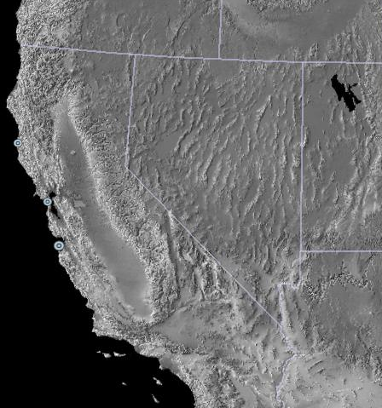
Consider Basin and Range Extension
Stress Magnitudes Invariant with Strain

Slide 41
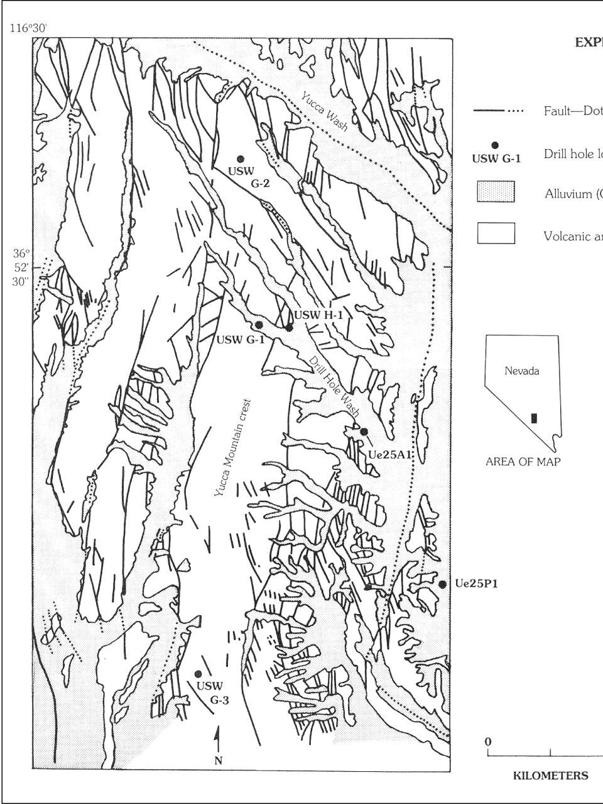
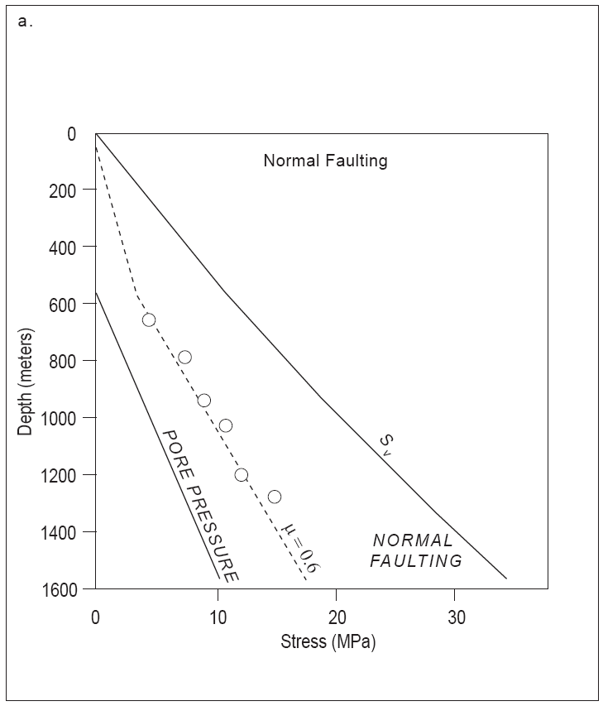
Yucca Mountain - Nevada Test Site
Solitario Canyon Fault

Slide 42
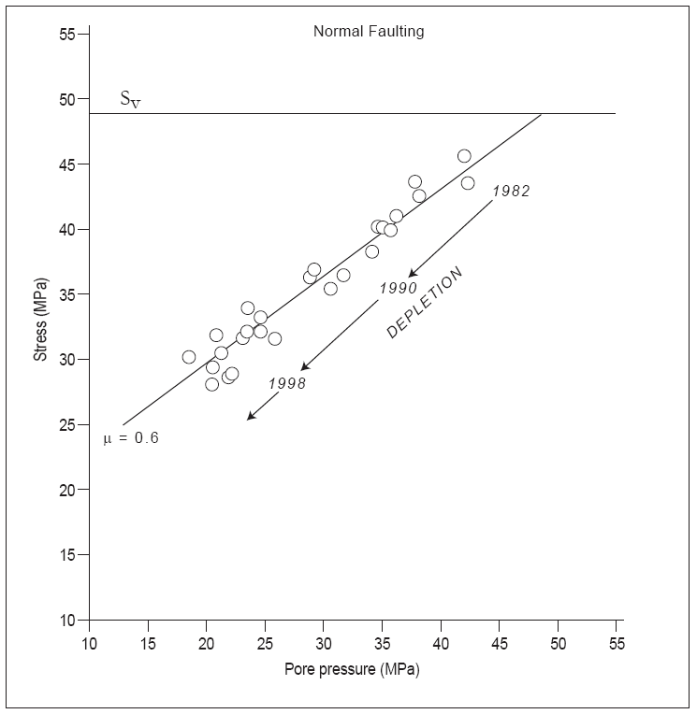
Valhall Field, North Sea Chalk Reservoir

Slide 43
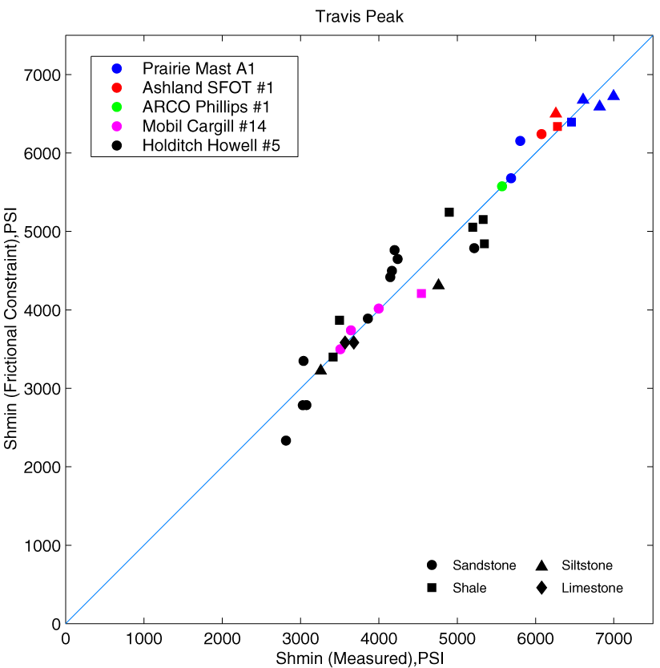
Travis Peak Formation
2
Using effective modulii and depth dependent tectonic stress

Slide 44
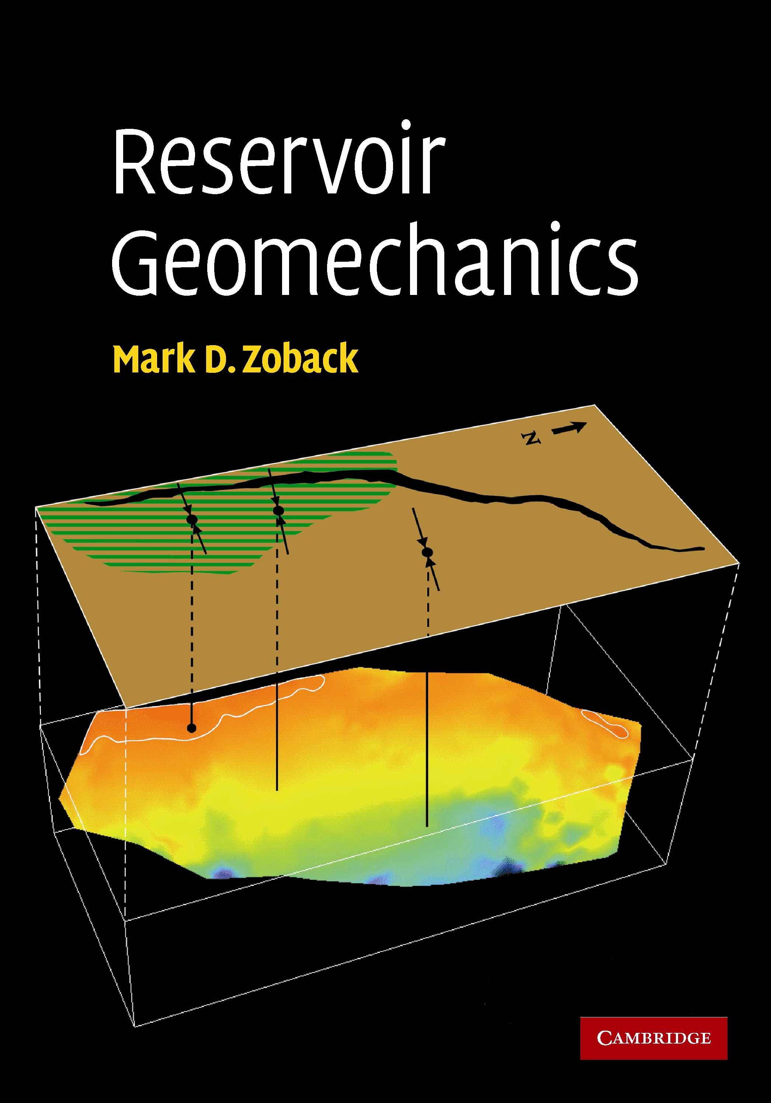
Appropriateness of Frictional Equilibrium Model
Documentation of frictional equilibrium model in 0il and gas reservoirs around the world
▪ Normal Faulting
▪ Strike-Slip Faulting
▪ Reverse Faulting
Applicability of frictional equilibrium model
▪ Critically-Stressed Faults and Flow in Fractured Reservoirs
▪ Wellbore Stability
▪ Effects of Reservoir Depletion
Deviations from this model in Visco-plastic formations such as
shale and uncemented sands

Slide 45
So What Should be Done to Control
Vertical Frac Growth?

Slide 46
Measure Stress With Extended LOT’s and MiniFracs

Slide 47
Why is Stress Usually Higher in Shales?
Stress profile, Mesaverde Group, Rifle, Colorado (after Warpinski et al., 1985)
Usually, S_{sand} < S_{shale}
Stress measurements in shale
Stress measurements in sand

Slide 48
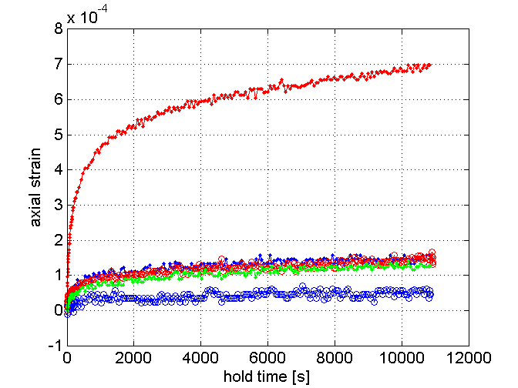
High Shale Stress Due to Creep?
39%clay
25%
22% clay
33%
5% clay

Slide 49
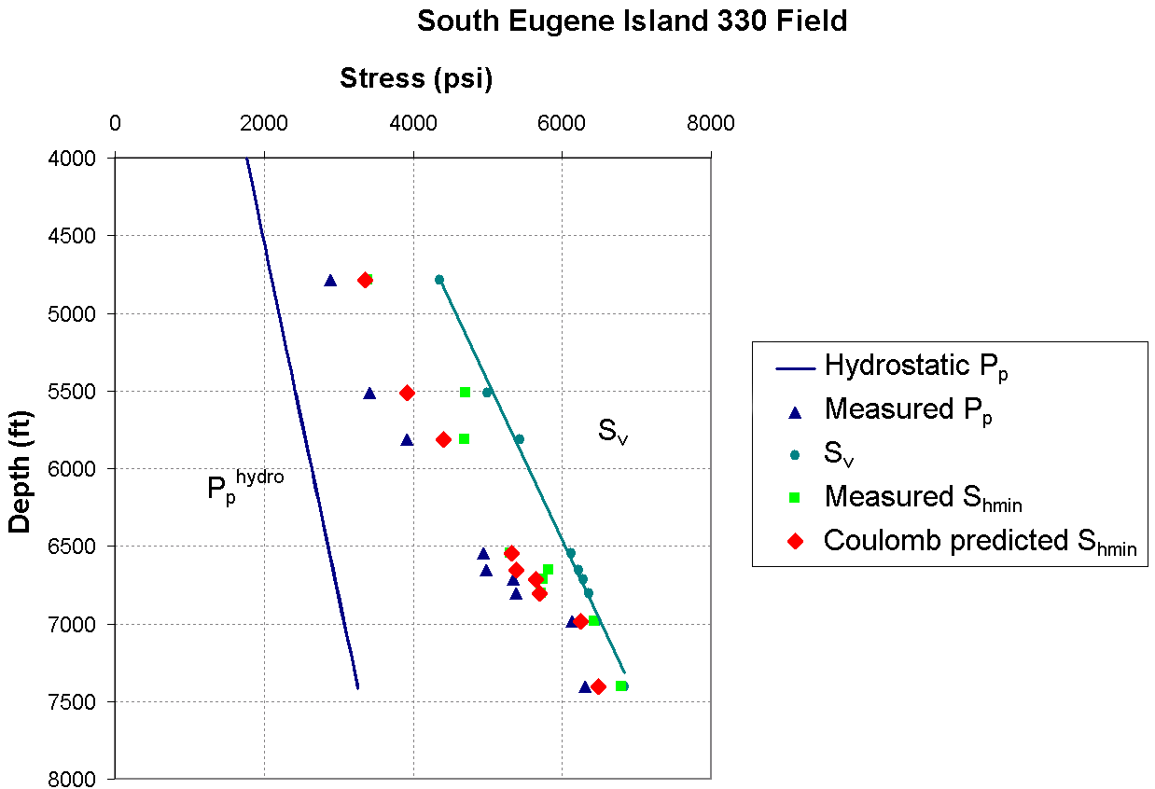
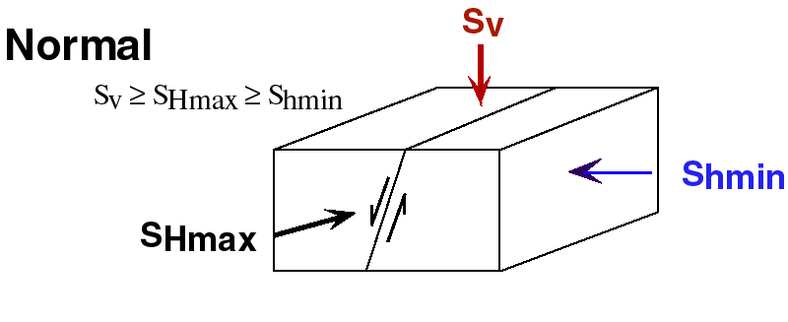
Visco-plastic Creep in GOM Shales
South Eugene Island Sands
Predicted S_{hmin}
Observed S_{hmin}
P_{p}

Slide 50
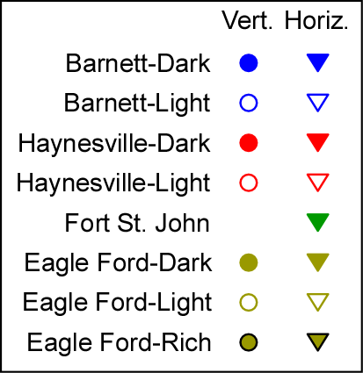
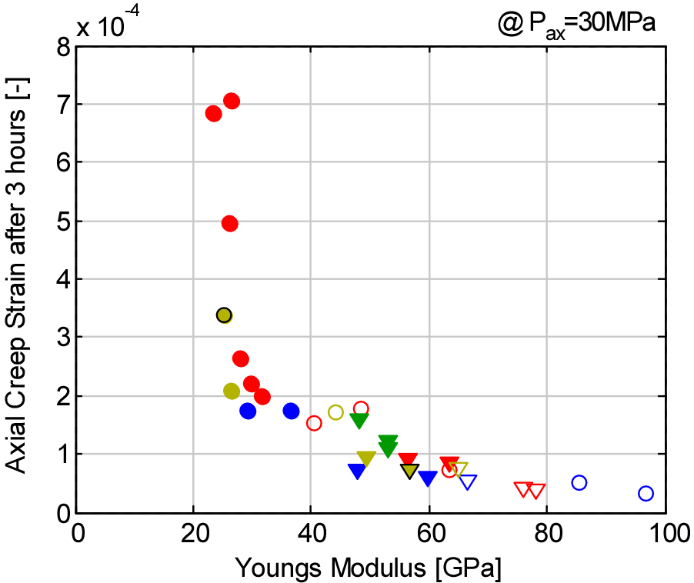
Creep Strain vs. Clay and E
Amount of creep (ductility) depends on clay content
Young’s modulus correlates with creep amount very well

Slide 51
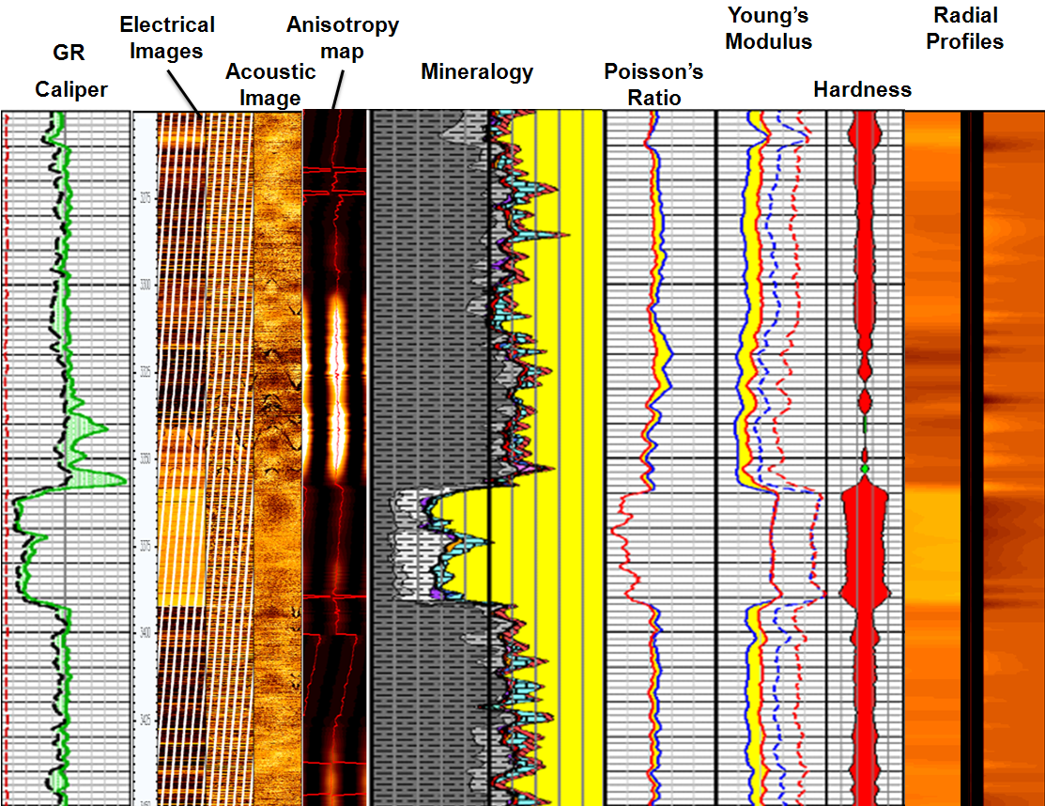
Mechanical Properties Shale/Sand

Slide 52
5 5 Wells – 50 Stages
How Do They Affect Each Other?

Slide 53
Fracturing and Monitoring Program
Stages in Well A and Well B are fractured at the same time, thus “simulfrac”
Stage in Well D and Well E are alternately fractured, thus “zipperfrac”
Well C is fractured conventionally
Fracturing of Wells A, B, D, & E are monitored by an array in Well C
Fracturing of Well C is monitored by an array in the vertical portion of Well B
Wells divided into 300 ft frac intervals
6 perf groups per interval, each 50 feet apart
Notes:
53

Slide 54
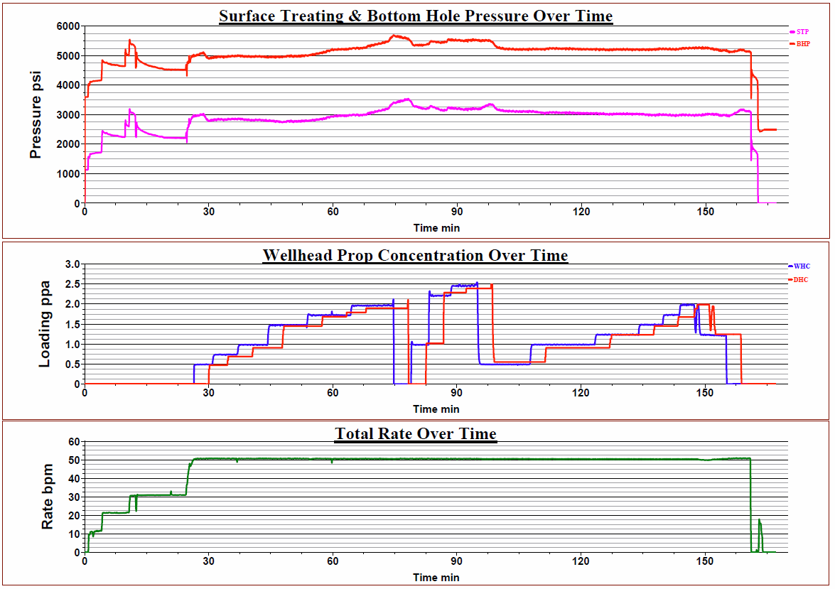
Nearly All Frac Stages Were Alike
Water: ~325,000 gal, Sand: ~400,000 lbs, Pumping Time: ~150 mins, Max Slurry Rate: 50-60 bpm
Well C
Stage 6
Notes:
54

Slide 55
How Does Stress Evolve with Stages?
Well C Stage 1
Pump Rate (bpm)
BHP (psi)
ISIP = 3700-3800 psi
Time (min)
Use instantaneous shut-in pressure (ISIP) to estimate trends in least principal stress (S3) at end of each stage
Precision is ± ~50 psi due to water hammer effect when pump is turned off
Notes:
55

Slide 56
ISIP’s Escalate From Toe To Heel – Well C
Cumulative increase in ISIPs from the toe to the heel of the well
900 psi difference between Stage 1 and peak at Stage 9
Decline seen in last two stages
Notes:
56

Slide 57
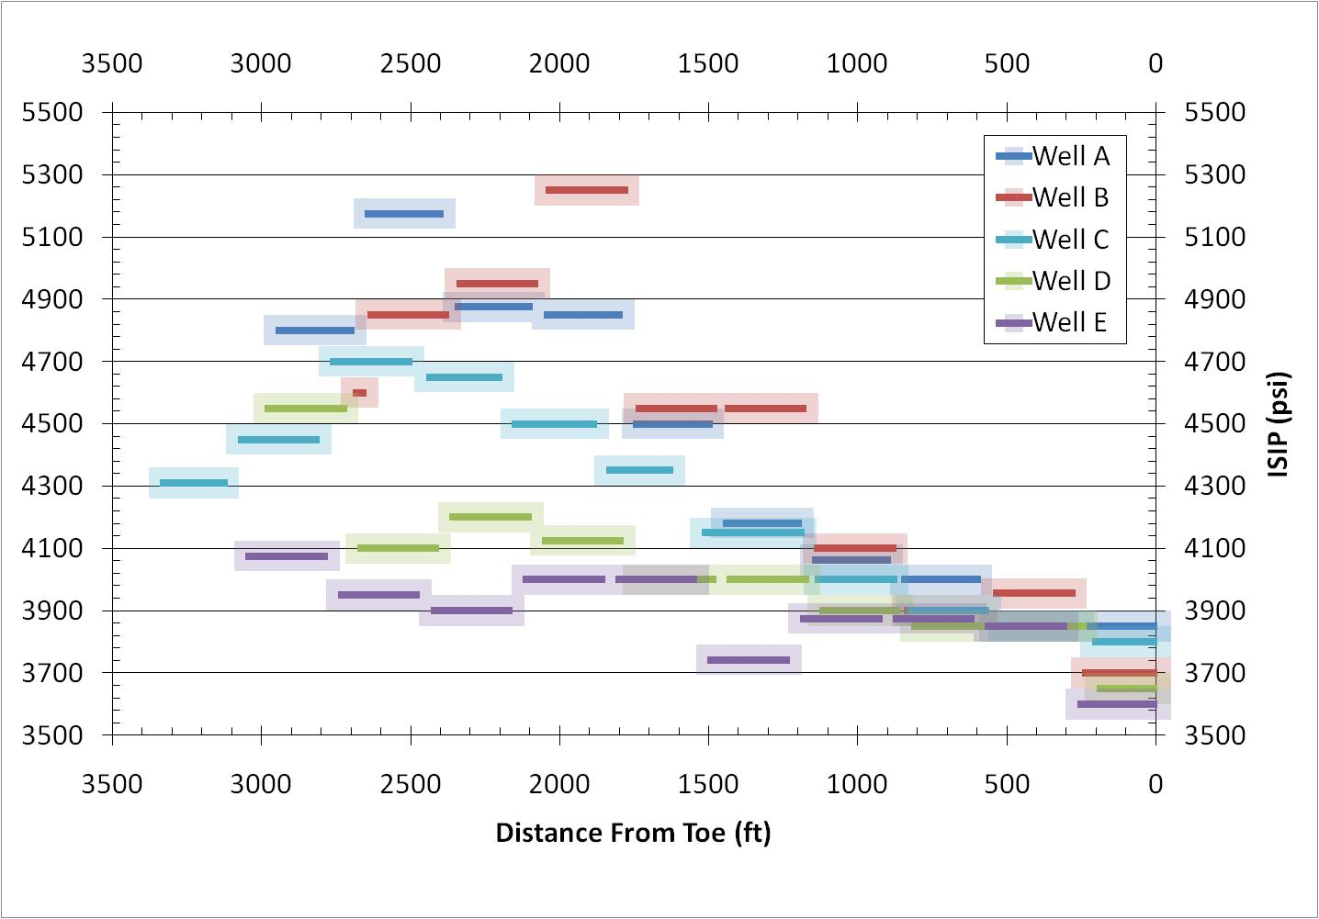
All Wells, All Stages
Fracturing Wells D & E (Zipperfrac) took twice as long as fracturing of Wells A & B (Simulfrac)
Are poroelastic effects important?
Notes:
57

Slide 58
Simple Sequential Crack Model
Fracture Height: 300 ft
Fracture Separation: 300 ft
Fracture Length: 1000 ft (modeled as infinite)
Net Pressure: 750 psi
Equivalent to crack opening of ~2 cm, from net pumping pressure or emplaced proppant
300 ft
z
Side View
300 ft
x
Notes:
58

Slide 59
Stress Increase From a Single Crack
Stress increase decays quickly from the crack face
Notes:
59

Slide 60
All Wells, All Stages
Simulfrac
Zipperfrac
Fracturing Wells D & E (Zipperfrac) took twice as long as fracturing of Wells A & B (Simulfrac)
Are poroelastic effects important?
Notes:
60

Slide 61
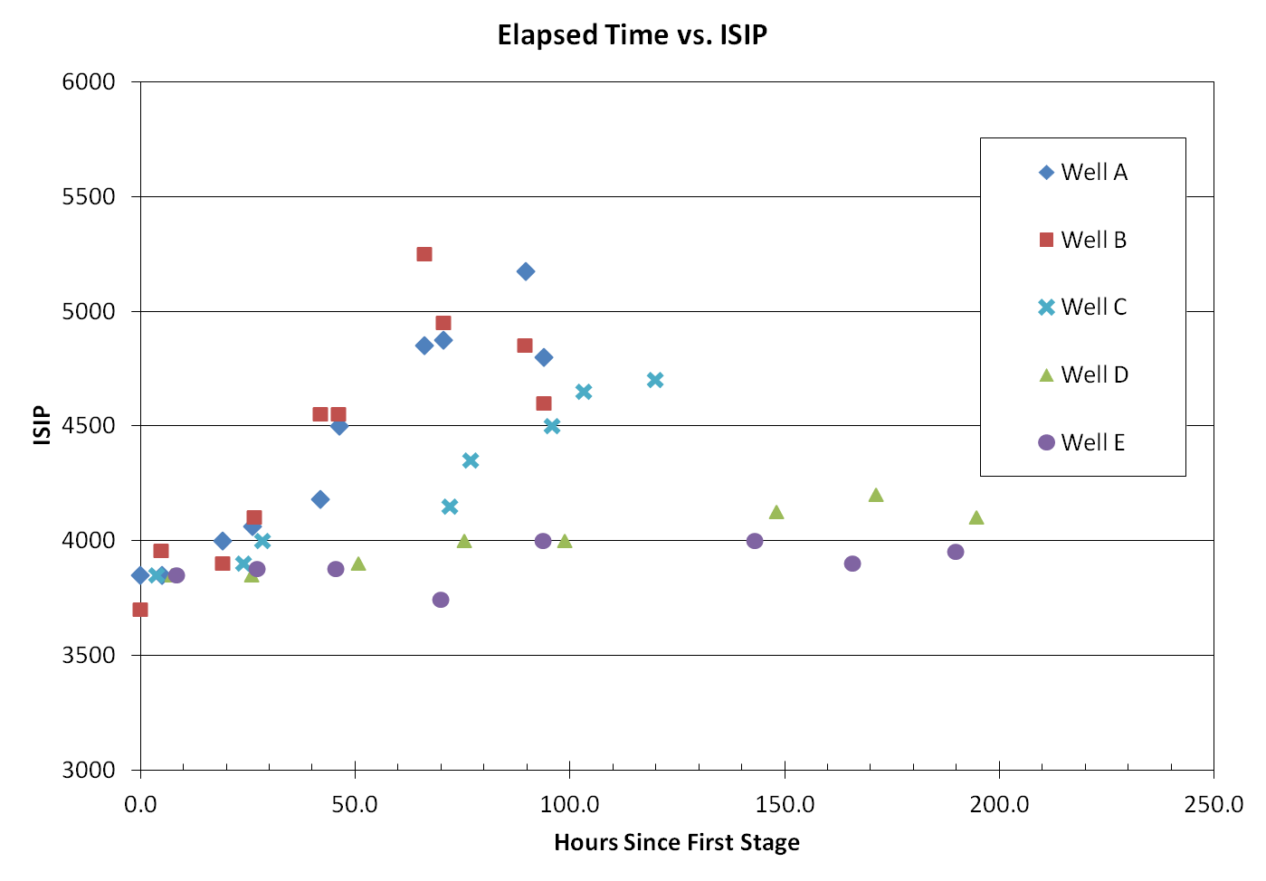
Changes in ISIP With Time Intervals
Last Stages
Simulfrac ~ 100 hours
Last Stages
Zipperfrac ~ 200 hours

Slide 62
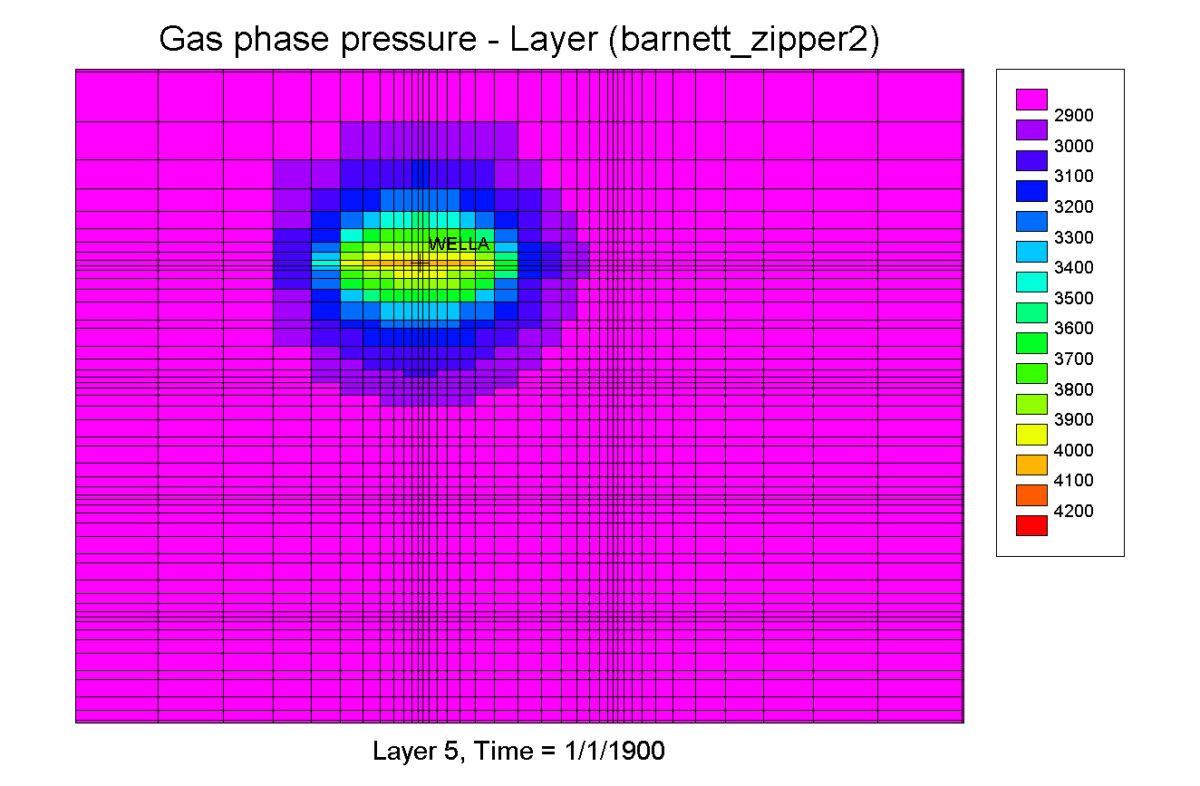
Modeling Poroelastic Effect
Well E
Well E
Well D
X
Well D
X
X
X
X
X
X
X

Slide 63
Poroelastic Model of Zipperfrac
Notes:
63

Slide 64
Coffee Break
Notes:
64

Slide 65
Well completion
Optimize Completion Design
Completion Types, Equipment, Multilaterals

Slide 66
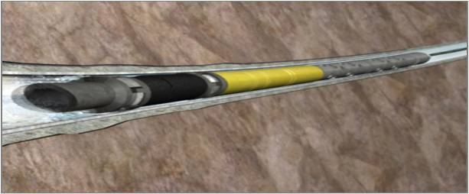
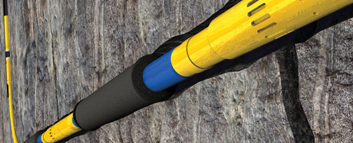
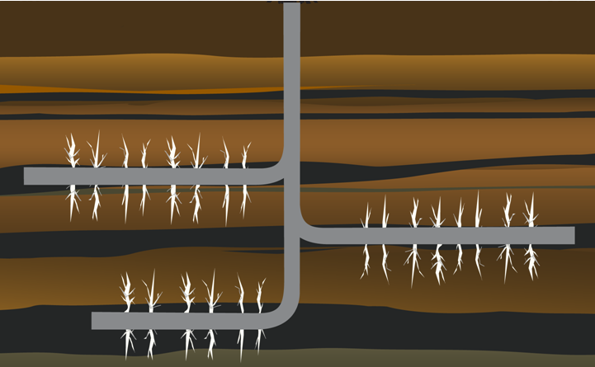
Typical Completion Options in Shale Gas - For Hydraulic Fracturing the Well
Cemented Liner
Plug-N-Perf Method
New, BHI OptiPort™
Openhole Completion System
Packer and Frac Sleeve
(BHI FracPoint™)
Multilateral Well Technology (New in Shale some in Tight Gas)
29

Slide 67
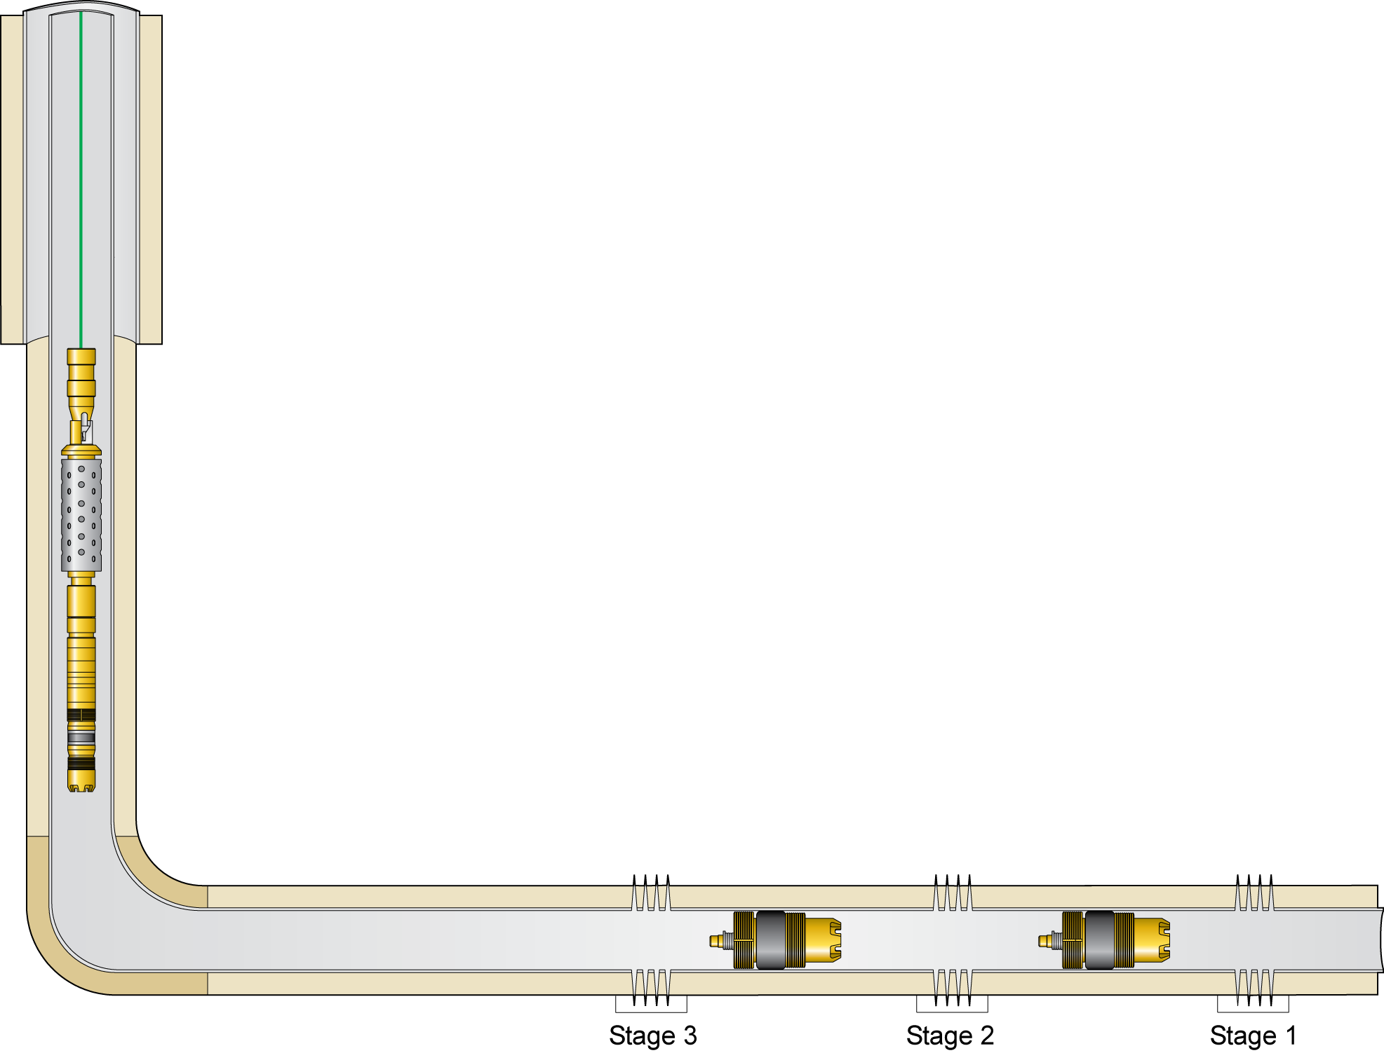



Plug-N-Perf Method (Cased Hole)
Cemented Casing liner or full string
For Fracturing and Producing Multiple zones
Composite Plugs to isolate Frac Stages
Stage Process: 1. Perf, 2. Frac, 3. Set Plug 4. Repeat
Drill out all plugs, then Flow back well
Perf Guns
E-4 Setting Tool
Composite Plug
67
Notes:
Main Points:
Plug & Perf are CASED HOLE completion only; Frac Point is the OPEN HOLE option
Plug & Perf has NO LIMIT on number of stages; Frac Point is limited to 24 stages, with ongoing project to get to 40 stages
Baker composite plugs were redesigned in 2005 specifically for horizontal pump downs; its impossible to pre-set the plug due to pump down; we’ll elaborate on the design later in the presentation

Slide 68




BHI QUIK Drill™ Composite Plugs
BRIDGE PLUG | FRAC PLUG
A solid plug that seals pressure from above and below the tool | A plug containing a one-way check valve that seals pressure from above the tool, but allows flow through the tool from below
Top-Venting Bridge Plug | Ball Type | Poppet Type
Most Plugs run are Ball Type
Poppet Type run if testing of plug required after setting
Wireline deployed, Horiz pumped
Pressures = 5,000 to 12,500 psi
Temperature = 200 to 450 °F
Composite Material
- Chopped Fiber Reinforced w/ Phenolic
- Woven Fibers Reinforced w/ Resin
Cast Iron Slips easy to drill
Drill Out Time = 10-30 min with mill or bit
Plug-Lift™ drill out fluid
Since 2008 over 85,000 Plugs have been run with >99.0% Success Rate
68
Notes:
Most plugs run are the Ball Type Frac Plug. Customers who require testing the plug after setting run Poppet Type Plug. Disadvantage of Poppet Type is that if the guns misfire you can not pump a second set of guns down.

Slide 69
FracPoint™ Openhole Completion System

Slide 70




FracPoint™ Completion System
One-trip system – Up to 40 stages
Continuous Multi-zone Frac (Only “slow” pump rate to drop ball)
Drop a Ball To:
- Shift sleeve
- Isolate previous Frac
- Open new zone
Versatile system
- Eliminates perforating & liner cementing
- Primary and Re-fracturing applications
- Significantly Reduced Time vs Plug-N-Perf
Ball with Frac Sleeve Open
Varying Ball Sizes
Frac Sleeve in Closed Position
450+ Installations in Shale Gas & Bakken (oil)
33
Notes:
Per Stage FracPoint takes average of 38% less time than Plug-N-Perf.

Slide 71


Re-Frac Application: Edwards Lime (South Texas)
Case History
November 2008
Reamed open hole horizontal
Installed a 4-stage multi-zone fracture completion system size: 435-281
Results:
>3X production increase
5-1/2” OD
20 #/ft. Casing
TD = 17,011’
3-1/2” OD
9.3 #/ft. Liner
4-5/8” ID
Open Hole
Notes:
Case History: Open Hole Re-Frac Application – Edwards Lime (Lavaca County, South TX)
November 2008
The well was re-entered. The open hole horizontal reamed and stimulated with a multi-stage fracture treatment. As a result, production from this well increased 400% from 0.5 MMcf/d to 2.5 MMcf/d.

Slide 72

FracPoint™ w/ Integral Real-Time Monitoring
Case History – Bakken/Tree Forks, ND
Deployment Date: May 2010
FracPoint w/ monitoring capabilities
10-stages across a 10,000 ft lateral
Distributed Temperature Sensor (DTS) fiber optic line
5 Pressure/Temperature (PT) gages, placed every other stage
Custom REPackers and Frac Sleeves w/ feed-through capabilities
Still in Operation with only 2/3 of fiber Line intact

Slide 73

FracPoint w/ Fiber Optic Monitoring
Case History – Bakken/Three Forks, ND
Project Details:
Date : May 11, 2010
Type: Oil Producer Lateral Length: 10,000 ft
Lateral Casing: 4-1/2”
Main Bore Casing: 5”
Number of Stages: 10 Stage FracPoint System
Gauges: (5) SurSens “150” pressure and temperature
Fiber Optic: (1) DTS (Distributed Temperature Sensor)
Clamps: Cannon special low profile clamps O/S Tbg.
Special Feed Through Sleeves and RE Packers
Status:
− FO cable severed; data fr 2/3 Well
Baker TEC Line
Baker Fiber Line

Slide 74

IN-Tallic™ Disintegrating Frac Balls
Controlled Electrolytic Metallic (CEM) Technology
Test Parameters: 150 deg F, 3% KCL
3.500-in.
2.877-in.
1.520-in.
Test Begins w/
Ball on Seat
22 hrs
80 hrs
~110 hrs
~250 hrs
Ball Unseated

Slide 75
FracPoint™ Installations
Installations in the US, Canada, China, Mexico, and Middle East
Notes:
China:
Dolomite and Sandstone
Average of 5-stages per well

Slide 76

Cemented Long String System
9th-Stage Ball
Surface Casing
5-1/2” Casing to Surface
Cemented Hole
Openhole
Hydraulic-Set Short-Radius Openhole Packers
FS
Base Pipe
Stage Tool
Debris Sub
X-Over
Ball-Activated Frac Sleeve
P-Sleeve
WIV

Slide 77
Selecting Type of Completion
Plug-N-Perf - preferred Completion in Shale Gas
Frac Sleeve & Packers – preferred Completion in Shale Oil
Some Studies find no appreciable effect on IP’s with either Type of Completion
Comparison of Plug-N-Perf vs Frac Sleeve & Packers to follow…

Slide 78
Plug-N-Perf (Cased Hole) -
Disadvantages
Longer Time to Frac – higher cost
Shut down Frac and run plugs between stages
Perfs through Csg & Cement creates complexity
Perforation types, number, diameter, locations, phasing impact fracture initiation
Trip/Time to drillout plugs
Advantages
Can run more stages and multiple perforations
Control on fracture placement
CT/WL conveyed plugs or sand plugs

Slide 79
Frac Sleeve and Packer System* (Open Hole) -
Advantages
Continuous Frac (slow down to drop balls/darts)
Shorter Time/Cost – No run liner/Csg, cement, perf
One trip installation
Swellable or mech. Packers
Can be run in Csg Hole for Re-Frac’s
Version can reclose – for Re-Frac
Disadvantages
Less control on fracture placement
Frac sleeve – no perf selection
Currrent limit – 40 stages (due to dropping balls/darts to shift sleeves & isolate stages)
Requires competent formation
Subject to Screen Outs
Hole condition affects packer setting (need competent form)
Restricted ID (can Drill out seats for full ID)
* Baker FracPoint, Packers Plus HZ StackFrac, Weatherford ZoneSelect, Number of others

Slide 80

Hydraulic Fracturing Process
Pump Pad
- Causes rock to fracture
- Creates fractures to accept Proppant
Pump Slurry
Proppant (size-graded particles, spherical white sand / man-made) mixed into fluid Slurry; pumped in to prop open created fractures
Flush
Clean fluid to clear surface lines & well tubulars of proppant; then pumps shut down
Bleed Off well pressure to allow fractures to close on proppant
Recover injected fluid by flowing/lifting well (typically recover <30% of frac fluid)
80
© 2009 Baker Hughes Incorporated. All Rights Reserved.

Slide 81
Location Schematic – Proppant Fracturing
Treatment
Monitoring
Frac Pumps
Blender
Hydration Unit
Fluid Tanks
Frac Pumps
Annulus Pump
Proppant
Low Pressure Lines
High Pressure Lines
Control/Data Cables
81
© 2011 Baker Hughes Incorporated. All Rights Reserved.

Slide 82
Typical Fracturing Location
Fluid Tanks
Hydration Unit
Blender
Proppant
Frac Pumps
Frac Pumps
High Pressure Lines

Slide 83
Functions of Fracturing Fluid
Initiate and Propagate Fracture
Easy to Handle at Surface (Batch or Continuous)
Viscosity
Transport Proppant to Well
Carry Proppant into Fracture
Support Proppant in Fracture
Minimize Leakoff
Other requirements
Cost effective
Environmentally acceptable
Low friction pressure
Controlled break
Non-damaging
Compatible with various quality mix waters

Slide 84
Fracturing Fluid = Base Fluid + Additives + Proppant
Typical slickwater for shale frac
Friction Reducer, 1.0 gpt
Biocide, Magnacide, 0.05 gpt
Clay Control, 1 gpt
Surfactant, 1 gpt
Proppant, Sand, 0.5 lb/gal
Water = 94.1%
Proppant = 5.6%
Chemical Additives = 0.3%
Chemicals
Water
Proppant
Notes:
84

Slide 85

Function of Fracturing Proppants
Keep the fracture Propped Open throughout the created fracture area
Across the length and height of the interval
Provide sufficient conductivity contrast to accelerate flow to the wellbore
Provide permeable pathway
Maintain fracture width
Act as a diverting agent to
aid development of complex
fracturing
Notes:
85

Slide 86

Barnett Shale – Vertical, Deviated, Horizontal
Small energized fracs
Crosslinked massive hyd. fracs
First horizontal well
μ−seismic
Slickwater
Barnett Shale Production Time Line - Evolution
86
© 2011 Baker Hughes Incorporated. All Rights Reserved.
Notes:
86

Slide 87
Design Criteria - 1
Completion Design
Cased or Open Hole (4 ½” and 5 ½” are common)
- Horizontal = 3000 to 5000 ft or more
Well Orientation, Well Spacing and Fracture Spacing
Ensure transverse fractures, economics. Avg frac stages spacing 250-350 ft. Thicker shales may require fewer stages with high injection rate, Thinner shales require smaller volume frac stages to avoid zone break outs.
Distance between frac stages = 1-1.5 x Zone Height

Slide 88
Design Criteria - 2
Perforations - 60 degree phasing, 4-6 shot/ft, 0.4” hole size, gun length less than 4 wellbore diameter (Kettler, 2008, Reigle 2007, Ceccarelli 2010)
Cluster spacing - 35-75 ft or more (1 ft spacing will have 4,000 psi stress, which will stop the second fracture initiation. 25 ft spacing in high modulus rock would exert up to 800 psi stress difference on starting fracture, low modulus – 170 psi, Walters, 2009)
Selecting Fracture Initiation Point
- Gas composition mud logging, rate of penetration of drilling, acoustic logs, cuttings mineralogy, etc

Slide 89
Design Criteria - 3
Fluid selection depends on the application
Slick water, foam, hybrid, x-linked
Slick water is the most common.
Proppant
100 mesh, 40/70, 30/50, 20/40
Concentrations – 0.25 ppg up to 3 ppg (100 mesh) and up to 2 ppg for 30/50 mesh with 0.25 ppg increase steps. Varies with application

Slide 90
Design Criteria - 4
Size of the frac stages depends on the application
Formation thickness, amount of natural fractures, presence of barriers, etc
Common range 8,000 – 15,000 bbls slurry and 80,000 – 300,000 lbs proppant per stage
Rate
Common practice – 20 bpm per cluster. Real diversion begins at 1 bpm/perf, As per Conway (2008) the most effective diversion happens in the range of 2.0 -2.5 bpm/perf
Breakdown fluid
10-15% HCL may be considered in shales with calcite cementation

Slide 91

Shale Frac Rules of Thumb
Horizontal = 3000 to 5000ft
Distance between frac stages = 1 to 1.5 x zone height (250 – 350ft)
Distance between perf clusters = 35 to 50+ ft
Length of perf cluster = 4 x well diameter (about 1 to 2 ft)
# of perf clusters in each stage is 4 to 8 (roughly 1.5 bpm/perf 10-15 bpm per cluster
# stages – depends on lateral length, normal 4 to 20+
Slickwater / Linear Gel / Hybrid / Cross-linked
Type of Fracture Treatment greatly dependent on type of production - Gas (wet vs. dry), Oil, and/or Water
Contact within Formation

Slide 92
Major Shale Plays - Typical Treatment Parameters
 |  |  | Bakken | Barnett | Eagle Ford | Haynesville | Marcellus
Avg MD ft |  |  | 17,535 | 10,873 | 14,643 | 16,566 | 10,722
Avg TVD ft |  |  | 10,207 | 7,331 | 9,392 | 11,941 | 6,937
Horz Perfed ft |  |  | 7,401 | 2,788 | 4,311 | 4,355 | 3,331
Avg ft per stg |  |  | 550 | 450 | 270 | 325 | 275
Avg BHP psi |  |  | 5,310 | 4,213 | 7,550 | 10,870 | 7,650
Avg rate BPM |  |  | 24.8 | 73.3 | 81.6 | 71.2 | 83.5
Avg Num Stgs |  |  | 13 | 6 | 16 | 13.3 | 12
Avg # Stg/day |  |  | 3.4 | 1.9 | 2.6 | 1.9 | 1.5
Amt Prop / Stg lb |  |  | 160,300 | 286,000 | 292,600 | 357,800 | 399,500
Amt Prop / Well lb |  |  | 1,998,000 | 1,515,000 | 4,304,000 | 4,675,500 | 4,425,600
Jan 2010 to March 31 2011
© 2011 Baker Hughes Incorporated. All Rights Reserved.

Slide 93

Fracture Treatment Monitoring Methods
Conventional Temperature and Tracer Surveys
- Data near well-bore vicinity
- Fluids & proppants ‘traced’
Distributed Temperature Sensing (DTS)
- Fiber Optic
Production Logging
- Spinner surveys
- Flow & Temperature
Microseismic Monitoring
- During fracture treatment / Near real-time
- Managing treatment and post-treatment analysis
- Currently most frequently used/effective Monitoring Method

Slide 94


Monitoring Fracturing With Microseismic
Operator wants to see
The Fracture stimulation (in real time)
Relative to the Borehole
Combined with other information such as Structure

Slide 95



Microseismic Monitoring & Mapping
Real-time microseismic monitoring is useful for in-job decisions:
Alert to approaching hazards Faults, Karsts, Wet Zones
Confirm diversion efficiency
Microseismic fracture mapping may provide information about the created fractures:
Geometry & azimuth
Fracture density
Stimulated reservoir volume
Reservoir stress orientation
Information is most useful for optimization of subsequent treatments

Slide 96

Comments from Around the Oil Field
Some 30-40% of Frac Stages do not contribute production
SRV is a misused term that is really not a volume of connected fractures
Most shale wells use Geometric Frac Stage Spacing as the Lateral is not Logged/Charcterized (Stage = every +/-300’ with Perf Clusters every 50-75’ within)

Slide 97



Slide 98
What Happens in the Reservoir During
Slick-Water Fracturing?
Microseismic Events
Horizontal Drilling and Multi-Stage
Slick-Water Hydraulic Fracturing
Induces Microearthquakes (M ~ -1 to M~ -3)
To Create a Permeable Fracture Network
Well
Hydraulic Fractures

Slide 99

Coulomb Criterion – Frictional Sliding
Sliding occurs when:
Coefficient of Friction
(sliding friction)
Equation 4.39 – pg.123
Coulomb Failure Function:
CFF = τ - μ σ_{n}
(S_{o} ∼ 0)
Equation 4.40 – pg.124
Effective Normal Stress:
σ_{n} = S_{n} -P_{p}

Slide 100


Triggered Seismicity
Waste Injection
Denver Arsenal
Fluid Injection
Rangely Oil Field

Slide 101

Maximum Friction for a Variety of Rock Types
Shale Friction
0.4 ≤ μ ≤ 0.6

Slide 102

Frictional Faulting Theory
Friction defines both limiting stress magnitudes and orientation of faults likely to slip
μ

Slide 103

In Situ Stress Measurements Confirm
Lab Friction Experiments

Slide 104

State of Crustal Stress in Frictional Equilibrium
Maximum stress difference is controlled by:
Frictional Strength of ‘well oriented’ pre-existing faults
Maximum differential stress in-situ cannot exceed fault strength

Slide 105
Faulting in Frictional Equilibrium
Frictional Faulting Theory:
Reverse Faulting:
Normal Faulting:
Strike-Slip Faulting:
Equation 4.43 – pg.132
Equation 4.47 – pg.133
Equation 4.45 – pg.133
Equation 4.46 – pg.133

Slide 106

Stress Magnitudes at Depth as Constrained by Frictional Strength of the Crust

Slide 107

Pre-existing Fractures and Faults in the Earth

Slide 108
Flow Through a Single Fracture (Parallel Plate Approximation)
Q = Volumetric flow rate
= Fluid viscosity
∇P = Pressure gradient
b ≡ separation of plates

Slide 109

Fluid Flow Through an Elliptical Fracture
But, there is a problem!

Slide 110
Fluid Flow Through an Elliptical Fracture
if (P_{f}-S₃) ~ 0.2 MPa
and E ~40 GPa, ν=0.25
b_{max} ~ 0.01 mm

Slide 111
Fluid Flow Through an Elliptical Fracture
if (P_{f}-S₃) ~ 0.2 MPa
and E ~40 GPa, ν=0.25
b_{max} ~ 0.01 mm
This is why hydraulic fractures need to be propped and why opening mode fractures are not permeable

Slide 112

From a Joint to a Fault
Faulting is key to increasing the permeability of a formation

Slide 113

Hydrocarbon Saturated Fault Breccia Zones From Pt. Arguello Area

Slide 114

Stress and Active Faulting

Slide 115
Characterizing Permeable Fractures and Faults in the Earth

Slide 116

Active Faults are Permeable Inactive Faults are Not

Slide 117

Identifying Active Faults with Temp Anomalies
Permeable
Fracture
Impermeable
Fracture

Slide 118



Application to KTB Borehole
Ito and Zoback (2000)

Slide 119


Hydraulically Conductive Fractures are Shear Faults Active (or Activated) in the Current Stress Field
From Barton, Zoback
and Moos (1995)
From Townend and
Zoback (2001)

Slide 120
Microearthquakes Can’t Explain Production
Volume Affected by 4000 Microearthquakes Can
Account for Less Than 1% of Gas Production in First 6 Months

