Slide 1

Opportunities and Challenges of
Shale Gas Development
Day 2
Gdansk Technical University
December 12-15, 2011
Mark D. Zoback
Professor of Geophysics
Stanford University

Slide 2

Opportunities and Challenges of
Shale Gas Development
Day 2
Gdansk Technical University
December 12-15, 2011
Mark D. Zoback
Senior Technical Advisor
Baker Hughes Incorporated

Slide 3

Course Overview
Day 1 Opportunities and Challenges of Shale Gas Development
Characterization and Physical Properties of Organic Rich Shales
Day 2 Geomechanics
Wellbore Stability
Drilling Operations
Day 3 Hydraulic Fracturing and Reservoir Stimulation
Day 4 Shale Permeability, Gas Production and Reservoir Simulation
Water Management and Minimizing Environmental Impacts

Slide 4
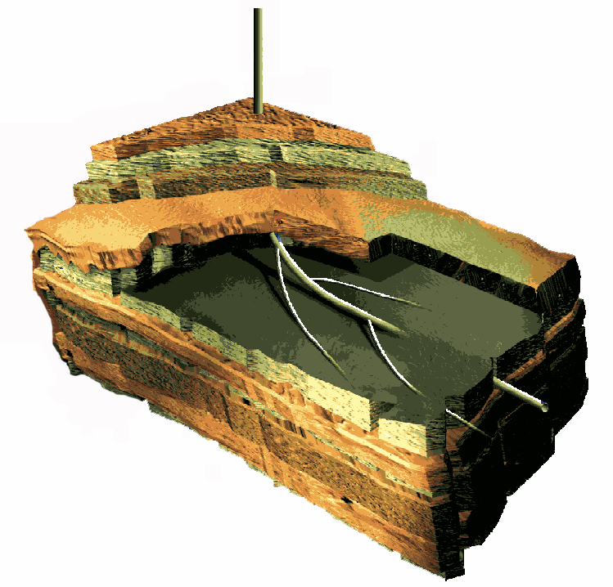
Building a Geomechanical Model
Principal Stresses at Depth
S_{v} – Overburden
S_{Hmax} – Maximum horizontal principal stress
S_{hmin} – Minimum horizontal principal stress
S_{v}
Additional Components of a
Geomechanical Model
UCS
Pp
P_{p} – Pore Pressure
UCS – Rock Strength (from logs)
Fractures and Faults (from Image Logs, Seismic, etc.)
S_{hmin}
S_{Hmax}
4
Notes:
4
The geomechanical model begins by defining the principal stress tensor.
The principal stress tensor resolves the in situ stresses into three mutually perpendicular vectors, S1, S2 and S3.
S1 is greater than or equal to S2, which is greater than or equal to S3.

Slide 5
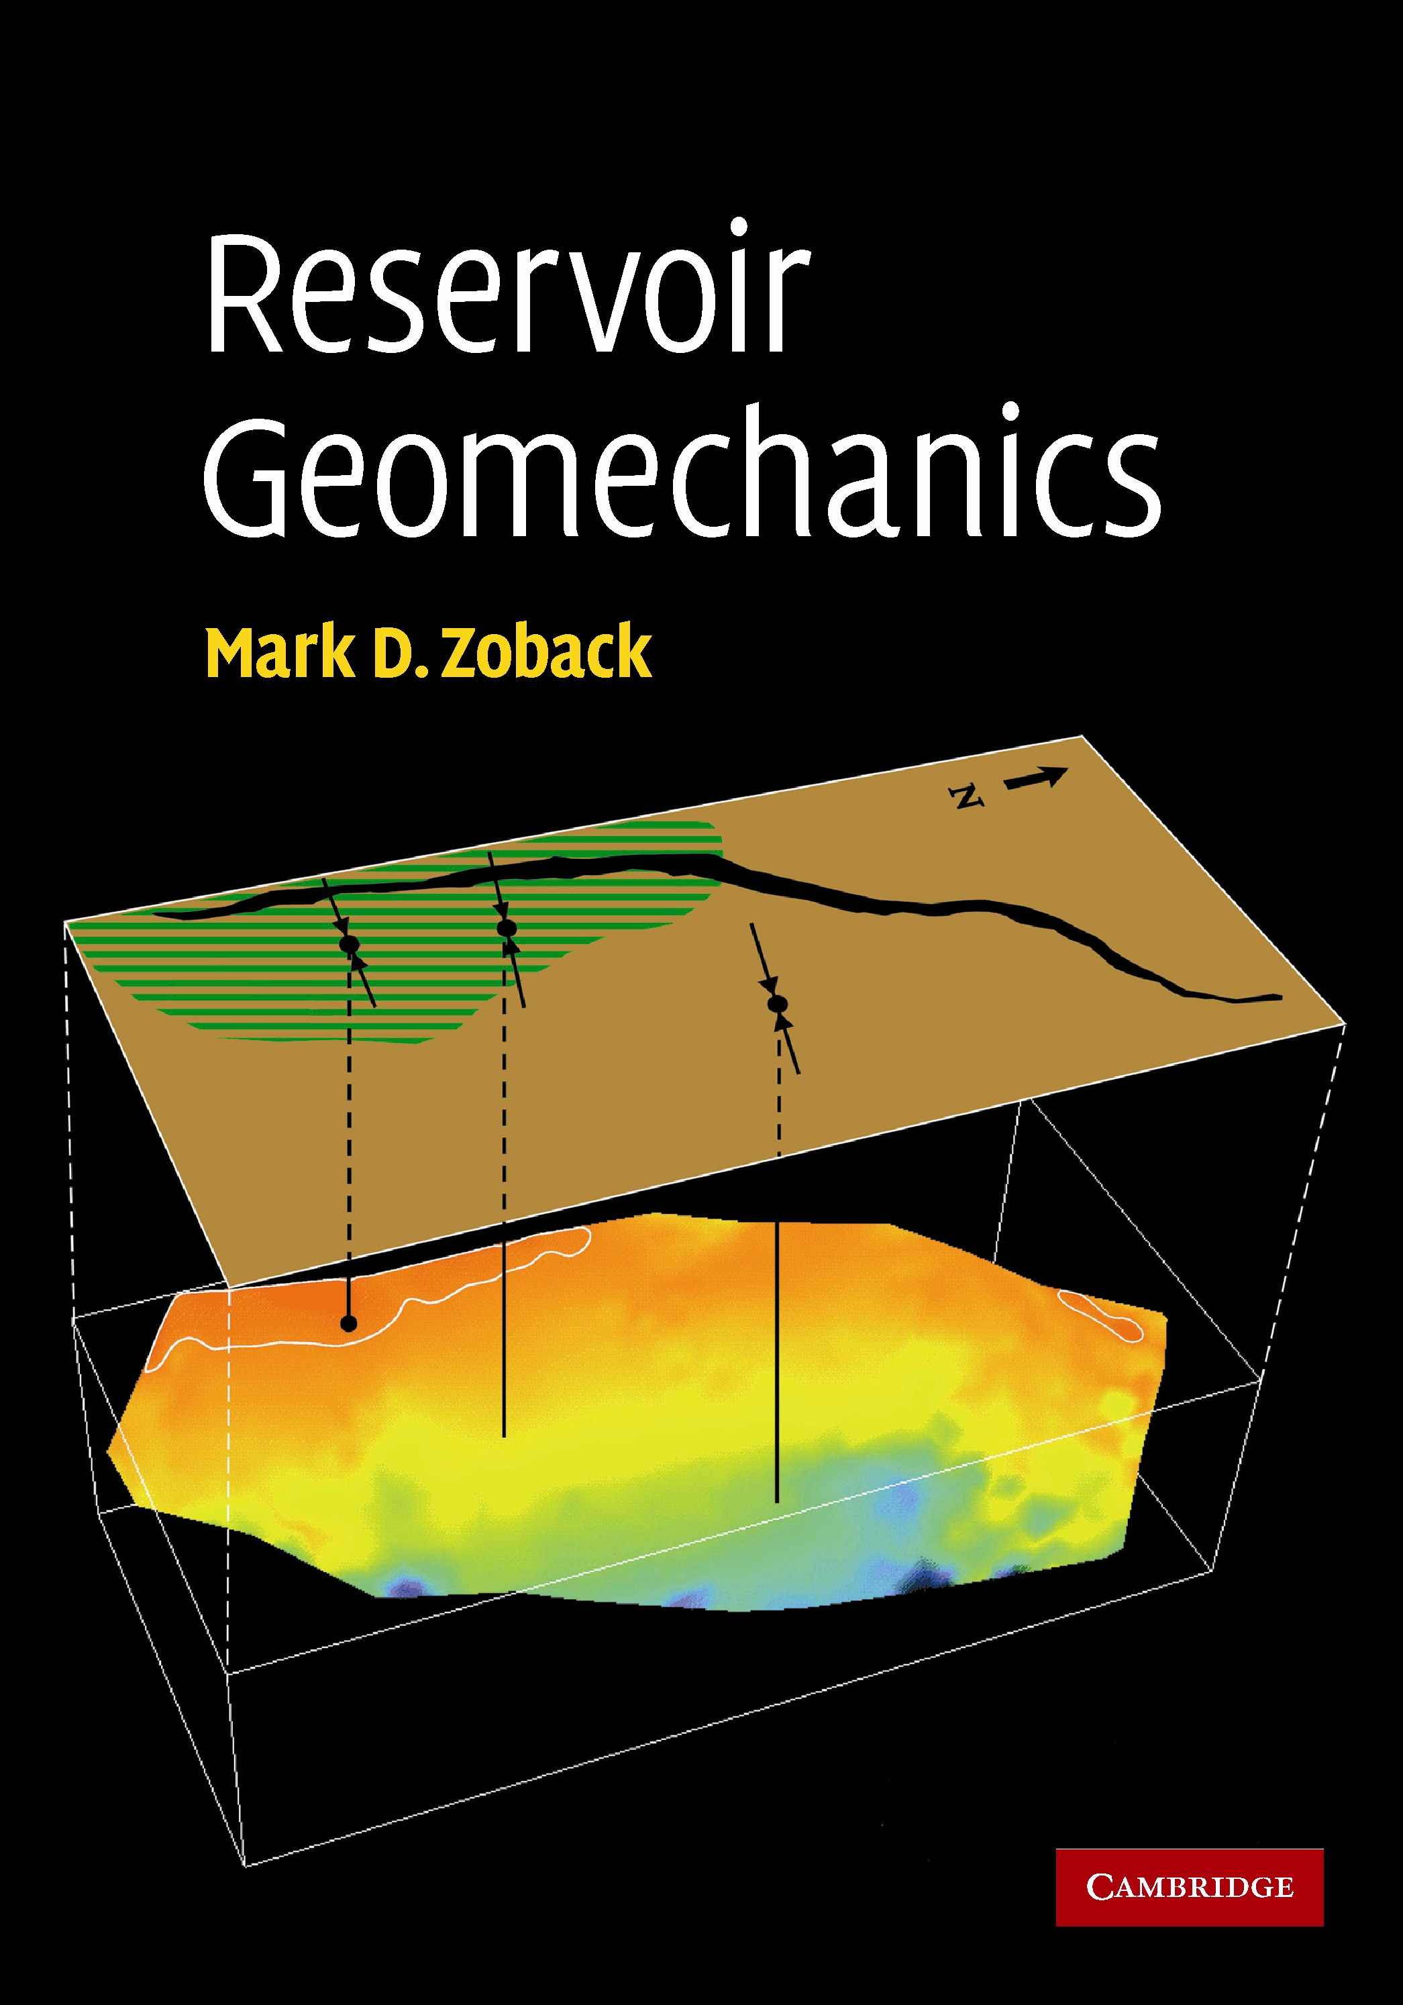

Slide 6
Stress is a Second Rank Tensor with 9 Components

Slide 7
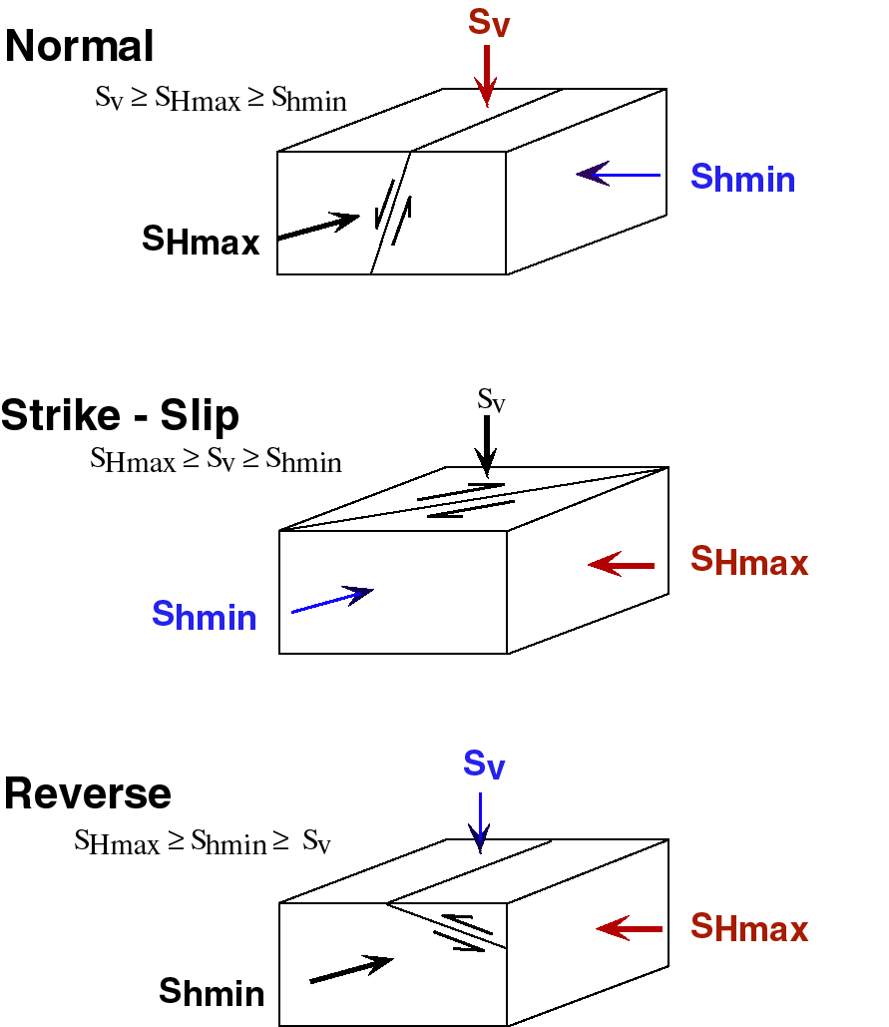
Anderson Classification of Relative Stress Magnitudes

Slide 8
Relative Stress Magnitudes and Faulting Regimes
Regime
/Stress
S
S
S
1
2
3
Normal
S
v
S
Hmax
S
hmin
Strike
-
Slip
S
Hmax
S
v
S
hmin
Reverse
S
Hmax
S
hmin
S
v

Slide 9
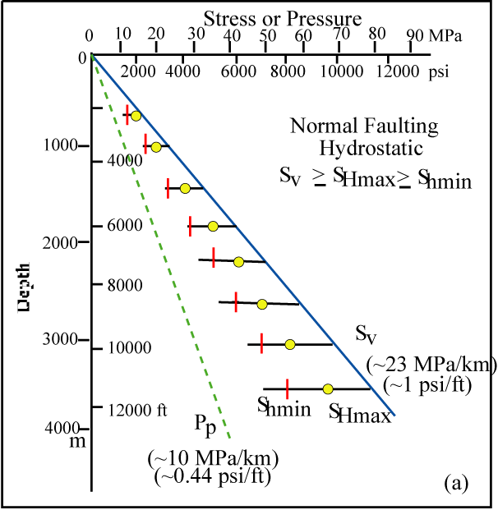
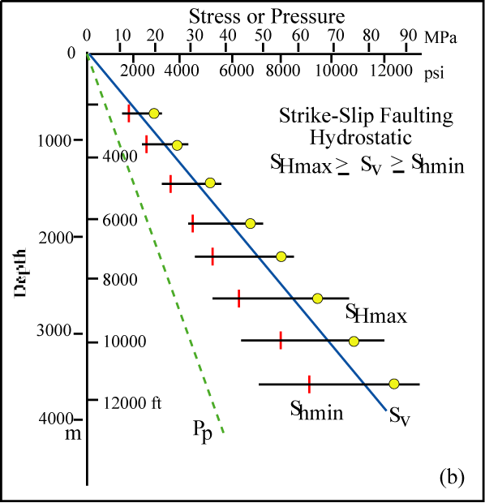
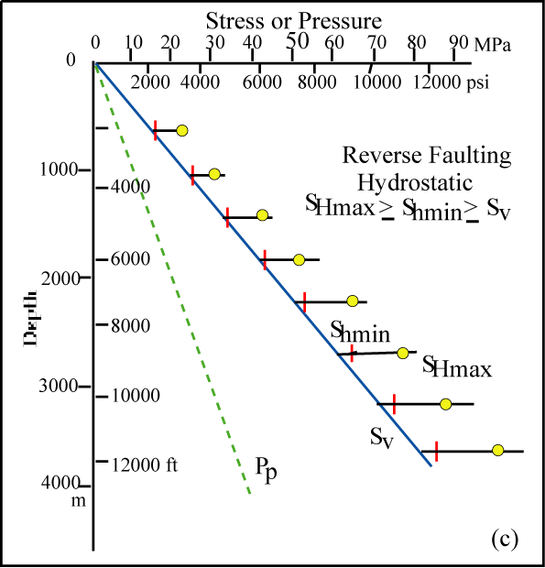
Range of Stress Magnitudes at Depth
Hydrostatic P_{p}
Notes:
Figure 1-3 (a-c) - Schematically demonstrates possible stress magnitudes for normal, strike-slip and reverse faulting environments when pore pressure is hydrostatic (a-c) and when it approaches pore pressure approaches lithostatic pressure at depth (d-f). At each depth the range of possible values of S_{hmin} and S_{Hmax} are limited by Anderson faulting theory (which defines the relative stress magnitude) and Coulomb faulting theory which determines maximum values of the differences between the maximum and minimum principal stresses in terms of the frictional strength of faulted rock at a given depth and pore pressure. Note in Fig. 1-3a, that if pore pressure is close to hydrostatic and the least principal stress is significantly below the vertical stress, an extensional, or normal faulting, regime is indicated and the maximum horizontal stress is less than or equal to the vertical stress. Alternatively, for the same pore pressure conditions, if S_{hmin} increases more rapidly with respect to S_{v} as shown in Fig. 1-3b, a more compressional strike-slip stress state may be indicated and S_{Hmax} may exceed S_{v}. When the least principal stress is equal to the overburden, a reverse faulting regime is indicated and both horizontal stresses will be greater than the vertical stress (Fig. 1-3c). As seen in (Fig. 1-3a-c), the differences between the three principal stresses can be large and can grow rapidly with depth when pore pressure is close to hydrostatic.
NOTES:

Slide 10
Horizontal Principal Stress Measurement Methods
Stress Orientation
Stress-induced wellbore breakouts (Ch. 6)
Stress-induced tensile wall fractures (Ch. 6)
Hydraulic fracture orientations (Ch. 6)
Earthquake focal plane mechanisms (Ch. 5)
Shear velocity anisotropy (Ch. 8)
Relative Stress Magnitude
Earthquake focal plane mechanisms (Ch. 5)
Absolute Stress Magnitude
Hydraulic fracturing/Leak-off tests (Ch. 7)
Modeling stress-induced wellbore breakouts (Ch. 7, 8)
Modeling stress-induced tensile wall fractures (Ch. 7, 8)
Modeling breakout rotations due to slip on faults (Ch. 7)
Table 1-2 p. 15

Slide 11
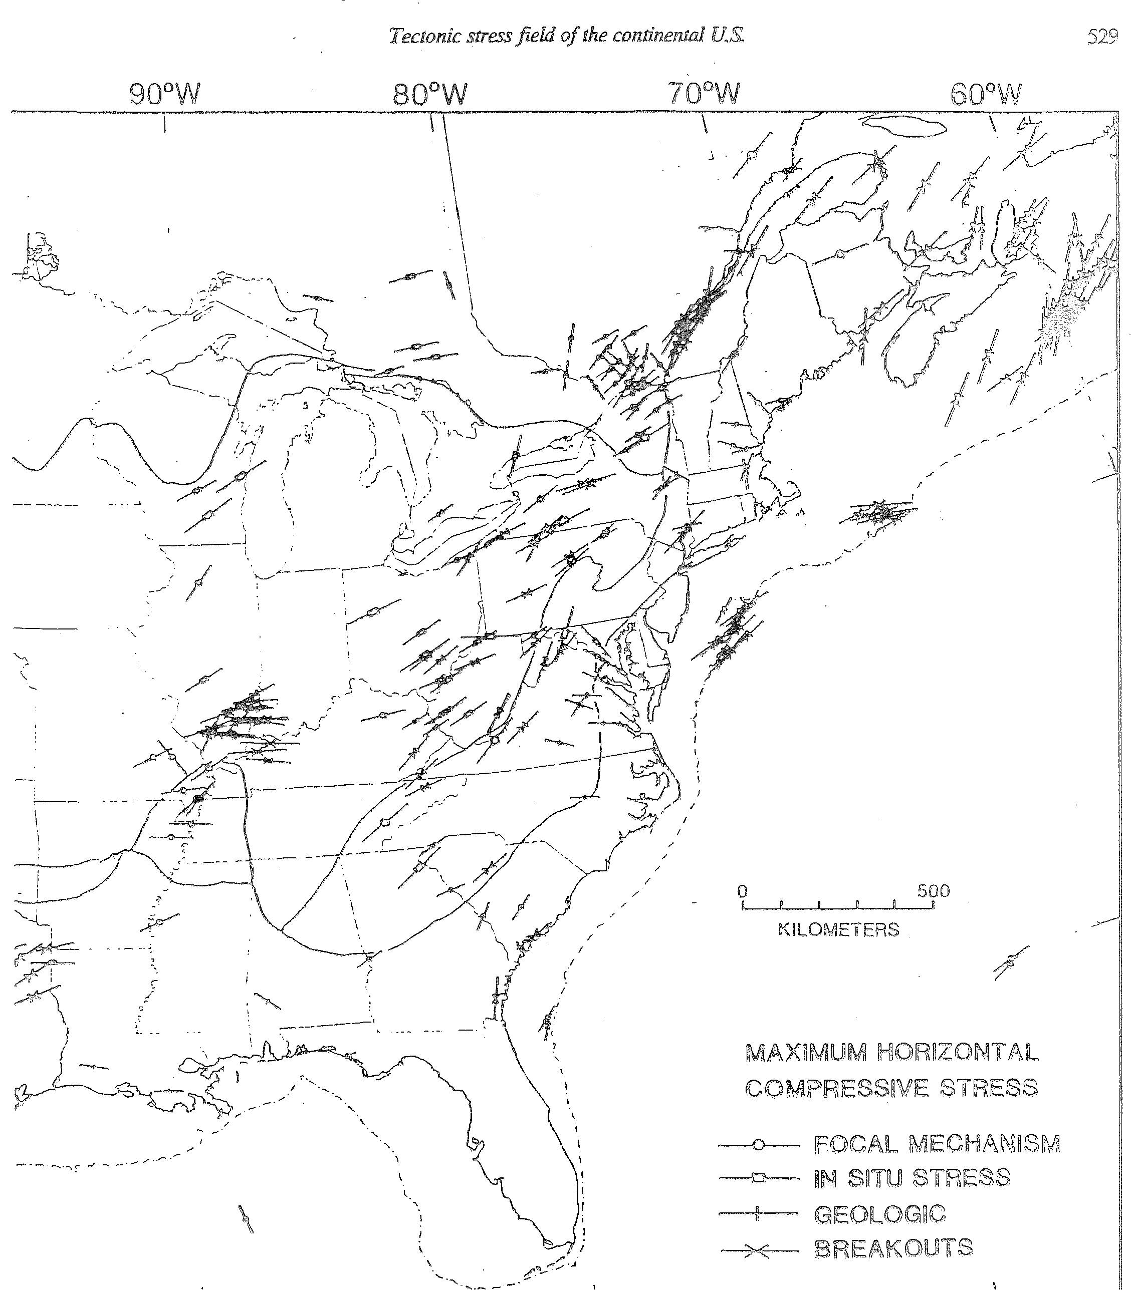
Zoback and Zoback (1980, 1989)

Slide 12
Generalized World Stress Map
M.L. Zoback (1992) and subsequent papers
Notes:
Figure 1-6 - Figure 1-6 is a generalized version of the Global Stress Map that is quite similar to that originally presented by . It delineates provinces of approximately uniform constant stress orientation and relative magnitude. In addition to stress orientations, relative stress magnitudes (stress regimes) are indicated in Fig. 5 using the following definitions: extensional stress regime (S_{v} > S_{Hmax} > S_{h}) (normal dip slip), includes categories NF and NS (rakes generally >50º); strike-slip stress regime (S_{Hmax} > S_{v} > S_{h} ) (dominant horizontal slip), SS category (rakes generally >40º); and thrust stress regime (S_{Hmax} > S_{h} > S_{v}) (reverse dip slip), includes categories TF and TS (rakes generally >50º).. Stress regime was inferred primarily from earthquake focal mechanisms and style of Quaternary faulting. Thick inward pointing arrows indicate S_{Hmax} orientations in areas of compressional (strike-slip and thrust) stress regimes. Thick outward pointing arrows give S_{hmin} orientations in areas of normal faulting regimes. Regions dominated by strike-slip tectonics are distinguished with the thick inward pointing and orthogonal, thin outward pointing arrows.
NOTES:

Slide 13
First Order Stress Patterns
In most places a uniform stress field exists throughout the upper brittle crust
    Consistent orientations from different techniques which sample very different rock volumes and depth ranges
Intraplate regions are dominated by compression
    Thrust and strike-slip stress regimes in which the maximum principal stress is horizontal
Active extensional tectonism
    Normal faulting stress regimes in which the maximum principal stress is vertical occurs in topographically high areas
Regional consistency of both stress orientations and relative magnitudes
    Broad scale regional stress provinces may be defined, many of which coincide with physiographic provinces, particularly in tectonically active regions.

Slide 14
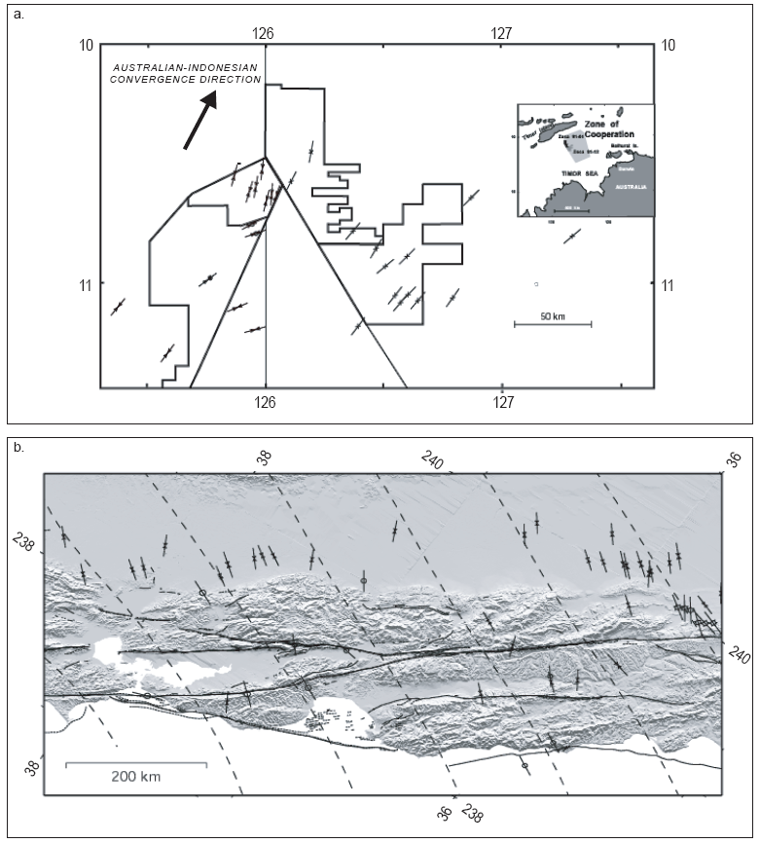
Stress in the Timor Sea and Western California

Slide 15
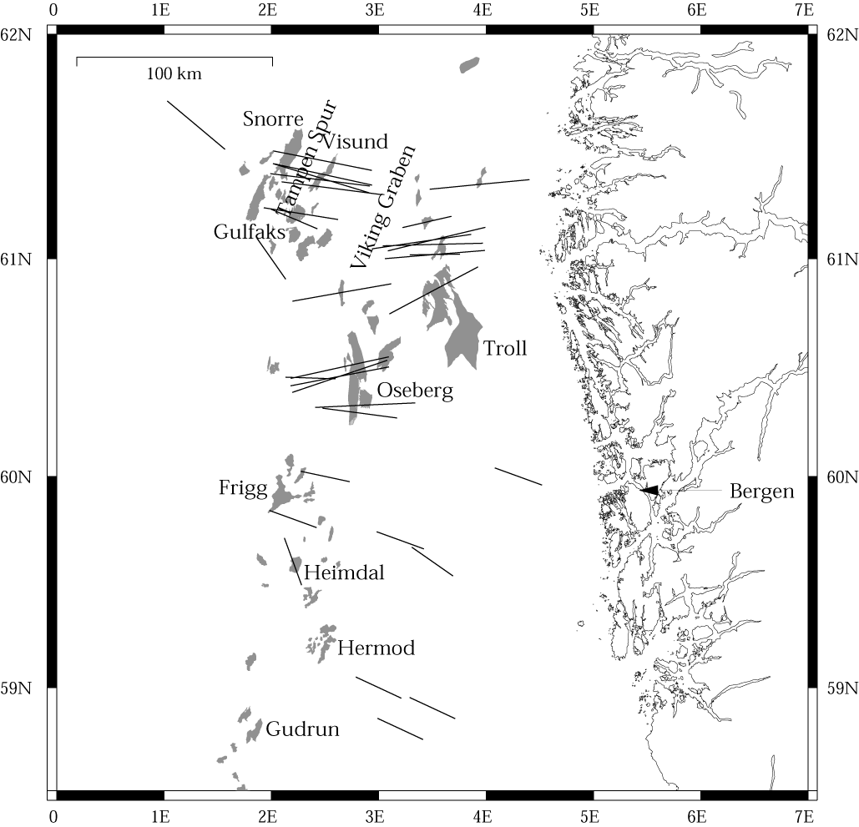
Stress Map of Northern North Sea
Notes:
Figure 1-8 - Drilling-induced tensile wall fractures reveal a consistent picture of stress orientation is also observed in the oil fields in the northern North Sea (after Wiprut).
NOTES:

Slide 16
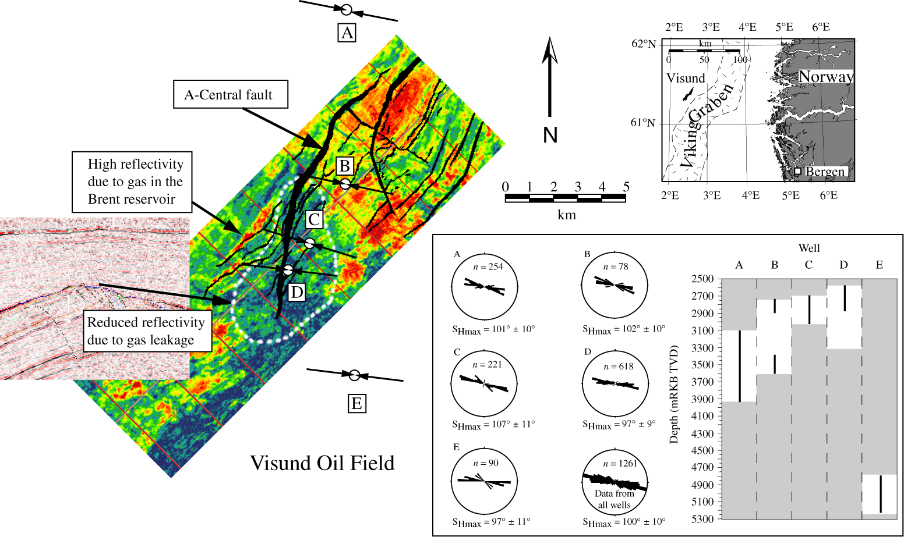
Visund Field Stress Orientations

Slide 17
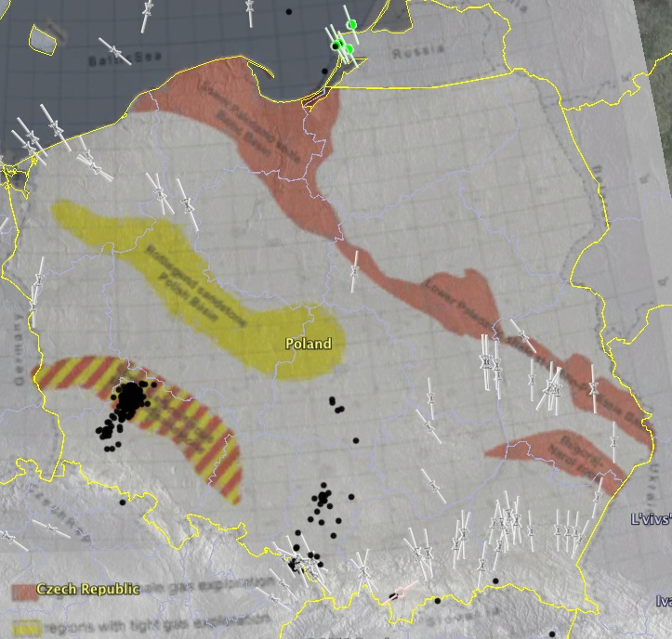
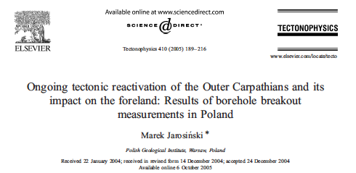
Stress Map of Poland

Slide 18
Developing a Comprehensive Geomechanical Model
Parameter
Data
z
0
S
(
z
)
=
∫
ρ
g dz
Vertical stress
v
0
Least principal stress
0
S_{hmin} ⇐ LOT, XLOT, minifrac
Max. Horizontal Stress
S_{Hmax} magnitude ⇐ modeling wellbore failures
Stress
Orientation
Orientation of Wellbore failures
Pore pressure
P_{p} ⇐ Measure, sonic, seismic
Rock Strength
Lab, Logs, Modeling well failure
Faults/Bedding Planes
Wellbore Imaging

Slide 19

Geomechanics Through the Life of a Field
Product
ion
Exploration
Appraisal
Development
Harvest
Abandonment
Wellbore Stability
Pore Pressure Prediction
Fault Seal/ Fracture Permeability
Sand Production Prediction
Compaction
Casing Shear
Subsidence
Coupled Reservoir Simulation
Fracture Stimulation/ Refrac
Depletion
Geomechanical Model
Time

Slide 20
Developing a Comprehensive Geomechanical Model
Parameter
Data
(
)
z
Vertical stress
S
z
=
∫
0
ρ
g dz
v
0
0
Least principal stress
S_{hmin} ⇐ LOT, XLOT, minifrac
Max. Horizontal Stress
S_{Hmax} magnitude ⇐ modeling wellbore failures
Stress
Orientation
Orientation of Wellbore failures
Pore pressure
P_{p} ⇐ Measure, sonic, seismic
Rock Strength
Lab, Logs, Modeling well failure
Faults/Bedding Planes
Wellbore Imaging

Slide 21
Calculating a Value for S_{v}
-
S_{v} =∫ρ(z)gdz ≈ ρgz
Correcting for water depth in offshore areas
-
S_{v} = ρ_{w}gz_{w} + ∫ρ(z)gdz ≈ ρ_{w}gz_{w +} ρg(z-z_{w})
-

Slide 22
Estimating Overburden Stress from Density

Slide 23
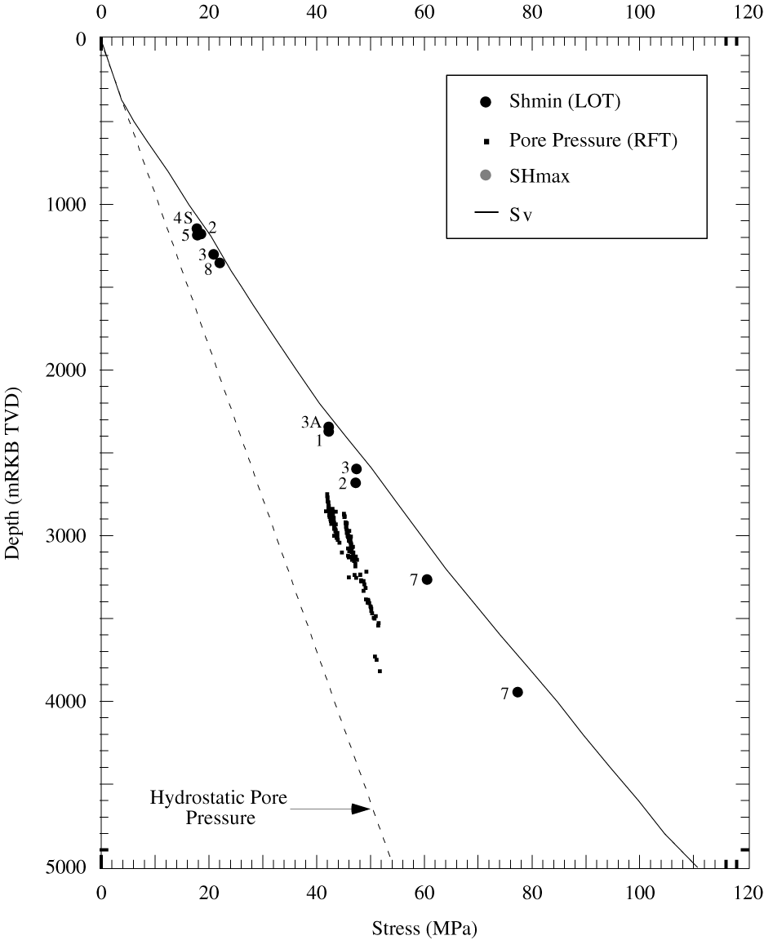
Visund Field, Northern North Sea
S₃ (as measured by
hydraulic fracturing) is
slightly less than S_{v}
Consistent with strike-slip/
reverse faulting regime.
Why do we care?
Hint: It has something to
do with hydraulic fracturing.

Slide 24
Developing a Comprehensive Geomechanical Model
Parameter
Data
z
0
S
(
z
)
=
∫
ρ
g dz
Vertical stress
v
0
Least principal stress
0
S_{hmin} ⇐ LOT, XLOT, minifrac
Max. Horizontal Stress
S_{Hmax} magnitude ⇐ modeling wellbore failures
Stress
Orientation
Orientation of Wellbore failures
Pore pressure
P_{p} ⇐ Measure, sonic, seismic
Rock Strength
Lab, Logs, Modeling well failure
Faults/Bedding Planes
Wellbore Imaging

Slide 25
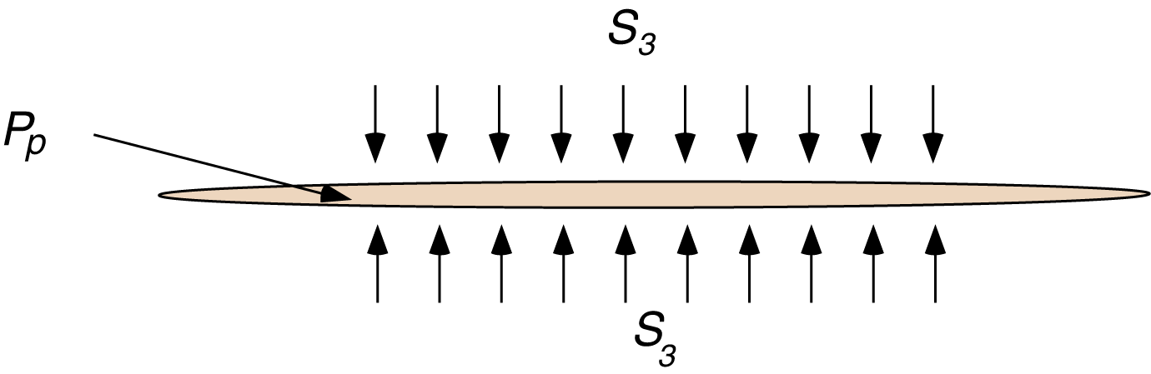
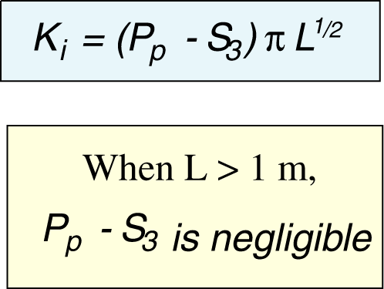
Propagation of a Mode I Fracture
P_{f}
P_{f}
P_{f}

Slide 26
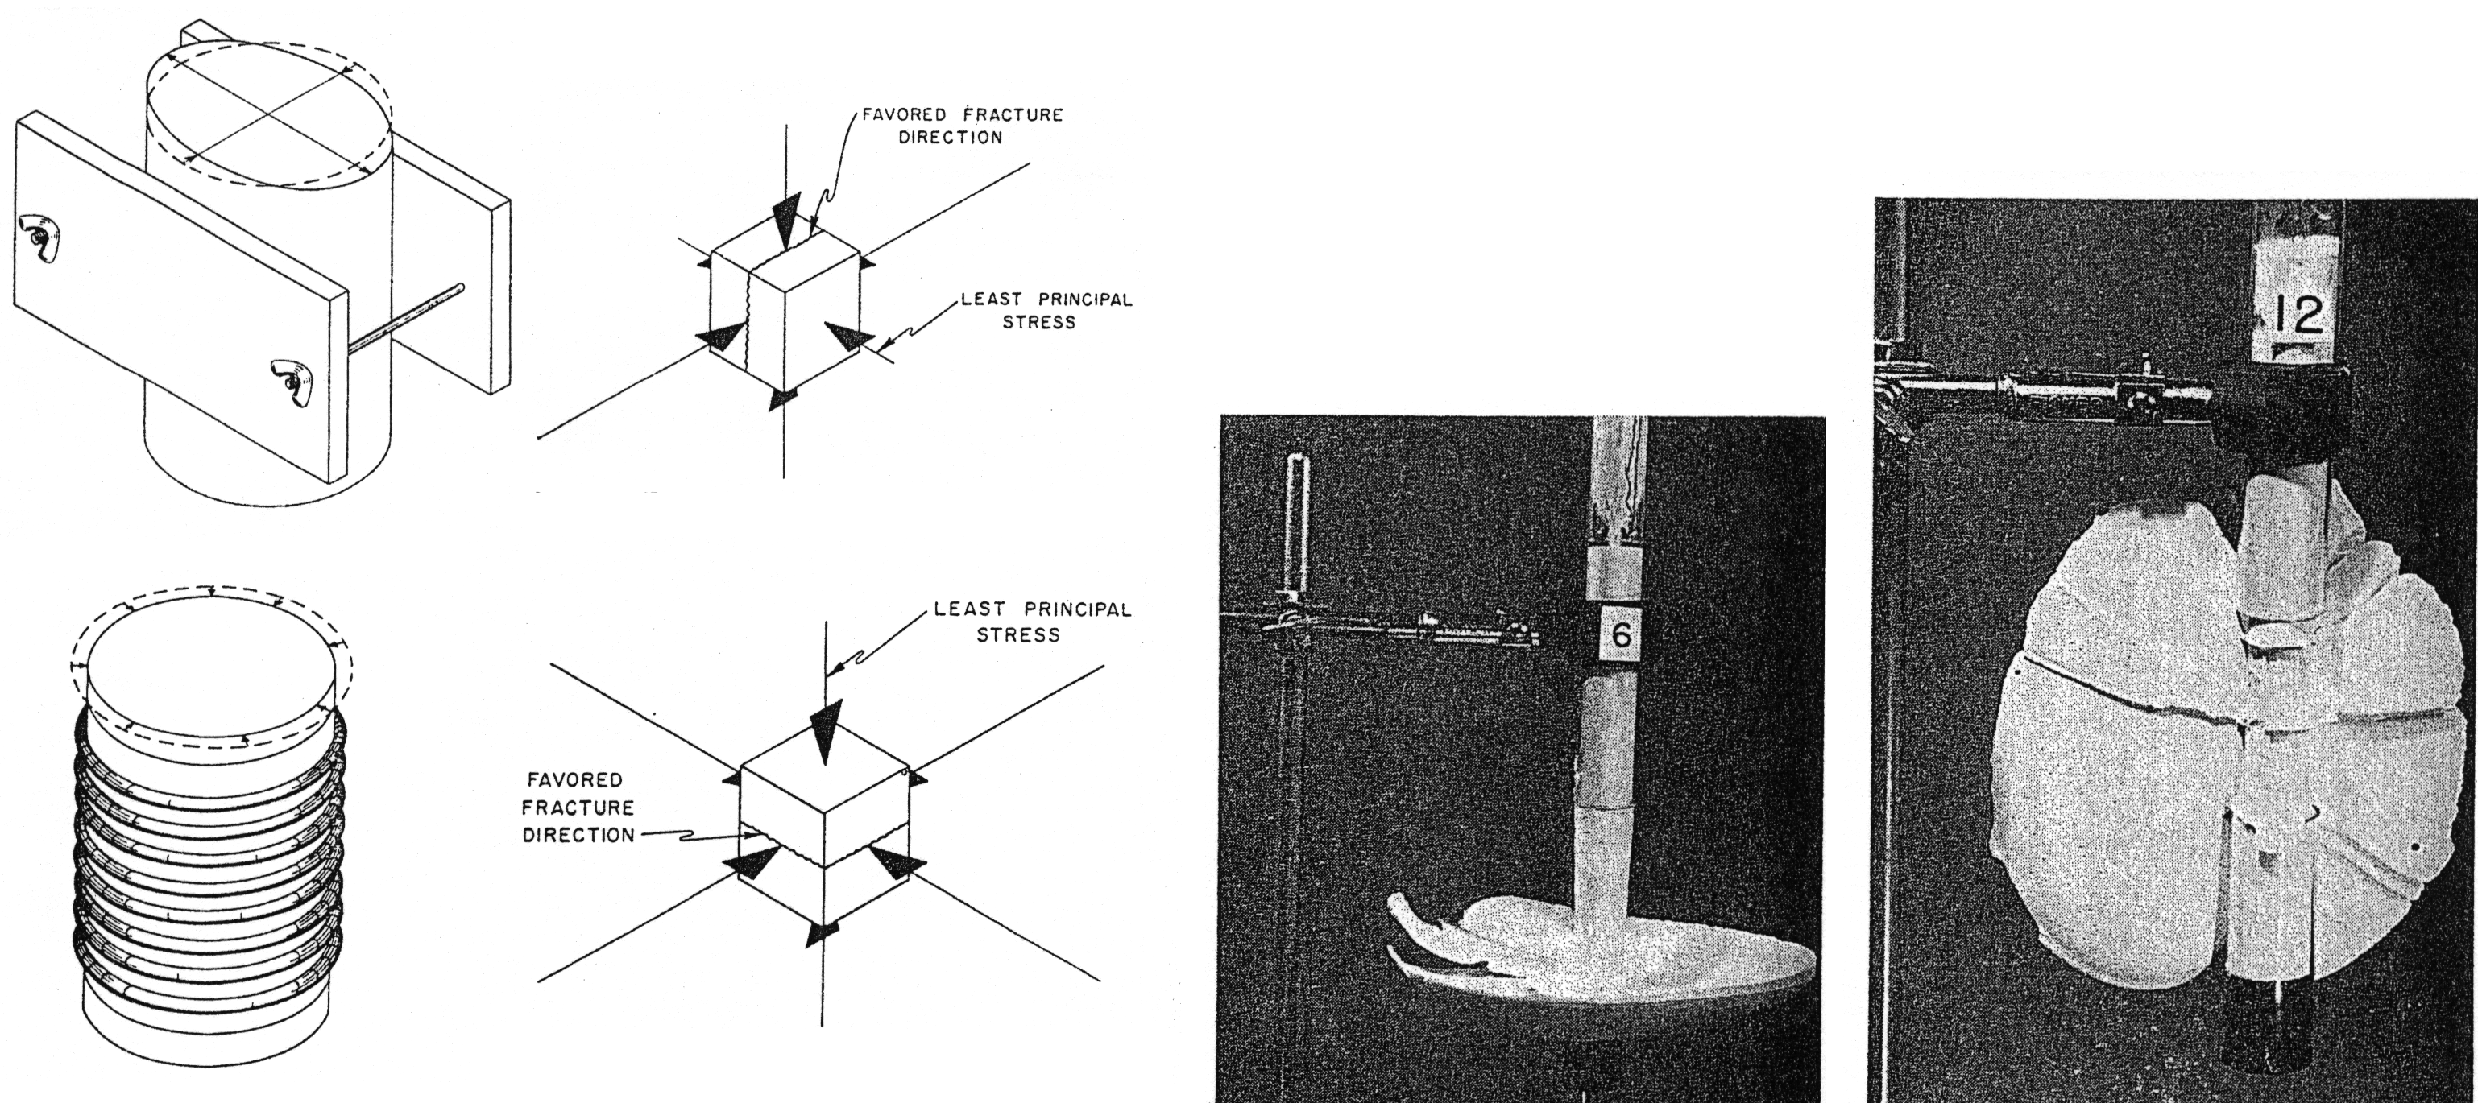
Hydrofracs Always Propagate Normal
to the Least Principal Stress
Hubbert and Willis (1957)

Slide 27
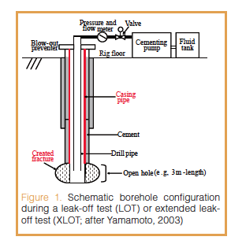
Extended Leak Off Test (or Mini-Frac)

Slide 28
Extended Leak Off Test (or Mini-Frac)

Slide 29
Hydraulic Fracturing in Horizontal Wells
Transverse
S_{Hmax}
S_{hmin}
Horizontal Well, Vertical Plane, Perpendicular to Wellbore
Longitudinal
S_{hmin}
S_{Hmax}
Horizontal Well, Vertical Plane, Parallel to Wellbore

Slide 30
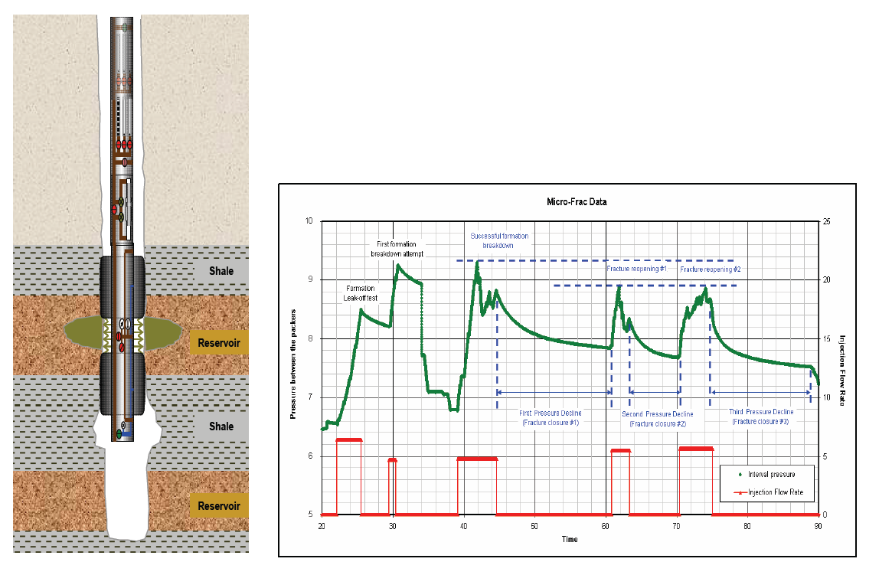
Use of Multiple RCI Microfrac Data
RCI
Reservoir Characterization Instrument (BHI)
Complete Formation Breakdown
Downhole Pressure
Cap Rock
Flow Rate
Shale Reservoir
Cap Rock
Key is understanding spatial variation in S_{hmin} or Fracture Gradient for purposes of Reservoir Performance and Fracturing Efficiency
Shale Reservoir

Slide 31
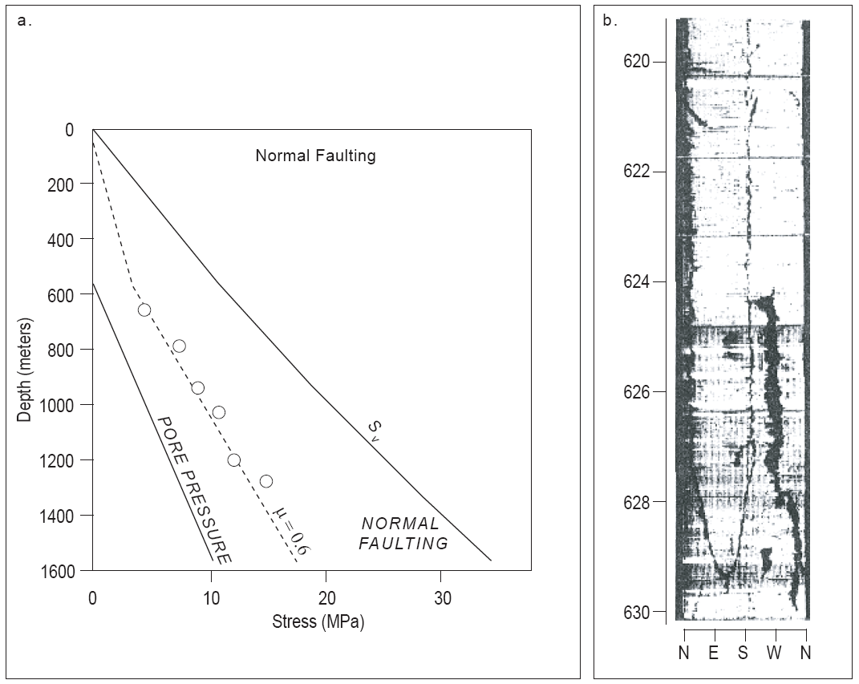
Least Principal Stress – Normal Faulting

Slide 32
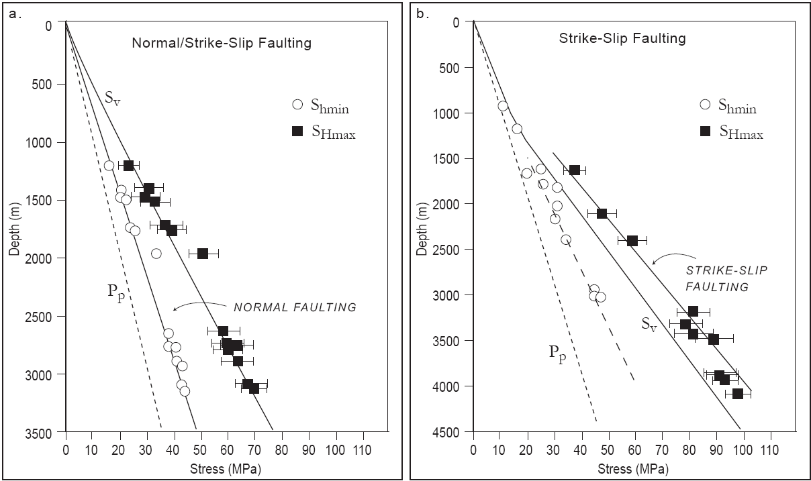
Least Principal Stress – Normal/SS Faulting

Slide 33
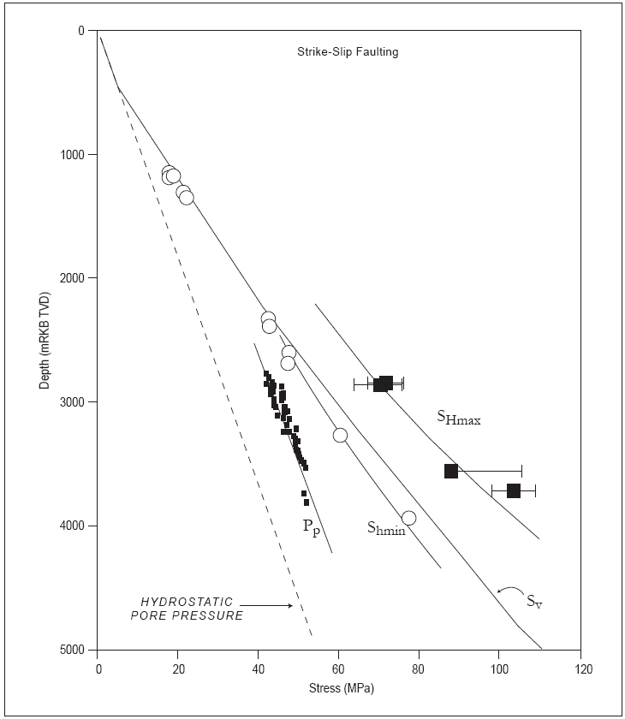
Least Principal Stress – SS/Rev Faulting

Slide 34
Developing a Comprehensive Geomechanical Model
Parameter
Data
z
0
S
(
z
)
=
∫
ρ
g dz
Vertical stress
v
0
Least principal stress
0
S_{hmin} ⇐ LOT, XLOT, minifrac
Max. Horizontal Stress
S_{Hmax} magnitude ⇐ modeling wellbore failures
Stress
Orientation
Orientation of wellbore failures
Pore pressure
P_{p} ⇐ Measure, sonic, seismic
Rock Strength
Lab, Logs, Modeling well failure
Faults/Bedding Planes
Wellbore Imaging

Slide 35
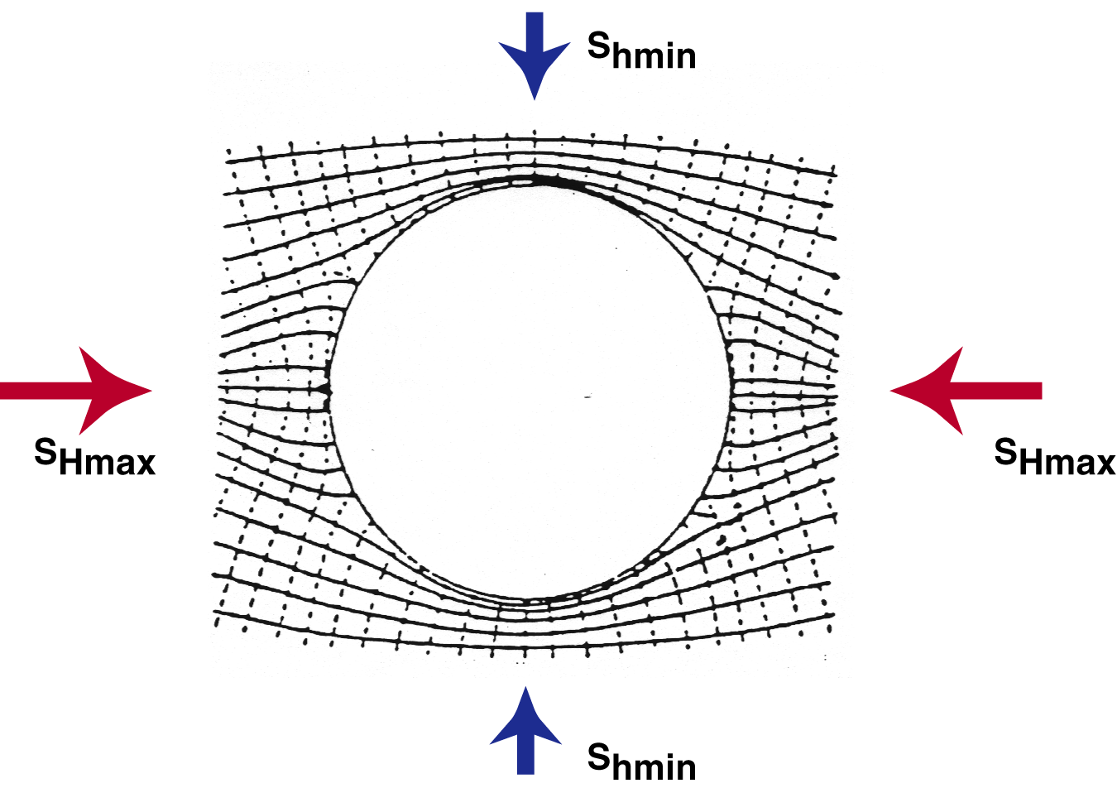
Kirsch (1898)
Local stress field perturbed due to the borehole

Slide 36
Kirsch Eqns. –Vertical Well, Stress Field (S_{Hmax}, S_{hmin})
Internal Pressure P₀, Θ measured from S_{Hmax}
R – Wellbore radius
r – radial distance from center

Slide 37
Parameters for Following Figures

Slide 38
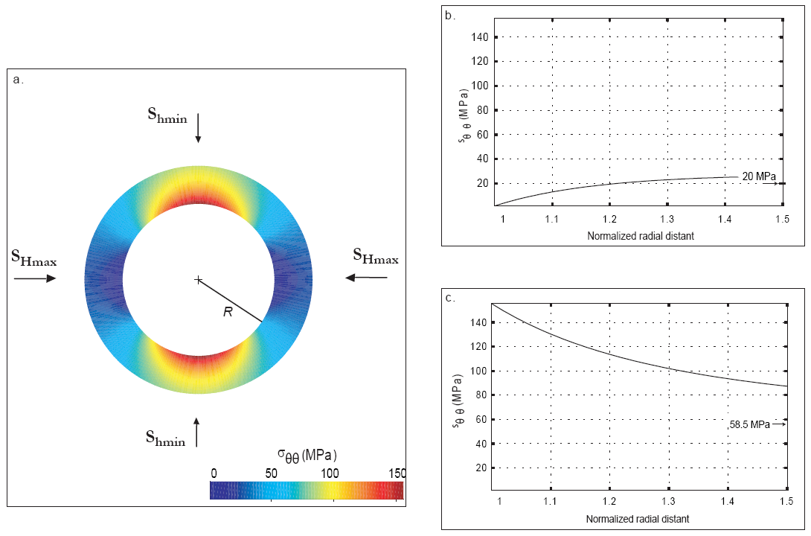
“Hoop” Stress Concentration

Slide 39
Stress Concentration At Wellbore Wall
Compressive and tensile wellbore failure is a direct result of the stress concentration around the wellbore that results from drilling a well into an already-stressed rock mass. In a homogeneous and isotropic elastic material in which one principal stress acts parallel to the wellbore axis, the effective hoop stress and radial stress at the wall of a cylindrical, vertical wellbore (overburden stress, S_{v} is a principal stress acting parallel to the wellbore axis) is given by the following equation:
σ_{θθ} = S_{hmin} + S_{Hmax} - 2(S_{Hmax} - S_{hmin}) cos2θ - 2P₀ - ΔP – σ^{ΔT}
σ_{rr} = ΔP
where θ is an angle measured from the azimuth of the maximum horizontal stress, S_{Hmax}, S_{hmin} is the minimum horizontal stress, P₀ is the pore pressure, ΔP is the difference between the wellbore pressure (mud weight) and the pore pressure, and σ^{ΔT} is the thermal stress induced by the cooling of the wellbore by ΔT.
The effective stress acting parallel to the wellbore axis is:
σ_{zz} = S_{V} - 2ν(S_{Hmax} - S_{hmin}) cos2θ – P₀ - σ^{ΔT}
where ν is Poisson's ratio.

Slide 40
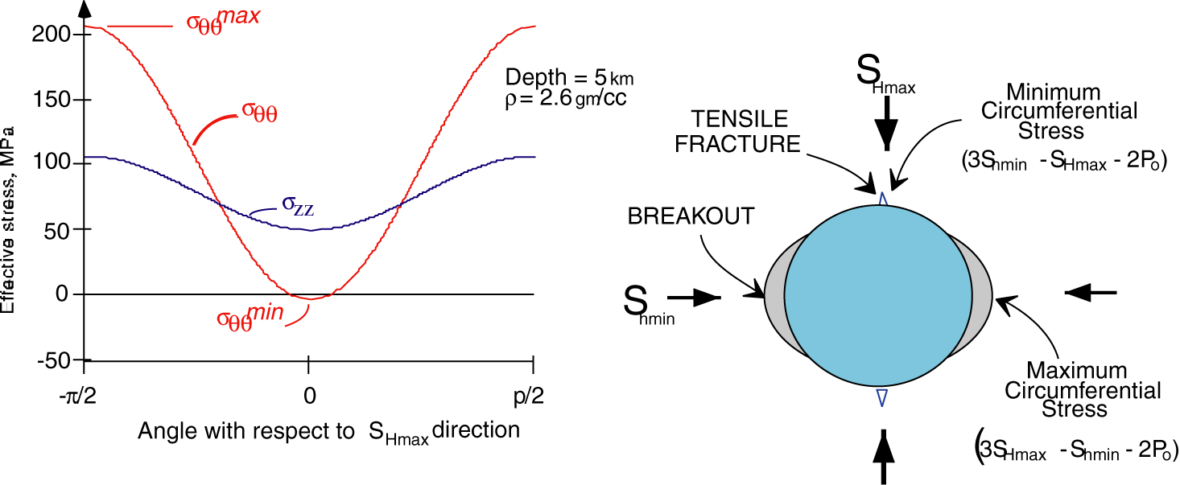
Stress Concentration at Wall of Wellbore
−π/2
π/2

Slide 41
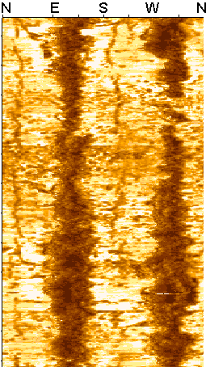
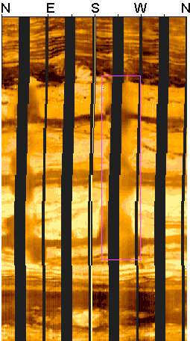
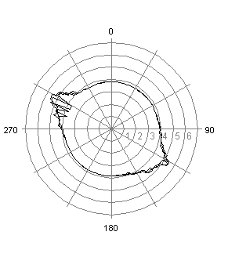
Wellbore Failure
S_{Hmax}
w_{BO}

Slide 42
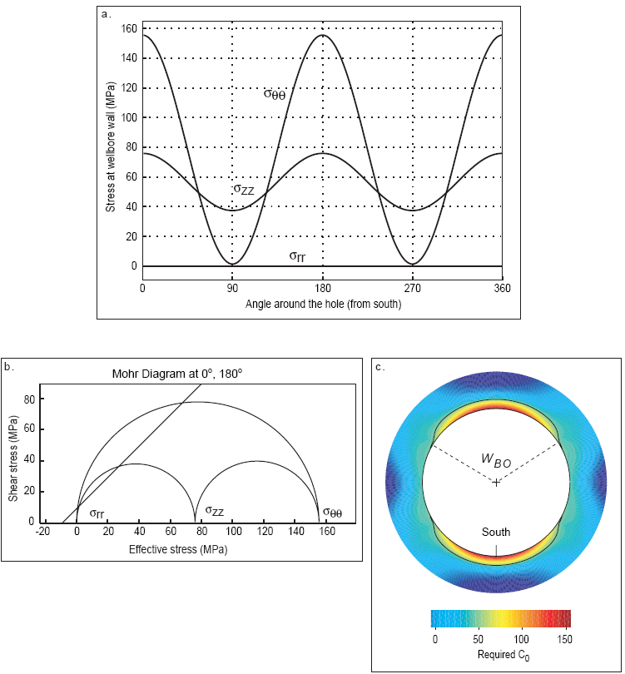

Slide 43
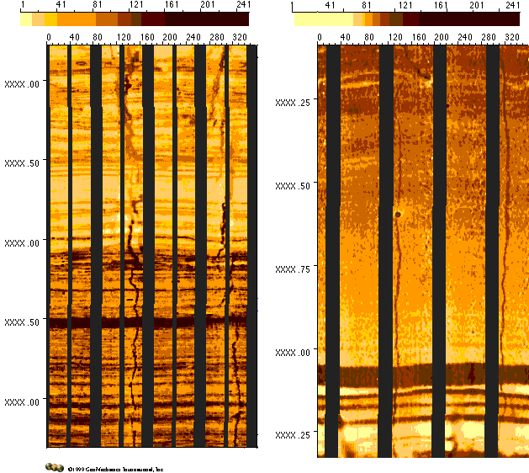
Drilling-Induced Tensile Fractures
FMI
FMS

Slide 44
Visund Field Stress Orientations

Slide 45
Why Does Wellbore Failure Work So Well for Determining Stress Orientations?
At the point of minimum compression around the wellbore (i.e, at θ = 0, parallel to S_{Hmax}), Equation (1) reduces to
σ_{θθ}^{min} = 3S_{hmin} - S_{Hmax} - 2P₀ - ΔP - σ^{ΔT}
Whereas, at the point of maximum stress concentration around the wellbore (i.e, at θ = 90°, parallel to S_{hmin}),
σ_{θθ}^{max} = 3S_{Hmax} - S_{hmin} - 2P₀ - ΔP - σ^{ΔT}
σ_{θθ}^{max} - σ_{θθ}^{min} = 4 (S_{Hmax}- S_{hmin})

Slide 46
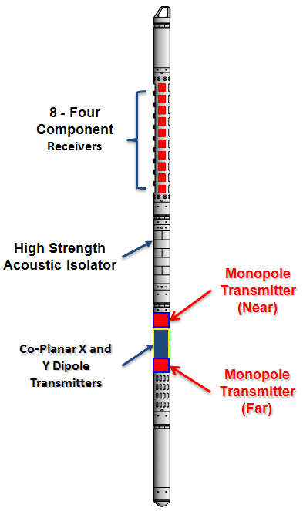
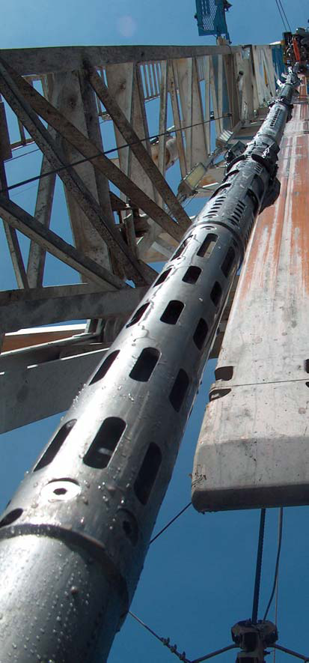
XMAC^{sm} F1 Tool Design and Specifications
Acquires 44 waveforms simultaneously at 30 ft/min:
- 4 Delta-T
- 8 Fullwave Monopole
- 32 Cross Dipole
Acoustic Isolator has 45,000 lb compression and tensile rating and limits rotation about tool body to < 1.5 degrees

Slide 47
Acoustic Anisotropy and Breakouts - XMac

Slide 48
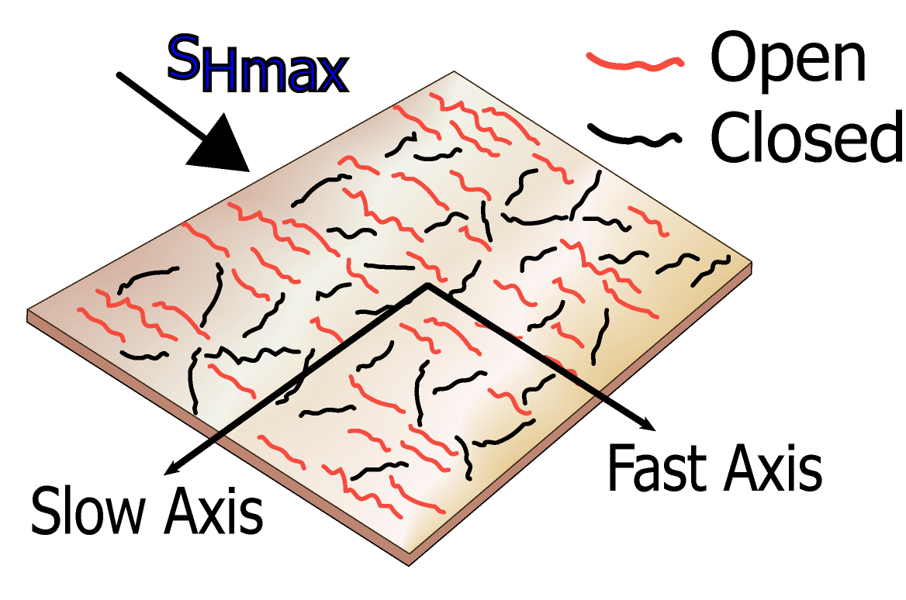
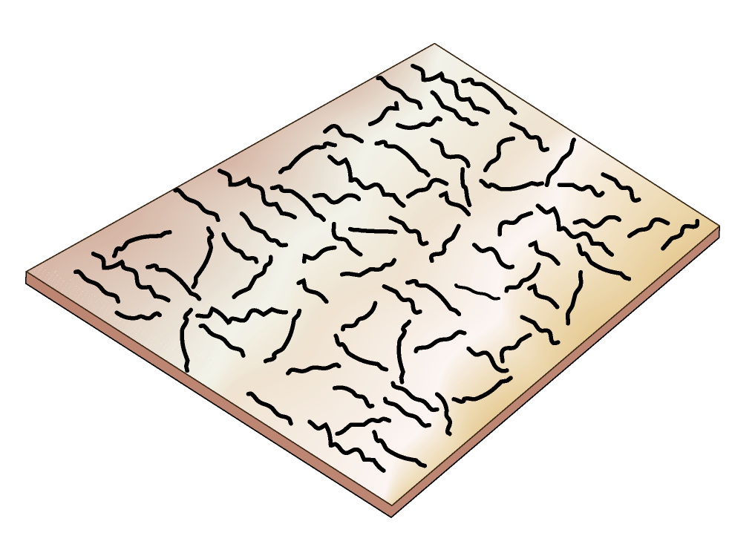
Stress-induced Shear Wave Anisotropy
Highly disordered system
Preferential closure of
fractures in response to S_{Hmax}
Stress parallel fast direction
Decreasing anisotropy with
depth as stress increases.

Slide 49
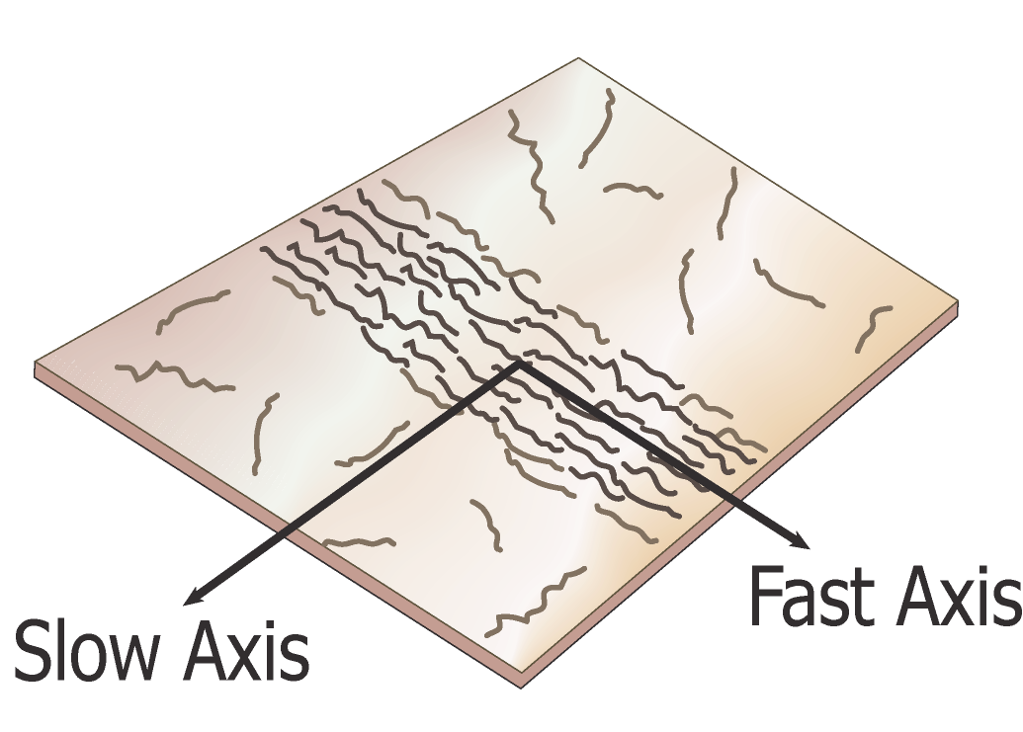
Structural anisotropy
Highly ordered system
Aligned macroscopic features (e.g., fault fabric or bedding)
Fast direction parallel to
structure

Slide 50
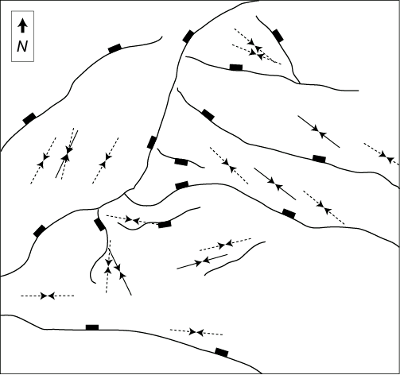
Scott Field, North Sea
Yale (2003)

Slide 51
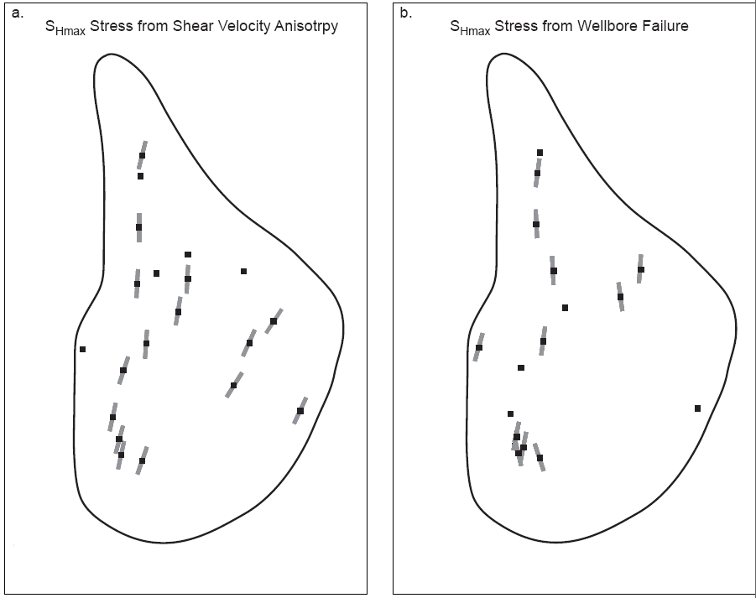
Southeast Asia

Slide 52
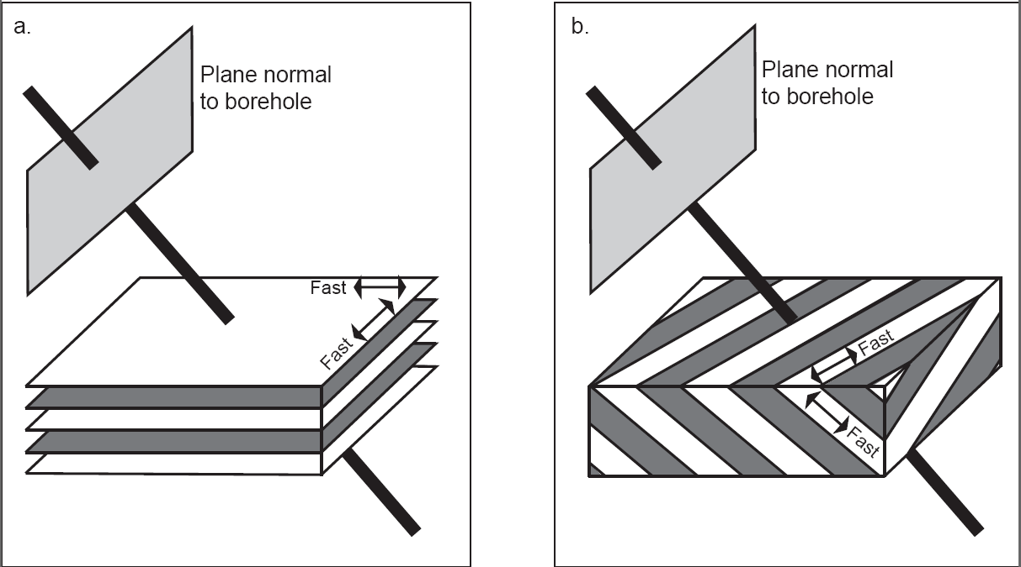
Deviated Wells and Bedding Dip
Adds Complexity
Boness and Zoback (2006)

Slide 53
Developing a Comprehensive Geomechanical Model
Parameter
Data
z
0
S
(
z
)
=
∫
ρ
g dz
Vertical stress
v
0
Least principal stress
0
S_{hmin} ⇐ LOT, XLOT, minifrac
Max. Horizontal Stress
S_{Hmax} magnitude ⇐ modeling wellbore failures
Stress
Orientation
Orientation of Wellbore failures
Pore pressure
P_{p} ⇐ Measure, sonic, seismic
Rock Strength
Lab, Logs, Modeling well failure
Faults/Bedding Planes
Wellbore Imaging

Slide 54
Using Wellbore Failure to Constrain S_{Hmax}
S_{Hmax}
w_{BO}

Slide 55
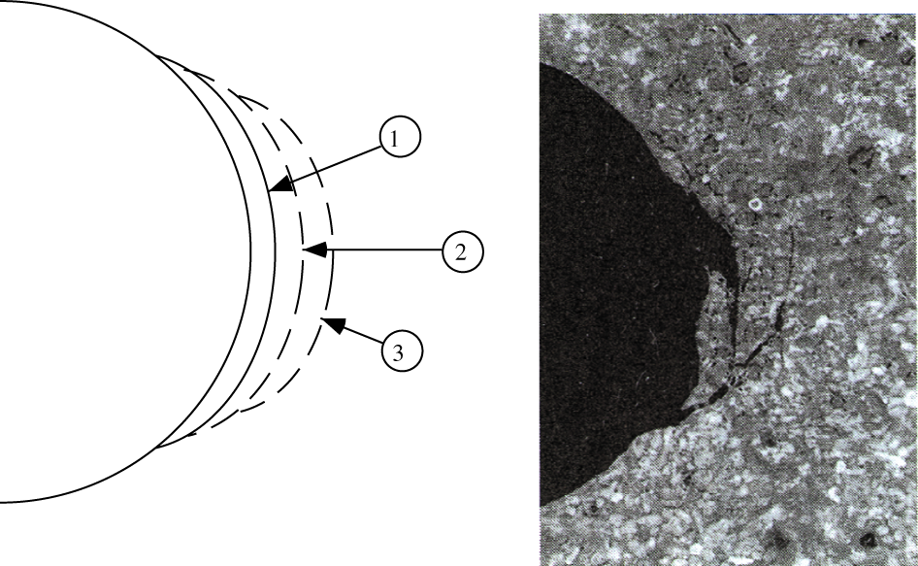
Breakouts Deepen with Successive Episodes of Failure
Breakout Width (Knowing S_{hmin})

Slide 56
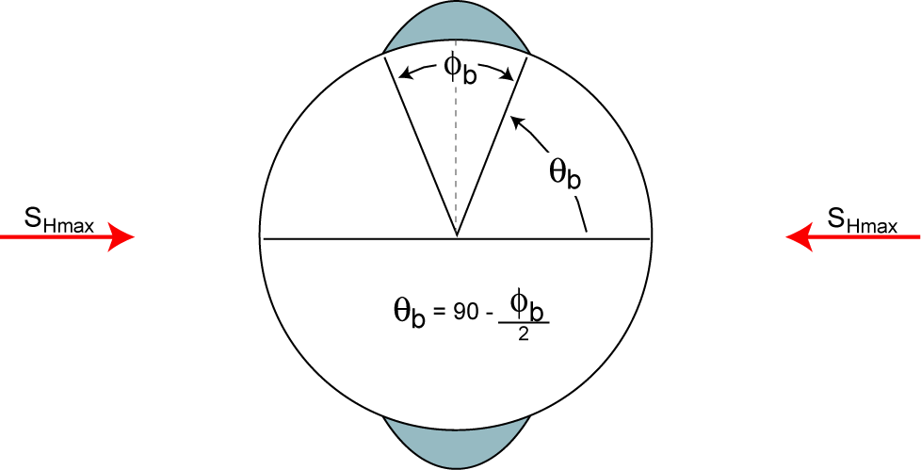
Breakout Width and DITF’s
Wellbore Breakouts
Tensile Fractures

Slide 57
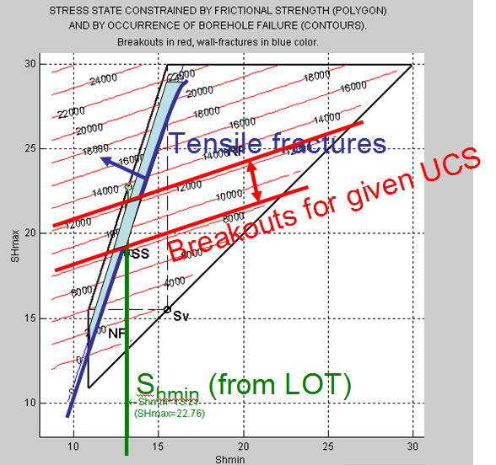
Constraining Stress Magnitudes

Slide 58
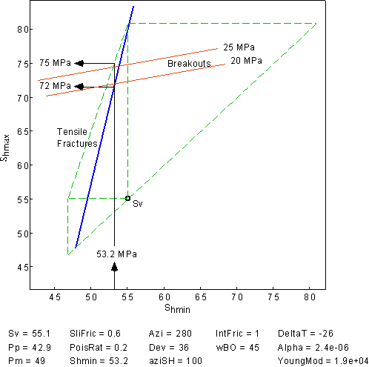
Visund Stress Magnitudes

Slide 59
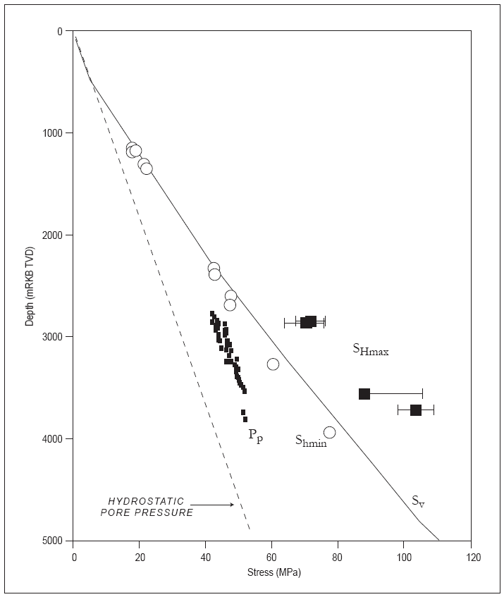
Visund Stress Magnitudes

Slide 60
Tensile Fractures in Vertical Wells Imply a Strike-Slip Faulting Environment
Earth (Strike-Slip Faulting)
for μ = 0.6
S_{Hmax} = 3.1 S_{hmin} – 2.1 P_{p}
S_{Hmax} = 3S_{hmin} – 2P_{p} + 0.1 (S_{hmin} – P_{p})
Vertical Wellbore (Tensile Fractures)
σ_{θθ} = 3S_{hmin} – S_{Hmax} – 2P_{p} = -T for T = 0
S_{Hmax} = 3S_{hmin} – 2P_{p}

Slide 61
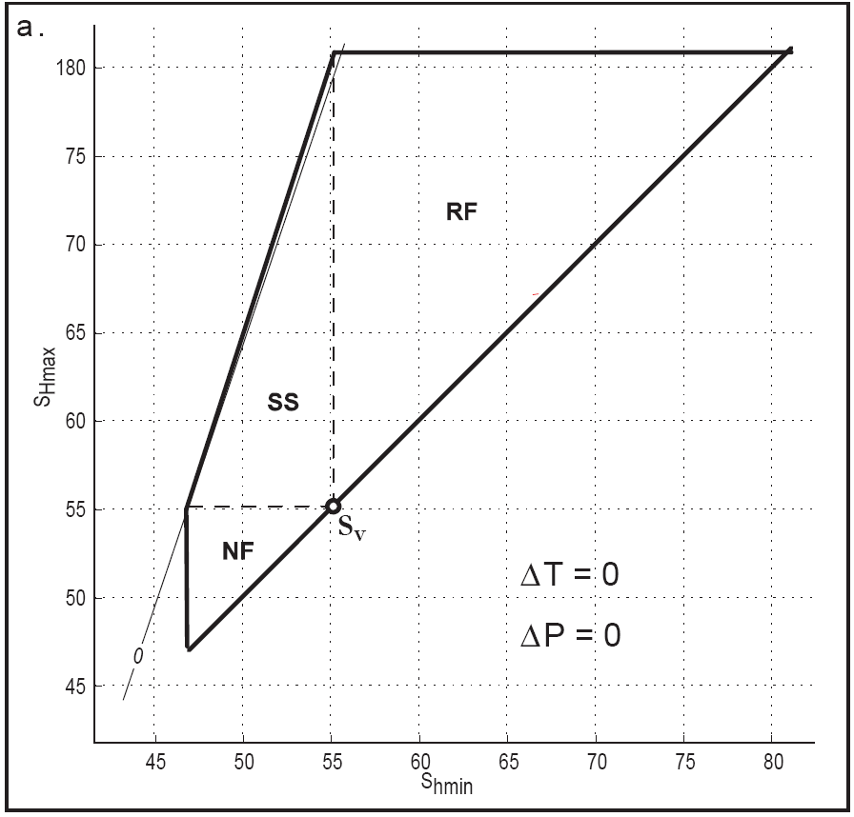
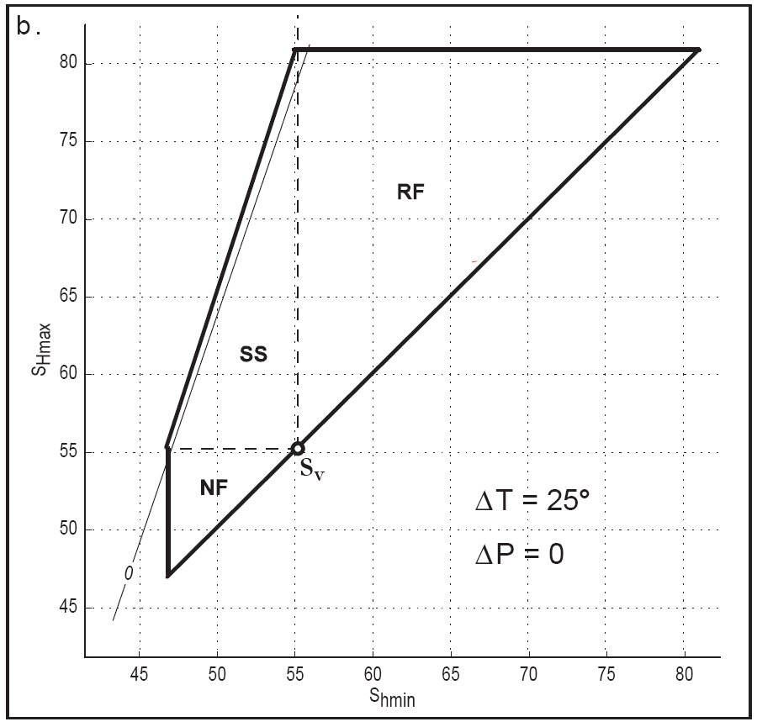
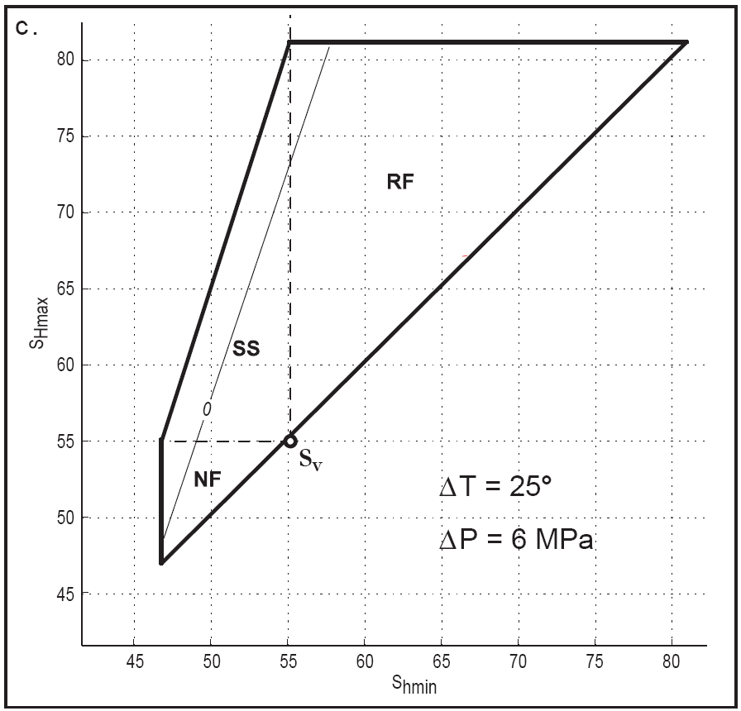
Tensile Fractures in Vertical Wells

Slide 62
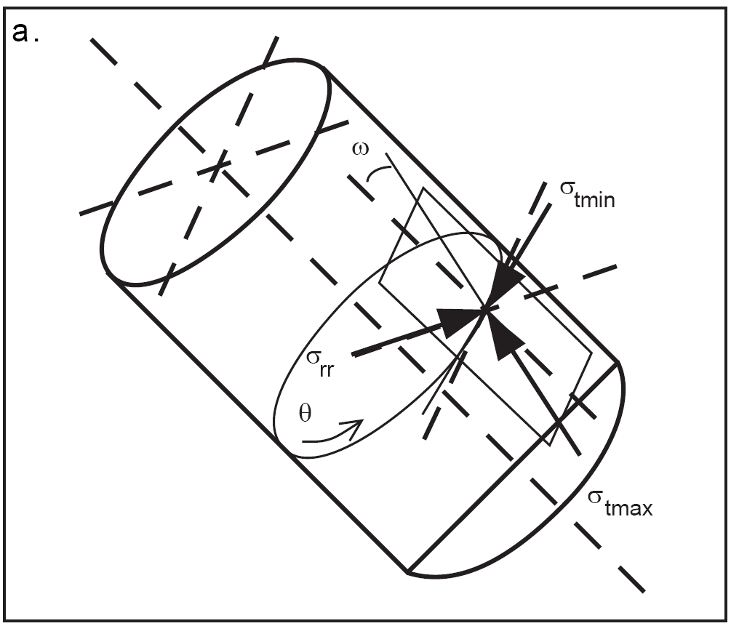
Wall Stresses in a Deviated Well

Slide 63
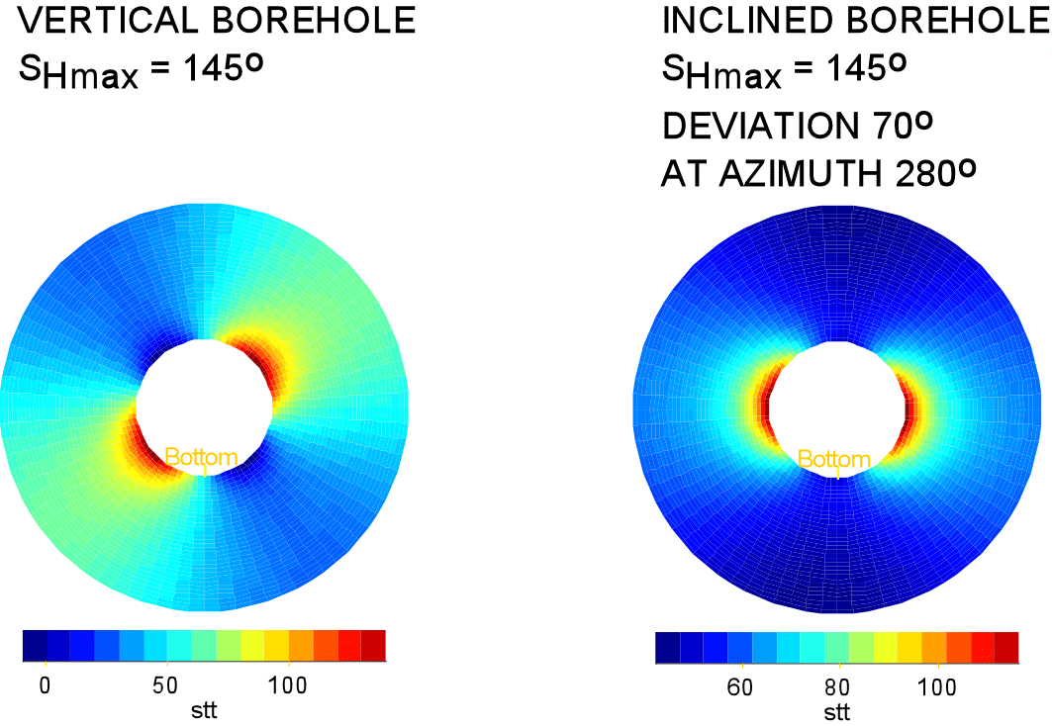
Breakouts in Deviated Wells
S_{Hmax} azimuth 145°
55º/235º
100º/280º
vertical well
tangential
stress
100º/280º
well inclined 70° at an azimuth of 280 °
Notes:
In deviated wells breakouts and tensile wall fractures will propagate at the position of maximum and minimum circumferential stress respectively. Wellbore failures in deviated well do not provide stress orientation directly, failure observations must be forward modeled (using SFIB) to determine the stress tensor.

Slide 64
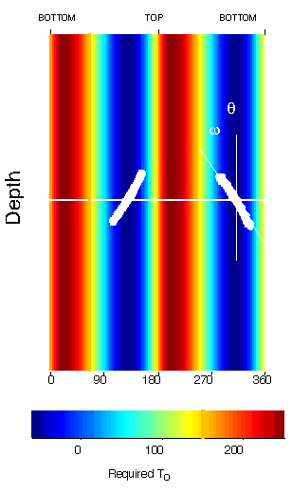
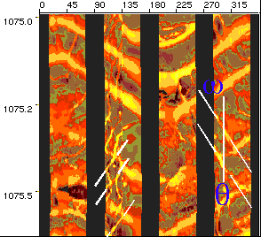
Drilling-Induced Tensile Fractures

Slide 65
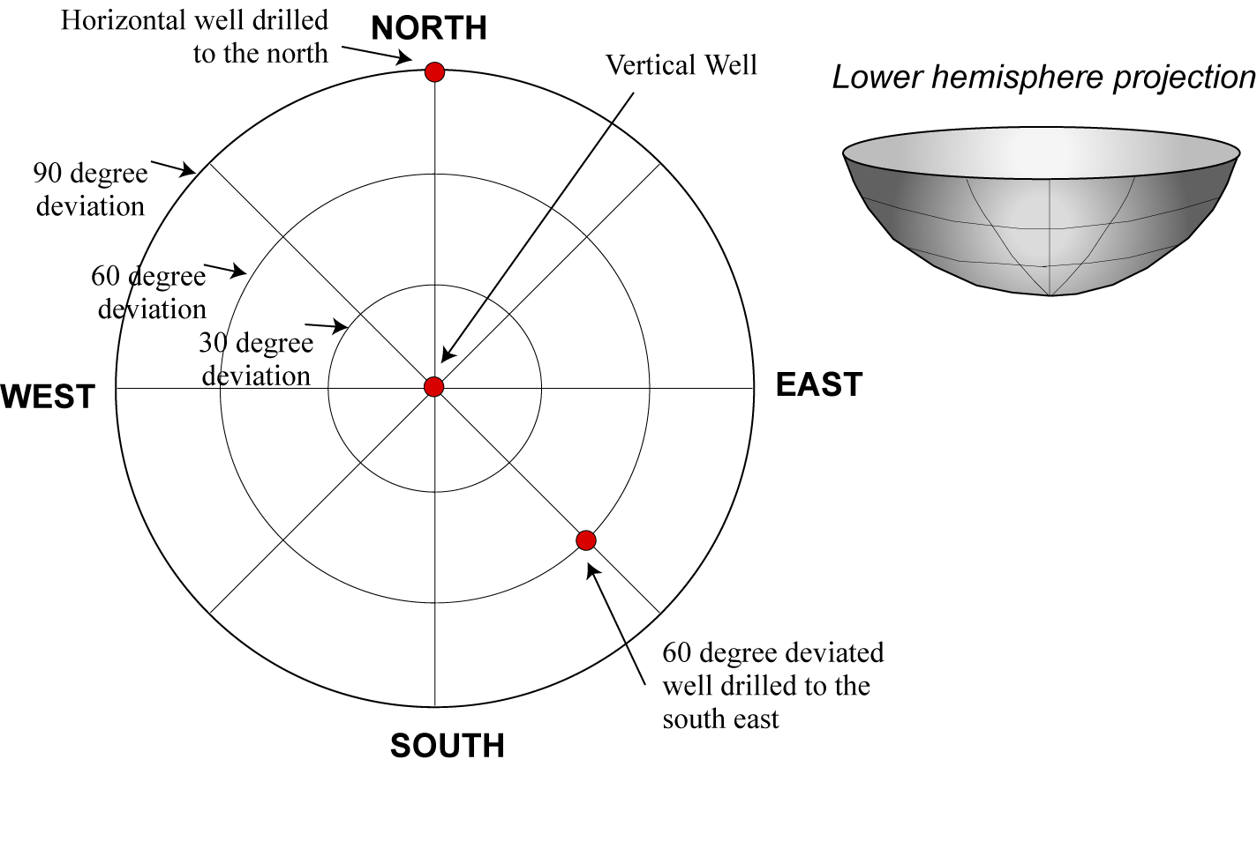
Hemispherical Plot for Deviated Wells
Easy and functional display of wellbore stability or risk for wells of any orientation.
Notes:
Many of the outputs of GMI’s software display wellbore stability on a “Lower Hemisphere Stereo Plot.”
This plot enables you to see a 2-D display of all possible wellbore trajectories. For example, a vertical well is represented at the direct center of the diagram. As you go farther out from the center, the wells are more inclined. The outer circle represents perfectly horizontal wells, drilled at 90 degrees.

Slide 66

Tendency for Breakout Initiation for Different Stress Regimes
3 km Depth, Hydrostatic P_{p}

Slide 67

Wellbore Failure Orientation in Deviated Wells

Slide 68



Pre-Salt, Brazil - S_{HMax} Azimuth?

Slide 69

BHI Shale Evaluation Suite: Log/Analyses
BHI Shale Evaluation Suite is an integrated petrophysical approach using logs and analyses to characterize the highly complex shale reservoirs
300+ Evaluation Suites in US shale plays; 40+ in Canada
Resistivity / Density /Neutron
FLeX /RockView | Spectralog | FracXplorer Micro-seismic | STAR / EI / CBIL | RCOR | XMAC | MReX
Geochemistry Lithology Mineralogy Total organic carbon | Lithology Mineralogy Th/U for Carbon classification | Image correlation with lithology and facies determined using FLeX | Fracture detection | Core analyses | Geomechanical properties from FLeX /RockView mineralogy | Porosity Independent determination of total organic carbon
Logging and analyses identify: Optimum “fracturable” intervals Optimum formations to drill horizontal laterals Potential barriers for frac containment Mineralogy key component integrated with geomechanics

Slide 70


Wellbore Imaging

Slide 71


Logging While Drilling (LWD) – BHI “Trak” Family
OnTrak™ MWD
AziTrak™ Deep Azimuthal Resistivity
LithoTrak™ LWD porosity
SoundTrak™ LWD acoustic
TesTrak™ real-time formation pressure
StarTrak™ imaging services
ZoneTrak™ Resistivity Near Bit
MagTrak™ LWD magnetic resonance
Notes:
The leading technology offered by the OnTrak service includes;
The OnTrak sensor sub offering reliability from a truly integrated suite of five MWD/LWD measurements including azimuthal gamma ray, annular pressure, resistivity, directional surveys and vibration monitoring.
The LithoTrak nuclear service builds on our leading Optimized Rotational Density and Caliper Corrected Neutron measurements to deliver density and photoelectric effect images, neutron porosity and azimuthal borehole caliper.
The SoundTrak service offers the only acoustic logging while drilling tool designed for rotary steerable applications, delivering reliable data in both fast and slow formations.
The TesTrak formation pressure testing tool is the only tool capable of intelligently adjusting to formation characteristics on its own, ensuring valid formation pressure measurements are achieved in the shortest time frame possible.
The aXcelerate High Speed Telemetry Service delivers data at user-selectable transmission rates enabling superior real-time data sets that allow real-time decision making.

Slide 72
Coffee Break

Slide 73

The Key to Wellbore Stability is Controlling the Width of Failure Zones

Slide 74

Design for Variations in Strength Increase
Mud Weight as Needed (Stay in Mud Window)

Slide 75
Tendency for Breakout Initiation for Different Stress Regimes
3 km Depth, Hydrostatic P_{p}

Slide 76

Mud Weight Needed to Maintain 30º Breakouts
Normal
Strike-Slip
Reverse
Stress States as in Fig. 8.2
UCS = 50 MPa

Slide 77

Failed Well Design – Pompano

Slide 78

Wellbore Stability Depends on Trajectory

Slide 79

Successful Well Design – Pompano

Slide 80

Drilling in South America

Slide 81

Drilling in Central and Eastern America
Barnett Shale – 1.5 km laterals
Few Wellbore Stability Problems
Bakken Shale – 3.0 km laterals
Few Wellbore Stability Problems
Marcellus Shale – 1.0 km laterals
Wellbore Stability Problems (especially due to weak bedding planes)
Hurd and Zoback (in press)

Slide 82

Wellbore Stability Nova Scotia
Problem
Severe wellbore instabilities in
the Fortune Bay shale led to
abandonment of original PG-2
well and required drilling a side track
The side track was completed
successfully by switching to oil
based mud and raising the mud
weight to 12 ppg in the Fortune
Bay shale.
Objective for future wells
Optimization of wellbore stability
in deviated and horizontal wells
Feasibility of drilling highly
deviated wells with a maximum
mud weight of ~11.5 ppg
Side track
abandoned
PG-2

Slide 83

Orientation of S_{Hmax}
Hibernia
World stress map data superimposed with mean S_{Hmax} orientation (red arrow) derived from 4-arm caliper and UBI breakout analysis in vertical wells of the Terra Nova field
Newfoundland
St. John’s
Terra Nova

Slide 84
Pore pressure and stress in the
Terra Nova Field
SSTVD [m]

Slide 85
Breakouts from UBI log in PG-2
Fortune
Bay
Shale
Total breakout length: 32 m
Mean breakout width: 40° (±11°)
Jeanne d’Arc
Reservoir

Slide 86

Confirming S_{Hmax} magnitude and rock strength with breakouts in a deviated well
In-situ conditions:
Borehole breakout (i.e., wBO and posBO) in PG-2 (deviated) from UBI images
S_{Hmax} azimuth from borehole breakouts in vertical well
S_{hmin} from XLOT
S_{v} from integrated density log
P_{p} from in-situ measurements
P_{m} from drilling reports
Range of S_{Hmax}
azimuth from
caliper analysis
in vertical wells
S_{v}

Slide 87

Breakouts from UBI log in PG-2
N
Lc2 shale within the
Jeanne d’Arc reservoir
W
E
S
Isotropic compressive failure
C1 sand within the
Jeanne d’Arc reservoir

Slide 88

Breakouts from EMS 6-arm caliper log in PG-2
Jeanne d’Arc reservoir
Fortune Bay shale
Isotropic failure
Anisotropic failure
The difference in failure behavior between the Fortune Bay shale and the Jeanne d’Arc reservoir is similar to the UBI images

Slide 89

Breakouts from UBI log in PG-2
Lowermost Fortune Bay shale
Anisotropic compressive failure

Slide 90

Modeling anisotropic breakouts in the Fortune Bay shale with the given in situ stress state
Anisotropic failure
Anisotropic failure
Bedding plane properties:
dip = 8° (from core data)
Azi = 23° (from core data)
S₀ = 4.8 MPa (from lab data)
μ_{s} = 0.21 (from lab data)
MW = 10.5 ppg
MW = 12 ppg
Result:
The in situ stress tensor
derived in this study and the
bedding plane properties
measured in the lab can
account for the anisotropic
breakouts seen in the Fortune
Bay shale
Isotropic failure
Observed

Slide 91


Predicting stability in the
Fortune Bay shale for well GIG-3
C₀ = 55 MPa
wBO = 75°
MW = 12 ppg
Assuming anisotropic behavior
There exists a steep stability gradient for deviations between 25° and 45 °
Well PG-2 is oriented less favorably in the current stress field
Well GIG-3 is oriented more favorably in the current stress field
Severe stability problems can be avoided for GIG-3 with a maximum
mud weight of 11.5 ppg if deviation < 30 °

Slide 92


Prediction of stability in the
Jeanne d’Arc reservoir for well GIG-3
C₀ = 35 MPa
wBO = 75°
MW = 10.5 ppg
For an isotropic Jeanne d’Arc reservoir, no stability problems are predicted
if the mud weight is approximately 10.5 ppg even for a rock strength that is
lower than the Fortune Bay shale.

Slide 93
Business impact
Petro-Canada successfully drilled well
GIG-3 through the Fortune Bay Shale
by limiting deviation to 27° and
mud weights to 10.5 ppg – 11 ppg
Petro-Canada avoided costly stability
problems by following GMI’s
recommendations for this well
successful
abandoned
PG-2
successful
GIG-3

Slide 94
Well design & drilling
Reduce Drilling Costs
Drilling Optimization, Bits- Systems-Fluids, Drilling Technology, Case Histories

Slide 95
Well Architecture / Drilling (U.S.)
Drill the lateral as “flat” as possible - Toe Up vs Toe Down
(Undulating / Porpoising results in low spots where fluid can collect)
Barnett (other Basins different)
  Normalized productivity decreases at greater lengths
  Most operators choose 2,500’ – 3,500’ = Optimum Lateral length
  Longer lateral lengths increase drilling risk
  (Encountering a Geohazard, Casing to bottom, or well Loss)
  Most use OBM Drilling Fluid to Drill the Curve & Lateral
  Typically either 4 ½” or 5 ½” Completion String for Cased Hole (5 ½” preferred for ease of Fracturing)
  Economics are better with Horizontal Wells – In Barnett Horizontal Wells yield 3x Production for 2x Cost of Verticals
  Drilling Cost is only 40-50% of Cost of Completed Well (Fracturing is 50-55% of the Cost)

Slide 96

















Drilling Optimization - Reducing (Cost) Days on Well
Vertical
Curve
Horizontal
Analytical tools, Modeling and Engineering Analysis Offset Well and Bit Analysis
Knowledge Management & Engineering Training
Realtime Implementation
Planning
Execute
Capture
Analyze
Downhole dynamics measurement

Slide 97

PRE-PROJECT
Shale Play Drilling Challenges / Objectives
Challenge | Solution
Wellbore Placement - Anticollision - drilling from pads | Precise well placement with most experienced directional drilling personnel
Inconsistent BUR in the curve sections | Motors and RSS capable of high BUR
Excessive torque at farther step out laterals | Geosteering with RSS in the lateral for accurate well placement within the reservoir Applications engineering for drilling optimization
Drilling interval in one run | Single Bit+BHA capable of drilling curve and lateral, hence eliminating trips
Low ROP while sliding with conventional mud motors | Delivering consistent performance, smooth well-bore and fast ROP
Wellbore stability, pack offs, stuck pipe | Strategic fluids management
Challenge / Objective | Impact
Bit and Motor Durability | Bit Trips – NPT
Performance Optimization | Reduced ROP – days on well
Challenge / Objective | Impact
BUR Inconsistency | BHA Trips – NPT
Bit and Motor Durability | Bit Trips – NPT
Borehole Quality | Problems running casing & Reduced ROP (torque / drag)
Challenge / Objective | Impact
Wellbore placement | Production optimization
Excessive sliding | Reduced ROP – days on well
Extended reach | Production optimization
Borehole Quality | Problems running casing & Reduced ROP (torque / drag)
97
Notes:
Major Challenges:
Minimize the trip time
Optimize drilling to increase ROP
How to steer to the right place in the formation
Applications engineering for drilling optimization
Advanced technology (RSS/ Motors / LWD / RNS)
PDC field engineer, design, and applications support
Strategic Fluids Management

Slide 98

Well Profile Woodford Shale-Anadarko Basin

Slide 99
Drilling Optimization: Barnett Shale Example
Reducing Costs/Optimization – Case History
Before | 6 wells drilled @ 32 ft/hr
After | 8 wells drilled @ 57 ft/hr
80% increase in average ROP, spud to TD
OPTIMIZATION
Modified PDC Bits
Model Re-design BHA - torque, drag, hydraulics
Optimized Parameters -WOB, Rotation
Critical Speed Analysis to Reduce Vibration
Result: increase ROP
5+ days saved
Notes:
OPTIMIZATION
Modified PDC Bits
Model Re-design BHA - torque, drag, hydraulics
Optimized Parameters -WOB, Rotation
Critical Speed Analysis to Reduce Vibration
Result: increase ROP

Slide 100

Reducing Cost (Minimizing Additional Trips)
Goal: Drill the curve and lateral with single bit and BHA trip
Drill Bits
Directional Services
  Quantec™ PDC and Tricone bits specifically designed for shale gas - vertical, curve, and laterals
  Customized BHAs
  Ultra and X-treme motor technology
  Rotary Steerable: AutoTrak G3, AutoTrak eXpress
  MWD tools – TeleTrak, E-MTrak
Notes:
Goal: Drill the curve and lateral with single bit and BHA trip -
Consistently being achieved
Quantec PDC – BHI most advanced bits utilize diamond volume management (DVM), superior cutters, optimized hydraulics and a unique stability technology
Quantec Force PDC – New generation of cutter and stabilization technology Delivers supreme performance in wide range of environments.
D-Technology
EZSteer Depth of Cut Control,
Patented
Superior directional control
Application specific
Mitigate torsional vibrations
Improve ROPs through stringers

Slide 101
Optimizing Wellbore Placement – Reservoir Navigation Services (RNS)
RNS - Real-time LWD to detect adjacent formations (AziTrak™ & GR)
    - Ensure optimal reservoir entry
    - Maintain optimal position within reservoir
    - Avoid reservoir exit
    - Steer to ‘sweet spot’
Reduced Number Wells/ST’s
Reduced overall Costs
Increased Production & EUR
Reservoir Navigation Services

Slide 102

Reservoir Navigation Services - RNS
(Azimuthal Resistivity & Gamma Images)
Armstrong Co., Pennsylvania – Marcellus Case History
Target for Lateral
High TOC = only 15ft Thick
Monitored LWD GR
Up and Down
To determine if well approaching formation top or bottom / correct
Well Trajectory Planned
Seismic
Shale Analysis
Offset Well Data
Notes:
Once the target zone has been identified it is important to place the well bore in the optimal part of reservoir following the natural dips in the formations and moving to follow faults. Today it is possible to use reservoir navigation services where engineers use the shale analysis with available seismic and offset well data to plan the trajectory of the well bore. During the drilling of the LWD data is monitored by experts located in remote Beacon centers and modifications are made to the trajectory to maintain the well bore in the optimal zone..
The example above shows a well drilled in the Marcellus where the target is a High organic content zone about 15ft thick. Data from seismic was used to identify dip angle and the well planned appropriately.
Monitoring gamma ray up and down during drilling identified whether well was approaching top or bottom of zone and remedial action taken to correct well path.
Image data allowed engineers to correct dip calculations to actual dip to allow forward planning of well path.
Red line is well path , light green zone is 15ft target zone. Dark green bands are less interesting formations either side of target.
Images at bottom identify whether we have drilled out of the top or bottom of zone, they are used to correct well path and establish the actual dip of the formation for forward planning.

Slide 103
REALTIME IMPLEMENTATION
Drilling Fluid
Hole Cleaning
  Cuttings removal
  Chemically inhibit clays
Wellbore Stability
  Reduced fluid and pressure transmission to the wellbore
High Performing
  Lubricous to avoid torque & drag and stuck pipe
  High ROPs
Most US Shale wells convert to some form of Oil Based Mud for Drilling the Curve and Lateral
TERRA-MAX ™ (WBM) alternative to OBM “Environmentally Friendly”
Cost Savings Compared to OBM
  Reduced time to drill the well
  Can be reused from well to well
  Faster cleanup at the completion of the well

Slide 104


Reduce Cost and Environmental Risk with BHI
Centralized Dewatering
Process WBM to remove suspended solids
Recycle flow back water and other waste water into drill or wash water
Improves disposal efficiency after de-watering
Modular system can service multiple rigs and can be adapted to meet demand
Reduce fluid waste, disposal costs, transportation fees, environmental impact
Reuse fluid in future well operations

