Slide 1

Opportunities and Challenges of
Shale Gas Development
Gdansk Technical University
December 12-15, 2011
Mark D. Zoback
Professor of Geophysics
Stanford University

Slide 2

Opportunities and Challenges of
Shale Gas Development
Gdansk Technical University
December 12-15, 2011
Mark D. Zoback
Senior Technical Advisor
Baker Hughes Incorporated

Slide 3

Course Overview
Day 1 Opportunities and Challenges of Shale Gas Development
Characterization and Physical Properties of Organic Rich Shales
Day 2 Geomechanics
Wellbore Stability
Drilling Operations
Day 3 Hydraulic Fracturing and Reservoir Stimulation
Day 4 Shale Permeability, Gas Production and Reservoir Simulation
Water Management and Minimizing Environmental Impacts

Slide 4
Current Research Collaborations
ConocoPhillips – Barnett Microseismic and Frac Data, Fault Damage Zones
Chevron – Geomechanics of Shale Gas and CO₂ Sequestration
RPSEA – Geomechanics of Shale Gas (with LBNL, Texas A&M)
Exxon – Heavy Oil, Clay Adsorption and Swelling
BP - Haynesville Core, Slickwater Frac’ing with CO₂, Geomechanics of Paleogene (GOM)
DOE - CO₂ Sequestration in Shale Gas Reservoirs
Hess – Bakken Shale, Microseismic and Geomechanics
Apache/Encana – Horn River Microseismic and Geomechancis Study

Slide 5

Multi-Disciplinary Studies of Shale Reservoirs

Slide 6
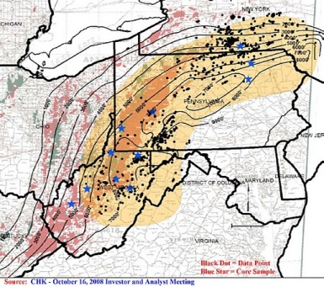
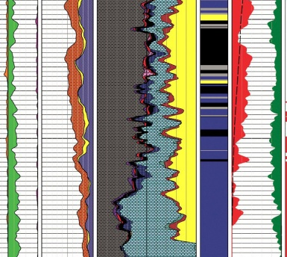
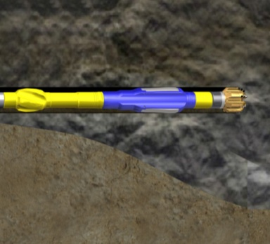

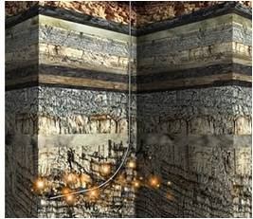
Baker Hughes Shale Reservoir Life Cycle Approach
Exploration
Appraisal
Development
Production
Rejuvenate
Geomechanic models GMI
Reservoir and Economic Analysis Gaffney Cline
Reservoir Characterization RDS
Reservoir Simulation Epic
Fracture Modeling Meyer and Associates
Baker Atlas Wireline Logging
Baker Hughes INTEQ MWD, directional drilling and coring
Hughes Christensen bits
Baker Hughes Drilling Fluids (Nemsco)
Baker Oil Tools Completion Systems, Fishing
BJ Services Pumping
Baker Atlas Wireline Logging
Baker Hughes INTEQ MWD, directional drilling and coring
Hughes Christensen bits
Baker Hughes Drilling Fluids (Nemsco)
Baker Oil Tools Completion Systems, Fishing and Whipstocks
BJ Services Pumping
Baker Petrolite Total Chemical Solution
Baker Atlas Production Logging and Monitoring
BJ Services Refracturing
Baker Petrolite Well Remediation
Baker Oil Tools Wellbore Intervention
6
© 2010 Baker Hughes Incorporated. All Rights Reserved.
Notes:
Baker Hughes and BJ Services has participated in X% of Marcellus wells over the past X years.
Currently, products and services are ordered on a well by well basis. Many of the product and services are selected independently of other phases of the well process. The right choices with the right applications create a lasting impact on getting more value out of your asset. Baker Hughes can bring value to your asset by selecting the right products and services to maximize reservoir value.
We can continue to add value with this current approach, but have a lot more to offer.
Because BHI & BJ Services have expertise though out the asset life, we are uniquely positioned as the partner of choice with (Customer). The earlier we are involved in your asset, the more we have to offer.
Baker Hughes now has the capability to offer a multi-disciplined approach to enhance your recovery and maximize the value over the life of your resource.
6

Slide 7
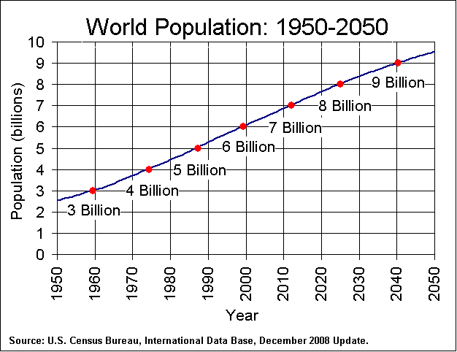

Global Energy and Environment Challenge
Economy
Society
National
Security
Environment
How Do We Provide Accessible, Affordable, and Secure Energy While Protecting the Planet (2x by 2050, 3-4x by 2100)?
Notes:
7

Slide 8
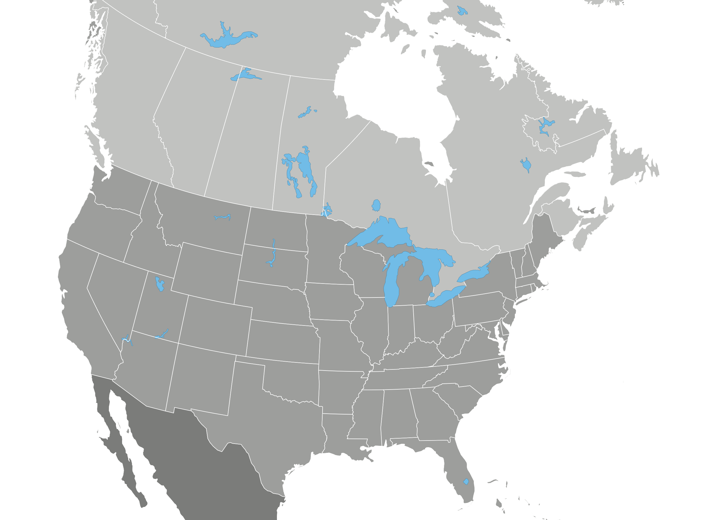
Opportunity: North American Shale Plays
Horn River Basin/
Cordova Embayment
>700 Tcf
Montney Deep Basin
>250 Tcf
Colorado Group
>300 Tcf
Bakken
3.65 Billion Bbl
Antrim
35-160 Tcf
Horton Bluff
Formation
Green River
1.3-2 Trillion Bbl
New Albany
86-160 Tcf
Utica
Shale
Gammon
Michigan Basin
Lewis/Mancos
97 Tcf
Niobrara/Mowry
Monterey
Cane
Creek
Marcellus
225-520 Tcf
Palo Duro
Woodford
Fayetteville
20 Tcf
Avalon
Floyd/
Conasauga
OIL SHALE PLAY
0
600
GAS SHALE PLAY
Haynesville
(Shreveport/Louisiana)
29-39 Tcf
MILES
Eagle Ford
25-100+ Tcfe
Barnett
24-252 Tcf
~2300 TCF (85% Shale Gas)
“100 years of Natural Gas” U.S. Consumption 23 TCF/y
Notes:
Widely distributed gas and recently oil/liquid rich plays

Slide 9
The Next 5-10 Years
~100,000 Wells, 1-2 Million Hydrofracs
Horn River Basin/
Cordova Embayment
>700 Tcf
Montney Deep Basin
>250 Tcf
Colorado Group
>300 Tcf
Bakken
3.65 Billion Bbl
Antrim
35-160 Tcf
Horton Bluff
Formation
Green River
1.3-2 Trillion Bbl
New Albany
86-160 Tcf
Utica
Shale
Gammon
Michigan Basin
Lewis/Mancos
97 Tcf
Niobrara/Mowry
Monterey
Cane
Creek
Marcellus
225-520 Tcf
Palo Duro
Woodford
Fayetteville
20 Tcf
Avalon
Floyd/
Conasauga
OIL SHALE PLAY
0
600
GAS SHALE PLAY
Haynesville
(Shreveport/Louisiana)
29-39 Tcf
MILES
Eagle Ford
25-100+ Tcfe
Barnett
24-252 Tcf
How Do We Optimize Resource Development?
How Do we Minimize the Environmental Impact?
Notes:
Widely distributed gas and recently oil/liquid rich plays

Slide 10
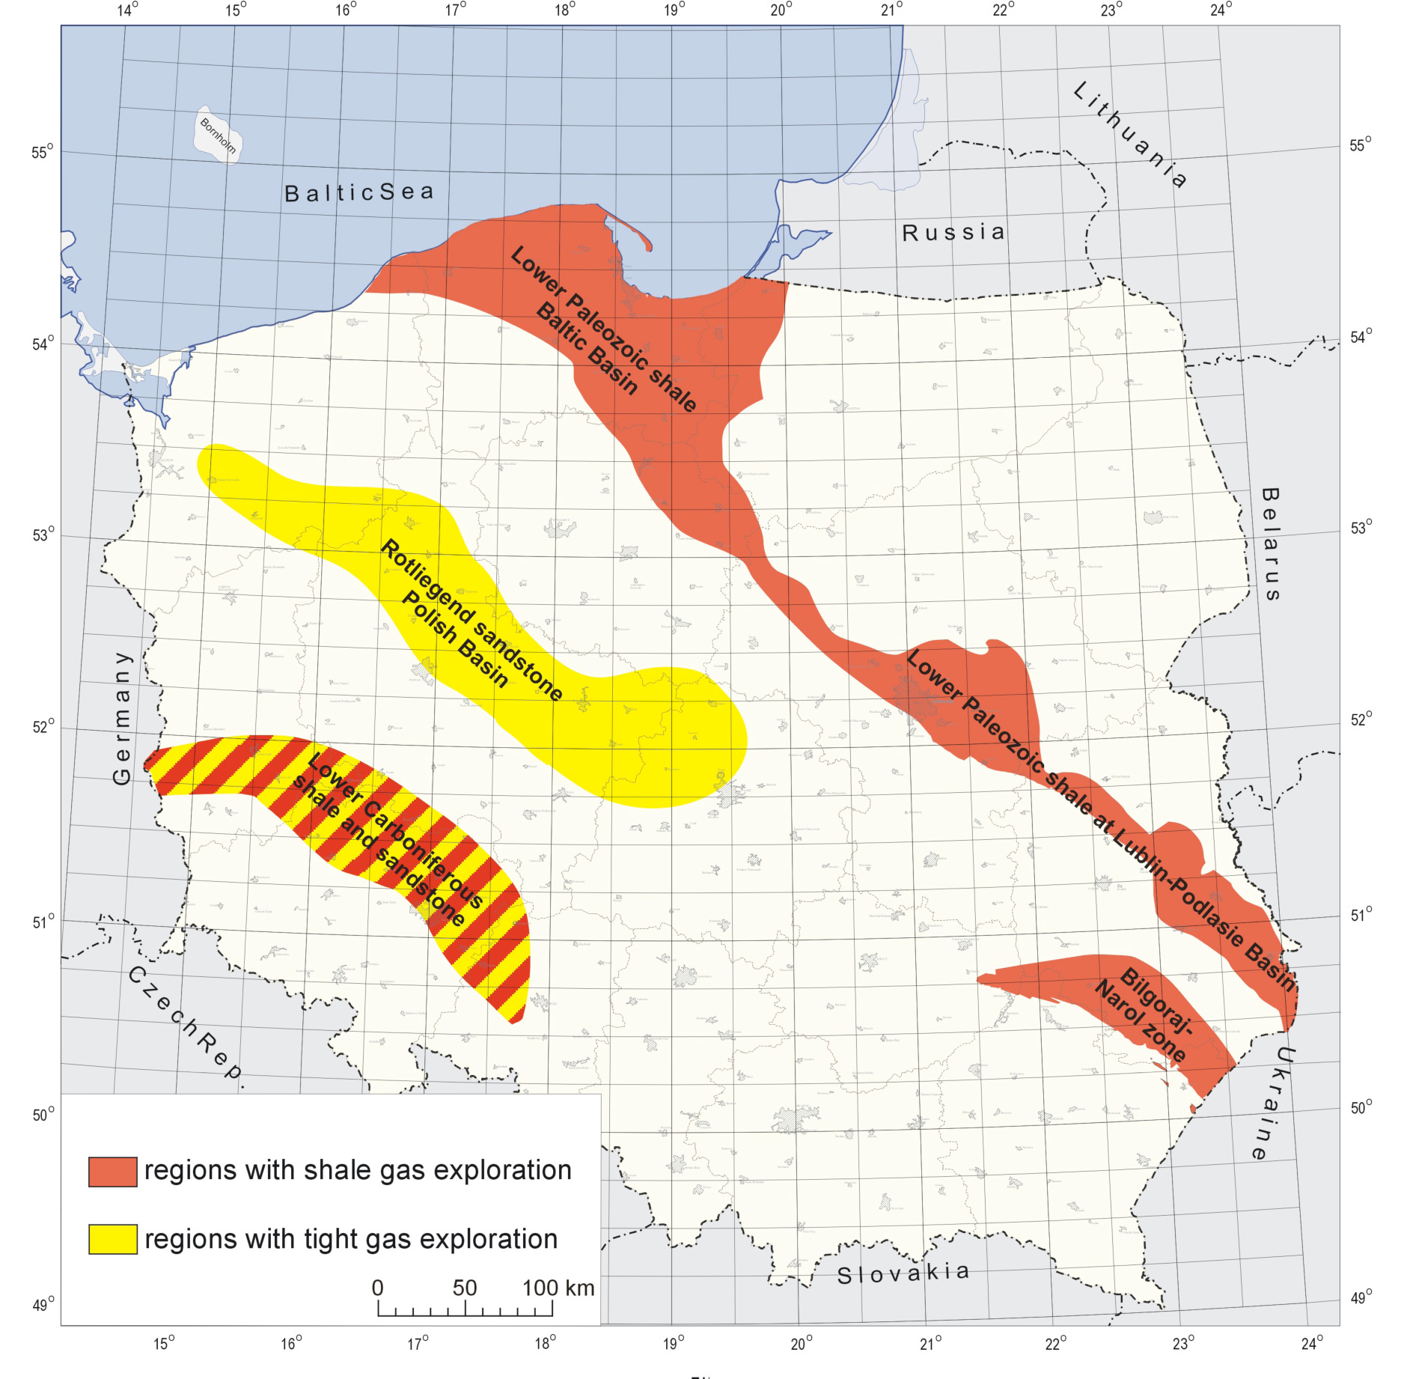
The Next 5-10 Years
? Wells, ? Hydrofracs
How Do We Optimize Resource Development?
How Do we Minimize the Environmental Impact?
Notes:
Widely distributed gas and recently oil/liquid rich plays

Slide 11
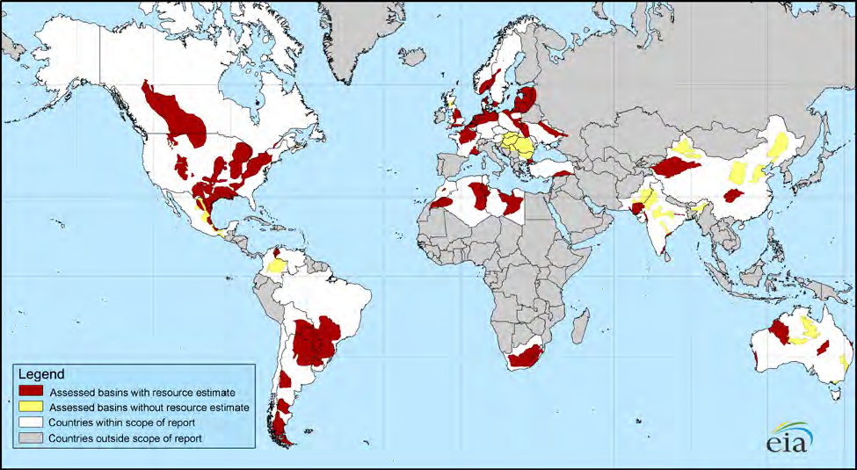
Opportunity: Global Shale Plays
Major Reassessments Reported
In England, Argentina and
Bengal Province
~22,600 TCF of Recoverable Reserves
6600 TCF from Shale (40%)
Current use ~160 TCF/year

Slide 12

Air Pollution and Energy Source*
CH₄
Oil
Coal
CO₂ | 117,000 | 164,000 | 208,000
CO | 40 | 33 | 208
NO_{x} | 92 | 448 | 457
SO₂ | 0.6 | 1,122 | 2,591
Particulates | 7.0 | 84 | 2,744
Formaldehyde | 0.75 | 0.22 | 0.221
Mercury | 0 | 0.007 | 0.016
*Pounds/Billion BTU
EIA, 1998
Global Climate & Energy Project

Slide 13
Drilling/Completion Technology
Key To Exploitation of Shale Gas
Microseismic Events
Horizontal Drilling and Multi-Stage
Slick-Water Hydraulic Fracturing
Induces Microearthquakes (M ~ -1 to M~ -3)
To Create a Permeable Fracture Network
Well
Hydraulic Fractures

Slide 14
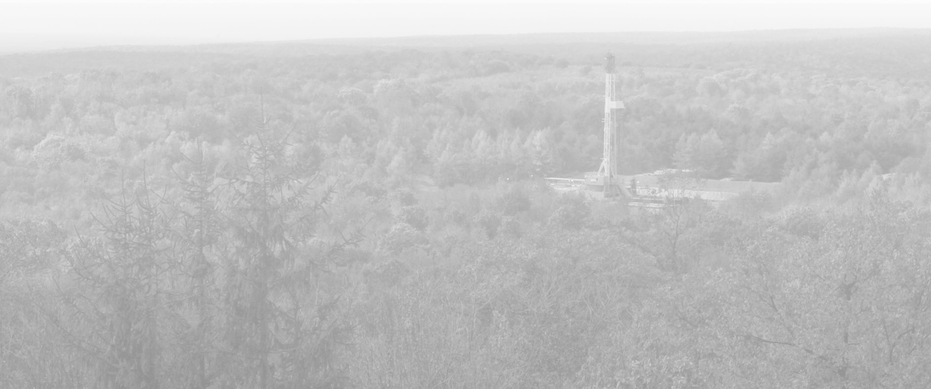
The Challenges of $4 Gas
Estimated NYMEX Price Required for 10% IRR
$8.00
2007-2008 PRICES
$6.00
NYMEX
$4.00
3/1/11
$2.00
Pinedale
Horn River
Nikanassin
Jonah
Huron Shale
Barnett (Tier 1)
Nora (CBM)
Haynesville
Uinta (Shallow)
Raton (CBM)
Barnett (Tier 2)
Barnett (Tier 3)
Granite Wash (HZ)
Wattenberg (Core)
Alberta Deep Basin
Mannville (CBM)
Fayetteville (3.4 Bcf)
Fayetteville (2.8 Bcf)
Deep Bossier (E. TX)
Woodford(Arkoma)
Alberta Shallow Gas
Powder River (CBM)
Marcellus Wet (Core)
Marcellus Dry (core)
Marcellus Dry (Tier 2)
Piceance (Highlands)
Piceance (Valley-Core)
Eagle Ford (Hawkville)
Montney (10 Stage Frac)
Woodford (Anadarko)
Jean Marie (Tight Gas)
Eagle Ford (Black Hawk)
Montney (4 Stage Frac)
Horseshoe Canyon (CBM)
Warwick (W. TX Overthrust)
Source: Morgan Stanley Research Report
Notes:
All the shale plays APC is involved in will meet 10% IRR at $4.00/mcf
Most of the larger plays such as Marcellus, Hville, EF and Horn River are economic down to lower price levels = very large COMMERCIAL resource
Sensitivities are more on some of the smaller shale resource plays
Shale gas is here to stay and will be predictable

Slide 15
Drilling/Completion Technology
Key To Exploitation of Shale Gas
Microseismic Events
Horizontal Drilling and Multi-Stage
Slick-Water Hydraulic Fracturing
Induces Microearthquakes (M ~ -1 to M~ -3)
To Create a Permeable Fracture Network
Well
Hydraulic Fractures

Slide 16
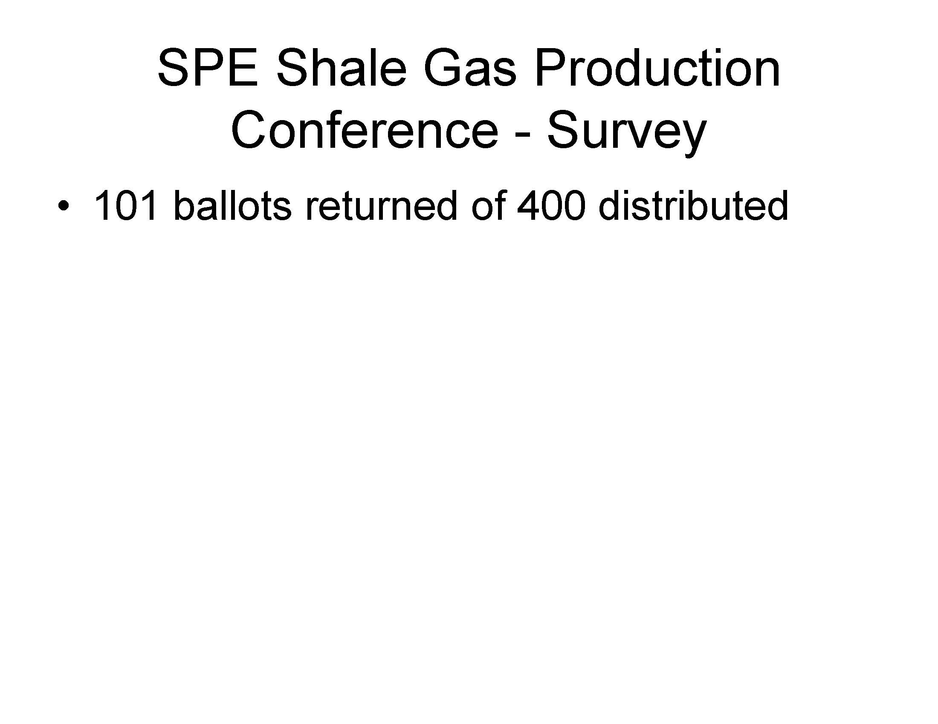
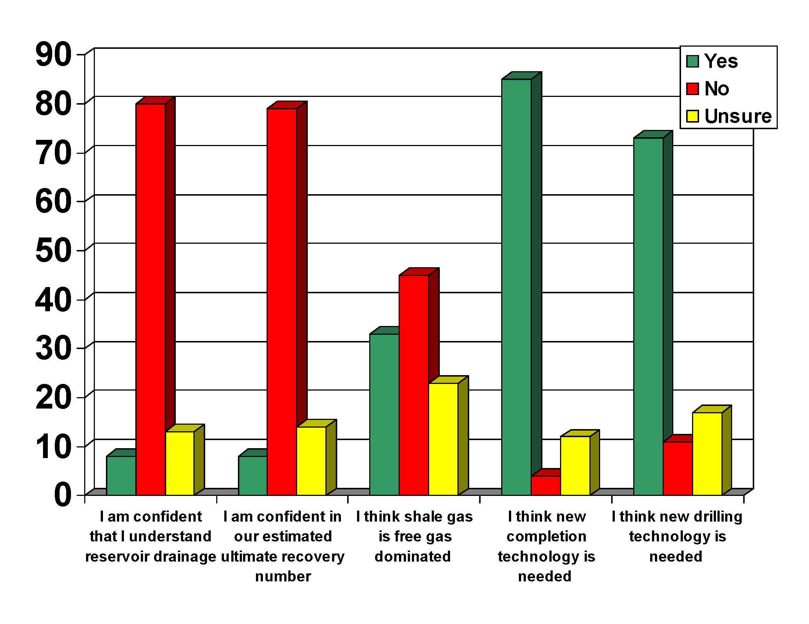

Slide 17
Research Themes
What factors control the success of slickwater frac’ing?
How do stress, fractures and rock properties affect the success of stimulation?
How do pressure and stress (and formation properties) evolve during stimulation?
What factors affect seismic and aseismic deformation mechanisms and how do these affect the reservoir?
Can we accurately model pore pressure and stress in the reservoir before, during, and after stimulation?
How do we optimize slickwater frac’ing?
Notes:
17

Slide 18
Outline of Presentation
Microseismicity and Reservoir Stimulation
Physical and Chemical Properties of Organic Rich Shales
Reservoir Drainage and EUR
Aseismic Fault Slip During Reservoir Simulation
Managing Triggered Seismicity
Minimizing the Environmental Impacts Associated with Shale Gas Development

Slide 19
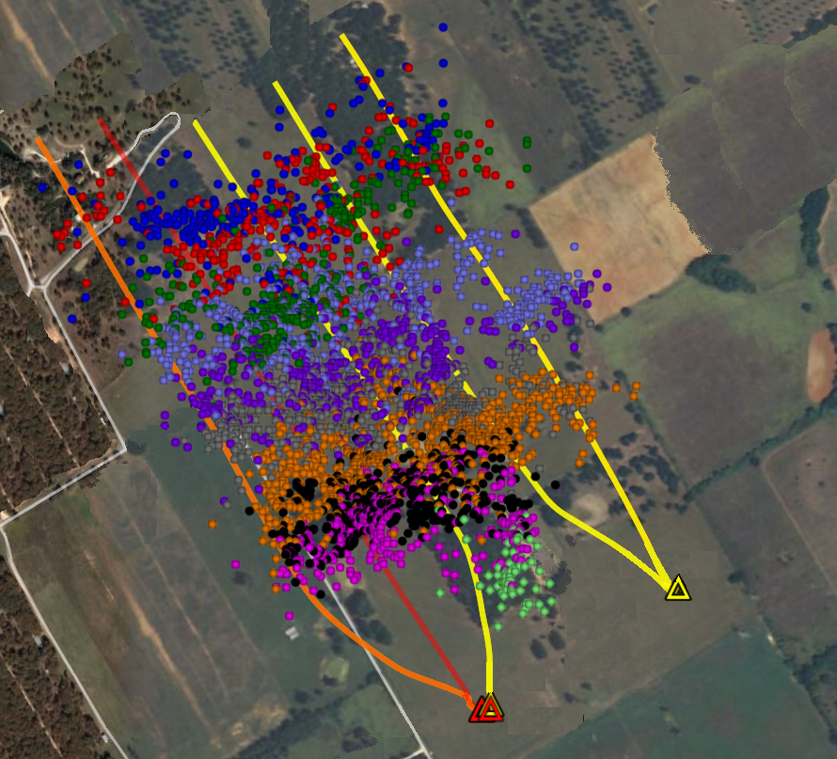
5 Wells – 50 Stages, ~ 100 Microearthquakes/Stage
Does the Cloud of Microearthquake Hypocenters Really Reflect the Stimulated Rock Volume?

Slide 20
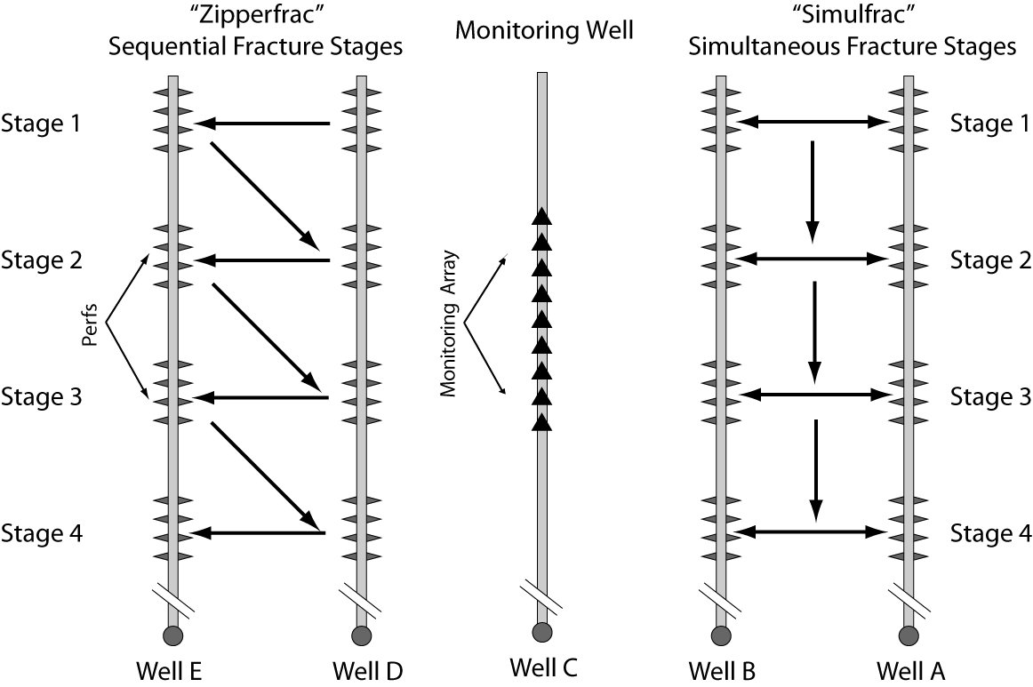
Fracturing and Monitoring Program
Stages in Well A and Well B are fractured at the same time, thus “simulfrac”
Stage in Well D and Well E are alternately fractured, thus “zipperfrac”
Well C is fractured conventionally
Fracturing of Wells A, B, D, & E are monitored by an array in Well C
Fracturing of Well C is monitored by an array in the vertical portion of Well B
Wells divided into 300 ft frac intervals
6 perf groups per interval, each 50 feet apart
Notes:
20

Slide 21
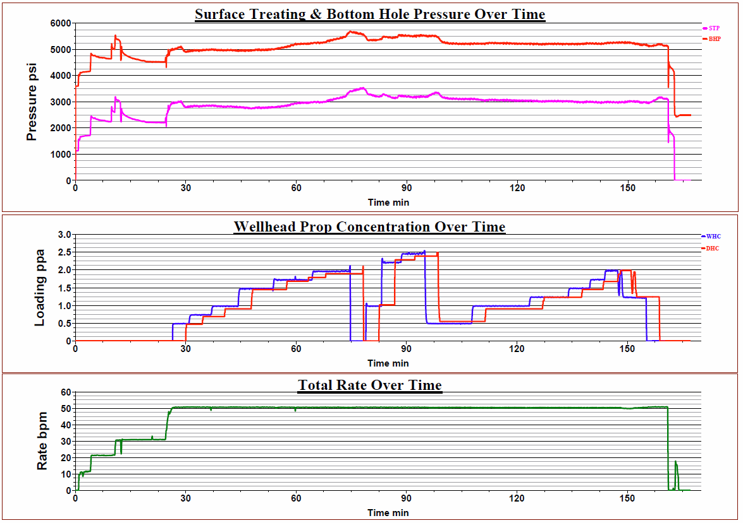
Nearly All Frac Stages Were Quite Similar
Water: ~325,000 gal, Sand: ~400,000 lbs, Pumping Time: ~150 mins, Max Slurry Rate: 50-60 bpm
Well C
Stage 6
Notes:
21

Slide 22
5 Number of Earthquakes Increase with Stage #

Slide 23
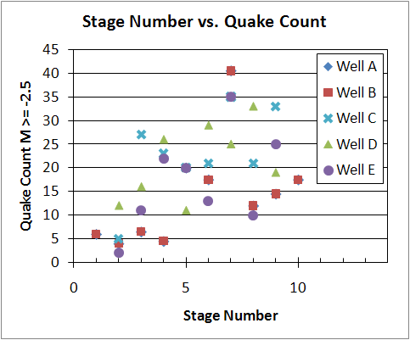
Why More Microearthquakes in Later Stages?
Notes:
23

Slide 24
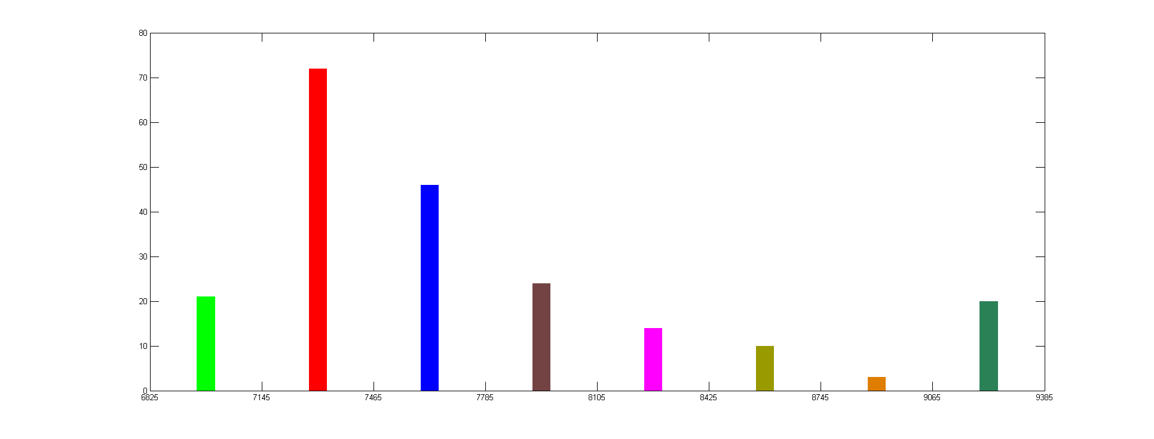
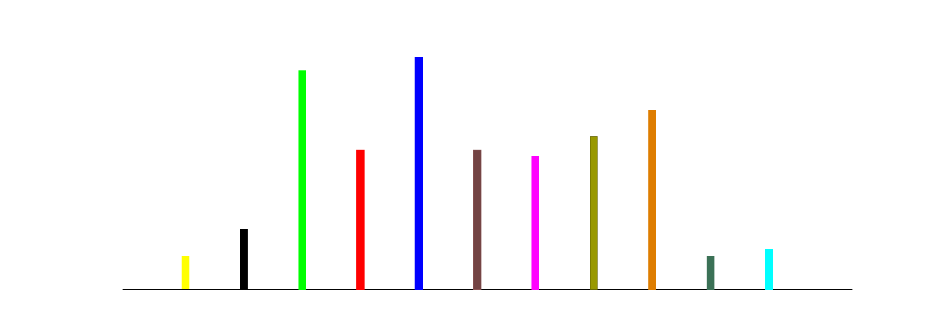
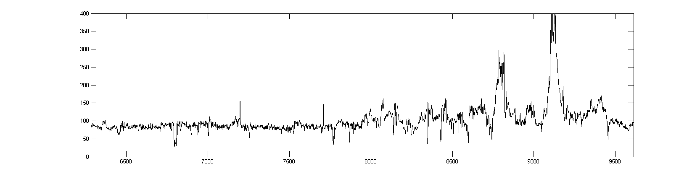
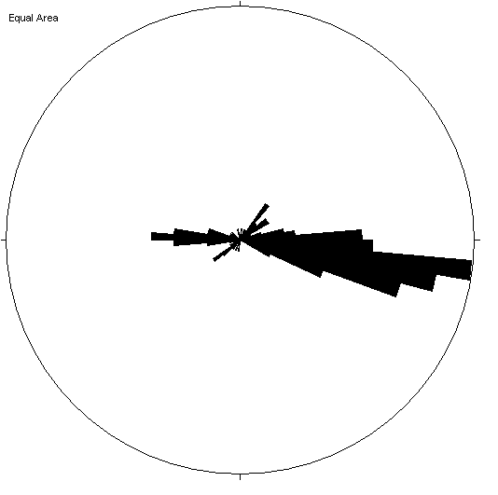
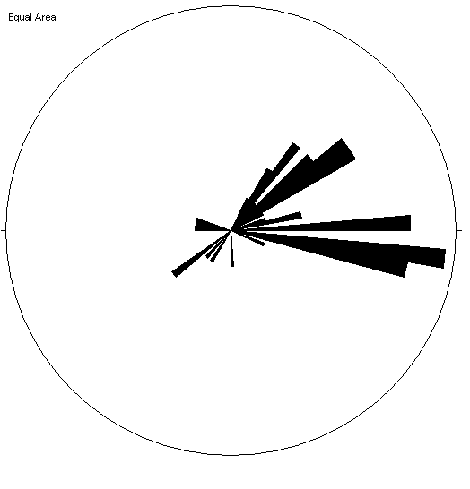
Well C
Recording Arrays in C
while frac-ing A-B
Heel
Toe
11
10
9
8
7
6
5
4
3
2
1
Frac Stages
80
Natural Fractures in Each Frac Stage (from FMI)
0
40
Number of meqs ≥-2.5 per Stage
0
400
API
Gamma Ray
0
Stages 6-9
Stages 1-5
S_{Hmax}
S_{Hmax}
Fracture Strikes

Slide 25
ISIP’s Escalate From Toe To Heel – Well C
Cumulative increase in ISIPs from the toe to the heel of the well
900 psi difference between Stage 1 and peak at Stage 9
Decline seen in last two stages
Notes:
25

Slide 26
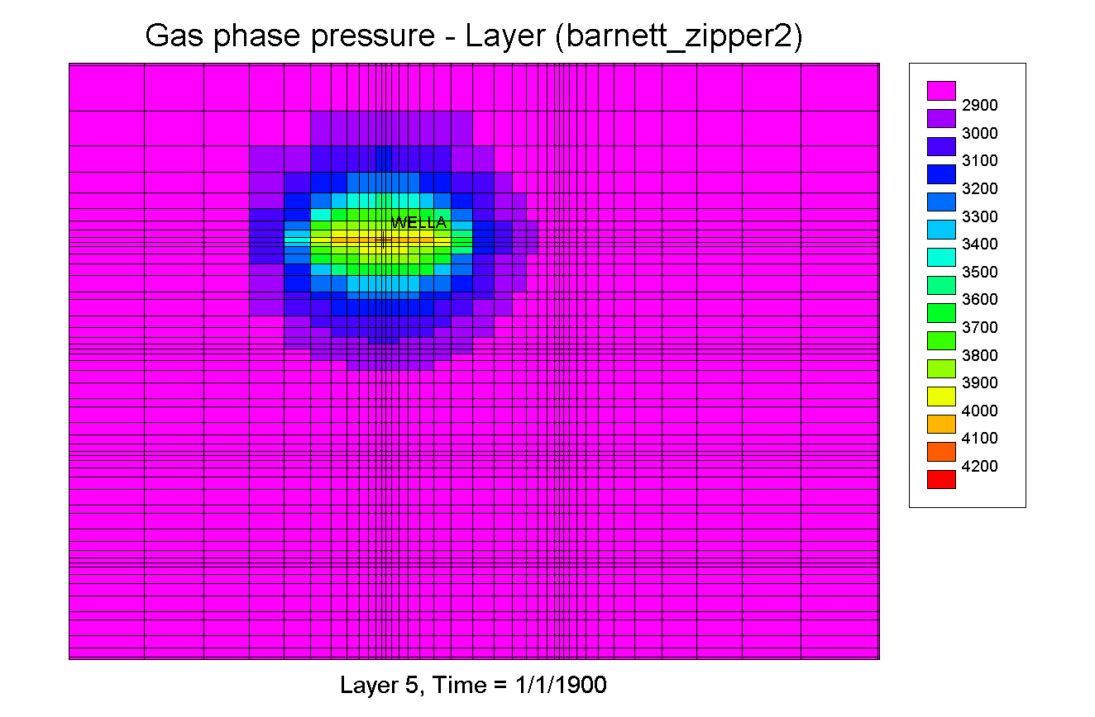
Is the Cumulative Effect of Frac’ing
Changing Pore Pressure and Stress?
Modeling
Poroelastic
Stress Changes
Well E
Well E
Well D
X
Well D
X
X
X
X
X
X
X

Slide 27
Outline of Presentation
Microseismicity and Reservoir Stimulation
Physical and Chemical Properties of Organic Rich Shales
Reservoir Drainage and EUR
Aseismic Fault Slip During Reservoir Simulation
Managing Triggered Seismicity
Minimizing the Environmental Impacts Associated with Shale Gas Development

Slide 28
Physical and Chemical Properties of Organic Rich Shales
How Do the Properties of Shale Affect the Outcome of Hydraulic Fracturing Stimulation?
5 Wells, 40 Stages, 4050 Microseismic Events

Slide 29
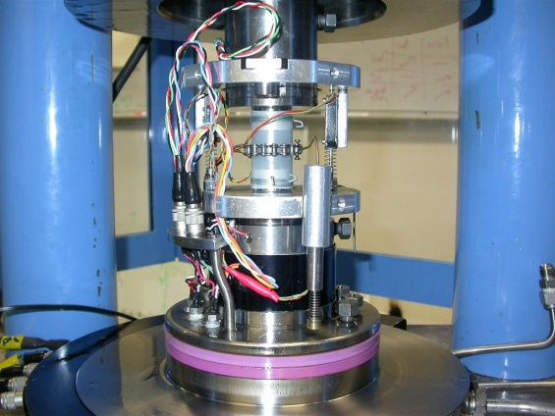
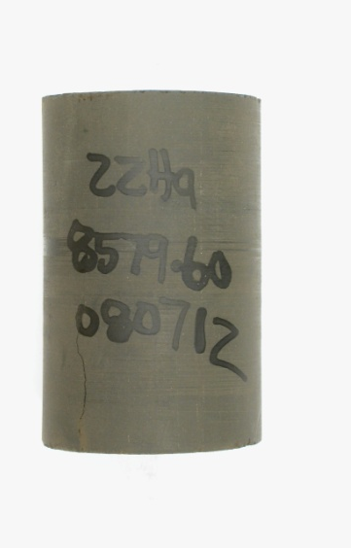
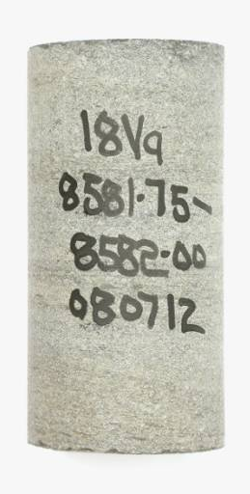
Organic Rich Shales
Sample group | Clay | Carbonate | QFP | TOC (wt%)
Barnett-dark | 29-43 | 0-6 | 48-59 | 4.1-5.8
Barnett-light | 2-7 | 37-81 | 16-53 | 0.4-1.3
Haynesville-dark | 36-39 | 20-23 | 31-35 | 3.7-4.1
Haynesville-light | 20-22 | 49-53 | 23-24 | 1.7-1.8
Fort St. John | 32-39 | 3-5 | 54-60 | 1.6-2.2
Eagle Ford-dark | 12-21 | 46-54 | 22-29 | 4.4-5.7
Eagle Ford-light | 6-14 | 63-78 | 11-18 | 1.9-2.5
Bedding plane and sample cylinder axis are either:
parallel (horizontal samples) or
perpendicular (vertical samples)
3-10 % porosity
All room dry, room temperature experiments
In-situ (and lab) effective stress between 15-30 MPa

Slide 30
Young’s Modulus
Strength
Bed-Parallel Samples
UCS (MPa)
Young’s Modulus (GPa)
Approximate Clay Content (%)
Approximate Clay Content (%)
Strength decreases with clay content
Internal friction coefficient decreases from 0.9 to 0.2
Modulus correlate with clay content and porosity
Bedding parallel samples are systematically stiffer
Notes:
30

Slide 31
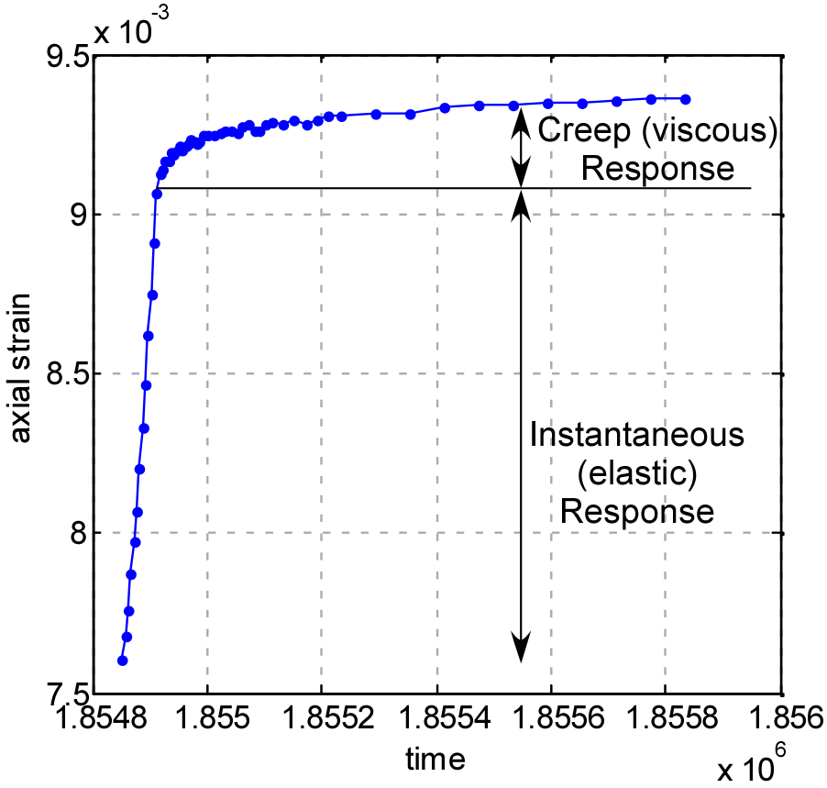
Shales Creep With Time (Viscoplastic)
Creep may prevent brittle fracturing (stimulation) and promote propant-embedment
Creep relaxes stresses

Slide 32
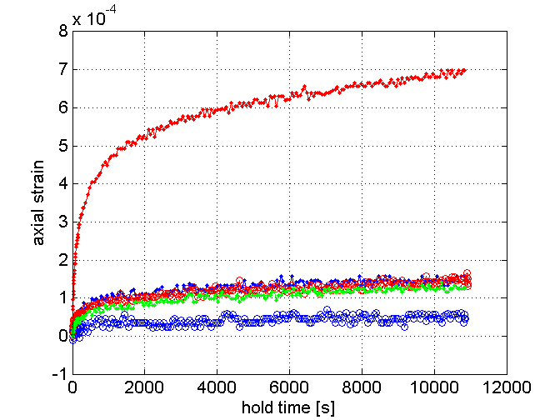
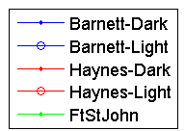
Creep Increases with Clay Content
39%clay
25%
22% clay
33%
5% clay
Notes:
32

Slide 33
Floyd Shale?
Horn River Basin/
Cordova Embayment
>700 Tcf
Montney Deep Basin
>250 Tcf
Colorado Group
>300 Tcf
Bakken
3.65 Billion Bbl
Antrim
35-160 Tcf
Horton Bluff
Formation
Green River
1.3-2 Trillion Bbl
New Albany
86-160 Tcf
Utica
Shale
Gammon
Michigan Basin
Lewis/Mancos
97 Tcf
Niobrara/Mowry
Monterey
Cane
Creek
Marcellus
225-520 Tcf
Palo Duro
Woodford
Fayetteville
20 Tcf
Avalon
Floyd/
Conasauga
OIL SHALE PLAY
0
600
GAS SHALE PLAY
Haynesville
(Shreveport/Louisiana)
29-39 Tcf
MILES
Eagle Ford
25-100+ Tcfe
Barnett
24-252 Tcf
Notes:
Widely distributed gas and recently oil/liquid rich plays

Slide 34
Average Shale Properties
 | BARNETT | MARCELLUS | EAGLE FORD | FLOYD
Depth (ft) | 3 – 9,000 | 2 – 9,500 | 4 – 13,500 | 6 – 13,000
TOC (%) | 1 – 10 | 1 – 15 | 2 – 7 | 1 – 7
RO (%) | 0.7 – 2.3 | 0.5 – 4+ | 0.5 – 1.7 | 0.7 – 2+
Porosity (%) | 2 – 14 | 2 – 15 | 6 – 14 | 1 – 12
Qtz + Calcite (%) | 40 – 50 | 40 – 60 | 50 – 80 | 20 – 30
Clay (%) | 20 – 40 | 30 – 50 | 15 – 35 | 45 – 65
Areal Extent (mi²) | 22,000 | 60,000 | 15,000 | 6,000
Resource Size (Tcf) | 25 – 250 | 50 – 500 | 10 – 100 | <<1
Subtle variations can mean large variations in economics
Notes:
Subtle variations can = very large differences in commerciality

Slide 35
Is the Floyd Shale too Viscous to Stimulate?
39%clay
25%
22% clay
33%
5% clay
Notes:
35

Slide 36
Eagleford Shale Pore Structure
Notes:
36

Slide 37
Eagleford Shale Pore Structure
Notes:
37

Slide 38
Eagleford Shale Pore Structure
Notes:
38

Slide 39
Outline of Presentation
Microseismicity and Reservoir Stimulation
Physical and Chemical Properties of Organic Rich Shales
Reservoir Drainage and EUR
Aseismic Fault Slip During Reservoir Simulation
Managing Triggered Seismicity
Minimizing the Environmental Impacts Associated with Shale Gas Development

Slide 40
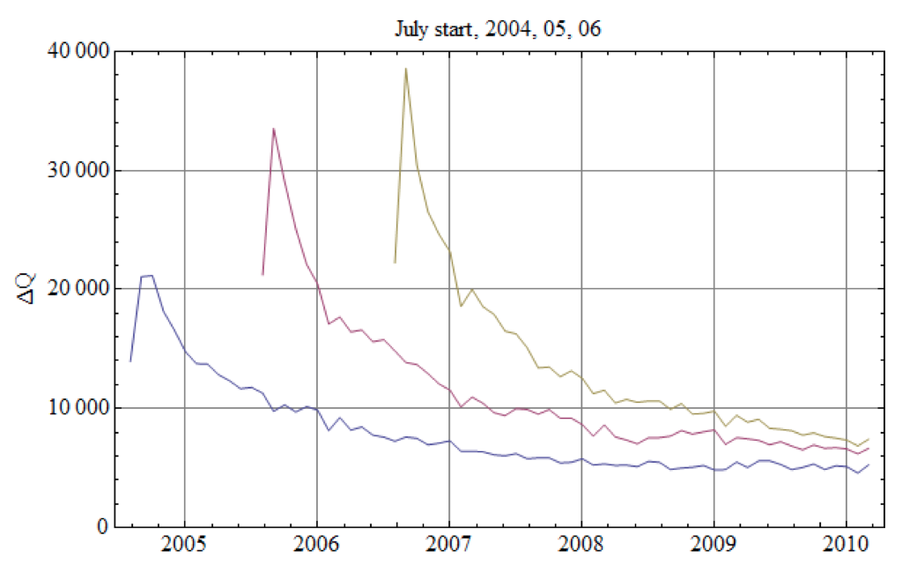
Why Is Production Persistent?
Average Monthly Well Production
Barnett Shale
Valko and Lee (2010)
Extended Exponential Model
SPE 134231
Notes:
40

Slide 41
Reservoir Drainage and EUR
~100 m
~300 m
How is an interconnected pore and fracture network created from:
Nano-scale pore network?
Pre-existing micro-cracks?
Pre-existing macro-scale fractures?
Induced shear events?
Slick-water frac plane?
~50 m
How does slip on ~100, ~ 1m fault patches change permeability and create an interconnected fracture network in the stimulated volume?
Notes:
41

Slide 42
Scale Dependent Flow Mechanisms
Sondergeld et al., 2010
Notes:
42

Slide 43
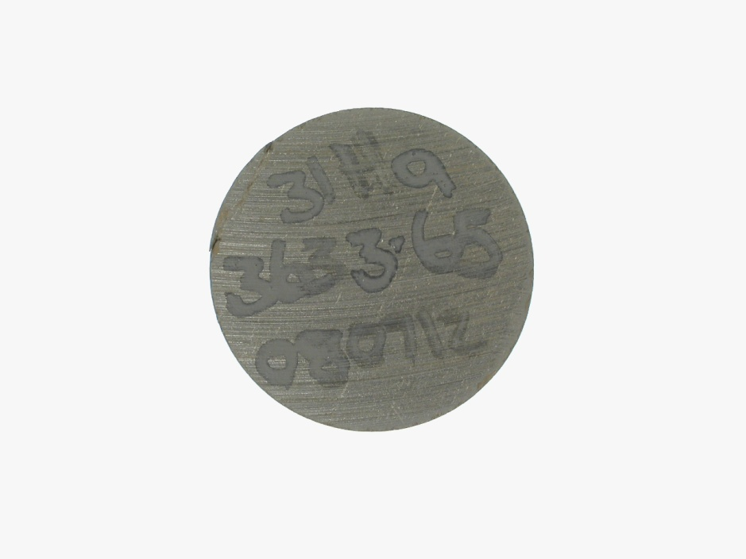
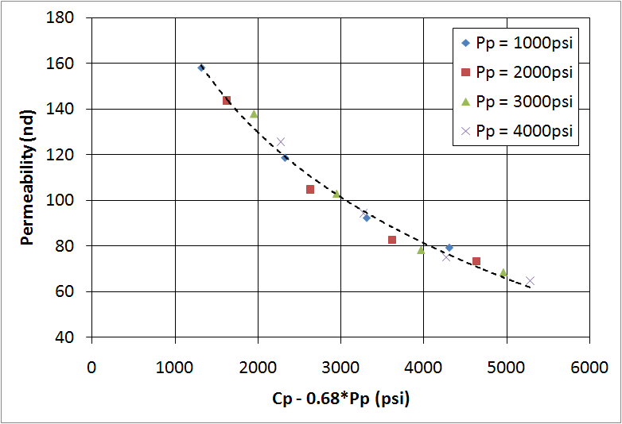
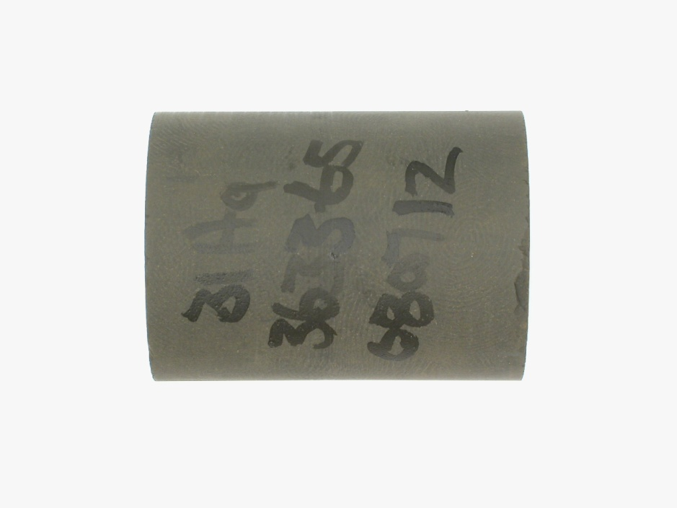
Permeability of Barnett Shale
Effective Stress Coefficient: χ = 0.68
Barnett Shale 31Ha
Typical dark, organic-rich sample
51.3% qtz, 0.4% carbonate, 37.4% clay, 5.3% TOC
Density porosity: 10.7%
Permeability Dominated by Flow Through Microcracks

Slide 44

Knudsen Diffusion
Knudsen diffusion will be the dominant mechanism whenever the mean free path is large compared with the pore diameter.
Collisions with the pore walls will be more frequent than those between the molecules
Knudsen diffusion prevails:
1) when gas density is low
2) when pore dimensions are very small
Notes:
44

Slide 45
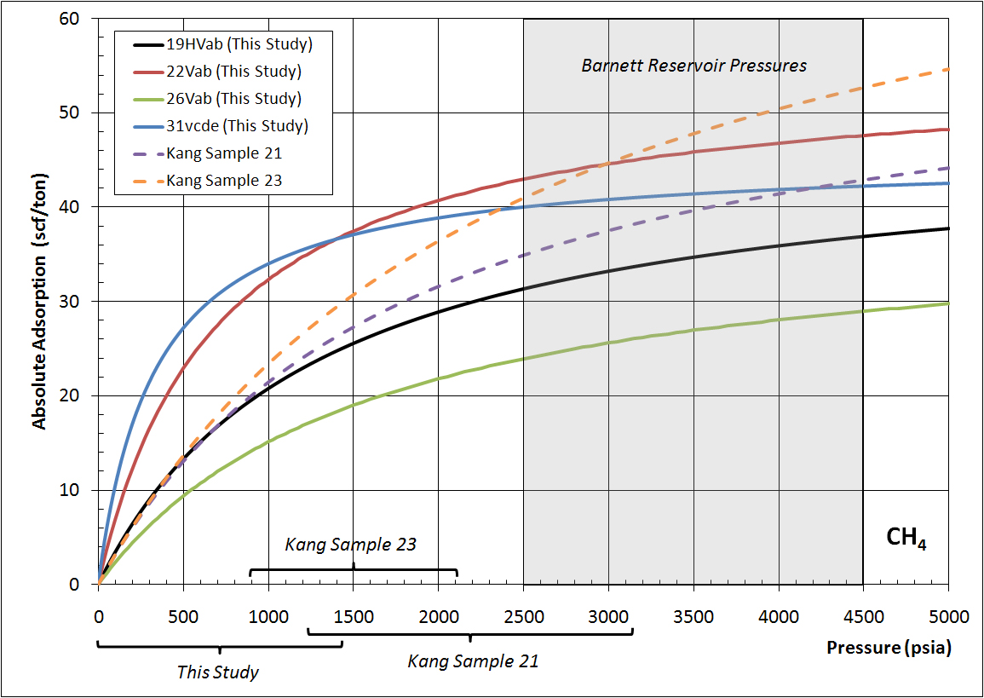
Is Desorption Important?

Slide 46
Why Is Production Persistent?
Average Monthly Well Production
Barnett Shale
Valko and Lee (2010)
Extended Exponential Model
SPE 134231
Are Diffusion and Desorption
Dominant?
How Long Will Production
Persist?
Notes:
46

Slide 47
Outline of Presentation
Microseismicity and Reservoir Stimulation
Physical and Chemical Properties of Organic Rich Shales
Reservoir Drainage and EUR
Aseismic Fault Slip During Reservoir Simulation
Managing Triggered Seismicity
Minimizing the Environmental Impacts Associated with Shale Gas Development

Slide 48
Off-Fault Damage – Zero Cohesion
Volume Affected by 4000 Microearthquakes Can
Account for Less Than 1% of Gas Production in First 6 Months

Slide 49
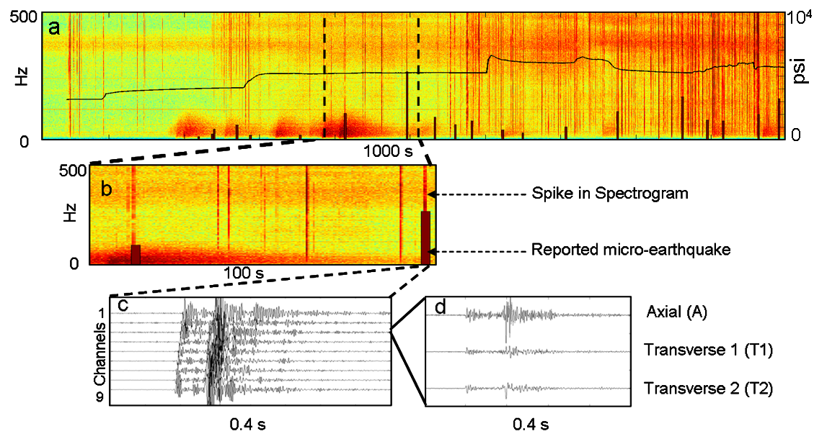
Typical Microearthquakes
Das and Zoback, The Leading Edge (July 2011)

Slide 50
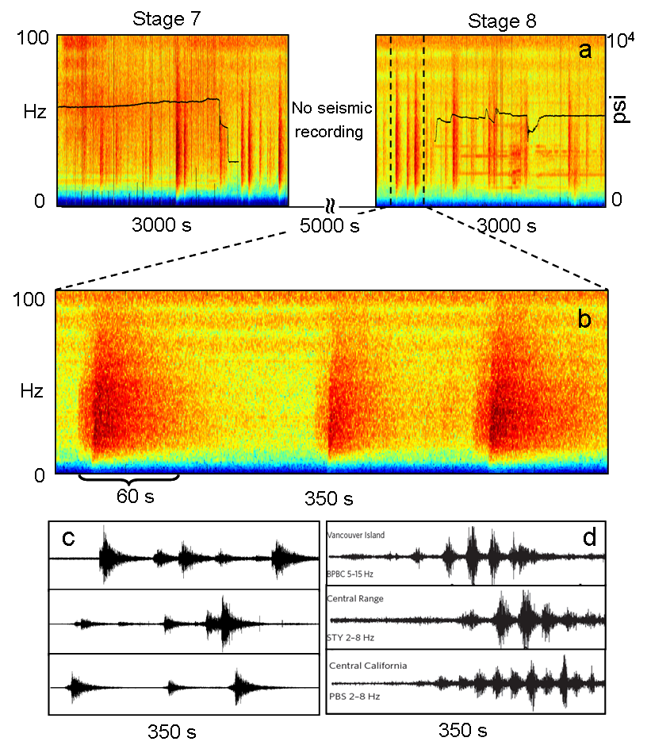
Long Period Long Duration Seismic Events
Das and Zoback,
The Leading Edge (July 2011)

Slide 51
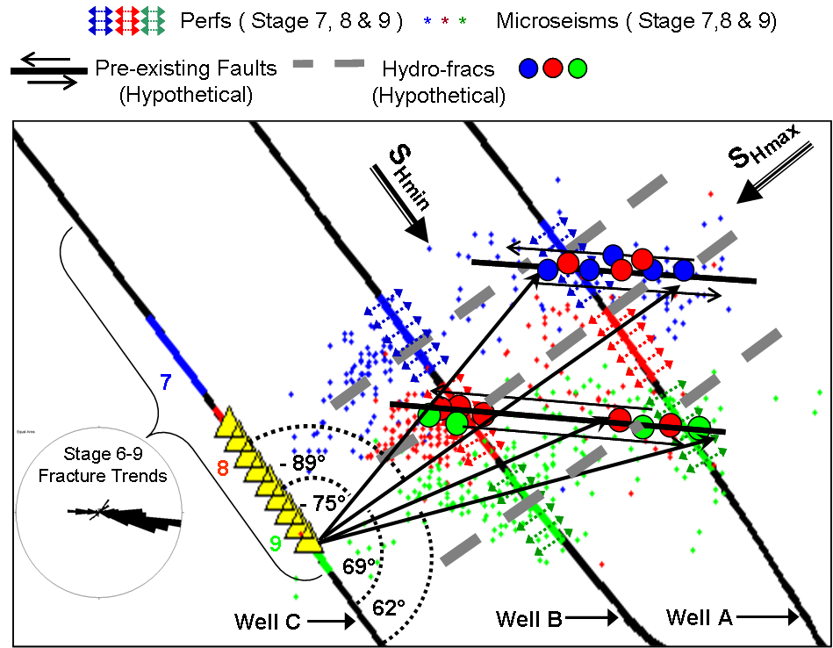
Slow Slip on Cross-Cutting Faults?
Das and Zoback, The Leading Edge (July 2011)

Slide 52
Can we Identify Optimal Areas For Reservoir
Stimulation Before Drilling and Frac’ing?

Slide 53
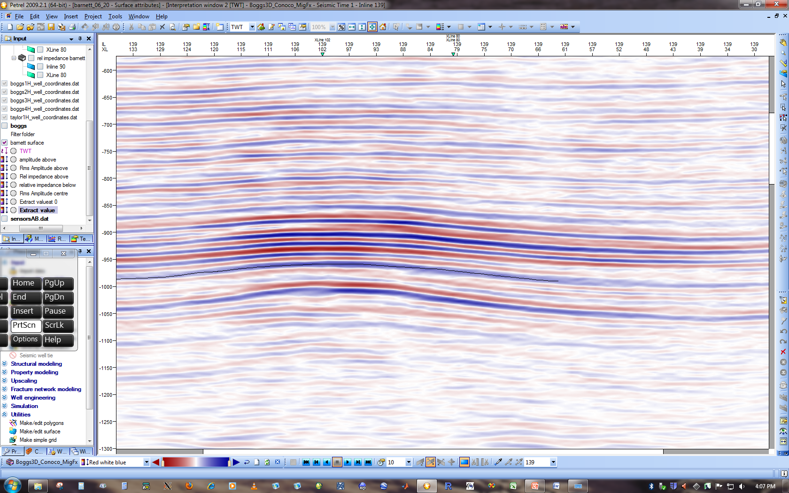
Relation of LPLD Events with Reservoir Properties
Horizons
Formation Top
Formation Bottom

Slide 54
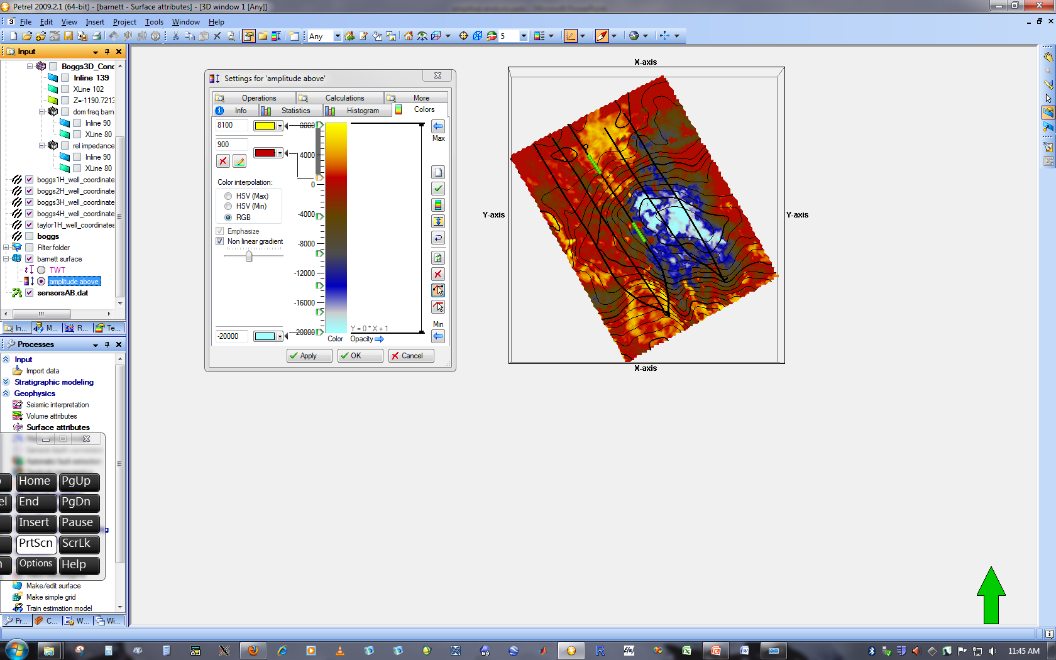
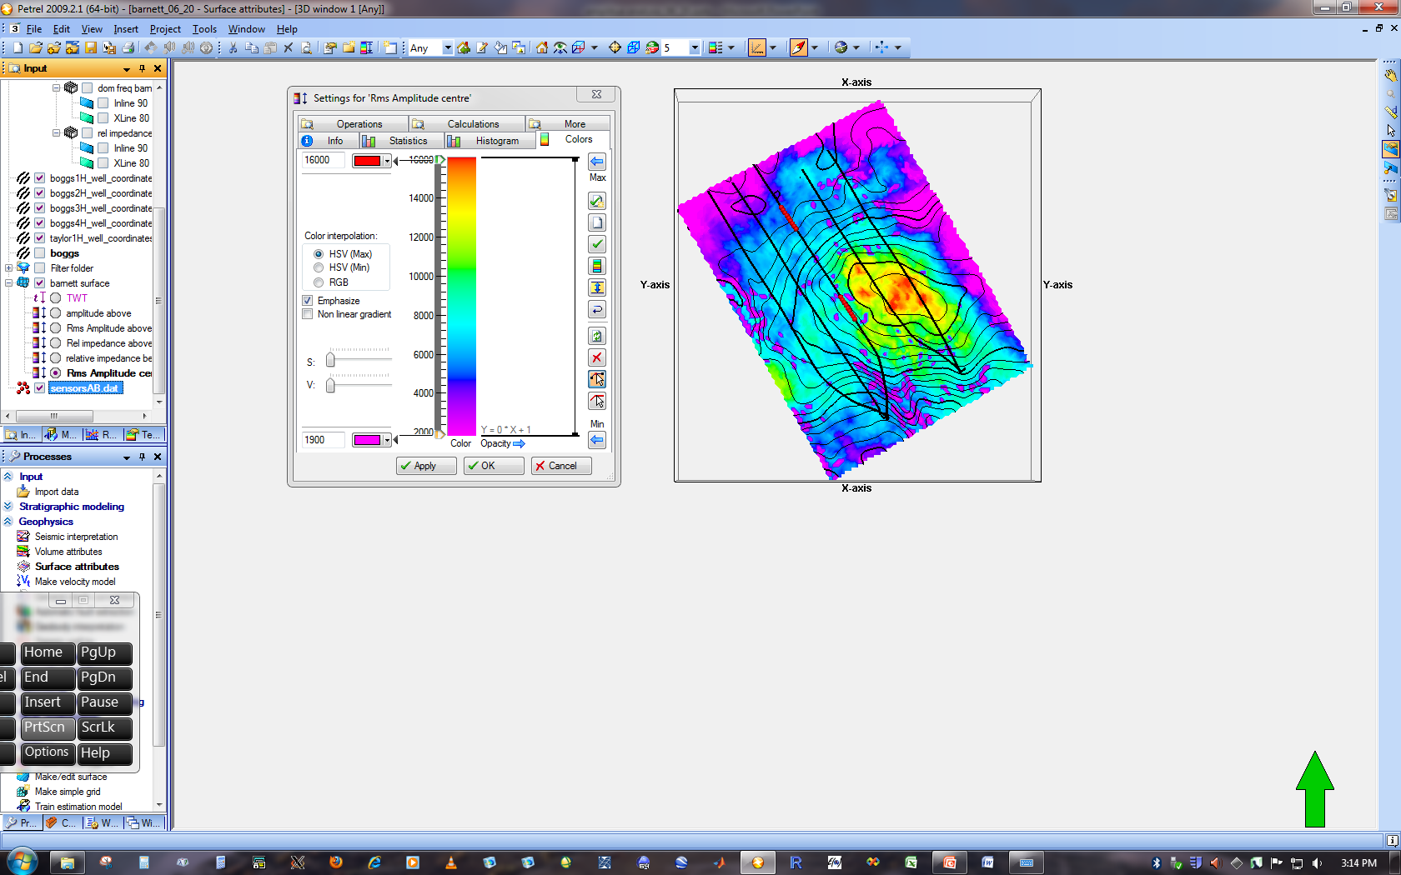
Attribute Analysis
Actual Amplitude Formation Top
RMS Amplitude Formation Top
8000
16000
-20000
2000
Location of LPLD events are correlative with amplitude anomalies

Slide 55
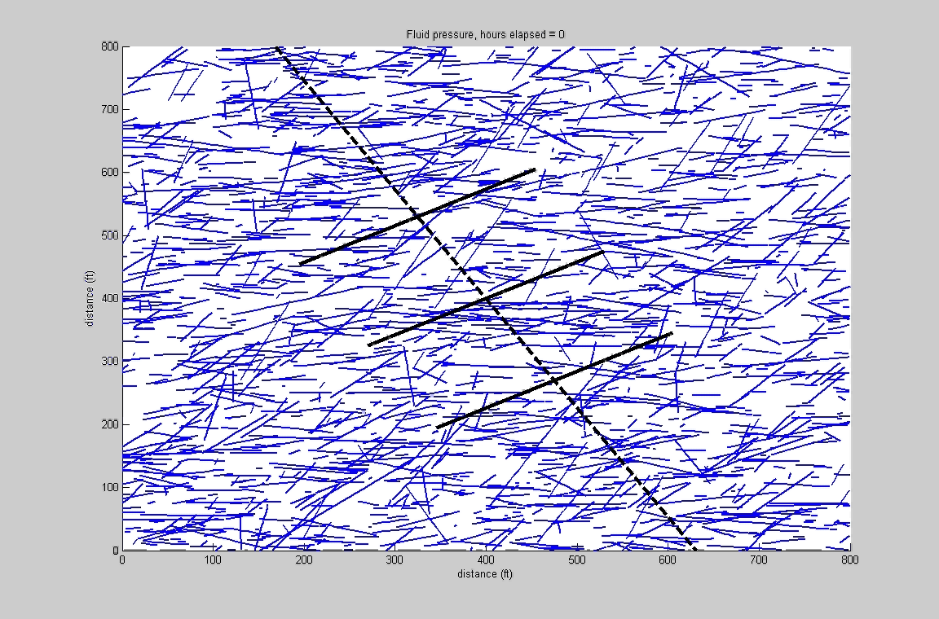
Evolution of Aseismic Slip in Reservoirs

Slide 56
Well C
Recording Arrays in C
while frac-ing A-B
Heel
Toe
11
10
9
8
7
6
5
4
3
2
1
Frac Stages
80
Natural Fractures in Each Frac Stage (from FMI)
0
40
Number of meqs ≥-2.5 per Stage
0
400
API
Gamma Ray
0
Light ➔Stick-Slip
Dark ➔Stable
Stages 6-9
Stages 1-5
S_{Hmax}
S_{Hmax}
Fracture Strikes

Slide 57
Physical and Chemical Properties of Organic Rich Shales
How Do the Properties of Shale Affect the Outcome of Hydraulic Fracturing Stimulation?
5 Wells, 40 Stages, 4050 Microseismic Events

Slide 58
Outline of Presentation
Microseismicity and Reservoir Stimulation
Physical and Chemical Properties of Organic Rich Shales
Reservoir Drainage and EUR
Aseismic Fault Slip During Reservoir Simulation
Managing Triggered Seismicity
Minimizing the Environmental Impacts Associated with Shale Gas Development

Slide 59
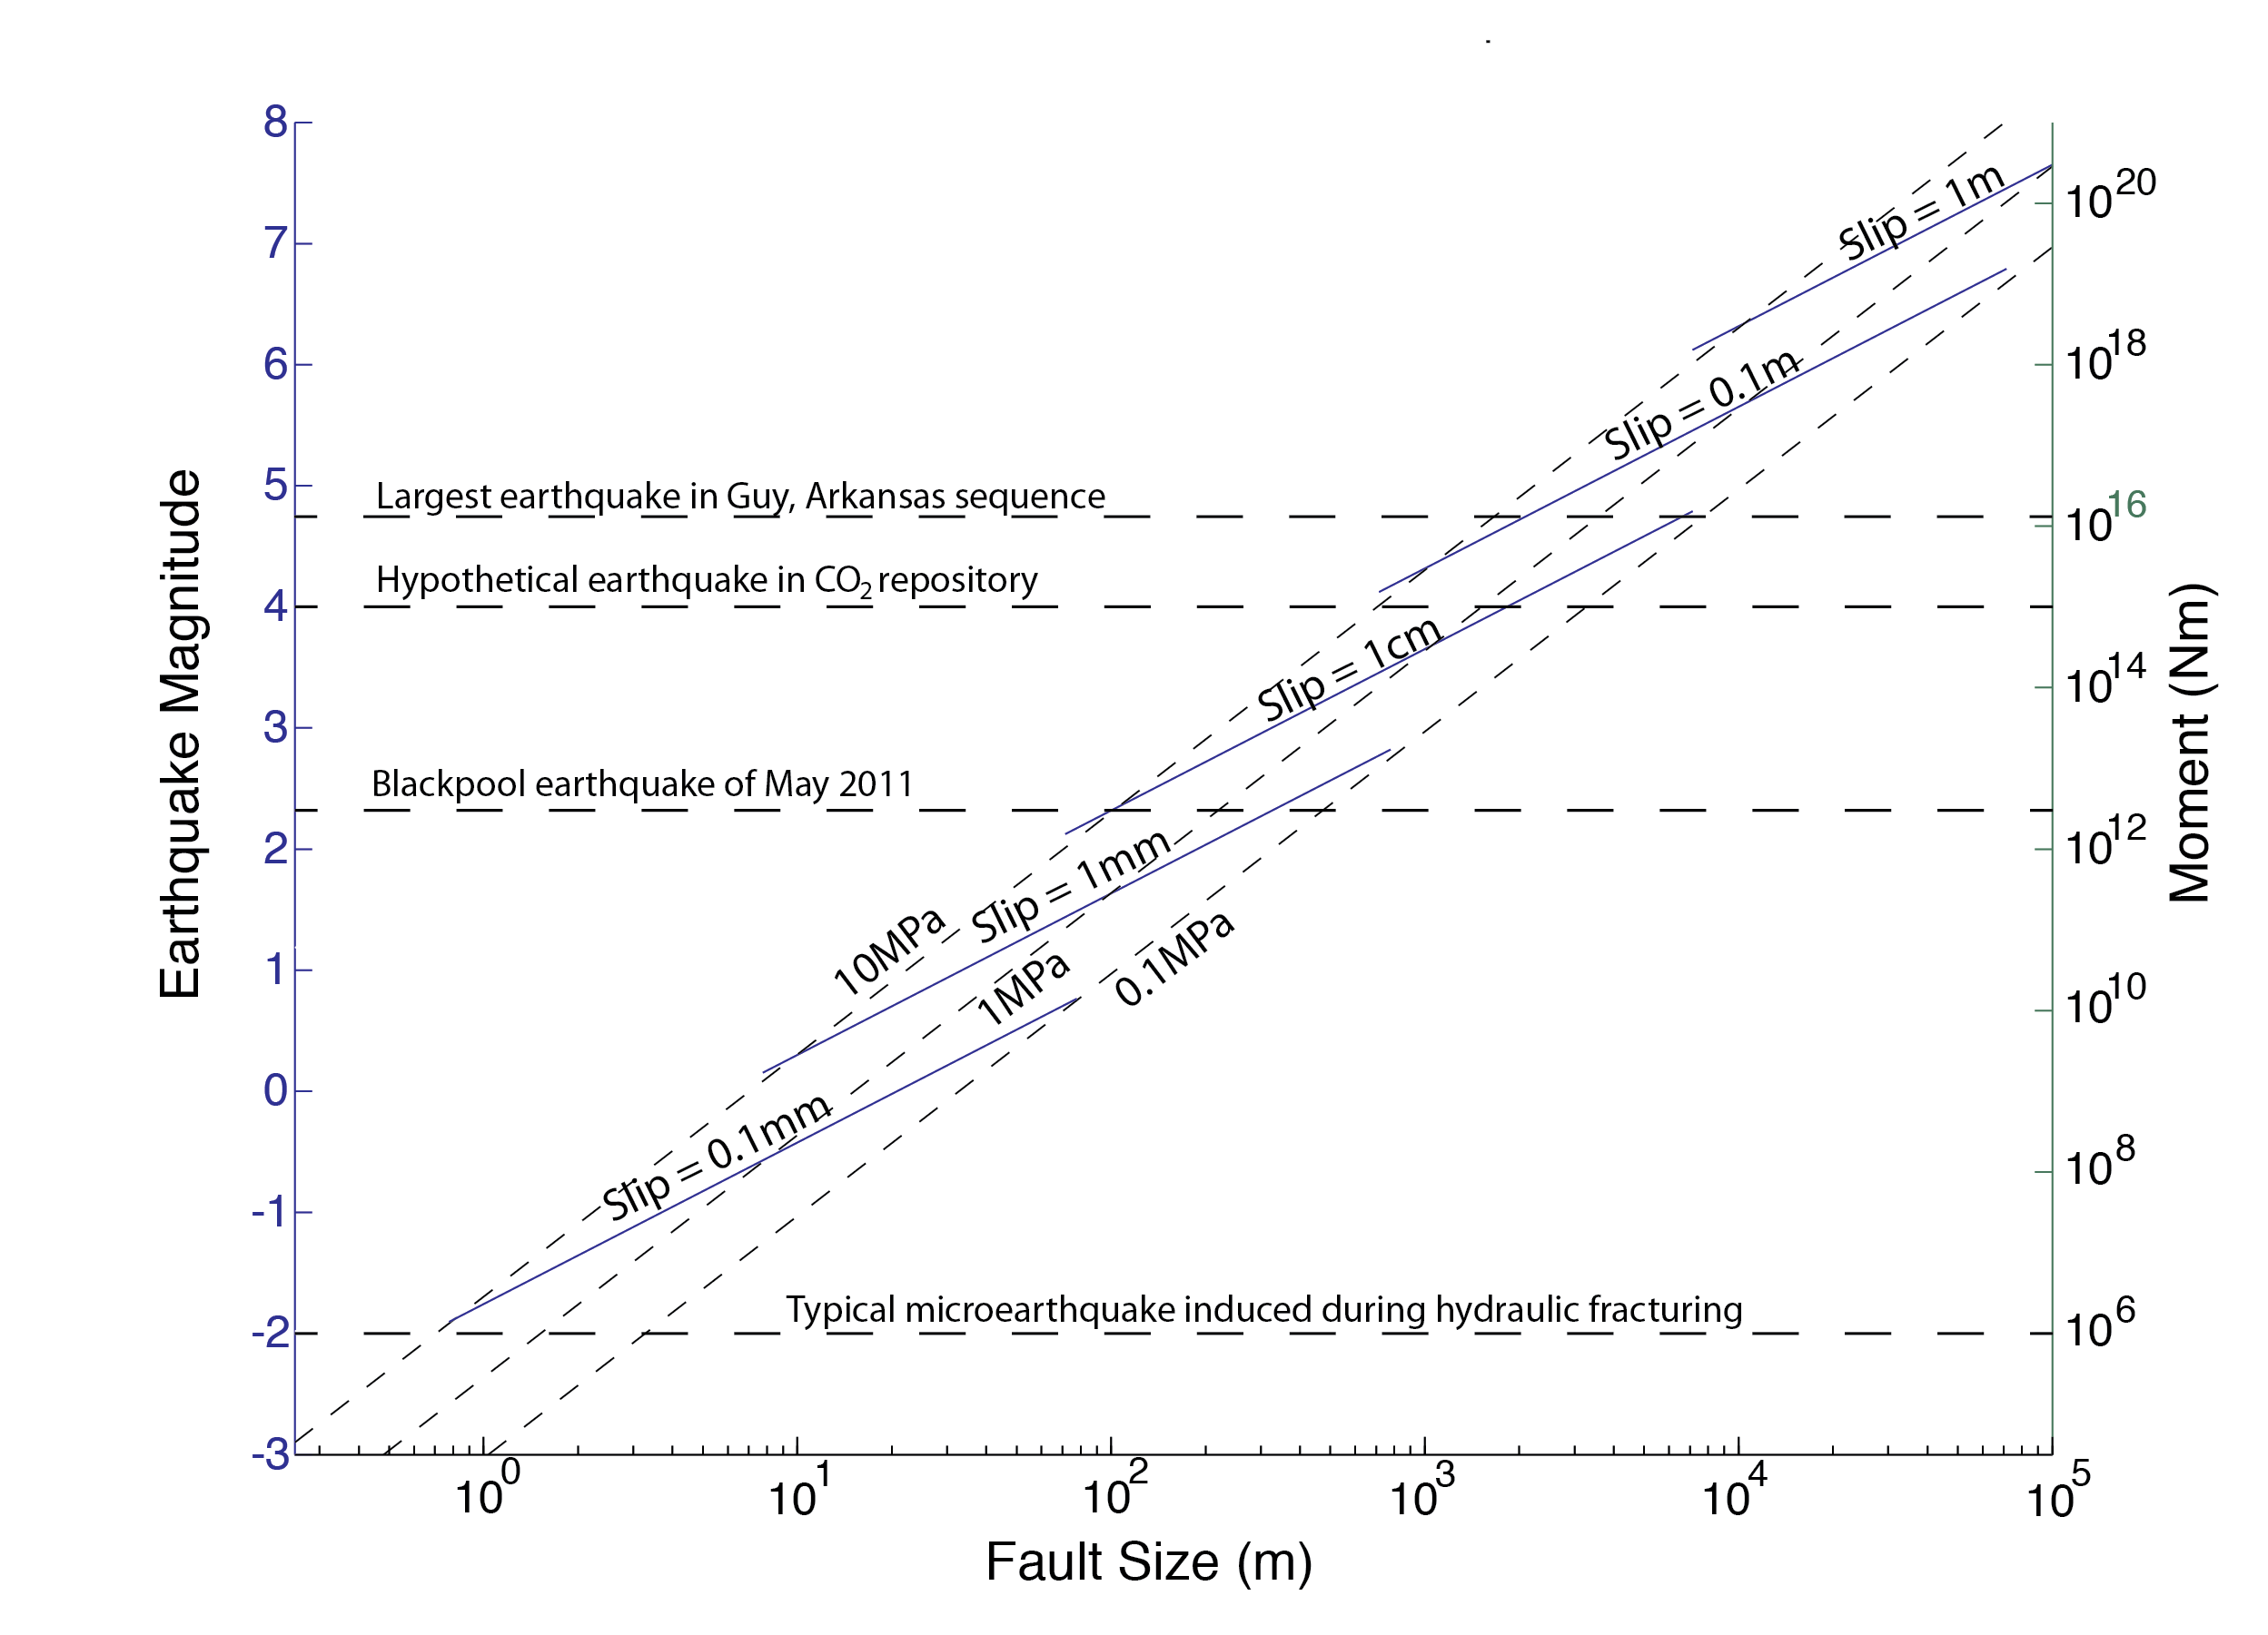
Scaling Fault Slip in Earthquakes
Notes:
59

Slide 60
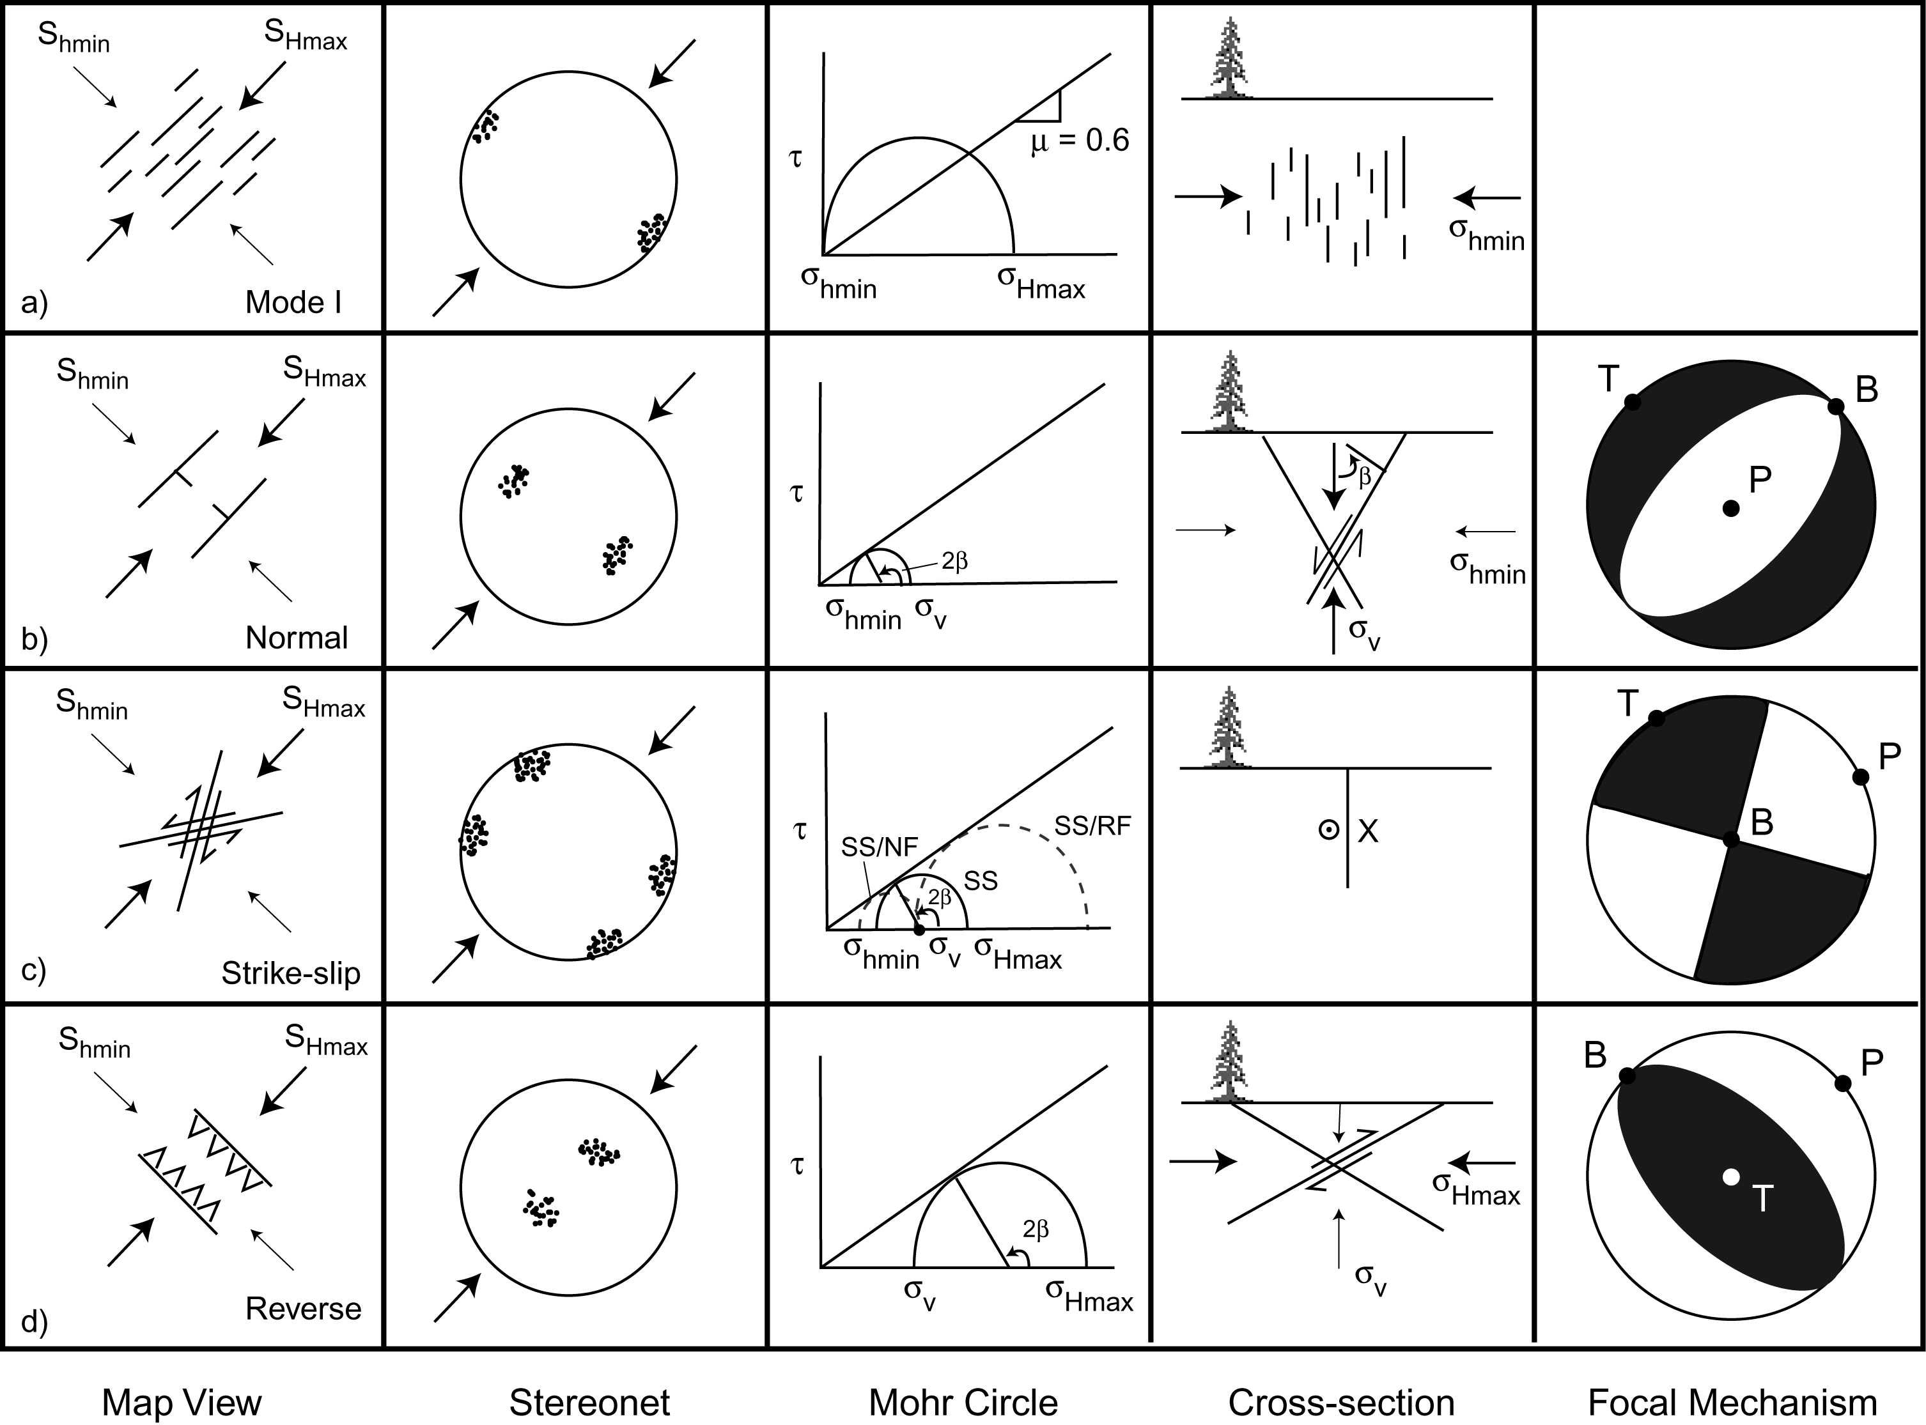
Relationship Between Stress State and Fault Slip
Normal faults trend parallel to S_{Hmax}
Normal
Strike-slip faults trend about
±30° from S_{Hmax}
Strike-Slip
Reverse faults trend perpendicular
to S_{Hmax}
Reverse

Slide 61
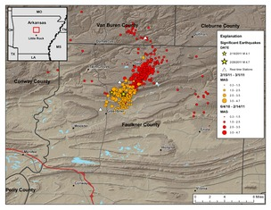
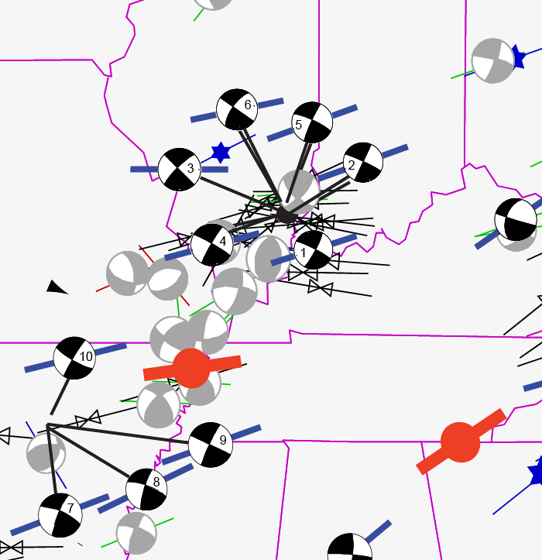
Stress Map
New Madrid Area
Guy Arkansas
Earthquake Swarm
Largest M 4.7
Hurd and Zoback (Submitted)
Right-Lateral SS Fault
30° from S_{Hmax}

Slide 62
Managing the Risk Associated with Triggered Earthquakes Associated with Shale Gas Development
Monitor Microseismicity
Avoid Faults, Limit Pressure Increases
Be Prepared to Abandon Some Injection Wells*
Guy Arkansas
Earthquake Swarm
or Injection Intervals*

Slide 63
Outline of Presentation
Microseismicity and Reservoir Stimulation
Physical and Chemical Properties of Organic Rich Shales
Reservoir Drainage and EUR
Aseismic Fault Slip During Reservoir Simulation
Managing Triggered Seismicity
Minimizing the Environmental Impacts Associated with Shale Gas Development

Slide 64
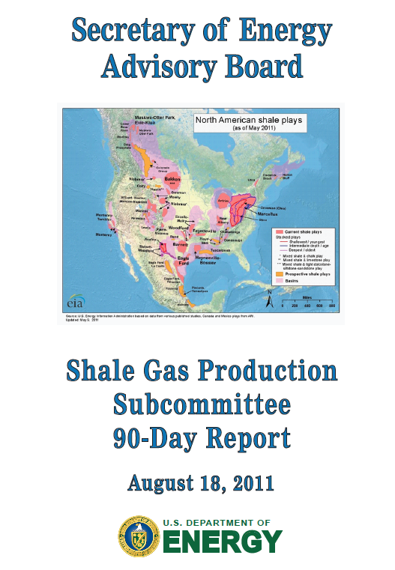
http://www.shalegas.energy.gov/

Slide 65


Slide 66
But we still
have a lot of work to do!
WILL

Slide 67
Coffee Break

Slide 68
Course Overview
Day 1 Opportunities and Challenges of Shale Gas Development
Characterization and Physical Properties of Organic Rich Shales
Composition
Physical Properties
Geophysical Well Logging

Slide 69
Average Shale Properties
 | BARNETT | MARCELLUS | EAGLE FORD | FLOYD
Depth (ft) | 3 – 9,000 | 2 – 9,500 | 4 – 13,500 | 6 – 13,000
TOC (%) | 1 – 10 | 1 – 15 | 2 – 7 | 1 – 7
RO (%) | 0.7 – 2.3 | 0.5 – 4+ | 0.5 – 1.7 | 0.7 – 2+
Porosity (%) | 2 – 14 | 2 – 15 | 6 – 14 | 1 – 12
Qtz + Calcite (%) | 40 – 50 | 40 – 60 | 50 – 80 | 20 – 30
Clay (%) | 20 – 40 | 30 – 50 | 15 – 35 | 45 – 65
Areal Extent (mi²) | 22,000 | 60,000 | 15,000 | 6,000
Resource Size (Tcf) | 25 – 250 | 50 – 500 | 10 – 100 | <<1
Subtle variations can mean large variations in economics
Notes:
Subtle variations can = very large differences in commerciality

Slide 70
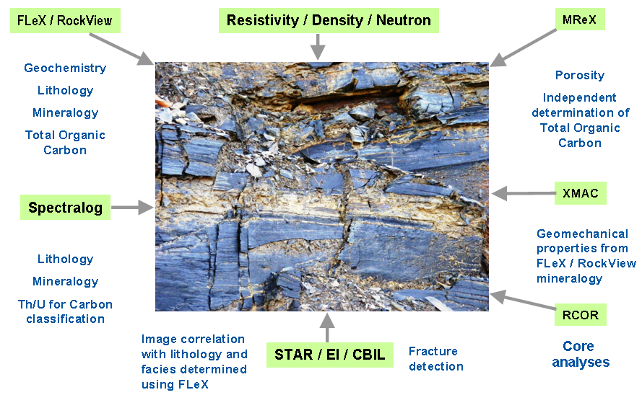
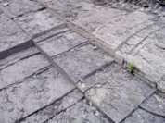
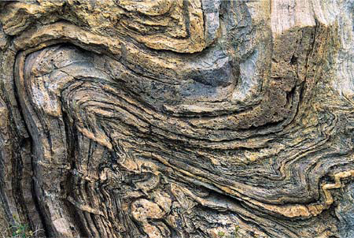
The Shale Reservoir
Shale Gas – Unconventional gas reservoir contained in fine-grained sedimentary rocks, dominated by shale, containing clay and other minerals like quartz, calcite (Shale is a grain size!)
Continuous Formation - No Trap – Gas/Oil Sourced and Remains in Same Formation (Not a Source Rock; Not a Shale Reservoir)
Total Organic Carbon, Thermal Maturity, Mineralogy, and Natural Fractures are Key
- Porosity & micro/nanoDarcy-Permeability, secondary
Gas stored in three ways:
Free Gas
a. In Rock Matrix Porosity
b. In Natural Fractures
Sorbed Gas
a. Adsorbed on organic and mineral surfaces w/in Nat Fractures
b. Absorbed on organic and mineral surfaces w/in Matrix
Dissolved - In HC liquids present in bitumen
Total Gas = Free + Sorbed + Dissolved
Notes:
The gas shale reservoir does not take the form of a conventional reservoir. These reservoirs do not require a trapping mechanism or structure in order for HC to accumulate. While conventional reservoirs are porous and permeable, shale gas reservoirs are assessed by measures of Total Organic Content (TOC), Thermal Maturity, and Mineralogy. Whereas permeability is “micro or nano Darcy” and measurement is not as critical as for conventional reservoirs. The challenge in Continuous Formations (like Shale Gas) is not to find the Shale, but rather to find those areas within the shale that will produce commercial amounts of gas.
Gas is stored in three ways within the shale…

Slide 71
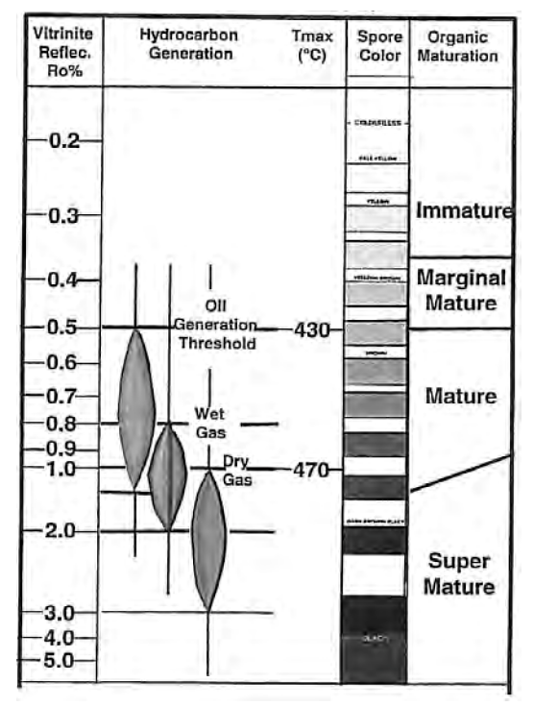
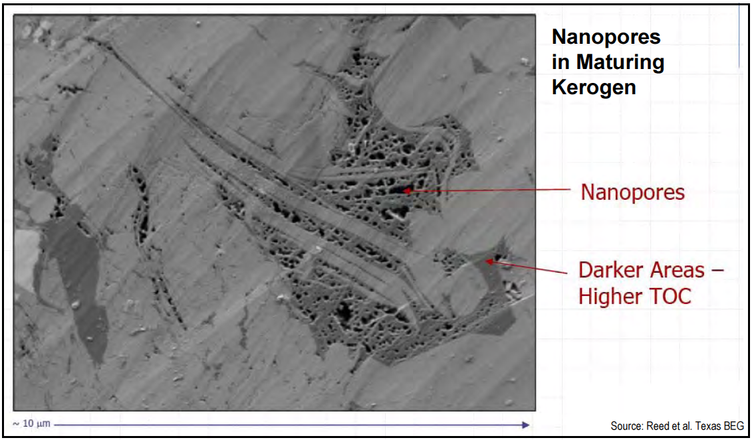
Thermal Maturity – Vitrinite Reflectance
Thermal Maturity measures the degree to which a formation has been exposed to high heat needed to breakdown organic matter into hydrocarbons
R_{o} % (Vitrinite Reflectance of certain type of minerals) is used as an indication of Thermal Maturity
Dry Gas – R_{o} > 1.0 (470 °C)
Wet Gas – R_{o} = 0.5 – 1.0
Oil – R_{o} < 0.5 (430 °C)
Higher Thermal Maturity leads to the presence of nanopores, which contribute to additional porosity in shale matrix
Notes:
Vitinite Reflectance – a widely used technique that measures the reflectance of a polished vitrinite (a maceral group formed by lignified, higher-land plant tissues, such as leaves, stems, and roots) in shale under a reflecting microscope. Increased reflectance is caused by aromatization of kerogen and loss of hydrogen. The reflectance (R_{o} ) starts at 0.2% at the surface; onset of petroleum 0.5 – 0.7%. At an R_{o} of 1.35 %, crude oil is cracked into thermal gas.

Slide 72
Average Shale Properties – RO%
 | BARNETT | MARCELLUS | EAGLE FORD | FLOYD
Depth (ft) | 3 – 9,000 | 2 – 9,500 | 4 – 13,500 | 6 – 13,000
TOC (%) | 1 – 10 | 1 – 15 | 2 – 7 | 1 – 7
RO (%) | 0.7 – 2.3 | 0.5 – 4+ | 0.5 – 1.7 | 0.7 – 2+
Porosity (%) | 2 – 14 | 2 – 15 | 6 – 14 | 1 – 12
Qtz + Calcite (%) | 40 – 50 | 40 – 60 | 50 – 80 | 20 – 30
Clay (%) | 20 – 40 | 30 – 50 | 15 – 35 | 45 – 65
Areal Extent (mi²) | 22,000 | 60,000 | 15,000 | 6,000
Resource Size (Tcf) | 25 – 250 | 50 – 500 | 10 – 100 | <<1
Subtle variations can mean large variations in economics
Notes:
Subtle variations can = very large differences in commerciality

Slide 73
Physical and Chemical Properties of
Organic Rich Shales
How Do the Properties of Shale Affect the Outcome of Hydraulic Fracturing Stimulation?
5 Wells, 40 Stages, 4050 Microseismic Events

Slide 74
Organic Rich Shales
Sample group | Clay | Carbonate | QFP | TOC (wt%)
Barnett-dark | 29-43 | 0-6 | 48-59 | 4.1-5.8
Barnett-light | 2-7 | 37-81 | 16-53 | 0.4-1.3
Haynesville-dark | 36-39 | 20-23 | 31-35 | 3.7-4.1
Haynesville-light | 20-22 | 49-53 | 23-24 | 1.7-1.8
Fort St. John | 32-39 | 3-5 | 54-60 | 1.6-2.2
Eagle Ford-dark | 12-21 | 46-54 | 22-29 | 4.4-5.7
Eagle Ford-light | 6-14 | 63-78 | 11-18 | 1.9-2.5
Bedding plane and sample cylinder axis are either:
parallel (horizontal samples) or
perpendicular (vertical samples)
3-10 % porosity
All room dry, room temperature experiments
In-situ (and lab) effective stress between 15-30 MPa

Slide 75
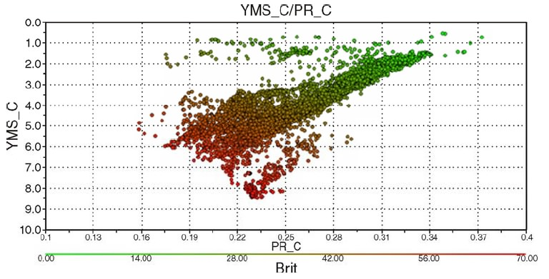
Deformational Properties of Shales
Clay-rich regions have higher fracture propagation pressure
→ Heterogeneous Stress
Clay-rich rocks are less brittle, more ductile
Heterogeneous Rock Property
Common approach: High E, Low n, more “Brittle”
→ Empirical, does not address effect of stress state
x
Rickman et al. (2008)
Goal is to understand,
1. Deformational properties
(modulii, strength, ductility)
2. Capture variations within a
and between reservoirs
3. Search for proxies to these
properties
Young’s Mod.
more brittle
Poisson’s Ratio

Slide 76



Creep Strain vs. Clay and E
Normal
To Bedding
Parallel
To Bedding
Amount of creep (ductility) depends on clay content and orientation of loading with respect to bedding
Young’s modulus correlates with creep amount very well

Slide 77

A Typical Experiment & Objective
Hydrostatic Stage: Bulk modulus, hydrostatic creep
Triaxial State: Young’s modulus, Poisson ration, triaxial creep
Failure&Friction: Onset of dilatancy, intact/frictional strength

Slide 78


A Typical Stress-Strain Curve
Barnett 31Vd
(Dark Sample)
Dilatancy
Strength
Friction
Creep?
Static Modulii
Notes:
78

Slide 79
Young’s Modulus
Strength
Bed-Parallel Samples
UCS (MPa)
Young’s Modulus (GPa)
Approximate Clay Content (%)
Approximate Clay Content (%)
Strength decreases with clay content
Internal friction coefficient decreases from 0.9 to 0.2
Modulus correlate with clay content and porosity
Bedding parallel samples are systematically stiffer
Notes:
79

Slide 80


Eagleford Shale Pore Structure
2 cm
Connecting Microstructure, Transport and Constitutive Properties
Notes:
80

Slide 81
Eagleford Shale
Notes:
Subtle variations can = very large differences in commerciality

Slide 82
Poisson’s Ratio
Poisson’s ratio does not seem to correlated with other properties
Notes:
82

Slide 83
Young’s Modulus
Bed-Parallel Samples
Darker rocks are softer, Barnett is stiffer compared to Haynesville
Modulus correlate with clay content and porosity
Bedding parallel samples are systematically stiffer
Notes:
83

Slide 84


Young’s Modulus
Young’s modulus falls within rough estimates of Voigt-Reuss bounds
Anisotropy exists between vertical and horizontal samples
Notes:
84

Slide 85
Why ductile properties?
Ductility is important because,
May prevent brittle fracturing (stimulation)
Could promote proppant-embeddment
Ductile deformation relaxes deviatoric stress over time
Drilling-induced tensile fractures disappear in high gamma sections of the well indicating locally isotropic stress

Slide 86
Experimental Procedures
Hydrostatic, Triaxial Stage:
Pressure applied in steps
Held for 3 hrs – 2 weeks
Failure&Friction: intact/frictional rock strength
From each pressure step,
The pressure ramp gives elastic modulus
The pressure hold gives the creep response
P_{c}
P_{ax}

Slide 87
Creep Strain vs. Clay and Young’s Modulus
Amount of creep (ductility) depends on clay content and sample orientation
Young’s modulus correlates with creep amount very well

Slide 88
Analysis by Viscoelasticity
How can the creep data be utilized to address the variation of stress anisotropy?
Viscoelasticity
Describe the behavior quantitatively to
→ Creep Constitutive Relation
Relate the creep behavior to stress relaxation using
→ Boltzmann Superposition
Investigate the implications of creep over geologic time scales

Slide 89

Longer term creep experiments
Most creep observed were only 3 hours long, and suggested logarithm function
Long experiments show that it is more closer to a power-law in the long term
Furthermore, the total response (elastic + creep) can be described by a power law

Slide 90


Power-Law Parameters
Parameter’s B and n are found for every creep step by fitting a line to the creep compliance, J(t), in log-log space
*J(t) determined by deconvolving creep data with stress ramp input
Compliant rocks have higher B and higher n

Slide 91
Viscoelasticity: Superposition
E(t)
Boltzmann superposition
Key elements:
E(t): Relaxation Modulus
J(t): Creep Compliance
In the Laplace domain,
Hagin and Zoback (2004)

Slide 92
Viscoelasticity: Power-Law formulation
If the creep compliance function, J(t), is a Power Law,
Therefore, the stress relaxation modulus, E(t), can be described in terms of creep compliance parameters if viscoelasticity holds

Slide 93


Accumulation of Differential Stress
Barnett Shale
320 Ma
Stable intraplate
t = 150 Ma
ε_rate = 10⁻¹⁹ s⁻¹

Slide 94
Creep and Young’s Modulus
Notes:
94

Slide 95
Summary
Conclusions
Elastic and ductile (creep) properties exhibit anisotropy and are dependent on mineralogy
The ductile behavior can be described quantitatively by visco-elasticity theory
Future Work:
Physical Mechanism:
Micro-crack growth, grain contact friction/creep?
Is it clay and/or organic content affecting the creep?
Further discussion on the origin of stress anisotropy variations

Slide 96

BHI Shale Evaluation Suite: Log/Analyses
BHI Shale Evaluation Suite is an integrated petrophysical approach using logs and analyses to characterize the highly complex shale reservoirs
300+ Evaluation Suites in US shale plays; 40+ in Canada
Resistivity / Density /Neutron
FLeX /RockView | Spectralog | FracXplorer Micro-seismic | STAR / EI / CBIL | RCOR | XMAC | MReX
Geochemistry Lithology Mineralogy Total organic carbon | Lithology Mineralogy Th/U for Carbon classification | Image correlation with lithology and facies determined using FLeX | Fracture detection | Core analyses | Geomechanical properties from FLeX /RockView mineralogy | Porosity Independent determination of total organic carbon
Logging and analyses identify: Optimum “fracturable” intervals Optimum formations to drill horizontal laterals Potential barriers for frac containment Mineralogy key component integrated with geomechanics

Slide 97


XMAC^{sm} F1 Tool Design and Specifications
Acquires 44 waveforms simultaneously at 30 ft/min:
- 4 Delta-T
- 8 Fullwave Monopole
- 32 Cross Dipole
Acoustic Isolator has 45,000 lb compression and tensile rating and limits rotation about tool body to < 1.5 degrees

Slide 98

Mechanical Properties Shale/Sand

Slide 99



Cross-Dipole Anisotropy
Zones of higher TOC tend to have greater anisotropy
Low anisotropy in the shale
Large anisotropy at the fractures
No anisotropy in the sand
Scattered zones of moderate anisotropy associated with evidence of organic materials
(c) Baker-Hughes
Notes:
Shear wave Cross-Dipole processing is plotted along the dipole shear wave radial mapping. The left radial map plots absolute shear wave slowness (DTS) while the right radial map plots the relative change in DTS versus radial distance upto 2 ft into the formation. The last track is the Shear wave dispersion plot.

Slide 100
Average Shale Properties – Composition
 | BARNETT | MARCELLUS | EAGLE FORD | FLOYD
Depth (ft) | 3 – 9,000 | 2 – 9,500 | 4 – 13,500 | 6 – 13,000
TOC (%) | 1 – 10 | 1 – 15 | 2 – 7 | 1 – 7
RO (%) | 0.7 – 2.3 | 0.5 – 4+ | 0.5 – 1.7 | 0.7 – 2+
Porosity (%) | 2 – 14 | 2 – 15 | 6 – 14 | 1 – 12
Qtz + Calcite (%) | 40 – 50 | 40 – 60 | 50 – 80 | 20 – 30
Clay (%) | 20 – 40 | 30 – 50 | 15 – 35 | 45 – 65
Areal Extent (mi²) | 22,000 | 60,000 | 15,000 | 6,000
Resource Size (Tcf) | 25 – 250 | 50 – 500 | 10 – 100 | <<1
Subtle variations can mean large variations in economics
Notes:
Subtle variations can = very large differences in commerciality

Slide 101


Shale Gas Formation Evaluation Requirements
Lithology and Mineralogy
Total Organic Content (TOC)
Kerogen Type & Maturity
‘Conventional’ Petrophysical Parameters − Porosity, Permeability, Gas Saturation
Geologic Characterization
Structural Features and Natural Fractures
Geomechanical Reservoir Characteristics
Stress Regime and Mechanical Rock Properties
Optimal Horizontal Lateral Well Placement
Frac Stage Placement for Effective Stimulation
K Bowker SPWLA 2005

Slide 102

Total Organic Content (Carbon) - TOC
Organic materials, microorganism fossils and plant matter, provide the required carbon, oxygen, and hydrogen atoms needed to create natural gas and oil
TOC is an important measure of gas generation potential of a shale formation
TOC of a prospective area needs to be = or > 2%
TOC ranges in shales – 2 to 14%
Total Porosity increases at higher TOC
TOC decreases at higher R_{o}
Relationship of TOC and Gamma Ray
(TOC correlates well to GR)

Slide 103






FLeX™ and RockView ™
The Formation Lithology eXplorer (FLeX) tool is a pulsed neutron tool combined with the Spectrolog™ device
RockView is the analysis system which utilizes the elemental information from FLeX to determine lithology and mineralogy
Spectralog detects gamma rays produced by naturally occurring radioactive elements
Pulse neutrons stimulate gamma ray emission particular to each element

Slide 104




Shale Reservoir Lithology and Mineralogy
Haynesville Shale
Barnett Shale
Eagle Ford Shale
How is lithology/mineralogy information obtained ?
Mineral Spectroscopy Tools
Conventional Log responses
Mud Logs
Conventional or rotary SWCs
Various Core Analyses
Notes:
Each vertical line is 10% weight fraction. Note there is no porosity shown. The output is presented in weight fractions of each mineral component which sum to 100%.
Clays are shades of grey with Illite the darkest. The term Illite is used in our approach to include Illite and mixed layer clays

Slide 105


Lithology and Mineralogy -
Shale Gas Reservoir Petrophysical Workflow Components:
Eagle Ford Shale
Barnett Shale
Marcellus Shale
What role does mineralogy play in shale gas evaluation?
Determine TOC
Reduce uncertainty in Porosity calculation
Identify shale Lithofacies
Assist with planning of Stimulation and Completion Design
Notes:
Each vertical line is 10% weight fraction. Note there is no porosity shown. The output is presented in weight fractions of each mineral component which sum to 100%.
Clays are shades of grey with Illite the darkest. The term Illite is used in our approach to include Illite and mixed layer clays

Slide 106
Shale Reservoir Lithology and Mineralogy
Haynesville Shale
Barnett Shale
Eagle Ford Shale
What role does Mineralogy play in Shale Gas evaluation?
Determine TOC
Reduce uncertainty in porosity calculation
Identify shale lithofacies
Assist planning of stimulation / completion design
BRITTLE
DOLOMITE
QUARTZ
CALCITE
ILLITE
MIXED-LAYERED
DUCTILE
C L A Y M I N E R A L S
Notes:
Each vertical line is 10% weight fraction. Note there is no porosity shown. The output is presented in weight fractions of each mineral component which sum to 100%.
Clays are shades of grey with Illite the darkest. The term Illite is used in our approach to include Illite and mixed layer clays

Slide 107

Mineralogy Varies in Shale Reservoirs

Slide 108

Lithology and Mineralogy - Shale Gas Reservoir Petrophysical Workflow Components
FLeXTM / RockViewTM Elements and Minerals
“20”

Slide 109

Rotary Sidewall Coring Service: MaxCORTM
Over 300% greater sample volume compared to PowerCOR!
Benefits - more sample volume means better lab results when analyzing:
Mechanical properties
Permeability
Capillary pressure
Electrical properties
NMR properties
“The Alternative to Conventional Coring”
PowerCOR™
1” dia core
MaxCOR™
1.5” dia core

Slide 110

Barnett Shale Integrated Shale Evaluation
Optimal Lateral Location
Shale lithofacies
Favorable Fracture Zones or Intervals for Horizontal Drilling- Lowest Minimum Horizontal Stress
Fracture Barriers-Highest Minimum Horizontal Stress
Mineralogy
FleX
GR Resist Porosity NMR S_{w} TOC GIP Stress

Slide 111


Logging While Drilling (LWD) – BHI “Trak” Family
OnTrak™ MWD
AziTrak™ Deep Azimuthal Resistivity
LithoTrak™ LWD porosity
SoundTrak™ LWD acoustic
TesTrak™ real-time formation pressure
StarTrak™ imaging services
ZoneTrak™ Resistivity Near Bit
MagTrak™ LWD magnetic resonance
Notes:
The leading technology offered by the OnTrak service includes;
The OnTrak sensor sub offering reliability from a truly integrated suite of five MWD/LWD measurements including azimuthal gamma ray, annular pressure, resistivity, directional surveys and vibration monitoring.
The LithoTrak nuclear service builds on our leading Optimized Rotational Density and Caliper Corrected Neutron measurements to deliver density and photoelectric effect images, neutron porosity and azimuthal borehole caliper.
The SoundTrak service offers the only acoustic logging while drilling tool designed for rotary steerable applications, delivering reliable data in both fast and slow formations.
The TesTrak formation pressure testing tool is the only tool capable of intelligently adjusting to formation characteristics on its own, ensuring valid formation pressure measurements are achieved in the shortest time frame possible.
The aXcelerate High Speed Telemetry Service delivers data at user-selectable transmission rates enabling superior real-time data sets that allow real-time decision making.

