Slide 1
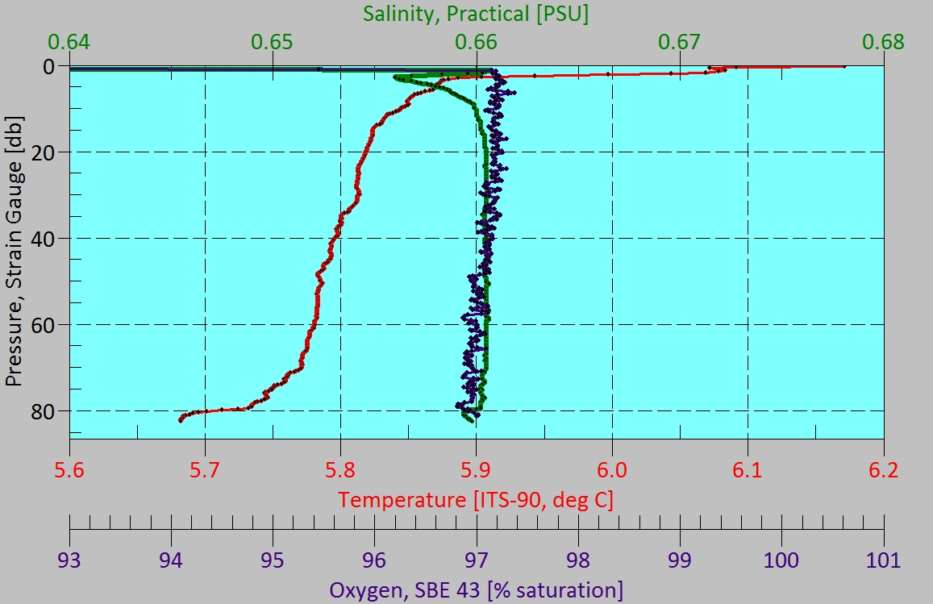
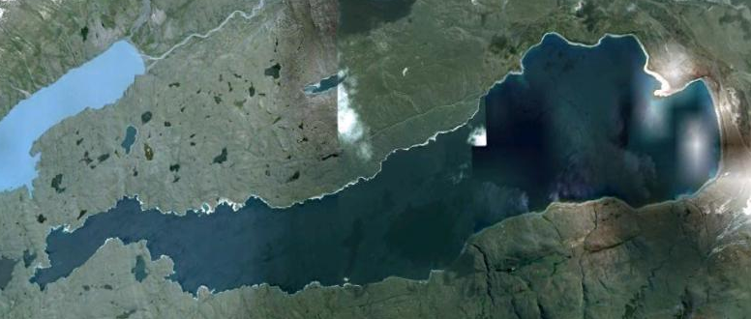
LS12-HC10

Slide 2
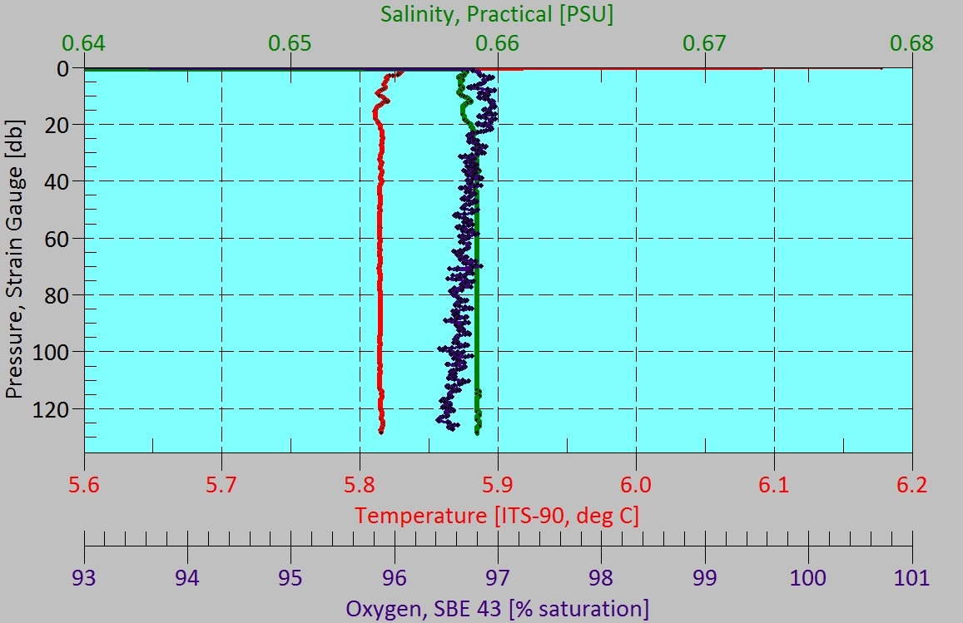
LS12-HC15

Slide 3
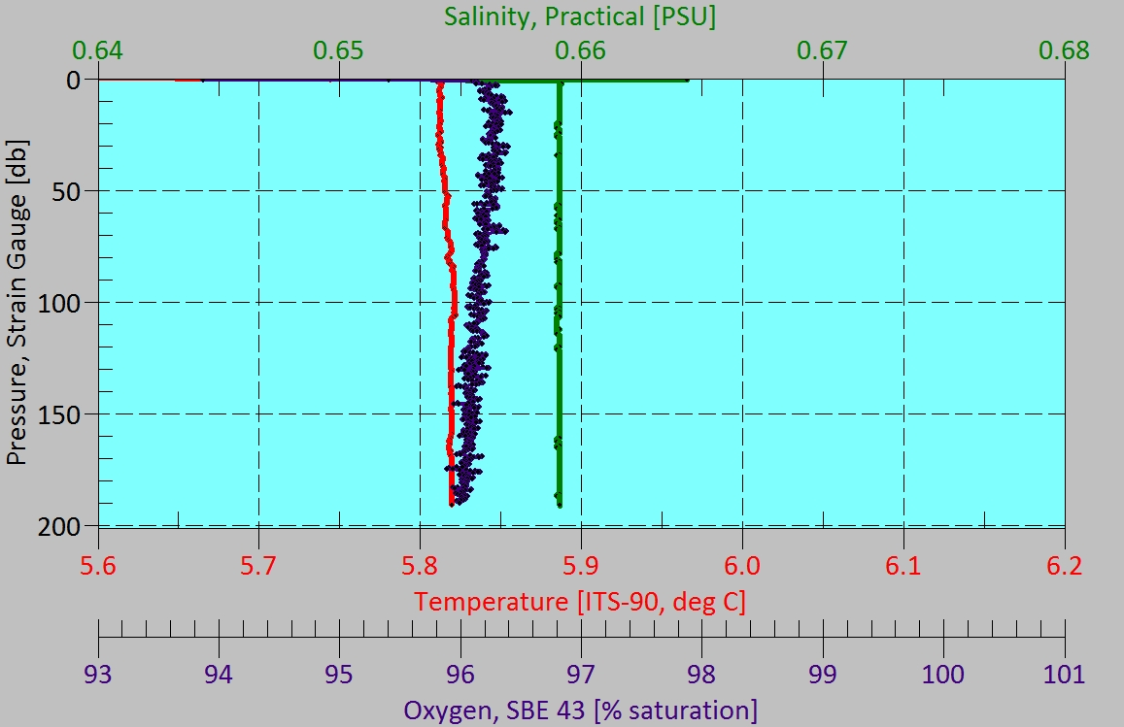
LS12-HC18

Slide 4
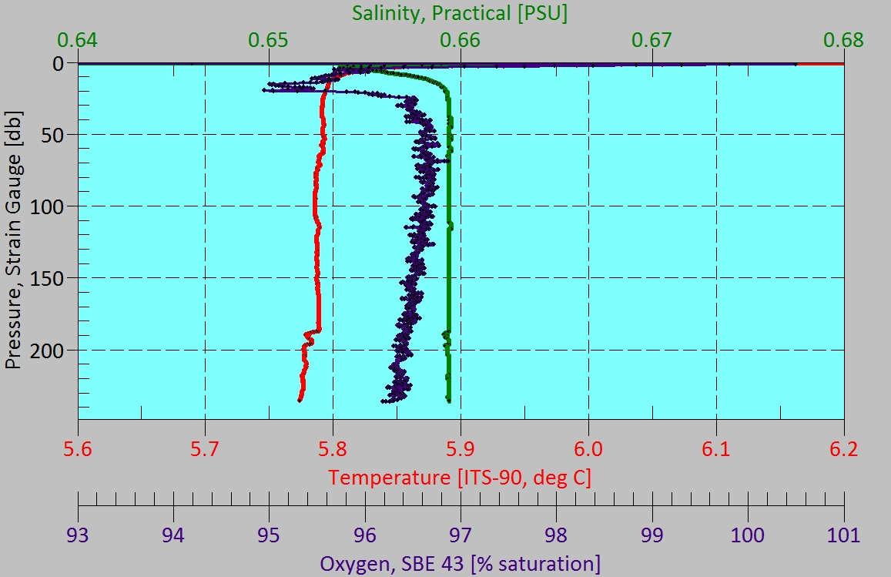
LS12-HC24

Slide 5
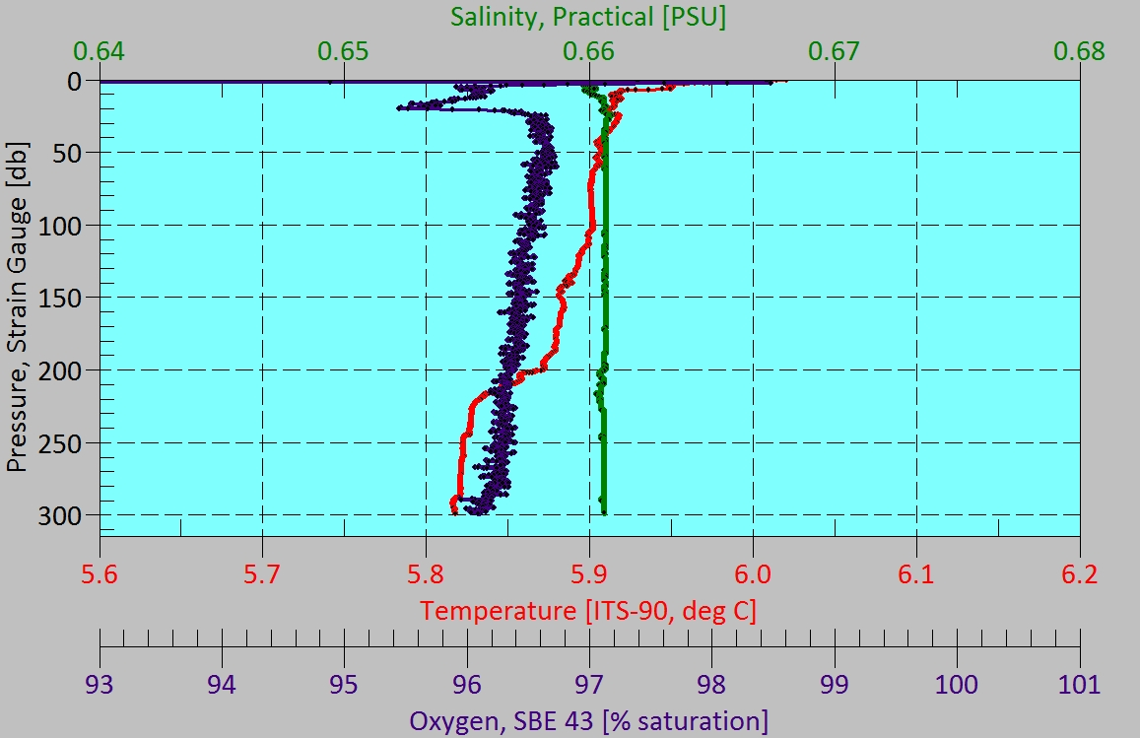
LS12-HC12

Slide 6
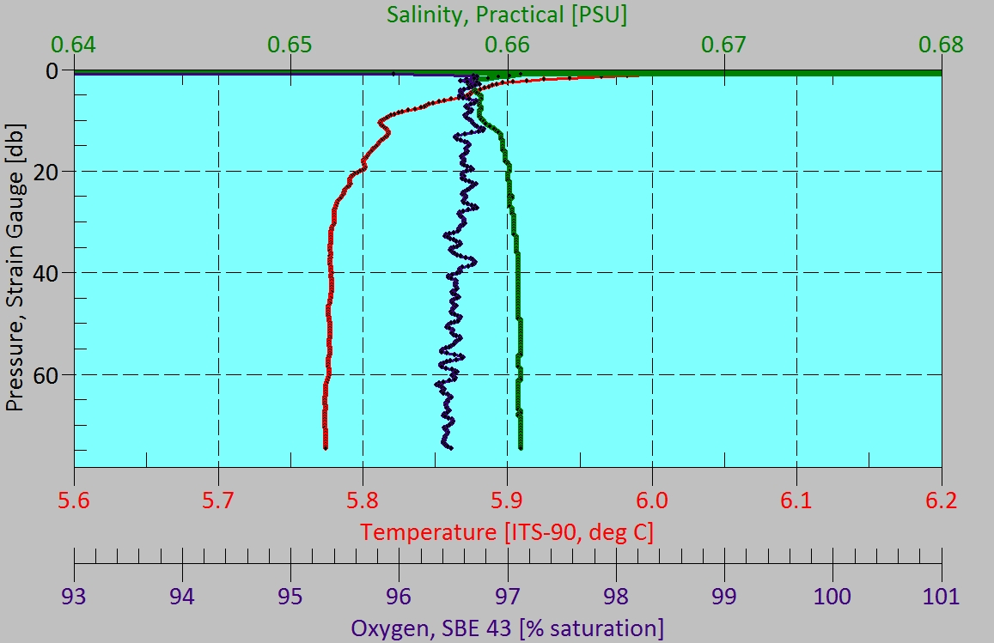
LS12-HC25

Slide 7
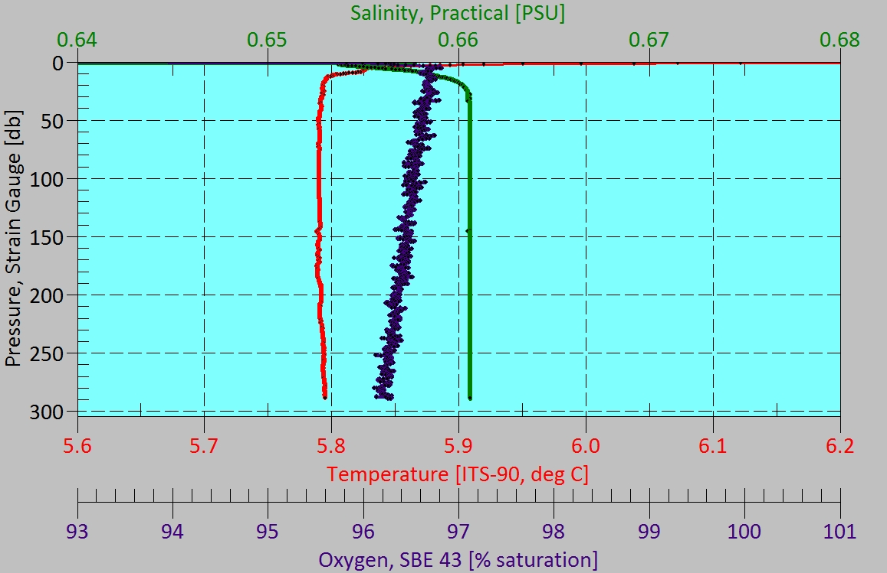
LS12-HC26

Slide 8
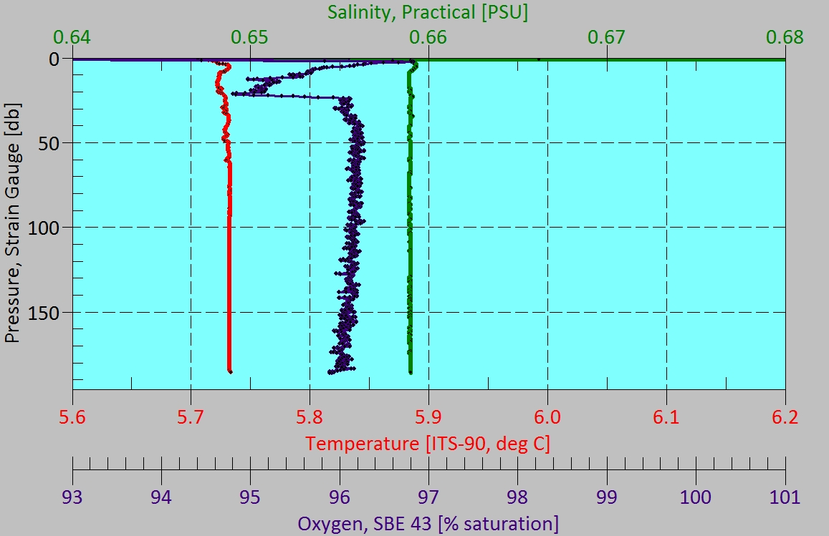
LS12-HC28

Slide 9
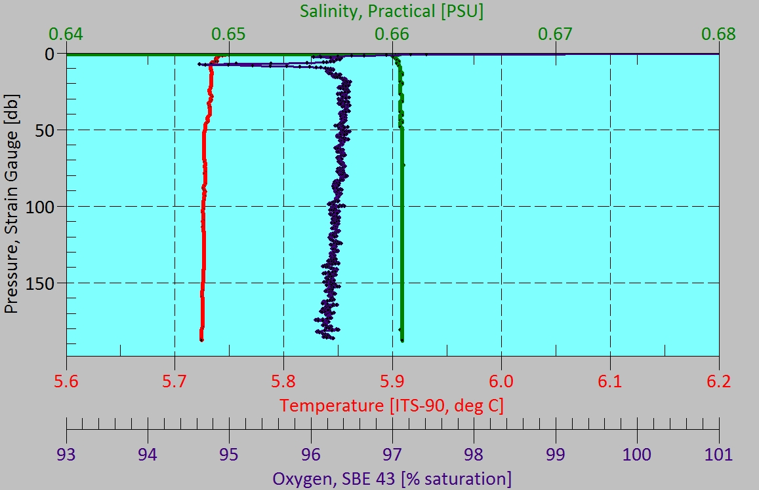
LS12-HC29

Slide 10
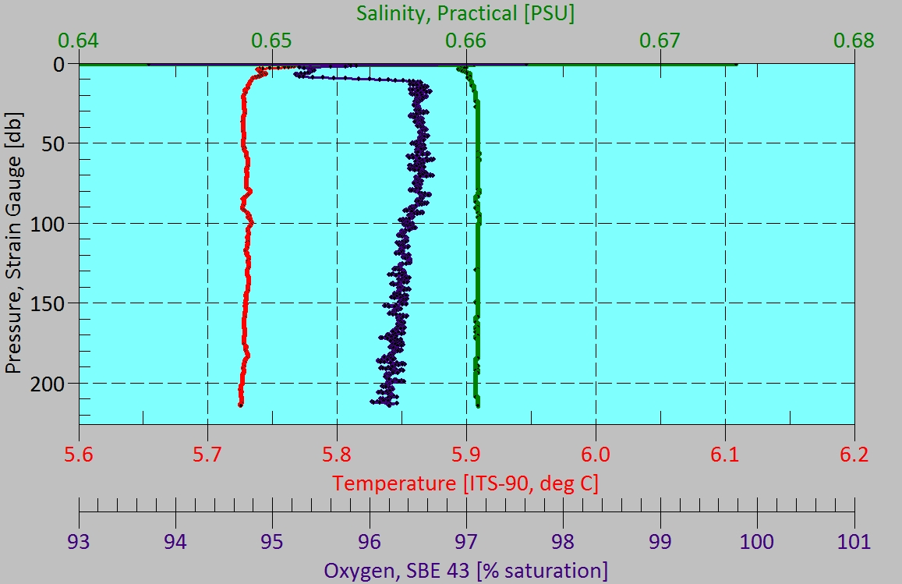
LS12-HC30

Slide 11
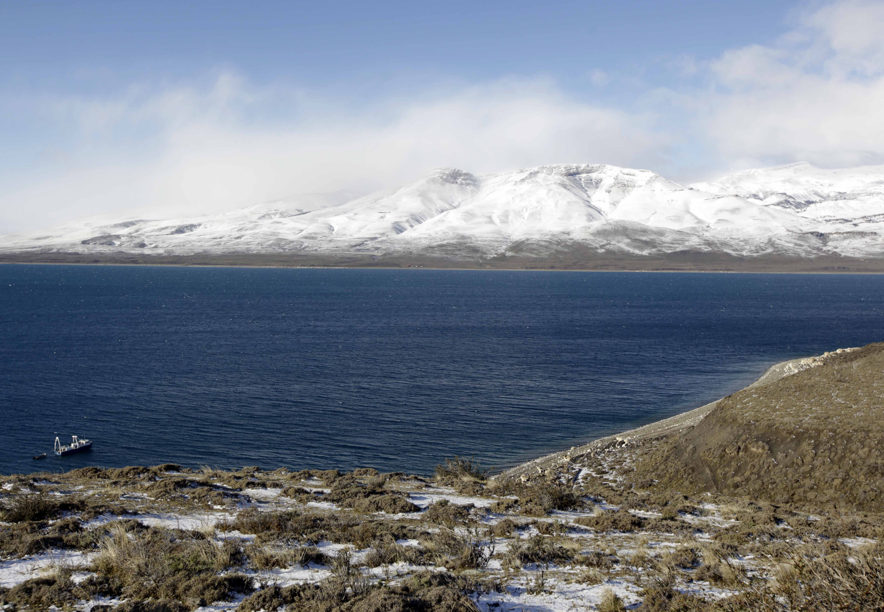
Brief Summary of Limnology Findings
Average Deep Water T = 5.73°C
Salinity gradient from west (0.659 psu) to east (0.661 psu)
Lago Sarmiento in winter: Low, but measurable primary productivity
Lake is convecting to full depth (>300 m) on weekly timescale
Weak Oxygen Minimum at some sites
Strong diurnal surface heating (up to 0.5°C)

