Slide 1
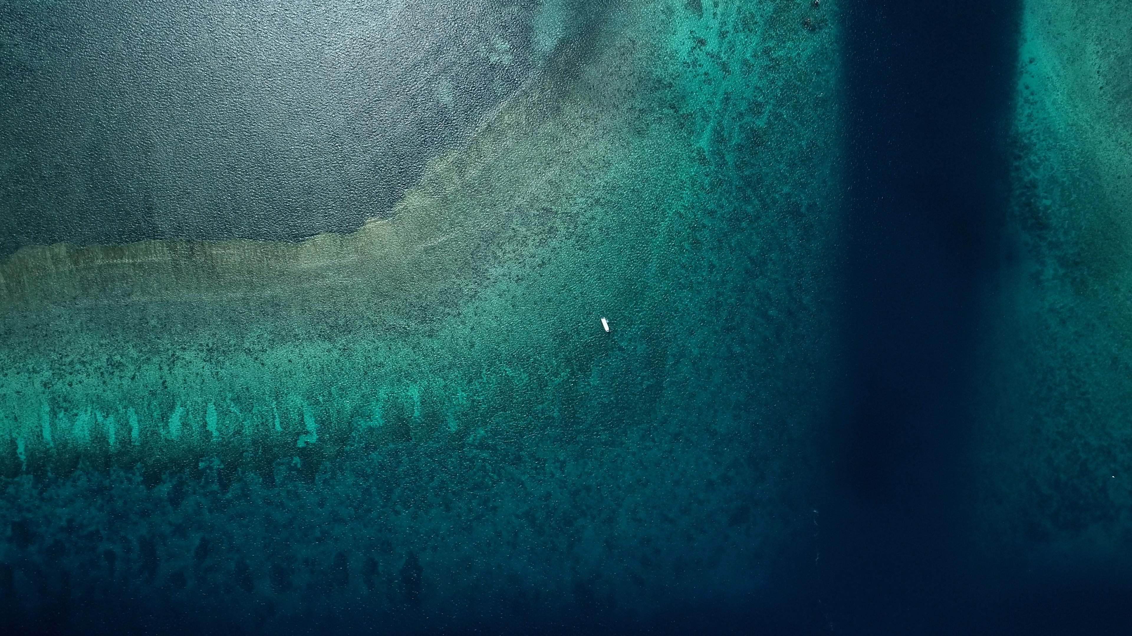
PICRC Carbonate Chemistry Session #5 - 10/11 March 2022

Slide 2
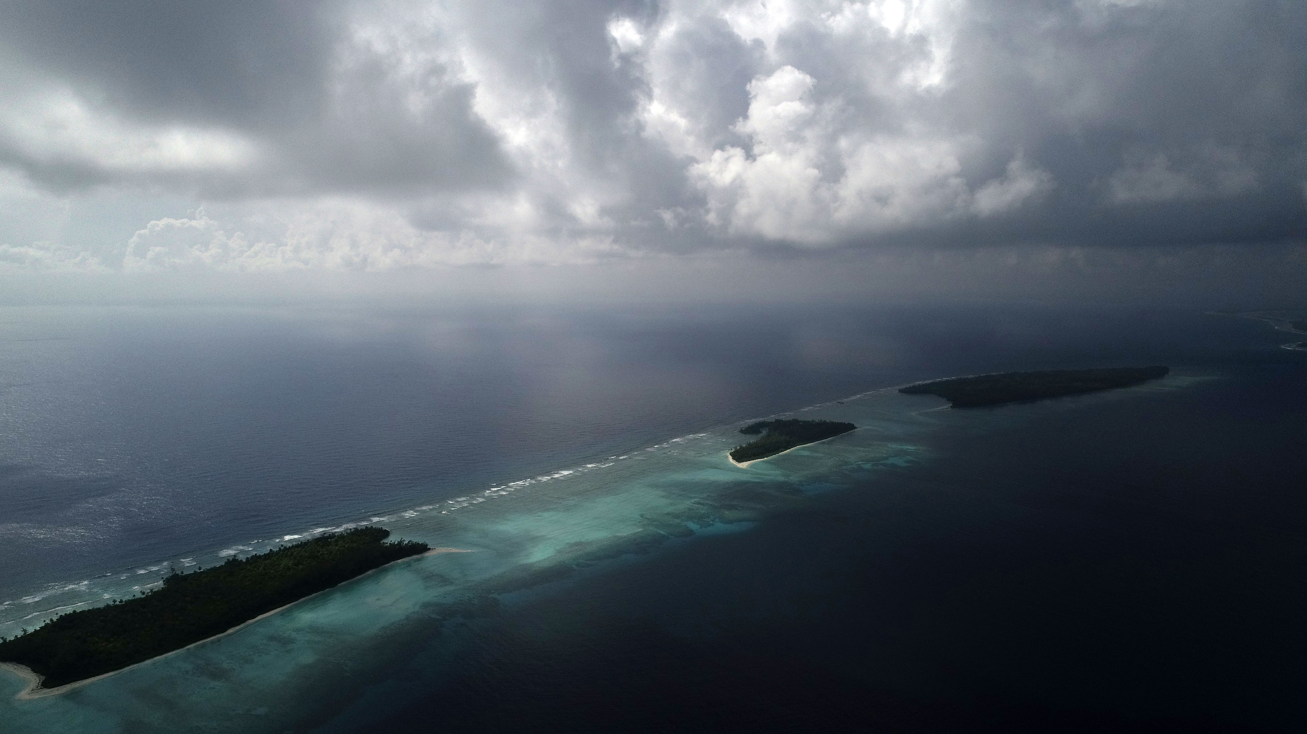
Ile du Coin, Chagos Archipelago, Indian Ocean

Slide 3
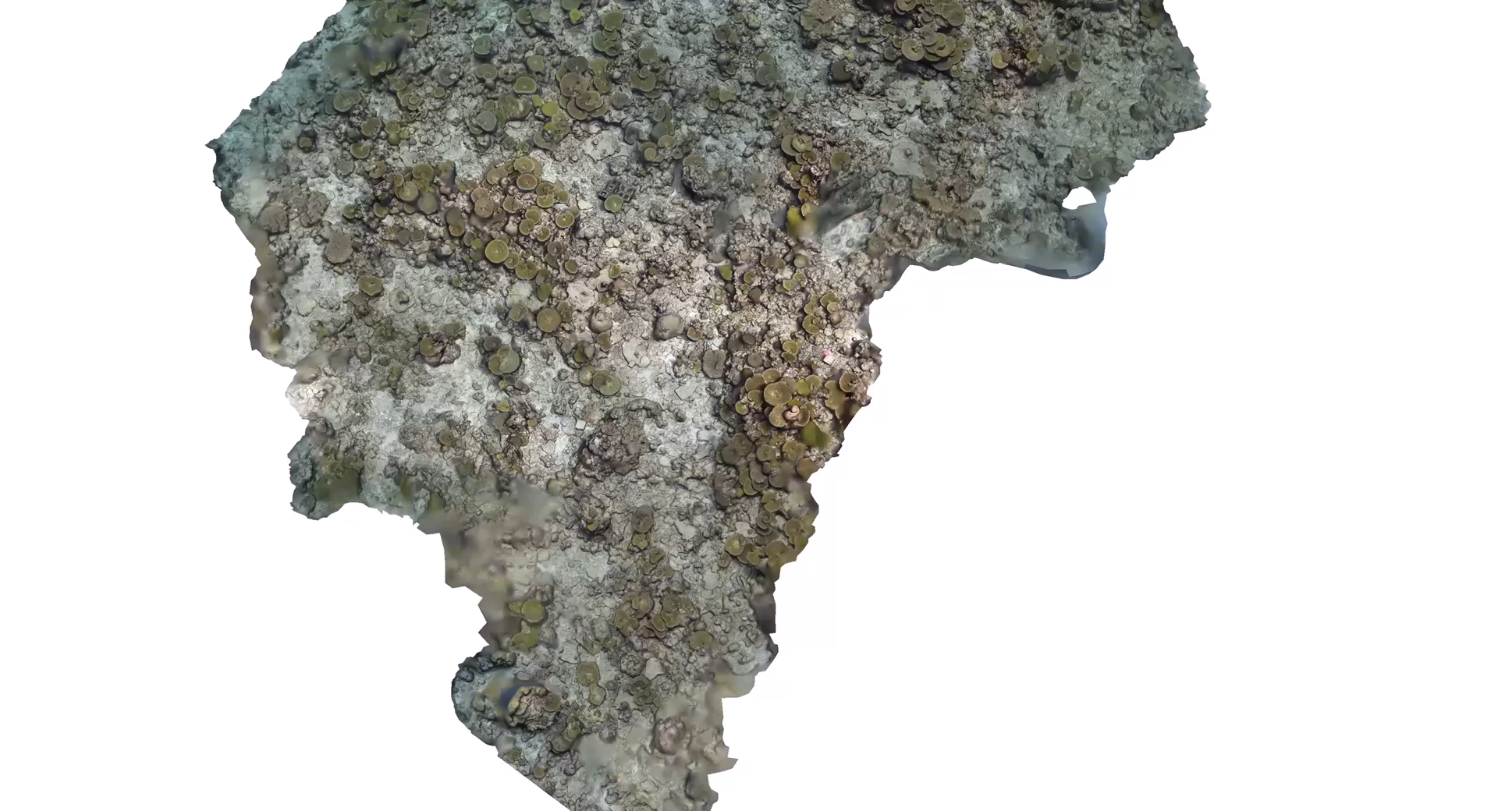
Riemersma and Dunbar 2022

Slide 4
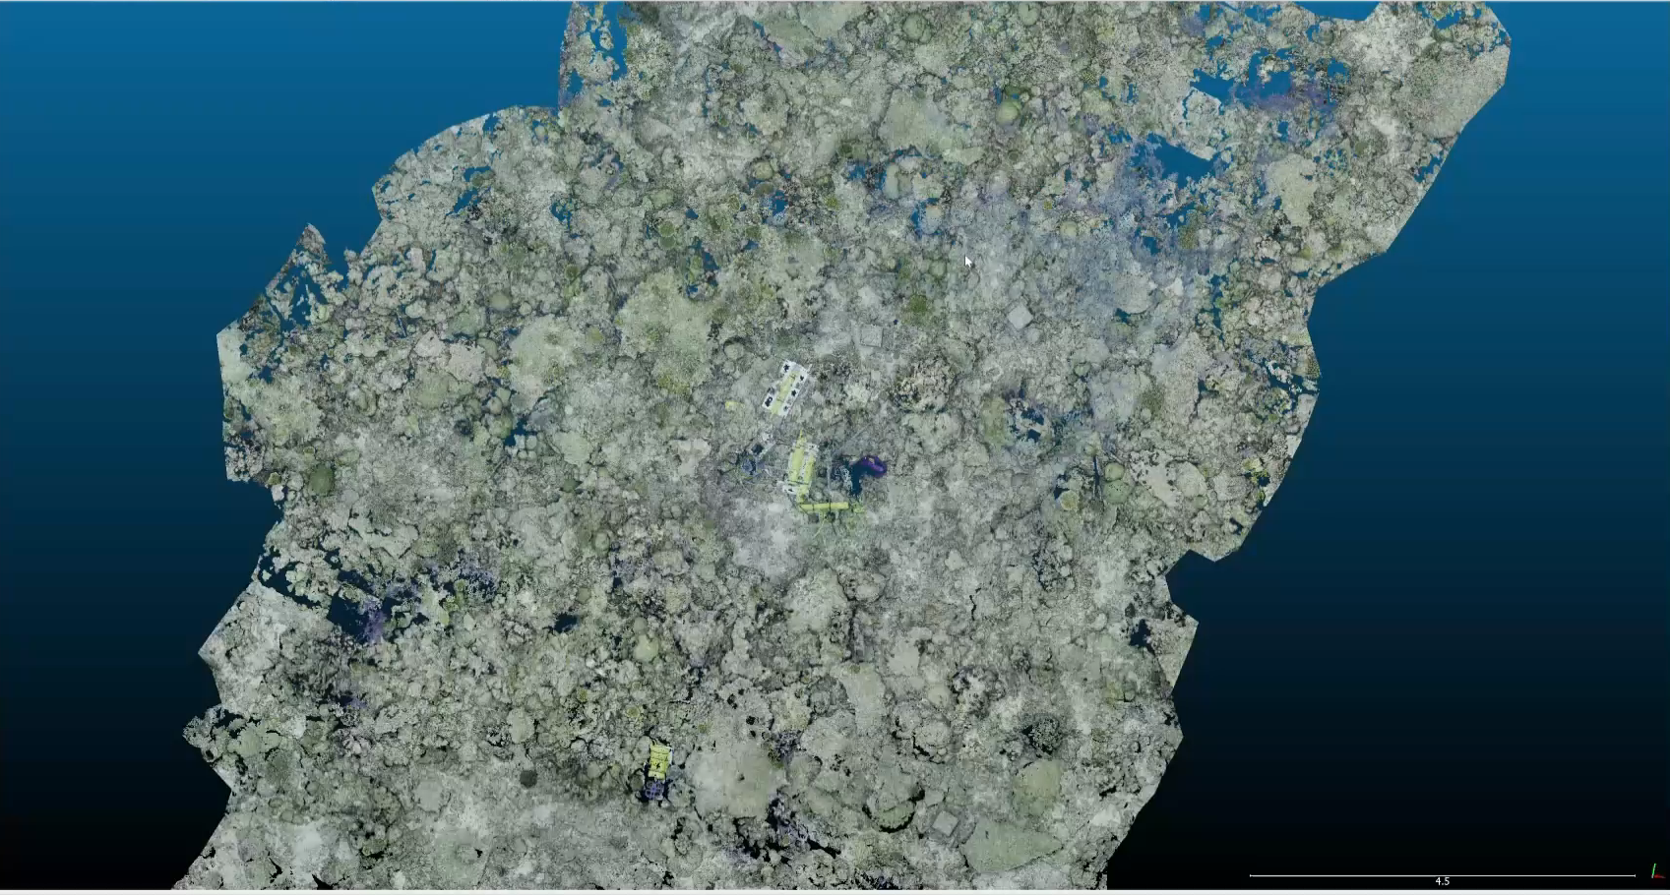
Differencing - comparing 2019 with 2021
Riemersma and Dunbar 2022
Notes:
Move text to top
Add another slide of individual coral from year to year

Slide 5
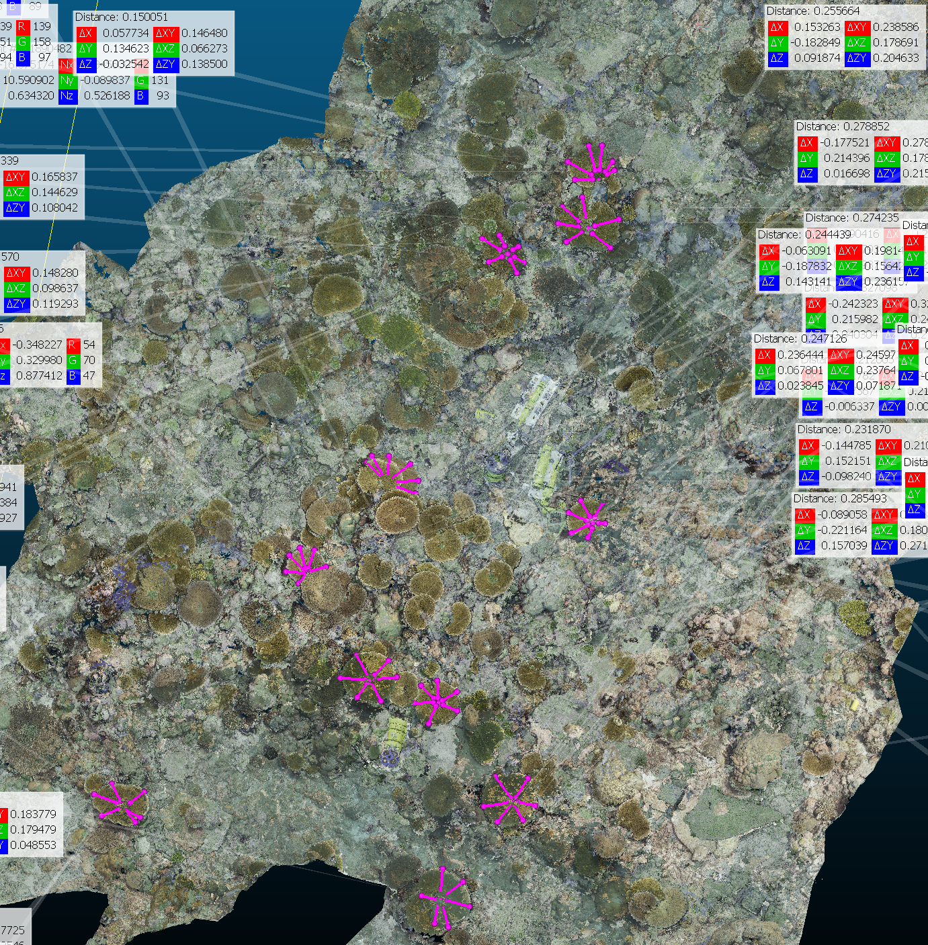
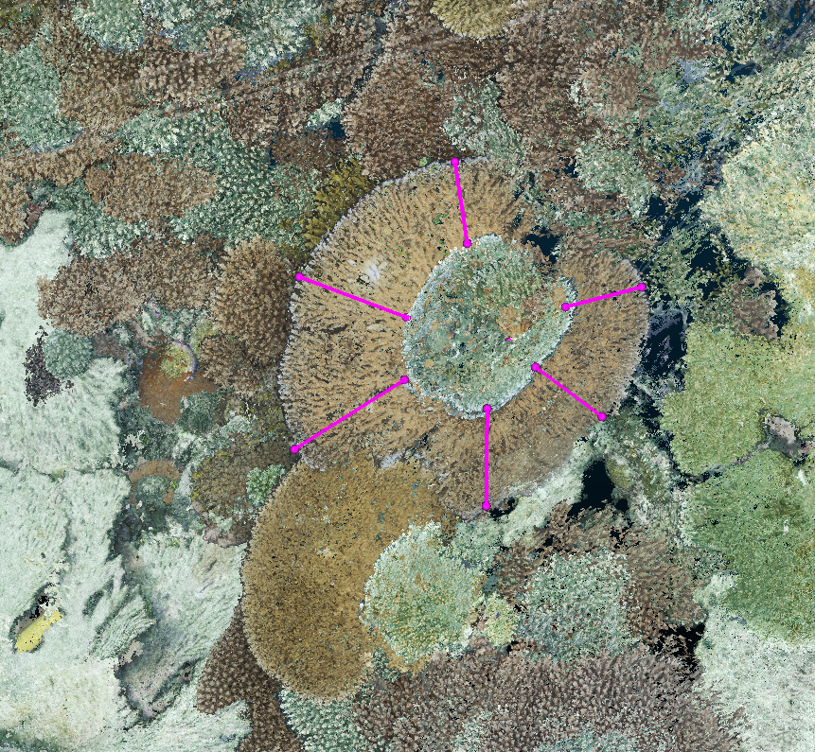
Growth rates measured on over 100 colonies
Coin: 90 mm/year
Anglaise: 111.5 mm/year (!)
Notes:
Add larger version of acropora with pink lines

Slide 6

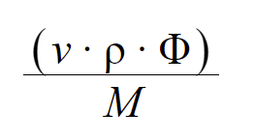
Volumetric Differencing
2019 model surface subtracted from 2021 model surface
Anglaise 6.74 m³ gained – areas are similar and are ~200 m²
Coin: 2.47 m³ gained
⍴=2.93 g/cm³
𝜱=0.7
M=100.09 g/mol
Anglaise: 21.8 kg CaCO³/m²/yr added, 9.6 kg CO₂/m²/yr released
Coin: 6.4 kg CaCO³/m²/yr added, 2.8 kg CO₂/m²/yr released
Riemersma and Dunbar 2022
Notes:
Subscript
Mention that it is using cloud compare
Define variables and input assumed values
Give idea of scale of reef CO2 emissions (compare to human process). On the order of magnitude of .05 gigatons/year

Slide 7
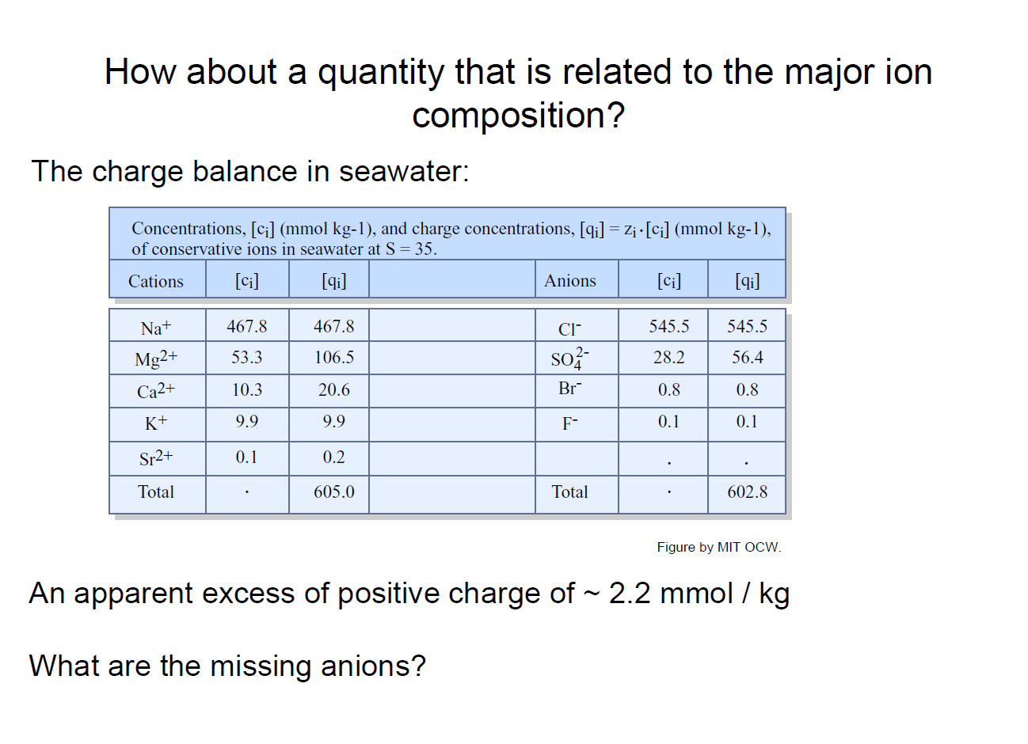
Yet another way to think about alkalinity…..

Slide 8
Alk = OH– + HCO₃– + 2CO₃^{–2} + B(OH)₄⁻ - H⁺
Bicarbonate dominates the alkalinity of seawater
Zeebe and Wolf-Gladrow

Slide 9
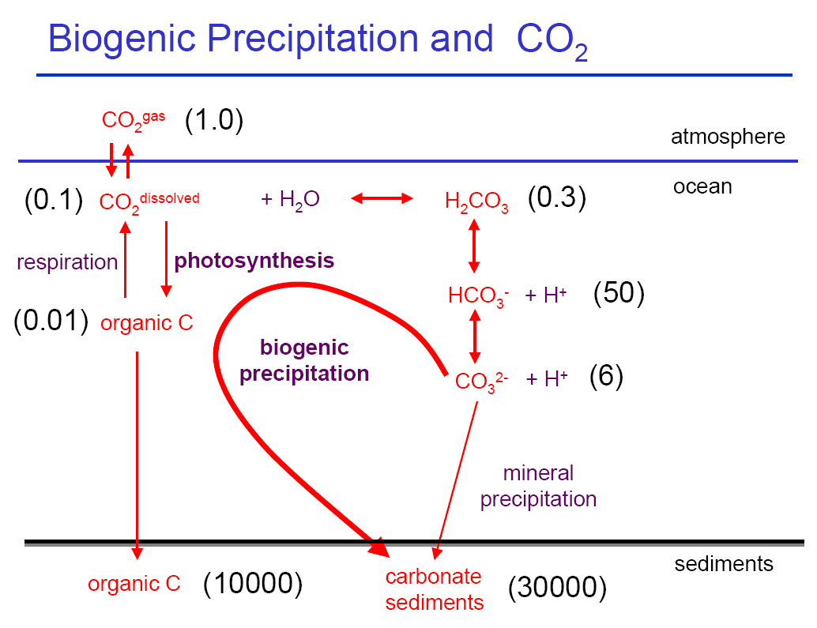
All amounts here are in units of one atmospheric mass of carbon dioxide

Slide 10
C system parameters that can be measured
1) pH
2) Total CO₂ (TDIC)
ΣCO₂= [CO₂aq] + [H₂CO₃] + [HCO₃] + [CO₃]
3) pCO₂
4) Titration Alkalinity
TA = [HCO₃] + 2[CO₃] + [B(OH)₄] + [OH] + [HPO₄] + 2[PO₄] + [SiO(OH)₃] + [HS] + 2[S] + [NH₃] - [H] - [HSO₄] - [HF] - [H₃PO₄]
There are relationships between these parameters based on equilibria. Any two values can determine the system. 3 or 4 overdetermine it – and you can calculate new equilibrium constants.
!! Primary Production & Respiration change ΣCO₂ but not TA.
CO₂(aq) + H₂O + CO₃⁼ <=> 2HCO₃⁻
!!! Carbonate Precipitation & Dissolution change ΣCO₂ and TA.
Ca⁺⁺ + CO₃⁼ <=> CaCO₃

Slide 11
DeCarlo et al., 2017

Slide 13

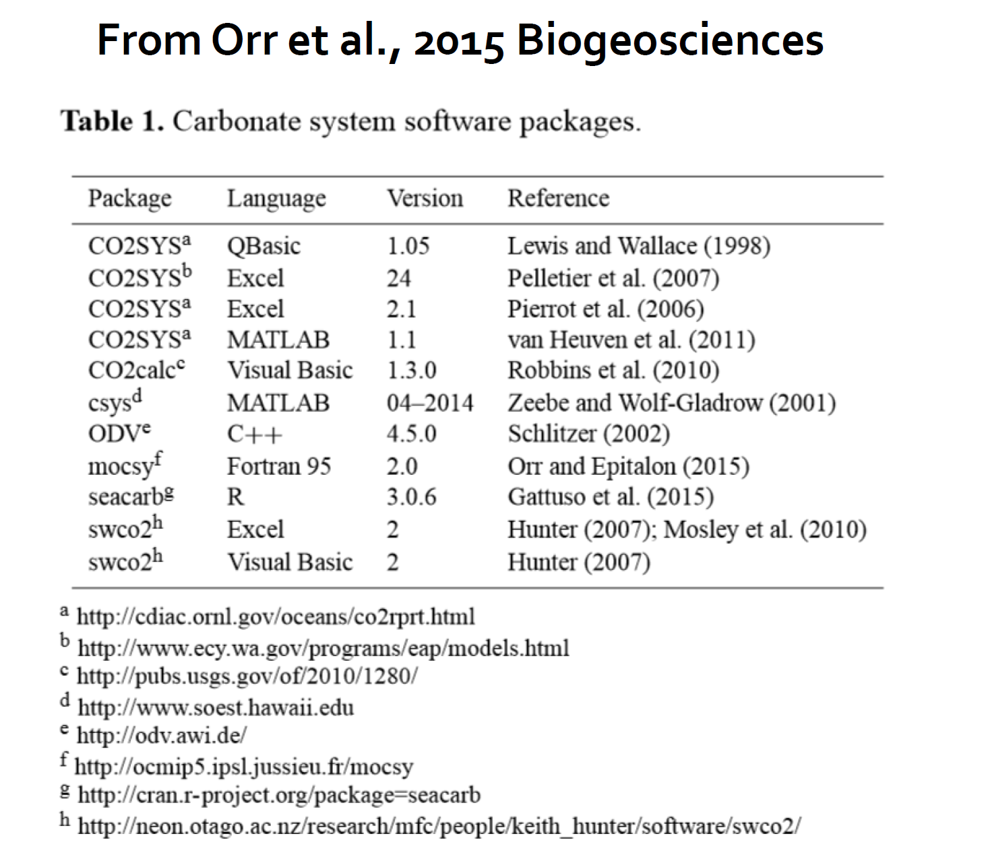

Slide 17
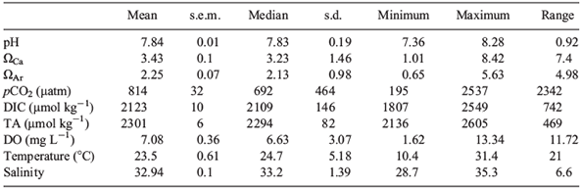
(Omega) is the saturation state of seawater with respect to a particular mineral phase.
So…Ω_{AR} = [Ca⁺⁺][CO³⁼]/K_{sp (aragonite)}
When Ω<1, seawater is undersaturated wrt aragonite
When Ω>1, seawater is supersaturated wrt aragonite

Slide 18
From Fabry et al., 2008

Slide 19
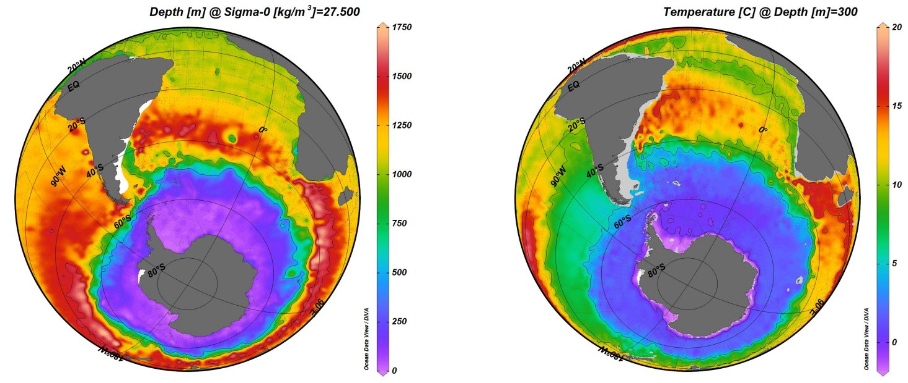
You can also perform carbonate system calculations in Ocean Data View

Slide 20
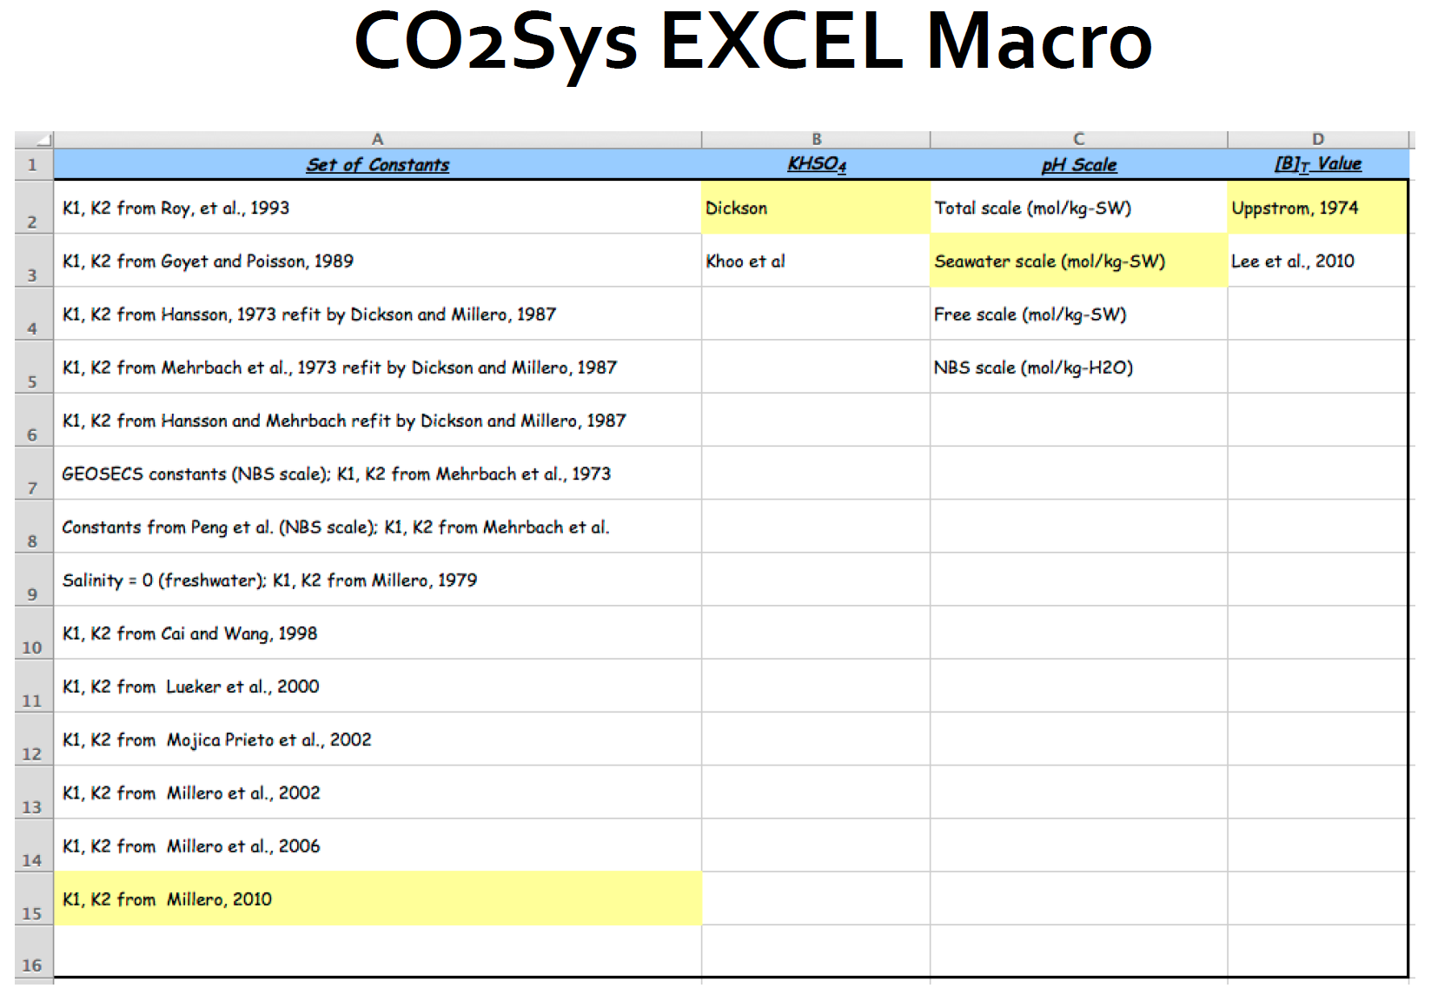

Slide 21
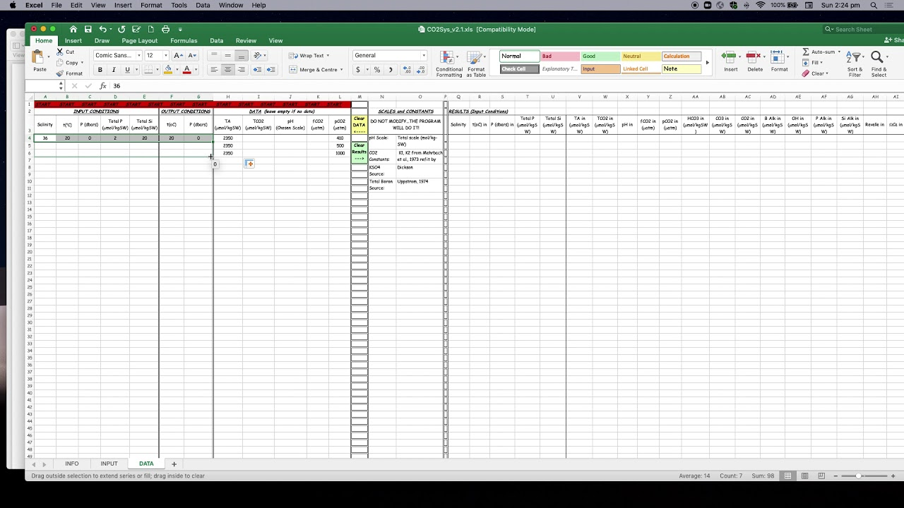

Slide 22
To acquaint you with a C system calculator, go ahead and download the CO2sys excel sheet macro from our ftp folder. Then consider the following.
“Nuku'alofa is the principal port of the Tonga and a port of entry. Coral reefs extend up to 9.0 nm off the coast. Several islands and islets lie on the reefs in the close approaches to the harbor. There is no sewer system in Tonga that would allow collection of municipal waste-water. Waste-water is disposed in non-sealed septic tanks. Leakage from these tanks pollutes groundwater (with nutrients, E. coli) and has led to environmental degradation in the lagoon and in the coastal zone along Nuku’alofa.”
Let’s examine the influence of sewage contaminated ground and surface water runoff on carbonate mineral saturation state on a harbor like this. I could not find real data for Tonga so we’ll use real pH data collected from Malakal Harbor in Palau in July 1980 in areas close to sewage-contaminated inputs and areas far-removed. The harbors are similar in terms of locations of corals and sewage contaminated freshwater inputs. Data from Cowan (1982) – “The influence of modern water supply and wastewater treatment systems on water quality in Micronesia”, University of Guam Technical Report #36.
The range in pH at the sewage-contaminated sites was 7.3 to 8.0 while the range in salinity was from 31-35. The range in pH at the “control” site was 7.7 to 8.4 and the salinity range was 33-35. Assume a total CO₂ value of 2000 µm kg⁻¹ and 2200 µm kg⁻¹, respectively, for the lowest pH and highest pH end-members. What do these ranges mean for aragonite saturation state conditions that the harbor reefs experience? (Note: when you plug these values in to CO2sys you need to only enter data for these two C system variables, e.g., clear everything else....and since the water is generally oligotrophic, you can enter zero for dissolved Si and Phosphate.) Now imagine a heavy rainfall event that drops harbor seawater salinity down to 25. In this case, the introduction of fresh water will dilute total C proportionally to S and will drop pH values by about 0.2. What is the lowest aragonite saturation value achieved? When are corals likely to experience stress associated with saturation state perturbations? This exercise is somewhat contrived as we used real data from Palau (from 1980) and applied it to Tonga, but do you think they might be worried? Is anyone looking after C system perturbations in Nuku’Alofa? As far as I know, nyet. They don’t have the PICRC lab!

Slide 23
