Slide 1


PICRC Carbonate System Course – Session 4

Slide 3
Dickson, 2016
Non-linear least squares

Slide 4
Alkalinity
Alkalinity is required for hard corals and coralline algae to build new skeletal material. When alkalinity levels drop, the carbonate ions needed are not available and the process slows or stops.
Alkalinity is measured in one of three units: milliequivalents per liter (meq/l), parts per million of calcium carbonate (ppm CaCO₃), or better still as µmol kg⁻¹.
The 'ppm CaCO₃' unit reports the concentration of CaCO₃ in pure water that would provide the same buffering capacity as the water sample in question. This does not mean the sample contains that much CaCO₃.
In natural seawater, though, the carbonate system makes up 96% of the alkalinity so equating alkalinity with carbonate “hardness” isn't too far off.

Slide 5
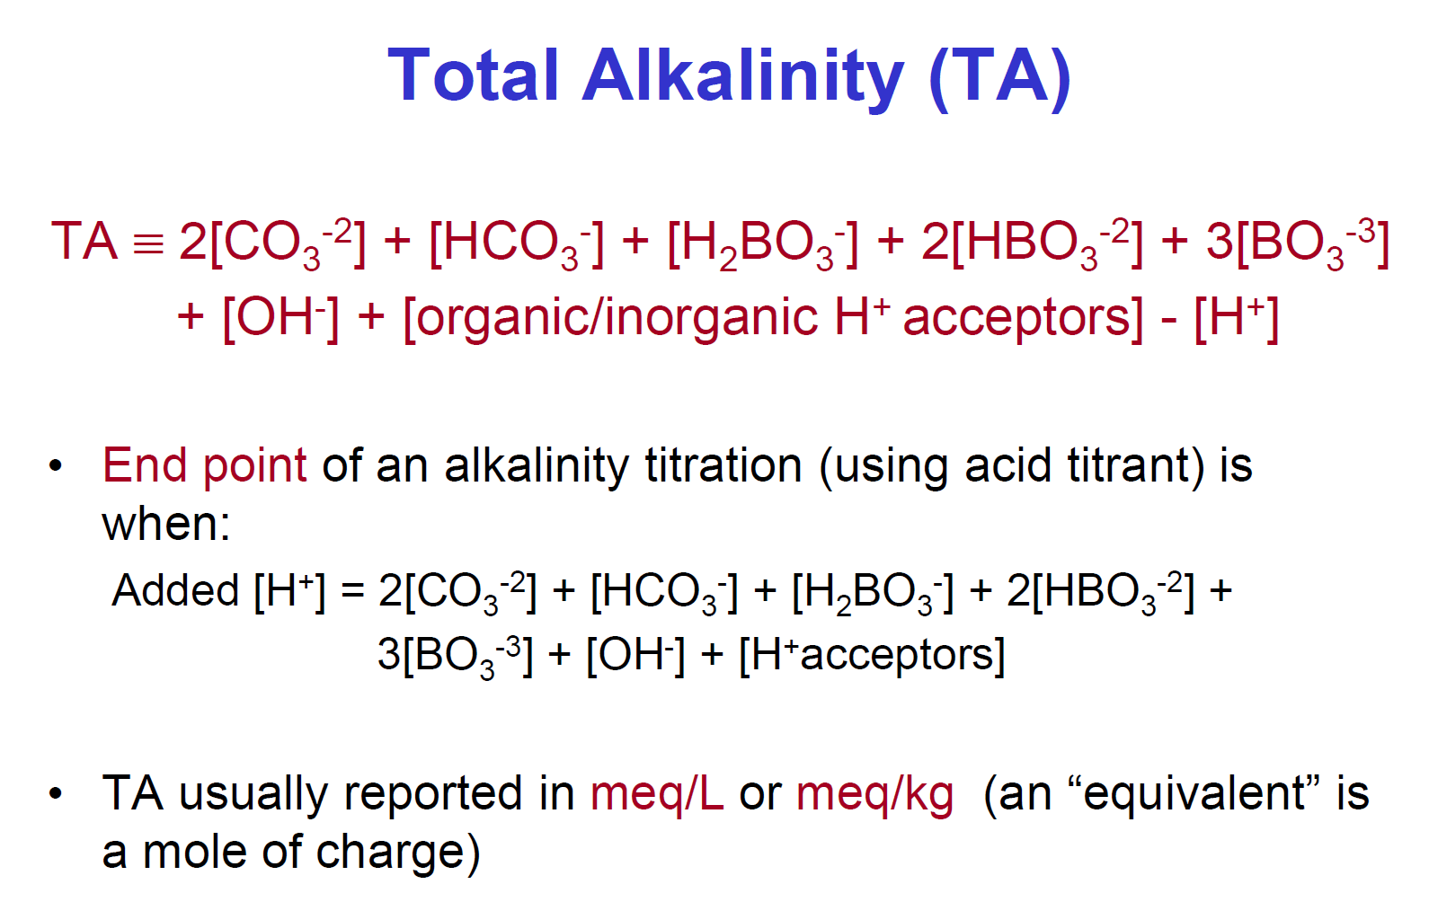
Not me! Please use µmol kg⁻¹

Slide 6
Dickson, 2016

Slide 7
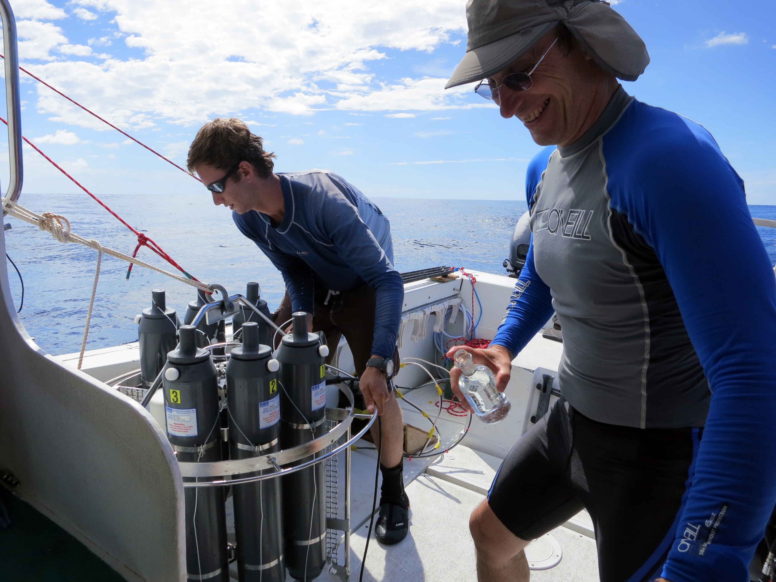

Slide 8
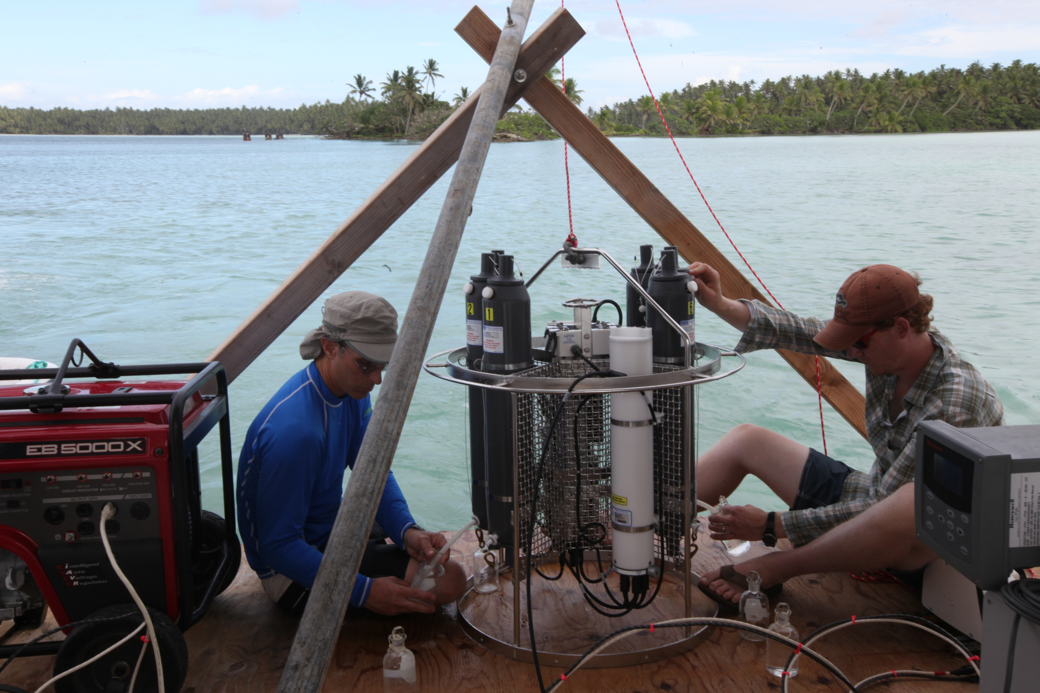

Slide 9


Slide 10
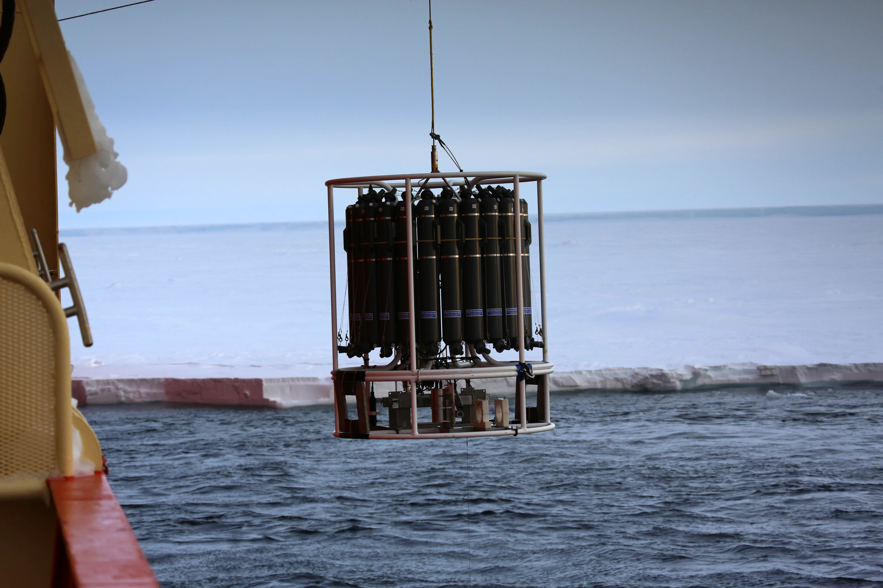

Slide 11
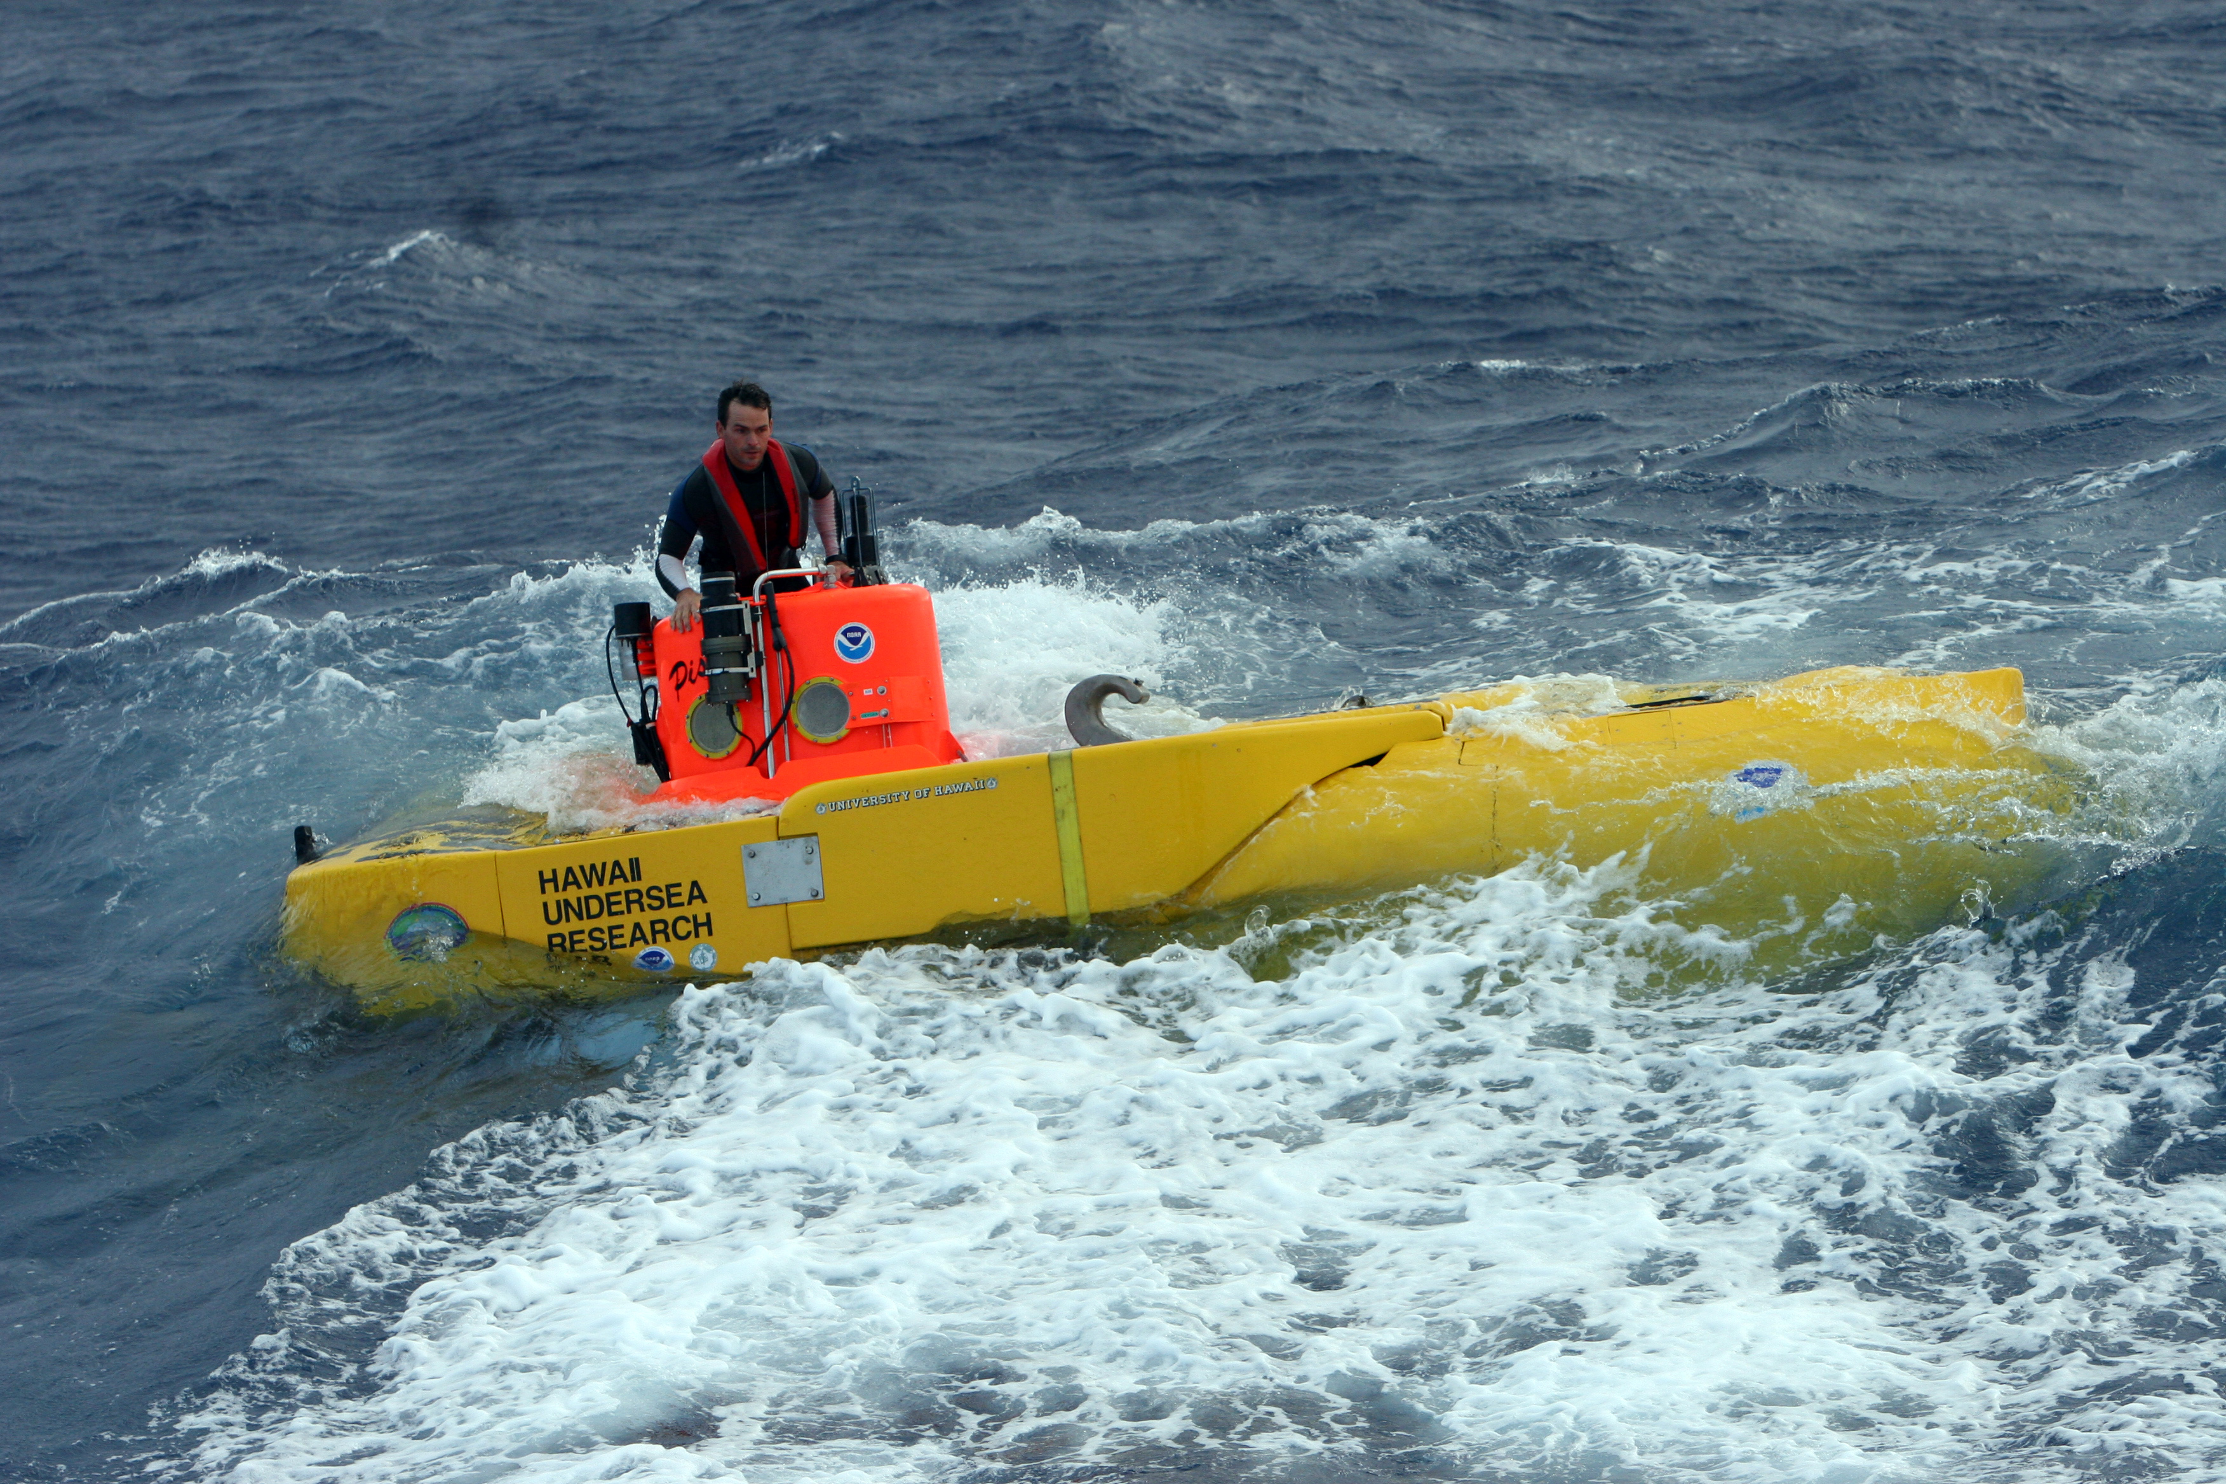

Slide 12
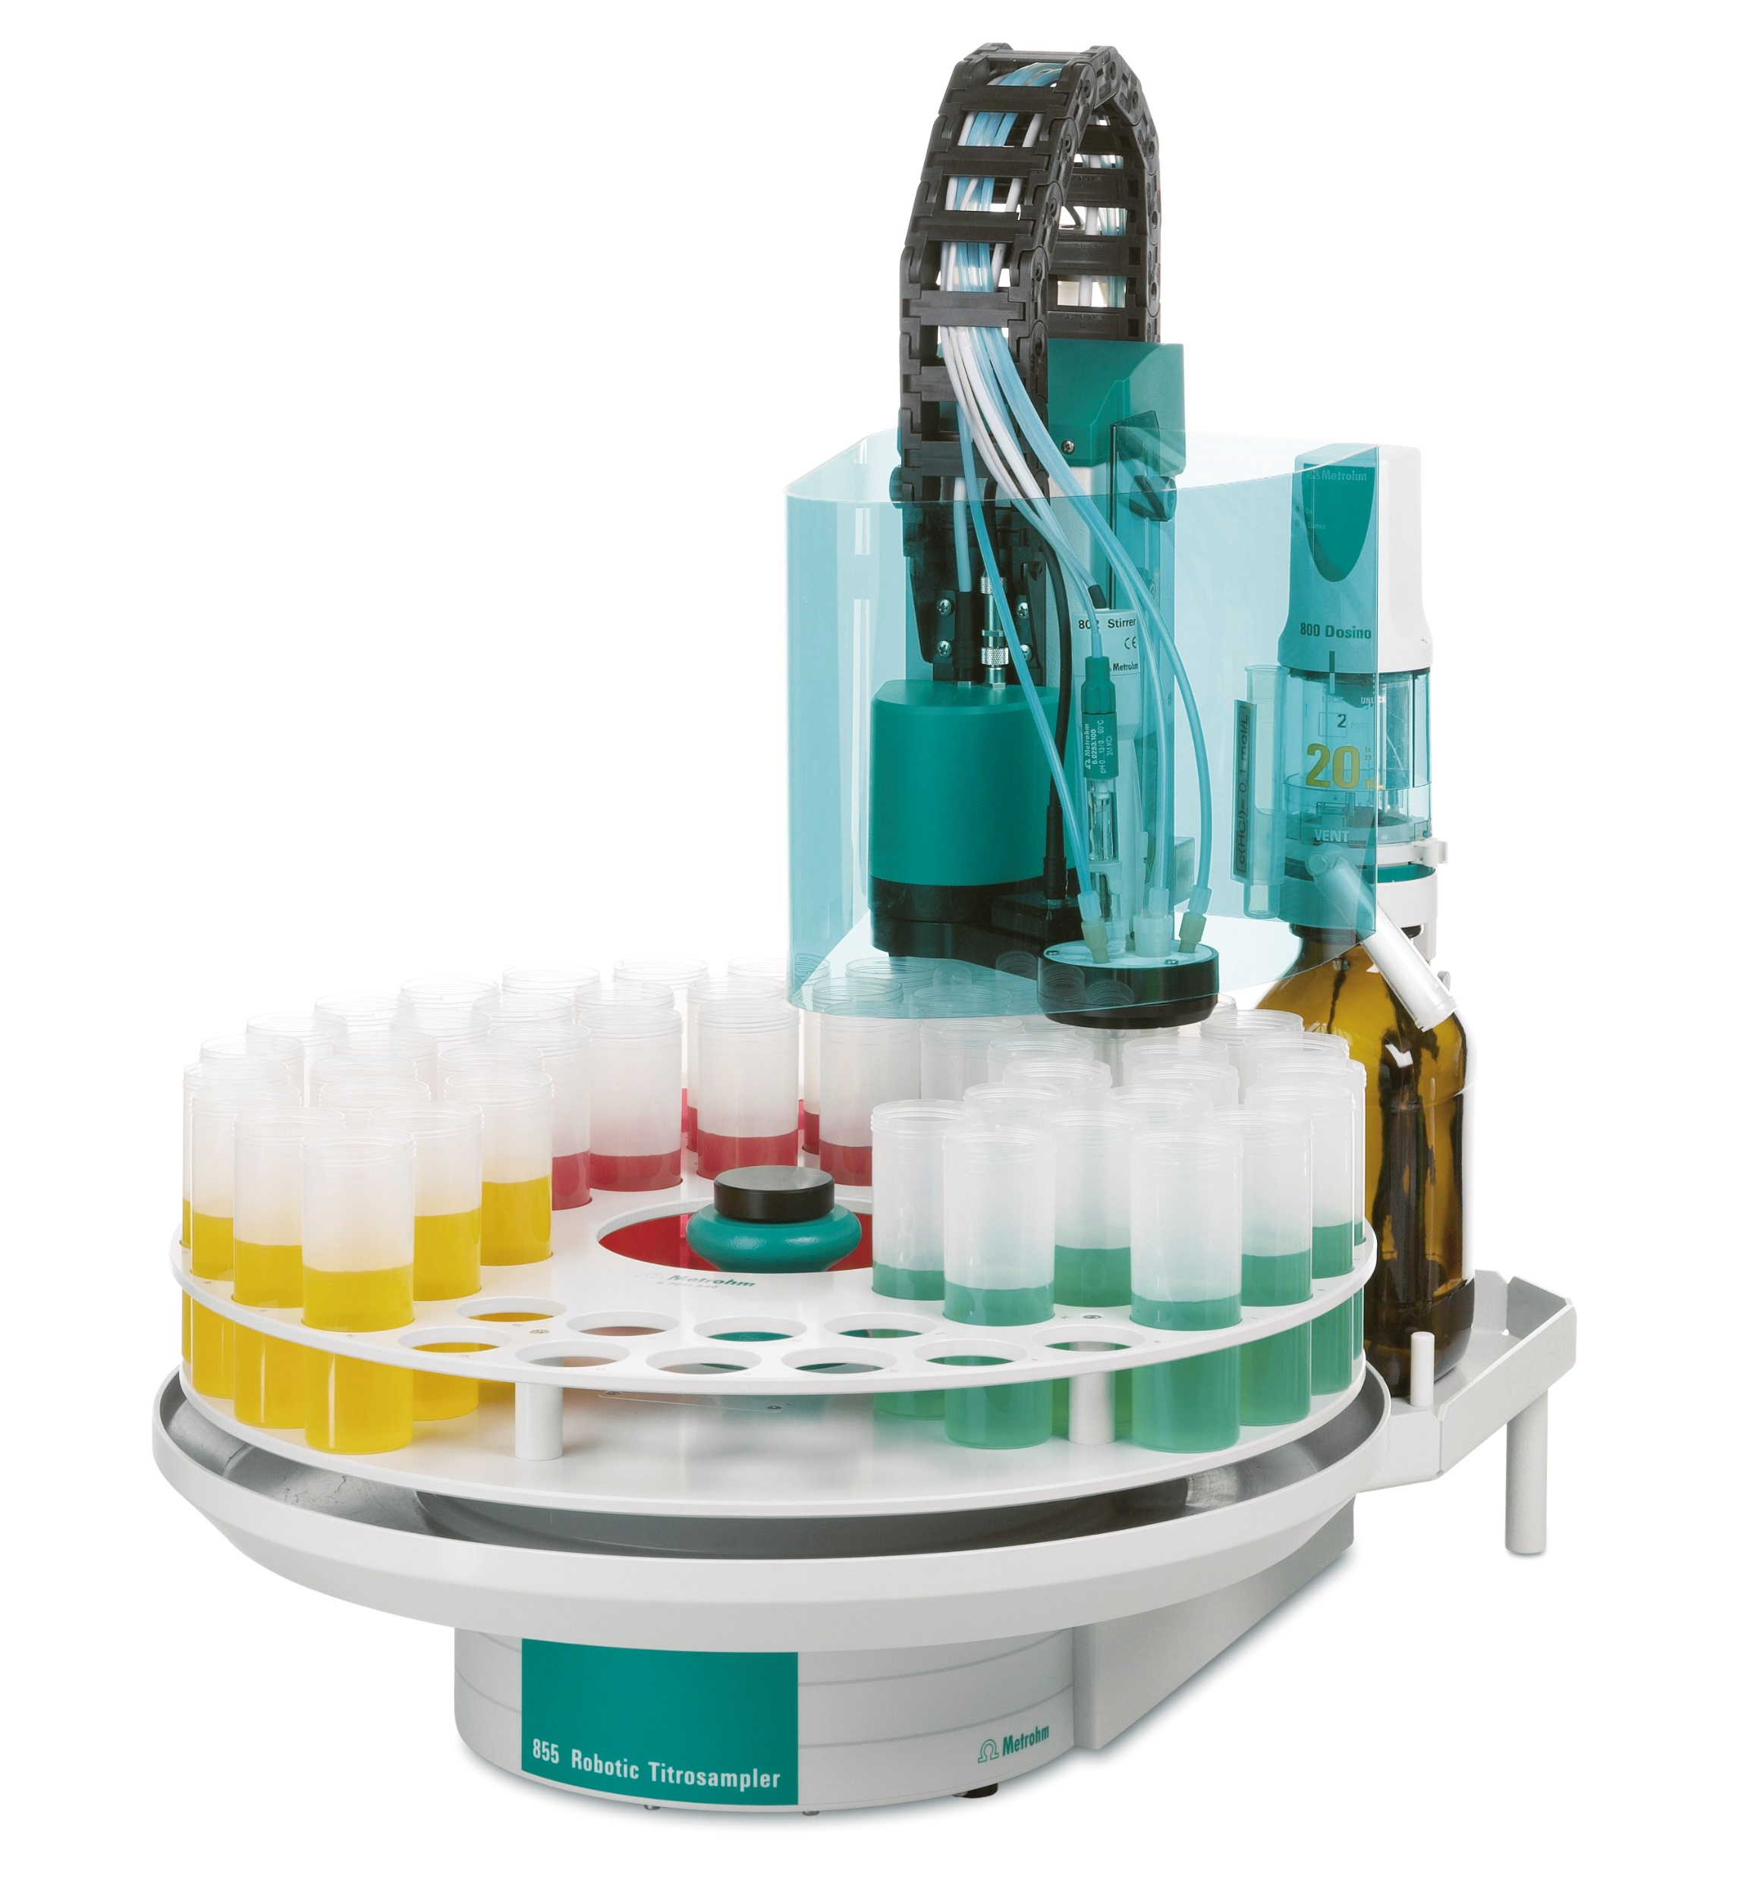
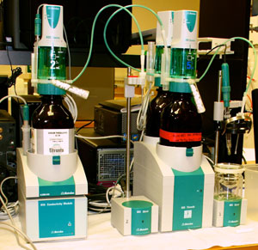

Slide 13

Coral Reefs at the macro-scale are doing these two things:
Gaining or losing CaCO₃ – this is net ecosystem calcification/dissolution (NEC + or -)
Producing or metabolizing food – this is net ecosystem productivity/respiration (NEP + or -)
Healthy reefs do both!

Slide 14
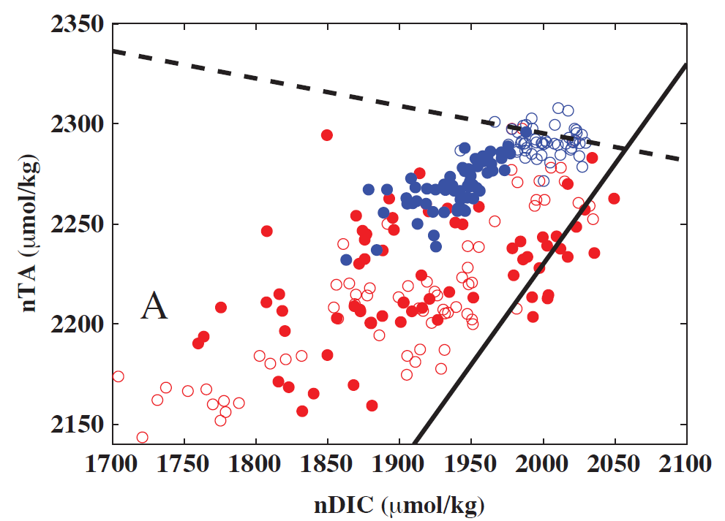
Some species are more resilient to ocean acidification than others.
Mixed lifestyle communities, like seagrasses and algae living with corals may be more resilient.
Photosynthesis
Solid = day
Open = night
Blue = Penguin Spit
Red = North Barren
Calcification
Teneva, Koweek, Mucciarone, Dunbar,
2014, 2015, 2016

Slide 15
Blue = RT4 (healthy reef)
Red = LL (degraded reef)
“The large differences in the ratio of
NCC to NCP observed across the two
sites indicate that monitoring this ratio
could be a powerful tool for monitoring
reef health, as has been previously
suggested [Albright et al., 2013;
Andersson and Gledhill, 2013].”
(Takeshita et al., 2016)

Slide 16
DeCarlo et al., 2017

Slide 17
C system parameters that can be measured
1) pH
2) Total CO₂ (TDIC)
ΣCO₂= [CO₂aq] + [H₂CO₃] + [HCO₃] + [CO₃]
3) pCO₂
4) Titration Alkalinity
TA = [HCO₃] + 2[CO₃] + [B(OH)₄] + [OH] + [HPO₄] + 2[PO₄] + [SiO(OH)₃] + [HS]
+ 2[S] + [NH₃] - [H] - [HSO₄] - [HF] - [H₃PO₄]
There are relationships between these parameters based on equilibria. Any two values can determine the system. 3 or 4 overdetermine it – and you can calculate new equilibrium constants.
!! Primary Production & Respiration change ΣCO₂ but not TA.
CO₂(aq) + H₂O + CO₃⁼ <=> 2HCO₃⁻
!!! Carbonate Precipitation & Dissolution change ΣCO₂ and TA.
Ca⁺⁺ + CO₃⁼ <=> CaCO₃

Slide 18
How precise do measurements of alkalinity and ΣCO₂ need to be?
This table shows possible precision, but you don’t always need to obtains the highest precision…
Dickson, 2016

Slide 19
Dickson, 2016

Slide 20
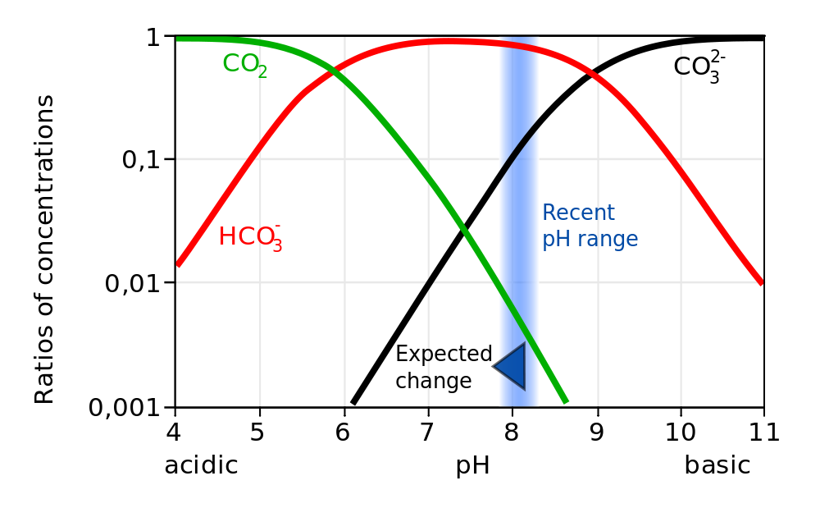
OK, what’s going on when CO₂ dissolves in seawater?

Slide 21
The C system in Seawater
CO₂ (air) <=> CO₂(aq) atm/ocean exchange
CO₂(aq) + H₂O <=> H₂CO₃ CO₂(aq) gas dissolved in SW
H₂CO₃ <=> H⁺ + HCO₃⁻ H₂CO₃ carbonic acid
HCO₃⁻ <=> H⁺ + CO₃⁼ bicarbonate ion CO₃⁼ carbonate ion
Ca⁺⁺ + CO₃⁼ <=> CaCO₃ Calcite or Aragonite
Another way of writing the precipitation/dissolution equation:
CaCO₃ + CO₂ + H₂O <=> Ca⁺⁺ + 2HCO₃⁻
Dissolution of carbonate takes up CO₂
These are equilibrium reactions…..they can happen forwards and in reverse!

Slide 22
Importance of carbonate system reactions
Buffer the pH of seawater to around 8
  Addition of H⁺ will drive reactions to right, e.g.:
  H⁺ + HCO₃⁻ → H₂CO₃
Buffers atmospheric CO₂
  Atmospheric CO₂ dissolved in seawater is converted to bicarbonate ion.
  CO₂ + H₂O → H⁺ + HCO₃⁻
  Solubility of CO₂ in ocean water is greatly enhanced as a consequence.

Slide 24
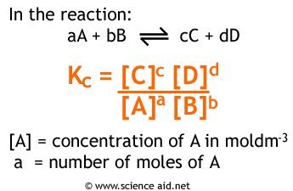
Equilibria
K = [CO₂(aq)]/[H₂CO₃], K=650 @ 25C, [CO₂(aq)] >> [H₂CO₃]
Define [H₂CO₃*] = [CO₂(aq)] + [H₂CO₃] , and
K_{H2CO3} = {H⁺}[HCO₃⁻]/[H₂CO₃], then if K₁ = K_{H2CO3}/(1 + K)
K₁ = { H⁺}[HCO₃⁻]/[H₂CO₃*]
K₂ = { H⁺}[CO₃⁼]/[HCO₃⁻]
K_{H} = PCO₂ /[ H₂CO₃*]
(Units: M/liter except K_{H} = M/l/atm)

Slide 25
For seawater – A “Bjerrum plot”

Slide 26
C system parameters that can be measured
1) pH
2) Total CO₂ (TDIC)
ΣCO₂= [CO₂aq] + [H₂CO₃] + [HCO₃] + [CO₃]
3) pCO₂
4) Titration Alkalinity
TA = [HCO₃] + 2[CO₃] + [B(OH)₄] + [OH] + [HPO₄] + 2[PO₄] + [SiO(OH)₃] + [HS]
+ 2[S] + [NH₃] - [H] - [HSO₄] - [HF] - [H₃PO₄]
There are relationships between these parameters based on equilibria. Any two values can determine the system. 3 or 4 overdetermine it – and you can calculate new equilibrium constants.
!! Primary Production & Respiration change ΣCO₂ but not TA.
CO₂(aq) + H₂O + CO₃⁼ <=> 2HCO₃⁻
!!! Carbonate Precipitation & Dissolution change ΣCO₂ and TA.
Ca⁺⁺ + CO₃⁼ <=> CaCO₃

Slide 27
DeCarlo et al., 2017

Slide 29
