Slide 1

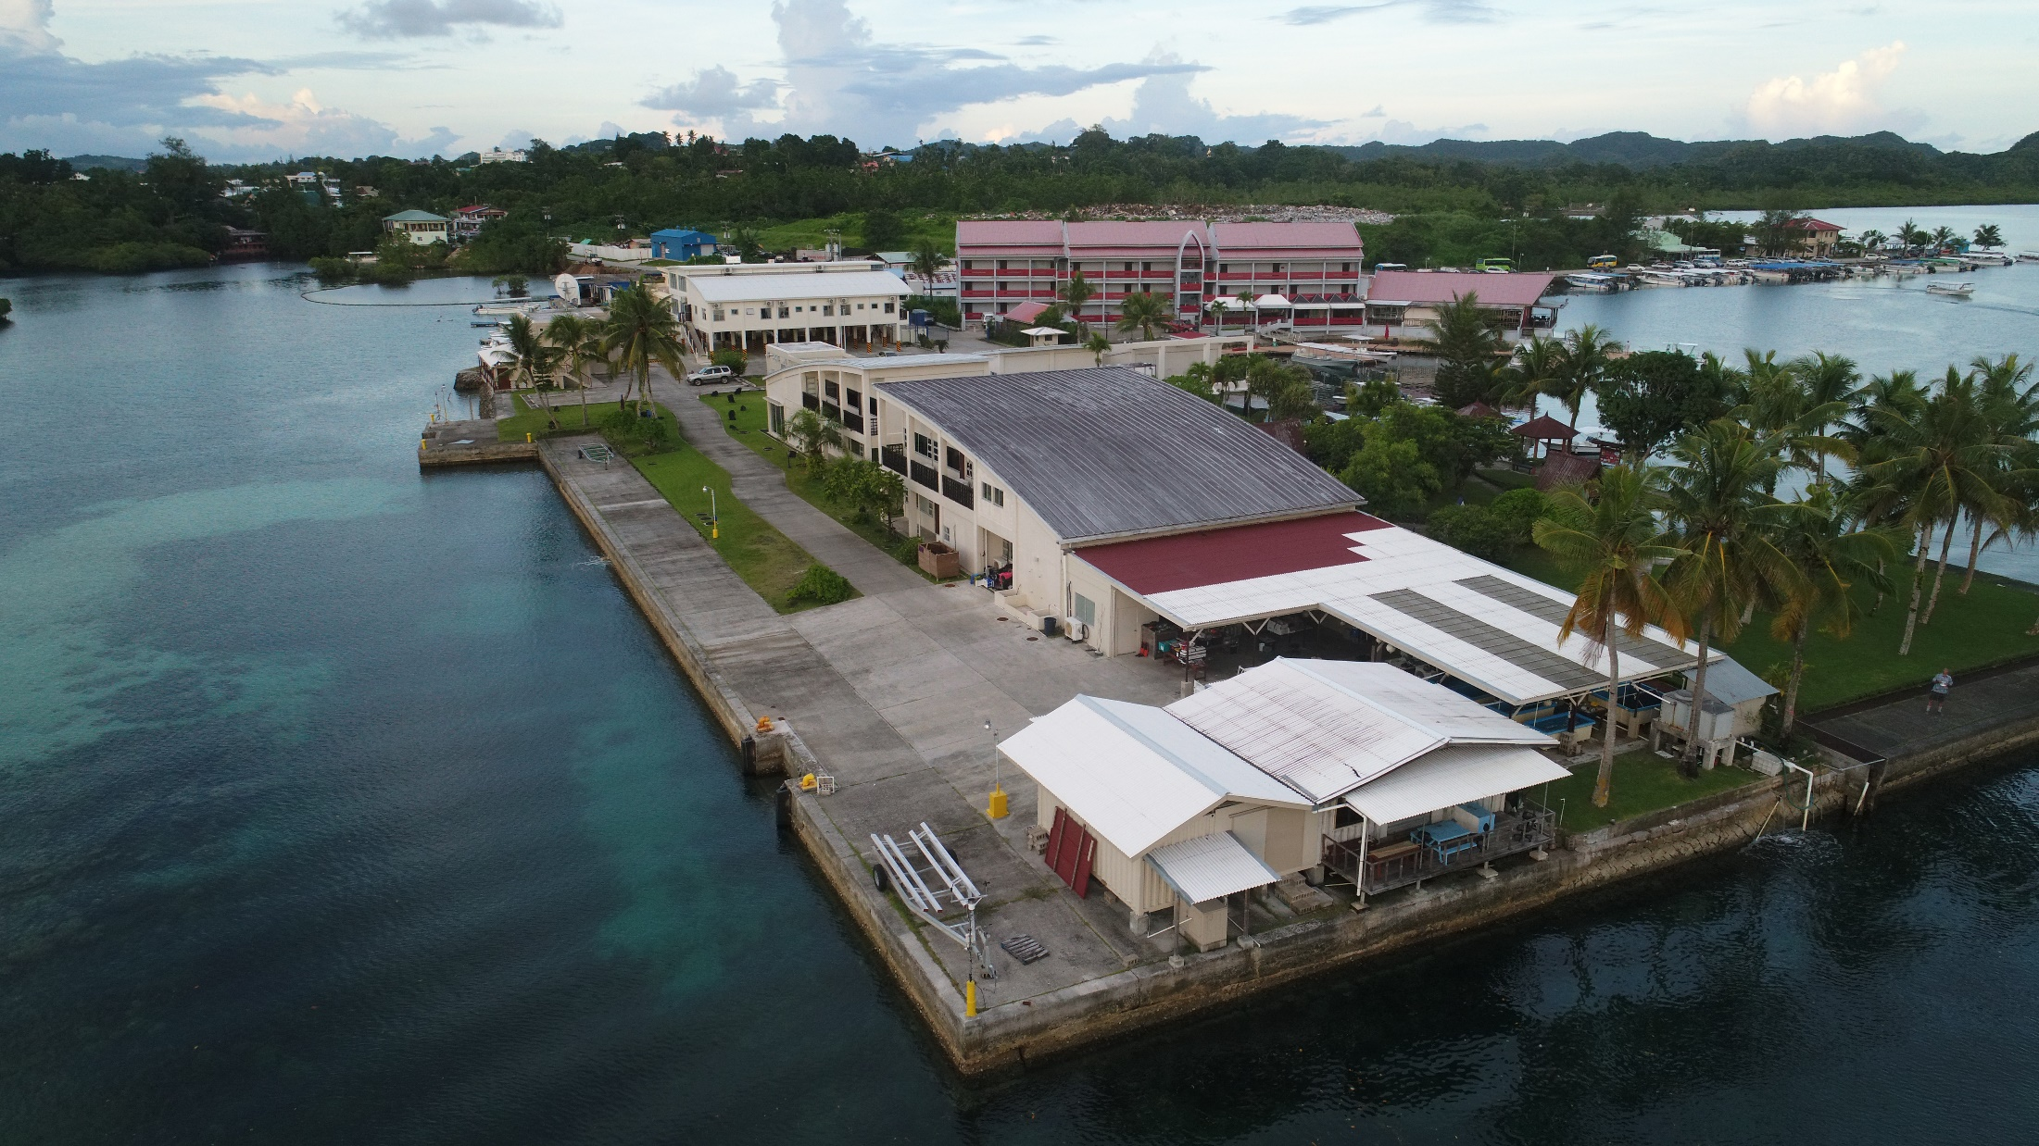
Informal training for IAEA Palau Ocean Acidification Project
Class 2
“Strengthening Conservation for a Sustainable Palau”

Slide 2

I bought my ticket! Again….. THANKS for being flexible.
I arrive on Sunday, April 17, and we can meet, work in the lab, collect samples, design research, write reports M-Th.

Slide 3
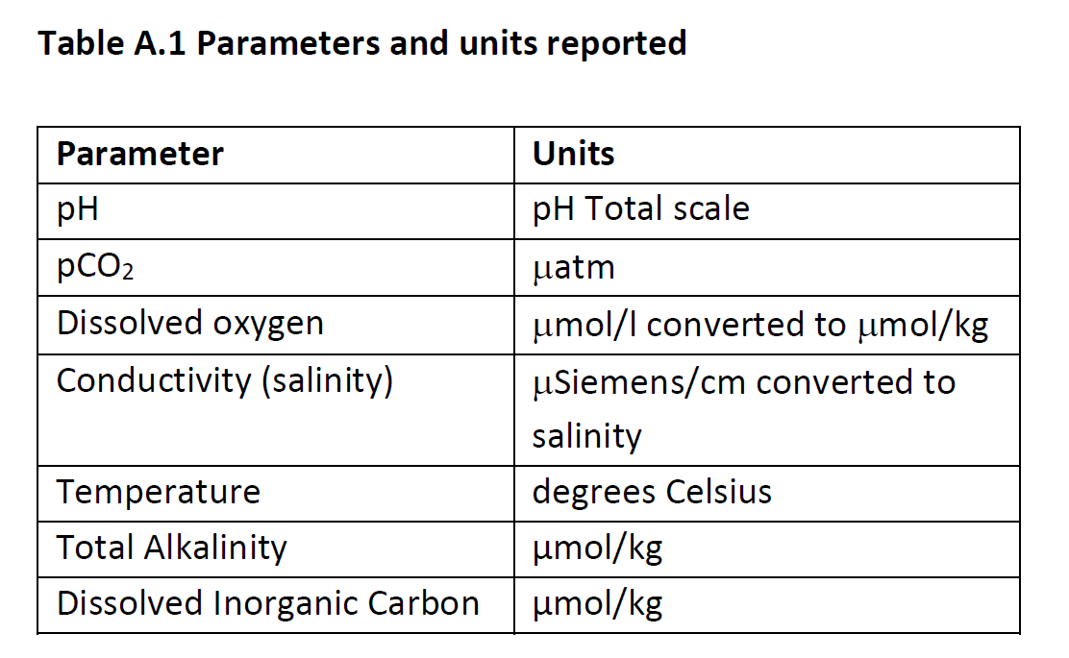
Most people doing C system work in the ocean need research grade measurements of:
* = todays topics
*
*
*
*

Slide 4
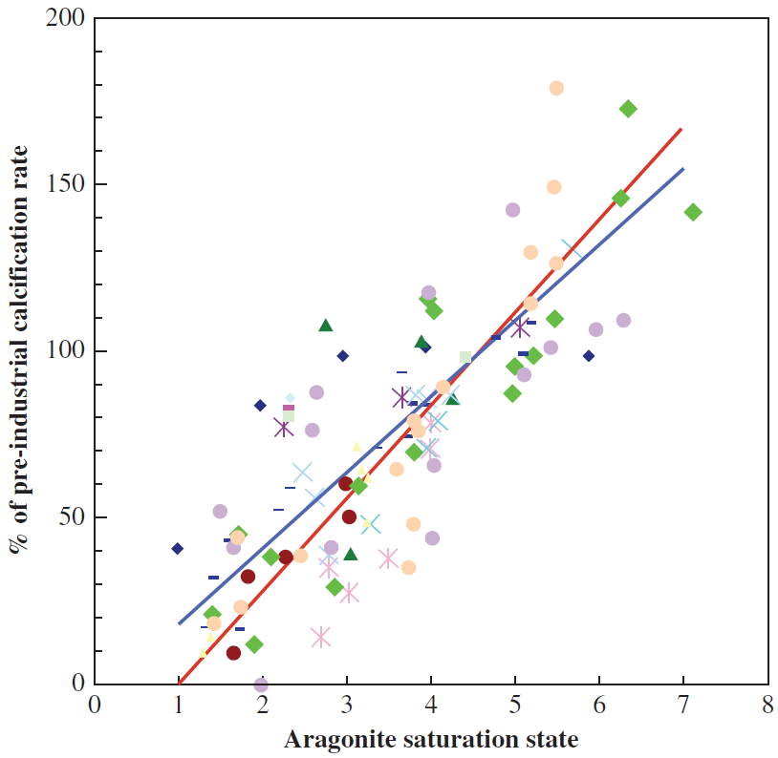
Ocean Acidification reduces Aragonite saturation in the ocean causing corals to
calcify and grow more slowly. We
don’t yet know the scale of the
problem “in the wild” over time.
11 different coral species
17 studies
Andersson et al., 2012
Notes:
Relative rate of calcification for a number of coral species as a function of aragonite saturation state. From Andersson et al., 2012 (Gattuso book Ocean Acidification)

Slide 5
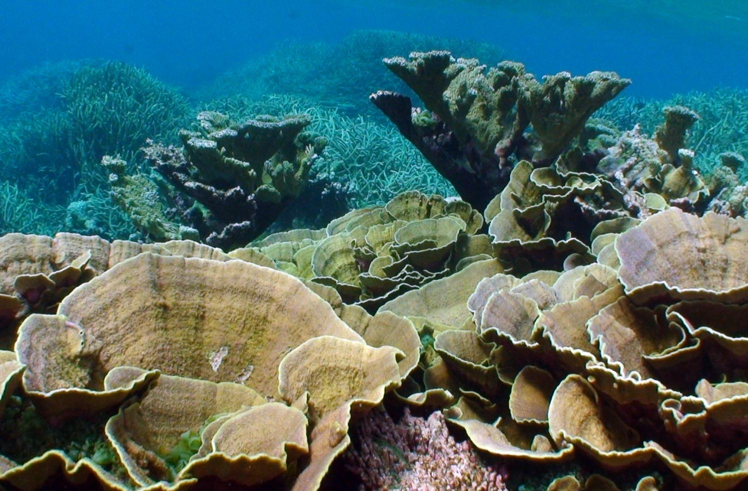
OK, what can be done? The global root cause is CO₂ emissions and they must be reduced. Local management can buy time, particularly for coral reefs. With healthy reefs atoll islands can keep up with SLR.

Slide 6
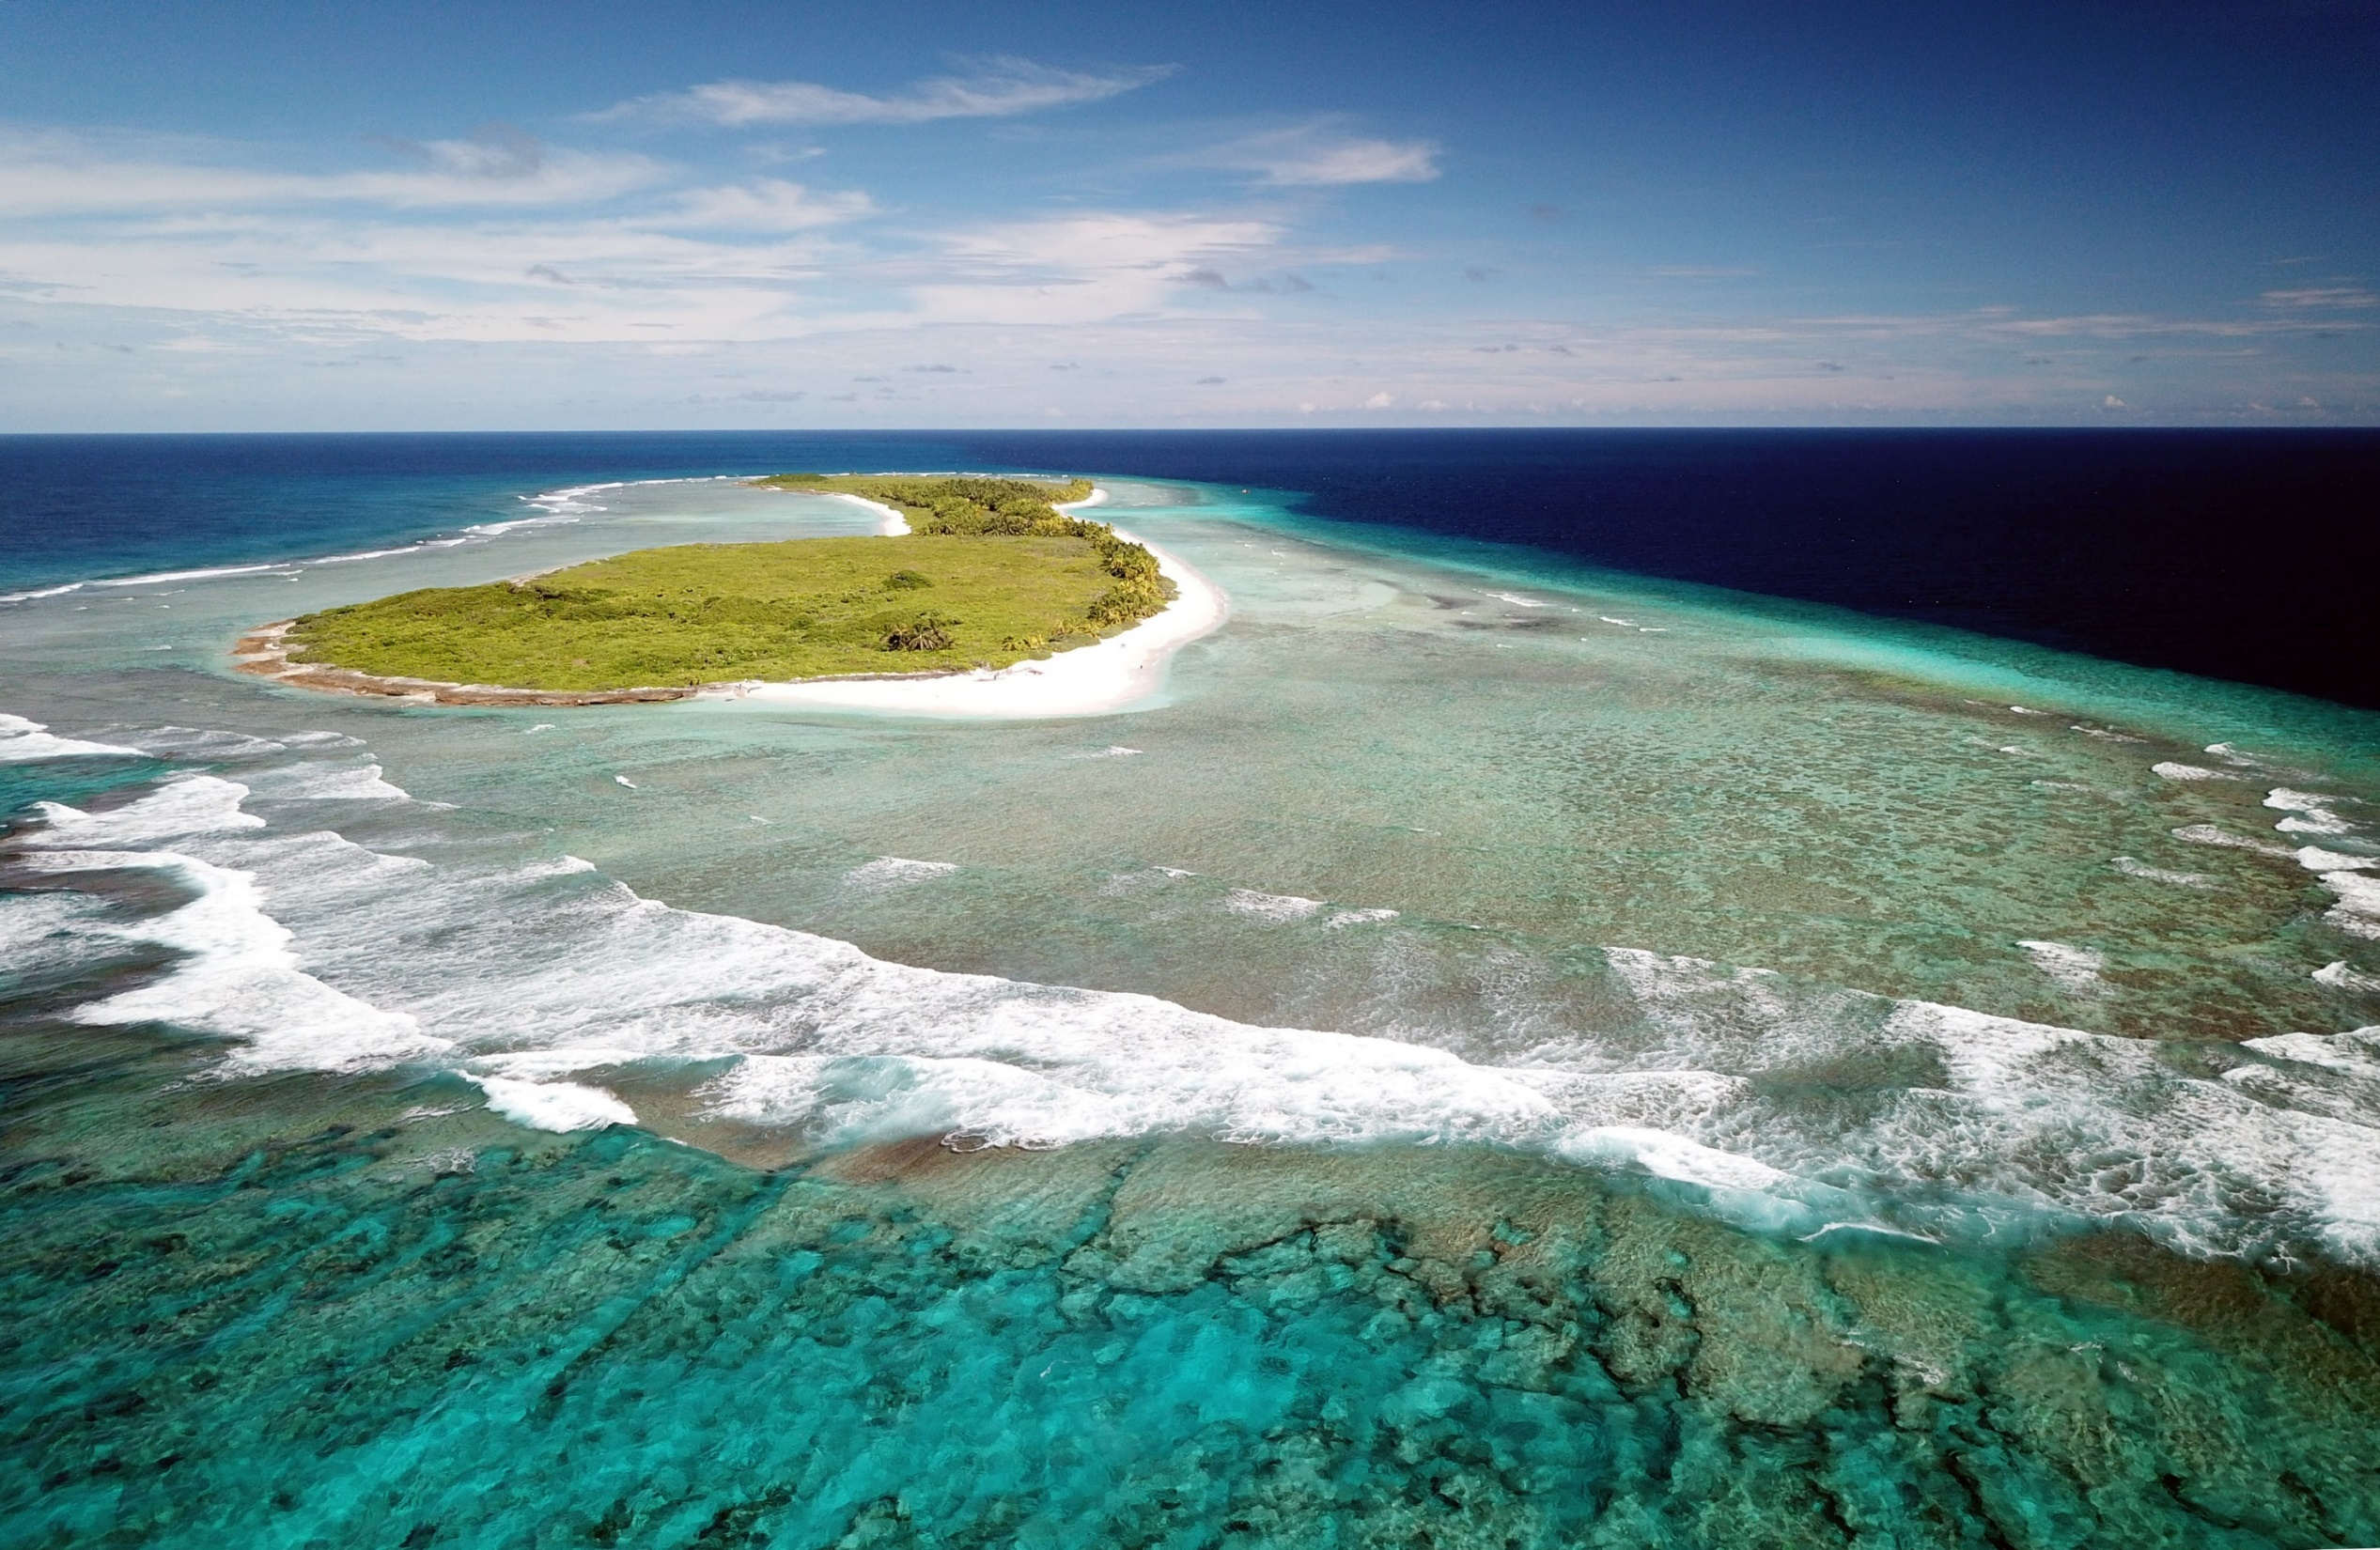

Coral reefs are the largest cement factories on Earth. They can absorb 70-95% of incoming storm wave energy and when healthy, can keep up with sea level rise……

Slide 7
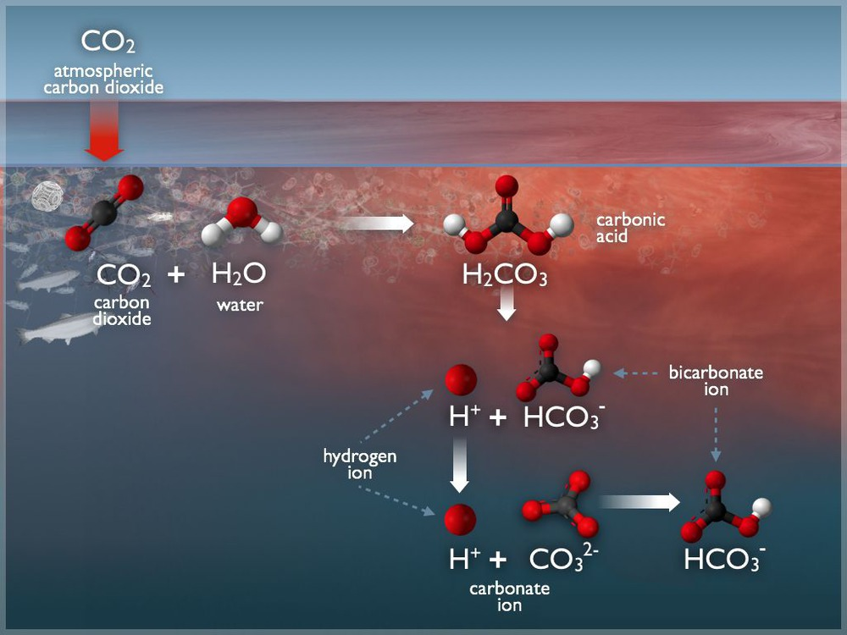
Let’s start with basic solution chemistry…..
pH buffering of the ocean
NOAA

Slide 8
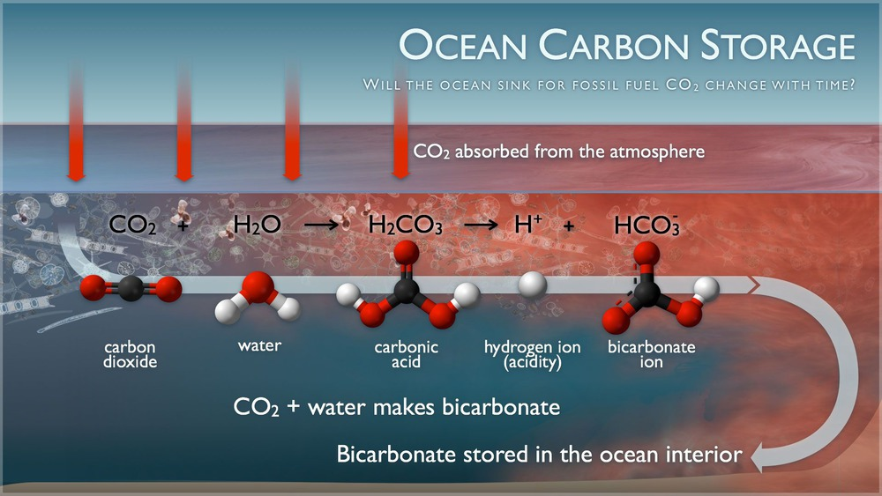
NOAA
What “credits” can Palau accrue through Ocean C storage?

Slide 9
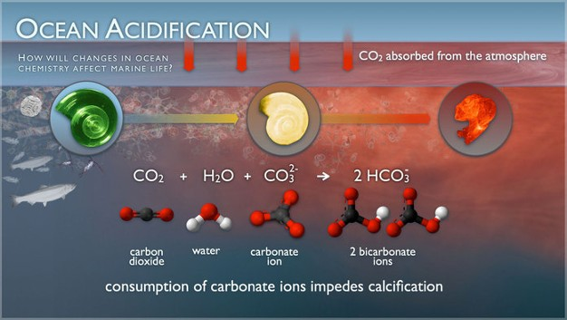
The above equation is super important, and the reaction can proceed in both directions.
This is an example of equilibria. The equation can also be written with CaCO₃ as a mineral.
NOAA

Slide 10
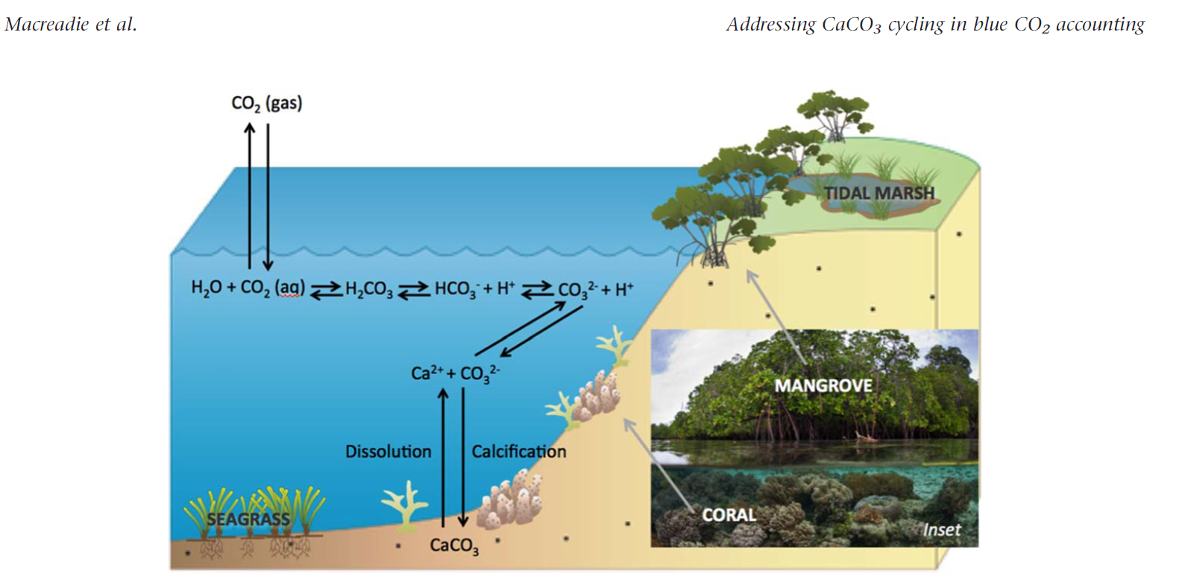
2017
When corals
CaCO₃ + CO₂ + H₂O <=> Ca⁺⁺ + 2HCO₃⁻
When corals grow they release CO₂
When corals dissolve they take up CO₂

Slide 11
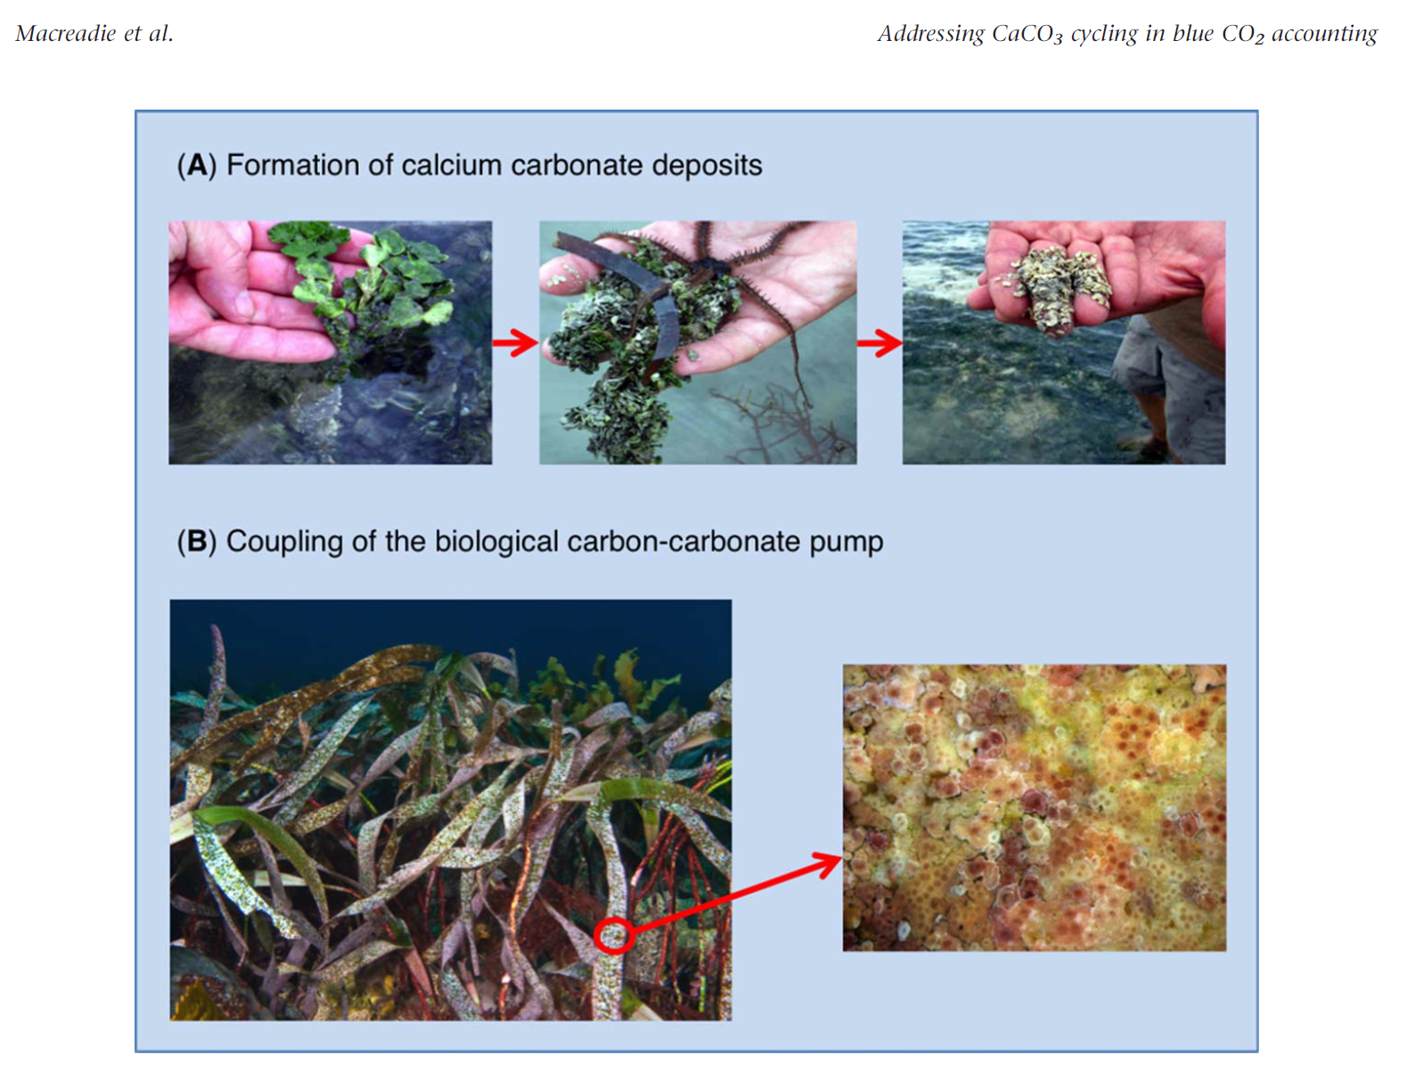
2017

Slide 12
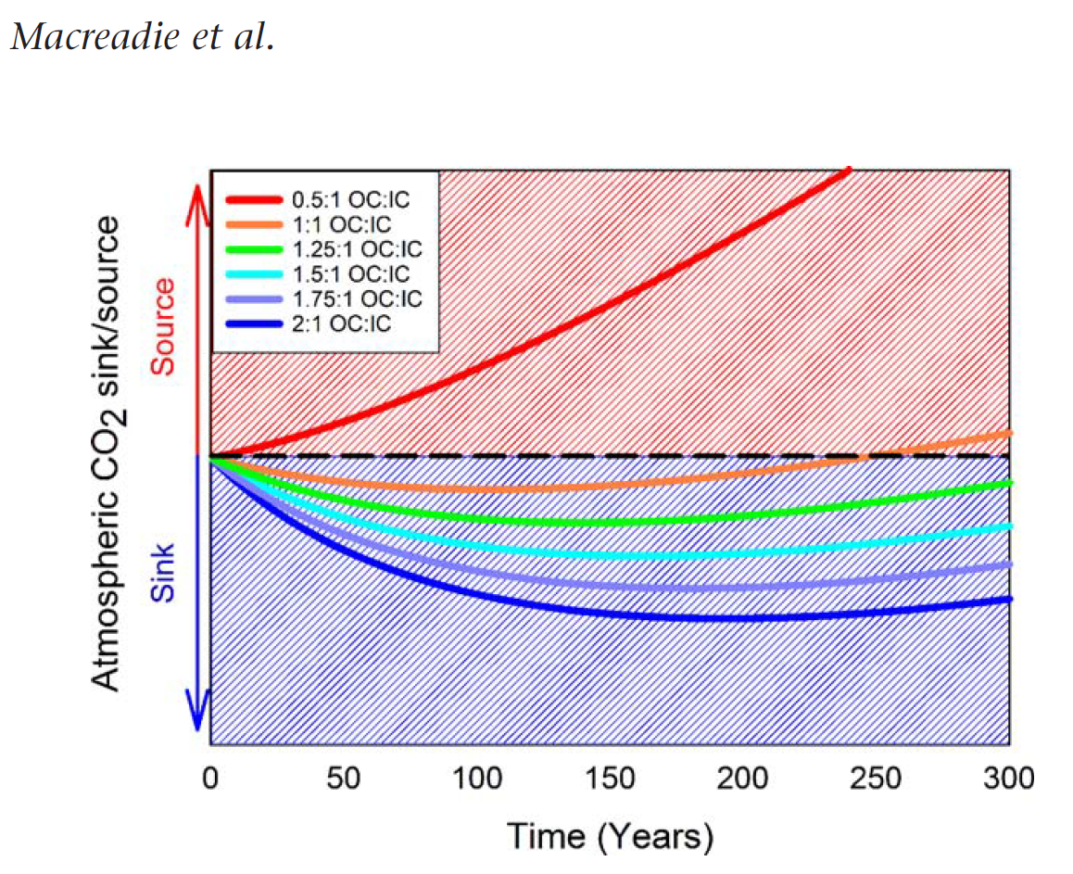
2017

Slide 13
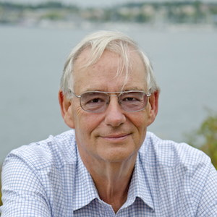
Dickson, 2016

Slide 14
Dickson, 2016

Slide 15
Dickson, 2016

Slide 16
Dickson, 2016

Slide 17
Dickson, 2016

Slide 18
Dickson, 2016

Slide 19
Dickson, 2016

Slide 20
Dickson, 2016

Slide 21
Dickson, 2016

Slide 22
Dickson, 2016
These are the two methods we use at Stanford – where we have built precise automated instruments for this purpose. A good reason to visit?

Slide 23
Dickson, 2016
We us both at Stanford. We use conventional

Slide 24
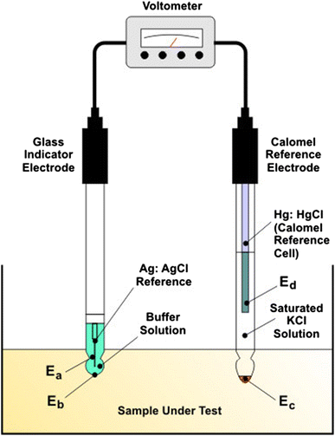
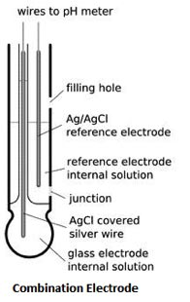
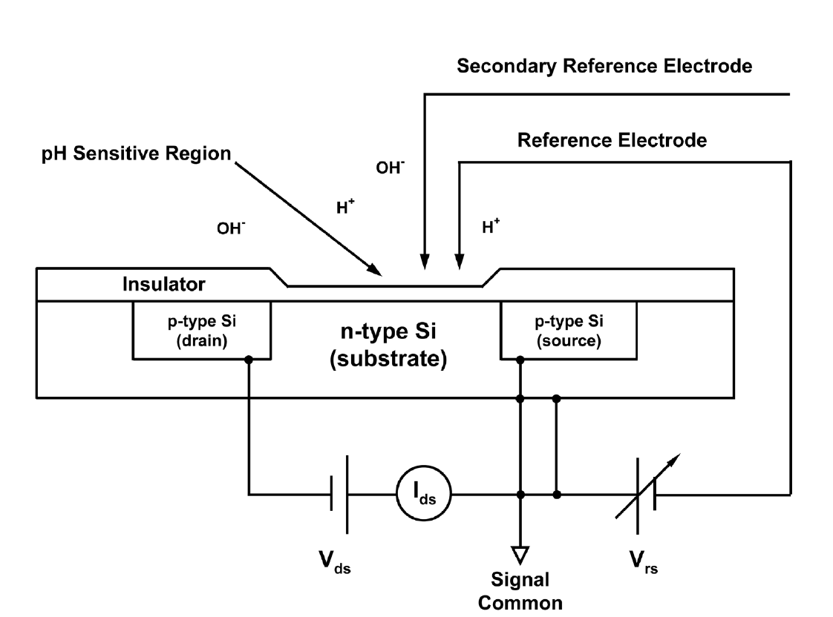
3 electrometric methods

Slide 25
Dickson, 2016
E=cell potential (voltage), R = universal gas constant, F = Faraday Constant

Slide 26
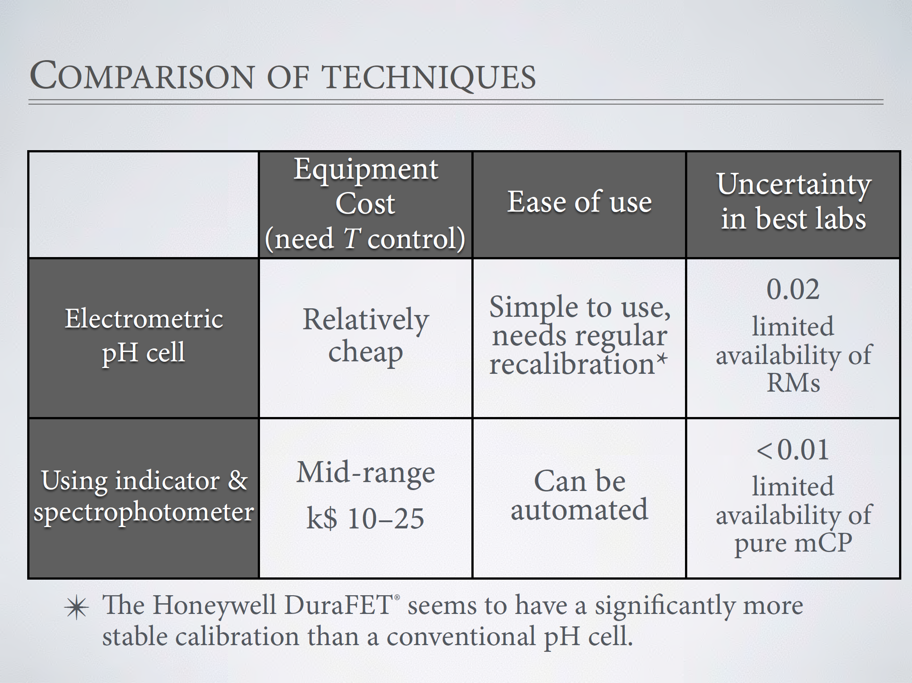
Dickson, 2016

Slide 27
Dickson, 2016

Slide 28
Dickson, 2016
“nondispersive infrared”

Slide 29
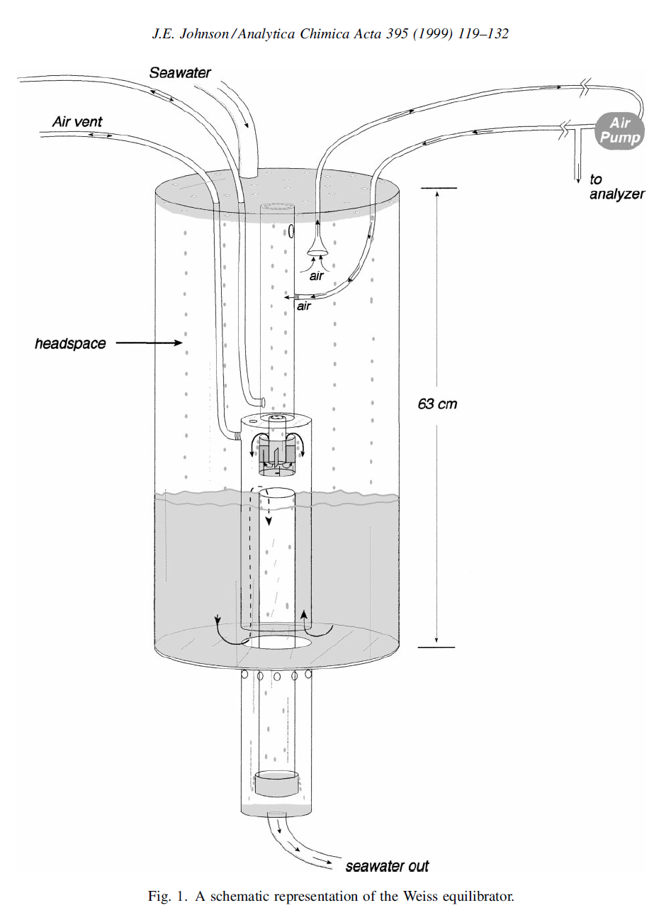
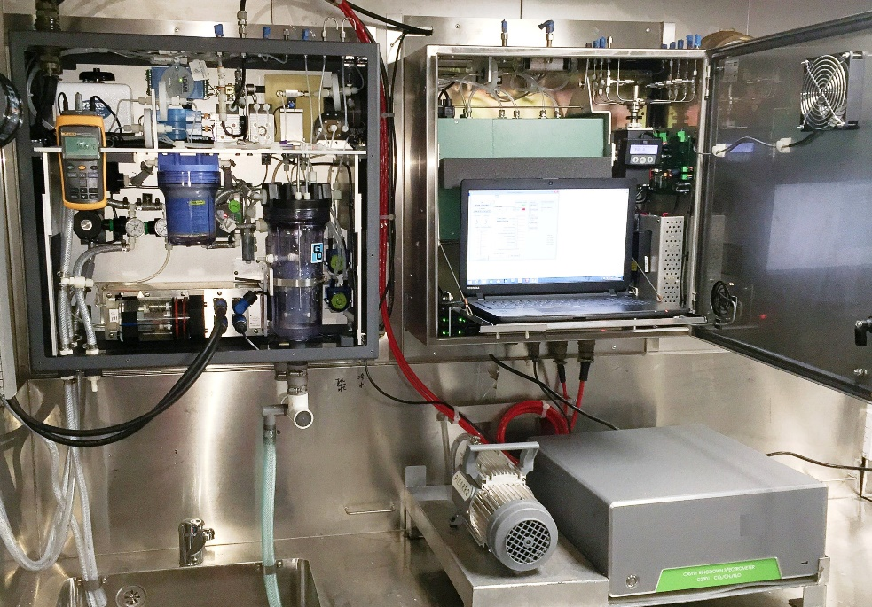

Slide 32
Dickson, 2016
Non-linear least squares

