Slide 1
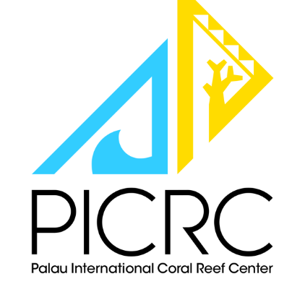
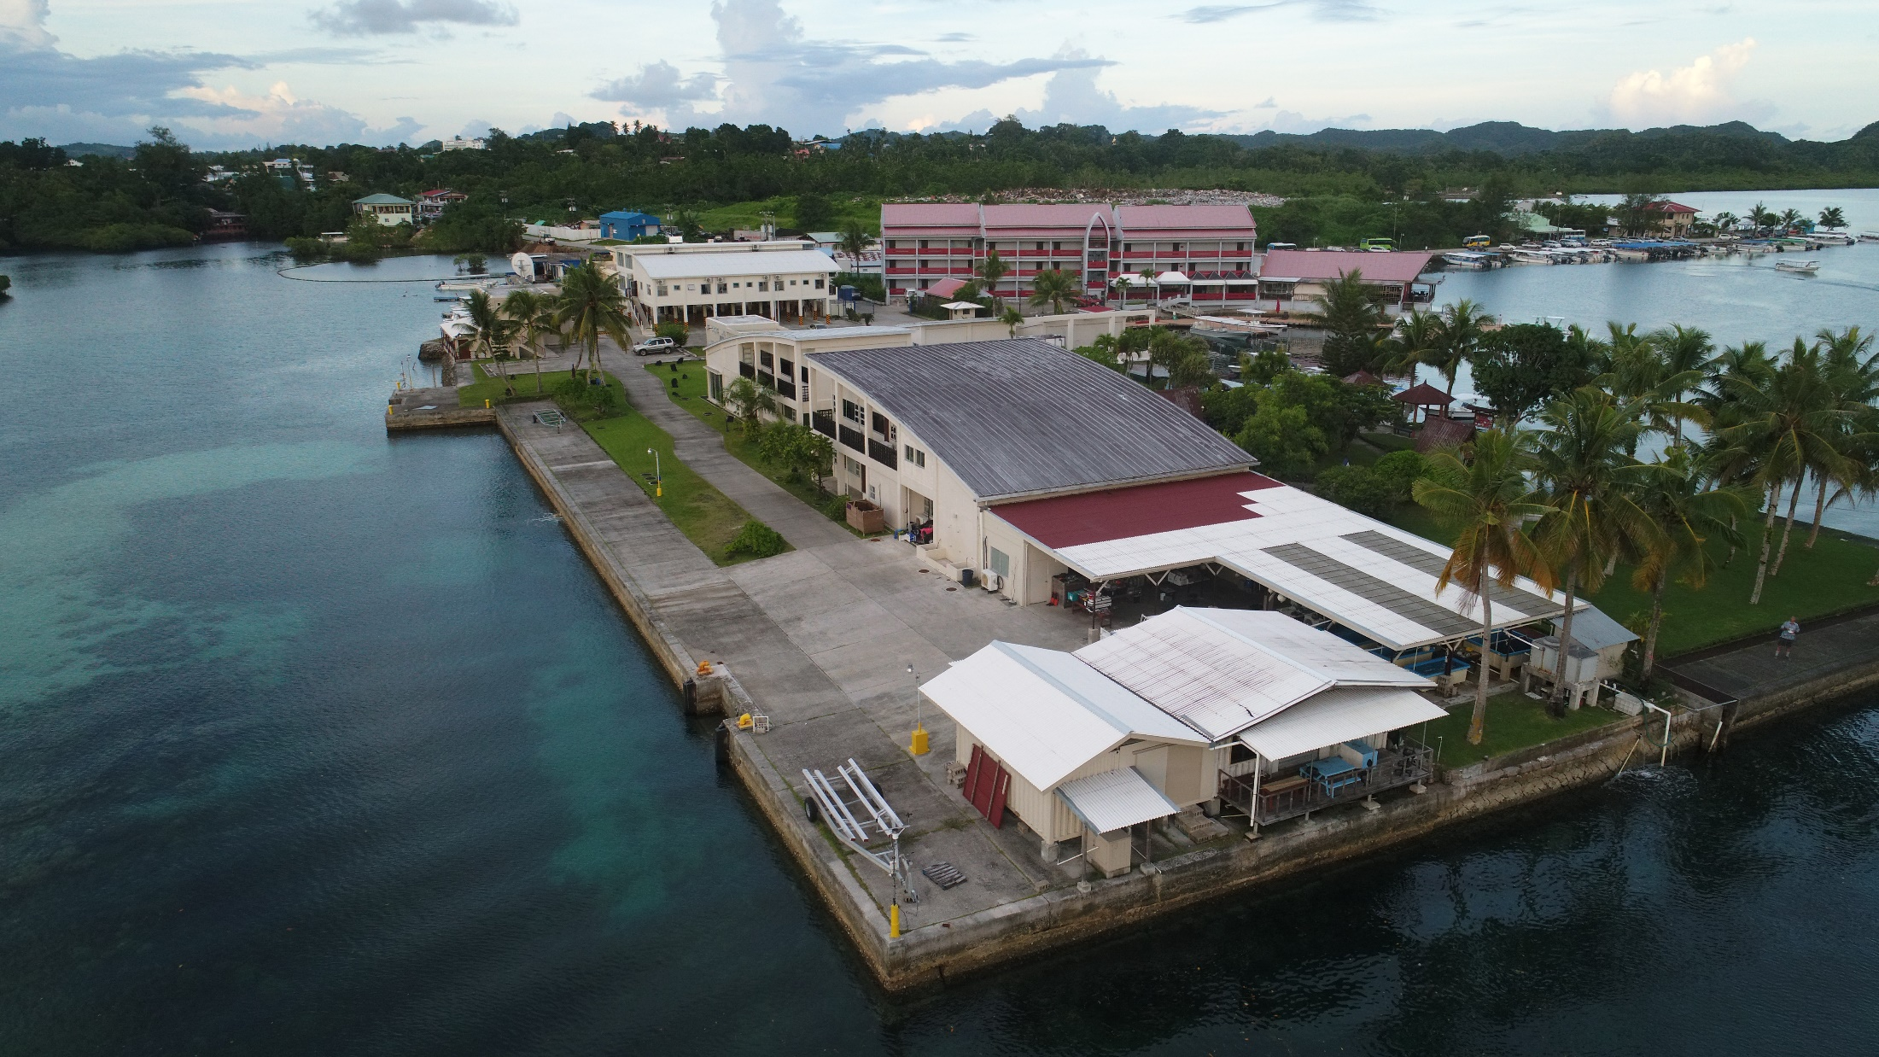
Informal training for IAEA Palau Ocean Acidification Project
“Strengthening Conservation for a Sustainable Palau”

Slide 2
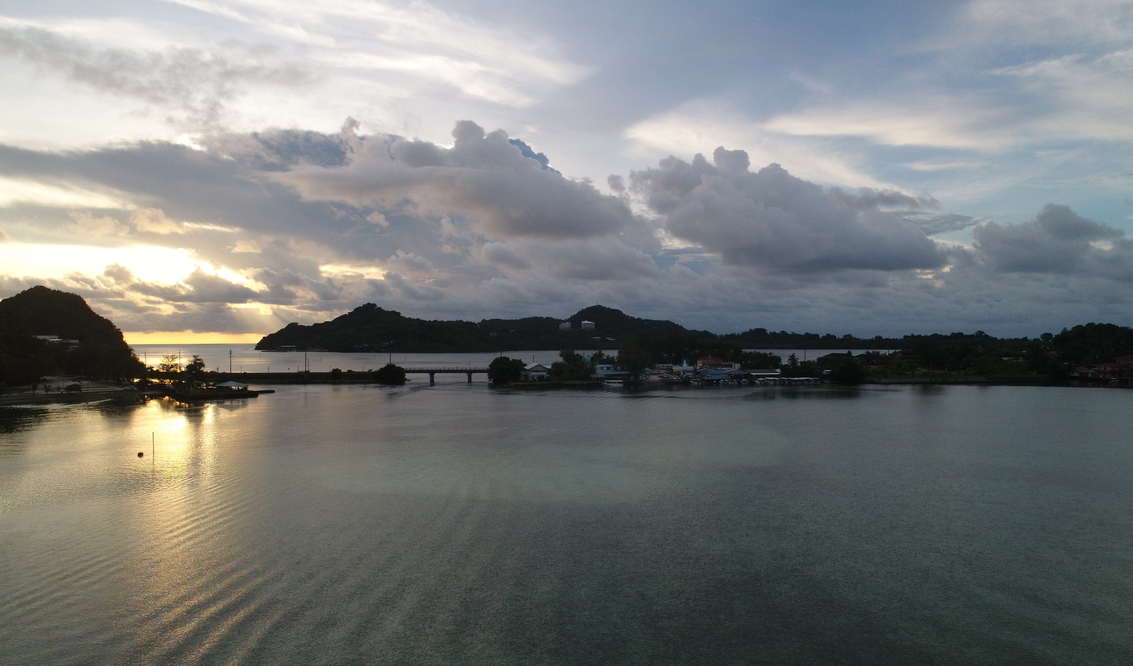
Alii!
What are we going to do?
Training on theory and practice for the new Ocean C Lab
Prepare Ikelau and MQ for Sabine Lab visit (April 2?)
Think about research activities by Palauans and for Palau
Plan future activities and educational possibilities

Slide 3
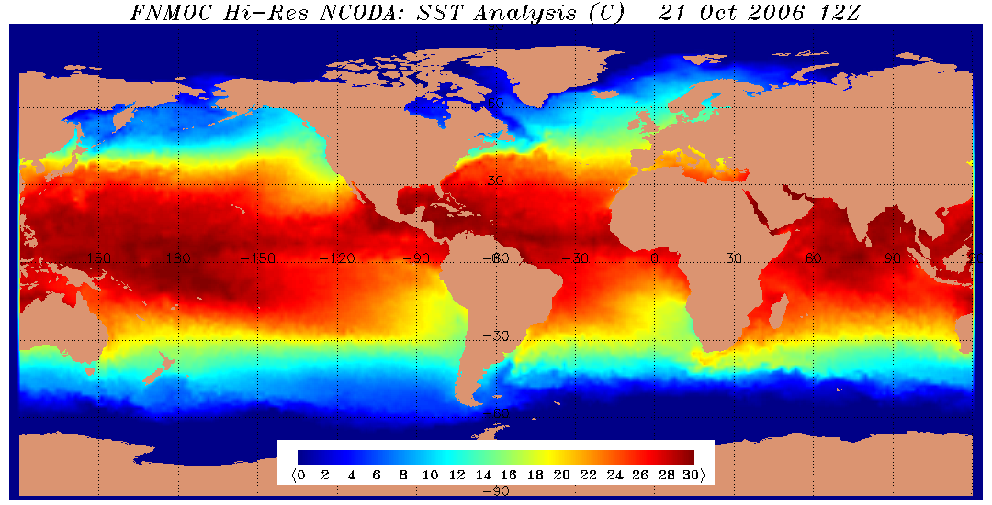
Who am I?
I’m a climate scientist and biogeochemist, working mainly in the ocean, studying El Niño and longer-term changes in the tropics and polar oceans. I’ve been doing this work since 1974. = places my lab has studied climate change and climate change impacts.

Slide 4
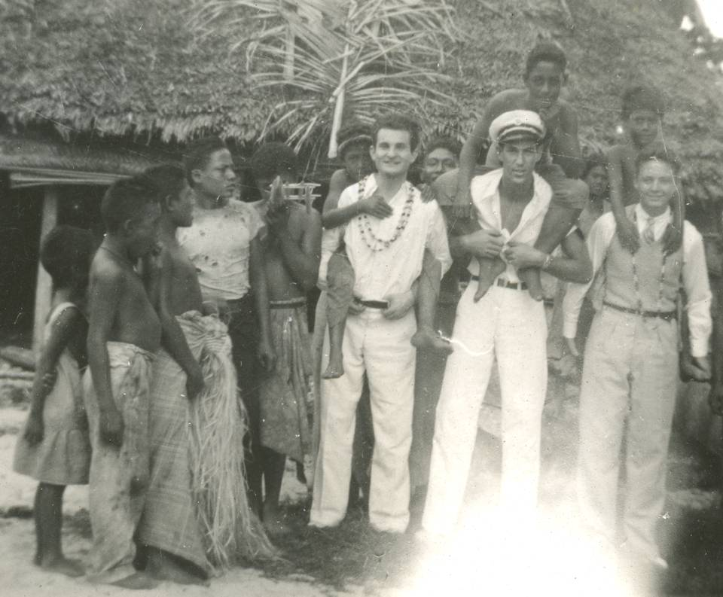
My Dad….Samoa in 1938….

Slide 5
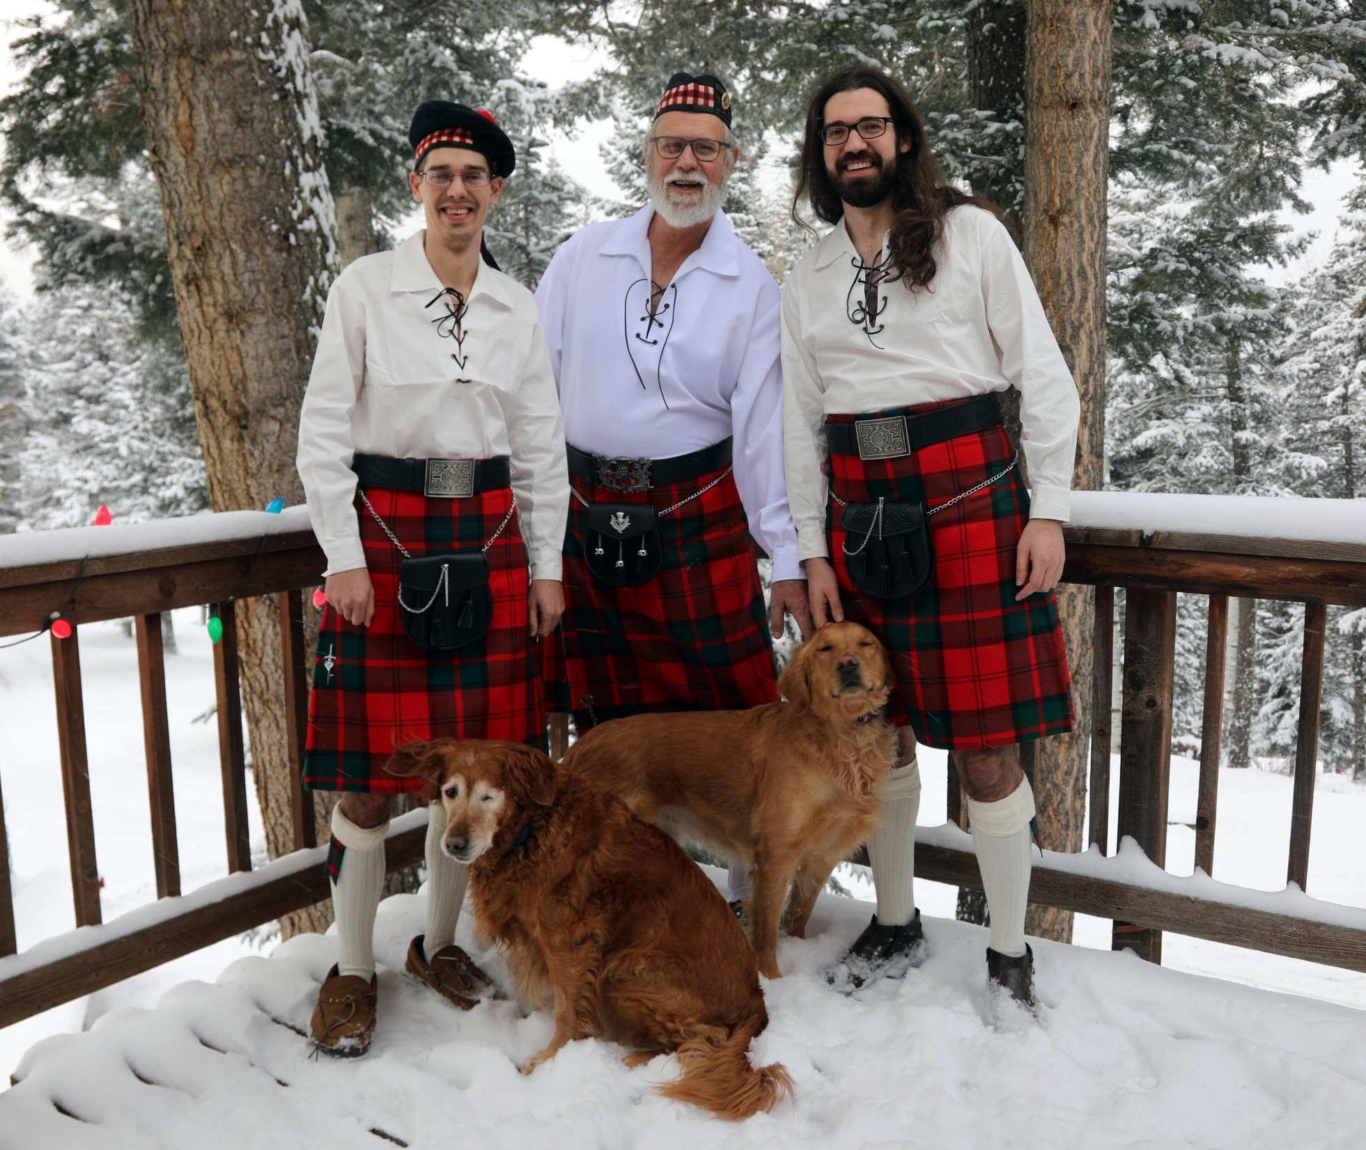
My boyz and dogs.

Slide 6
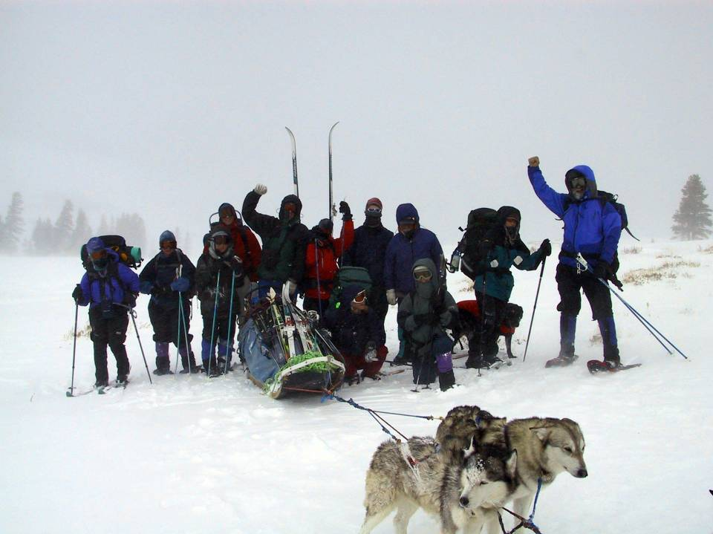
Teaching Outside the Walls
GES38 at Carson Pass

Slide 7
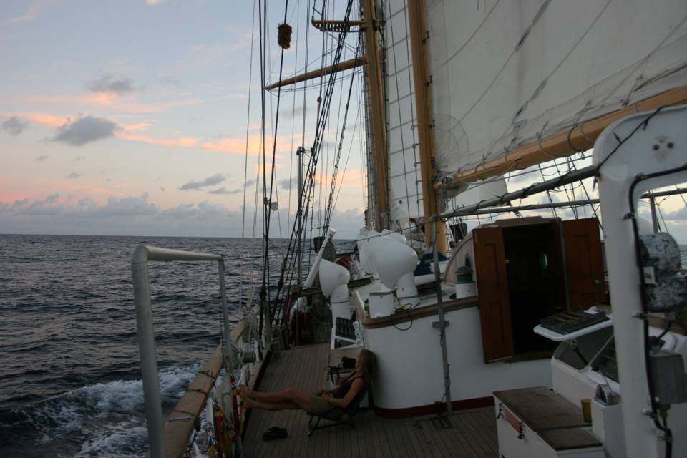
Stanford@SEA – April-June every other year

Slide 8
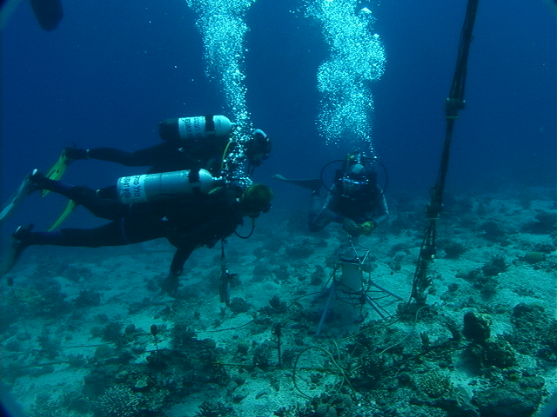

C cycle impacts/buffering in coral reef ecosystems
Notes:
Dunbar Lab research projects as of May 2002. Student opportunities are available within each of these projects. Image: The first direct in-situ measurement of net community dissolution on a coral reef in Eilat, Israel (R. Dunbar).

Slide 9
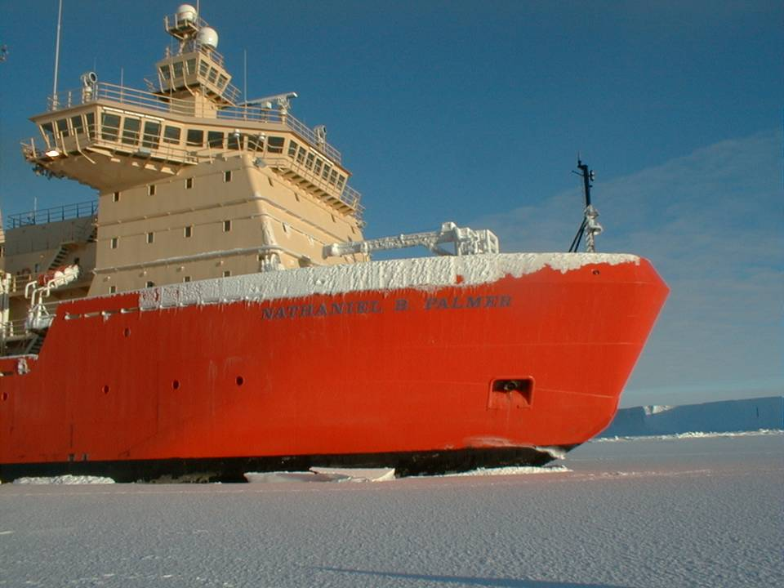
CO₂ uptake in the Southern Ocean: Physics vs. Biology
Notes:
Nathaniel B. Palmer, Bay of Whales, 1998.
Photo by Rob Dunbar.

Slide 10
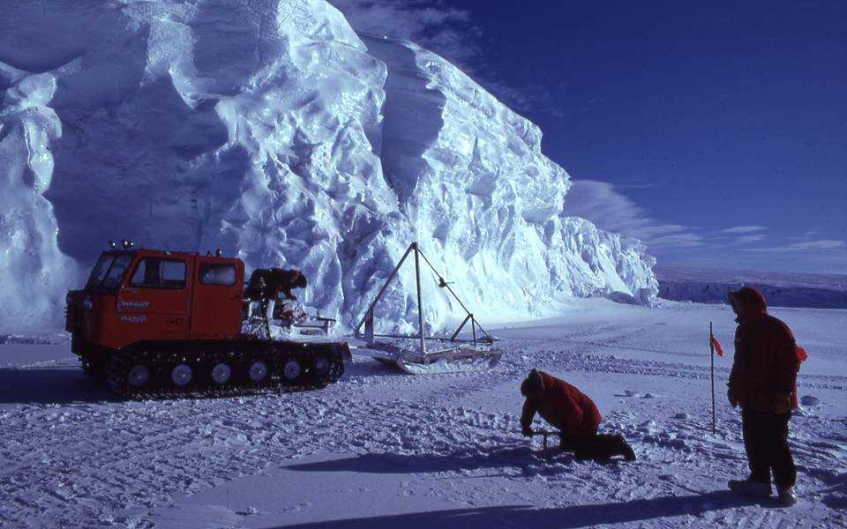
Stanford Students in Antarctica – 1982 to 2020

Slide 11
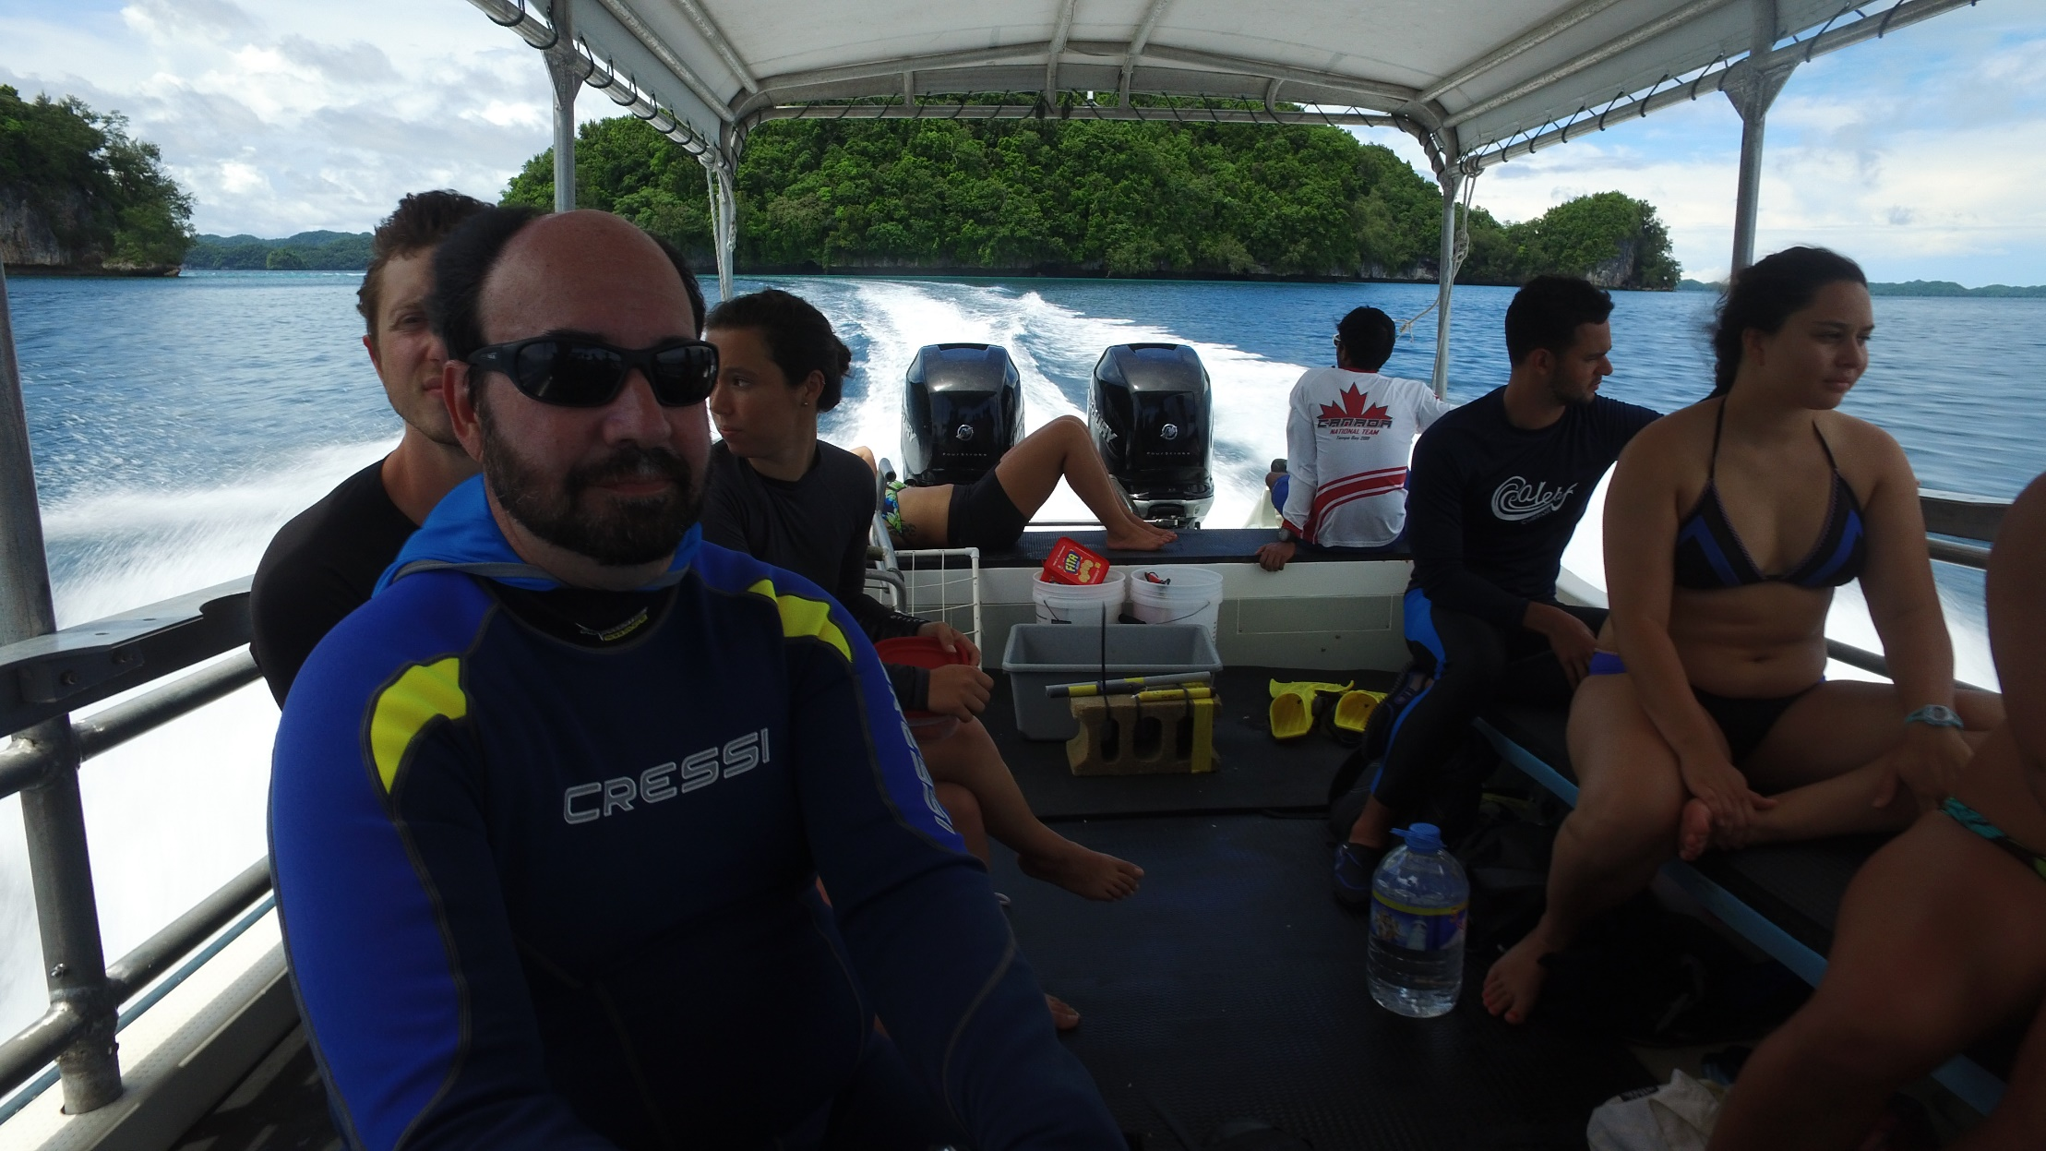
Stanford Students in Palau - 2005 - 2022

Slide 12
Questions from Ikelau:
The titrating acid – design spec is 0.1N in a solution of seawater ionic strength (0.7). As long as it is kept sealed, it doesn’t go bad, but precise normality can change from evaporation. Shoot for a salinity of 34-35 ppt.
“The acid titrant, prepared by weight from an approximate 1 M stock solution, has a concentration of 0.1 mol kg⁻¹ and is prepared in a 0.6 mol kg⁻¹sodium chloride background to approximate the ionic strength of seawater (0.7 mol kg⁻¹ ).”
Dickson et al., 2003
If you have 0.153N HCl you could dilute it to 0.1N and then add some NaCl to bring ionic strength to 0.7. It may not be a precisely know normality but if it close to 0.1N it should be fine, and you can calibrate it using Dickson CRM’s (certified reference materials). You can also buy calibrated 0.1N HCl and add salt.
How do you measure salinity at the lab? How accurate?
Do you have CRM’s? They are VERY important for TDIC (Total CO₂) and Alkalinity calibration and measurement.
At Stanford, we usually buy 0.1N HCl for seawater titrations directly from Andy Dickson at SIO. Not sure how long this will be possible…..
When might your new Dilut-It 1N HCl arrive. Always good to have spare bottles.
What was the symptom that led you to think the acid was no longer working well?

Slide 13
Questions from Ikelau:
I wouldn’t try to use Tris-HCL as a titrant. Tris HCL is a buffering agent (acidic buffer) commonly used by molecular biologists to adjust the pH of a solution or stabilize the pH. Commercially available Tris HCl is Tris with HCl added. Tris HCl is often used to measure the performance of or calibrate a pH electrode. That’s probably why you have it.
To make a 0.1 N solution , pipette 100 ml of the 1N HCl solution and place it in a 1000 ml volumetric flask, then add water to the 1000 ml mark. Add enough NaCl to the diluting DeI water so that the final solution is close to 0.7 ionic strength. So you have it right!
NOTE: the above is kind of backwards with any concentrated acid, never add water to acid, always add acid to water. Always wear PPE.
Re the Metrohm Titrando, YES, we can help with that. I suggest we use a camera in the lab and Dave Mucciarone can give a lesson and answer any questions. He REALLY knows this precision instruments – how to use them and how to service them. Plus, our alkalinity set up is just like yours.

Slide 14
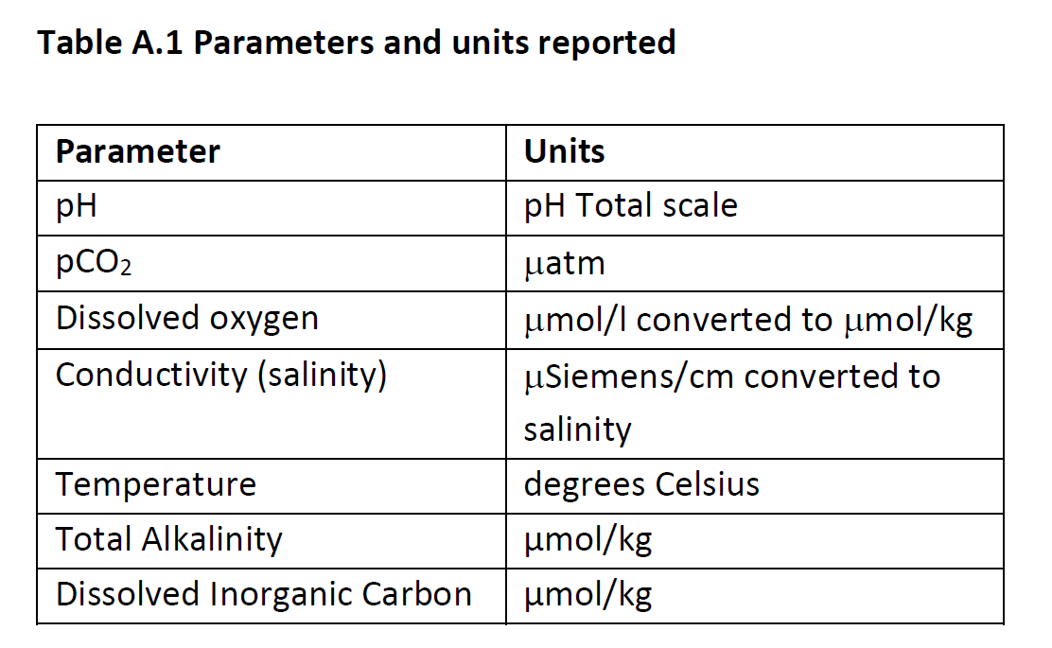
Most people doing C system work in the ocean need research grade measurements of:

Slide 15
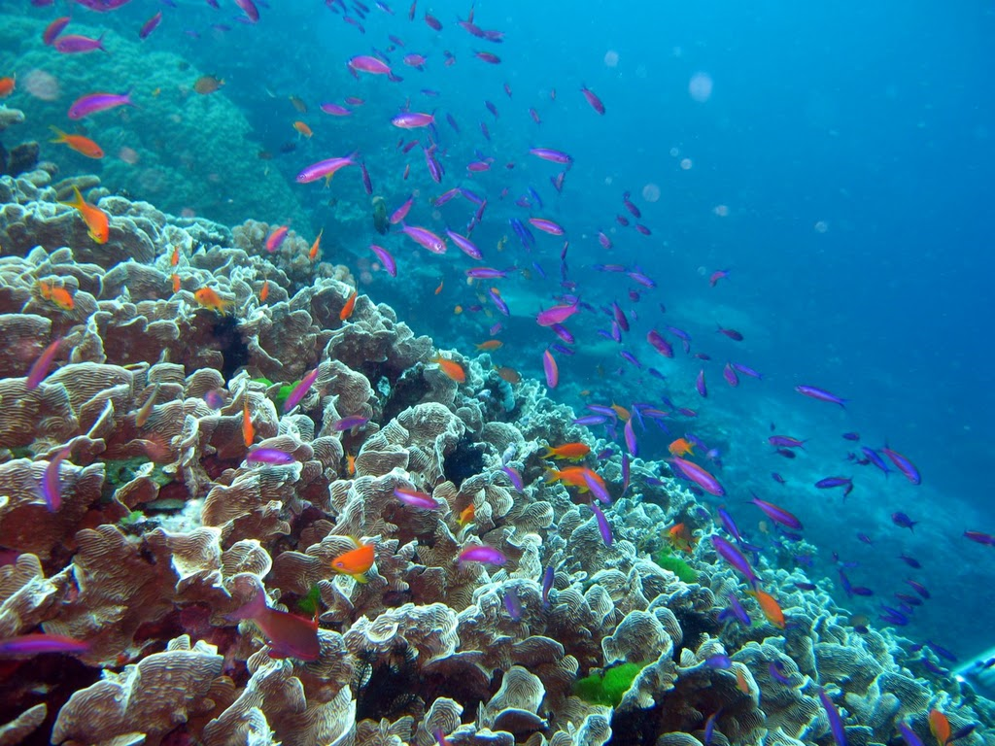
Ocean Acidification
Even if you are a climate change skeptic, there is no denying the simple physics of CO₂ in water

Slide 16
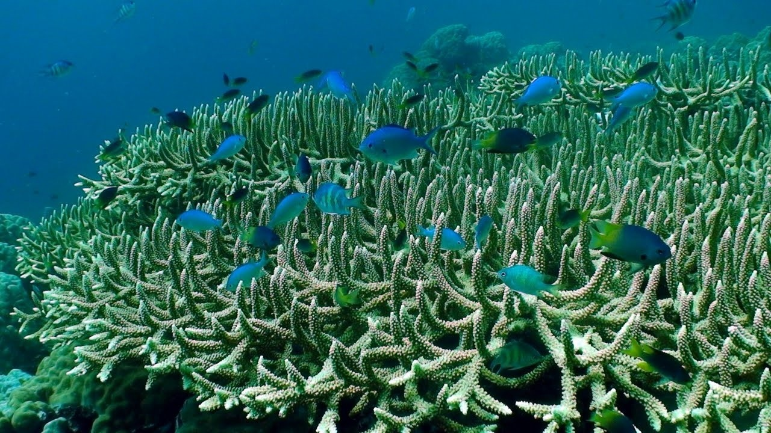
Impacts on Marine Life
Direct effects on Carbonate Producers
Dissolution of shells
Increased energy demand to build & maintain shells
Decreased marine biodiversity

Slide 17
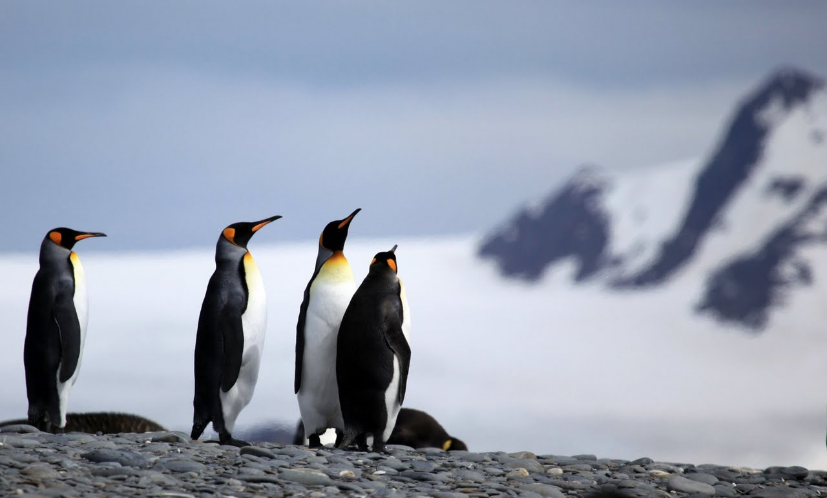
Effects on many organisms
Physiological sensitivities
Acidosis, reduced metabolism
Reduced oxygen uptake
Reduced reproductive success

Slide 18
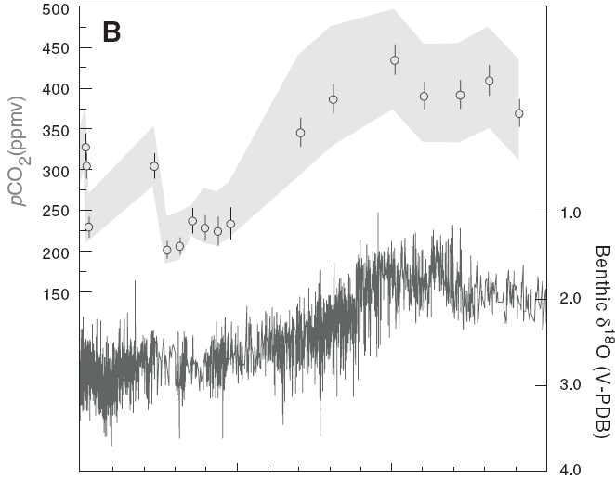
For most of geologic time, pCO₂ levels in the atmosphere were higher than today
2030? (450 ppmv)
Today (415 ppmv)
5
10
15
20
Millions of Years Ago
Tripati et al., 2009

Slide 19
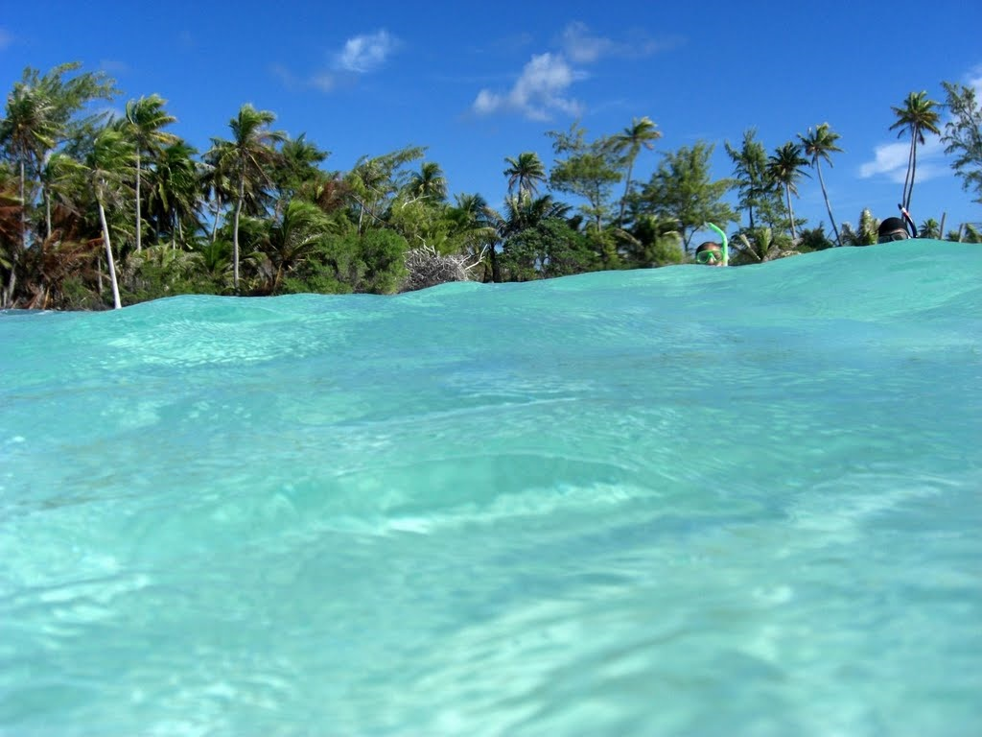
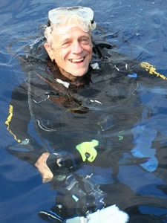
“The prospect of ocean acidification is potentially the most serious of all predicted outcomes of anthropogenic CO₂ increase.”
- J.E.N. “Charlie” Veron, 9/08

Slide 20
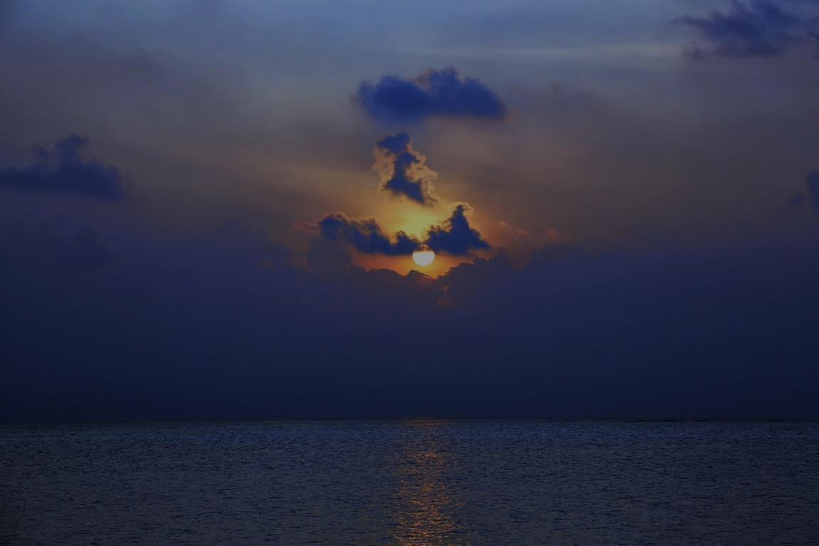
The Problem of Ocean Acidification and the SIS is of Global Importance
Corals/Coral Reefs are found in >98% of SIS nations.
>1/4 of all marine species associate with coral reefs.
One third of SIS nations consist wholly or in part of islands at sea level built entirely by coral reef organisms.
100’s of studies suggest decreased calcification rates by many organisms as pH declines.
Most SIS are in parts of the ocean experiencing the most rapid OA – and this will continue to be true.

Slide 21
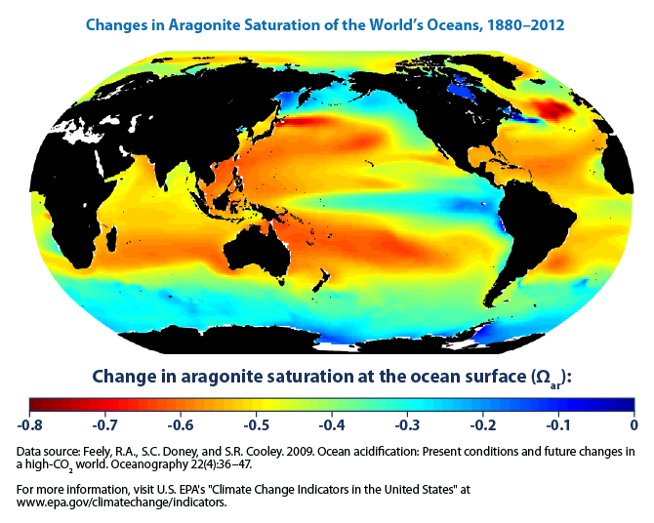
Feely et al., 2009, 2012

Slide 22
Feely et al., 2009, 2012
= SIS

Slide 23
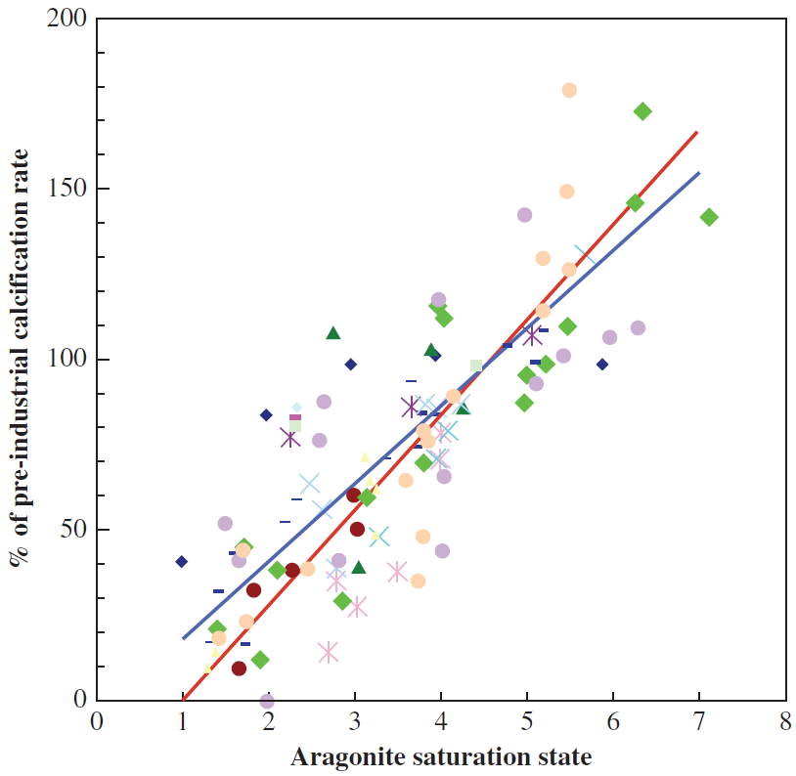
Ocean Acidification reduces Aragonite saturation in the ocean causing corals to
calcify and grow more slowly. We
don’t yet know the scale of the
problem “in the wild” over time.
11 different coral species
17 studies
Andersson et al., 2012
Notes:
Relative rate of calcification for a number of coral species as a function of aragonite saturation state. From Andersson et al., 2012 (Gattuso book Ocean Acidification)

Slide 24
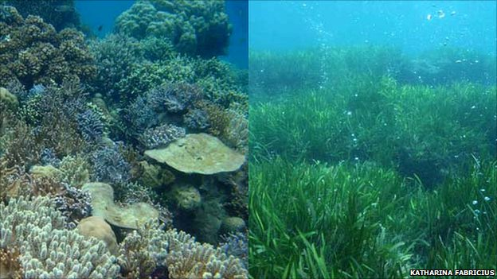

Slide 25
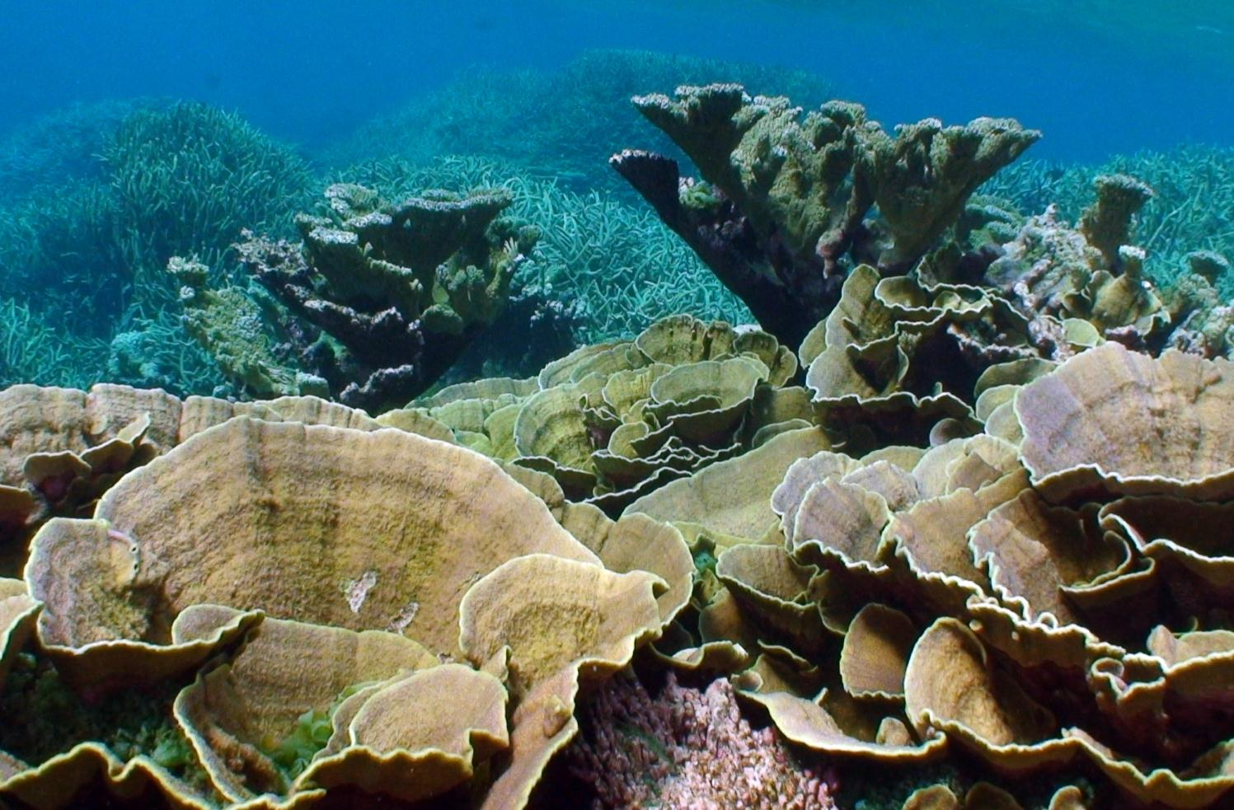
OK, what can be done? The Global root cause is CO₂ emissions and they must be reduced. Local management can buy time, particularly for the SIS with coral reefs. With healthy reefs atoll islands can keep up with SLR.

