Slide 1
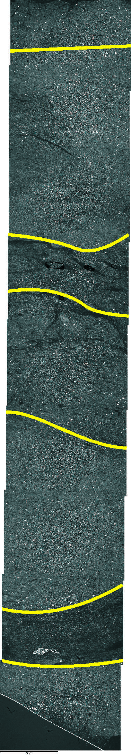
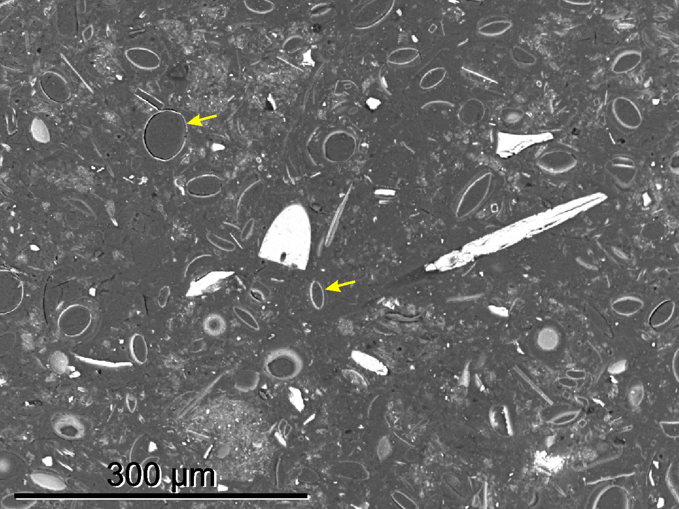
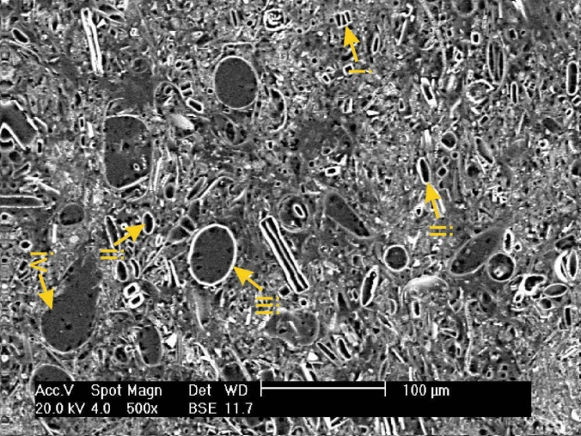
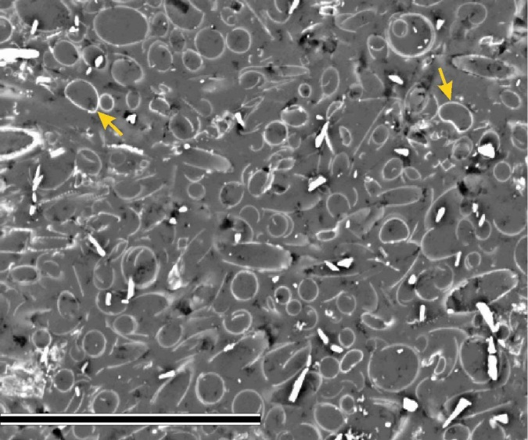
BSEI analysis
“Autumn” assemblage –Porosira glacialis dominate
Mixed summer assemblage:
i) Fragilariopsis spp.
ii) Thalassiosira antarctica
Stellarima microtrias
Corethron pennatum
“Spring/summer” assemblage – Rhizosolenia spp. dominate
1cm
Gregory, Pike et al.
See poster on Wed!
300 µm
Notes:
Left image: Photomontage of a thin section taken at 20X magnification using back scattered electron imagery (BSEI). Yellow lines indicate boundaries between different sub-laminae.
Right images: High magnification BSEI images showing different sub-laminae types. Although Rhizosolenia may not be a genus typically associated with early spring conditions, my counts on these lamination types from MD material shows they’re actually dominated by cryophilic Fragilariopsis spp., with Rhz. being visually obvious due to their size.
This sequence is not necessarily “typical”, I have just selected a section with (hopefully) more obviously different sub-lamina types to highlight variations.

Slide 2
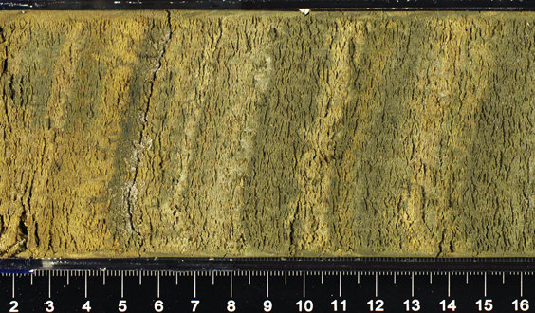
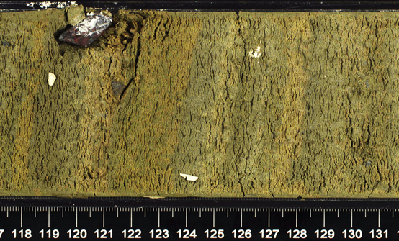
U1357B-19H-4A
82 light/dark couplets in 143 cm
1.7 cm/band, close to the long-term sed rate of 1.6 cm/yr

Slide 3
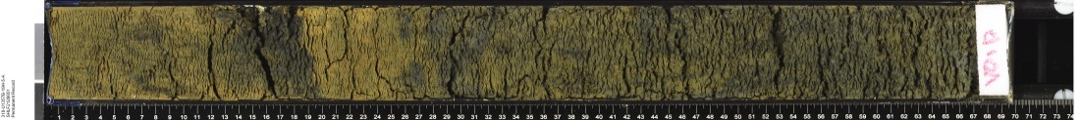
U1357B-18H-5
Cal ¹⁴C age = 11,125 yrs B.P.
U1357B-18H-6
U1357B-18H-7
Cal. AMS age = 410 years
# laminae pairs = ~310
U1357B-19H-1
U1357B-19H-2
U1357B-19H-3
Cal ¹⁴C age = 11,535 yrs B.P.
U1357B-19H-4
U1357B-19H-5
Cal ¹⁴C age = 36,620 yrs B.P.

Slide 4
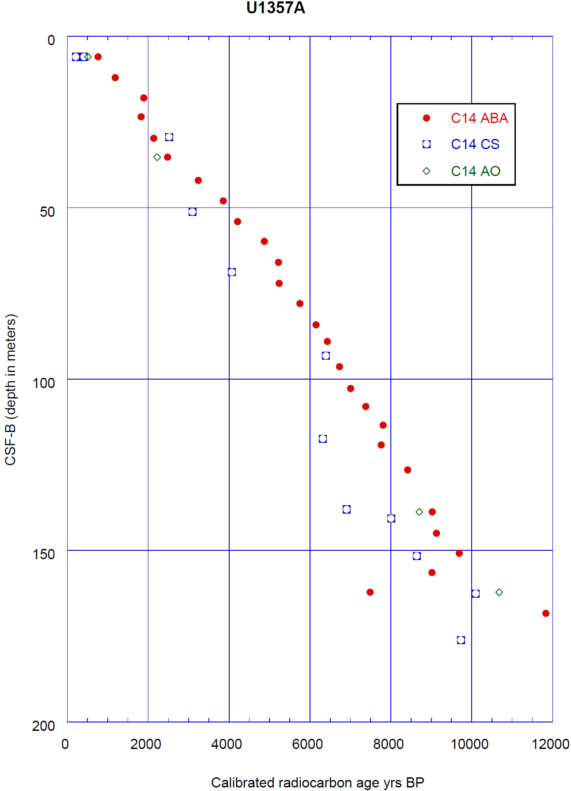

Slide 5
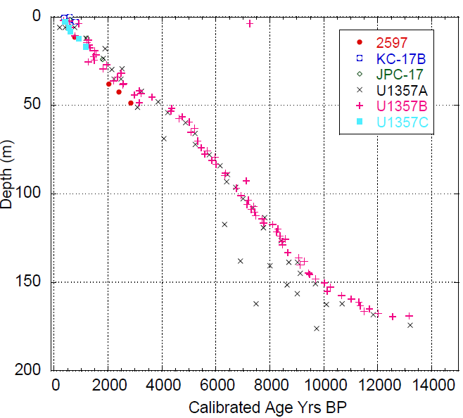
Site 1357 Chronology
144 AMS ¹⁴C dates:
Bulk TOC – AO
Bulk TOC- ABA
Carbonates
Fatty Acid (CS)
³²Si – 5 dates
Secular Pmag

Slide 6
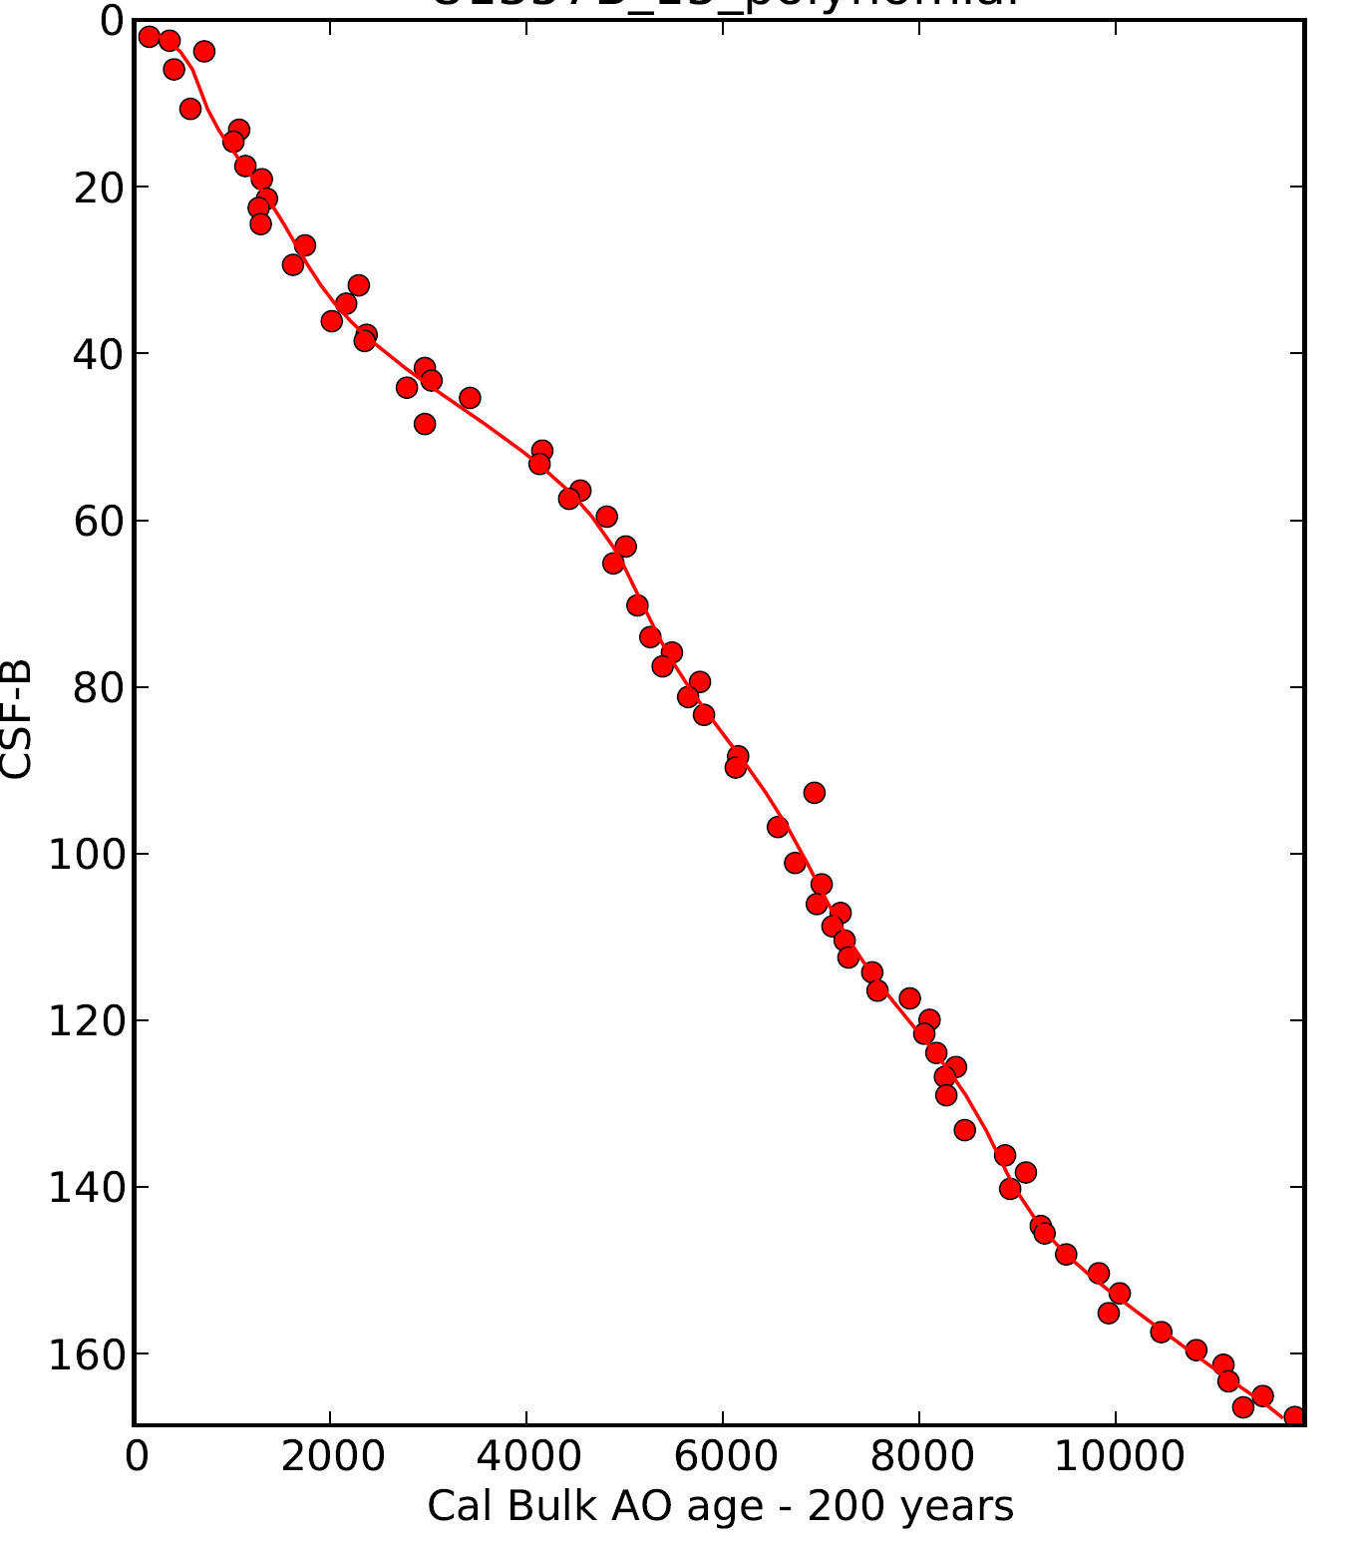
Higher order polynomial gives best fit to AMS dates as well as to secular paleomag inclination curve
U1357B
Bulk TOC AMS ¹⁴C dates – corrected for SO reservoir ages plus a small detrital “dead”
C offset.
Meters below seafloor (CSF-B)

Slide 7
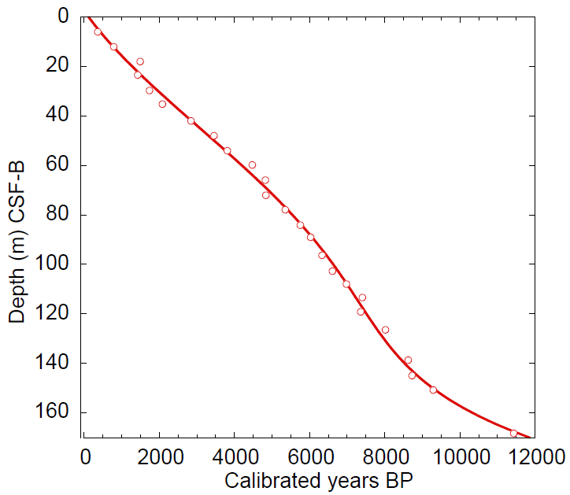
U1357A
AMS ¹⁴C dates – corrected for SO reservoir ages plus a small detrital “dead”
C offset as determined by ¹⁴C age offsets between carbonates and AO and ABA treated TOC

Slide 8
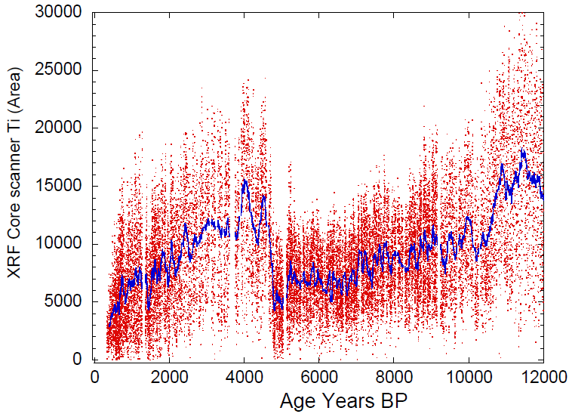
U1357B

