Slide 1
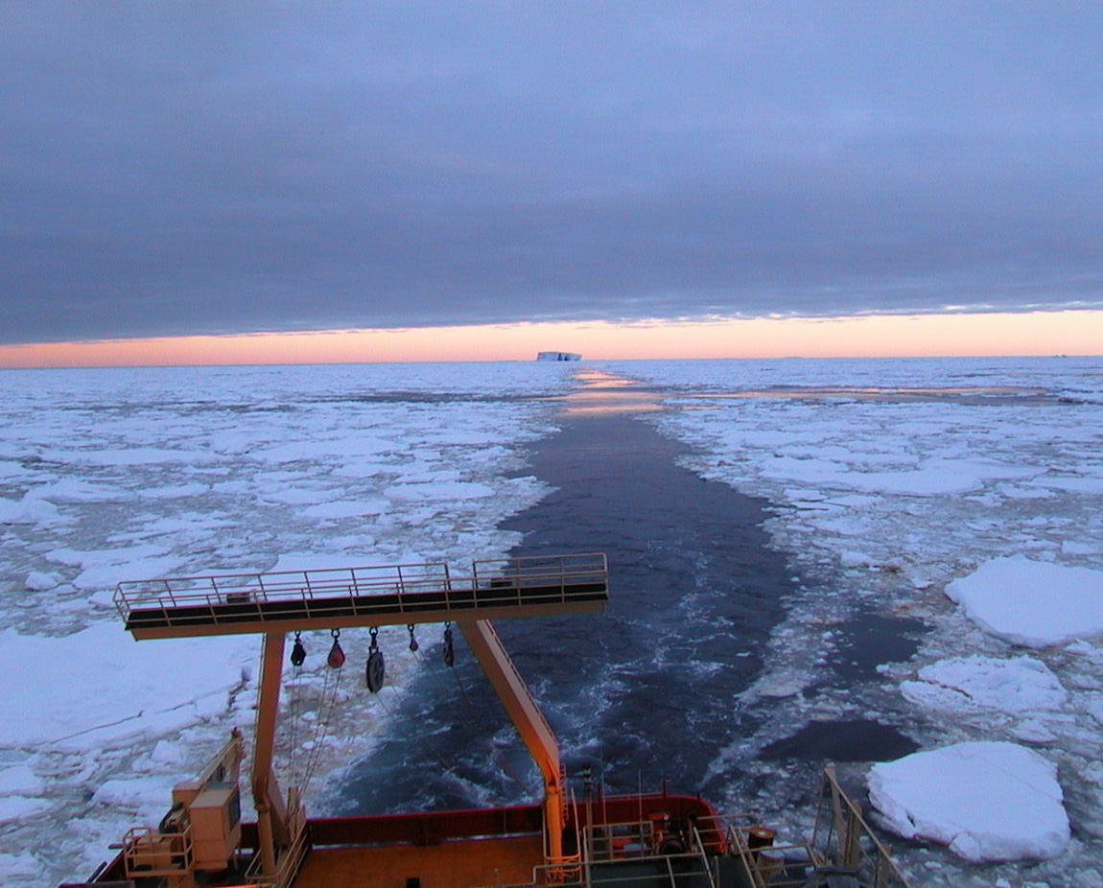
Holocene Antarctic Climate Variability from long sediment cores from the East Antarctic Margin, including early results from IODP Expedition 318
Dunbar R., Jimenez-Espejo F., Willmott, V., Riesselman C., Pekar S., Kryc K., Crosta X., Costa E., Etourneau J., Masse G., and Expedition 318 Scientists

Slide 2
Why should we care about Holocene Variability in Antarctica?
The baseline period against which anthropogenic impacts are assessed and attributed
Useful for forcing-response analysis
    Strong insolation seasonality signal
    ΔpCO₂ small (6%)
    ΔpCH₄ moderate (20%)
    Can incorporate “modern” modes of variability
    ENSO absent in early Holocene
    coupling of tropical and polar climate
Periods of Holocene warmth provide insights into the greenhouse future – polar amplification, rates of ice loss, sea ice regime
Holocene Geoscience enjoys some advantages in Antarctica?
Records haven’t been removed by glacial advance
Many basins with rapidly depositing sediments
Good age-dating tools

Slide 3
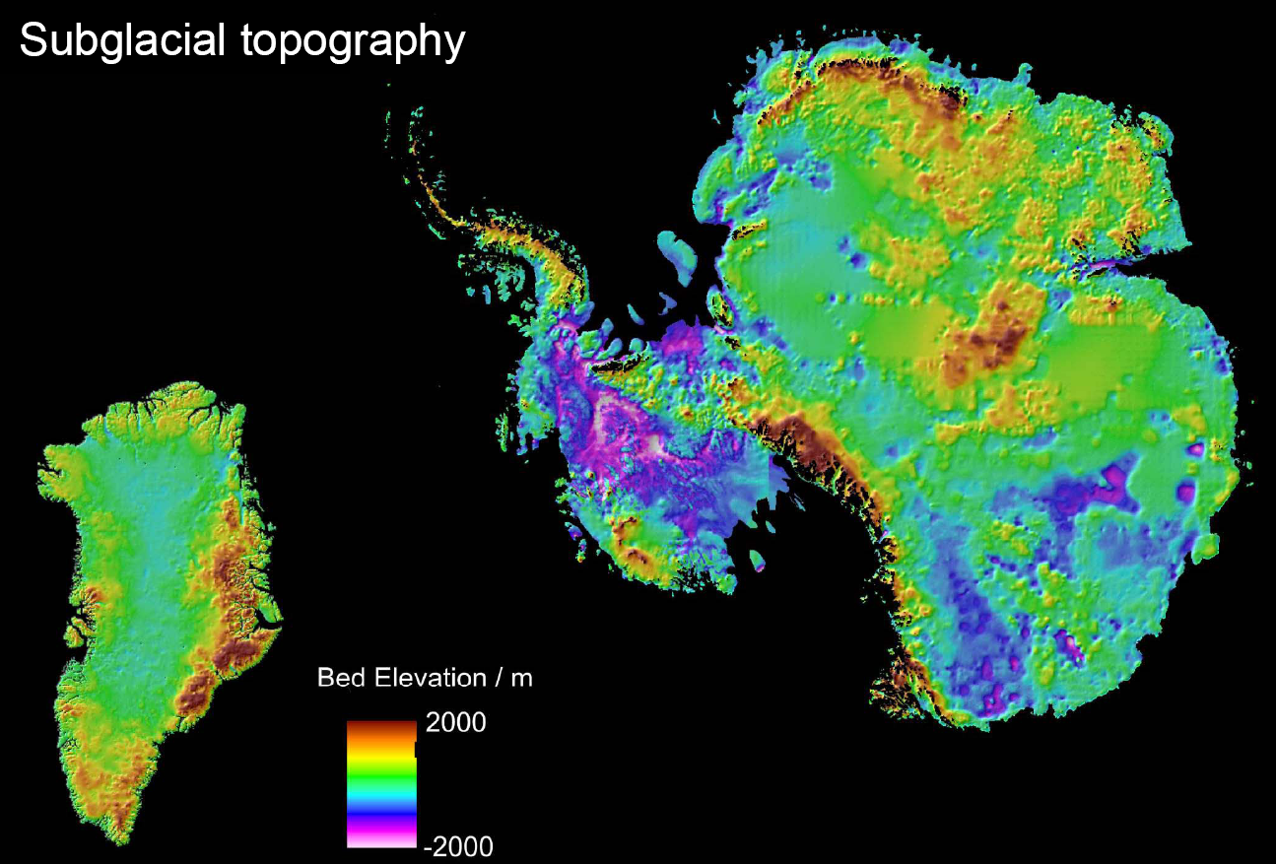
Mac.Rob.
Bedmap and J.L. Bamber
Palmer Deep
IODP Expedition 318
Jan – Mar 2010

Slide 4
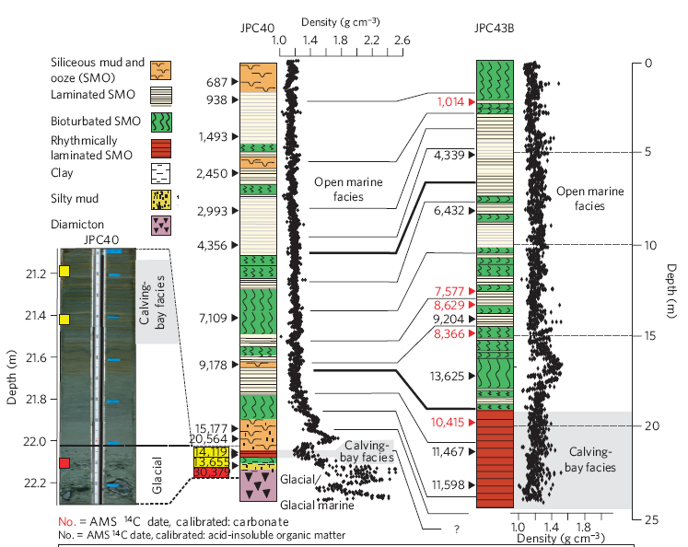
Mackintosh et al., 2011

Slide 5
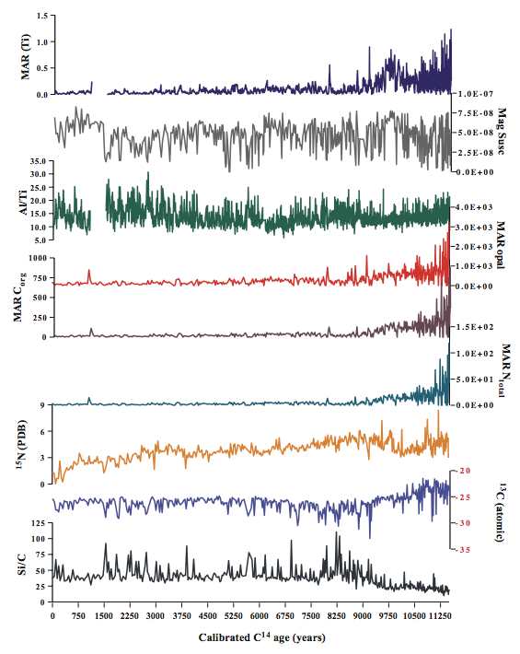

JPC-43B – ICPMS-calibrated XRF core scanner data

Slide 6
JPC-43B

Slide 7
High % C_{org}
Muted mid-Holocene variability

Slide 8
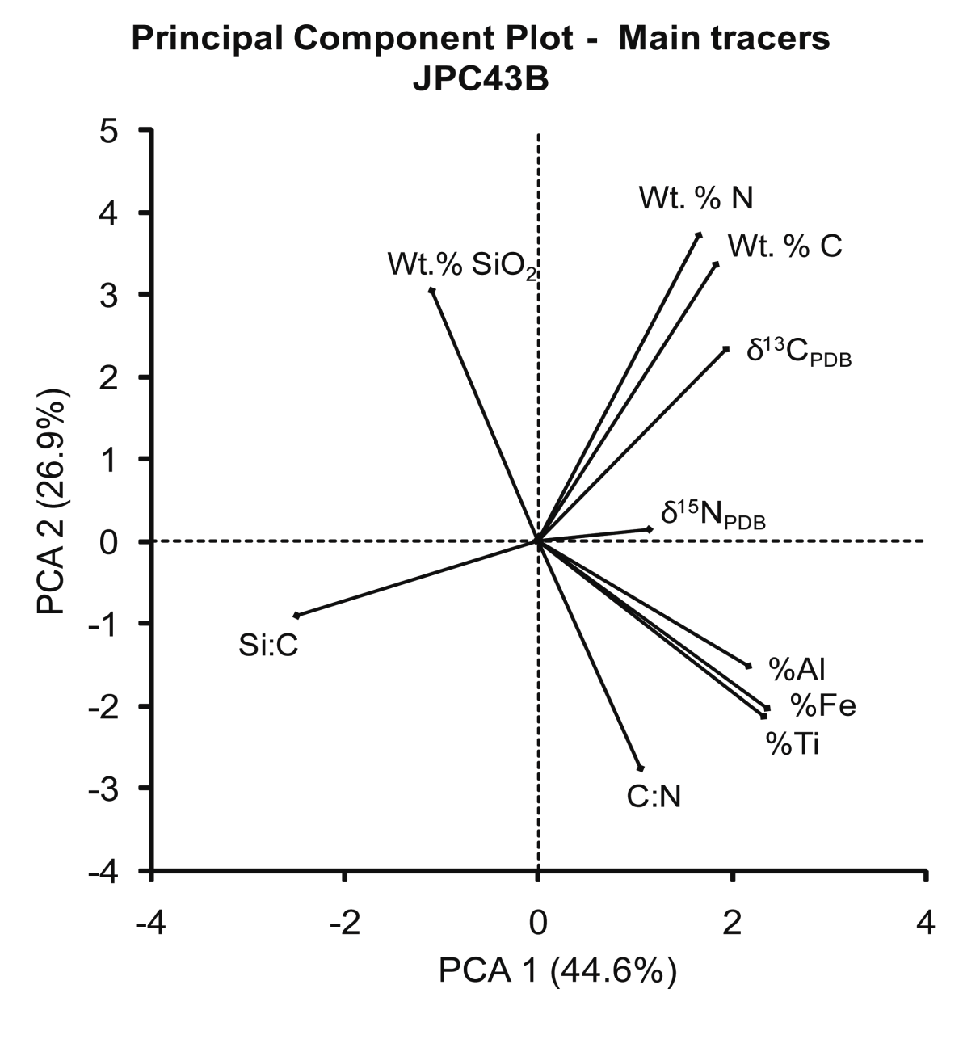

Slide 9
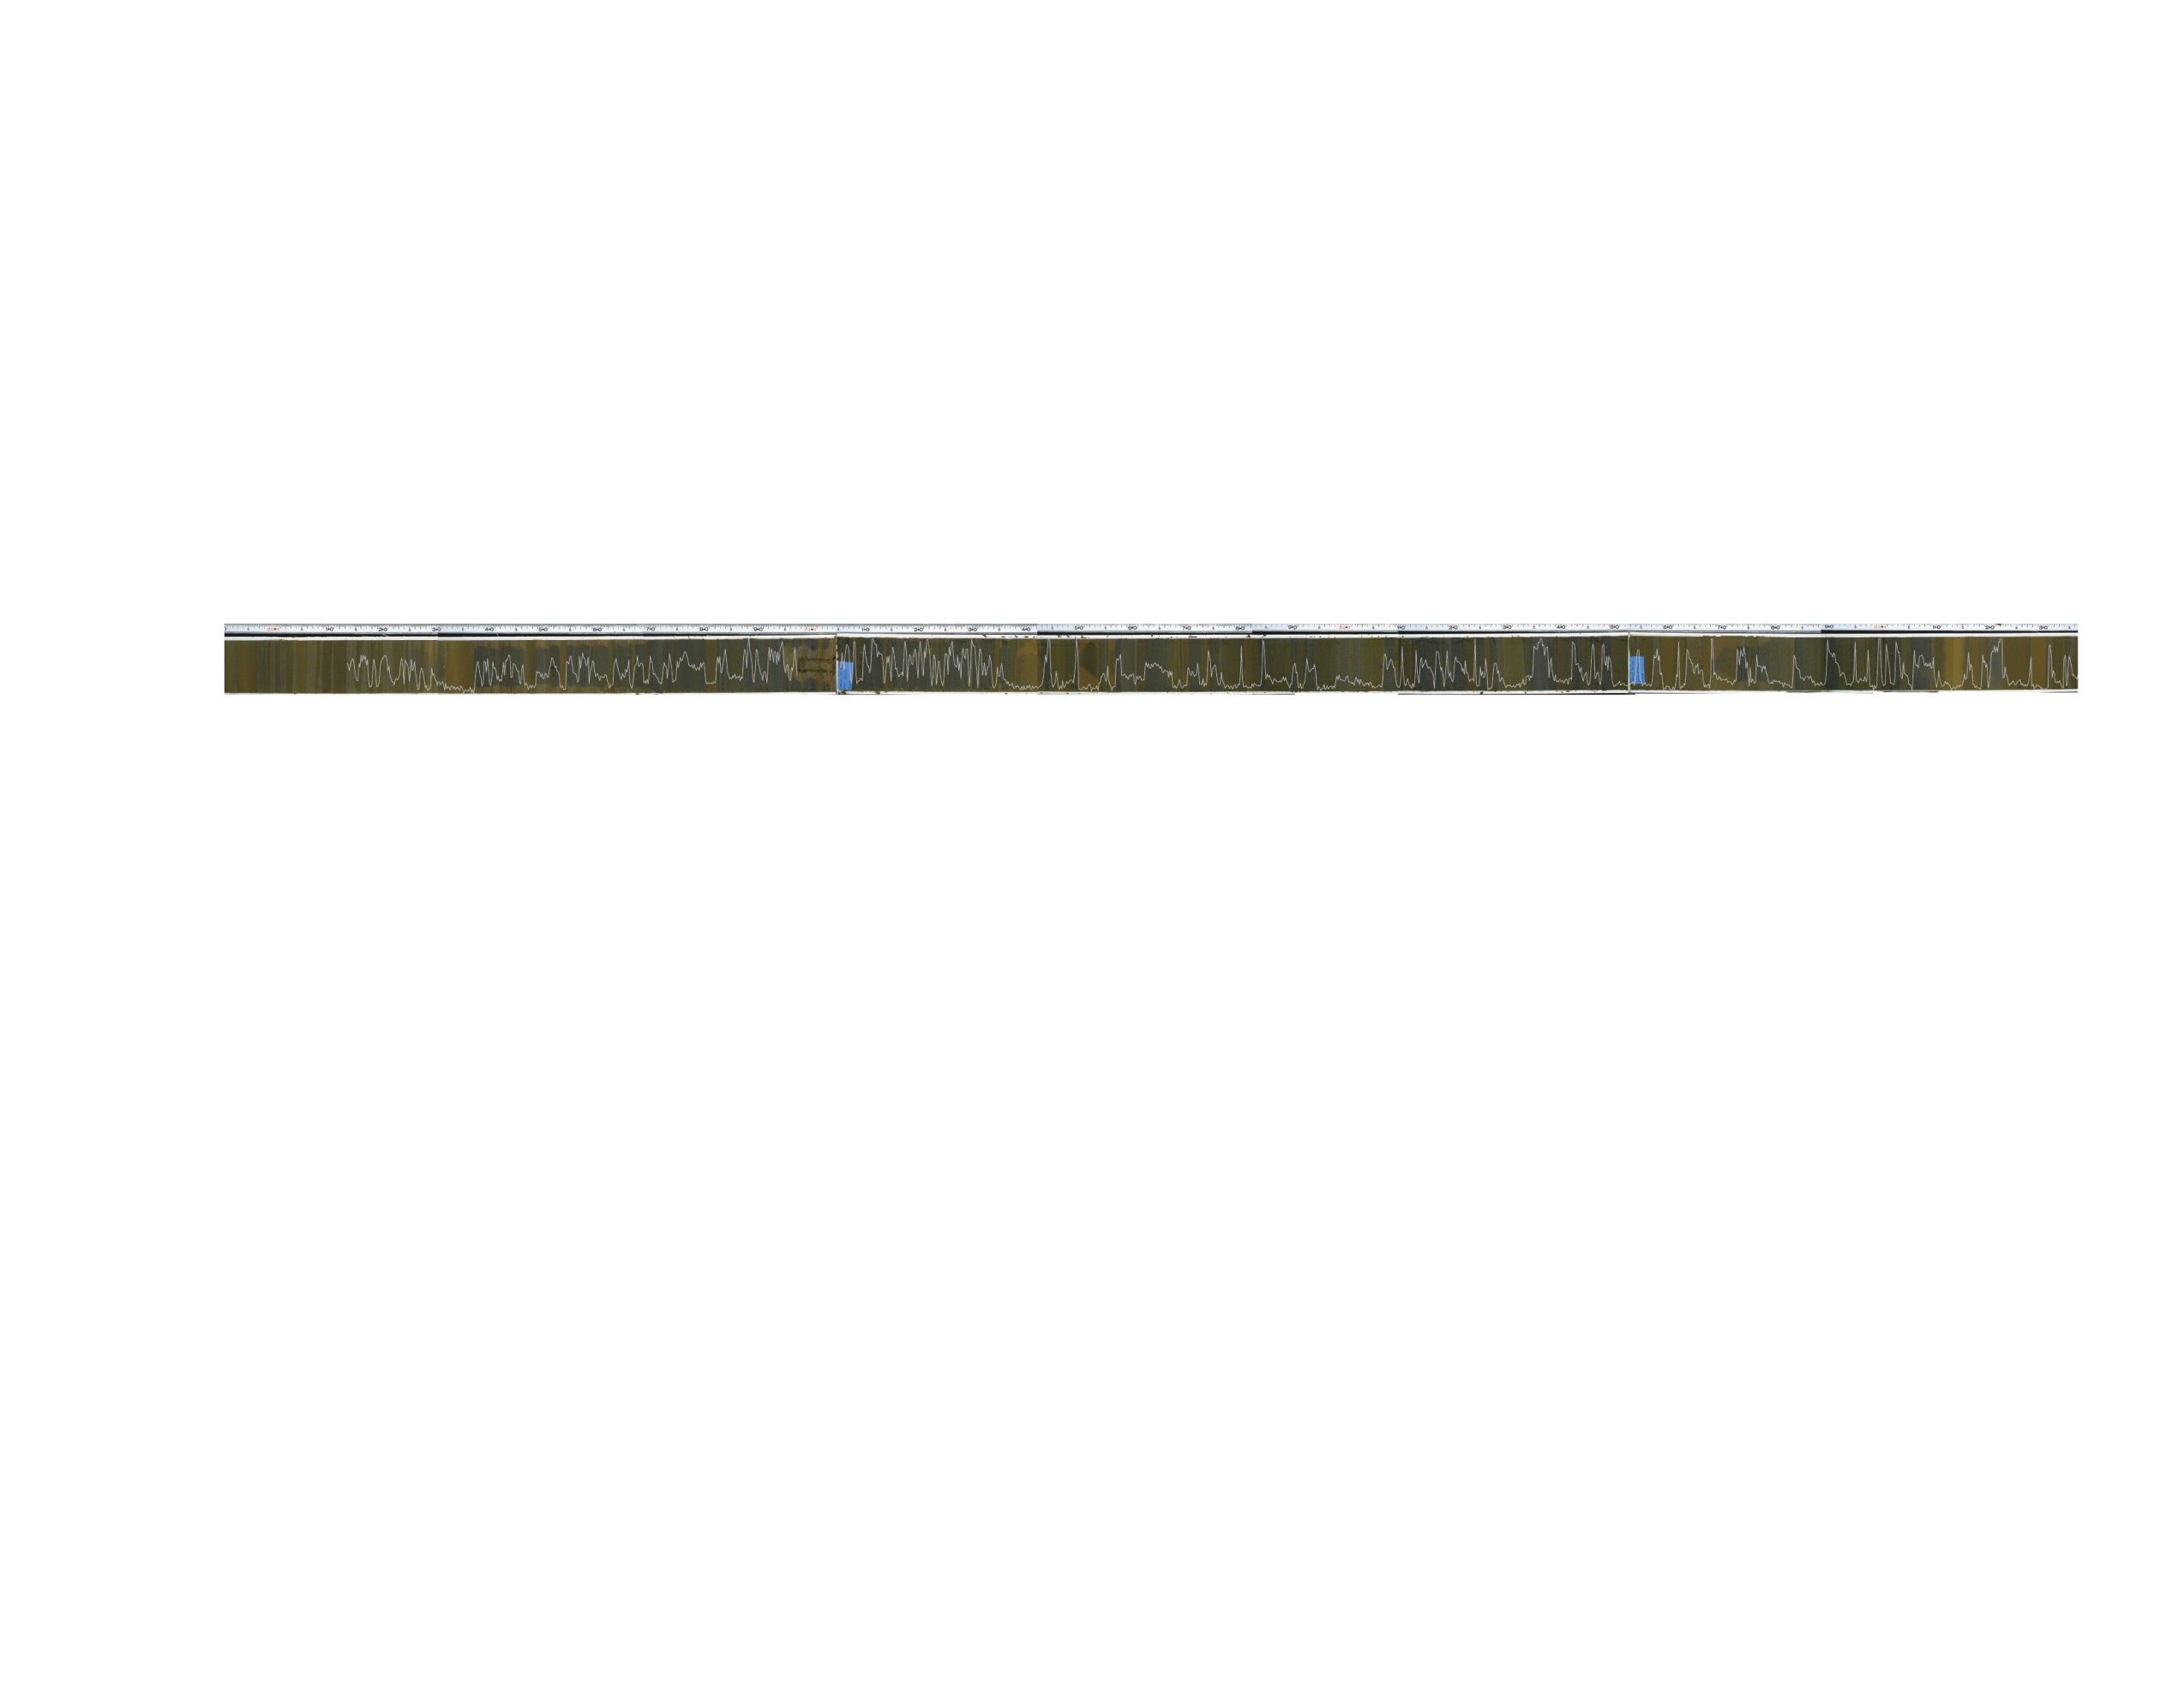
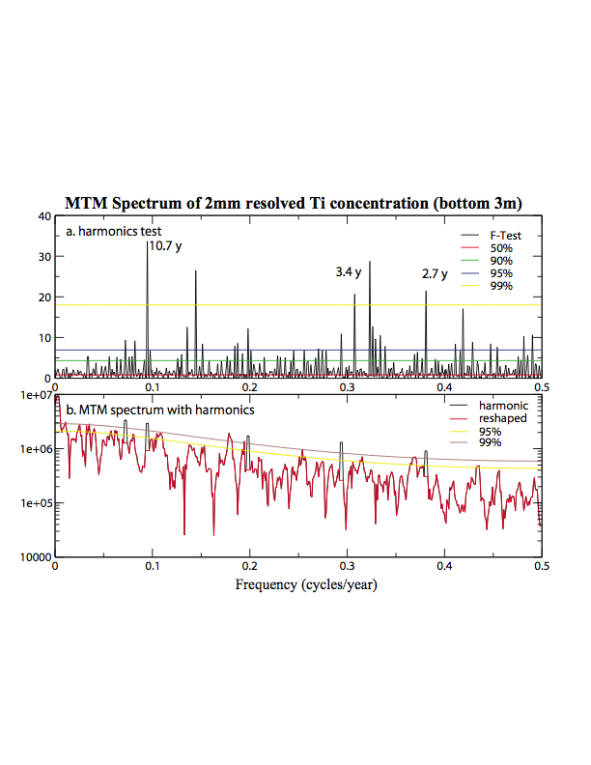

Slide 10
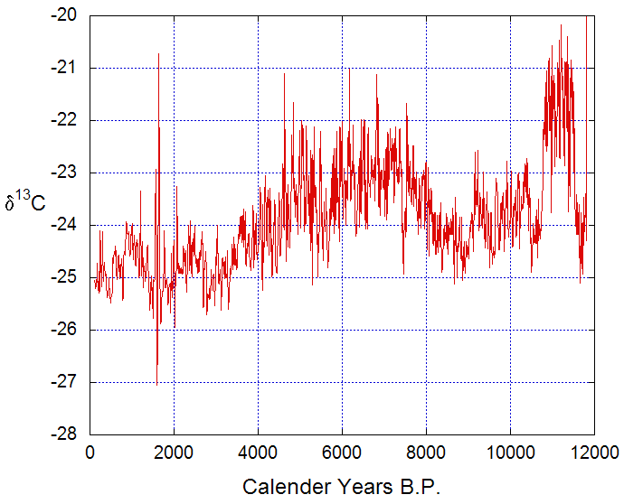
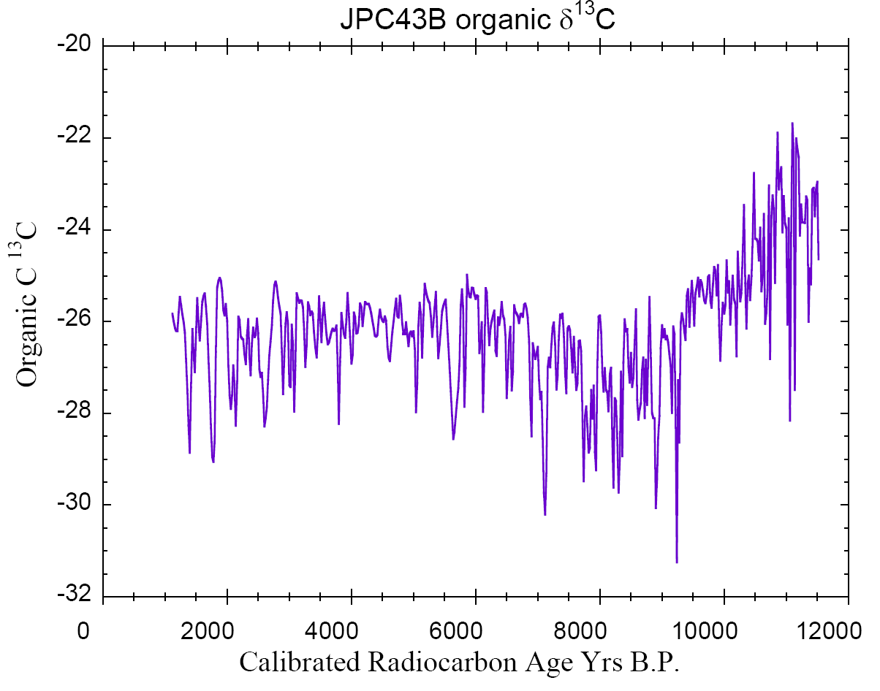
-20
Palmer Deep, Antarctic Peninsula
-22
δ¹³C_{org}
-24
-26
-28
-20
-22
JPC-43B, Mac.Robertson Shelf
δ¹³C_{org}
-24
-26
-28
-30

Slide 11
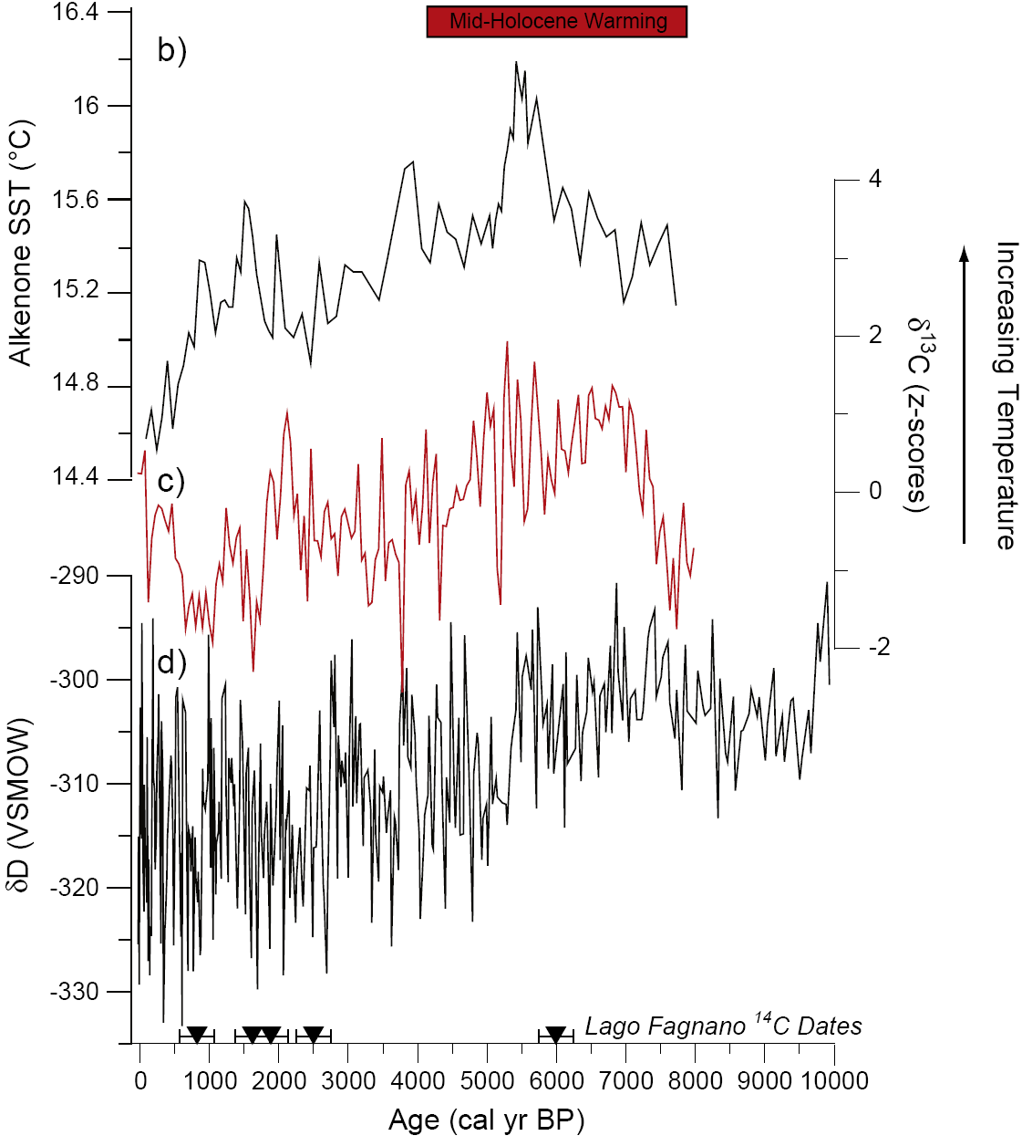
Mid-Holocene Warmth
From Moy et al., 2010
41°S, Lamy et al., 2002
55°S, this work
Taylor Dome, Antarctica, Steig et al., 2000

Slide 12
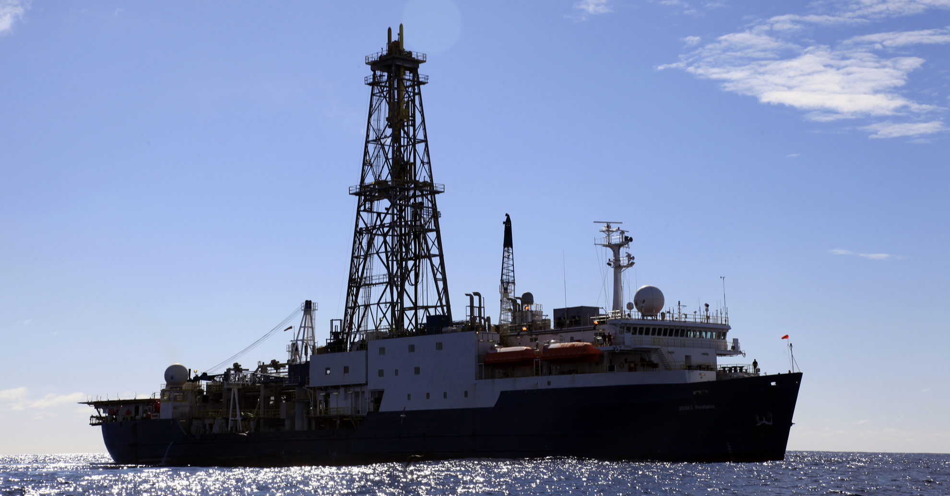
U1357 – Adelie
Basin Report
IODP Exp 318
Wilkes Land

Slide 13
MD-2601
Figure from J. Etourneau

Slide 14
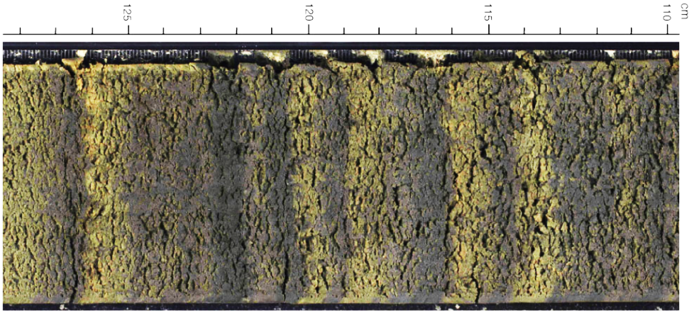
Site U1357 – Adelie Drift, 185 m of Holocene sediment triple cored, Feb, 2010 during IODP Exp 318
5 cm
Entire sequence is laminated at cm-scale.
Laaminations also present at mm-scale.

Slide 15
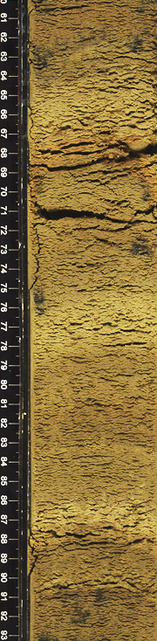
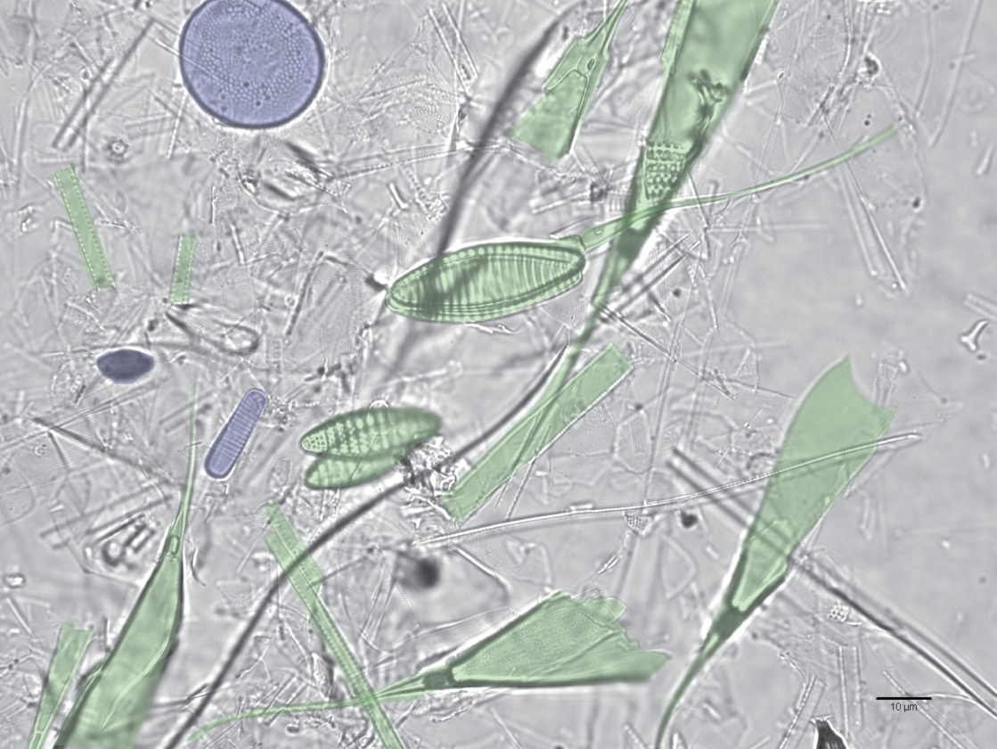
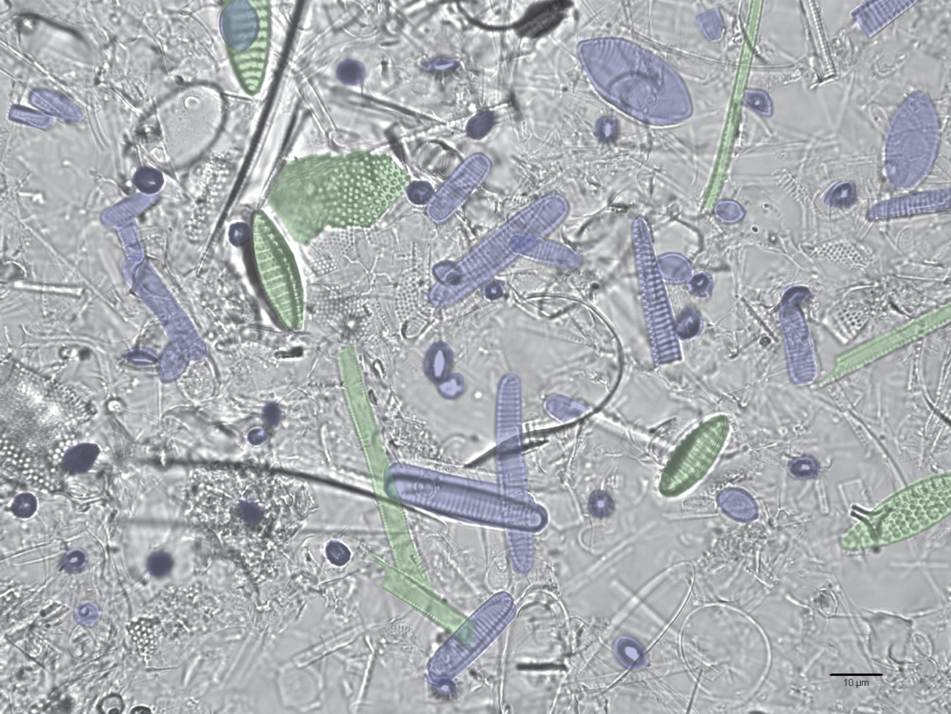
U1357A-15H-7
Light lamina
138.65 mbsf
Green = open ocean spp.
Blue = sea ice spp.
Dark lamina
138.69 mbsf
Notes:
Representative fields of view of a light/dark couplet in Section U1357A-15H-7. (A) Light lamina from 67 cm (138.65 mbsf); (B) Dark lamina from 71 cm (138.69 mbsf). Open ocean species (Crosta et al., 2005) are false colored green and dominate the light lamina (A). Sea ice-associated species (Armand et al., 2005) are false colored blue and dominate the dark lamina (B). Scale bars = 10 μm.

Slide 16
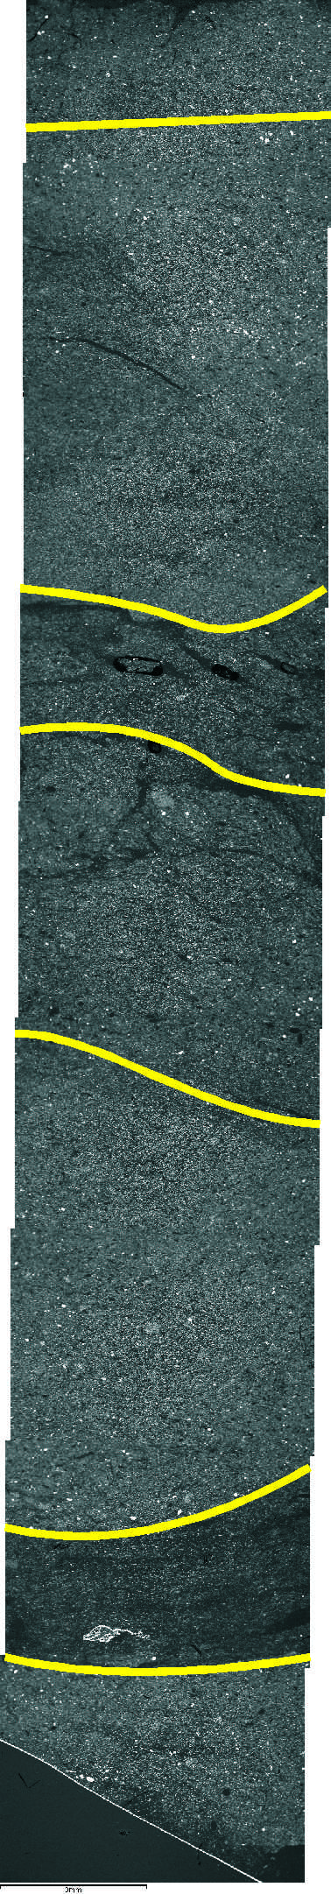
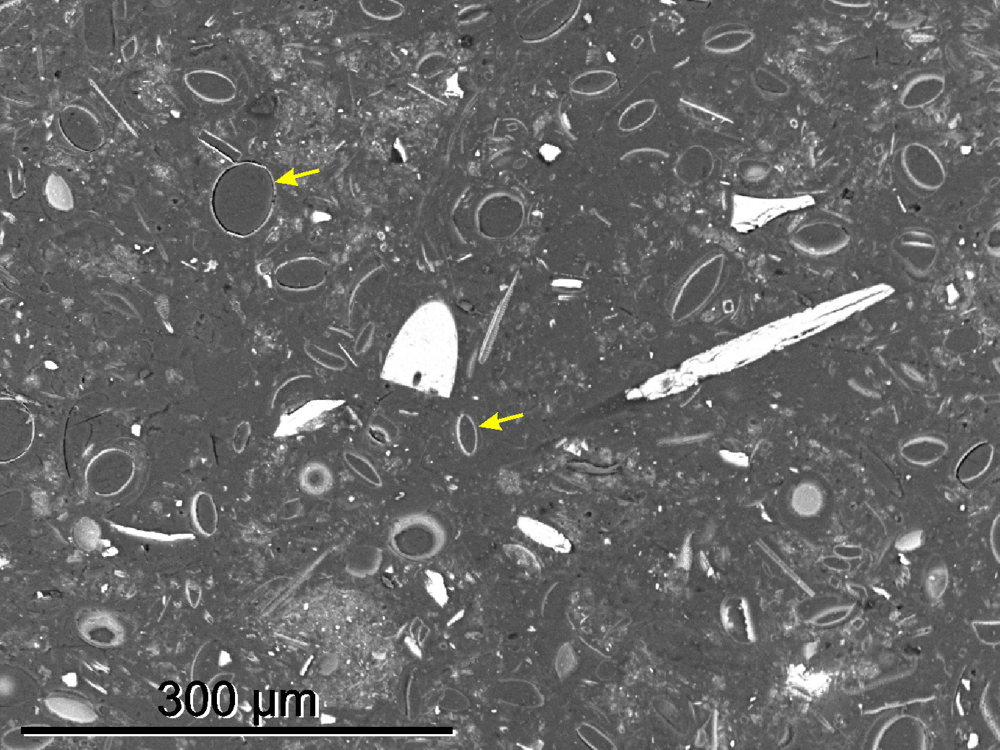
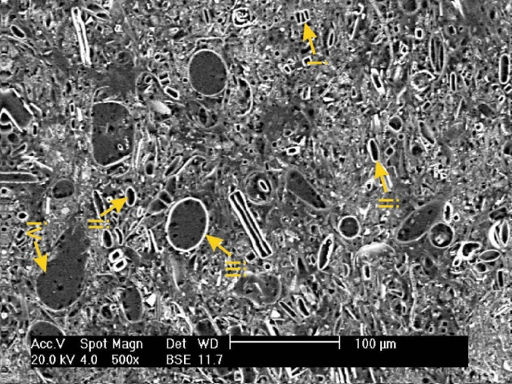
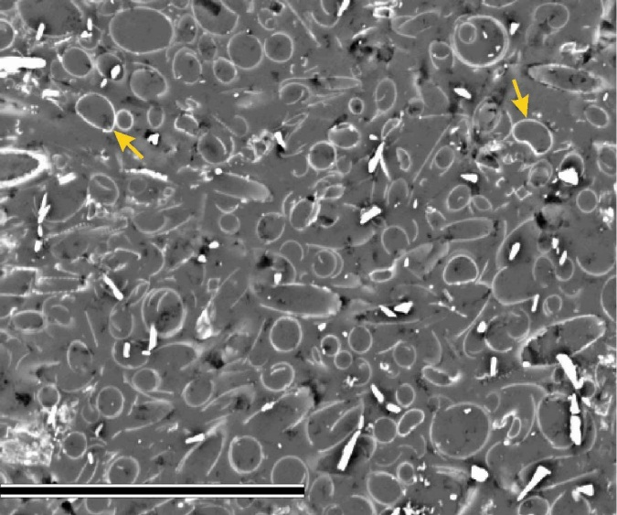
BSEI analysis
“Autumn” assemblage –Porosira glacialis dominate
Mixed summer assemblage:
i) Fragilariopsis spp.
ii) Thalassiosira antarctica
Stellarima microtrias
Corethron pennatum
“Spring/summer” assemblage – Rhizosolenia spp. dominate
1cm
Gregory, Pike et al.
See poster on Wed!
300 µm
Notes:
Left image: Photomontage of a thin section taken at 20X magnification using back scattered electron imagery (BSEI). Yellow lines indicate boundaries between different sub-laminae.
Right images: High magnification BSEI images showing different sub-laminae types. Although Rhizosolenia may not be a genus typically associated with early spring conditions, my counts on these lamination types from MD material shows they’re actually dominated by cryophilic Fragilariopsis spp., with Rhz. being visually obvious due to their size.
This sequence is not necessarily “typical”, I have just selected a section with (hopefully) more obviously different sub-lamina types to highlight variations.

Slide 17
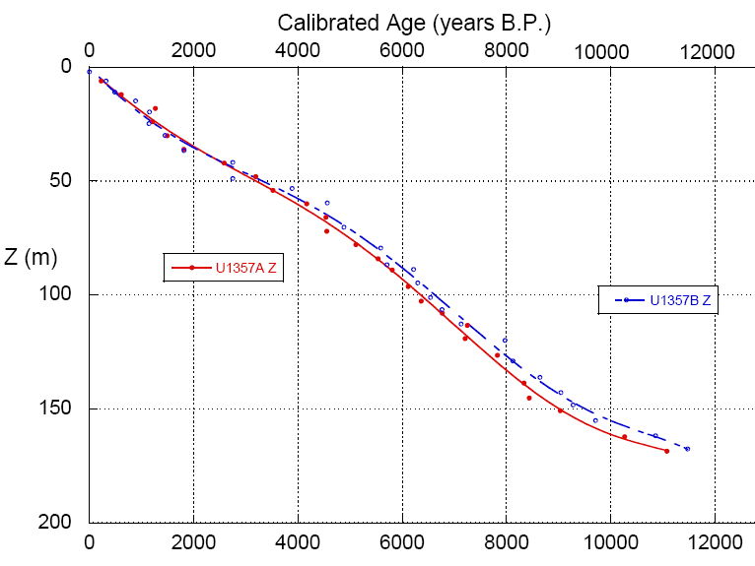
63 bulk C dates (so far……)

Slide 18
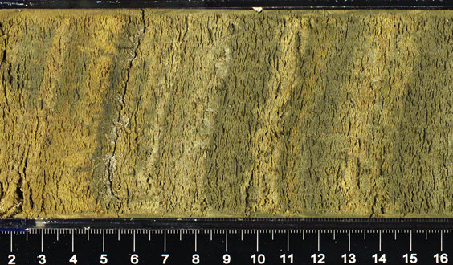
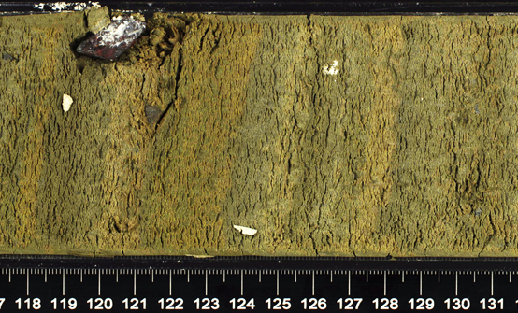
U1357B-19H-4A
82 light/dark couplets in 143 cm
1.7 cm/band, close to the long-term sed rate of 1.6 cm/yr

Slide 19
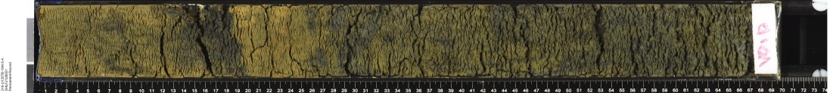
U1357B-18H-5
Cal ¹⁴C age = 11,125 yrs B.P.
U1357B-18H-6
U1357B-18H-7
Cal. AMS age = 410 years
# laminae pairs = ~310
U1357B-19H-1
U1357B-19H-2
U1357B-19H-3
Cal ¹⁴C age = 11,535 yrs B.P.
U1357B-19H-4
U1357B-19H-5
Cal ¹⁴C age = 36,620 yrs B.P.

Slide 20
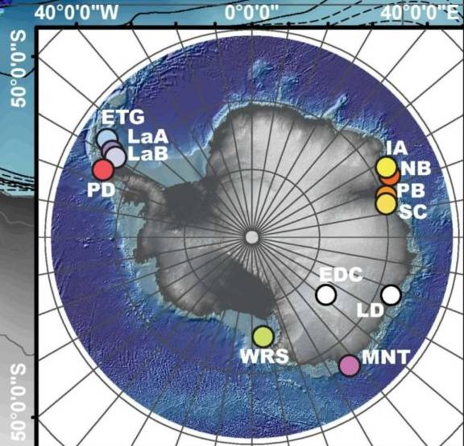
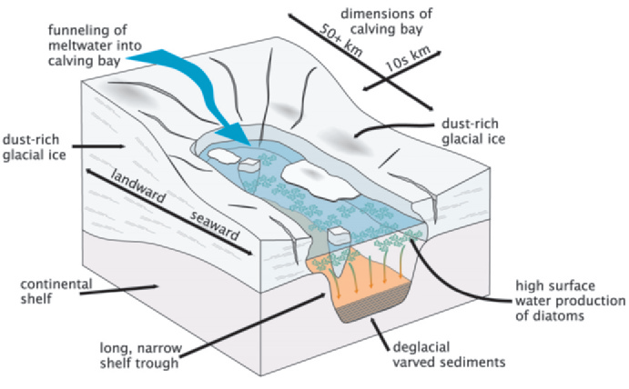
Calving bays in East Antarctica?
U1357
Leventer et al., 2006
From Mackintosh et al. 2011

Slide 21
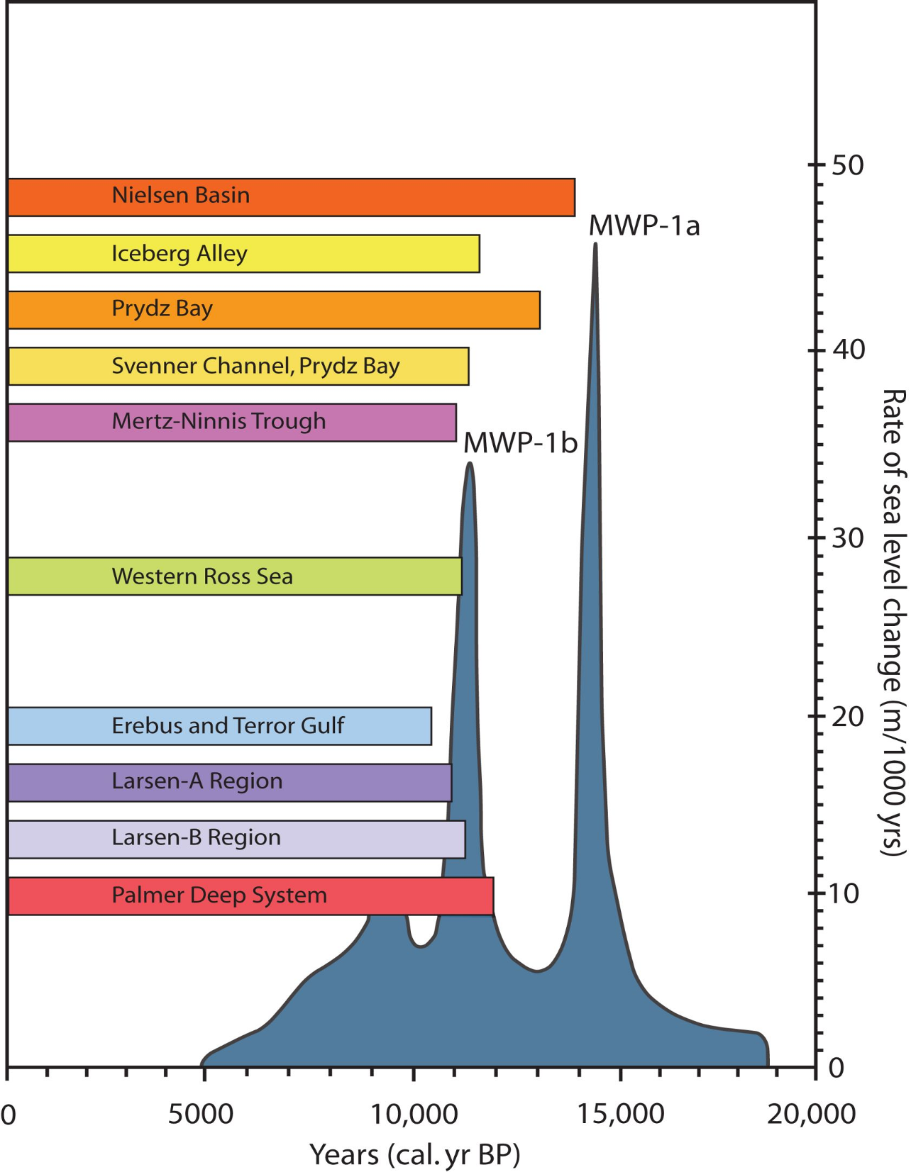
No response
U1357A&B
Initial retreat
Widespread
retreat
Present ice margin reached
Onset of marine sedimentation
(multiple ¹⁴C ages)
From Mackintosh et al. 2011

Slide 22
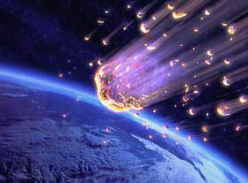
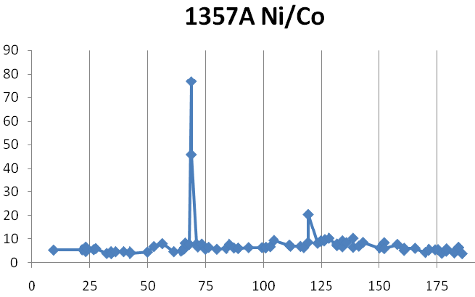
Data from Jimenez et al.
Ni spike at ~68 meters = ~4500 cal. yrs B.P.
mbsf

Slide 23
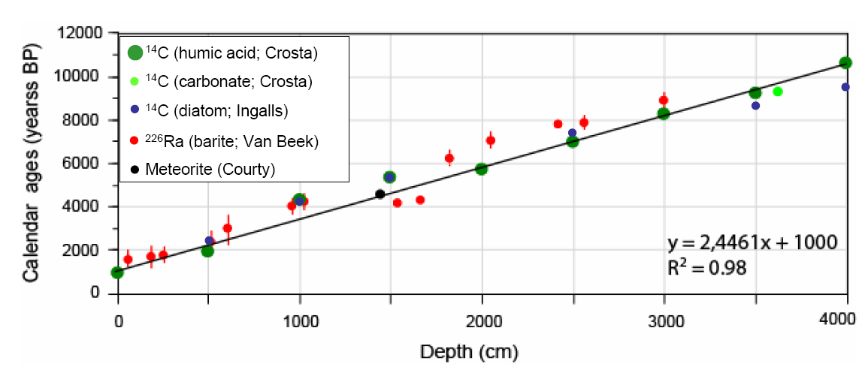
Age-dating comparisons MD03-2601
Denis et al. (2009) &
Pers. Comm. Crosta (2011)

Slide 24
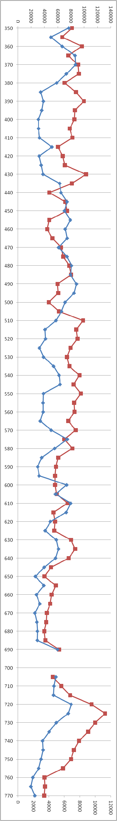
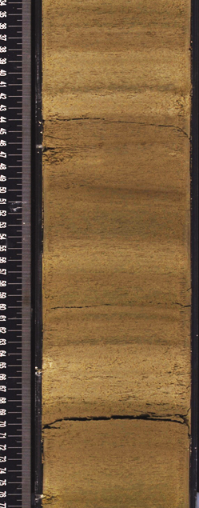
Jimenez et al.
In general:
Color bands correspond to chemical composition
Dark: high detrital
Light: low detrital
1357B 18H 6A
Red: Calcium
Blue: Aluminum

Slide 25
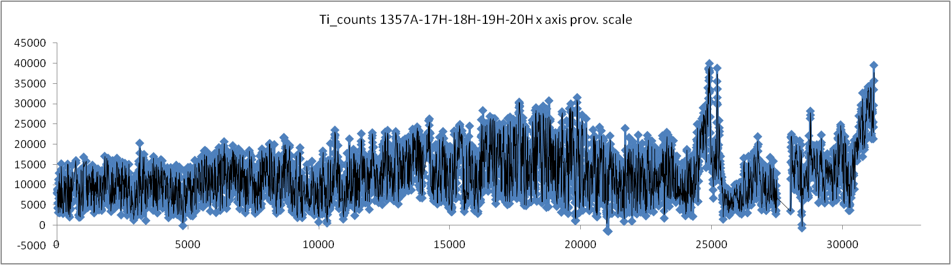
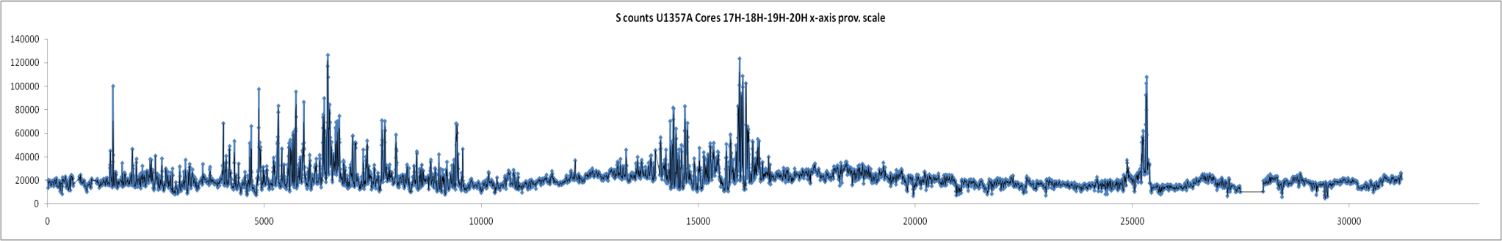
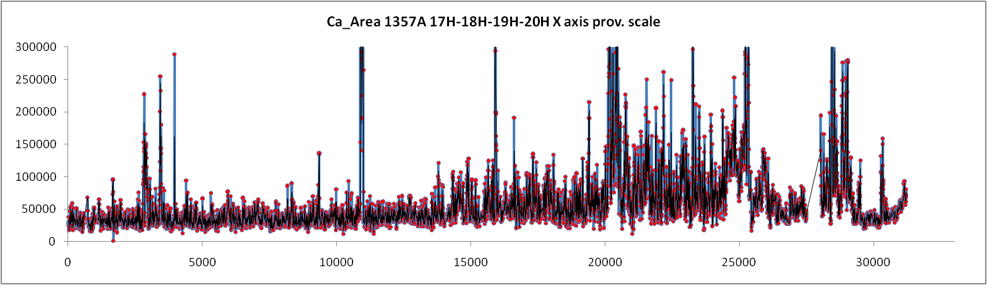
U1357A
Jimenez et al.
150.3 to 184.5 m: ~9,000 to ~11,600 yrs B.P.
Ti
S
Ca

Slide 26
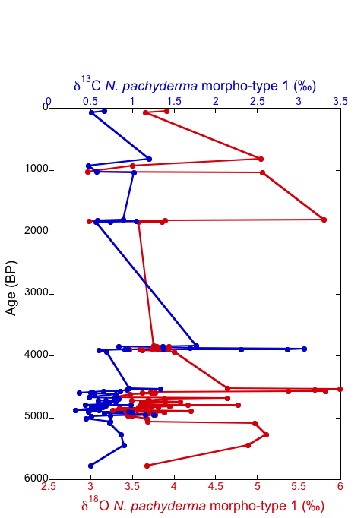
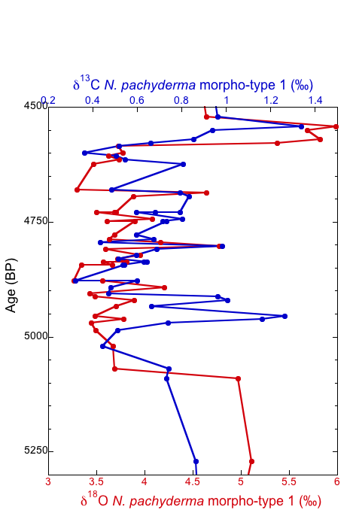
Foram Isotopes
U1357A
Planktonic foraminifera
Δδ¹⁸O >
Δδ¹³C

Slide 27
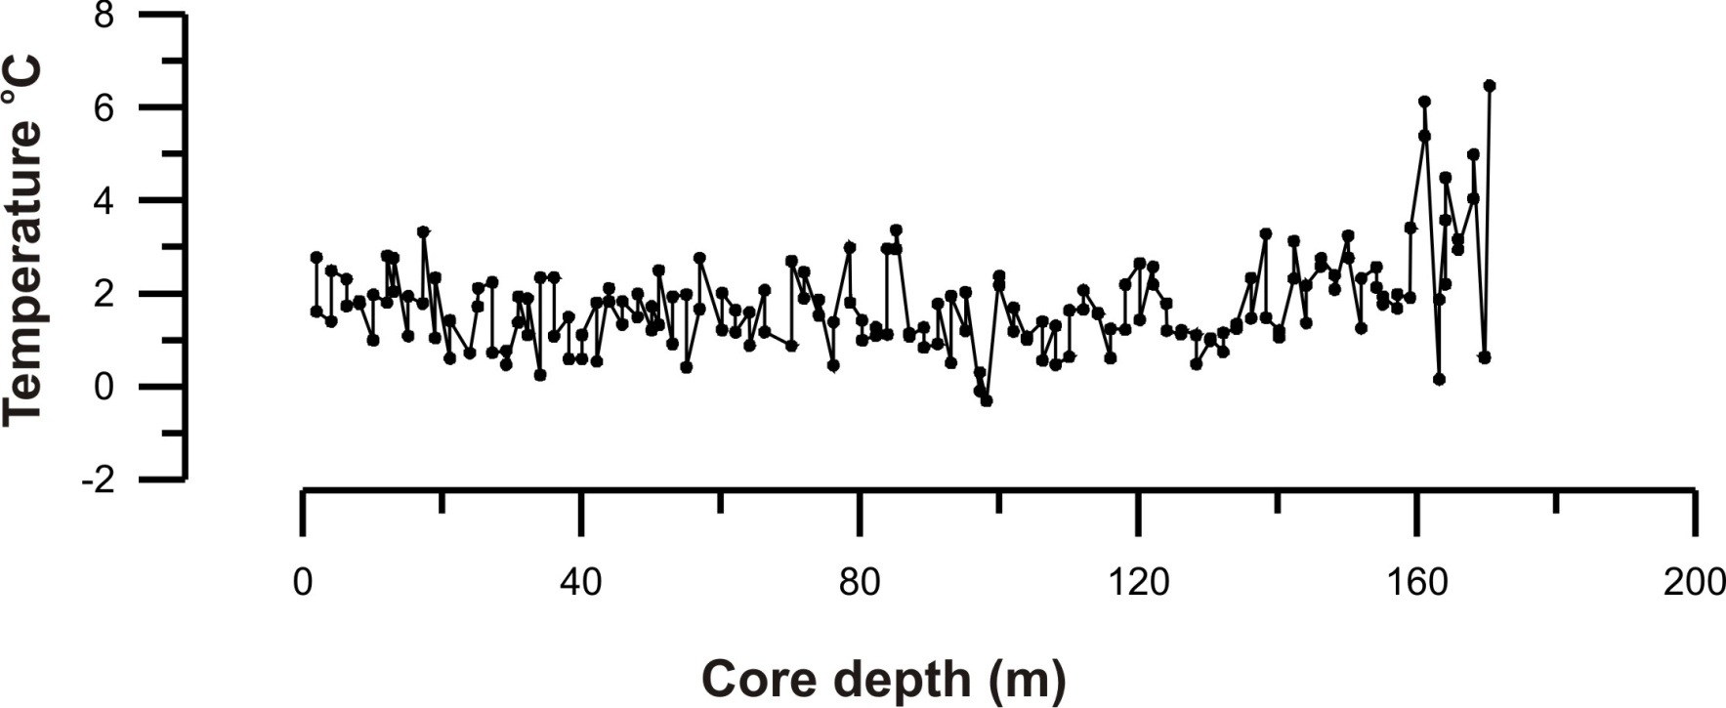
Adelie Basin (U1357B) TEX₈₆^{L} Ocean Temperature
~11,600 cal yrs B.P.
~10,500 cal yrs B.P.
Willmott et al. - See Veronica Willmott’s talk in the Wilkes Land session Thursday

Slide 28
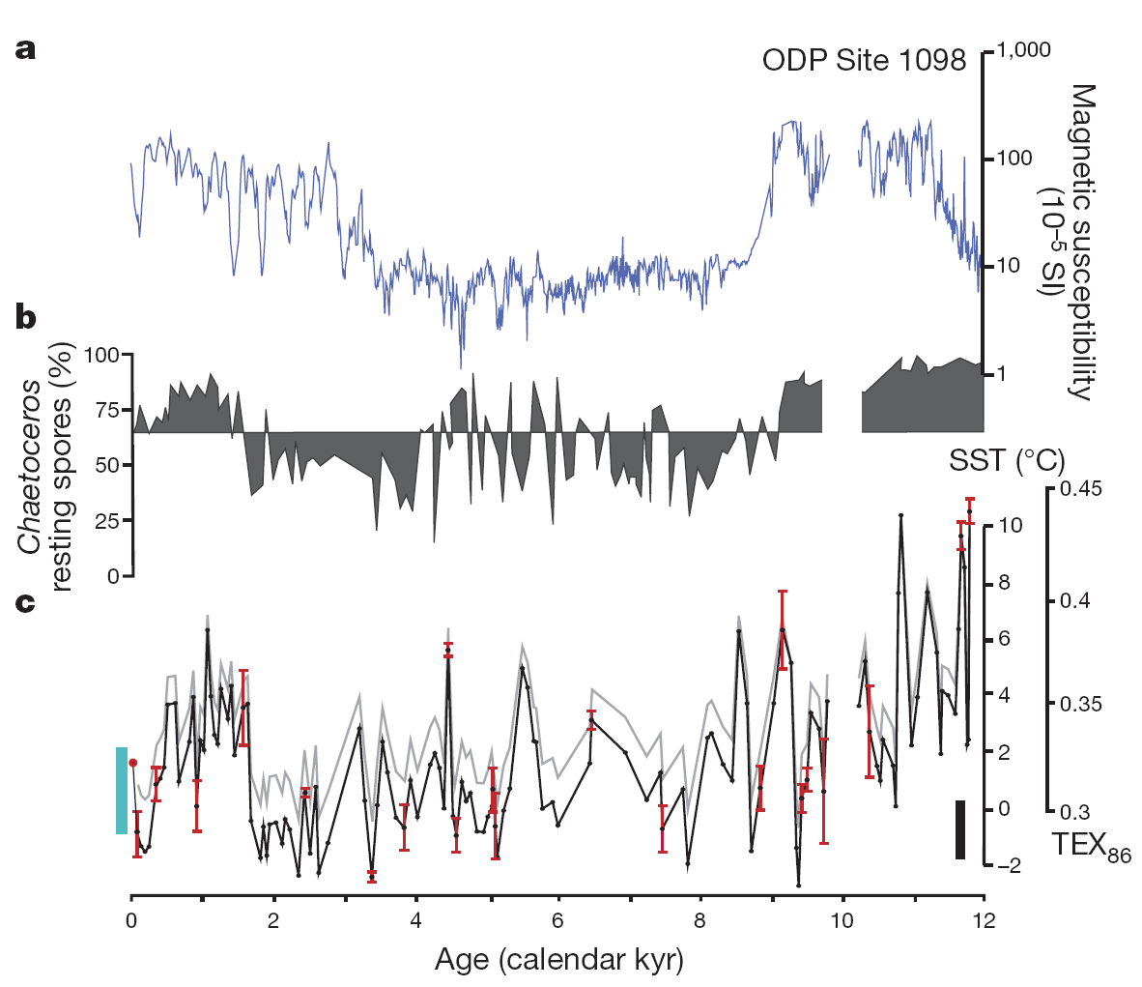
Shevenell et al., 2011
~10,700 cal yrs B.P.

Slide 29
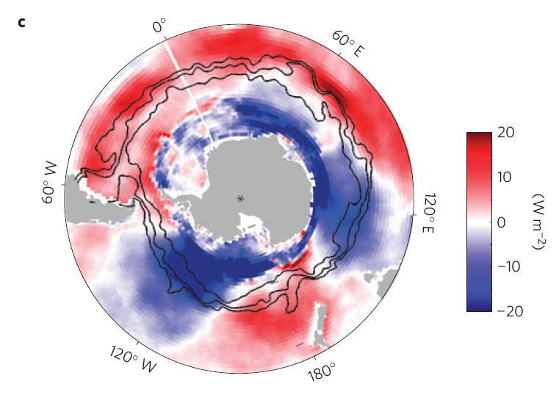
Should we expect heterogeneous responses around the margin?
Depends on the
timescale.
Sum of Ekman and air–sea heat fluxes regressed onto the SAM. Positive values refer to the ocean gaining heat. (From Sallee et al., 2010))

Slide 30
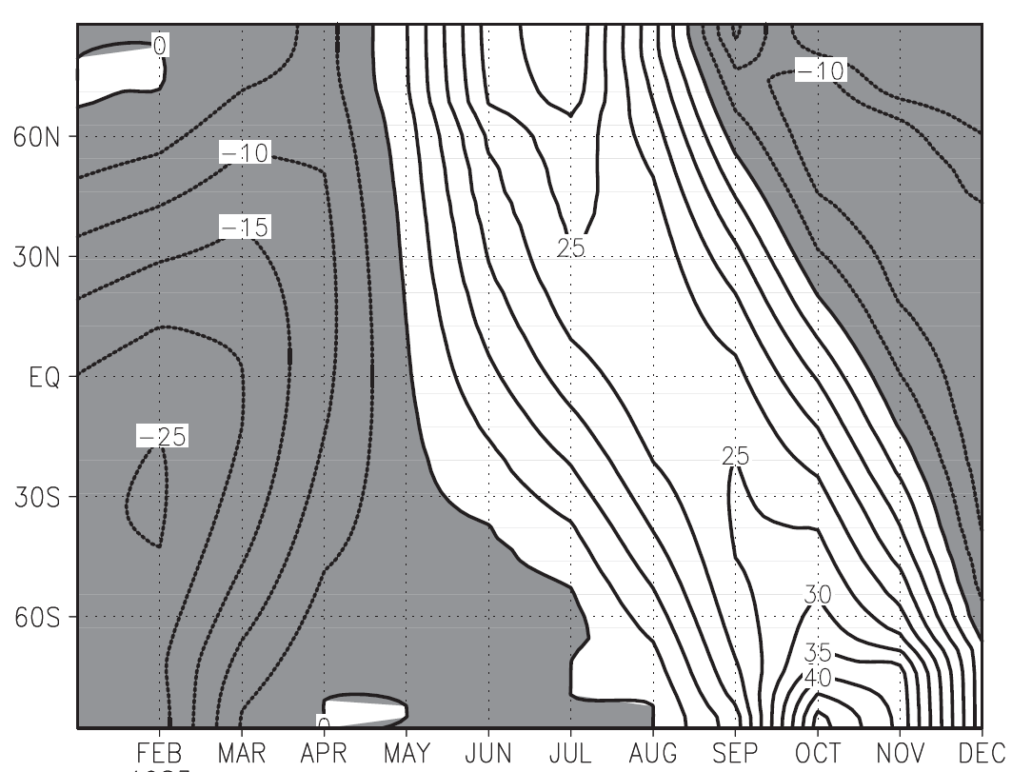
Top of the atmosphere solar insolation (in watts/m²), 6kyr B.P. relative to modern (from Chiang et al., 2009)

Slide 31
Community Climate System Model, version 3.0 (CCSM3)
Holocene Paleoclimate Experiment – Coupled model forced with insolation only.
Extracted 100 years of output (SLP, surface T, Zonal Wind) at modern, 2kyr, 4kyr, and 6kyr to examine impacts on following three regions:
1) Adelie: 56°S to 66°S and 120°E to 165°E
2) Mac.Robertson: 57°S to 67°S and 45°E to 90°E
3) Palmer: 56°S to 66°S and 60°W to 90°W

Slide 32
 | SLP Adelie |  | SLP Mac.Robert |  | SLP Palmer
 | mb | stdev | mb | stdev | mb | stdev
0kyr | 980.5 | 6.3 | 981.3 | 5.6 | 985.5 | 6.0
2kyr | 980.4 | 6.1 | 981.2 | 5.3 | 984.8 | 5.9
4kyr | 980.3 | 6.0 | 981.2 | 5.1 | 984.9 | 6.1
6kyr | 980.9 | 5.9 | 981.4 | 5.4 | 985.4 | 5.8
Δ (6Kyr-0kyr) | 0.4 |  | 0.1 |  | -0.1
 | SST Adelie |  | SST Mac.Robert |  | SST Palmer
 | °C | stdev | °C | stdev | °C | stdev
0kyr | -4.5 | 4.0 | -6.8 | 5.2 | -2.9 | 4.1
2kyr | -6.0 | 4.5 | -8.1 | 5.8 | -0.5 | 3.0
4kyr | -5.8 | 4.4 | -8.1 | 5.8 | -0.4 | 3.0
6kyr | -4.6 | 4.0 | -6.9 | 5.2 | 0.6 | 2.6
Δ (6Kyr-0kyr) | -0.1 |  | -0.1 |  | 3.6
 | Zonal Wind Adelie |  | Zonal Wind Mac.Robert |  | Zonal Wind Palmer
 | m/s | stdev | m/s | stdev | m/s | stdev
0kyr | -0.50 | 2.46 | -0.04 | 2.47 | 3.56 | 2.87
2kyr | -0.42 | 2.41 | 0.07 | 2.48 | 3.90 | 2.86
4kyr | -0.42 | 2.40 | -0.01 | 2.44 | 3.77 | 2.89
6kyr | -0.47 | 2.37 | -0.20 | 2.37 | 3.68 | 2.81
Δ (6Kyr-0kyr) | 0.0 |  | -0.2 |  | 0.1

Slide 33
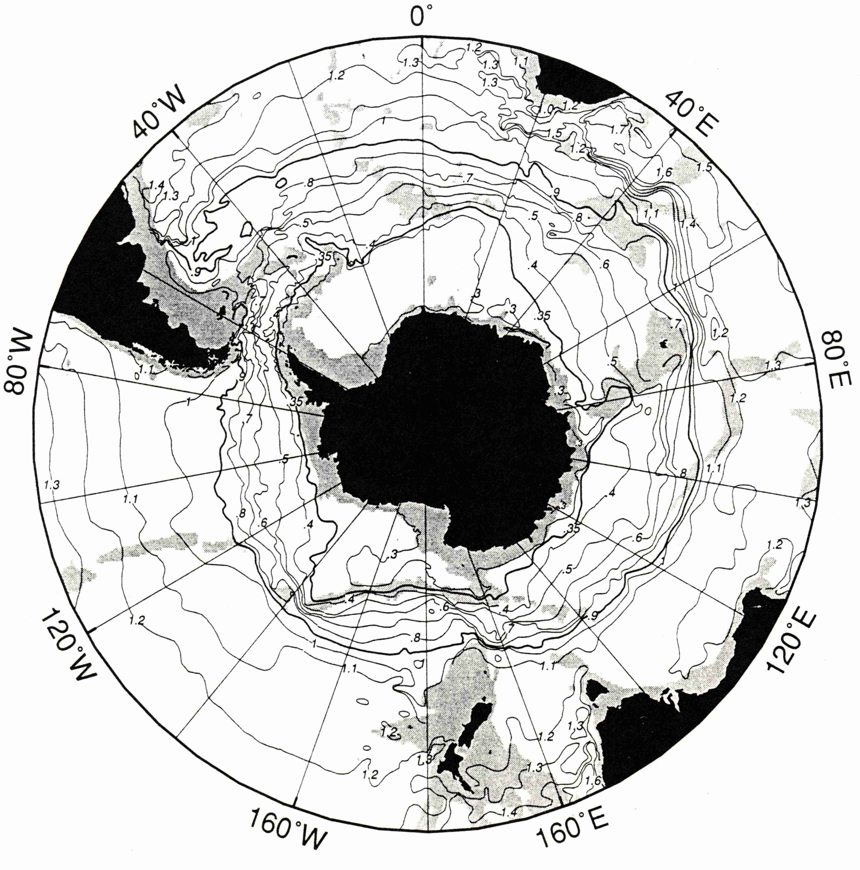
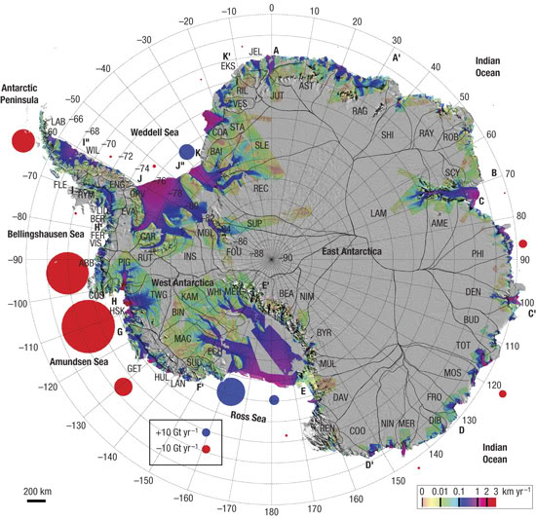
Where is Antarctic Ice melting today?
10 gigatons per year
Africa
Antarctic Circumpolar Current
South
America
Melt rates from Rignot et al., 2008
Antarctica
Australia
ACC from Orsi et al., DSR, 1995
Rignot
Rignot et al., 2008
Figure assembled by Doug Martinson
Notes:
Doug Martinson; Lamont-Doherty Earth Observatory, Columbia University
33
Last Revision: 7/11/2011 8:38:13 AM
ACC circulates UCDW around the continent. This is the water mass that has been identified as a major (if not primary) reason of the accelerated glacial melt in the Amundsen Sea Embayment, draining the WAIS most rapidly.
Reason UCDW is effective in melting glacier ice in the melt regions is those are the locations where the ACC delivers the warm water close to the coast.

Slide 34
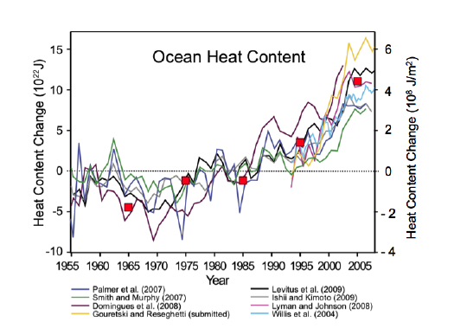
Deep Ocean Heat Content
and ACC response
= “LTER-grid” heat contents (from Martinson)
Notes:
Red squares show increase of UCDW heat content of upper water column (that available to continental shelf) in the LTER grid (downstream of the ASE). Defining the water mass and its history of warming is one of the great results of our previous ship use.
Several reasons can be responsible for this long term exponential rise in heat content. But, a huge fraction of the heat that originally went into the atmosphere as global warming has ended up in the ocean. 8 independent studies here show that this has led to exponential warming of global deep waters.
All ocean basins have some south bound current that must deliver this warm water to the ACC, and from there it will get to Western Antarctica.

Slide 35
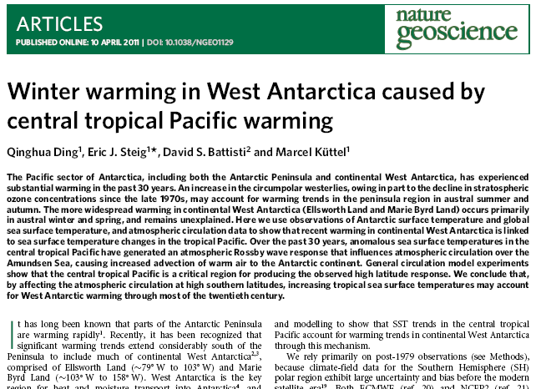
Ding et al., 2011

Slide 36
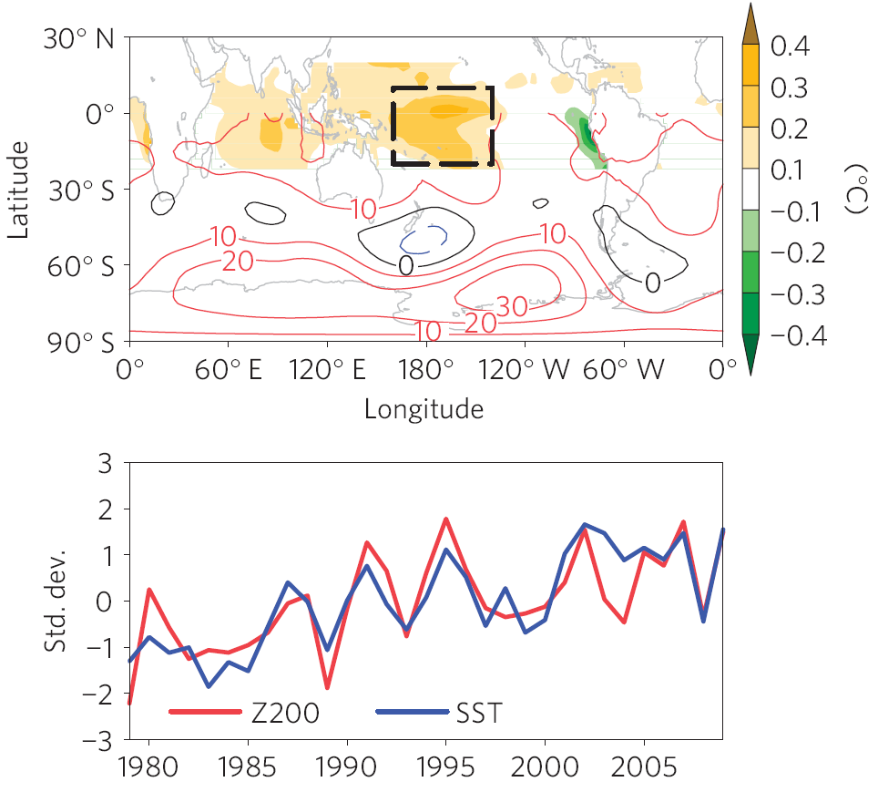
Ding et al., 2011
Z200 = S. Hem. 200 hPa geopotential height
Central Tropical Pacific SST

Slide 37
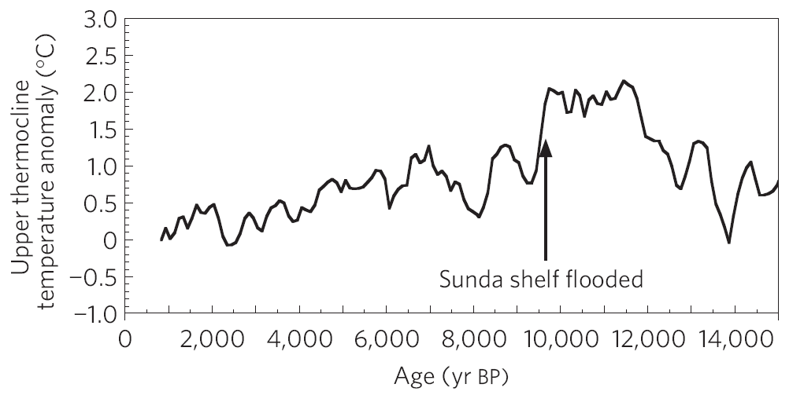
Figure from Linsley et al., 2010
Foram δ¹⁸O and Mg/Ca records from WPWP region suggest strong early Holocene warming of central and western Pacific – up to 2°C. Is this part of the amplifier that produces 6°C and greater heat anomalies on the Antarctic margin?

