Slide 1
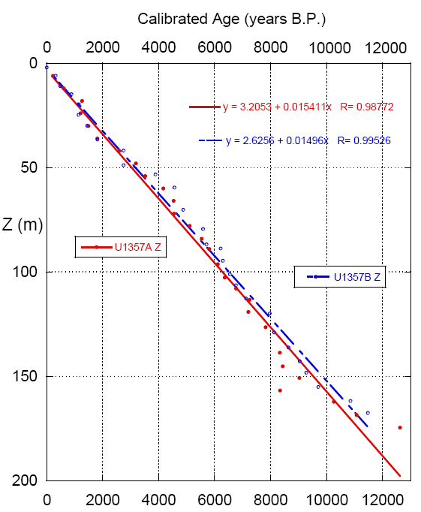

Slide 2
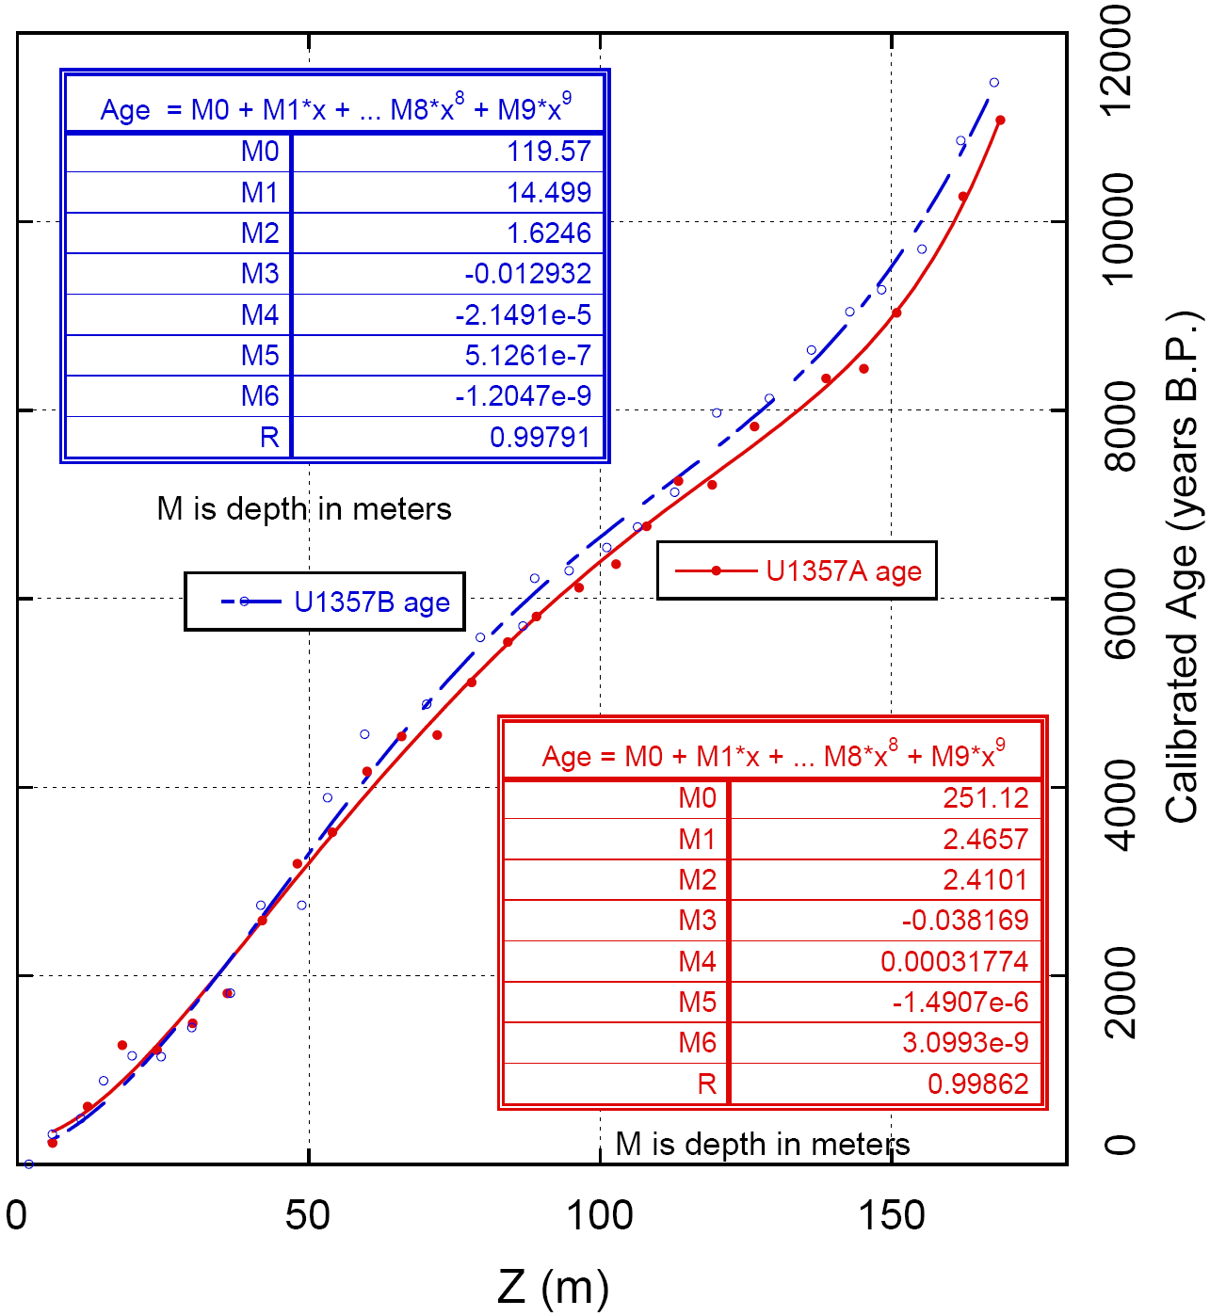

Slide 3
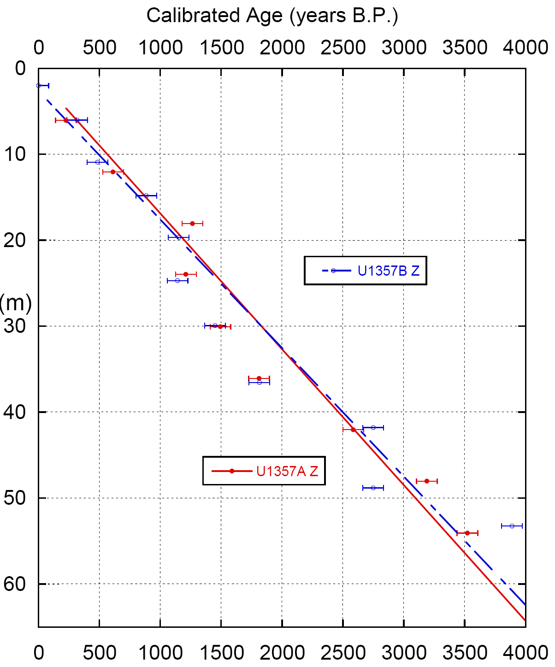

Slide 4
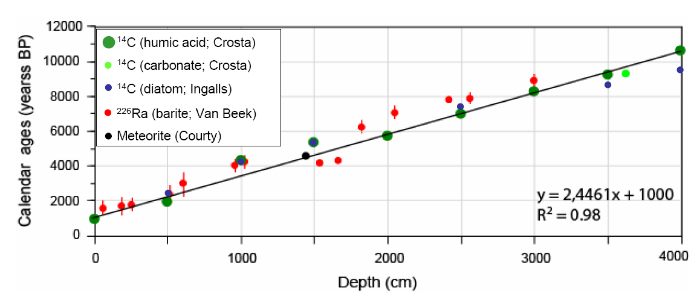
Age-dating comparisons MD03-2601
Pers. Comm. Crosta (2011)

Slide 5
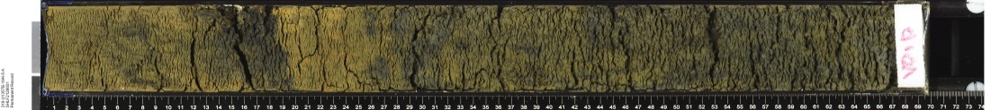
U1357B-18H-5
Cal ¹⁴C age = 11,125 yrs B.P.
U1357B-18H-6
U1357B-18H-7
Cal. AMS age = 410 years
# laminae pairs = ~310
U1357B-19H-1
U1357B-19H-2
U1357B-19H-3
Cal ¹⁴C age = 11,535 yrs B.P.
U1357B-19H-4
U1357B-19H-5
Cal ¹⁴C age = 36,620 yrs B.P.
# laminae pairs 19H-3 age to base of hole ~140

Slide 6
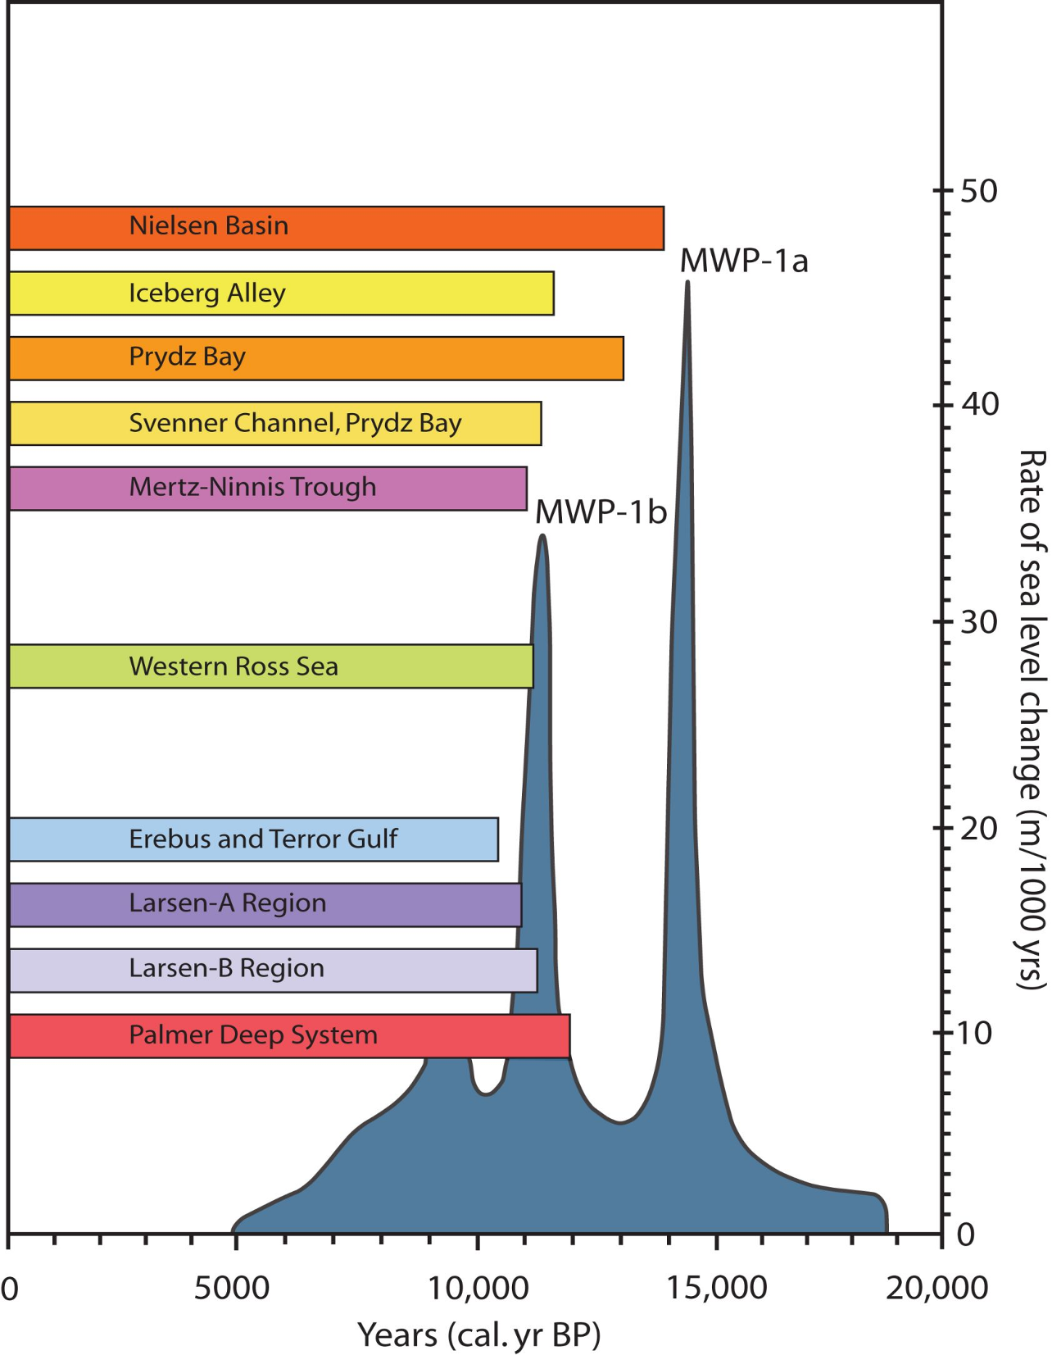
No response
U1357A&B
Initial retreat
Widespread retreat
Present ice margin reached
Onset of marine sedimentation (multiple ¹⁴C ages)
From Mackintosh et al. 2011

Slide 7
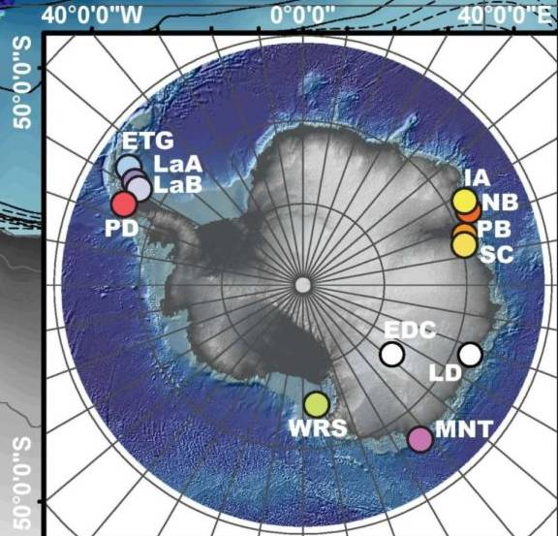
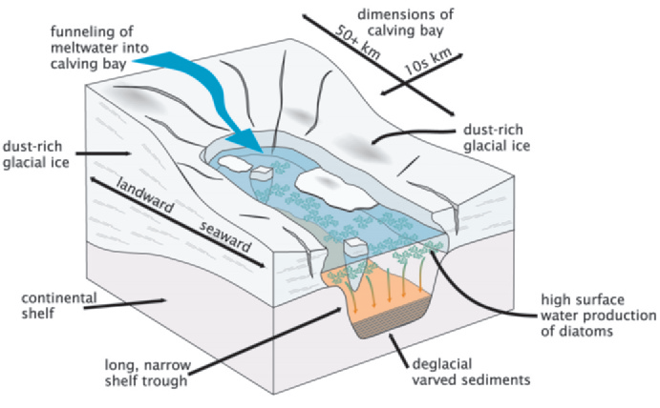
Near-shore marine sediments
Calving bays on E Antarctic continental shelves
From Mackintosh et al. 2011
U1357

Slide 8
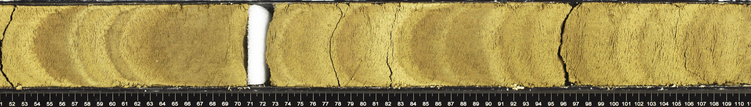
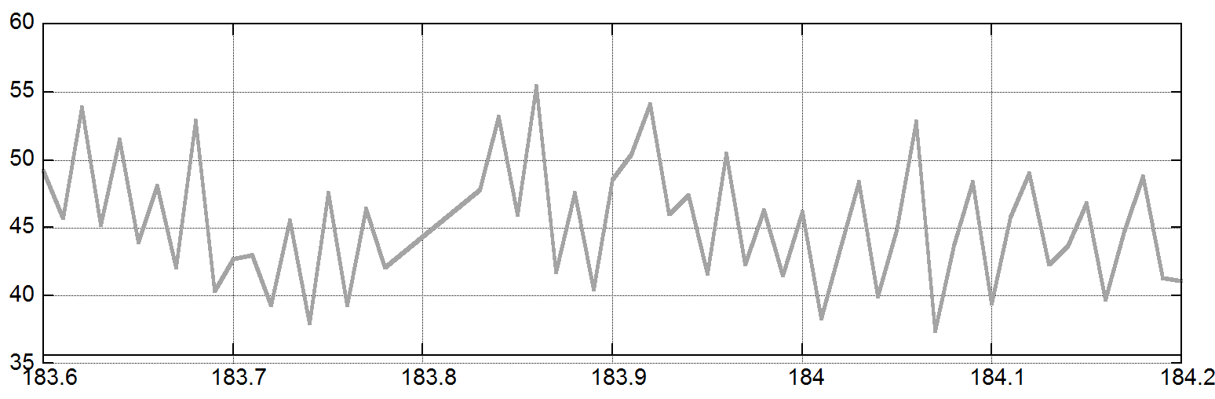
U1357A-20H-4A 51 – 111 cm
Cielab L*
Cielab L* faithfully captures banding at the cm scale

Slide 9
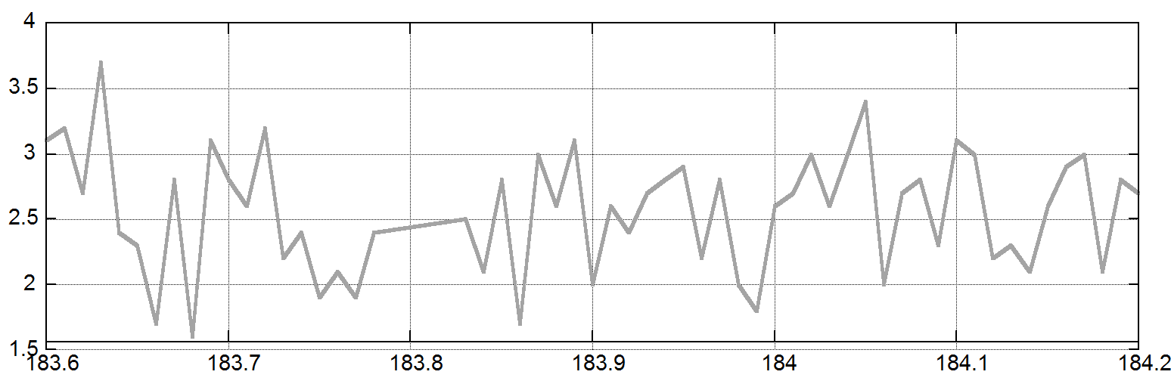
U1357A-20H-4A 51 – 111 cm
Cielab a*
Cielab a* faithfully captures banding at the cm scale

Slide 10
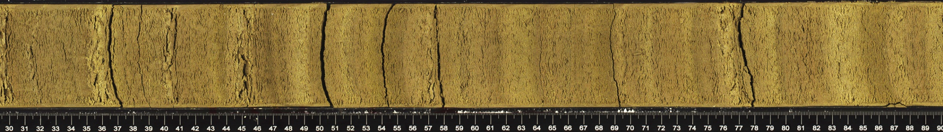
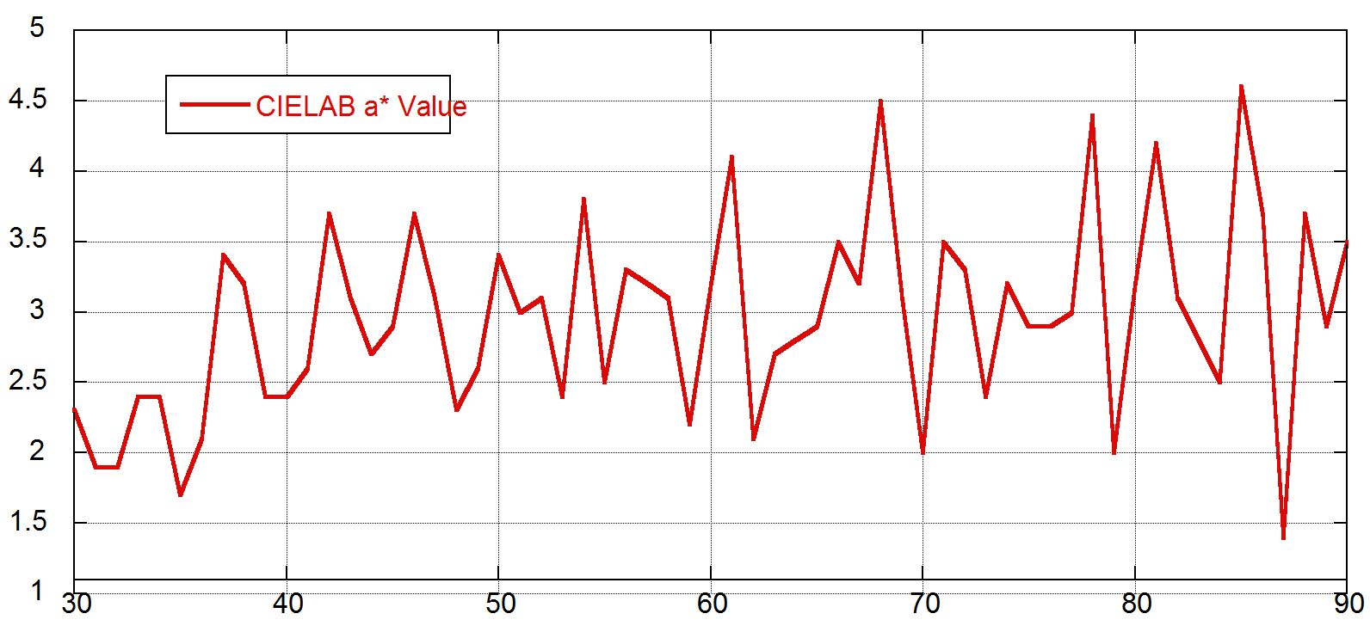
U1357A-19H-1A 30 – 90 cm
Cielab a* faithfully captures banding at the cm scale

Slide 11
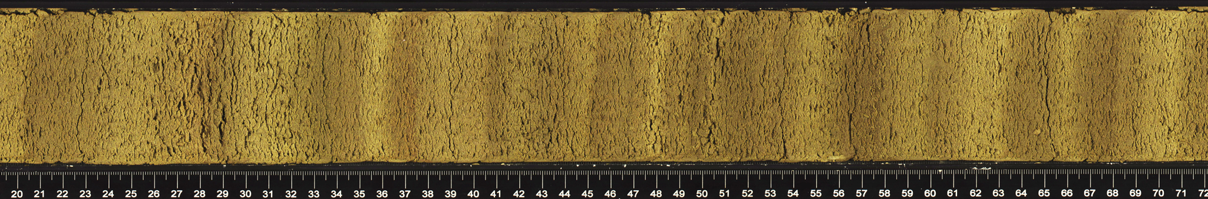
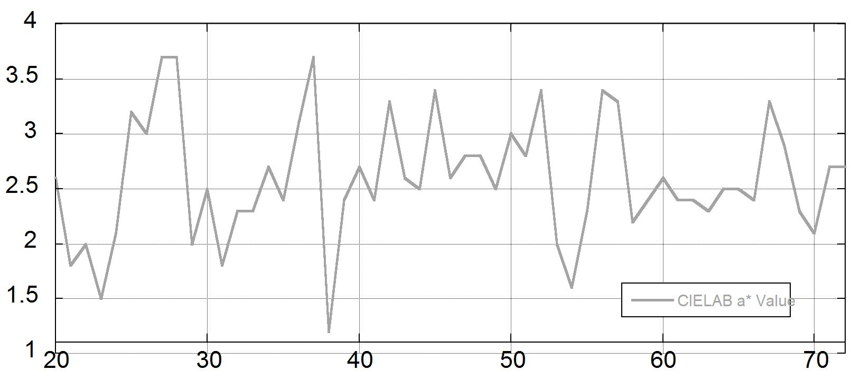
U1357A-14H-1A 20 – 72 cm
Cielab a* faithfully captures banding at the cm scale

Slide 12
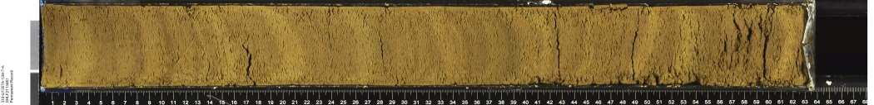
U1357A-1H-5A, ~6.0 cm/band
U1357A-3H-4A, ~5.4 cm/band
U1357A-4H-5A, ~3.9 cm/band
U1357A-6H-4A, ~2.8 cm/band
U1357A-13H-47, ~2.3 cm/band
U1357A-14H-1A, ~2.9 cm/band
U1357A-15H-4A, ~2.4 cm/band

Slide 13
U1357A-15H-8A, ~3.3 cm/band
U1357A-17H-1A, ~3.8 cm/band
U1357A-16H-3A, ~2.6 cm/band
U1357A-16H-4A, ~3.3 cm/band
U1357A-16H-6A, ~3.0 cm/band
U1357A-17H-3A, ~2.4 cm/band
U1357A-17H-4A, ~2.9cm/band

Slide 14
U1357A-17H-5A, ~3.3 cm/band
U1357A-17H-6A, ~2.7 cm/band
U1357A-18H-2A, ~2.4 cm/band
U1357A-18H-4A, ~1.9 cm/band
U1357A-18H-5A, ~2.5 cm/band
U1357A-19H-1A, ~2.3 cm/band
U1357A-19H-4A, ~3.1 cm/band
U1357A-20H-3A, ~3.0 cm/band

Slide 15
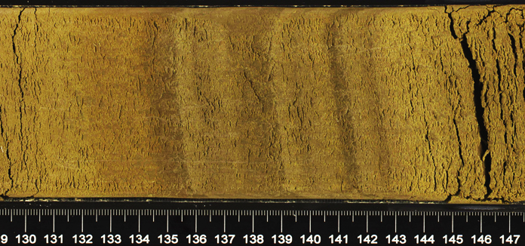
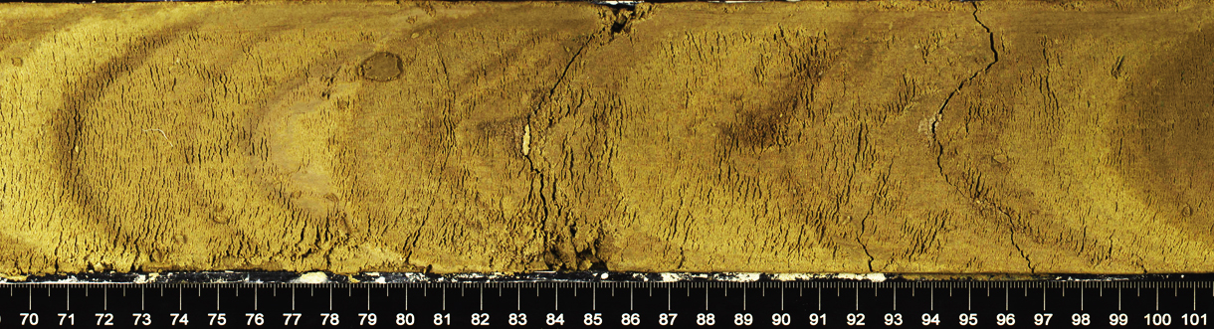
Likely examples of annual bands
7 bands in 10 cm
318-U1357A-18H-5-A
cm-scale bands near base of hole
318-U1357A-20H-3-A

Slide 16
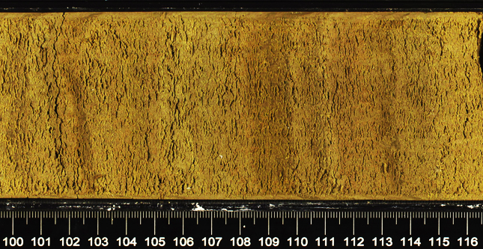
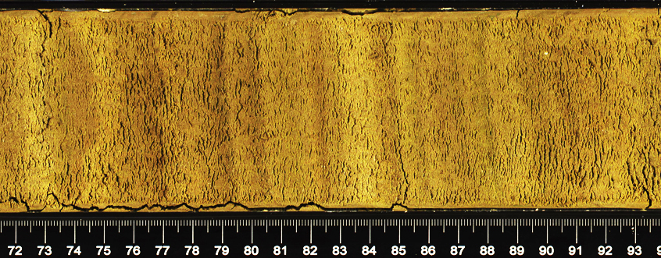
Likely examples of annual bands
9 bands in 13 cm
318-U1357A-19H-1-A
12 bands in 17 cm
318-U1357A-17H-5-A

Slide 17
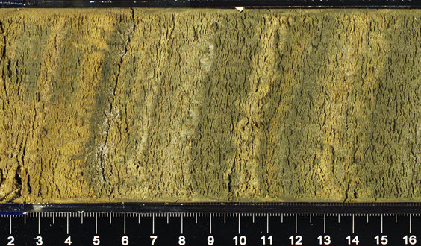
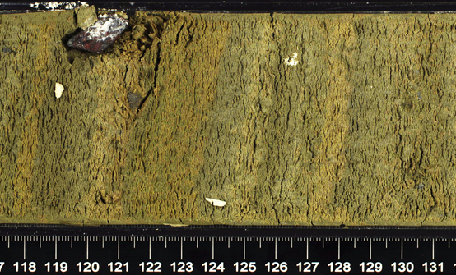
U1357B-19H-4A
82 light/dark couplets in 143 cm, e.g. 1.7 cm/band, close to the long-term sed rate of 1.6 cm/yr

Slide 18
Age-dating comparisons MD03-2601
Pers. Comm. Crosta (2011)

Slide 19
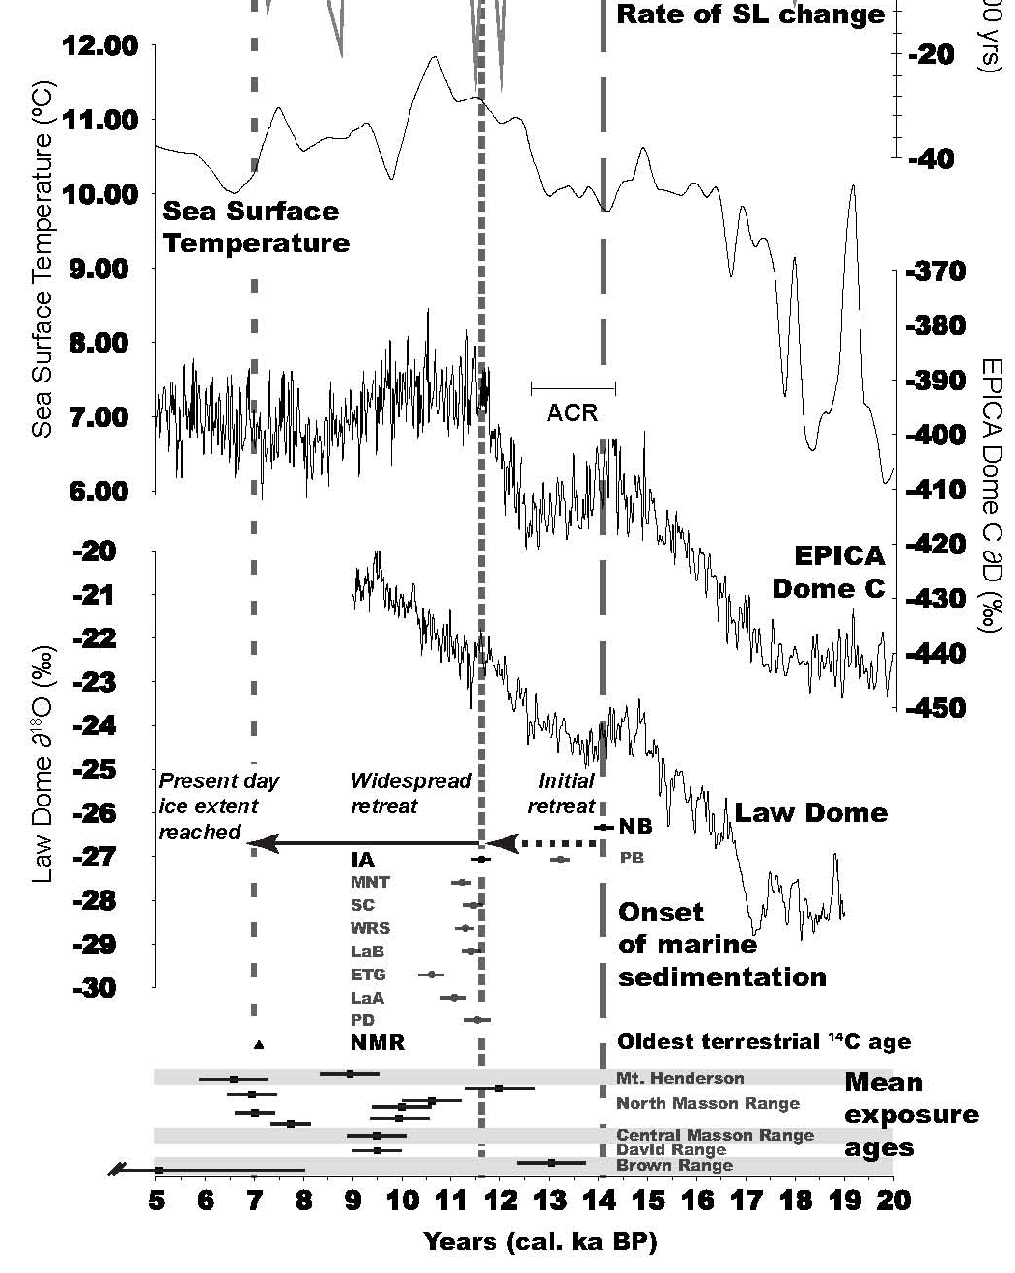
No response
Initial retreat
Widespread retreat
Present ice margin reached
From Mackintosh et al. 2011

Slide 20
No response
U1357A&B
Initial retreat
Widespread retreat
Present ice margin reached
Onset of marine sedimentation (multiple ¹⁴C ages)
From Mackintosh et al. 2011

Slide 21
Near-shore marine sediments
Calving bays on E Antarctic continental shelves
From Mackintosh et al. 2011
U1357

Slide 22
Likely examples of annual bands
7 bands in 10 cm
318-U1357A-18H-5-A
cm-scale bands near base of hole
318-U1357A-20H-3-A

Slide 23
Likely examples of annual bands
9 bands in 13 cm
318-U1357A-19H-1-A
12 bands in 17 cm
318-U1357A-17H-5-A

Slide 24
U1357B-19H-4A
82 light/dark couplets in 143 cm, e.g. 1.7 cm/band, close to the long-term sed rate of 1.6 cm/yr

Slide 25
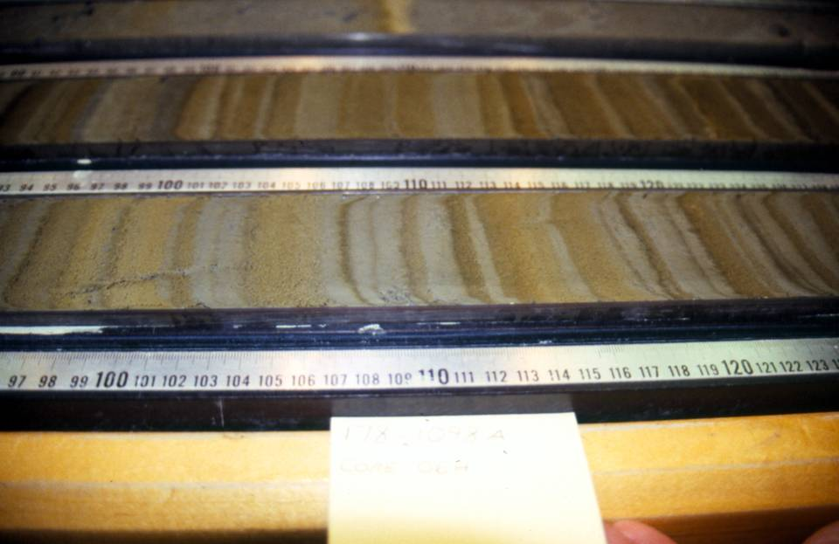
Laminations at base of Holocene section, site 1098, ~11-11.5 kyr BP
Notes:
Laminations in sediments from the deglacial interval of site 1098. Image: R. Dunbar.

Slide 26
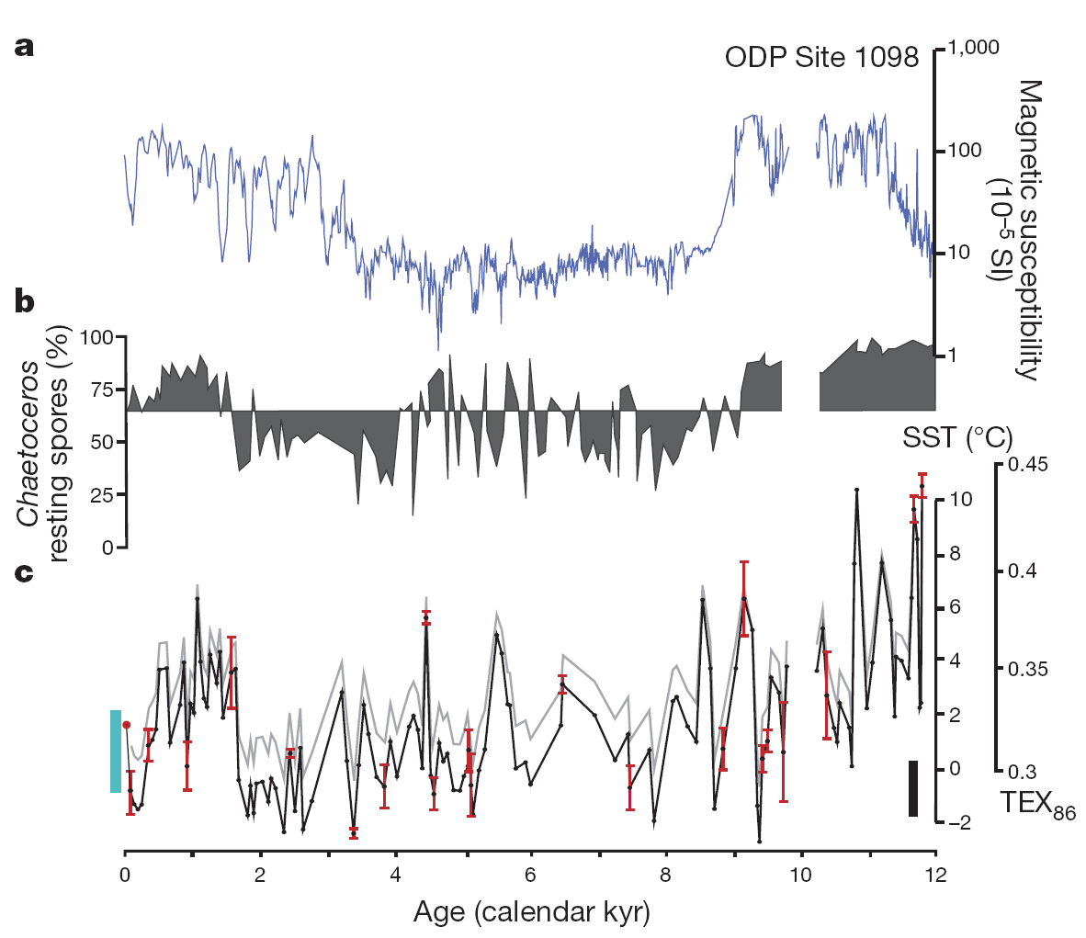
Shevenell et al., 2011

Slide 27
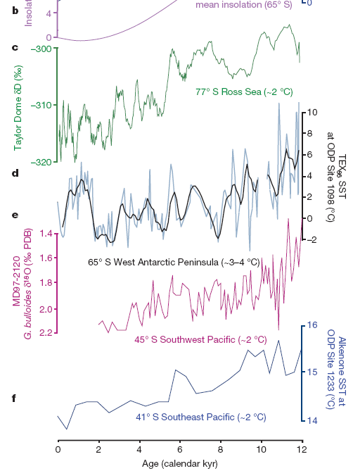
Shevenell et al., 2011

Slide 28
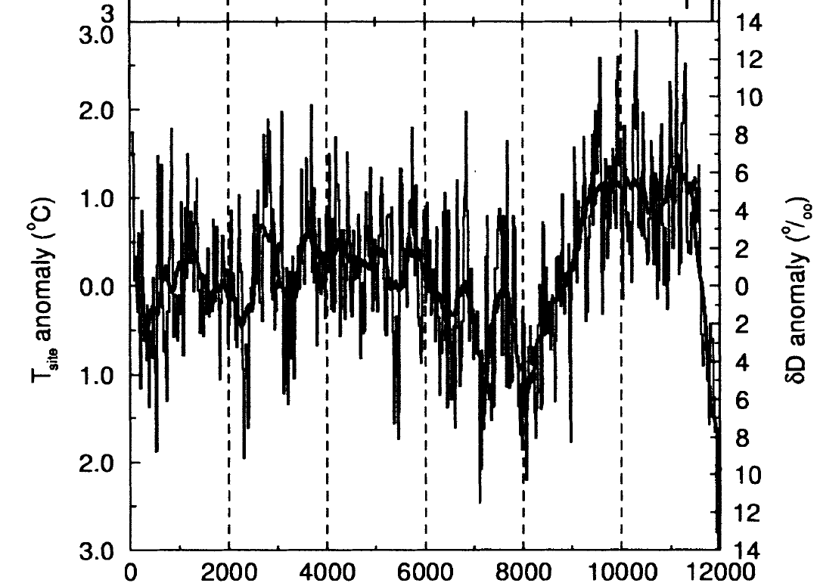
Masson-Delmotte et al., 2004
EPICA Dome C

Slide 29
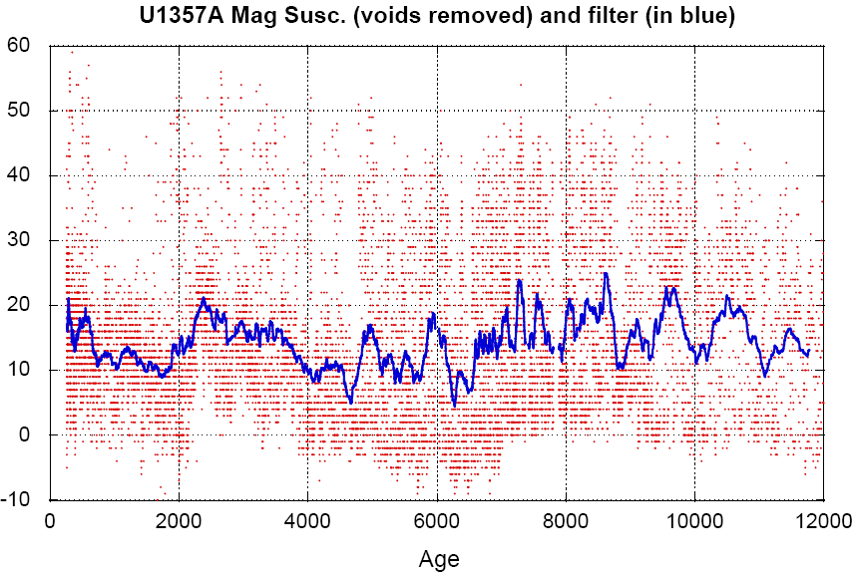

Slide 30
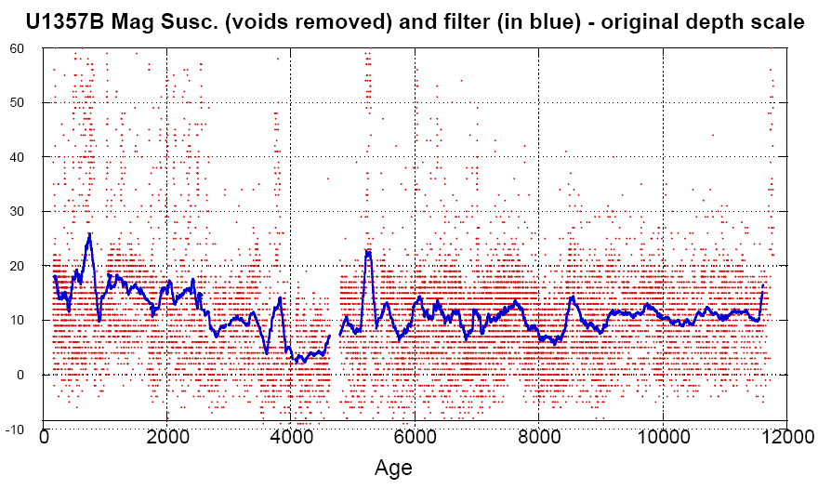

Slide 31
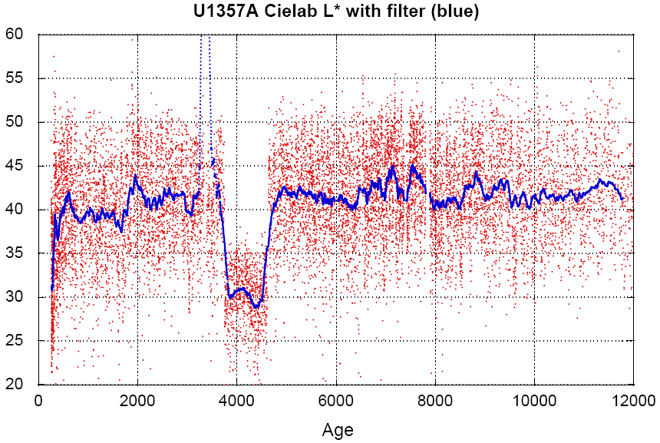

Slide 32
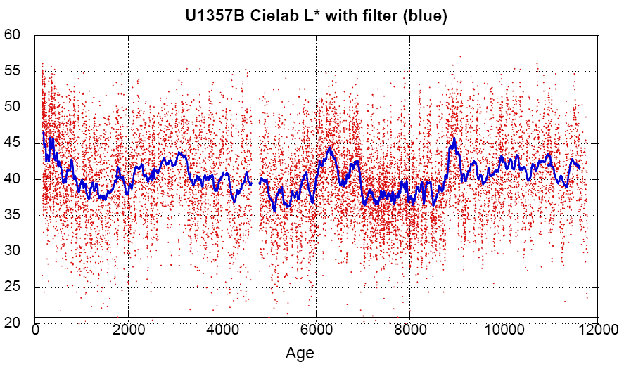

Slide 33
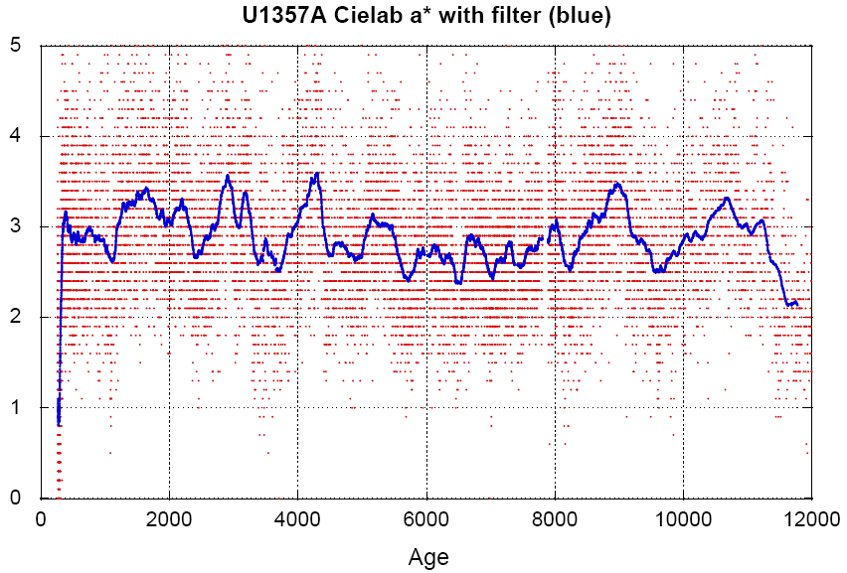

Slide 34
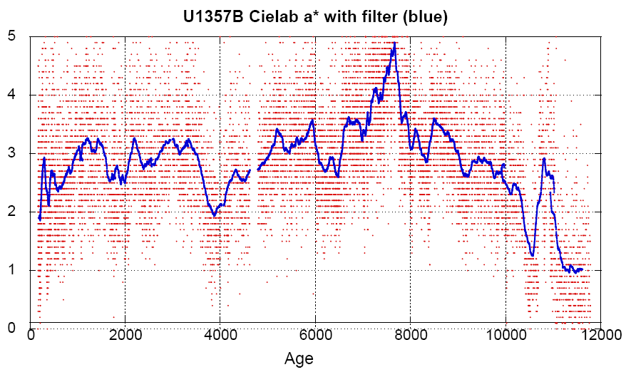

Slide 35
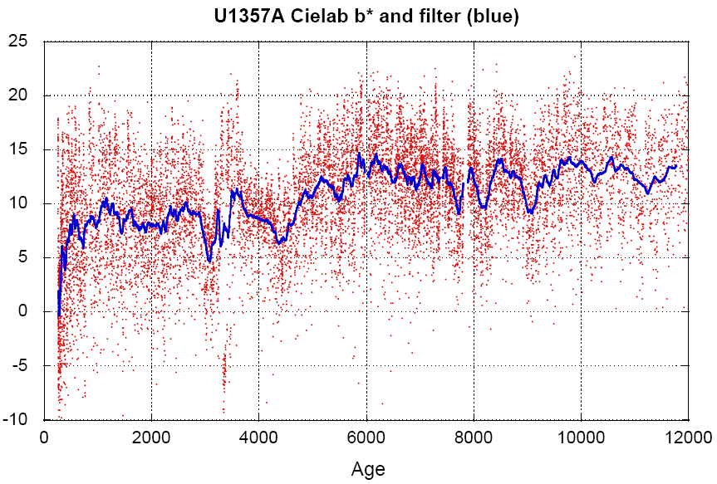

Slide 36
