Slide 1
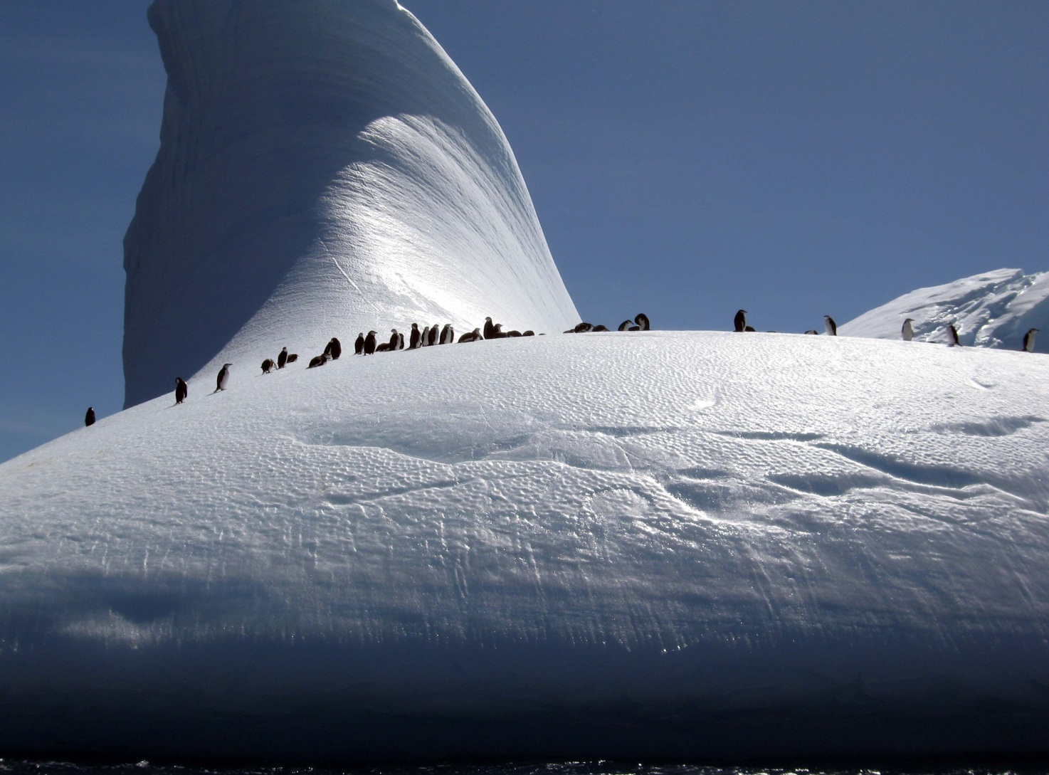

Slide 2
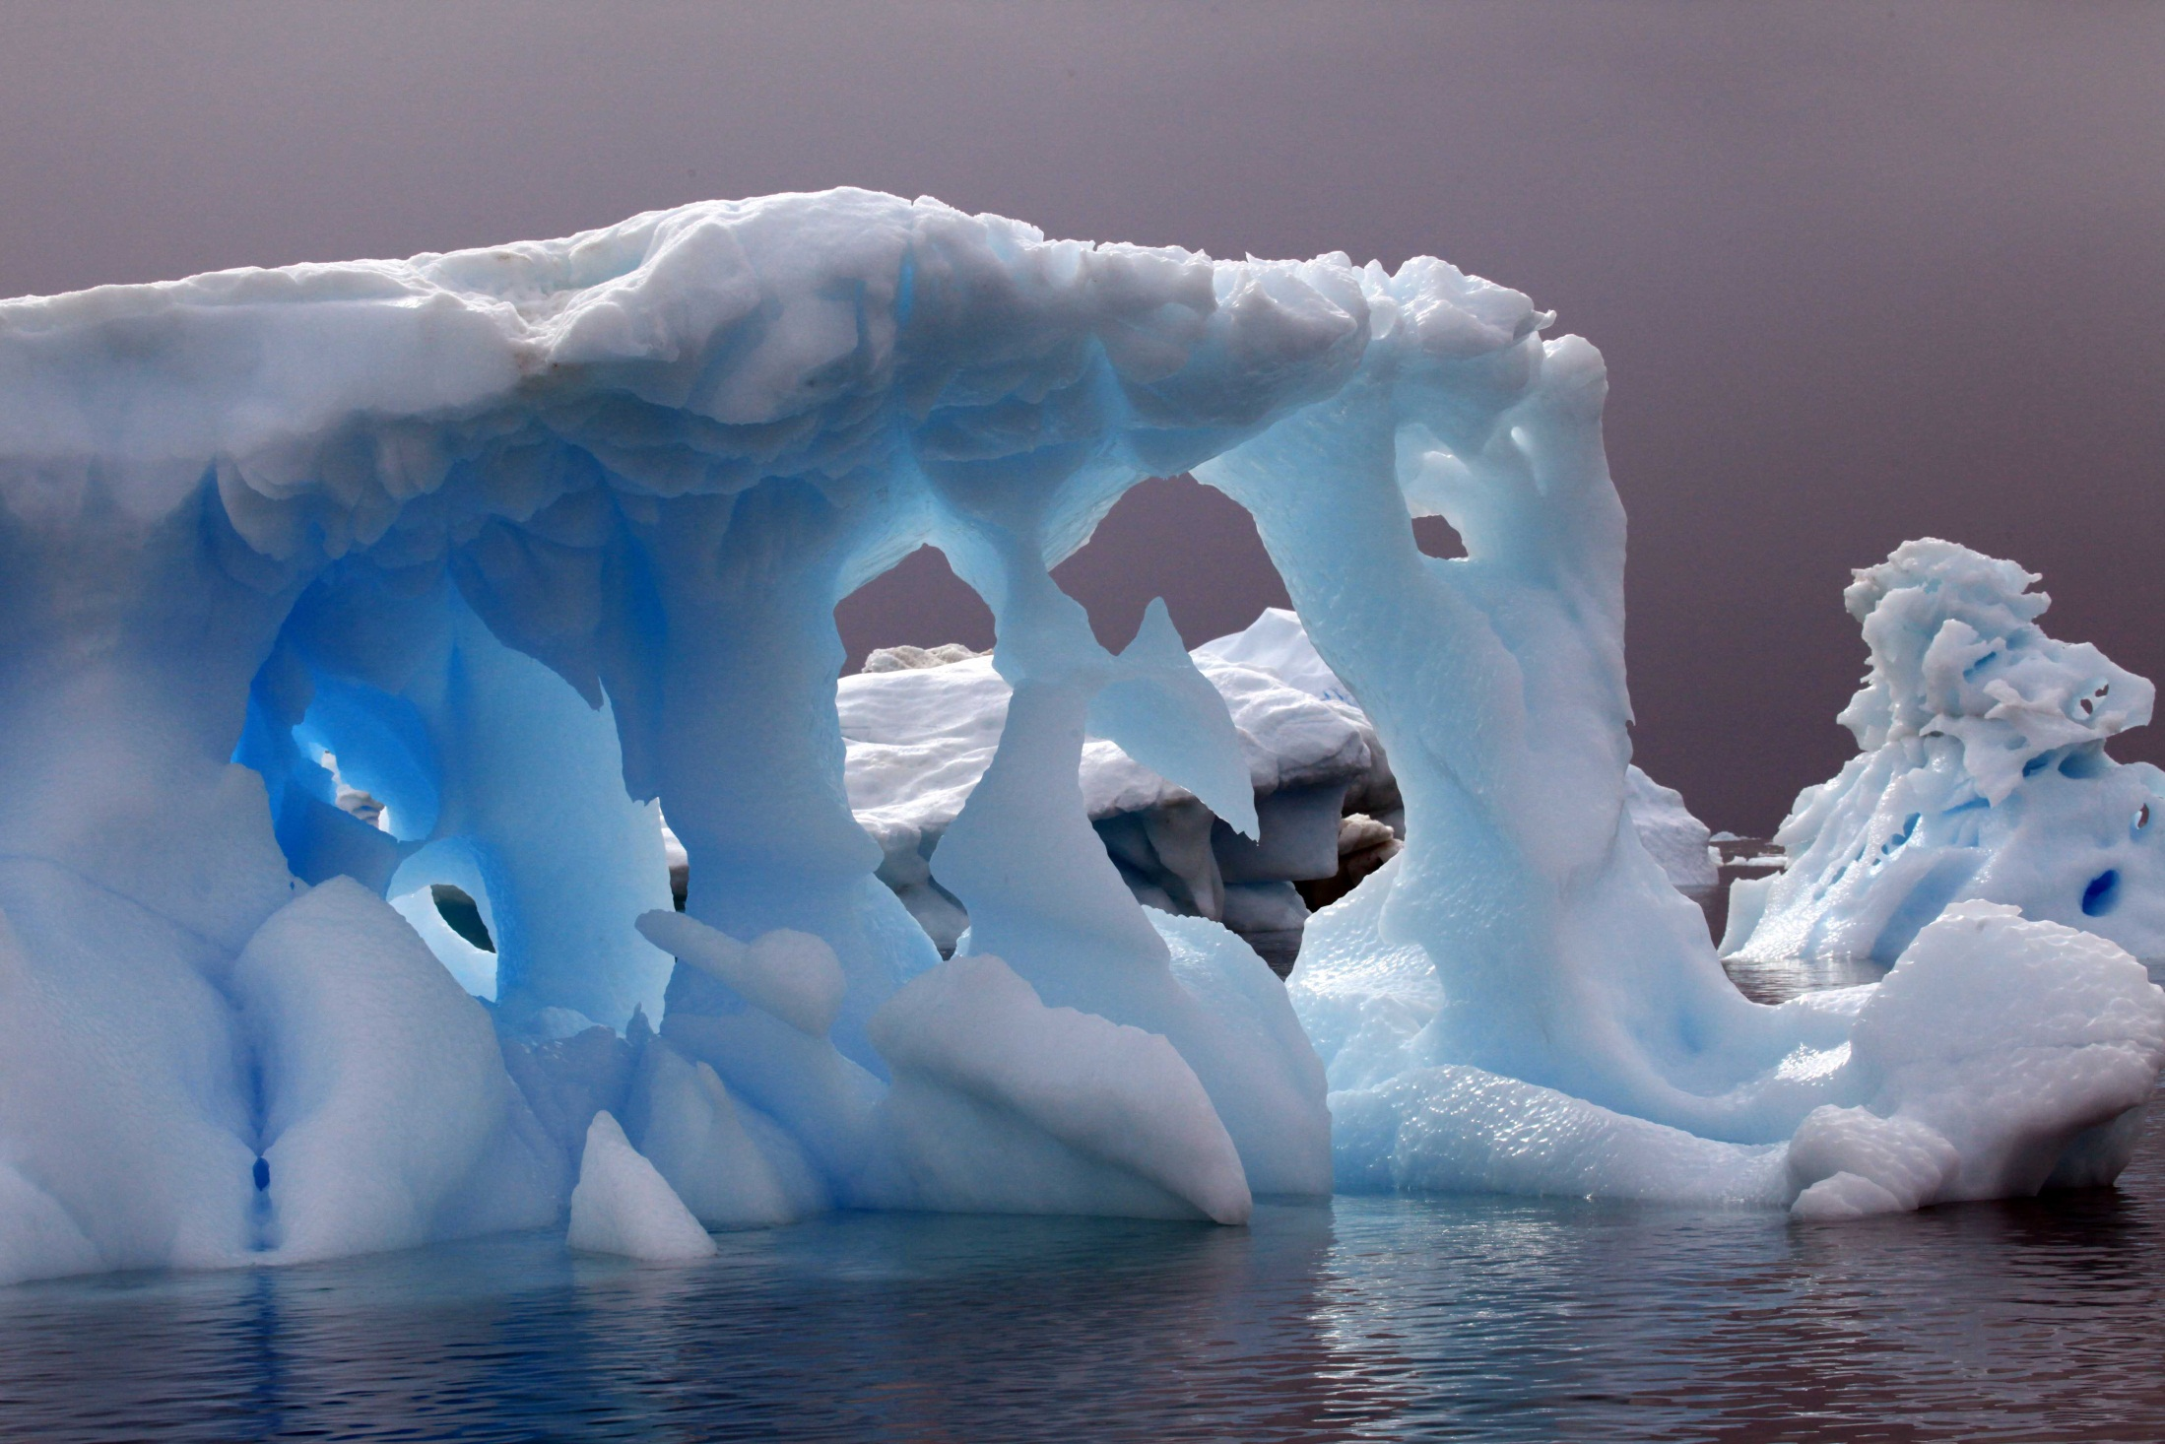


Past, Present, and Future Climate Evolution in Antarctica: The Holocene
Rob Dunbar
Stanford University
Rob McKay, Francis Jimenez, Steve Pekar, James Bendle, Veronica Wilmott, Lisa Tauxe, B.K. Khim, J. Kim, Johan Etorneau, Xavier Crosta, Guillaume Masse, J. Pike, T. Gregory, P. Campagne, M. Yamane, N. Okouchi, Y. Yokoyama, C. Escutia, H. Brinkhuis, Exp 318 party

Slide 3
Why should we care about Holocene Variability in Antarctica?
The baseline period against which anthropogenic impacts are assessed and attributed
Useful for forcing-response analysis
    Strong insolation seasonality signal
    ΔpCO₂ small (6%)
    ΔpCH₄ moderate (20%)
    Can incorporate “modern” modes of variability
    ENSO absent in early Holocene
    coupling of tropical and polar climate
Periods of Holocene warmth provide insights into the greenhouse future – polar amplification, rates of ice loss, sea ice regime
Holocene Geoscience enjoys some advantages in Antarctica?
Records haven’t been removed by glacial advance
Many basins with rapidly depositing sediments
Good age-dating tools

Slide 4
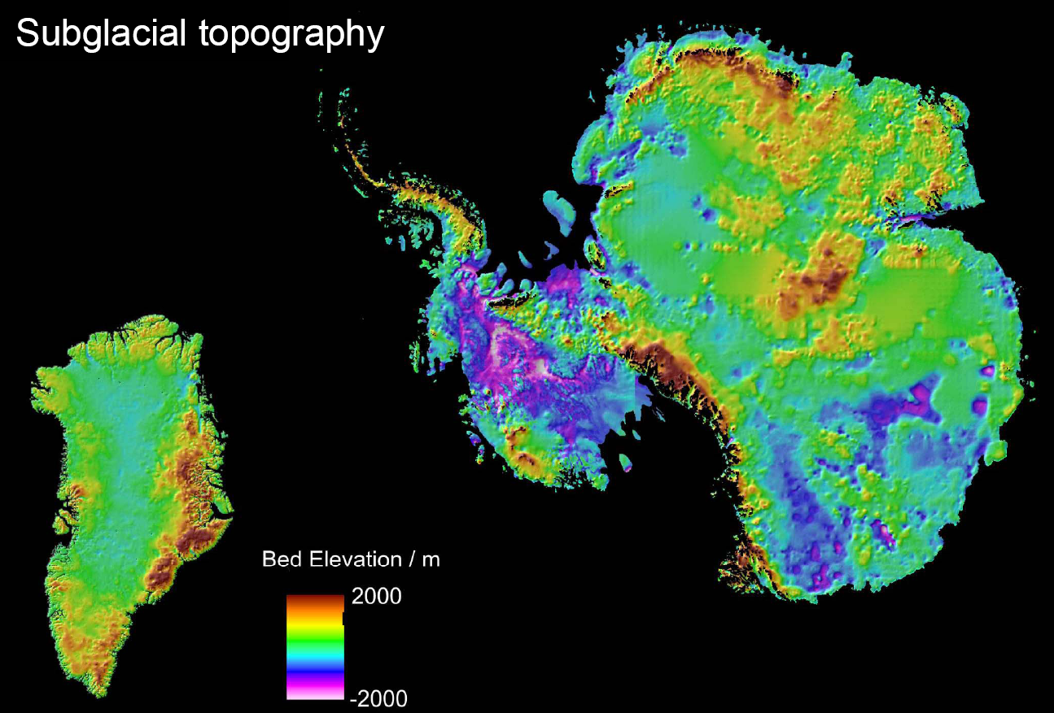
Mac.Rob.
Bedmap and J.L. Bamber
Palmer Deep
IODP Expedition 318
Jan – Mar 2010

Slide 5
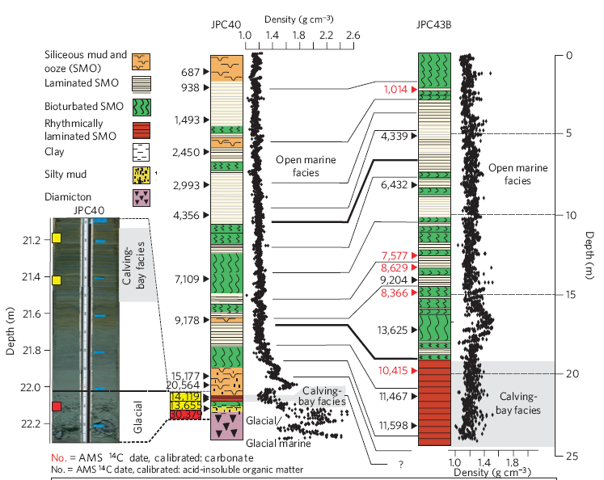
Mackintosh et al., 2011

Slide 6
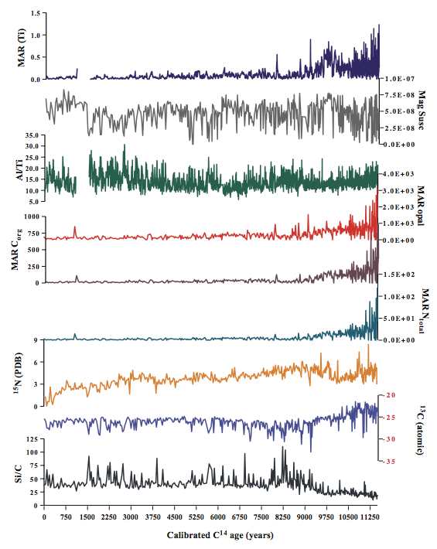

JPC-43B – ICPMS-calibrated XRF core scanner data

Slide 7
JPC-43B

Slide 8
High % C_{org}
Muted mid-Holocene variability

Slide 9
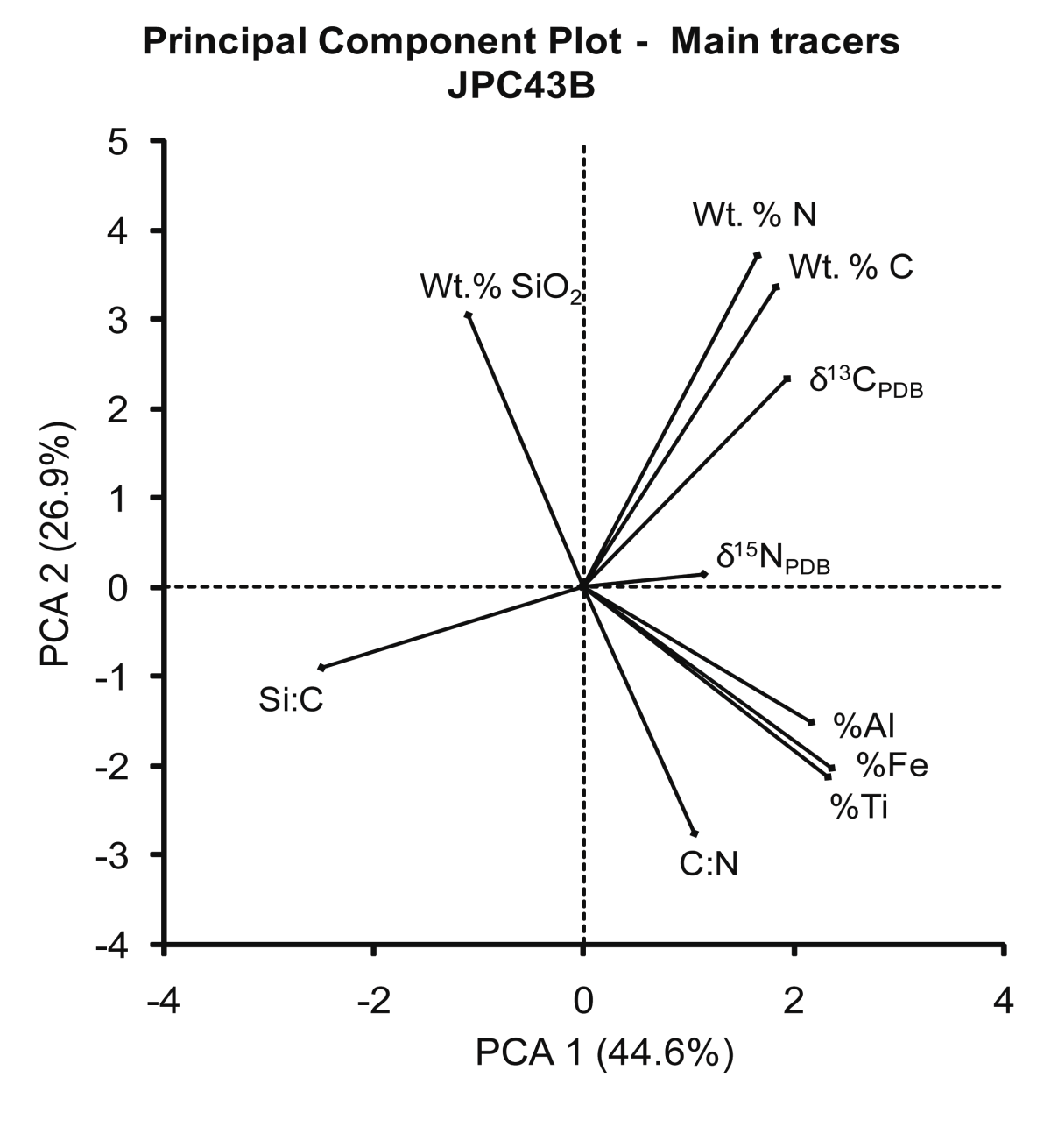

Slide 10
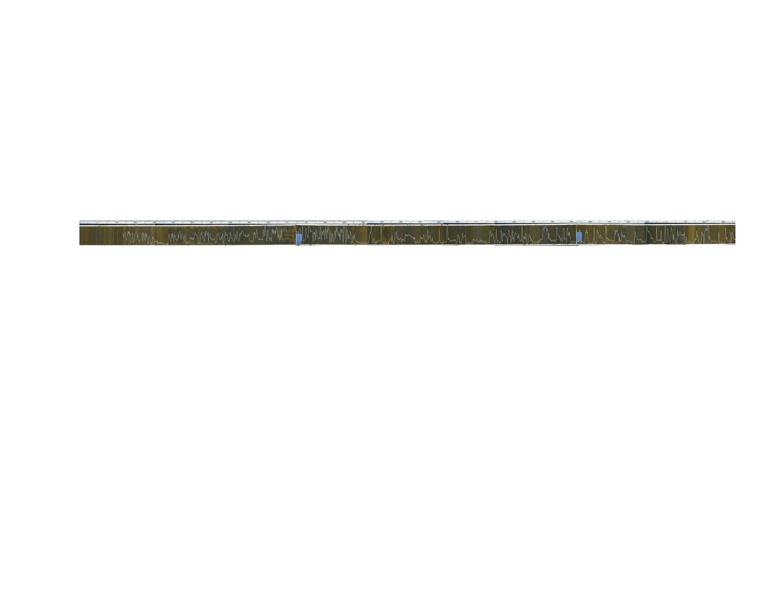
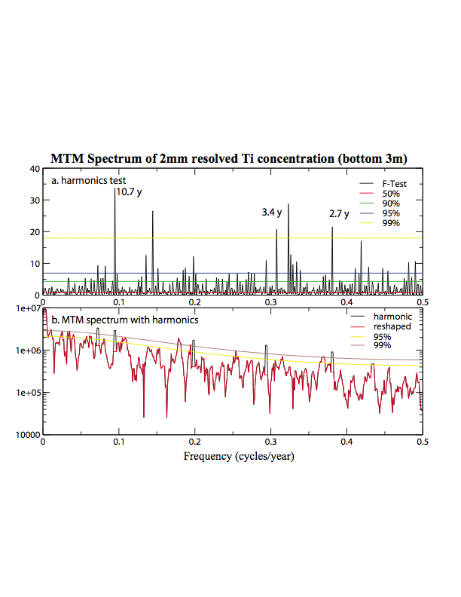

Slide 11
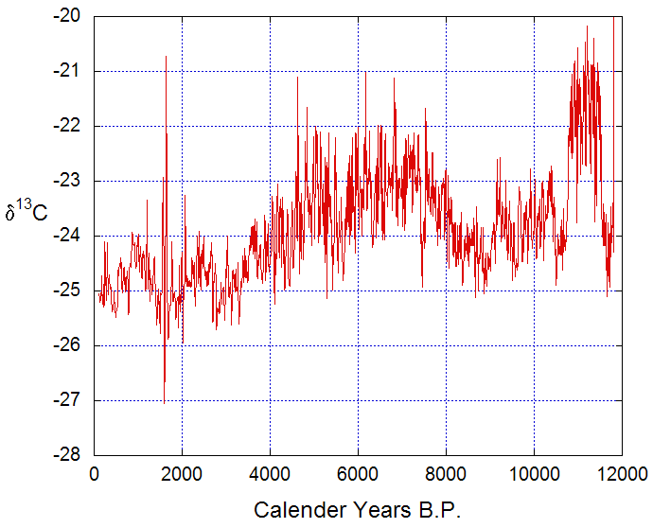
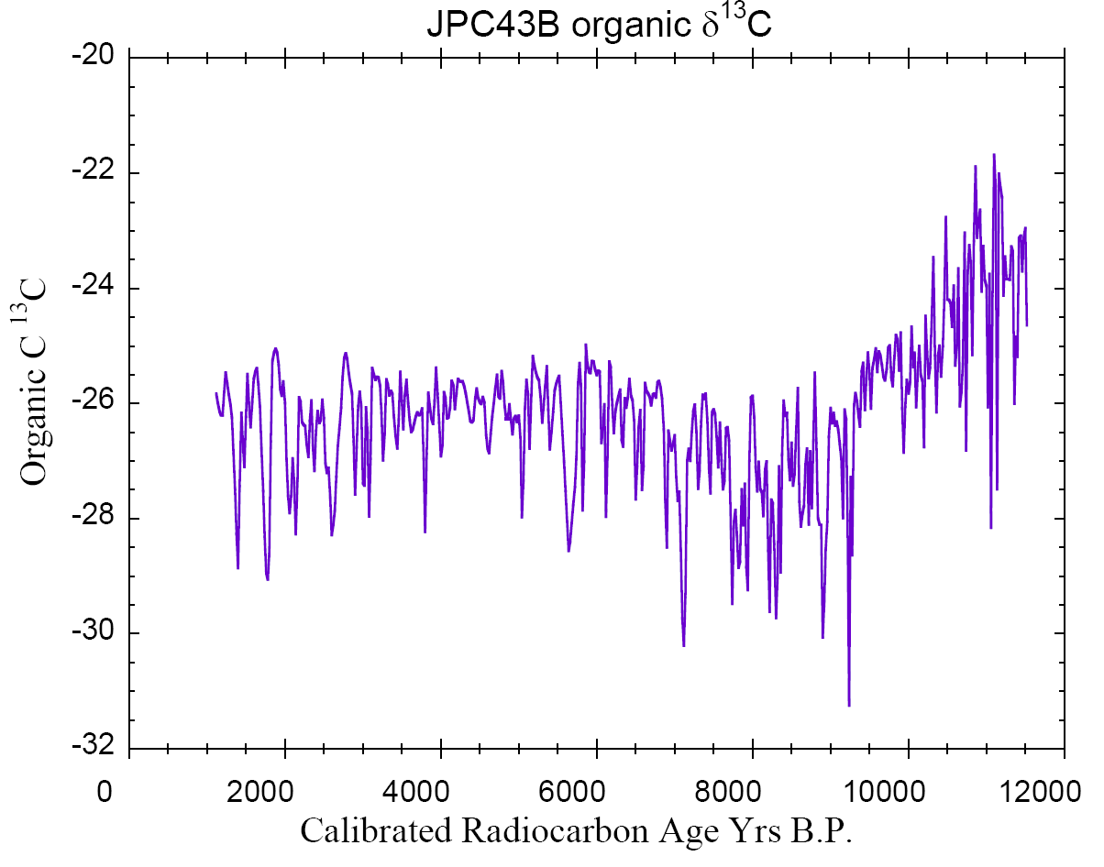
-20
Palmer Deep, Antarctic Peninsula
-22
δ¹³C_{org}
-24
-26
-28
-20
-22
JPC-43B, Mac.Robertson Shelf
δ¹³C_{org}
-24
-26
-28
-30

Slide 12
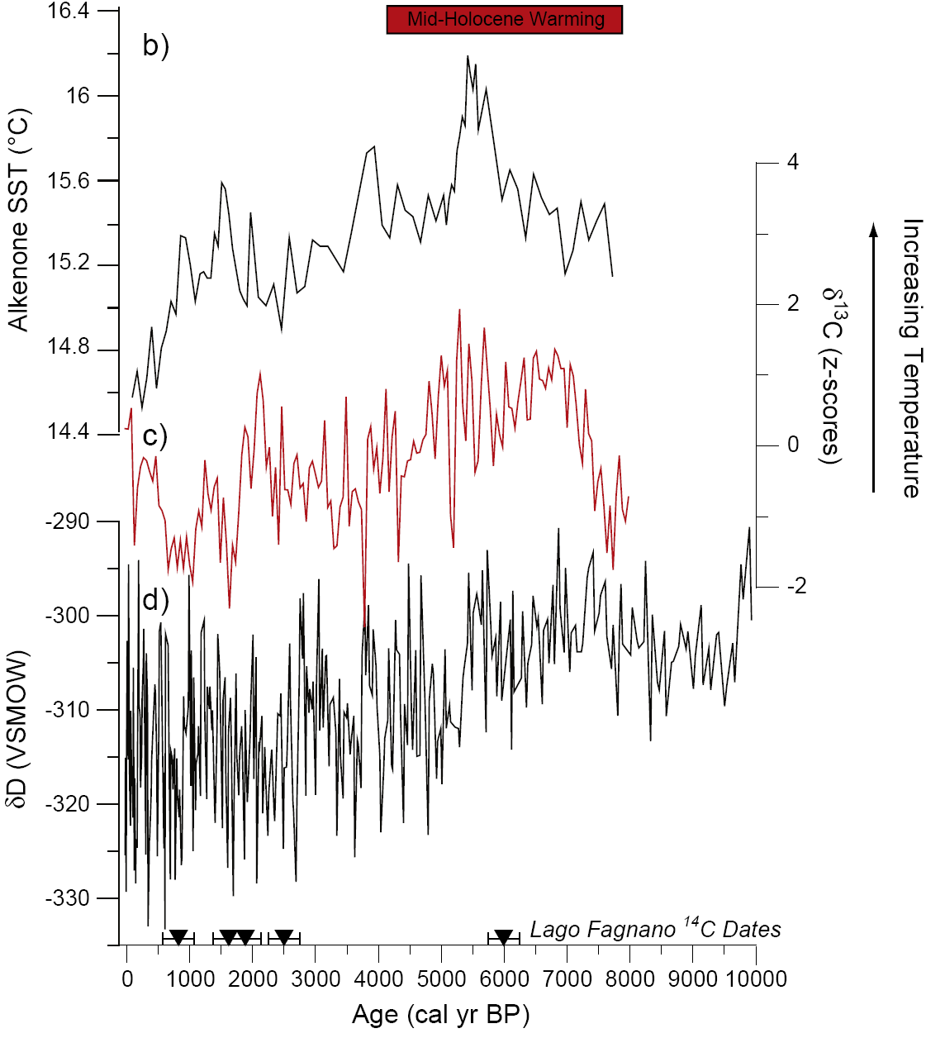
Mid-Holocene Warmth
From Moy et al., 2010
41°S, Lamy et al., 2002
55°S, this work
Taylor Dome, Antarctica, Steig et al., 2000

Slide 13
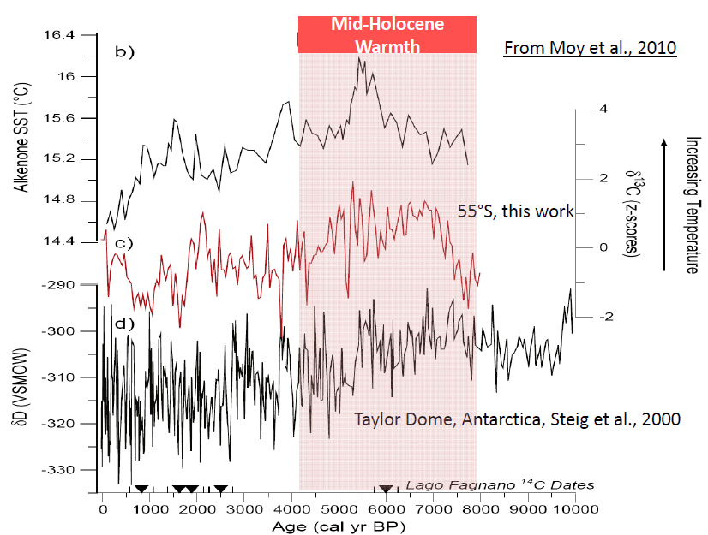
Palmer Deep, Antarctic Peninsula (Dunbar et al., 2008)

Slide 14
Mid-Holocene Warmth
From Moy et al., 2010
55°S, this work
Taylor Dome, Antarctica, Steig et al., 2000

Slide 15
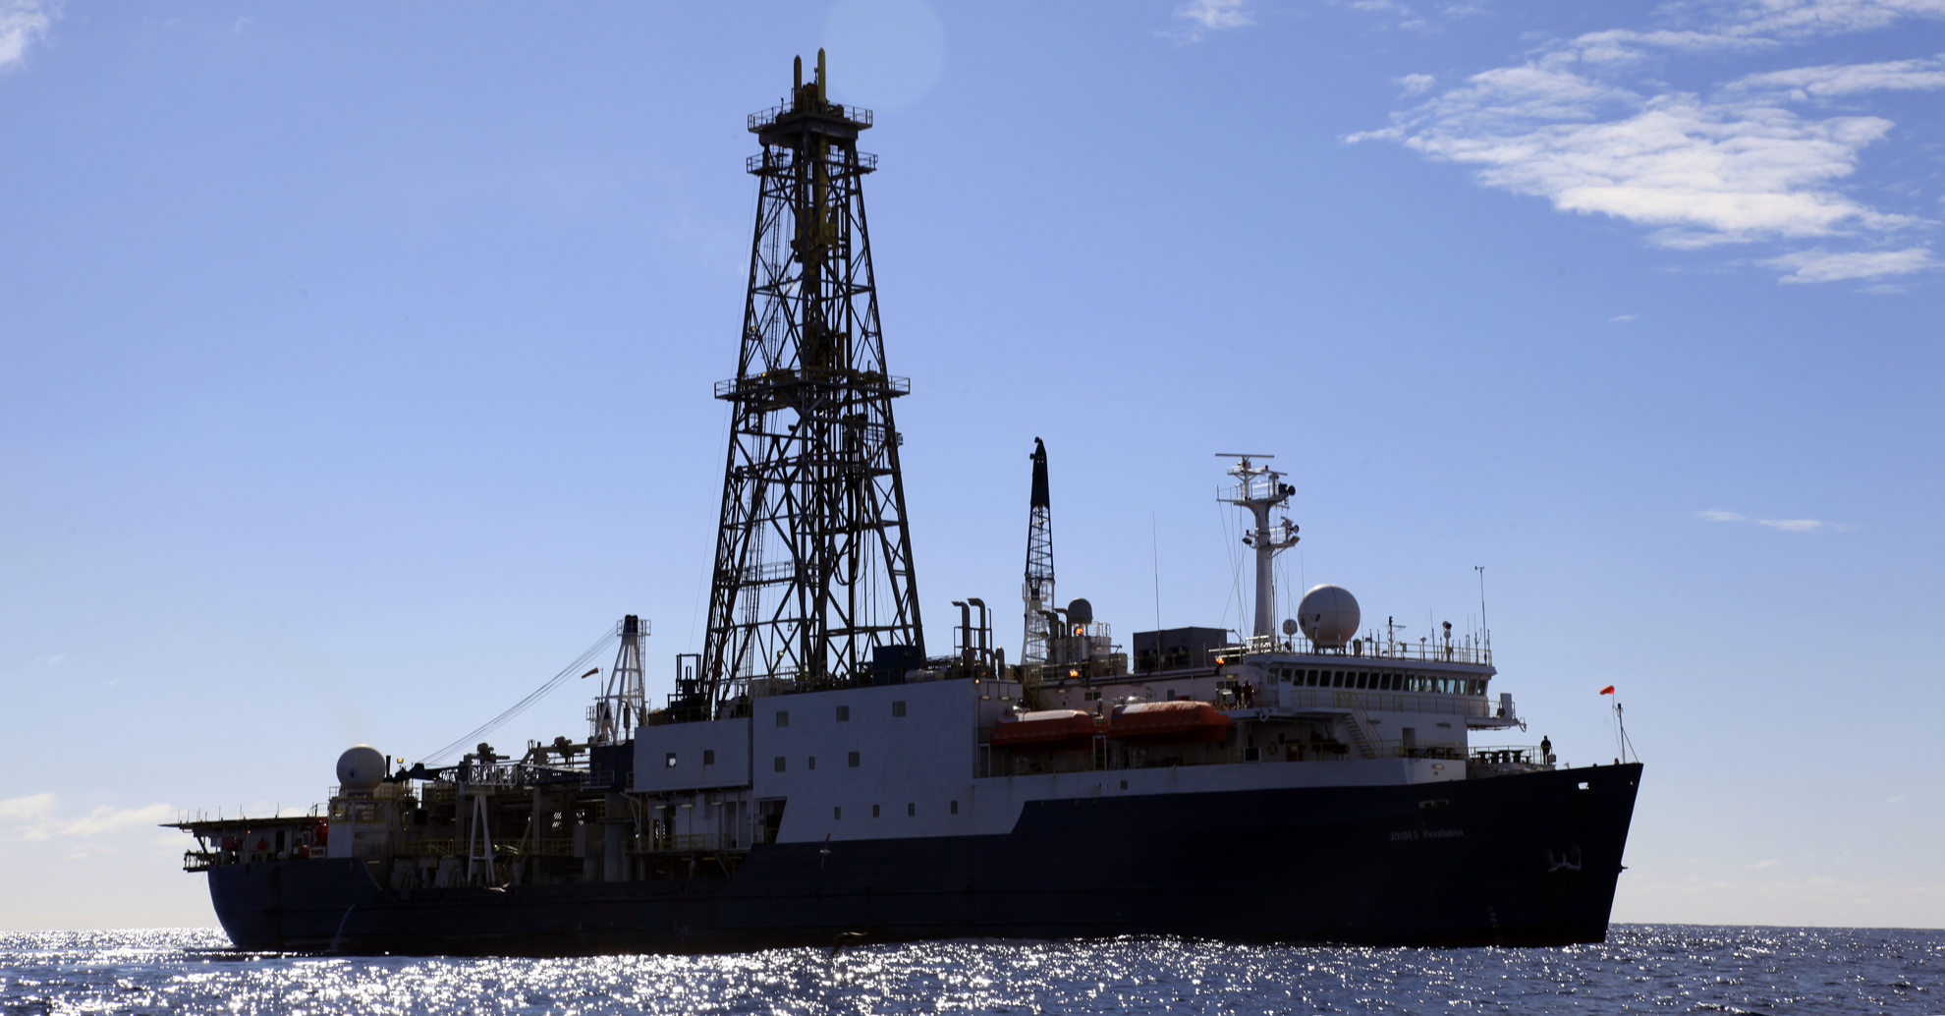
U1357 – Adelie
Basin Report
IODP Exp 318
Wilkes Land

Slide 16
MD-2601
Figure from J. Etourneau

Slide 17
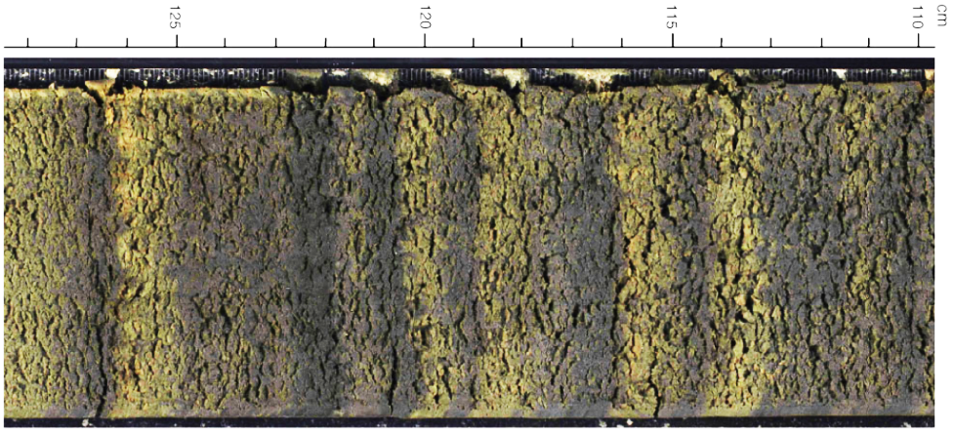
Site U1357 – Adelie Drift, 185 m of Holocene sediment triple cored, Feb, 2010 during IODP Exp 318
5 cm
Entire sequence is laminated at cm-scale.
Laaminations also present at mm-scale.

Slide 18
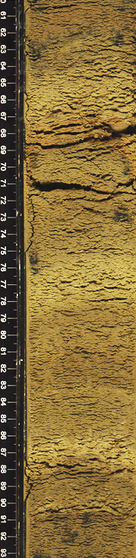
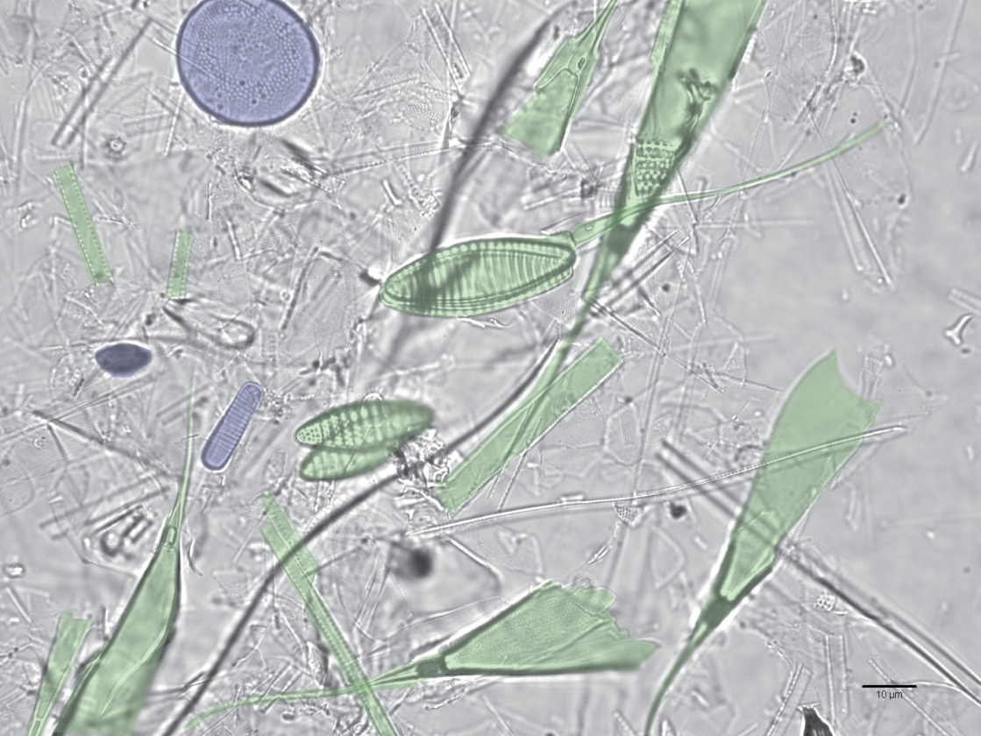
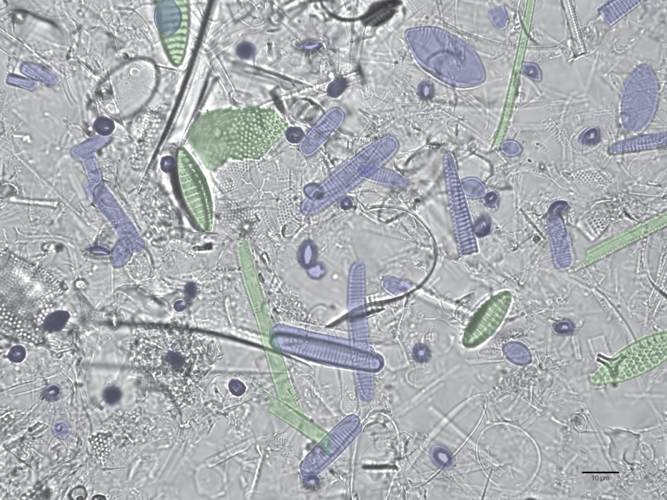
U1357A-15H-7
Light lamina
138.65 mbsf
Green = open ocean spp.
Blue = sea ice spp.
Dark lamina
138.69 mbsf
Notes:
Representative fields of view of a light/dark couplet in Section U1357A-15H-7. (A) Light lamina from 67 cm (138.65 mbsf); (B) Dark lamina from 71 cm (138.69 mbsf). Open ocean species (Crosta et al., 2005) are false colored green and dominate the light lamina (A). Sea ice-associated species (Armand et al., 2005) are false colored blue and dominate the dark lamina (B). Scale bars = 10 μm.

Slide 19
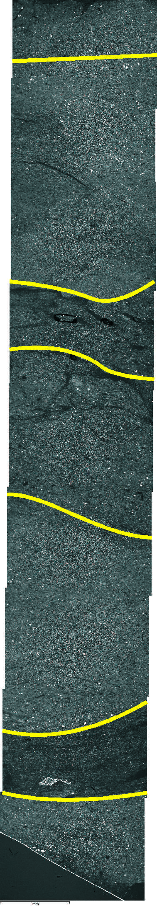
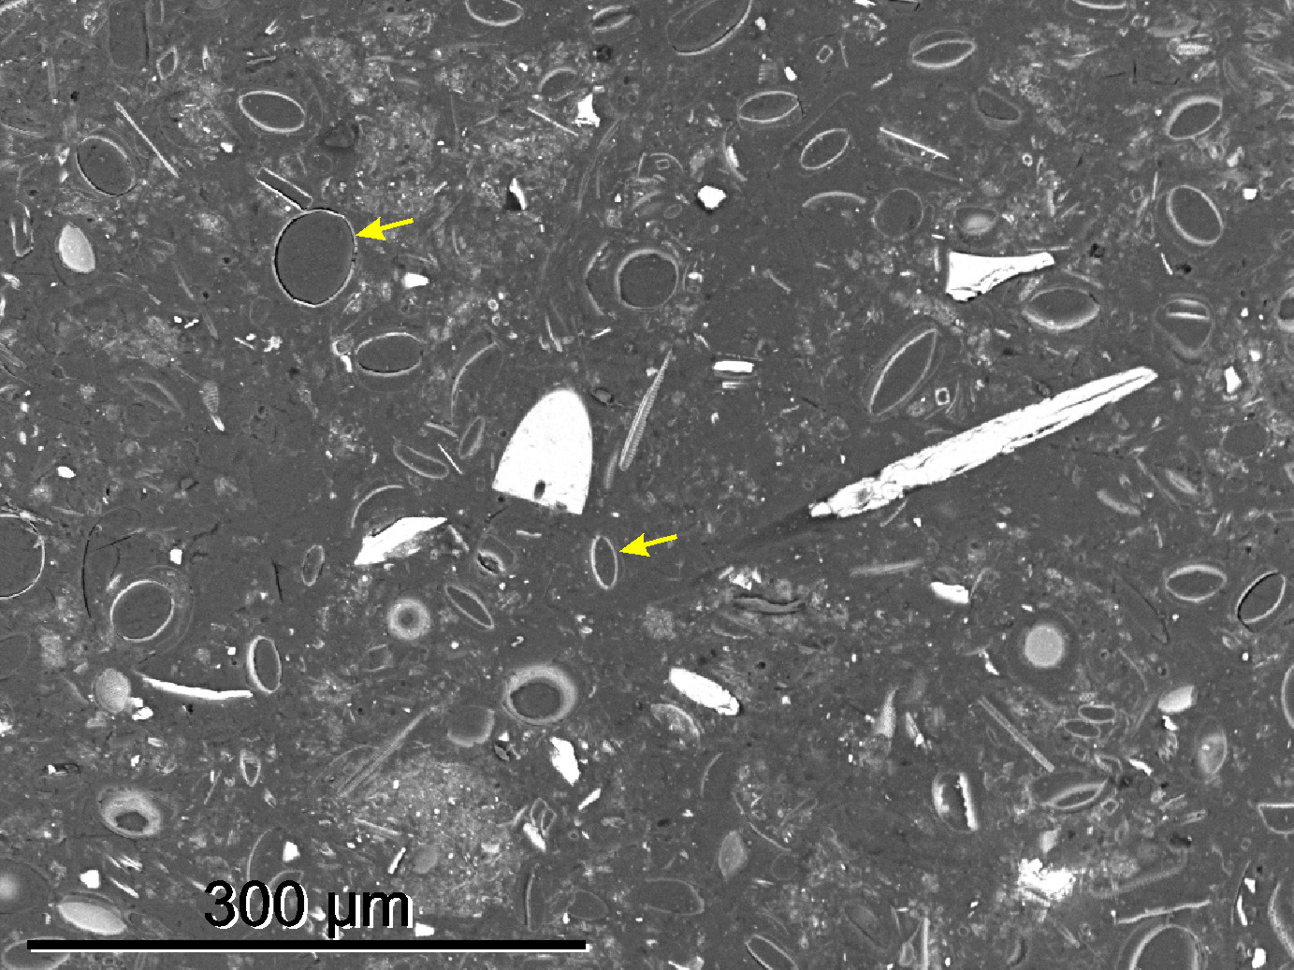
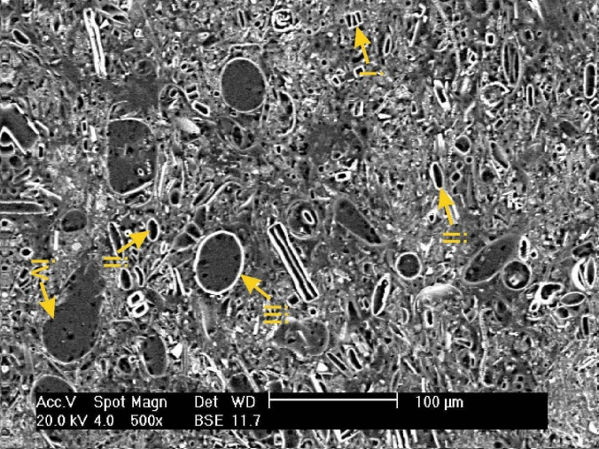
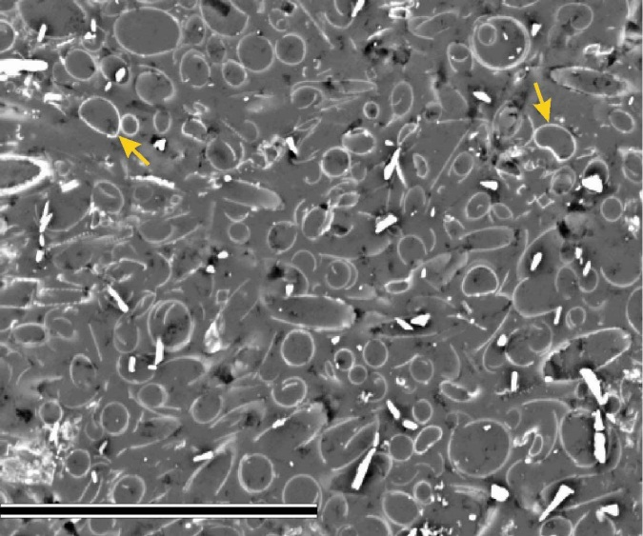
BSEI analysis
“Autumn” assemblage –Porosira glacialis dominate
Mixed summer assemblage:
i) Fragilariopsis spp.
ii) Thalassiosira antarctica
Stellarima microtrias
Corethron pennatum
“Spring/summer” assemblage – Rhizosolenia spp. dominate
1cm
Gregory, Pike et al.
See poster on Wed!
300 µm
Notes:
Left image: Photomontage of a thin section taken at 20X magnification using back scattered electron imagery (BSEI). Yellow lines indicate boundaries between different sub-laminae.
Right images: High magnification BSEI images showing different sub-laminae types. Although Rhizosolenia may not be a genus typically associated with early spring conditions, my counts on these lamination types from MD material shows they’re actually dominated by cryophilic Fragilariopsis spp., with Rhz. being visually obvious due to their size.
This sequence is not necessarily “typical”, I have just selected a section with (hopefully) more obviously different sub-lamina types to highlight variations.

Slide 20
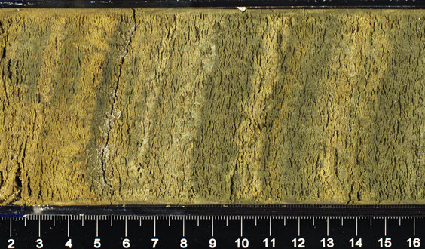
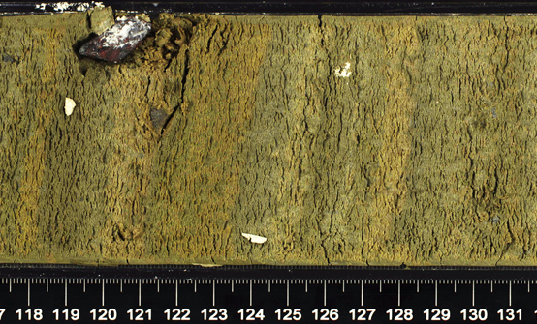
U1357B-19H-4A
82 light/dark couplets in 143 cm
1.7 cm/band, close to the long-term sed rate of 1.6 cm/yr

Slide 21
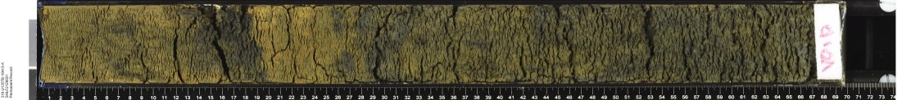
U1357B-18H-5
Cal ¹⁴C age = 11,125 yrs B.P.
U1357B-18H-6
U1357B-18H-7
Cal. AMS age = 410 years
# laminae pairs = ~310
U1357B-19H-1
U1357B-19H-2
U1357B-19H-3
Cal ¹⁴C age = 11,535 yrs B.P.
U1357B-19H-4
U1357B-19H-5
Cal ¹⁴C age = 36,620 yrs B.P.

Slide 22
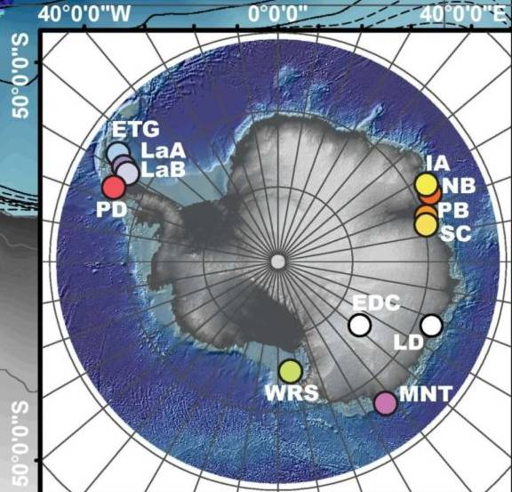
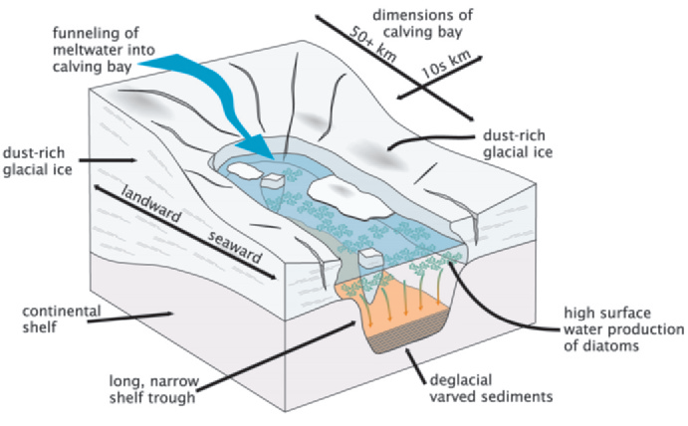
Calving bays in East Antarctica?
U1357
Leventer et al., 2006
From Mackintosh et al. 2011

Slide 23
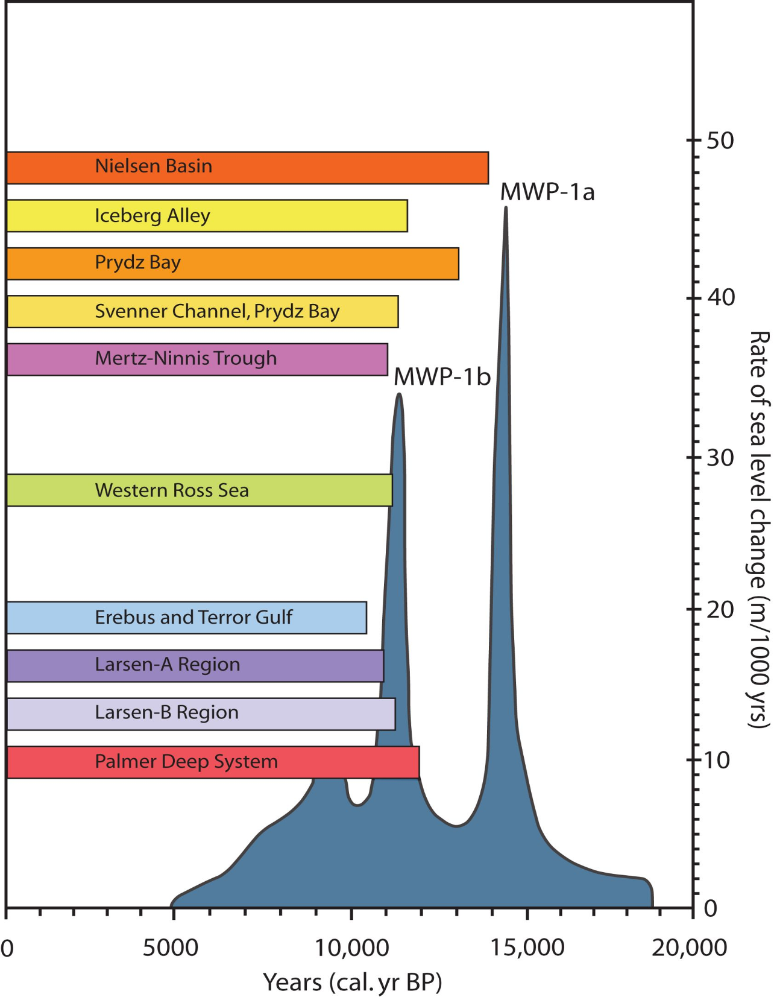
No response
U1357A&B
Initial retreat
Widespread
retreat
Present ice margin reached
Onset of marine sedimentation
(multiple ¹⁴C ages)
From Mackintosh et al. 2011

Slide 24
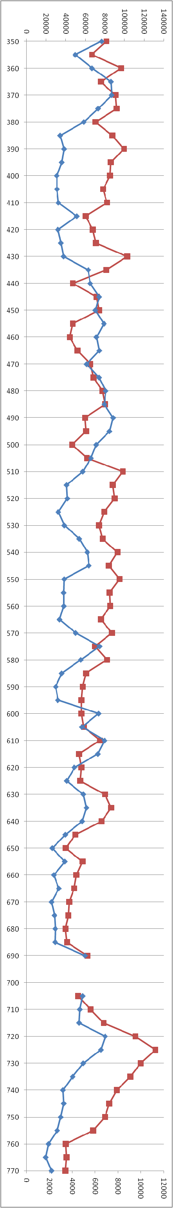
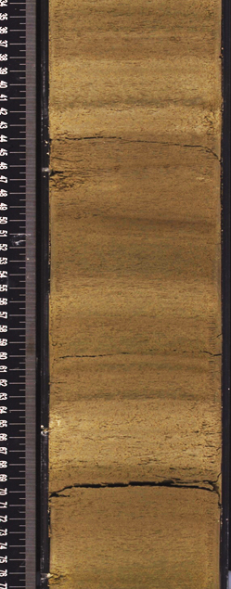
Jimenez et al.
In general:
Color bands correspond to chemical composition
Dark: high detrital
Light: low detrital
1357B 18H 6A
Red: Calcium
Blue: Aluminum

Slide 25
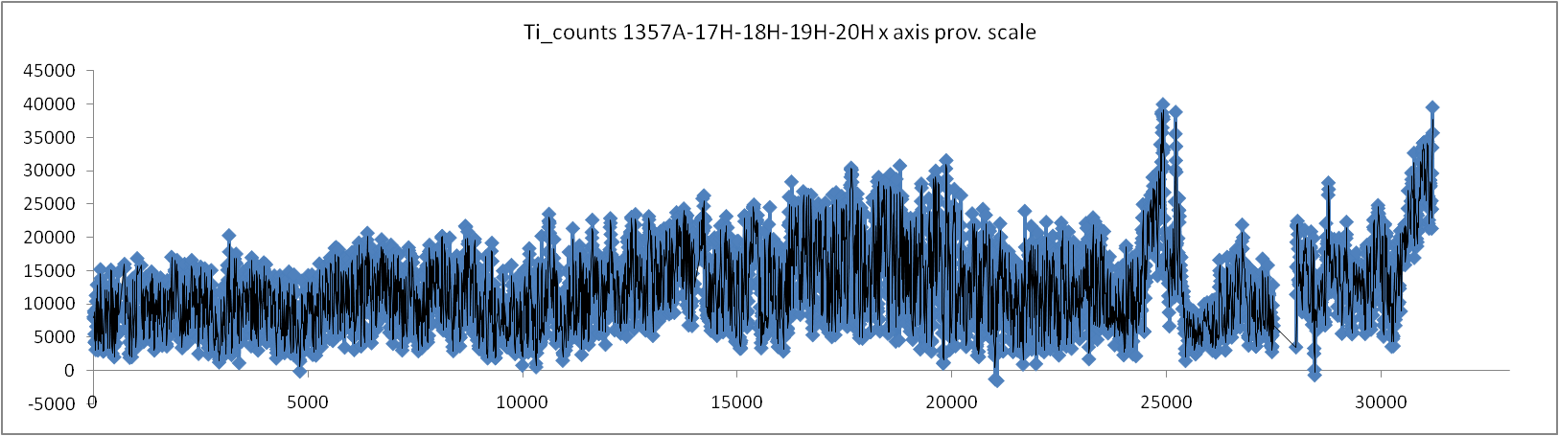
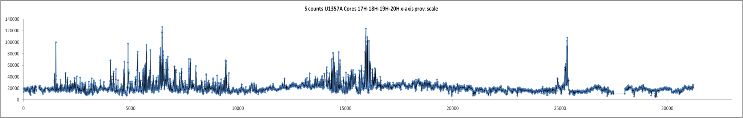
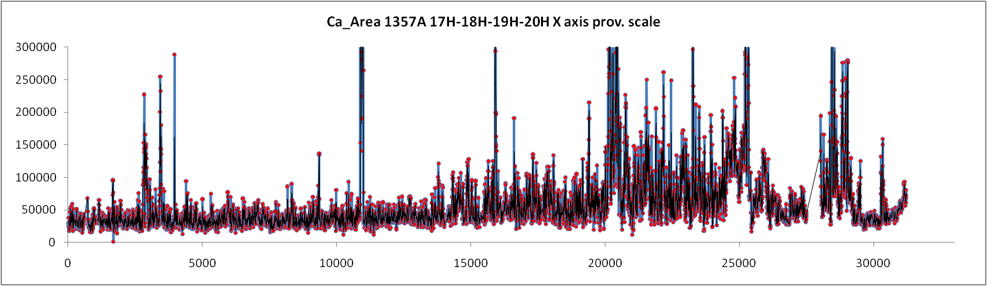
U1357A
Jimenez et al.
150.3 to 184.5 m: ~9,000 to ~11,600 yrs B.P.
Ti
S
Ca

Slide 26
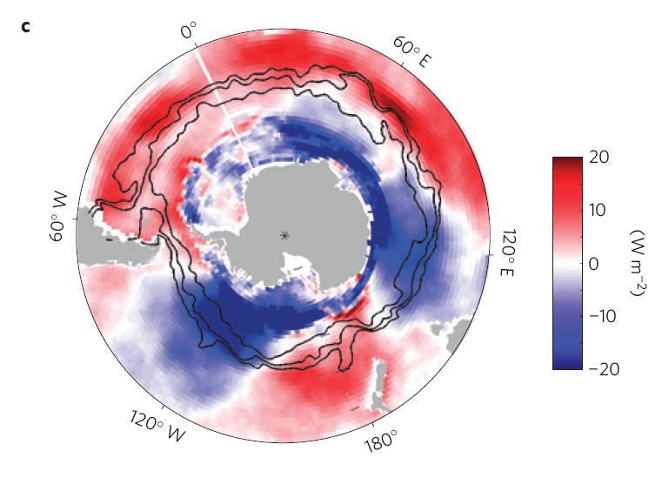
Should we expect heterogeneous responses around the margin?
Depends on the
timescale.
Sum of Ekman and air–sea heat fluxes regressed onto the SAM. Positive values refer to the ocean gaining heat. (From Sallee et al., 2010))

Slide 27
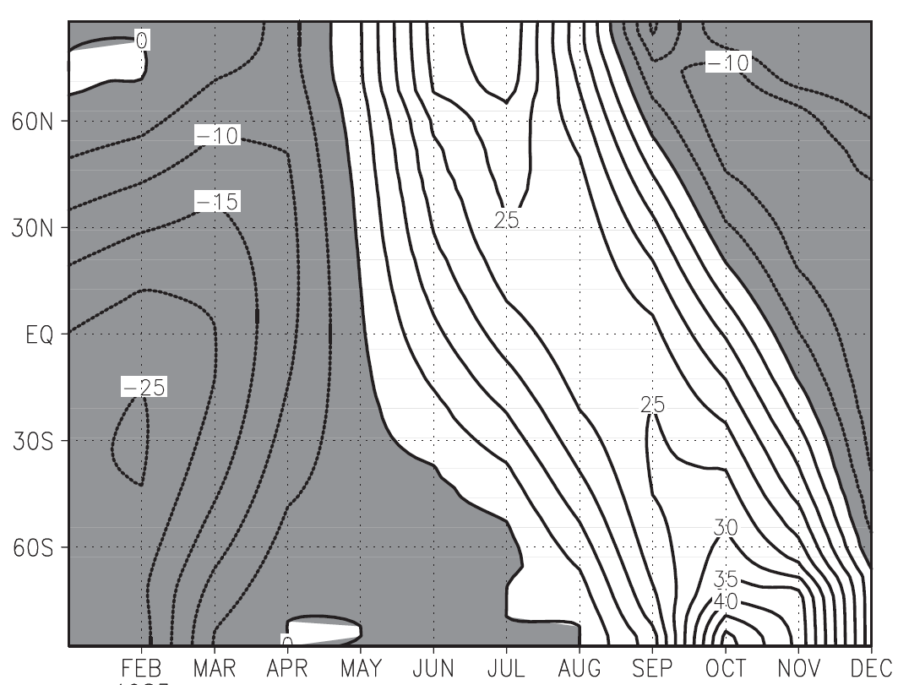
Top of the atmosphere solar insolation (in watts/m²), 6kyr B.P. relative to modern (from Chiang et al., 2009)

Slide 28
Community Climate System Model, version 3.0 (CCSM3)
Holocene Paleoclimate Experiment – Coupled model forced with insolation only.
Extracted 100 years of output (SLP, surface T, Zonal Wind) at modern, 2kyr, 4kyr, and 6kyr to examine impacts on following three regions:
1) Adelie: 56°S to 66°S and 120°E to 165°E
2) Mac.Robertson: 57°S to 67°S and 45°E to 90°E
3) Palmer: 56°S to 66°S and 60°W to 90°W

Slide 29
 | SLP Adelie |  | SLP Mac.Robert |  | SLP Palmer
 | mb | stdev | mb | stdev | mb | stdev
0kyr | 980.5 | 6.3 | 981.3 | 5.6 | 985.5 | 6.0
2kyr | 980.4 | 6.1 | 981.2 | 5.3 | 984.8 | 5.9
4kyr | 980.3 | 6.0 | 981.2 | 5.1 | 984.9 | 6.1
6kyr | 980.9 | 5.9 | 981.4 | 5.4 | 985.4 | 5.8
Δ (6Kyr-0kyr) | 0.4 |  | 0.1 |  | -0.1
 | SST Adelie |  | SST Mac.Robert |  | SST Palmer
 | °C | stdev | °C | stdev | °C | stdev
0kyr | -4.5 | 4.0 | -6.8 | 5.2 | -2.9 | 4.1
2kyr | -6.0 | 4.5 | -8.1 | 5.8 | -0.5 | 3.0
4kyr | -5.8 | 4.4 | -8.1 | 5.8 | -0.4 | 3.0
6kyr | -4.6 | 4.0 | -6.9 | 5.2 | 0.6 | 2.6
Δ (6Kyr-0kyr) | -0.1 |  | -0.1 |  | 3.6
 | Zonal Wind Adelie |  | Zonal Wind Mac.Robert |  | Zonal Wind Palmer
 | m/s | stdev | m/s | stdev | m/s | stdev
0kyr | -0.50 | 2.46 | -0.04 | 2.47 | 3.56 | 2.87
2kyr | -0.42 | 2.41 | 0.07 | 2.48 | 3.90 | 2.86
4kyr | -0.42 | 2.40 | -0.01 | 2.44 | 3.77 | 2.89
6kyr | -0.47 | 2.37 | -0.20 | 2.37 | 3.68 | 2.81
Δ (6Kyr-0kyr) | 0.0 |  | -0.2 |  | 0.1

Slide 30
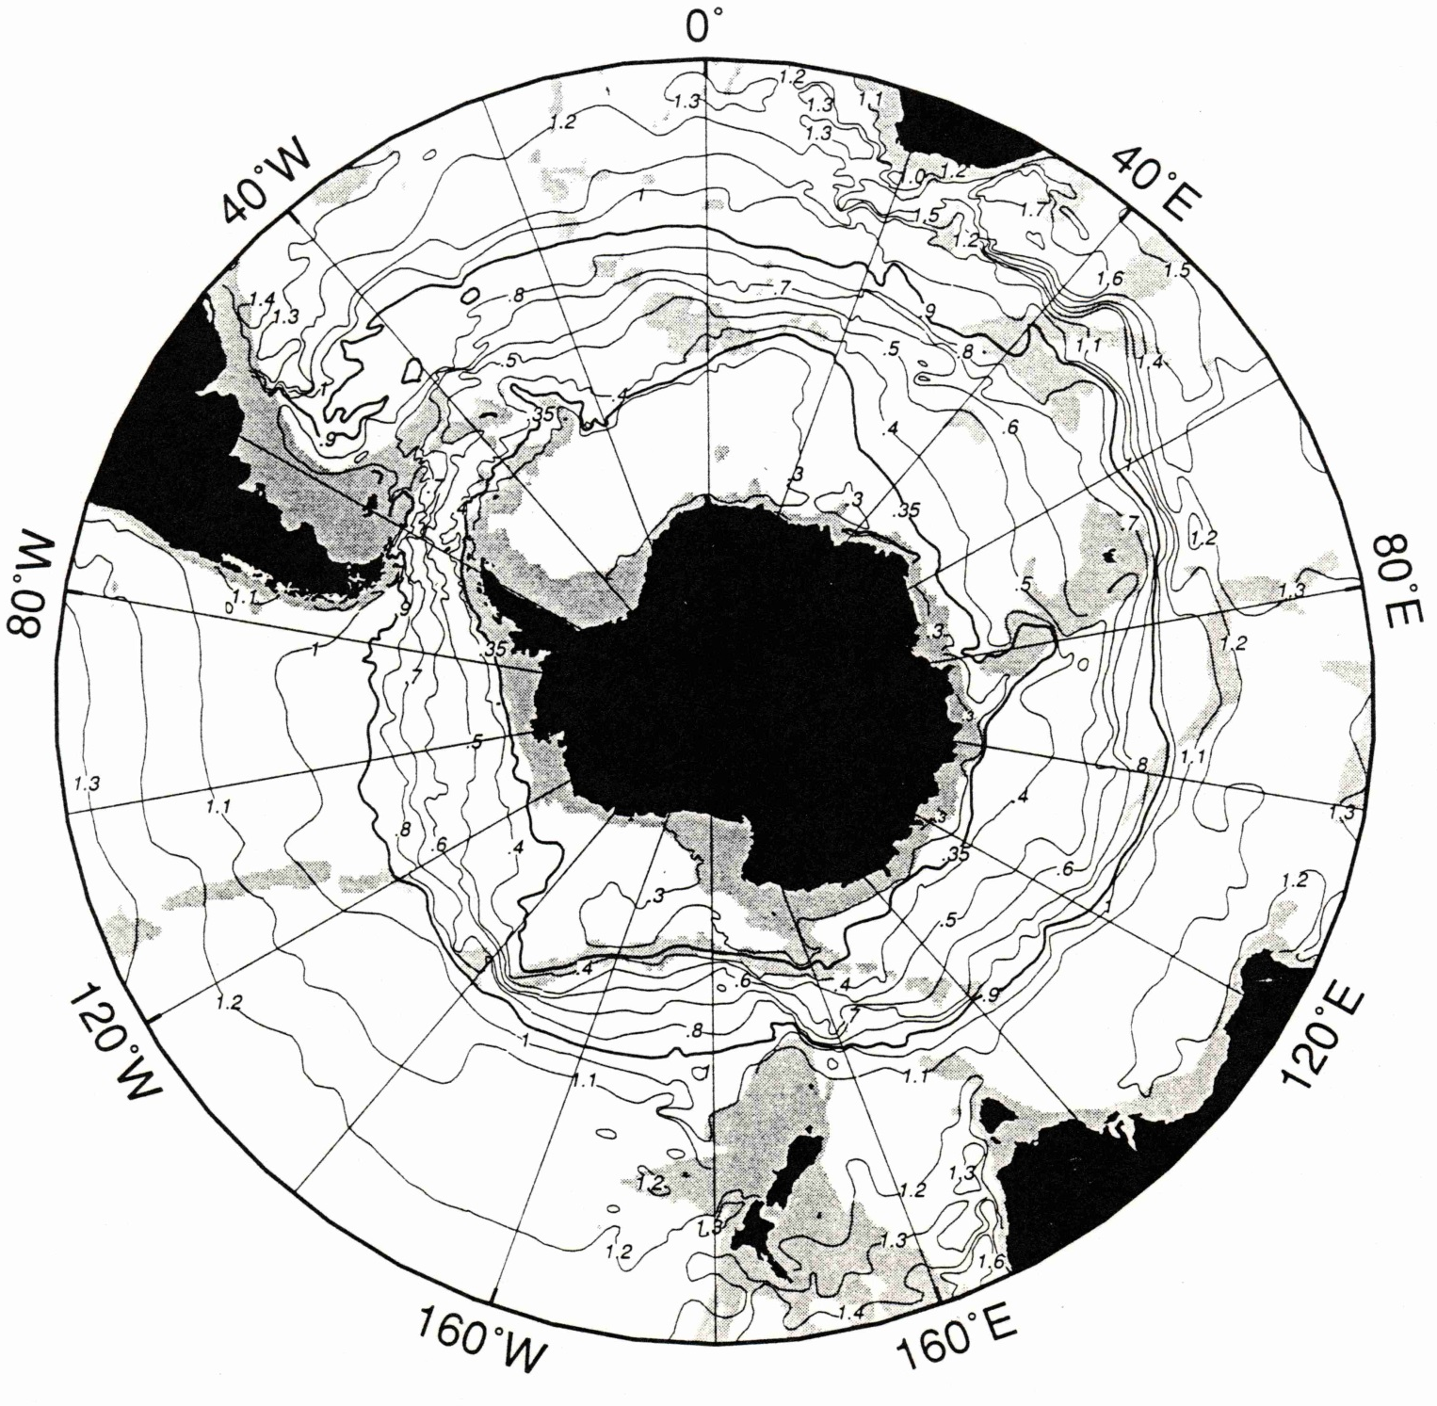
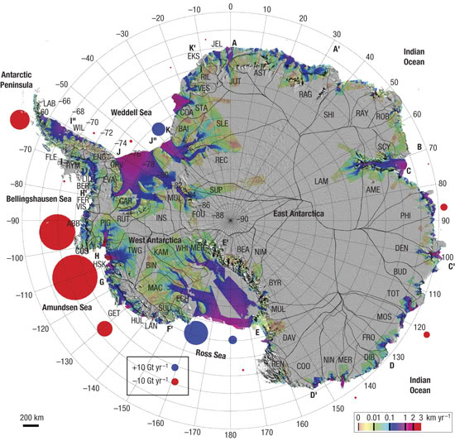
Where is Antarctic Ice melting today?
10 gigatons per year
Africa
Antarctic Circumpolar Current
South
America
Melt rates from Rignot et al., 2008
Antarctica
Australia
ACC from Orsi et al., DSR, 1995
Rignot
Rignot et al., 2008
Figure assembled by Doug Martinson
Notes:
Doug Martinson; Lamont-Doherty Earth Observatory, Columbia University
30
Last Revision: 4/17/2013 9:28:53 AM
ACC circulates UCDW around the continent. This is the water mass that has been identified as a major (if not primary) reason of the accelerated glacial melt in the Amundsen Sea Embayment, draining the WAIS most rapidly.
Reason UCDW is effective in melting glacier ice in the melt regions is those are the locations where the ACC delivers the warm water close to the coast.

Slide 31
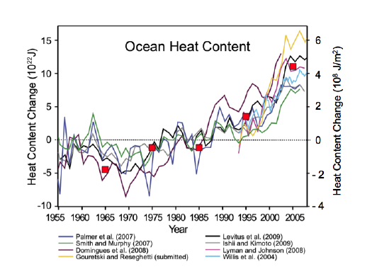
Deep Ocean Heat Content
and ACC response
= “LTER-grid” heat contents (from Martinson)
Notes:
Red squares show increase of UCDW heat content of upper water column (that available to continental shelf) in the LTER grid (downstream of the ASE). Defining the water mass and its history of warming is one of the great results of our previous ship use.
Several reasons can be responsible for this long term exponential rise in heat content. But, a huge fraction of the heat that originally went into the atmosphere as global warming has ended up in the ocean. 8 independent studies here show that this has led to exponential warming of global deep waters.
All ocean basins have some south bound current that must deliver this warm water to the ACC, and from there it will get to Western Antarctica.

Slide 32
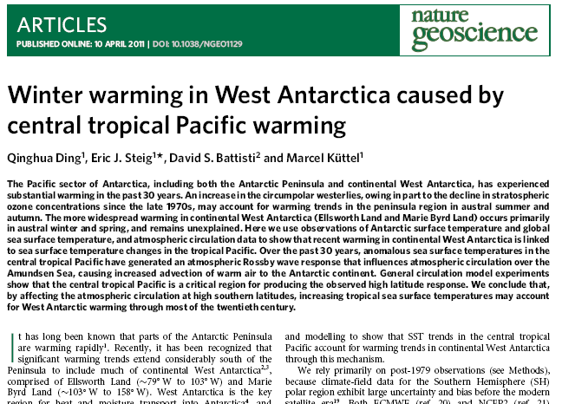
Ding et al., 2011

Slide 33
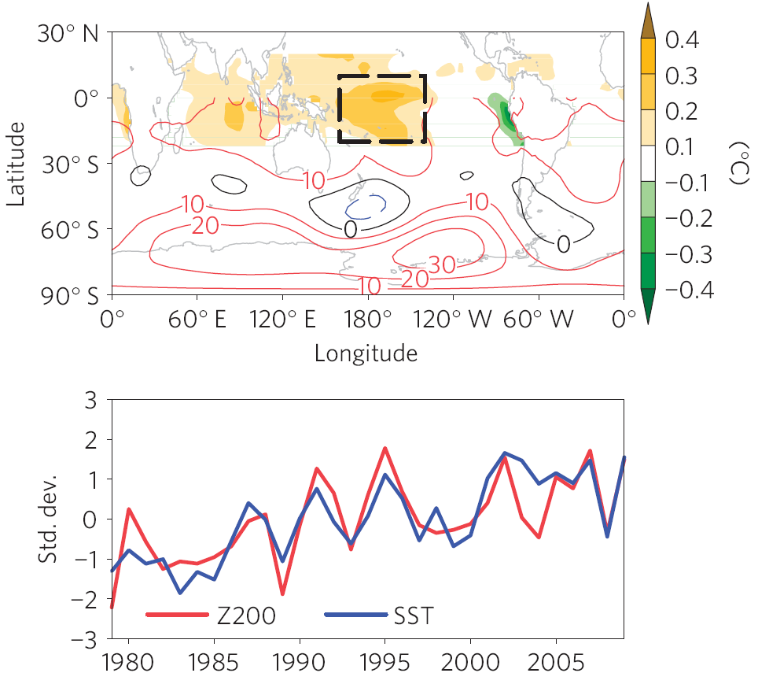
Ding et al., 2011
Z200 = S. Hem. 200 hPa geopotential height
Central Tropical Pacific SST

Slide 34
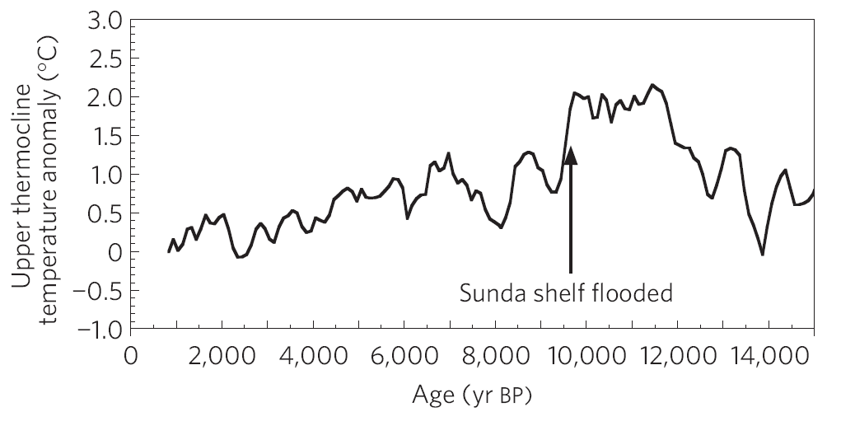
Figure from Linsley et al., 2010
Foram δ¹⁸O and Mg/Ca records from WPWP region suggest strong early Holocene warming of central and western Pacific – up to 2°C. Is this part of the amplifier that produces 6°C and greater heat anomalies on the Antarctic margin?

Slide 35
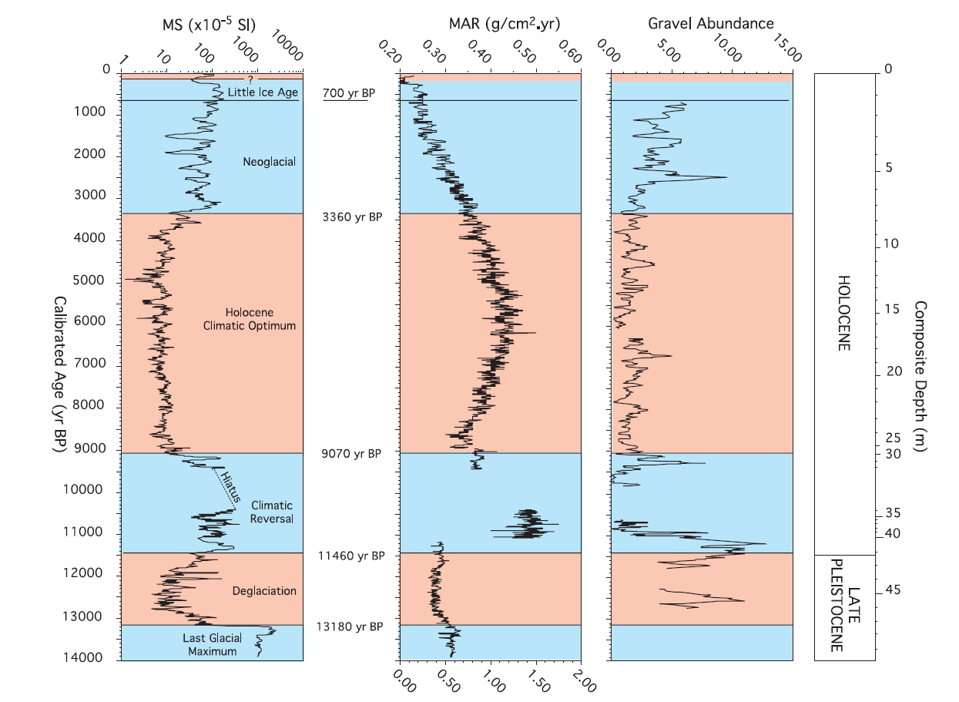
Palmer Deep (Antarctic Peninsula): Site 1098
Domack et al, 2001, The Holocene

Slide 36
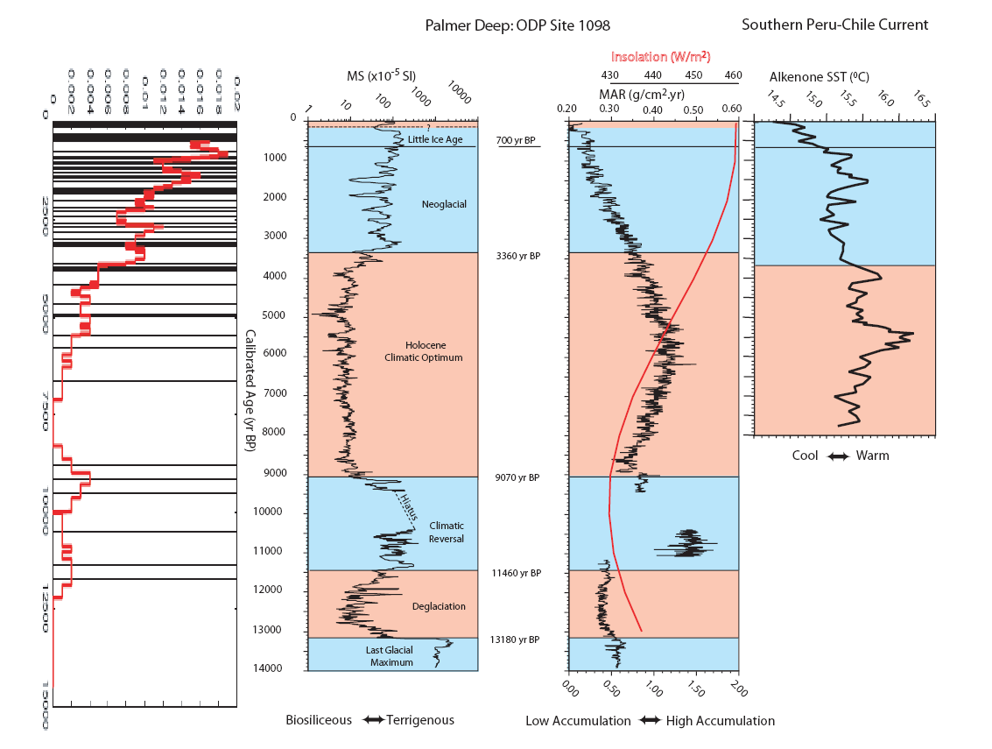
Siple Dome
melt layer frequency
Domack et al., 2001
Lamy, 2005
Das & Domack, AGU, 2005

Slide 37
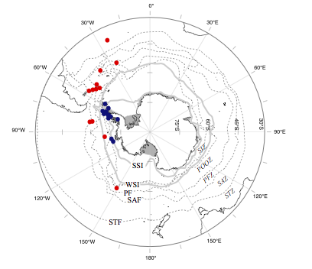
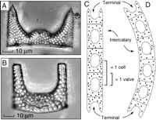
What happens to the “system” in the early mid Holocene?
?? Increased abundance of sub-polar form of Eucampia antarctica
Whitehead et al., 2005
“Sub-polar”
Unanswered Questions:
Where do we see these forms in the modern system?
Underway sampling, Upper ocean biology, sediment traps, moored instruments
Is this caused by overall warming of surface waters or influx of sub-polar water mass?
Upper ocean biology and physical oceanography, other proxies?
“Polar”

Slide 38
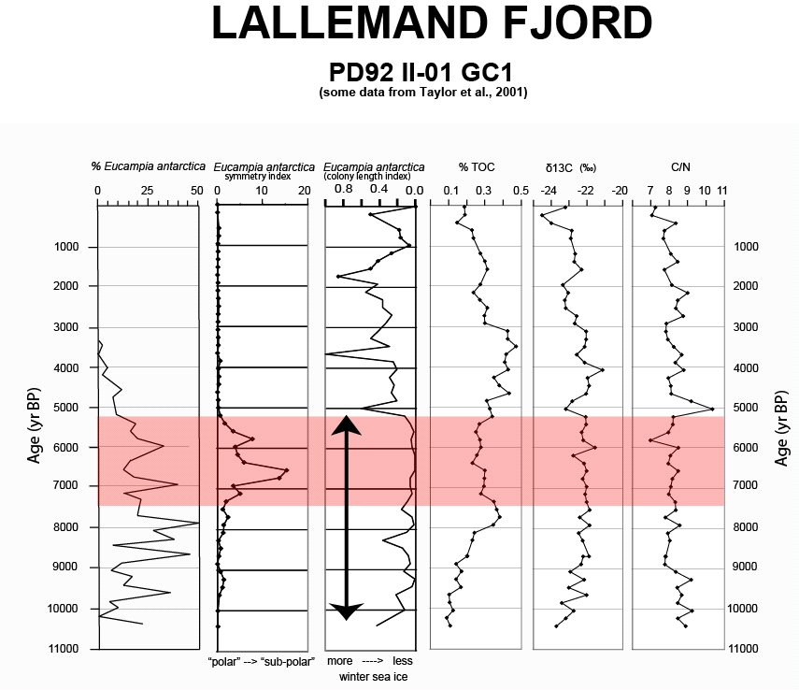

Slide 40
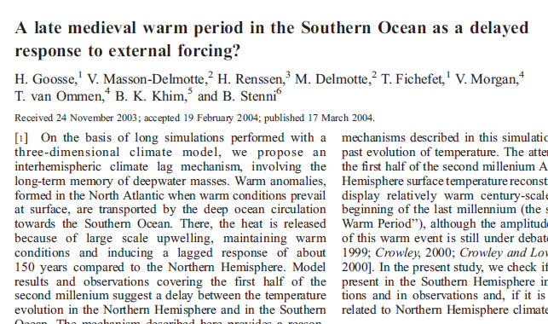
GRL, 2004

Slide 41
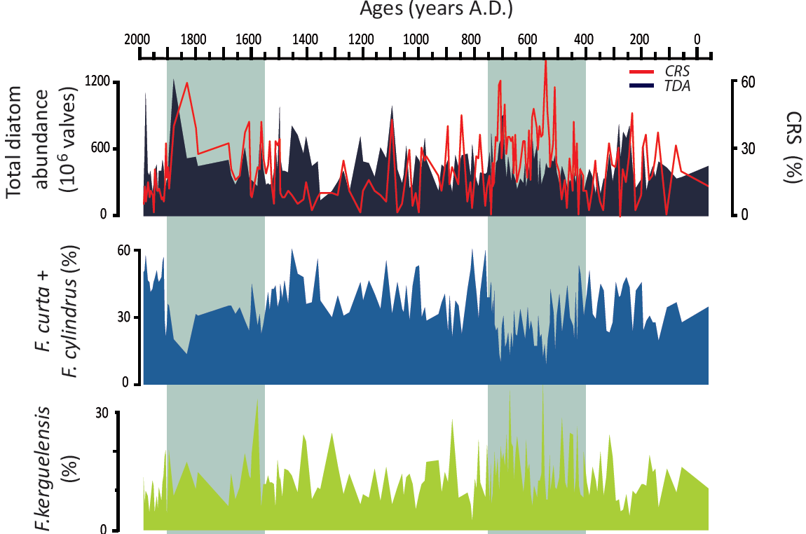

Slide 42
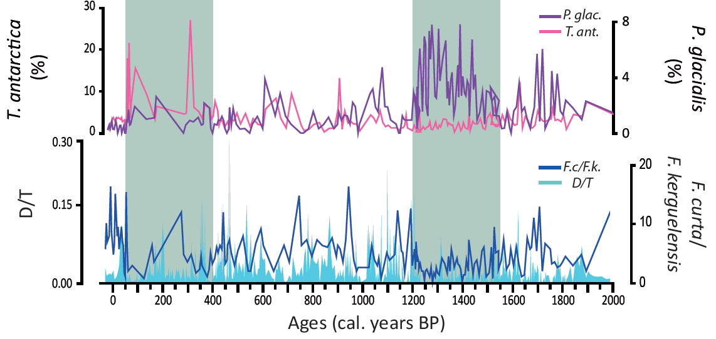

Slide 43
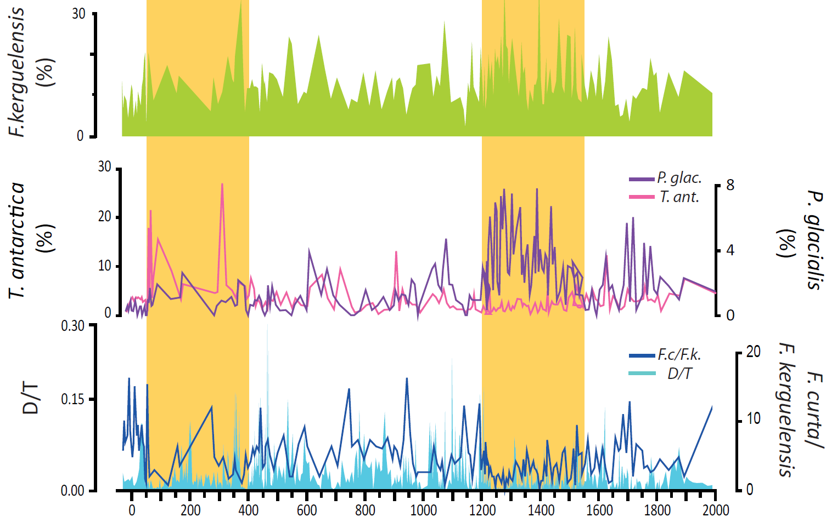

Slide 44
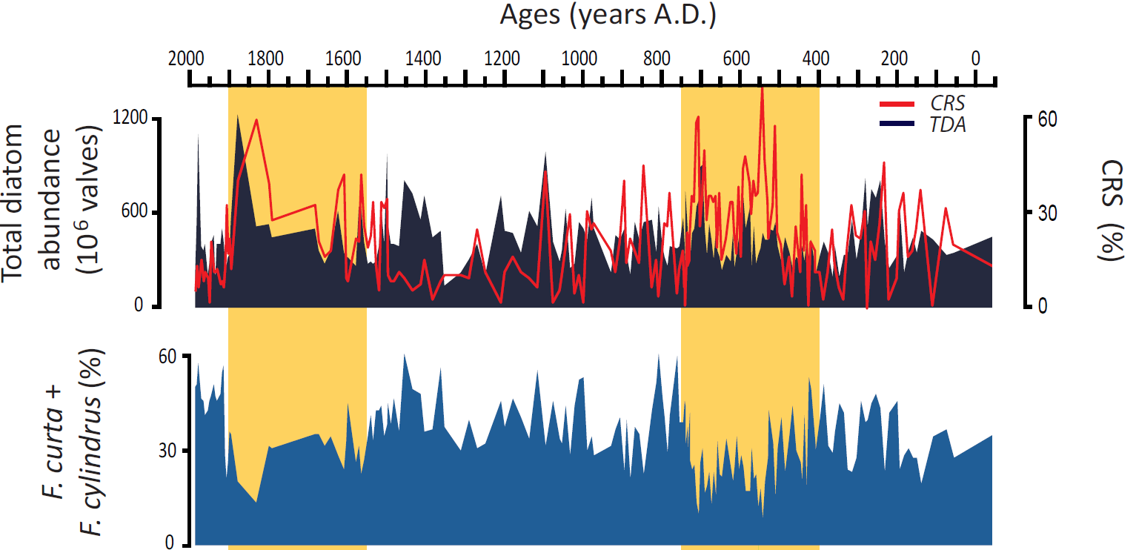

Slide 45

Masson-Delmotte et al., 2011

Slide 46


Slide 47

Masson-Delmotte et al., 2011
EDC
U1357

Slide 48

Modeled origin of moisture arriving at ice core sites
JFM
ASO
Epica Dome C
TALDICE
Vostok
TALDICE, Epica Dome C (EDC), and Vostok show similar moisture sources
Masson-Delmotte et al., 2011

Slide 49

Masson-Delmotte et al., 2011

Slide 50

Signals common to 5 Holocene Antarctic Ice Cores – 1st two PC’s
Masson-Delmotte et al., 2011

Slide 51


Signals common to 5 Antarctic Ice cores (EDC, DF, VK, DML, TALD)
Mode 1 (78% of variance)
1º/oo “optimum” 11.5 to 10 kyr BP
minimum at 8 kyr BP
0.4º/oo “optimum” at 4 kyr BP
Mode 2 (18% of variance)
long term decrease 12 to 2 kyr BP
Masson-Delmotte et al., 2011

Slide 52

Masson et al., 2000

Slide 53

Masson et al., 2000

Slide 54

From Berger, 1978

Slide 55

Simulated maximum positive surface temperature anomaly for early Holocene Thermal Maximum relative to the preindustrial mean from OGMELTICE – Renssen et al., 2012, QSR

Slide 56

at 9 Kyr BP
Renssen et al., 2012

Slide 57

Renssen et al., 2012

Slide 58

Johnson et al., 2011

Slide 59

Gomez et al., 2011

Slide 60

Mohtadi et al., 2011

Slide 61
Number of years in satellite record (November 1978 – December 2008) in which sea ice parameters first occur for a given month.
Month of sea ice first occurrence in satellite record | <80% sea ice concentration | <20% sea ice concentration | >80% sea ice concentration
Doesn’t occur | - | 3 | -
November | 8 | - | -
December | 8 | 4 | -
January | 9 | 11 | -
February | 2 | 10 | -
March | 1 | - | -
April | - | - | 23
May | - | - | 5
At the Adelie Basin Site, Spring variability dominate over Autumn variability
Gregory, 2012

Slide 62




Annual Sequence of Lamination Types
P. glacialis
Ch. dichaeta
F. curta

Slide 63


Slide 64


U1357A-14H-1A 20 – 72 cm
Cielab a* faithfully captures banding at the cm scale

Slide 65

Spring, windy:
Phaeoceros
Chaetoceros
+ Corethron
Spring, icy:
Fragilariopsis
± CRS
Summer, cool
and variable
sea ice:
Fragilariopsis
(esp.
F. kerguelensis)
Spring, less icy
and less windy:
Fragilariopsis
+ Corethron
Autumn, ice growth
(cold spring
and summer):
P. glacialis

Slide 66

P. glacialis laminae:
cold spring and cold summer
Correlation of SAM Index with
satellite-derived sea ice concentration
- strongest correlations with March-April-May sea ice
[Comiso 1999, updated 2008;
Marshall 2003]

Slide 67

IODP U1357
Neoglacial
c. 1.2 ka:
73-yr time-series
ENSO-band
frequencies
in spring and
autumn
- more frequent
during cool,
positive phases
of SAM

Slide 68


Slide 69


Slide 70

AAO regression slope of surface T: Model results of
van den Broeke et al., 2004
A stronger circumpolar vortex (high AAO index) induces significant cooling over most of East Antarctica, and significant warming over the entire AP

Slide 71


There is a strong seasonal component to the AAO-surface T relationship
DJF
MAM
van den Broeke et al., 2004

Slide 72

East Antarctica (esp. Wilkes Land) shows cooling at high AAO indices all year whereas the warming signal in the AP is strongest in Mar-Aug.
JJA
SON
van den Broeke et al., 2004

Slide 73


Spatial correlation patterns of tropical SST (shading) and 200 hPa geopotential heights associated with “MCA mode 2”. Warming in the CTP sets up circulation patterns that drive warmer air masses to West Antarctica.
Ding et al., 2011

Slide 74

Ding et al., 2011
Notes:
Relationship between Southern Hemisphere circulation and
West Antarctic climate in austral winter. Figure shows the regression of
austral winter mode 2 Z200 time series from maximum covariance
analysis against independent AVHRR surface temperature (brown and
green shading), sea ice concentration (red and blue shading) and sea level
pressure (contour interval 1 hPa). ‘Amund.’ D Amundsen Sea; ‘Bell.’ D
Bellingshausen Sea.

Slide 75

Upper thermocline T anomaly in the Western Pacific Warm Pool
Peak Heat
11.7 to 9.7 kyr BP
Linsley et al, 2010
Notes:
MD78 (near
Sumba Indonesia) Pulleniatina obliquiloculata Mg/Ca upper thermocline
temperatures (80–120 m).

Slide 76








δ¹⁸O for Holocene portion of 6 ice cores used in Masson-Delmotte, 2011, COTP
-48
Epica Dome C
-52
Vostok
-56
-40
EPICA Dronning Maud Land
-58
-44
-34
TALDICE
-48
-38
Dome Fuji
-36
-50
-40
-54
Taylor Dome
-44
-58
Years BP
Years BP

Slide 77

James Bendle, U. Glasgow

Slide 78

James Bendle, U. Glasgow

Slide 79
Signals common to 5 Antarctic Ice cores (EDC, DF, VK, DML, TALD)
Mode 1 (78% of variance)
1º/oo “optimum” 11.5 to 10 kyr BP
minimum at 8 kyr BP
0.4º/oo “optimum” at 4 kyr BP
Mode 2 (18% of variance)
long term decrease 12 to 2 kyr BP
Masson-Delmotte et al., 2011

Slide 80


PC (δ¹⁸O º/oo)
Masson-Delmotte et al., 2011
James Bendle, U. Glasgow

Slide 81


Slide 82


Slide 83

PC (δ¹⁸O º/oo)
Masson-Delmotte et al., 2011

Slide 84


Slide 85


Slide 86


Slide 87

Site 1357 Chronology
144 AMS ¹⁴C dates:
Bulk TOC – AO
Bulk TOC- ABA
Carbonates
Fatty Acid (CS)
³²Si – 5 dates
Secular Pmag

Slide 88

Higher order polynomial gives best fit to AMS dates as well as to secular paleomag inclination curve
U1357B
Bulk TOC AMS ¹⁴C dates – corrected for SO reservoir ages plus a small detrital “dead”
C offset.
Meters below seafloor (CSF-B)

Slide 89

U1357A
AMS ¹⁴C dates – corrected for SO reservoir ages plus a small detrital “dead”
C offset as determined by ¹⁴C age offsets between carbonates and AO and ABA treated TOC

Slide 90

U1357B

Slide 91

U1357B

Slide 92

U1357B

Slide 93

U1357B

Slide 94

U1357B

Slide 95

U1357B

Slide 96

U1357B

Slide 97

51 Ba cycles over 50 calendar years based on ¹⁴C
10
40
50
20
30
U1357B

Slide 98

32 Ba cycles over 30 calendar years based on 14C
5
15
20
25
10
30
1
U1357B

Slide 99

U1357A

Slide 100

U1357A

Slide 101

U1357A

Slide 102

Power Spectra of U1357A wt. % Opal (Using Redfit)
Variance observed 0-6 kyr B.P.
900 y
500 y
215 y
385 y

Slide 103

Holocene Opal MAR range in Palmer Deep
U1357A

Slide 104
U1357B

Slide 105

LIA
MWP
DACP
RWP
LIA: Little Ice Age
MWP: Medieval Warm Period
DACP: Dark Ages Cold Period
RWP: Roman Warm Period
Periods range from Yang et al., 2011 Nat. Geosciences

Slide 106

Little Ice Age
MWP
LIA: Little Ice Age
MWP: Medieval Warm Period
Periods from Yan et al., 2011 Nat. Geosciences

Slide 107
U1357C Pore Waters
45 pore water samples taken in upper 20 m
Measured: DIC, DIC δ¹³C, Salinity, Particulate Organic Matter (%C %N), Biomass (PLFA), TOC, Sulfate, Cl, Na, Si, B, K, Mg, Ba
5 bulk sed TOC AO ¹⁴C dates in upper 20 m (Hole C). 5 samples analysed for ³²Si age (U. Morgenstern, GNS New Zealand) Good agreement at 12 m (550 years BP).

Slide 108

Cl, Na and isotopic anomaly
Na and Cl measured using two different methods (IC, and ICP)

Slide 109
Possible Explanations?
Lateral mass movement with sediment retaining parent pore water compposition.
Gas hydrate destabilization
Variation in bottom water salinity
    We propose that pore waters in uppermost sections of U1357C faithfully record bottom water composition. Little diagenesis and transport – pore water age = sediment age.
    Implications? At this location LIA appears to have lower production rate of HSSW in the local polynyas compared to the MWP time, e.g. warmer, less windy, less ice.

Slide 110
Wilkes Land
Adelie Land
(a)
75%
100%
(b)
(c)
Glacier
Deep Current
Sea Ice
Climate
Glacier
Deep Current
Sea Ice
Climate
0%
25%
50%
???
Uncertain
Energic bottom current
Cool
E8
More sea ice
E7
% undifferentiated agglutinated spp.
Energic bottom current
More sea ice
Neo-glaical
Planktonic/ benthic ratios
Trochaminna spp.
Textularia spp.
Globocassidulina spp.
Mid- Holocene Climate Optimum
Warm
Fursenkoina spp.
E6
Epistominella spp.
Age (Calendar years BP)
N. Pachyderma
Weak bottom current
More open water
E5
Cooling
Total # of foraminifers
Warm / wet
Weak bottom current
Cold
Total # of Agglutinated spp.
Cooling
10
50
100
0
0.5
1.0
1.5
2.0
2.5
Figure 3. Preliminary foraminiferal assemblage data compared to previous studies from the Wilkes Land/ Adelie Land shelf.
Left three panels show: (a) total number of foraminifers and total number of agglutinated foraminifers; (b) planktonic to benthic ratio; and (C) cumulative percent graph of dominate foraminiferal taxa.
The right panel is the synthesis of glacier movements, deep-water current activity, sea-ice conditions and climatic trends documented in the Adélie and Wilkes Land areas modified from Denis et al. (2009).
Dark shaded areas indicates times of increased lithic inputs and are interpreted as major changes in the glacier–sea ice–ocean system, called E1 to E8 (Denis et al., 2009).

Slide 112


δ¹⁸O (‰)
δ¹⁸O (‰)
Age (Calendar years BP)
Age (Calendar years BP)
δ¹³C (‰)
δ¹³C (‰)
Figure 4. Preliminary carbon and oxygen isotope data planktonic foraminiferal species Neogloboquadrina pachyderma from Hole U1357A. Age is based on C-14 dates.

Slide 113
N. Pachyderma from U1357A
6
δ¹⁸O
δ¹³C
5.5
1
5
4.5
0.5
4
3.5
0
3
5000
5200
5400
5600
5800
6000
Years B.P.
Grey box shows equilibrium Calcite (-0.7 º/oo for N. Pachyderma per Kohfeld et al., 1996) at modern SST’s (0 to -1.6°C) and δ¹⁸O_{SW}.
Century-long excursion at~5100 yr BP requires extremely cold and saline waters – High production of sea ice and HSSW?

Slide 114
S (psu)
Circum
Polar
Deep Water
Precipitation
f
Sea Ice melt/freeze
Wall melt
m
Basal melt

Slide 115
Extreme Cold Anomaly
Observed in Planktic
foram δ¹⁸O

Slide 116

U1357A – Deglacial Interval

