Slide 1
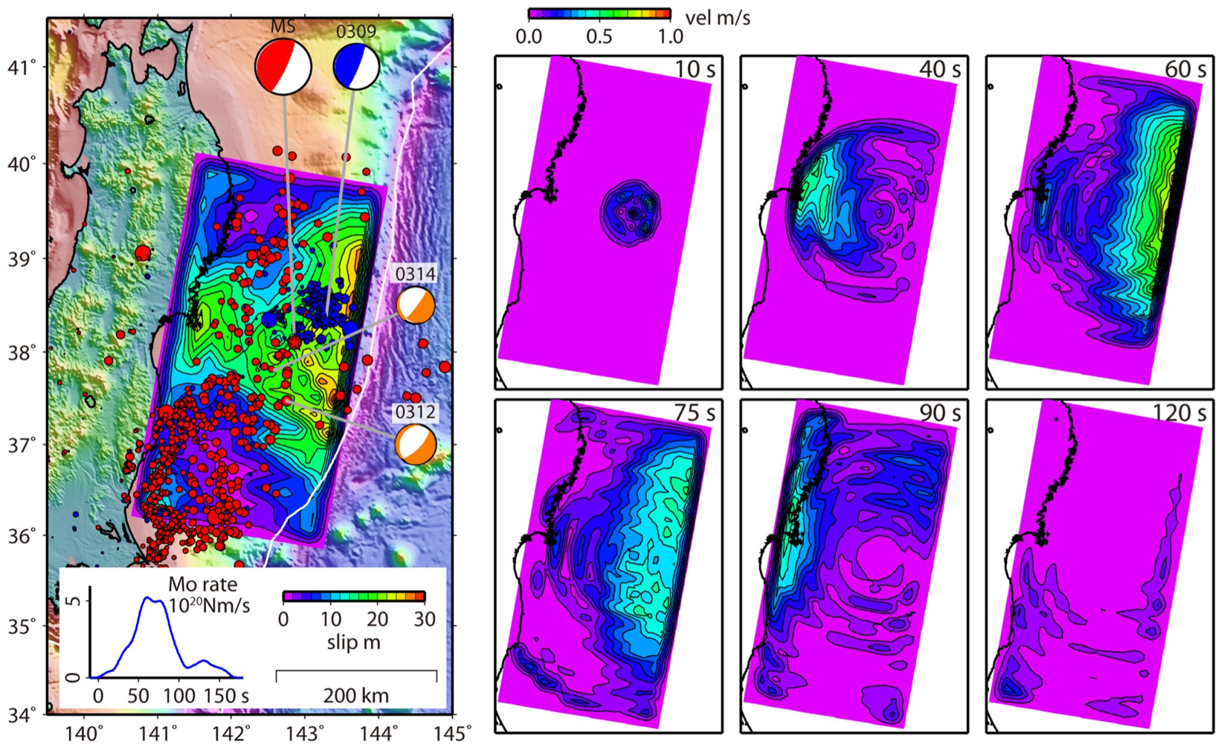
A Mechanism for Extreme Slip and Exceptional Tsunamigenesis in the 2011 Tohoku-oki Earthquake
Greg Beroza,
Annemarie Baltay
Stanford University
Satoshi Ide
University of Tokyo
USGS Earthquake Science Center Seminar
July 6, 2011

Slide 2
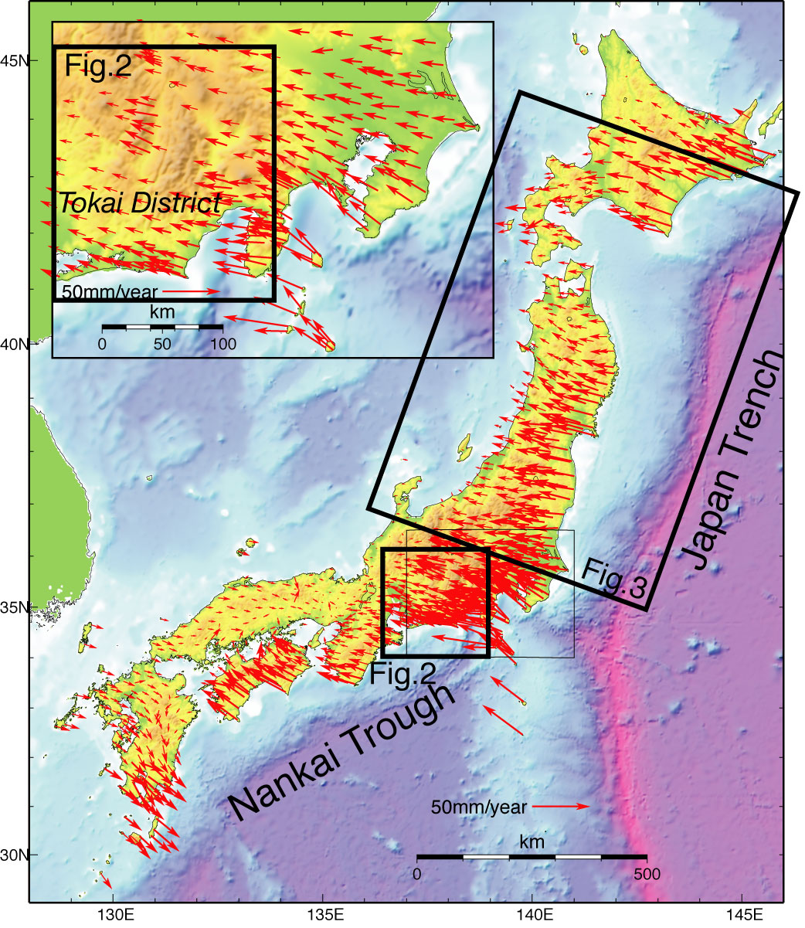
Tectonic Setting
Japan Trench
~83 mm/yr convergence
Old, cold Pacific Plate
Nankai Trough
~43 mm/yr convergence
Hot, young Philippine Sea Plate
Figure of GPS velocity vectors from GSI website

Slide 3
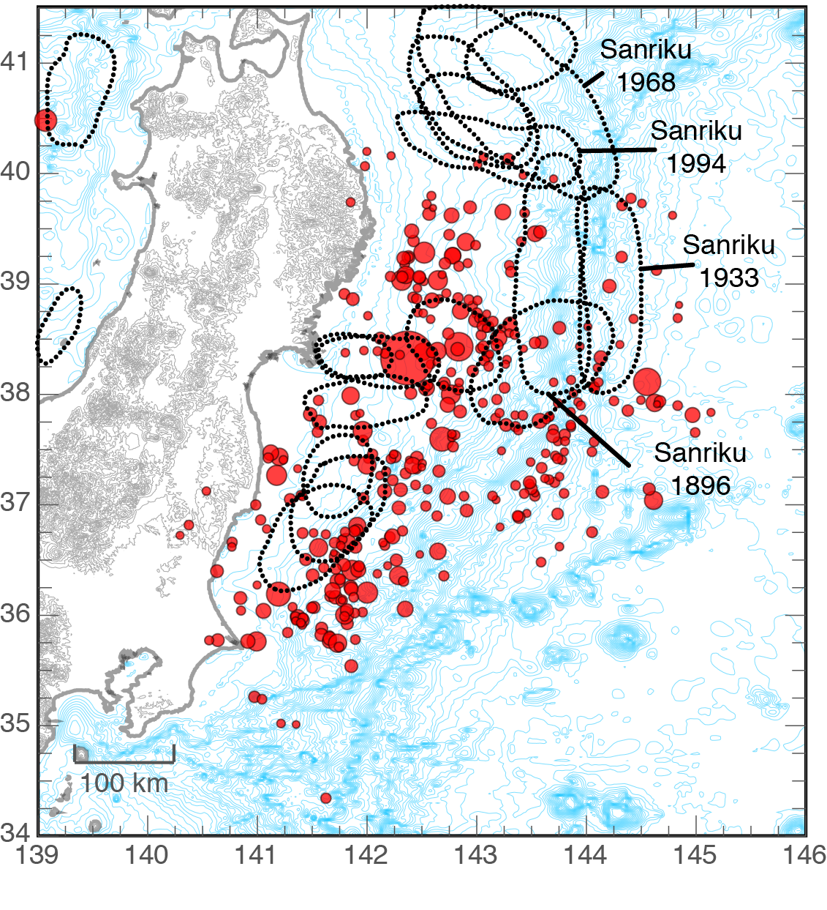
Previous Historical Earthquakes
Large (up to M 8+)
Not gigantic (M 9)
1896 tsunami event
1994 composite event
Image: Chuck Ammon; Rupture outlines: Hiroo Kanamori; Earthquake Locations: USGS

Slide 4
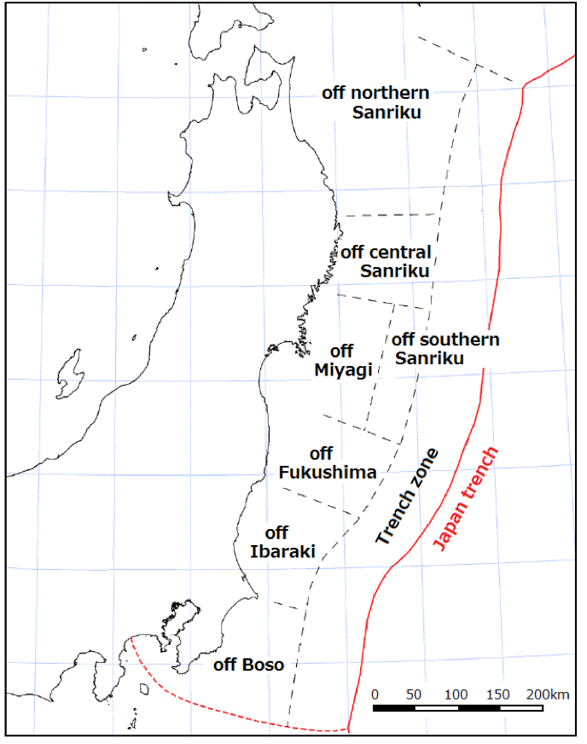
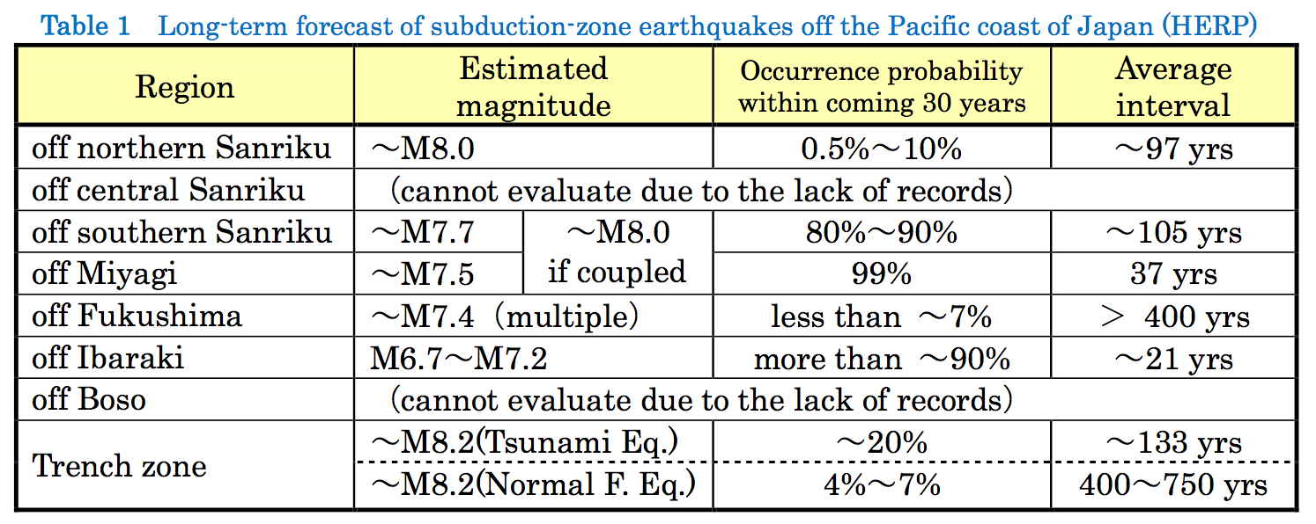
ERC Segmentation Model
Off Miyagi, 6 earthquakes – 1793(M8.2), 1835(M7.3), 1861(M7.4), 1897(M7.4), 1936(M7.4), and 1978(M7.4) – occurred in the past 200 years with an average interval of 37.1 years.
30-year probability of 99% (highest in Japan).
M7.2 earthquake occurred in 2005. Since the M was less than estimated level of M7.5, the “expected” earthquake was not considered to have occurred.
Adapted from Preliminary report of the 2011 off the Pacific coast of Tohoku Earthquake Mar. 25, 2011 Yoshimitsu Okada (President, NIED)

Slide 5
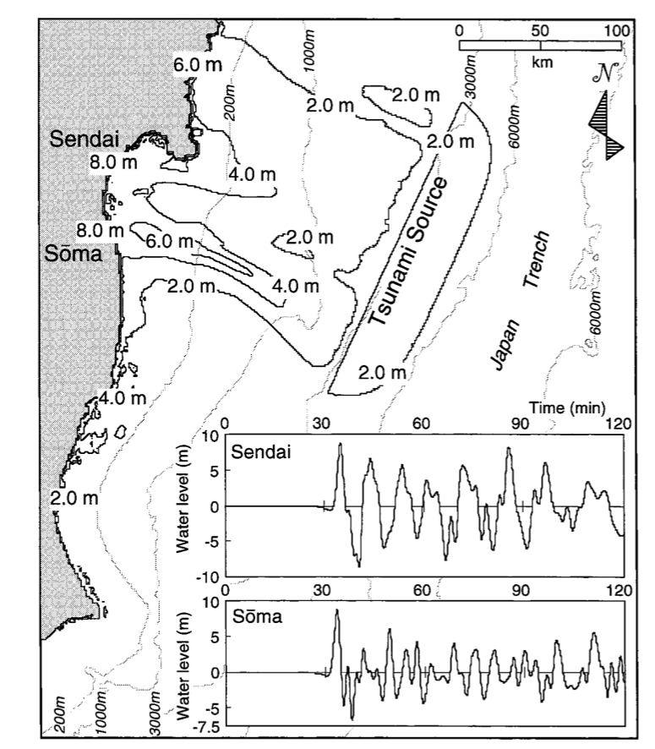
Geologic Evidence for Larger Earthquakes
Last earthquake of this size may have been 869 AD Jogan earthquake. From tsunami modeled as M_{w} 8.3 (Minoura et al., 2001), but could have been larger.
Unclear how extensive tsunami from 1611 Keicho earthquake was.
Also noted deposits from two earlier tsunamis indicating, “…gigantic tsunamis occurred three times during the last 3000 years.”
They wrote, “More than 1100 years have passed since the Jogan tsunami and, given the recurrence interval, the possibility of a large tsunami striking the Sendai Plain is high.”

Slide 6
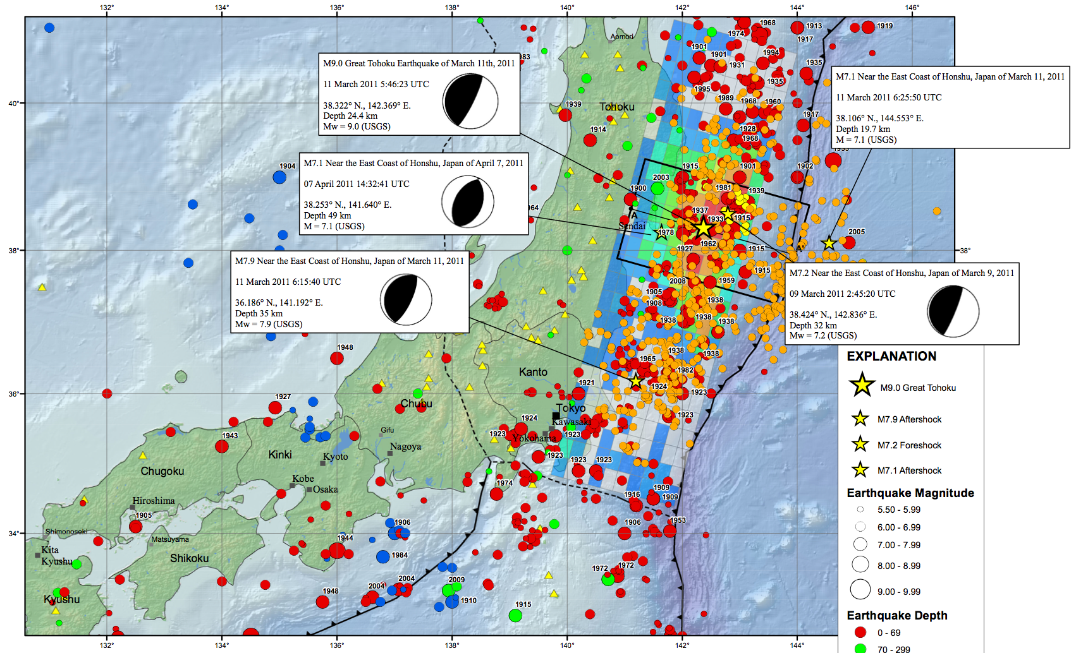

March 11, 2011 M_{w} 9.0 Mainshock

Slide 7

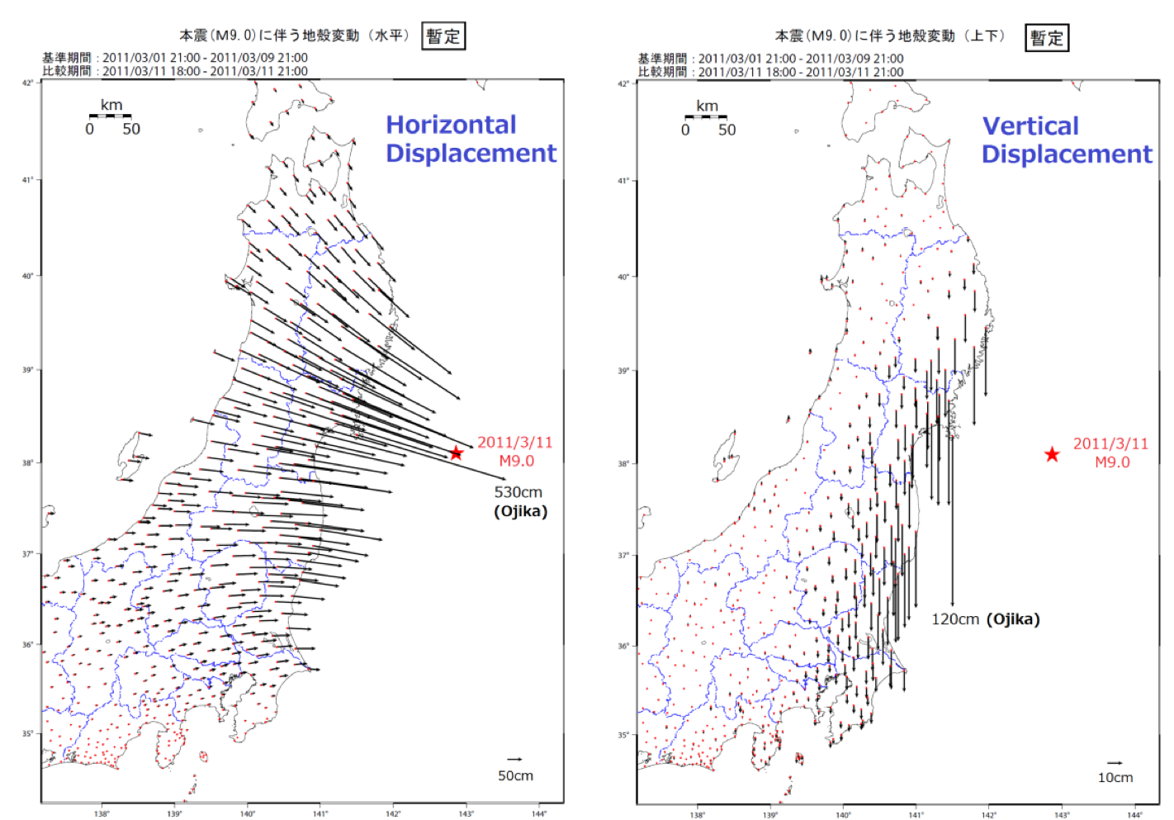
Permanent Displacements from GPS
(Geospatial Information Authority of Japan)

Slide 8
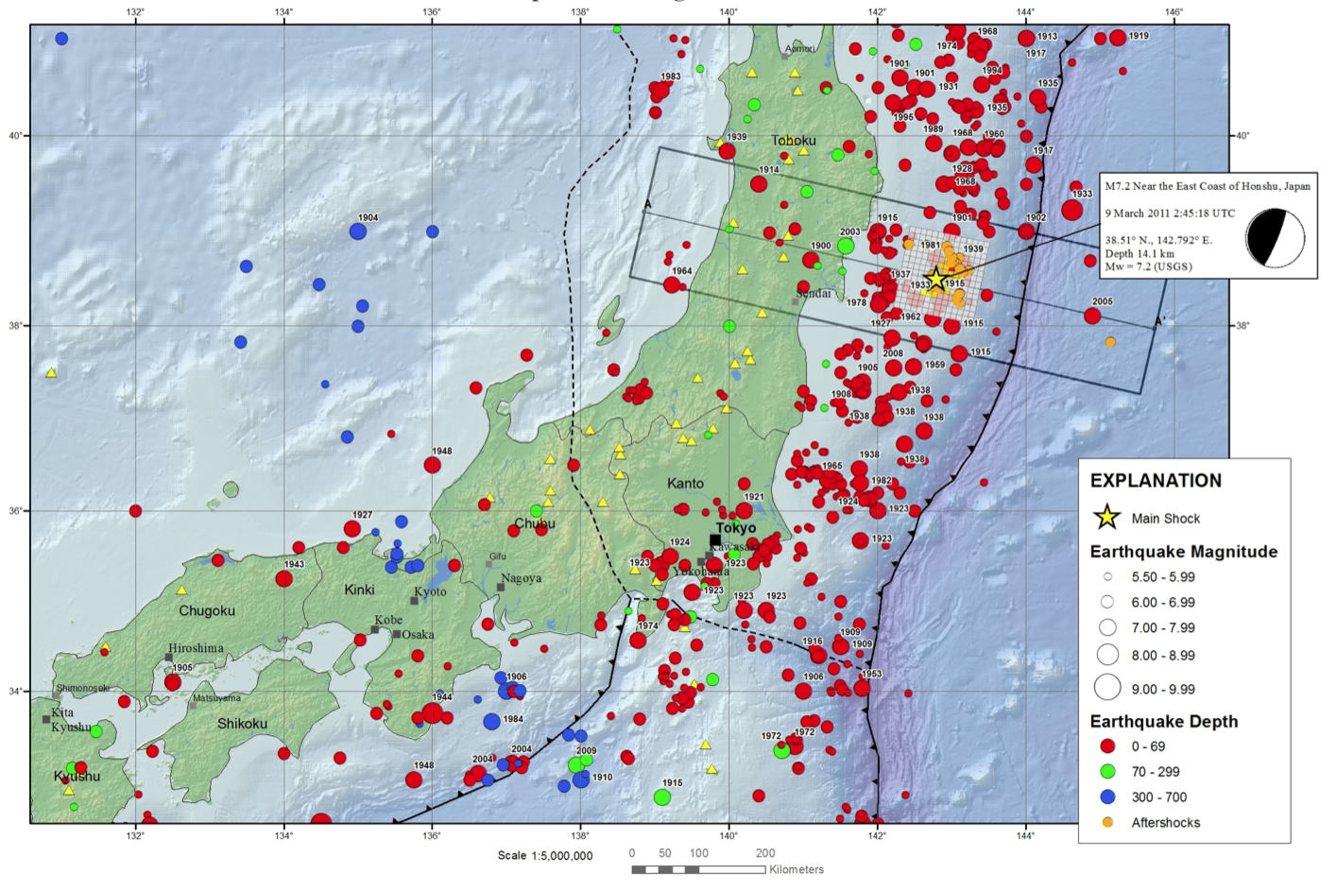
March 9, 2011 Foreshock
the biggest eGf ever

Slide 9
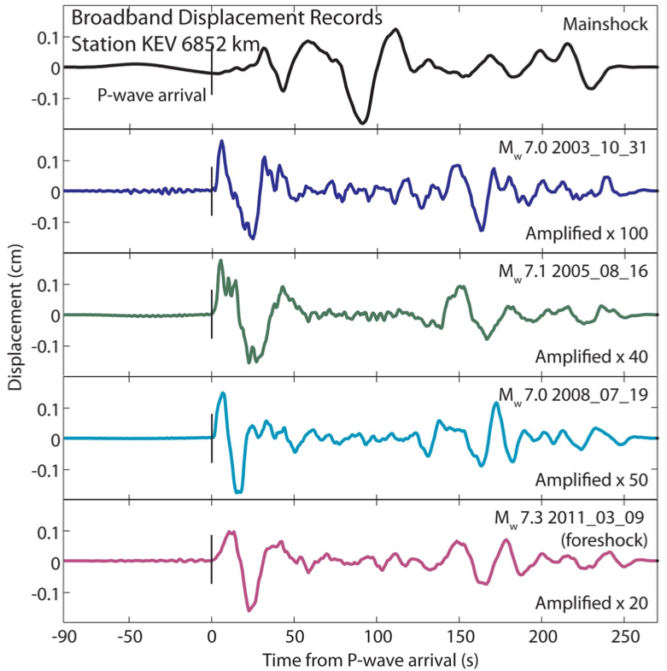
Mainshock and Candidate eGfs
Data from 50 broadband GSN stations
Deconvolution for relative STF to estimate mainshock slip distribution.
Deconvolution for moment spectrum to estimate radiated energy.
4 candidate eGfs: 2003, 2005, 2008, and 2011 (foreshock).

Slide 10
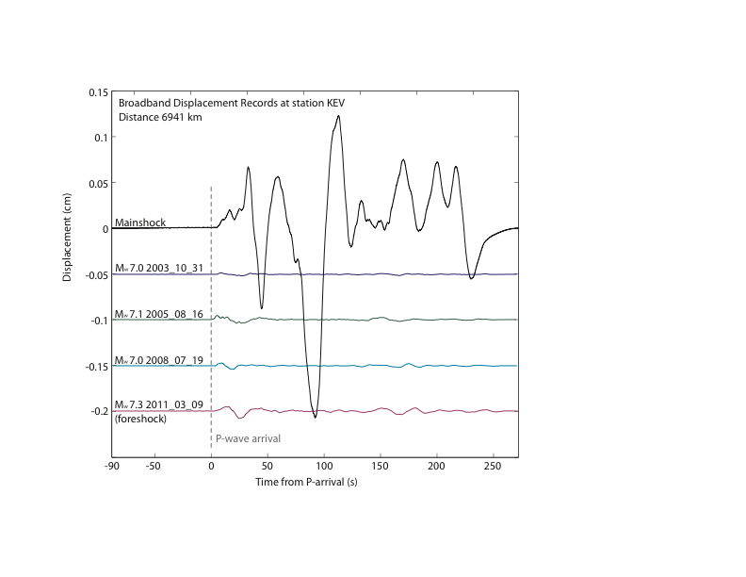
P-wave Displacements at KEV

Slide 11
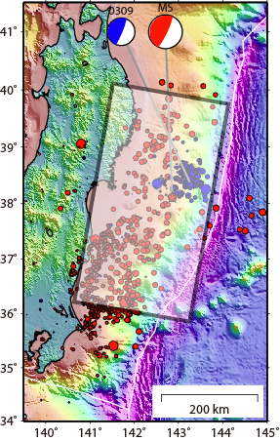
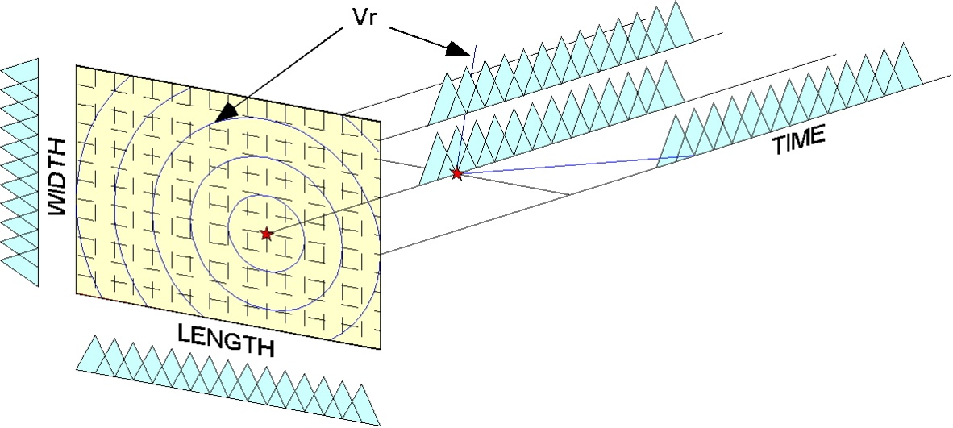
Slip Inversion
Dip
15 deg
Ide and Takeo (1997)
Ide (2002)
440
km
440 x 240 km fault plane discretized using spline basis with 10-km interval in space and 5-s interval in time for 160 s
Linear Inversion (NNLS)
Space & Time Smoothing (Bayesian)
ABIC Minimum Solution
240 km

Slide 12
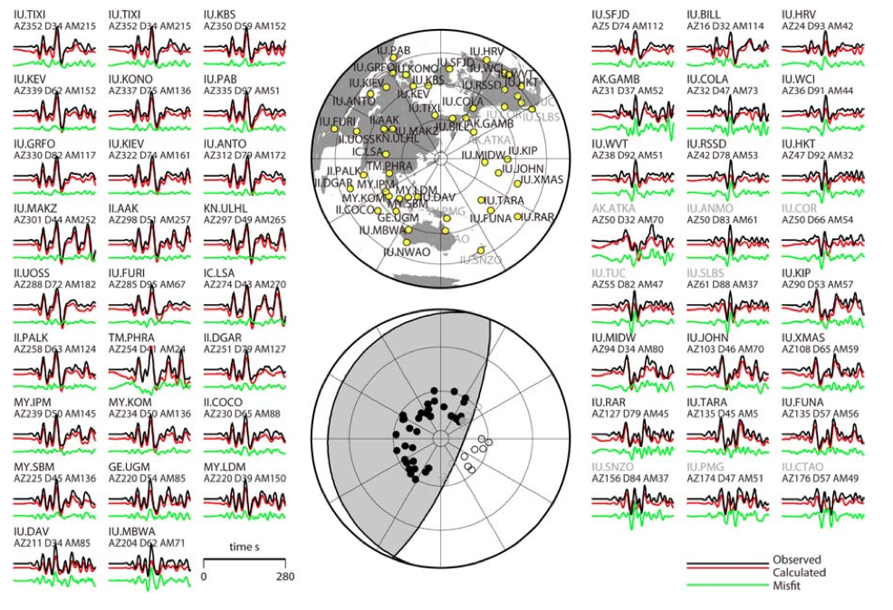
Fit to Data

Slide 13
Slip Evolution in the Tohoku-Oki Earthquake
Ide et al. (2011)

Slide 14
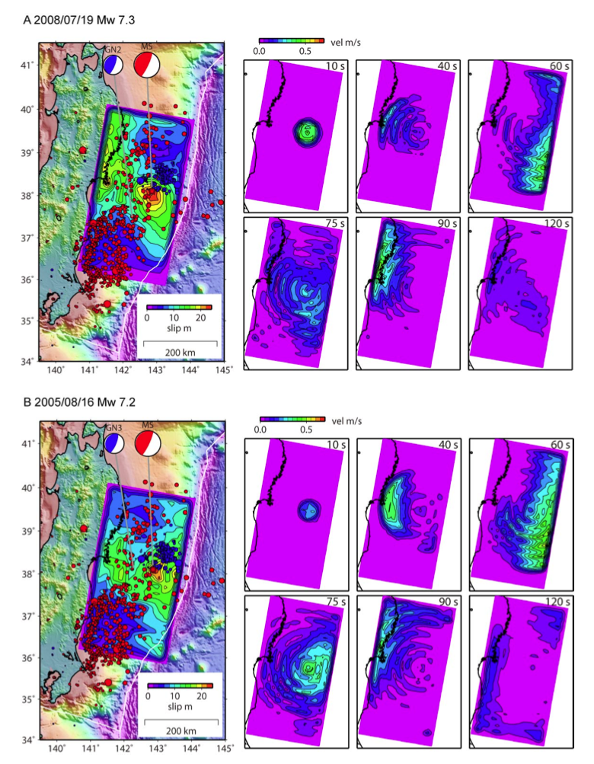
Gross features of rupture evolution - particularly explosive slip growth as rupture reaches the trench - are consistent for different assumed eGfs.
Ide et al. (2011)

Slide 15
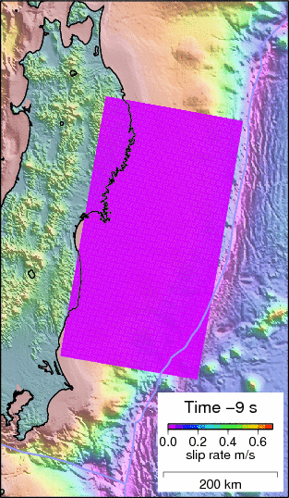
Final Slip
Moment-rate function indicates rapid growth about 50 s after initiation.
Moment rate is equivalent to one M_{w} 8.0 earthquake every 2 seconds for an extended period.
Locally exceeds 30 m near the trench.
Slip extends along strike near the trench.
Animation of Slip Evolution
Slip-rate distribution
Time in seconds relative to the mainshock origin time is shown in the legend in the lower right.
Slip-rate (in meters/second) is shown with colors as the earthquake evolves.
Ide et al. (2011)

Slide 16
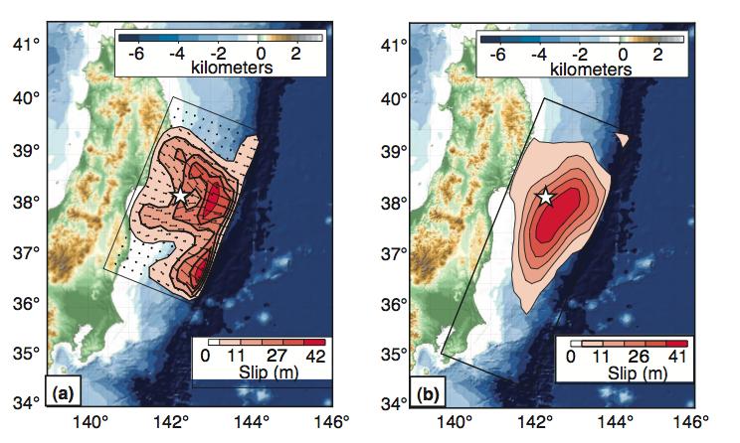
Other Slip Models
Broadband P
P + R1 + cGPS
Koper et al. (2011)

Slide 17
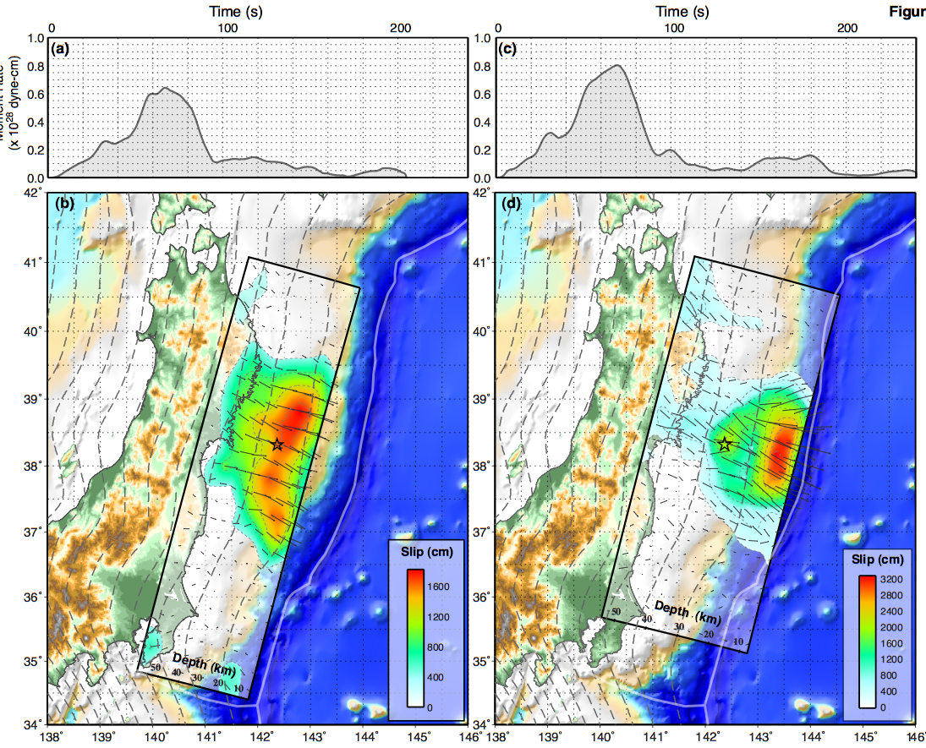
Other Slip Models
Initial
Updated
Hayes (2011)

Slide 18
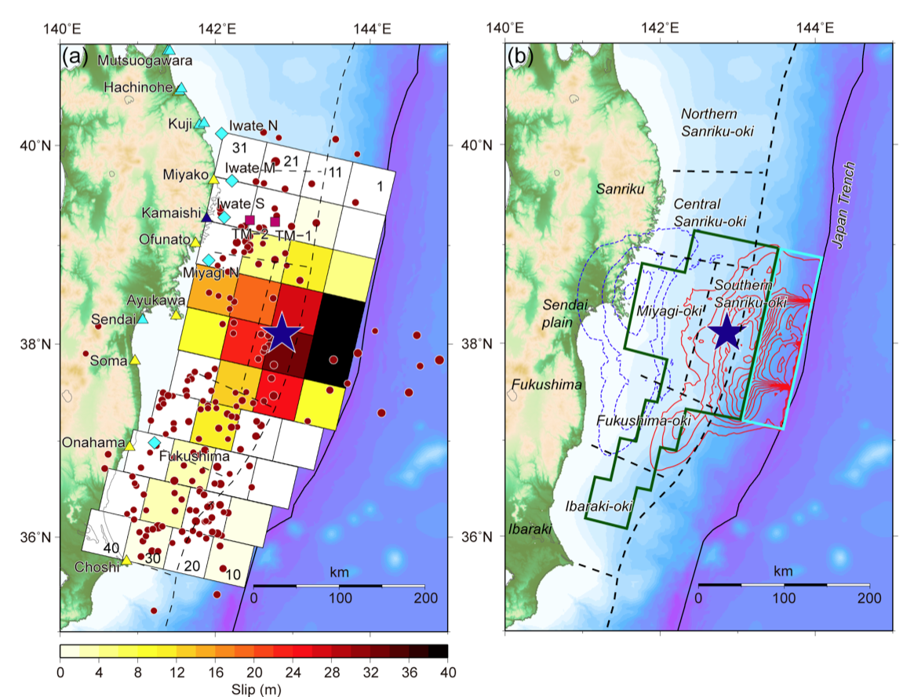
Other Slip Models
Fujii et al. (2011)

Slide 19
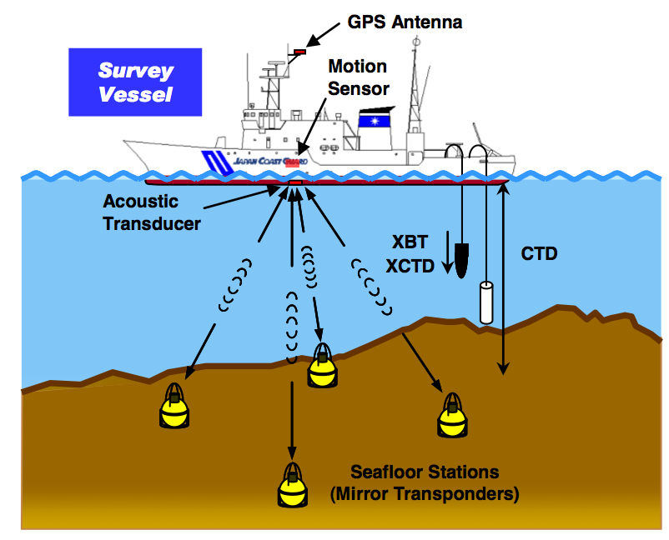
Seafloor Geodesy
Sato et al. (2011)

Slide 20
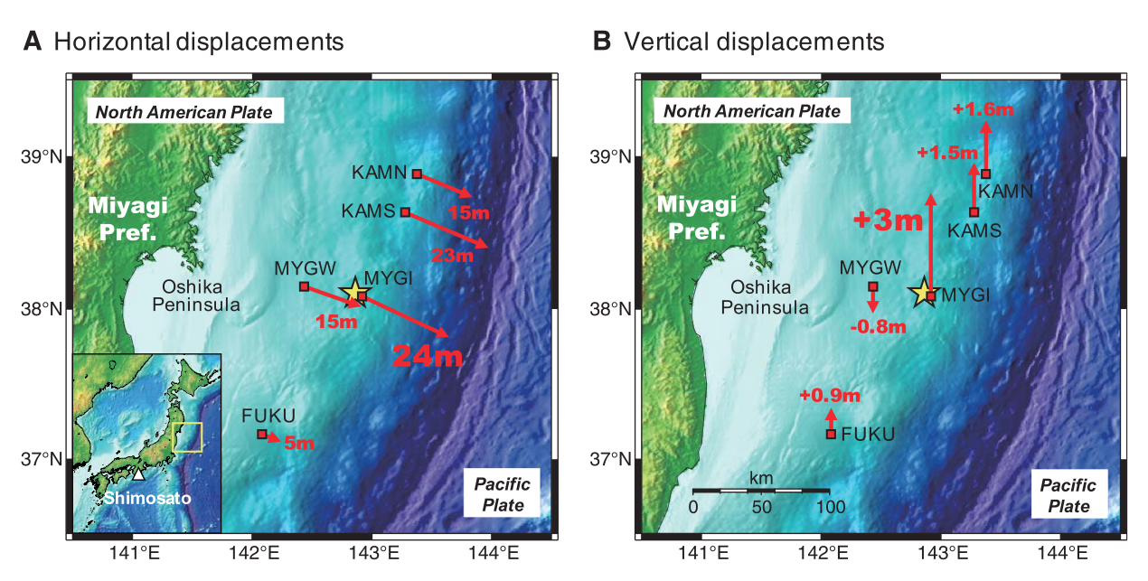
Seafloor Geodesy Confirms Extreme Slip
Sato et al. (2011)

Slide 21
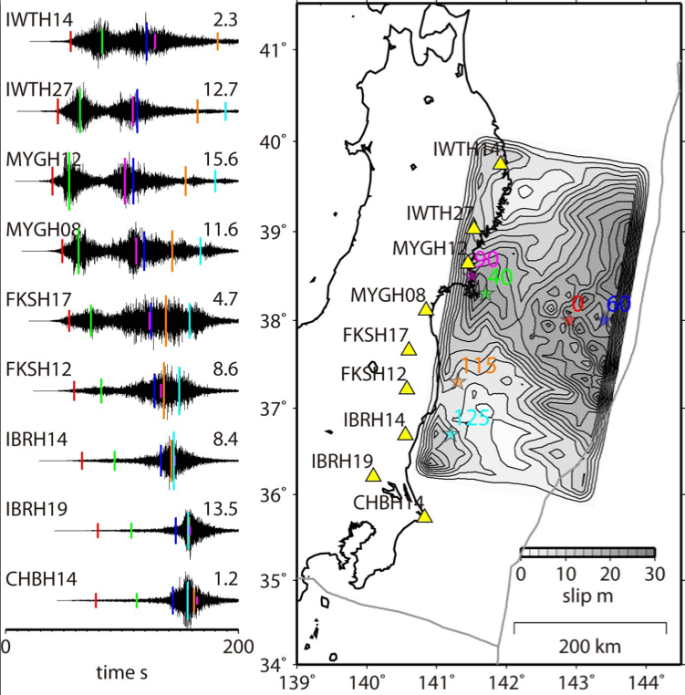
High-frequency Waves from Deep Rupture Only
Highpass filtered
KiK-net data
S-wave arrival times
from source points
on the fault plane
Color-keyed location
Size of bar ~1/r
Large-slip area (blue) should dominate, but is almost undetectable.

Slide 22
NE Japan Subduction Zone
Depth-dependent change of frictional behavior?
Tsunami EQ component?
Ordinary Es/Mo in average

Slide 23
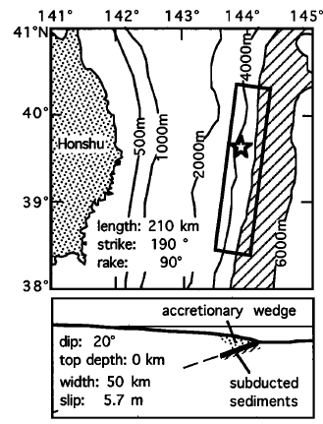
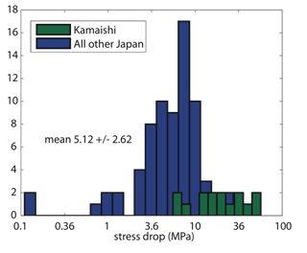
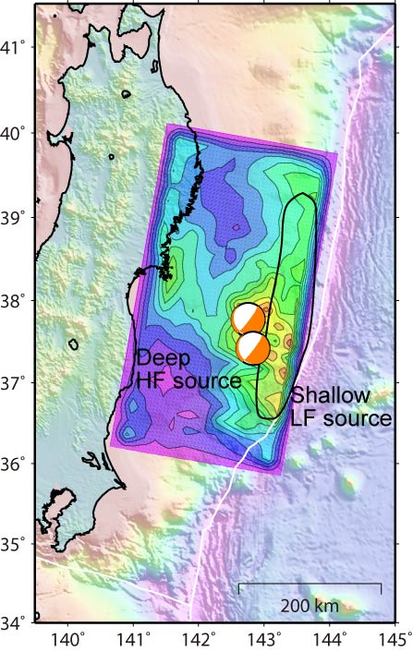
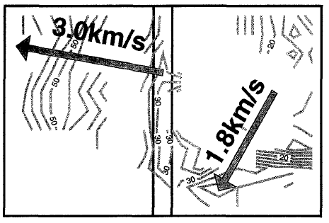
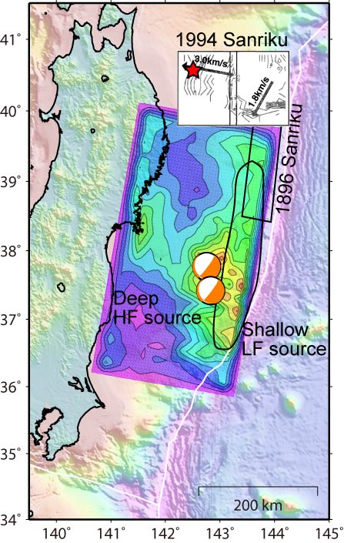
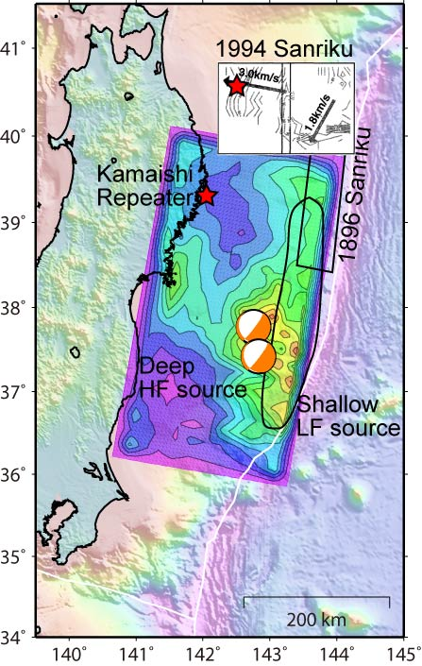
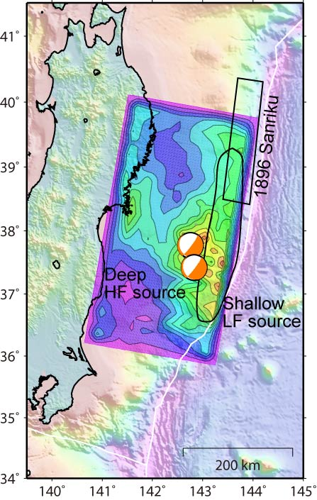
NE Japan Subduction Zone
HF
source
Nakayama and Takeo (1997)
Baltay et al. (2011)
Tanioka and Satake (1996)
Depth-dependent change of frictional behavior?
Tsunami EQ component?
Ordinary Es/Mo on average

Slide 24
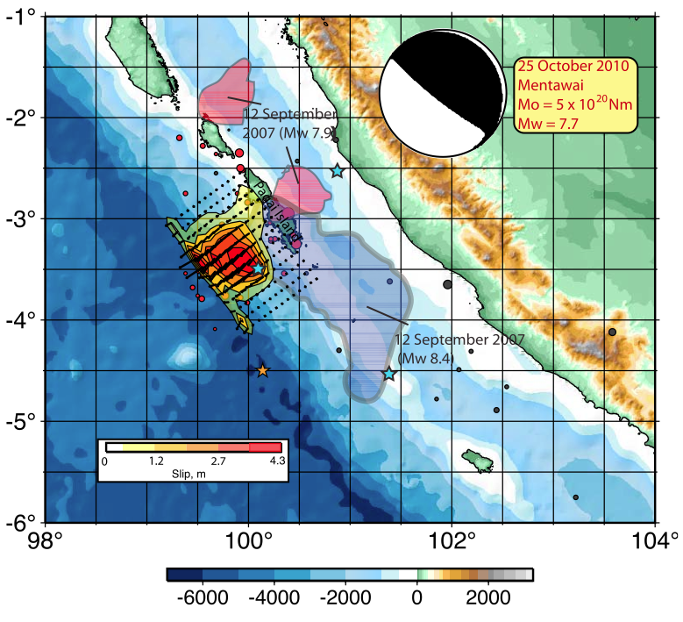
Mentawai Tsunami Earthquake
Lay et al. (2011)

Slide 25
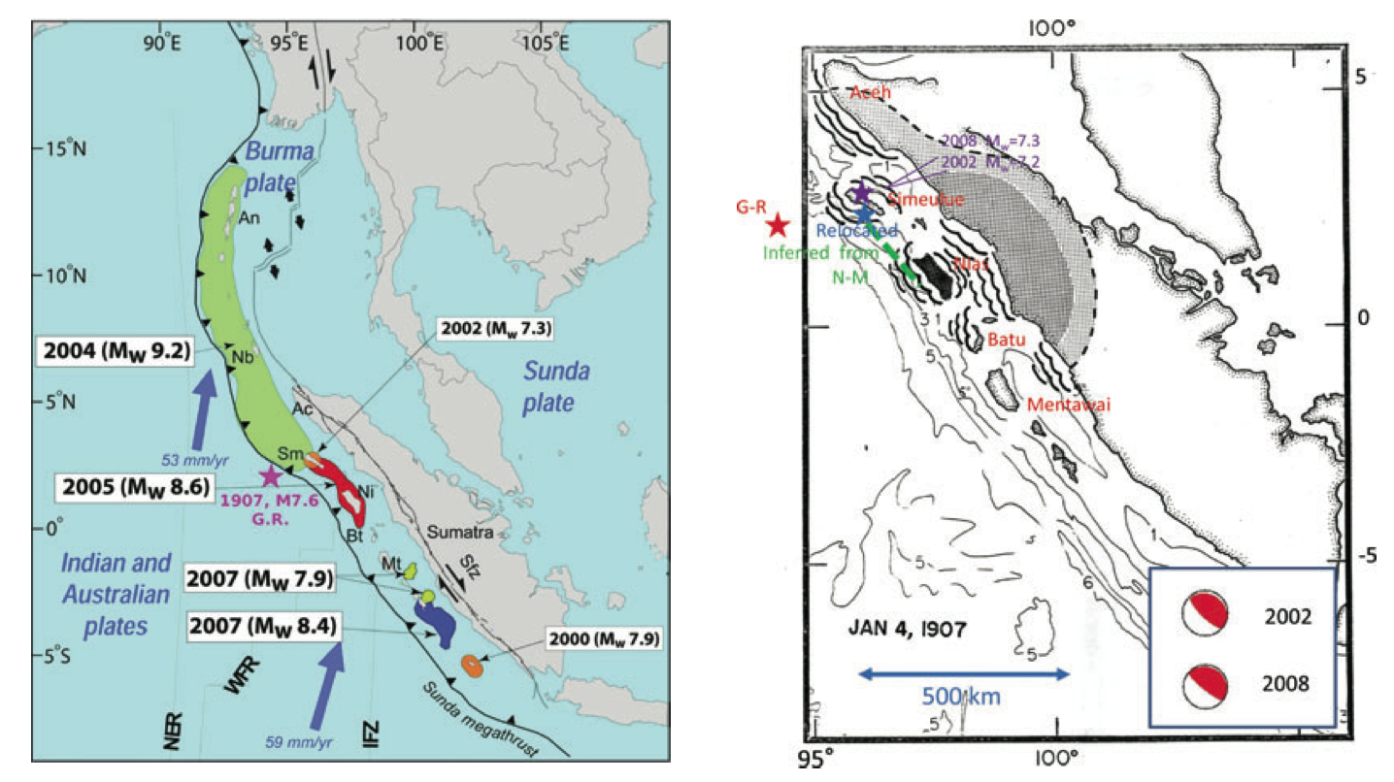
1907 Sumatra Tsunami Earthquake
Interplate earthquake, near trench slip, extensive tsunami
Kanamori et al. (2010)

Slide 26
eGf-based Spectra for Energy

Slide 27
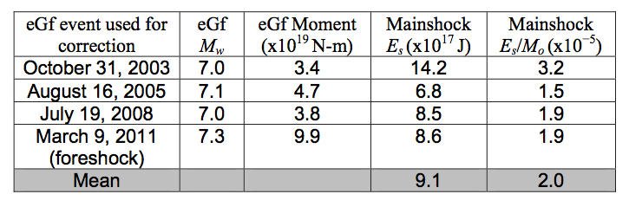
Most energy in
0.01-0.1 Hz band
High frequency contribution is negligible (as expected)
Strong azimuthal variation

Slide 28
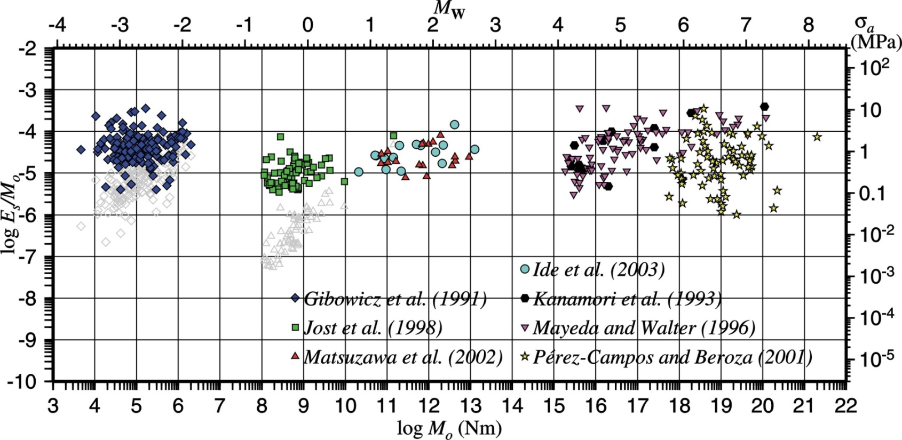
Scaled Energy is in the Normal Range
Tohoku EQ
Tsunami EQ range
Ide and Beroza (2001)

Slide 29
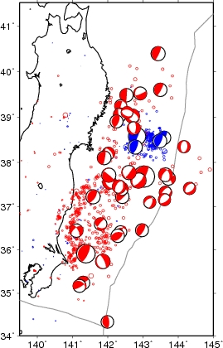


Complete Stress Drop/Dynamic Overshoot?
Global CMT Mechanisms: March 9-14
2011/03/14 15:12 (JST)
Mw 6.1 (D 7 km, JMA)
2011/03/12 10:47 (JST)
Mw 6.5 (D 0 km, JMA)

Slide 30
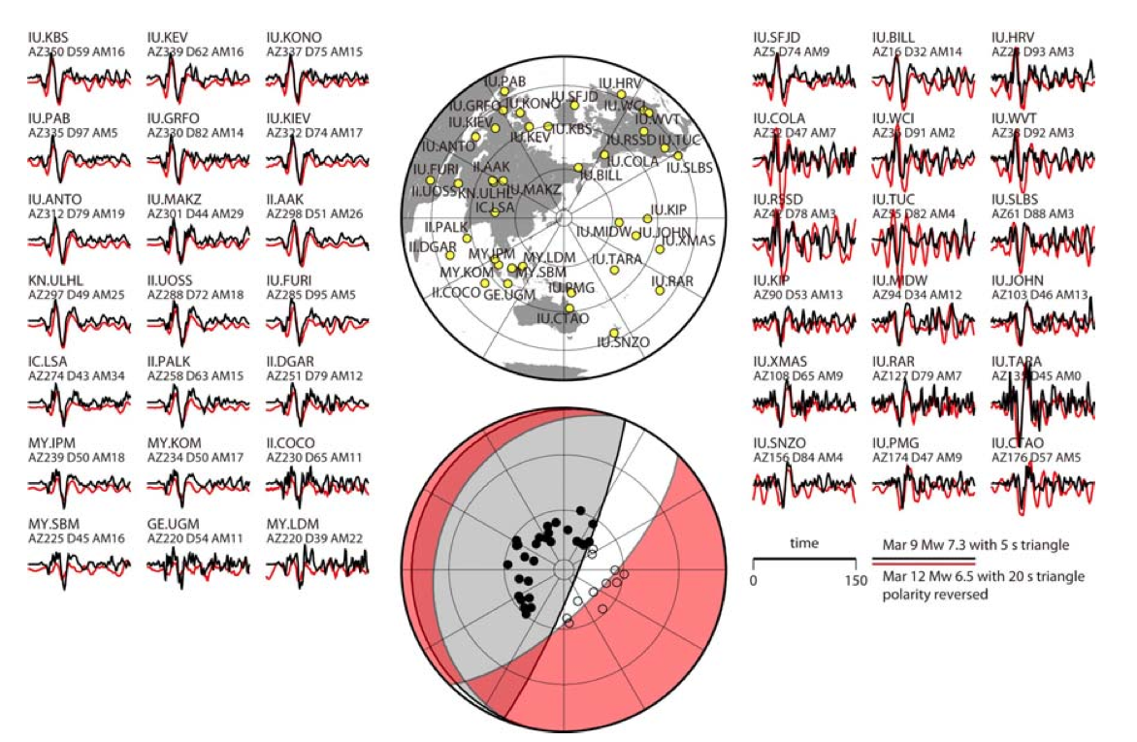
Reversed-Slip Aftershocks Suggest Near Complete Stress Drop/Dynamic Overshoot

Slide 31
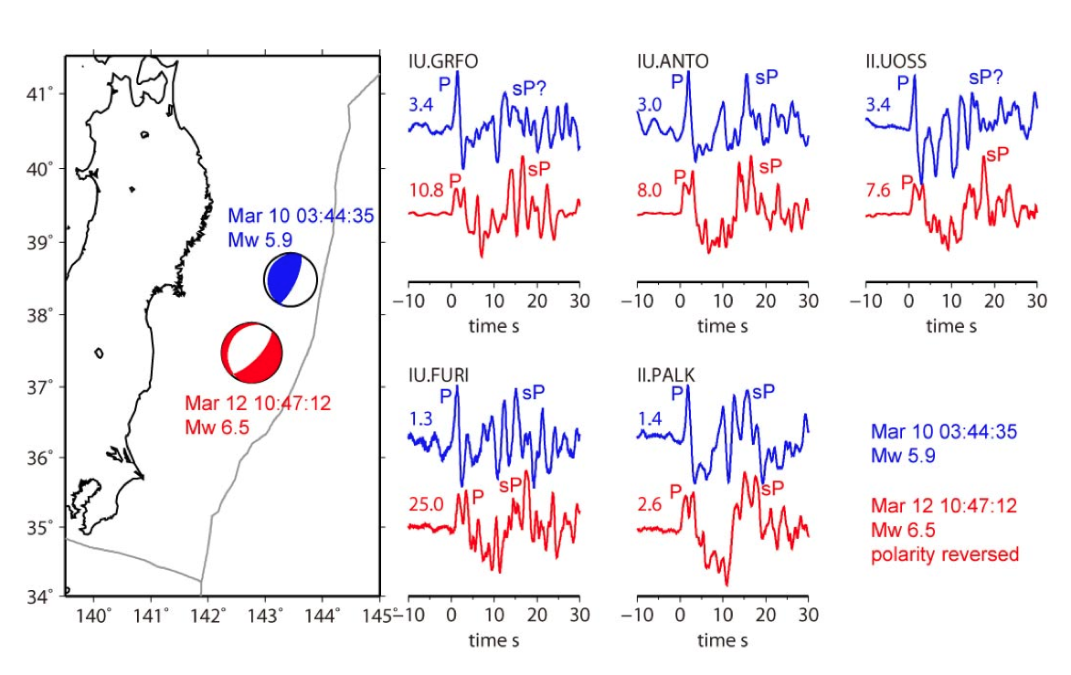
Depth of Largest Normal Aftershock Similar to Foreshock - Suggesting Near Plate-Boundary Normal Faulting

Slide 32
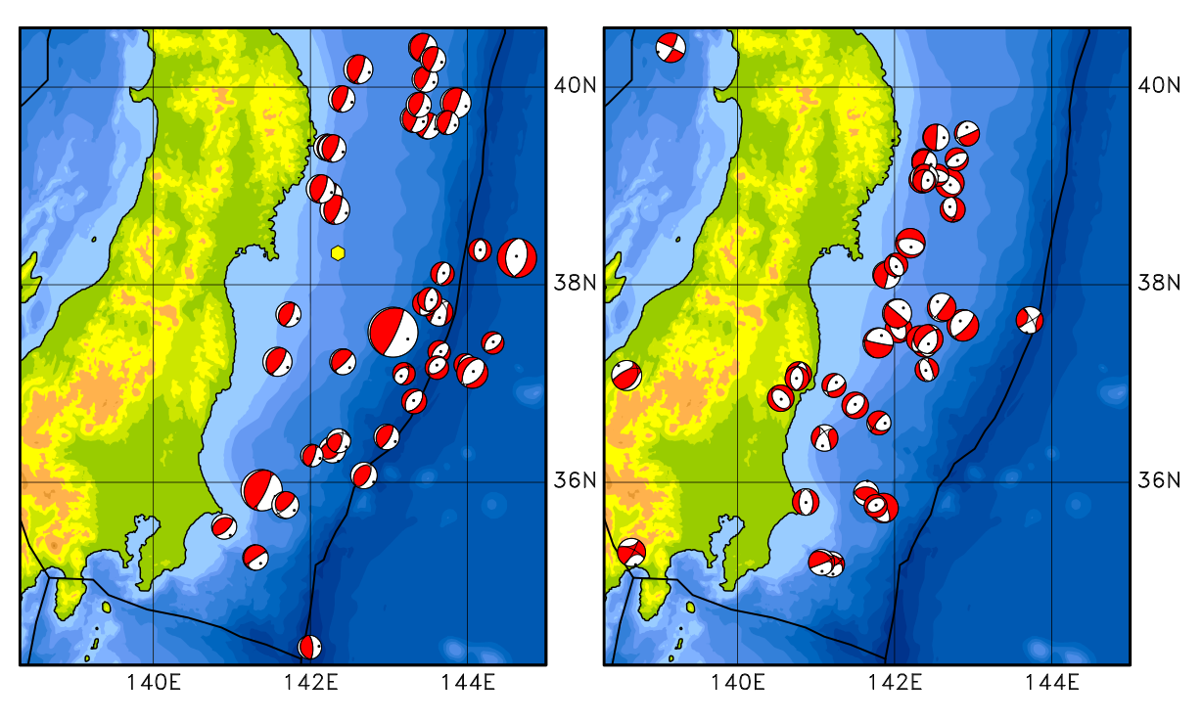
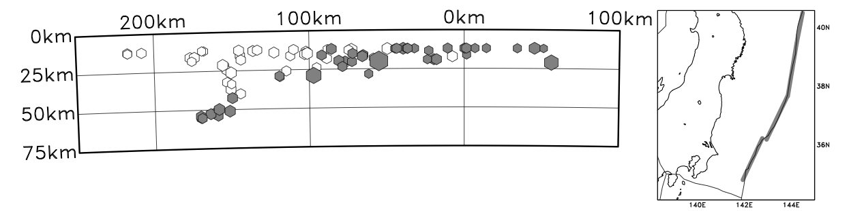
G-CMT Depth Distribution of Reversed Aftershocks
Nettles et al. (2011)

Slide 33
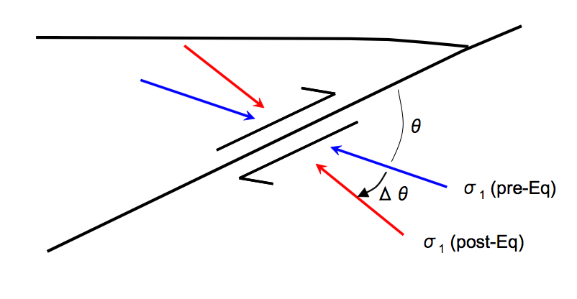
Change in Stress Orientation from Stress Inversion
Infer that ~20 MPa represents near complete stress drop.
Hasegawa et al. (2011)

Slide 34
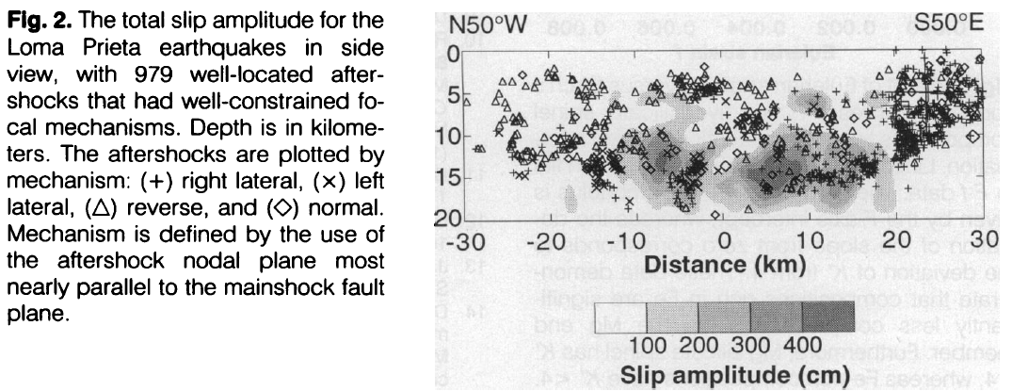
Reversed Aftershocks in the 1989 Loma Prieta Earthquake
1989 Loma Prieta earthquake
Mainshock (right-lateral + reverse)
Beroza and Zoback (1993)

Slide 35
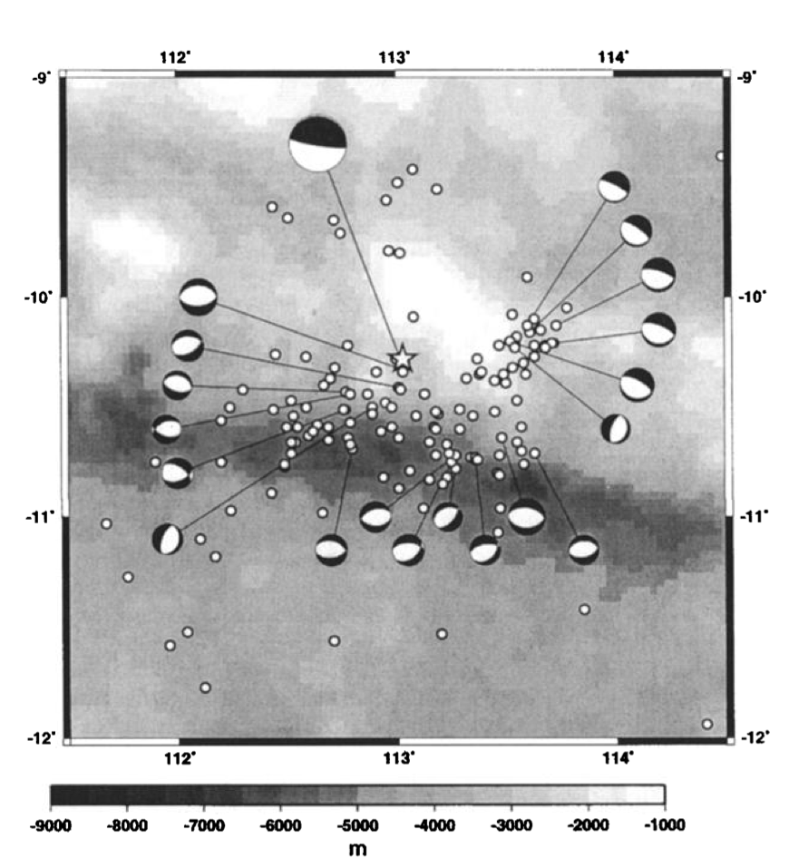
Reversed Aftershocks in 1994 Java Tsunami Earthquake
Abercrombie et al. (2001)

Slide 36
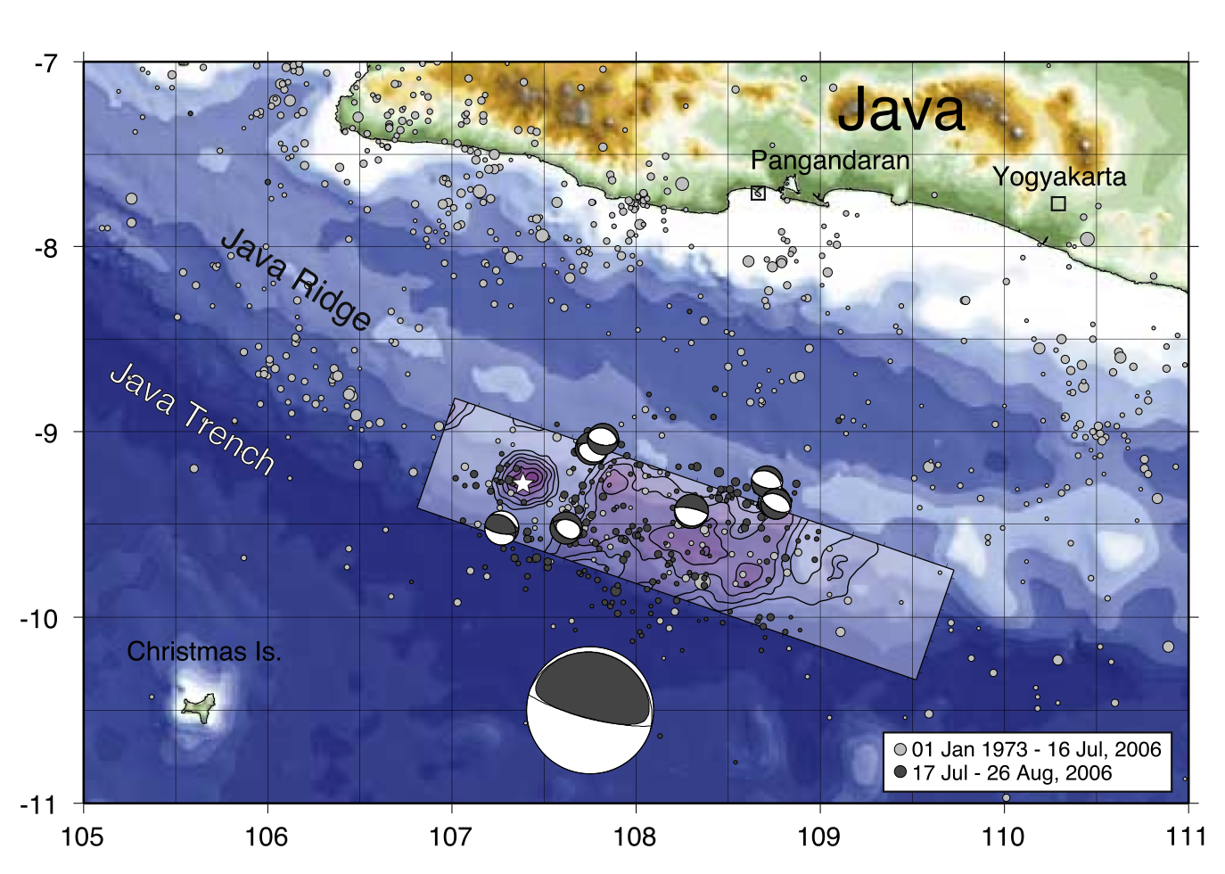
Reversed Aftershocks in 2006 Java Tsunami Earthquake
Ammon et al. (2006)

Slide 37
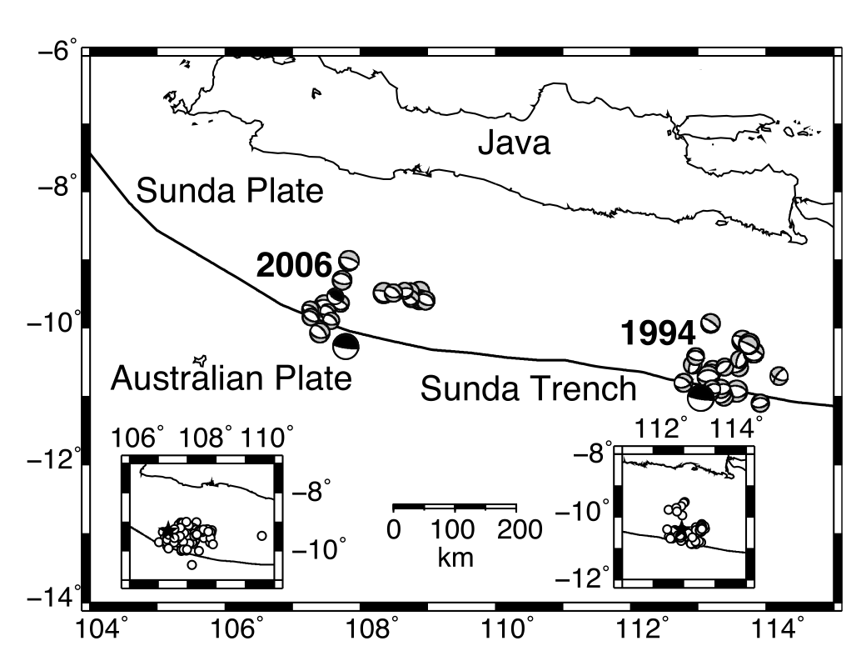
Both Java Tsunami Earthquakes Adjacent to the Trench
El Hariri and Bilek (2011)

Slide 38
Observations
Extremely high slip near the trench
Weak high-frequency radiation from high-slip region
Complete stress drop/dynamic overshoot
How can this occur?

Slide 39
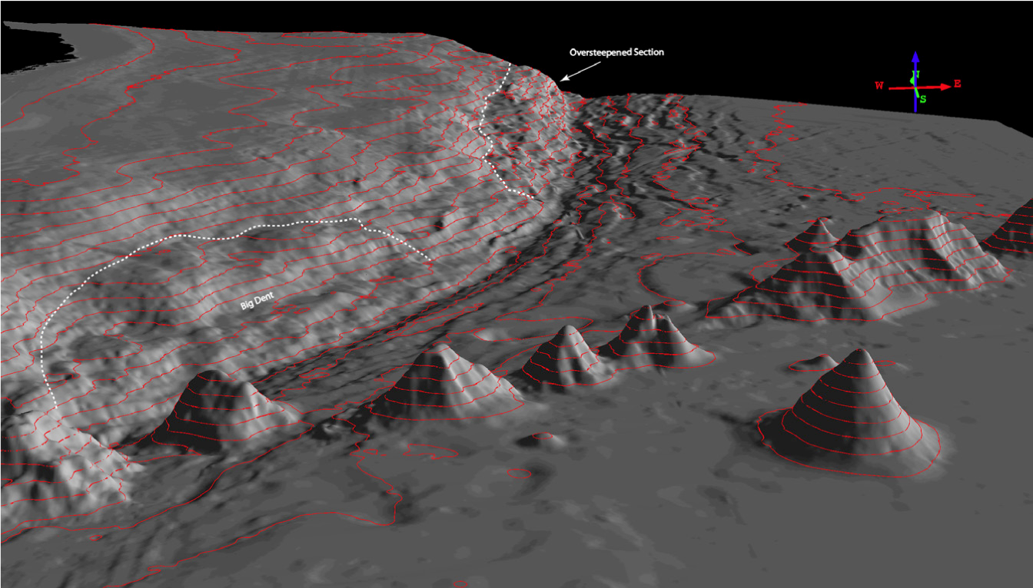
High Strength due to Seamount Subduction
Hudnut (2011)
Possible supporting evidence from tomography (Matsubara and Obara, 2011).

Slide 40
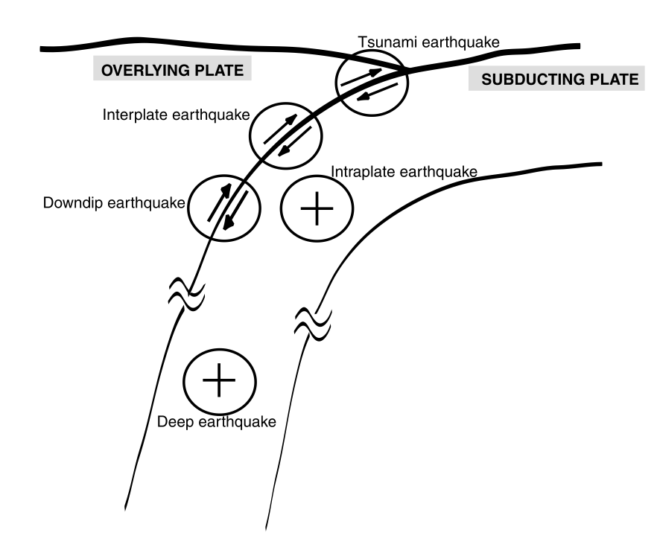
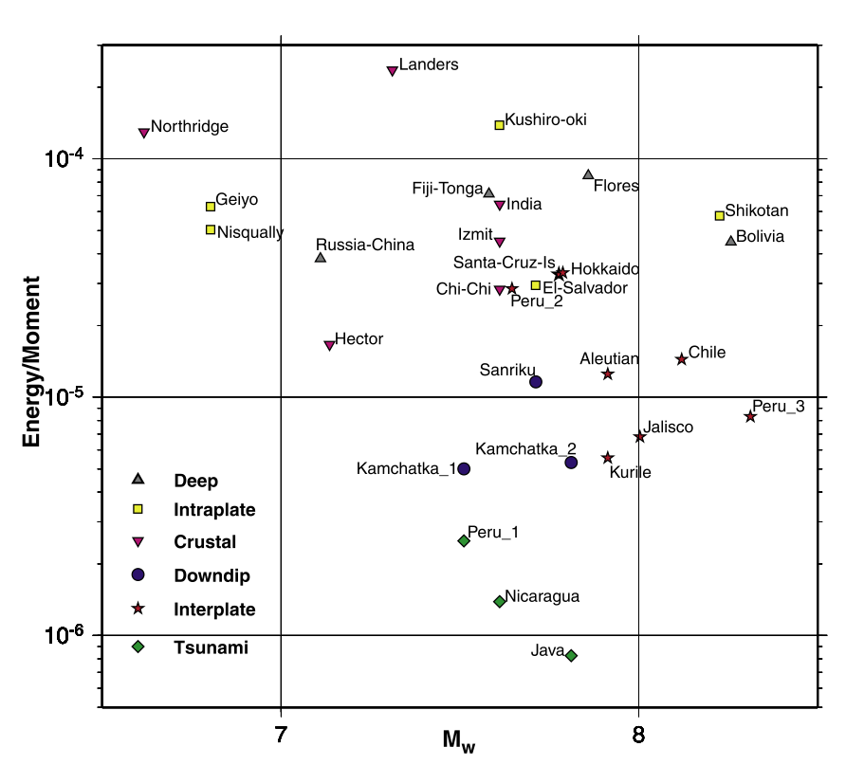
High Fracture Energy
Venkataraman and Kanamori (2004)

Slide 41
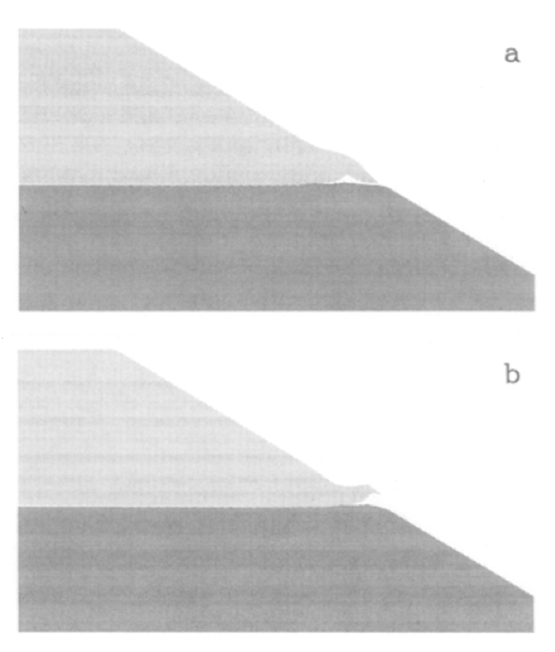
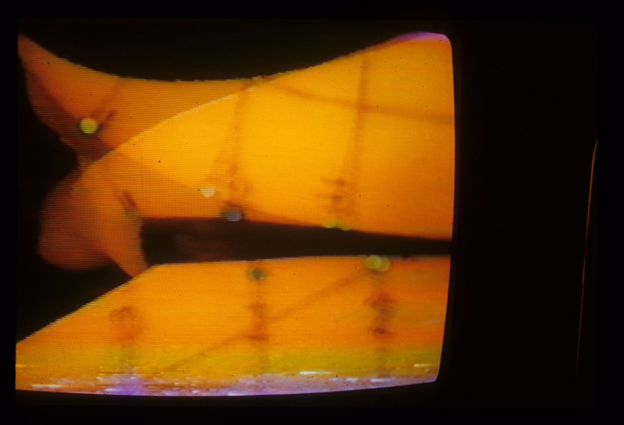
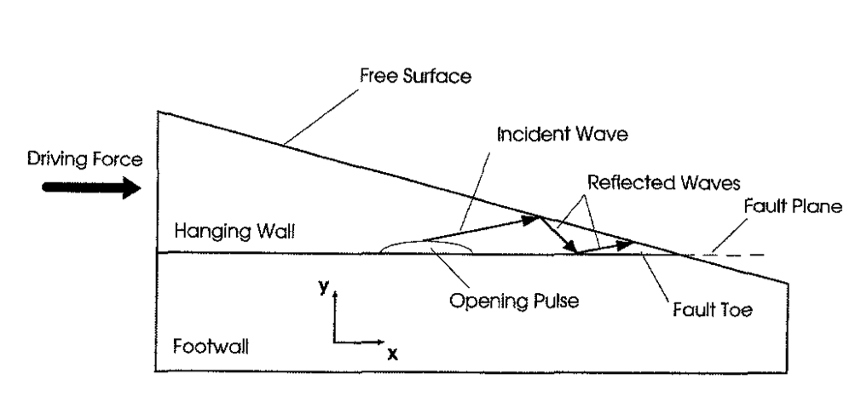
Hanging Wall Effect
Shi et al. (1998)

Slide 42
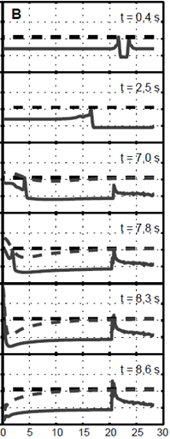


Hanging-Wall Effect
Free Surface
As rupture approaches surface on a reverse fault, dynamic normal stress behind tip drops, causing higher stress drop. The effect propagates back down the fault, extends duration, and increases slip (Shi et al, 1998; Oglesby et al., 1998).
Shear Stress
Excess
stress
drop
Ma and Beroza (2008)
Oglesby et al. (1998)

Slide 43

Slip on Fault with Shallow (15°) Dip
Tamura and Ide

Slide 44




Snapshots of Surface Deformation
Tamura and Ide

Slide 45

Hanging-Wall Effect
As rupture approaches the Earth’s surface, the hanging wall is effectively more compliant, slip increases, and becomes asymmetric.
Ma and Beroza (2008)

Slide 46
Damped Hanging-Wall Effect
This effect can be counteracted by a compliance contrast
Compliant
Ma and Beroza (2008)

Slide 47
Reinforced Hanging-Wall Effect
Compliant
In subduction zones, hanging wall is less compliant (sediments vs. basalt), so bi-material effect reinforces hanging-wall effect.
Result is large hanging wall displacement and strong asymmetry.
Ma and Beroza (2008)

Slide 48



Miura et al. (2003)

Slide 49

Forearc Structure off Tohoku
Tsuru et al.
(2004)
Miura et al. (2003)

Slide 50
Free Surface
Ide et al. (2011)

Slide 51
Extreme Shallow Slip ➔ Exceptional Tsunami
Compliant
Exceptional tsunami excitation because largest displacement occurs near the trench where:
(1) it translates most directly into seafloor deformation
(2) the displaced water column is deepest.

Slide 52
Conclusions
Extremely high slip near the trench, which was the source of the exceptional tsunami
Little high-frequency radiation from high-slip region
Normal-faulting aftershocks at plate-boundary depth in high-slip region support complete stress drop
Hanging wall + bi-material effects offer a possible explanation (need to model with realistic structure in 3D)
Similar effects should be observable in other subduction zones with near-trench slip

