Slide 1

Earth Science Aspects of the 2011 Tohoku Earthquake
What the Earth did during the earthquake.
How that led to the tsunami.
Why an earthquake of this size was not anticipated.
What does this mean for earthquake hazards elsewhere?
Greg Beroza, Department of Geophysics, Stanford University
Symposium on the Great Tohoku, Japan Disaster, April 25-26, 2011

Slide 2
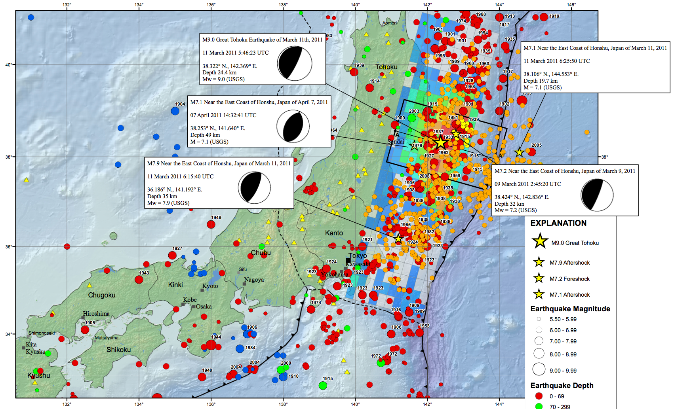
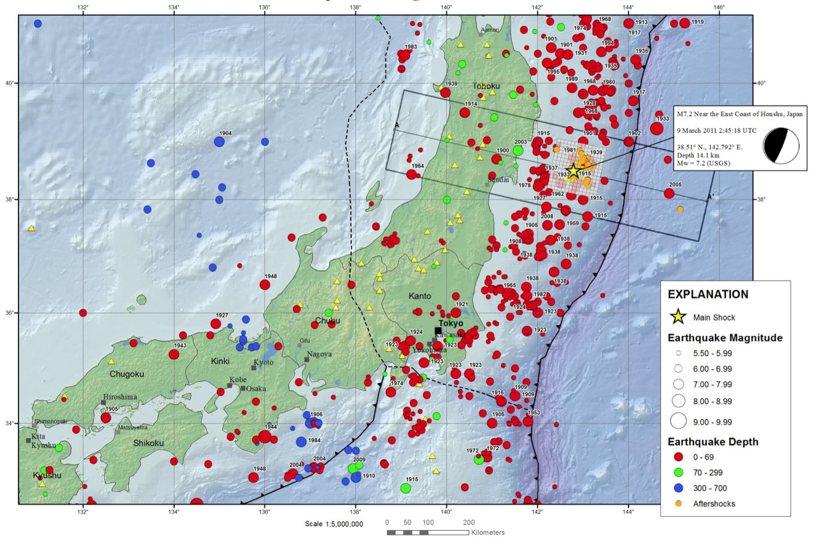

March 9, 2011
March 11, 2011

Slide 3
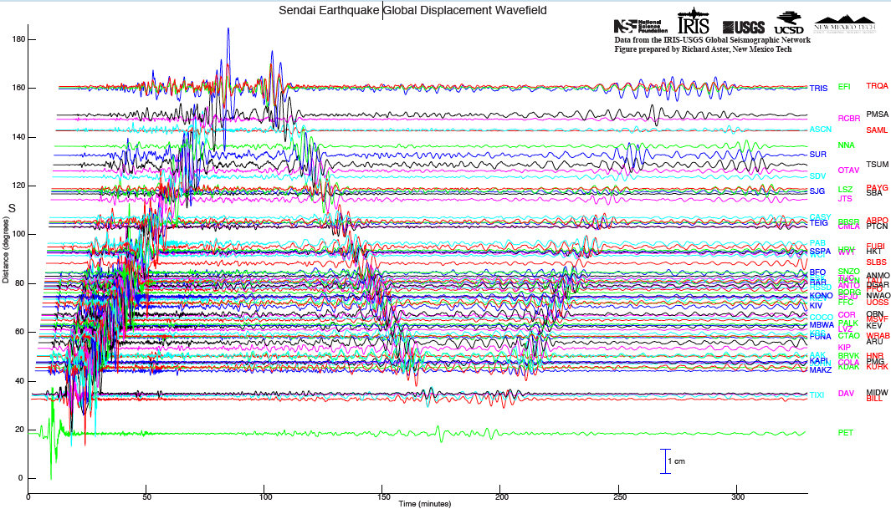
Global Wavefield
M 7.9 aftershock
Unless you were in an airplane, the waves from
this earthquake moved you several cm.

Slide 4
Real-Time Seismology
0 minutes Mainshock began at 11 Mar 2011 05:46:23 UTC. (ruptured for ~160 seconds)
3 minutes JMA estimated M 6.8
5 minutes PTWC estimated M 7.3
~10 minutes PTWC & JMA estimated M 7.9 and issued warnings
20 minutes USGS estimated M 8.8 – clearly an extraordinary event.
Now Officially M 9.0, but estimates range from 8.8 to 9.1.

Slide 5
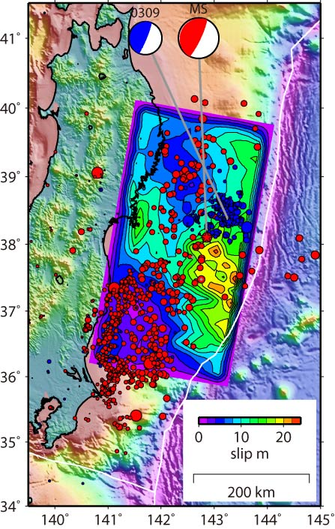
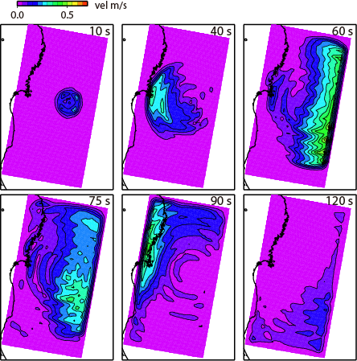
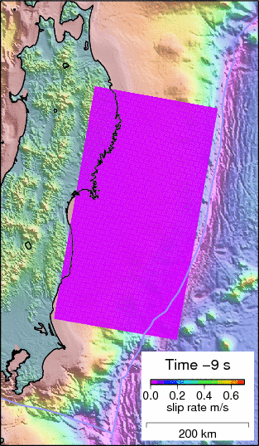


Slip Model from Seismic waves
Ide et al. (2011)
University of Tokyo

Slide 6
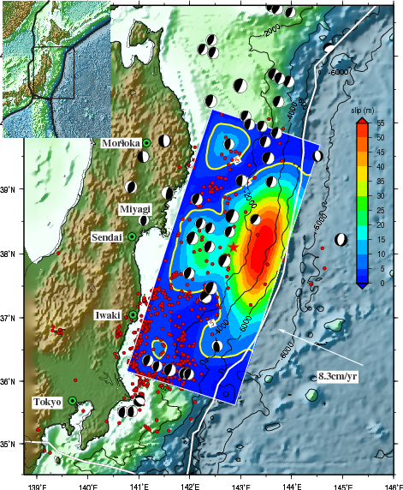
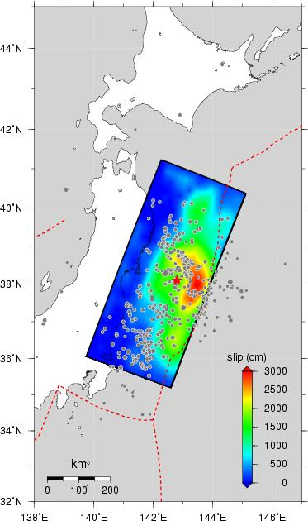
Other Seismically Based Slip Models
Shao, Li, Ji, and Maeda
Wei, Sladen, et al.

Slide 7
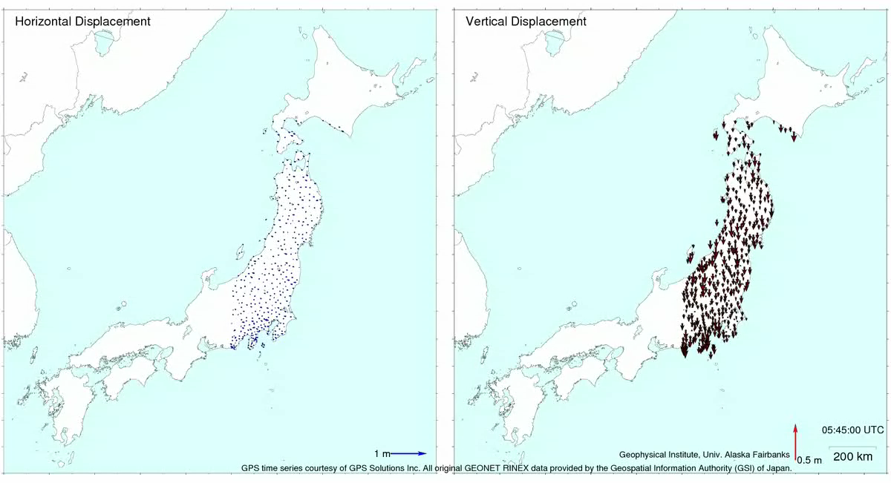
GPS Measurements
Courtesy of Ronni Grapenthin and Jeff Freymueller, University of Alaska
Preliminary GPS time series provided by the ARIA team at JPL and Caltech.
Original GEONET RINEX data provided by the Geospatial Information Authority (GSI) of Japan.

Slide 8

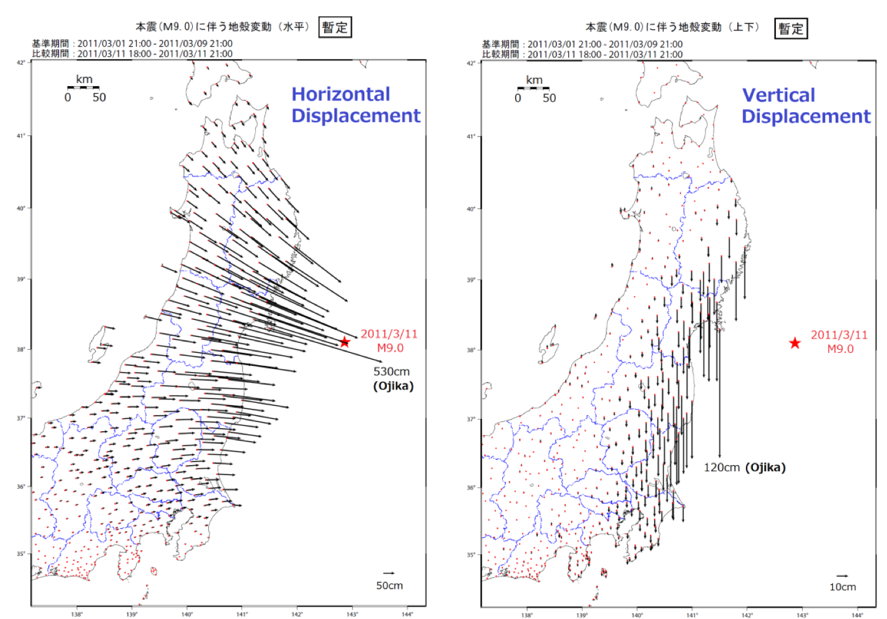
Permanent Displacements from GPS
(Geospatial Information Authority of Japan)

Slide 9
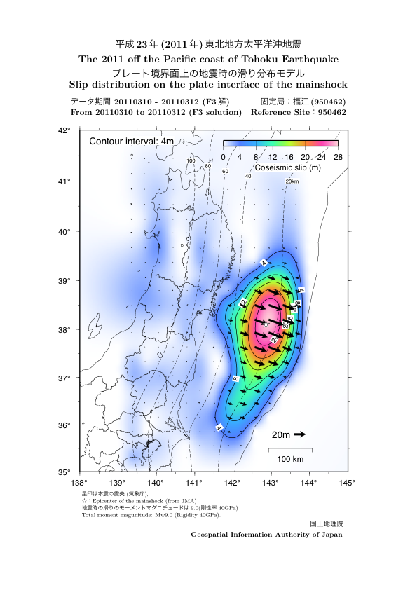
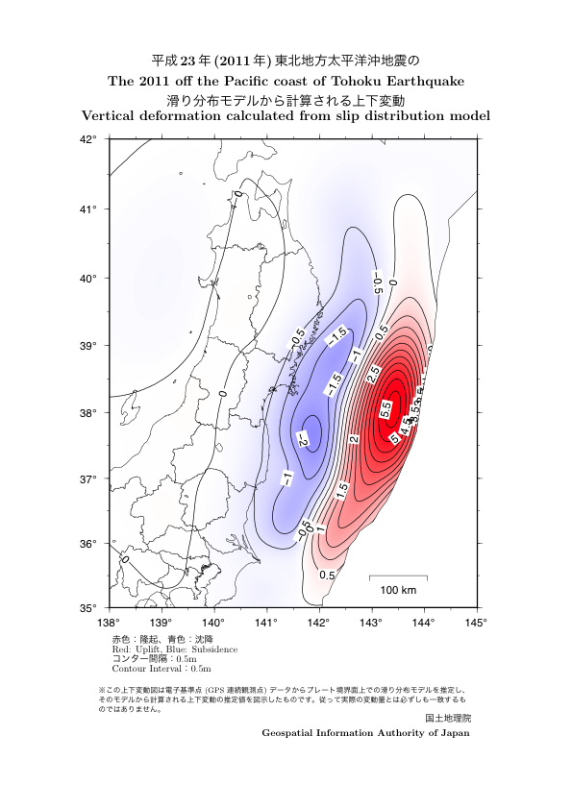
Slip and Vertical Deformation
(Geospatial Information Authority of Japan)

Slide 10
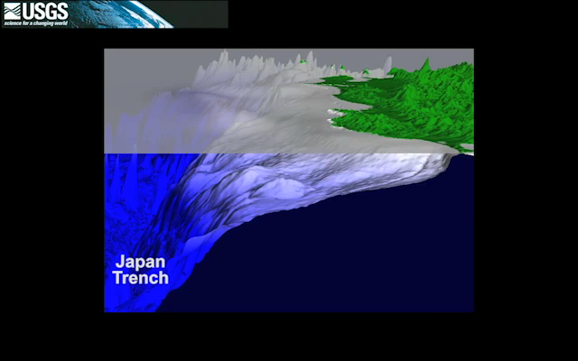
Tsunami Propagation

Slide 11
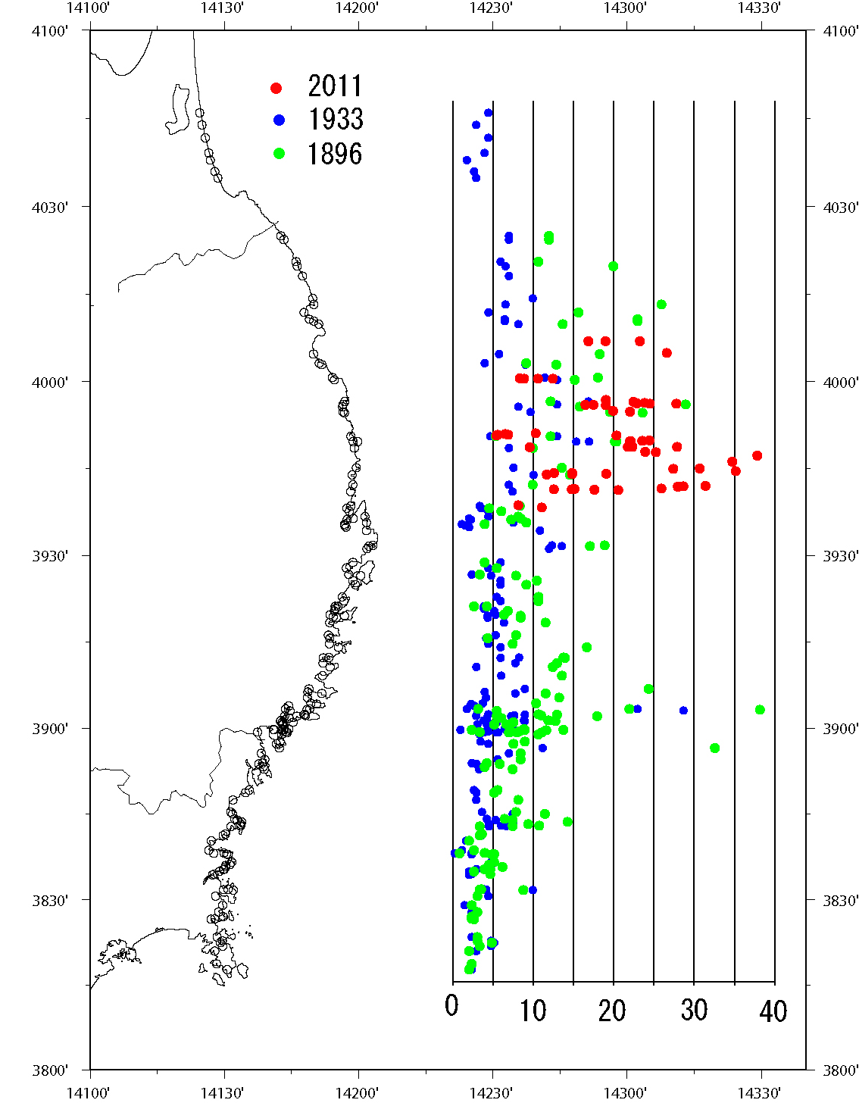
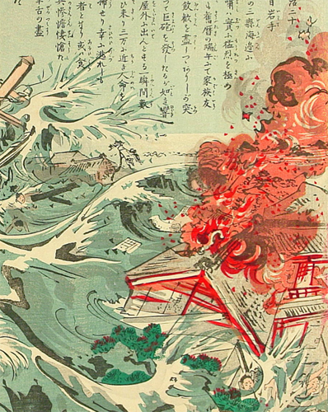
Most Tsunami-Aware Region on Earth
Utagawa Kokunimasa (1874-1944)
Locally very large tsunamis in 1896 & 1933.
Tsuji et al. (2011)

Slide 12
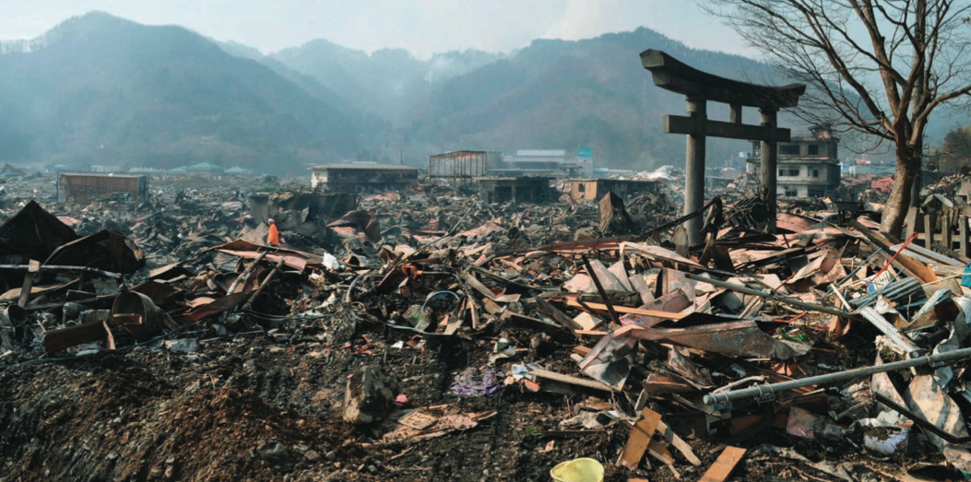
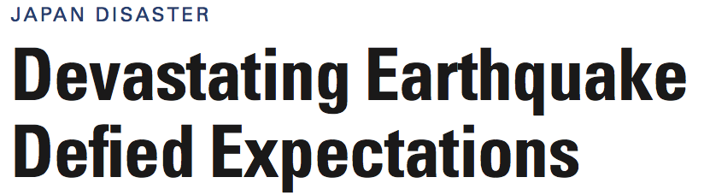
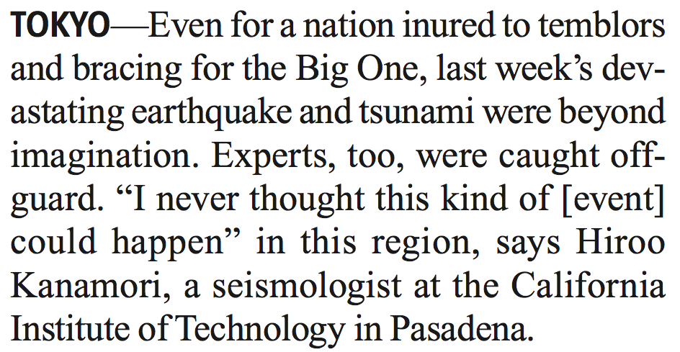

Slide 13
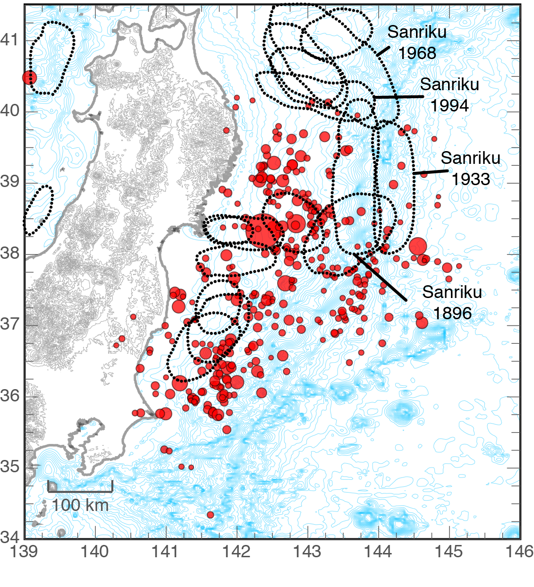
Historical Earthquakes
Large (up to M 8+).
Not gigantic (M 9).
Image: C. J. Ammon (Penn State); Rupture outlines: Hiroo Kanamori (CaltecEQ locations h); (USGS)

Slide 14
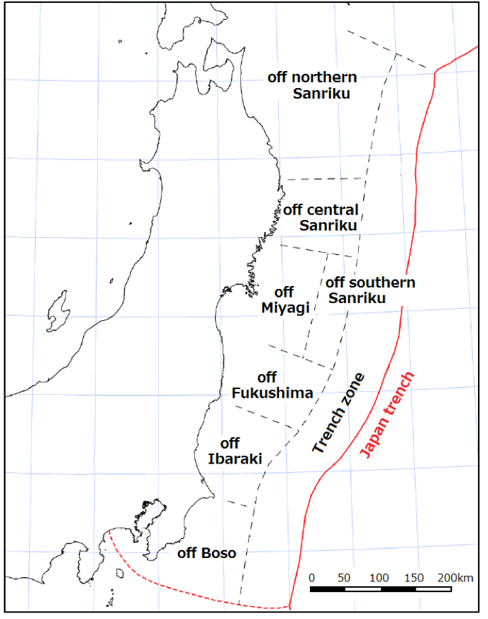
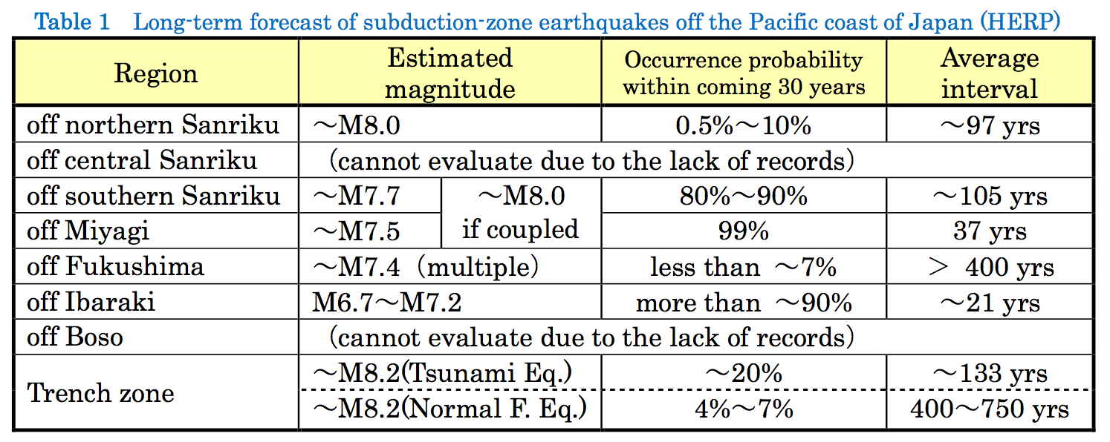
Earthquake Research Committee Segmentation Model
Off Miyagi, 6 earthquakes – 1793(M8.2), 1835(M7.3), 1861(M7.4), 1897(M7.4), 1936(M7.4), and 1978(M7.4) – occurred in the past 200 years with an average interval of 37.1 years.
30-year occurrence probability of 99% (the highest value in Japan).
A M7.2 earthquake occurred in 2005. Since the M was less than estimated level of M7.5, the “expected” earthquake was not considered to have occurred.
However this was a foreshock of the M9.0 event and the main shock involved five regions from “off central Sanriku” to “off Ibaraki” as well as “trench zone”.
Historically, it was known that a great earthquake associated with huge tsunami occurred in 869 (Jogan) in Heian Era and killed more than 1,000 people at Tagajo, Miyagi Prefecture.
But one could hardly imagine that such a event would recur nor the greater event would happen in the land of the living.
An M7.3 earthquake of M7.3 occurred in the “off southern Sanriku” on March 9, 2011. This time, there was an opinion that the occurrence probability of the coupled event of “off Miyagi“ and “off southern Sanriku” may be lowered.
Adapted from Preliminary report of the 2011 off the Pacific coast of Tohoku Earthquake Mar. 25, 2011 Yoshimitsu Okada (President, NIED)

Slide 15
Whole (M 9.0) >> Sum of the Parts
Sum of Parts:
M 8.0 + M 7.4 + M 7.2 + M 8.2 = M 8.3
Energy released by an M 9.0 is ~ 10x that released by an M 8.3 earthquake.
When larger fault area breaks, slip is much greater.
Adapted from Preliminary report of the 2011 off the Pacific coast of Tohoku Earthquake Mar. 25, 2011 Yoshimitsu Okada (President, NIED)

Slide 16
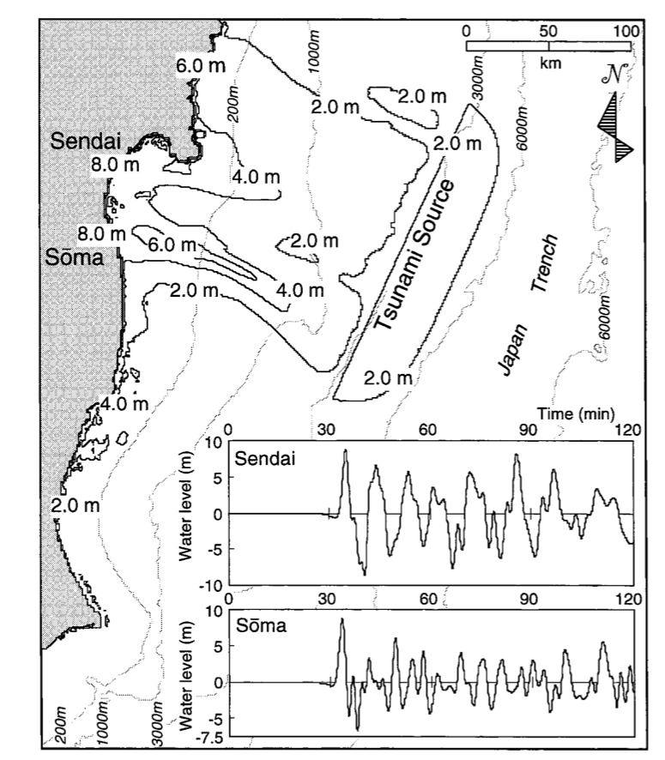
Accurate Hazard Characterization is Required if Risk Mitigation is to be Effective
Extreme Events: Size of the earthquake was unanticipated. The last earthquake of this size there may have been 869 AD Jogan earthquake. Record in Japan is among the longest anywhere, yet earthquakes over the last 1000 years have been considerably smaller. Other parts of the world where unexpectedly large earthquakes might be anticipated?
40,000 km of subduction zones worldwide. Most thought not to be capable of great earthquakes, perhaps due to “segmentation.” Examples include: Java, Central America, Mexico (1787?), Tonga, southern Europe, Makran.
In most places reliable historical records only for last few hundred years.
Multi-disciplinary approach that combines long-term constraints from geology, where processes such as gravity and erosion matter, with recent observations is essential to progress.

Slide 17
Conclusions
First great earthquake to hit a developed country with modern infrastructure and cutting-edge earthquake science and engineering know-how. Lessons learned will be critical to improving the resilience of other regions - including California - to earthquakes.
Cascadia subduction zone from northern California to southern Canada could unleash a comparable event.
Earthquake monitoring in Japan is state-of-the-art - far better than in the US in almost every respect. Earthquakes in Japan are ~6 times more frequent than in western US. That combination has led to a string of fundamental discoveries coming out of Japan.
The Tohoku earthquake will provide new insight into earthquake processes and tsunamigenesis. Earthquake scientists and engineers around the world need to learn as much as possible from it in order to reduce losses from future earthquakes in Japan, and elsewhere.

Slide 18
Thank You

Slide 19
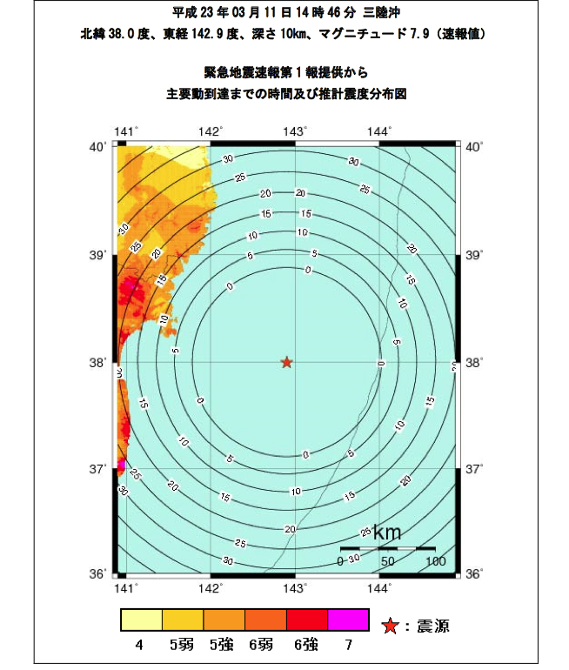

Earthquake Early Warning Contours show seconds of warning before arrival of strong shaking
Warning Issued by JMA before strong shaking began.

Slide 20
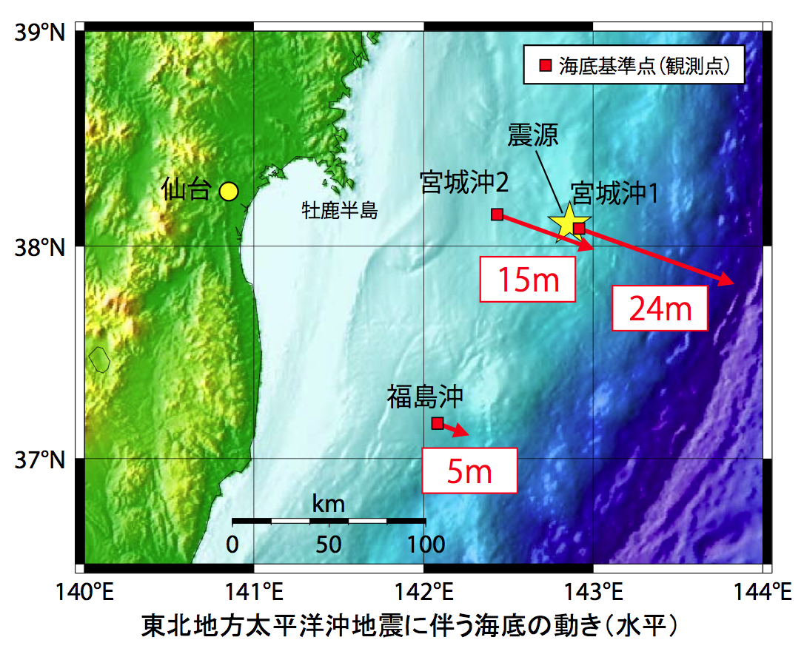

Seafloor Geodesy Confirms Extreme Slip
Hydrographic and Oceanographic Department, Japan Coast Guard

Slide 21
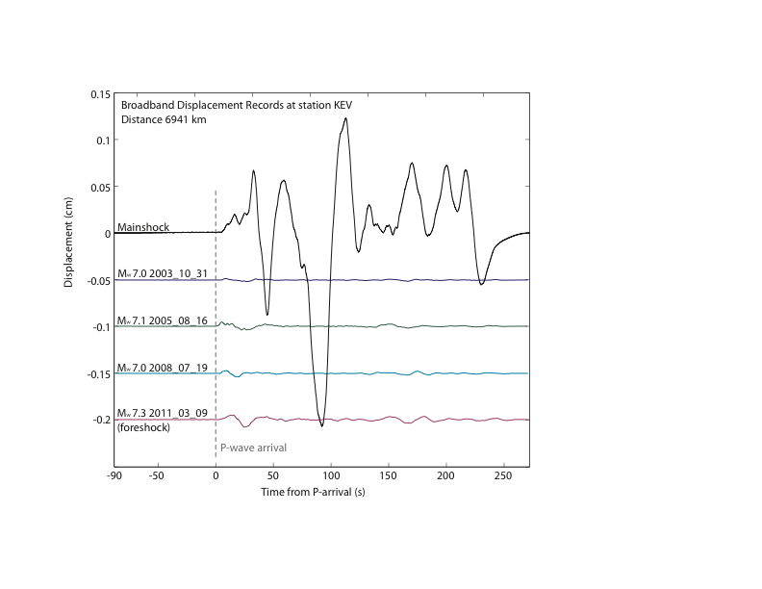
Seismological View of a Magnitude 9
Figure from Annemarie Baltay

