Slide 1
Outstanding Research Questions:
What have we learned and where do we go from here?
Greg Beroza
Stanford University
2011 SACNAS National Conference
“Empowering Innovation and Synergy Through Diversity"
October 27-30, 2011, San Jose, California

Slide 2
Outstanding Research Questions:
What have we learned and where do we go from here?
(1) How could this earthquake and tsunami have been anticipated?

Slide 3
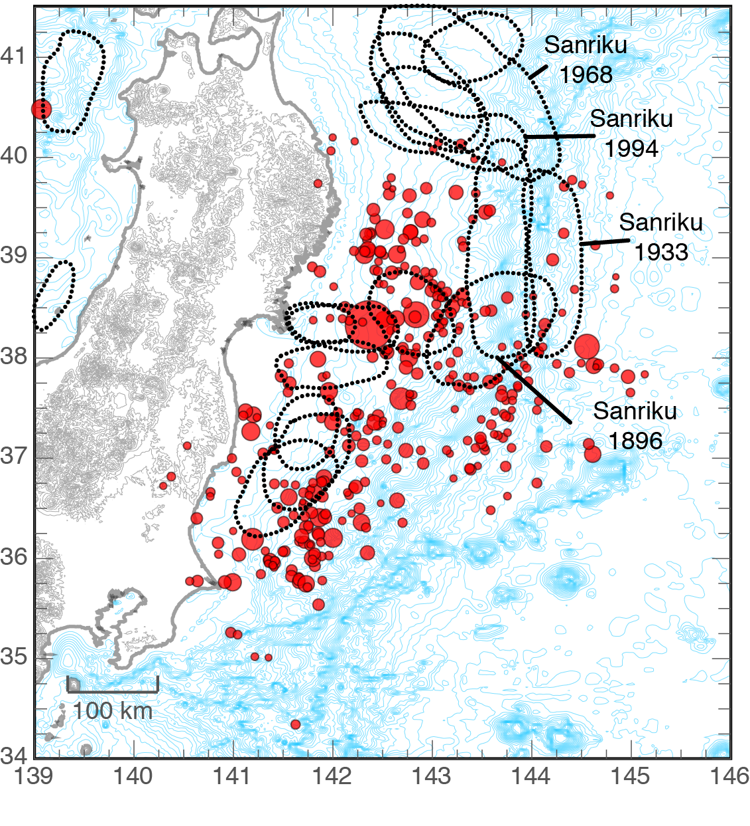
Previous Historical Earthquakes
Lots of earthquakes
Large (up to M 8+)
Not gigantic (M 9)
Image: Chuck Ammon; Rupture outlines: Hiroo Kanamori; Earthquake Locations: USGS

Slide 4
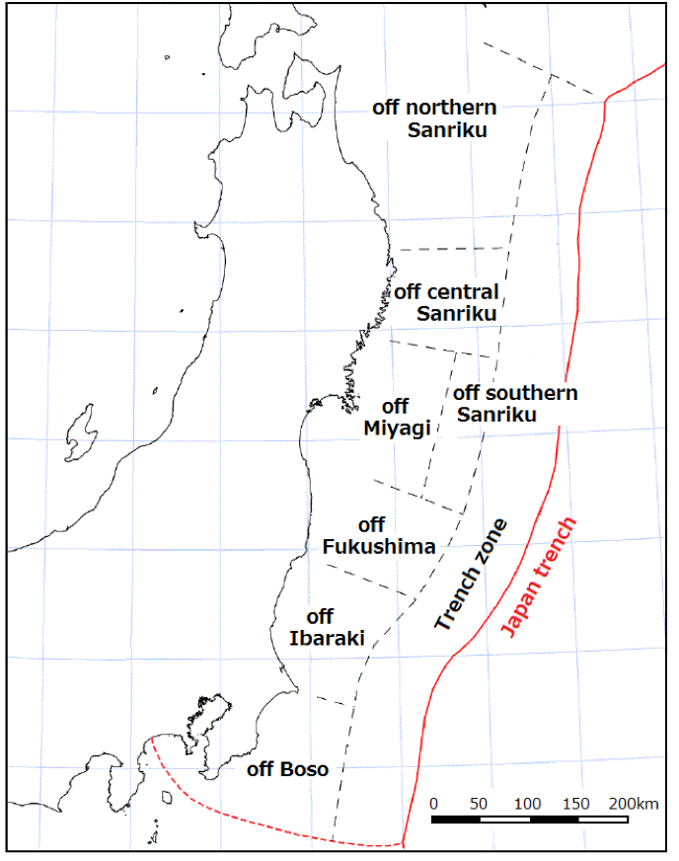
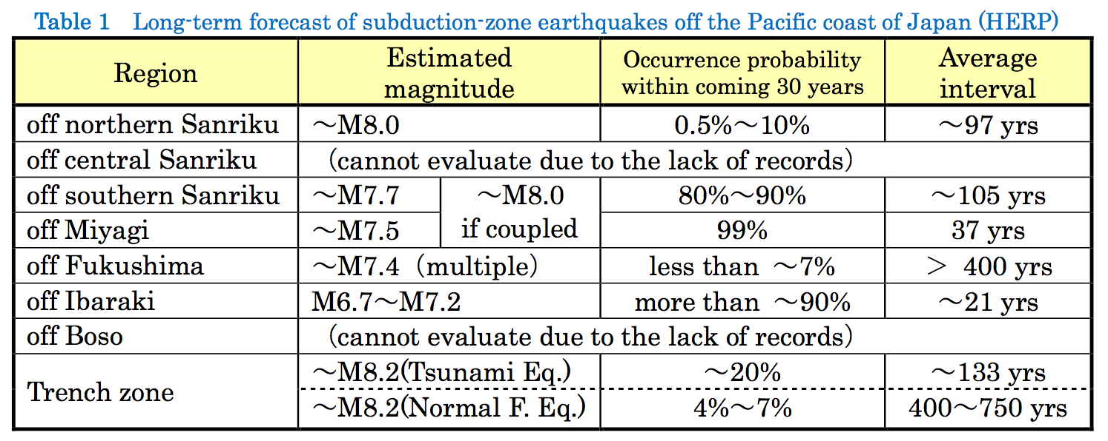
Segmentation Model
Off Miyagi between 1793 and 1978, 6 earthquakes
(M 7.3-8.2 ) – occurred for average interval of 37.1 years.
30-year probability of 99% (highest in Japan).
M 7.2 earthquake occurred in 2005. Since the size was less than estimated level of M7.5, the “expected” earthquake was not considered to have occurred.
Adapted from Preliminary report of the 2011 off the Pacific coast of Tohoku Earthquake Mar. 25, 2011 Yoshimitsu Okada (President, NIED)

Slide 5
Whole (M 9.0) >> Sum of the Parts
Sum of Parts:
M 8.0 + M 7.4 + M 7.2 + M 8.2 = M 8.3
Energy released by M 9.0 is ~ 10x that released by an M 8.3 earthquake.
When larger fault area breaks, slip is much greater.
Adapted from Preliminary report of the 2011 off the Pacific coast of Tohoku Earthquake Mar. 25, 2011 Yoshimitsu Okada (President, NIED)

Slide 6
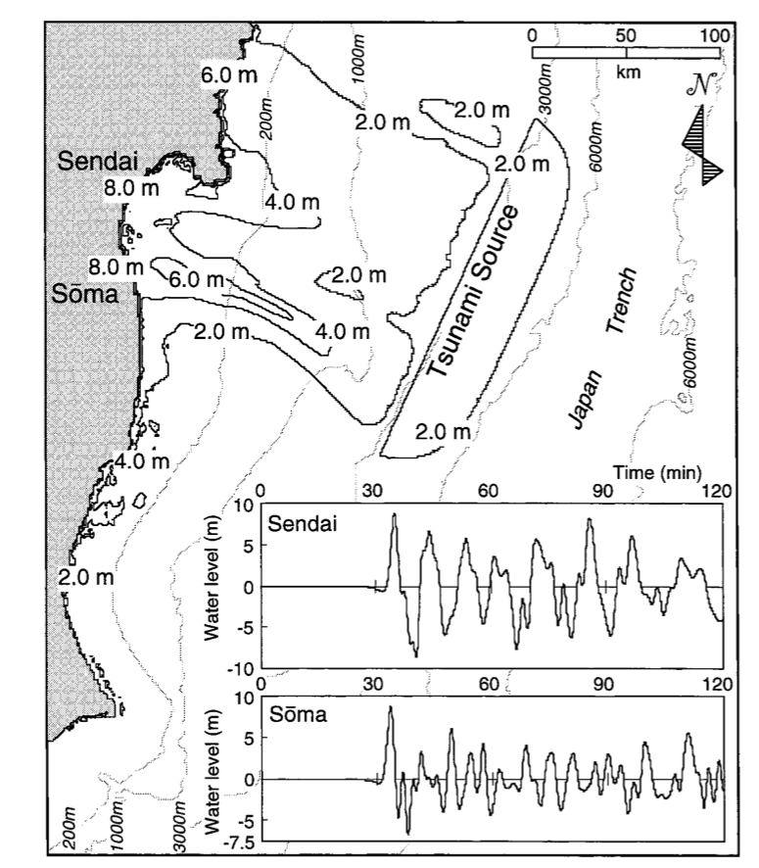
Geologic Evidence for Larger Earthquakes
Evidence of large 869 AD Jogan earthquake with tsunami. Perhaps M_{w} 8.3 (Minoura et al., 2001), but could have been larger.
1611 Keicho earthquake had a large tsunami too, but unclear how extensive.
Also noted deposits from two earlier tsunamis indicating, “…gigantic tsunamis occurred three times during the last 3000 years.”
They wrote, “More than 1100 years have passed since the Jogan tsunami and, given the recurrence interval, the possibility of a large tsunami striking the Sendai Plain is high.”
Earth scientists will be searching the world’s coasts and ocean floor to find evidence for ancient tsunamis.

Slide 7
Outstanding Research Questions:
What have we learned and where do we go from here?
(1) How could this earthquake and tsunami have been anticipated?
(2) How can a fault slip so much?

Slide 8
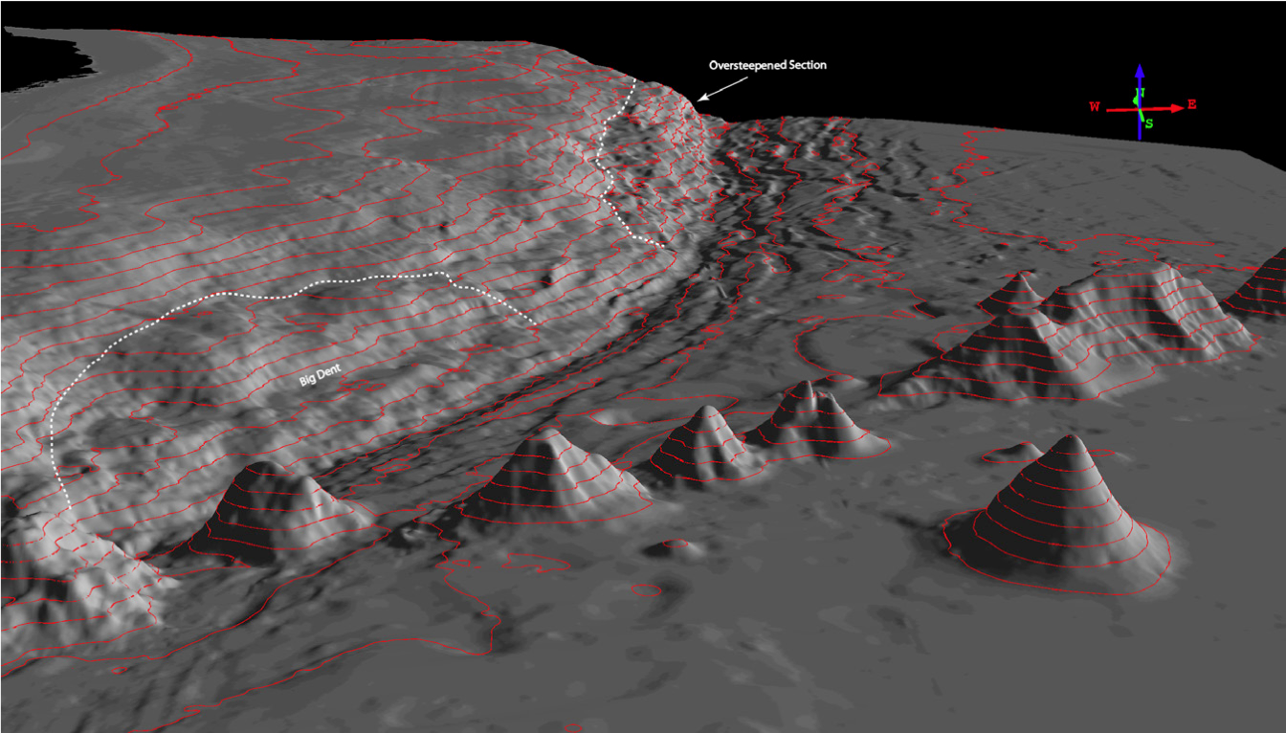
High Strength due to Seamount Subduction?
Hudnut (2011)
Possible supporting evidence from tomography (Matsubara and Obara, 2011).

Slide 9
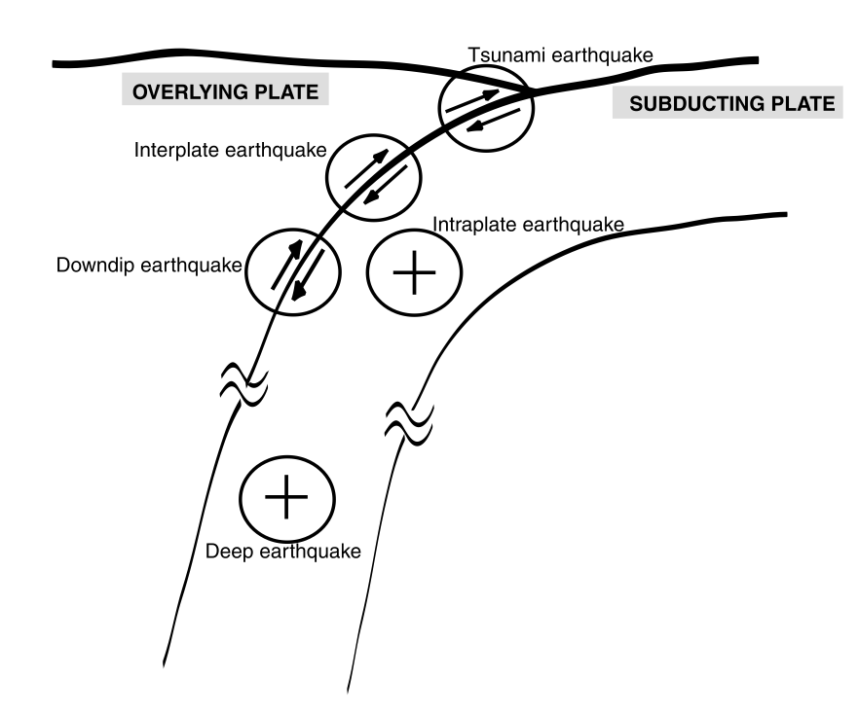
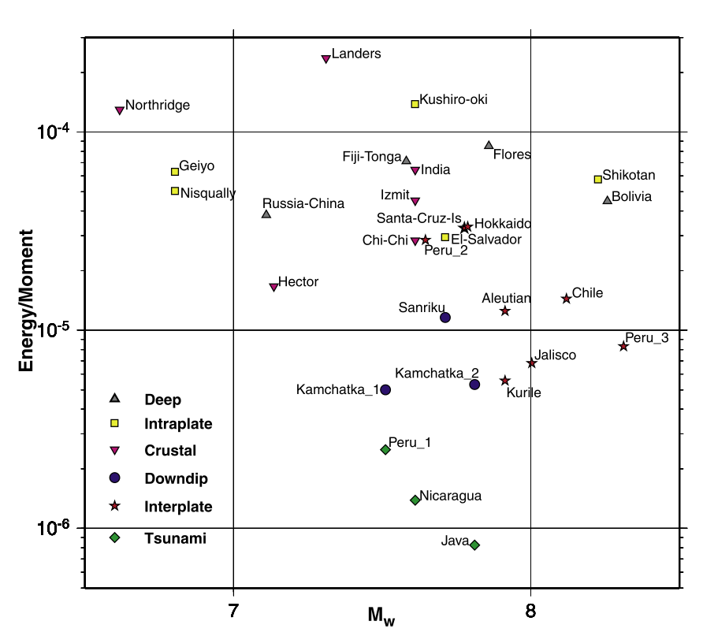
High Fracture Energy?
Venkataraman and Kanamori (2004)

Slide 10
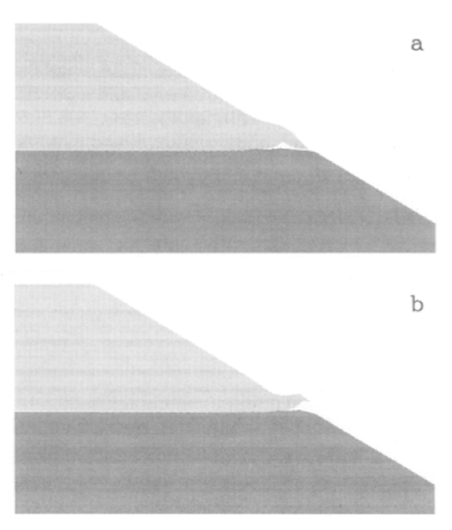
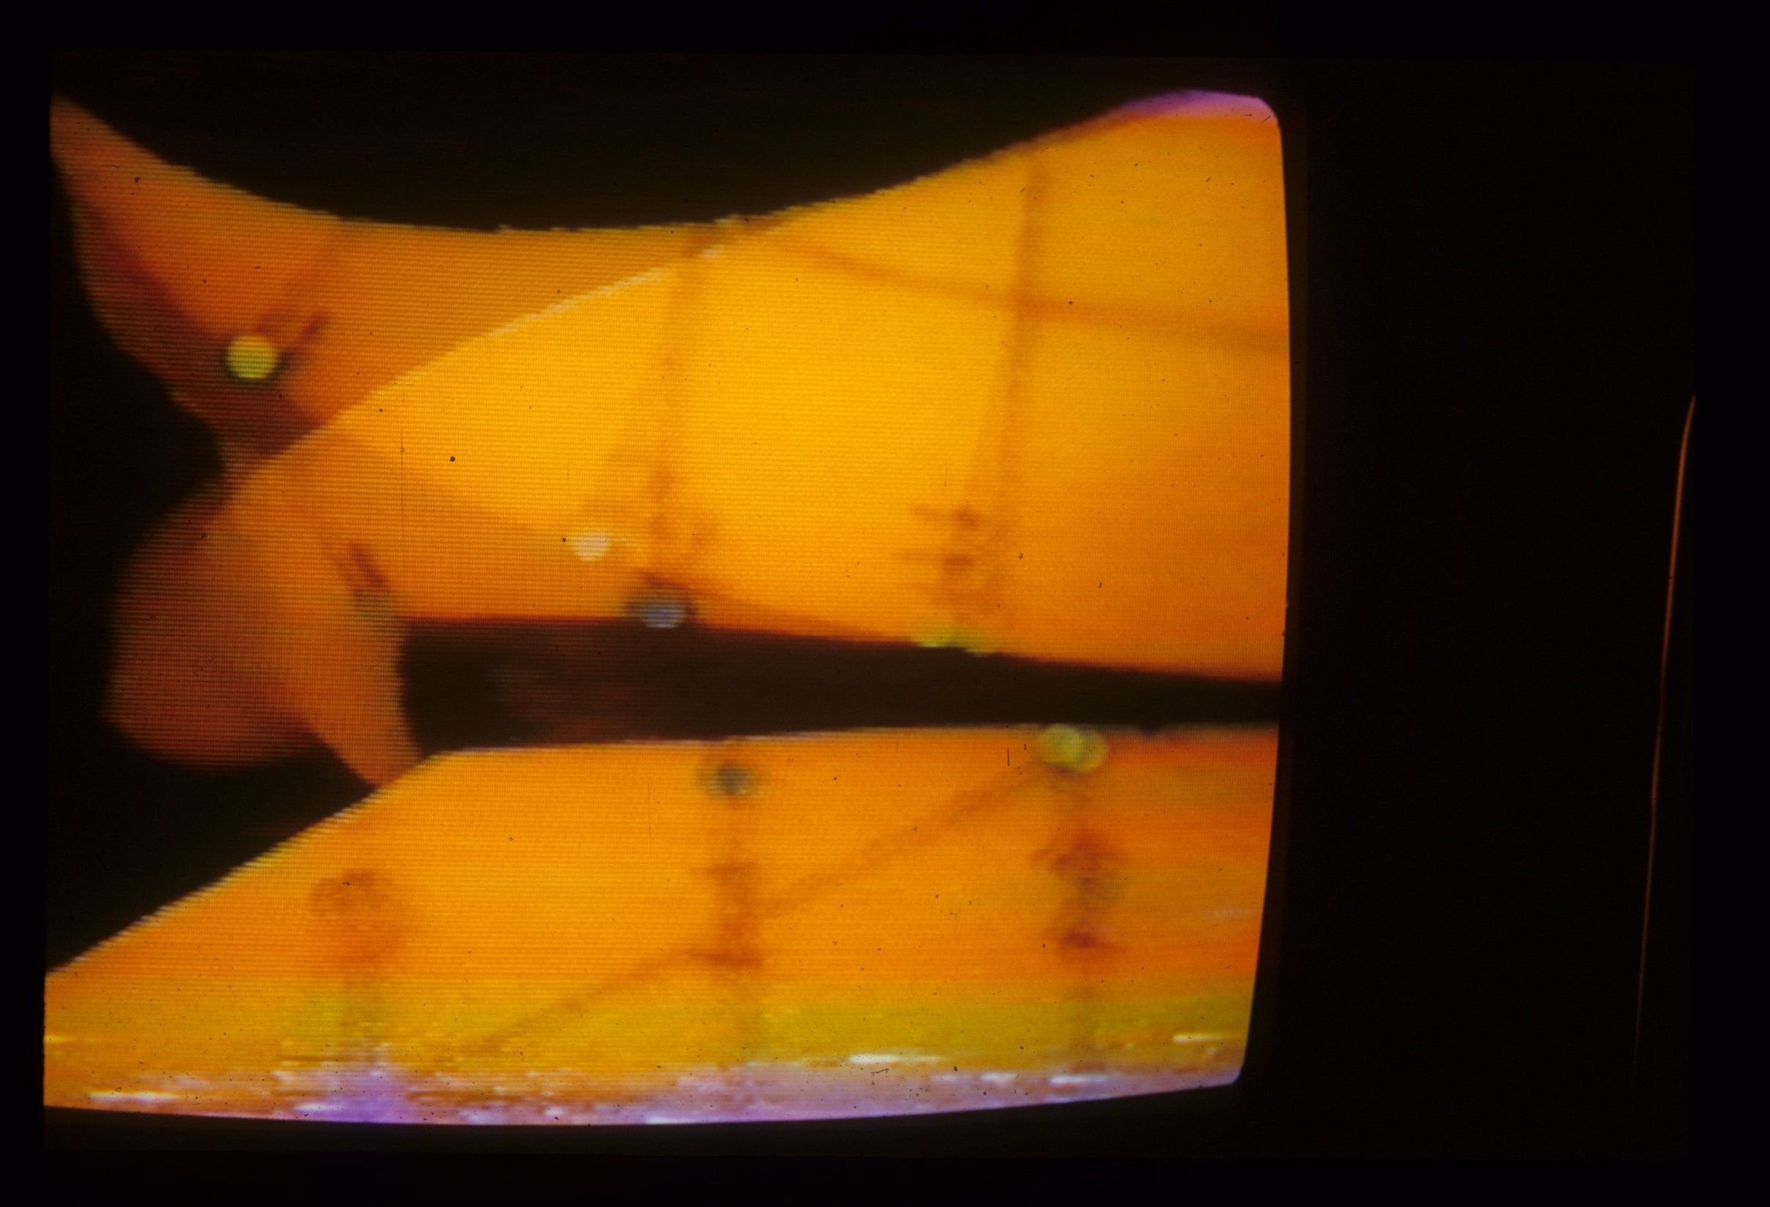
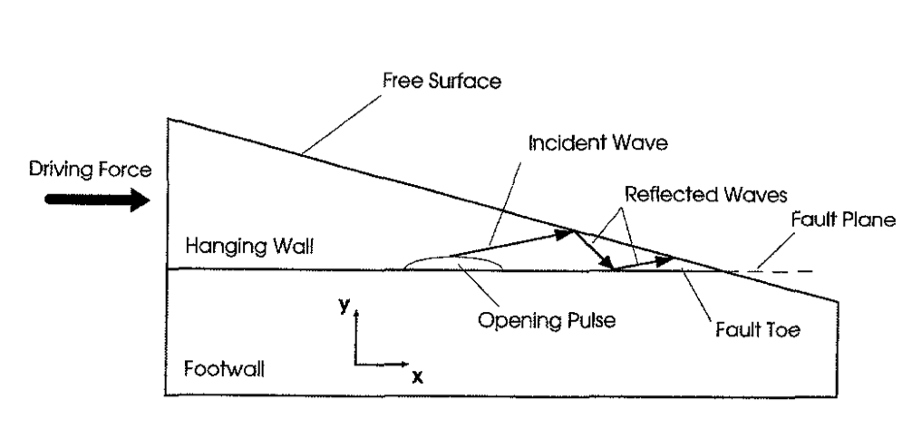
Hanging Wall Effect?
Shi et al. (1998)

Slide 11
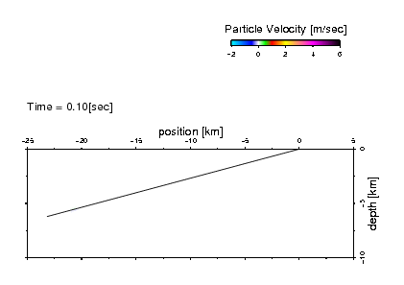
Slip on Fault with Shallow (15°) Dip
Tamura and Ide

Slide 12
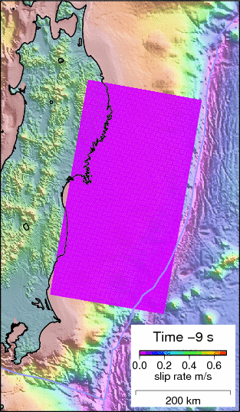
Animation of Slip Evolution
Slip-rate distribution for the fault that ruptured in the magnitude 9.0, March, 11, Tohoku Oki earthquake.
Time in seconds relative to the mainshock origin time is shown in the legend in the lower right. Slip-rate (in meters/second) is shown with colors as the earthquake evolves.
What physical mechanism(s) enable such enormous slip?
Ide et al. (2011)

Slide 13
Outstanding Research Questions:
What have we learned and where do we go from here?
(1) How could this earthquake and tsunami have been anticipated?
(2) How can a fault slip so much?
(3) What are the implications for future hazard in Japan?

Slide 14
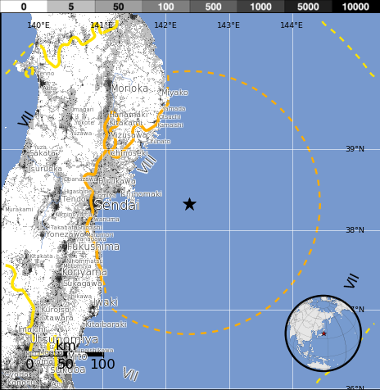
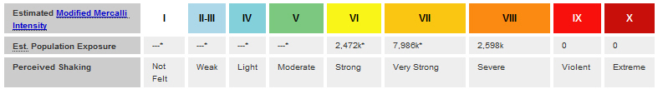
10+ Million People Exposed to Strong Motion
USGS PAGER
Population Exposed to Earthquake Shaking
The USGS PAGER map shows the population exposed to different shaking levels.
Overall, the population in this region resides in structures that are resistant to earthquake shaking.
Tsunami grabbed headlines, but despite the huge exposure there was only limited damage from widespread intense shaking.
The color coded contour lines outline regions of MMI intensity. The total population exposure to a given MMI value is obtained by summing the population between the contour lines. The estimated population exposure to each MMI Intensity is shown in the table below.
Image courtesy of the US Geological Survey

Slide 15
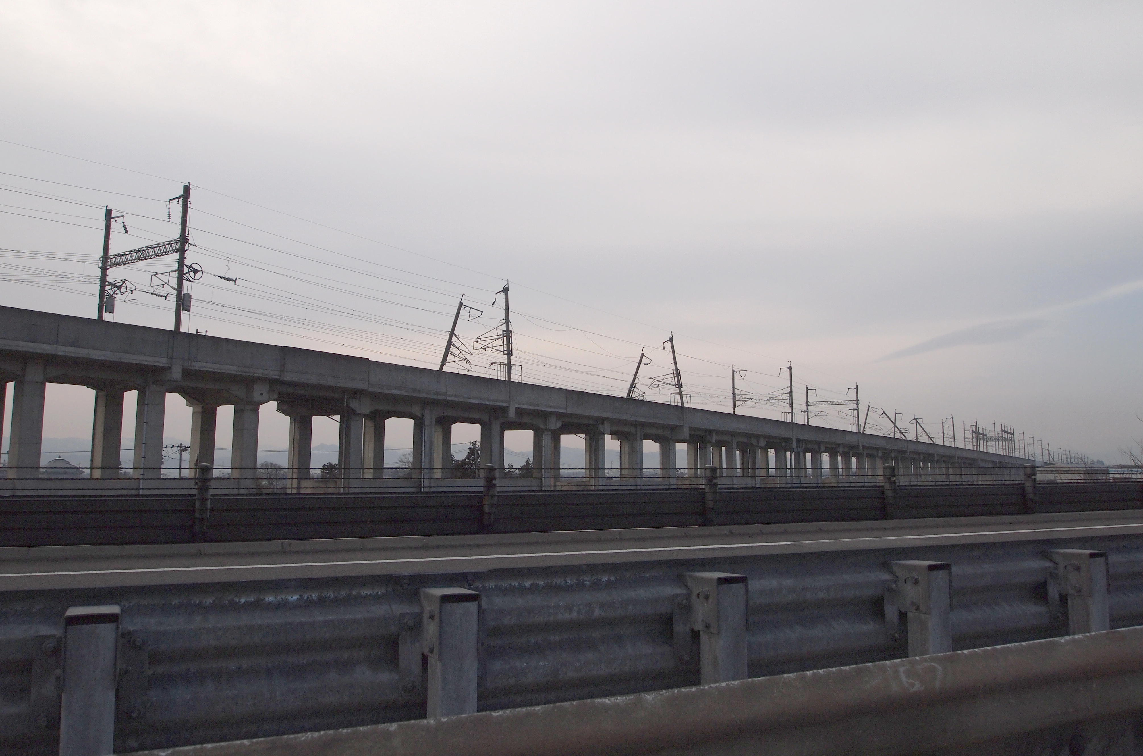
Transportation Infrastructure Affected
Damage to Tohoku Shinkansen line. 24 trains shut down automatically. Limited damage to tracks, bridges, and tunnels (resiliency)

Slide 16
Outstanding Research Questions:
What have we learned and where do we go from here?
(1) How could this earthquake and tsunami have been anticipated?
(2) How can a fault slip so much?
(3) What are the implications for future hazard in Japan?
(4) What are the implications for hazard elsewhere?

Slide 17
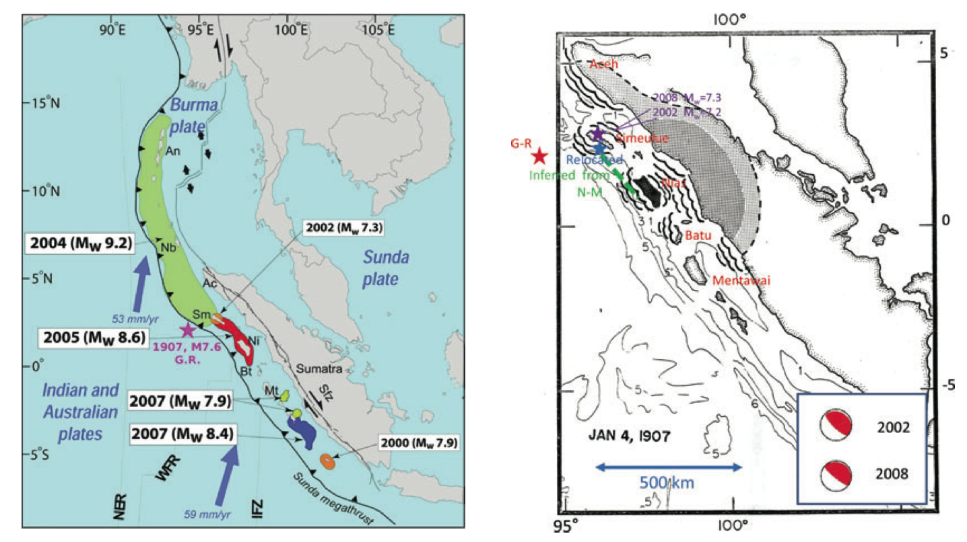
1907 Sumatra Tsunami Earthquake
Interplate earthquake, near trench slip, extensive tsunami
Kanamori et al. (2010)

Slide 18
Accurate Hazard Characterization is Required if Risk Mitigation is to be Effective
Extreme Events: Size of the earthquake was unanticipated. The last earthquake of this size there may have been 869 AD Jogan earthquake. Record in Japan is among the longest anywhere, yet earthquakes over the last 1000 years have been considerably smaller. Other parts of the world where unexpectedly large earthquakes might be anticipated?
40,000 km of subduction zones worldwide. Most thought not to be capable of great earthquakes, perhaps due to “segmentation.” Examples include: Java, Central America, Mexico (1787?), Tonga, southern Europe, Makran.
In most places reliable historical records only for last few hundred years. What other surprises are out there?
Multi-disciplinary approach that combines long-term constraints from geology, where processes like gravity and erosion matter, with recent observations is essential to progress.

Slide 19
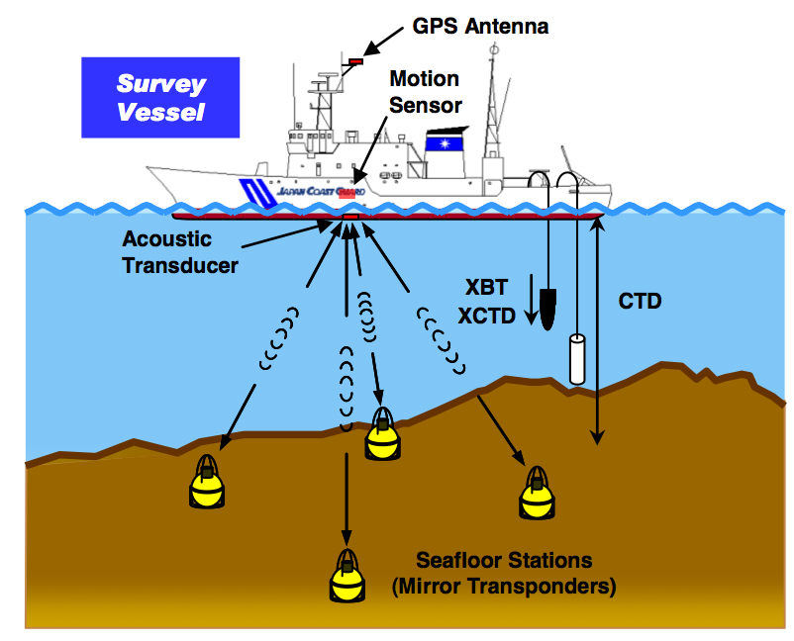
Seafloor Geodesy
Most plate boundaries are underwater, where GPS signals don’t penetrate. Combination of acoustic ranging and ship-born GPS can overcome this.
Sato et al. (2011)

Slide 20
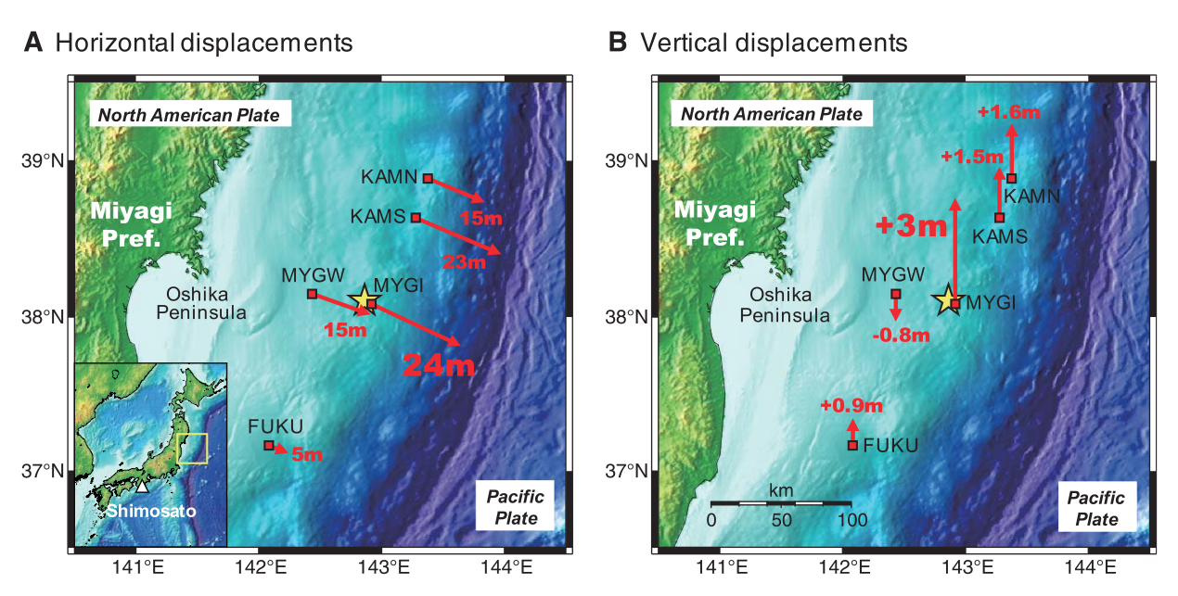
Seafloor Geodesy Confirms Extreme Slip
Monitoring of seafloor deformation will open new opportunities in earthquake science
Sato et al. (2011)

