Slide 1
Structural Seismology
Use recordings of seismic waves to image the internal structure of the Earth.
Transmitted wave imaging (usually low resolution) – solve for velocity or possibly attenuation
Reflected wave imaging (potentially high resolution) – solve to impedance.
For horizontal boundaries in a layered Earth: P-SV scatters into P-SV and SH scatters into SH

Slide 2
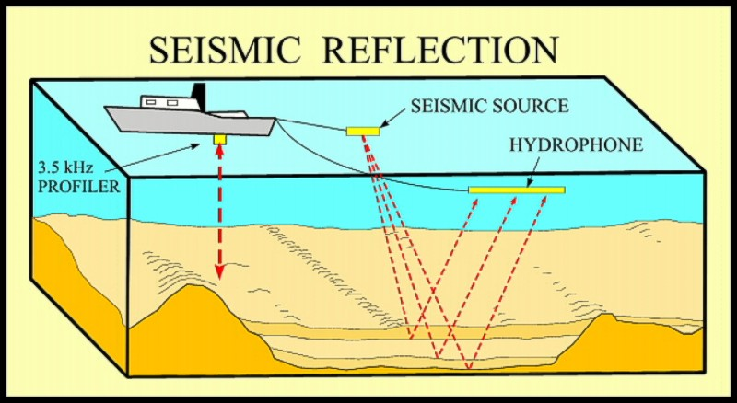
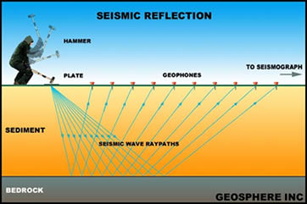
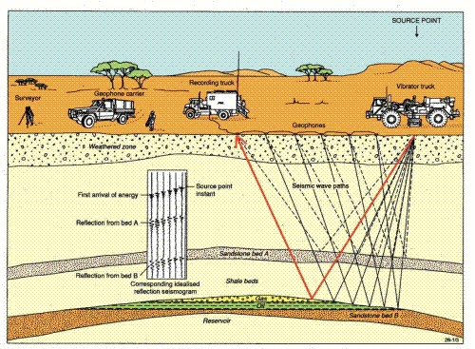
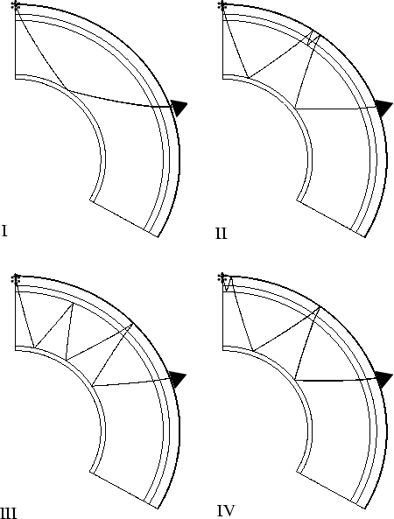
Reflection Imaging over a Range of Scales

Slide 3
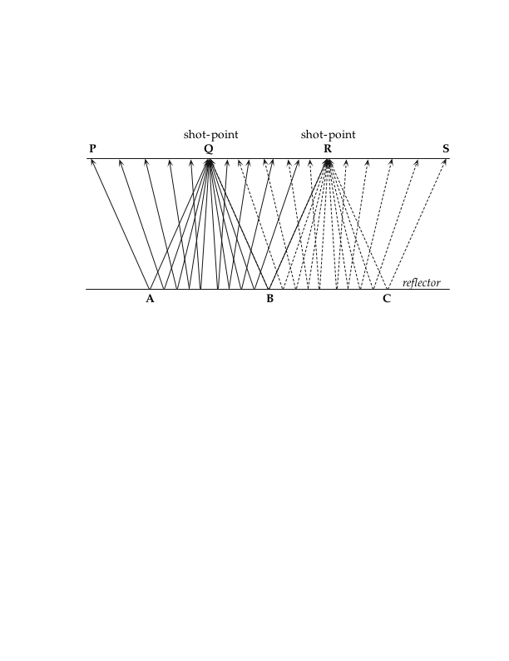
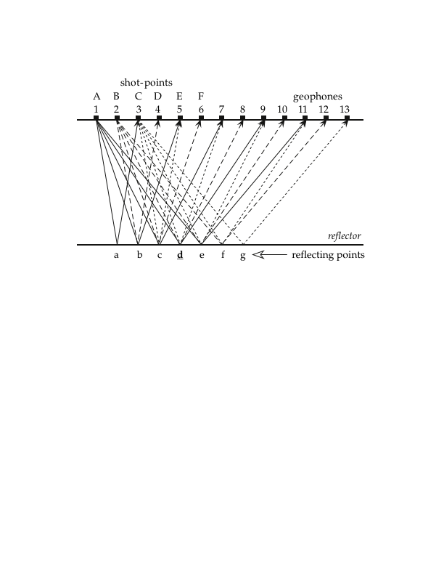
Seismic Reflection Data
Split-Spread Method
Common-Mid-Point Method

Slide 4
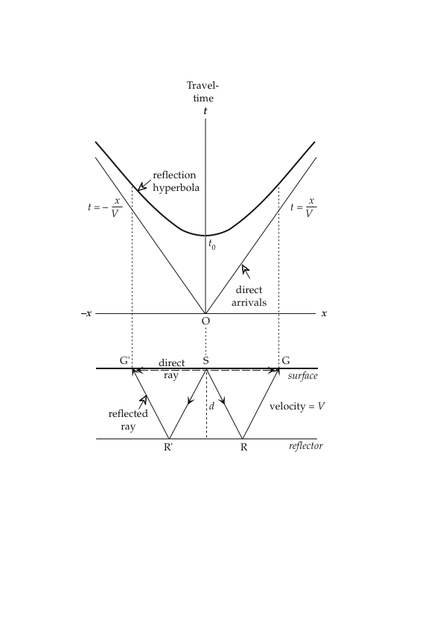
Reflection from Horizontal Boundary
Formula for travel time of a reflected wave. 2d/V is the zero-offset time, and the rest defines the normal moveout (NMO) correction.
t vs. x describes a hyperbola.

Slide 5
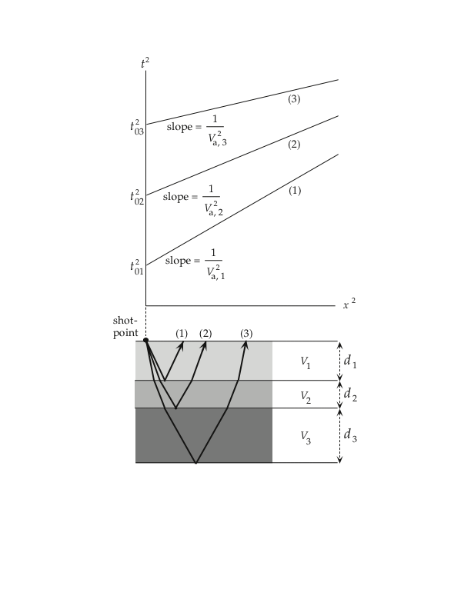
Reflection from Horizontal Boundary
Another way of writing the same relation,
shows t² is linear in x² with slope V⁻²:
This can be used to solve for V of the
shallowest layer, given observations
of t. This is referred to as the interval
velocity, V₁. The arrival times from deeper layers can be modeled using the rms velocity of the interval layers:

Slide 6
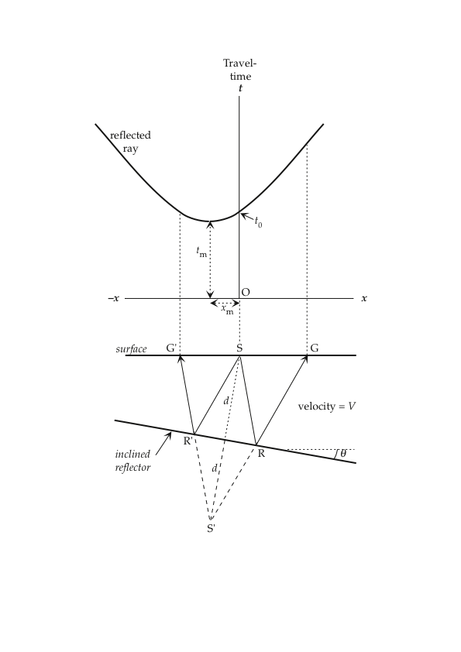
Reflection from Inclined Boundary
This also describes a hyperbola, but its axis of symmetry and minimum travel time are shifted

Slide 7
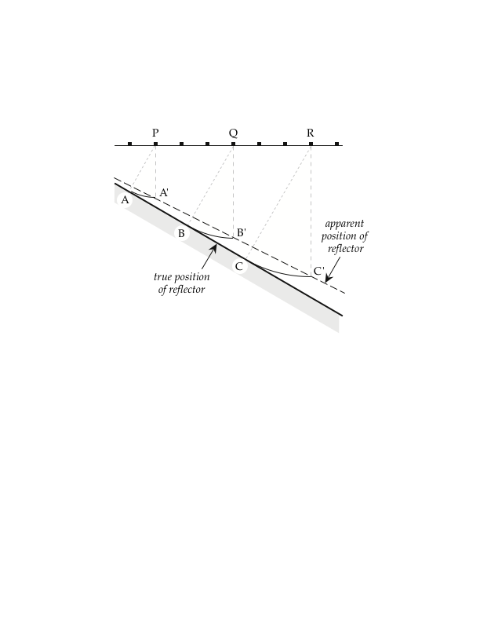
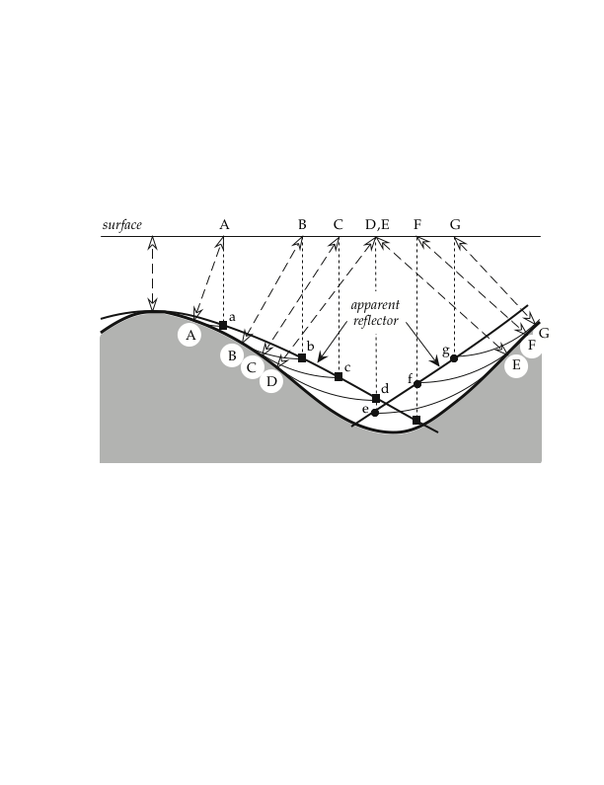
Reflectors can be Mis-located for Dipping Structures

Slide 8
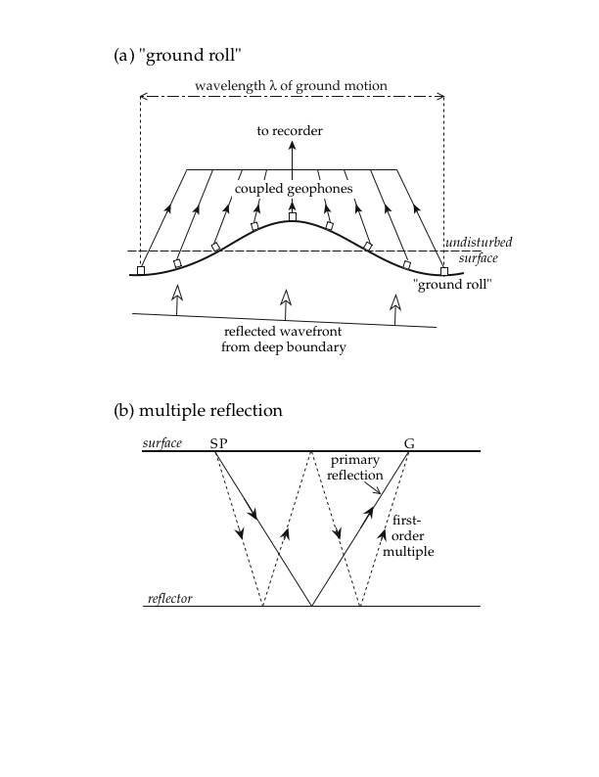
Sources of Noise in Reflection Seismic Data

Slide 9
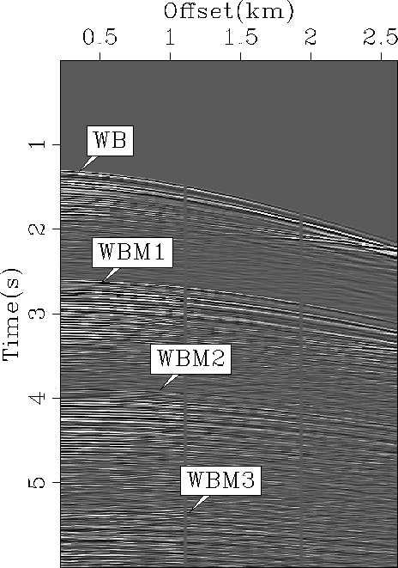
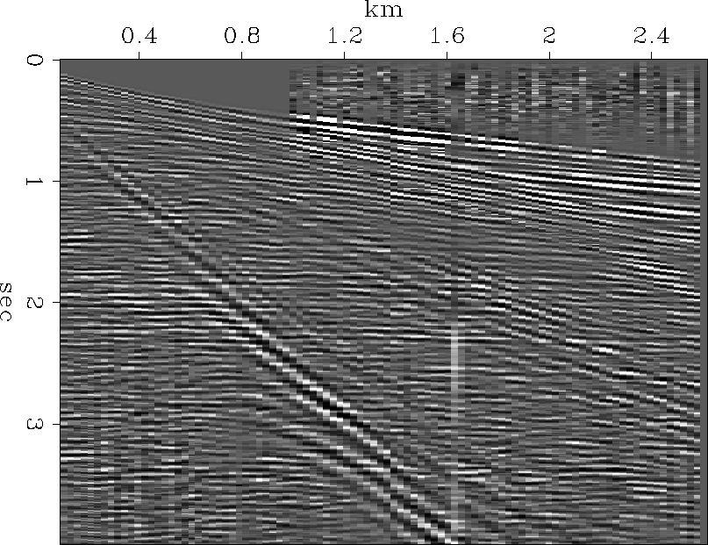
Sources of Noise in Reflection Seismic Data
Ground roll
Multiple reflections

Slide 10
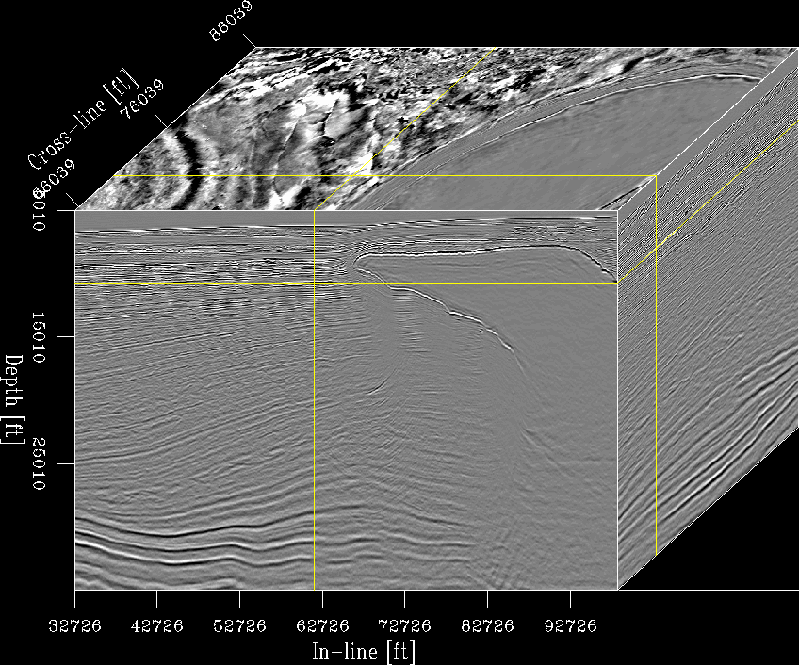
Seismic Reflection Imaging in the Gulf of Mexico

Slide 11
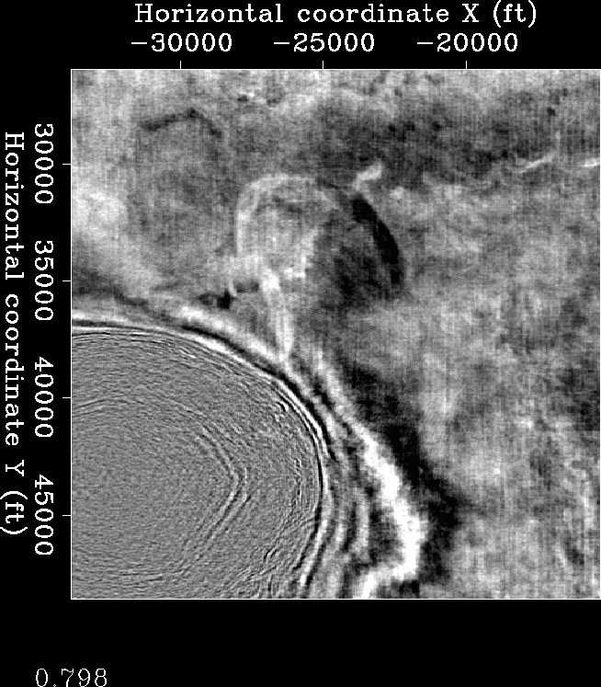
Seismic Reflection Imaging in the Gulf of Mexico

Slide 12
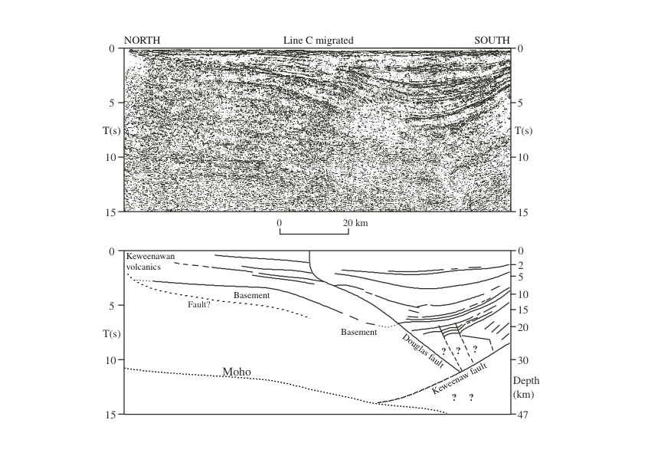
Reflection Imaging Under Lake Superior

Slide 13
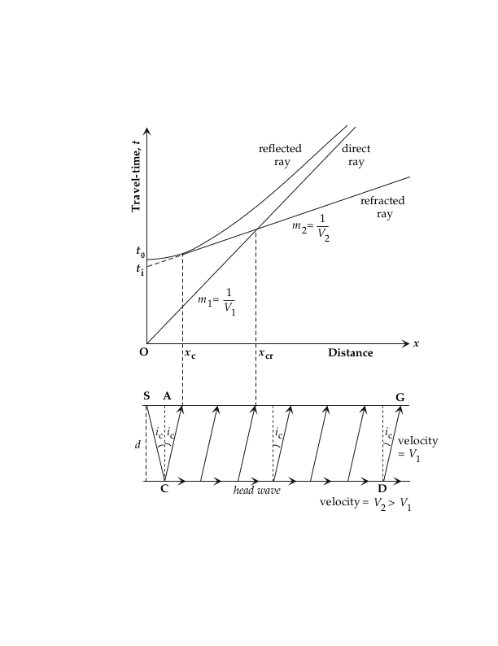
Travel-time Curve for Layer over a Half Space
For the refracted wave:
Which can be simplified to:

Slide 14
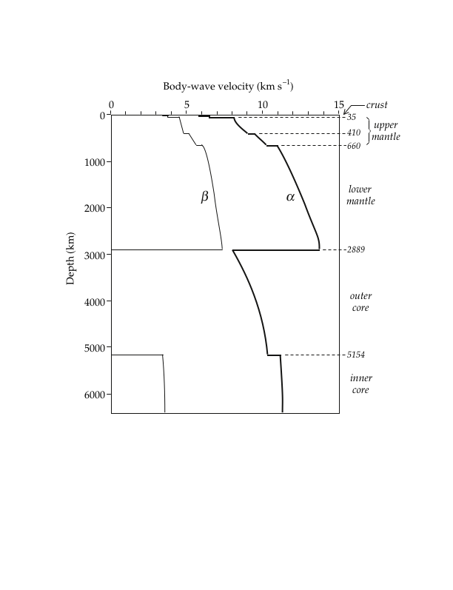
Radial Earth Structure

Slide 15
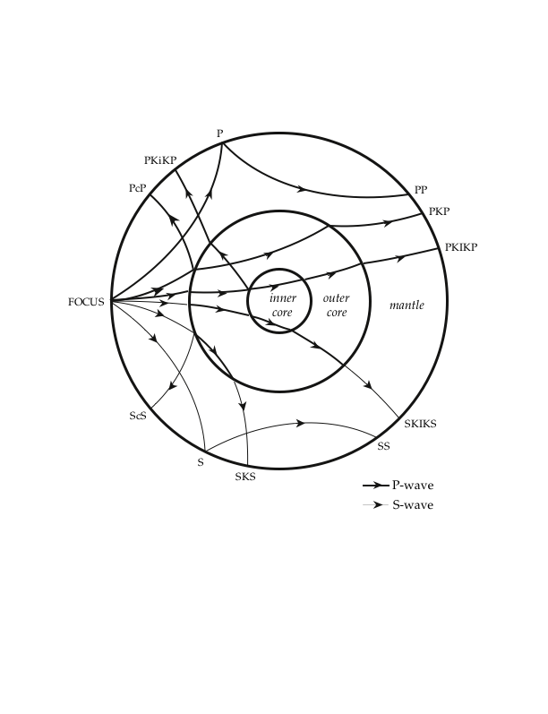
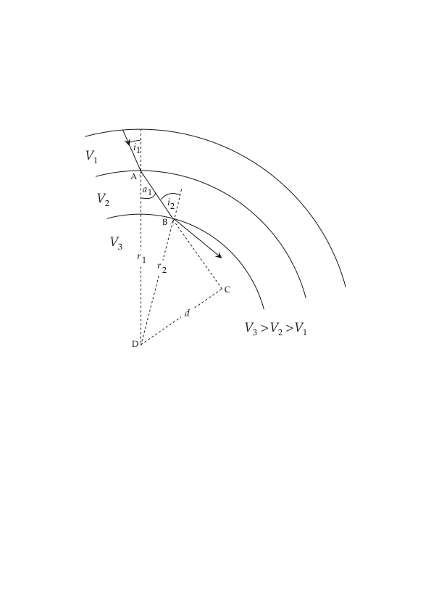
Rays in a Radially Symmetric Earth
Angular slowness is conserved for a ray.

Slide 16
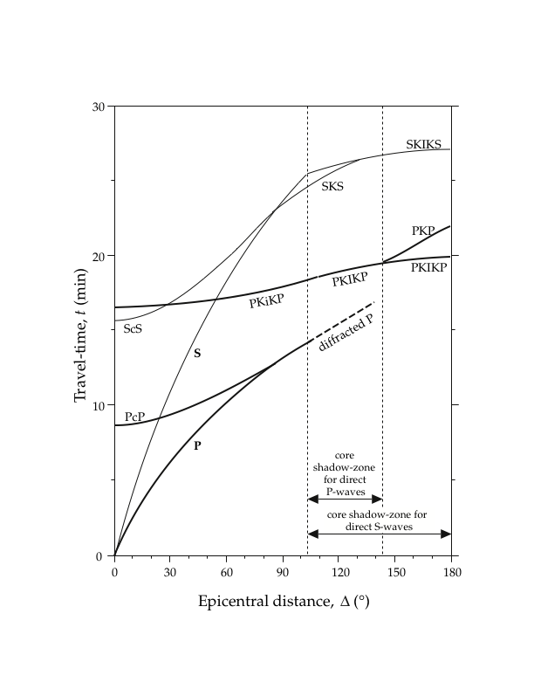
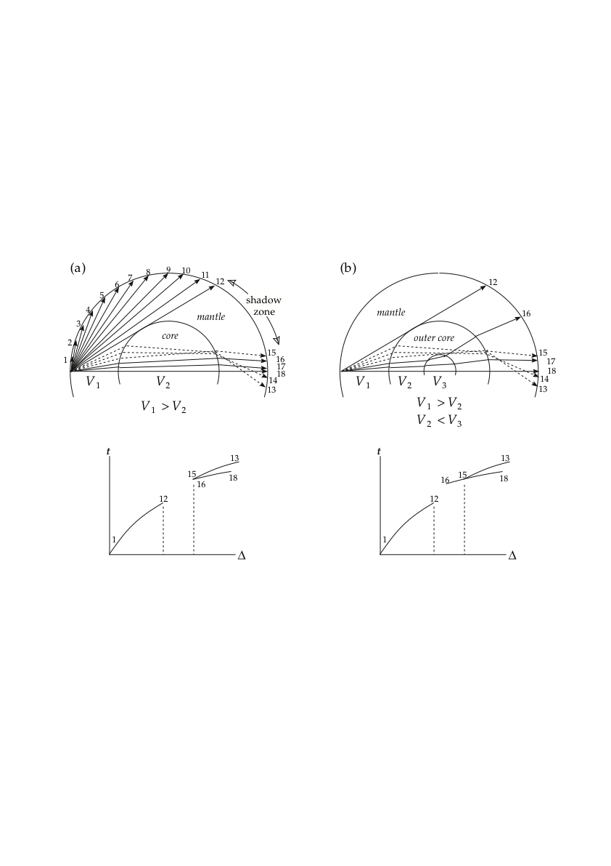
Travel-time Curve for Phases that Interact with the Core

Slide 17
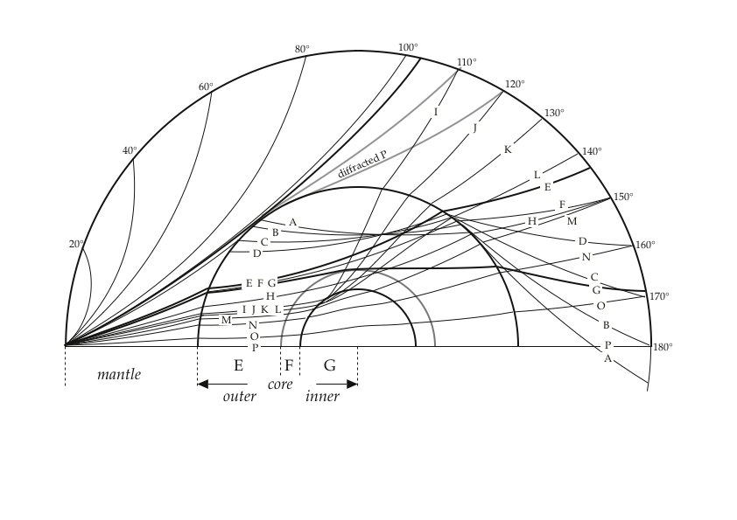
Travel-time Curve for Phases that Interact with the Core

Slide 18
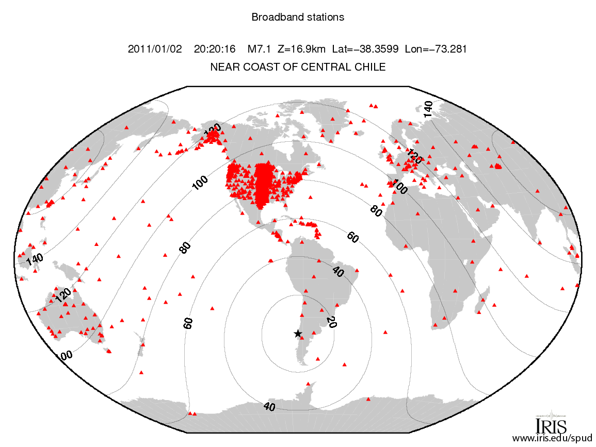

Slide 19
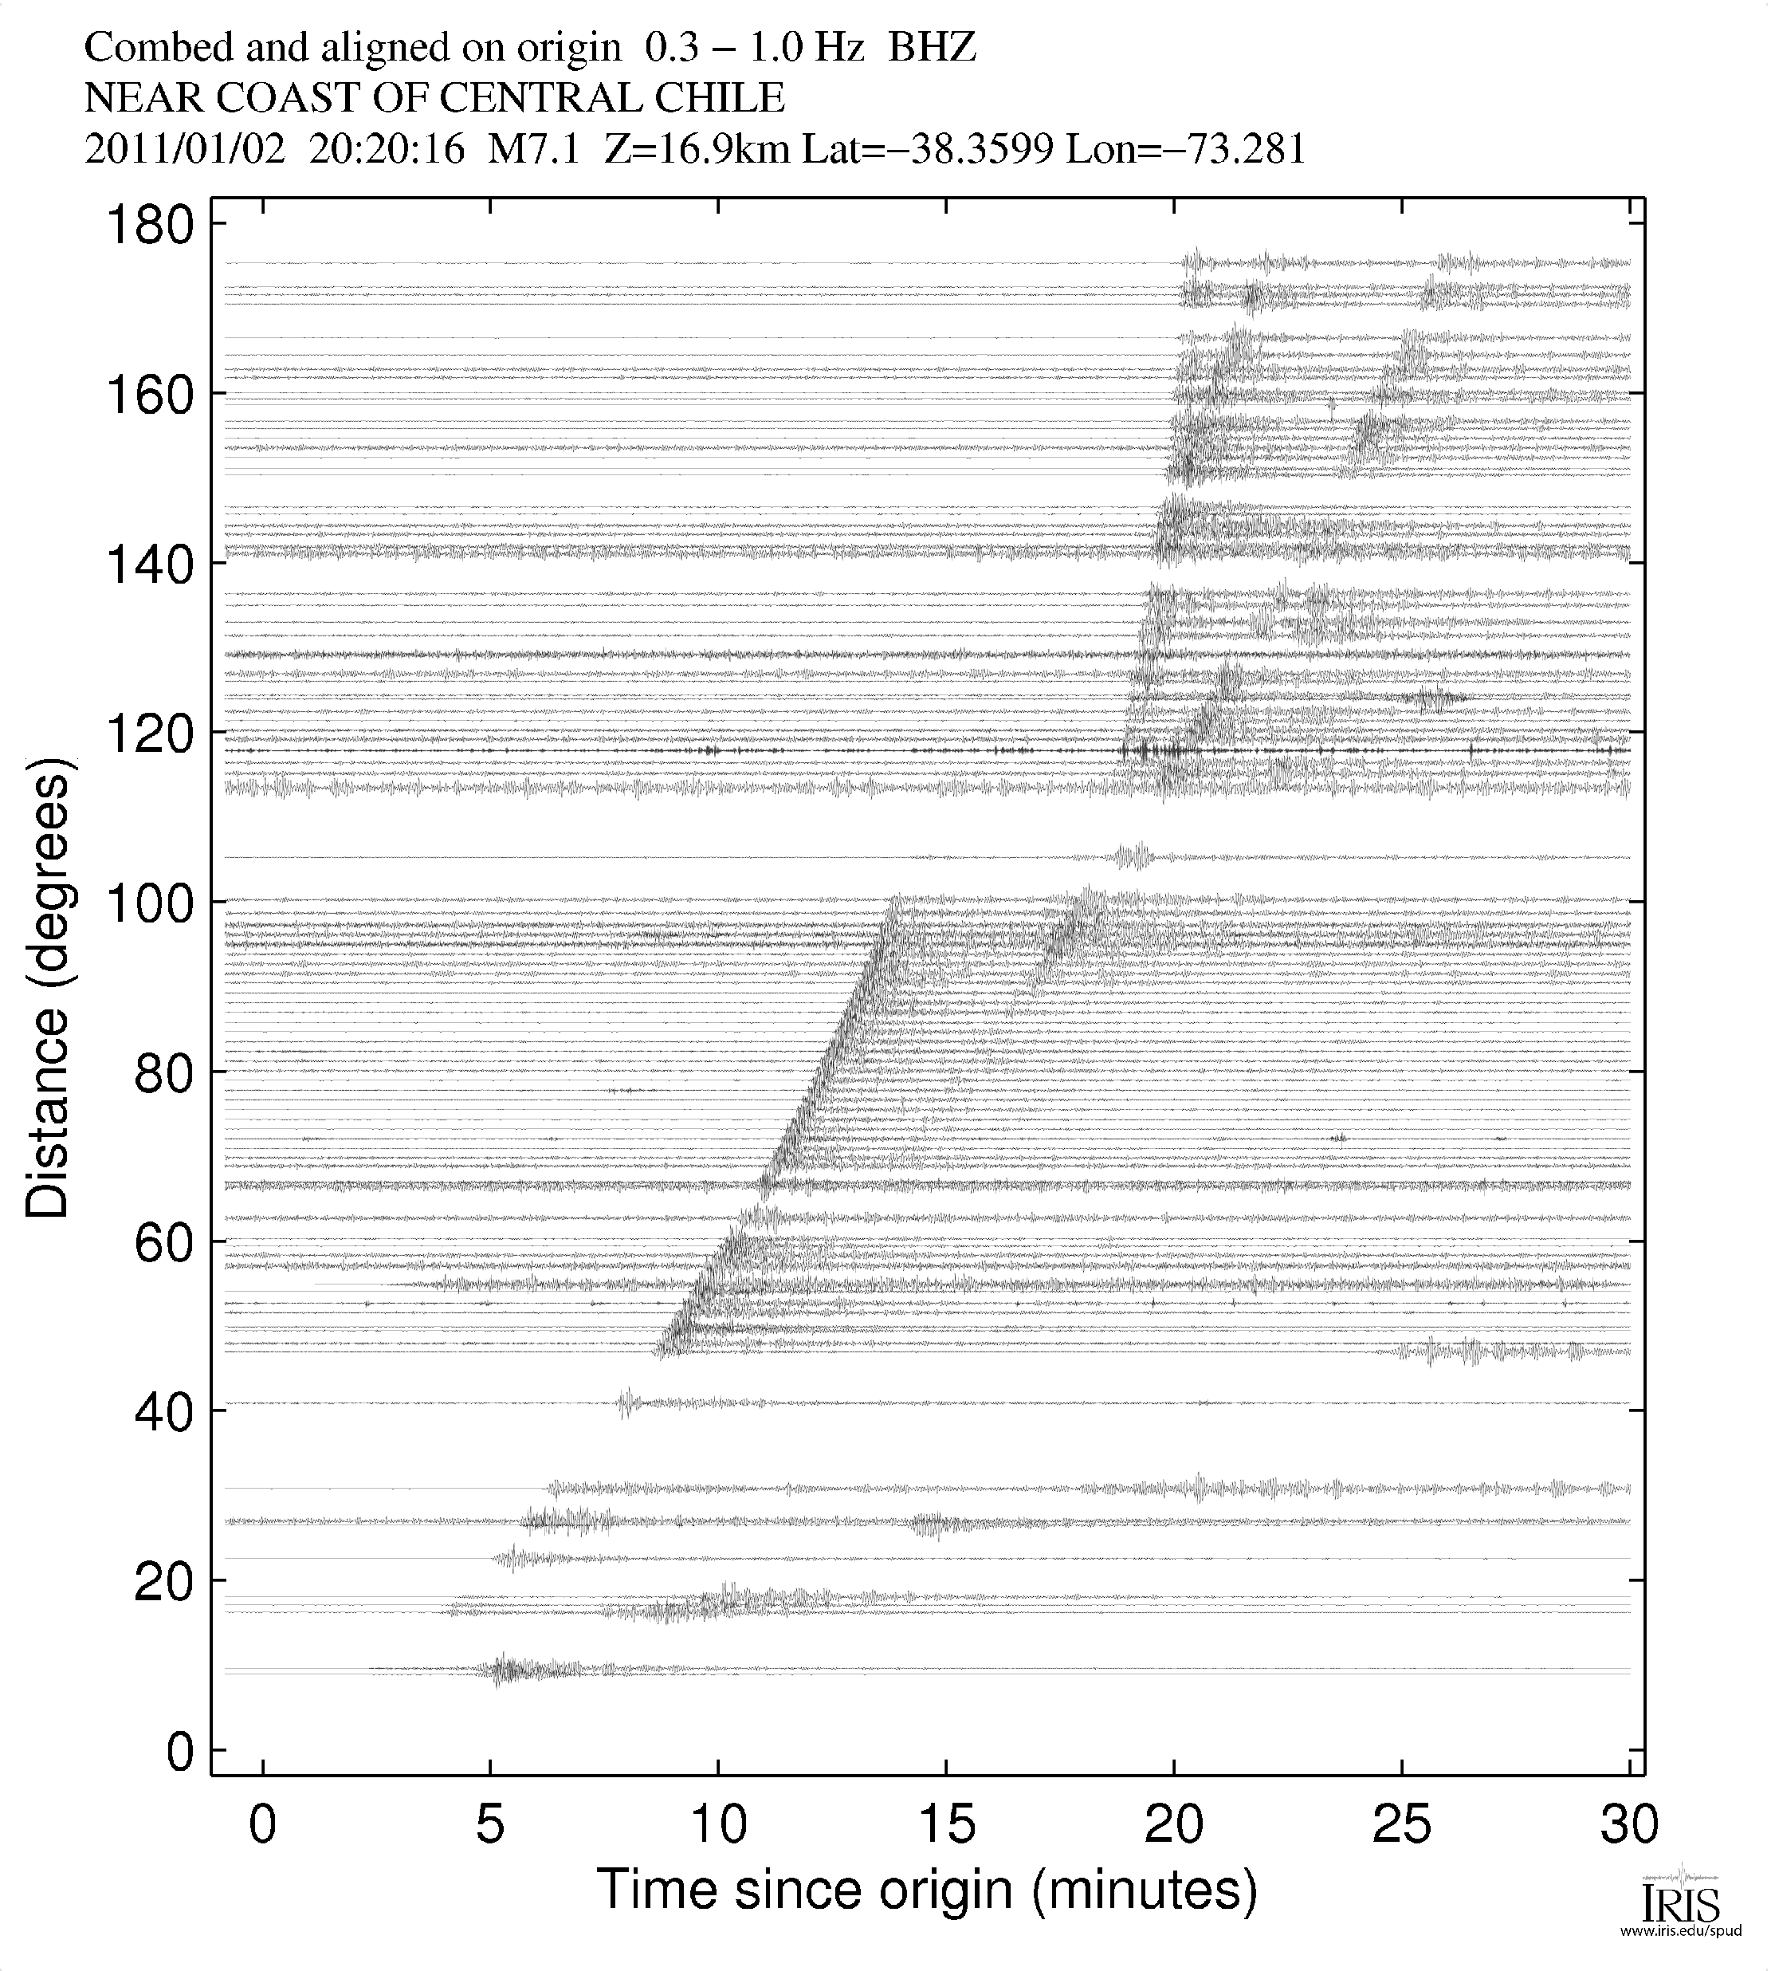

Slide 20
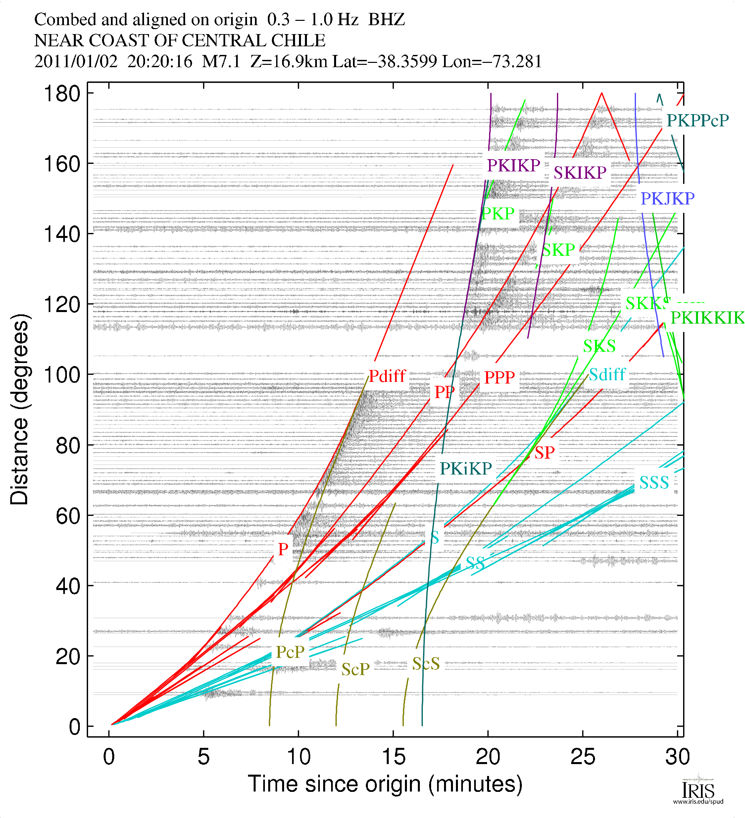

Slide 21
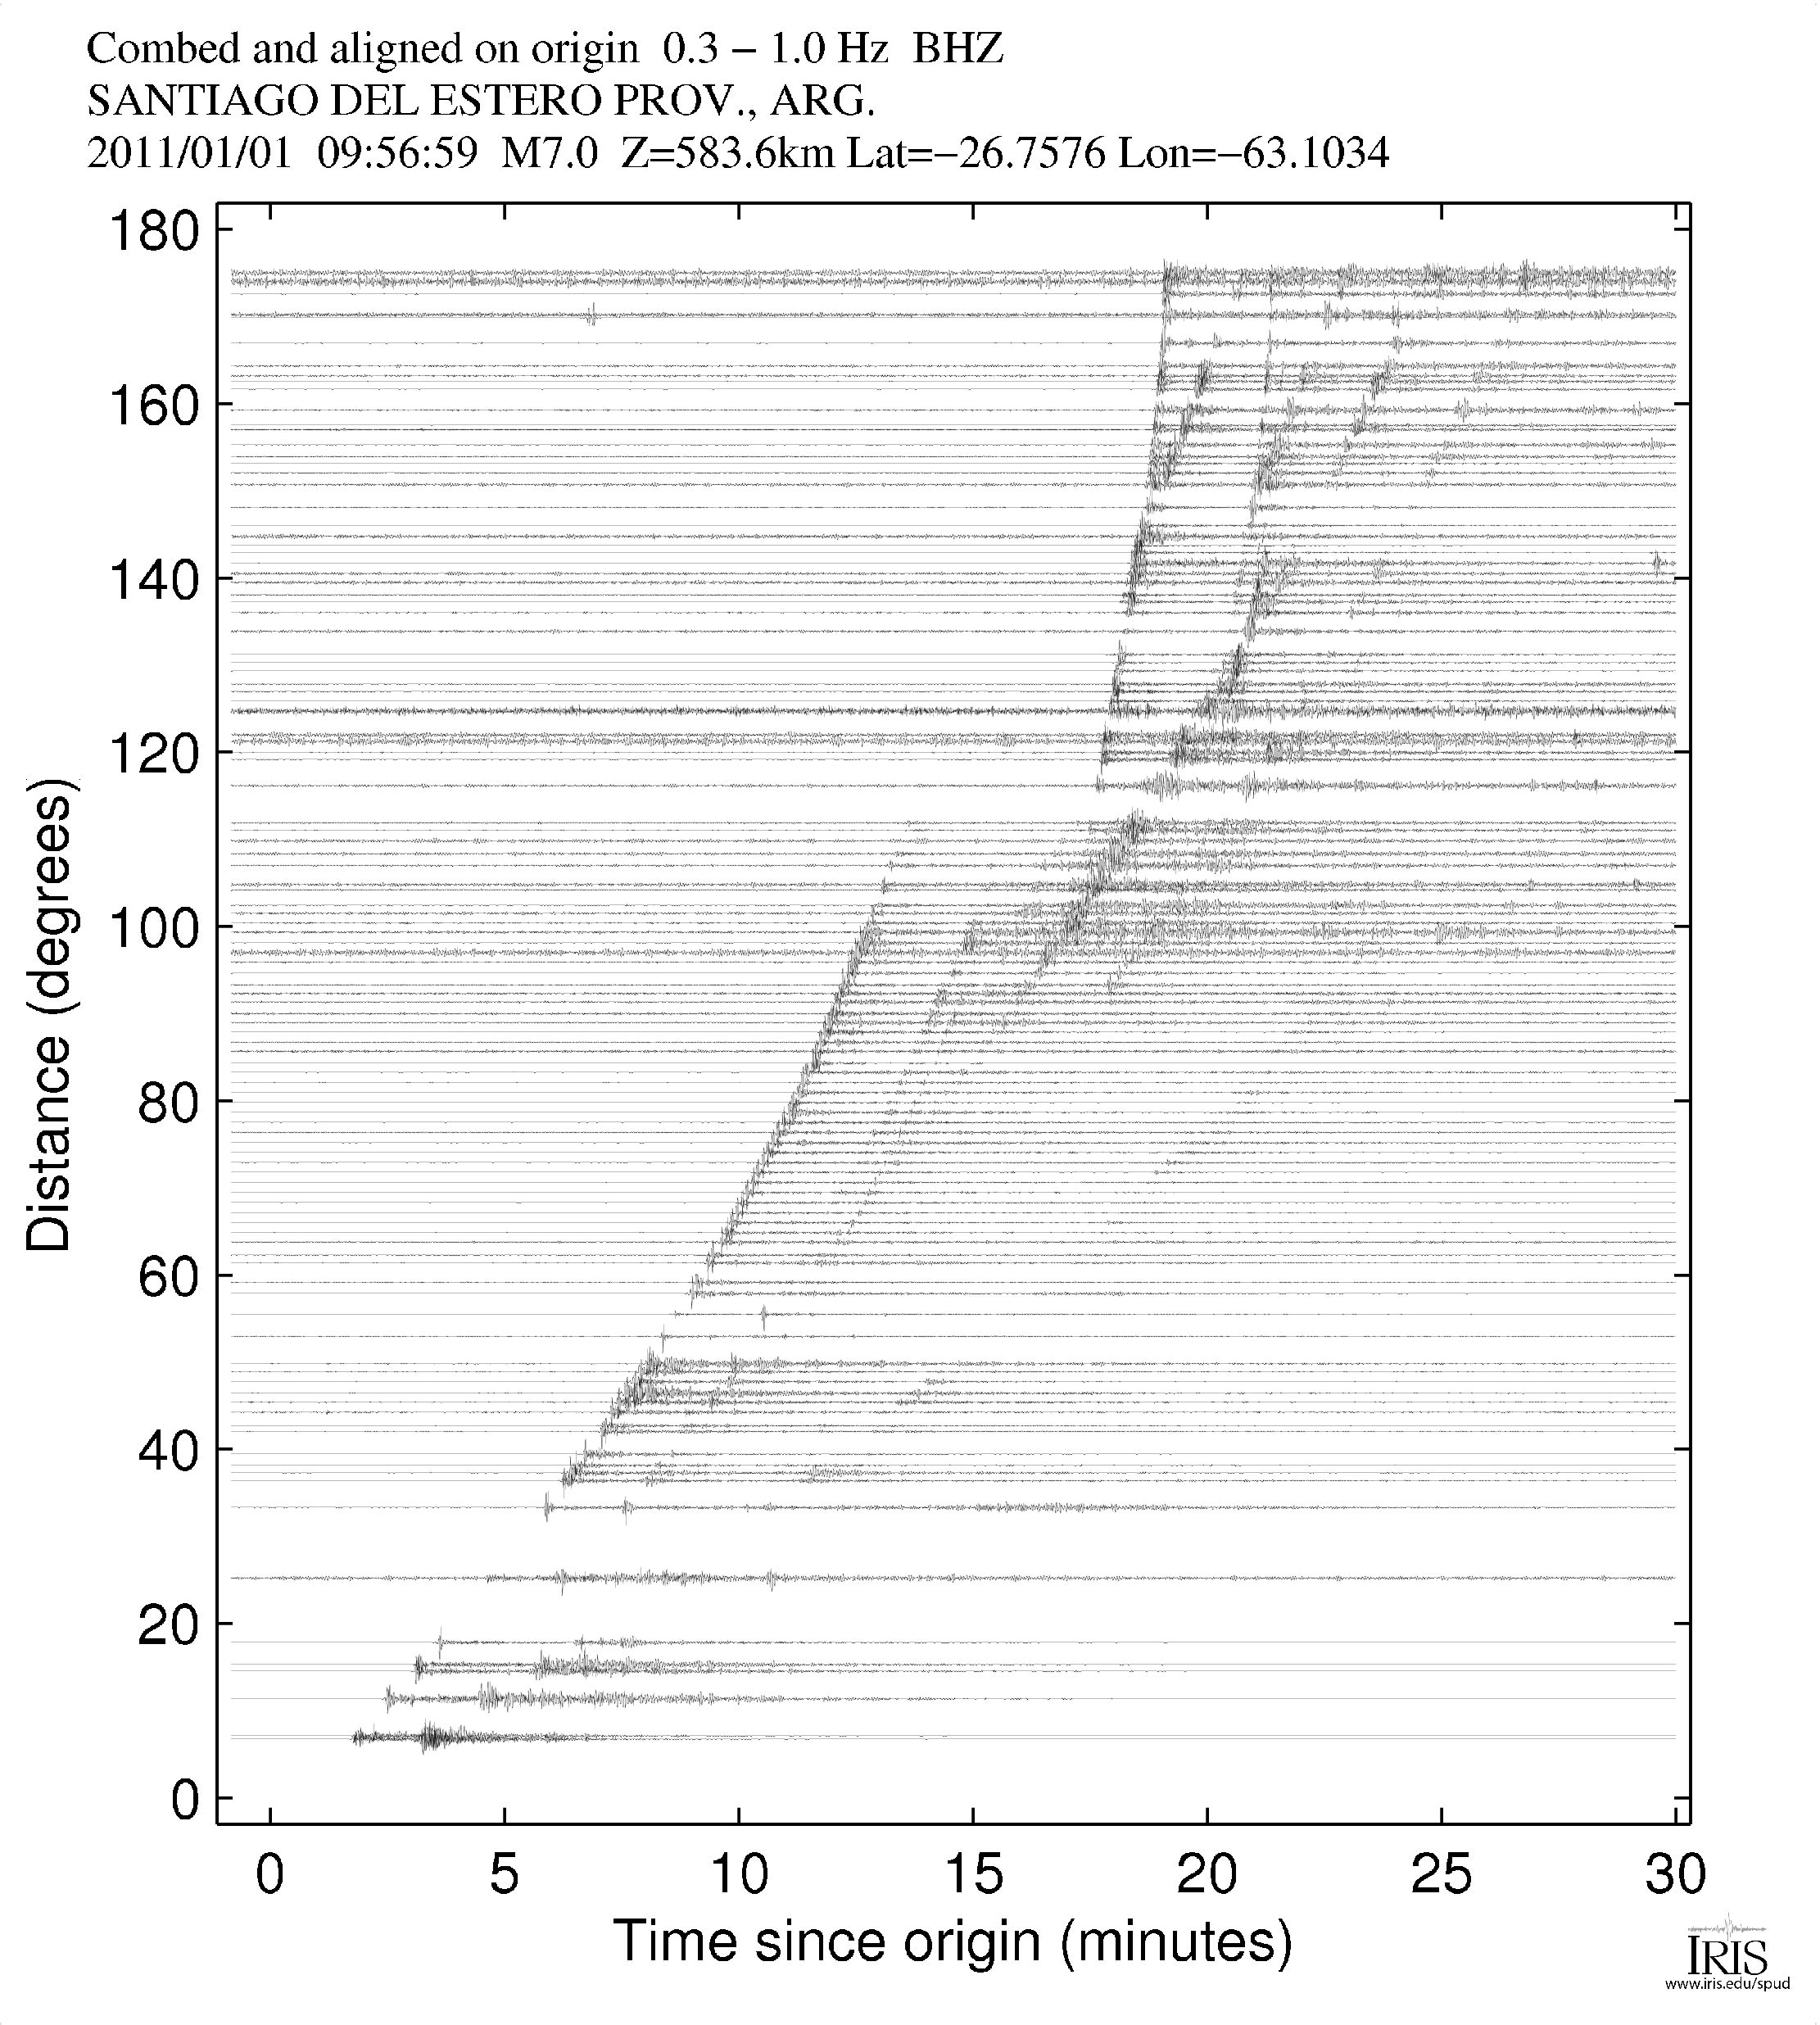

Slide 22
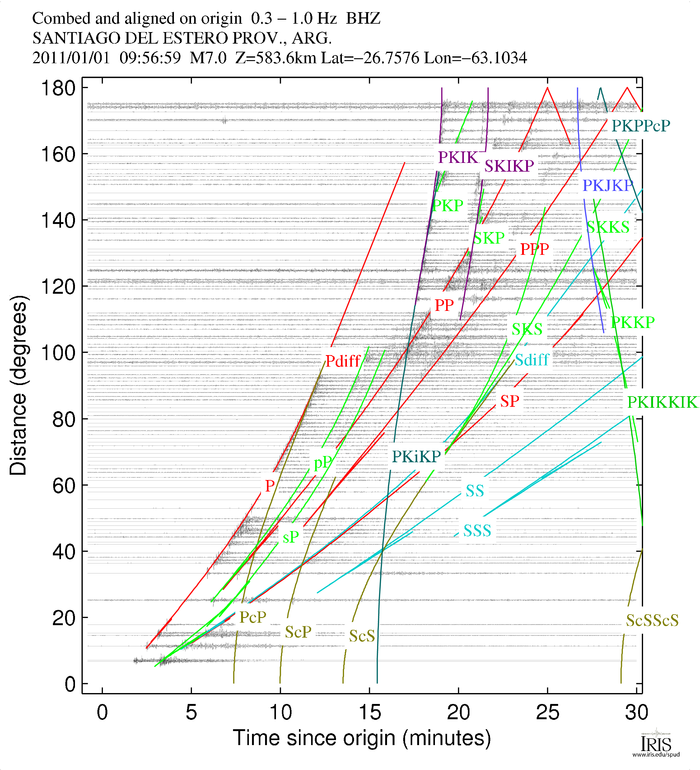

Slide 23
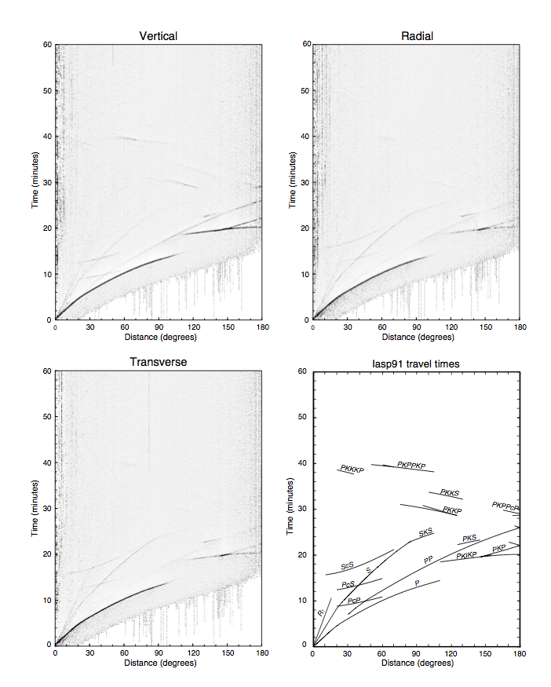
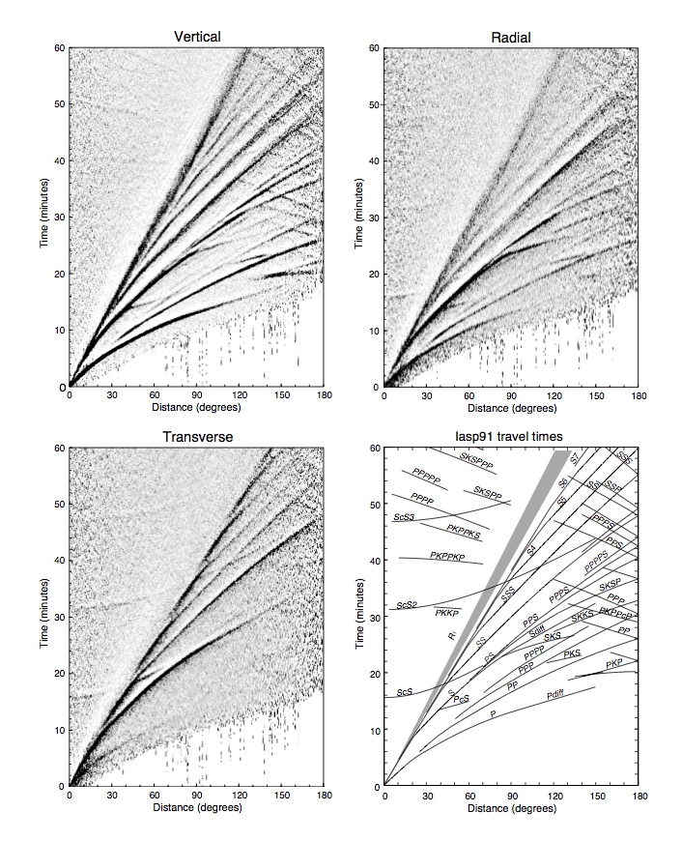
Short-Period Arrivals
Long-Period Arrivals

Slide 24
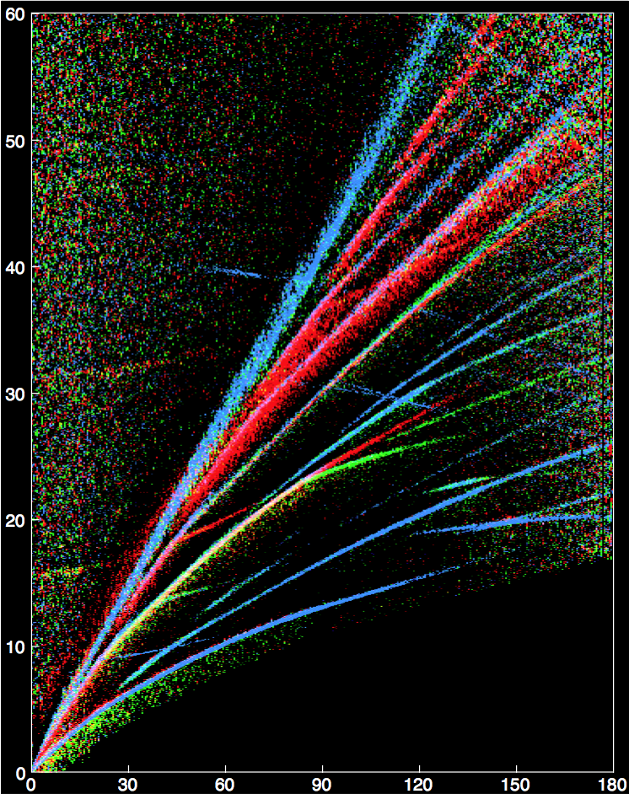

Slide 25
GMV Plots
http://www.iris.edu/spud/gmv

