Slide 1

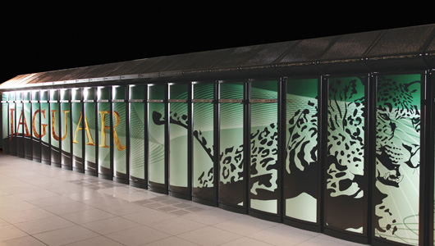
Greg Beroza
Department of Geophysics
Stanford University
Earthquakes,
the Cocktail Party Problem,
and Capacity Computing
Computational Geosciences Seminar Series
October 3, 2010

Slide 2
Earthquakes

Slide 3
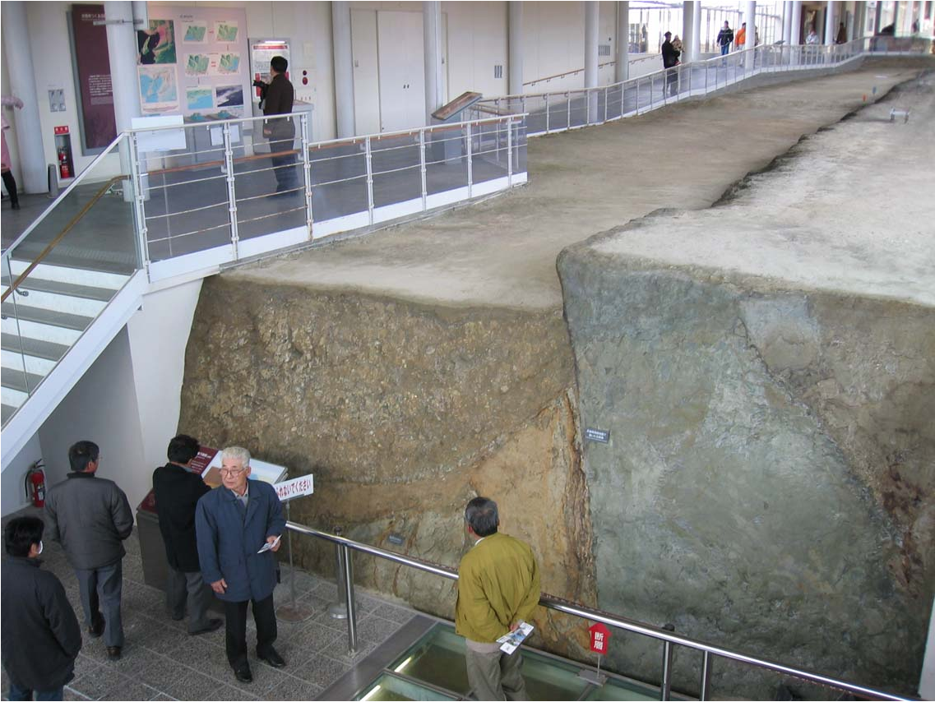
Earthquake
Sudden fault slip that generates waves.

Slide 4
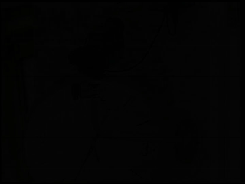
Footage of the Kobe Earthquake
Not uncommon: 15-20 earthquakes at least as large somewhere on Earth every year.
Sudden onset: About 3 seconds from the first waves to violent motion.
Location: same size as 1989 Loma Prieta earthquake, but part of the fault ruptured directly under the city of Kobe

Slide 5
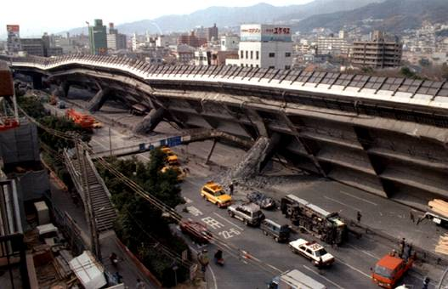
The 1995 M 6.9 Kobe Earthquake
6000+ fatalities
$200+ billion in damage
Kobe was Asia’s busiest port

Slide 6
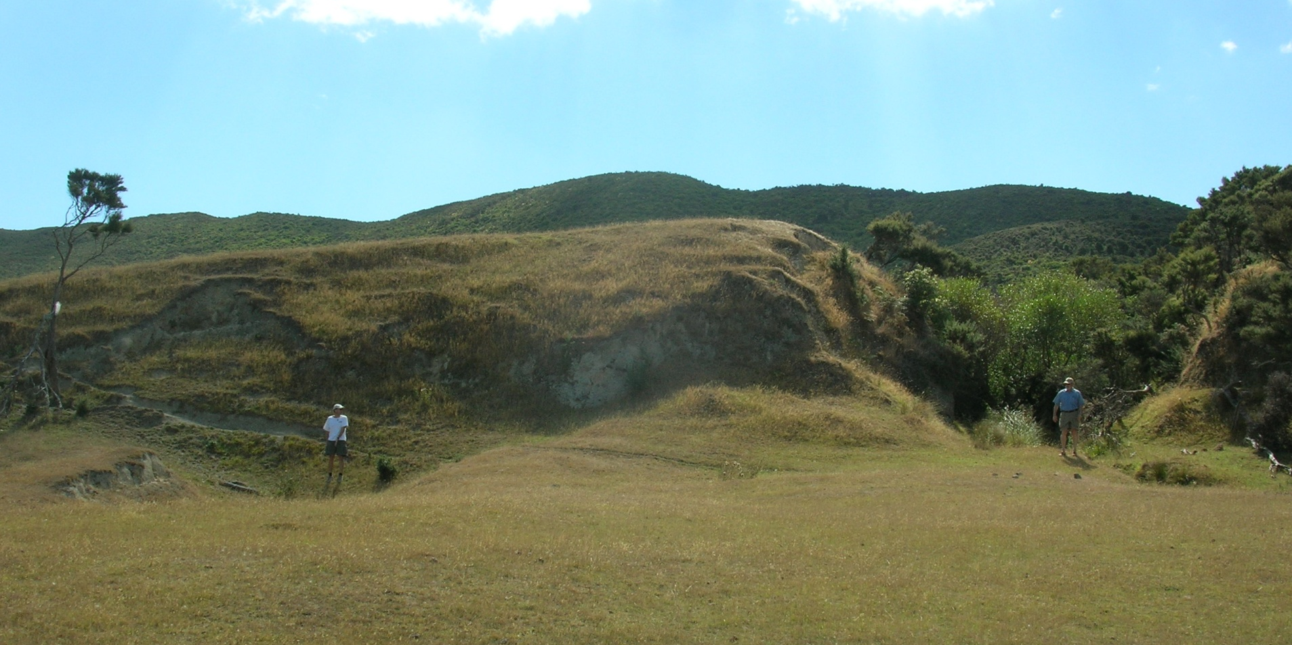
Earthquakes can be really big
18 meters (~ 59 feet)
Wairarapa fault, New Zealand, right-lateral offset in 1855 earthquake
Notes:
What you can expect in this magnitude 7.8 earthquake.
In a Really Big One like the ShakeOut earthquake, roads and other infrastructure crossing the fault will be offset a LOT!
Here is an example from New Zealand, in which an earthquake in1855 offset a stream channel. Before the earthquake, this channel came straight across the fault towards us. The earthquake offset it laterally by 54 feet.
[click to show distance]
Although our ShakeOut scenario earthquake is not this extreme, it does have extensive slip offsetting lifelines along the fault.

Slide 7
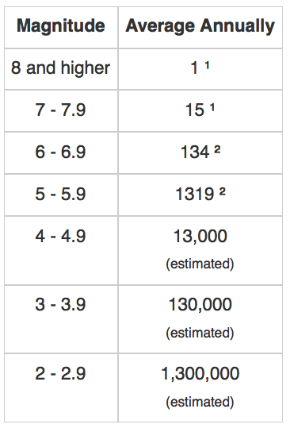
How many earthquakes?
Size distribution of earthquakes follows a power law known by seismologists as the Gutenberg-Richter relation:
log N = a - b M,
where b = 1.
Most earthquakes are little.
We can learn a lot from little earthquakes.

Slide 8
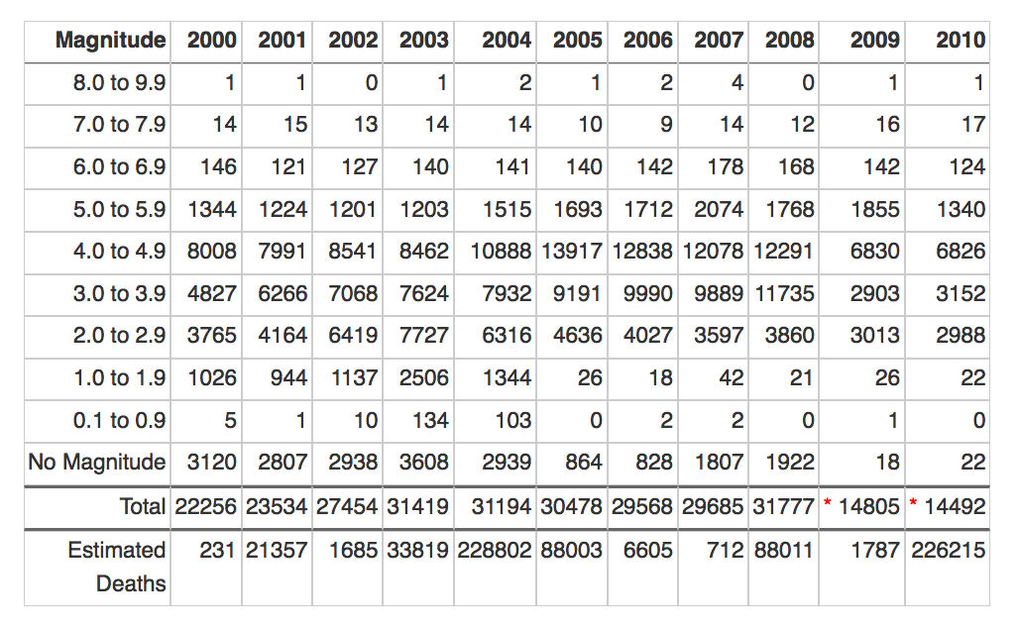
Earthquakes Worldwide (NEIC)
5.0 to 5.9 nearly all are detected.
4.0 to 4.9 ~5,000 missing yearly.
3.0 to 3.9 ~120,000 missing yearly.
2.0 to 2.9 ~1,300,000 missing yearly.

Slide 9
the Cocktail Party Problem

Slide 10
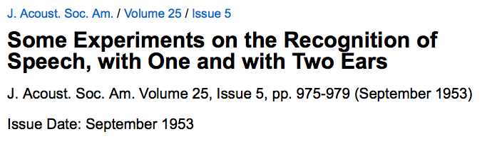
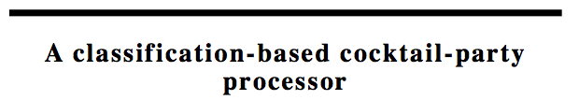
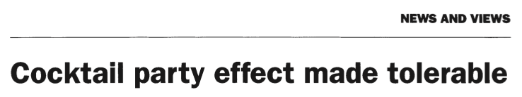

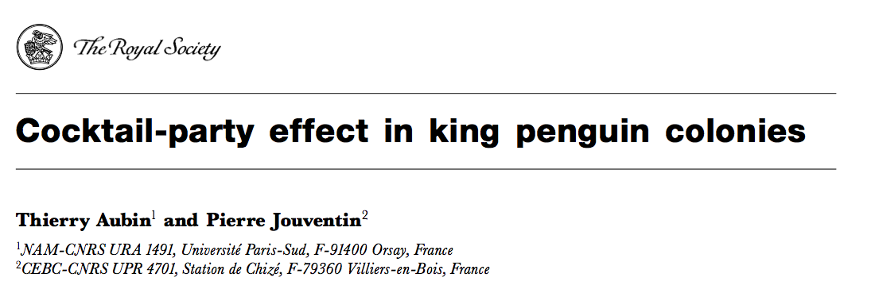

Slide 11

“The Cocktail Party” by Alex Katz
The “cocktail party problem” refers to the question of how people manage to hear the person they are talking with, and to ignore simultaneous background conversations and noise.

Slide 12
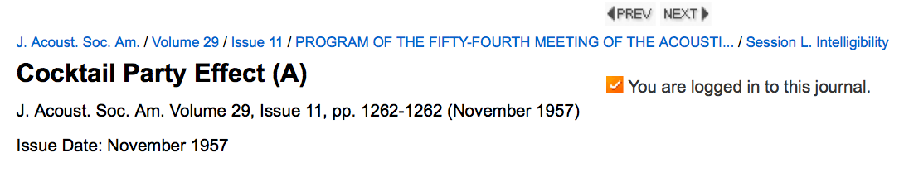
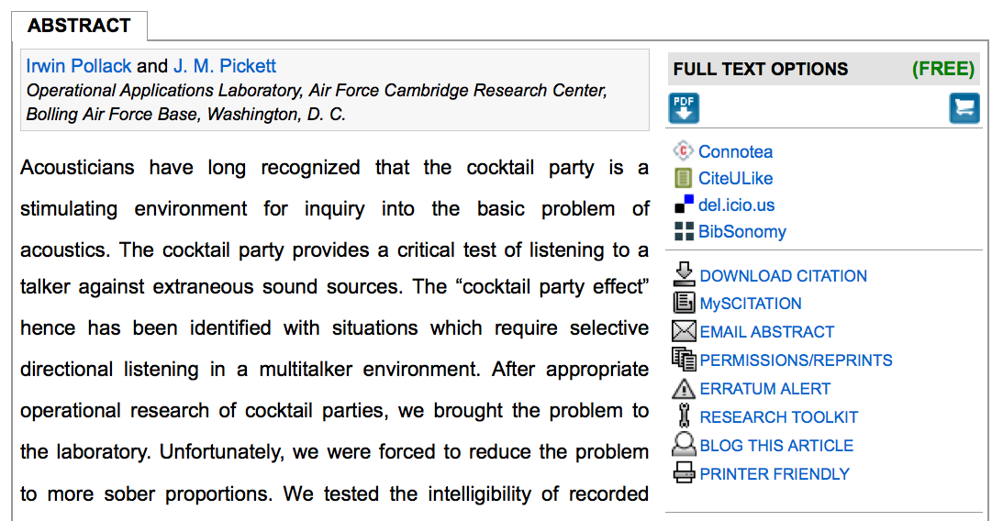

Slide 13
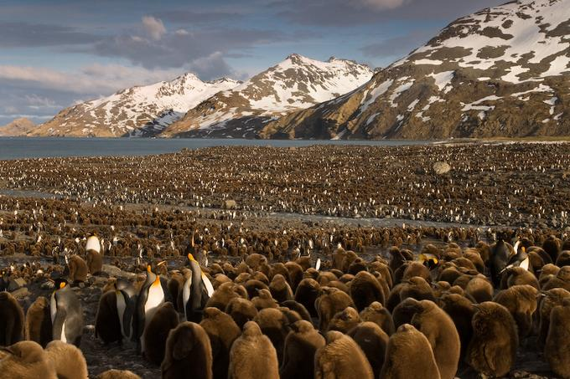
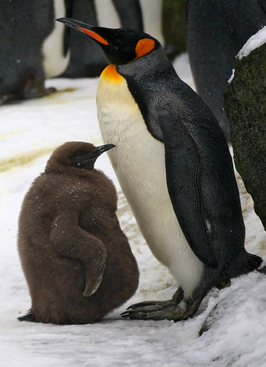

Slide 14
Capacity Computing

Slide 15
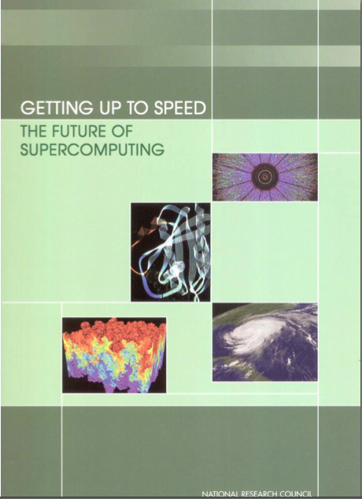
Capability computing. Use of most powerful supercomputers to solve the largest and most demanding problems. Main figure of merit is time to solution. A system is often dedicated to running one problem.
Capacity computing. Use of smaller and less expensive high-performance systems to run parallel problems with more modest computational requirements. Main figure of merit is the cost/performance ratio.
Graham et al. [2005]

Slide 16
Earthquakes,
the Cocktail Party Problem,
and Capacity Computing

Slide 17

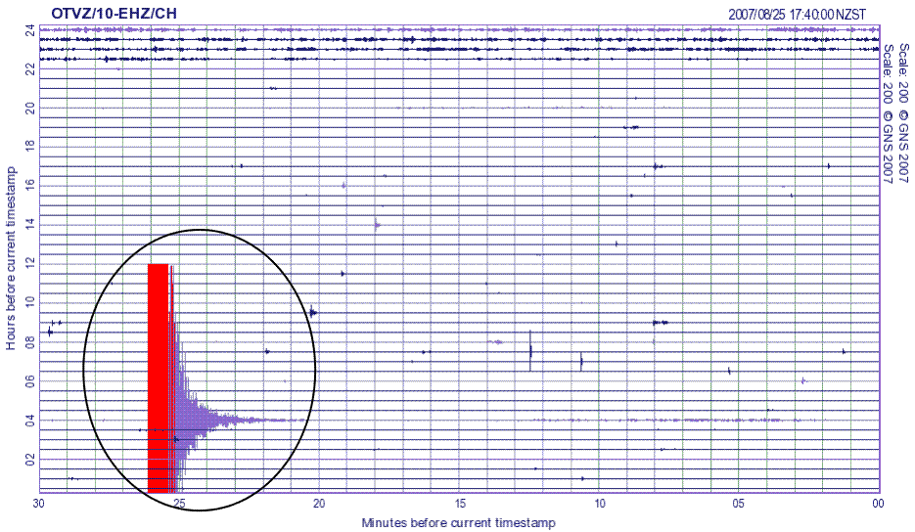
Earthquake Seismogram

Slide 18
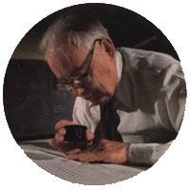
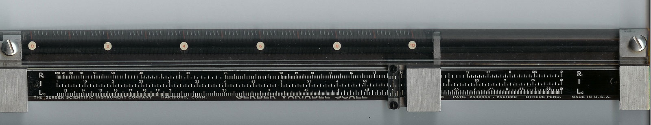
Richter “Reading” a Seismogram
Gerber variable scale (expandable ruler) used to measure time precisely.

Slide 19
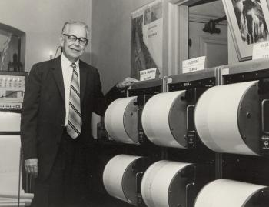
Seismographic Network to Detect
and Locate Earthquakes
Measuring arrival times at multiple
stations to locate earthquakes.

Slide 20
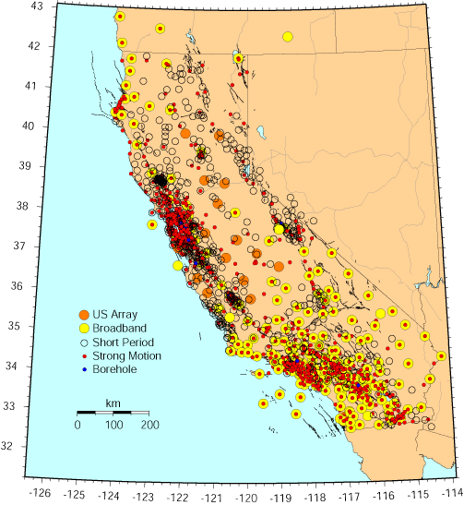
California Integrated Seismic Network
Inventory (2006)
Urban Strong Motion | 974
Broadband + Strong Motion | 208
Short Period + Strong Motion | 77
Analog Short Period | 290
Borehole | 51
Geotechnical Arrays | 22
Buildings | 221
Bridges | 70
Dams | 26
SAFOD | 1
Others | 13

Slide 21
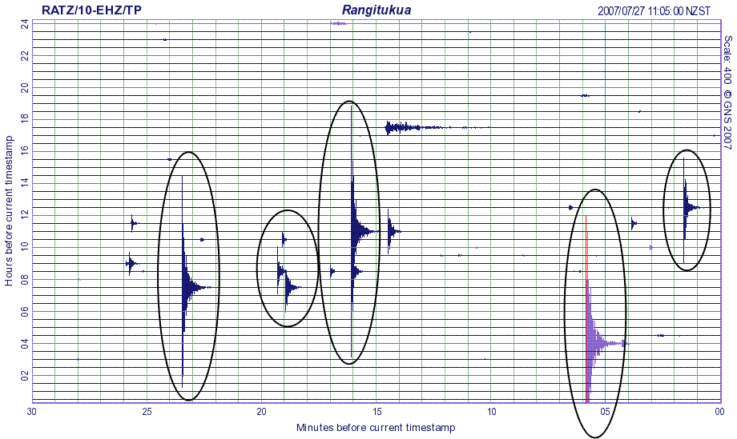
Multiple Earthquakes

Slide 22
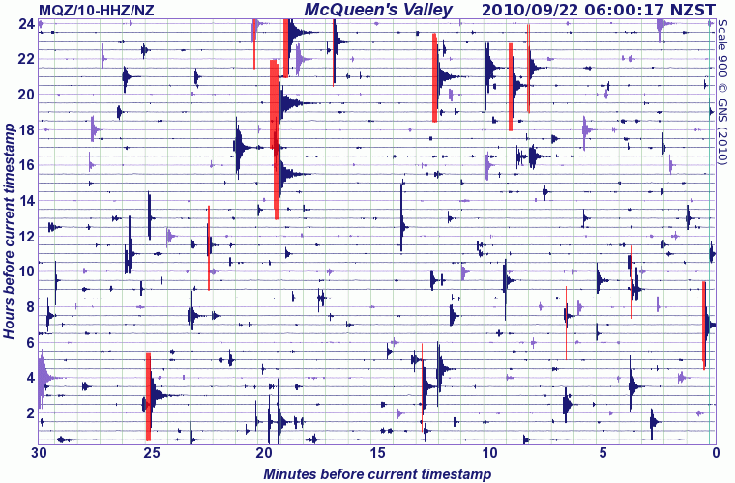
Aftershocks in New Zealand

Slide 23
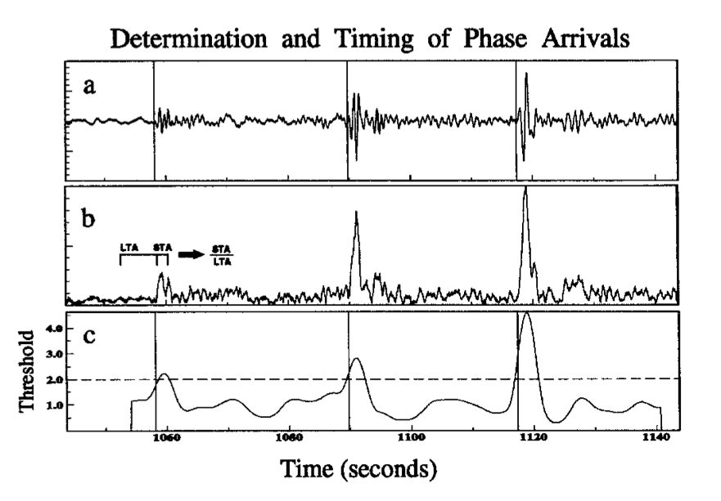
Example algorithm: STA/LTA - takes ratio of short-term average and long-term average signal - maximized at/near the time of the first arrival.
Earle and Shearer [1994]

Slide 24
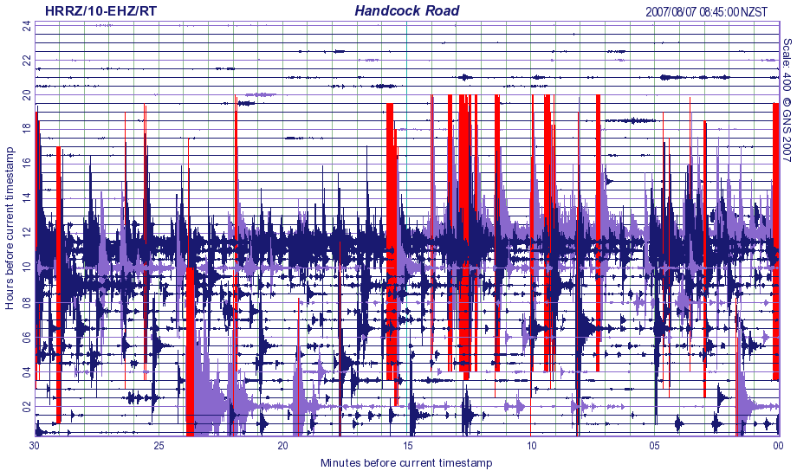
Earthquake Swarm
STA/LTA algorithms get overwhelmed when things get really active/interesting.

Slide 25
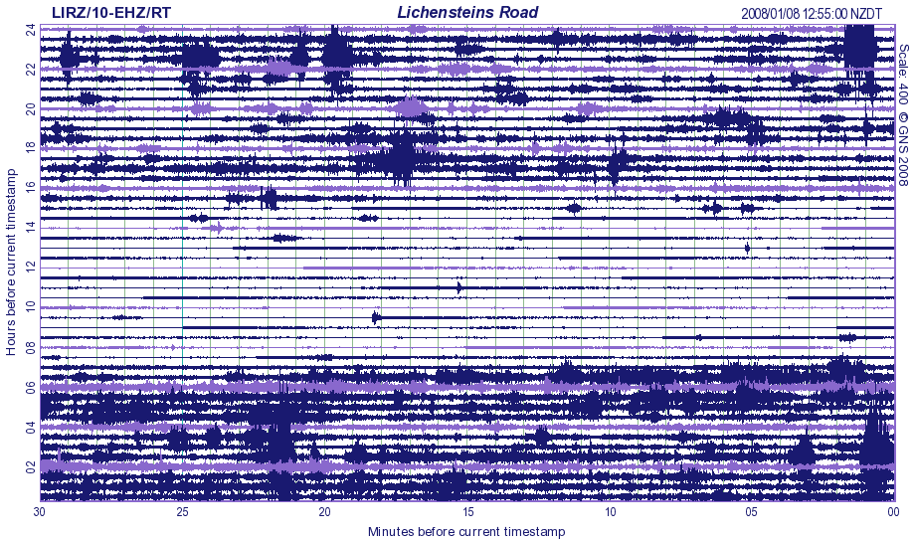
Automobile Traffic

Slide 26
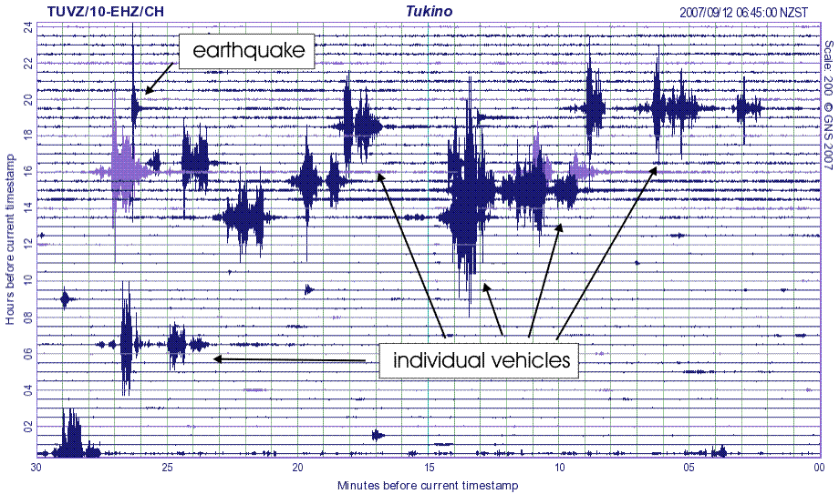
Traffic and Earthquake

Slide 27
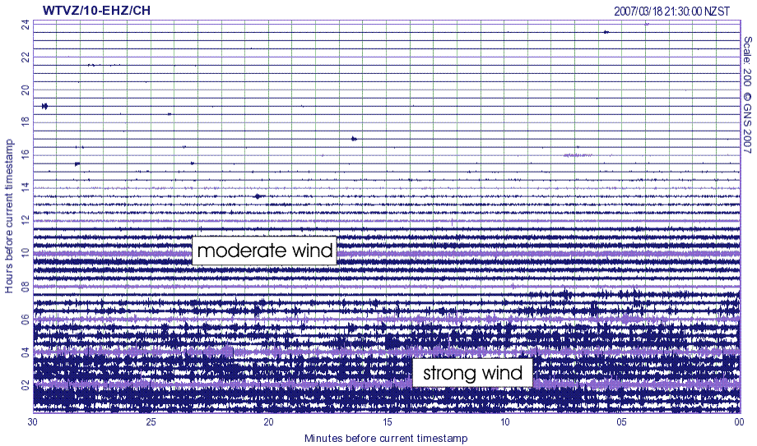
Wind

Slide 28
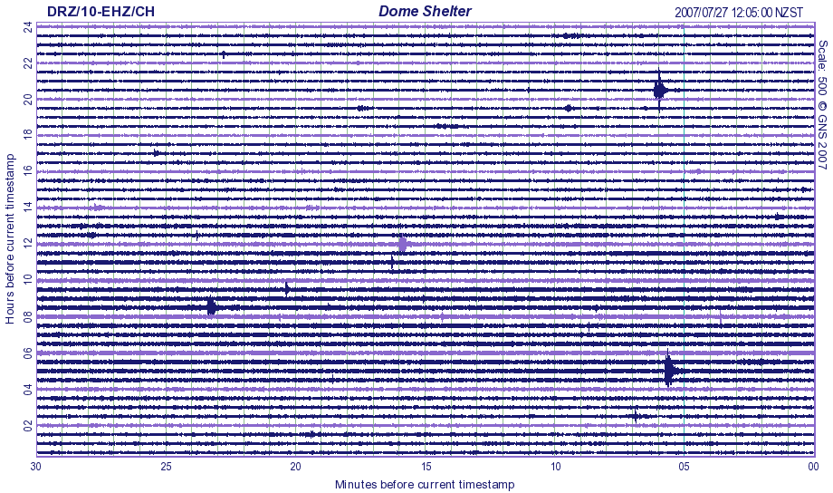
Volcanic Tremor

Slide 29
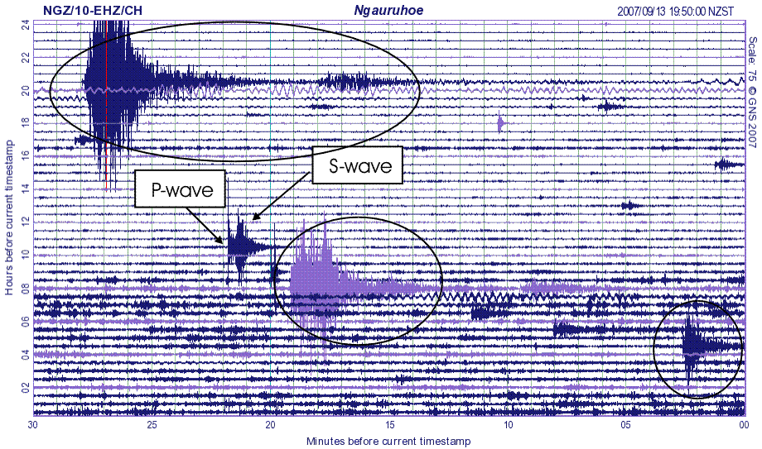
What’s Signal? What’s Noise?
This is “the Cocktail Party Problem” for Seismologists.

Slide 30
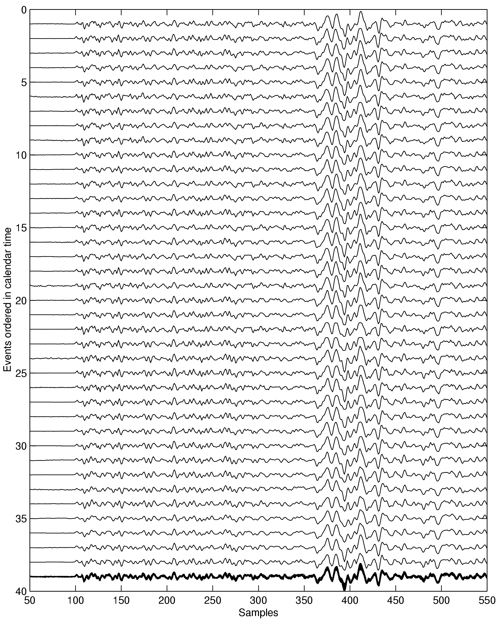
How to approach the Cocktail Party Problem?
Slip occurring at different times in the same place, generates identical seismograms.
We can look for a repeating signal.
Seismograms from 38 Different Earthquakes

Slide 31
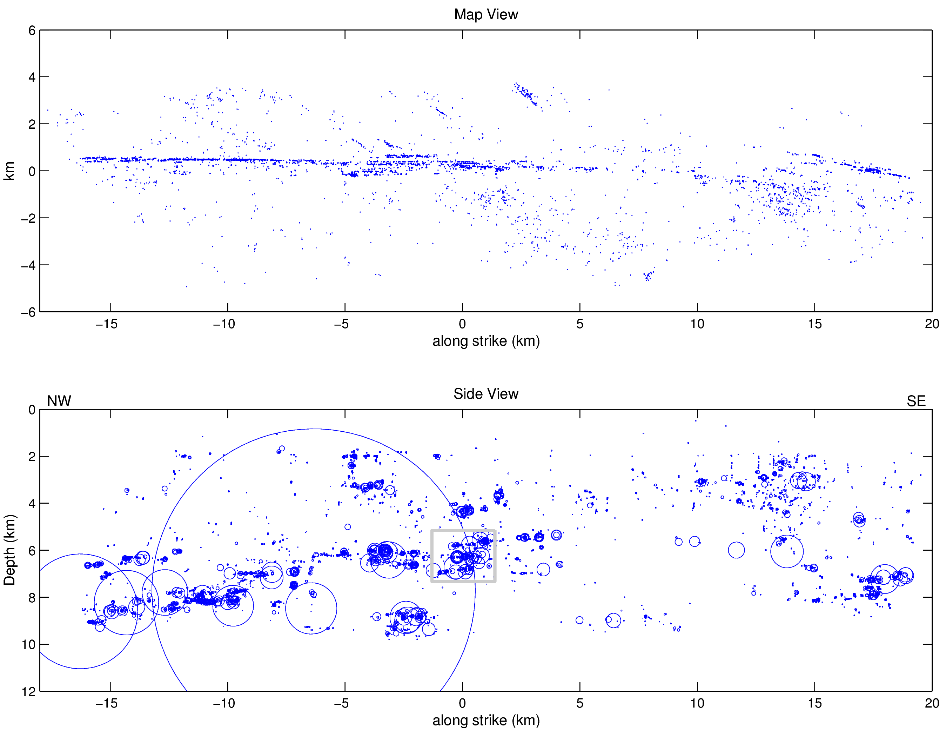
Earthquakes on the Calaveras Fault

Slide 32
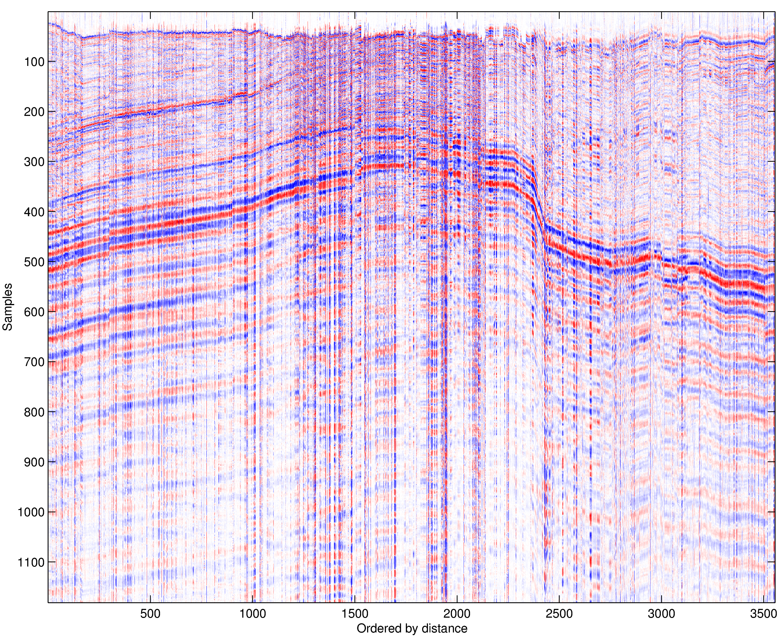
Earthquake Seismograms (Receiver Gather)
Adjacent earthquakes have very similar signals and we can exploit this property to detect them.

Slide 33
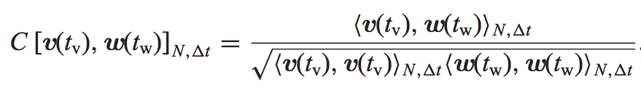
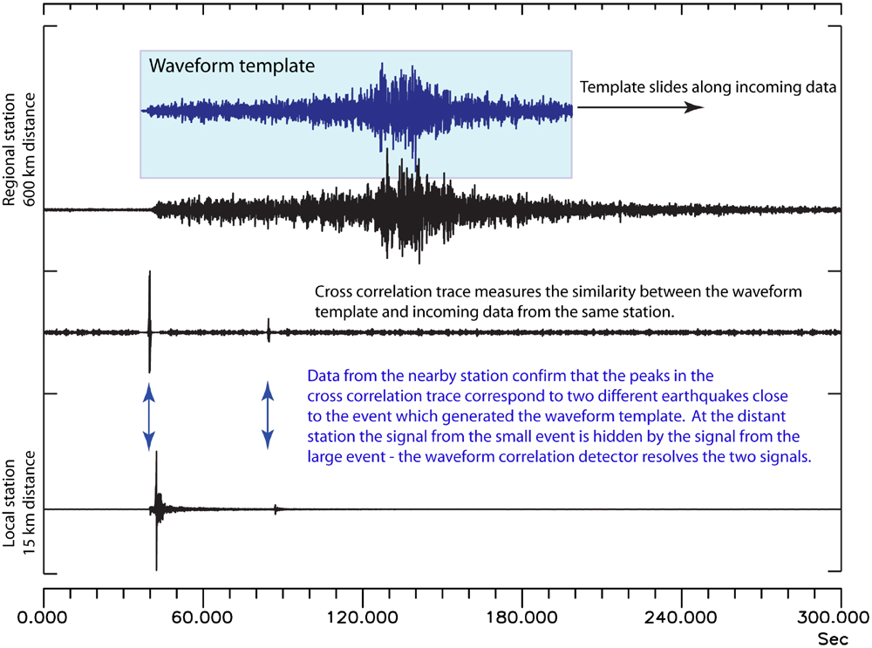
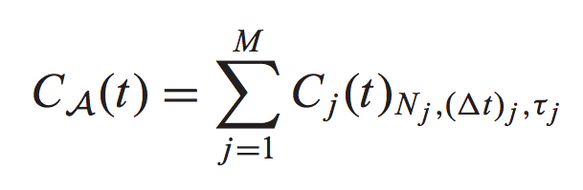
Normalized inner product as basic measure
Network inner product (summed over j channels)
Gibbons and Ringdal [2006]

Slide 34
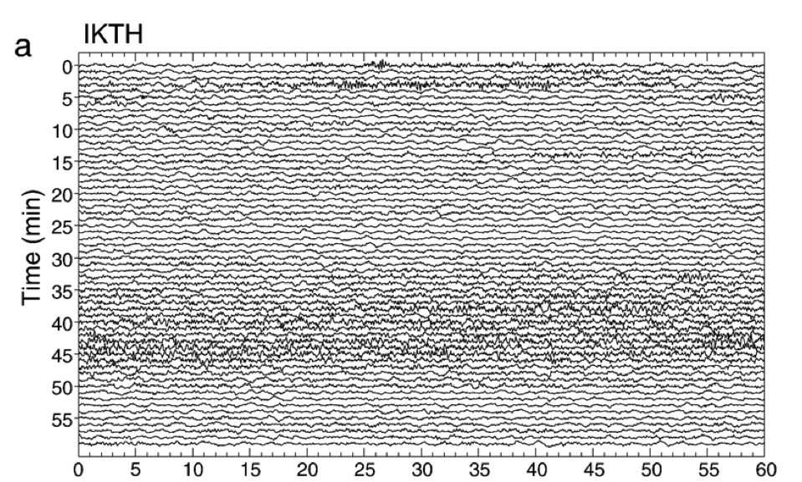
Deep, Non-Volcanic Tremor
New kind of earthquake
Obara [2002]

Slide 35
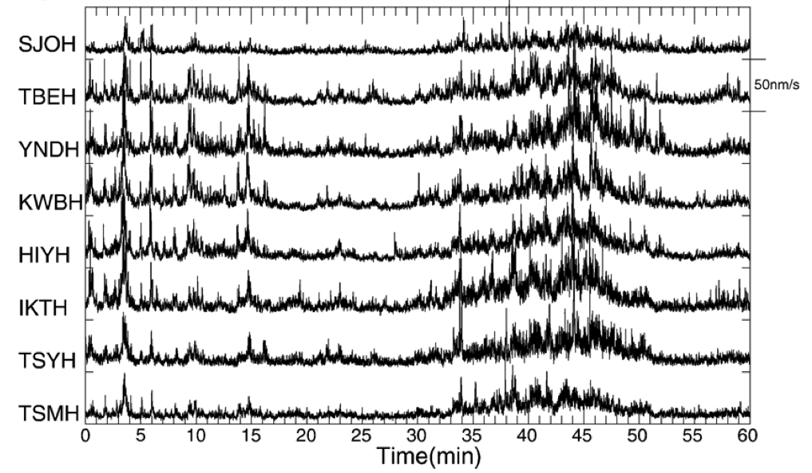
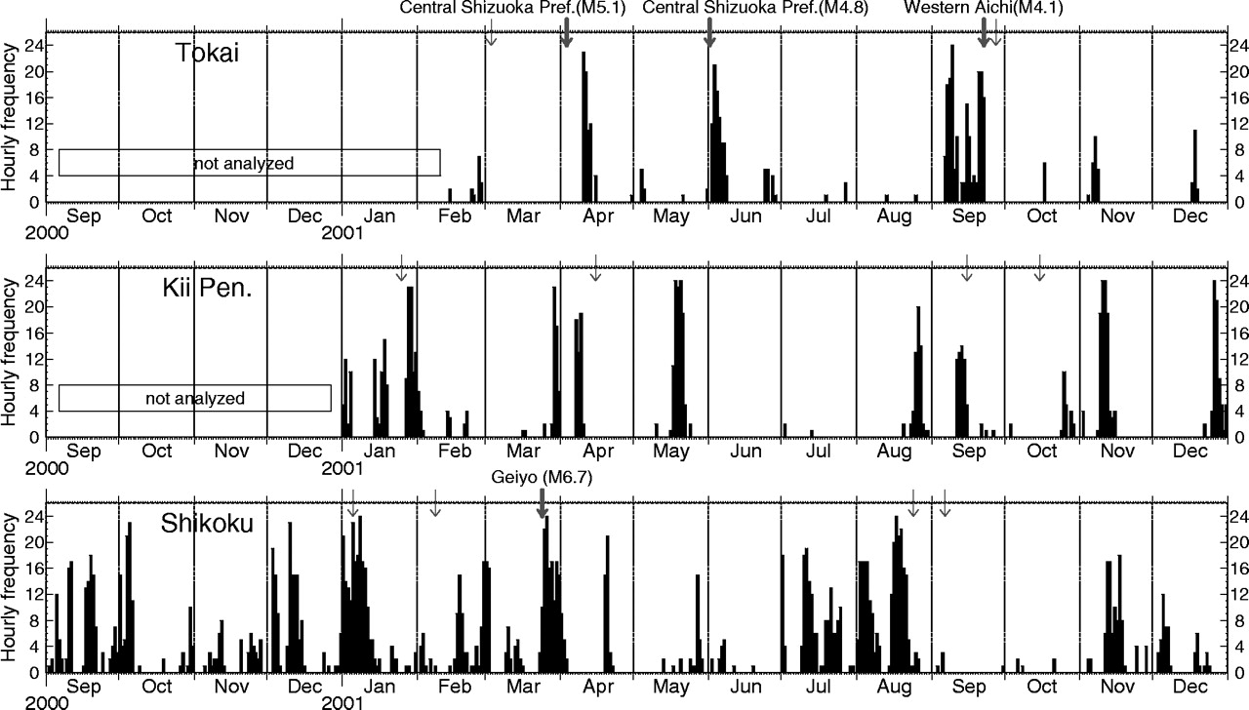
Similar Signal at Widely Spaced Stations
Occurs every few months and lasts a week or so.
Obara (2002)

Slide 36
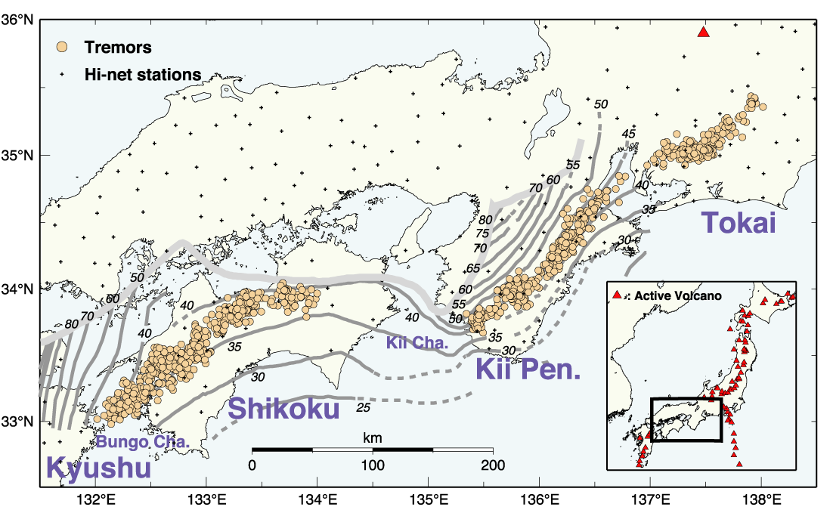
Discovered in SW Japan

Slide 37
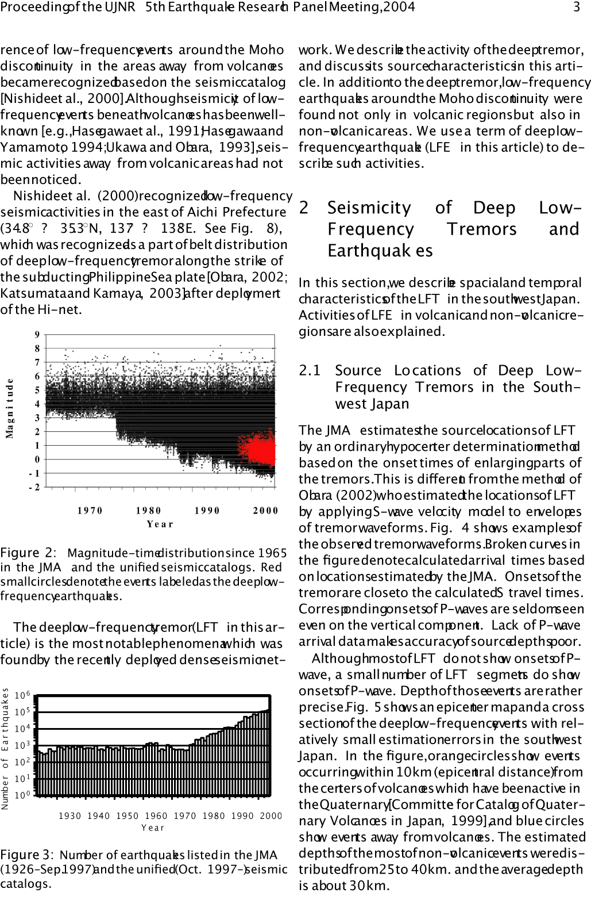
Low Frequency Earthquakes (LFEs)
LFEs (in red) discovered after Kobe because of Hi-NET
Kamaya et al. [2004]

Slide 38
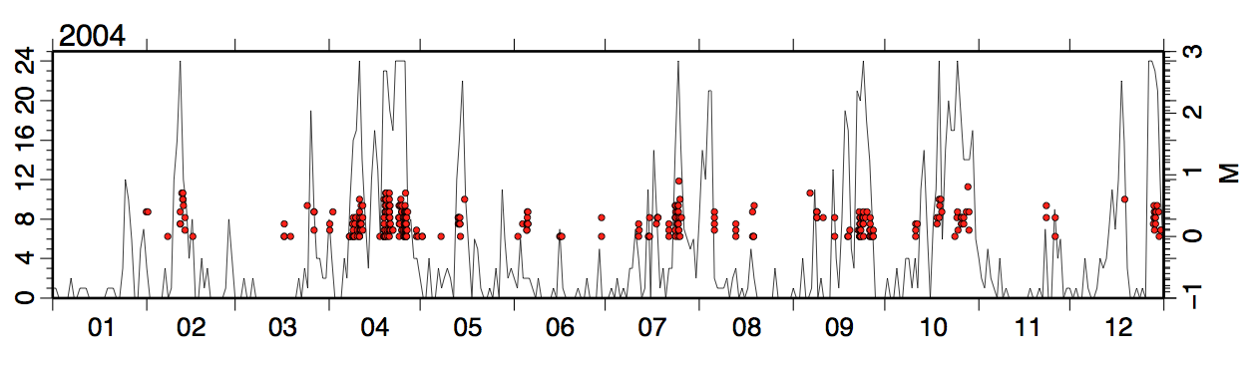
LFEs Occur During Tremor
JMA LFE catalog and NIED (Obara’s) tremor activity: correlation is nearly perfect.

Slide 39
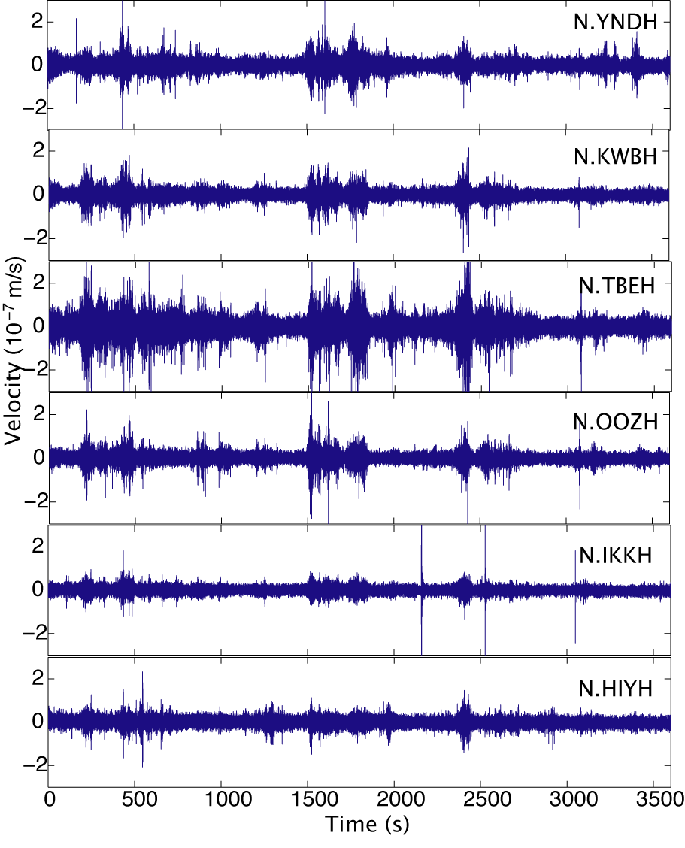
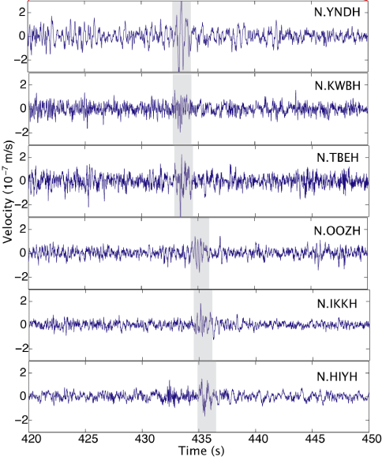
4 LFEs in 1 hour of tremor
S-wave arrival
1 hour
30 sec

Slide 40
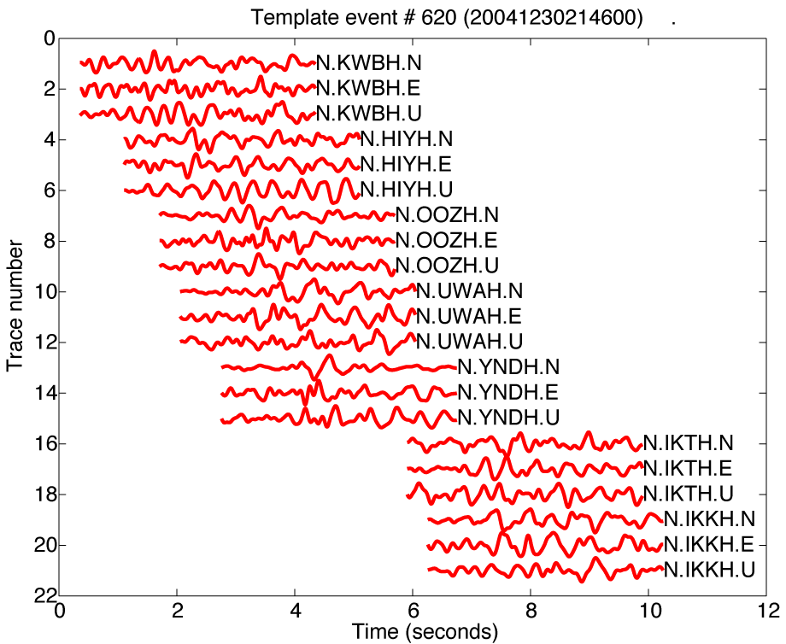
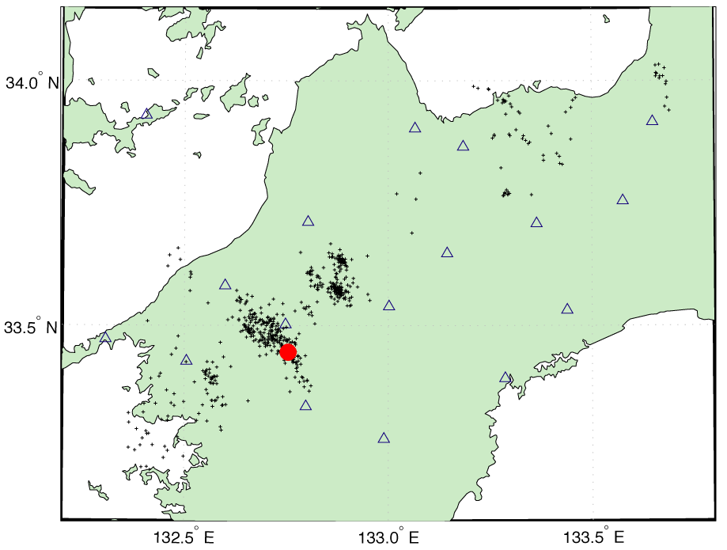
LFEs Provide Template Waveforms

Slide 41
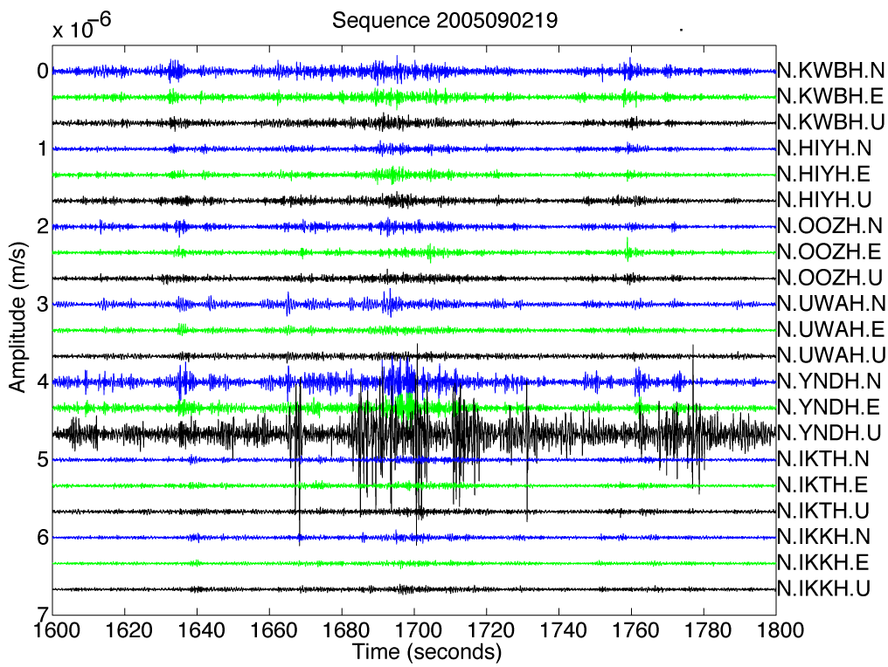
Template LFE Buried in Tremor?
Template LFE
Continuous Tremor
Is it in here somewhere???

Slide 42
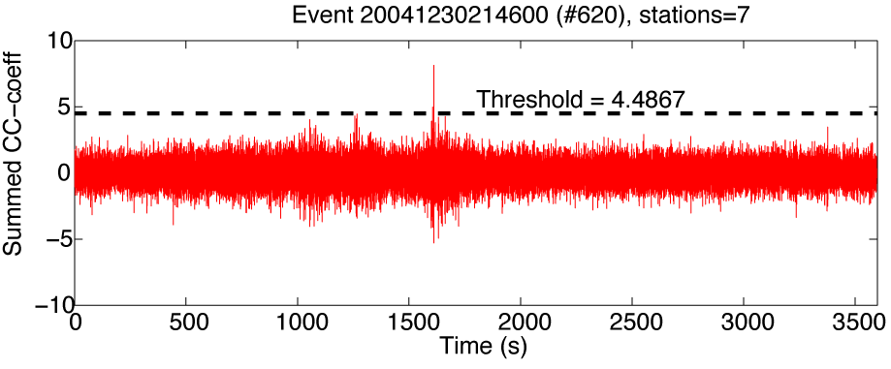
Summed correlation function
Detection
1 hour
Type-I Error Rate: ~1 false detection per hour.

Slide 43
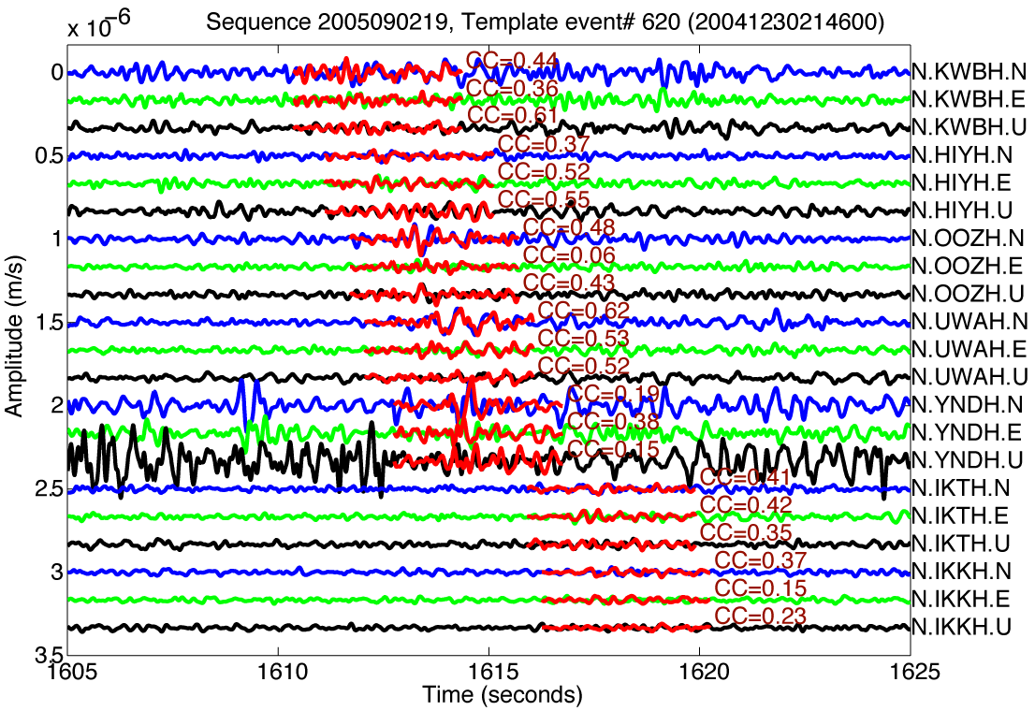

Slide 44
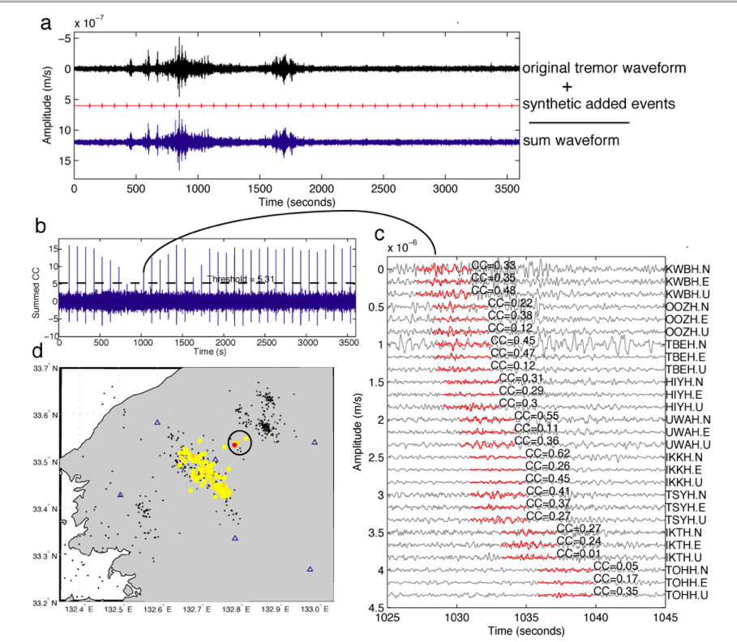
Detection algorithm is Powerful (few Type II errors)
LFEs planted in real data at snr of 0.1
34/36 are detected

Slide 45

Putting detections from all 677 template events together….
Strong Detection
Weaker Detection
“Nearby” Detection
Tremor is a swarm of thousands of LFEs

Slide 46

Movie 2: Half Day of LFE-Tremor Matches

Slide 47

Tremor locates on Deep Extension of Faults
One in a Family of Slow Earthquakes

Slide 48

Also found in California
Shelly [2009, 2010]

Slide 49

Cholame Tremor
LFE Template
Shelly [2010]

Slide 50

Cholame Tremor
~540,000 LFEs over 8.5 years in this small area.
~216,000 events in NCSN catalog during that time.
5 years ago, few CA earthquakes were known deeper than 18 km.
Now we have over half a million that are deeper in one locale!
Shelly [2009, 2010]

Slide 51
Templates: Scale of the Problem
40 samples per second
6 seconds per correlation
4.8 x 10² floating point ops per correlation
40 samples per second
6 seconds per correlation
4.8 x 10² floating point ops per correlation
10 lags per second
86,400 seconds/day
365 days/year
10 years digital data
N = 10*86,400*365*10 = 3.1 x 10¹⁰ correlations
60 channel seismic network
40 samples per second
6 seconds per correlation
4.8 x 10² floating point ops per correlation
10 lags per second
86,400 seconds/day
365 days/year
10 years digital data
N = 10*86,400*365*10 = 3.1 x 10¹⁰ correlations
Good luck Charlie!
~10¹⁵ operations per template

Slide 52

Parkfield Aftershocks
Also works for ordinary earthquakes
11,138 events detected
933 events in the NCSN catalog
Peng and Zhao [2009]

Slide 53
What if we don’t have a template?
Example of “Blind Source Separation”
(knowledge of source is limited)
Can still use notion of looking for similar events across the network.
Compare everything with everything else.

Slide 54




CCij = u_{i} • u_{j}
HIYH YNDH KWBH TBEH TSYH
a_{ij} = ∑ CC_{ij} , n components
n
Brown et al. [2008]

Slide 55
LFE Alignments at OOZH
S and P arrivals from waveform cross-correlation
Brown et al. [2008]
P S
P S
P S

Slide 56

3 Hours of LFEs during tremor in the Nankai Trough
Brown et al. [2009]

Slide 57
3 Hours of LFEs during tremor in Cascadia
Brown et al. [2009]

Slide 58
3 Hours of LFEs during tremor in Costa Rica
Note that ordinary earthquakes are also detected
Brown et al. [2009]

Slide 59
Scale of the Problem
40 samples per second
10 seconds per correlation
8 x 10² floating point ops per correlation
10 lags per second
86,400 seconds/day
365 days/year
10 years digital data
N = 10*86,400*365*10 = 3.1 x 10¹⁰ time windows
N(N-1)/2 = 5 x 10²⁰ unique correlations
5 x 10² channel seismic network
Good luck Charlie!
10²⁶ operations

Slide 60
Scale/Potential of the Problem
Being clever allows us to reduce by effort by several orders of magnitude, but it’s still computationally imposing (though really simple).
Reducing the number further is feasible, but requires making some choices.
We need to push hard to make the measurements (capacity). We’ll soon have a lot more sensors (data streams) to exploit.
Huge opportunities:
earthquakes real-time network seismology
volcanoes geothermal shale gas
other?

Slide 61
Earthquakes,
the Cocktail Party Problem,
and Capacity Computing
Thank you for your attention.

