Slide 1
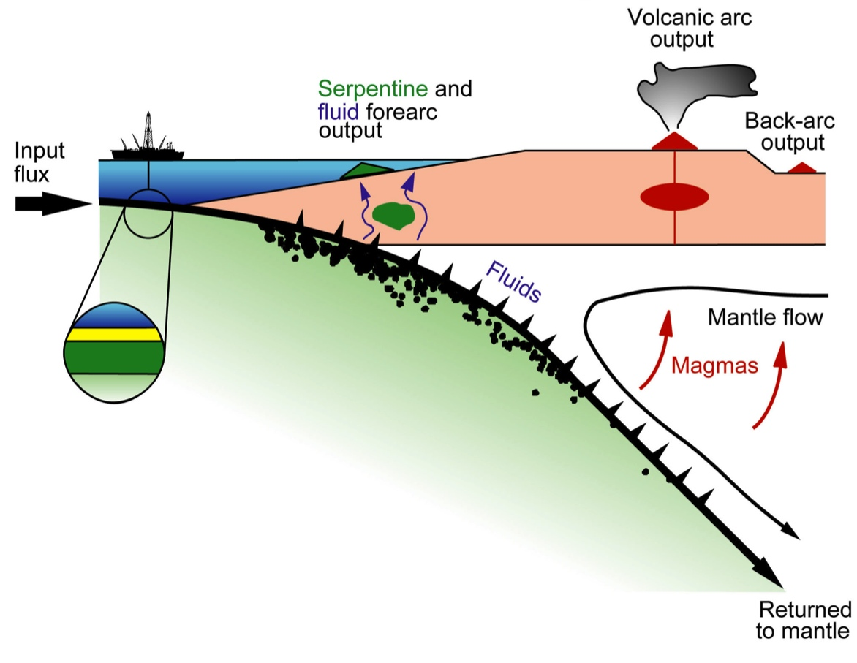
Lecture 8 January 31, 2013
Subduction Zones
Magmatic Arcs
Topics:
• Dip, Thermal Parameter (=age*rate), effect on or of overriding plate
• Penetration into lower mantle and phase changes
• Thermal, metamorphic structure and fluid release from slab
• Mantle wedge structure
• Magmatic arc; Back-arc basins
• Focus of this lecture is on the descending lithosphere and mantle wedge. “Convergent Margins” lecture will focus on the responses of the overriding plate
Reading:
Stern.SubductionZones.RevGeophys.2002.pdf Lallemand.SubductionParameters.G3.2005.pdf
Wiens.MantleWedge.AREPS.2008.pdf CagnioncleParmentier.MantleWedgeWater.JGR.2007.pdf
TatsumiStern.SubductionFactory.Oceanography.2006 TakahashiKlemperer.Mariana.Geology.2007.pdf Garnero.D''CoreMantle.Science2004.pdf SantoshMaruyama.EarthFluidFactory.Lithosphere.2009.pdf

Slide 2
Subduction Zones are the Most Important Control on Earth Tectonics
Cause plates to move and mid-ocean ridges to spread
Dominant mode of (upper) mantle convection (plumes are 2nd order features)
Maintain chemical exchange between the Earth’s surface and mantle
Responsible for continental crust (some of what goes down comes back up)
Create ore deposits, earthquakes, explosive volcanism
Arc-Trench Systems are regions of new or magmatically transformed lithosphere in the hanging wall of a subduction zone

Slide 3
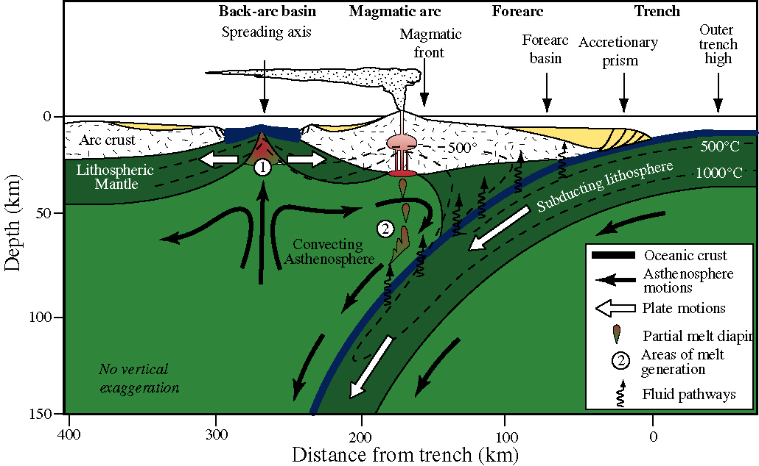
Volcano-trench distance 166±60 km
Mean depth of seismic zone
below volcano 124±38 km

Slide 4
Common paradigms, incorrect and correct:
4
1. Mantle motions drags plate
2. Over-riding mantle is static
3. Friction between plates leads to melting
4. Plate descends into mantle with the dip of the subduction zone
Wrong!
1. Higher slab density provides gravitational pull
2. Mantle wedge circulates, refertilizing melt zone
3. Fluids from the slab lower mantle-wedge solidus, causing melting
4. Slab sinks at steeper angle than dip of subduction zone controlled by gravity, directed downwards
X

Slide 5
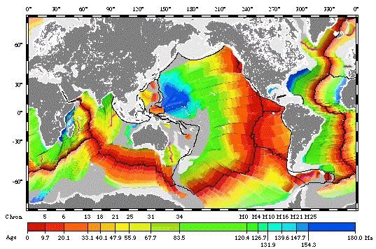
As with most tectonic features of Earth, discussion (and understanding) of subduction zones is limited by what is currently available for us to study:
Most subduction zones are Circum-Pacific features:
East Pacific: mostly young (warm) lithosphere subducts under the Americas;
West Pacific: mostly old (cold) lithosphere subduct under oceanic or accreted arc terranes

Slide 6
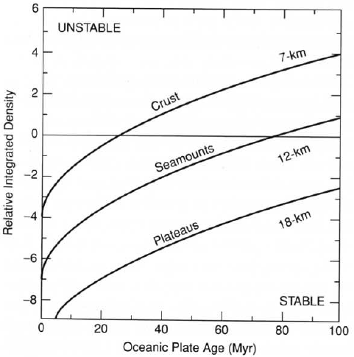
The (possible) importance of lithosphere age: older lithosphere is denser (considering only the cooling effect, no phase changes)
Thermal parameter = age * rate of subduction (km)

Slide 7
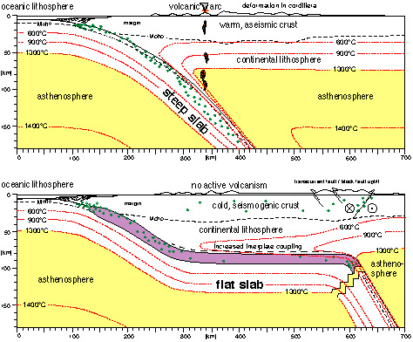
Flat vs. Normal (Steep) subduction
Flat subduction is presumably caused by subduction of buoyant lithosphere,
  either because it is young (hot) or because it has thicker-than-normal crust
No mantle wedge
No asthenosphere

Slide 8
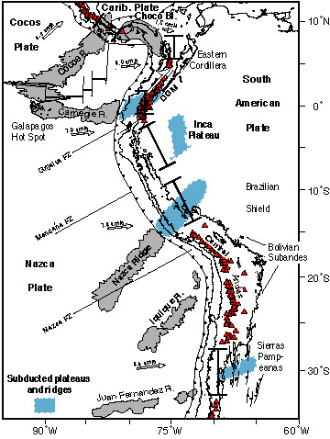
Flat Slab segments beneath South America
Note that there are no arc volcanoes above these flat slab regions.
Flat slab regions may allow for more stress to build up between the plates – flat slabs represent ~10% subduction zones but ~40% of M>8 earthquakes
Gutscher et al., 2000

Slide 9
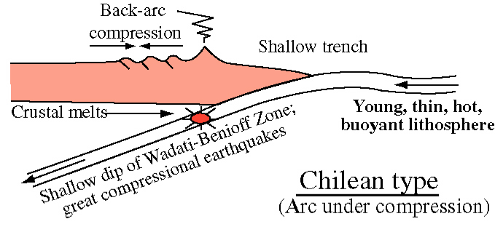
“Chilean-type” arcs subduct young, warm lithosphere at shallow dips and are under compression

Slide 10
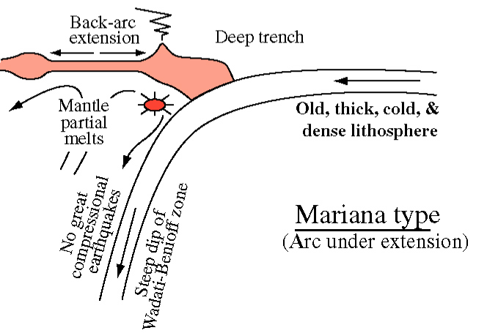
“Mariana-type” arcs subduct old, cold lithosphere at steep dips and are under extension
Uyeda and Kanamori (1979) popularized the idea that this dichotomy (steep dip/shallow dip) was related to age (temperature) of the slab

Slide 11
However, recent attempts at statistical analysis disagree:
Slab dip does not correlate well with
magnitude of slab pull,
age of subducting lithosphere at the trench,
thermal regime of the subducting lithosphere,
convergence rate,
or
subduction polarity (east versus west).
(Lallemand et al., G3, 2005)

Slide 12
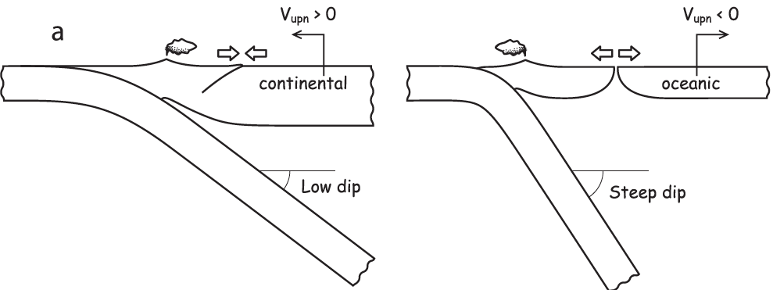


However, recent attempts at statistical analysis disagree:
Low dip correlates with:
Steep dip correlates with:
Does correlation imply causation?
Which is the controlling parameter? (dipping slab or upper plate)
(Lallemand et al., G3, 2005)

Slide 13
However, recent attempts at statistical analysis disagree:
Slab dip does not correlate well with
magnitude of slab pull,
age of subducting lithosphere at the trench,
thermal regime of the subducting lithosphere,
convergence rate,
subduction polarity (east versus west).
Does this imply that slab pull is not important?
(Lallemand et al., G3, 2005)

Slide 14
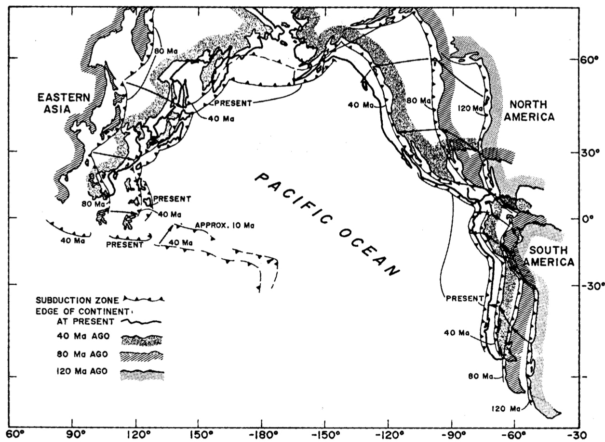
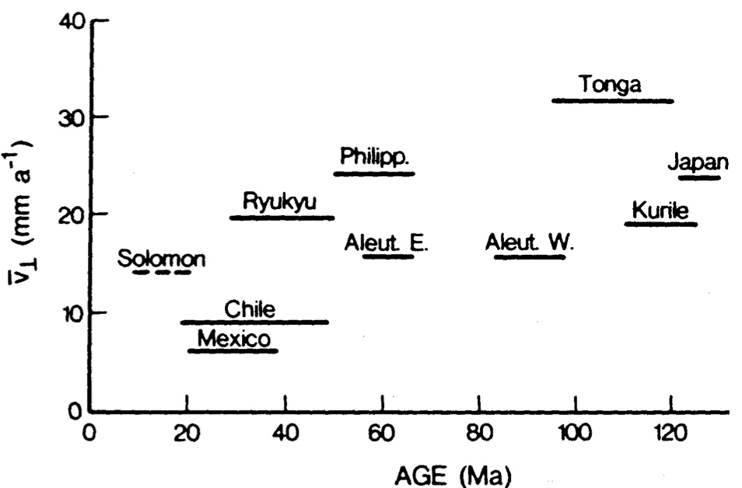
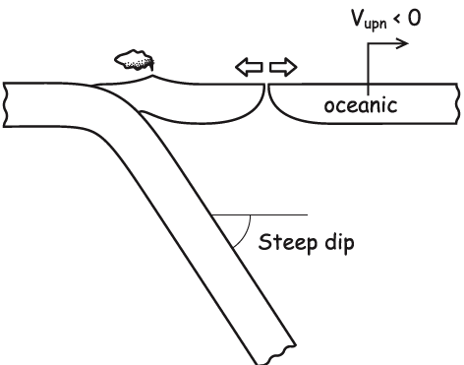
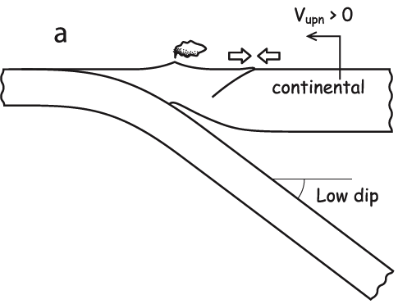
Trench Rollback (Slab Retreat)
Pacific Ocean has been getting smaller
Requires migration of trenches towards the ocean
Trench rollback rates are ~10–25% of subduction rates
Note advancing upper plate in Americas even in locations/periods of flat slab subduction
Garfunkel et al., 1986

Slide 15
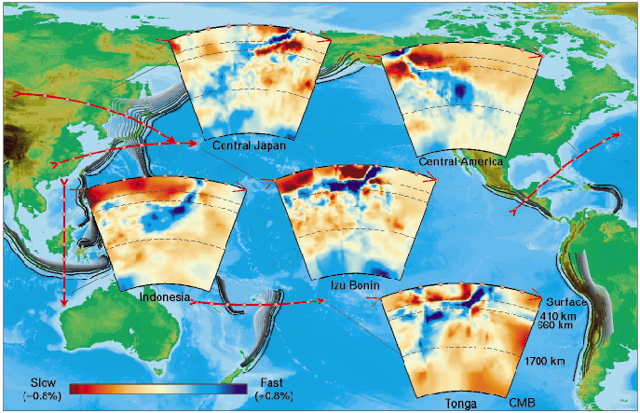
Seismic Tomography of Subduction Zones
If dip doesn’t correlate with slab pull, what about depth?
(Albarede &
van der Hilst, 2002)

Slide 16
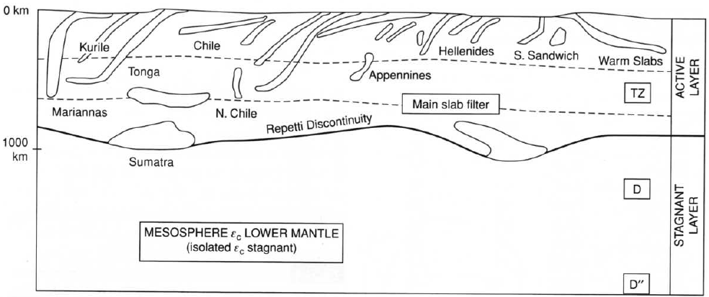
Some subduction zones extend from the surface to the core-mantle boundary; others maybe only to the transition zone or mid-mantle
– perhaps young plates are thermally buoyant, thermally equilibrate rapidly, and don’t sink far:
“just because some slabs penetrate below 670 km doesn’t mean they all do”
(Stern, 2002)
(Don Anderson, New Theory of the Earth, 2007)

Slide 17
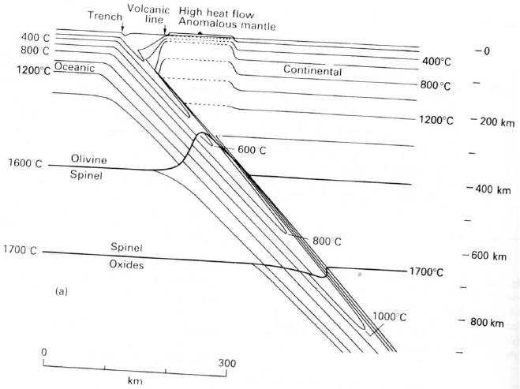
Thermal parameter (km) proportional to depression of isotherms within the slab
Olivine α-phase, orthorhombic Molar volume = 43.67 cm³/mol
Wadsleyite: β-phase, orthorhombic; 40.52 cm³/mol
Ringwoodite: γ-phase, cubic 39.65 cm³/mol (“spinel” phase)
Ringwoodite disproportionates into Perovskite ((Mg,Fe,Al)SiO₃) and Magnesiowüstite (Mg,Fe)O
Upper Mantle
<410 km
Transition Zone
410-670 km
Lower Mantle
>670 km

Slide 18
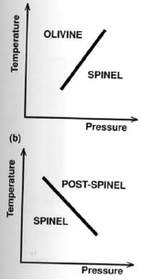
Upper Mantle
<410 km
Transition Zone
410-670 km
Lower Mantle
>670 km
Clapeyron curves: equilibrium pT curves separating regions in which different phases are thermodynamically stable, with “Clapeyron slope” dp/dT.
410 km discontinuity: Olivine α to “Spinel” phase: exothermic (+ve Clapeyron slope) 670 km discontinuity: “Spinel” to oxides: endothermic (-ve Clapeyron slope)
Transition zone is thicker-than-normal in slabs (and thinner in plumes)

Slide 19
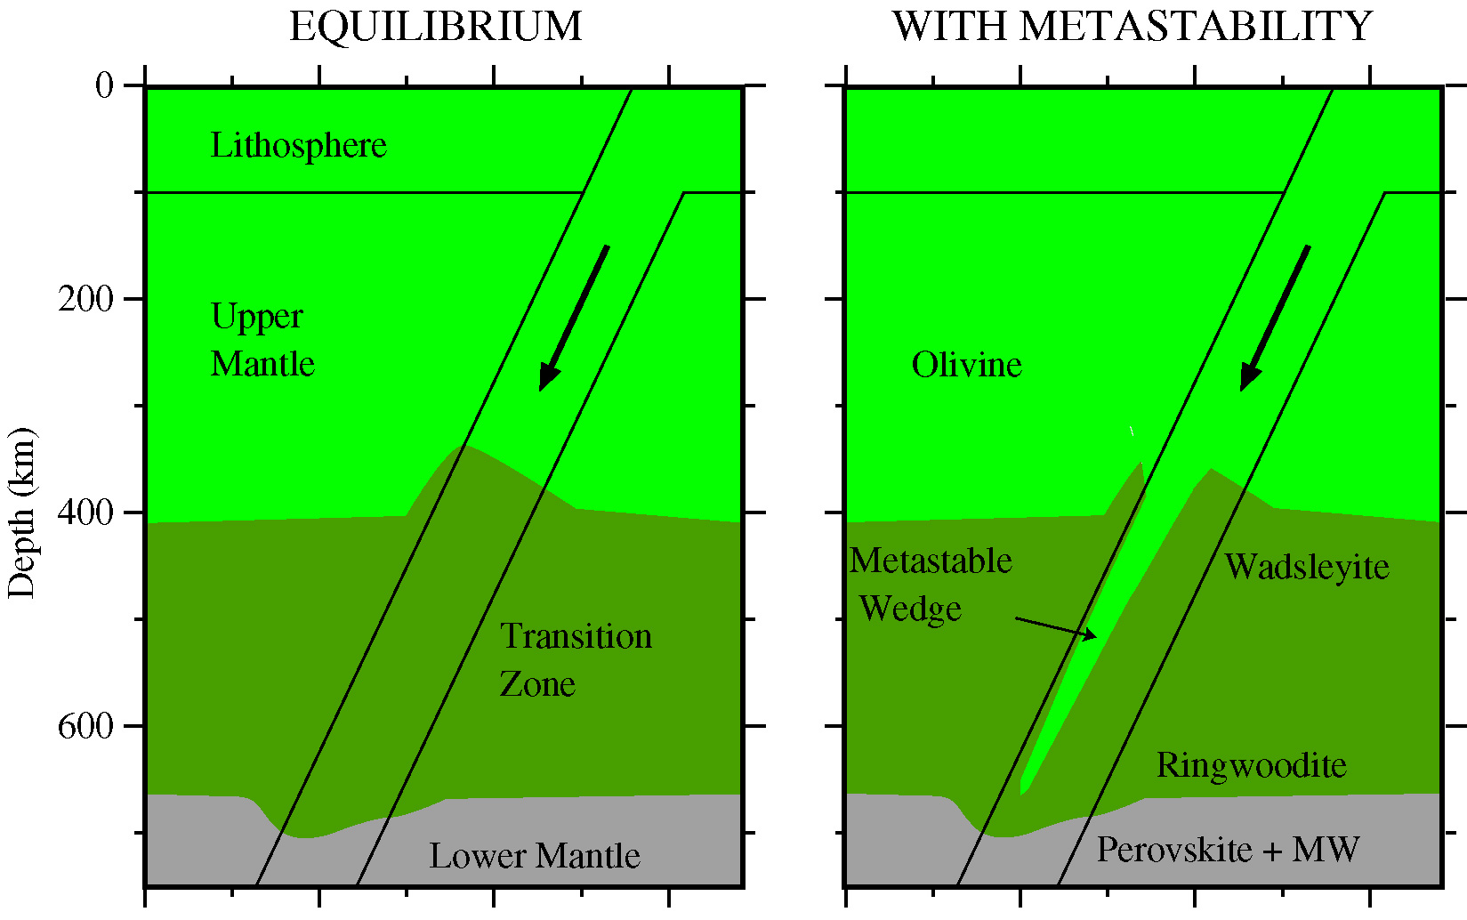
Kinetics limits the rate of transformation;
a metastable wedge of α-phase olivine is carried deep into the transition zone;
deep earthquakes are transformational earthquakes (in which large volumes of olivine revert “instantaneously” to the stable “spinel” phase)
Stein & Rubie 1999

Slide 20
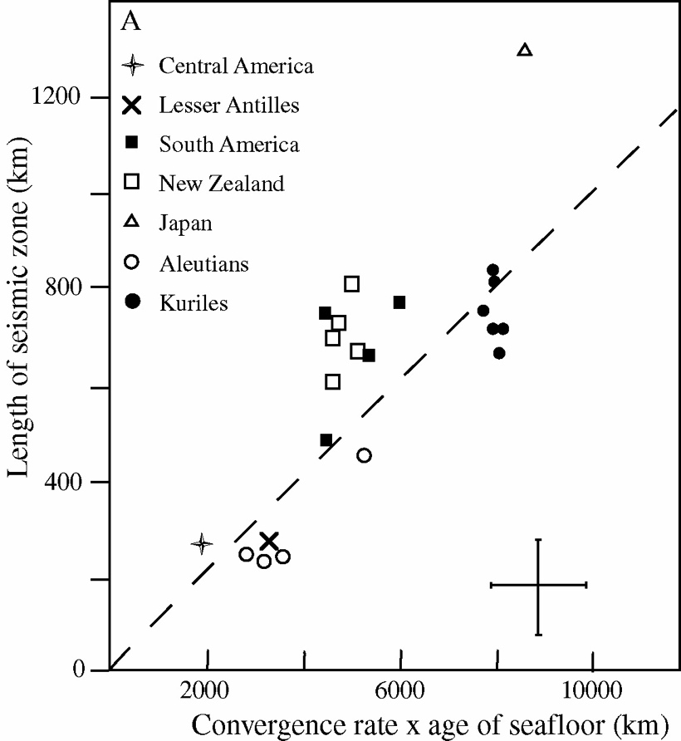
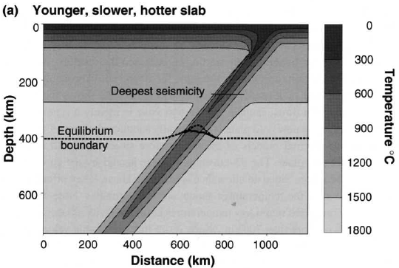
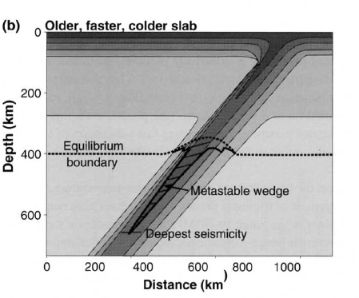
Importance of lithosphere age:
Thermal parameter is proportional to depression of isotherms within the slab:
controls depth of earthquakes, not necessarily depth of penetration

Slide 21
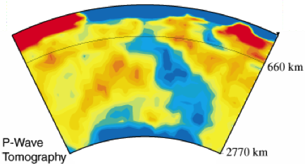
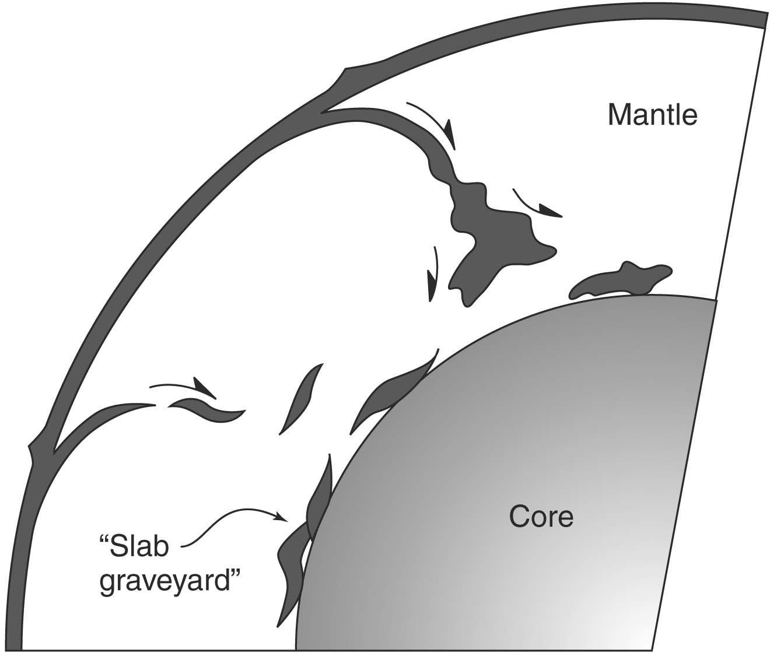
All subduction zones are colder than surrounding mantle Thermal effects of subduction zones last a long time
Mantle tomography beneath US:
Grand et al., 1997, GSA Today
Deep Mantle = Slab Graveyard?

Slide 22
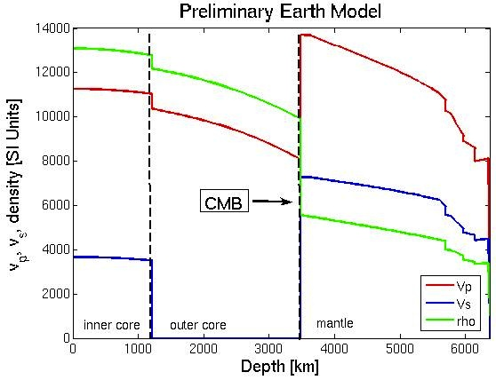
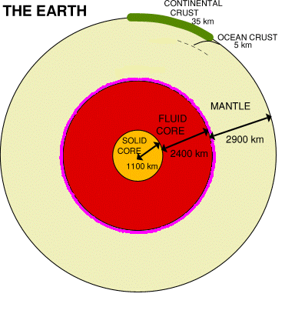
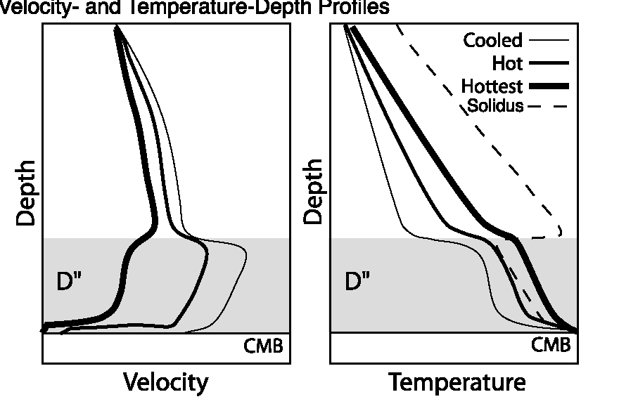
Properties of the Core-Mantle Boundary –
D” Layer
D”(200~300km)
Major boundary at 2900 km depth
Major change in composition, T and seismic velocities across CMB
Temperature jump of about 1500°C
D” layer at base of mantle is
~200-300 km thick but quite variable

Slide 23
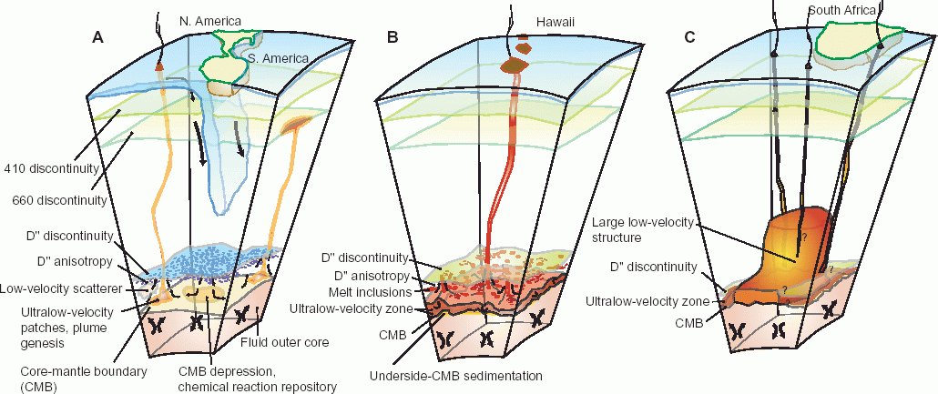
Current models of the CMB & D”
Americas
Cold/high velocity
Downwelling slabs??
Hawaii
Hot/low velocity
ULVZ
Plume root??
South Africa
Hot/low velocity
ULVZ?
Superplume root?

Slide 24
All subduction zones are colder than surrounding mantle
Seismic Tomography of a Cold Subduction Zone (NE Honshu)
Injection of cold lithospheric material affects the mantle in two ways:
  It cools the surrounding mantle and causes it to descend with the subducted lithosphere.
  It releases water and fluid-mobile elements that rise into the overlying mantle and cause it to melt.
Zhao et al., 1994

Slide 25
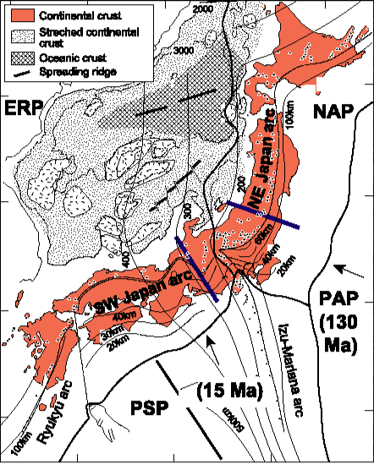
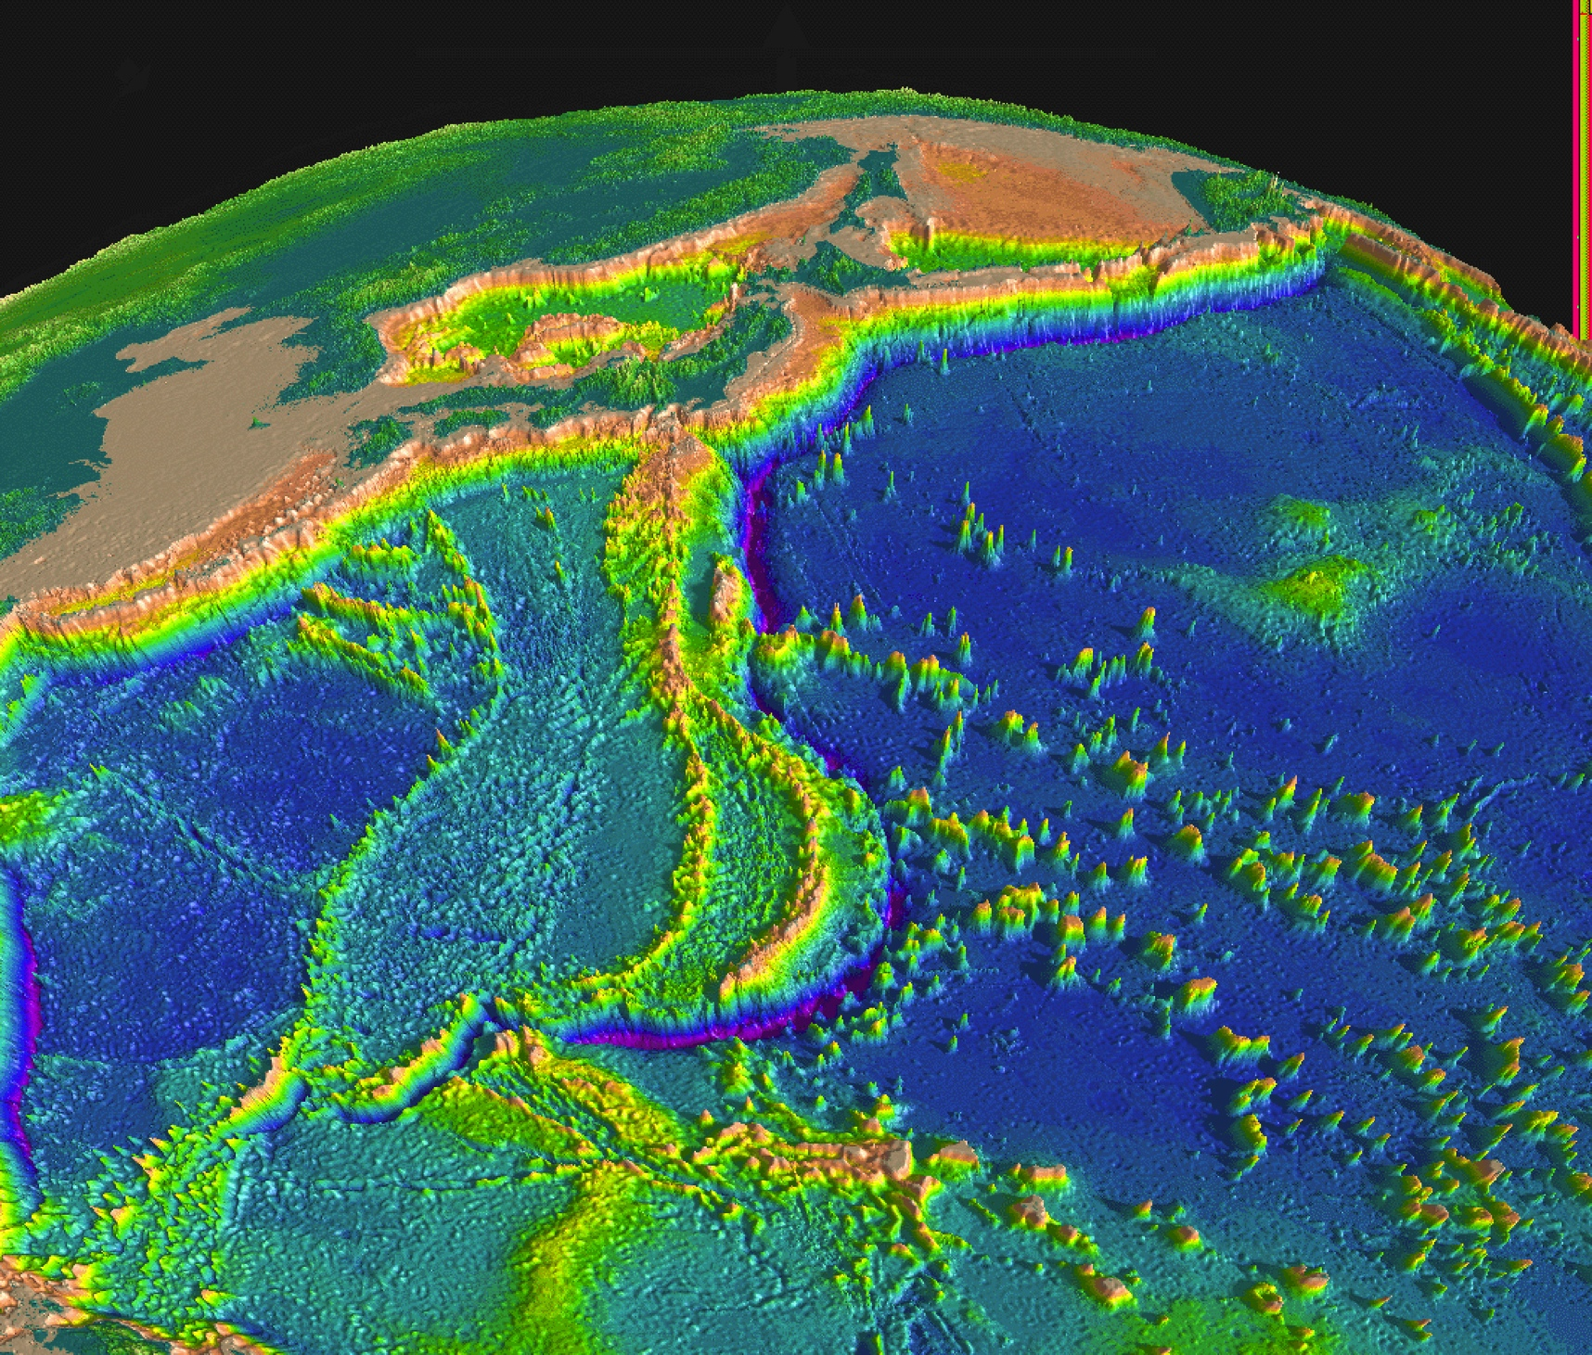
Japan’s two subduction zones exemplify differences in thermal structure: Cretaceous seafloor subducted beneath NE Japan & Miocene seafloor subducted beneath SW Japan

Slide 26
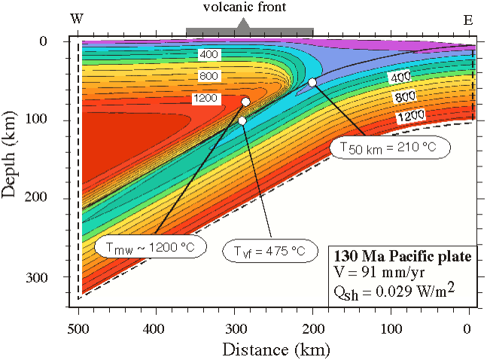
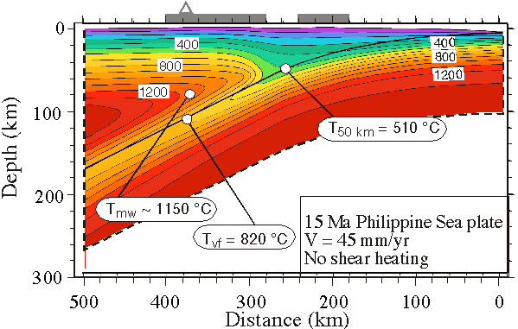
Cretaceous lithosphere subducted beneath NE Japan Cold, fast (and large thermal parameter)
Miocene lithosphere subducted beneath SW Japan Warm, slow (and small thermal parameter)
Peacock & Wang 1999

Slide 27
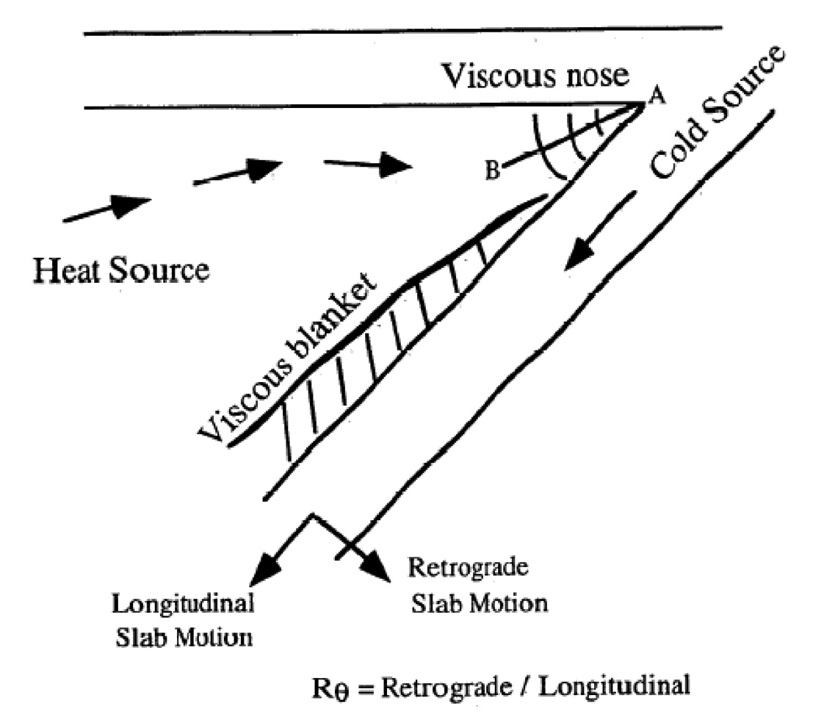
Viscous blanket grows as the slab sinks; downward motion of slab induces wedge convection
Cooling of adjacent mantle makes this more viscous (order of magnitude increase of viscosity with each 100°C decrease in temperature for mantle rheologies).
More viscous mantle around the sinking slab moves with it.
Induced
flow in
viscous
wedge
Kincaid and Sacks, 1997 JGR

Slide 28
Getting the viscosity correct is vital for modelling the mantle wedge thermal structure
Lowered viscosity allows hot mantle into nose of wedge
Van Keken et al., 2002

Slide 29
(van Keken et al.) is required in order to model melting in the mantle wedge
Peacock & Wang 1999 didn’t achieve melting temperatures, even in their hot slab!

Slide 30
Low heat flow beneath forearcs
(best modelled with little shear heating on subduction interface, i.e. a weak plate boundary fault)
NE Honshu
(van Keken
et al. 2002)

Slide 31
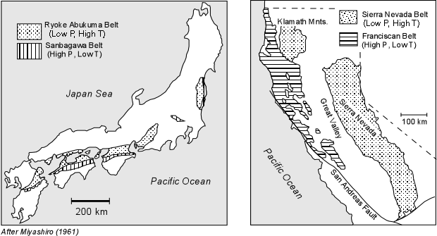
Paired Metamorphic Belts reflect contrasting thermal regimes of forearc and magmatic arc

Slide 32
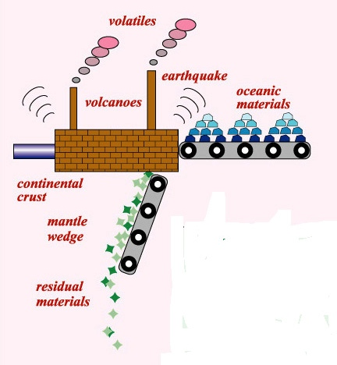
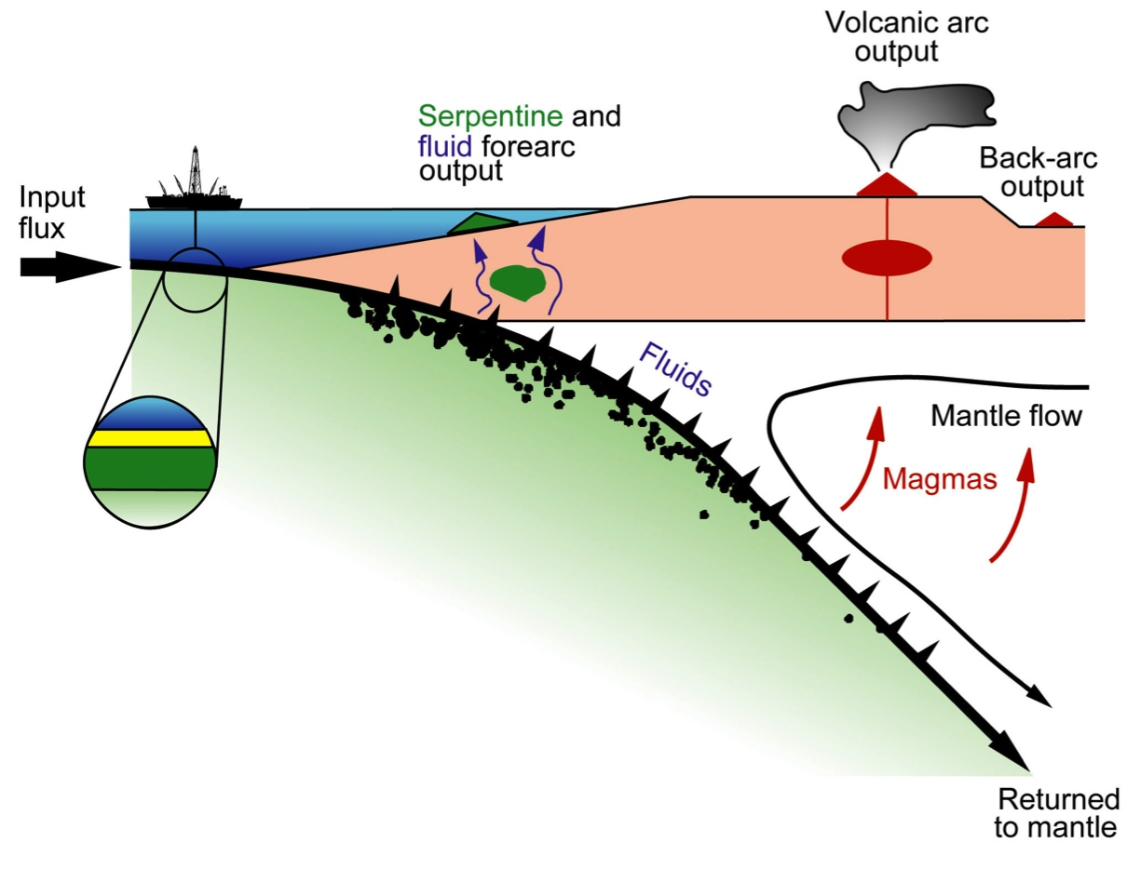
Deeper parts of Subduction Zones are dynamic chemical factories where elements are distilled from subducted materials and mixed with overlying mantle to generate new continental crust. Residues sink to the bottom of the mantle.
The Subduction Factory
What are the most important controls on convergent margin magmatism?

Slide 33
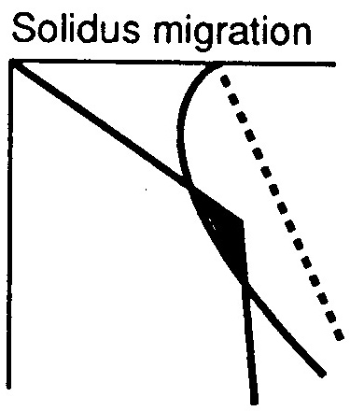
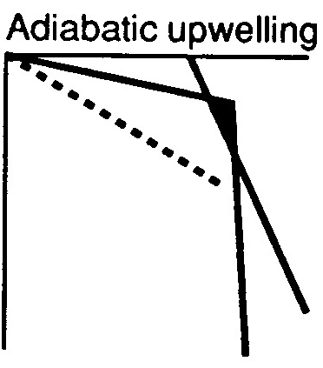

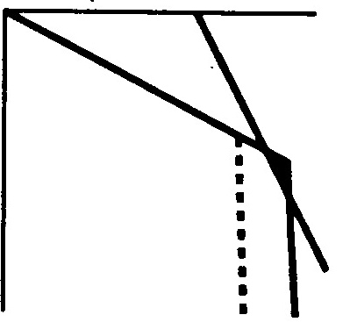
Three causes of melting:
lower the melting temperature (solidus) by adding water
raise the mantle temperature
decompress the mantle (bring asthenosphere to the surface)
• subduction zones
• mantle plumes
• mid-ocean ridges

Slide 34
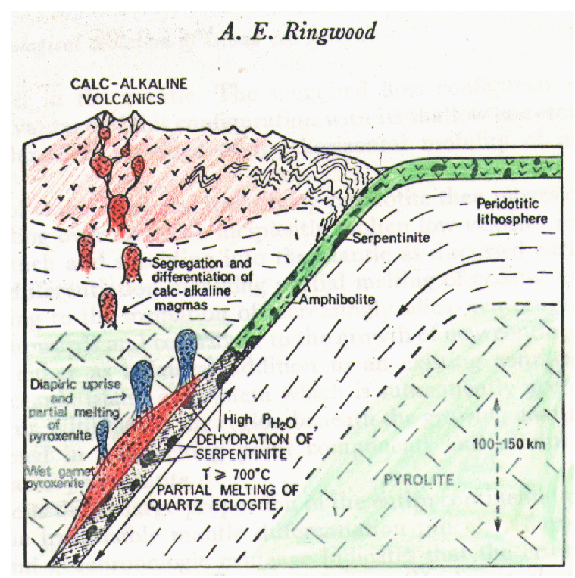
1974
Slab melting was popular in the 1970s, then fell out of favor
two stage distillation:
melt at ridge
melt again in subduction
enrich low melting pt components

Slide 35
Dehydration reactions in subducted materials release water to the overlying mantle wedge and progressively dehydrate the sinking slab
Today’s conventional textbook wisdom:
Schmidt & Poli, 1998

Slide 36
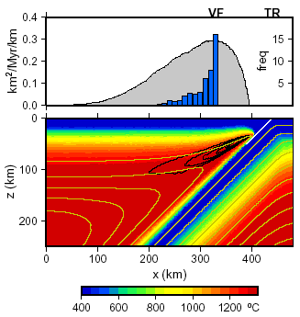
Decompression melting may result just due to ascent into the hot corner
(melting contoured from 0.2%/yr to 1%/Myr)
Now adiabatic melting is also recognised as contributory:
ENCH
Conder et al., 2002

Slide 37
Dehydration reactions in subducted materials release water to the overlying mantle wedge and progressively dehydrate the sinking slab
Today’s conventional textbook wisdom:
Schmidt & Poli, 1998

Slide 38
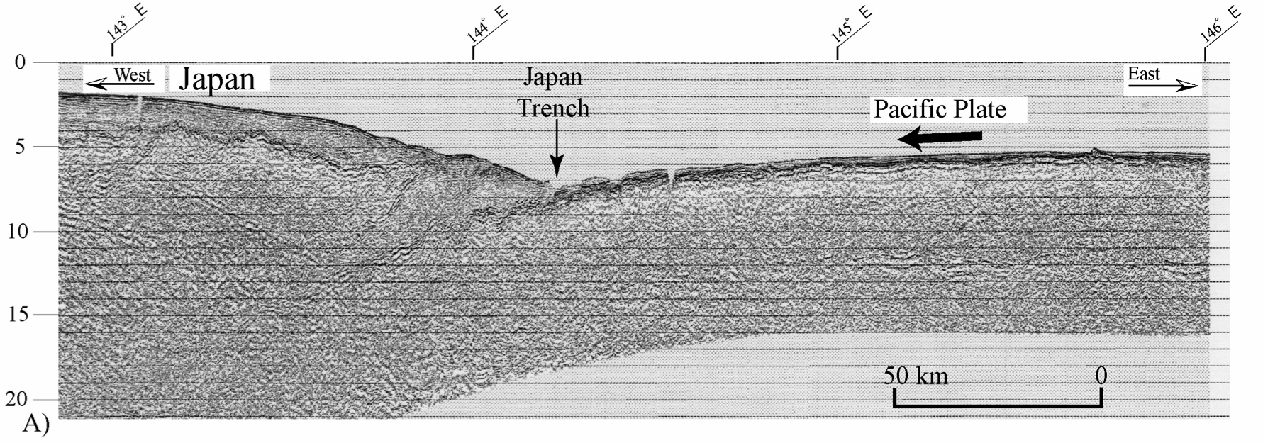
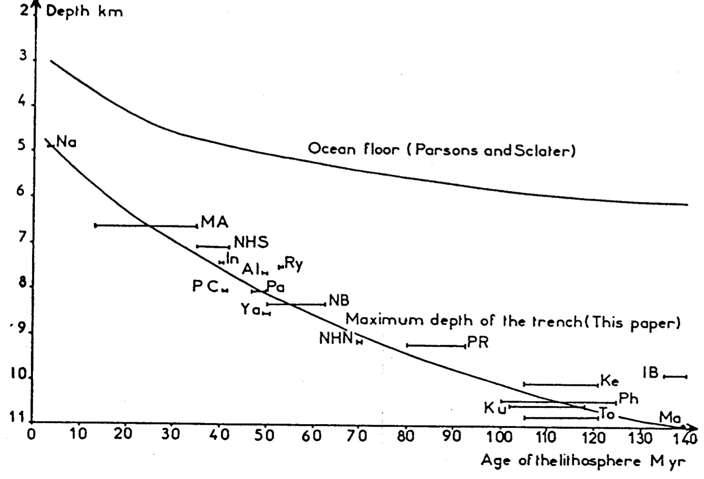
Trenches are deeper than other crust of same age:
VE ~ 4x
NE Japan Convergent margin
Grellet & Dubois 1982

Slide 39
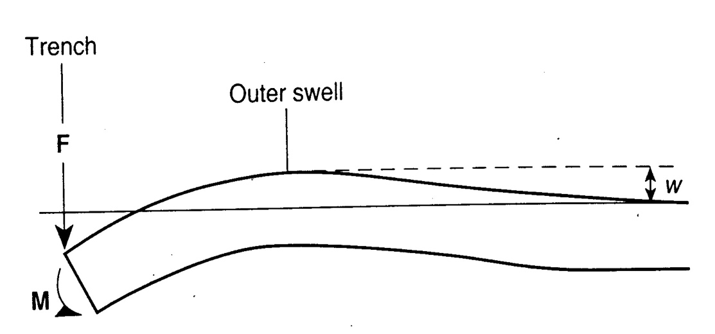
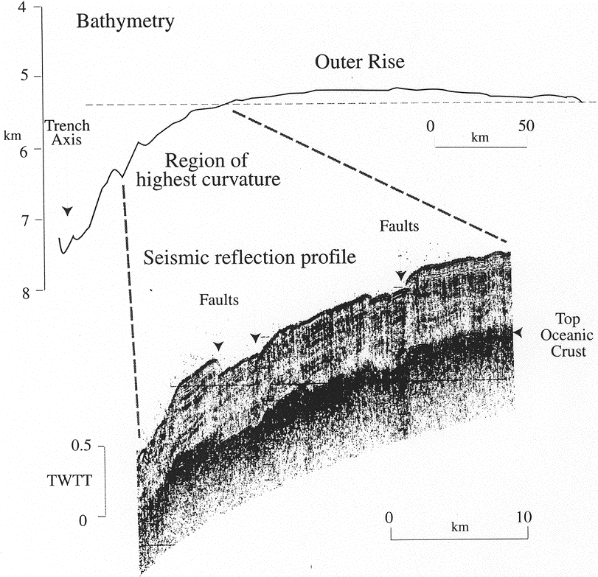
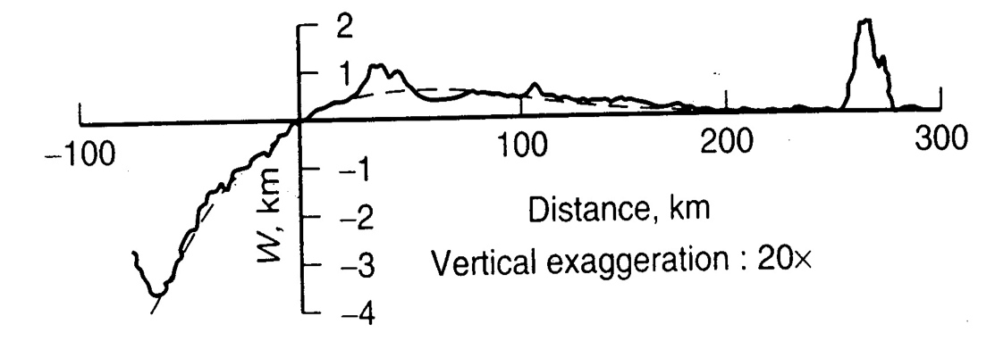
The Outer Trench Swell (aka Outer Rise) is where the subducting plate begins to be deformed.
Model of the Outer Swell as bending of Elastic Plate:
Theoretical
Mariana profile
Watts 2001
T_{e} varies from 42km (Kurile Trench) to 55km (Mariana Trench
Describes plate acted on by only a vertical load
Normal faulting in outer trench slope, Japan Trench, releases plate bending stresses
M&T 95

Slide 40
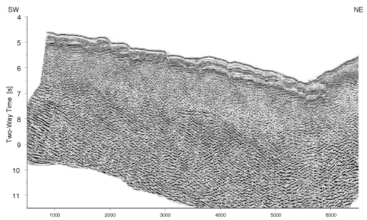
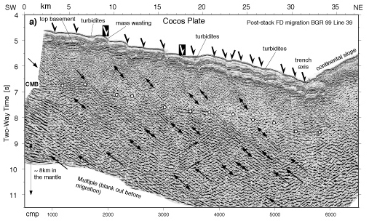
Reflection profiles of faults in subducting Cocos Plate
Ranero et al., 2003 Nature
MCS line
MCS line showing the Cocos plate as it descends into the Middle America Trench. Moho (CMB) is delineated by white filled circles, at ~5 km depth. Single arrows mark surface faults; double arrows are reflective normal faults due to plate bending, continuing across Moho to ~18–20 km where they are masked by the seafloor multiple.
Assume serpentinization on faults spaced ~2–3 km in the 25 km closest to the trench. Hydration occurs for 0.3Myr (convergence rate ~80 km/Myr); water diffuses ~1km/Myr implying ≤30% serpentinization of uppermost mantle. For 3-30% serpentinization at Moho decreasing linearly to 0% at ~30 km (where 23 Myr-old lithosphere reaches 600°C stability limit of serpentine). Water is ~13wt% of serpentine, implying 0.17–1.7 km of water per unit length of trench.

Slide 41
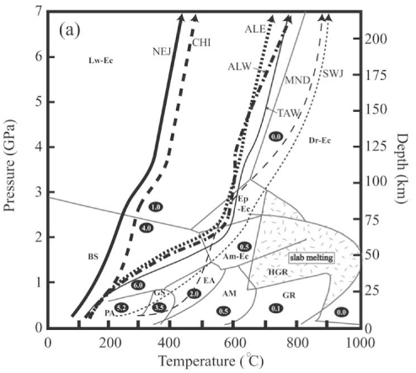
Subduction Zones are cold:
Blueschist –Eclogite metamorphic facies
PA, pumpellyite-actinolite; GS, greenschist; EA, epidote-amphibolite; AM, amphibolite; GR, granulite; HGR, high-pressure granulite; BS, blueschist; Am-Ec, amphibole-eclogite; Ep-Ec, epidote-eclogite; Lw-Ec, lawsonite-eclogite; Dr-Ec, dry eclogites.
Metamorphic phase diagram for water-saturated MOR basalt showing cold and warm subduction. Prograde metamorphism requires dehydration in both: circled numbers indicate H₂O wt % of each phase. P-T paths at the midcrustal level are depicted on the phase diagram. NEJ, northeast Japan; SWJ, southwest Japan; CHI, northern Chile; MND, Mendocino; ALE, Aleutians; ALW, western section of eastern Aleutians; and TAW, northeast Taiwan. (Yamasaki and Seno JGR 2003).

Slide 42
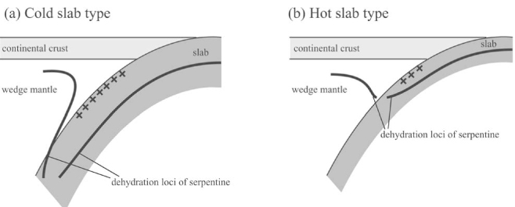
Thermal state and Dehydration of the subducted slab
Schematic showing the dehydration loci of serpentine for (a) cold slab and (b) hot slab, which is contolled by location of ~600°C isotherm. Thick lines are indicating the dehydration loci of serpentine. The upper plane seismicity is shown with crosses (Yamasaki and Seno 2003 JGR-B).

Slide 43
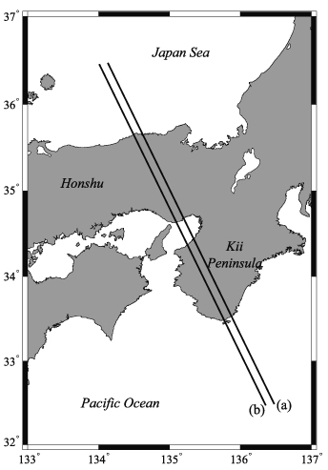

Double subduction zones not found in Warm SZs: SW Japan
Cross section through southwest Japan (Honshu), showing earthquake hypocenters (dots), calculated temperature structure (gray curves), and dehydration loci of metamorphosed crust (narrow green rectangle) and serpentinized mantle (dashed line; Yamasaki & Seno 2003 JGR-B).

Slide 44


Double Seismic Zones in cold subduction zones: NE Japan
earthquake hypocenters (dots), calculated temperature (gray curves), and dehydration loci of metamorphosed crust (narrow green rectangle) and serpentinized mantle (dashed line)
Yamasaki & Seno 2003 JGR).
1) Upper plane seismicity is located along the dehydration loci of the crust/sediments
2) Lower plane seismicity is located where subducted serpentine dehydrates: requires that subducting mantle serpentinized

Slide 45

Possible seismic imaging of blueschist in the subducting slab beneath northern Honshu, Japan
Vertical slice of Vp/Vs velocity structure beneath Honshu.
Dots are earthquake focii.
Numbered areas are interpreted as:
(1) partial melting,
(2) serpentine,
(3) transformation of oceanic crust to blueschist,
(4) transformation of blueschist to eclogite,
(5) partially hydrated harzburgite, and
(6) serpentine dehydration.
Zhang et al. 2004. Geology

Slide 46
Importance of Water to melt generation in Subduction
Zones
Stern, 2002 RoG

Slide 47
Water also transports soluble cations to mantle wedge.
Plank and Langmuir

Slide 48

Hot hydrous fluids contain much silicate material even below solidus; solubility is less sensitive to pressure
min. melt
Manning et al., 1994

Slide 49

Eclogite consists of garnet and sodium-rich pyroxene (omphacite).
Forms by medium temperature and high-pressure isochemical phase change of basalt and gabbro at 400–1000 °C and > 12 kbar (>45 km).
km
Provides density drive for slab pull
NEJ
SWJ
Peacock & Wang 1999

Slide 50

Hot subduction zones: Thermal conditions of subducted crust needed to form Adakite
Shaded field indicates conditions favorable for adakite melt generation: young ocean crust < 10 Ma
Adakite: a volcanic rock with trace-element ratios (low yttrium) indicating garnet-bearing rock was melted.
DB=dry basalt, DP=dry peridotite, WB=wet basalt, WP=wet peridotite. (Thorkelsen & Breitsprecher 2005 Lithos)

Slide 51

Sr/Y for Adakite vs. ADR suites
Sr/Y
Adakites
ADR suites
Y (ppm)
ADR = low-pressure fractionation sequence andesite-dacite-rhyolite.
Variations in Sr/Y reflect relative importance of residual garnet (retains Y) vs. plagioclase-cpx-ol (no residual garnet so doesn’t retain Y).
Drummond & Defant (1990)

Slide 52

Location of modern adakites (Martin 1999)
C
C
H
H
Hot & Cold subduction zones
C
H
H
C
H
C
Hot = H = Subducting seafloor >40 Ma = E. Pacific, SW Japan, and Solomons
Cold = C = Subducting seafloor <40 Ma = most others

Slide 53


Old (>40Ma) subducted crust does not melt but stimulates melting of the overriding mantle wedge

Slide 54
Key Questions
Where is arc magma generated and by what process?
-- pathway of water through the mantle in arcs?
What is mantle melt porosity and permeability? -- transport?
Depth extent of magma production system
-- deep slab dehydration?
• What is the mantle flow pattern in the wedge
-- slab driven counterflow, along-strike flow? 2D or 3D?
• Degree of spatial interaction between arc and backarc magma
production regions
Geophysical observables:
P velocity
S velocity
Attenuation (1/Q)
Velocity Anisotropy
Electrical Conductivity
?
Material Properties:
Temperature
Melt content
Composition
Water (+ other volatiles?)

Slide 55


Shear wave splitting in arcs: along-strike flow, or water?
Many subduction zone show along-strike fast anisotropy
Other subduction zones show a complex pattern, often with along-strike fast
directions near the trench and strike-perpendicular directions in the backarc
Conditions favorable to type-b fabric (low T, high stress) occur in the forearc
Yet several arcs show along-strike fast directions extend well into the backarc
This suggests that along-strike fast directions result from mantle flow
Shear wave splitting - N. Japan
(Nakajima and Hasagawa, 2004)

Slide 56


Seismic and Geochemical Evidence for Mantle Flow -- Lau basin
Shear wave splitting
Mantle flow
diagram
Smith et al., [2001]
After Turner and
Hawkesworth, 1998

Slide 57


Seismic proxies
Shear Attenuation (1/Qs)
Poisson’s Ratio ~ Vp/Vs
melt
free H₂O
d=1 mm
10 mm
2 GPa, 1000°
Takei (2002) poroelastic theory
Faul & Jackson (2005), adjusted to 2.5 GPa
other theories scale differently
Notes:
To do this, use other proxies. Attenuation of seismic waves varies by orders of magnitude for expected temperature variations, so is sensitive to T at high temperatures.
Vp/Vs, scaled to poisson’s ratio, is less T sensitive but could be very sensitive to melt presence, depending upon the pore geometry.
(probably LHS is really Jackson et al. 2002 model)

Slide 58

P,S, and Q Tomography - Tonga Arc
Velocity tomography from Conder and Wiens [2005]; Q tomography from new tomographic
Inversion of data from Roth et al [1999]

Slide 59






Geodynamic Modeling of Tomographic Velocities & Attenuation structure
(Lau Basin)
Temperature Model
P velocity calculated
from temperature model
S velocity calculated
from temperature model
Q calculated from
temperature model
Q tomography

Slide 60



Effect of solid flow above a subducting slab on water distribution and melting at convergent plate boundaries
Fluid distribution
Freezing front
Mantle depletion (melting)
Melt front
Cagniocle, Parmentier, Elkins-Tanton, JGR, 2007
Notes:
Temperature distributions for a convergence rate of 60 km Ma􏰁1, a slab age of 90 Ma, and a dip of 45°. Serpentine and chlorite stability fields, derived from phase diagrams from Schmidt and Poli [1998] are superimposed (solid and dashed, respectively). The serpentine and chlorite layers redistribute the water released by slab dehydration reactions into a broad dehydration pulse (see text). (b) Fluid distribution. Fluid is released from the slab at a rate based on the results of Schmidt and Poli [1998] and follows a Gaussian distribution centered at a depth of 115 km with a half width of 40 km. Fluid rises by buoyant porous flow along grain edge channels with a permeability based on a uniform grain size of 1 mm. Melting occurs where hydrous fluids interact with hot mantle. Solid flow (shown by white streamlines) in the mantle wedge generated by the motion of the plate is calculated according to a temperature-dependent viscosity based on thermally activated creep (see text). Fluid flow lines are shown in black. (c) Mantle depletion. Values reflect the amount of melt extracted from the solid mantle or F. Fluid flow lines are shown in black, and solid flow lines are shown in white.

Slide 61

Ascent of corrosive fluids through porous media will lead to channelization: Numerical experiments of ‘Reaction Infiltration Instability’
Spiegelman et al, 2001 JGR

Slide 62






Vp/Vs & 1/Q
Broad area of high 1/Q, low Vp (high T)
Narrow conduit of high Vp/Vs beneath arc
1/Qs
Vp
Vp/Vs
Nicaragua
(Syracuse et al., G3, 2008; Rychert et al., G3, 2008)
Notes:
Plausibly, 1/Q gives T, and Vp/Vs shows melt. This makes sense, as Vp and 1/Q show broad hot regions, but the Vp/Vs suggests a narrow conduit feeding the volcanoes.

Slide 63

Hot Wedge & Melting Column
Numerical Simulation
1/Qs
Temperature
Melt - porosity
Vp/Vs
Cagnioncle et al.,JGR, 2007
Notes:
This pattern looks surprisingly like recent numerical models for coupled solid-melt flow in wedges. This model, by Cagnioncle et al., shows a broad wedge (geometry slightly different) like the 1/Q, a result of corner flow. The melt flows through this solid flow field but is much more focused as it ascends to the arc. This pattern has not been clearly identified elsewhere, but few studies have had resolution in the right places.

Slide 64
Dehydration reactions in subducted materials release water
Schmidt & Poli, 1998

Slide 65
Arc magmatic crustal plumbing is poorly understood

Slide 66

Petrologic models of magmatic arcs based on wide-angle seismic and petrologic modelling
Fliedner & Klemperer, EPSL, 2000
Middle crust has Vp characteristic of continental crust:
magmatic arcs are believed to be the source of most continental crust

Slide 67
Back Arc Basins (BAB) and Interarc Basins (IAB)
Back-arc basins are extensional basins that formed as a result of seafloor spreading behind an island arc.
Interarc basins are zones of rifting associated with arcs which have not progressed to the point of seafloor spreading.
Both may be active or extinct.

Slide 68

Marginal Basin vs.
Back-arc Basin vs. Interarc Basin
Marginal Basins:
any distinct basins along the margins of continents or oceans:
No genetic connotation
e.g. Aleutian Basin, Cayman Trough and Caribbean Sea are not back-arc basins

Slide 69

“Mariana-type” subduction zones under extension
Uyeda &
Kanamori, 1979

Slide 70

Active back-arc basins

Slide 71

Active vs. Extinct Backarc basins
Actively extending BAB and IAB are volcanically active and have high heatflow.
Extinct BAB and IAB have normal heatflow.

Slide 72


Back-arc basins form by sea-floor spreading
Seismic Structure
Decompression melting
Structure similar to mid-ocean ridges
Significant variations between active backarcs – Lau slowest, and Mariana fastest
Variations largely confined to the “melt producing” region - 40 to 100 km depth
Wiens, Kelley, Plank, EPSL, 2006

Slide 73


What causes back-arc basins?
Kinematic models
Lau Basin
Mariana Trough

Slide 74


Izu-Bonin-Mariana (IBM)
Mariana Trough (active) and Parece Vela-Shikoku (extinct)
Back-Arc Basins

Slide 75

Two episodes of BAB formation in the West Philippine Sea
I
II

Slide 76

Mariana Trough
(~ 1400 km long = about as long as California)

Slide 77

Central Mariana Trough
Extension has been going on for some time (~7 Ma); Seafloor spreading occurs. Morphology of ridge axis looks like that of a slow-spreading ridge, Volcanic arc is mature.

Slide 78
Sub-Moho low Vp represents crustal cumulates – vol. ~50% of lower-crustal restites
Sub-Moho low Vp represents crustal cumulates, &/or melts & serpentinization
Fliedner & Klemperer, EPSL, 2000
Takahashi et al., Geology, 2007

Slide 79

Van Keken et al., Subduction Factory 4, JGR, 2011

Slide 80


Tomographic Image of Warm Subduction Zone
No deep earthquakes, so no deep images!

Slide 81
How are geophysical observations related to material properties?
Geophysical observables:
P velocity
S velocity
Attenuation (1/Q)
Velocity Anisotropy
Electrical Conductivity
?
Material Properties:
Temperature
Melt content
Composition
Water (+ other volatiles?)
Complex and Difficult Inverse Problem !
“…. as we know, there are known knowns; there are things we know we know.
We also know there are known unknowns; that is to say we know
there are some things we do not know. But there
are also unknown unknowns - the ones we don't know we don't know”
U.S. Secretary of Defense Donald Rumsfeld
Press Briefing, February 12, 2002

