Slide 1
Lecture 7 January 29, 2013 Planetary Plate Tectonics Plate Kinematics and Dynamics Forces on Plates
Topics:
• Controls on stagnant vs. plate vs. mobile tectonics
• Plate tectonics as a kinematic description of plate geometry and motions
• Plate dynamics as a description of the forces controlling plate motion
• Body and boundary forces: Slab pull, Slab suction, Ridge push, Continental Drag
Reading:
RichardsBunge.Asthenospere&PlateTectonics.G3.2001
ForsythUyeda.PlateForces.GJRAS.1975
Carlson.SlabPull.GRL.1995
Conrad.SlabPullSuction.Science.2002 Bokelmann.PlateForcesNAM.Geology.2002

Slide 2
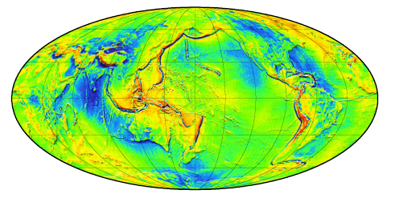
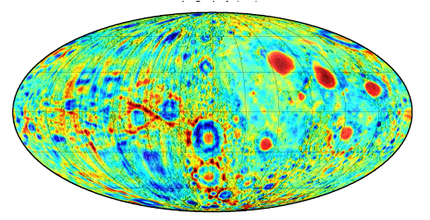
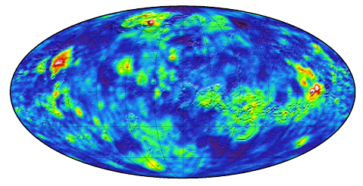
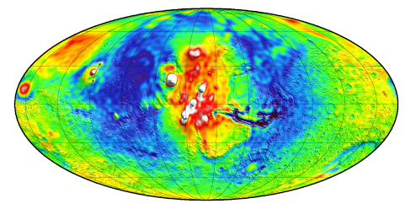
Earth Moon Mars
Free-air gravity scale as a proxy for lithospheric strength:
350 mGal 700 mGal
range range
270 mGal 950 mGal
range range
“conventional” (multi-)plate tectonics
Stagnant lid
Frozen lid
Single plate
Mobile lid, or
transitional between mobile and frozen
Venus

Slide 3
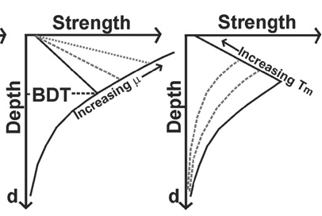
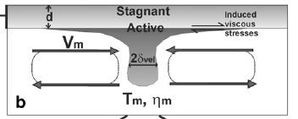
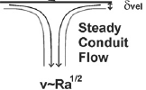
Mobile (Earth, Venus) vs. Stagnant (Mars, Moon) lithospheres:
Boundary between mobile and stagnant regimes occurs when
Convective stresses ~ Plate strength
Plate strength ~ depth to brittle-ductile
transition (μρgh)
Decreasing ε’
Convective stress ~ asthenospheric velocity * viscosity
thickness of velocity boundary layer
(O’Neill, Australian JES, 2012)

Slide 4
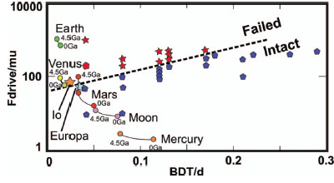
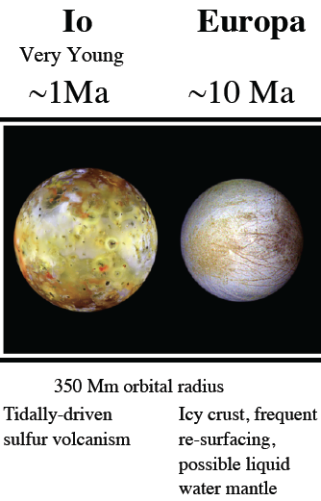
Numerical simulations identify boundary
between mobile and stagnant regimes
on a plot of driving forces vs. plate strength:
MOBILE
STAGNANT
Simple parameterization explains
“mobile” vs. “stagnant”
but not “plate tectonics” vs. “mobile”
(O’Neill, Australian JES, 2012)

Slide 5
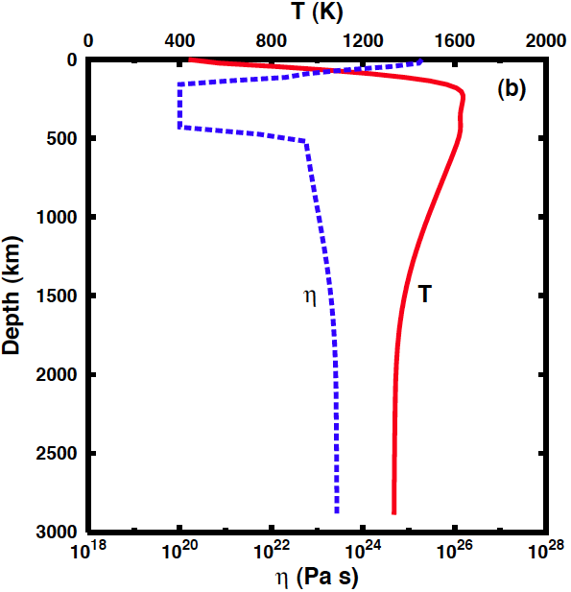
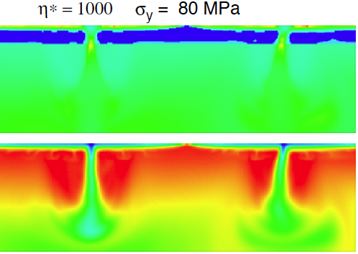
Plate tectonics (Earth) vs. Mobile (Venus, Io) lithospheres:
Richards et al. (G3, 2001)
“Role of a low-viscosity zone in stabilizing plate tectonics”
Low-viscosity zone reduces tractions on base of plates, discouraging formation of new plate boundaries
A narrow low-viscosity zone implies a more-viscous deep mantle, allowing stronger tractions on subducting slabs
RIDGE
η*
η/Pa.s
“SUBDUCTION”
ZONES
T/°C

Slide 6
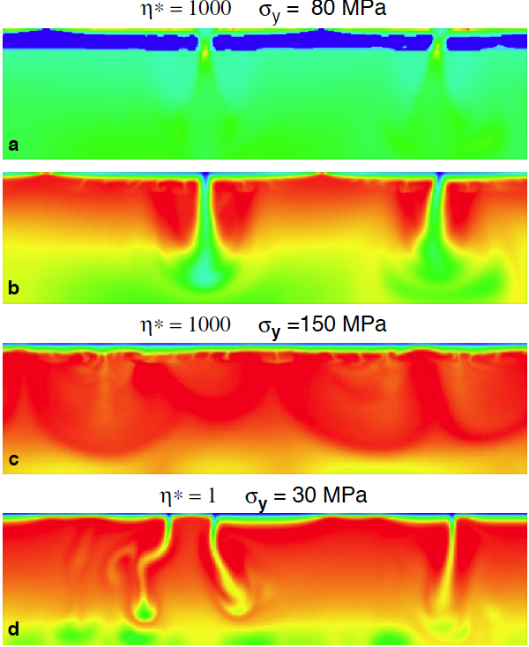
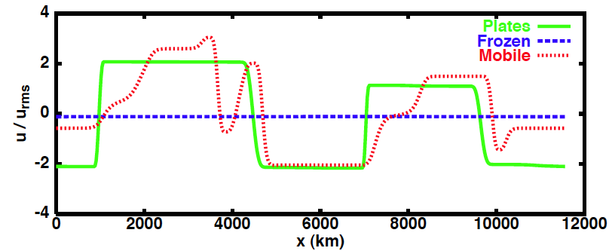
Convection models parameterized in terms of
(1) lithospheric yield stress σ (2) LVZ viscosity contrast η∗
EARTH
PLATES
MARS
FROZEN
VENUS?
MOBILE
(Richards et al., G3, 2001)

Slide 7
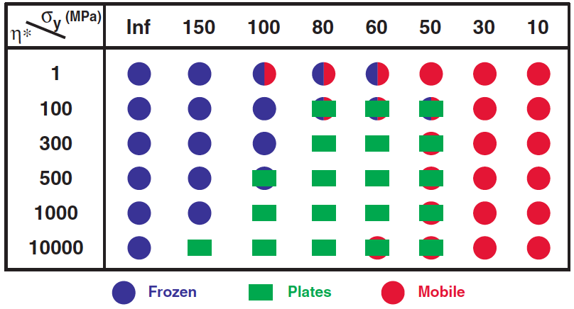
Convection models parameterized in terms of
(1) lithospheric yield stress σ (2) LVZ viscosity contrast η
EARTH
PLATES
MARS
FROZEN
VENUS?
VENUS
MOBILE
MARS
EARTH
(Richards et al., G3, 2001)

Slide 8
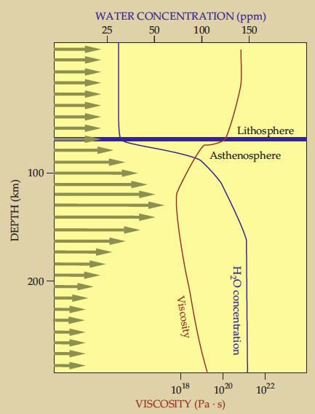
Water in mantle
(as hydrogen atoms in defects in nominally anhydrous ol, pz, gt) probably controls the LVZ
• on Venus, no water now, so no LVZ now, so no plate tectonics now
• higher temperatures on early Earth produced thicker dryer lithosphere so slower plate tectonics;
• subduction of water to hydrate the mantle was a gradual process;
• plate tectonics only describes the last 3 Ga±
(Hirschmann & Kohlstedt, Phys. Today, 2012)
(Korenaga, Annals N.Y. Acad. Sci., 2012)

Slide 9
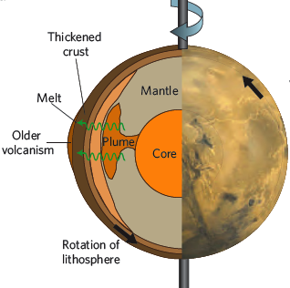
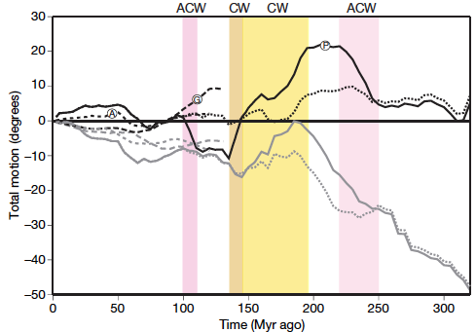
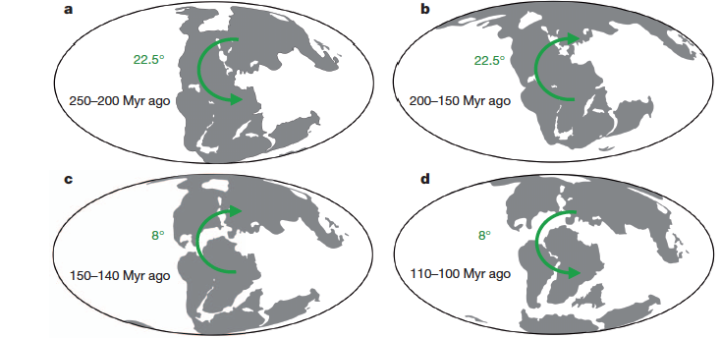
Mars (single-plate planet):
True Polar Wander occurs to place
mass concentrations at the equator
(rotational energy is least when rotation axis is aligned with axis of largest principal moment of inertia – centrifugal force moves the mass excess to the equatorial bulge)
Earth:
Paleomagnetically inferred times of mean N-ward or S-ward plate motion represent supercontinents (and the antipodal mantle convection superswells they generate) migrating toward the equator at plate rates, ~ 1°/Ma = 10 cm/yr
(Tsai & Stevenson, JGR, 2007; Steinberger & Torsvik, Nature, 2008; Creveling, Mitrovica et al., Nature, 2012)

Slide 10
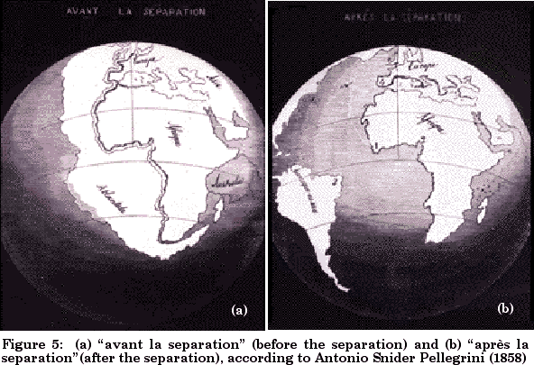
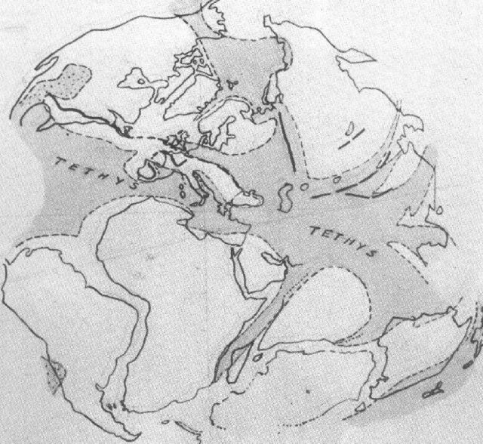
Continental Drift - Seafloor Spreading - Plate Tectonics – Plate Dynamics
Continental drift: an idea lacking a mechanism
Shoreline fit across the Atlantic: Francis Bacon, 1620
Geologic fit across the Atlantic:
Edwin Suess, 1883 – Gondwanaland
Alfred Wegener, 1915 – claimed plate rates of meters/year
Alex du Toit, 1937 – recognized glacial features in tropical latitudes, and vice versa

Slide 11
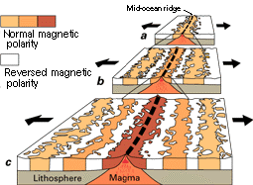




Continental Drift - Seafloor Spreading - Plate Tectonics - Plate Dynamics
Seafloor spreading: a mechanism for continental drift
Sub-crustal convection currents – Arthur Holmes, 1931
“Continent and ocean basin evolution by spreading of the sea floor” – Robert Dietz, Nature, 1961
Mid-ocean ridges have high elevation, high heat-flow, low-mantle velocity; associated with upwelling convection – Harry Hess, 1962
“Magnetic anomalies over oceanic ridges”
- Fred Vine, Drum Matthews, Nature, 1963

Slide 12
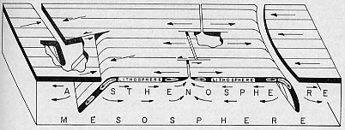
Continental Drift - Seafloor Spreading - Plate Tectonics - Plate Dynamics
Plate tectonics: plate geometry; kinematics of lithospheric motion
Transform faults “A new class of faults and their bearing on continental drift” - J. Tuzo Wilson, Nature, 1965
Euler poles “Rises, trenches, great faults, and crustal blocks”
- Jason Morgan, JGR, 1968; “Sea-floor spreading and continental drift” - Xavier Le Pichon, JGR,1968
Triple junction evolution “The North Pacific—an example of tectonics on a sphere”- Dan McKenzie & Bob Parker, Nature, 1967
Benioff zones = underthrusting of the lithosphere at island arcs “Seismology and the
new global tectonics”
- Bryan Isacks,
Jack Oliver, Lynn Sykes,
JGR, 1968

Slide 13
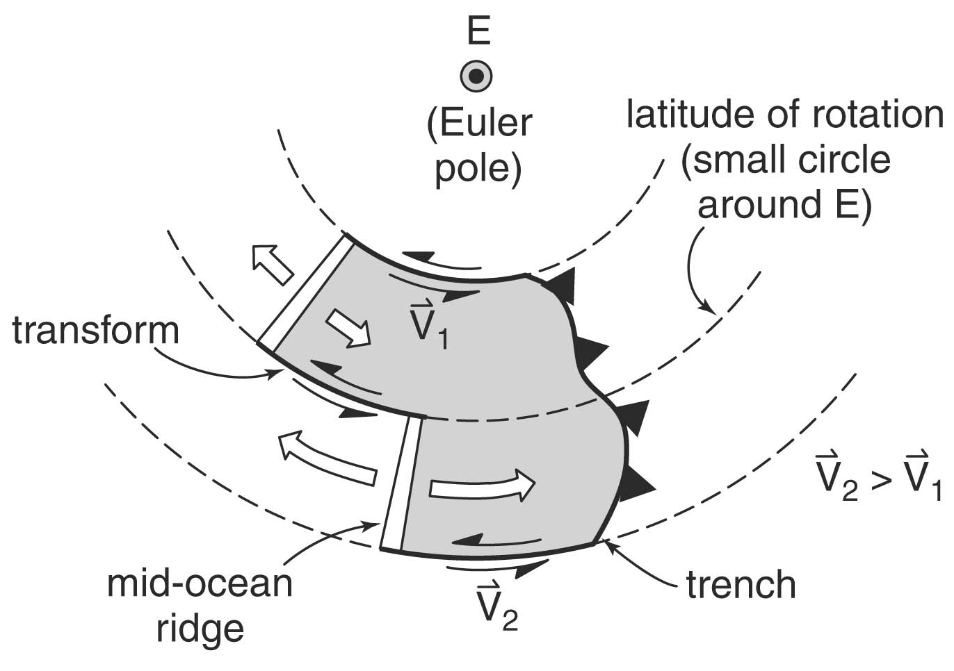
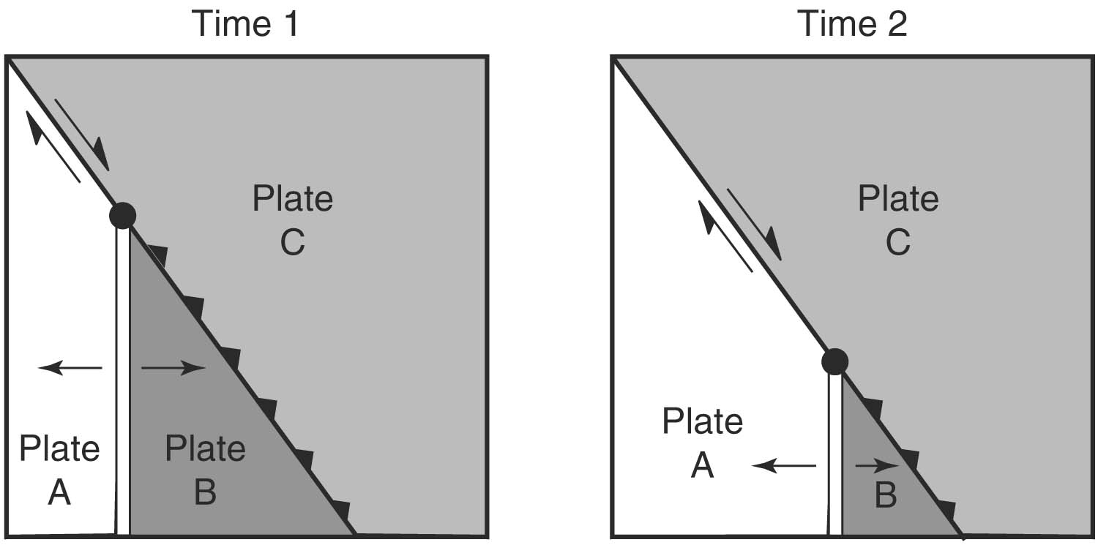
Plate geometry constraints
• Conservative, constructive and destructive plate margins; sum of all plate motions is zero
• Euler’s theorem: Any motion of a rigid shell on a sphere can be described by a rotation around a pole e.g. _{A}ω_{B}, in °/Ma
• Convergence or divergence velocity is
_{A}V_{B} = R . sin θ . _{A}ω_{B}
• Triple junctions may be stable or unstable; stable triple junctions migrate with time retaining the same geometry
Example of RTS triple junction: south end of San Andreas fault
Notes:
θ = angular distance from the Euler pole to the point on the plate boundary

Slide 14
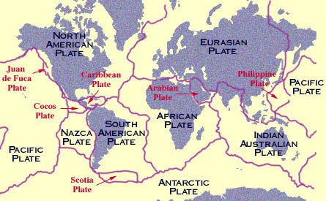
NUVEL (12 plates)
Relative Plate Motion Kinematic Models
Pacific (Pa)
North America (Na)
South America (Sa)
Eurasia (Eu)
Africa (Af)
Antarctica (An)
Australia (Au)
Nazca (Nz)
Caribbean (Ca)
Cocos (Co)
India (In)
Arabia (Ar)
NUVEL-1: DeMets et al. (1990) determined best-fitting Euler vectors (magnetically-inferred spreading rates (last 3 Ma), transform azimuths, earthquake slip vectors) between 12 assumed rigid plates.
NUVEL-1A: Modification required because of changes to the magnetic timescale. Basically multiply all NUVEL-1 rates by 0.9562

Slide 15
REVEL (19 plates)
Sella et al. 2002 determined plate motions based on GPS
- an absolute determination of motion within the ITRF (International Terrestrial Reference Field)
- best fit of all the data to a rigid plate model on a sphere
19 Plates used in REVEL (NUVEL in bold):
North America (Na) Caribbean (Ca)
Nazca (Nz) South America (Sa)
Antarctica (An) Pacific (Pa)
Eurasia (Eu) Philippine Sea (Ph)
Australia (Au) Arabia (Ar)
Somalia (So) Nubia (Nu)
Amuria (Am) Anatolia (At)
India (In) Okhotsk (Ok)
S. China (Cs) Sierra (Sr)
Sunda (Su)
NUVEL plates not used in REVEL:
no GPS sites: Cocos (Co)
Other minor plates omitted:
Scotia (Sc)
Juan de Fuca (Jf)
Rivera (Ri)

Slide 16
REVEL vs. NUVEL (purple) (yellow)

Slide 17
REVEL vs. NUVEL: Europe vs. North America; and Africa (“Nubia”) vs. South America A remarkable agreement given the different time-scales

Slide 18
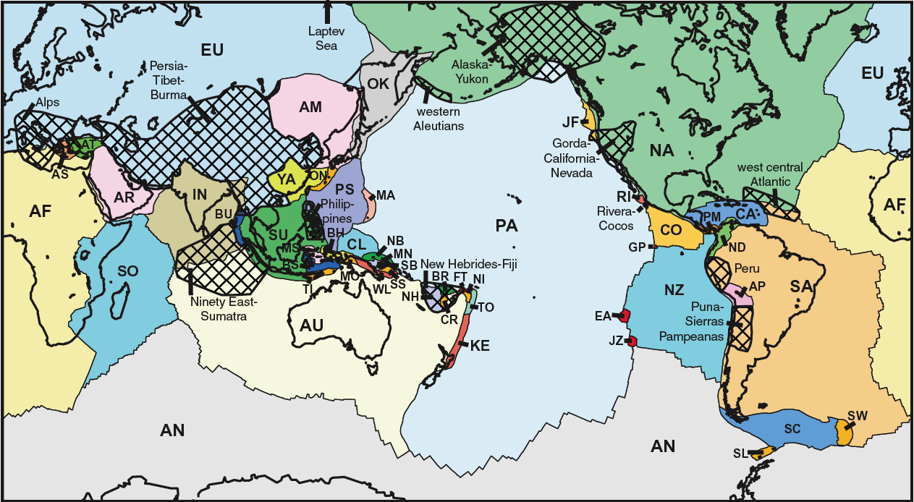
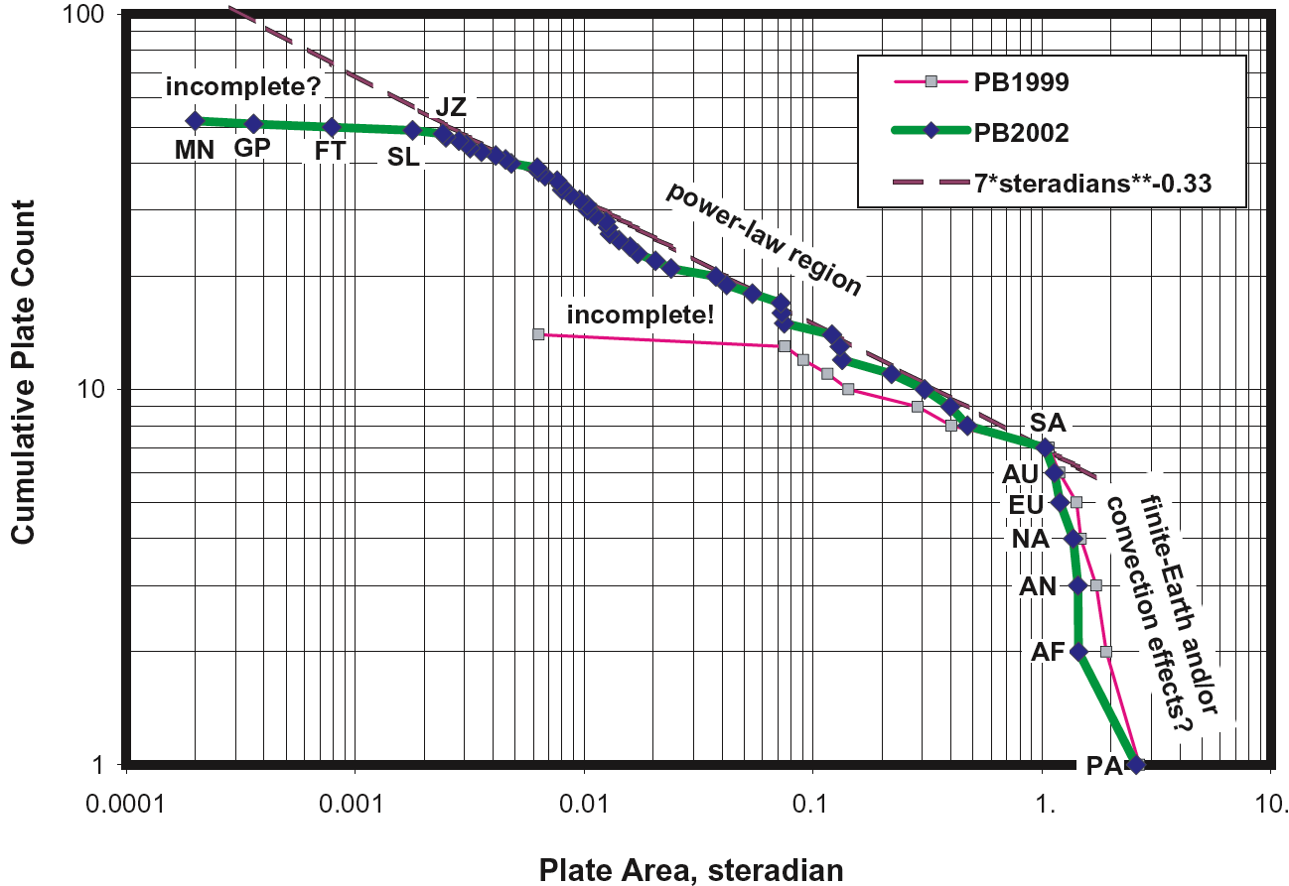
PB2002: 52 Plates
Peter Bird, G-cubed, 2002
14 big plates of NUVEL-1A: Africa, Antarctica, Arabia, Australia, Caribbean, Cocos, Eurasia, India, Juan de Fuca, Nazca, North America, Pacific, Philippine Sea, South America
38 small plates: Okhotsk, Amur, Yangtze, Okinawa, Sunda, Burma, Molucca Sea, Banda Sea, Timor, Birds Head, Maoke, Caroline, Mariana, North Bismarck, Manus, South Bismarck, Solomon Sea, Woodlark, New Hebrides, Conway Reef, Balmoral Reef, Futuna, Niuafo’ou, Tonga, Kermadec, Rivera, Galapagos, Easter, Juan Fernandez, Panama, North Andes, Altiplano, Shetland, Scotia, Sandwich, Aegean Sea, Anatolia, Somalia
11 orogenic regions: Alps, Persia-Tibet-Burma, Ninety-East-Sumatra, Philippines, New Hebrides-Fiji, western Aleutians, Alaska-Yukon, Gorda-California-Nevada, Peruvian Andes, Sierras Pampeanas, west-central Atlantic

Slide 19
Relative: Fixed plate - hold any one arbitrary plate fixed Absolute: No-net rotation frame - plates are imagined to move relative to a fixed Earth center, and the lithosphere does not move relative to the underlying mantle, or the sum of its movements is zero ITRF2000 reference frame - plates move relative to the GPS satellite constellation and the Earth’s center of mass Hotspot reference frame - the hotspots are presumed to be fixed above a stationary deep-mantle source, and the plates are presumed to move over them
Reference frames

Slide 20
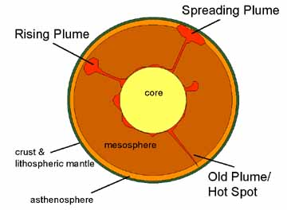
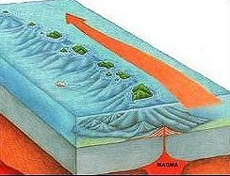
Absolute (hotspot reference frame) Plate Motion Kinematic Models
Assumes that hotspots are fixed in the mantle, so the tracks of hotspot chains can be used to constrain absolute motions back to about 130 Ma.

Slide 21
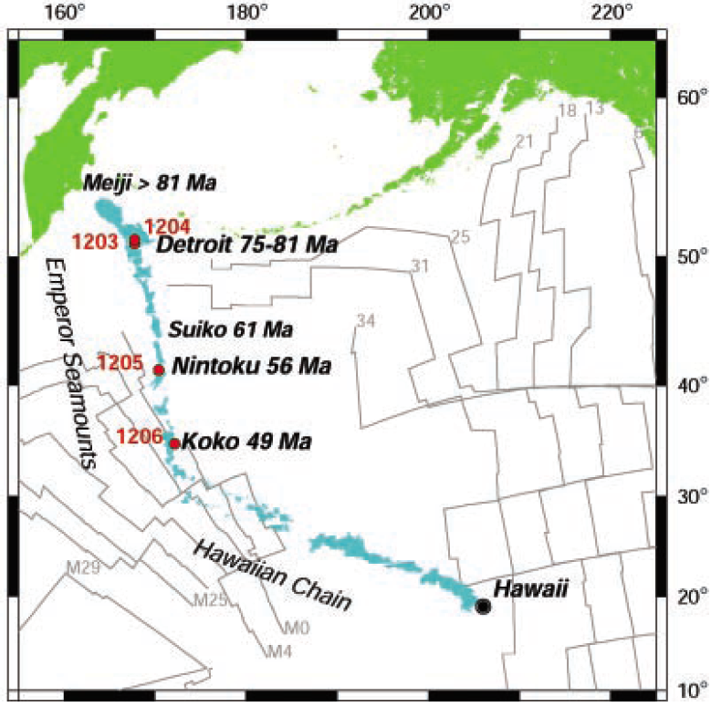
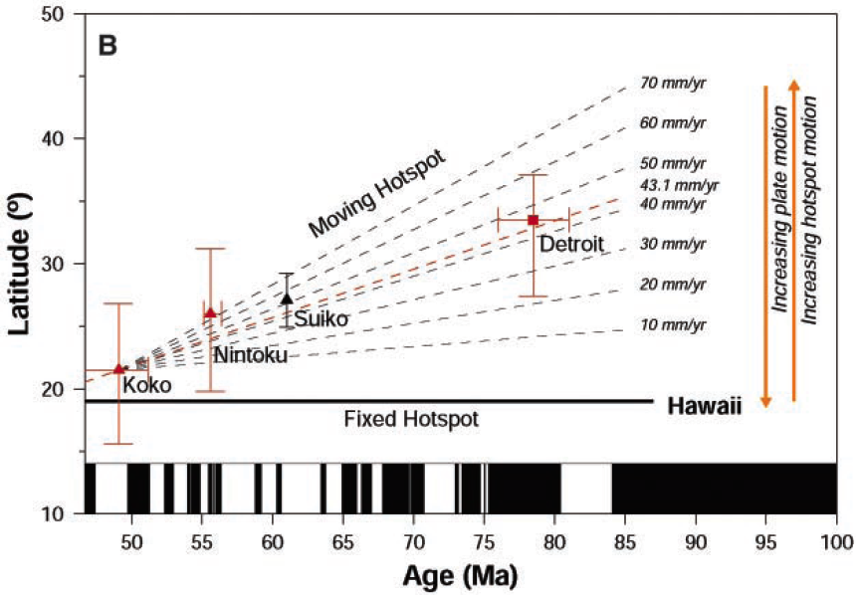
Motion of the Hawaiian Hotspot Plume in Earth’s Mantle
Tarduno et al., Science, 2003
The ages of the Emperor seamounts indicate
rapid (>5 cm/year) relative motion between the
plate and the hotspot source from 81 to 47 million
years ago. This could mean that the Pacific plate was moving northward over a stationary hotspot source, or the Pacific plate could have been stationary, underlain by a southward-moving hotspot.
Increased paleolatitude of older hotspot volcanics implies it is the hotspot that has moved, not the plate; i.e. big bend in Hawaiian hotspot trail is due to a change in hotspot velocity, not in Pacific plate velocity,

Slide 22
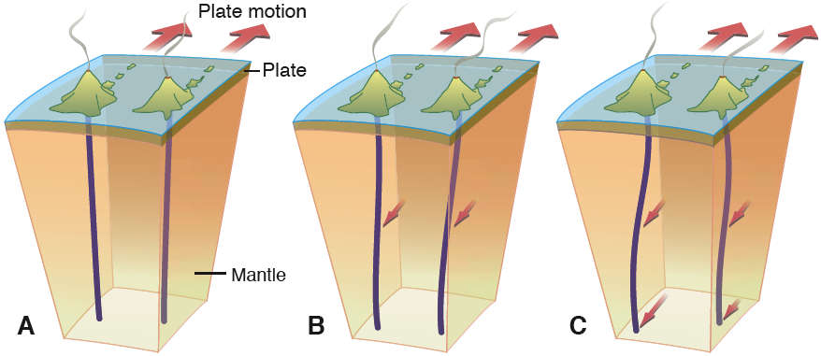
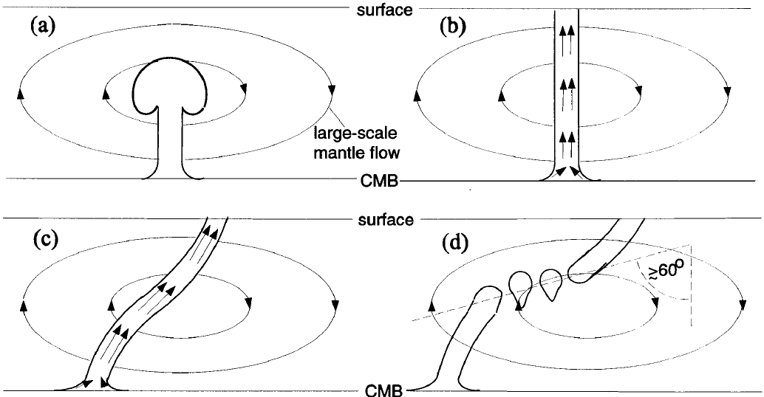
Stationary plumes Plumes + Plumes + Mantle wind Source drift + Mantle wind
Life-cycle of a plume

Slide 23
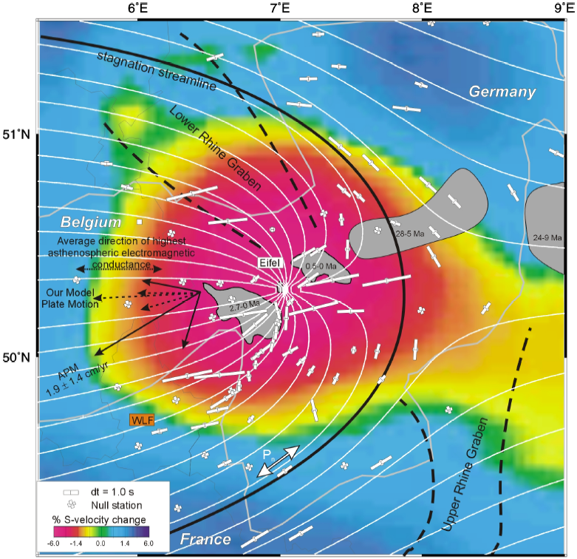
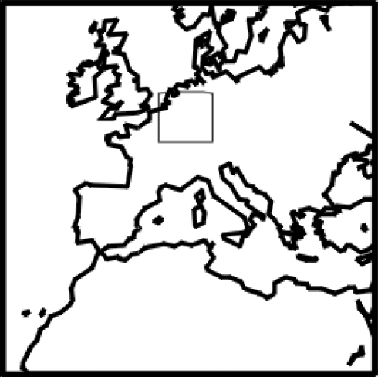
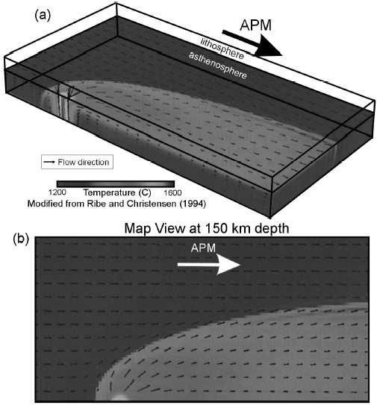
Hotspots also record relative plate motion in the olivine crystallographic fabric due to shear between plate and plume, detectable by shear-wave splitting Walker et al., GJI, 2005

Slide 24
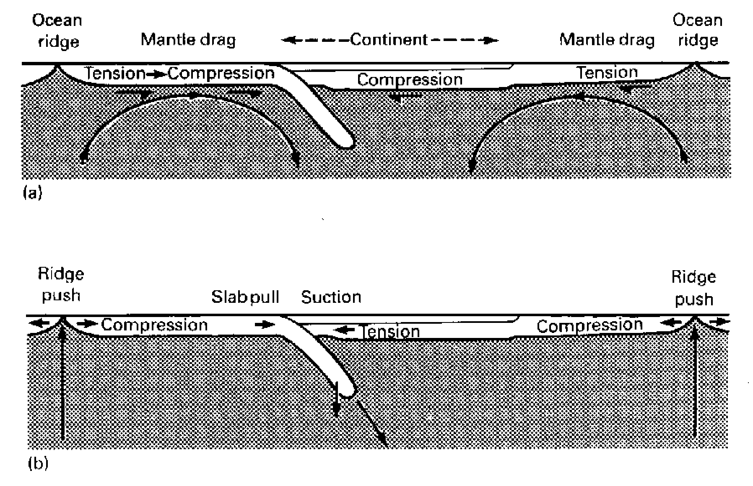
Mantle Convection is associated with Plate Motion
Continental Drift - Seafloor Spreading - Plate Tectonics - Plate Dynamics
Plate dynamics: quantitative description of forces that drive the plates
but:
does convection drive the plates?
or do the plates drive the convection?

Slide 25
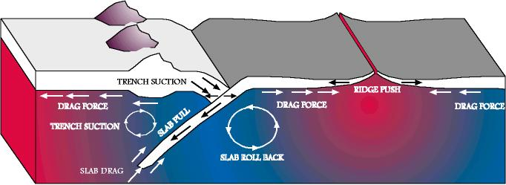
categories of plate-driving forces: • boundary forces on bottom of plate • boundary forces acting on side of plate • body forces (topographic gravitational loads)

Slide 26
Forces acting on bottom (or top): Boundary: Basal drag due to asthenospheric flow - applied to the base of the lithosphere, hence to the mantle - Body forces due to topographic loads - applied primarily to the crust (though buoyant roots are sometimes important) - can only be transmitted up or down if the upper crust is mechanically coupled to the upper mantle (how weak is the jelly in the sandwich?) In contrast, Forces acting on sides: Boundary forces arising from plate-tectonic motions - applied at all depths in the lithosphere - naturally lead to vertically coherent deformation For the following discussion, we treat the plate as rigid, and strong throughout its vertical extent.

Slide 27
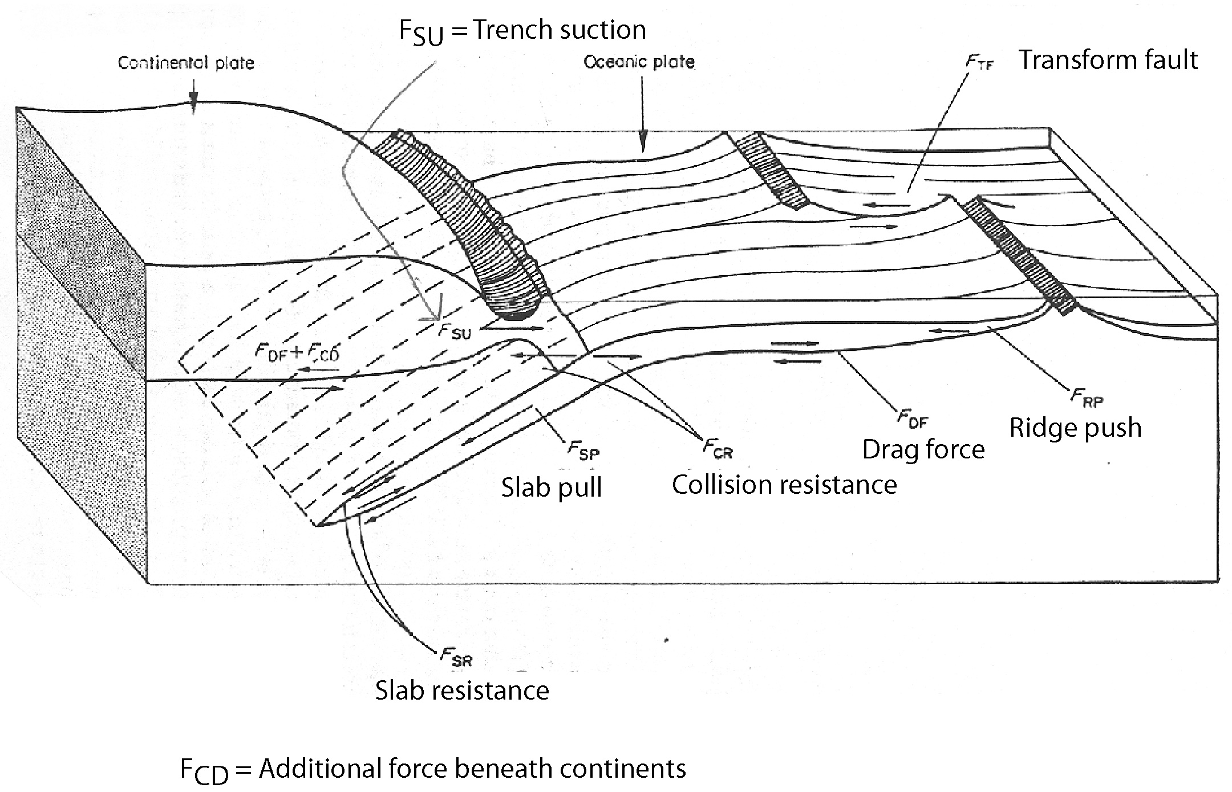
2 forces acting on bottom of plate (viscous coupling between lithosphere & asthenosphere)
Forsyth & Uyeda speculated about 8 possible forces:
F_{DF}: drag is positive if convection drives the plates, negative if asthenosphere is passive
F_{CD}: Possible additional force beneath continents (i.e. drag beneath continents = F_{DF} +F_{CD})
Forsyth & Uyeda, GJRAS, 1975

Slide 28
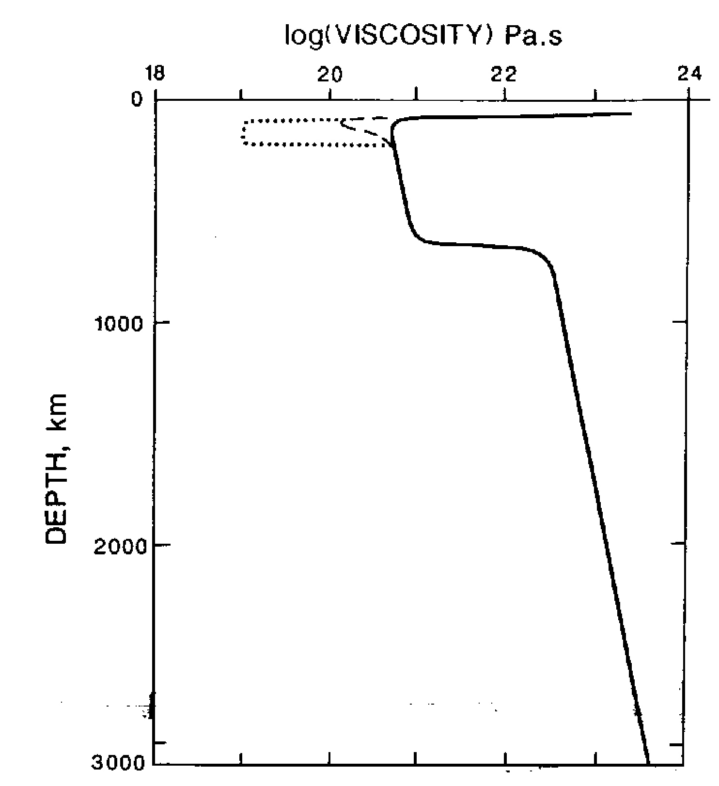
Drag forces depend critically on Viscosity in the Upper Mantle (Davies and Richards, 1992)

Slide 29
2 forces acting on divergent/transform plate boundaries
F_{RP} = Ridge push force: Force acting at diverging plate boundary due to gravitational sliding of younger, shallower lithosphere towards older, deeper lithosphere.
F_{TF} = force at transform boundary (resistive)

Slide 30
4 forces acting at Convergent Margins
F_{SP} = Slab pull. Downward negative buoyancy of sinking lithosphere
F_{SU} = Trench suction. Force moving overriding plate towards the ocean
opposed by
F_{SR} = Slab resistance. Resistance of mantle to sinking slab
F_{CR} = Collision resistance. Friction between two plates

Slide 31
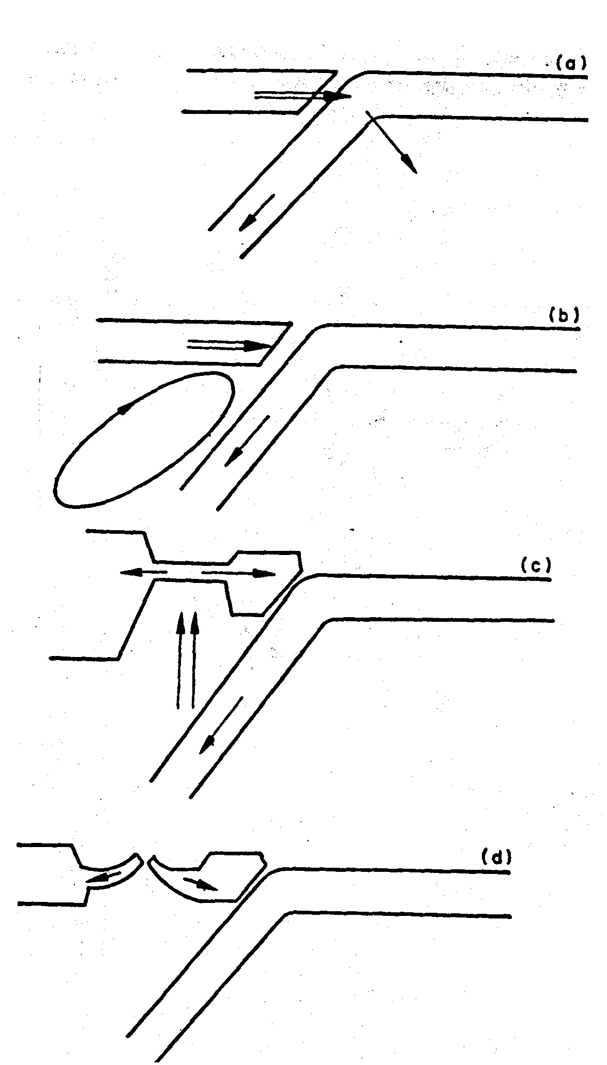
Trench suction: used by Forsyth & Uyeda as a catch-all for a range of possibilities:
A) Trench retreats seaward, creating gap (trench rollback)
B) Sinking slab induces secondary convection
C) Injection of hot mantle
D) Ridge push from back-arc basin

Slide 32
Eight forces acting on the plate: Which are important?
Two approaches: (1) calculate ab inito (2) compare observed plate velocities to plate variables
Mantle drag (F_{CD}, F_{DF}) should be proportional to the area and to the velocity of the plate relative to the asthenosphere.
Ridge Push (F_{RP}): reflects elevation of ridge relative to surrounding seafloor and should be independent of velocity, but proportional to ridge length.
Slab Pull (F_{SP}): should relate to trench length, slab age and downdip extent.

Slide 33
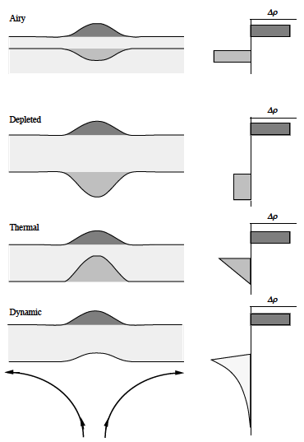
Ridge Push
Ridge Push has been modelled either as a body force or as a boundary force.
Body force: the horizontal pressure gradient attributable to cooling and thickening of oceanic lithosphere with age is integrated over the area of the oceanic plate.
Boundary force: the potential energy of the warm, buoyant mantle upwelling beneath the ridge crest causes a topography-induced horizontal pressure gradient applied along the edge of the lithospheric plate, proportional to the length of the ridge.
• Ridge Push is independent of compensation mechanism so long as the swell is long wavelength and has local compensation.
• Ridge Push can be amplified by a factor of two when hot spot activity is centered on a spreading ridge axis.

Slide 34
Ridge Push Force
The pressure head that the ridge supplies to the adjoining mantle (neglecting the negative buoyancy of the cooling lithosphere away from the ridge) is:
where x is the horizontal coordinate orthogonal to the ridge, h is the elevation of the seafloor above the normal reference level, w is the water depth above the seafloor.
For an order of magnitude calculation we can neglect the pressure of the water and give an overestimation of the ridge push force balanced by the neglect of the far field topography and negative buoyancy from cooling:
More precise calculations suggest

Slide 35
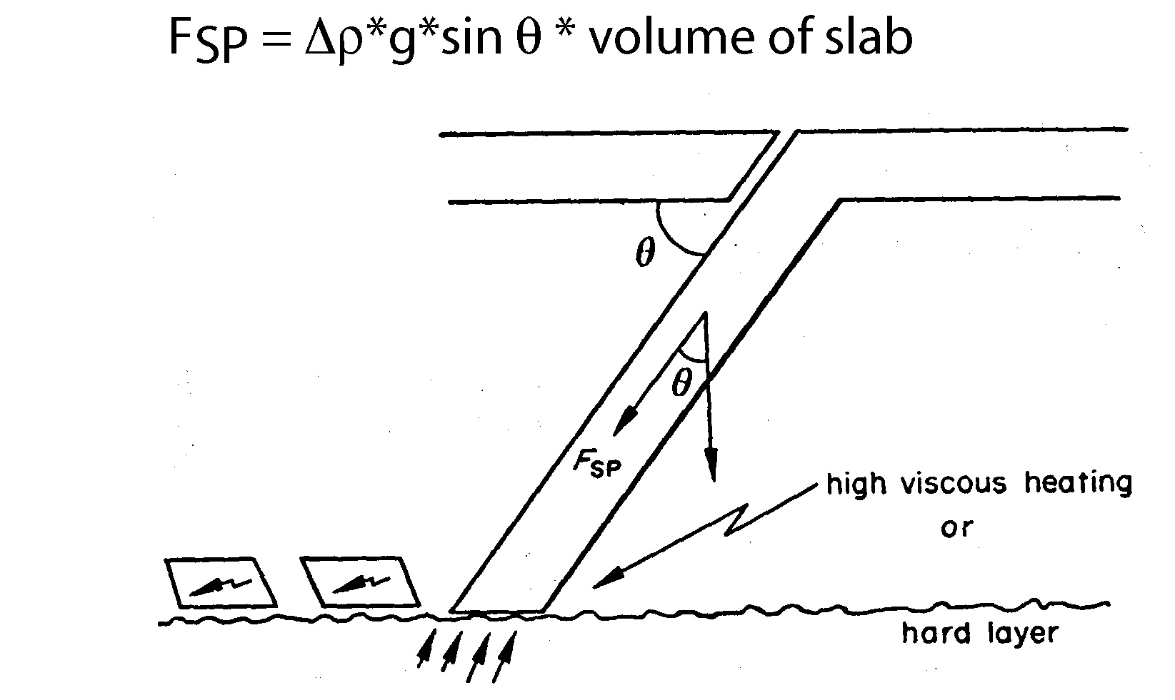
Slab Pull (F_{SP})
F_{SP} directed along the length of the slab
Δρ is small at shallow depths, increases greatly when gabbro-eclogite transition occurs.
Negative buoyancy of subducted slab is transmitted to the attached horizontal part of the lithosphere
F_{SP} depends on:
Dip of subducted slab
Length of subducted slab
Age of subducted slab
T difference between slab and mantle

Slide 36
Slab Pull Force
The gravitational body force from the negative buoyancy of such a slab is:
F_{slab} _{pull} = gdz(ρ_{lithosphere} - ρ_{asthenosphere})
where d is the thickness of the downgoing slab (say 100 km, undoubtedly an overestimate) and z is the depth that the slab penetrates (say 660 km, a minimum value).
More precise calculations indicate F_{sp} ~ 3.3 to 4.9 10¹³ N/m
the precise value is less important than noting that
F_{sp} is an order of magnitude greater than F_{rp}

Slide 37
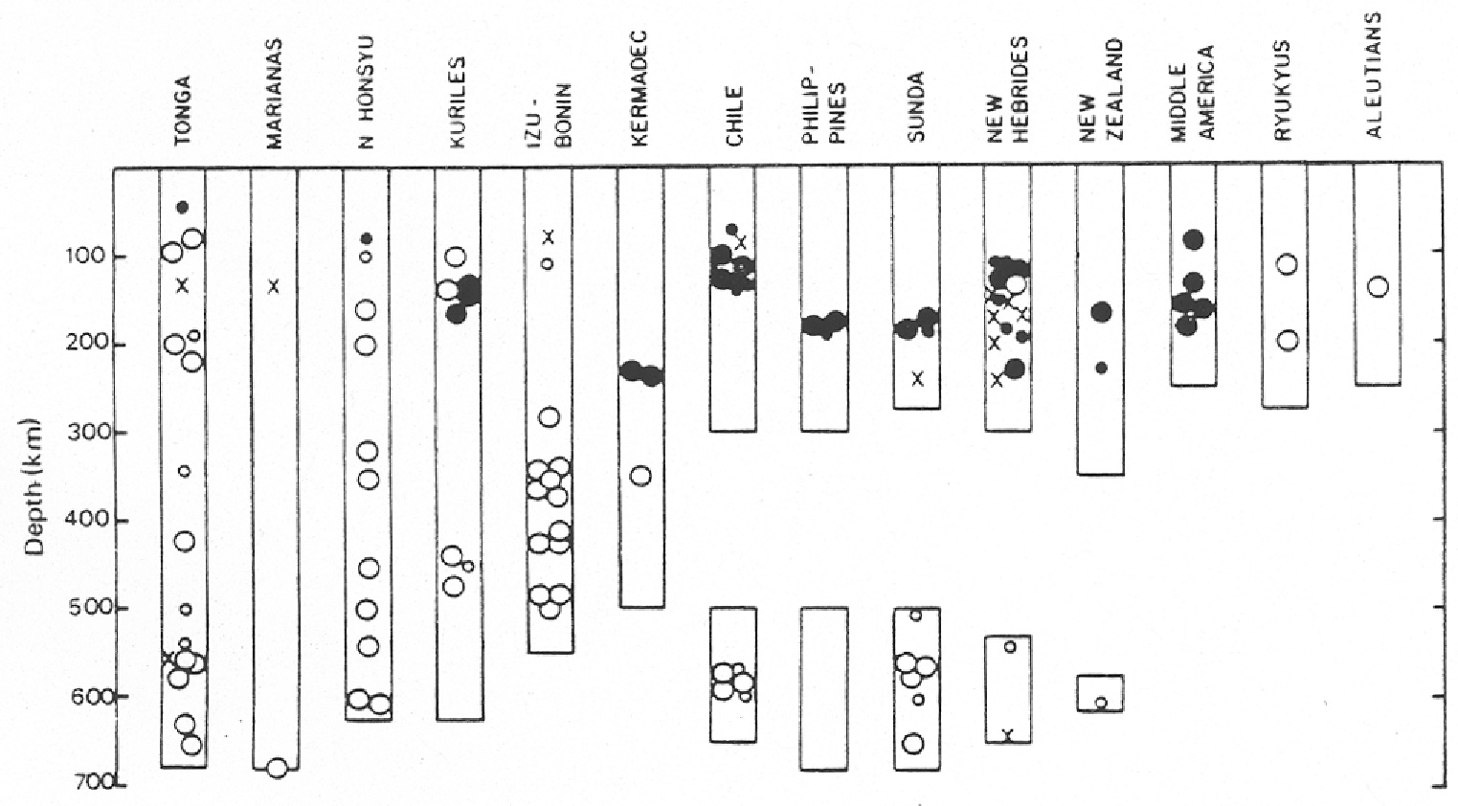
Forces (continued)
F_{SR} (slab resistance) is proportional to the velocity of the subducting slab and to the viscosity of the mantle. Viscosity is low in asthenosphere and increases with depth into the mesosphere.
Changing down-dip stress regime in slab may indicate slab resistiance increasing at depth
Filled circle = extension; open circle = compression; crosses are neither
(Isacks & Molnar, 1969)

Slide 38
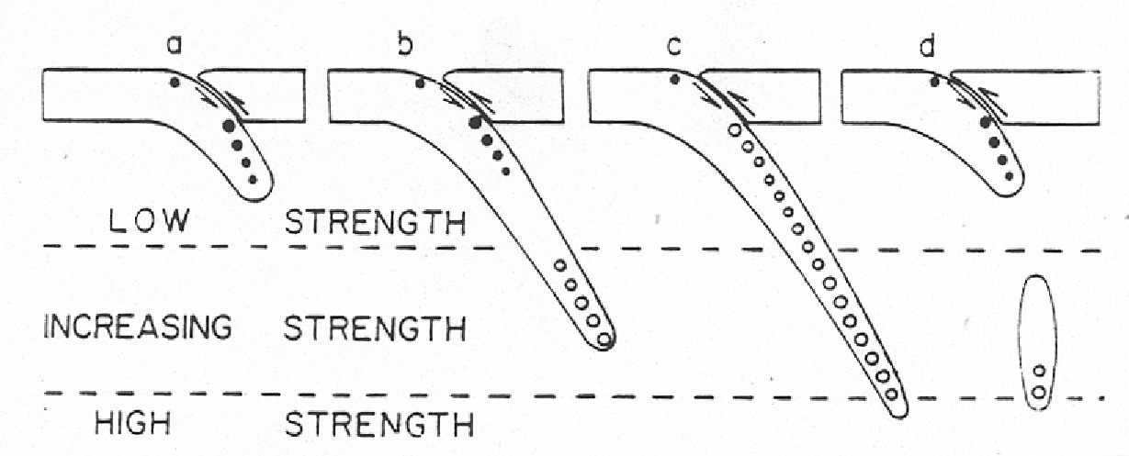
Possible explanation: extension due to dominance of slab pull in low viscosity asthenosphere; compression due to increasing slab resistance in higher-visocity mesosphere
VISCOSITY
VISCOSITY
VISCOSITY

Slide 39
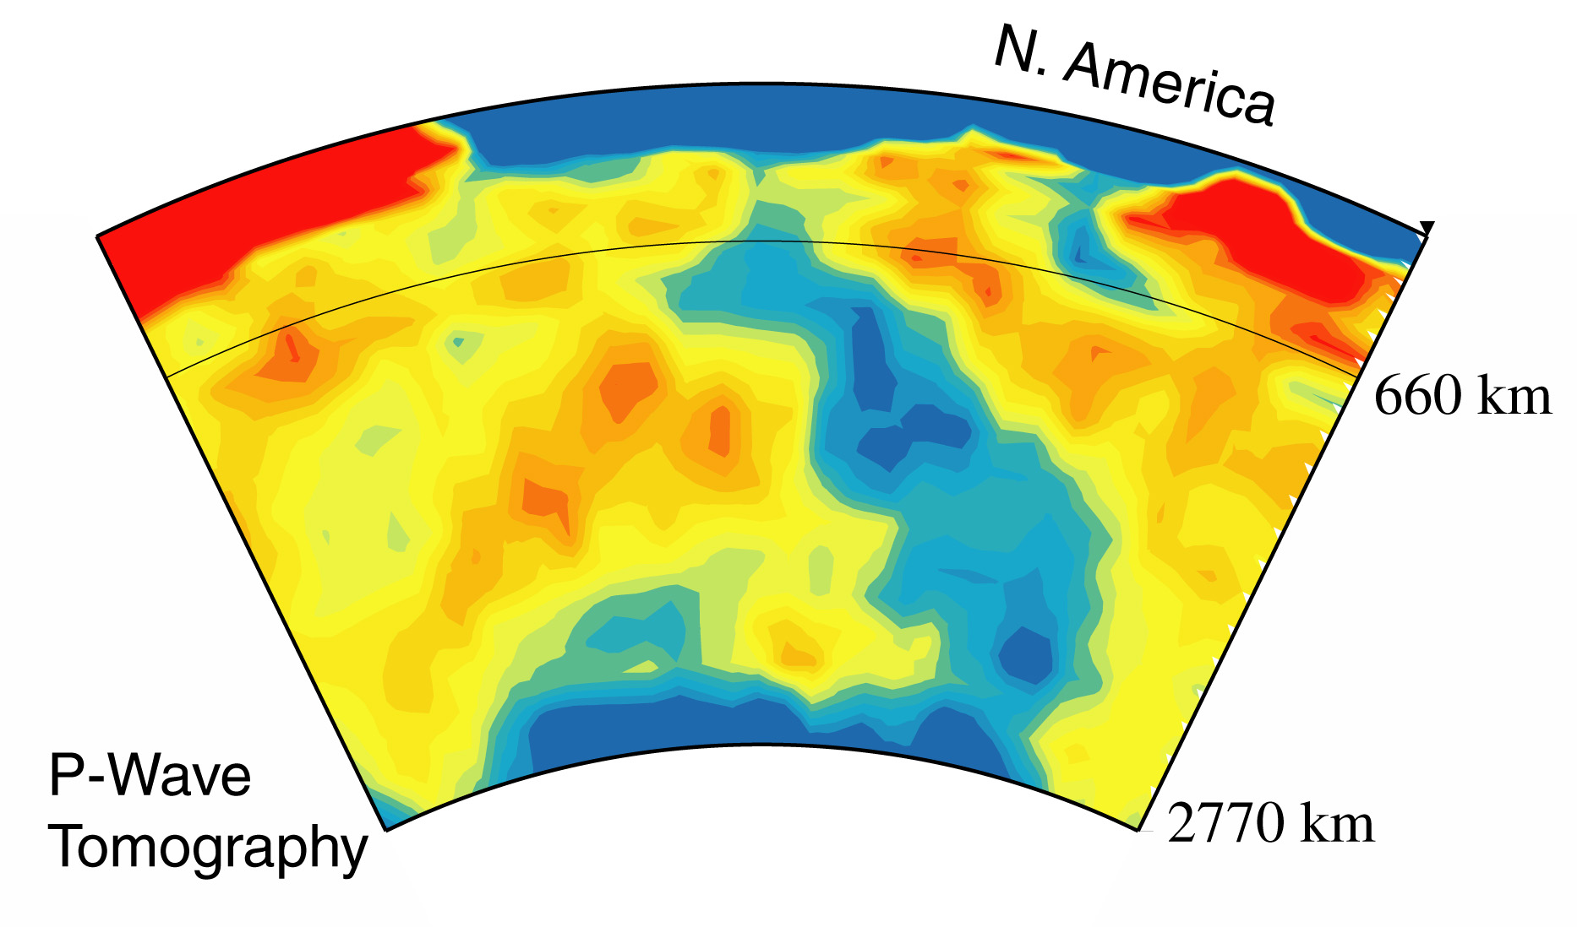
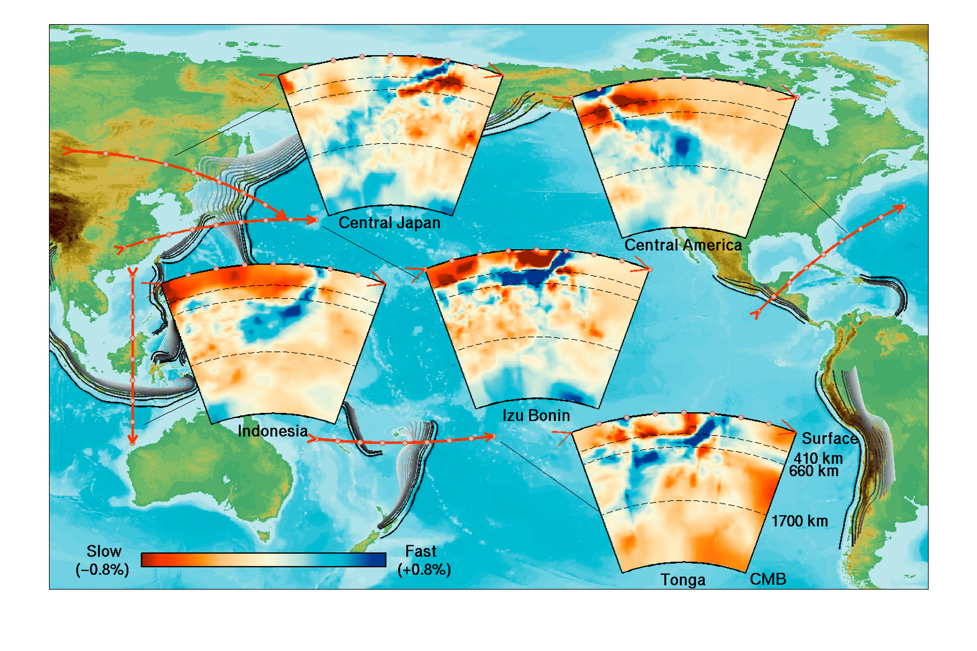
P-wave tomography beneath western hemisphere (Grand et al., 1997)
Do subducted slabs penetrate the 670 km discontinuity?
Tomography of various subduction zones (Karason & van der Hilst 2001)

Slide 40
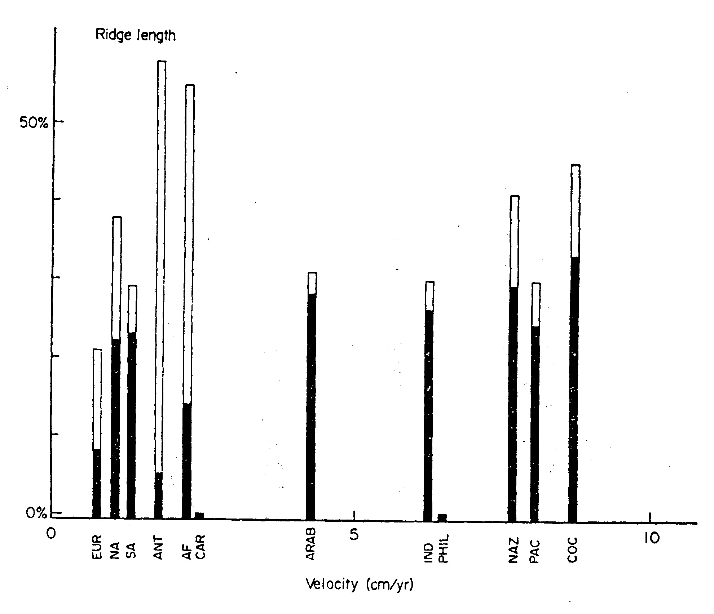
Spreading ridges vs. velocity
Forsyth & Uyeda looked at plate velocities as a function of different variables:
No significant variation; hence the ridge push force F_{RP} is not important.

Slide 41
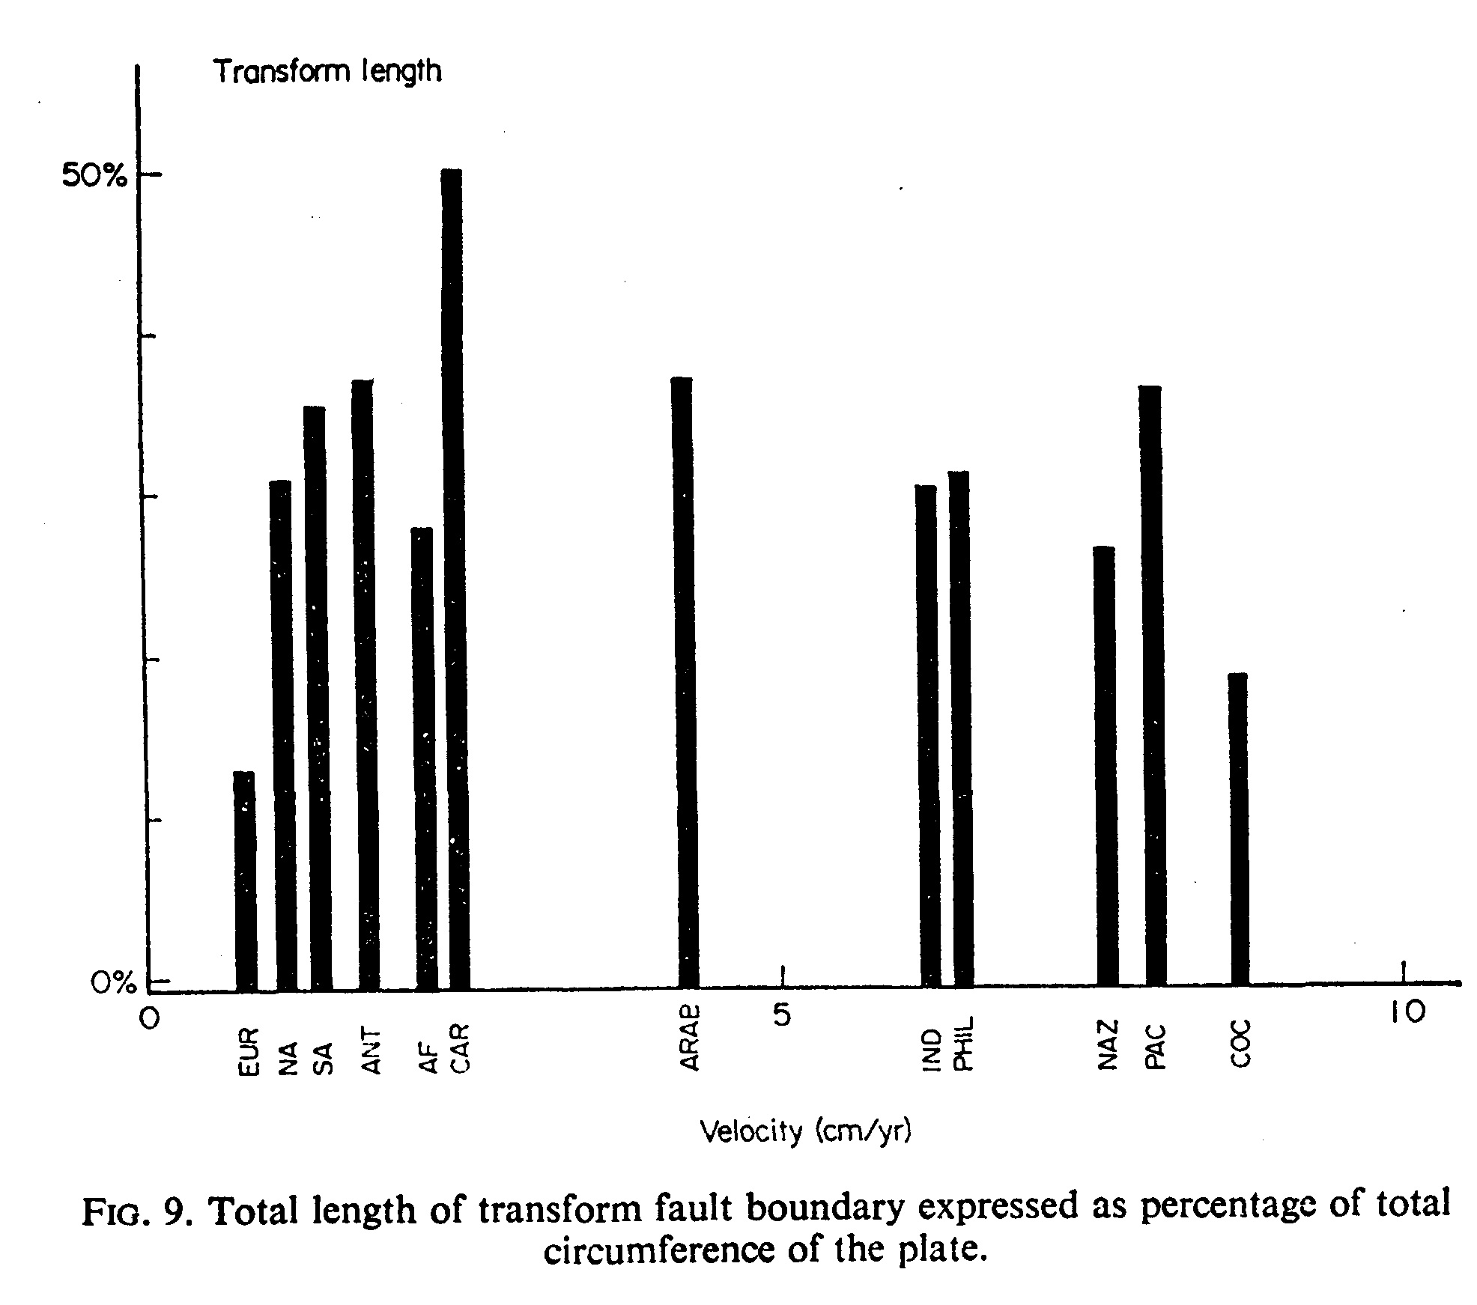
Transform faults vs. Velocity
No significant variation; hence the transform fault force F_{TF} is not important.

Slide 42
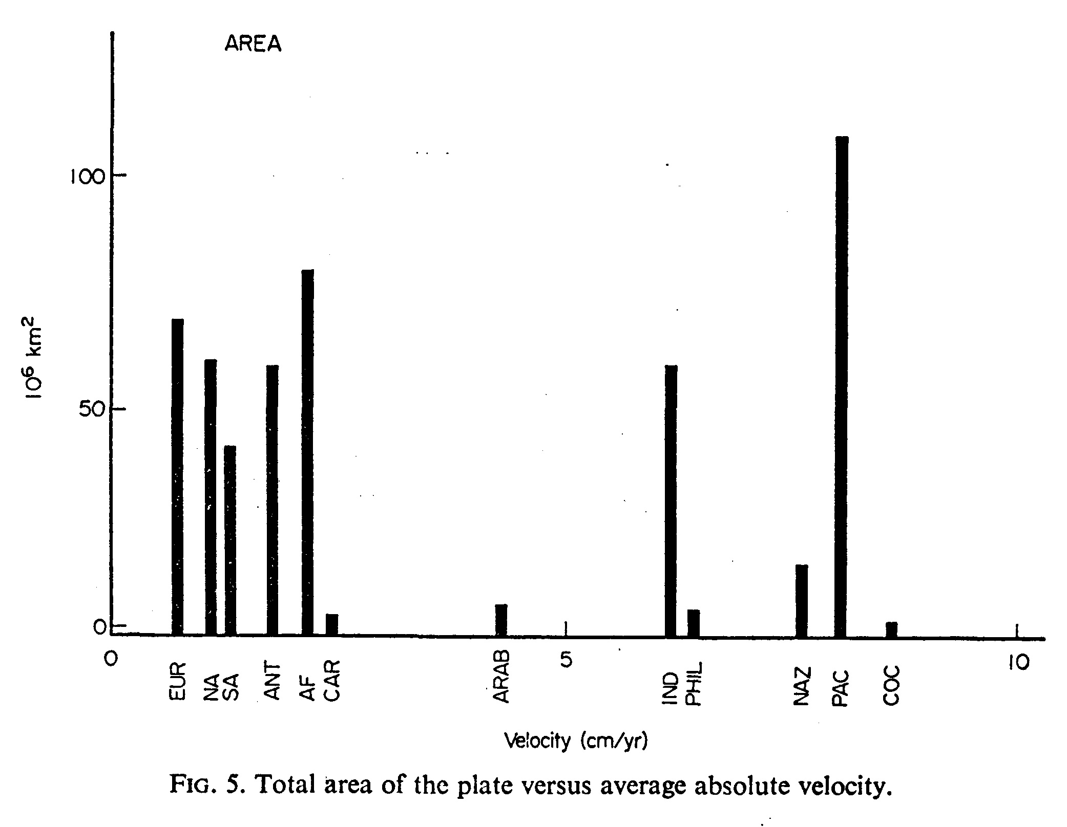
Total area of plate vs. velocity
No relation; hence the drag force F_{DF} is not important.

Slide 43

Continental area vs. Velocity
More continental area is correlated with slower plates; hence F_{CD}, the “additional force beneath continents”, is important

Slide 44

Convergent margins vs. velocity
A larger fraction of plate boundary that is a subducting boundary is strongly correlated with faster plates; hence slab pull F_{SP} (or maybe F_{SU}) is important (certainly greater than other forces)
F_{SR} (slab resistance) F_{CR} (collision resistance) are opposite in sign to slab pull, so must be much smaller – we can neglect them

Slide 45

What drives the plates? (Carlson et al., 1995, GRL 22, 1977-1980)
•if slab-pull is the dominant driving source for plate tectonics,
•because the excess mass of subducted slab = f(lithosphere age),
•it follows that the subduction rate should be related to the age of the lithosphere at the trench.

Slide 46

What drives the plates? (Carlson et al., 1995, GRL 22, 1977-1980)
•this relationship - that subduction rate is related to the age of subducting lithosphere - is good enough that one can even distinguish between:
•less good “half-space” cooling models (lithosphere cools and thickens forever) and
•better “plate” cooling models (lithosphere has a maximum thickness beyond which it becomes unstable to small-scale convection and loss of “thermal boundary layer”

Slide 47
How can sinking slabs pull the plate?
Shouldn’t they just break off and sink more rapidly
through the mantle?
Actually, they can do so, and still provide the driving force for plate motions!
The gravitational pull of subducted slabs drives the motions of Earth’s tectonic plates, but the coupling between slabs and plates is not well established.
If a slab is mechanically attached to a subducting plate, it can exert a direct pull on the plate.
Alternatively, a detached slab (in the lower mantle) may drive a plate by exciting flow in the mantle that exerts a shear traction on the base of the plate.

Slide 48

Slab suction
vs.
Slab pull

Slide 49
Conrad & Lithgow-Bertelloni (2002) use the geologic history of subduction to estimate the relative importance of “pull” versus “suction” for the present-day plates.
Descending slabs may induce mantle circulation patterns that exert shear tractions at the base of nearby plates. These “slab suction” forces have been shown to cause both subducting and overriding plates to move toward subduction zones.
Observed plate motions are best predicted if slabs in the upper mantle are attached to plates and generate slab pull forces that account for about half of the total driving force on plates. Slabs in the lower mantle are supported by viscous mantle forces and drive plates through slab suction.

Slide 50


Continental locations are shown in gray. Plate velocities in the no-net rotation reference frame are shown as arrows of length proportional to and color corresponding to velocity relative to the average plate velocity.
(B) the velocity field of observed plate motions shows overriding plates move at one-fourth to one-third the rate of subducting plates, as demonstrated by the blue ring of low plate velocities surrounding the red- and orange-colored fast velocities of the Pacific, Nazca, Cocos, and Indian-Australian plates.
Conrad & Lithgow-Bertollini,
How Mantle Slabs
Drive Plate Tectonics,
Science v. 298, 207-209, 2002
(and JGR, v. 109, B10407, 2004)

Slide 51

(C) plate velocities are calculated from slab pull forces alone; in this case the pull from attached upper-mantle slabs is applied to subducting plates and forces from unattached slabs are ignored.
Overriding plates typically move with the correct speed, but in the wrong direction.

Slide 52

(A) Results from the slab suction model, in which mantle slabs drive plates by inducing a mantle circulation that exerts shear tractions at the base of plates.
(The location of slabs at 660 km is shown in gray for comparison.)
In this model, overriding plates move nearly as fast as subducting plates.
This deviates from the velocity field of observed plate motions, shown in (B), in which overriding plates move at one-fourth to one-third the rate of subducting plates.

Slide 53

(D) models the pull force from attached upper-mantle slabs operating along with the suction force from unattached lower-mantle slabs.
The plate velocity field more closely matches the observed field for both the direction and the relative speeds of subducting and overriding plates, shown in (B).

Slide 54

Subducting plates are pulled toward subduction zones with a force equivalent to the excess weight of the upper mantle portion of slabs, which must therefore remain physically intact and strong.
Slab suction and slab pull presently account for about 40 and 60% of the forces on plates.
These two mechanisms by which mantle slabs drive the surface plates cause subducting plates to move rapidly toward subduction zones while overriding plates move toward subduction zones more slowly.
Conrad and Lithgow-Bertollini, JGR v. 109, doi:10.1029/2004JB002991
Slabs in the lower mantle are detached from those in the upper mantle. Their excess weight is supported by the viscous mantle, which deforms and flows in response to this weight. This induced mantle flow exerts tractions on the base of the surface plates that draws both subducting and overriding plates toward subduction zones.

Slide 55

Why are plates with continents so slow? Deeper roots produce larger C_{DF}
Brown, Hawkesworth, and Wilson 1992

Slide 56

Which forces drive North America?
Bokelmann, 2002, Geology 30, 1027-1030.
Are the continents pulled / pushed from the side, or does mantle convection play an active role in driving the plates?
This question can be addressed by studying the deformation of deep continental roots.

Slide 57
Simple-shear deformation due to plate-mantle interaction leads to preferred mineral orientation in portions of thick lithosphere, and seismic anisotropy. Seismic fast axes are shown schematically by diagonal dashes. Dip direction of fast axes is indicative of driving mechanism.
If driving forces are large, diagnostic pattern of orogenesis (mountain building) and extension may develop; orogenesis will occur on side toward which root is moving.

Slide 58


Orientation of fast axes for stations in northern North America.
P-wave fast azimuths are shown by arrows in light gray for southwestern direction (between 180° and 260°) and in black for other directions; shades in sphere (lower right) show angular ranges. Length of arrow shows dip angle. Background map shows S-wave traveltimes, δt_{S}, integrated from 400 km to surface in tomographic model from Grand (1994).
Darker gray shades indicate extent of thick lithosphere - this region corresponds to stations that have exclusively southern to western fast directions, whereas other areas have very different fast directions.

Slide 59

Angular variations of P-wave delays determine both the azimuths and the dip angles of the fast direction of seismic velocity anisotropy in North America, and indicate that the deeper mantle moves at a higher velocity than the North American plate and that the mantle plays an important role in driving the plates.

Slide 60
The stress field at the western edge of the stable continent is currently compressional to the north of Montana up to Alaska. The extensional Basin and Range in the western United States represents an exception in this large-scale pattern that may be explained as an effect of internal gravitational forces, which may occur even if there is a compressional stress field acting from outside.
The northeastern United States shows evidence for extension in the Baffin Bay area and the Labrador Sea during much of the Atlantic opening. Such extension occurring in the wake of a thick continent would be naturally explained by driving from below.

Slide 61
Key plate driving forces are: (plates driving convection)
(1) Slab pull (body force)
(2) Slab suction (boundary force)
to a lesser extent (convection driving plates):
(3) Ridge push
(4) Viscous drag on continental roots
Continents are also deformed internally by gravitational forces due to topography (western USA; Tibet …)

Slide 62


(left) Gravitational potential energy (continental spreading under its own weight), calculated assuming Airy compensation of topography, is a dominant driving force of the modern Basin-Range extension, and can be used to correctly predict (right) the modern velocity field (from GPS, VLBI, Quaternary fault slip, and NUVEL-1A).
Dynamics of the Pacific-North American Plate Boundary in the Western United States
Lucy Flesch et al., 2000, Science, v. 287, 834-836

