Slide 1
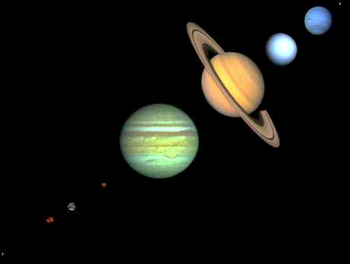
Lecture 6 January 22, 2013
Tectonics of the Silicate Planets
You are here
Topics:
•Four inner planets and Moon share commonalities (to first order, density & size)
Radius controls cooling controls tectonics (Earth is largest)
•Other planets show alternative tectonics – plate tectonics is not inevitable
Earth alone has abundant water and life – possibly important to plate tectonics
•Earth’s tectonics have destroyed Hadean rocks (>4Ga), and 97% of Archean (>2.5Ga) => other planets are our best guide to Earth’s ancient tectonics, cratering and impacts, early environment and conditions for origin of life
Reading:
McKinnon.MercuryMESSENGERoverview.Science.2012 PhillipsHansen.VenusReview.Science.1998
Wieczorek.MoonGeophysics.Elements.2009 Solomon.MarsReview.Science.2005
O'Neill.PlanetaryPlateTectonics.AJES.2012 Wilson.PlanetaryVolcanism.NatureGeo.2009

Slide 2
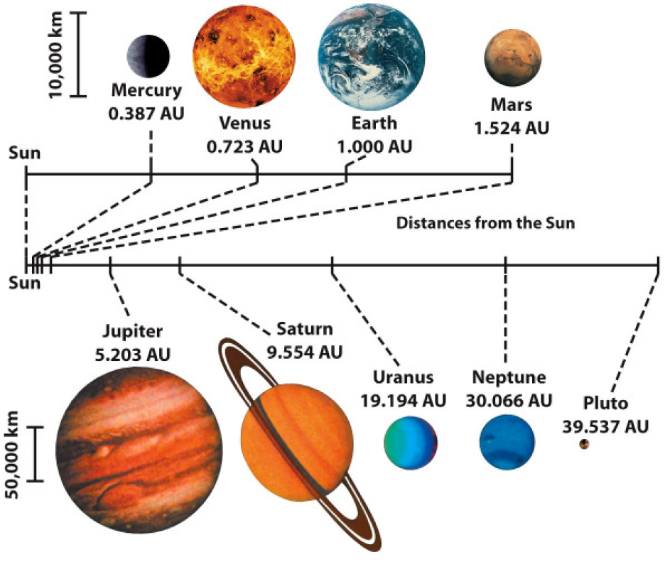
Focus on Silicate planets only
uncompressed density: 5.4 4.2 4.2 3.35 3.3
Moon
The four inner planets are called terrestrial planets
– Relatively small (with diameters of 5000 to 13,000 km)
– High average densities (4000 to 5500 kg/m3)
– Composed primarily of rocky materials
The four giant outer planets are called Jovian planets
– Large diameters (50,000 to 143,000 km)
– Low average densities (700 to 1700 kg/m3)
– Composed primarily of hydrogen and helium.

Slide 3
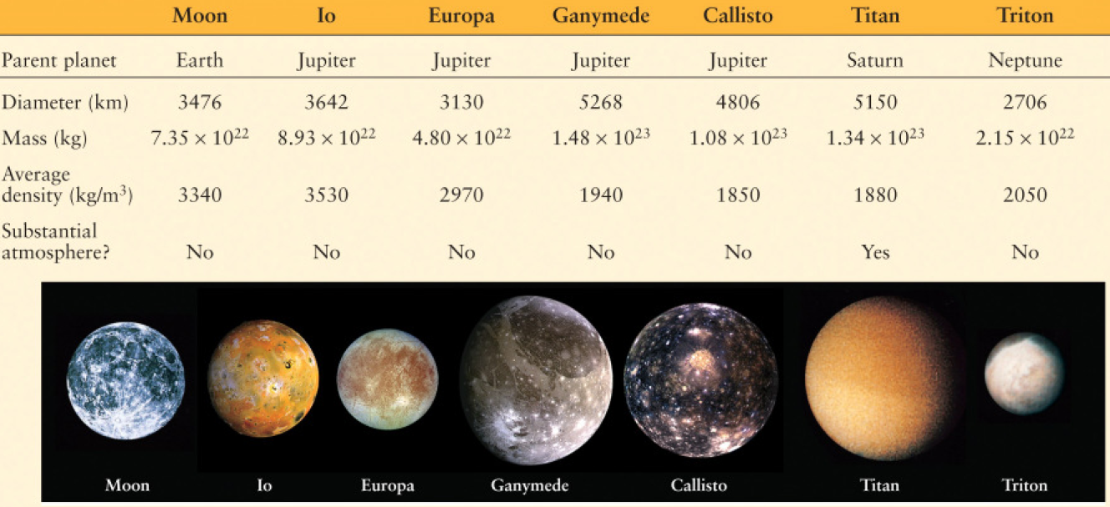
Seven large satellites are almost as big as
the terrestrial planets
- comparable in size to the planet Mercury
- the remaining satellites of the solar system are much smaller

Slide 4
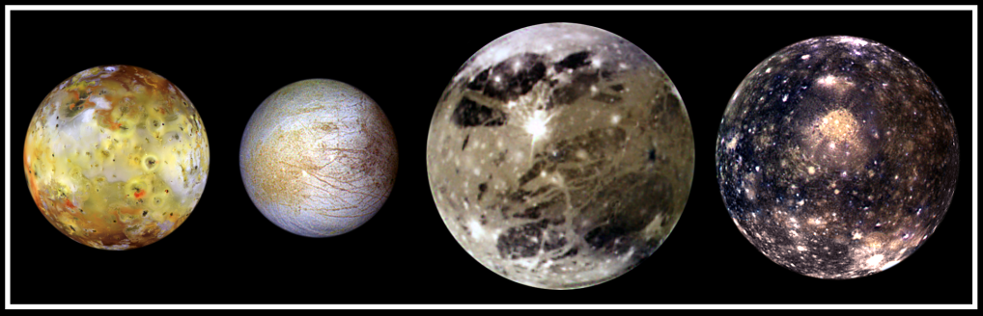
Galilean Satellite Ages
Io Europa Ganymede Callisto
Very Young Very Old
~1Ma ~10 Ma 0.5-1 Ga >4 Ga
350 Mm orbital radius 1800 Mm
Tidally-driven Icy crust, frequent Icy craters, plus No tectonics/ volcanism.
sulfur volcanism re-surfacing, crustal deformation. Valhalla, 4000km diam.,
possible liquid Water ice plus is one of largest impact
water mantle rocky material features known
Notes:
In this 'family portrait,' the four Galilean Satellites are shown to scale. These four largest moons of Jupiter shown in increasing distance from Jupiter are (left to right) Io, Europa, Ganymede, and Callisto. These global views show the side of volcanically active Io which always faces away from Jupiter, icy Europa, the Jupiter-facing side of Ganymede, and heavily cratered Callisto. The appearances of these neighboring satellites are amazingly different even though they are relatively close to Jupiter (350,000 kilometers for Io; 1, 800,000 kilometers for Callisto). These images were acquired on several orbits at very low "phase" angles (the sun, spacecraft, moon angle) so that the sun is illuminating the Jovian moons from completely behind the spacecraft, in the same way a full moon is viewed from Earth. The colors have been enhanced to bring out subtle color variations of surface features. North is to the top of all the images which were taken by the Solid State Imaging (SSI) system on NASA's Galileo spacecraft.
Io, which is slightly larger than Earth's moon, is the most colorful of the Galilean satellites. Its surface is covered by deposits from actively erupting volcanoes, hundreds of lava flows, and volcanic vents which are visible as small dark spots. Several of these volcanoes are very hot; at least one reached a temperature of 2000 degrees Celsius (3600 degrees Fahrenheit) in the summer of 1997. Prometheus, a volcano located slightly right of center on Io's image, was active during the Voyager flybys in 1979 and is still active as Galileo images were obtained. This global view was obtained in September 1996 when Galileo was 485,000 kilometers from Io; the finest details that can be discerned are about 10 km across. The bright, yellowish and white materials located at equatorial latitudes are believed to be composed of sulfur and sulfur dioxide. The polar caps are darker and covered by a redder material.
Europa has a very different surface from its rocky neighbor, Io. Galileo images hint at the possibility of liquid water beneath the icy crust of this moon. The bright white and bluish parts of Europa's surface are composed almost completely of water ice. In contrast, the brownish mottled regions on the right side of the image may be covered by salts (such as hydrated magnesium-sulfate) and an unknown red component. The yellowish mottled terrain on the left side of the image is caused by some other, unknown contaminant. This global view was obtained in June 1997 when Galileo was 1.25 million kilometers from Europa; the finest details that can be discerned are 25 kilometers across.
Ganymede, larger than the planet Mercury, is the largest Jovian satellite. Its distinctive surface is characterized by patches of dark and light terrain. Bright frost is visible at the north and south poles. The very bright icy impact crater, Tros, is near the center of the image in a region known as Phrygia Sulcus. The dark area to the northwest of Tros is Perrine Regio; the dark terrain to the south and southeast is Nicholson Regio. Ganymede's surface is characterized by a high degree of crustal deformation. Much of the surface is covered by water ice, with a higher amount of rocky material in the darker areas. This global view was taken in September 1997 when Galileo was 1.68 million kilometers from Ganymede; the finest details that can be discerned are about 67 kilometers across.
Callisto's dark surface is pocked by numerous bright impact craters. The large Valhalla multi-ring structure (visible near the center of the image) has a diameter of about 4,000 kilometers, making it one of the largest impact features in the Solar System. Although many crater rims exhibit bright icy 'bedrock' material, a dark layer composed of hydrated minerals and organic components (tholins) is seen inside many craters and in other low lying areas. Evidence of tectonic and volcanic activity, seen on the other Galilean satellites, appears to be absent on Callisto. This global view was obtained in November 1997 when Galileo was 684,500 kilometers from Callisto; the finest details that can be discerned are about 27 kilometers across.

Slide 5
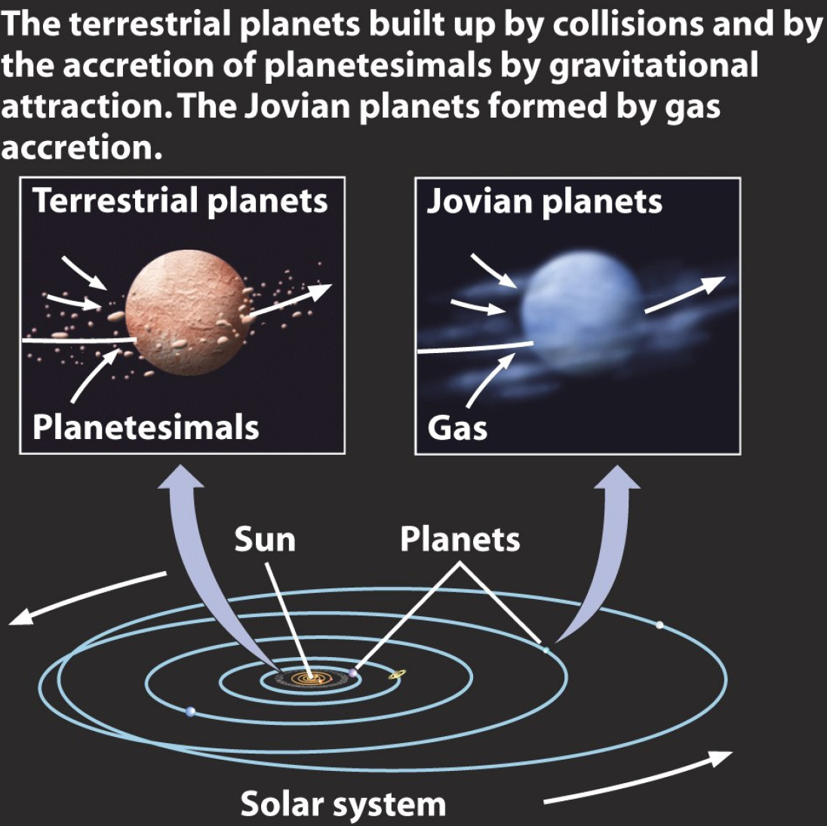
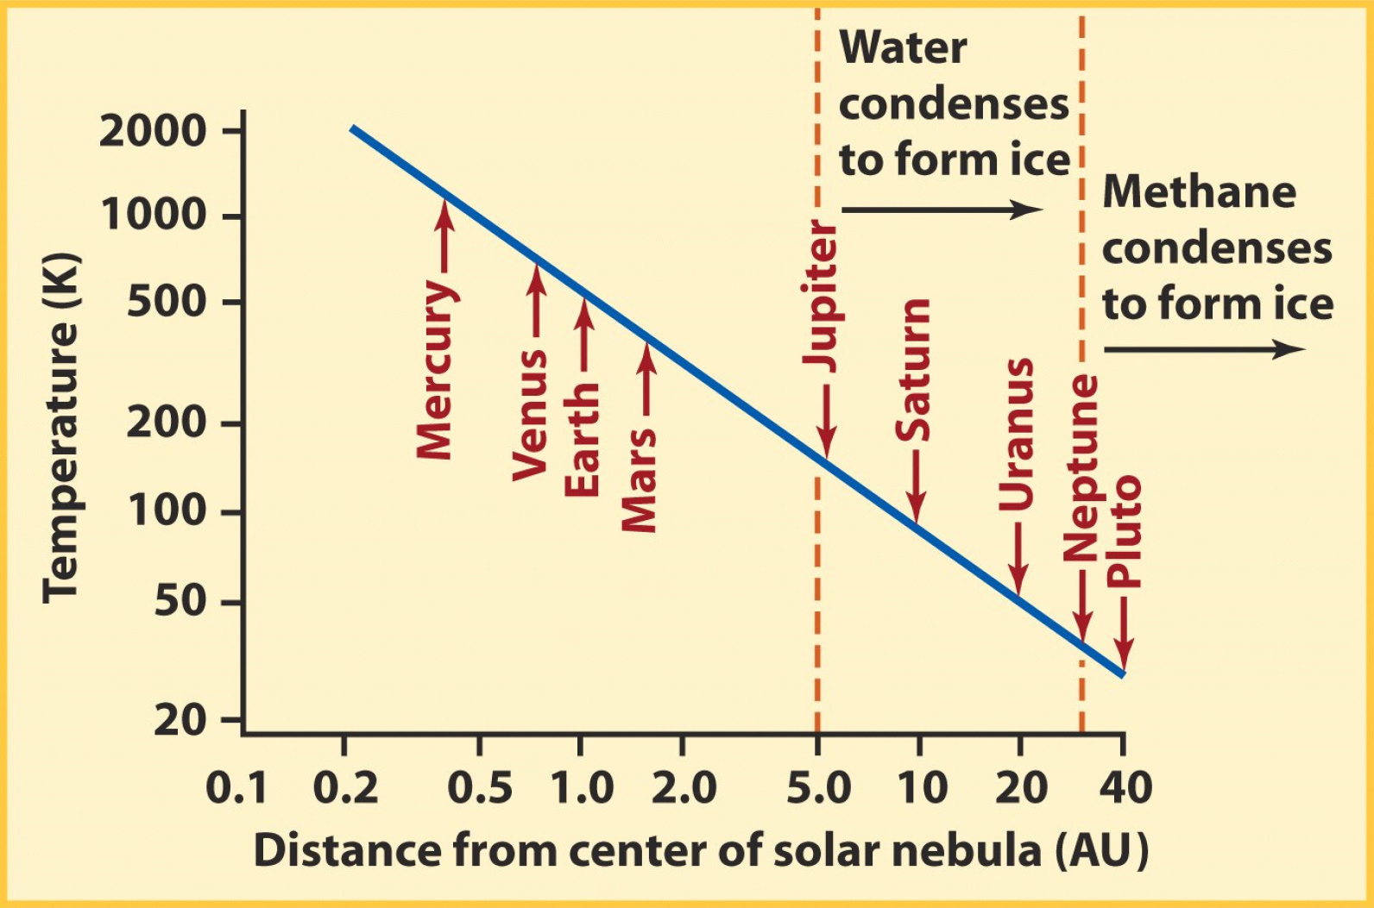
Evolution of the Solar System from the solar nebula
Metals condense
Rocks condense
Asteroid belt
density: 5.4
4.2
3.3

Slide 6
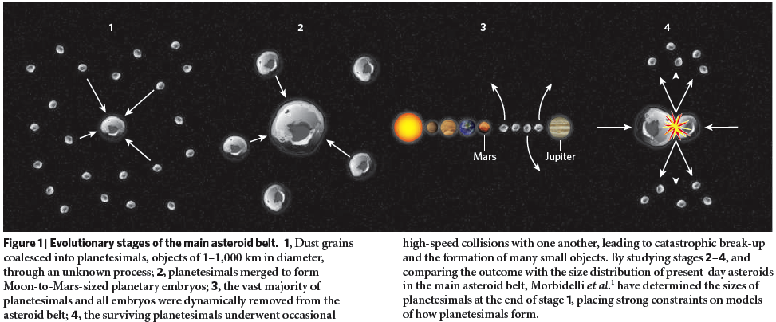
Solar system formed at 4.567 Ga: all silicate planets were hot at first
Planets were probably molten at first, due to several heat sources: accretion, core formation, decay of radionuclides, and Sun’s T-tauri event.
Low mass protostars (T Tauri stars, M less than 2 M(sun)) evolve within a few Ma: very slowly rotating cloud => collapse => central star + surrounding dust disk => fusion begins => strong stellar wind burns off much of remaining disk
Spectroscopy of the asteroid belt reveals a heliocentric magmatic and metamorphic gradient: asteroids showing igneous differentiation are inside, metamorphosed asteroids in the middle, and unheated asteroids are outside.
=> T-tauri wind blows off the atmospheres of the inner planets and melts them; heats the asteroids, but has little effect on the outer planets which retain their original atmospheres. Earth’s oceans post-date T-tauri phase; presumed due to cometary influx.
Chambers, 2009

Slide 7
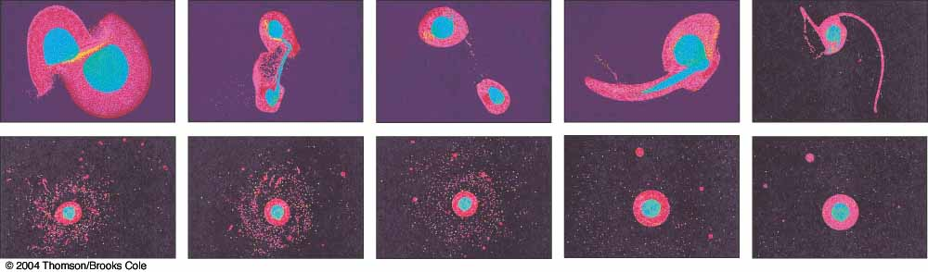
Earth’s early history:
•Moon-forming impact about 4.5 Ga; a large body (perhaps bigger than Mars) collided with Earth and ejected a considerable amount of material from the Earth’s upper layers; but the future Moon lost most of its core to Earth and all its volatiles.
•for a few thousand years: Earth had a rock atmosphere
•for a few million years: a molten magma ocean
•for 10 - 200 million years: a mush magma ocean, with heat-flow controlled by convection
•the primordial silicate crust formed from this magma ocean is preserved on Moon, Mercury, and southern Mars.
•Acasta gneiss: 4.0 Ga; zircons in Jack Hills quartzite: 4.2 Ga

Slide 8
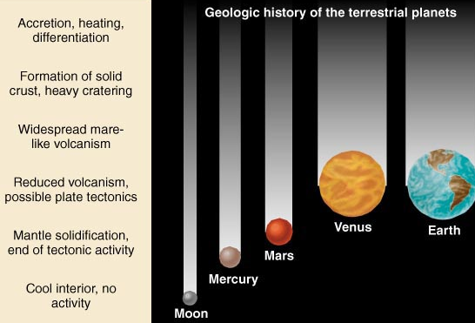
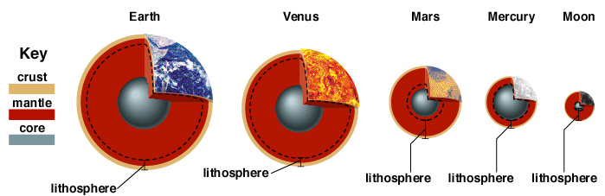
TODAY:
Whether a Silicate Planet is tectonically active depends on its mass: Planetary mass (radius) controls cooling
Body Diameter Mass (kg) Tectonics
Earth 12756 km 60 *10²³ kg Active
Venus 12103 49 *10²³ Active
Mars 6794 6.4*10²³ Half-dead
Mercury 4880 3.3*10²³ Dead
Moon 3876 .7*10²³ Dead
Thickness of the lithosphere is controlled by the depth to which the planet has cooled conductively:

Slide 9
On Earth, which global data sets
are most relevant to recognizing
the global tectonics that characterize
Earth today, i.e. plate tectonics?

Slide 10
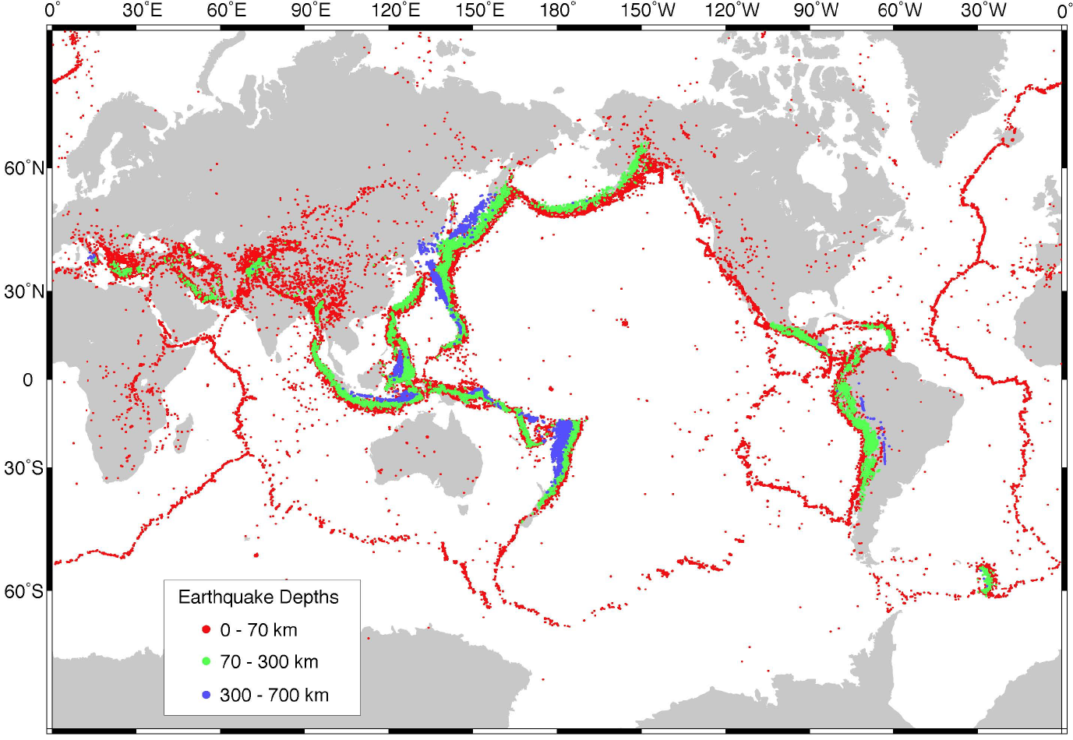
Global seismicity distribution (magnitude > 5.1) highlights plate boundaries and reveals their tectonic style.
Shallow earthquakes (< 30 km) on slow-spreading ridges (normal-faulting) (largely absent along fast-spreading ridges) and transform faults (strike-slip faults); deep earthquakes only in subduction zones where Benioff zones show cold lithosphere is subducting into the mantle, to at least 670 km.
Distributed earthquake activity in broad deformational zones is seen in e.g. Asian continent and Indian Ocean.
Engdahl et al., 1998

Slide 11
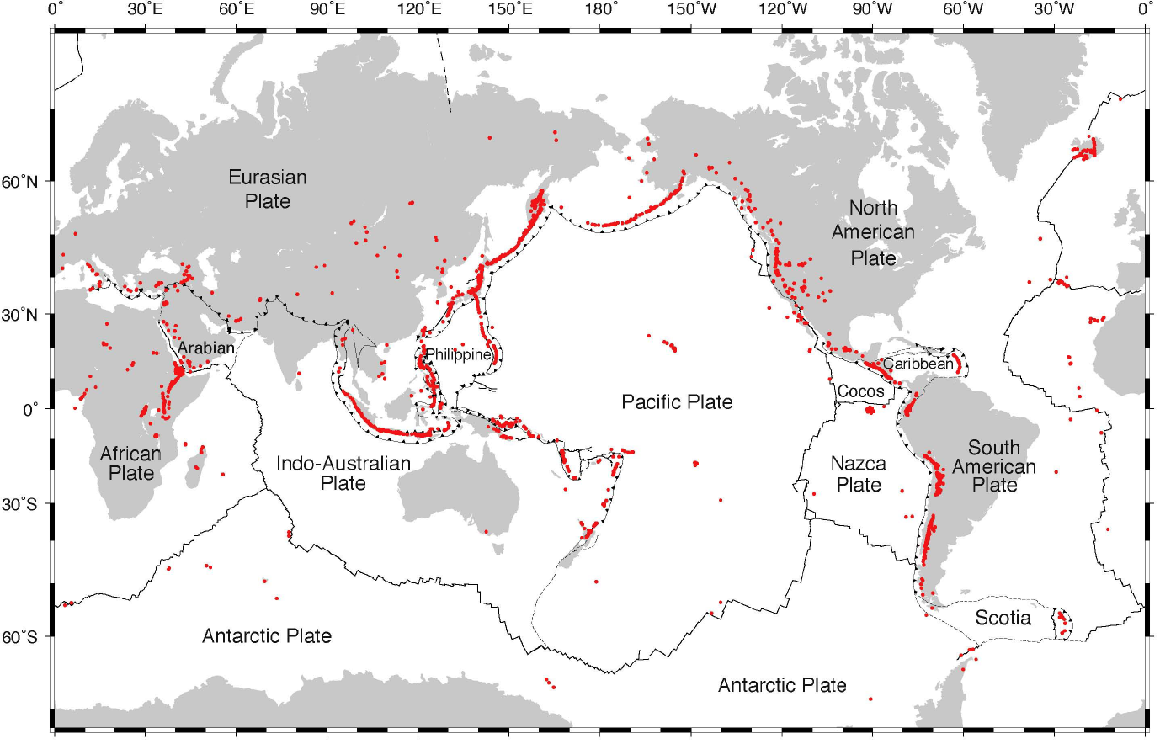
Distribution of volcanism:
The majority of Quaternary off-ridge volcanoes are associated with convergent boundaries where wet subducting slabs reach asthenospheric depths and trigger back-arc volcanism.
A few active volcanoes occur in plate interiors (“hot spots”) and diffuse extensional plate boundaries.
(Siebert & Simkin, 2002)

Slide 12
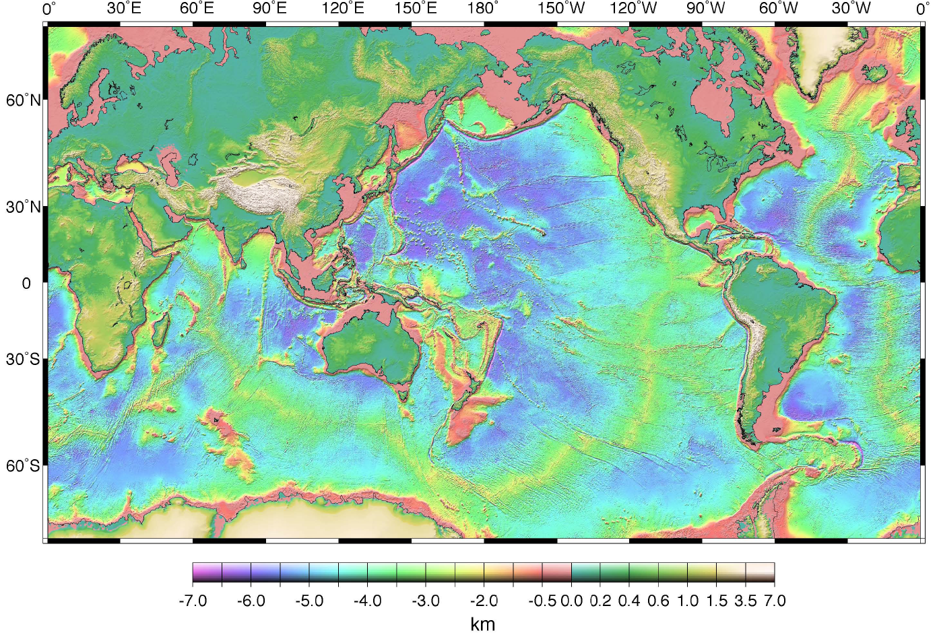
Global topography highlights ridges: nearly all seafloor spreading ridges lie at 2500-3000 m below sea level which is the level of isostasy for hot thin lithosphere.
Bi-modal hypsometry: Continents are at ~sea-level; old ocean basins away from ridges are 4500 - 5000 m deep because of cooling and thermal contraction, oceanic transform faults are very visible.
Land data: GTOPO30 (edc.usgs.gov/products/elevation/gtopo30/gtopo30.html) ocean data largely from satellite altimetry (Smith & Sandwell, 1997)

Slide 13
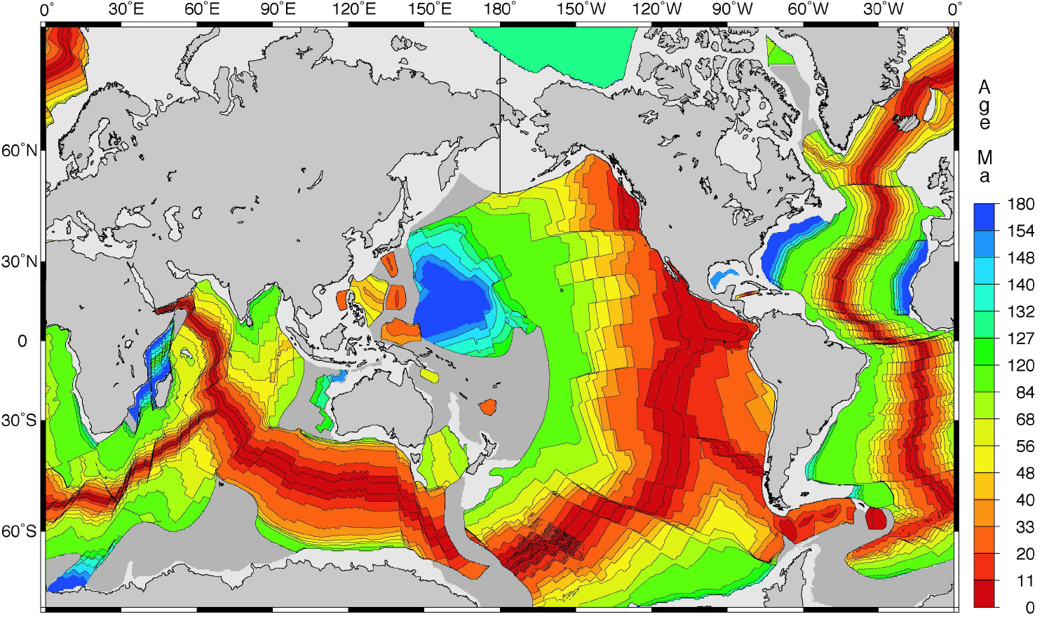
Topography and seismicity provide strong evidence for tectonic activity but little information on the rate of motion.
Marine magnetic anomalies, combined with plate motion reconstructions based on satellite altimeter measurements of fracture-zone trends, provide a global age map of the relatively young (< 180 Myr) oceanic lithosphere. (Mueller et al., 1997)

Slide 14
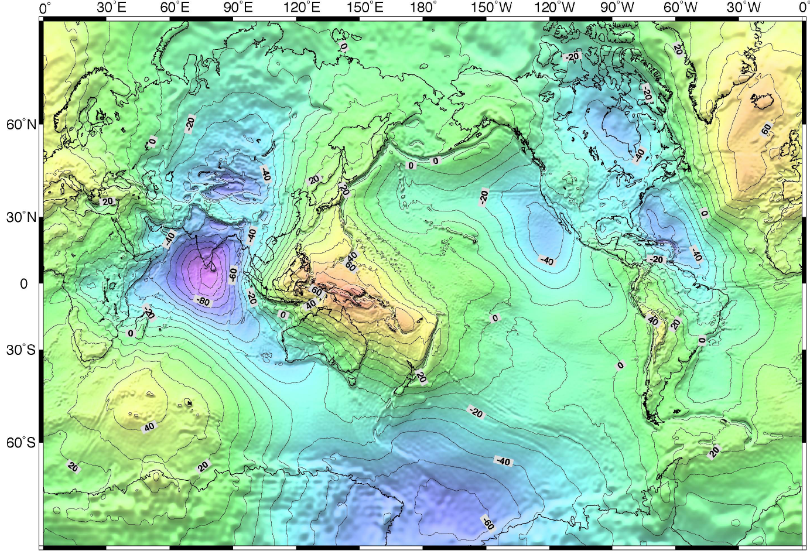
Long-wavelength geoid (EGM96: spherical harmonic model complete to degree and order 360) height above reference ellipsoid WGS84 is based on satellite tracking and shows little long wavelength correlation with surface tectonics (except where old lithosphere has recently subducted) and primarily reflects mass anomalies deep in the mantle. (Lemoine et al., 1998)

Slide 15
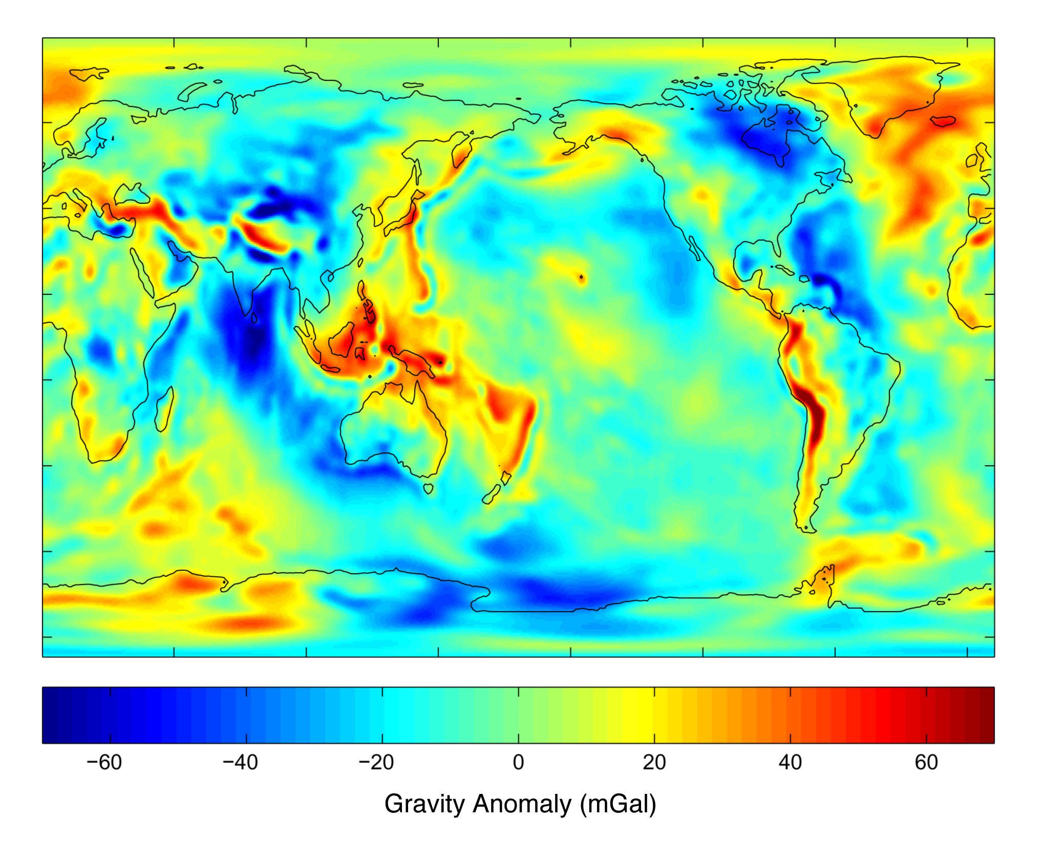
Free-air gravity anomaly, mGal (GRACE: satellite model from twin orbiting spacecraft).
Paired high-low linear anomalies mark parallel trenches/arcs (Kurile-Japan-Philippines; Tonga-Kermadec; Andes).
Ridges not visible except where plume-affected (Iceland-North Atlantic) (NASA web-site)

Slide 16
Of the global data sets most relevant to plate tectonics:
Observable from satellites:
- short-wavelength topography, gravity and paleomagnetism;
surface temperature & core dynamo (as evidence for molten interior)
Not observable from orbit:
- seismicity

Slide 17
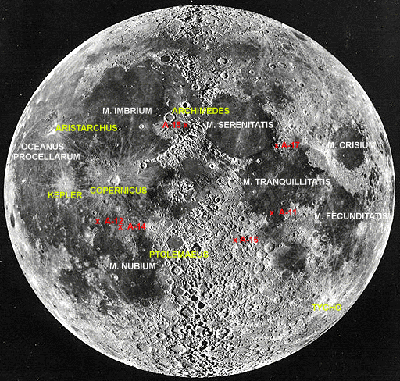
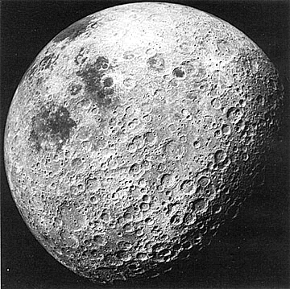
Moon: A Good Example of a Small, Dead Planet
Two kinds of terrains: Highlands (cratered) and Maria (oceans) (less-cratered)
Maria dominate the Near side; cratered terrain dominates the Far side
Above: M. stands for Mare; A refers to Apollo Landing Sites
[in red]; and major craters show in yellow)

Slide 18
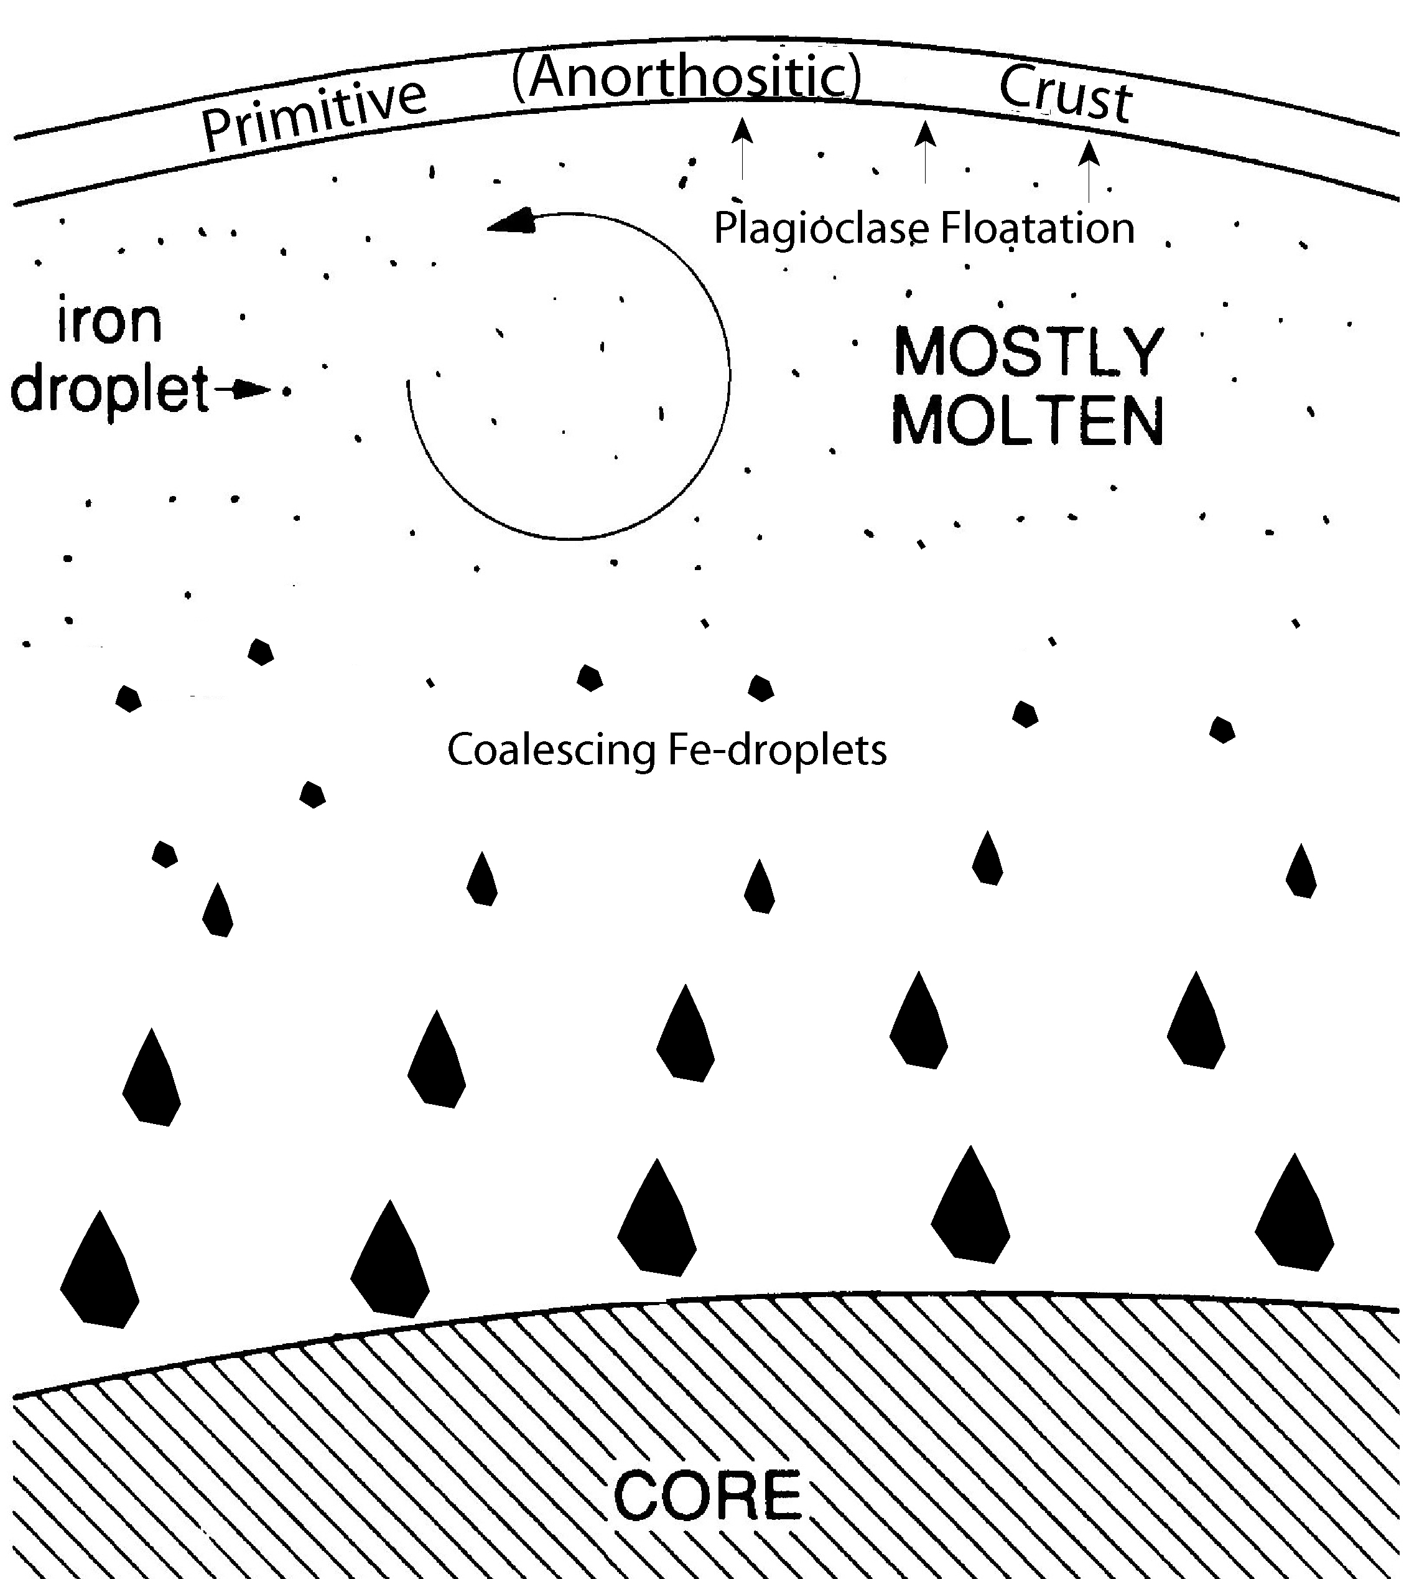
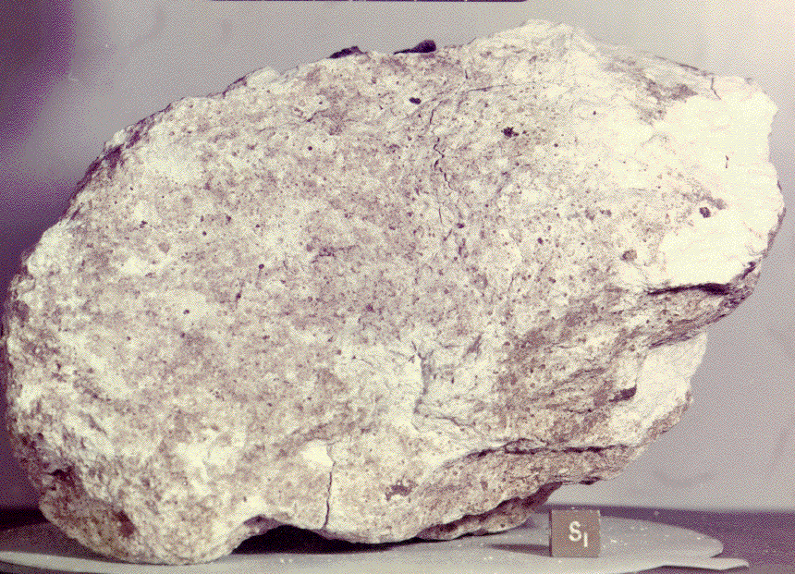
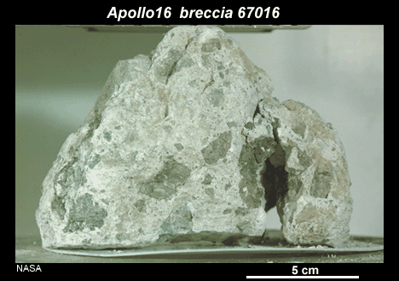
Magma Ocean, Core Formation, and Generation of Primitive Crust
(all of the inner planets experienced this)
Lunar Highlands are dominated by anorthositic rock. ~ 4.5 to 4.3 Ga remnants of primordial crust.
Primordial lunar crust formed as a result of flotation of plagioclase on top of a slowly-cooling magma ocean.
These rocks are now highly brecciated as a result of many impacts.
Anorthosite
4.44 - 4.51 Ga
95% anorthite
Magma Ocean
No Water
Polymict
breccia

Slide 19
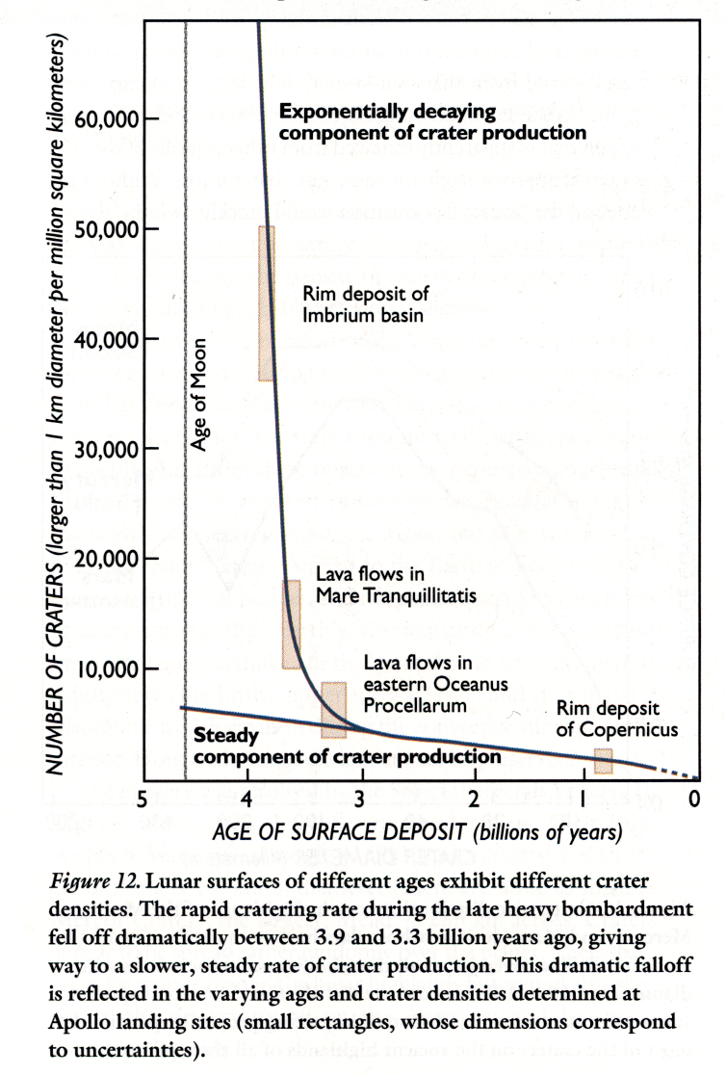
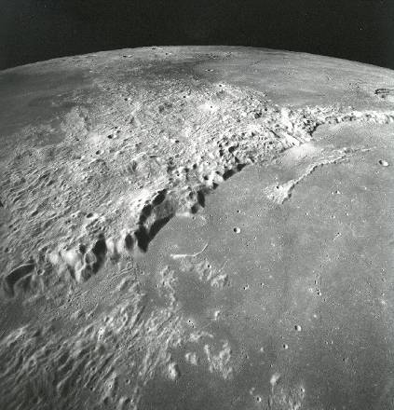
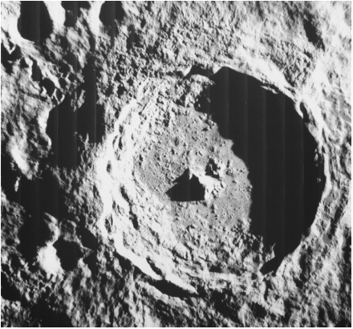
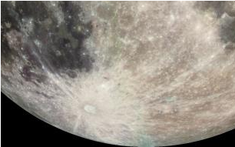
Moon: A Good Example of a Small, Dead Planet
Lunar impact basins up to 1000 km, due to big frequent impacts that continued through c. 3.8 Ga
Intense early bombardment: preserved on Moon, Mercury, S. Mars; record missing from Venus, Earth, N. Mars
Lunar highlands are ‘saturated’ with craters
Cratering continues to present (Chicxulub, Chesapeake Bay)
Tycho crater is very fresh, with rays extending thousands of kilometers, estimated age 100 Ma
Crater density provides means to infer age of planetary surface.
Tycho Crater (85 km) and rays
Imbrium Rim and Mare (1150 km diameter)
3.8 Ga; filled ~ 3.3 Ga
Notes:
Wikipedia – Late Heavy Bombardment may be an artifact of limited sampling by Apollo – perhaps all the dated impact melt rocks came from Imbrium, even though Apollo 16 & 17 were closer to Nectaris and Serenitatis;
Although no lunar meteorites are older than 3.9 Ga, maybe all older rocks were pulverized and reset.
If LHB is real: could be due to realignment of gas giant orbit, or a now destroyed inner planet, or gas giant.
If LHB real – several 5000km basins on Earth; serious environmental consequences every 100 years; life may be first surviving life, not first evolving life. Isua at 3.8 Ga seems to have biogenic signature.

Slide 20
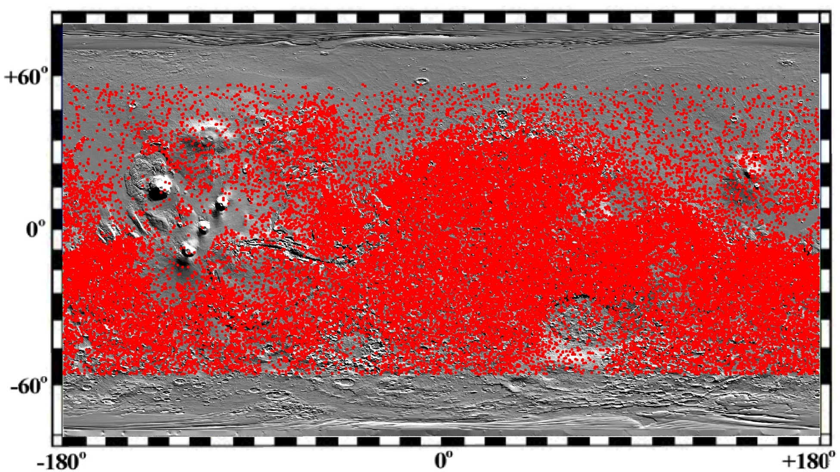
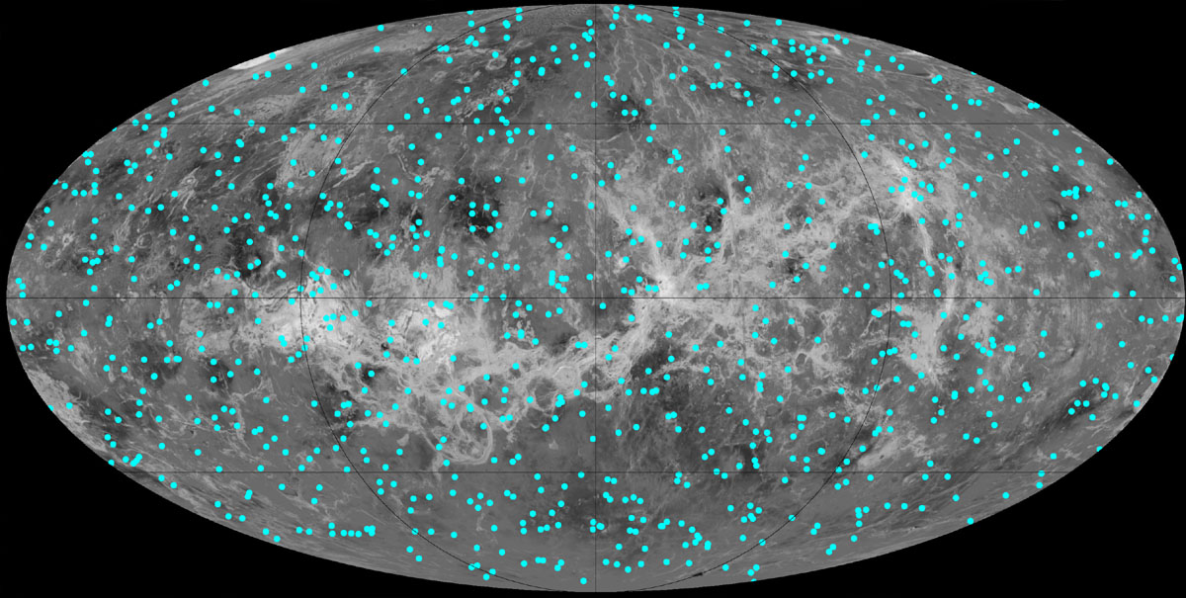
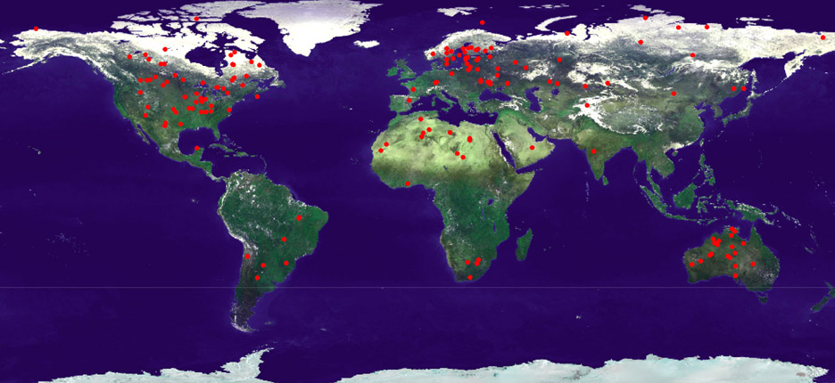
Impact Craters
on Mars
on Venus
on Earth

Slide 21
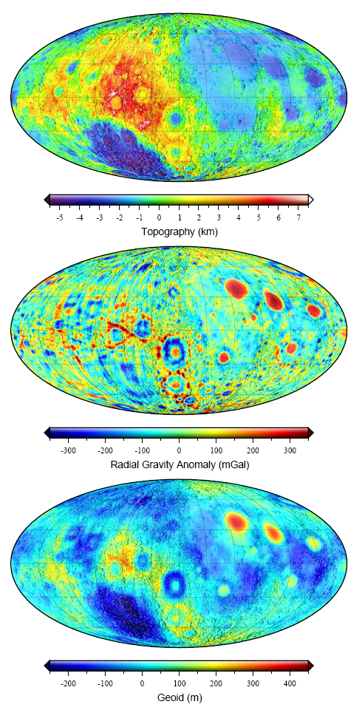
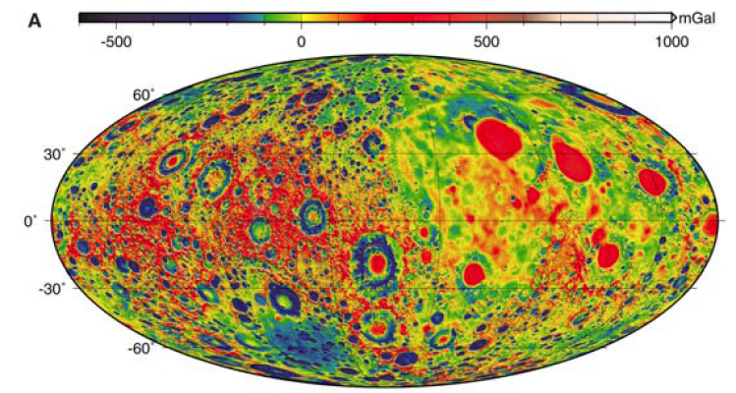
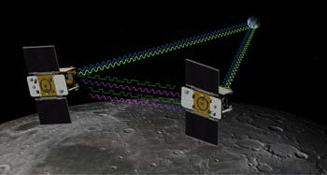
Lunar Orbiter Laser Altimeter (2010) LOLA: 10 m radial and 100 m spatial resolution (Smith, GRL, 2010)
GRAIL (2012) (Gravity Recovery and Interior Laboratory) modelled after Earth-observing GRACE (2002) (Gravity Recovery and Climate Experiment) flew twin spacecraft in tandem orbits around the moon to measure its gravity field to degree & order 420, ~ 13 km block size
Free-air gravity

Slide 22
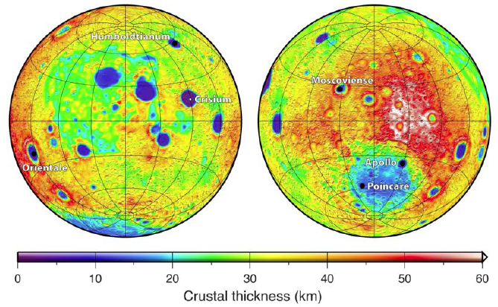
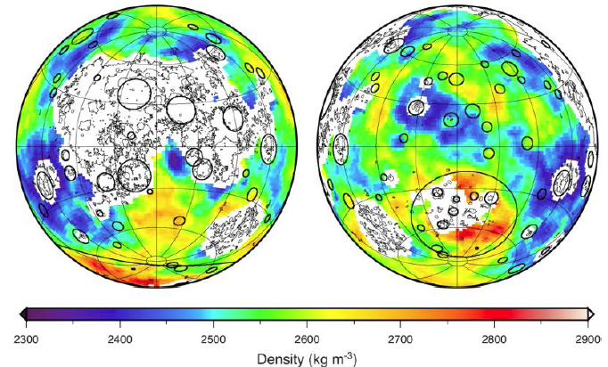
Gravity anomalies can be interpreted using:
Pratt isostasy (Lateral density fluctuations in the crust)
or
Airy isostasy (Constant density crust that varies in thickness)
or a hybrid:
GRAIL crustal thickness map of the moon
varied crustal density based on Clementine spectroscopy;
fixed mantle density (3220 kg/m³) and porosity (12%);
applied constraint of seismic thickness at Apollo landing sites (~40 km) and at deepest impact basin (~1 km in Crisium)
(Wieczorek et al., Science, 2012)

Slide 23
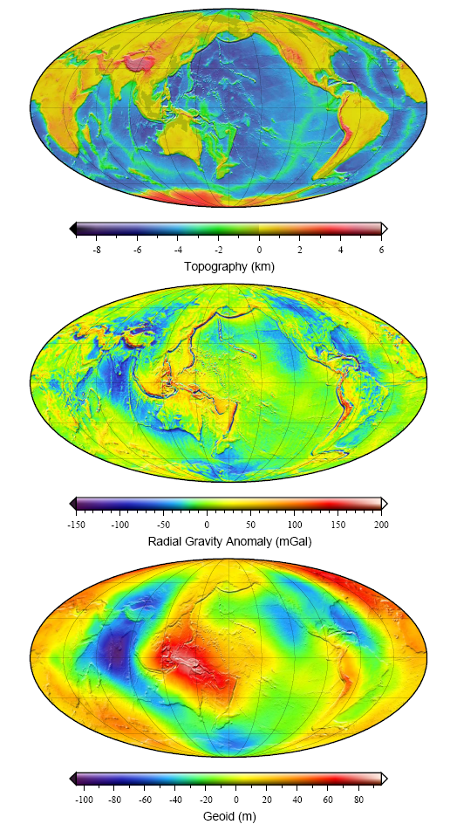
Earth Moon
Topography
scale range =
Free-air gravity
Geoid
15 km 13 km
350 mGal
>1000 mGal
200 m 700 m

Slide 24
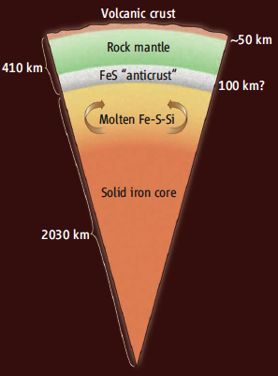
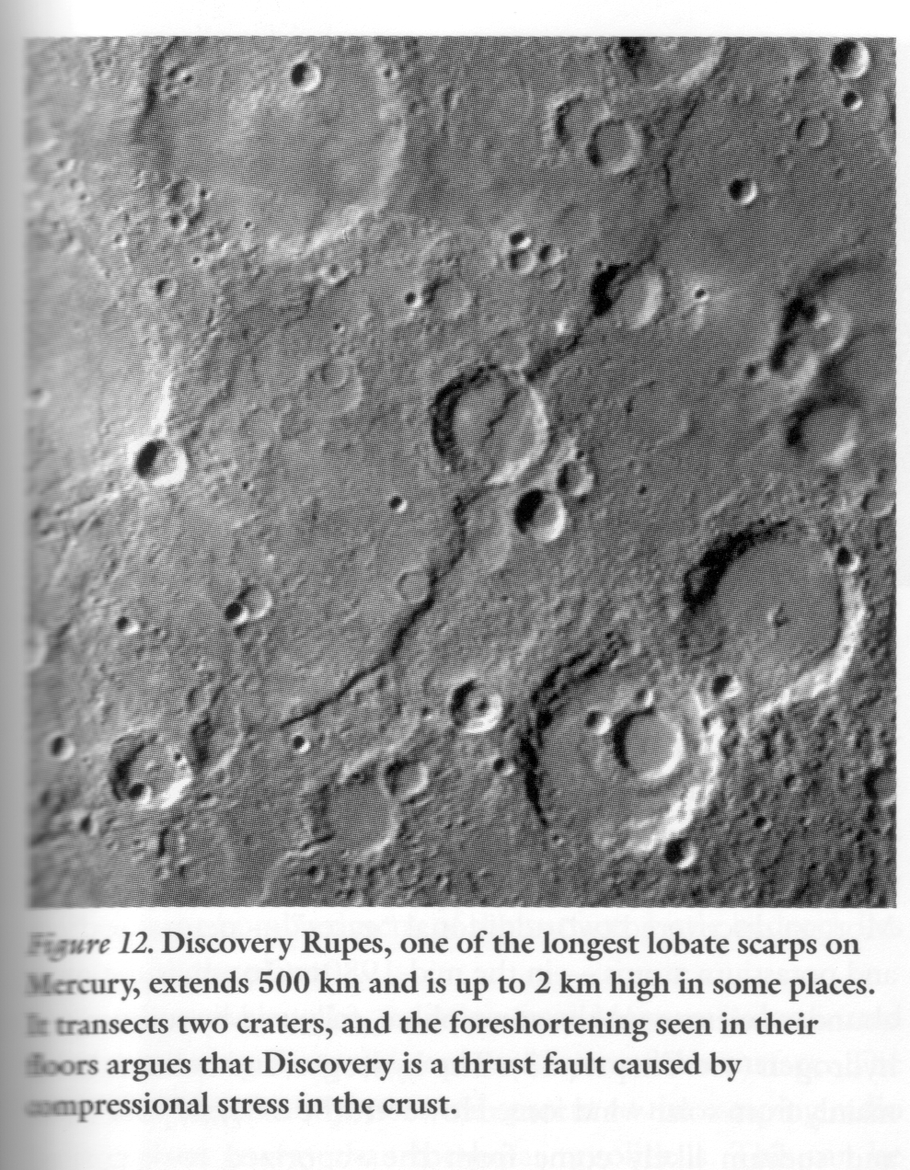
Mercury
Mercury is 3x mass of moon
Density 5.3 g/cc (> Earth). Iron core occupies 75% of planetary radius. Rocky mantle may have been stripped away in T-Tauri phase or by giant impacts
MESSENGER has recently provided global stereo images at 250 m/pixel resolution, surface compositions, magnetosphere, topography, gravity, …
Highlands
  Heavily cratered terrain, like the Moon
Lowlands smooth plains
  Post heavy bombardment, ~3.8 Ga, analogous to lunar maria?
  possibly close to north pole because of true polar wander
Lobate scarps
  Curved thrust faults unique to Mercury, younger than plains
  Imply planetary contraction of 1-2 km?

Slide 25
Summary of the Dead Planets (Moon, Mercury)
No magmatic or tectonic activity for billions of years
Preservation of primitive crust and ancient bombarded surface
Large gravity anomalies supported by thick lithosphere
No evidence of spreading ridges, trenches, or transform faults
No plate tectonics

Slide 26
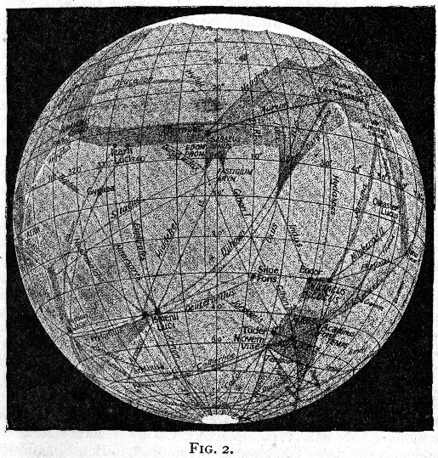
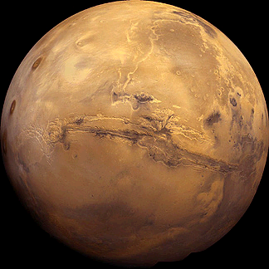
Remote Sensing of Mars
Viking mosaic, 1976
Lowell’s (1906) remote sensing interpretation
of Mars canals from a 24” telescope.

Slide 27
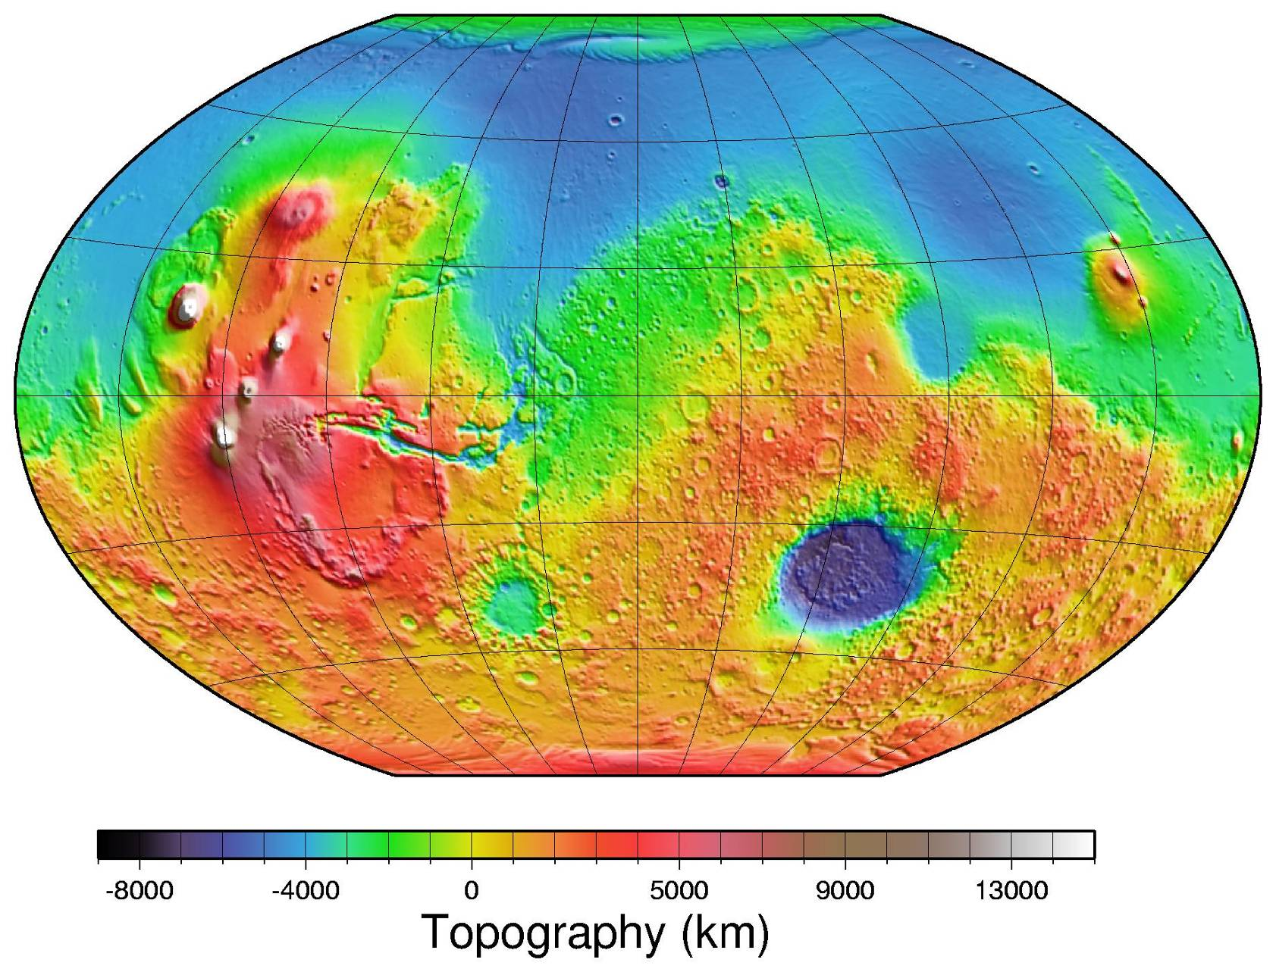
The southern hemisphere contains cratered terrain (remnant primordial crust?), with the bulk of the larger impact structures of which the biggest is Hellas Planitia.
Note three volcanoes of Tharsis Montes; Olympus Mons (largest volcano in the solar system); Alba Patera (a caldera-capped volcano) - together sufficient to affect planetary moment of inertia.
Note the long, curvilinear Valles Marineris, with associated chasmas or tributary canyons.
The northern hemisphere has few impact craters - these plains are thought to represent relatively recent volcanism and rifting. Did an ocean once occupy the relatively featureless northern plains?
Topography
of Mars
AP
OM
Th
VM
HP

Slide 28
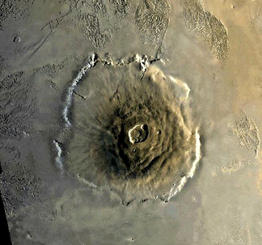
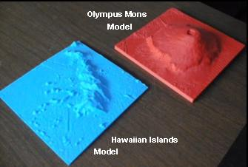
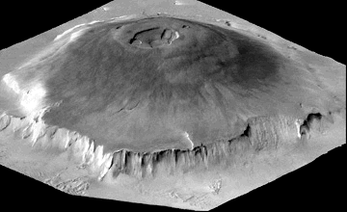
Volcanism on Mars: Olympus Mons
Olympus Mons has a median diameter of 625 km and a height of 25 km, the largest volcano on any planet - by volume 10,000 x Mauna Loa (9 km high, 120 km diameter)
Its elliptical central caldera is 80 km across.
A cliff 6 km high surrounds Olympus Mons, and stands out in the perspective view.

Slide 29
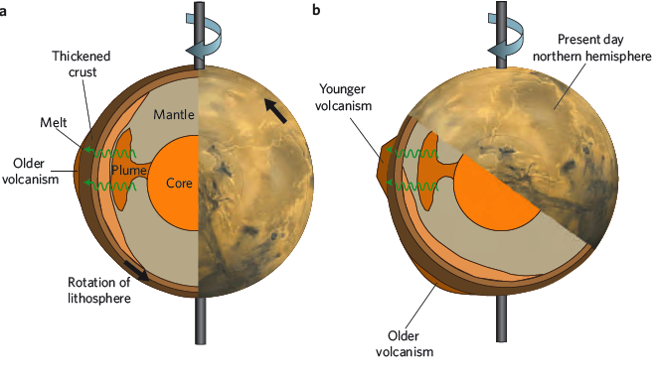
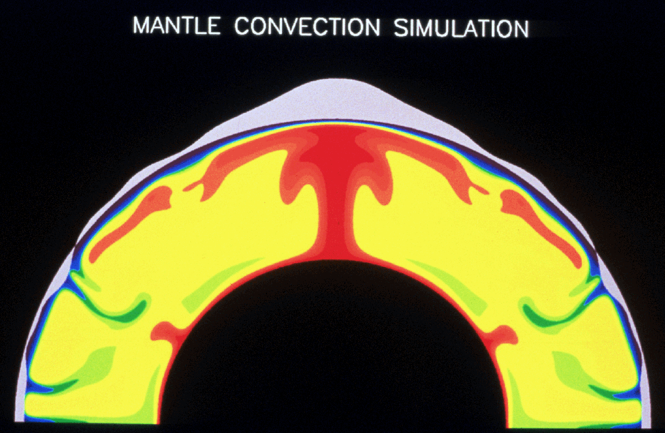
Martian bulges & large volcanoes are built above mantle plumes:
On Earth, the movement of the plates across plumes prevents large volcanoes from forming.
Did huge volcanoes form on Mars is because the surface remained relatively fixed with respect to the mantle source region for hundreds of millions of years?
Wherever Tharsis formed, its load would have reoriented to the equator, to form a stable rotational configuration.
At 3.8 Ga, Mars was a single-plate planet with bulk lithospheric motion: the stagnant lithospheric lid is not returned to the mantle below, but rotated bodily with respect to the mantle, leading to “true polar wander”
Nimmo, Nat. Geosci., 2008
(News & Views about Zhong paper in same issue)

Slide 30
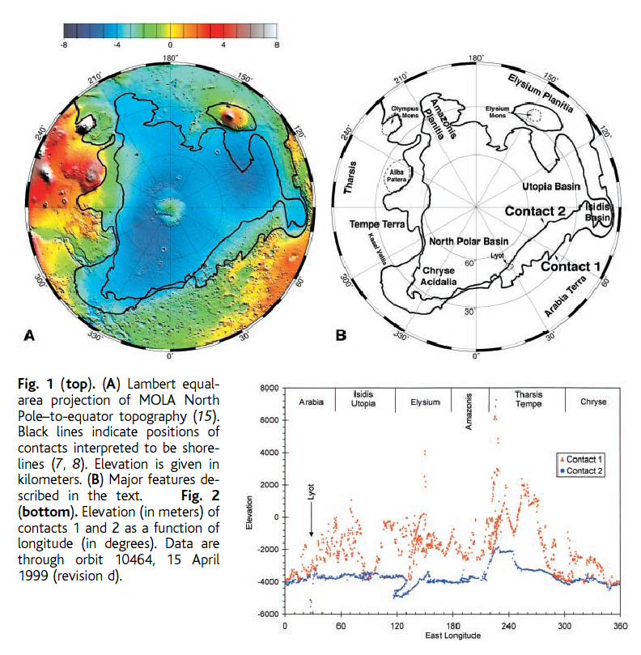
Northern Plains … if one strips off the younger Tharsis volcanoes, an elliptical basin, possibly a massive impact basin (11000 x 8000 km)
As on Earth, there was an impact re-supply of volatiles following the loss of the earliest atmosphere.
Did water persist and pool?
in an ancient ocean bounded by equi-elevation contours that correspond with geomorphic features, potentially shorelines
The “shorelines” are not truly uniform elevation- but true polar wander over the equatorial bulge may have deformed them to their present state
(Head et al., Science,1999)

Slide 31
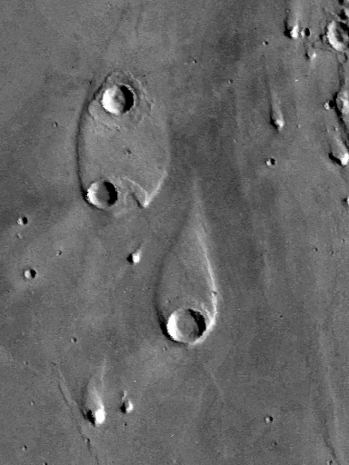
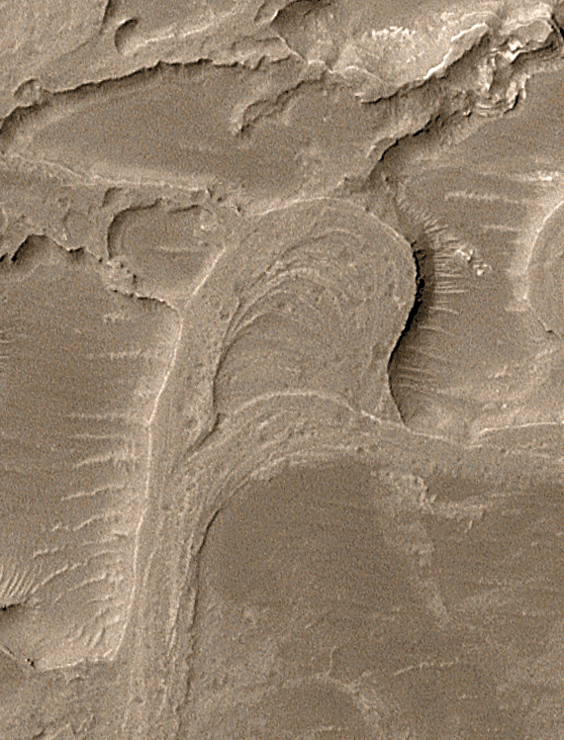
Ample evidence of past water…
Streamlined islands:
Meandering and migrating channels:
NE Holden Crater delta

Slide 32
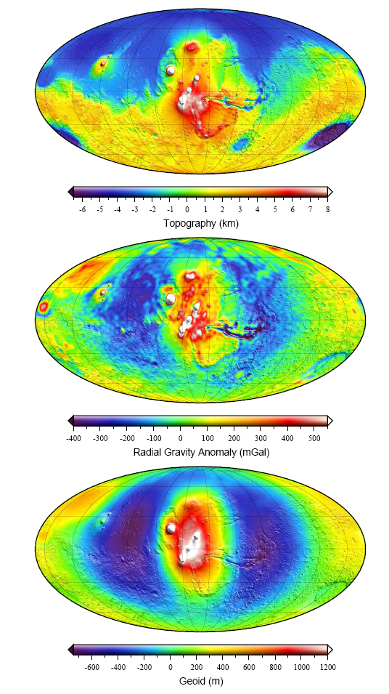
Earth Mars
Topography
scale range =
Free-air gravity
Geoid
15 km 15 km
350 mGal
950 mGal
200 m 2 km

Slide 33
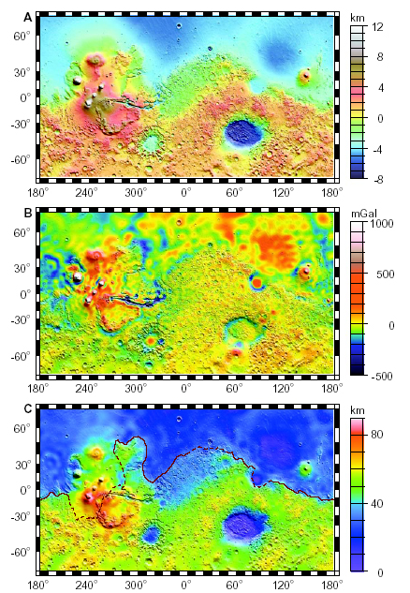
What about ocean crust, ocean spreading, “Earth-like” plate tectonics?
Mars topography
Free-air gravity anomaly
Bouguer anomaly converted to crustal thickness:
Northern Plains probably 20-40 km thick
Zuber et al., Science, 287, 1788-1793,2000.

Slide 34
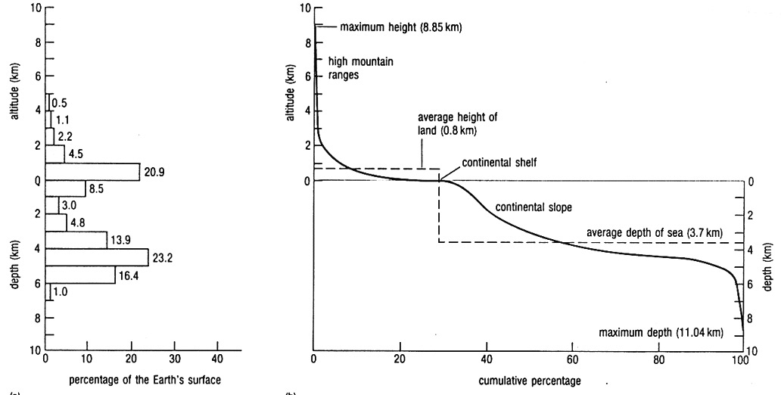
Earth’s Hypsometry is unique among the silicate planets because it is bimodal (continental and oceanic crust)
Histogram showing actual frequency distribution.
Hypsographic curve = cumulative frequency curve based on the histogram (not a profile of Earth’s surface), showing percent of the Earth’s surface that lie above any given level.

Slide 35


Planetary Hypsometry
Mars Earth

Slide 36

Ancient Seafloor Spreading on Mars?
Linear magnetic anomalies found in the south hemisphere.
Bands are oriented approximately east-west and are about 160 km wide and 965 km long, although the longest band is more than 1,930 km.
Not present in the northern hemisphere.

Slide 37





Mars: Satellite magnetic field
Earth: Satellite magnetic field, 400 km
K: Cretaceous Quiet Zone
R: Spreading ridge
W: Walvis Ridge
(Purucker, 2000)

Slide 38
MARS SUMMARY
Mars possibly had plate tectonics early in its evolution, but not today, allowing preservation of primordial crust of the southern hemisphere.
Northern hemisphere was resurfaced more recently, probably by a massive but low-angle impact - basin is an ellipse, 11,000 km x 8,000 km.
Mars is dominated by long-term stability of mantle plumes (Tharsis and Elysium provinces) and zone of rifting (Valles Marineris); the massive volcanoes re-oriented the lithosphere with respect to the spin axis in “one-plate” tectonics.
Modest tectonic and magmatic activity are associated with the largest volcanoes and rifts of the silicate planets.

Slide 39



Venus: Earth’s twin: Plate Tectonics?
Body Diameter (km) Mass (kg) Tectonics
Venus 12,103 49 *10²³ Active
Earth 12,756 60 *10²³ Active
Almost Earth’s twin in mass (82%)
Dense CO₂ atmosphere (90 atm)
Surface T = 480°C
Three USSR landers (Venera: 1975, 1975, 1982) plus US Magellan radar mapping (1984)
Venera 13, 1982

Slide 40



Slide 41



Venusian Impact Craters
no record of early heavy bombardment period, hence Venus was resurfaced at 300 to 500 Ma.
most craters appear pristine because they were formed after resurfacing with little geologic activity to degrade them; but some tectonized examples exist.
Venus has fewer small (<2km diameter) craters than other planets because small projectiles vaporize in the dense atmosphere before they reach the surface.
Because of the high temperature on the Venusian surface, impacts produce more melt than on other planets; e.g. Addams crater with a thin outflow that extends 600 km from the crater, controlled by the local topography

Slide 42
Impact Craters
on Mars
on Venus
on Earth

Slide 43


Ovda Regio, Venus: ridges 8-15km wide,
30-60km long (similar to Appalachians)
Guinevere Plains, Venus:
tensile fracture ribbons a few km wide
Tectonic Forces at work.
Convection Cells

Slide 44

Pancake Volcanoes
Volcanic features dominate,
some familiar from Earth:
four overlapping domes is located on the eastern edge of Alpha Regio
~25 km diameter, ≤ 0.75 km
presumably viscous lava on level ground allowing the lava to flow in an even lateral pattern.
Calderas
Sacajawea Patera is an elliptical caldera in Ishtar Terra.
260 by 175 km; ~2 km deep

Slide 45


Coronae
Volcanic features dominate,
some unknown on Earth:
circular to oblong structures, 200 - 1000 km diameter. ~ 2 km elevation, with a surrounding moat
possibly associated with large mantle plumes beneath the Venusian lithosphere
evolution involves cyclic uplift and collapse leading to concentric ring fractures
abundant volcanic features found in the interior may reflect melting of the plume head and extrusion of these melts at the surface
Ba'het Corona, 230 km long, 150 km across.
Note surrounding concentric ridges and troughs.
Arachnoids
similar in form but generally smaller than coronae; 50 to 230 km diameter
circular to ovoid features with concentric rings and a complex network of fractures extending outward.
radar-bright lines extending for many km may result from upwelling magma which fractured the surface.
possibly a precursor to coronae formation.

Slide 46

Earth Venus
Topography
scale range =
Free-air gravity
Geoid
15 km 9 km
350 mGal
270 mGal
200 m 200 m

Slide 47

Venusian Tectonics?
Venusian surface is dominated by magmatism due to mantle plumes.
Downwelling must also happen, perhaps by delamination and sinking of dense lithosphere.
Possible thin (mobile)-lid / thick (stagnant)-lid transition shown at ~600Ma.
In the thin-lid era, lithospheric recycling was associated with mantle downwellings whose surface expression included compressional ridge belts.
In the thick-lid era, lithospheric extension over mantle upwellings produces corona chains; the topographic basins of the plains reflect mantle downwellings.
But no evidence of subduction or plate tectonics!
Phillips & Hansen, 1998, Science

Slide 48
Venus Summary
Venus may be magmatically and tectonically active.
No evidence of primordial crust.
No evidence for plate tectonics.
Abundant evidence for mantle plumes.
  - long lava channels indicate very hot magmas
Venusian surface may have been massively resurfaced between ~750 - ~300 Ma.
Volcanoes indicate upwelling mantle and additions to the crust. - how does lithosphere return to the mantle without subduction?
No water. Would Venus have plate tectonics if it had water?

Slide 49
Earth has Plate/Subduction Tectonics, Why doesn’t its near-twin Venus?
About the same size and density
Conventional answer: Earth has water but Venus does not
(Venus lost its water due to atmospheric dissociation and escape of H from the upper atmosphere into space)
•Water lowers the solidus temperature
•Even small amounts of water weakens olivine.
Both effects may weaken the mantle sufficiently to let lithosphere sink (subduction)

Slide 50
Take-away message:
• Plate tectonics (subduction tectonics) is unusual from a planetary perspective
Leading to the questions:
• When did it initiate on Earth? When did it end on Venus?
•Why does Earth have plate tectonics and not an alternative?
e.g. stagnant-lid = frozen-lid = single-plate convection;
or continuously mobile lid (ubiquitous surface failure)
•A mobile lid need not correspond to plate tectonics –
the most volcanically active body in the Solar System is Io (due to Jupiter’s tidal heating) – lid-failure and recycling efficiently cool Io without plate tectonics

Slide 51




Earth Moon
Venus Mars
350 mGal 1000 mGal
270 mGal 950 mGal
Free-air gravity scale range

Slide 52




Earth Moon
Venus Mars
15 km 13 km
9 km 15 km
Topographic scale range

