Slide 1
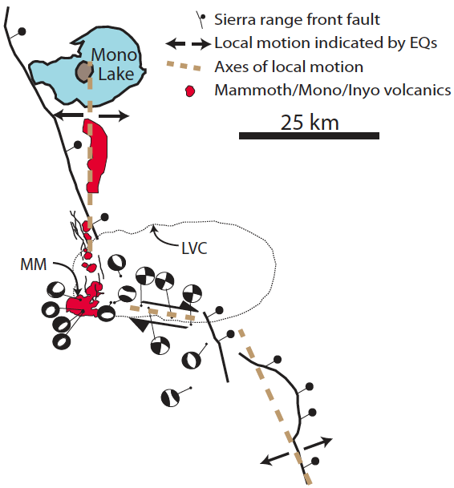
Spring Quarter 2013
Tectonics Field Trip
Geophysics 171
Almost certainly:
• 4-day field trip over Memorial Day
weekend (skip Friday classes)
(some camping, some cabins)
• Sierra Nevada/Basin-Range transition:
- recent volcanic features, 2 Ma b.p. to 1600 A.D.
- active normal and transtensional faulting
- Yosemite batholith
• co-led by Leif Karlstrom
• Tectonics, not “geology” – hammer, hand-lens & Brunton optional
• one class meeting per week (nominally Monday 2:15, open to negotiation, to introduce regional and local tectonics, S/NC, 1-3 units
• Outcrops chosen based on student interest – planning meeting this Thursday 14:30
– the sooner you sign up, the sooner you get to vote!

Slide 3
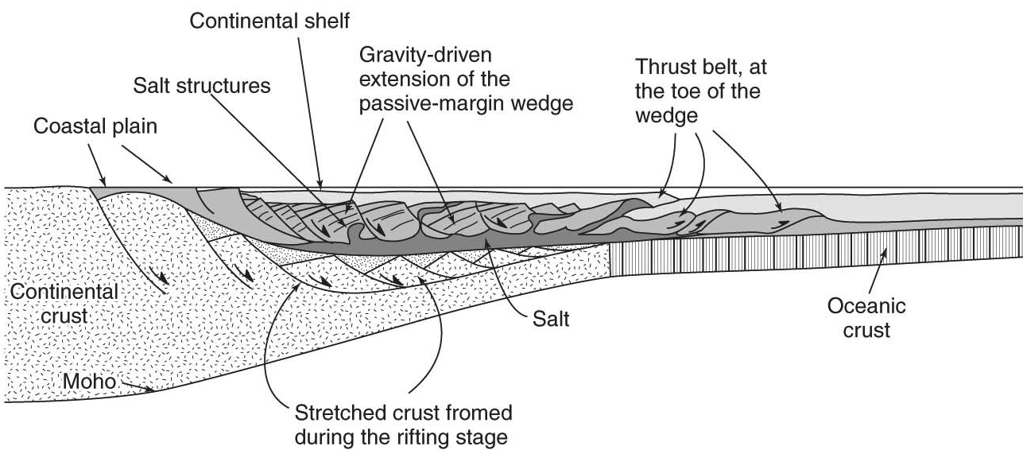
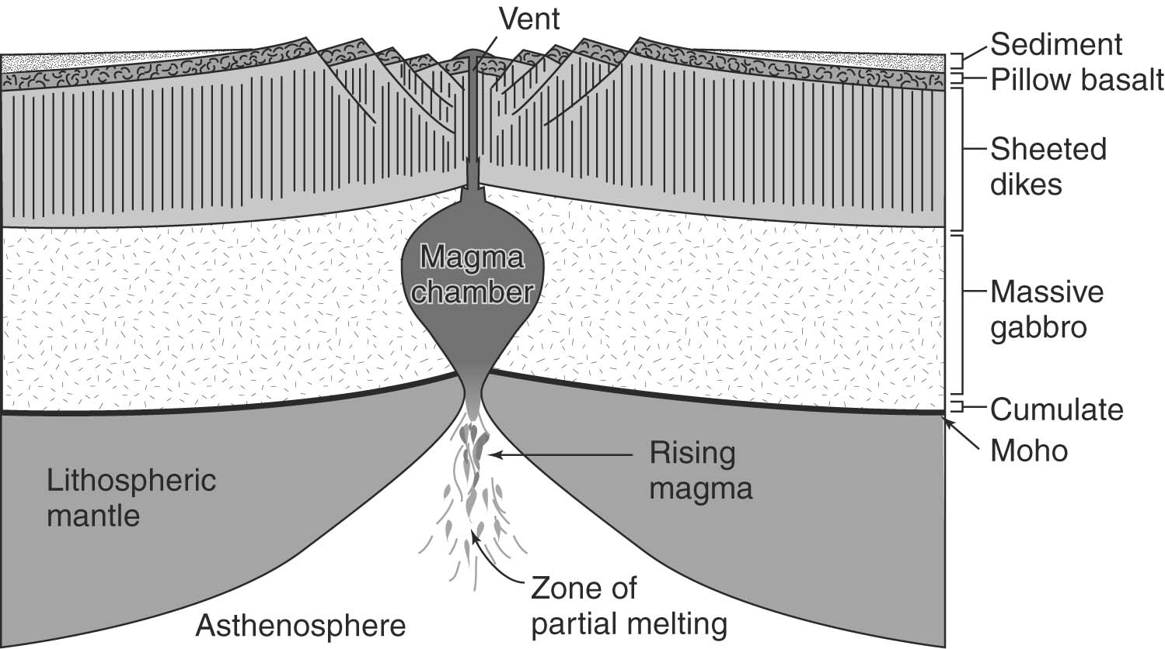
Lecture 17 March 5, 2013
Passive margins
Ocean spreading
Topics:
• Progression from rifting to passive
margin to ocean spreading
• Volcanic vs. non-volcanic rifted margins
• Fast, slow and ultra-slow ridges
Reading:
Geoffroy.VRM.ComptesRendues.2005.pdf Reston.nVRMreview.IJES.2007.pdf RaneroPerezGussinye.ConjugateMarginFaulting.Nature.2010.pdf
TaylorGoodliffe.Woodlark.JGR.1999.pdf
Macdonald.Ridges.Encyclopedia.2004.pdf Dick.ODPreview.Oceanography.2006.pdf DunnForsyth.MORseismicstructure.TreatiseGeophysics.2007.pdf

Slide 4
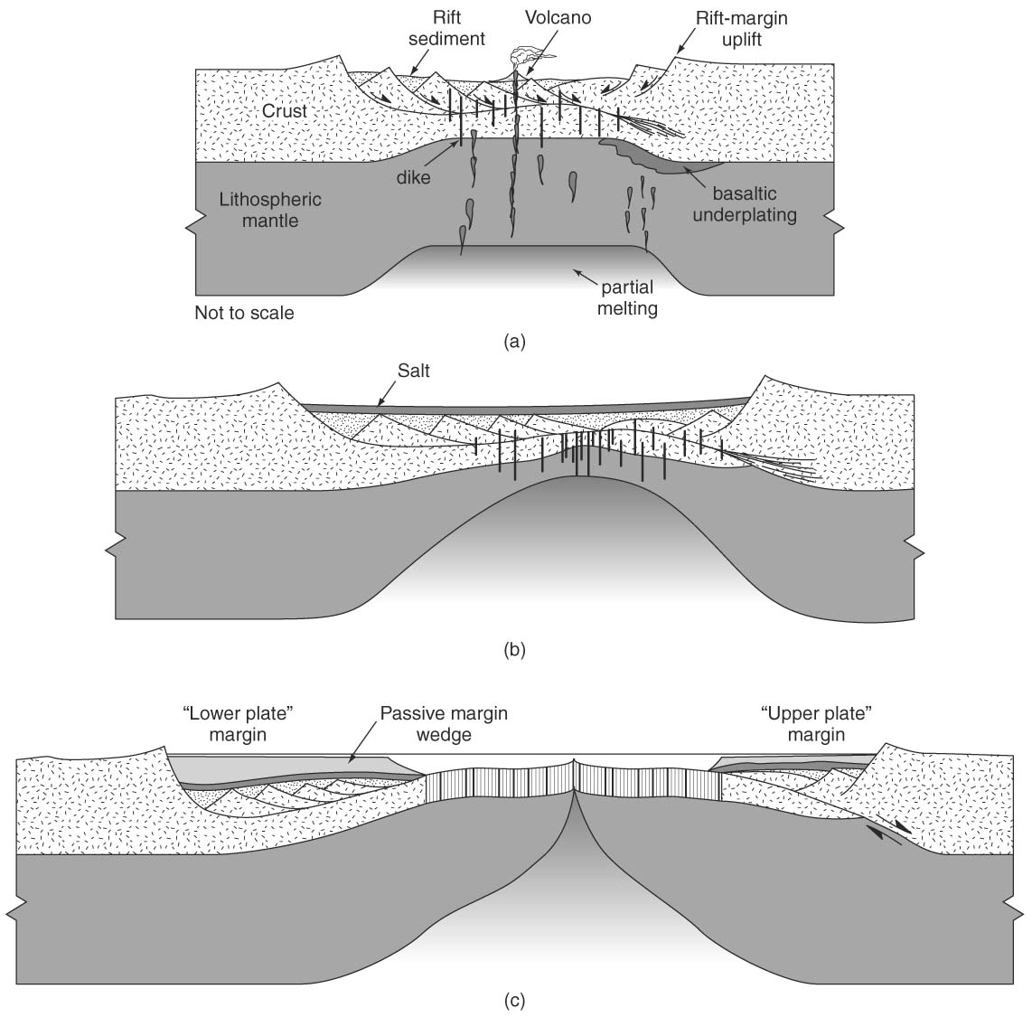
Rifting: non-marine flood
basalt and intrusions; terrestrial sediments fill basin (redbeds)
Rift-Drift Transition: begin sea-floor spreading; shallow narrow sea and evaporites
After 5-100 Myr:
Drift: formation of
passive-margin basin;
marine carbonates and
terrestrial sediments cover rift-drift sediments

Slide 5
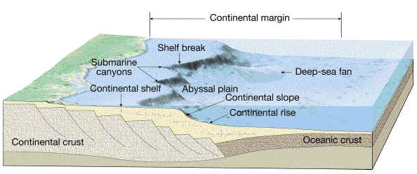
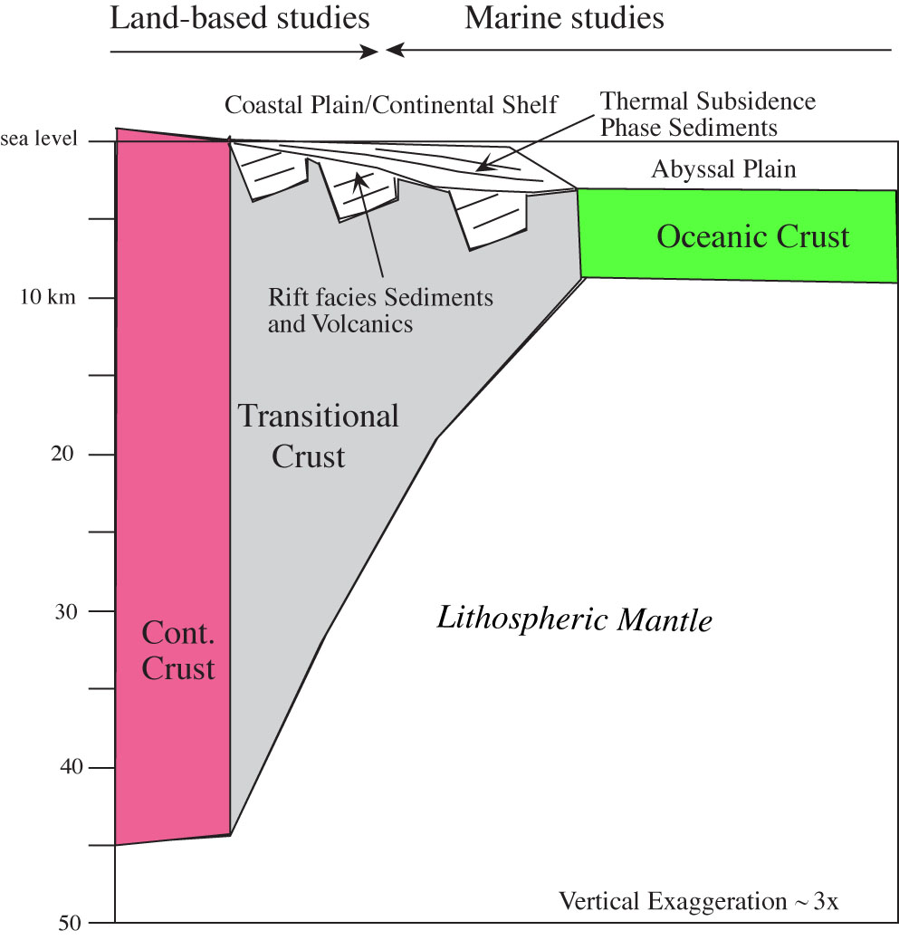
Passive Continental Margins join continental and oceanic lithospheres across a broad and often deeply buried “transitional lithosphere”
Broad, shallow shelf
Shelf break @ ~200m
Continental slope
Continental rise
Shelf is underlain by thick sediments and ‘transitional’ crust
Two end-members of transitional crust:
Volcanic Rifted Margins (VRM)
- transitional crust is a magmatic construction
Non-Volcanic Margins or Rifted Passive Margins
- transitional crust is composed of stretched crust

Slide 6
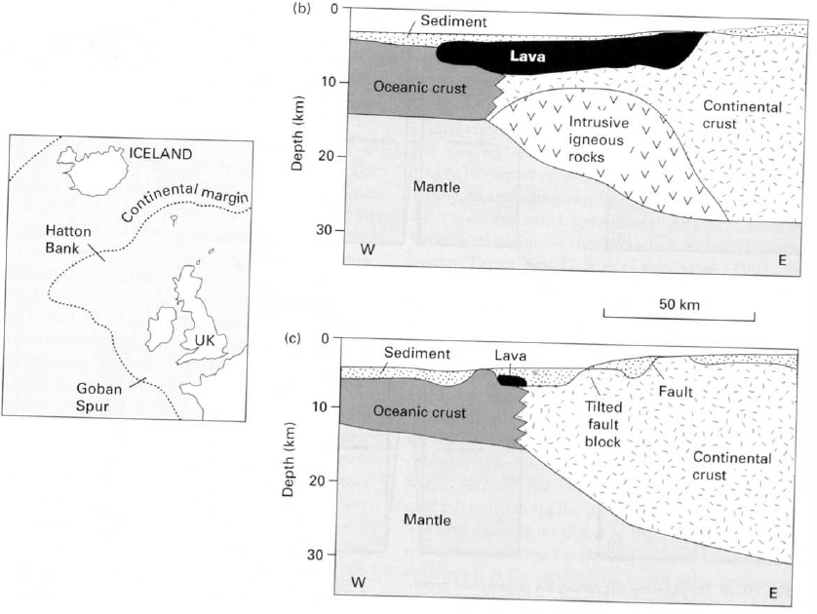
Bob White, 1993 ; Kearey & Vine, 2nd ed.
Volcanic vs.
non-volcanic rifted margins
As for most dichotomies,
the truth for each margin
lies between the end-members

Slide 7
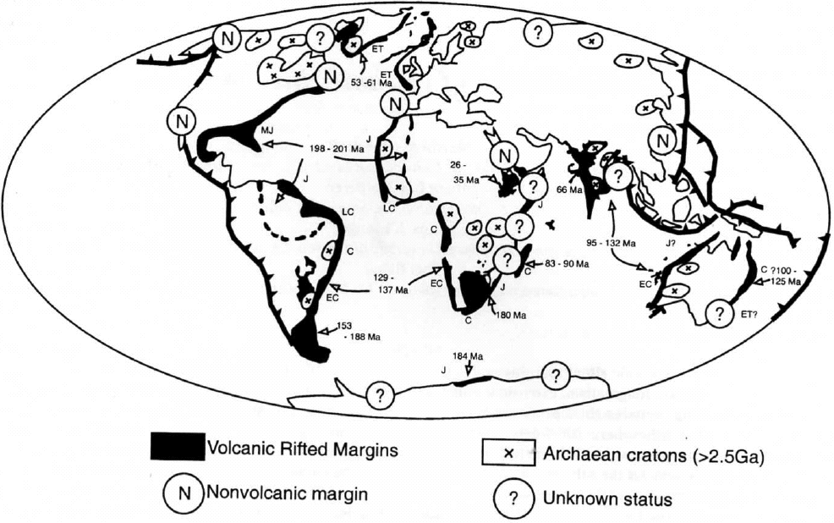
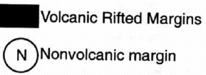
VRM vs. nVRM
Originally margins were thought to be non-volcanic …
then VRM were recognized as a special case …
now VRM seem more common than non-VRM!
Volcanic Passive Margins have high P-wave velocities ≥7km/sec in the transitional crust.
Volcanic Passive Margins have seaward-dipping reflectors in the transitional crust.
Rifted passive margins have modest P-wave velocities ~6 km/sec in the transitional crust.
Rifted Passive Margins often have continentward-dipping reflectors in the transitional crust.
Menzies, Klemperer, et al., 2003

Slide 8
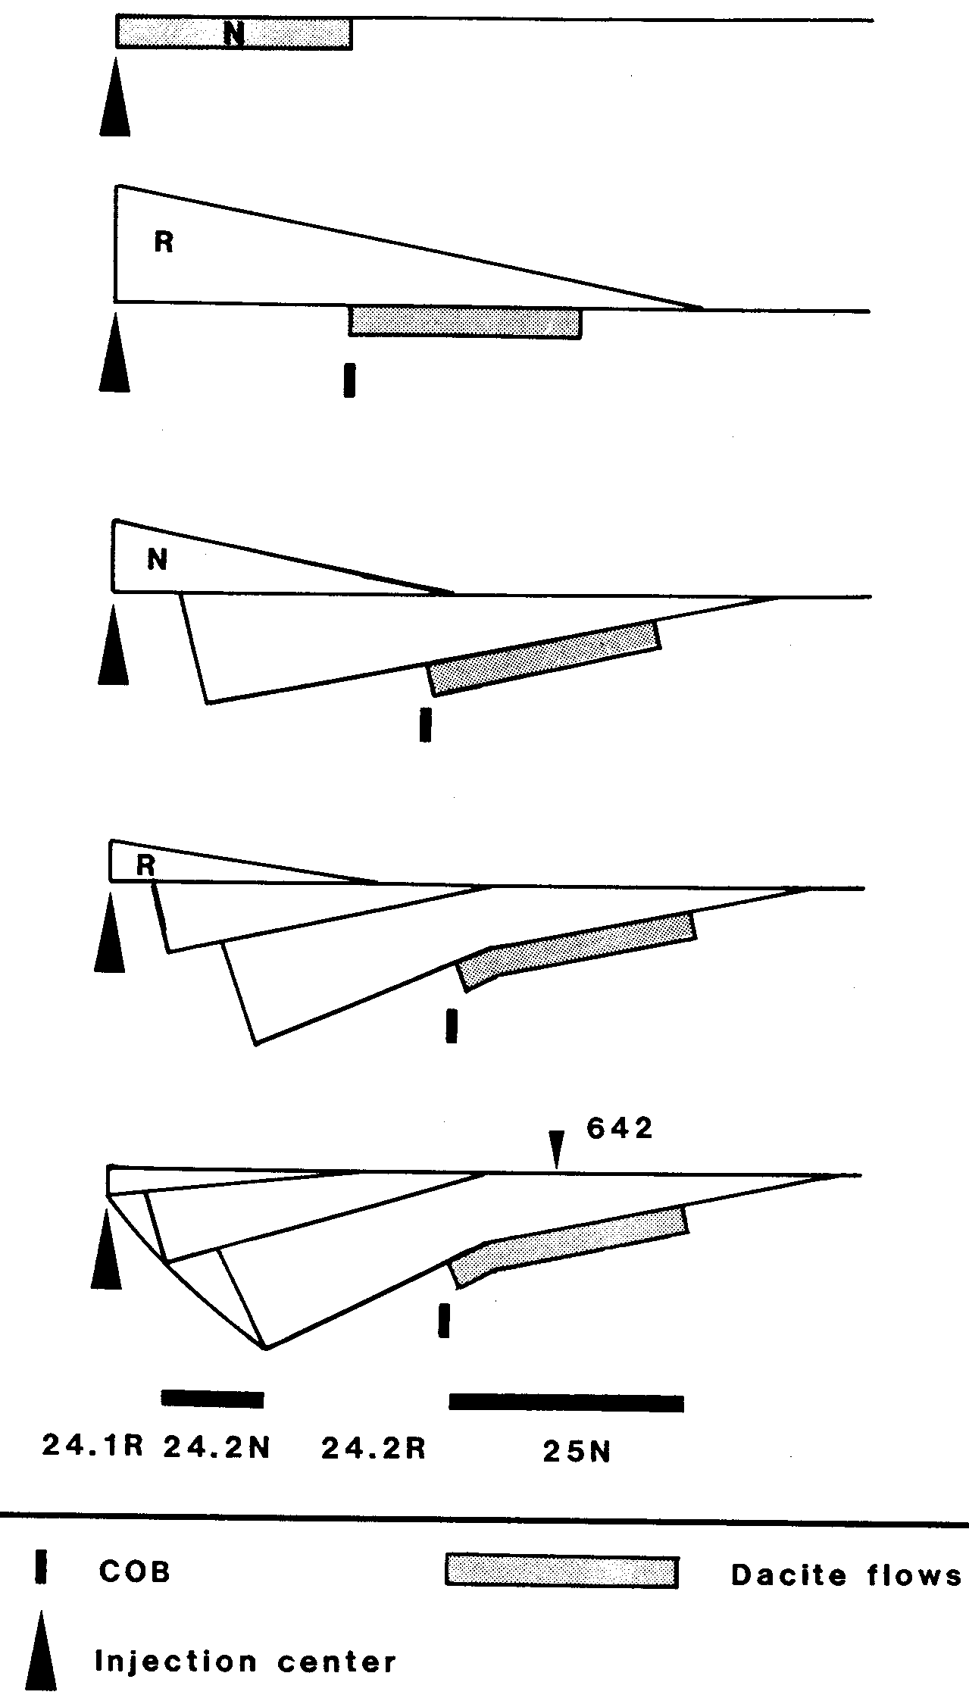
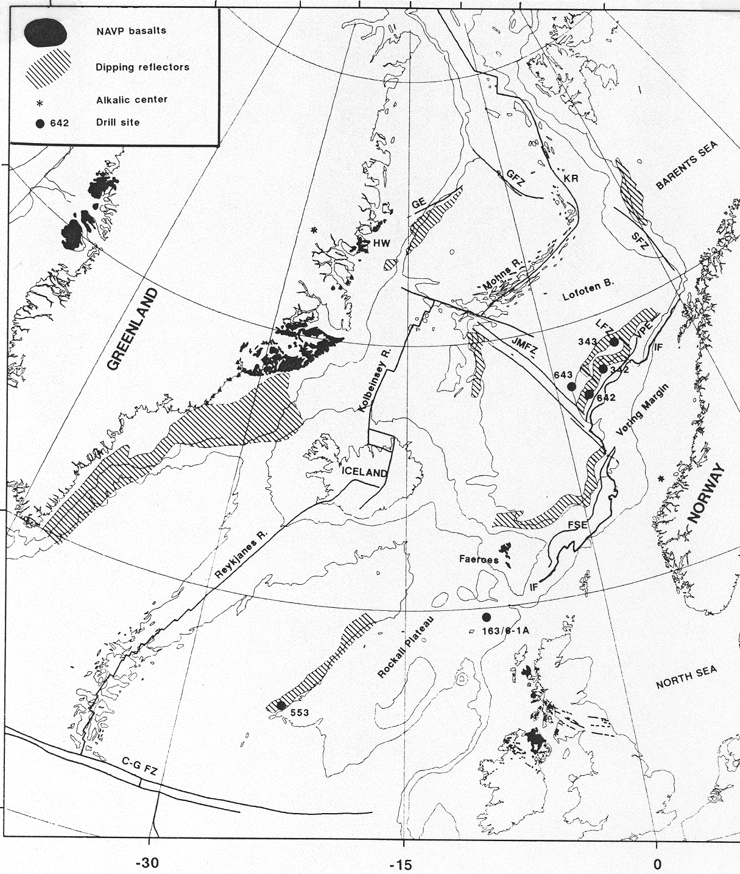
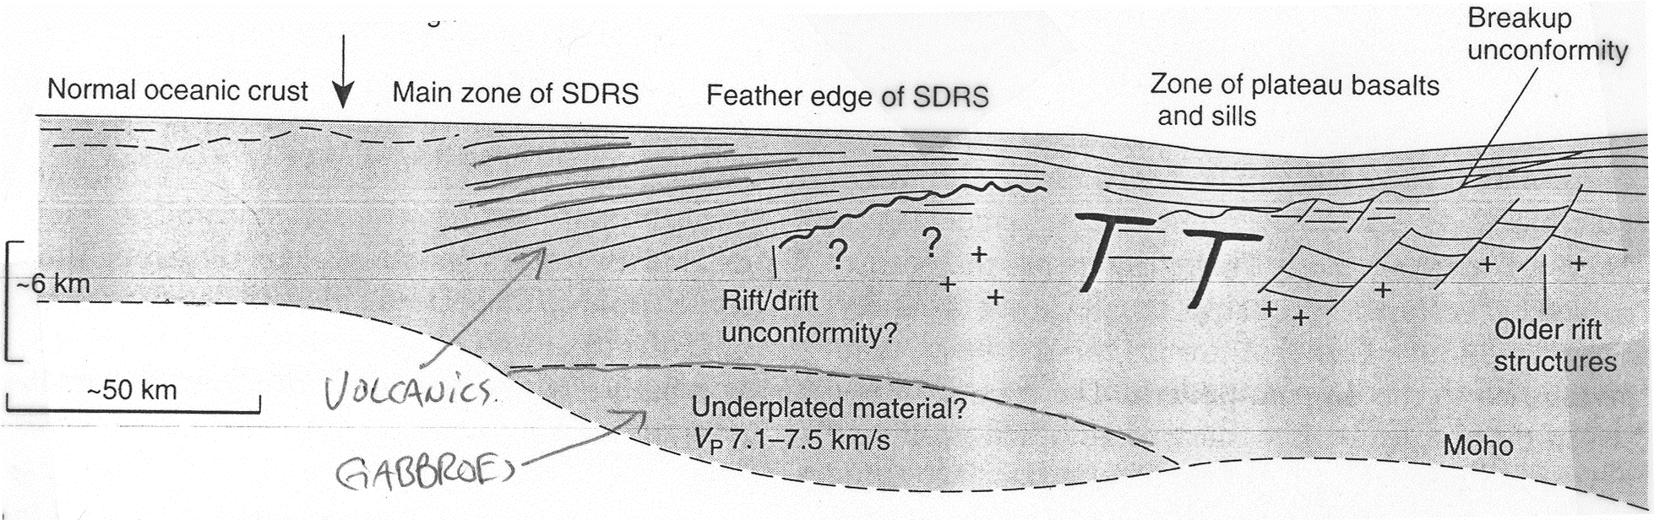
Origin of Seaward-dipping reflectors:
ODP 104
overlapping lava flows
North Atlantic volcanic province; Vøring Plateau; ODP leg 104
Ocean
Continent

Slide 9
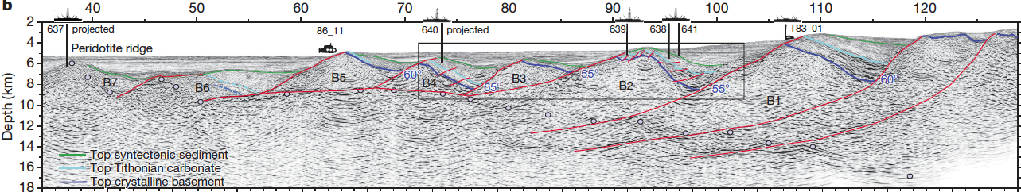
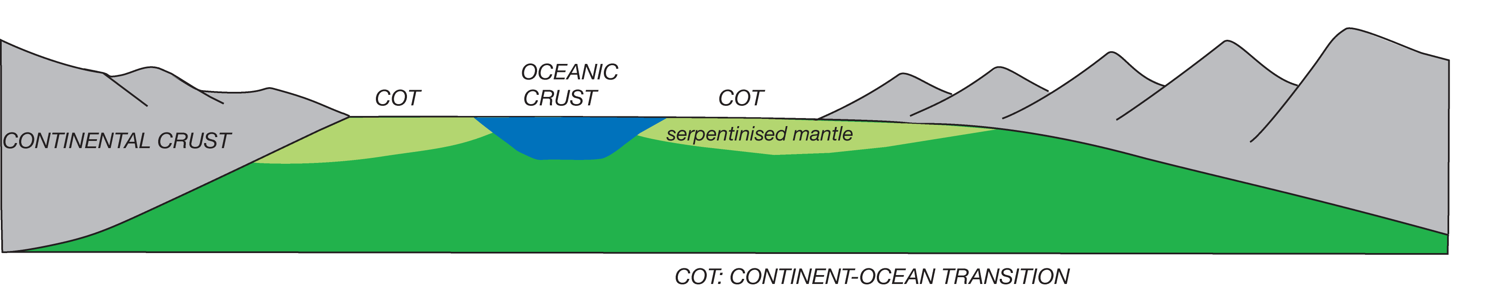
Origin of Landward-dipping reflectors: rotated sedimentary packages in half-grabens
MOHO
MOHO
faults cut Moho constrained by wide-angle seismic data
NEWFOUNDLAND
IBERIA
mantle
nVRM include hyper-extended margins with mantle exhumation & dramatic asymmetry of “upper-plate” and “lower-plate” margins
Ranero & Pérez-Gussinyé, Nature, 2010

Slide 10
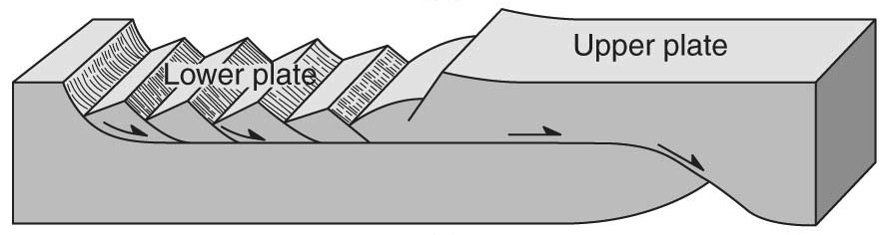
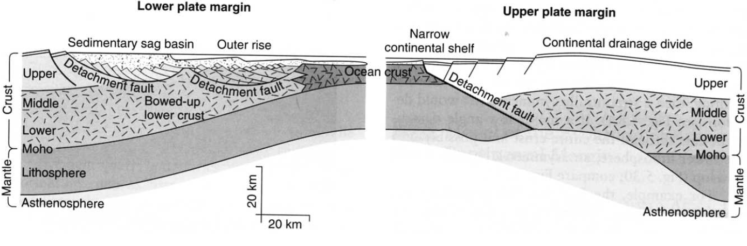
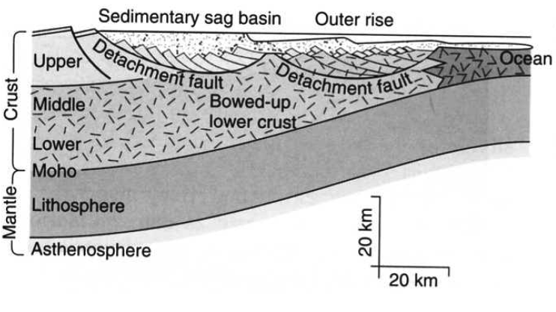
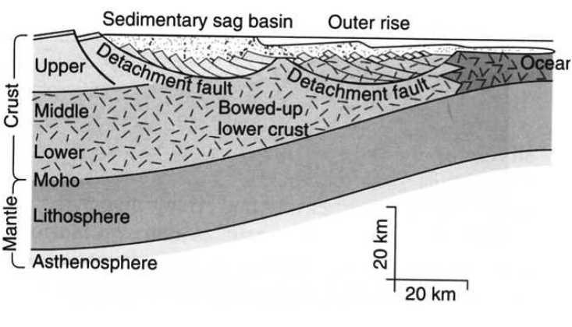
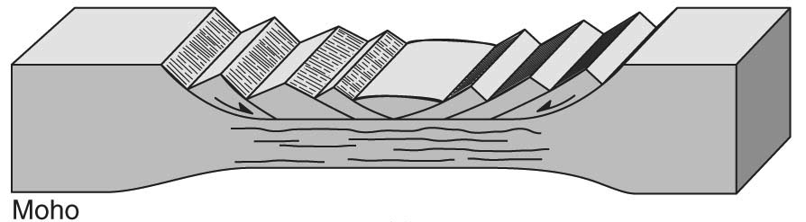
Origin of asymmetry:
possibly Structural inheritance from the rift stage:
asymmetric / simple shear
vs.
symmetric / pure shear

Slide 11
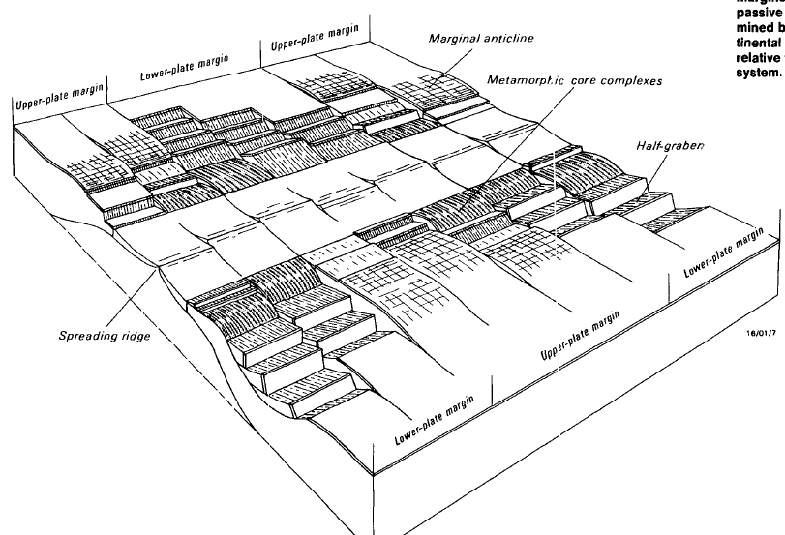
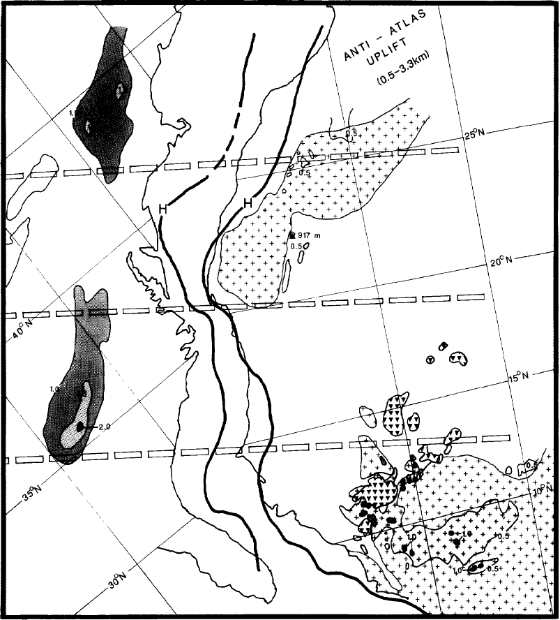
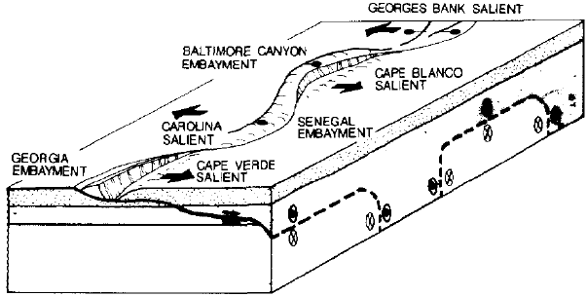
Concept of “upper-” and “lower-” plate margins
Lister et al., Geology, 1986
but in detail its hard to match subsidence patterns (see earlier slide)
Interpretation of U.S. and African margins as upper-” and “lower-” plate
Wernicke & Tilke, AAPG. Mem., 1989

Slide 12
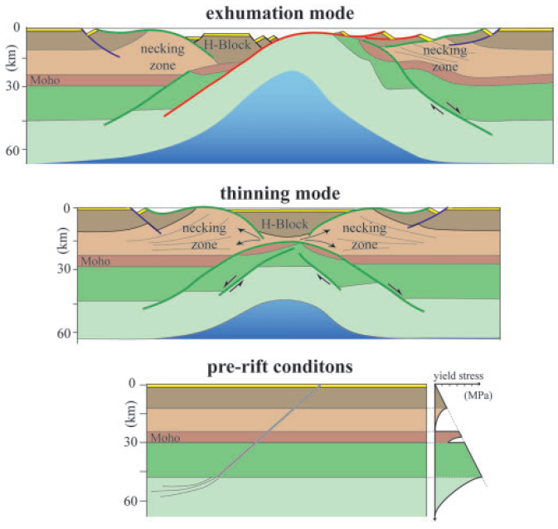
Origin of asymmetry:
Lavier & Manatschal, Nature, 2006
possibly
Crustal thinning by conjugate concave-downward faults with large extension that form very thin crust (<10km) and exhume mid-crustal and finally mantle material, with very depth-dependent stretching.
Transitional crust is capped by sub-horizontal detachments over >100km.
But the detachments are thus far invisible on seismic data …

Slide 13
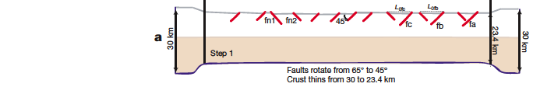
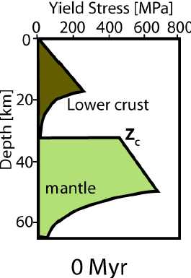
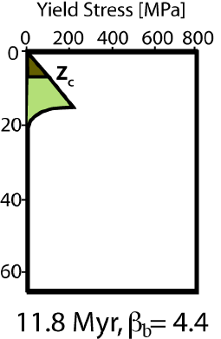
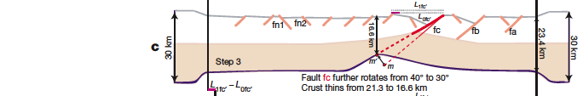
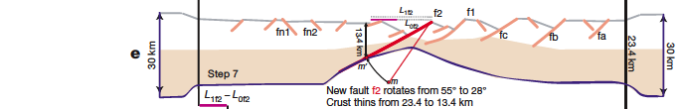
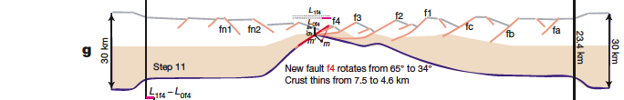
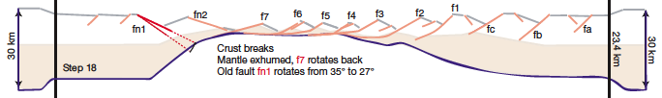
Origin of asymmetry: sequential high-angle faulting with progressive fault rotation, in an evolving thermal structure: early faulting has uniform stretching of brittle/ductile crust; extension is slow, so lower crust becomes cool and brittle; late faults cut through to the mantle
Increasing extension
Beginning
of extension
Just before crustal break-up
No active LANF;
no depth-dependent stretching
Ranero & Pérez-Gussinyé, Nature, 2010

Slide 14
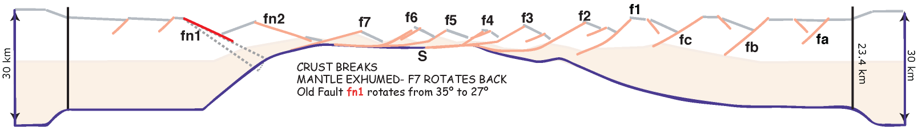
Mantle serpentinization:
Buoyant serpentinised
mantle
1 - Progressive embrittlement of lower crust 2 - Mantle serpentinization once the crust is brittle (faults cut into mantle)
Process requires magma-inhibition during mantle exhumation:
• Cold mantle temperature – 25-50K colder than normal (1250-1275°C) &/or
• Mantle depletion (in the basaltic constituents, i.e. non-fertile) delays melting and reduces melt production
&/or
• Ultra-slow extension (≤6 mm/yr half-rate) allows mantle serpentinization (at Moho) simultaneously with or immediately prior to decompression melting (at depth).

Slide 15
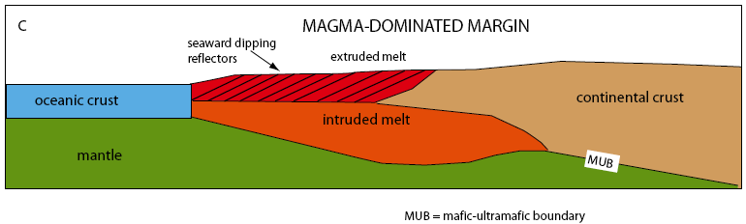
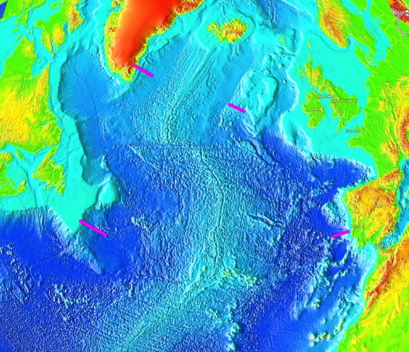
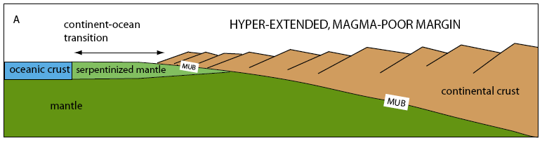
VRM and nVRM are fundamentally different
Volcanic e.g. Greenland-NW Europe
VRM are not just high volumes of magma superimposed on nVRM rift structures
Non-volcanic e.g. Iberia-Newfoundland

Slide 16
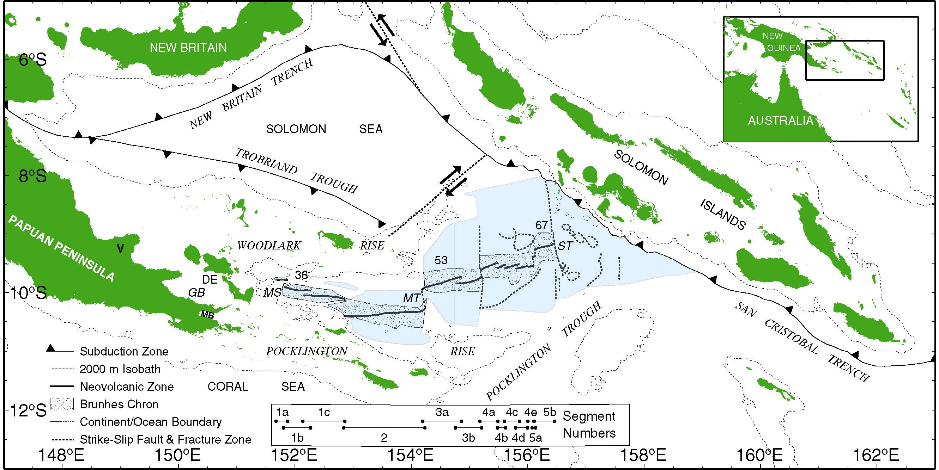
Woodlark Basin - Regional Setting
How does rifting proceed to spreading?
Active continental rifting evolving to oceanic spreading within weak proto-continental crust
Andy Goodliffe, pers. comm. 2005
Taylor et al., JGR, 1999
Goodliffe & Taylor, GSL Spec. Pub., 2007

Slide 17
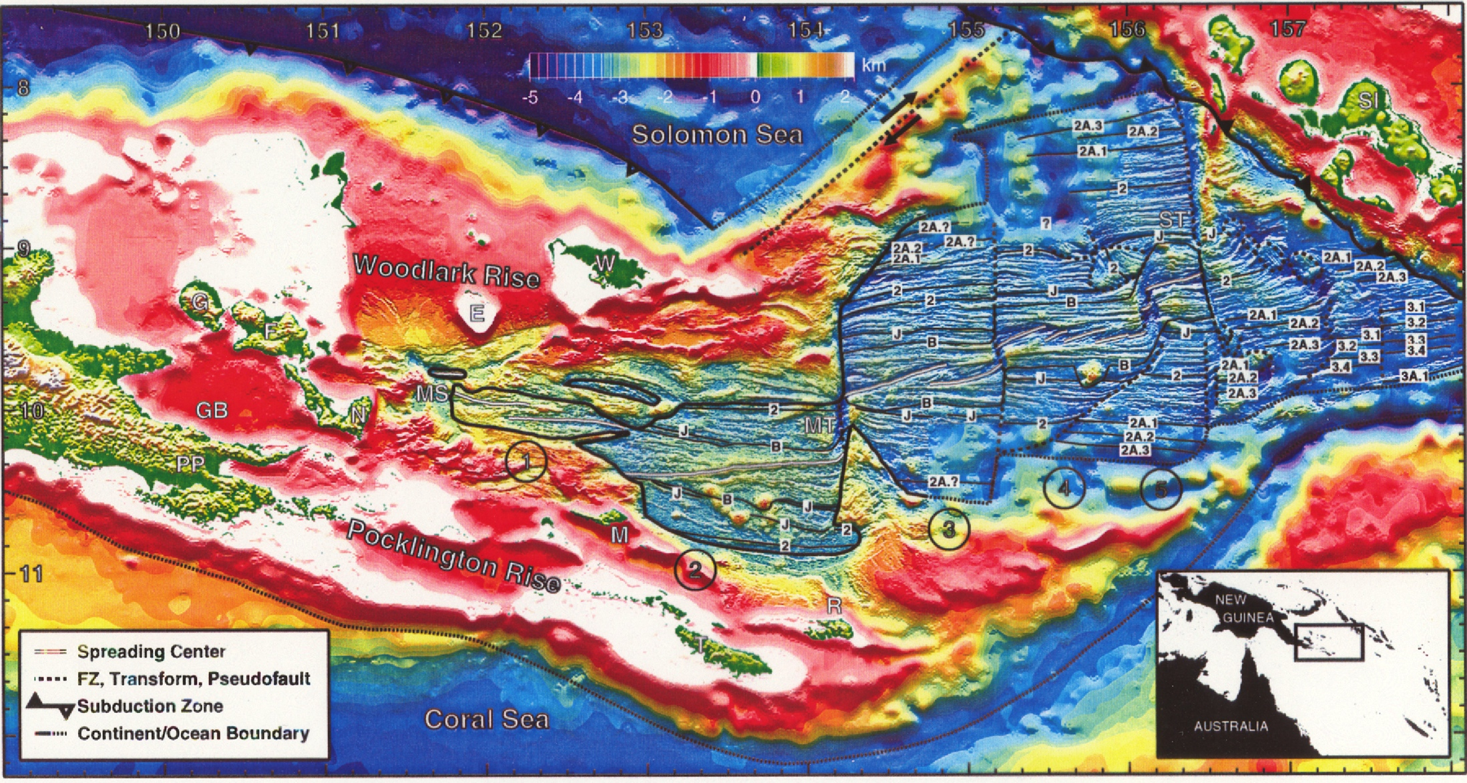
Woodlark Basin Spreading Note westward propagation of rifting & spreading
Taylor et al., 1999

Slide 18
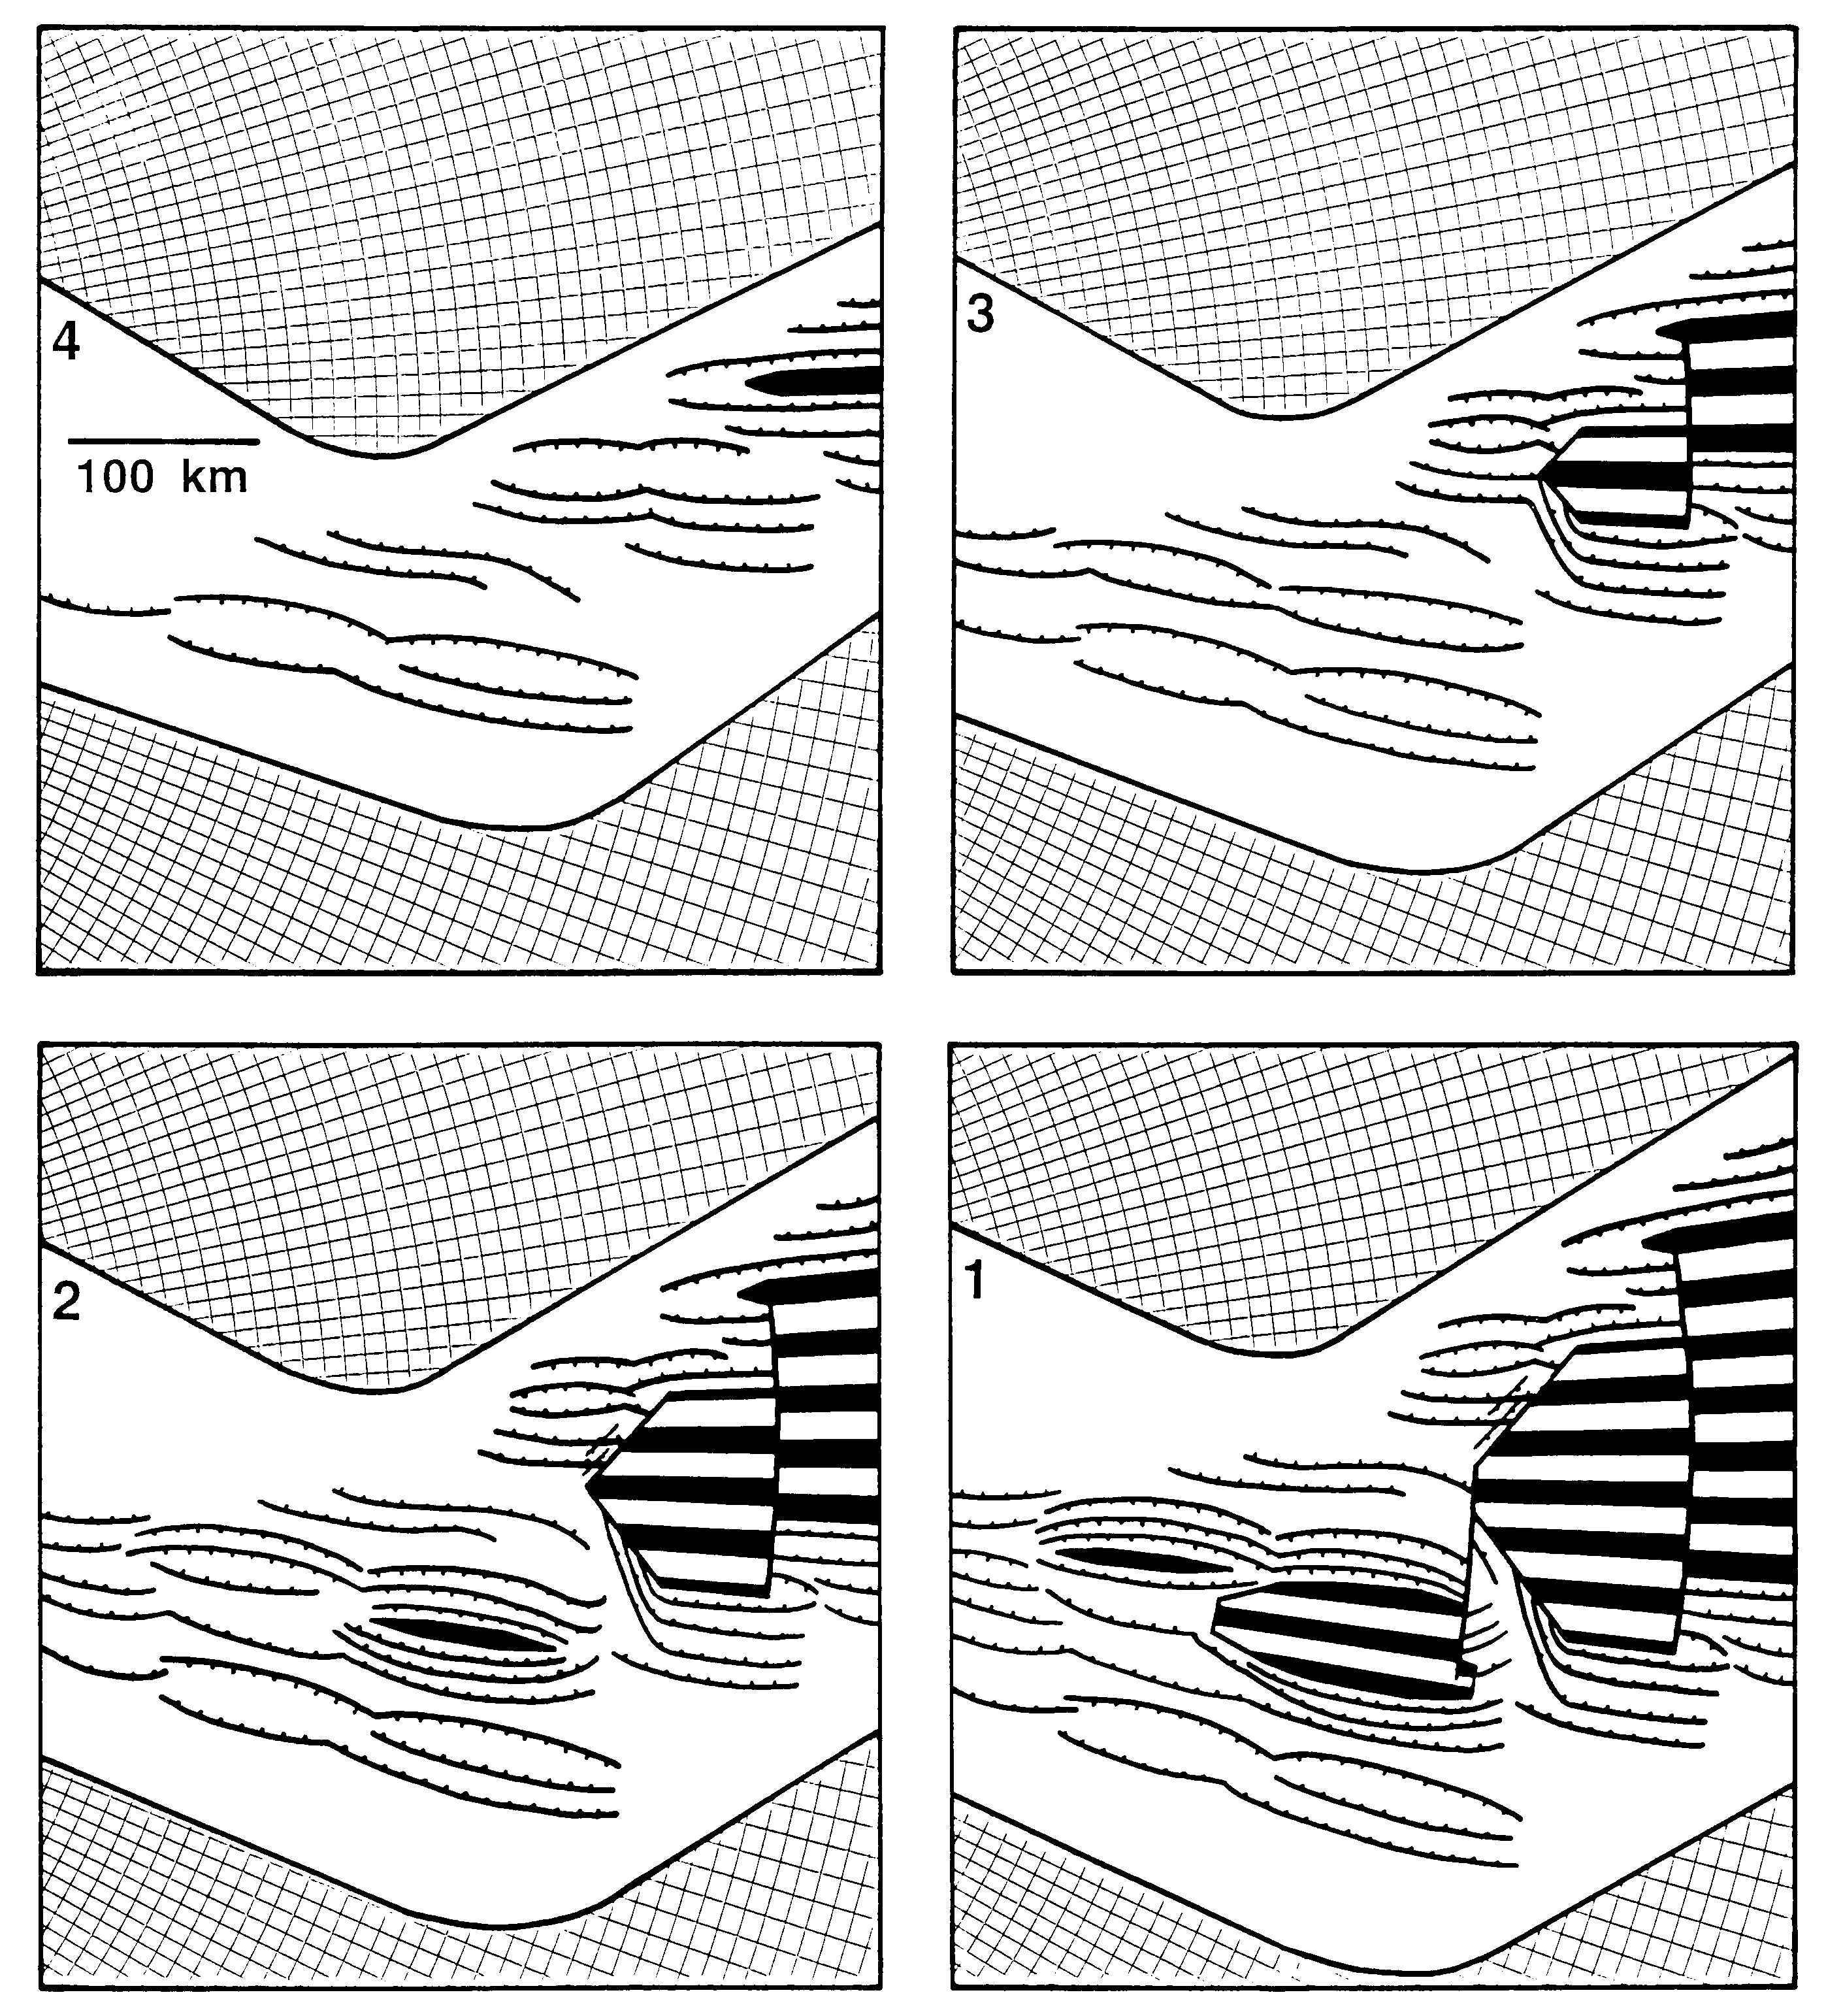
Four time steps: 4 Ma to 1 Ma. Breakup proceeds by successive phases of
• rifting localization,
• spreading center nucleation,
• spreading center propagation (and stalling),
• jump across an offset to the next site of localized rifting.
Accommodation zones focus spreading nucleation to the centers of late-stage rift basins where normal faulting and crustal thinning have been maximised.
Early propagation of nucleated spreading segments and subsequent transform development across nontransform spreading centers typically removes any correlation between segmentation of the rifted margins and of the spreading centers.
Taylor et al., JGR, 1999
Woodlark Basin (Papua New Guinea)

Slide 19
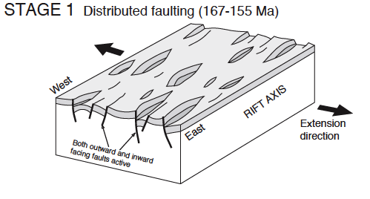
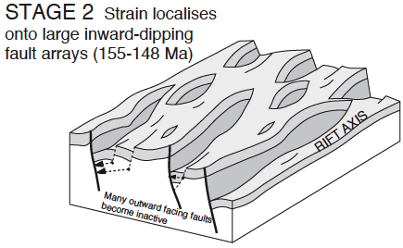
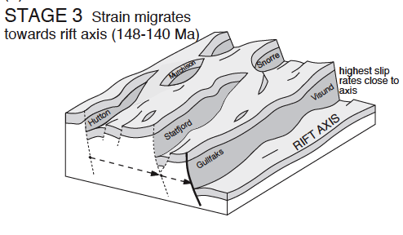
• rifting localization,
cf. North Sea (East Shetland Basin)
Low slip rate, many inward and outward-facing faults
Half-grabens form inward-dipping arrays with increasing slip rate
Rift axis clearly defined with high slip rate; lower slip rates persist on margins
Notice numerous rifts destined to fail
Cowie et al., EPSL, 2005

Slide 20
• rifting localization,
• spreading center nucleation,
Late-stage rifting focused extension into rift basins delimited along-strike by acommodation zones
Volcanoes locally extruded magmas;
upwelling asthenosphere fed magmas into thinning continental lithosphere.
Magmatism nucleated a spreading center that propagated rapidly (500 mm/yr) to both ends of the basin, producing subparallel rift and seafloor fabrics
Taylor et al., JGR, 1999
Woodlark Basin (Papua New Guinea)

Slide 21
• rifting localization,
• spreading center nucleation,
• spreading center propagation (and stalling),
• jump across an offset to the next site of localized rifting.
Segment 3 propagates west into lithosphere that has its main rifting locus further south, forming a COB discordant to the oceanic isochrons and continental margin structures
Segment 4 nucleates on the main rifting locus further south, offset by a transform from segment 3, and rapidly propagates west
Taylor et al., JGR, 1999
Woodlark Basin (Papua New Guinea)

Slide 22
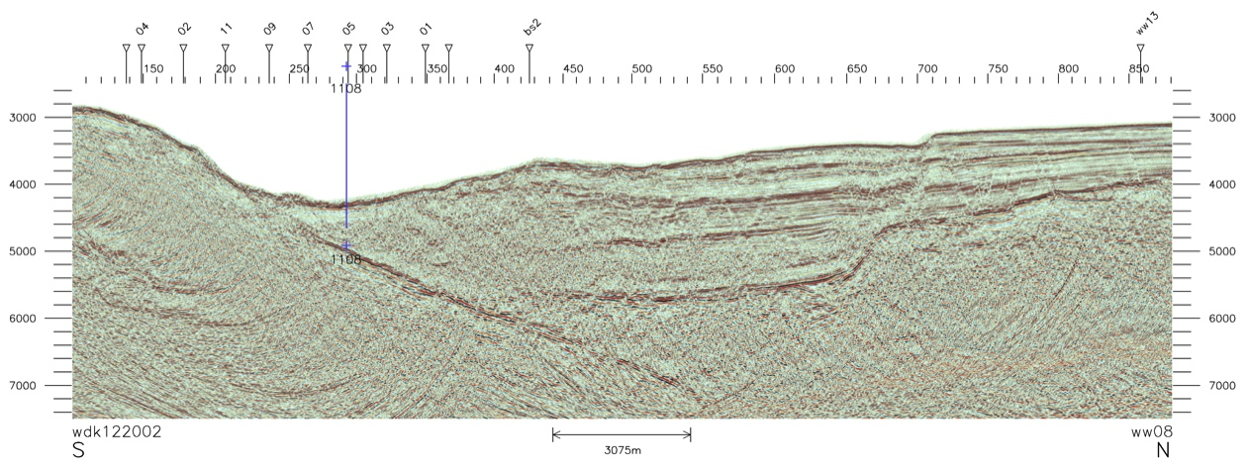
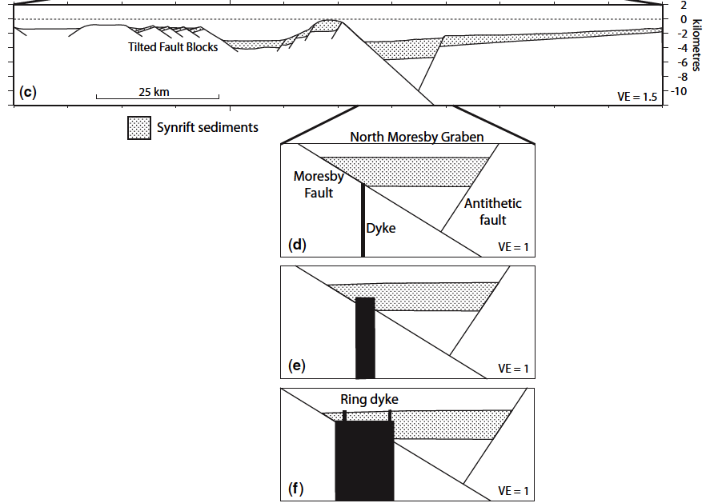
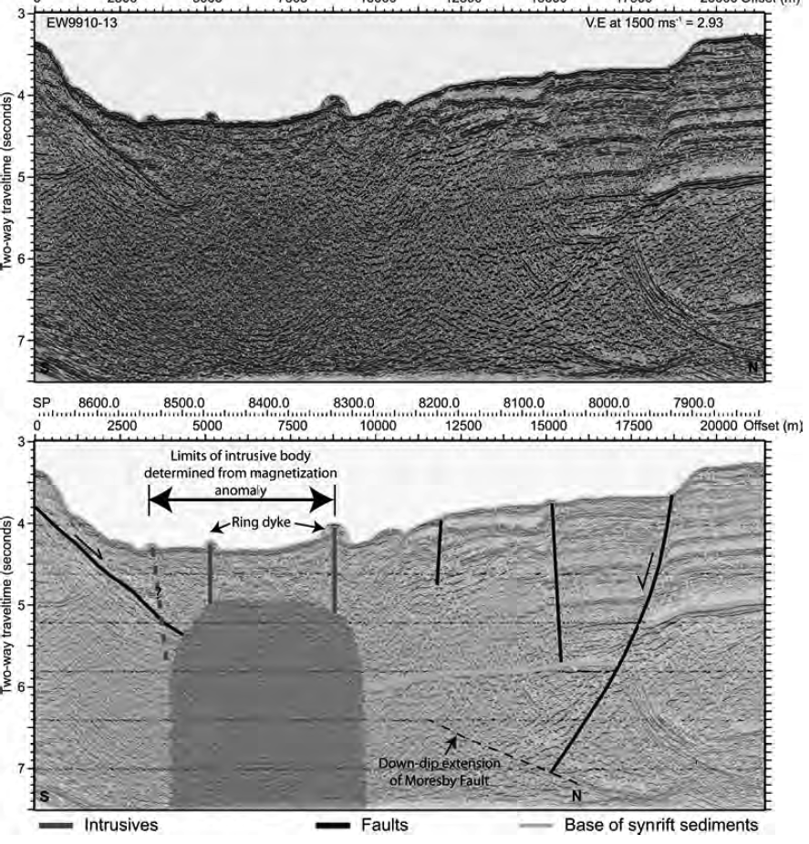
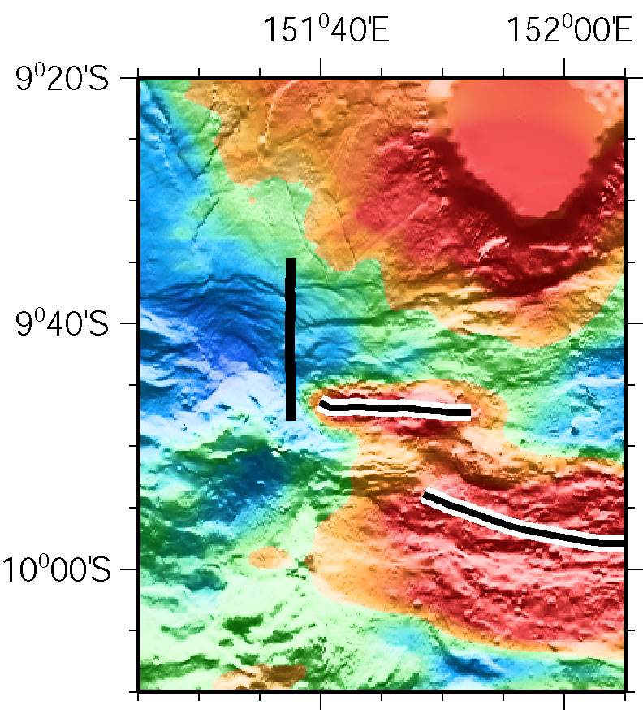
Moresby fault dips 33°
(Goodliffe & Taylor, GSL Spec. Pub., 2007
EW9510: MCS ahead of the Spreading Tip

Slide 23
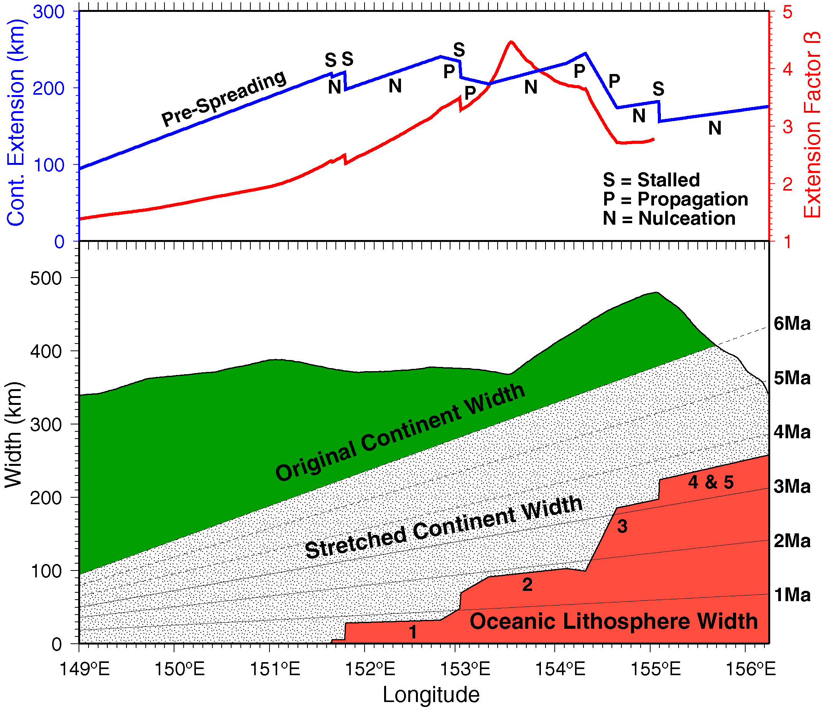
Break-up at β=2–4, & 200±40 km stretching
Spreading or stretching >6Ma now subducted
Whole Basin Strain Analysis
Onset of spreading at 3.6 Ma, propagates westward at 140mm/yr
Goodliffe 2005 pers. comm.

Slide 24
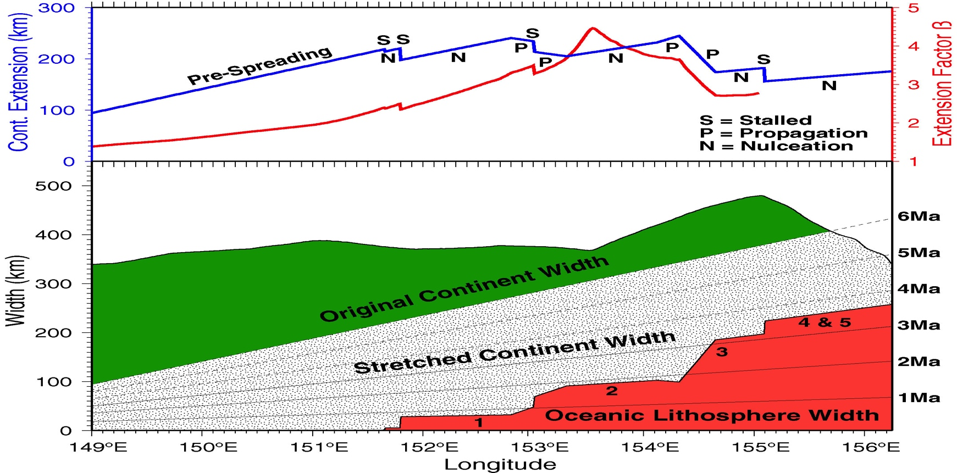

Whole Basin Strain Analysis
Goodliffe 2005 pers. comm.

Slide 25
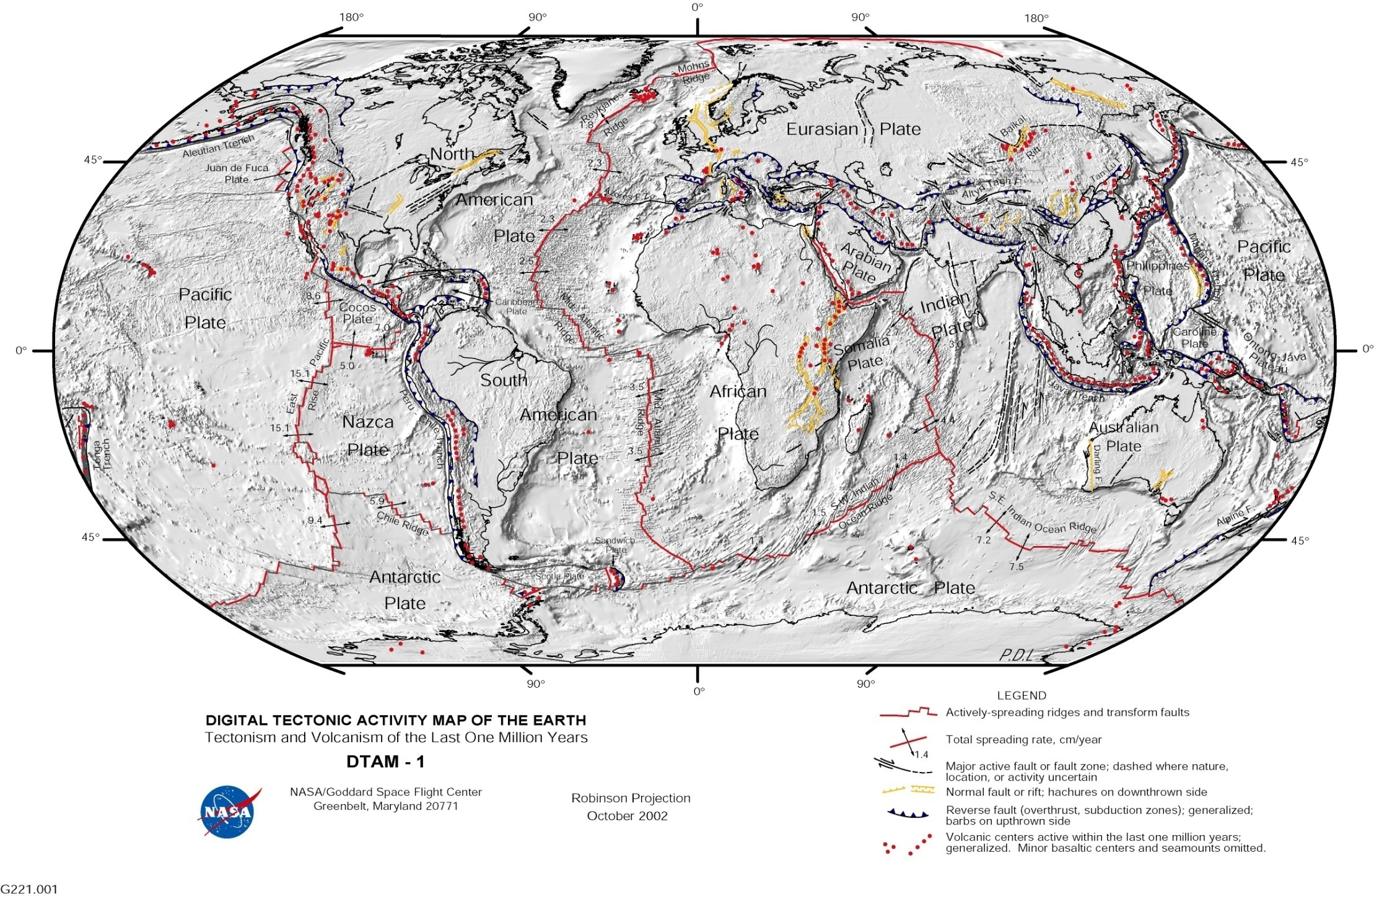
Mid-Ocean Ridge System: Fast, Int., Slow, Ultra-slow
40,000 km of ridges – about 20 km³ of new ocean crust is formed each year by global mid-ocean-ridge system

Slide 26
Ridge classification - plate spreading rate vs global ridge length
ULTRA-SLOW
(<2cm/yr)
(full spreading rates)
INTERMEDIATE
(5-8 cm/yr)
8
(from Dick, pers.comm)

Slide 27
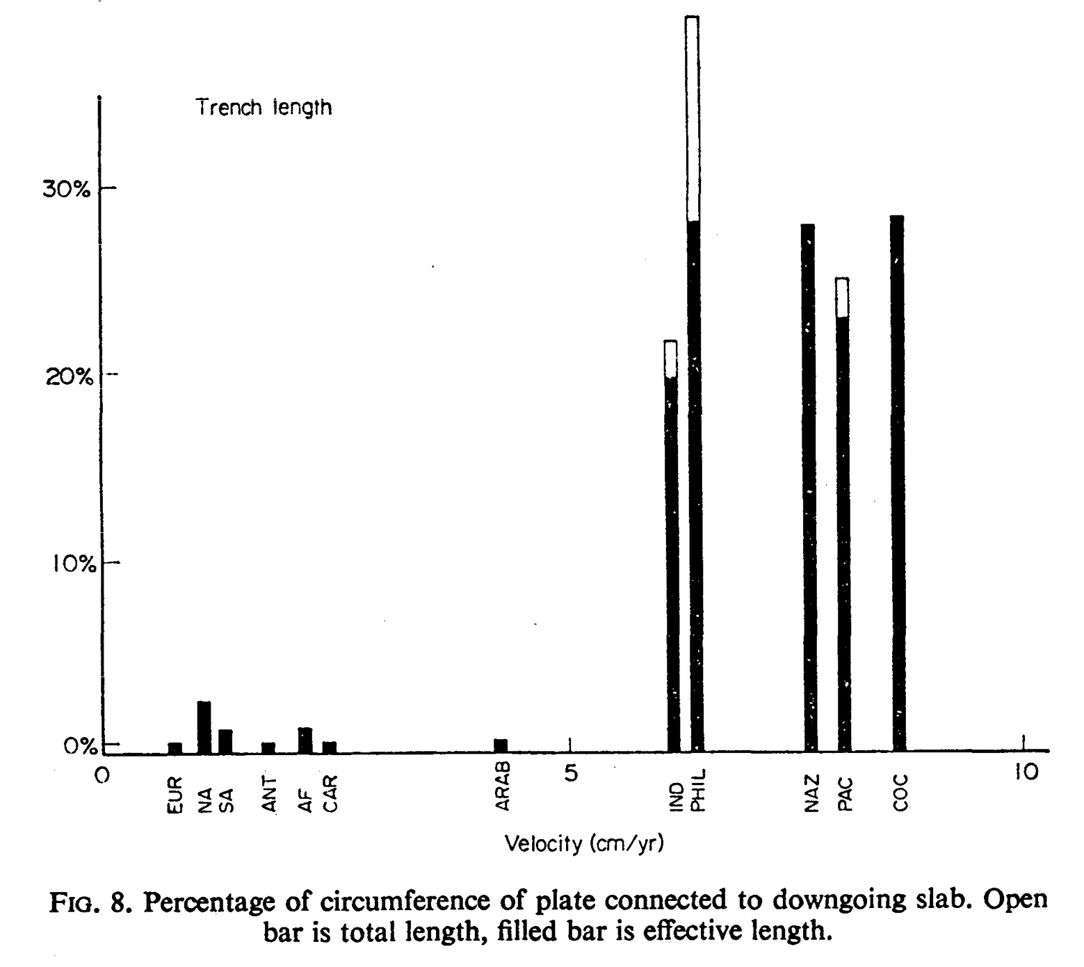
First-order control on spreading rate: % of plate margin that is convergent margin
Slow-spreading ridges bound plates with no subduction zones

Slide 28
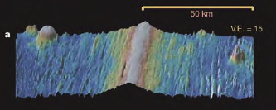
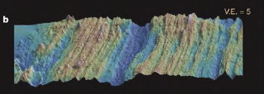

Fast,
Low-relief (15x v.e.)
Axial rise
EPR
Intermediate,
High-relief,
Axial valley,
SEIR
Slow,
Extreme relief,
Axial valley,
Long-lived transforms,
MAR
Buck et al., Nature, 2005

Slide 29



Ridge segmentation and discontinuities related to melt supply
Axial profiles
Flow-line profiles

Slide 30




Spreading rate defines magmatic supply
presumably morphology also relates to supply:
Flow-line profiles Axial profiles: discontinuities occur at depth maxima

Slide 31

Slow-spreading ridges can have “inflated” ridge morphology if they are near a mantle plume (e.g., Reykjanes Ridge near Iceland)

Slide 32




Slide 33

Extension purely magmatic
Extension by faulting & magmatism: conductive cooling creates cold lid

Slide 34






East Pacific Rise: magma chambers, low velocities, melt interpretations
(Dunn & Forsyth, JGR, 2003)
(Dunn & Toomey, Nature, 1997)
(McKenzie & Bickle, J. Petrol., 1988)

Slide 36
Spring Quarter 2013
Tectonics Field Trip
Geophysics 171
Almost certainly:
• 4-day field trip over Memorial Day
weekend (skip Friday classes)
(some camping, some cabins)
• Sierra Nevada/Basin-Range transition:
- recent volcanic features, 2 Ma b.p. to 1600 A.D.
- active normal and transtensional faulting
- Yosemite batholith
• co-led by Leif Karlstrom
• Tectonics, not “geology” – hammer, hand-lens & Brunton optional
• one class meeting per week (nominally Monday 2:15, open to negotiation, to introduce regional and local tectonics, S/NC, 1-3 units
• Outcrops chosen based on student interest – planning meeting this Thursday 14:30
– the sooner you sign up, the sooner you get to vote!

