Slide 1
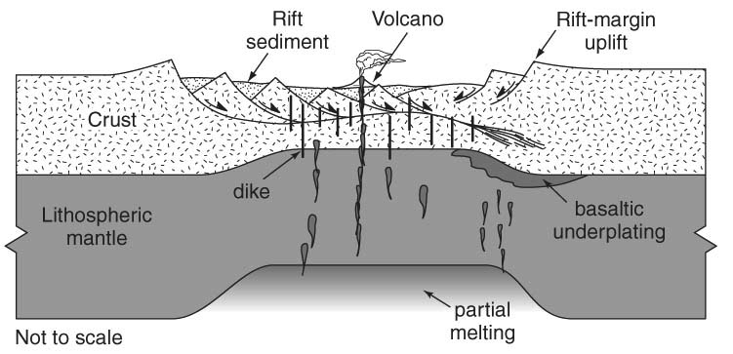
Lecture 16 February 28, 2013
Continental
Extension
Topics:
• Progression from rifting to passive
margin to ocean spreading
• Active vs. passive rifting • Uniform vs. depth-dependent rifting
• Pure shear vs. simple shear mechanisms • Narrow vs. broad rifts; Core complexes
• Magmatism in rifting
Reading:
Buck.Extension.EncycGeophys.2007.pdf Cloetingh.Rifting.EncycGeophys.2007.pdf
KeranenKlemperer.EAGLE.GeologyALL.2004.pdf
KeranenKlemperer.DiscontinuousDiachronousMER.EPSL.2008.pdf
KeranenKlemperer.hotbroadMER.G3.2009.pdf

Slide 2
Why Are Rifts Important?
Rifts are the manifestation of lithospheric scale extension and ultimately the break-up of continents (a fundamental part of the Wilson Cycle)
Rifts preserve the rock record in their basins and produce long-lived flaws in the crust that are often reactivated
Modern rifts are often a major source of geothermal energy (also modest volcanic and earthquake hazards)
Rift basins contain water and petroleum resources
Post-rift subsidence also forms basins containing significant resources (i.e., the North Sea, Anadarko Basin)

Slide 3
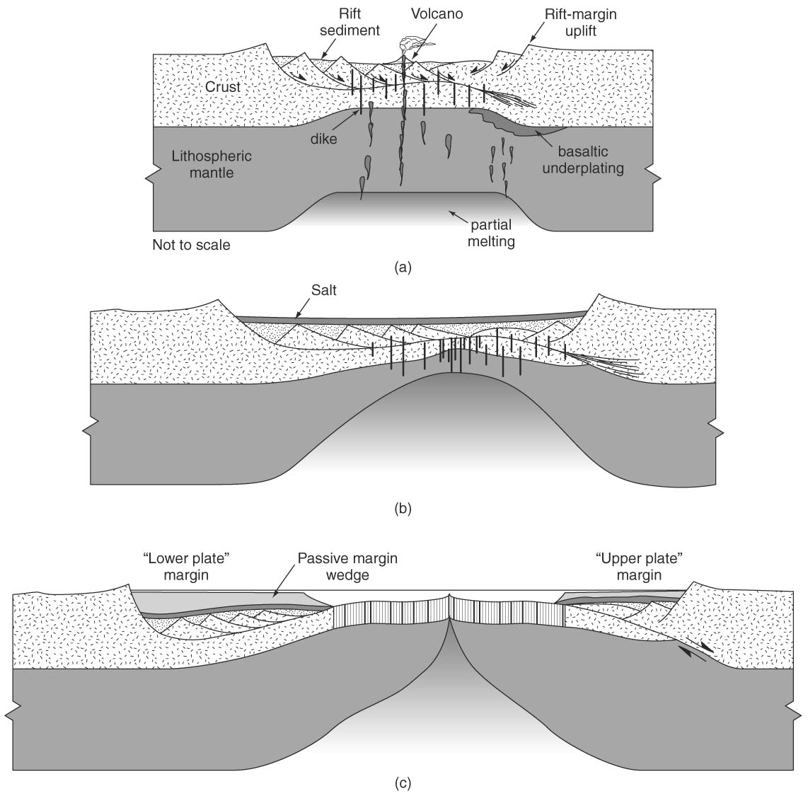
Rifting: non-marine flood
basalt and intrusions; terrestrial sediments fill basin (redbeds)
Rift-Drift Transition: begin sea-floor spreading; shallow narrow sea and evaporites
After 20-100 Myr:
Drift: formation of
passive-margin basin;
marine carbonates and
terrestrial sediments cover rift-drift sediments

Slide 4
Rifting is NOT Spreading:
Rifting involves stretching of pre-existing crust and mantle lithosphere
Spreading creates new oceanic crust, rifting does not
Continental crust rifts, oceanic crust spreads
Continental rifting ultimately may lead to seafloor spreading. This also produces a passive margin
Aulacogens are “failed rifts” at high-angle to passive margins (successful rifts)

Slide 5
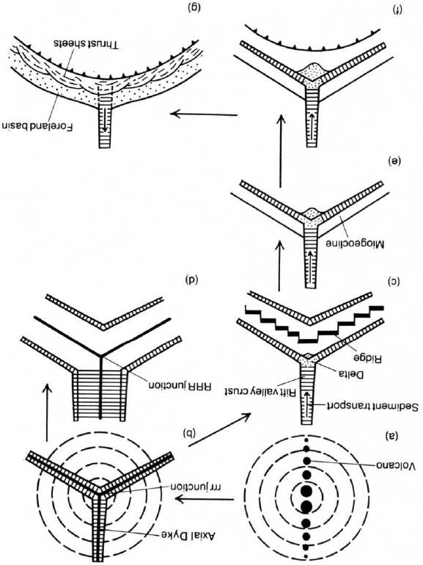
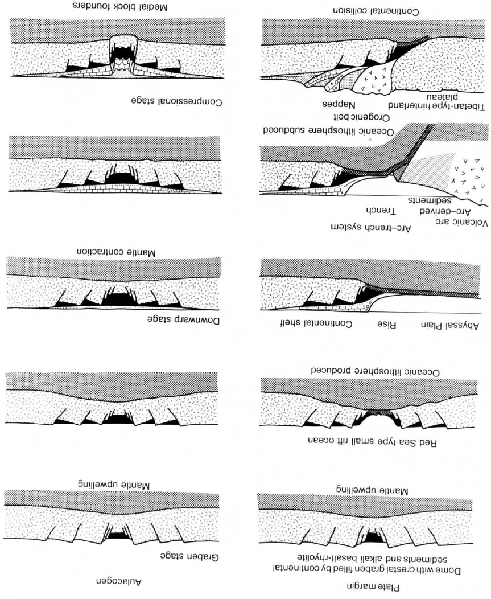
Wilson Cycle for successful rifts and aulacogens
Burke, 1976;
Kearey & Vine, 2nd ed.
Burke & Dewey, 1974; Kearey & Vine, 2nd ed.

Slide 6
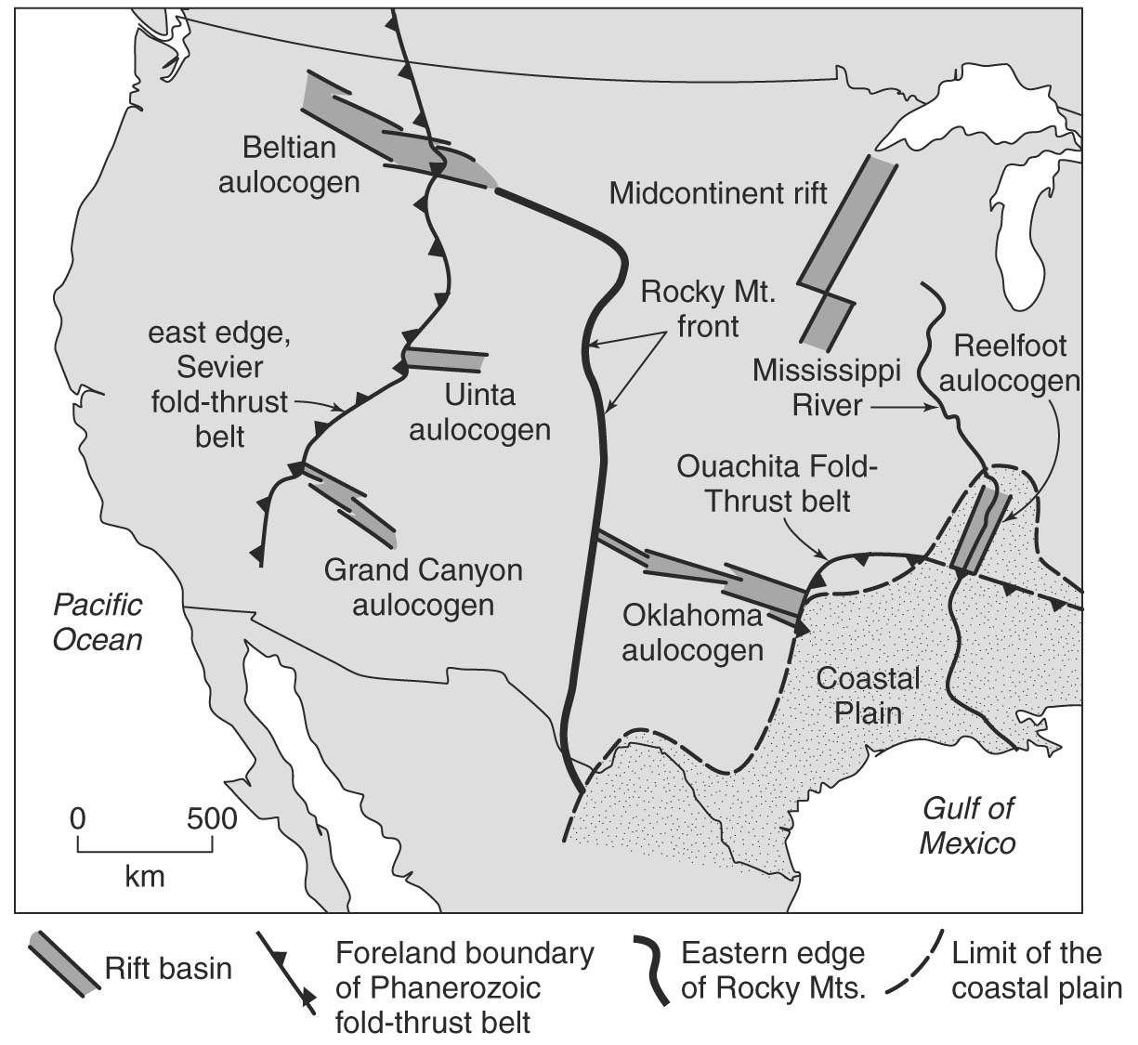
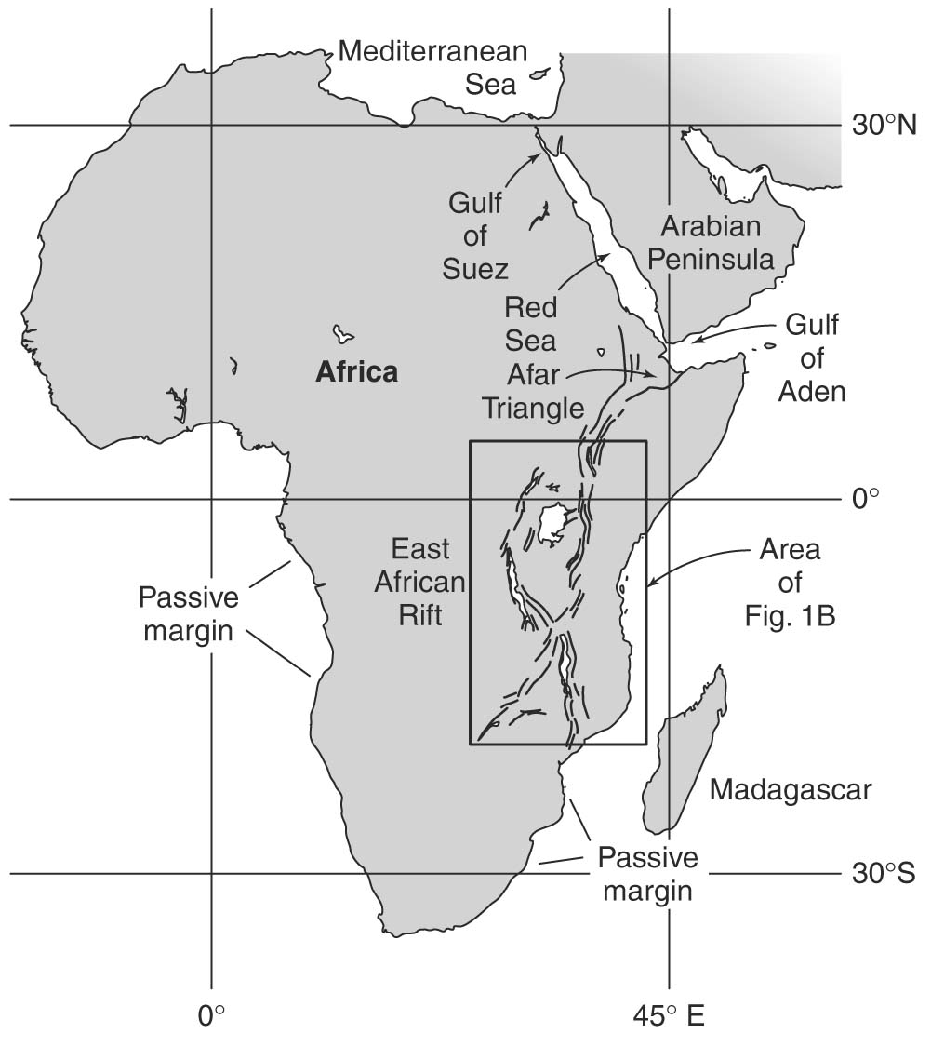
Aulacogens stranded by ocean spreading:
East African Rift: future spreading center?
Or future aulacogen?

Slide 7
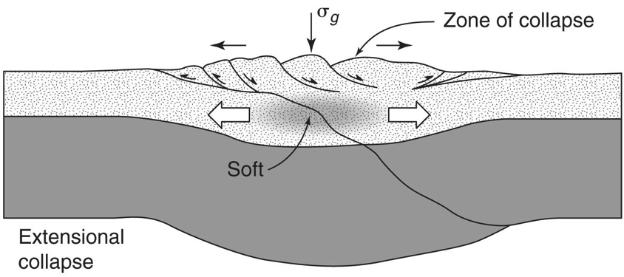
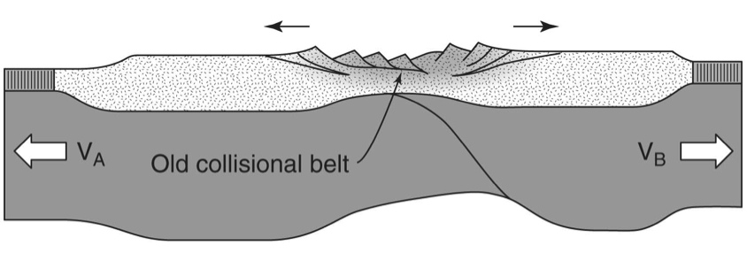
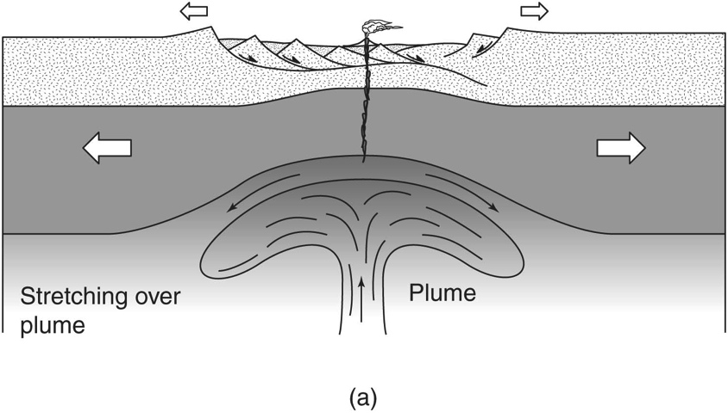
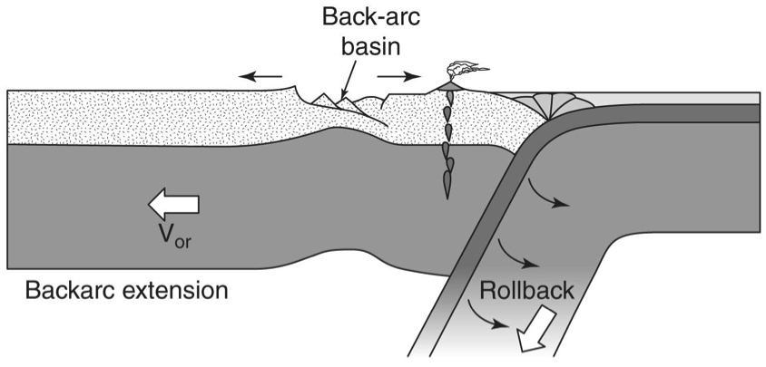
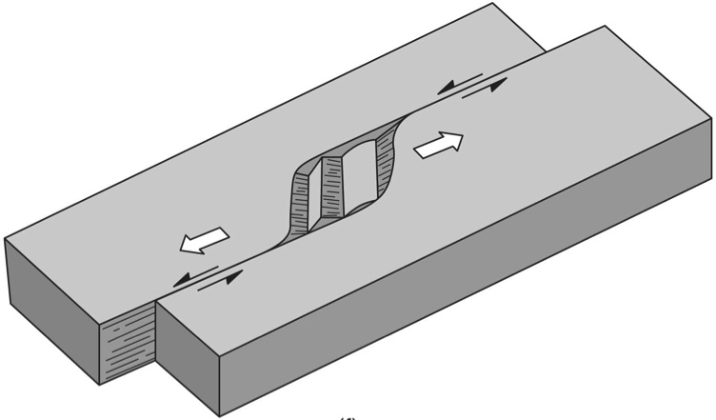
What causes rifts?
Active … Passive
Far-field stress
Mantle upwelling and divergence
Far-field stress
Back-arc basin
Pull-apart basin

Slide 8
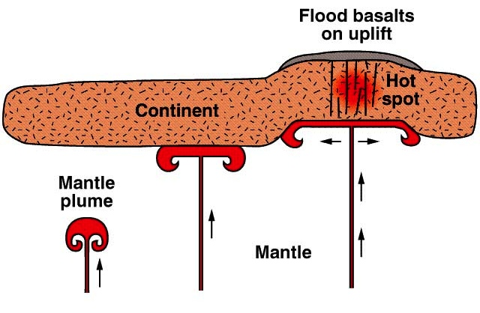
Active rifting
Caused by mantle upwelling and basal tractions on lithosphere
Doming, volcanism (flood basalts) and erosion precede rifting
Plume may thermally weaken lithosphere, making it more susceptible to extension

Slide 9
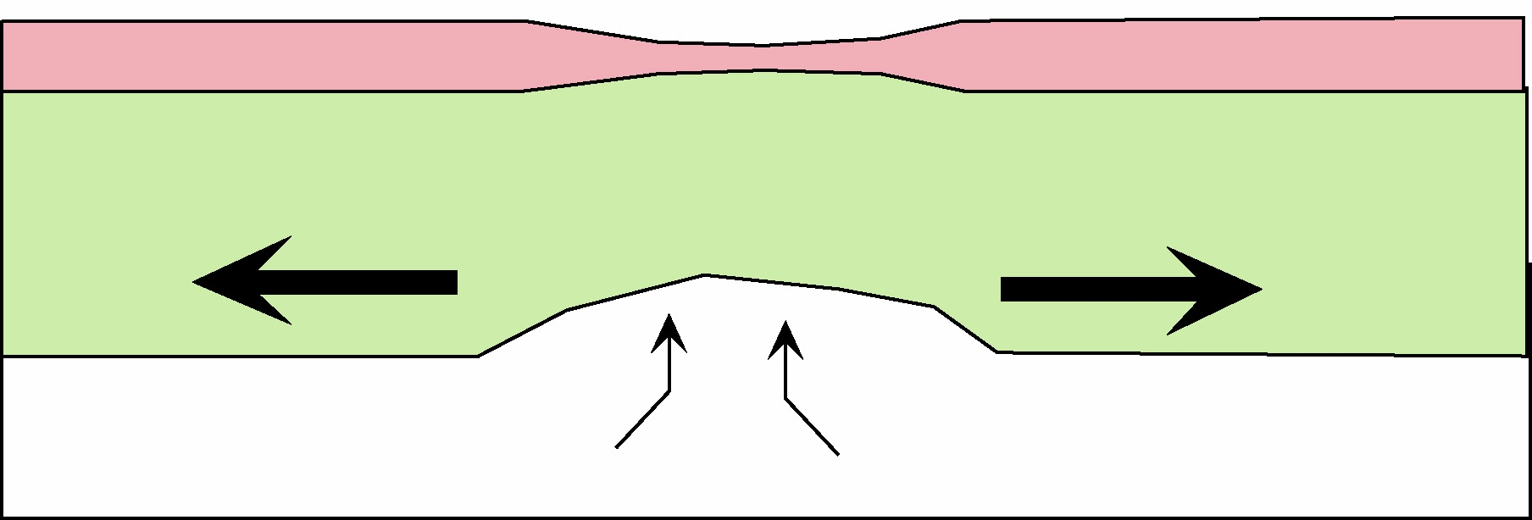
Passive rifting
Caused by plate stretching in response to far-field stresses and basal tractions on lithosphere
Subsidence, but no volcanism or erosion prior to rifting
Stretching increases geotherm and potentially produces magmatism after onset of rifting

Slide 10
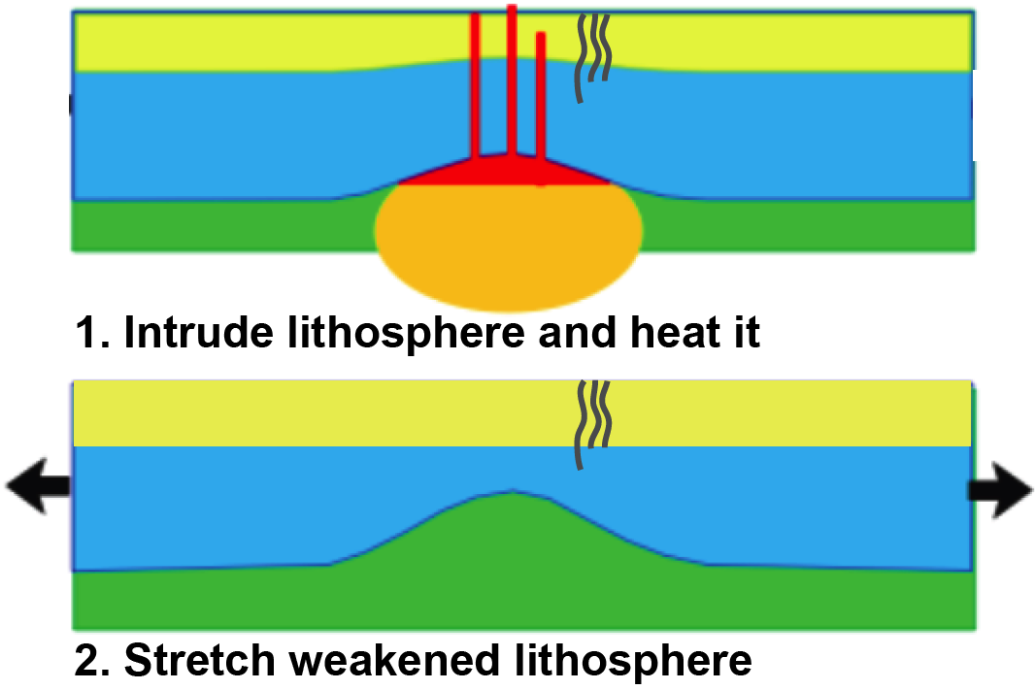
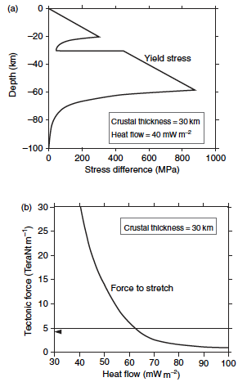
Active vs. Passive rifting may be a false dichotomy
Ethiopia example: Heating weakens the crust:
30 Ma:
Afar plume head arrives
Active upwelling without rifting
≈ 20 Ma:
Passive regional rifting of thermally-reactivated craton in response to far-field stresses

Slide 11
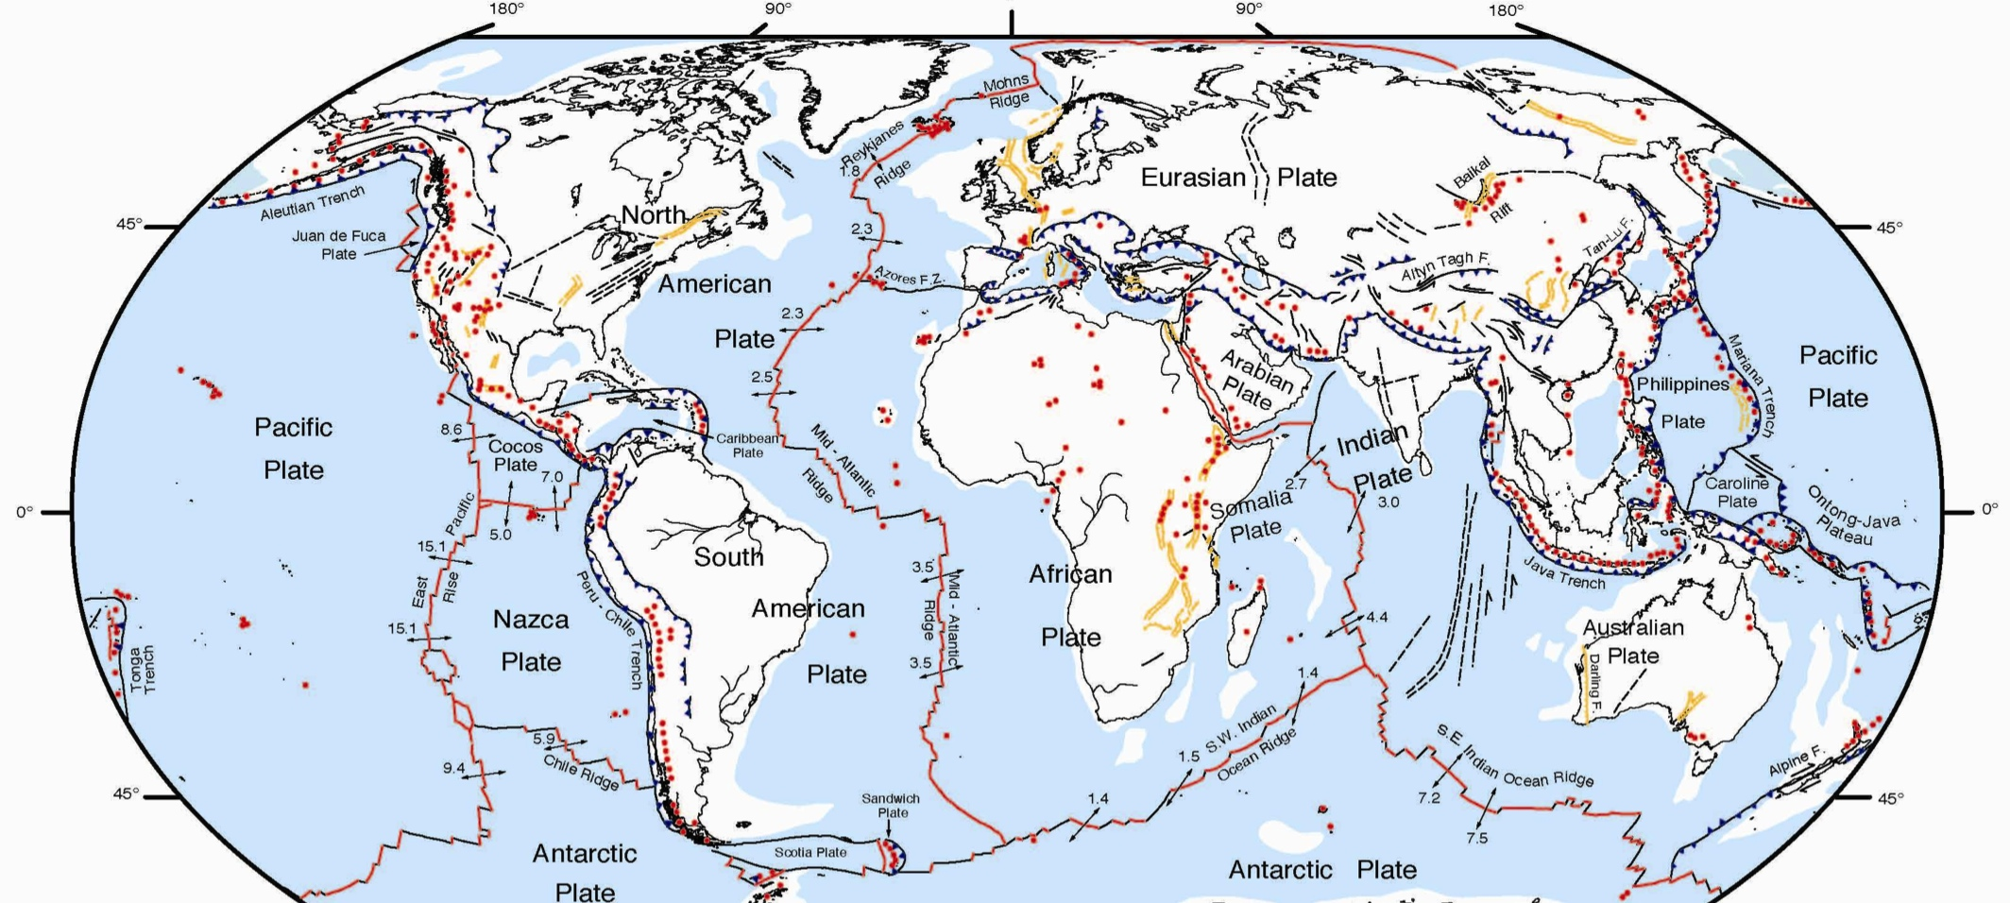
Active intra-continental rifts
Ethiopia/Afar - The classic triple junction of 3 rifts
Baikal and Western Rift of EAR - Major continental rifts with little magmatism; controlled by old sutures
Rio Grande Rift - A major continental rift zone occurring in a area with considerable pre-rift tectonism, cuts across Precambrian trends; minor young basaltic magmatism
NASA
Notes:
You don’t need me to tell you that rift processes are important to society at large.
By studying modern, active analogues, we can learn about the basins that host our natural resources.
Basin & Range, Salton Trough, Rio Grande rifts here at home,
Rhine Graben and Aegean province in Europe; Tibet, Baikal, Lena Delta in Asia; Woodlark & Taupo in Oceania
Today I’ll focus on East African rift

Slide 12
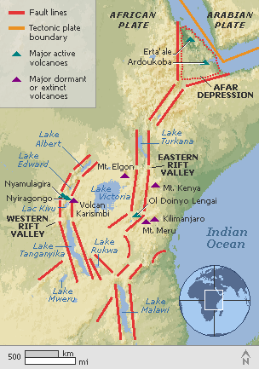
Active intra-continental rifts
Kenya Rift - The classic continental rift valley with considerable magmatism and young axial volcanoes
Basin and Range - A wide, highly-extended region with a rather constant crustal thickness even though extension locally varies by a factor of at least two, suggesting large magmatic input to lower crust
Notes:
You don’t need me to tell you that rift processes are important to society at large.
By studying modern, active analogues, we can learn about the basins that host our natural resources.
Basin & Range, Salton Trough, Rio Grande rifts here at home,
Rhine Graben and Aegean province in Europe; Tibet, Baikal, Lena Delta in Asia; Woodlark & Taupo in Oceania
Today I’ll focus on East African rift

Slide 13
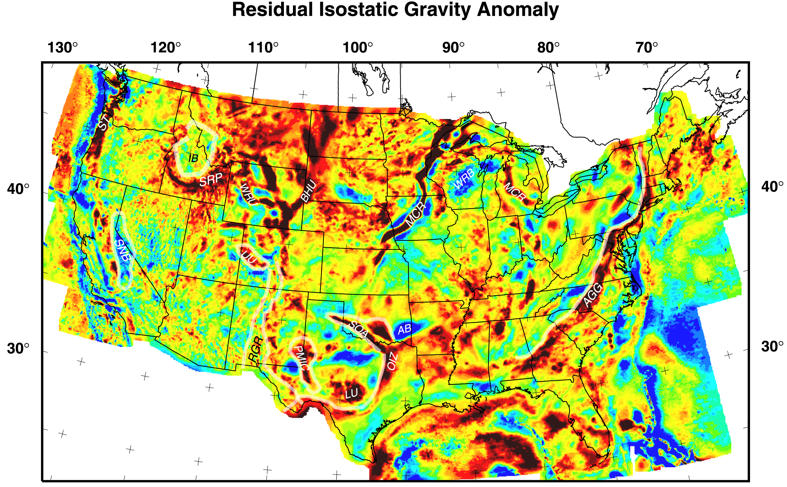
And paleorifts
Paleo-Rifts
Mid-Continent Rift
Southern Oklahoma Aulacogen
Southern Oklahoma Aulacogen - massive intrusion of the upper crust, formation of a major post-rift basin, strong inversion
Mid-Continent Rift - massive magmatism in the upper crust in which the pre-existing crust has been largely destroyed

Slide 14
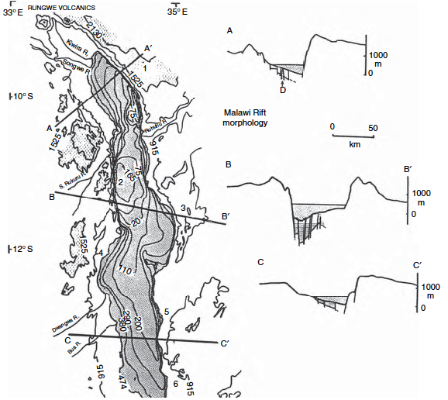
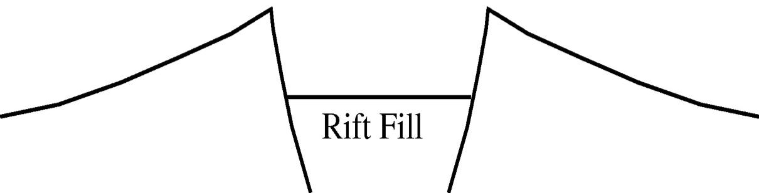
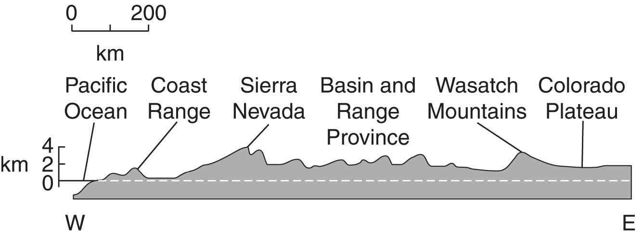
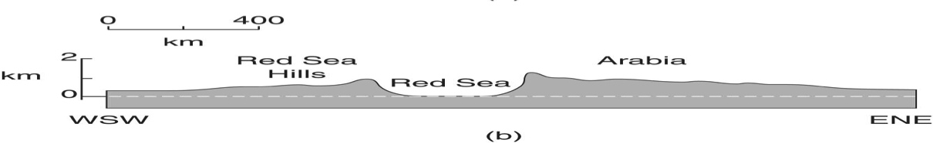
Morphological expression of rifts
- across a single graben; or across an entire province
Rift-flank uplift Flank uplift
Rift Valley

Slide 15
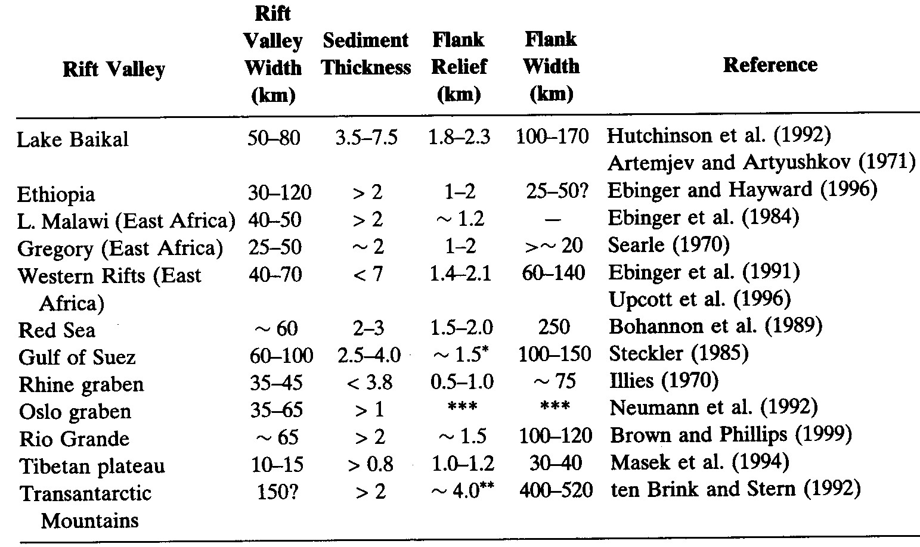
Continental Rifts vary in dimension (Watts 2001)
Rift valley width ~40km Sediment thickness ~3km
Rift flank relief ~1.5km Rift flank width ~100km

Slide 16
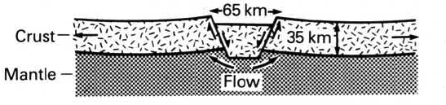
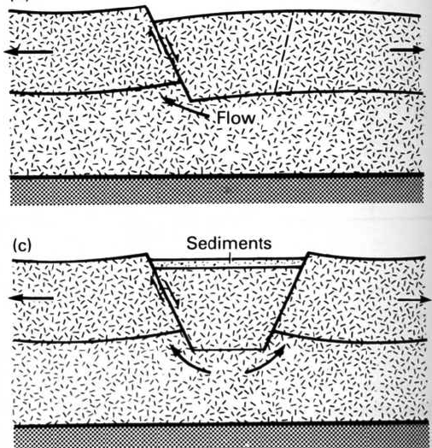
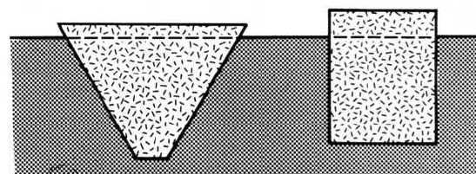
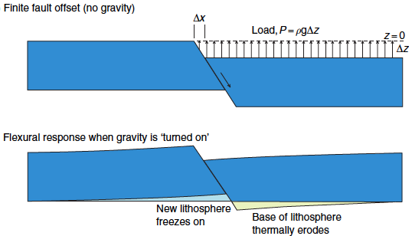
Heiskanen & Vening-Meinesz, 1958 Bott, 1981
Andersonian faulting creates a block that isostatically subsides into the mantle (Vening-Meinesz) or lower crust (Bott).
Unloading of the footwall causes elastic flexural uplift

Slide 17
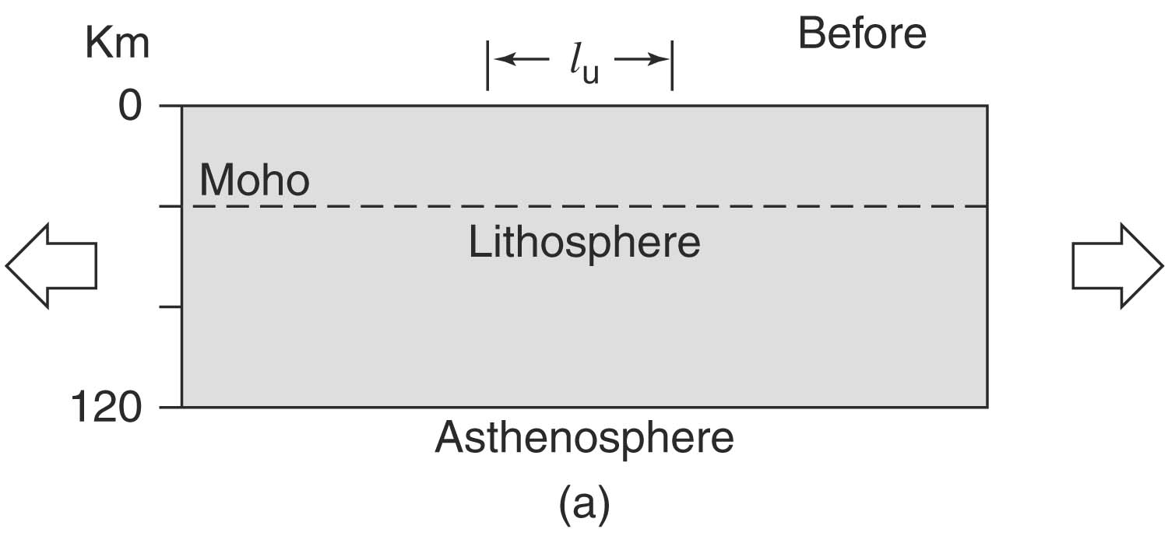
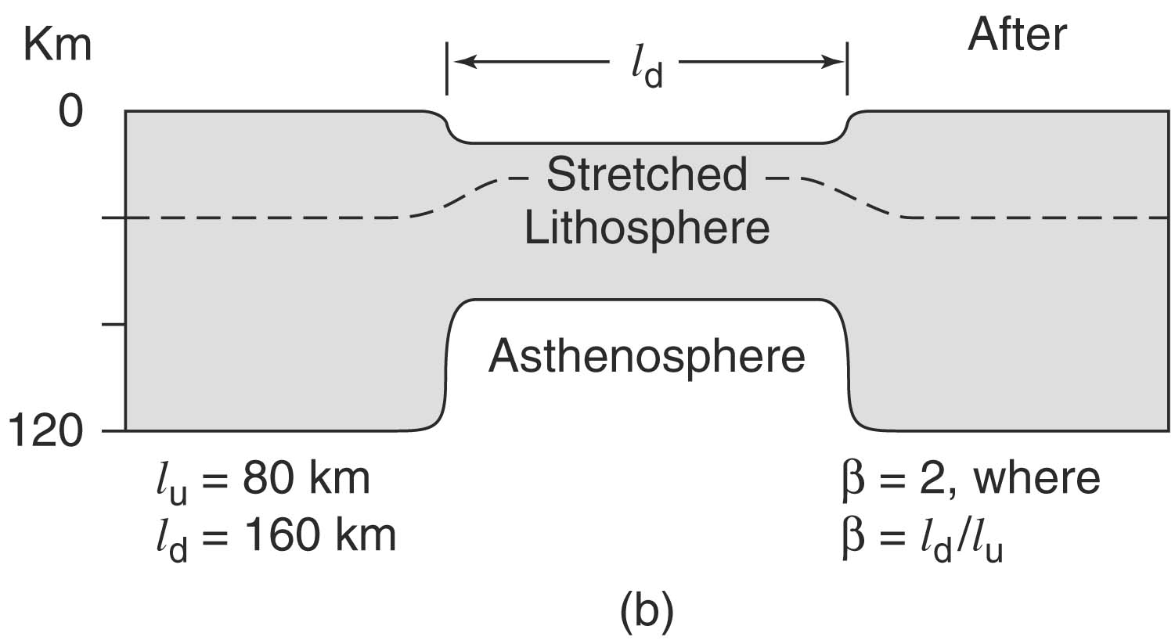
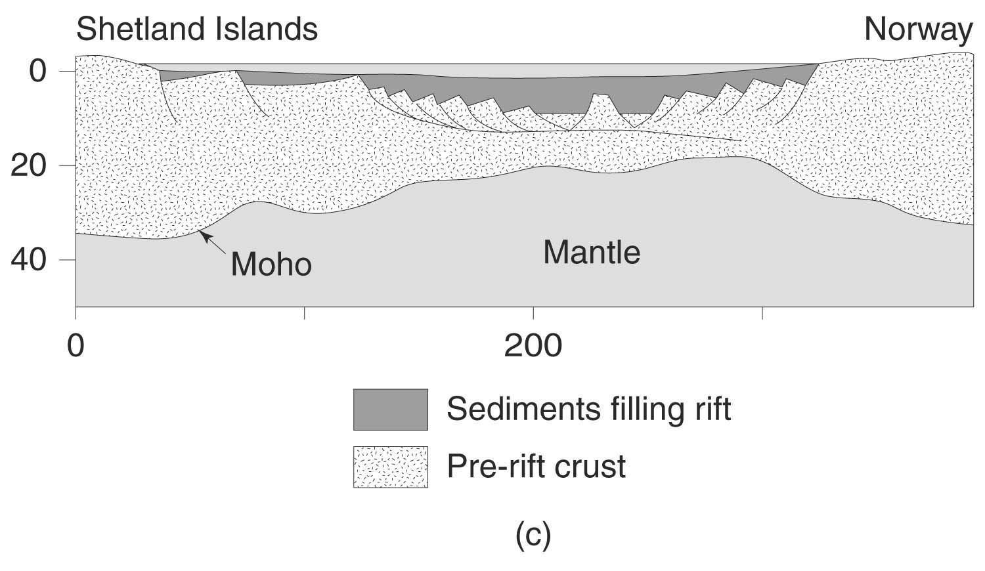
“Uniform”
or
“Pure shear” stretching of the whole lithosphere

Slide 18
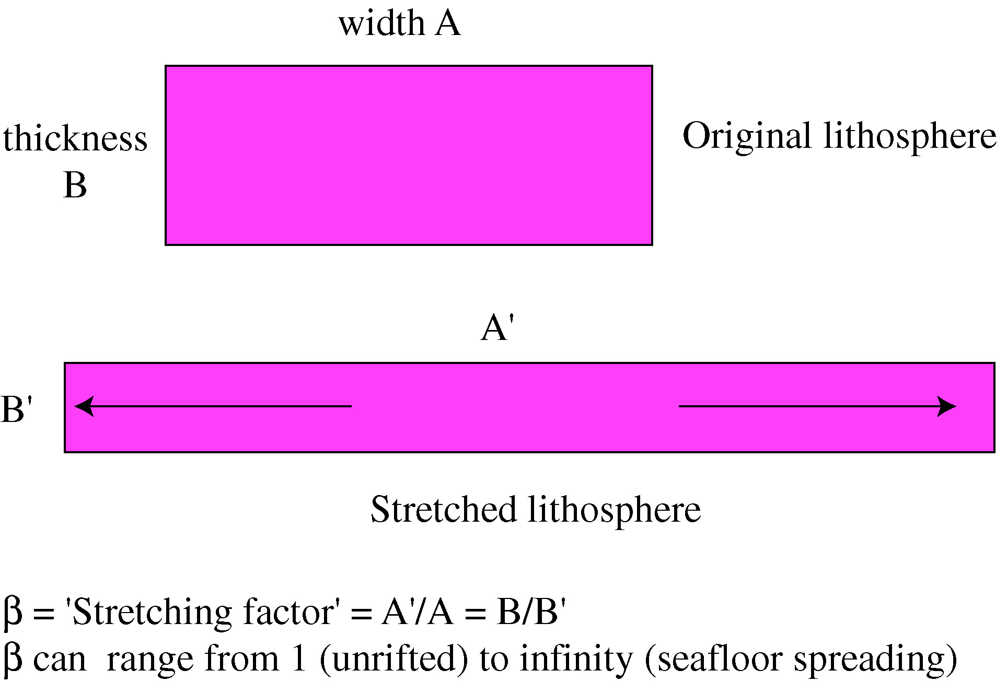
Definition of Stretching Factor ‘β’
For most rifts β ~ 1.2-2.0

Slide 19
Why do rifts subside?
Subsidence is caused by rapid stretching (=> initial, “tectonic” subsidence) followed by slow cooling (=> “thermal” subsidence).
“tectonic” subsidence: stretching thins the crust and so increases the bulk density of the lithosphere causing it to subside isostatically (fault-controlled subsidence)
“thermal” subsidence: rifts continue to subside slowly as a result of cooling of initially uplifted isotherms (e.g. lithosphere-asthenosphere boundary)
Total subsidence = tectonic and thermal subsidence
These two effects give rift basins the characteristic “steer’s head” architecture.
McKenzie 1978 “Some Remarks on the Development of Sedimentary basins”

Slide 20
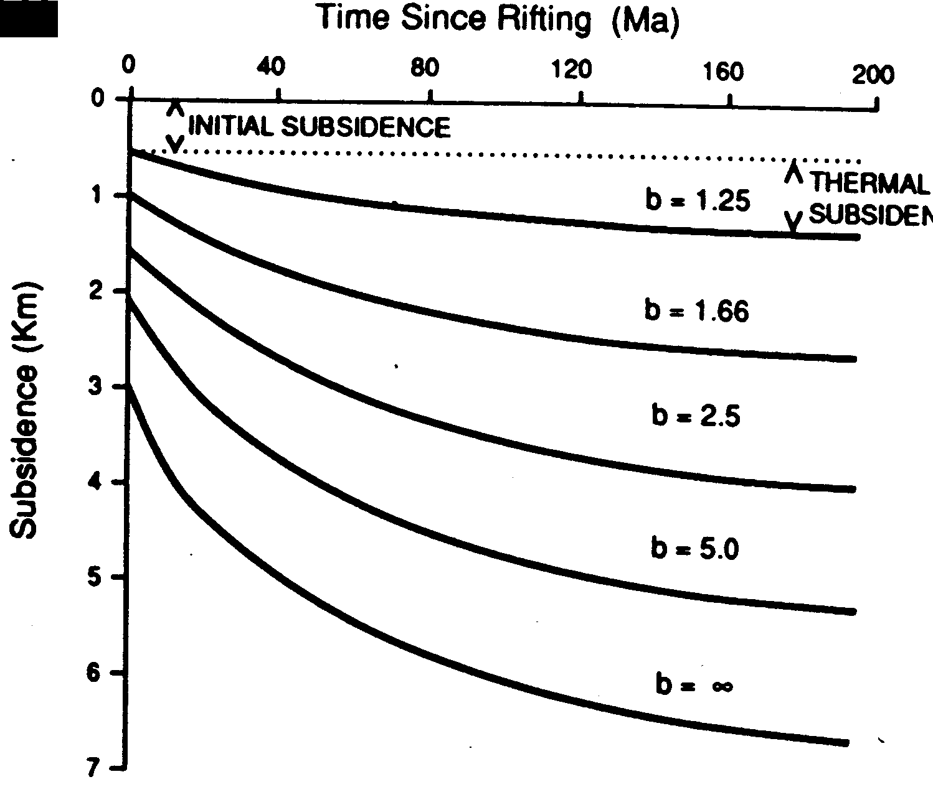
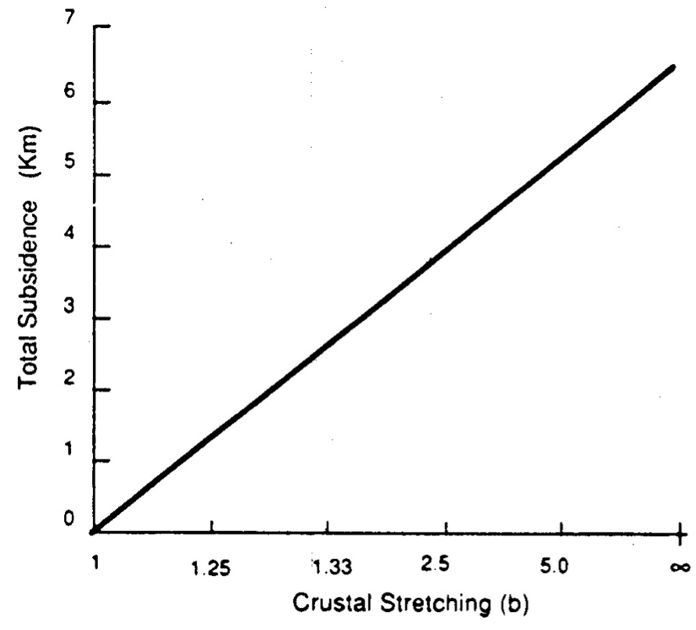
Subsidence due to instantaneous uniform extension

Slide 21
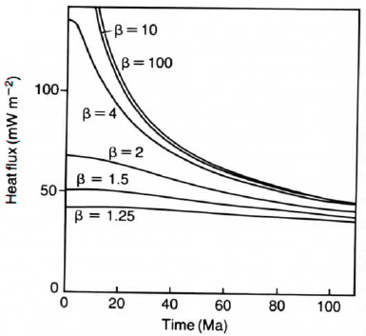
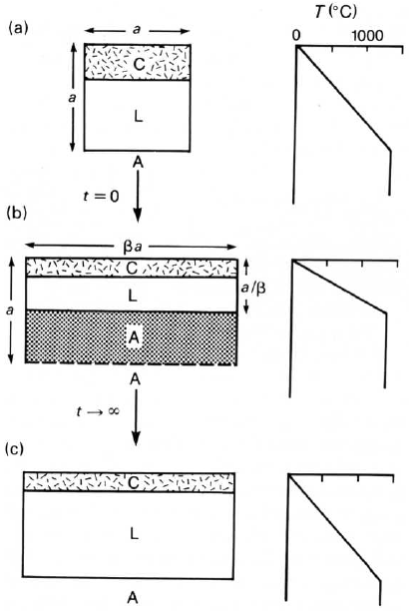
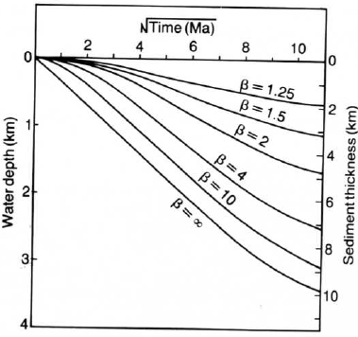
Thermal perturbation due to instantaneous uniform extension
Before rifting,
t ≤ 0
At rifting,
t = 0
After rifting, t = ∞

Slide 22
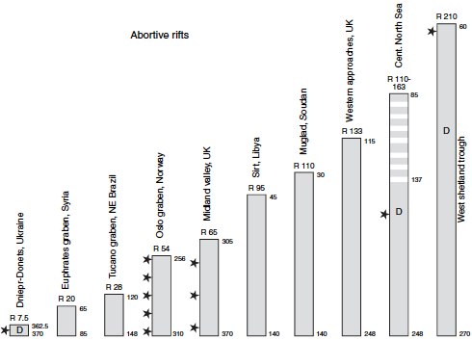
Extension is not instantaneous! spans 5 – 50 Myr

Slide 23
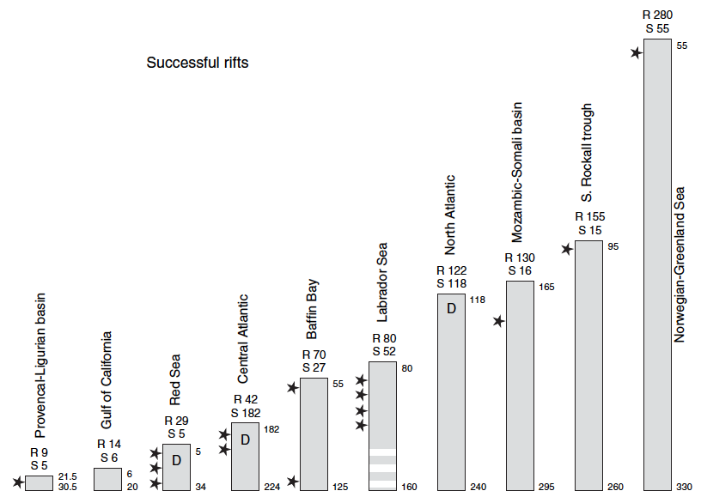
Extension is not instantaneous! spans 5 – 50 Myr
Whether rifts are abortive or successful doesn’t depend on duration of stretching
Whether rifts are abortive or successful doesn’t depend on duration of stretching –
depends on stretching rate

Slide 24
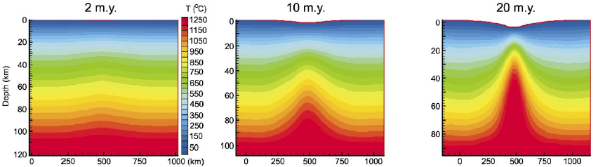
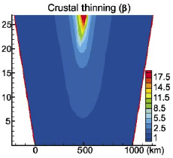
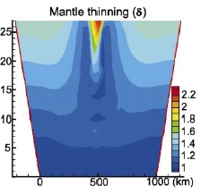
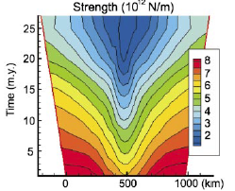
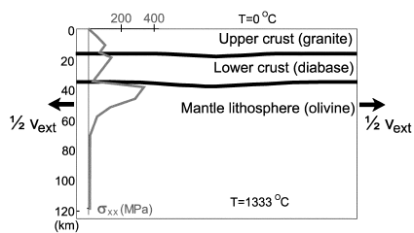
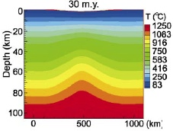
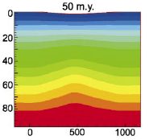
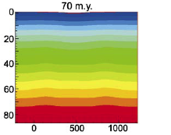
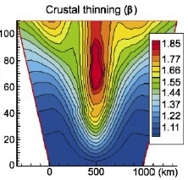
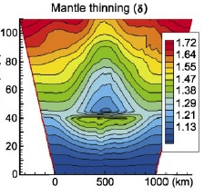
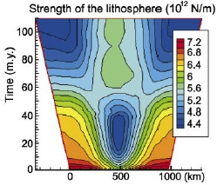
But spreading rate controls thermal behavior:
DEPTH
Fast, 16 mm/yr:
TIME
DEPTH
Slow, 6 mm/yr:
TIME
Van Wijk & Cloetingh, EPSL, 2002

Slide 25
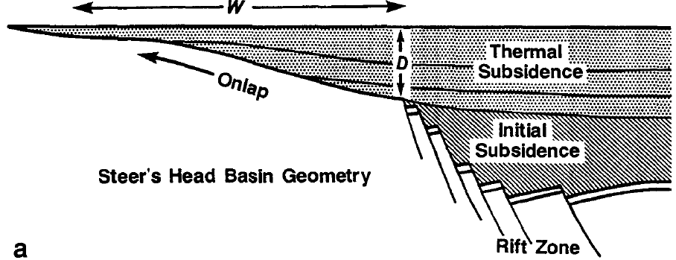

Tectonic + Thermal Subsidence = ‘Steer’s head basin’
Rift morphology and stretching distribution in space:
Model:
North Sea (Viking graben):

Slide 26

Tectonic + Thermal Subsidence = ‘Steer’s head basin’
‘Steer’s head’ explained by increasing elastic thickness/flexural rigidity due to lithospheric cooling after rifting
Tony Watts

Slide 27


‘Steer’s head’ explained by broader zone of rifting in the mantle than in the crust
‘Steer’s head’ explained by broader zone of rifting in the mantle than in the crust
Nicky White, Geology, 1988

Slide 28

Uniform vs. Depth-dependent extension
Uniform extension:
Crust & mantle lithosphere are stretched equally
Non-uniform extension: Crust and mantle are differentially stretched
Greater stretching of crust relative to mantle lithosphere will lead to greater subsidence.

Slide 29

Non-uniform extension
(β for crust is different than β for lithospheric mantle
Busby & Ingersoll, 1995)

Slide 30

High-angle faulting
Most rifts have high-angle faults at the surface.
What happens to them at depth?
Why might extension be non-uniform with depth?

Slide 31


Master (border), Antithetic & Synthetic faults
Busby & Ingersoll, 1995

Slide 32

Upper-crustal faults may be planar or listric:

Slide 33



Accommodation structures

Slide 34



Pure shear vs. Simple shear:
Extension in the lower crust is probably accommodated by subhorizontal ductile shear
In pure shear a cube is shortened in z direction and elongated in x and y directions. The sides of the cube remain parallel and perpendicular.
In simple shear a cube is converted into a rhomboid. The sides progressively lengthen but the top and bottom surfaces neither stretch nor shorten.

Slide 35

Symmetric:
“McKenzie”
“Pure shear”
Asymmetric:
“Wernicke”
“Simple shear”

Slide 36


Core complex extension:
Simple shear in mid-crust
Distribution and general regional tectonic setting of Cordilleran metamorphic core complexes (after Coney, 1980).
An MCC consists of a metamorphic basement ‘core’ and an unmetamorphosed cover; these are separated by a decollement with a mylonitic fabric.
MCCs form as a result of simple shear extension of very warm crust, and are sites of large extension with no local subsidence.

Slide 37


Evolution of a Core Complex

Slide 38


Rolling hinge model: An initially high-angle fault is progressively rotated to lower dips by isostatic uplift resulting from denudation

Slide 39

Can the low-angle detachment model be applied to great depth as
“whole lithosphere normal simple shear”?
(Wernicke, 1985)
Footwall
Hanging wall

Slide 40


Pure Shear rifts should be symmetric
Simple Shear rifts should be asymmetric
Buck et al., 1988

Slide 41




Symmetry of rift topographic profiles to distinguish pure shear from simple shear rifts
Eaton, 1987, GSL Spec Pub

Slide 42


Symmetry of rift flank uplifts
to distinguish pure shear from simple shear rifts

Slide 43


North Sea, Viking Graben:
Asymmetric or symmetric reflection patterns?
Asymmetric or symmetric subsidence patterns?
Klemperer, Tectonics, 1988
Klemperer & White, 1989, GAC Mem.

Slide 44



Rifts: the Third dimension
Rift evolution consists of forming half grabens with different asymmetries and linking them up as β increases.
vs.
Rifts propagate by linkage of discrete rift segments
not by progressive unzipping along the rift axis
Rift propagation (time axis)

Slide 45



Ideal half-graben
Linked opposing half-grabens
Differential shear taken up by strike-slip faulting along an ‘accommodation zone’

Slide 46




Rift Evolution
magma dominates
SPATIAL PROPAGATION
??
BREAK-UP
Main Ethiopian Rift
X
TRANSITION
faulting dominates
INITIATION
TEMPORAL DEVELOPMENT ??
Cindy Ebinger
Peter Maguire et al., unpublished grant proposal, 2000
Notes:
In a series of crustal scale seismic experiments, KRISP in the 90s, our own EAGLE work this decade, and German studies in the 70s, have been used to support a simple model of rift development, of initiation / transition / break-up

Slide 47


Modes of continental extension:
narrow East African Rift vs. broad Basin-&-Range province
Notes:
Since the time of Bullard and Vening Meinesz, EAR has become the archetypal narrow rift, dominant as such in textbooks, Localized seismicity
ETOPO1 datasets, at same scale on Google-globes - 1 minute topography

Slide 48


Does the Buck (1991) paradigm:hold true?
“Narrow rifts occur in cold/strong crust; Wide rifts in hot/weak crust”
Roger Buck 1991; Hopper & Buck, 1996
Notes:
Roger Buck in a classic paper has explained this first-order variation in rift style
as resulting from the thermal state of lithosphere;
He even used the East African Rift as one of his key data points

Slide 49
Localizing processes (strain weakening)
Buck 2007
Heat advection moves up the isotherms that marks the base of the lithosphere, thinning and weakening the lithosphere
Dyke intrusion requires magmatic pressure to equal the horizontal stress, so reduces the tectonic stress needed for rifting; and the thermal capacity of the magma further weakens the crust
Extension on existing normal faults is easier than creating new faults

Slide 50
Delocalizing processes (strain hardening)
Buck 2007
Thermal diffusion thickens and strengthens the brittle lithosphere
Viscous flow strengthens material because strength is proportional to strain rate
Local isostatic forces put the center of a low elevation basin into compression
Stress changes on and around the fault inhibit continued offset

Slide 51




Modes of continental extension
In strong crust, thermal advection substantially reduces strength, localizing rifting to ~ lithospheric thickness
Crust that is weak can initiate rifting outside the necked area that is put into compression by local isostasy, broadening the strained zone to a few lithospheric thicknesses
Roger Buck 1991; Hopper & Buck, 1996
Notes:
Up doming of Moho)
Necking = localized thinning of lithosphere

Slide 52
Most lithosphere is stronger in extension than the available tectonic force; suggesting extension only happens where crustal thickening, crustal heating or diking weakens the crust

Slide 53


Seismic reflection (controlled & natural-source) shows magma in the crust (Rio Grande Rift)
(Are sills more common than dykes?
Or do our methods only illuminate horizontal structure?

Slide 54




Ethiopian Rift: 3D tomography yields volume model of discrete high-Vp intrusions beneath rift.
Solidified gabbros underlie the rift
Intrusions perpendicular to extension
Modern extension is taken up by diking in the axial zone
Depth slice (velocity) at 10 km
3D volume visualization
red=fast blue=slow
Katie Keranen et al., Geology, 2004

Slide 55




Magmatic localization allows continental rift to evolve towards mid-ocean ridge spreading
In Ethiopia:
• Mio-Pliocene border faults control
initial extension
• Crust thermally weakens in rift center
• Magmatic injection localizes strain
into a narrow proto-ridge axis
• Magmatic zone is 20-km-wide
(= 8 mm/a for 2.5 Ma - i.e. Quaternary
extension is taken up by crustal growth)
Keranen et al., Geology, 2004
Time
~100 km
~10 km

Slide 56

Mechanical vs. Magmatic rifting may be a false dichotomy:
30 Ma:
Afar plume head arrives
Active upwelling without rifting, ignoring old crustal structure
≈ 20 Ma:
Passive regional rifting of thermally-reactivated craton in response to far-field stresses
≈10 Ma:
Mechanical rifting occurs discontinuously and diachronously along the old suture
0 Ma:
Magmatic rifting dominates prior to break-up.
modified after Roger Buck, 2007

Slide 57


Magma volumes & ages
Plume-head volcanism is orders-of-magnitude more voluminous than rift magmatism
Rift-related volcanics
Plume-head flood basalts
Oligocene basalts
250 150 50 0 50
thousands of cubic kilometers of volcanics
Notes:
This is because of the Tertiary history of the rift.
In the Neogene, the East African Rift has been modestly magmatic - a few tens of thousands of cubic kilometers here and there up and down the rift.
Compare the Rio Grande Rift - 7000km3 in the Oligocene in the Socoro-Magdalena field
But in the Oligocene, a plume head impinged on the base of the lithosphere, and in a short space of time erupted nearly 300000 km3 of basalt -
enough to cover New Mexico to 1 km (New York State to a depth of >1 mile, Montana to a depth of 2500ft, California to 2000ft)

Slide 58


Magma volumes
Magma production depends on stretching factor and on mantle potential temperature
(also crucially on stretching rate, not considered here)
Crustal growth by intrusion leads to over-estimation of original crustal thickness and under-estimation of β-factor
White & McKenzie, JGR, 1989
McKenzie & Bickle, J.Petrol,1988

Slide 59



Magma effect on subsidence
Resultant “rift pillow” has characteristic density ~3 and velocity 7.x
White & McKenzie, JGR, 1989

Slide 60



Rifting above hot mantle (plumes) can release enormous volumes of adiabatic melts
- but which came first, the plume or the rift?

Slide 61



Lithosphere
Roger Buck, 2007
Sierd Cloetingh, 2007

