Slide 1
Lecture 12 February 14, 2013 Convergent Margins
Continental growth and destruction
Topics:
• The main site for continental formation and destruction
• Naked vs. sedimented forearcs; Uplift vs. subsidence => underplating or erosion
• Relamination?
• Arc growth; the andesite paradox; delamination
• Earthquake cycle; accretionary prism thrusting
Reading:
SternScholl.CrustalGrowthRates.IGR.2010.pdf
SchollvonHuene.AccretionaryPrisms.CJES.2010.pdf HueneRanero.SubEros.Geology.2004.pdf
Calvert.IslandArcCrust.SpringerVol.2011.pdf Zandt.SierraNevadaDrip.Nature.2004.pdf
Hacker.CrustalRelaminationFelsicLC.EPSL.2011.pdf

Slide 2
Focus in “Subduction Zones” lecture was on the downgoing plate. Focus in this lecture will be on the response of the overriding plate, and on continental growth and destruction Convergent margin ~ over-riding plate of subduction zone.

Slide 3
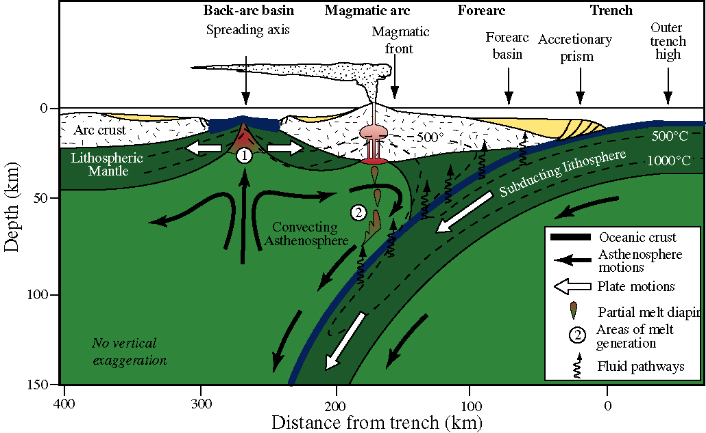
Arc-Trench Systems: The crust’s response to and record of subduction

Slide 4
Lecture 8: Subduction Zones Dehydration reactions in subducted materials release water
Schmidt & Poli, 1998

Slide 5
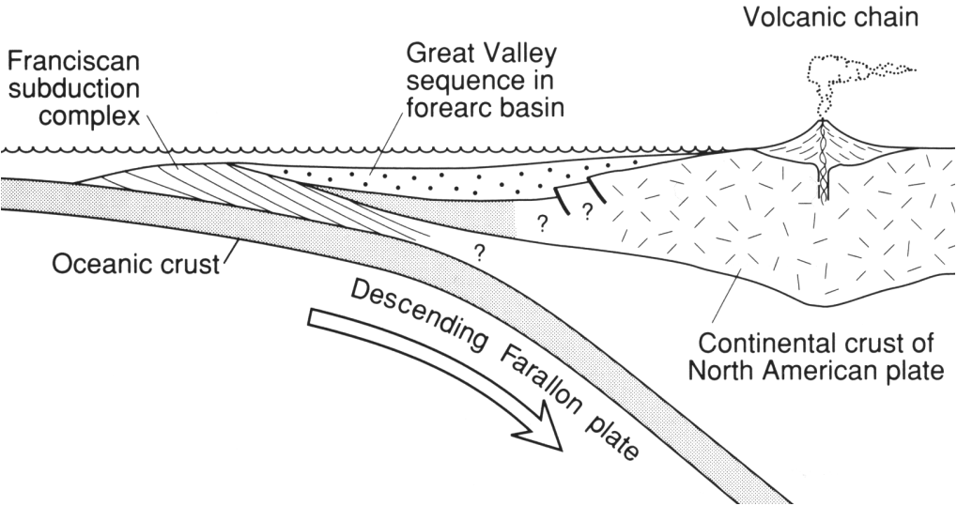
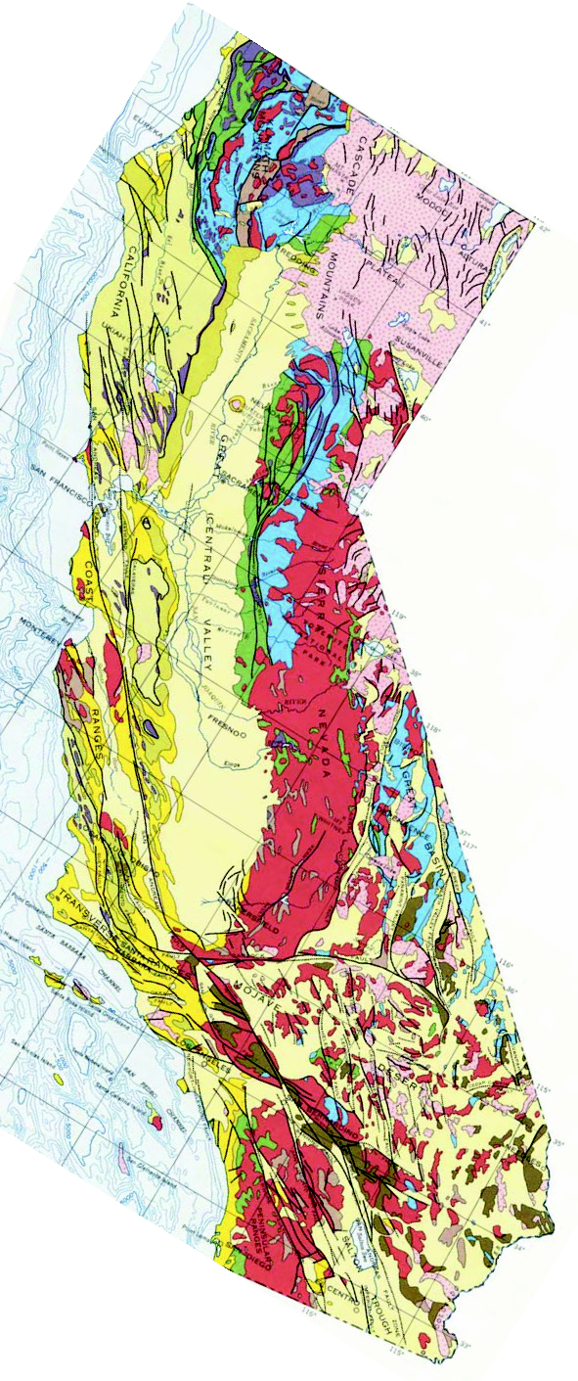
Green
Yellow
Red
Geology:
Slow earthquakes, tremor
Purple
Mesozoic cross-section through California
– the archetypal convergent margin: typical or atypical?

Slide 6

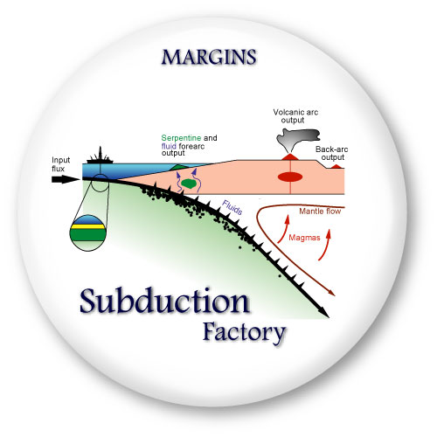
The provinces of the Mariana system
Subducting Pacific plate
Forearc
Arc
Backarc
Remnant arc
Notes:
Explain that this is a 3-D image looking at the Mariana system from the NNE
Introduce the different provinces of the Mariana system and point out key features
The eyes and thick green arrow indicate the “look direction” in the 3-D plot.

Slide 7
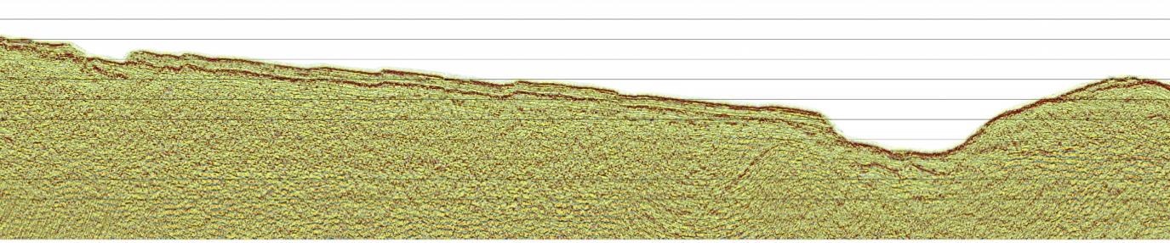

The Subducting Pacific Plate
Seamount
Pacfic Plate
Normal
Faults
Forearc
Trench
Tension
Notes:
1) Subducting Pacific plate - some of the oldest oceanic lithosphere
2) As this is old and cold it subducts easily - the subduction angle is steep. The slab is almost vertical beneath the active volcanoes (how do we know this - earthquakes)
3) This is also at type location for trench rollback - the trench is moving east, probably explaining the presence of extension in the forearc and backarc.
4) NE-SW lineation on the seafloor are normal faults that are created as the plate bends close to the trench
5) Middle-left figure is from the Woodlark basin, and shows how a seamount might subduct as it enters a trench.

Slide 8
The Forearc
Trench
Serpentine
Mud Volcano
Oakley et al., 2007
Oakley et al., 2007
Notes:
1) The Mariana forearc is in tension - is is being extended.
2) Fluids rising from the suducting slab serpentinize parts of the mantle. The resultant rock is much lower in density and rises to the surface along normal faults.
3) The serpentine muds erupt at the surface, creating mud volcanoes (Big Blue is shown here).
4) Seismic images (bottom right) show internal flows and the pre-volcano seafloor. An infilled crater is also imaged.

Slide 9
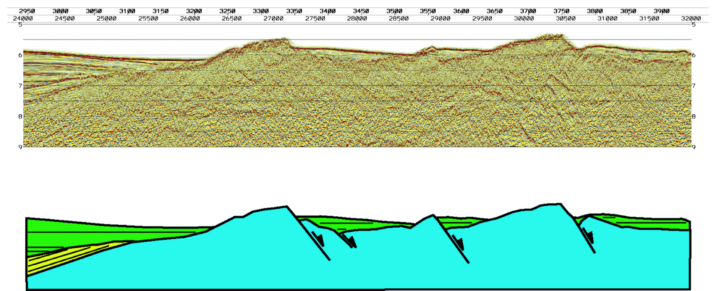
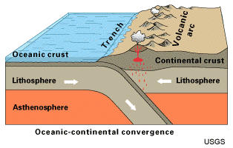
The Forearc
Oakley et al., 2007
Notes:
1) In another part of the forearc we can image the rotated fault block created as the forearc extends.
2) Blocks like these probably underly the mud-volcanoes but are today hidden from site.
3) Remember that in this type of setting the trench is trying to move away from the active arc, resulting in extension across the system.

Slide 10
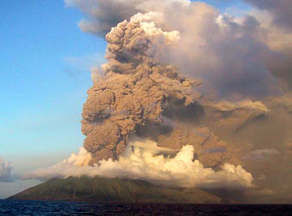
The Arc
Basement of old
volcanic line (Eocene)
Arc Line
Pagan Volcano
Anatahan Volcano: Courtesy Washington University St Louis
Notes:
1) The active volcanic arc is characterized by fairly evenly spaced volcanoes, many of which do not reach the surface.
2) Pagan (arrow) is an example of a volcano that does reach the surface - click on the “Global Volcanism Project” hyperlink to find out more (last eruption 2006)
3) Use Google Earth to show some of the volcanic islands.
4) The ridge to the east of the arc line represent a much older extinct line of volcanoes. Guam sits on this ridge
5) Anatahan volcano (last eruption 2006; bottom left)
6) Discuss volcanic risk

Slide 11
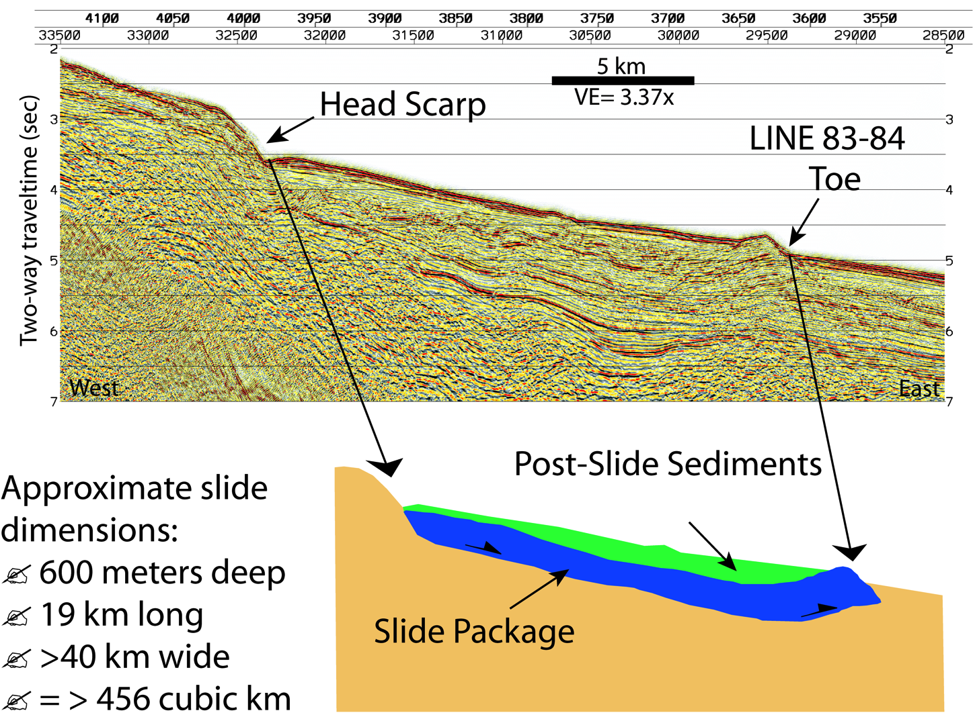
The Arc: Other Hazards
Could a slide like this cause a tsunami?
Notes:
1) On the east flank of the volcanic line a large slump has been imaged in the multi-channel seismic reflection data.
2) With a volume of > 456 cu km, this could have resulted in a large tsunami.
3) Such an event today would pose a major risk to human life.

Slide 12
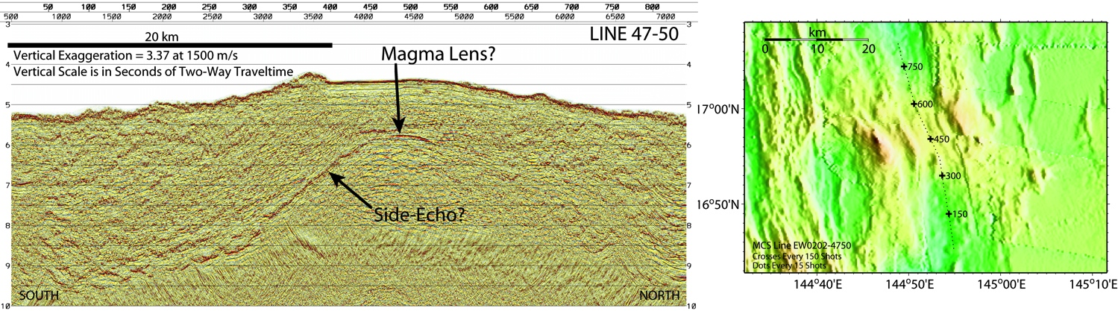
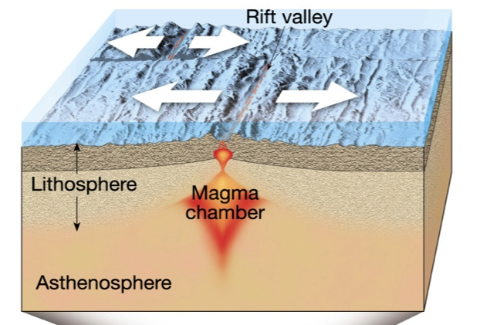
The Backarc
Remnant Arc
Oceanic Lithosphere
Spreading Center
Active Arc
Tarbuck & Lutgens
Notes:
1) The backarc basin has been formed by seafloor spreading since ~6 Ma, moving the remnant arc to the west
2) Why is the current spreading center (apparently) close to the eastern side of the basin (ans. The active arc is built partly on the new oceanic crust and sediments shed from the volcanoes have covered the abyssal hill fabric (explain what abyssal hill fabric is)
3) A multi-channel seismic reflection line along the spreading center (location shown in lwr right figure) shows a reflection from the magma chamber beneath the spreading center
4) Lower-right figure explains concept of seafloor spreading

Slide 13
The Backarc
Notes:
1) A combination of bathymetry and seismic reflection data allows us to see under the sediments and image the underlying oceanic lithosphere and extended arc crust

Slide 14
Keep in mind: 1) Not all arcs have the textbook “Convex-outward” appearance (e.g. Tonga-Kermadec) 2) Not all arcs consist of islands (e.g. Cascadia) 3) Arcs are broad (~200-km wide) crustal tracts 4) Arcs typically persist for several tens to hundreds of millions of years (volcanoes only persist for several Ma)

Slide 15
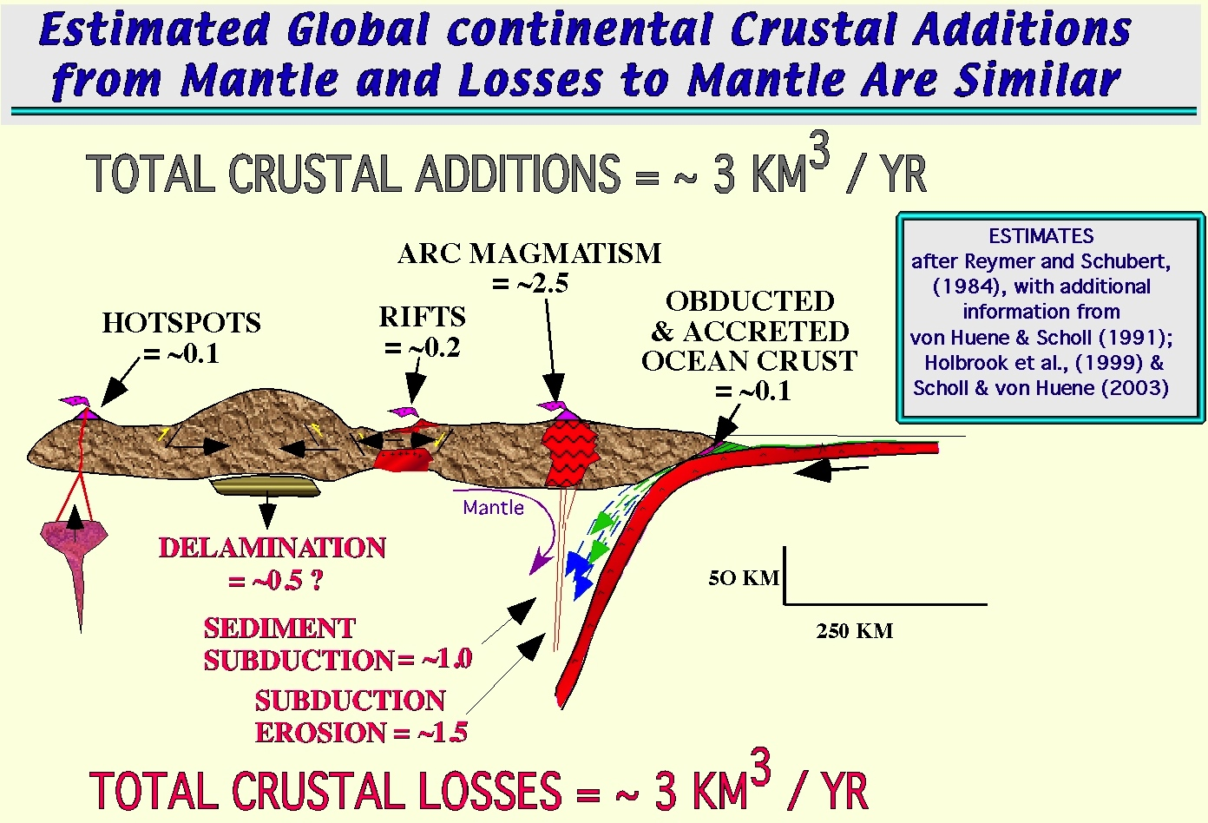
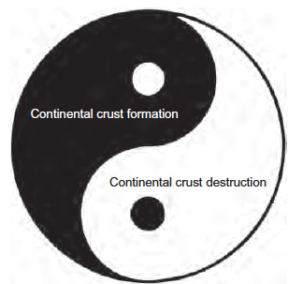

Slide 16
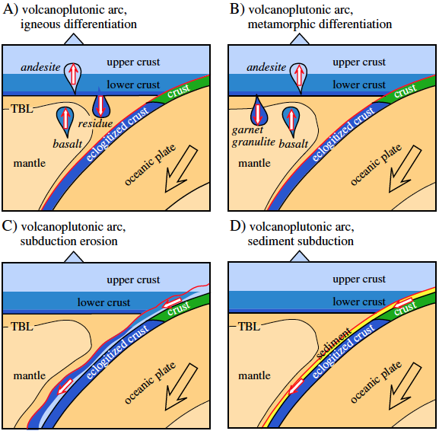
Growth
Loss
Hacker et al.,
EPSL, 2011

Slide 17
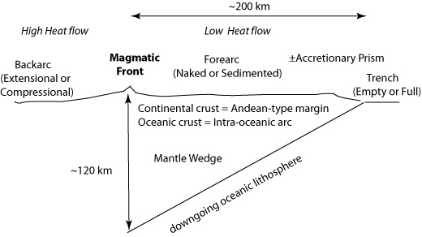
Architecture of an arc-trench system

Slide 18
What are the most important controls on convergent margin deformation?
Thickness (buoyancy) of subducting crust
Thin crust is easily subducted, thick crust impedes subduction, deforms the forearc, and may stop subduction.
aka ‘collision’, ‘suturing’, terrane accretion.
Age (buoyancy) of subducting lithosphere
Old lithosphere (>~40Ma) is denser than underlying asthenosphere and subducts easily; young lithosphere (<~40 Ma) is less dense than asthenosphere and resists subduction.
Obliquity of convergence
Strain is partitioned between dip-parallel and along-strike faulting.
Sediment thickness
Thick sediments (>1km) on downgoing plate are largely scraped off to form an accretionary prism between trench and forearc;
Thin sediments result in tectonic ‘erosion’ of the forearc

Slide 19
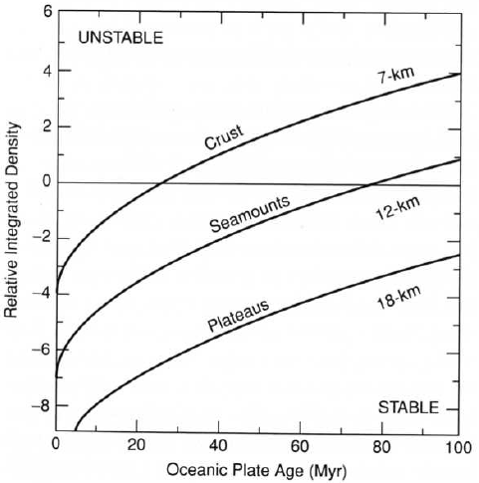
The (possible) importance of lithosphere age: older lithosphere is denser (considering only the cooling effect, no phase changes)
Thermal parameter = age * rate of subduction (km)

Slide 20
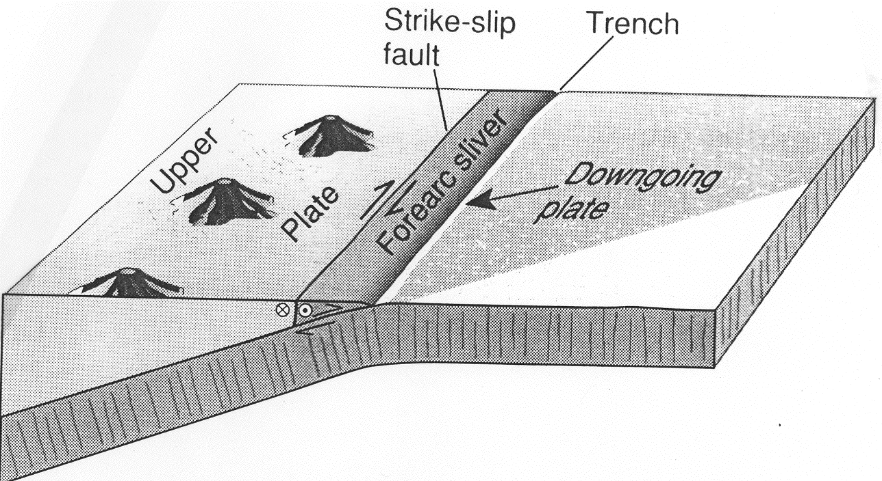
Oblique Convergence
Convergent margins where relative plate motion is not perpendicular to the trench may have strain partitioned between trench-normal contraction and forearc strike-slip shearing. M&T95

Slide 21
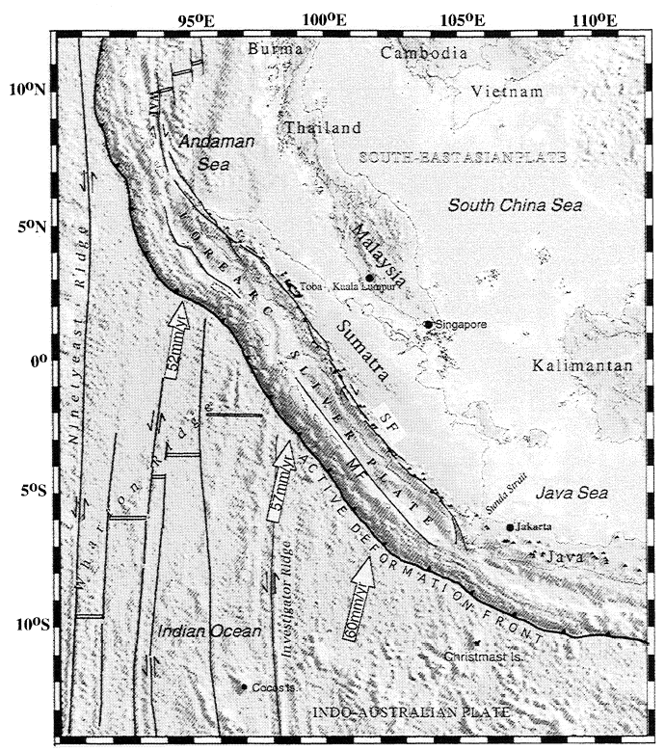
Sumatran Fault
Margin-parallel strike-slip faults are frequently found inboard of strongly oblique convergent margins
Margin-parallel shear is localized landward of the strongest contractional strain, often within the volcanic line:
Sumatra Fault: 1900 km long
Dextral
~25mm/year slip
Sieh & Natawidjaja 2000

Slide 22
What are the most important controls on convergent margin deformation?
Thickness (buoyancy) of subducting crust
Thin crust is easily subducted, thick crust impedes subduction, deforms the forearc, and may stop subduction.
aka ‘collision’, ‘suturing’, terrane accretion.
Age (buoyancy) of subducting lithosphere
Old lithosphere (>~40Ma) is denser than underlying asthenosphere and subducts easily; young lithosphere (<~40 Ma) is less dense than asthenosphere and resists subduction.
Obliquity of convergence
Strain is partitioned between dip-parallel and along-strike faulting.
Sediment thickness
Thick sediments (>1km) on downgoing plate are largely scraped off to form an accretionary prism between trench and forearc;
Thin sediments result in tectonic ‘erosion’ of the forearc

Slide 23
Forearc basin vs. accretionary prism
Naked forearcs are erosive
(as are some sedimented forearcs)

Slide 24
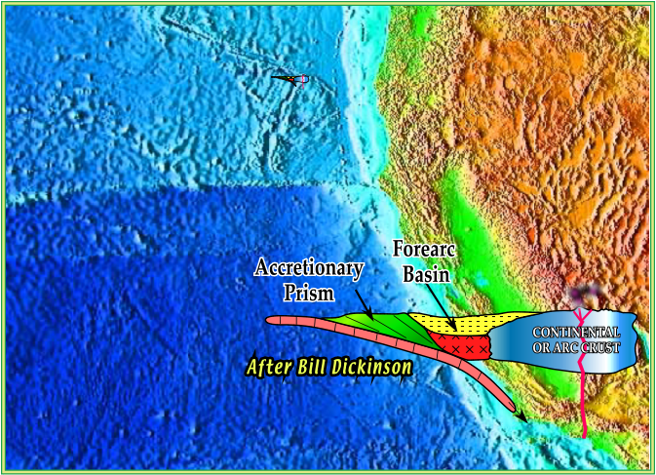

Slide 25
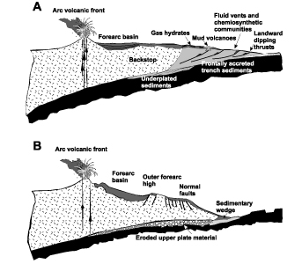
Forearc types Clift & Vannuchi, RGSP, 2004
Accretionary
Erosive/
Non-accretionary
Accretionary margins, such as Cascadia, are characterized by thrusted and penetratively deformed trench and oceanic sediments that often develop mud diapirism and volcanism because of sediment overpressuring. Gas hydrate zones are also common.
Erosive margins, such as IBM and Tonga-Kermadec have steep trench slopes, composed of volcanic, plutonic, and mantle rocks (arc infrastructure). Forearc tectonics is dominated by serpentine-tectonics.

Slide 26
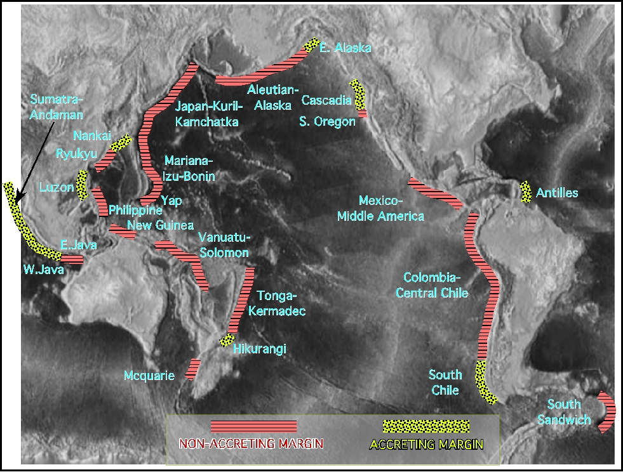
Distribution of Accretionary vs.
Non-accretionary forearcs
Not shown are Makran and Aegean margins (both accreting)
21,000 km of non-accretionary margins,
25,000 km of accretionary margins.
(Von Huene & Scholl, in press).

Slide 27
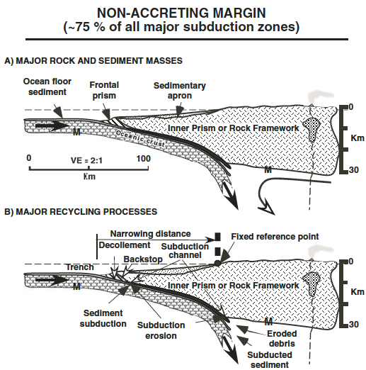
• close spacing of the basement to the trench
•small (or absent) prisms of accreted lower-plate sediment behind the actively deforming material of the frontal prism. Material of the frontal prism can be scraped-off ocean floor sediment or composed of debris shed from the inner trench slope.
•forearc narrows with time
(Scholl & von Huene, GSA Mem., 2007)

Slide 28
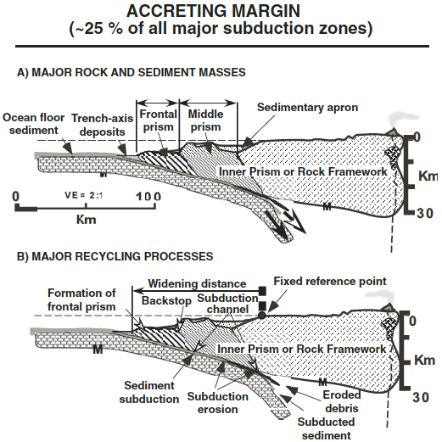
•Accreting margins have a wide body of accreted material consisting of a little-deforming, older accreted prism and, at the base of the slope, the frontal prism of actively de-forming (shortening) sediment scraped off the subducting lower plate
•forearc widens with time (trench retreats seaward)
(Scholl & von Huene, GSA Mem., 2007)

Slide 29
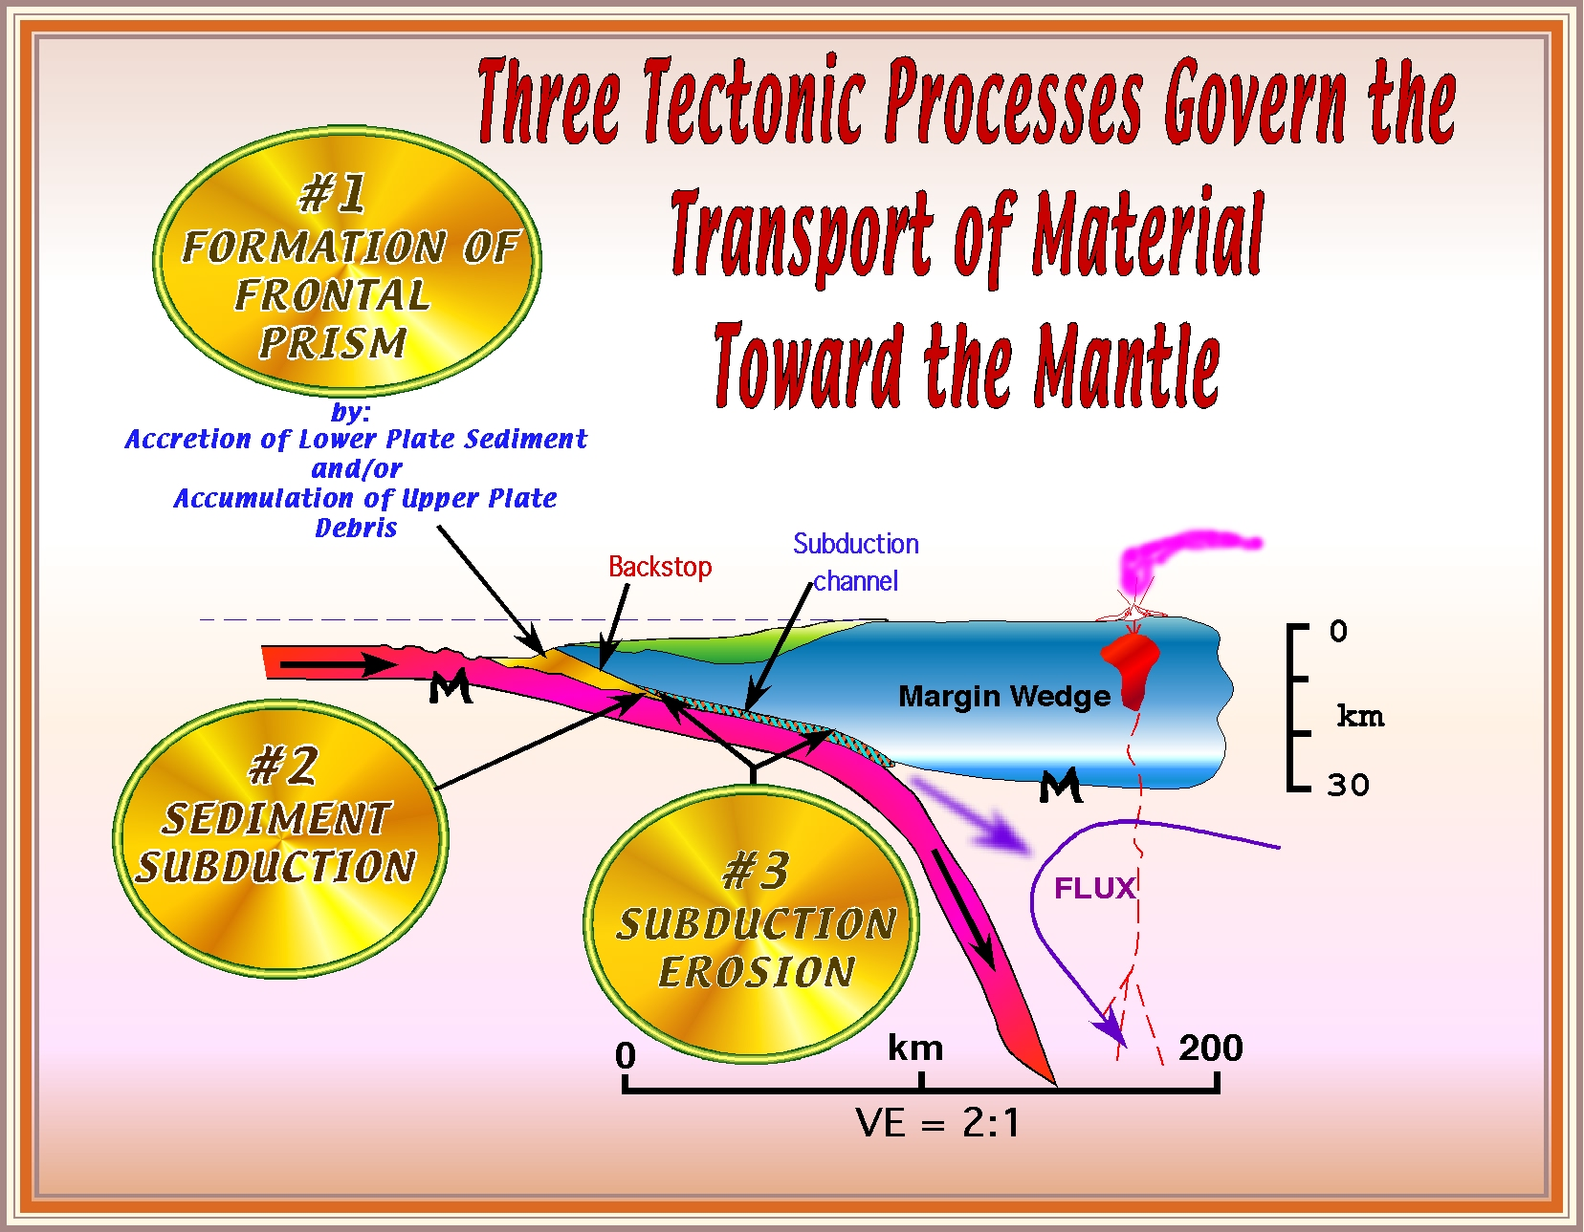

Slide 30
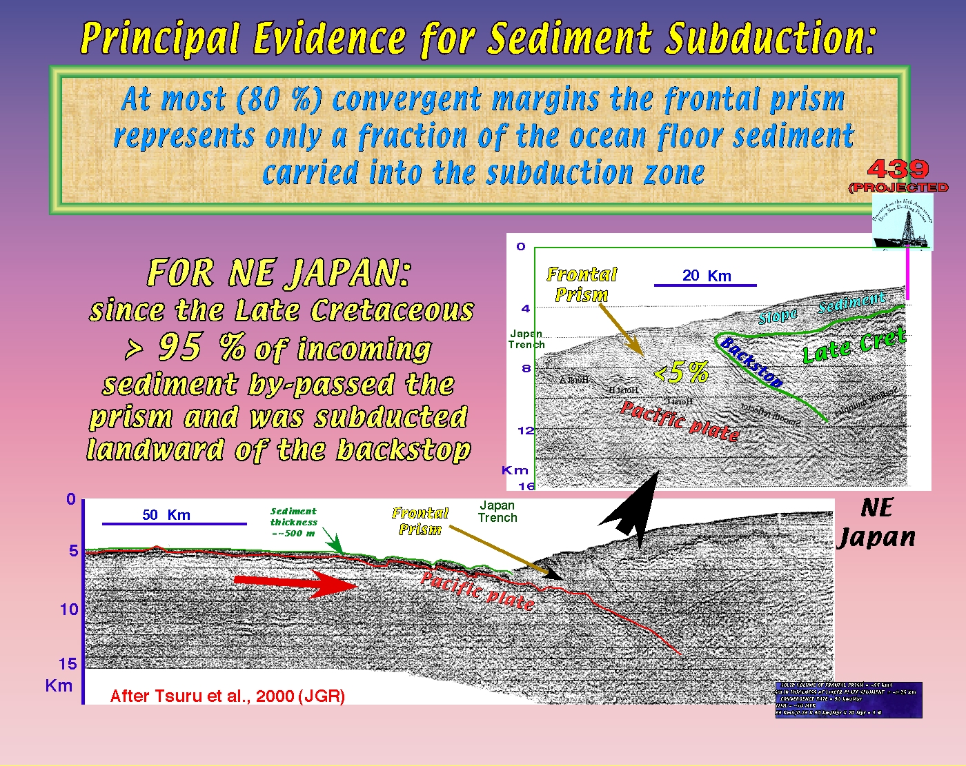

Slide 31
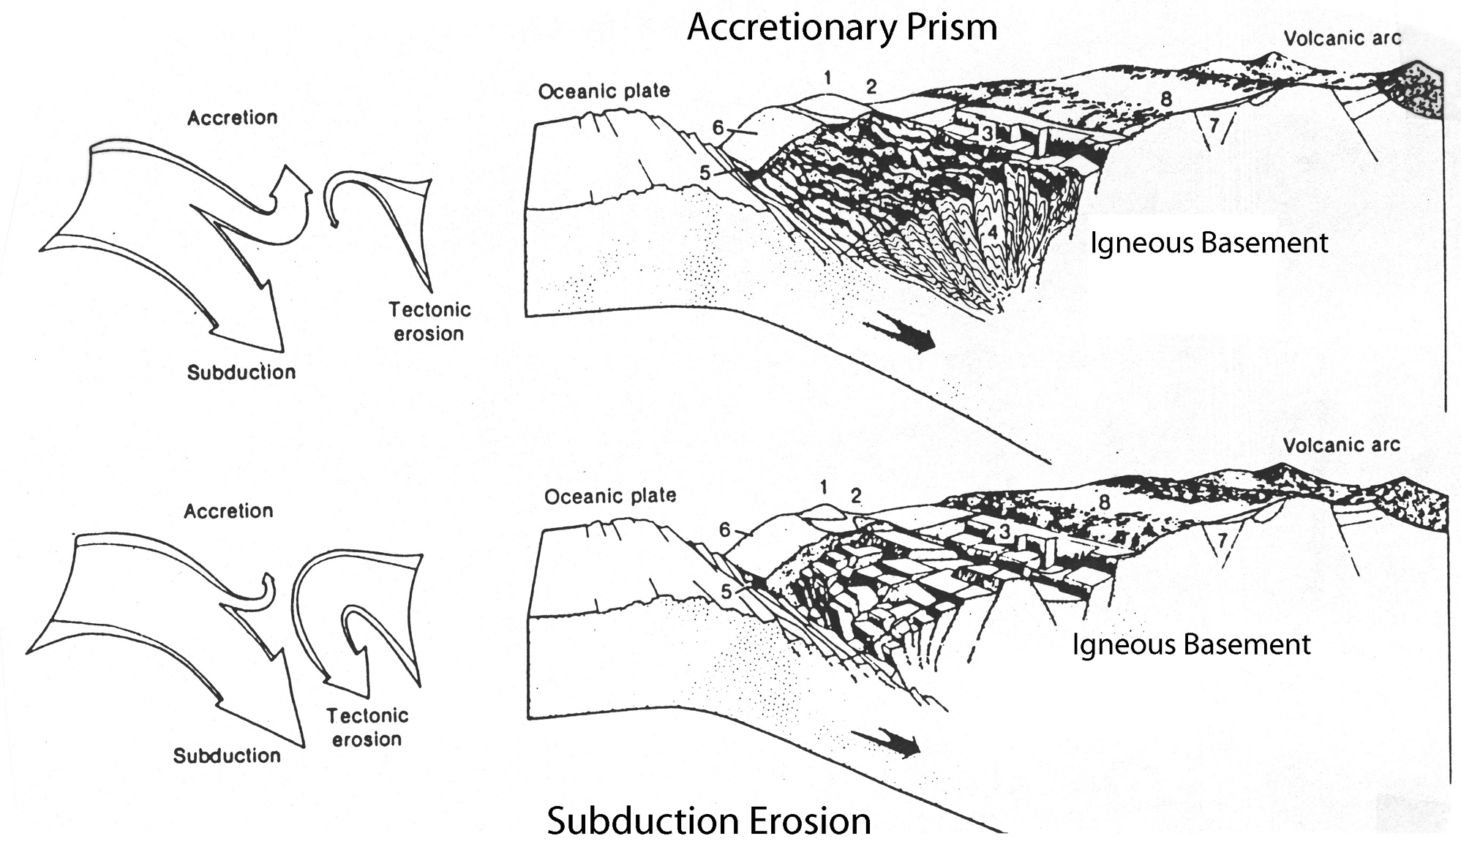
Sediment Accretion vs. Subduction ‘Erosion’
The threshold for growth of an accretionary prism is ~1km of sediment in the trench.
Coulbourn 1986

Slide 32
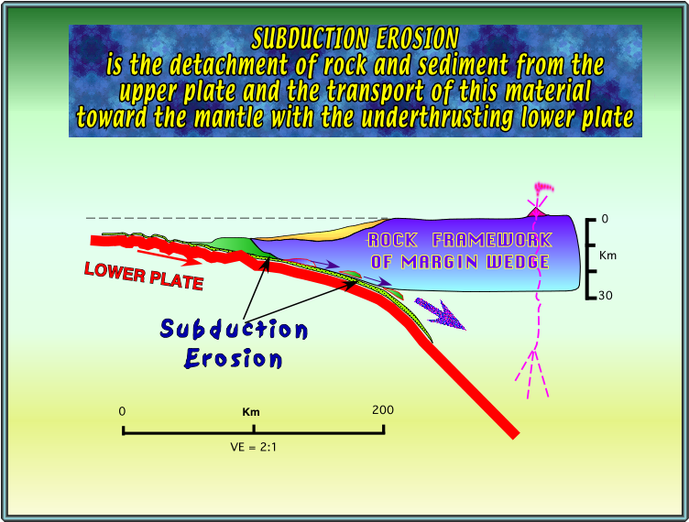

Slide 33
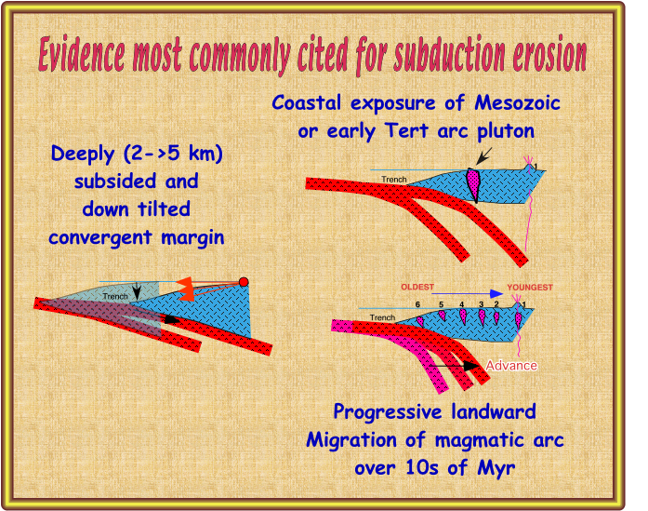

Slide 34
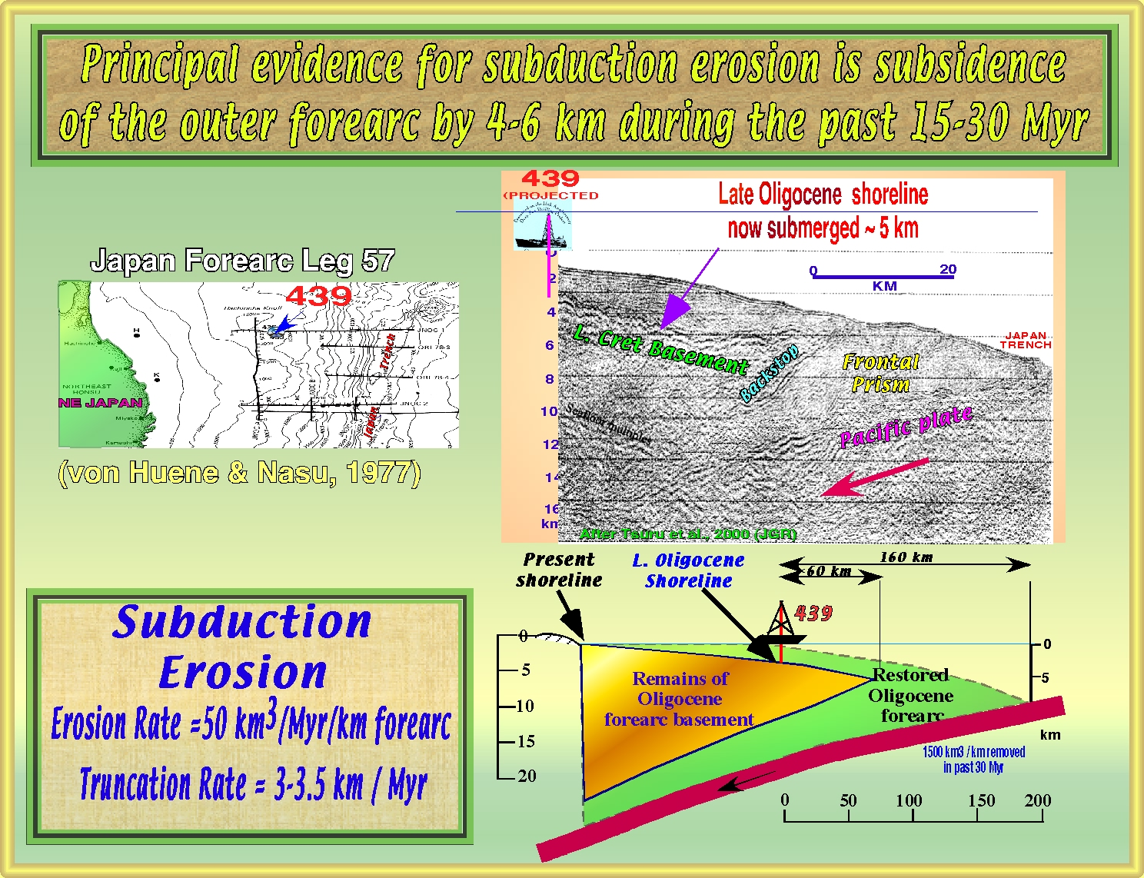

Slide 35
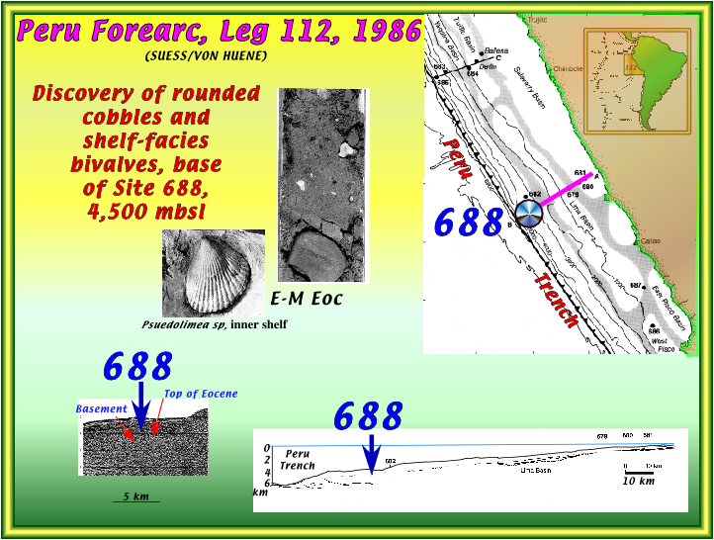

Slide 36
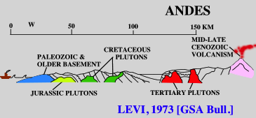
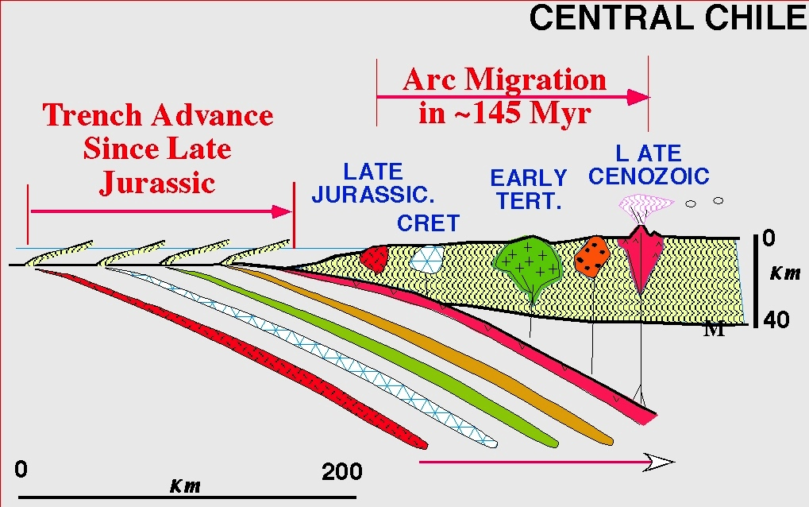
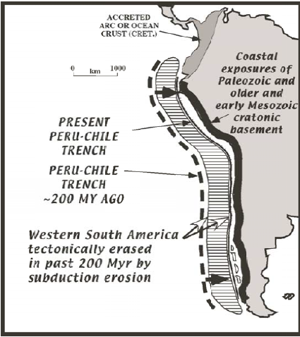
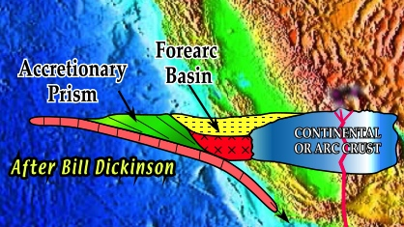
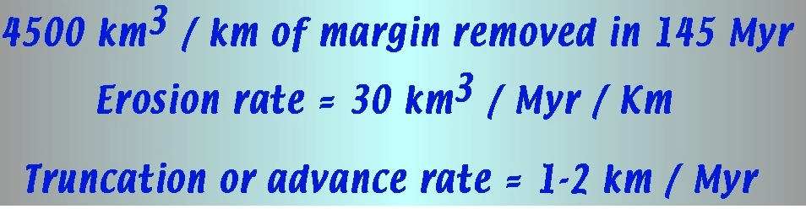
More evidence for subduction erosion:
Coastal exposure of Mesozoic arc plutons, & progressive landward migration of arc plutons

Slide 37
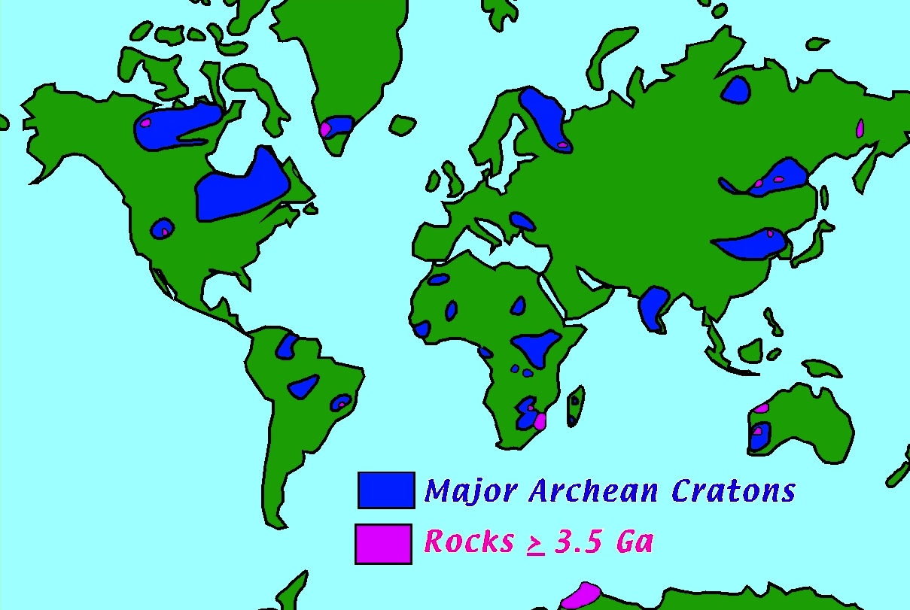
Is rarity of Archean rocks a function of slow production of continental crust?
or of rapid subduction erosion?

Slide 38
Distribution of Accretionary vs.
Non-accretionary forearcs
21,000 km of non-accretionary margins,
25,000 km of accretionary margins (many of which undergo subduction erosion at greater depth).
(Scholl & Von Huene, GSA Mem., 2007).

Slide 39
Scholl & Von Huene, CJES, 2010

Slide 40
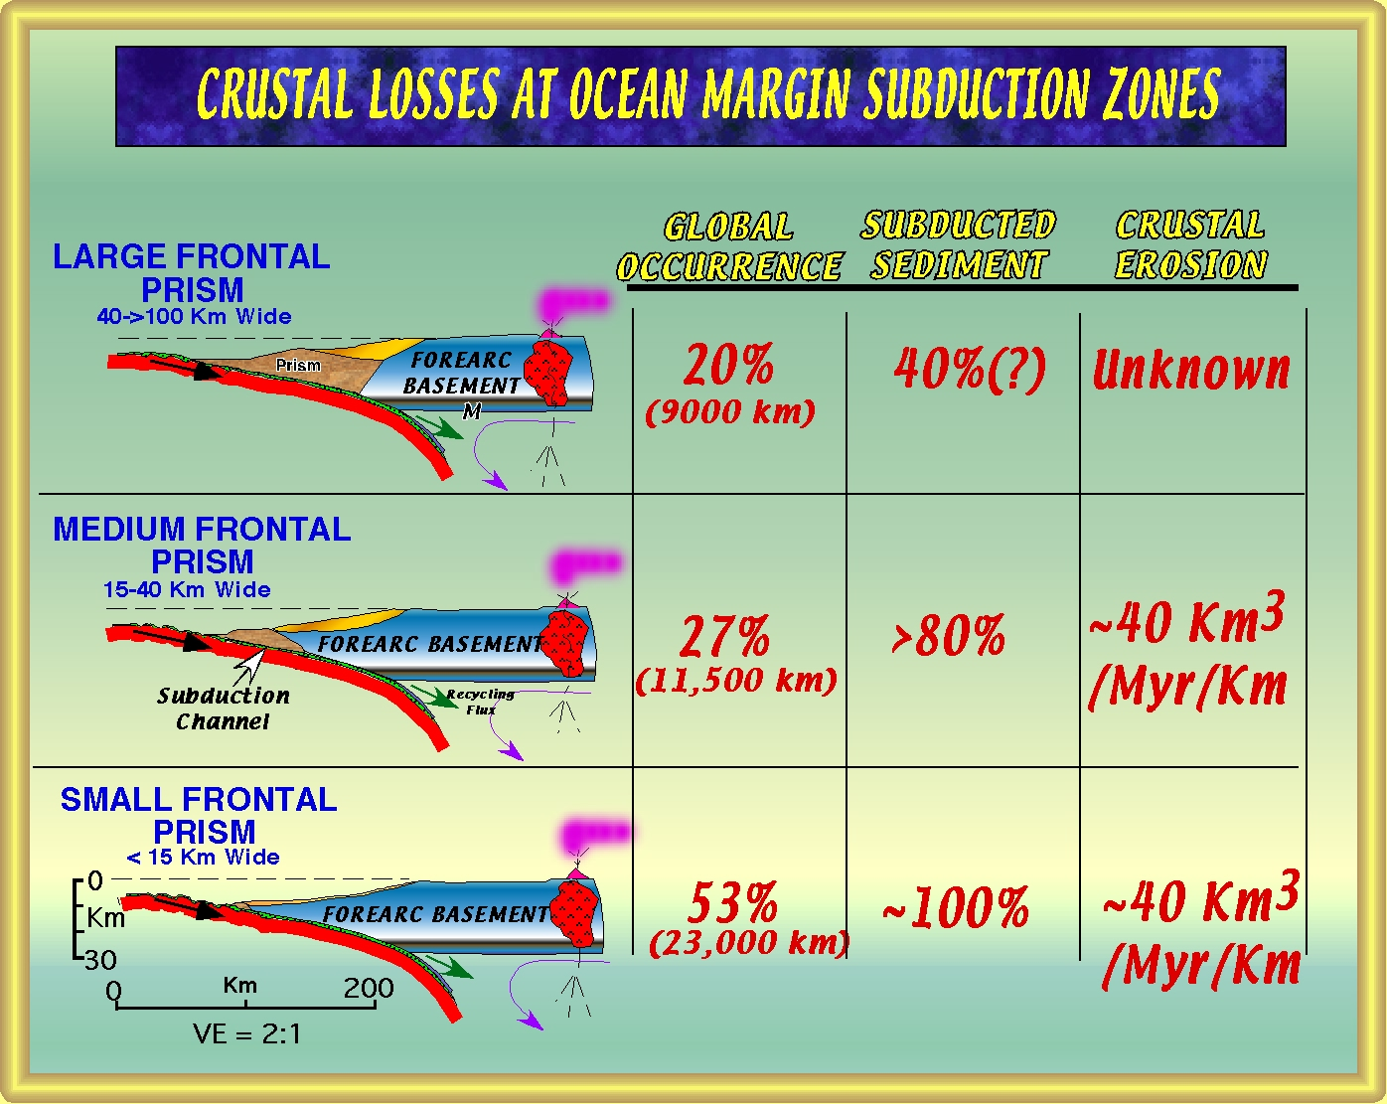

Slide 41
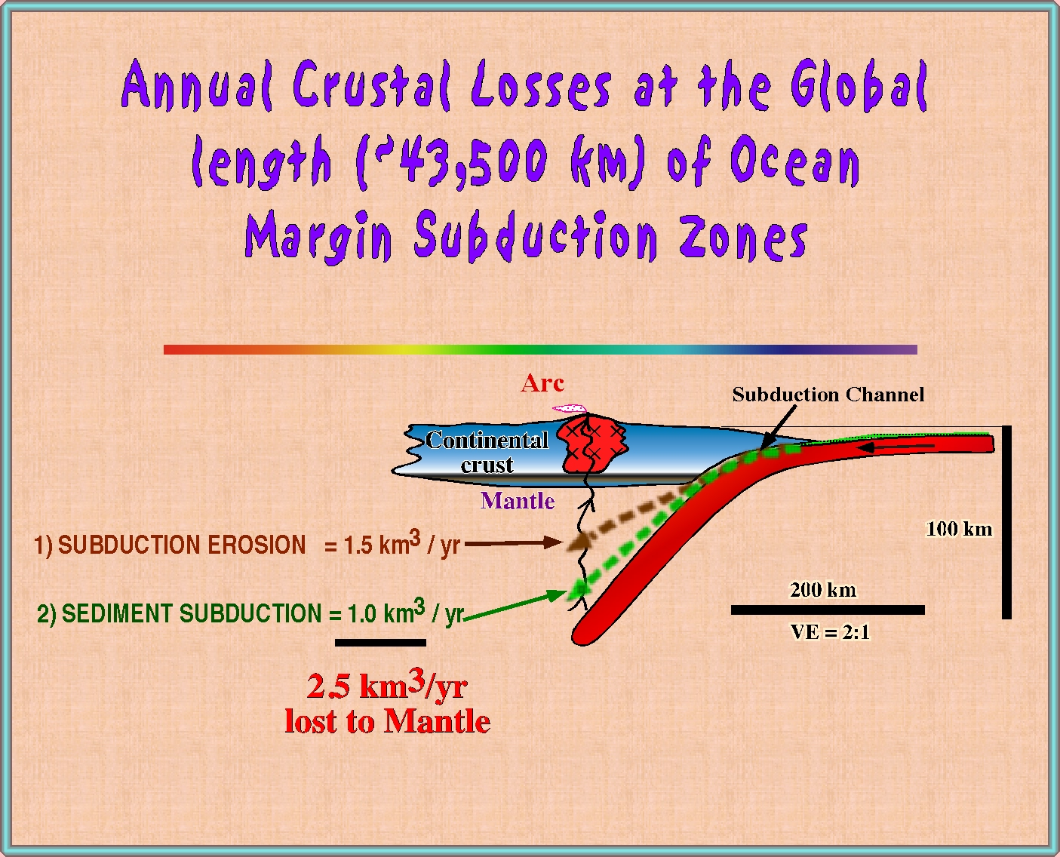

Slide 42
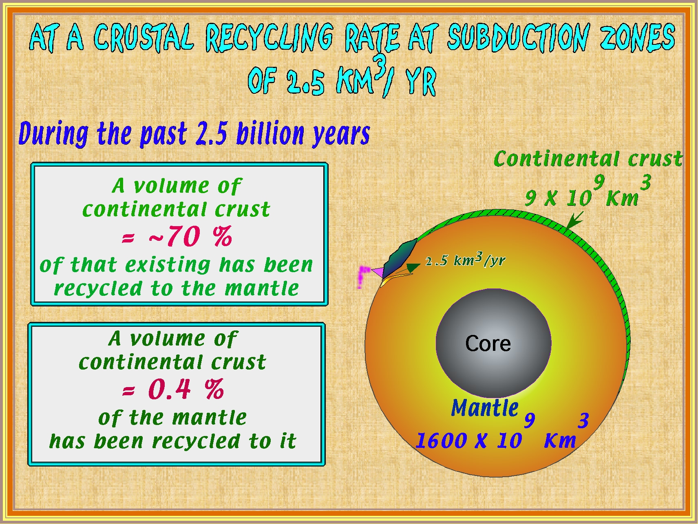

Slide 43
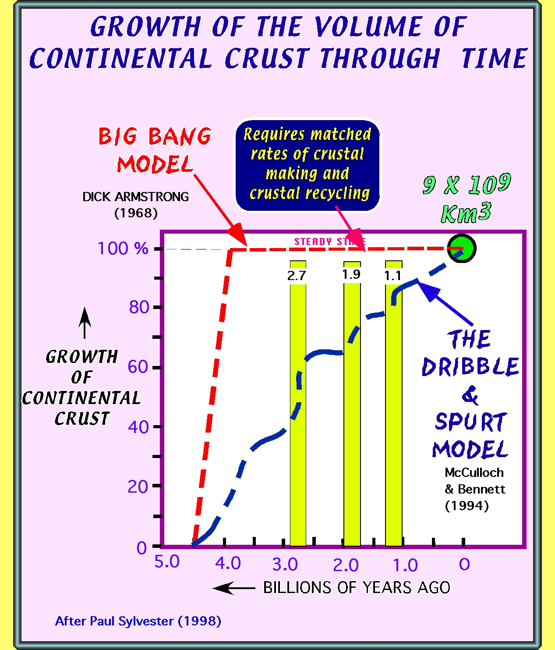

Slide 44
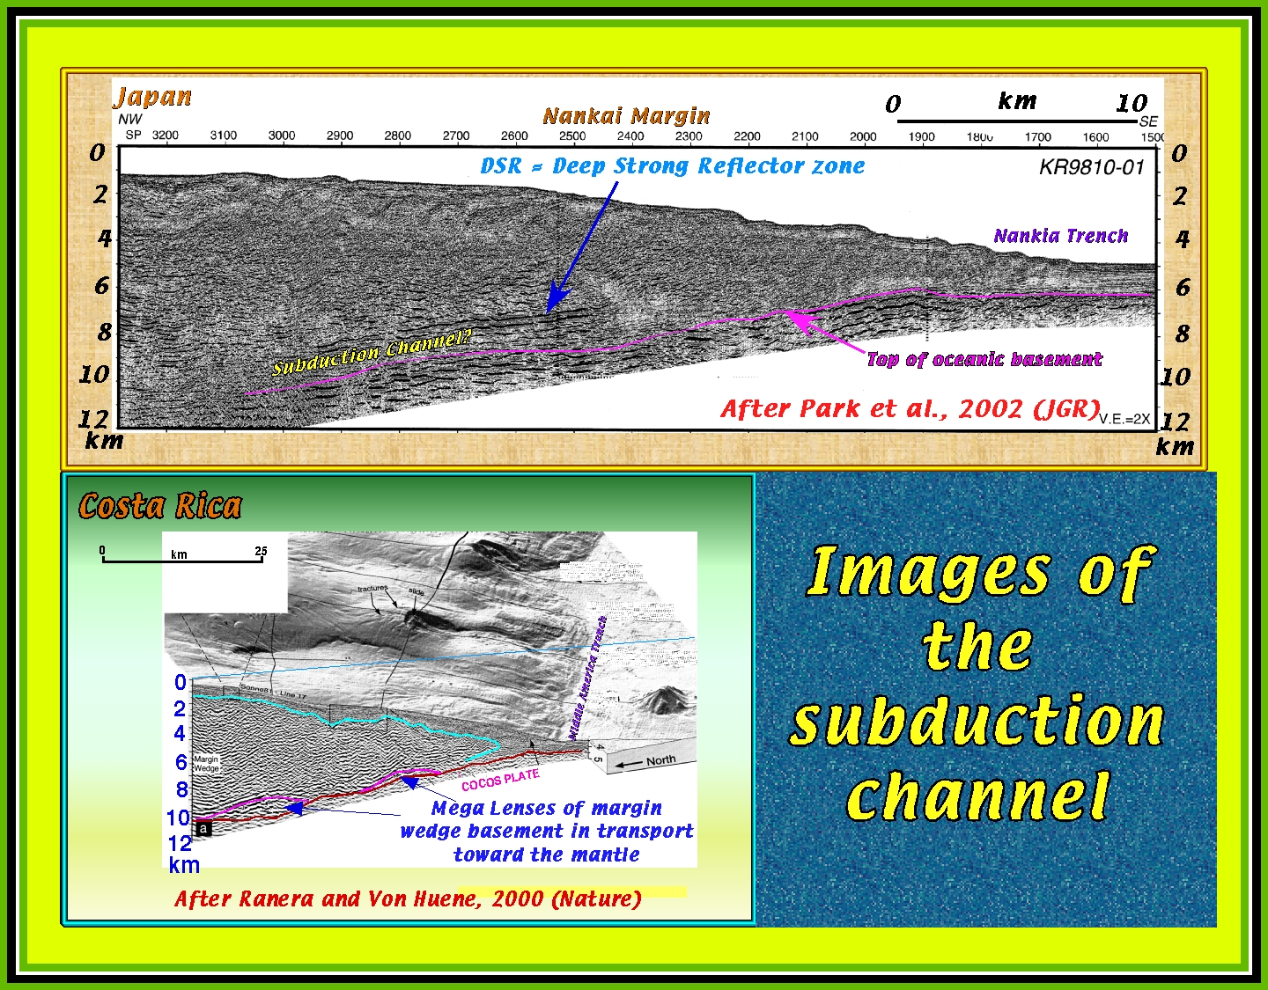

Slide 45
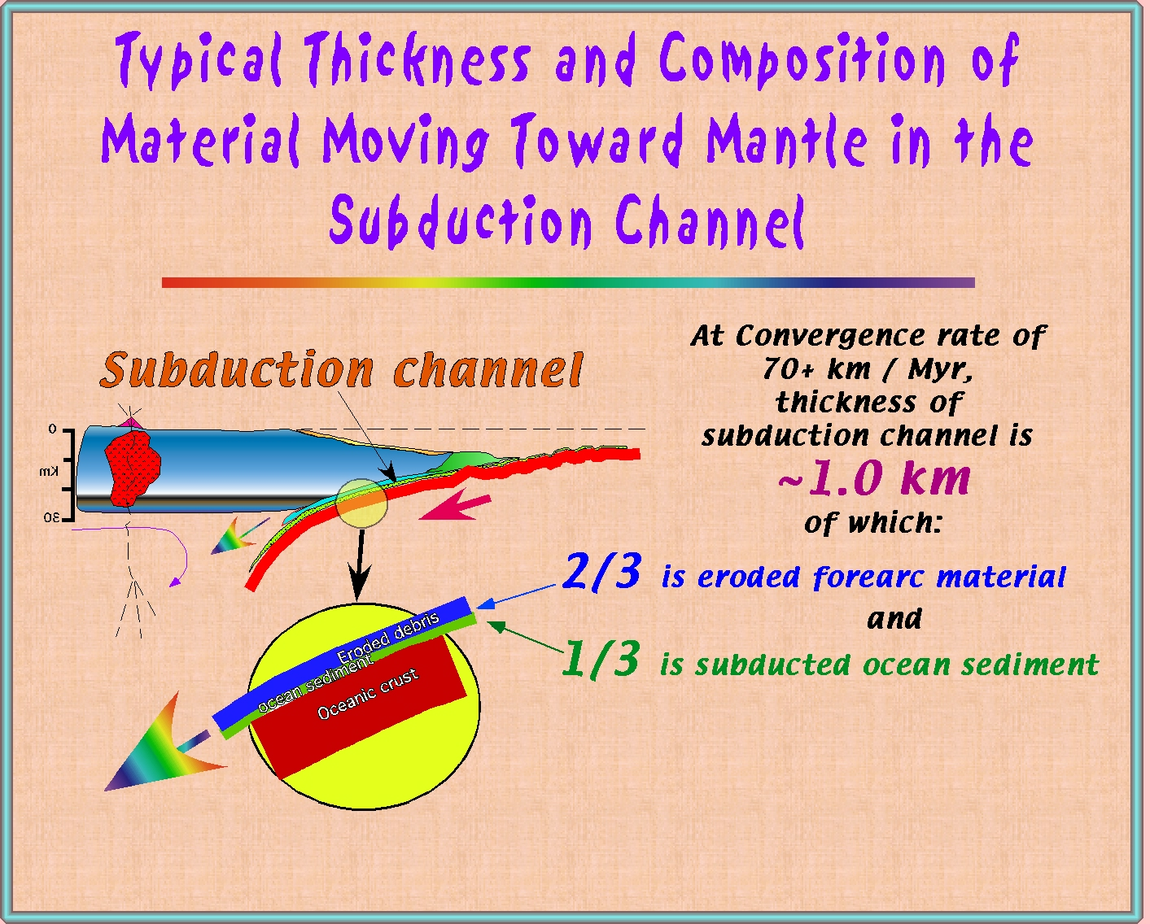

Slide 46
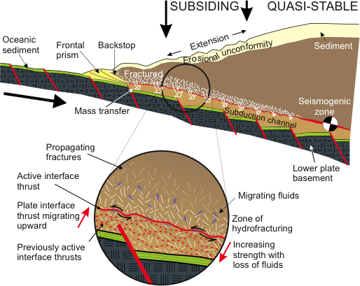
A Generic Model for Subduction Erosion
Fluid overpressure and normal faulting combine to remove material from the base of the shallow mantle wedge (Von Huene et al., Geology 2004)

Slide 47
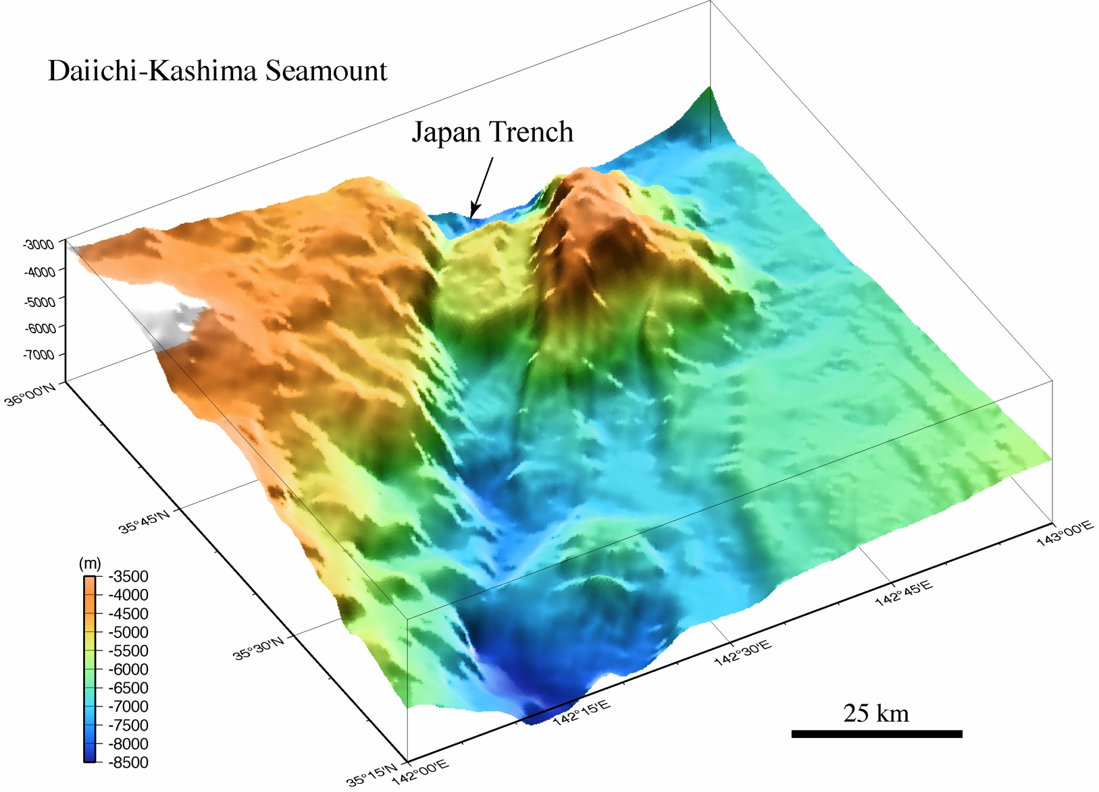
Subduction of Seamounts Disrupts the Accretionary Prism

Slide 48
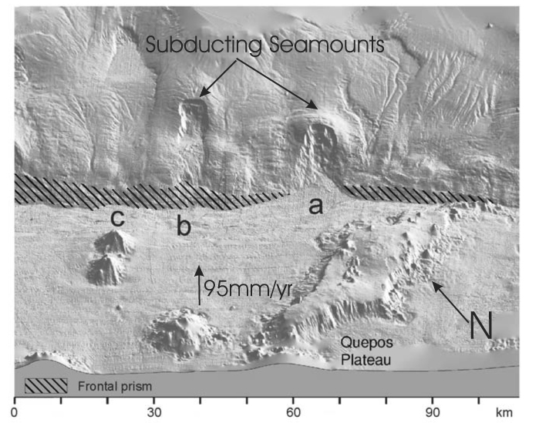
Subducting Seamounts in the Middle America Trench and Subduction Erosion
Von Huene et al.,
Geology 2004
Seamount subduction oversteepens slope and increases sediment flux from forearc to trench

Slide 49
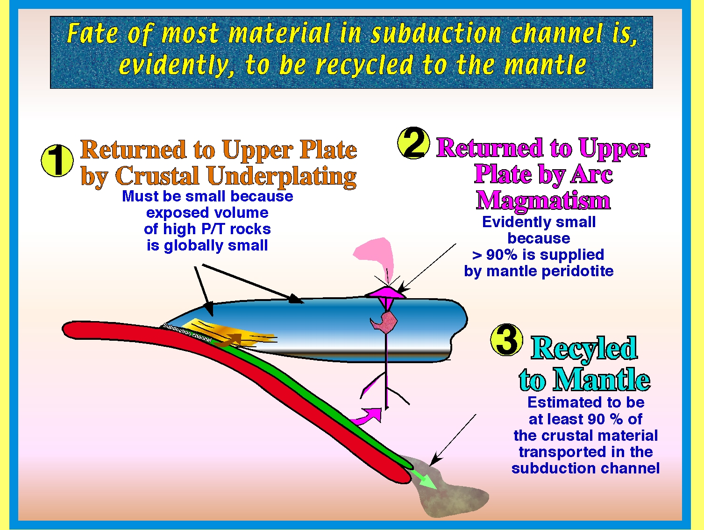
Conventional view

Slide 50
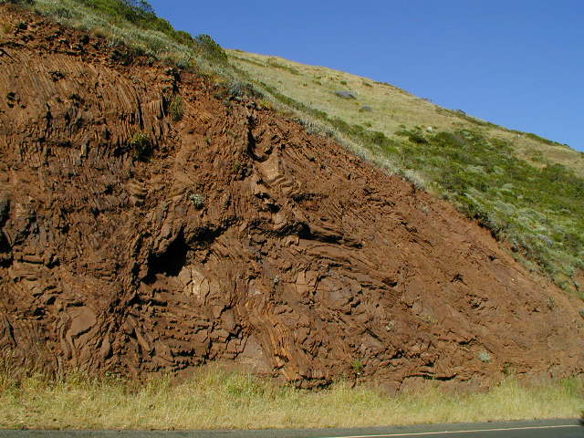
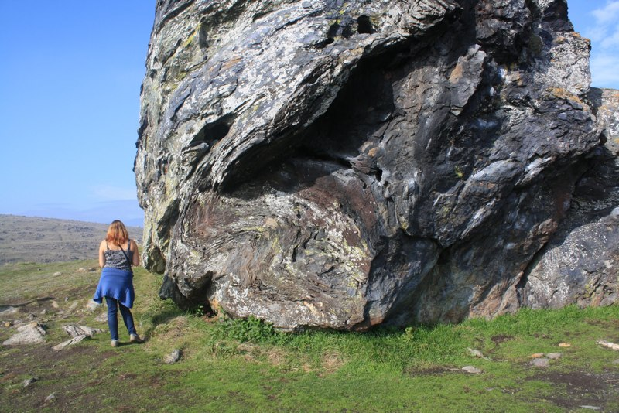
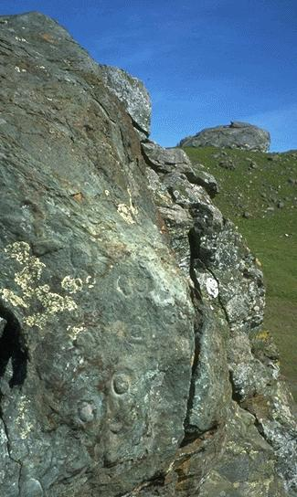
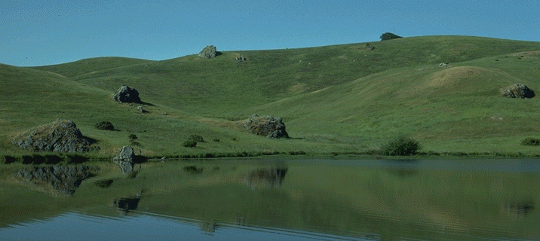
Franciscan serpentinite mélange and bluschist metamorphism
Central terrane: Ring Mt & GGNRA
Classic mélange

Slide 51

How to uplift high-grade material
from >50 km depth?
dependent on geometry of subduction zone
Ernst, Terra Nova, 2005
After Ernst, 1985

Slide 52


Slide 53



Coesite rimmed by quartz
in eclogitic garnet,
Dabieshan
(Wang et al., 1989;
inclusion ~20 μm)
Microdiamonds
in zircon from a
Kokchetav paragneiss
(Sobolev & Shatsky
1990)

Slide 54

coesite (diamond) imply return of material from >90 (>130) km)
Liou 2004

Slide 55



Tiny amounts of HP/UHP reach the surface.
But suppose a density filter traps them in the lower crust?
Hacker et al., EPSL, 2011,
suggest 1 km³/yr of silicic material is recovered,
implying a felsic lower crust
Outrageous new idea
61% 65% SiO₂

Slide 56
Arc magmatic crustal structure: What is the composition? What is the volume?

Slide 57

Stern & Scholl, IGR, 2010
Arc crustal magmatic growth rate:
20-40 km³/Ma-km of arc (Reymer & Schubert, 1984)
30-95 km³/Ma-km of arc (Dimalanta et al. 2004)
80-120 km³/Ma-km of arc (Calvert et al. 2008)
165 km³/Ma-km of arc (Scholl et al.)

Slide 58



Velocity Structures of Island Arcs: dominantly “basaltic”
“Basalt”
“Andesite”
Fliedner & Klemperer, EPSL, 2000
Calvert, 2011

Slide 59

Continental Crust Composition
The Andesite Paradox:
How can we form an andesitic continental crust when most mantle-derived magmas are basaltic?
Rudnick and Fountain, 1995

Slide 60

The Andesite Paradox: solution #1
Arcs are unimportant – continents grew early in Earth history by other mechanisms
Taylor and McLennan, 1995
… but most models still produce 25-40% crust at arcs

Slide 61

The Andesite Paradox: solution #2
Arcs aren’t really basaltic - Relamination produces a garnet-bearing felsic lower crust that has seismic P-velocities similar to gabbro
… new and untested, but potentially confounding idea
Hacker et al., 2011

Slide 62
The Andesite Paradox: solution #3
Arcs aren’t all the same - some arcs produce crust that chemically and geophysically resembles continents
Izu-Bonin middle crust has Vp characteristic of continents

Slide 63
But petrologic models require a crustal cumulate volume ~ seismic lower crust volume
as the petrologic counterpart to the intermediate middle crust:
Where is it?
Sub-Moho low Vp represents crustal cumulates – vol. ~50% of lower-crustal restites
Sub-Moho low Vp represents crustal cumulates, &/or melts & serpentinization
Takahashi et al., Geology, 2007

Slide 64

The Andesite Paradox: solution #4
Delamination: the lower-crustal root eclogitizes, becomes gravitationally unstable, and sinks into the mantle
Garnet growth
at low T, high p leads to density instability.
At T > 700°C, Rayleigh-Taylor drips form on time-scales ~10 Ma; i.e. “continuously” during arc evolution
Jull & Kelemen, JGR, 2001

Slide 65


The Andesite Paradox: solution #4
Where is the root to the Sierra Nevada?
Fliedner, Klemperer, et al., JGR, 2000; EPSL, 2000

Slide 66



Seismic evidence for active delamination of an eclogitic root?
Zandt et al., Nature, 2004
Boyd et al., Science, 2004

Slide 67


Wide-angle and CCP images of Cascadia
Pronounced Moho beneath arc – where’s the delamination?

Slide 68

Seismogenic Zone The biggest earthquakes occur in subduction zones at depths of ~20-30 km
the ‘Seismogenic Zone’ exists because of friction between the two plates: the geotherm controls the deepest point of brittle failure; this depth plus slab dip control the downdip length of the seismogenic zone, and the largest potential earthquake

Slide 69

Larger earthquakes are associated with higher convergence rates and continental arcs (thicker crust, so longer seismogenic zone down-dip)
Diagonal lines are magnitudes of largest earthquakes (Stern 2002 Rev. Geophys.)

Slide 70


Slide 71


Earthquake Cycle
Interseismic period:
Strain builds up for decades or centuries
Coseismic period:
Strain is released in a few minutes

Slide 72



Dec. 26 2004 Magnitude 9.0
Banda Aceh before & after
Banda Aceh
Tectonic subsidence, not tsunami damage

