Slide 1

Producing Natural Gas from Shale – Opportunities and Challenges of a Major New Energy Source
Mark D. Zoback
Professor of Geophysics
Stanford University

Slide 2
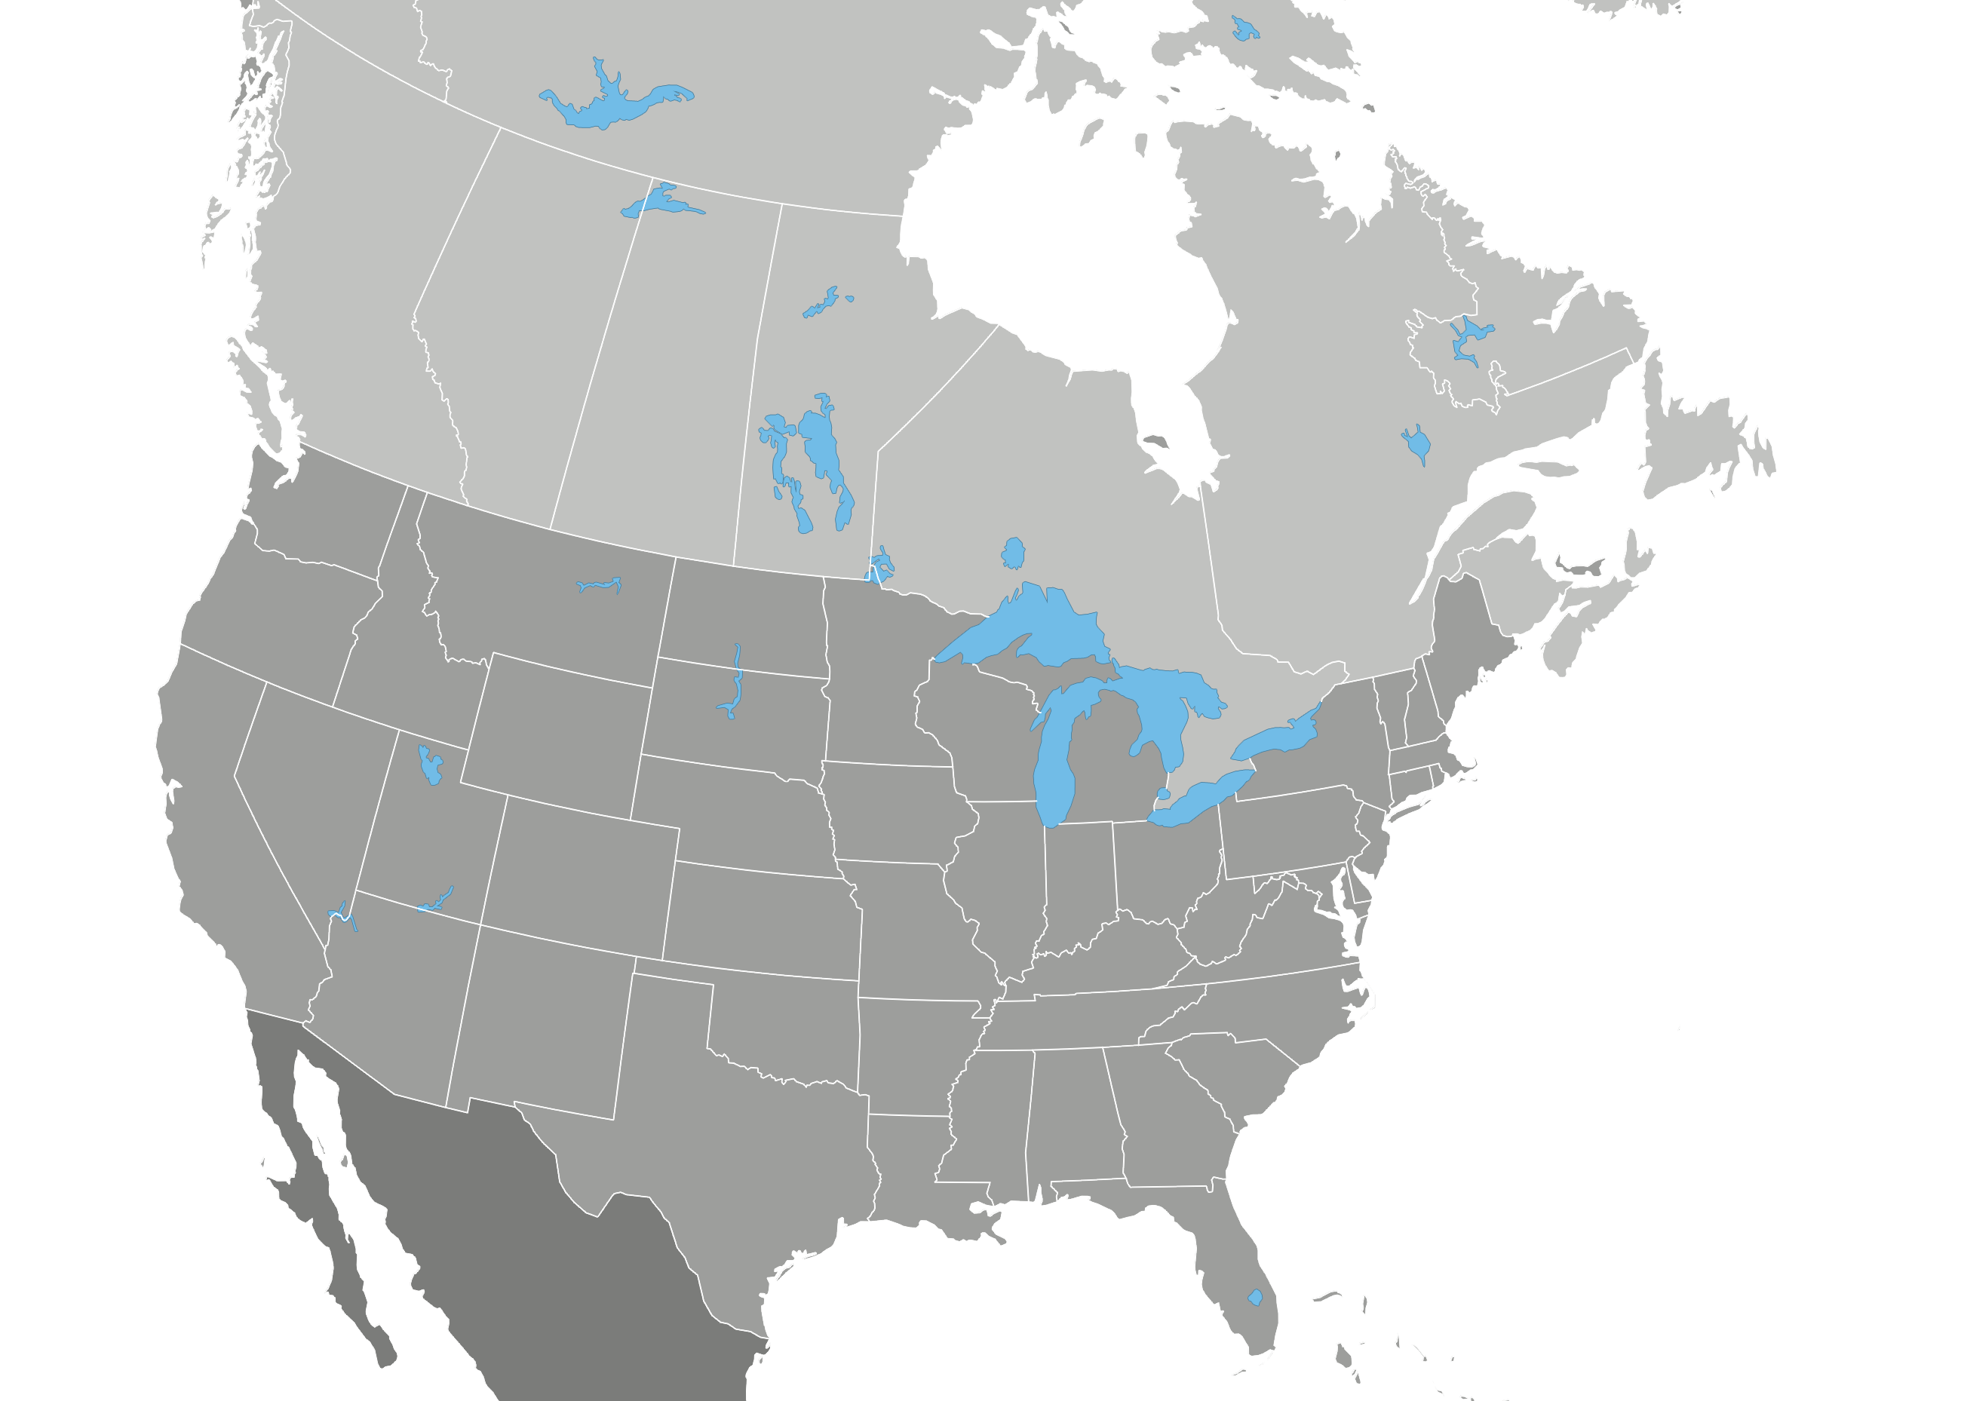
Opportunity: North American Shale Plays
Horn River Basin/
Cordova Embayment
>700 Tcf
Montney Deep Basin
>250 Tcf
Colorado Group
>300 Tcf
Bakken
3.65 Billion Bbl
Antrim
35-160 Tcf
Horton Bluff
Formation
Green River
1.3-2 Trillion Bbl
New Albany
86-160 Tcf
Utica
Shale
Gammon
Michigan Basin
Lewis/Mancos
97 Tcf
Niobrara/Mowry
Monterey
Cane
Creek
Marcellus
225-520 Tcf
Palo Duro
Woodford
Fayetteville
20 Tcf
Avalon
Floyd/
Conasauga
OIL SHALE PLAY
0
600
GAS SHALE PLAY
Haynesville
(Shreveport/Louisiana)
29-39 Tcf
MILES
Eagle Ford
25-100+ Tcfe
Barnett
24-252 Tcf
~2300 TCF (85% Shale Gas)
“100 years of Natural Gas” U.S. Consumption 23 TCF/y
Notes:
Widely distributed gas and recently oil/liquid rich plays

Slide 3
The Next 5-10 Years
~100,000 Wells, 1-2 Million Hydrofracs
Horn River Basin/
Cordova Embayment
>700 Tcf
Montney Deep Basin
>250 Tcf
Colorado Group
>300 Tcf
Bakken
3.65 Billion Bbl
Antrim
35-160 Tcf
Horton Bluff
Formation
Green River
1.3-2 Trillion Bbl
New Albany
86-160 Tcf
Utica
Shale
Gammon
Michigan Basin
Lewis/Mancos
97 Tcf
Niobrara/Mowry
Monterey
Cane
Creek
Marcellus
225-520 Tcf
Palo Duro
Woodford
Fayetteville
20 Tcf
Avalon
Floyd/
Conasauga
OIL SHALE PLAY
0
600
GAS SHALE PLAY
Haynesville
(Shreveport/Louisiana)
29-39 Tcf
MILES
Eagle Ford
25-100+ Tcfe
Barnett
24-252 Tcf
How Do We Optimize Resource Development?
How Do we Minimize the Environmental Impact?
Notes:
Widely distributed gas and recently oil/liquid rich plays

Slide 4
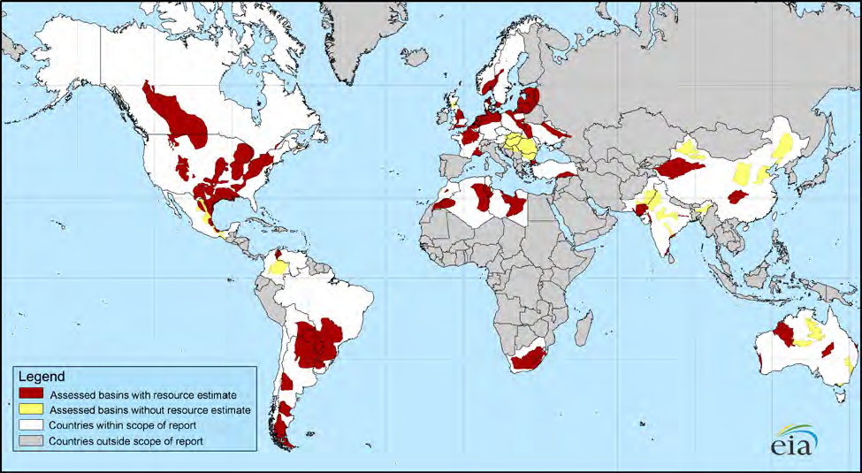
Opportunity: Global Shale Plays
Major Reassessments Reported
In England, Argentina and
Bengal Province
~22,600 TCF of Recoverable Reserves
6600 TCF from Shale (40%)
Current use ~160 TCF/year

Slide 5
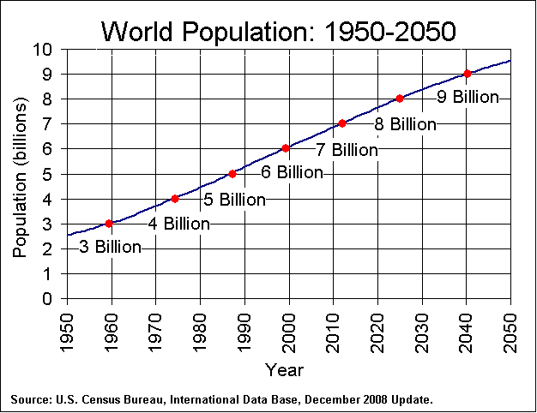

Global Energy and Environment Challenge
Economy
Society
National
Security
Environment
How Do We Provide Accessible, Affordable, and Secure Energy While Protecting the Planet (2x by 2050, 3-4x by 2100)?
Notes:
5

Slide 6

Air Pollution and Energy Source*
CH₄
Oil
Coal
CO₂ | 117,000 | 164,000 | 208,000
CO | 40 | 33 | 208
NO_{x} | 92 | 448 | 457
SO₂ | 0.6 | 1,122 | 2,591
Particulates | 7.0 | 84 | 2,744
Formaldehyde | 0.75 | 0.22 | 0.221
Mercury | 0 | 0.007 | 0.016
*Pounds/Billion BTU
EIA, 1998

Slide 7
Drilling/Completion Technology
Key To Exploitation of Shale Gas
Microseismic Events
Horizontal Drilling and Multi-Stage
Slick-Water Hydraulic Fracturing
Induces Microearthquakes (M ~ -1 to M~ -3)
To Create a Permeable Fracture Network
Well
Hydraulic Fractures

Slide 8
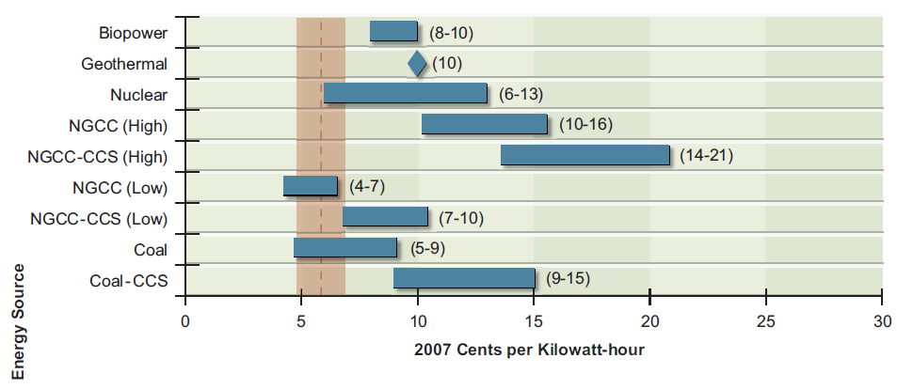
Gas And Coal Economics
(from America’s Energy Future) NAS - 2009
15

Slide 9
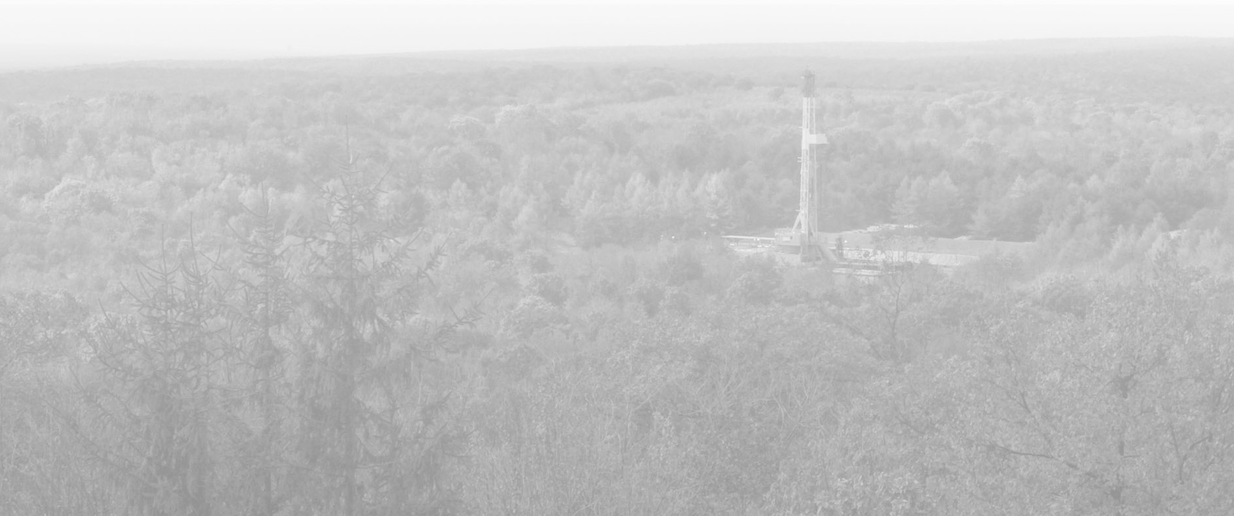
The Challenges of $4 Gas
Estimated NYMEX Price Required for 10% IRR
$8.00
2007-2008 PRICES
$6.00
NYMEX
$4.00
3/1/11
$2.00
Pinedale
Horn River
Nikanassin
Jonah
Huron Shale
Barnett (Tier 1)
Nora (CBM)
Haynesville
Uinta (Shallow)
Raton (CBM)
Barnett (Tier 2)
Barnett (Tier 3)
Granite Wash (HZ)
Wattenberg (Core)
Alberta Deep Basin
Mannville (CBM)
Fayetteville (3.4 Bcf)
Fayetteville (2.8 Bcf)
Deep Bossier (E. TX)
Woodford(Arkoma)
Alberta Shallow Gas
Powder River (CBM)
Marcellus Wet (Core)
Marcellus Dry (core)
Marcellus Dry (Tier 2)
Piceance (Highlands)
Piceance (Valley-Core)
Eagle Ford (Hawkville)
Montney (10 Stage Frac)
Woodford (Anadarko)
Jean Marie (Tight Gas)
Eagle Ford (Black Hawk)
Montney (4 Stage Frac)
Horseshoe Canyon (CBM)
Warwick (W. TX Overthrust)
Source: Morgan Stanley Research Report
Notes:
All the shale plays APC is involved in will meet 10% IRR at $4.00/mcf
Most of the larger plays such as Marcellus, Hville, EF and Horn River are economic down to lower price levels = very large COMMERCIAL resource
Sensitivities are more on some of the smaller shale resource plays
Shale gas is here to stay and will be predictable

Slide 10
So Do We Know How This Works?
Microseismic Events
Horizontal Drilling and Multi-Stage
Slick-Water Hydraulic Fracturing
Induces Microearthquakes (M ~ -1 to M~ -3)
To Create a Permeable Fracture Network
Well
Hydraulic Fractures

Slide 11
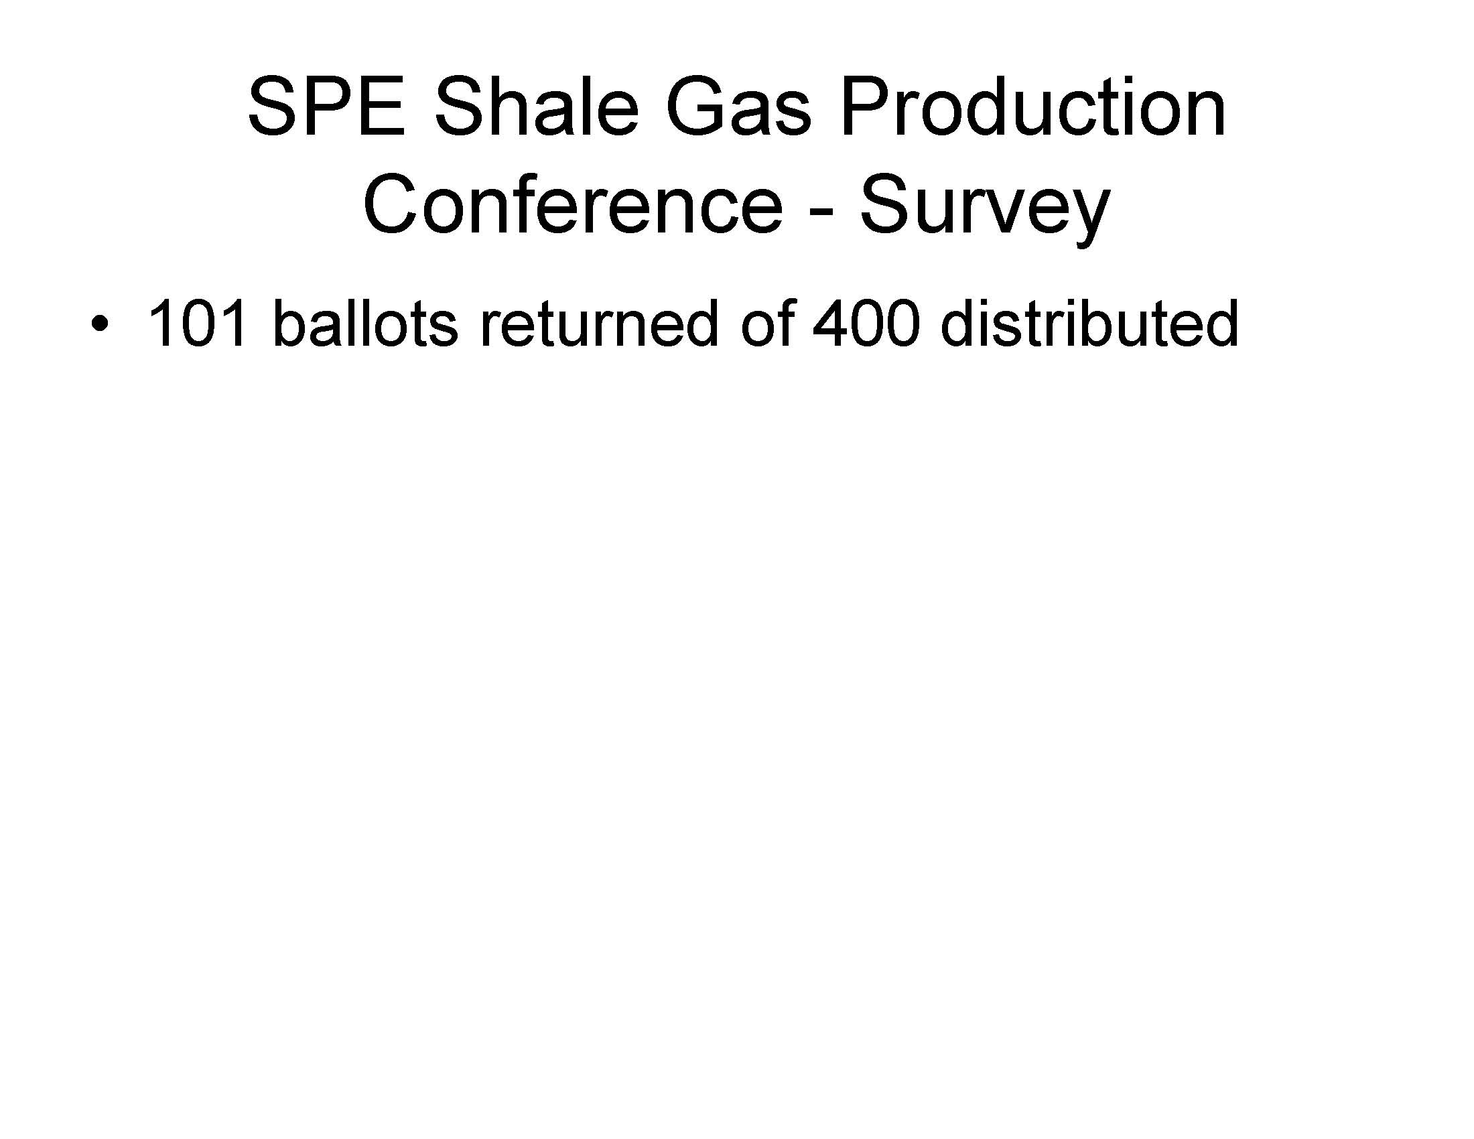
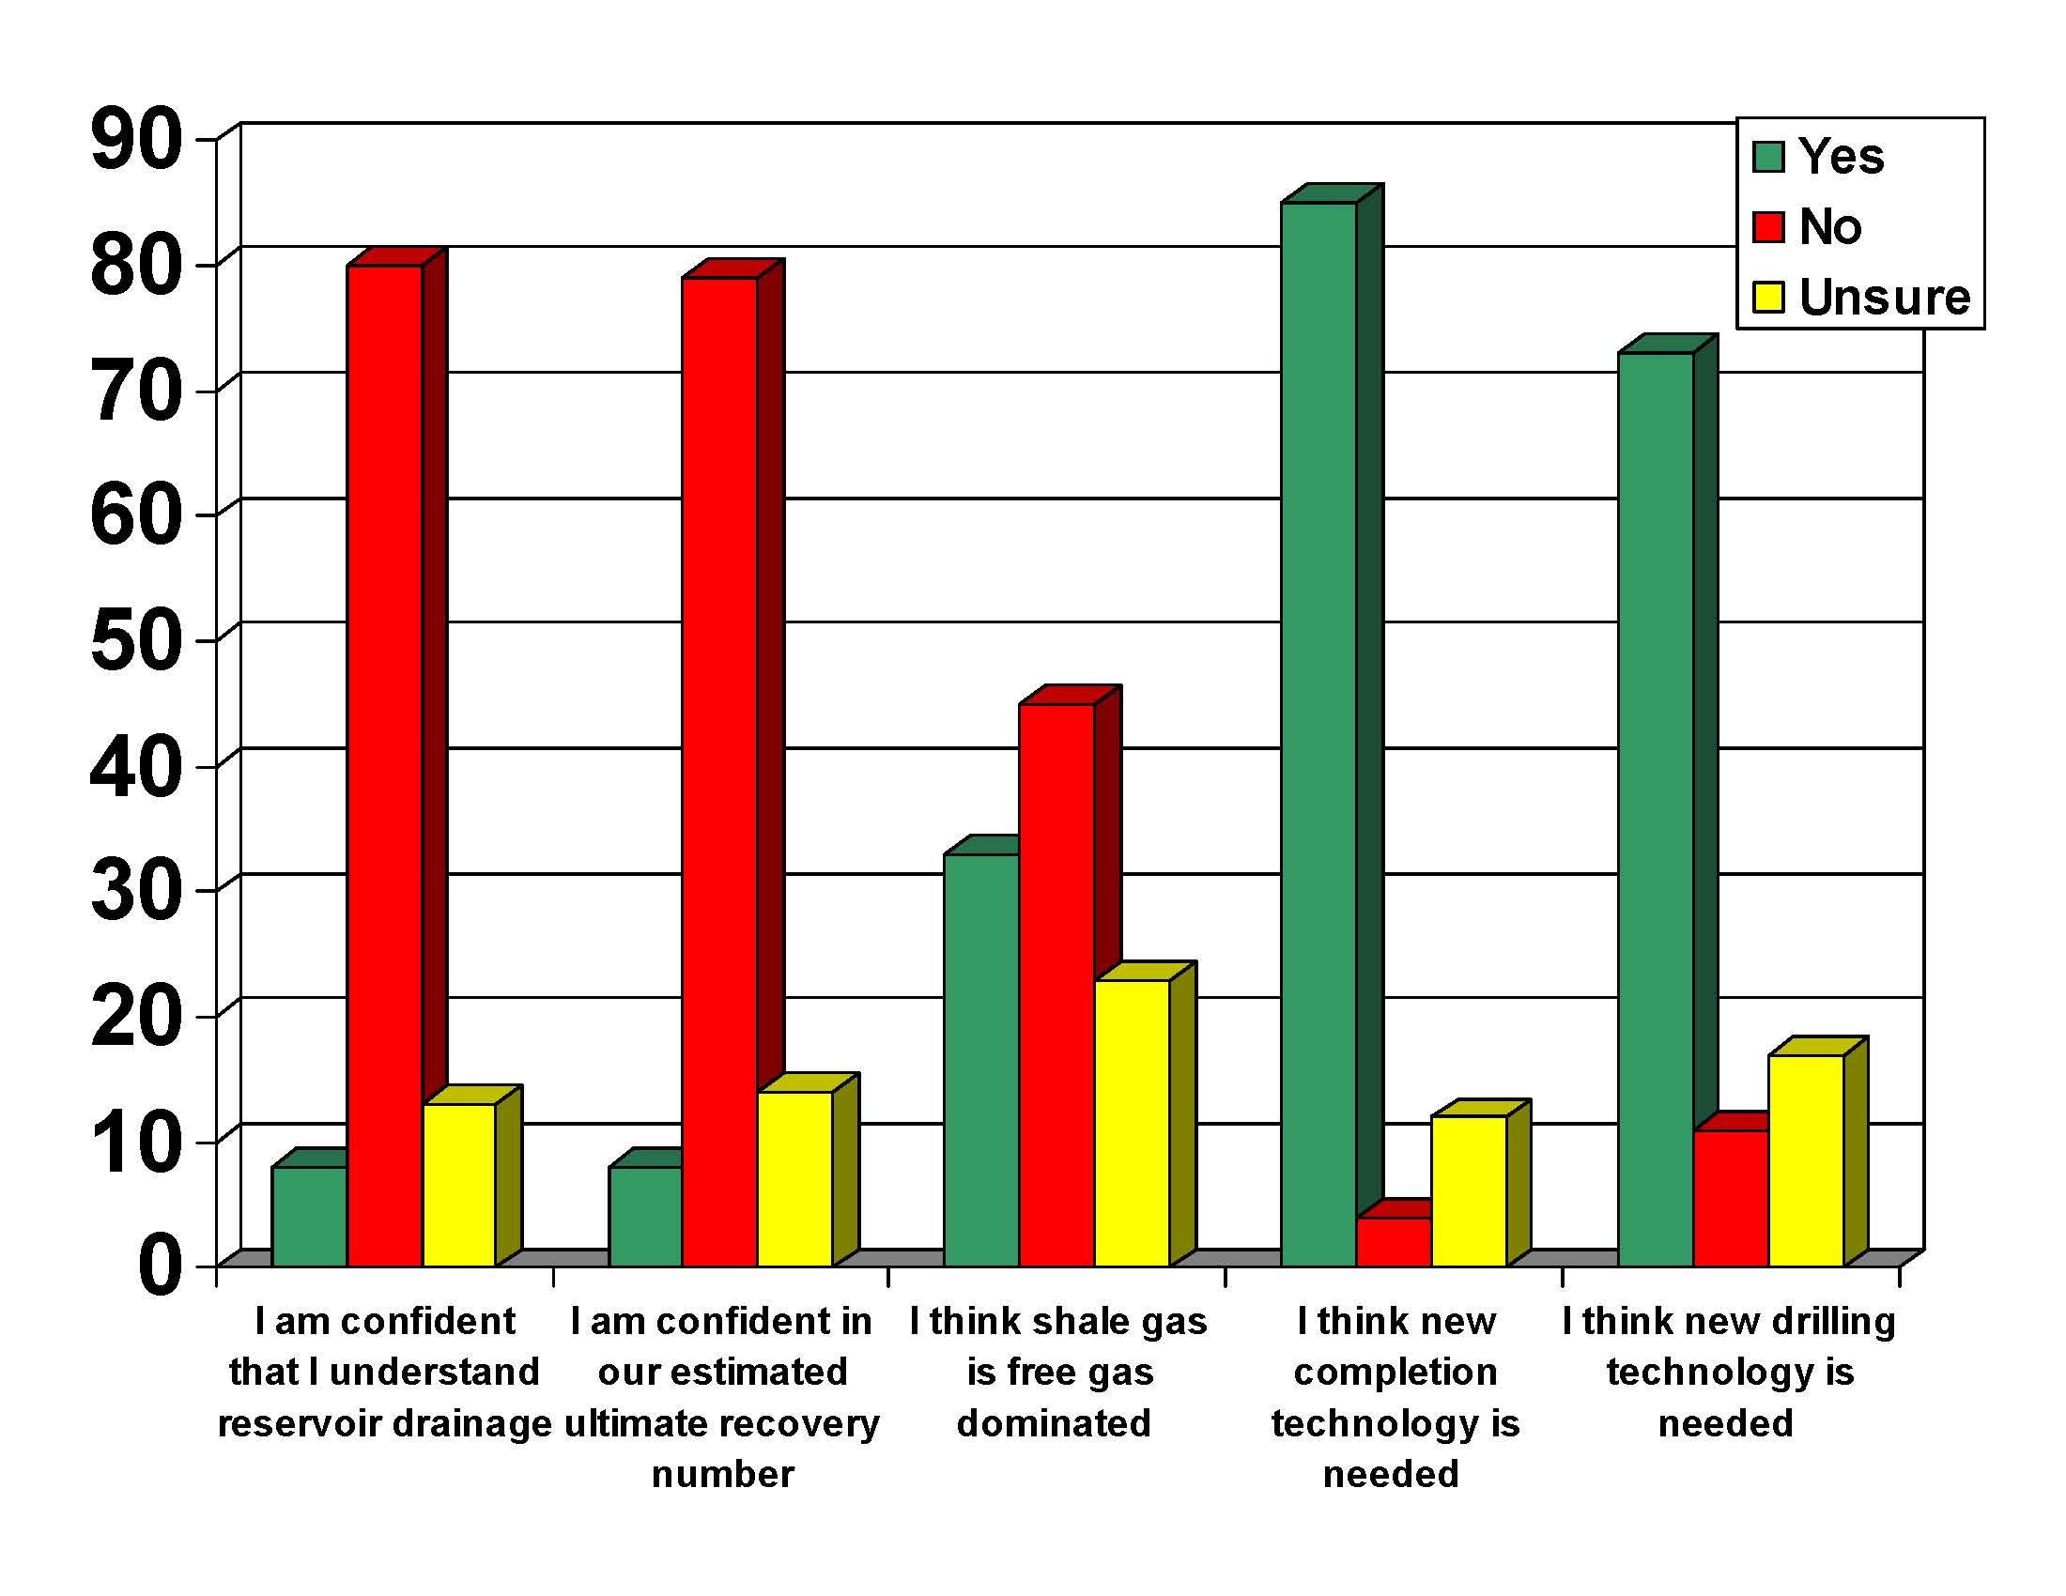

Slide 12
Some New Ways of Thinking
Fundamental Science
How rock properties affect the success of stimulation
The importance of aseismic deformation mechanisms on reservoir stimulation
Factors affecting ultimate recovery
Notes:
12

Slide 13
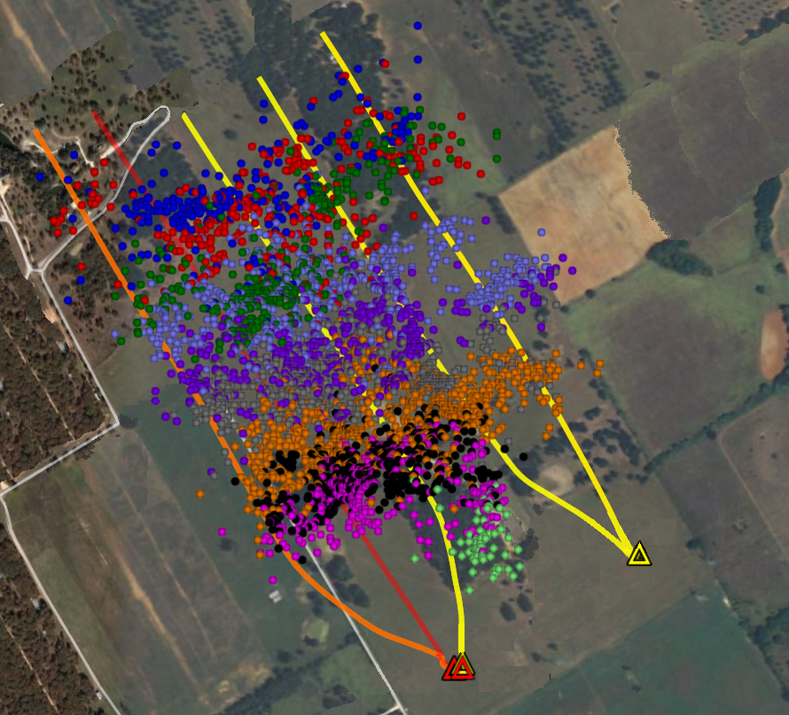
Physical and Chemical Properties of Organic Rich Shales
How Do the Properties of Shale Affect the Outcome of Hydraulic Fracturing Stimulation?
5 Wells, 40 Stages, ~4000 Microseismic Events

Slide 14
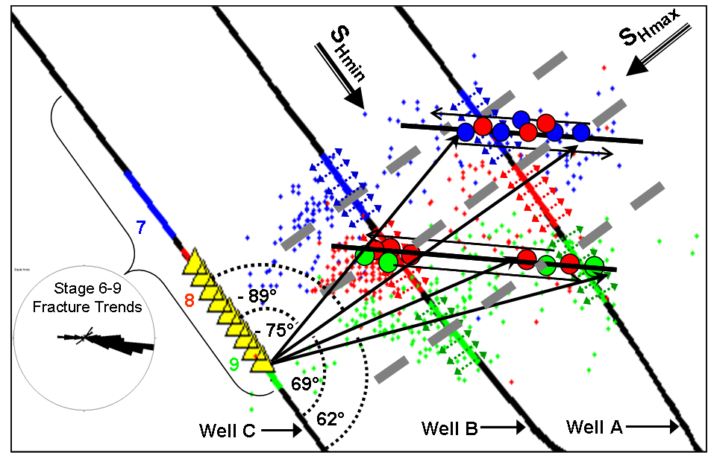
What is Going on Within the Reservoir
During Hydraulic Fracturing?
Volume Affected by 4000 Microearthquakes Can
Account for Less Than 1% of Gas Production in First 6 Months

Slide 15
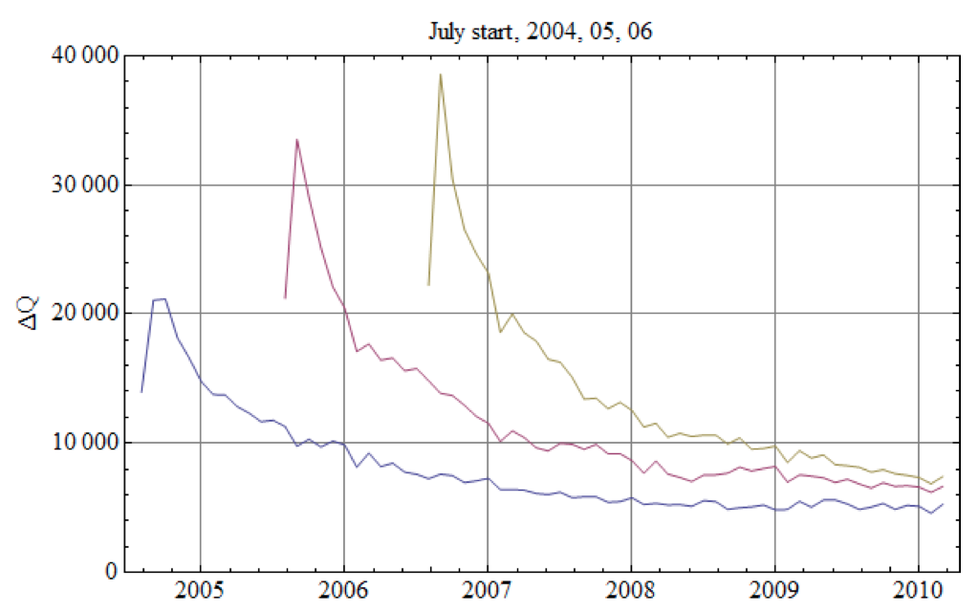
Why Is Production Persistent?
Average Monthly Well Production
Barnett Shale
Valko and Lee (2010)
Extended Exponential Model
SPE 134231
Notes:
15

Slide 16
Current Research Collaborations
ConocoPhillips – Barnett Microseismic and Frac Data, Shale Core, Fault Damage Zones
Chevron – Geomechanics of Shale Gas and CO₂ Sequestration
RPSEA – Horn River Shale Gas (w/ LBNL, Texas A&M)
Exxon – Heavy Oil, Adsorption and Swelling
BP - Haynesville Core, Slickwater Frac’ing with CO₂, Geomechanics of Paleogene (GOM)
DOE - CO₂ Sequestration in Shale Gas Reservoirs
Hess – Bakken Shale, Frac’ing, Microseismic and Geomechanics
Apache/Encana – Horn River Microseismic and Geomechancis Study

Slide 17

Current Research Collaborations

Slide 18
Some New Ways of Thinking
Fundamental Science
How rock properties affect the success of stimulation
The importance of aseismic deformation mechanisms on reservoir stimulation
Factors affecting ultimate recovery
Operations
Minimizing the environmental impact of shale gas development
Notes:
18

Slide 19
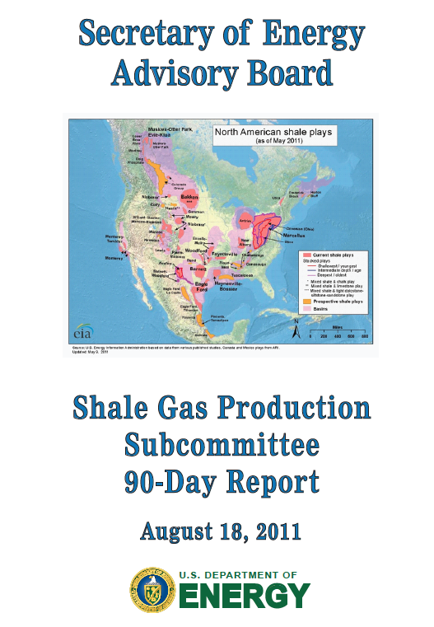

Slide 20
DOE Shale Gas Subcommittee
John Deutch – MIT
Stephen Holditch – Texas A&M
Fred Krupp – Environmental Defense Fund
Katie McGinty – Pennsylvania DEP
Sue Tierney – Massachusetts Energy
Dan Yergin – Cambridge Energy Research
Mark Zoback - Stanford

Slide 21
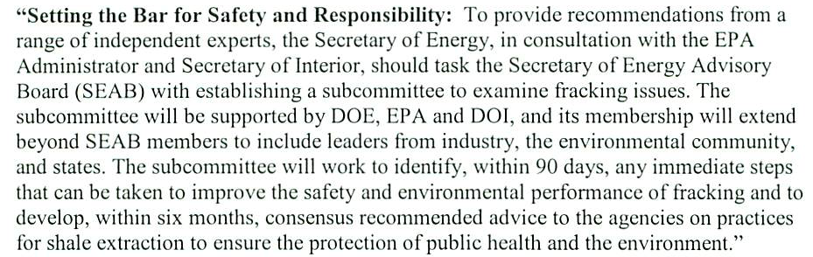
New DOE Committee
President Obama directed Secretary Chu to convene this group as part of the President’s “Blueprint for a Secure Energy Future”

Slide 22
90 Day Report Summary
Shale gas is extremely important to the energy security of the United States
Shale gas currently accounts for 30% of the total US natural gas production
Shale gas development has a large positive economic impact on local communities and states
Shale gas development creates jobs
Shale gas can be developed in an environmentally responsible manner.

Slide 23
90 Day Report Summary
Improve public information about shale gas operations: Create a portal for access to a wide range of public information on shale gas development…
Improve communication among state and federal regulators: Provide continuing annual support to STRONGER (the State Review of Oil and Natural Gas Environmental Regulation) and to the Ground Water Protection Council…
Improve air quality: Measures should be taken to reduce emissions of air pollutants, ozone precursors, and methane as quickly as practicable...

Slide 24
90 Day Report Summary
Protection of water quality-1: The Subcommittee urges adoption of a systems disclosure of the flow and composition of water at every stage of the shale gas production process.

Slide 25
90 Day Report Summary
Protection of water quality-1: The Subcommittee urges adoption of a systems disclosure of the flow and composition of water at every stage of the shale gas production process.

Slide 26
90 Day Report Summary
Protection of water quality-2: Hydraulic Fracturing

Slide 27
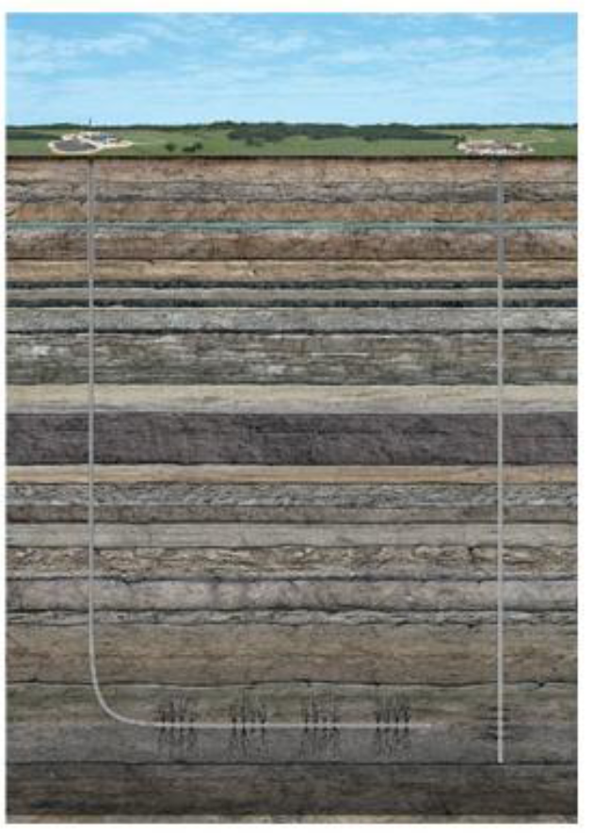
Will Vertical Hydrofrac Growth Affect
Water Supplies?

Slide 28
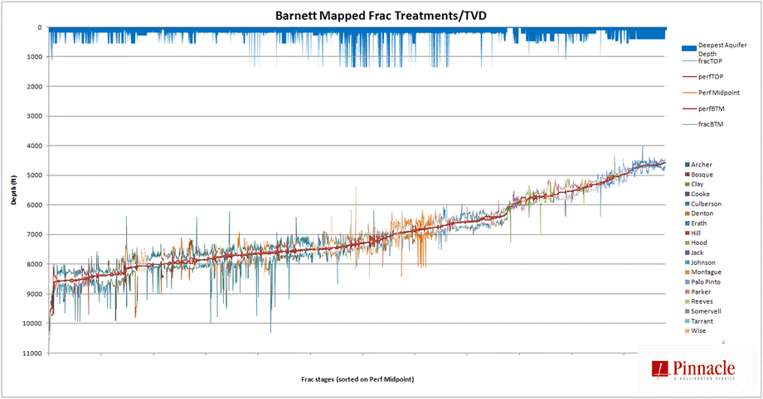
Depth of Affected Region Affected
by Hydraulic Fracturing
Fisher (2010)
http://nwis.waterdata.usgs.gov/nwis/inventory

Slide 29
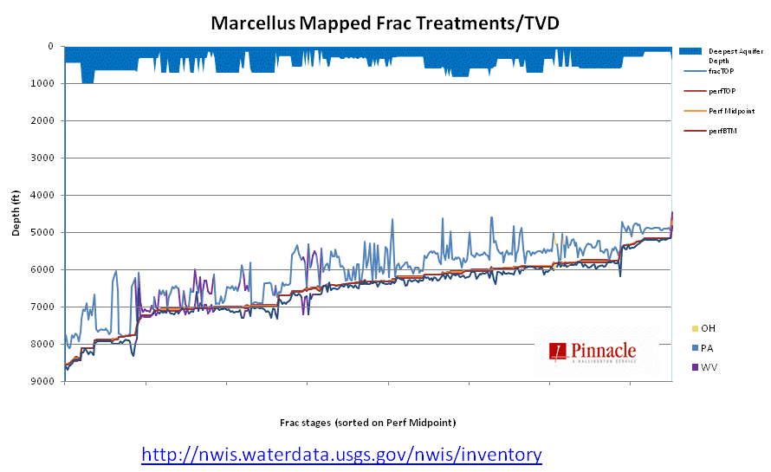
Depth of Affected Region Affected
by Hydraulic Fracturing
Fisher (2010)

Slide 30
Will Vertical Hydrofrac Growth Affect
Water Supplies?
Representation and
Public Opinion

Slide 31
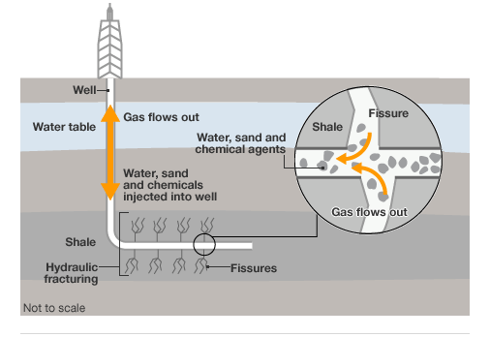
News report following Blackpool Earthquake
BBC, online news

Slide 32
90 Day Report Summary
Protection of water quality-3:
  Adopt best practices in well development and construction, especially casing, cementing, and pressure management. Pressure testing of cemented casing and state-of-the-art cement bond logs should be used to confirm formation isolation.

Slide 33
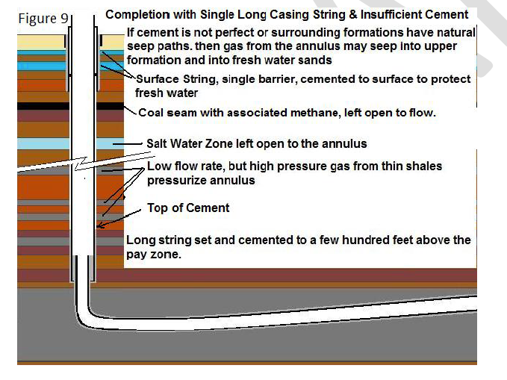
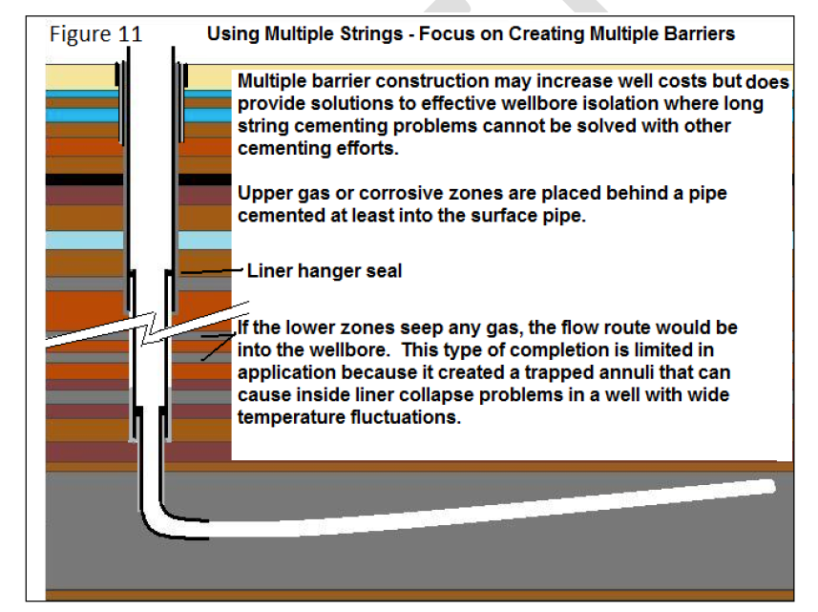
Courtesy George King, Apache Corp.

Slide 34
90 Day Report Summary
Protection of water quality-4:
  Water use and water disposal issues are changing rapidly

Slide 35
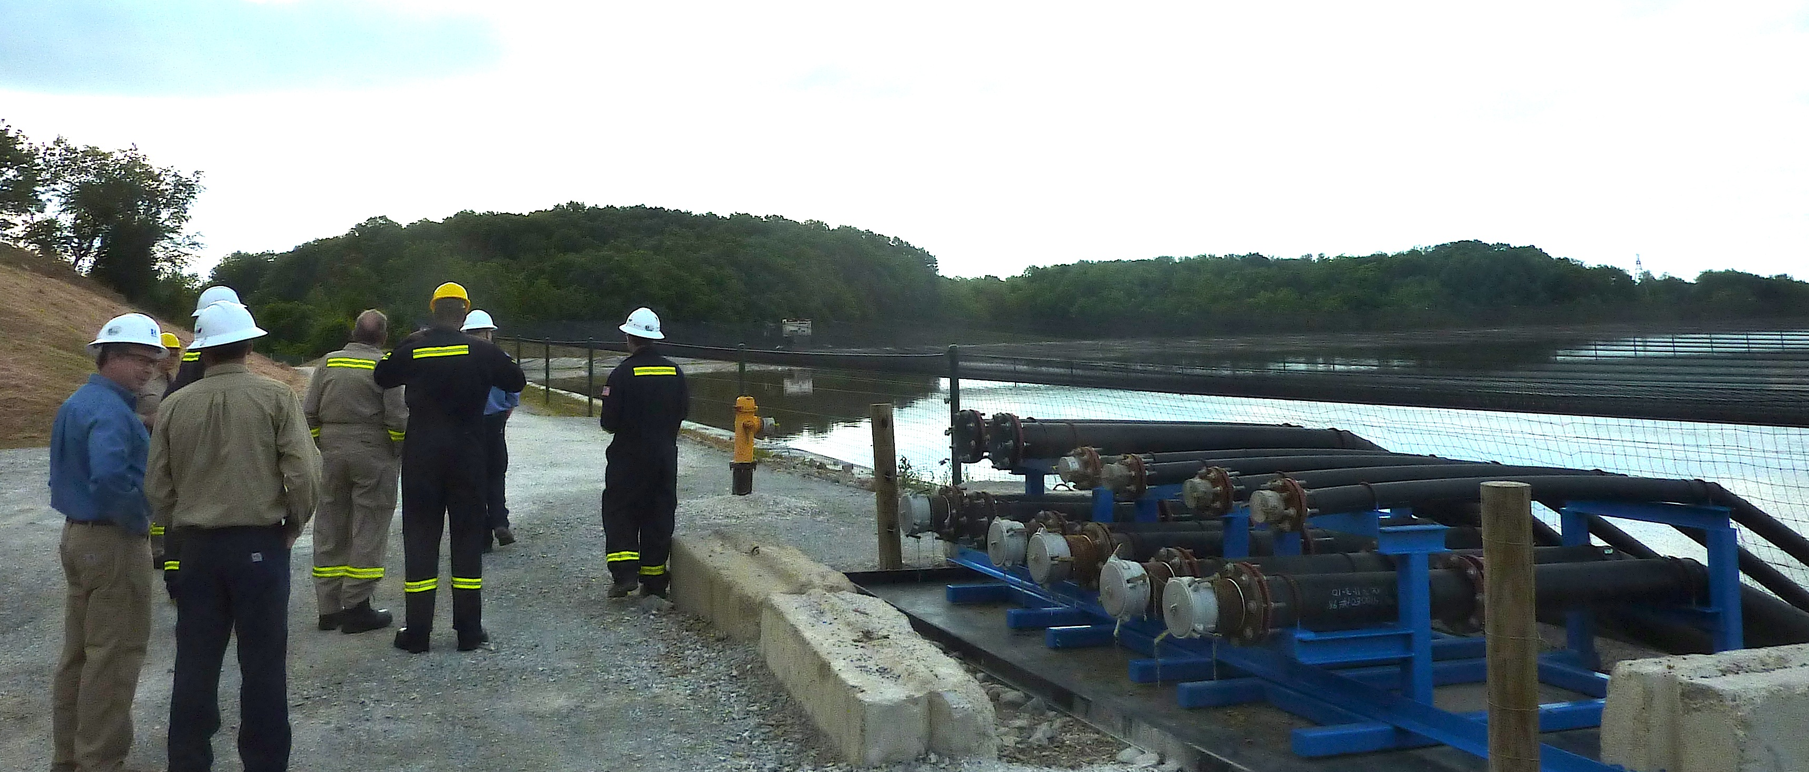
Water Issues Changing Rapidly

Slide 36
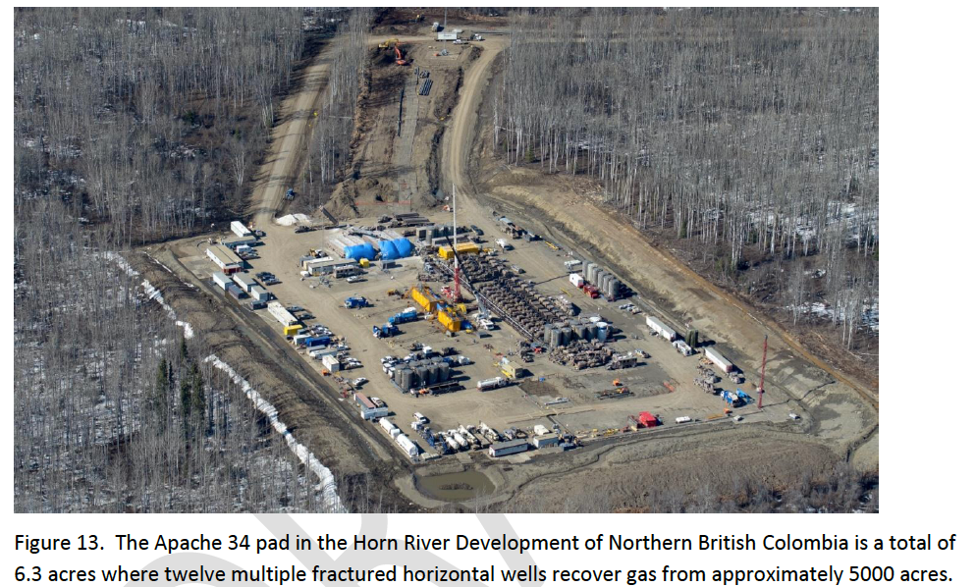
Water Issues Changing Rapidly
Courtesy George King, Apache Corp.

Slide 37
90 Day Report Summary
Disclosure of fracturing fluid composition: The Subcommittee shares the prevailing view that the risk of fracturing fluid leakage into drinking water sources through fractures made in deep shale reservoirs is remote. Nevertheless the Subcommittee believes there is no economic or technical reason to prevent public disclosure of all chemicals in fracturing fluids...
http://www.shalegas.energy.gov/

Slide 38
90 Day Report Summary
Managing short-term and cumulative impacts on communities, land use, wildlife, and ecologies. Each relevant jurisdiction should pay greater attention to the combination of impacts from multiple drilling, production and delivery activities
http://www.shalegas.energy.gov/

Slide 39
90 Day Report Summary
Organizing for best practice: The Subcommittee believes the creation of a shale gas industry production organization dedicated to continuous improvement of best practice, defined as improvements in techniques and methods that rely on measurement and field experience, is needed to improve operational and environmental outcomes.
Final Report: Just Released
http://www.shalegas.energy.gov/

Slide 40


Slide 41
But we still
have a lot of work to do!
WILL

