Slide 1
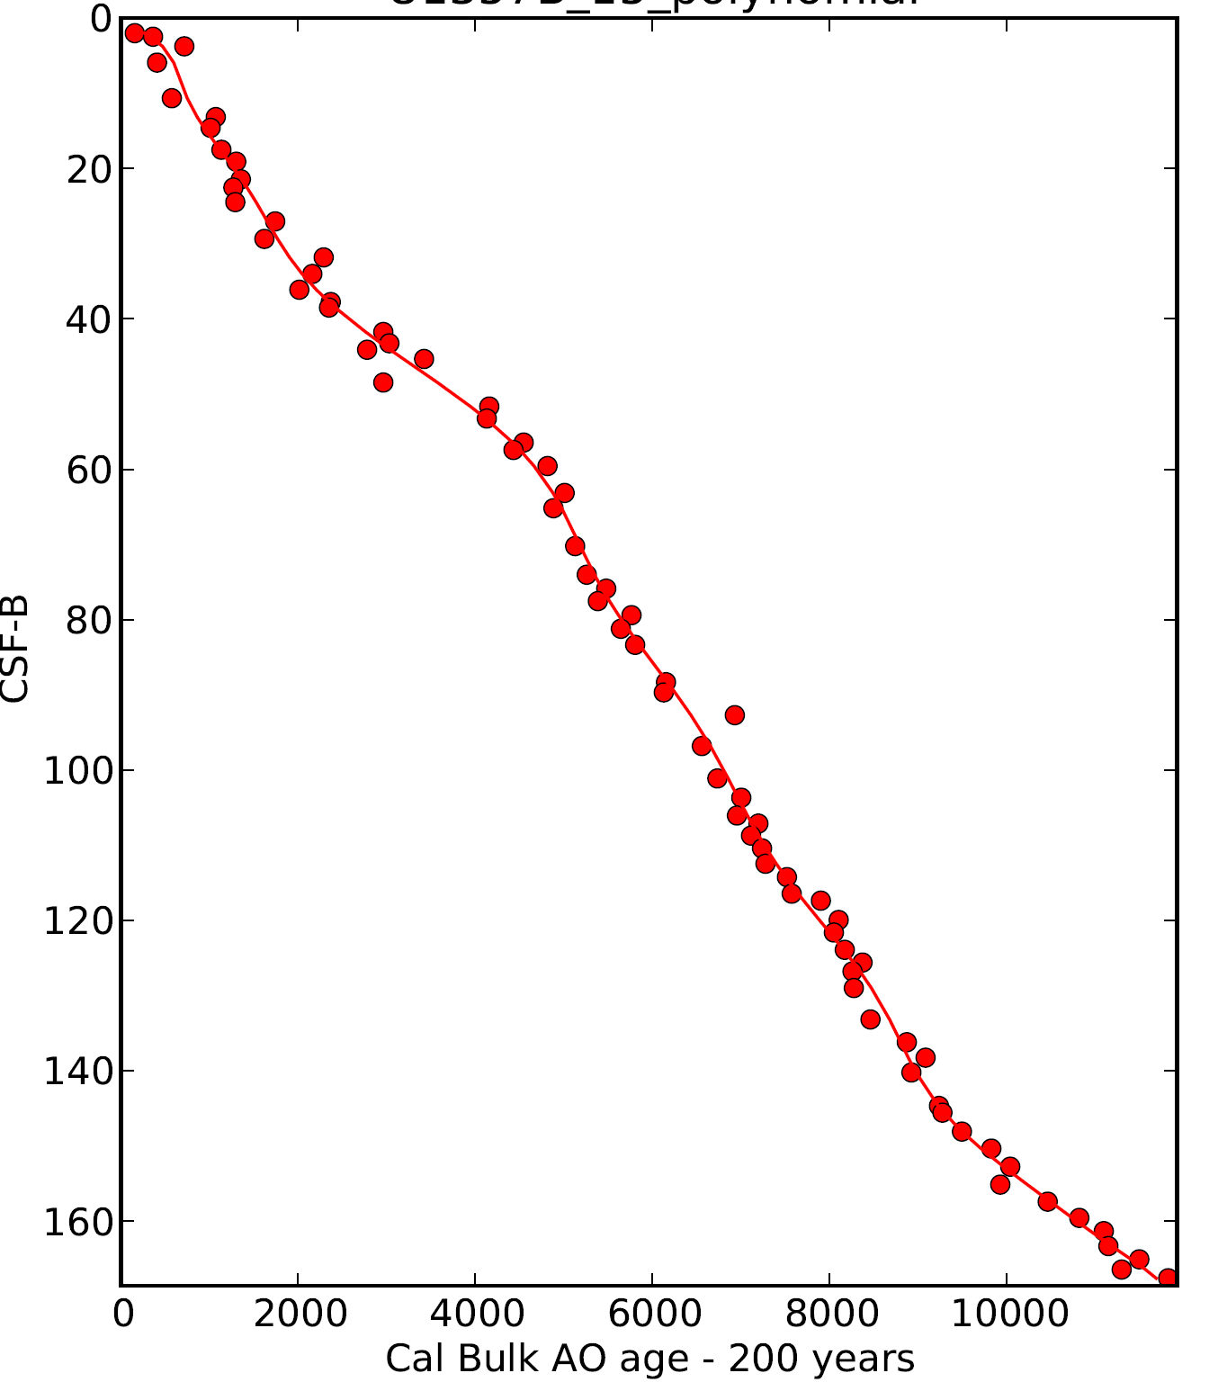
Higher order polynomial gives best fit to AMS dates as well as to secular paleomag inclination curve
U1357B
Bulk TOC AMS ¹⁴C dates – corrected for SO reservoir ages plus a small detrital “dead”
C offset.
Meters below seafloor (CSF-B)

Slide 2
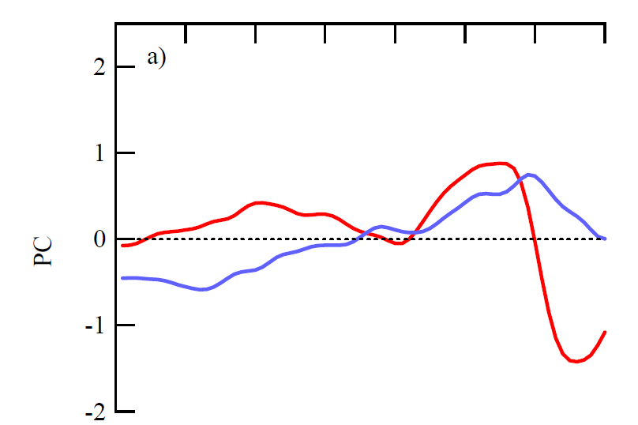
Signals common to 5 Antarctic Ice cores (EDC, DF, VK, DML, TALD)
Mode 1 (78% of variance)
1º/oo “optimum” 11.5 to 10 kyr BP
minimum at 8 kyr BP
0.4º/oo “optimum” at 4 kyr BP
Mode 2 (18% of variance)
long term decrease 12 to 2 kyr BP
Masson-Delmotte et al., 2011

Slide 3
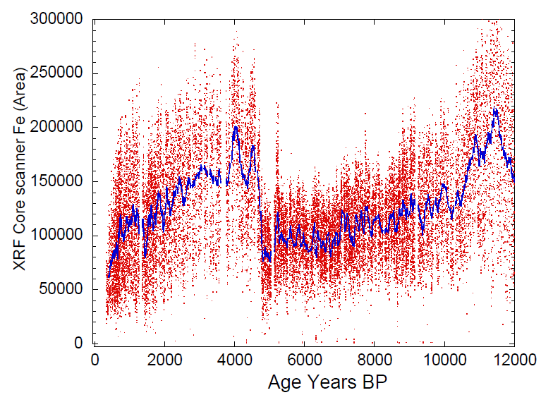

Slide 4
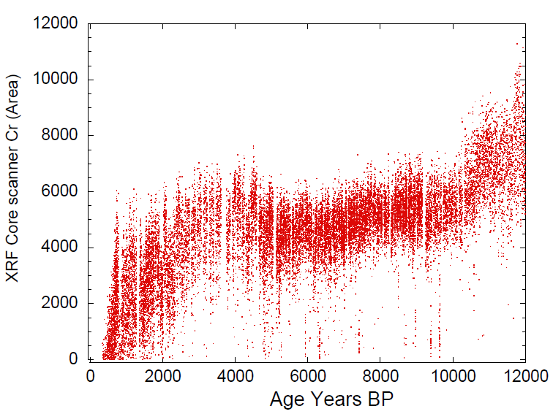

Slide 5
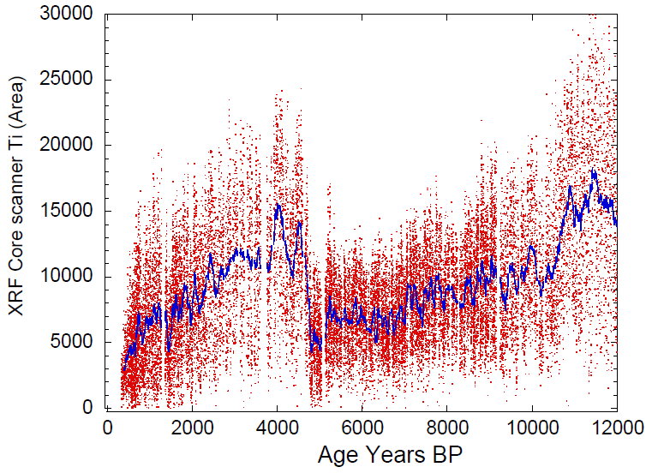

Slide 6
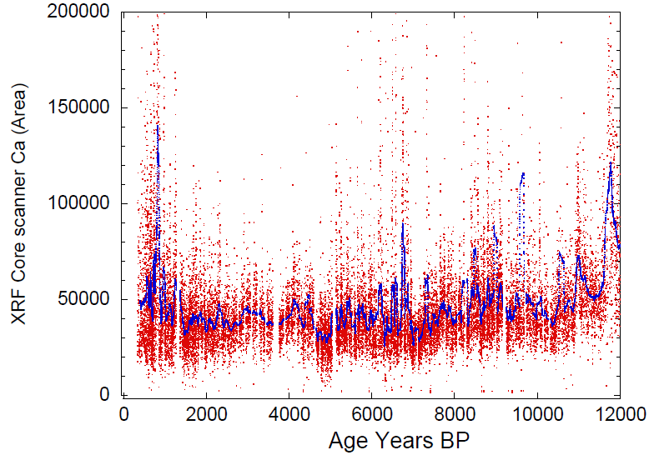

Slide 7
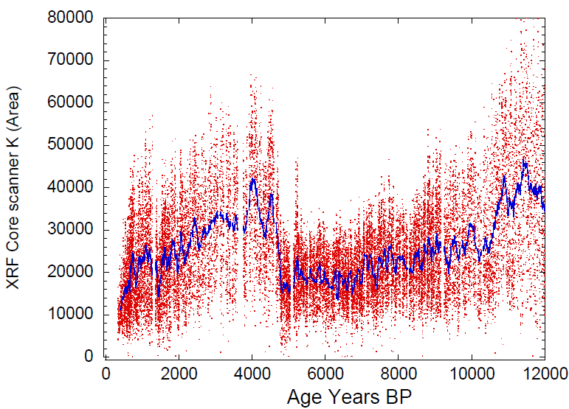

Slide 8
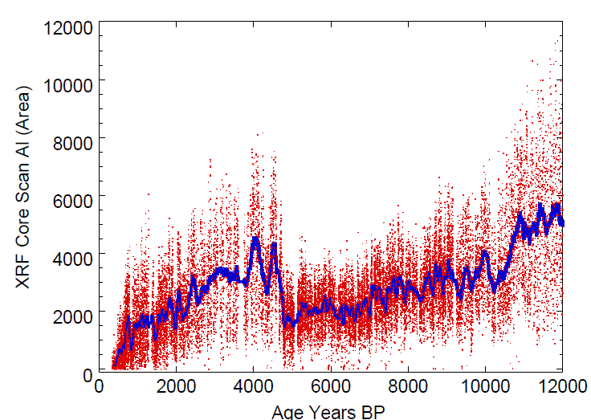

Slide 9
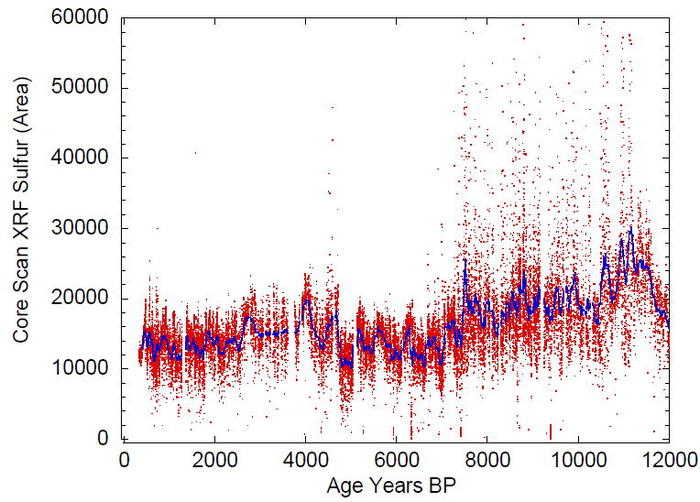

Slide 10
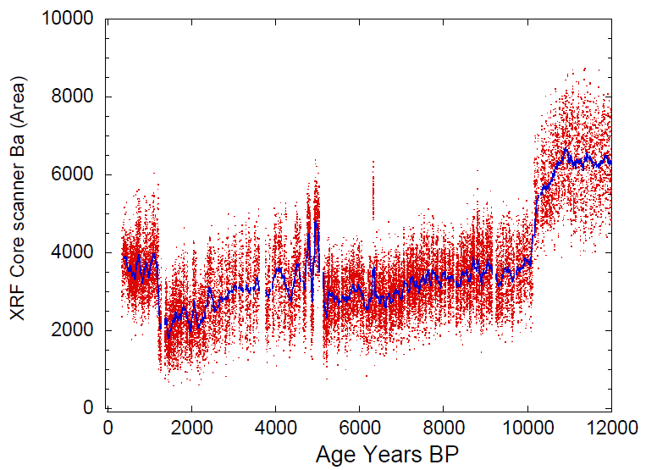

Slide 11
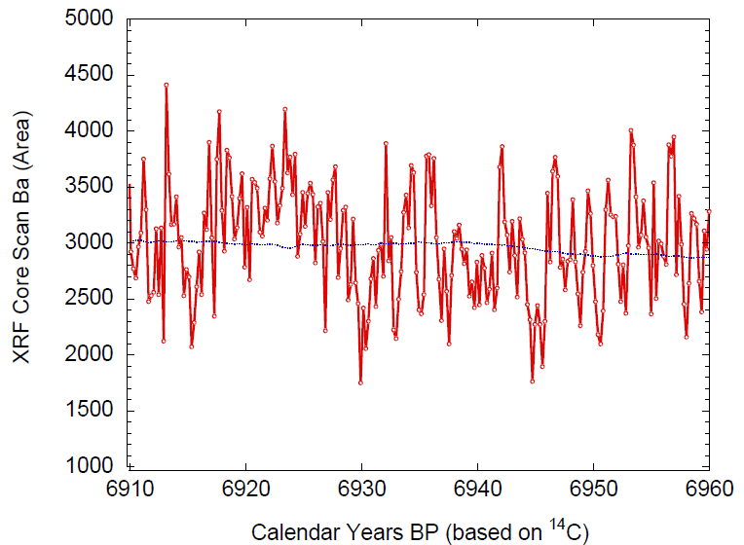
51 Ba cycles over 50 calendar years based on ¹⁴C
10
40
50
20
30

Slide 12
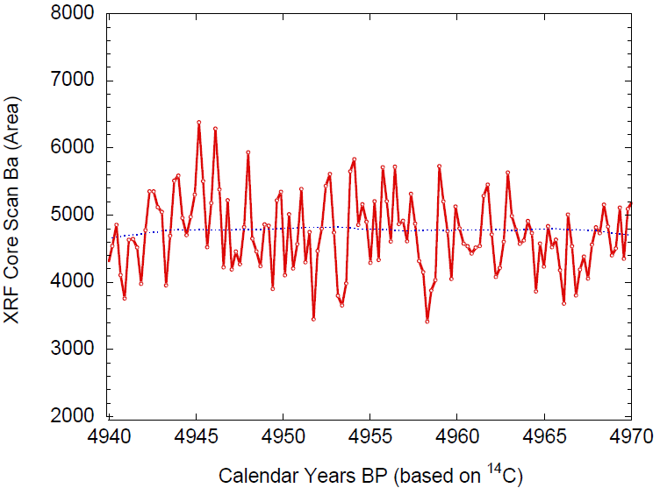
32 Ba cycles over 30 calendar years based on 14C
5
15
20
25
10
30
1

