Slide 1
Universal Kriging with Training Images
Lewis Li, Thomas Romary, & Jef Caers
27th SCRF Affiliates’ Meeting
May 8-9th 2014

Slide 2
Motivation: An Alternative Formulation of Univeral Kriging
Universal kriging: Elegant theory, sometimes hard to apply
Decomposition
Variogram modeling
Spatial estimation with training images: UK-TI
Combination with existing MPS techniques: e.g. Direct Sampling
Comparison with variogram based approach

Slide 3
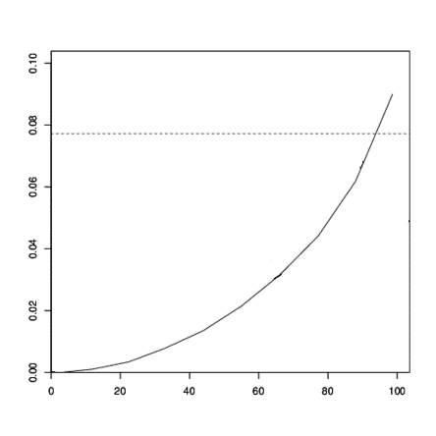
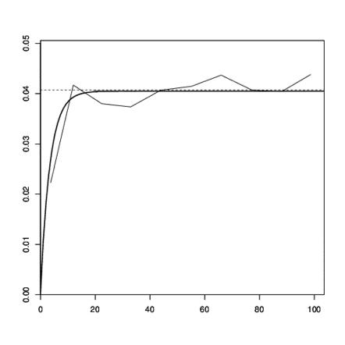
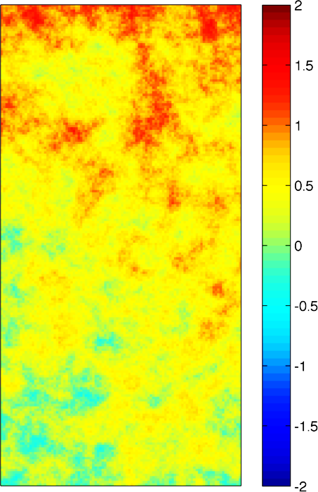
Review of Universal Kriging
Ordinary kriging: local stationarity + slowly varying means
Universal kriging: estimate trend, kriging on residuals
Z$\left(x\right)=m\left(x\right)+R(x)$
Raw Variogram
Residual Variogram
γ(h)
γ(h)
h
h

Slide 4
Problem 1: Residual Covariance - Catch 22
Catch 22
Need m(X) to find R(x) Need R(x) to find m(x)
Z$\left(x\right)=m\left(x\right)+R(x)$
Estimate trend: Ordinary Least Squares (OLS)
Compute residuals, model variogram
Re-estimate trend using Generalized Least Squares (GLS)
Re-compute residuals, re-model variogram
Kriging

Slide 5
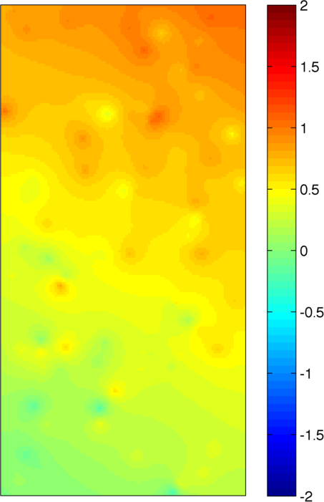
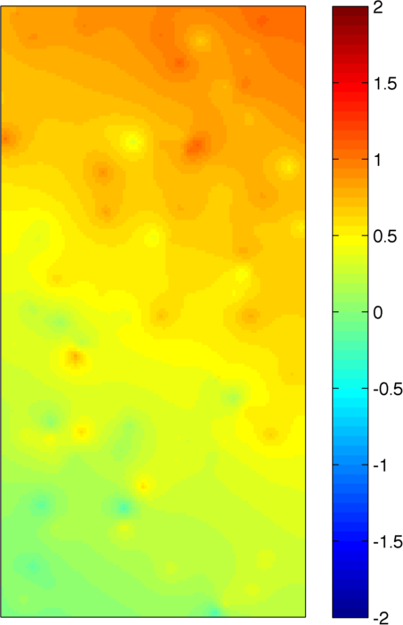
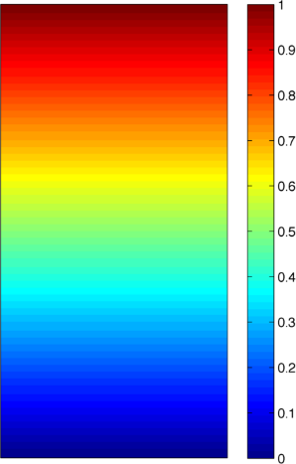
Simple Trend Example
Reference
True Trend
Estimated Trend
OLS Only
OLS + GLS

Slide 6
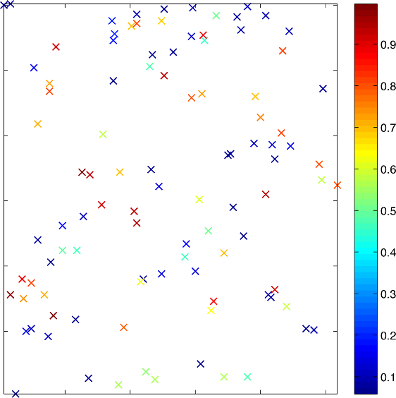
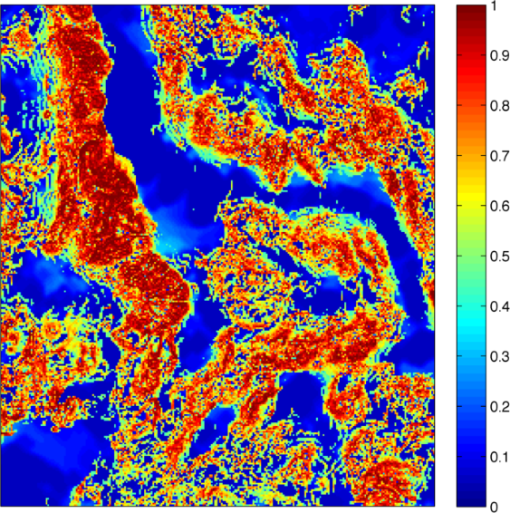
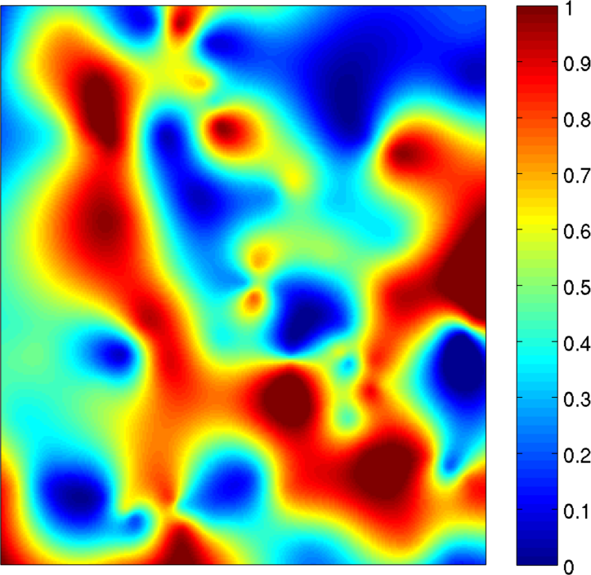
Walker Lake Trend
Bi-harmonic splines?
Thin plate splines?
Bi-cubic interpolation?
Nearest-neighbor?
Lanczos resampling?

Slide 7
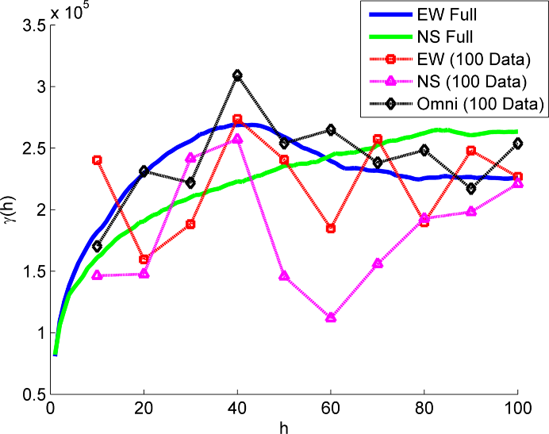
Problem 2: Variogram Modeling
Improper decomposition
Sparse data
Skewed histogram
Higher order correlations
Walker Lake Variograms

Slide 8
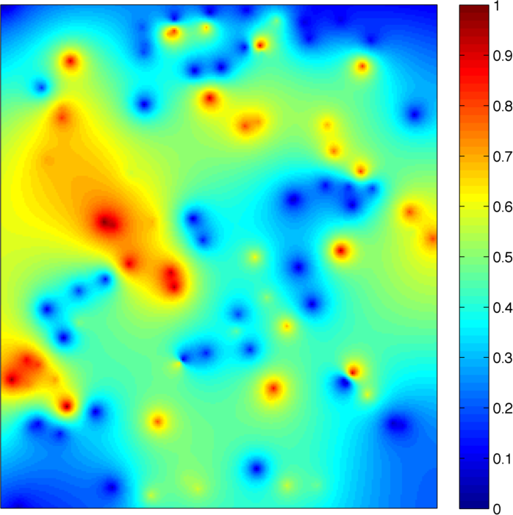
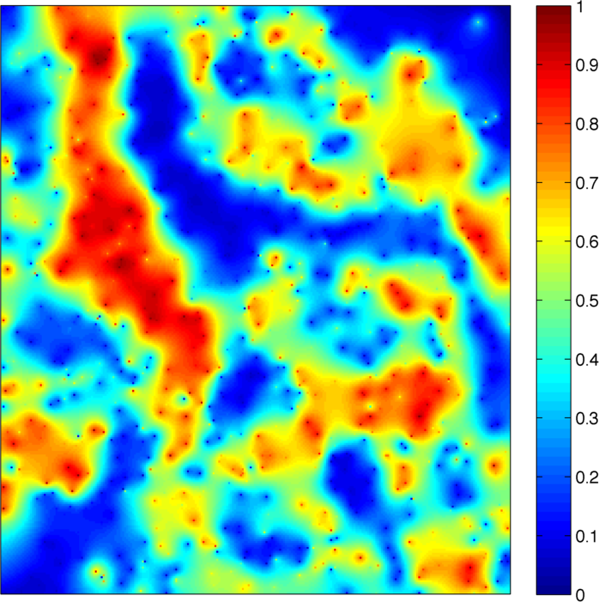
Walker Lake Universal Kriging
100 Data Points
1000 Data Points

Slide 9
Universal Kriging With Training Images
Previous Works:
Matheron (1978): “Repetitive process/schéma glissant”
Journel (1996): “Deterministic geostatistics”
Advances in training image methodology
Continuous variables
Constructing of non-stationary training images
More intuitive for non-experts

Slide 10
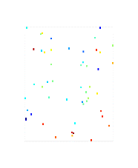
Calculating Statistics on TI
Estimator:
$$z^{\#}\left(x\right)= \sum_{α=1}^{n}{λ_{α}z(x_{α}})$$
$$Z^{∗}\left(x\right)= \sum_{α=1}^{n}{λ_{α}Z(x_{α}})$$
Zero Error Sum/Unbiased Condition:
$$\sum_{x∈{TI}_{dcf}}{(z_{TI}^{\#}}\left(x\right)−z_{TI}(x))=0$$
$$E\left(Z^{∗}\left(x\right)−Z\left(x\right)\right)=0$$
Data Configuration:
$$dcf=\{x+h_{1};x+h_{2};…;x+h_{n}\}$$

Slide 11
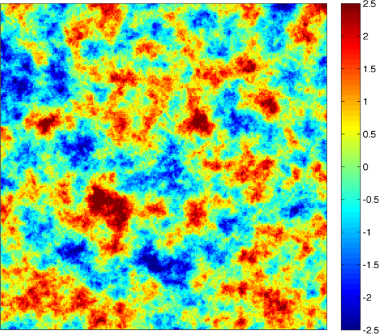
Mathematical Erosion
Data Configuration: dcf
TI_{dcf}
#|TI_{dcf}|: Number of cells in TI_{dcf}
Eroded Training Image
Training Image

Slide 12
Objective Function
Minimum Sum of Square Error Condition:
$$\min_{}{\sum_{x∈{TI}_{dcf}}{(z_{TI}^{\#}}\left(x\right)−z_{TI}(x))2}$$
$$\min_{}{E\left(Z^{∗}\left(x\right)−Z\left(x\right)\right)2}$$
UK-TI System Equations:
$${sop}_{{TI}_{dcf}}\left(hα,hβ \right)= \frac{1}{{\#|{TI}_{dcf}\text{|} }_{}}\sum_{x∈{TI}_{dcf}}{z_{TI}^{}(x+hα)}z_{TI}^{}(x+hβ)$$
$${av}_{{TI}_{dcf}}(hα)= \frac{1}{{\#|{TI}_{dcf}\text{|} }_{}}\sum_{x∈{TI}_{dcf}}{z_{TI}^{}(x+hα)}$$

Slide 13
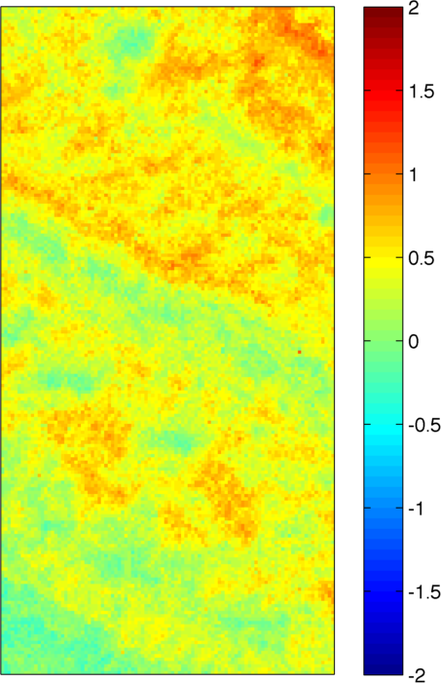
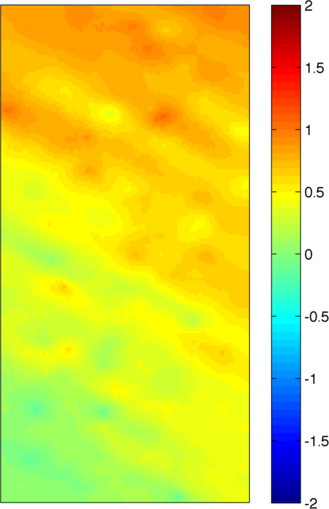
Simple Trend
Training Image
UK - Variogram
UK – Training Image

Slide 14
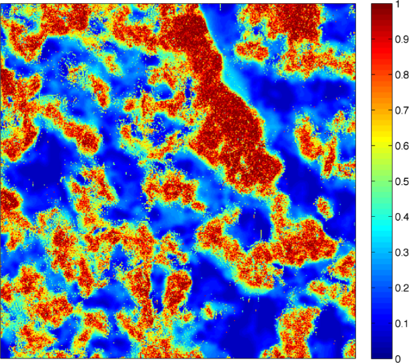
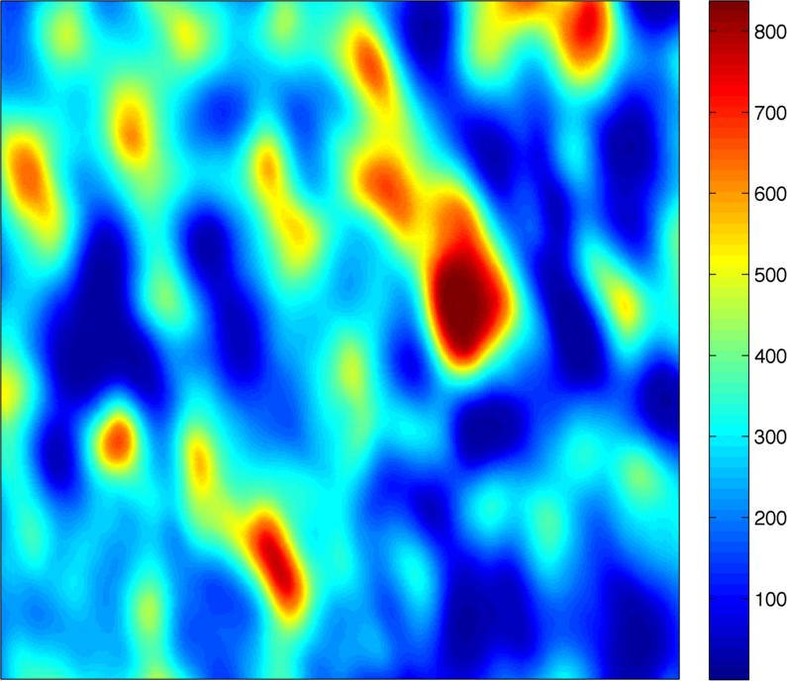
Where Do Training Image Come From?
Training Image
Auxiliary Data

Slide 15
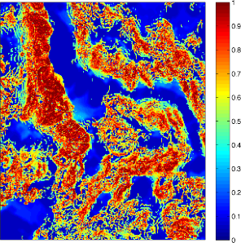
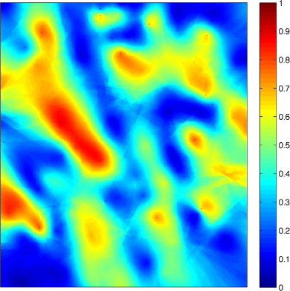
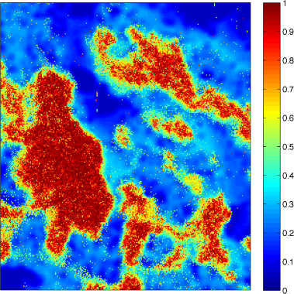
Walker Lake With UK-TI
Walker Lake
Variogram Kriging Estimate
Auxiliary Data: Primary Domain
“Local” Training Image
UK-TI Kriging Estimate

Slide 16
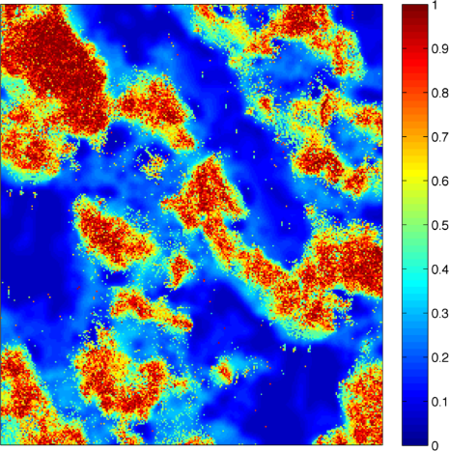
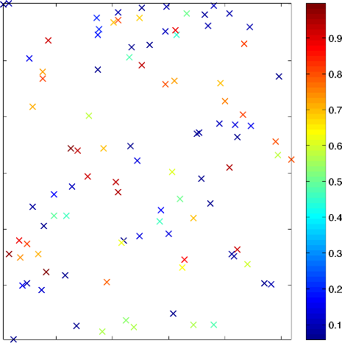
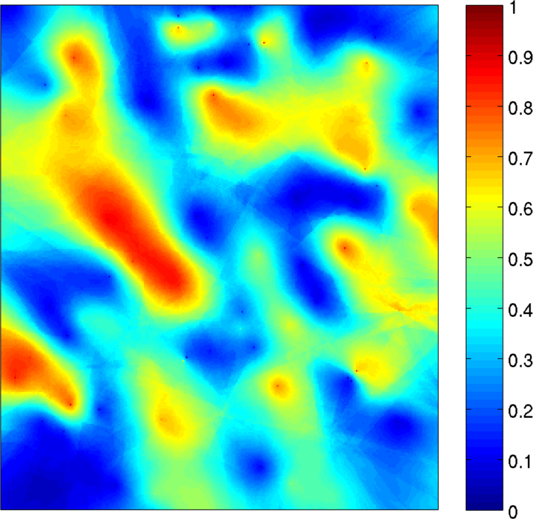
No Auxiliary Data On Primary Domain
Use data points as conditioning data for Direct Sampling

Slide 17
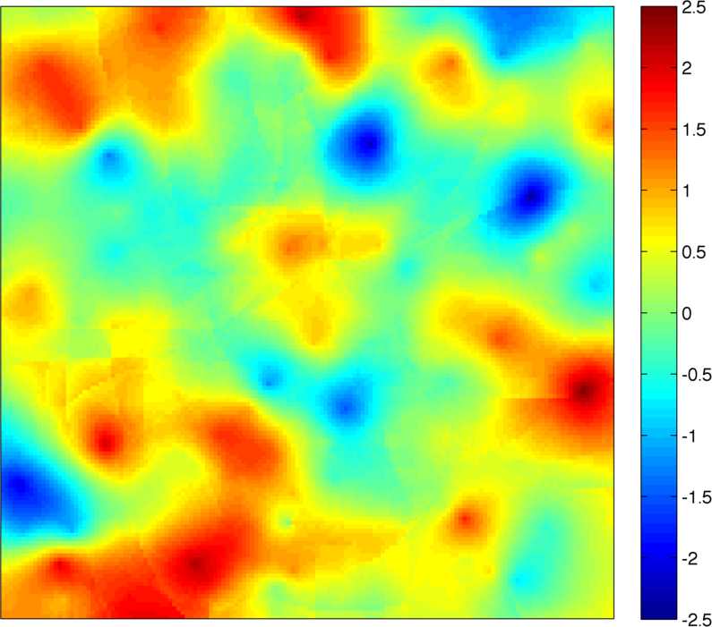
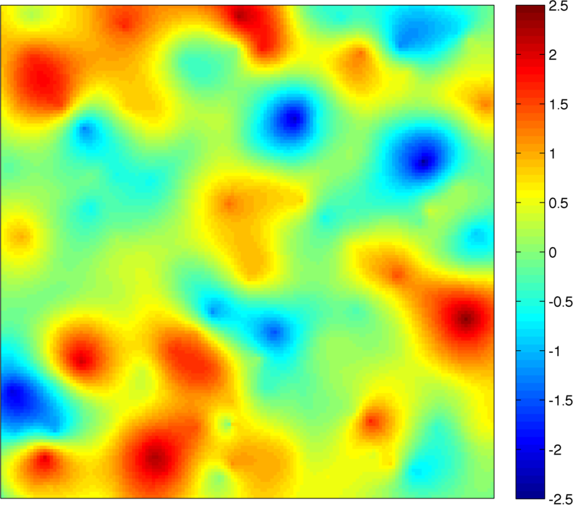
Challenge #1: Finite Domain
Search Neighborhood
Finite Kriging Correction: Solve multiple systems
Location 1
Location 2
Kriging weights change dramatically when data point leave neighborhood!

Slide 18
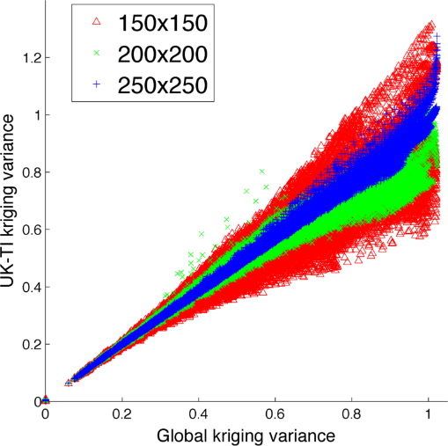
Challenge #2: Training Image Size
Global kriging: variogram approach + global neighborhood
TI Size: Related to largest features
Small training image causes fluctuations in correlations + artifacts

Slide 19
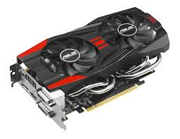
Challenge #3: Computational Expense
UK-TI: “embarrassingly” parallel: reduction + prefix sum
Texture memory on Graphics Processing Unit (GPU) for training image
GPU implementation on GTX760 = same run time as variogram on CPU i5
Fast Fourier Transform (FFT) Implementation

Slide 20
Conclusions
Summary
Future Work
Modeling efforts on images
No decomposition
Auxiliary variable of TI
Works with sparse data sets
Application to subsurface data
Extension to co-kriging and simulation
Fast Fourier Transform implementation

Slide 21
Extra Slides

Slide 22
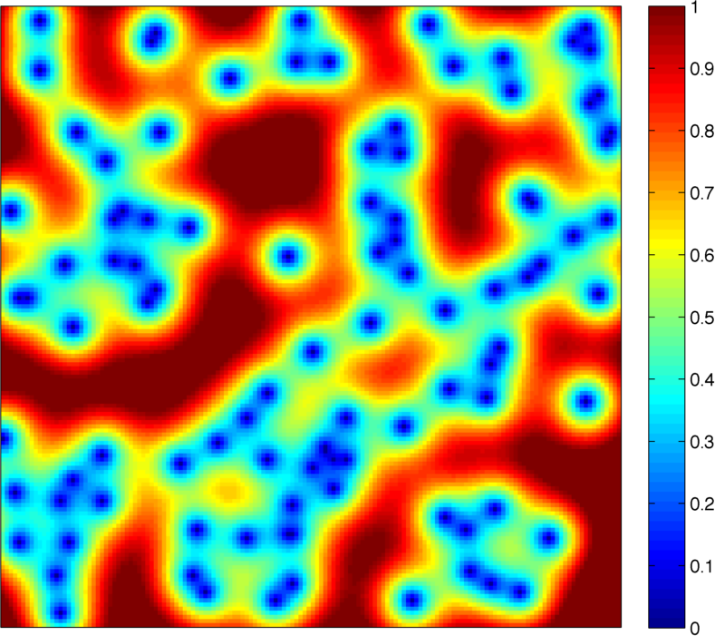
Kriging Variances

Slide 23
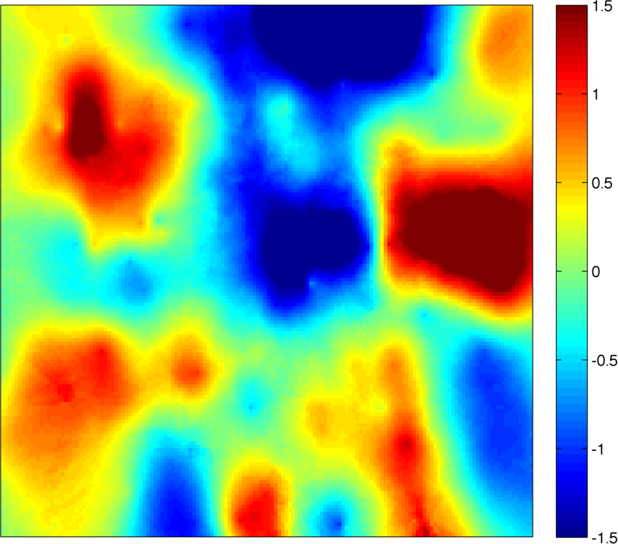
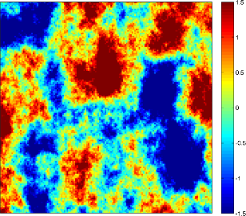
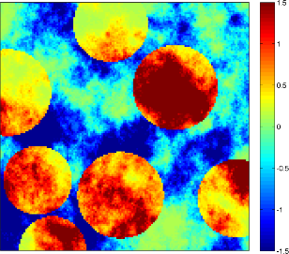
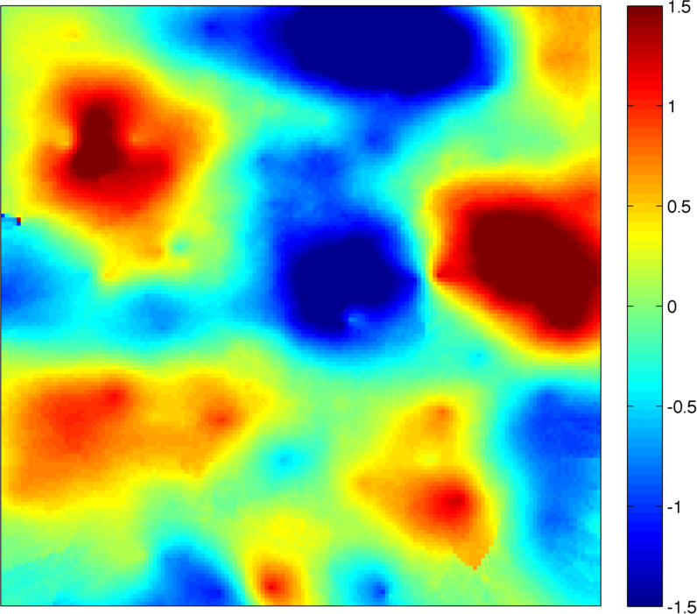
Visually Contrasting TIs

