Slide 1
A neighborhood algorithm for modeling dual-medium scenario uncertainty from production data
Sarah Alsaif, Jef Caers
May 8th, 2014

Slide 2
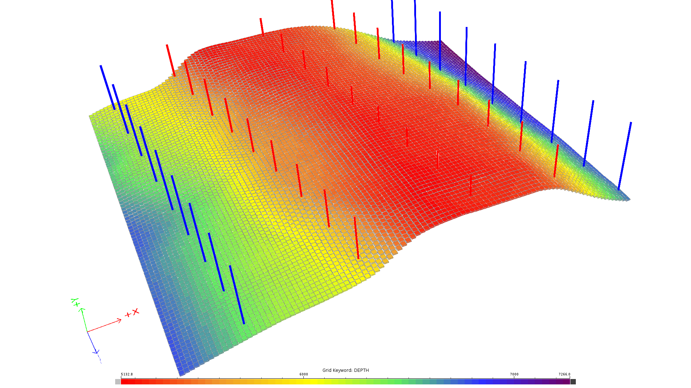
Case Study
Y
x
27 Producers
Y
reservoir dimensions: 102 x 86 x 1 cells
cell dimensions: 600 x 600 x 25 ft
18 Injectors
X
Z
5132
6000
7000
7266
depth

Slide 3
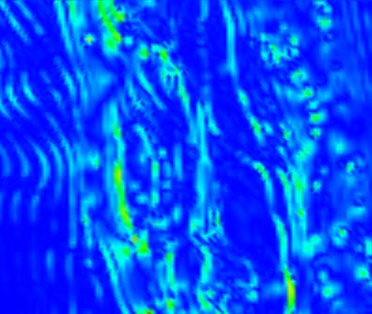
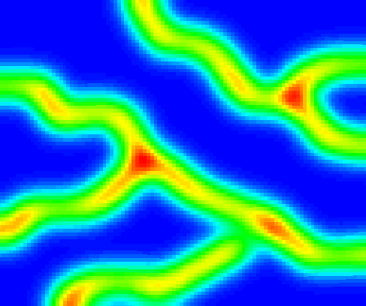
Uncertainties in DFN modeling
Conceptual / interpretation
folding/curvature
Seismic coherence
full factorial
experimental design
Parameters of fractures
N
156 discrete fracture network models
(DFN)
270°
90°
180°
length\ equivalent radius
orientation distribution

Slide 4
DFN models to dual-medium models
Fracture porosity
threshold
Dual-medium
Single medium
4 x156 DFN
624 Dual-medium models

Slide 5
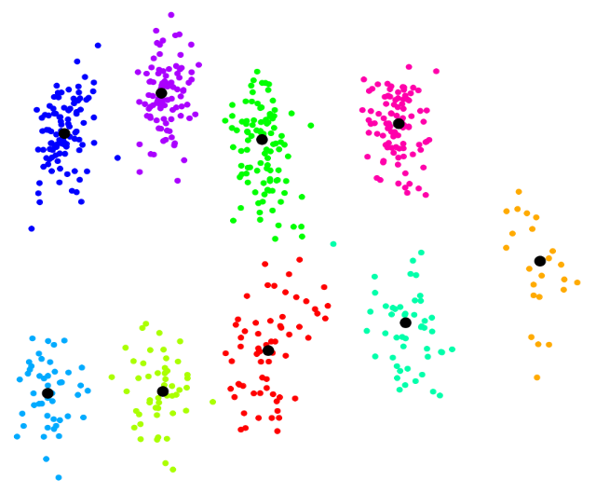
Prior uncertain space defined by MHD
Modified Hausdorff distance, MHD
MDS and K-medoid clustering
9 representative dual-medium geological scenarios

Slide 6
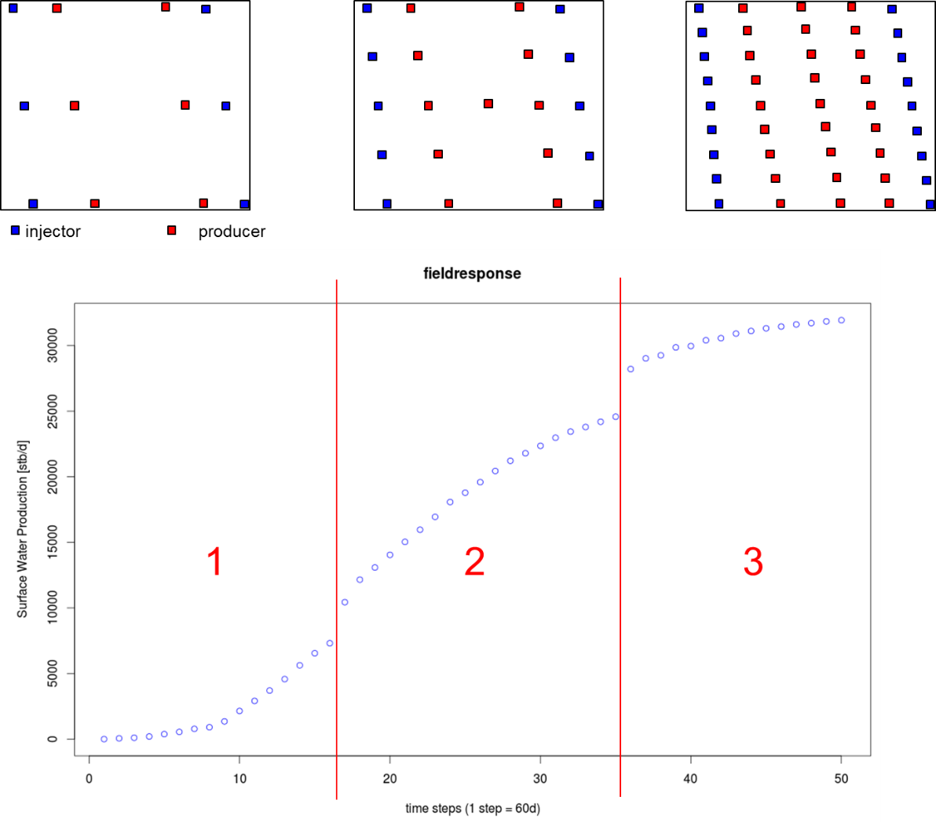
Field production development plan
30000
Surface water production, stb/d
15000
0
0
Time, days
3000

Slide 7
Neighborhood Algorithm (NA)
Global search algorithm > finds multiple minima
Partitions the prior space into Voronoi cells as it proceeds
Two main steps: - Forward simulation
- Calculating misfit function, O
Where;
N_{time} | : Number of time steps
d_{simulated} | : flow simulation response
d_{observed} | : Data observed
$$\text{O}\text{=}\frac{\text{1}}{{\text{N}}_{\text{time}}}\sum^{{\text{N}}_{\text{time}}}{{\left\{{\text{d}}_{\text{simulated}}\text{-}{\text{d}}_{\text{observed}}\right\}}^{\text{2}}}$$

Slide 8
Neighborhood Algorithm (NA)
Prior space defined by modified Hausdorff distance

Slide 9
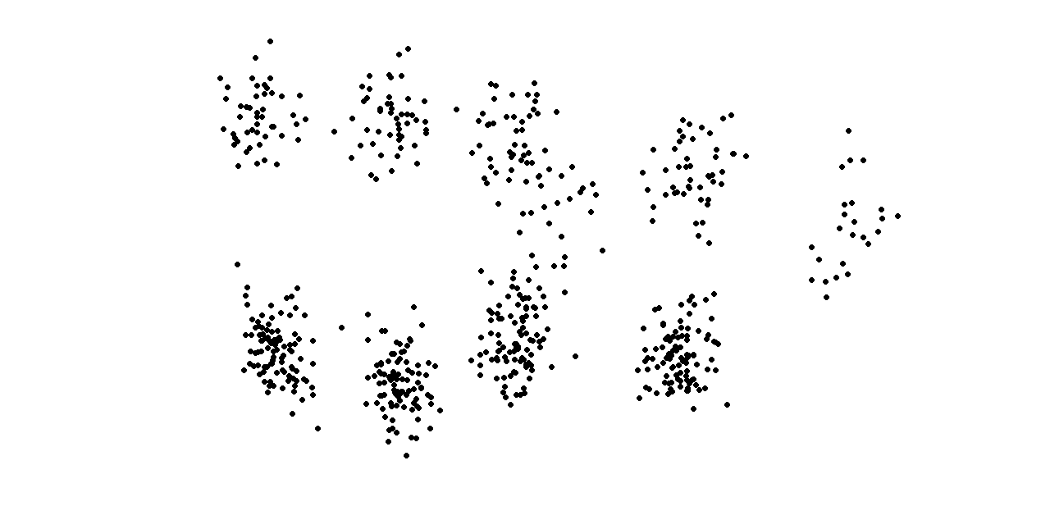
Neighborhood Algorithm (NA)
Low objective function
High objective function
Prior space defined by modified Hausdorff distance
Prior space with 624 simulated models

Slide 10
Applying NA to the fractured reservoir
O=58
O=189
Low objective function
High objective function

Slide 11
Applying NA to the fractured reservoir
Stochastic search path determined by selection probability;
$$\text{p}\text{=}\text{exp}\left\{ \text{−}\frac{\text{1}}{\text{T}}\frac{O}{\text{M}} \right\}$$
Where;
O | : Objective function
M | : Number of prior models in the cell
T | : determined such that total probability =1

Slide 12
Applying NA to the fractured reservoir
O=58
P=0.46
O=189
P=0.54
Low objective function
High objective function

Slide 13
Applying NA to the fractured reservoir
O=58
P=0.46
O=189
P=0.54
Low objective function
High objective function

Slide 14
Applying NA to the fractured reservoir
O=58
O=189
O=189
P=0.54
O=95
Low objective function
High objective function

Slide 15
Applying NA to the fractured reservoir
O=58
P=0.40
O=189
O=189
P=0.43
P=0.54
O=95
P=0.17
Low objective function
High objective function

Slide 16
Applying NA to the fractured reservoir
Low objective function
High objective function

Slide 17
NA converges to the ‘right’ solution
135 simulated models
624 simulated models
Low objective function
High objective function

Slide 18
Neighborhood Algorithm (NA) output
Model | Objective function O | Cell Area A | Geological scenario
1 | 9.4 | 0.004 | 5
2 | 11.6 | 0.005 | 6
3 | 16.7 | 0.002 | 1
4 | 16.7 | 0.016 | 1
5 | 16.8 | 0.080 | 4
6 | 17.4 | 0.055 | 4
7 | 19.3 | 0.013 | 4
8 | 20.5 | 0.015 | 4
9 | 20.7 | 0.013 | 1
10 | 22.2 | 0.103 | 3
11 | 23.2 | 0.013 | 9
12 | 25.5 | 0.005 | 9
Increasing objective function, O
Low objective function
High objective function
Total surface area = 3.6
... etc.

Slide 19
Neighborhood Algorithm (NA) output
Model | Objective function O | Cell Area A | Geological scenario
1 | 9.4 | 0.004 | 5
2 | 11.6 | 0.005 | 6
3 | 16.7 | 0.002 | 1
4 | 16.7 | 0.016 | 1
5 | 16.8 | 0.080 | 4
6 | 17.4 | 0.055 | 4
7 | 19.3 | 0.013 | 4
8 | 20.5 | 0.015 | 4
9 | 20.7 | 0.013 | 1
10 | 22.2 | 0.103 | 3
11 | 23.2 | 0.013 | 9
12 | 25.5 | 0.005 | 9
Increasing objective function, O
Low objective function
High objective function
Total surface area = 3.6
... etc.

Slide 20
Neighborhood Algorithm (NA) output
Model | Objective function O | Cell Area A | Geological scenario
1 | 9.4 | 0.004 | 5
2 | 11.6 | 0.005 | 6
3 | 16.7 | 0.002 | 1
4 | 16.7 | 0.016 | 1
5 | 16.8 | 0.080 | 4
6 | 17.4 | 0.055 | 4
7 | 19.3 | 0.013 | 4
8 | 20.5 | 0.015 | 4
9 | 20.7 | 0.013 | 1
10 | 22.2 | 0.103 | 3
11 | 23.2 | 0.013 | 9
12 | 25.5 | 0.005 | 9
Increasing objective function, O
Low objective function
High objective function
Total surface area = 3.6
... etc.

Slide 21
Posterior probability of dual-medium geological scenarios
$\text{P}\left(\text{scenario} | \text{data}\right)$ = ??
Where;
F | : likelihood density function
O | : objective function
 | : scaling parameter
A | : area of the polygon
$$\text{F}\text{=}\text{exp}\left(\text{−}\frac{\text{O}}{\text{α}} \right)$$
$$\sum_{\text{i}\text{∈}\text{Models}}^{\text{M}}{{\text{F}}_{\text{i}}\text{ × }{\text{A}}_{\text{i}}\text{=}\text{C}}$$
$$\text{P}\left(\text{model} | \text{data}\right)\text{=}\frac{{\text{F}}_{\text{i}}}{\text{C}}\text{×}{\text{A}}_{\text{i}}$$
$$\text{P}\left(\text{scenario} | \text{data}\right)\text{=}\sum_{\text{j}\text{∈}\text{Sci}}{\frac{{\text{f}}_{\text{j}}}{\text{C}}\text{×}{\text{A}}_{\text{j}}}$$

Slide 22
Posterior probability of dual-medium geological scenarios
Model | Objective function O | Cell Area A | Geological scenario | P(model|data)
1 | 9.4 | 0.004 | 5 | 0.009
2 | 11.6 | 0.005 | 6 | 0.010
3 | 16.7 | 0.002 | 1 | 0.003
4 | 16.7 | 0.016 | 1 | 0.025
5 | 16.8 | 0.080 | 4 | 0.126
6 | 17.4 | 0.055 | 4 | 0.085
7 | 19.3 | 0.013 | 4 | 0.018
8 | 20.5 | 0.015 | 4 | 0.020
9 | 20.7 | 0.013 | 1 | 0.018
10 | 22.2 | 0.103 | 3 | 0.132
11 | 23.2 | 0.013 | 9 | 0.016
12 | 25.5 | 0.005 | 9 | 0.006
Increasing objective function, O
... etc.

Slide 23
Posterior probability of dual-medium geological scenarios
Model | Objective function O | Cell Area A | Geological scenario | P(model|data)
1 | 9.4 | 0.004 | 5 | 0.009
2 | 11.6 | 0.005 | 6 | 0.010
3 | 16.7 | 0.002 | 1 | 0.003
4 | 16.7 | 0.016 | 1 | 0.025
5 | 16.8 | 0.080 | 4 | 0.126
6 | 17.4 | 0.055 | 4 | 0.085
7 | 19.3 | 0.013 | 4 | 0.018
8 | 20.5 | 0.015 | 4 | 0.020
9 | 20.7 | 0.013 | 1 | 0.018
10 | 22.2 | 0.103 | 3 | 0.132
11 | 23.2 | 0.013 | 9 | 0.016
12 | 25.5 | 0.005 | 9 | 0.006
Increasing objective function, O
... etc.

Slide 24
Posterior probability of dual-medium geological scenarios
Model | Objective function O | Cell Area A | Geological scenario | P(model|data)
1 | 9.4 | 0.004 | 5 | 0.009
2 | 11.6 | 0.005 | 6 | 0.010
3 | 16.7 | 0.002 | 1 | 0.003
4 | 16.7 | 0.016 | 1 | 0.025
5 | 16.8 | 0.080 | 4 | 0.126
6 | 17.4 | 0.055 | 4 | 0.085
7 | 19.3 | 0.013 | 4 | 0.018
8 | 20.5 | 0.015 | 4 | 0.020
9 | 20.7 | 0.013 | 1 | 0.018
10 | 22.2 | 0.103 | 3 | 0.132
11 | 23.2 | 0.013 | 9 | 0.016
12 | 25.5 | 0.005 | 9 | 0.006
Increasing objective function, O
... etc.

Slide 25
Posterior probability of dual-medium geological scenarios
Scenario | P(scenario|data)
1 | 0.18
2 | 0
3 | 0.23
4 | 0.22
5 | 0.06
6 | 0.11
7 | 0
8 | 0
9 | 0.20
1
2
3
4
5
6
7
8
9
9 dual-medium geological scenarios representing the prior space

Slide 26
Posterior probability of dual-medium geological scenarios
Scenario | P(scenario|data)
1 | 0.18
2 | 0
3 | 0.23
4 | 0.22
5 | 0.06
6 | 0.11
7 | 0
8 | 0
9 | 0.20
Low objective function
High objective function
Prior space with 624 simulated models

Slide 27
Posterior probability of dual-medium geological scenarios
Scenario | P(scenario|data)
 | NA | Kernel smoothing
1 | 0.18 | 0.14
2 | 0 | 0
3 | 0.23 | 0.28
4 | 0.22 | 0.34
5 | 0.06 | 0.01
6 | 0.11 | 0.04
7 | 0 | 0
8 | 0 | 0
9 | 0.20 | 0.19
1
2
3
4
5
6
7
8
9
9 dual-medium geological scenarios representing the prior space

Slide 28
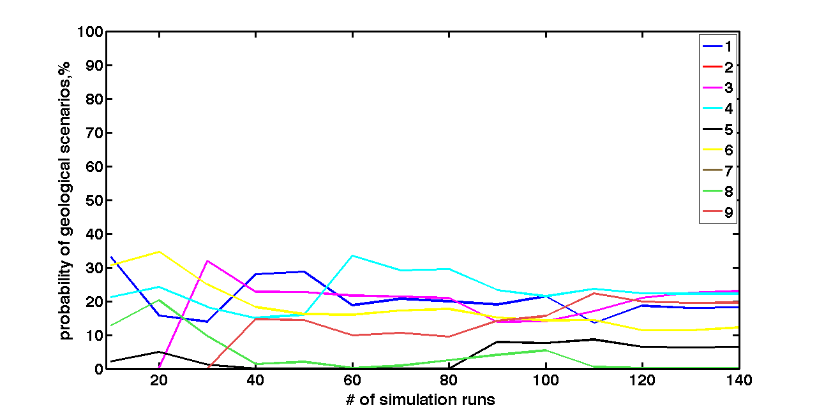
When to stop(number of models to simulate)
Probabilities converge at 135 runs

Slide 29
Advantages and disadvantages of NA
Advantages
Find multiple minima
Fast and efficient selection of models
Converges to the ‘right’ solution
Number of models to be simulated > no decision in advance
Disadvantages
Over-sample low misfit areas > does not find all minima

Slide 30
Conclusions and future work
Efficiently Identified regions with low misfit function
Fewer dual medium geological scenarios were selected
Start history matching using the selected scenarios
Global field scale > Investigate local scale

