Slide 1
Multiple-point Geostatistics:
Stochastic Modeling with Training Images
Jef Caers
Stanford University, USA

Slide 2
Acknowledgements
My co-author: Gregoire Mariéthoz
Wiley-Blackwell
SCRF affiliate members

Slide 3
A challenge in science & engineering
Data science
  “Big data”
  Data mining
  Forecasting with data
  Uncertainty
Physical science
  PDEs
  Genetic modeling
  Physical experiments
How to merge these two fields ?

Slide 4
An evolution in geostatistics
Mineral resources: large data sets
Petroleum: sparse data sets + indirect data
Environmental science: spatio-temporal data
Physically realistic models that are data charged
provide better forecasts

Slide 5
Multiple-point geostatistics: MPS
Extension to higher-order statistics is not incremental
  complex pattern variability: current statistical models have failed
The link between physical realism and data science: a set of exhaustive 3D/4D images: the training images
An increased role for Computer Science

Slide 6
Current application areas of MPS
Oil/gas, conventional & unconventional
Mineral resources
Hydrogeology
Hydrology
Environmental Sciences
Ecology
Remote sensing
Soil Sciences
Medical imaging
Finance

Slide 7
Random function theory or not?
Definition of stochastic process Z(x)
Definition of expectations E[Z(x)]
Assumes an infinite domain (ergodicity)
Assumes the truth is a realization of a stochastic process
Inference calls for stationarity: untenable in most cases
Our view: RF theory is not needed to solve spatial modeling problems
  ALL MPS can be formulated without RF theory

Slide 8
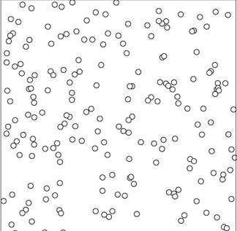
Why RF is a challenging concept: the Poisson Process
Imagine a set of trees
Even if you would know the exact location of every tree (the truth), then λ is still not “determined”
Many λ could have generated the same set of locations
The Poisson intensity λ is not a physical quantity
MPS/training images:
Not: work with non-physical (probabilistic) parameters of imaginary processes
Yes: use realizations of physical reality
v

Slide 9
Illustration: Universal kriging
Based on RF theory and the decomposition
Decomposition of trend
Kriging system of equations:

Slide 10
Universal kriging: challenges
What is trend, what is residual ?
How to infer covariance/variogram of R with only data on Z
  Bias can be problematic
Circular argument
  To know Z, I need to know R, which I need to get from Z
Considerable expertise required

Slide 11
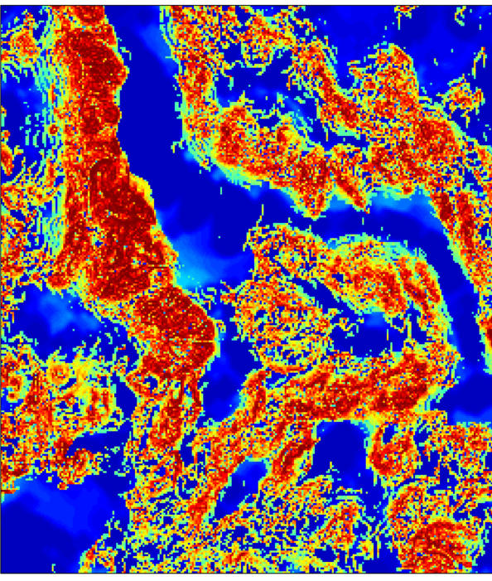
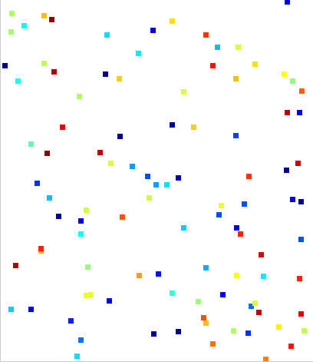
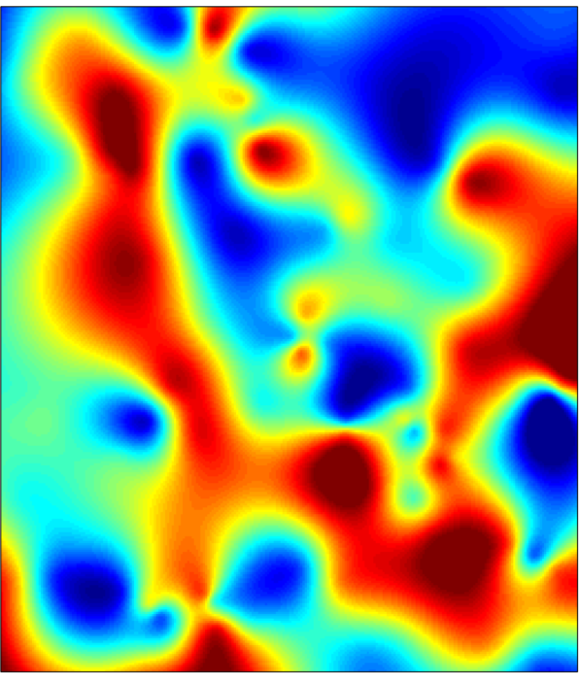
Example: Walker Lake data

Slide 12
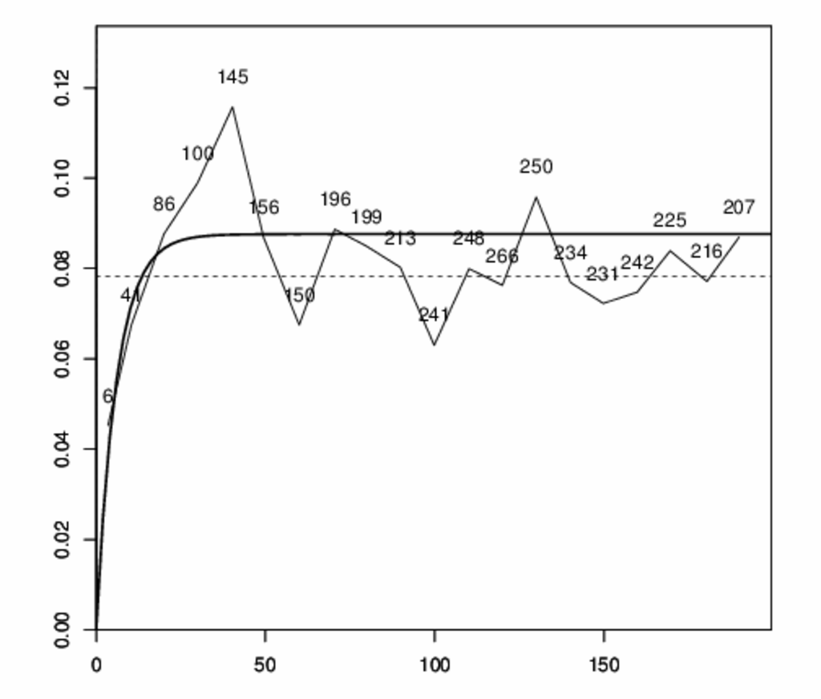
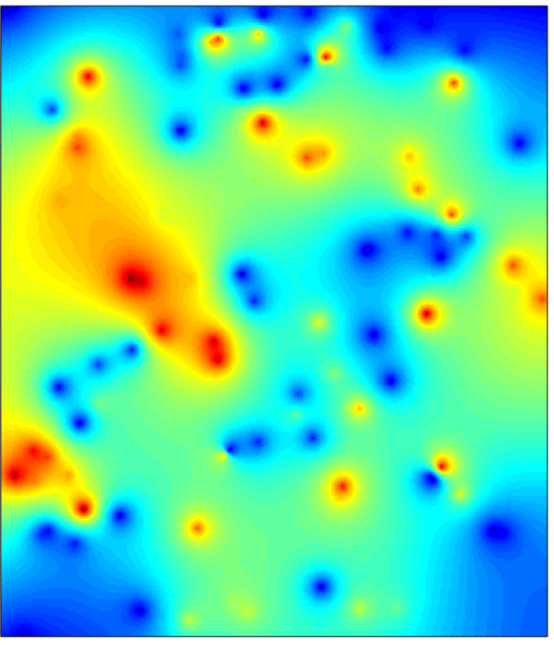
Result
Universal Kriging estimate
RGeos package - Fontainebleau

Slide 13
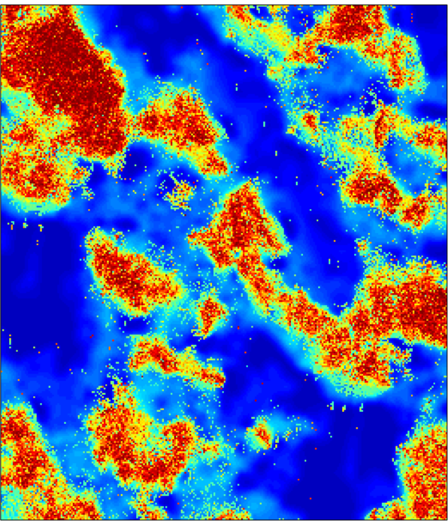
Universal kriging with training images
Given a training image for the domain: an exhaustive example truth
No use of
Expectation
Random variable
Random function
Stationarity
Ergodicity
Decomposition (m and R)
Covariance/variogram

Slide 14
Rewrite the kriging equations
(See talk by Lewis Li)
sop = sum of product
av = average
Directly lifted from training image
No modeling, no parameters, no decomposition

Slide 15
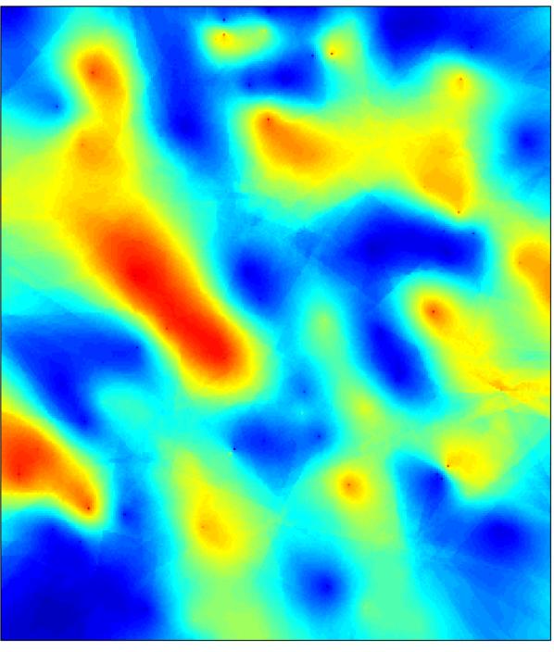
Result and comparison
Universal Kriging - TI
Universal Kriging - Variogram

Slide 16
Stochastic simulation: snesim
Strebelle, 2002
SNESIM: special case of simple indicator kriging with training images

Slide 17
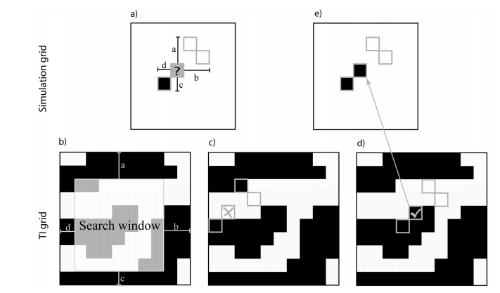
Stochastic simulation: direct sampling Mariethoz, 2010
Why determine a pdf/cdf when all you need is a sample?

Slide 18
Convolutions

Slide 19
Stochastic simulation: patterns
Arpat, 2005, Honarkhah, 2010, Tahmasebi, 2012
Why simulate a single pixel ? what is needed is pattern reproduction
Patterns
Image Quilting
Raster path
Convolution

Slide 20
Conditioning
Geostatistics: data is used twice (often)
  To get spatial model: variogram
  To constrain locally
MPS: issues
  Possible inconsistency between prior (TI) and data
  Point conditioning is biased
  Inverse problems: dynamic data

Slide 21
Conditioning to soft data: probability approach
Training Image
Soft data
Truth
Hard Data

Slide 22
Probability approach
Soft data
snesim
realizations

Slide 23
Probabilistic conditioning
Point-wise conditioning
  The “pattern” in the soft data is not used
Requires categorizing data
Requires knowing proportions (used in tau-model)
Confusion between proportion & probability

Slide 24
Confusion around probability and proportion
Proportion constraint: what happens in a single realization over some defined volume
Probability constraint: what happens over many realizations in each single grid cell
Seismic data calibration often mixes both
  Calibration requires some volume averaging (implicit or explicit)
  Probability maps as NTG maps (proportion maps)
  Probability: a “trick” to import desired properties in a single realization

Slide 25
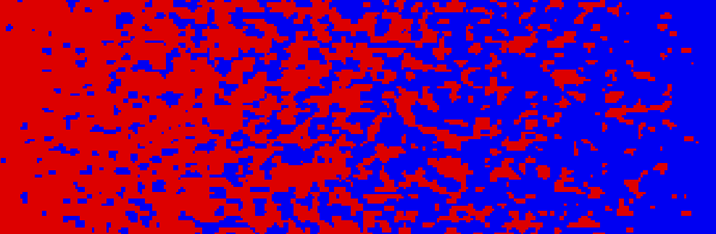
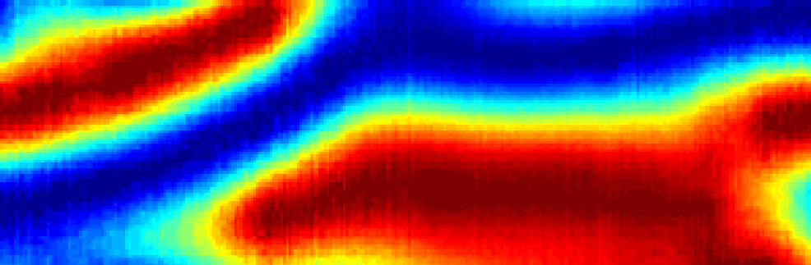
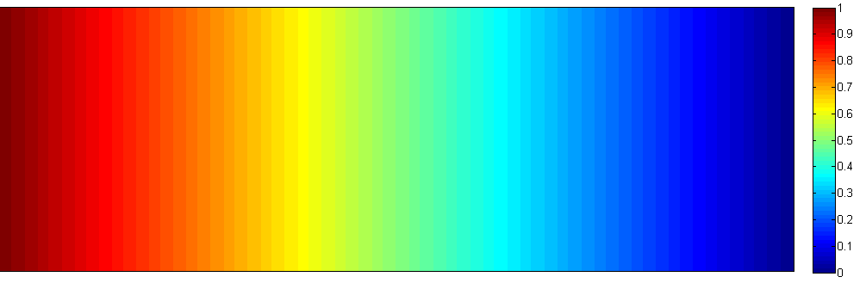

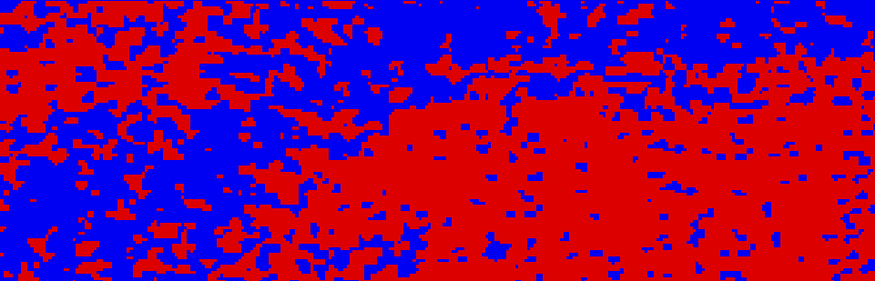
Conditioning to soft data: auxiliary approach
Training image
Soft data = auxiliary variable domain AUXD
auxiliary variable training image AUXTI
Realizations
What is the training image auxiliary variable ?
Consistency with domain auxiliary variable ?
Hu & Chugunova, 2008

Slide 26
Conditioning to point data
Problems/biases with all MPS methods
  The consequence of dropping random function theory
Conditioning:
  Methods focus on a single realization
  But conditioning affects the ensemble of realization (spatial uncertainty)
Variogram-based geostatistics
  Ensemble average of multi-Gaussian realizations = simple kriging
What is the equivalent of this in MPS ?

Slide 27
Turning point data into pattern data
TI
HD
AUXD
AUXTI
Conditional
Variance
Image
Quilting
Realizations

Slide 28
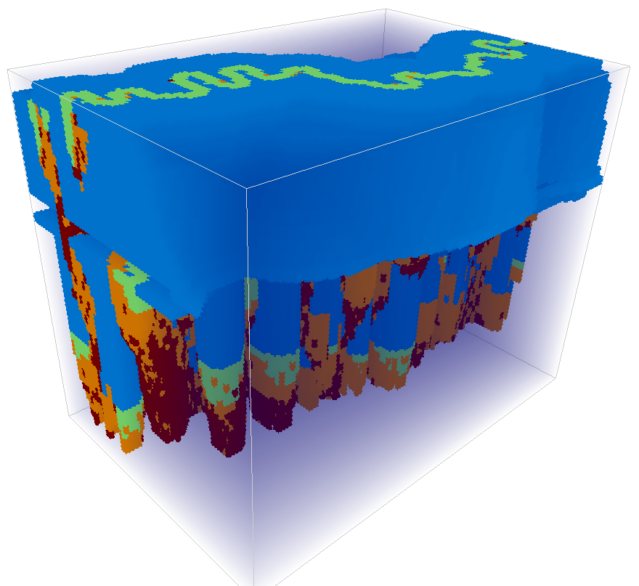
Non-stationary modeling
Chapter II.5
Premise of modern MPS: Training images carry physical realism
Such realism includes all non-stationary model variation
Current approaches still rely in some way on
(TURMY model, provided by ENI)

Slide 29
Multi-scale / multi-variate
Chapter II.6
Chapter III.3
Climate model downscaling

Slide 30
Downscaling + multi-variate + temporal
Soil Moisture
Latent Heat

Slide 31
Reservoir forecasting and MPS
Sparse data and seismic data
Most consequential: exploration to early production
Modeling depositional uncertainty with multiple training images

Slide 32
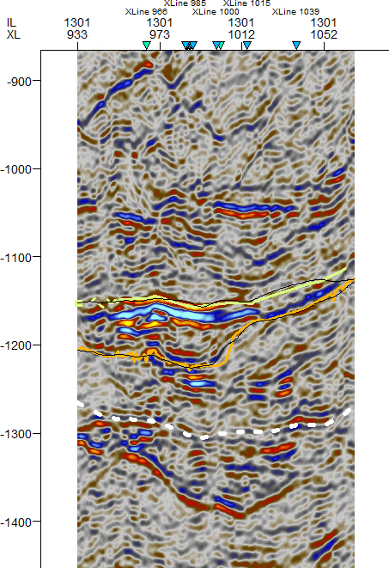
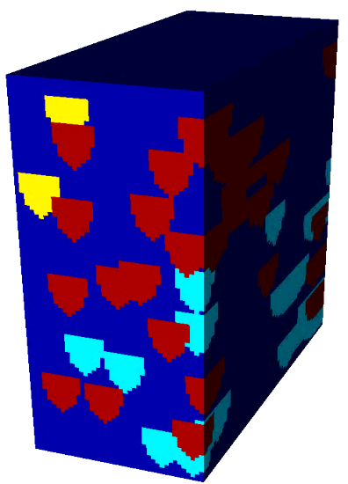
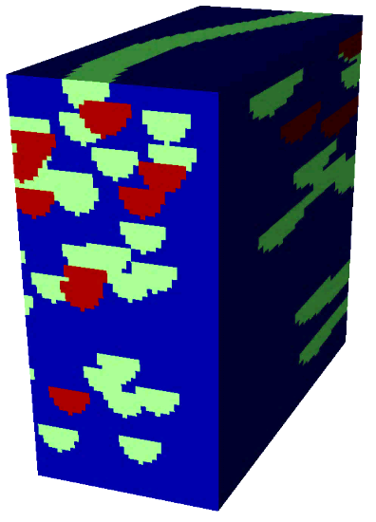
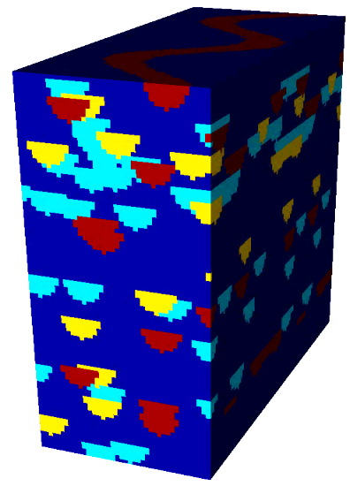
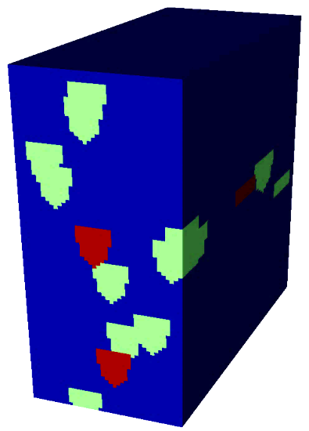
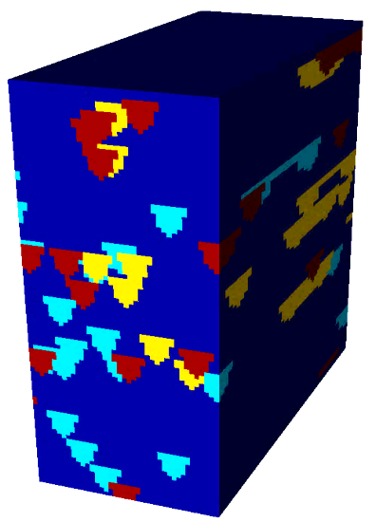
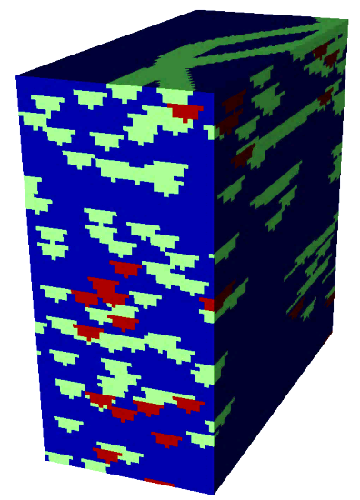
Training images: uncertainty & validation
?
Talk by Cheolkyun Jeong
Talk by Celine Scheidt

Slide 33
Outlook: an ideal future?
Robust commercial grade software
Automation: sensitivity on tuning parameters
Focus on multi-variate data, complex patterns, validation
Increased understanding on what methods apply best in what situation

