Slide 1
Exploring Needed Complexity in Structural Modeling Using Procrustes Analysis
Orhun Aydin, Jef Caers

Slide 2
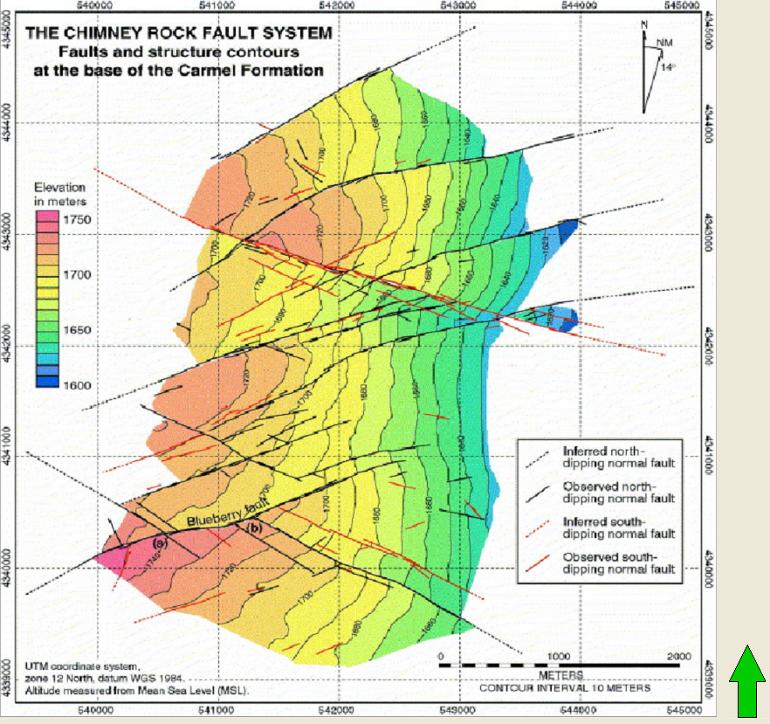
A Common Question
Known:
Drilling plan
Development Plan
Flow Parameter to Quantify the Uncertainty of
A conceptual model of the faulting in the field
Unknown:
How many (and which) of these faults are needed?

Slide 3

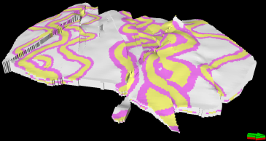
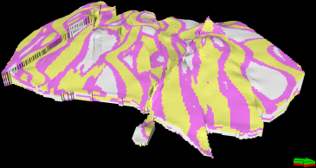
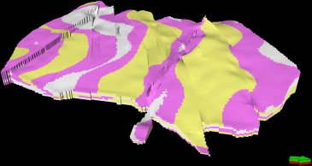
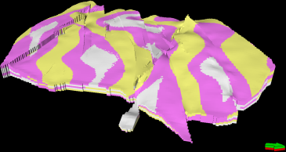
Reaching Simple Enough:
A Bottleneck
One Idea: Simplify the Complex Structural Model and Observe the Effect of Faults on Uncertainty Quantification
Requires the Complex Structural Grid & Flow Simulation
Requires Comparing Uncertainty Quantifications

Slide 4
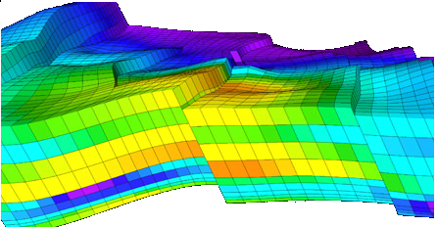
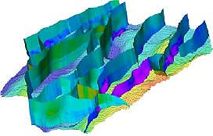
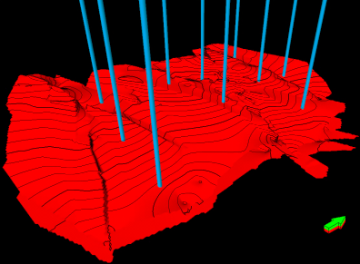
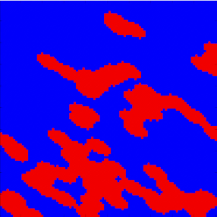
Leverage 1: A Fast Flow Proxy
If proxy requires complex structural grid
Creating the most complex structural grid defeats the purpose!
What kind of inputs we need?
PROXY
+
+
-
Structural Grid

Slide 5
What Do We Do With the Proxy?
We DON’T approximate forward functions
We DID approximate forward function variations (Aydin & Caers, 2013)
We DO capture forward function variation characteristics

Slide 6
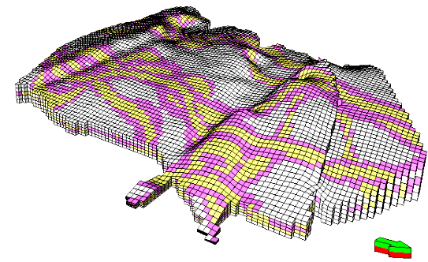
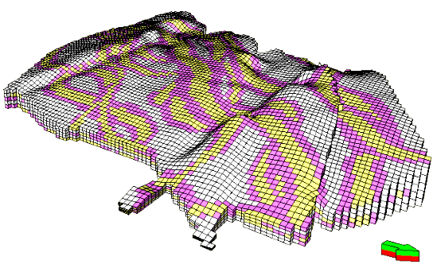
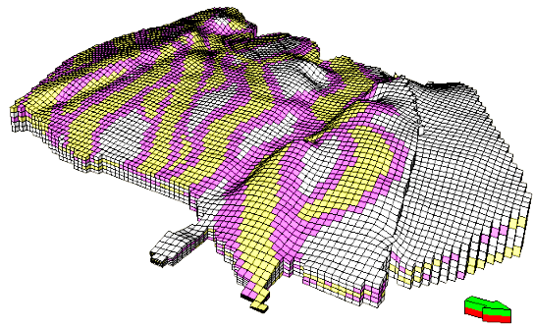
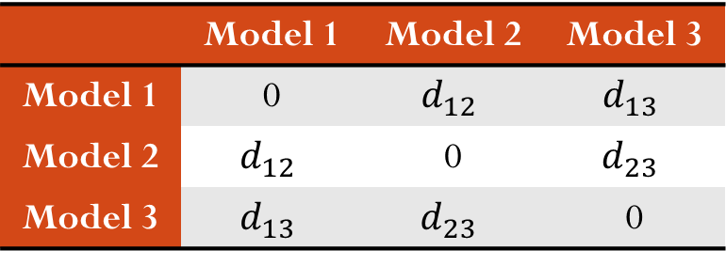
Representing Variations with Distances
PROXY RESPONSE
 | Model 1 | Model 2 | Model 3
Model 1 | 0 | $$d_{12}$$ | $$d_{13}$$
Model 2 | $$d_{12}$$ | 0 | $$d_{23}$$
Model 3 | $$d_{13}$$ | $$d_{23}$$ | 0
$$d_{12}=d(response 1, response 2)$$
$$d_{ij}:Distance btw. Forward Responses of Model i and Model j$$

Slide 7






Leverage 2:
Comparing Uncertainty Clouds
Models with
100+ Faults
Models with
90 Faults
Models with
1 Fault
Clouds Dissimilarities
 | Cloud 1 | Cloud 2 | Cloud3
Cloud 1 | 0
Cloud 2 |  | 0
Cloud 3 |  |  | 0
$$d_{12}$$
$$d_{13}$$
$$d_{21}$$
$$d_{23}$$
$$d_{31}$$
$$d_{32}$$

Slide 8
Working Hypothesis
Variation of the proxy’s uncertainty cloud’s shape is representative of variations of flow parameter’s uncertainty cloud shape for different complexity levels
U.Q. of Proxy
U.Q. of Flow Response
100 + Faults
100 + Faults
90 Faults
90 Faults
80 Faults
80 Faults
…
…
40 Faults
40 Faults
30 Faults
30 Faults

Slide 9
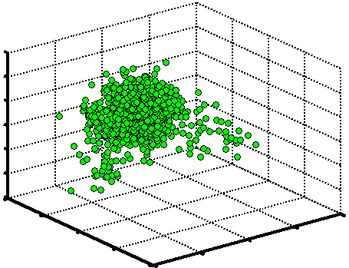
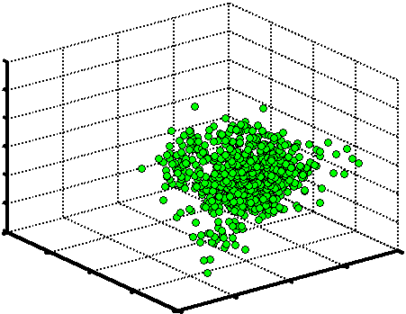
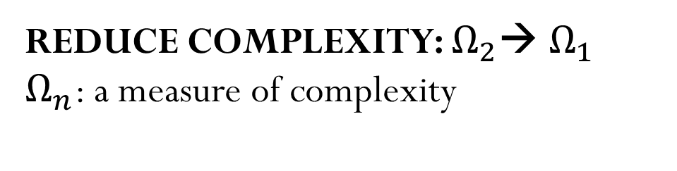


Workflow in a Nutshell
A Static Proxy
For Complex Models
Uncertainty Cloud for Proxy Response
$${\text{Ω}}_{2}$$
Complex Faulting Scenario
REDUCE COMPLEXITY: ${\text{Ω}}_{2}$→ ${\text{Ω}}_{1}$
${\text{Ω}}_{n}$: a measure of complexity
Simpler Faulting Scenario
A Static Proxy
For Simpler Models
Uncertainty Cloud for Proxy Response
$${\text{Ω}}_{1}$$
Complex Model Proxy Dissimilarity
Simple Model Proxy Dissimilarity
How did simplifying changed the cloud?

Slide 10
Illustrative Example: Fluvial Reservoir with Faults
Producers
How many of the faults need to be modeled?
Injectors
(Taken from Maerten et.al, 2003)
How to answer this question without building the pillar grid for complex models?
No grid = No flow simulation

Slide 11
Structural Complexity & Uncertainty
+
+
Before reservoir simulation and structural gridding answer these:
How complex earth models need to be for uncertainty quantification?
100+ Faults. How many do we need?
Do we need accurate stratigraphic grids to quantify uncertainty?

Slide 12
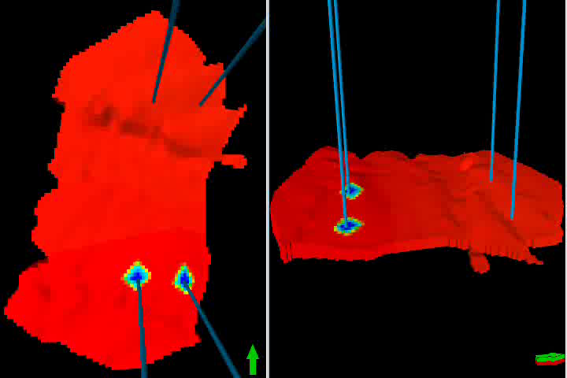
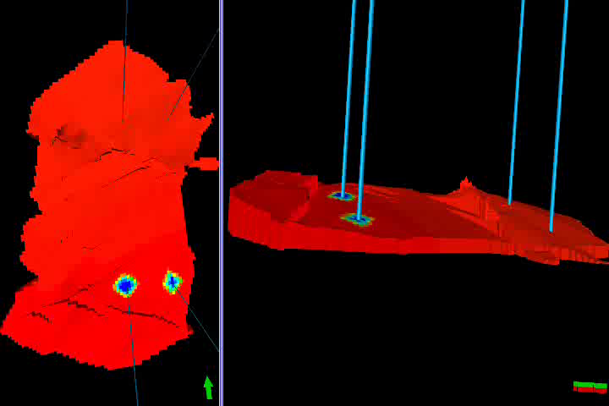
Proxy: What to Look For?
Case with No Faults
Case with 27 Faults
The proxy to emulate needs factor in:
  Well Locations
  Production/Injection from a Well
  Fault Location and Fault Geometry
  Fault Transmissibility
  Facies and Petrophysical Properties

Slide 13
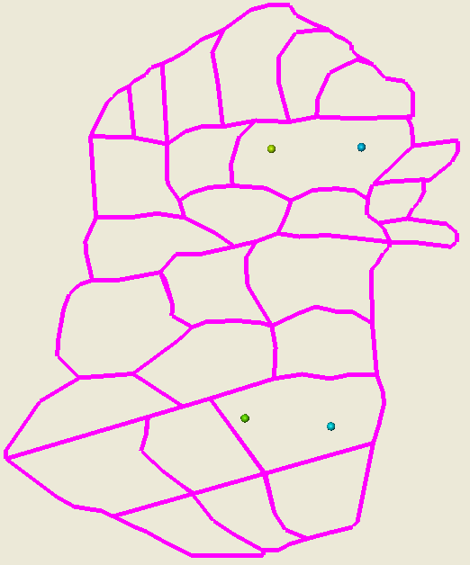
Proxy Response Variation Change: Image Dilation as a Static Proxy
Depositional Grid
Producer Block
Overlay Fault Blocks
Injector Block
2X2X1 Structuring Element
Producer Block
Less Dilated
Injector Block
Maximally Dilated
10X10X1 Structuring Element

Slide 14
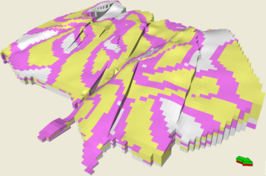
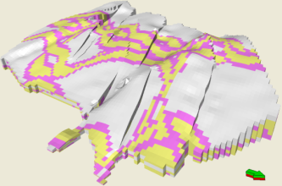
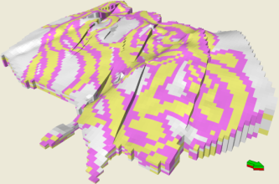
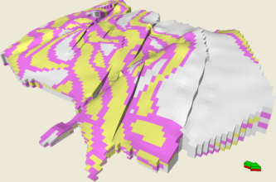
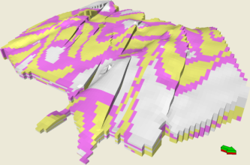
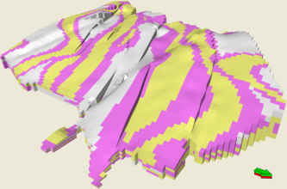
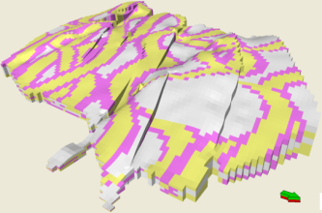
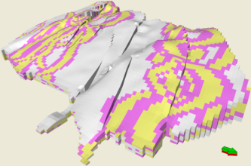
Illustrative Example Components
Prior Information
Data
Modeling Purpose
A 2D fault map is used for fault interactions
No Fault Uncertainty
240 draped channel models with varying.
  Channel Width
  Channel Angle
Well log data used to infer facies
Earth Models are constrained to facies
Water-cut uncertainty needs to be determined

Slide 15
Defining Different Complexity Levels
Different Fault Scenarios
  100 Faults
  85 Faults
  50 Faults
  34 Faults
  27 Faults
  25 faults
  23 faults
  19 Faults
  6 Faults
Simpler Scenarios
Which one of the above is simple enough?

Slide 16
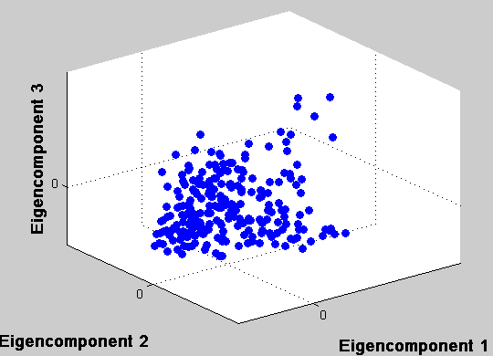
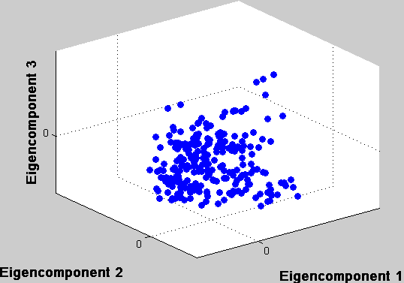
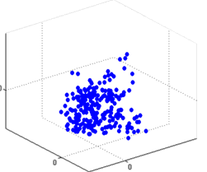
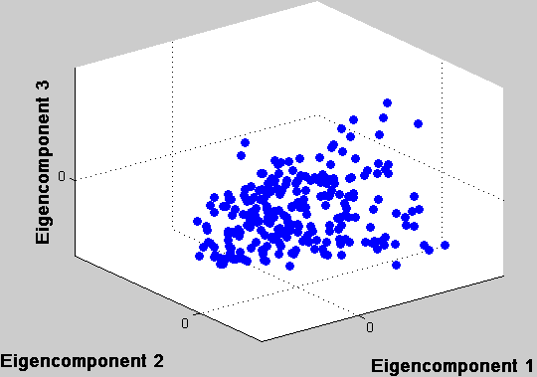
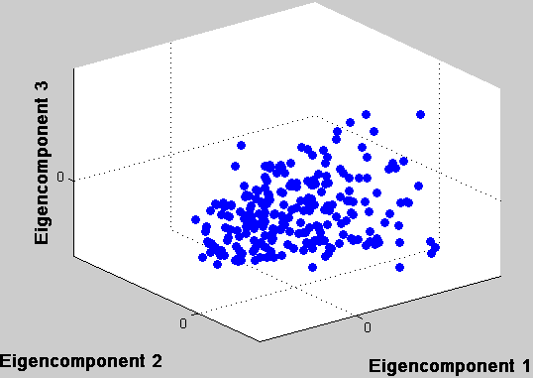
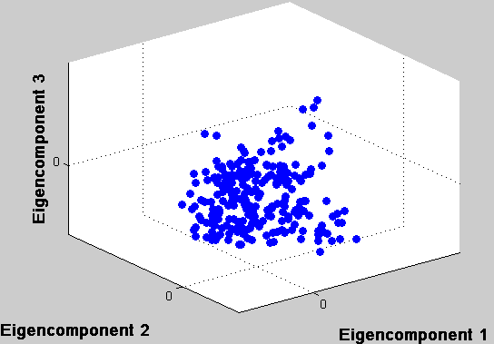
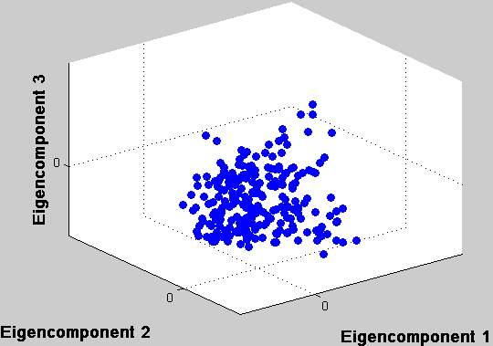
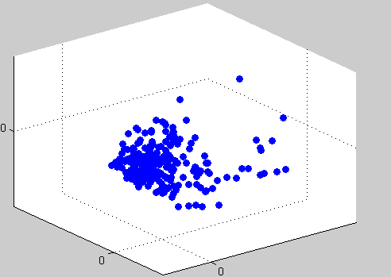
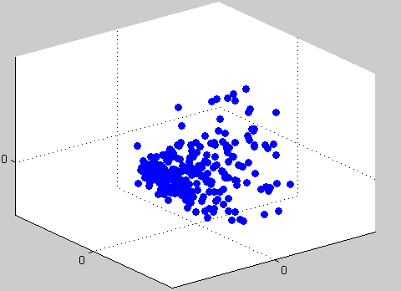
Comparing Uncertainty Clouds
100 Faults
85 Faults
50 Faults
34 Faults
25 Faults
27 Faults
23 Faults
19 Faults
6 Faults

Slide 17
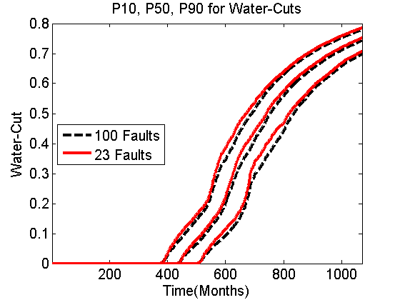
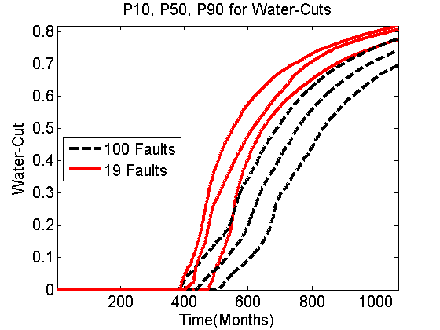
Comparing Proxy Variations
Clouds with Similar Shape
Clustering

Slide 18
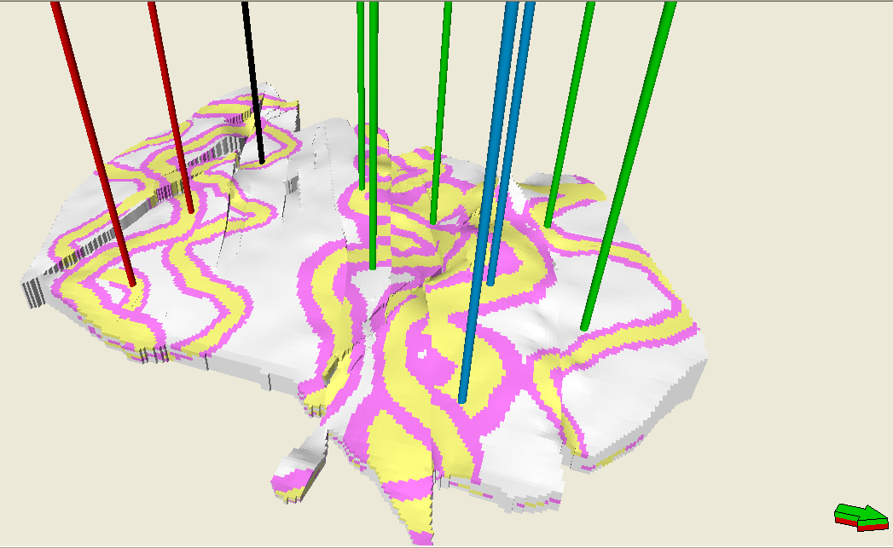
A Case with More Wells
5 New Producer Wells
1 New Injector Well
Static Proxy is applied for the new development plan and workflow resulted in 85 Faults as “Simple Enough” to quantify water-cut uncertainty

Slide 19
Limitations of the Method
Proxy Selected is important for the workflow: QUESTION OF PROXY ROBUSTNESS
  Faults are sealing and have low transmissibility
  System is water displacing oil
  Proxy needs to be revised or changed for another system

Slide 20
A Poor Proxy
+
+
WORKFLOW RETURNS 50 FAULTS AS THE SIMPLE ENOUGH CASE

Slide 21
Future Work
Rigorous ways to define different complexity levels of different sources of complexity
Considering different structural complexities such as fault damage zones and fault gauges and fault patterns
Considering structural uncertainty

Slide 22
Conclusions
Method Provides CPU advantage
  Structural Modeling
  Flow Simulation
Depositional Models → Faster to Generate
Modified Image Dilation
    0.38 sec. per 200X250X5 Earth Model
Detailed stratigraphic grids aren’t necessary for uncertainty quantification

Slide 24
Discussion: Note About Proxies
Case 1, eg. Modified Image Dilation
Variation of good proxy captures variation of forward response
Points at simplest models having similar variation to complex ones
Case 2, eg. Modified Image Dilation with No Well Information
Cannot capture the variations due to main source(s) of complexity
Causes oversimplification
Case 3, Flow Capacity vs Storage Capacity
It also cannot capture the variations due to main source(s) of complexity
Gives a conservative complexity level
Variation of Flow Response Changes
100 Faults
85 Faults
50 Faults
34 Faults
27 Faults
25 Faults
23 Faults
19 Faults
6 Faults

