Slide 1
A strategy for managing uncertainty
Jef Caers
Stanford University, USA

Slide 2
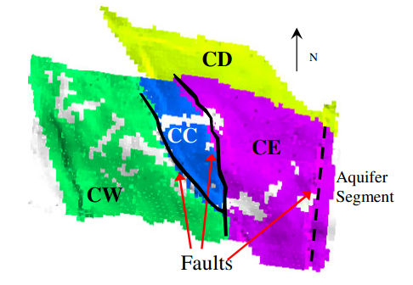
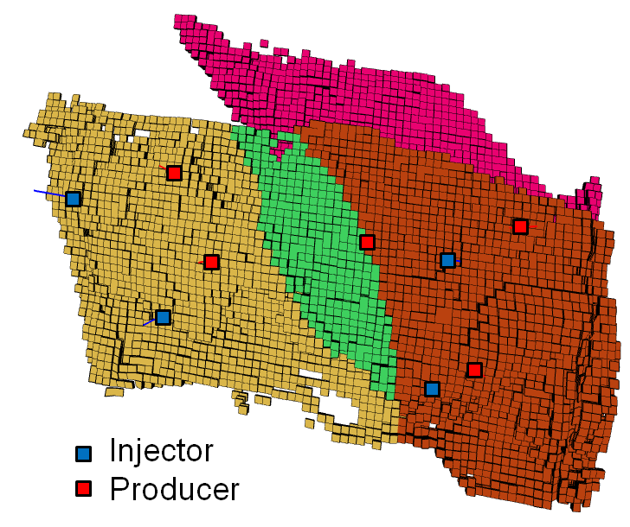
Importance of uncertainty and risk
New well planned
P3
P1
P4
P2
West-Coast Africa (WCA) slope-valley system
Data courtesy of Chevron

Slide 3
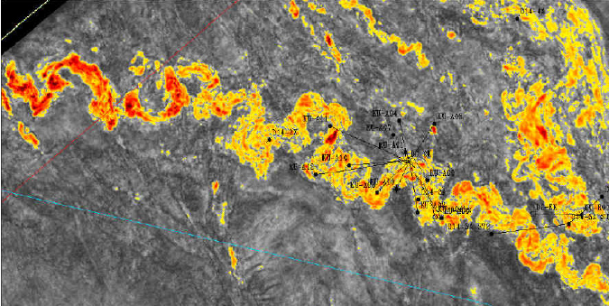
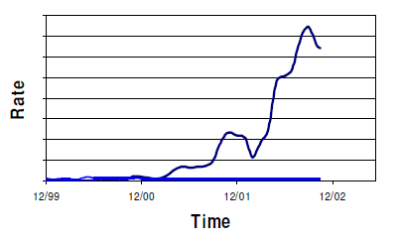
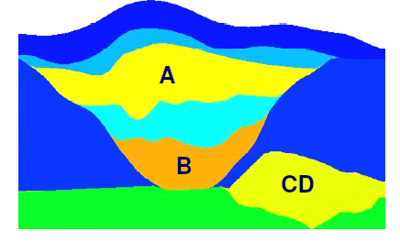
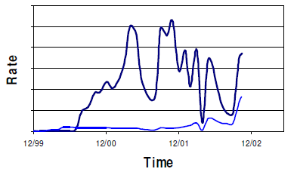
Data
Early production data
(water rate)
Well X
Geophysics
Well Y

Slide 4
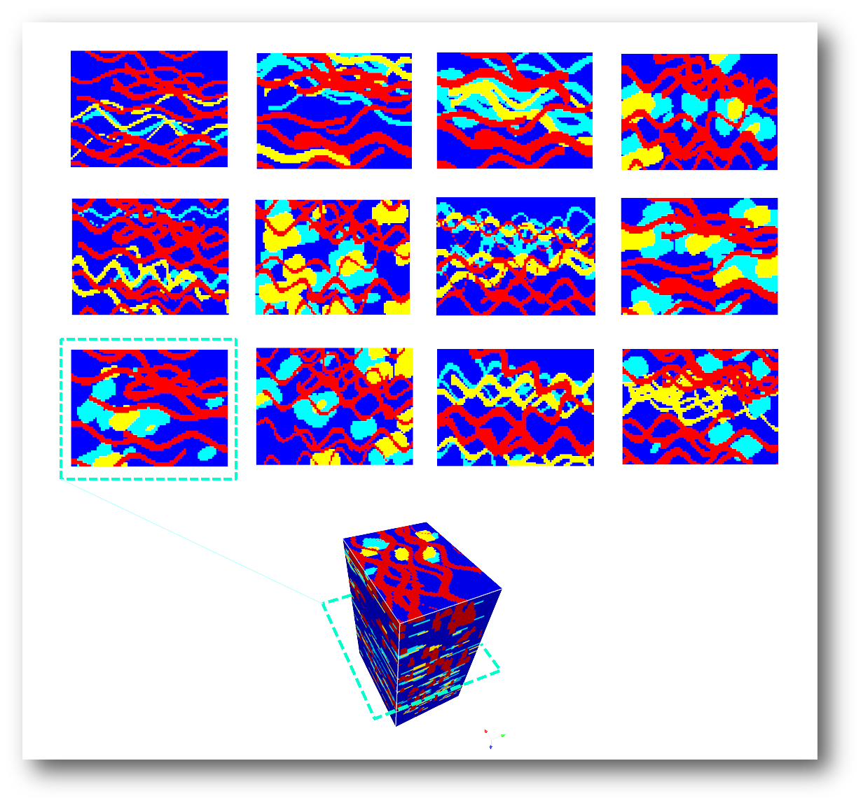
Uncertainty in the depositional model
Uncertainty on
Architecture
Association
Proportion/NTG
Channel width
Channel width/thickness ratio
Sinuosity

Slide 5
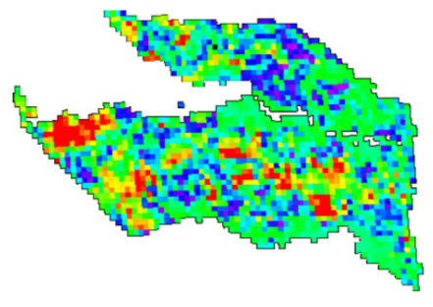
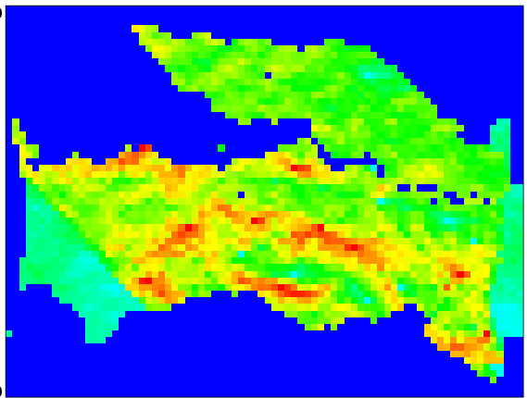
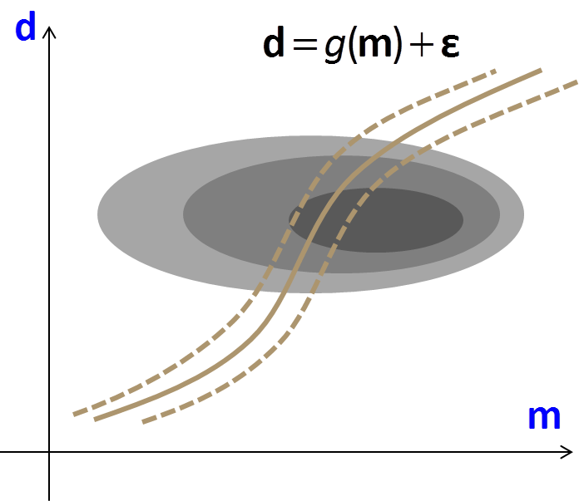
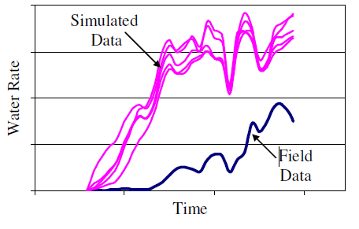
Current practice of
“data assimilation”
Seismic impedance
Porosity/permeability
models
Gradient-based optimization
Gaussian-like models
ENKF
The fundamental uncertainty
is largely ignored

Slide 6
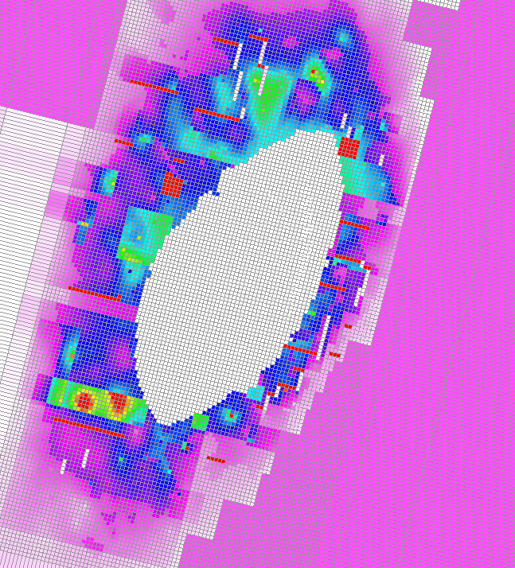
An extreme example
“data assimilation”
A reservoir model built from seismic using geostatistics and then adjusted to match production data
All data is assimilated
History matched permeability
in a real field currently in production

Slide 7
Current practice
“Chasing data”
2D seismic
The reservoir
The reservoir
3D seismic
3D seismic+production
Life-time
Life-time
4D seismic+production
“data assimilation”
building models around the data only to be surprised by new data
“realistic priors”
A strategy based on
sensitivity/rejection

Slide 8
A strategy
Uncertainty has no impact if it does not affect a decision variable
  An argument for sensitivity
Starting from building models that match data often leads to reduced uncertainty
  An argument for rejection
The leading uncertainties are often “interpretations” from data not just the reservoir models built from data
  An argument for scenario modeling

Slide 9
Reservoir forecasting
Volume
Recovery
Well planning
Well control
Prediction (r)
How much do I need (to match)
data to get a good prediction?
How complex should the model
be to get a good prediction?
Uncertain
relationship
?
Core/log
Seismic
production
Data (d)
Model (m)
Conceptual
Numerical

Slide 10
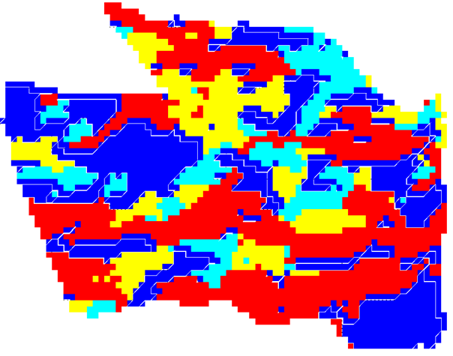
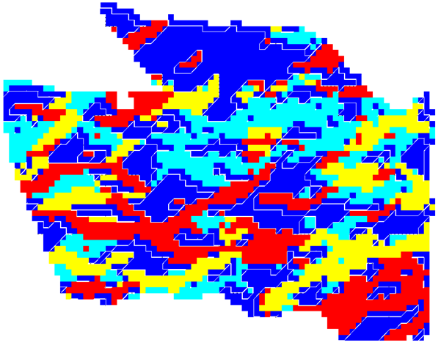
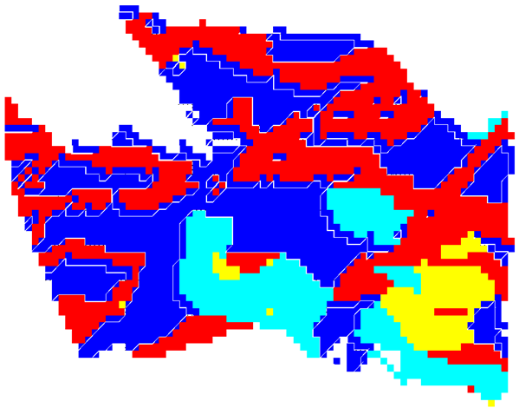
An argument for a subsurface focused sensitivity analysis
Darryl Fenwick
m
Prior uncertainty
Proxy flow
model complexity
Response r
Structure
Rock
Fluid
p
stochastic
Time
p_{i}
p_{j}
p_{j}
CDF
CDF
Kv/Kh
Training image
Dim. Reduction
classification
0.2
0.4
0.6
0.8
TI₁
TI₂
TI₃
TI₄
TI₅

Slide 11
An argument for strict Bayesian modeling
Why follow a theory ? Repeatability.
Modeling uncertainty in practice is never strict Bayesian
Prior: should be data independent
Product: prior and likelihood should be obtained independently
Posterior: uncertainty can only be reduced, not increased

Slide 12
Popper-Bayes in subsurface geosciences
Interpretation or scenarios
Only few (not hundreds)
Only consider important/sensitive ones
Depositional models/ rock physics models / Structural scenarios

Slide 13
Sensitivity analysis & Rejection for a true Bayesian UQ
data

Slide 14
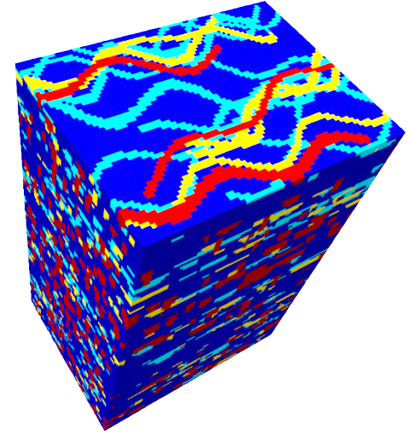
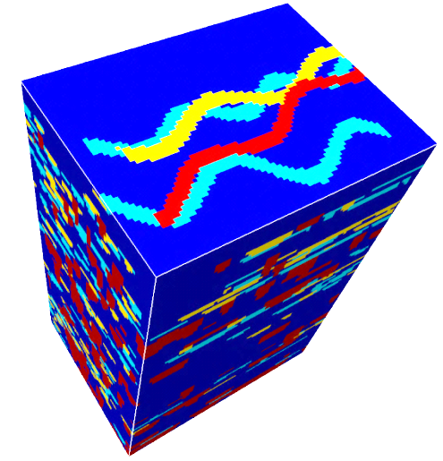
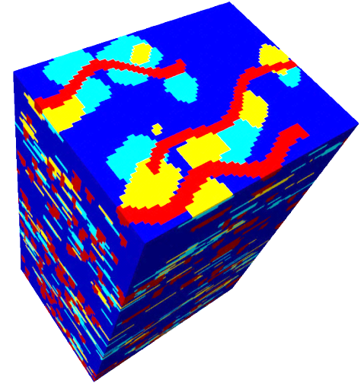
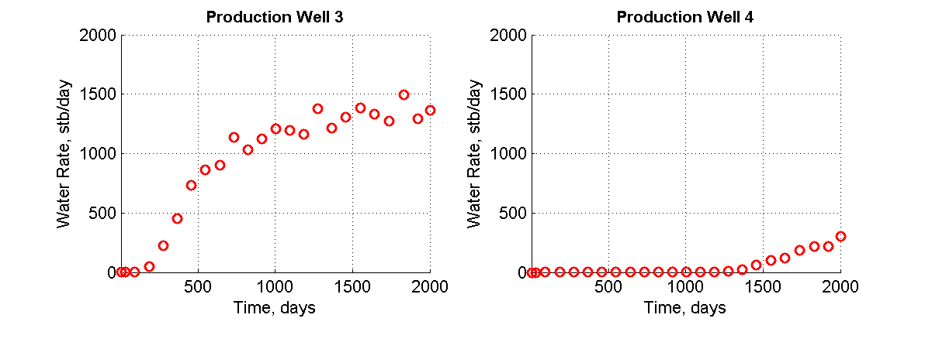
A discipline assimilation challenge: geosciences and engineering
Park, H., Scheidt, C., Fenwick, D., Boucher, A., & Caers, J. (2013). History matching and uncertainty quantification of facies models with multiple geological interpretations. Computational Geosciences, 1-13.
WCA
geological
scenario
uncertainty:
3 training images
TI1: 50%
TI2: 25%
TI3: 25%
Production
Data:
Water rate/well
Notes:
They are represented by three different training images as shown.
Its prior probabilities are given as 50 25 25 respectively.
We generate reservoir models using SNESIM algorithm in Sgems.

Slide 15
Two modeling questions

Slide 16
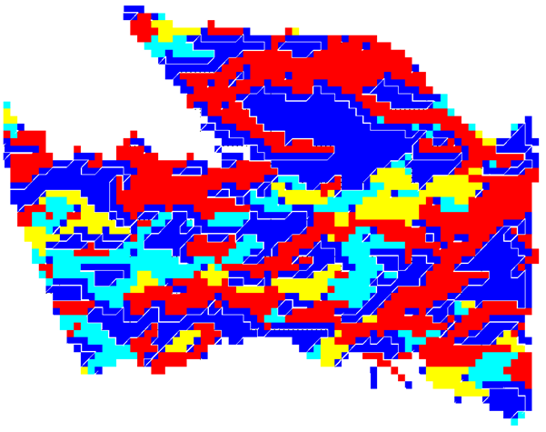
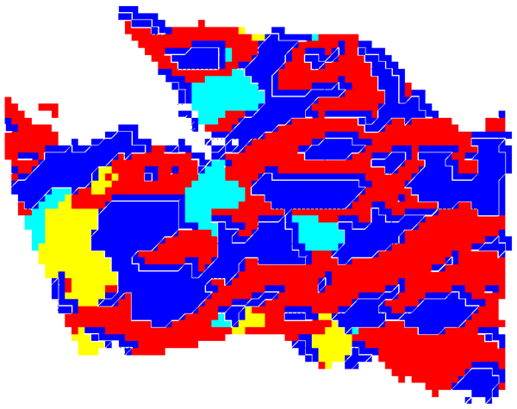
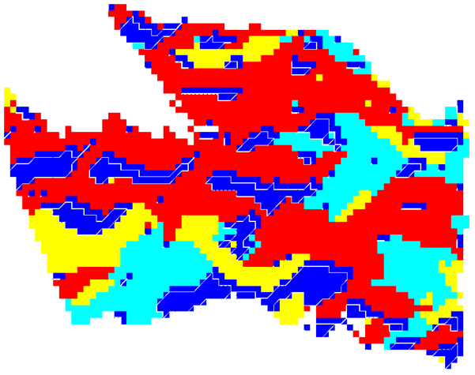
Generate a set of scoping reservoir models
TI₁: 50%
TI₂: 25%
TI₃: 25%

Slide 17
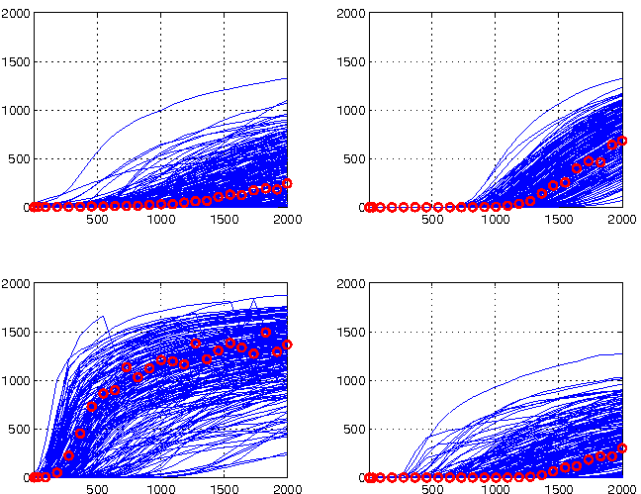
data response from prior
Well 1
Well 2
Water rate
Well 3
Well 4
Time/Days
Notes:
Here is our production data represented by red dots in 4 production wells during 2000 days.
It is given as water rate.
Blue lines are 300 scoping runs from 3 TIs. 100 scoping runs from each TI.
As it shows, there are a lot of uncertianties for each production well.

Slide 18
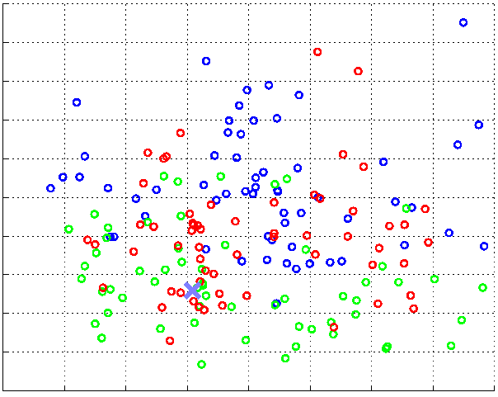
Multi-dimensional scaling
Eigencomponent 2
Production data
TI1 responses
TI2 responses
TI3 responses
Eigencomponent 1
MDS: distance = difference in water rate response for all wells
9 dimensions = 99% of variance

Slide 19
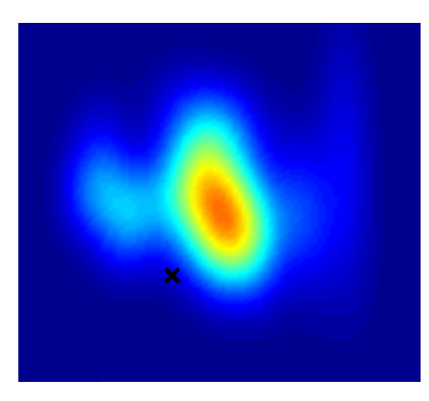
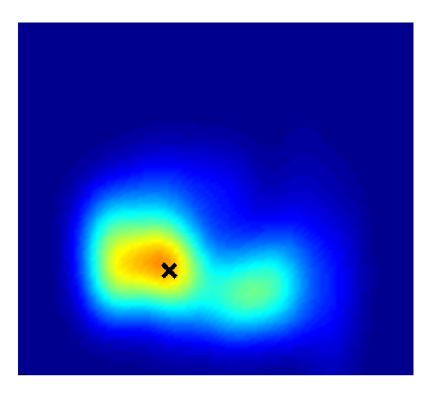
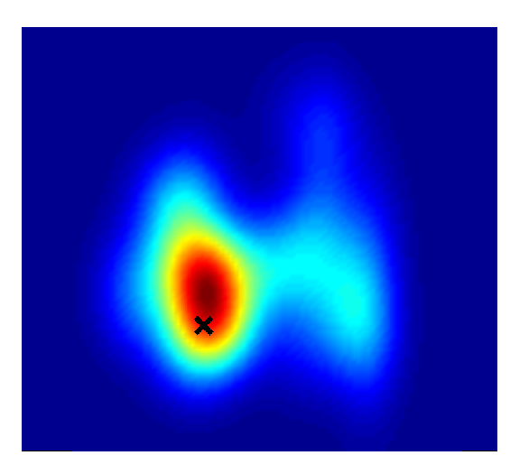
f (data | TI_{k} )
Kernel density estimation in 9D
for TI₁
for TI₂
for TI₃
Water rate data

Slide 20
Posterior sampling

Slide 21
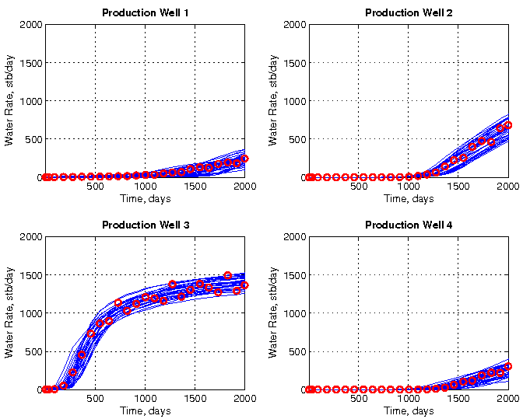
Posterior results for all TIs
CPU: Average of 24 flow simulations/model

Slide 22
Forecasting
P90
P50
P10
P10
P50
P90

Slide 23
This meeting
Talks on sensitivity & complexity
  A generalized method for sensitivity
  Purpose-driven model building
  How to use proxies ?
Talks on scenario modeling
  Fractures
  Structural
  Facies & Seismic (3D/4D)
Talks on prior
  Process-based modeling
  Tank experiments
Talk on alternatives to Bayesian theory
  Bayesian-like possibilitistic learning

